Slide 1
Constraining compact star EoS in Multimessenger Era
Enping Zhou
2022/12/03 @ UCAS online seminar
PRD 103 123011 2021；PRD 106 103030 2022; 2022 in prep
In collaboration with:
Masaru Shibata, Kenta Kiuchi, Antonios Tsokaros, Koji Uryu

Slide 2
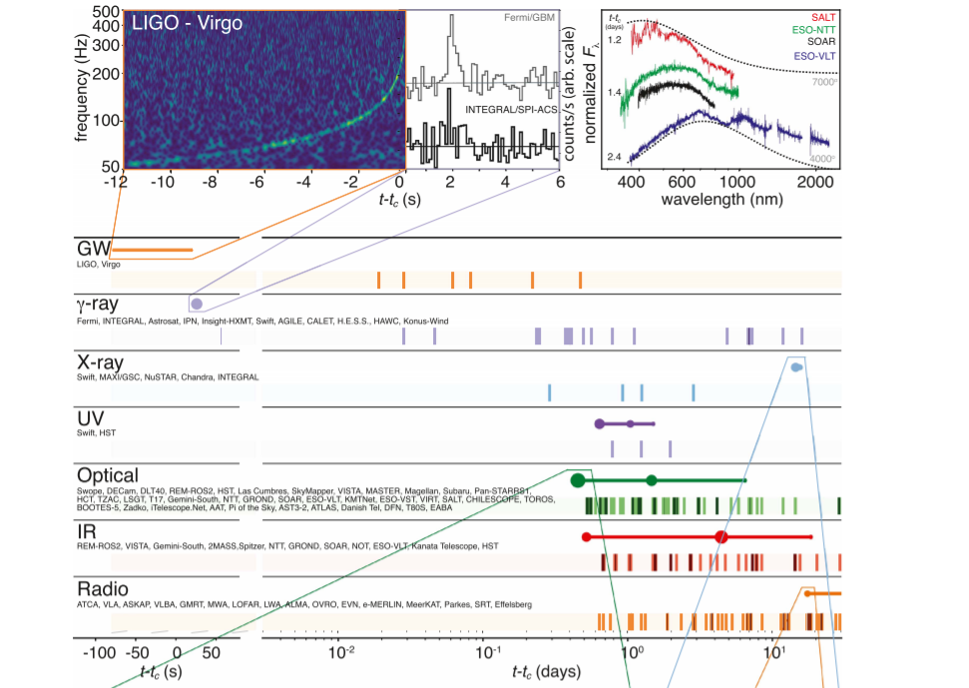
GW170817/GRB170817A/AT2017gfo
Observation
->
evolution channel
->
Threshold mass(es)
GW170817
favors a delayed collapse to BH scenario; model dependently favors a short-lived HMNS remnant
(M_tot < M_thr;
M_tot > M_kep)
Abbott et al. 2017

Slide 3
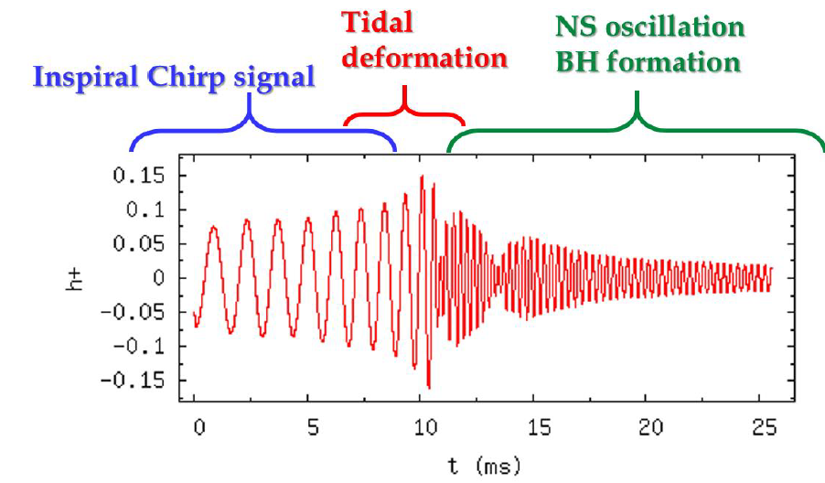
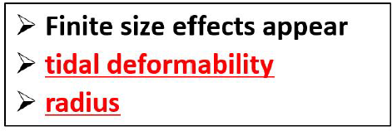
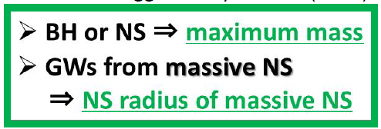
Implication of EOS with GW
PN
EOB/EOBNR/IMRPheonom
Numerical Relativity

Slide 4
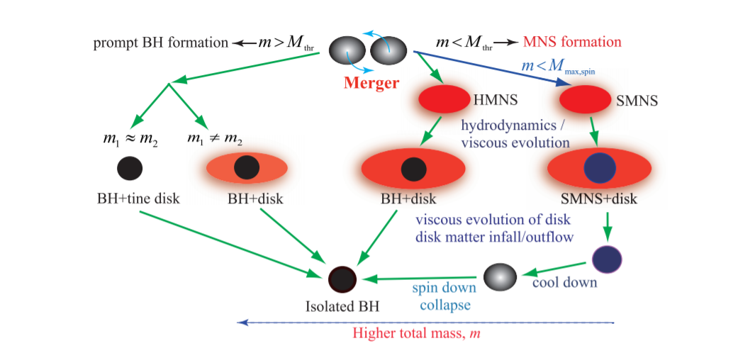
Post-merger evolution channels for BNS
The relation between total mass and several threshold masses determines the evolution channel in the post-merger.
Hotokezaka & Shibata 2019

Slide 5
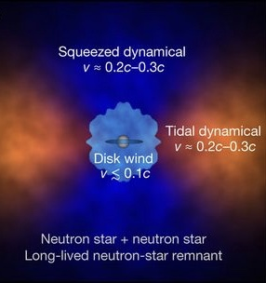
Implication from EM counterparts
EoS of compact star
-->
Velocity/amount/Y_e
of ejected material
-->
Observational property of
kilonova

Slide 6
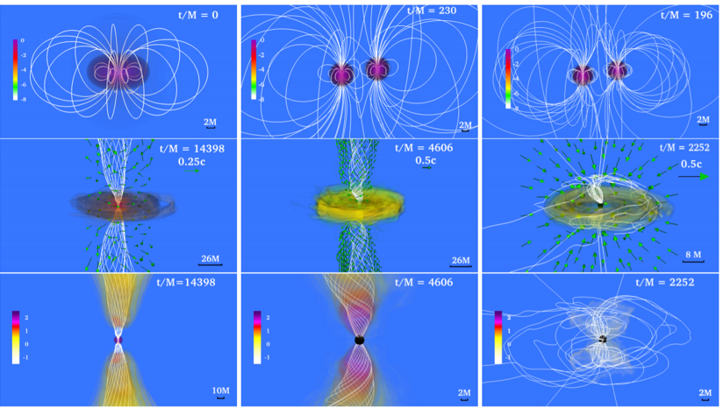
Implication from EM counterparts
Margalit & Metzger 2017
Ruiz et al. 2018

Slide 7
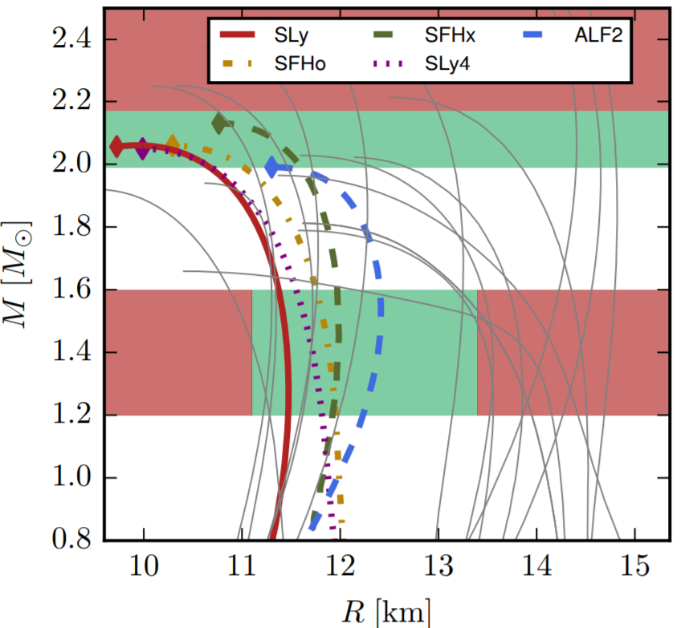
Constraining EoS in MM era
Merger product -> Mtov constraint ？
Tidal deformability -> Radius constraint
No prompt collapse -> Radius constraint
Coughlin et al 2019

Slide 8
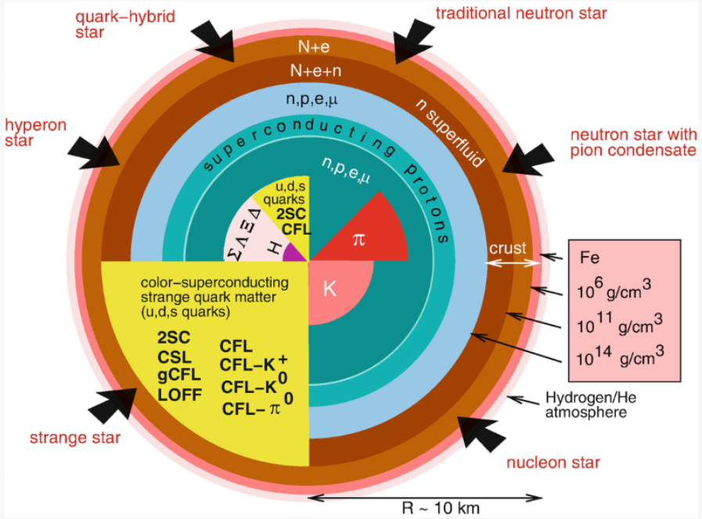
Implications of observation
All the observational constraints help us understand the equation of state and internal composition of cold dense matter better, which is a difficult from ab-initial nuclear physical calculations due to the non-perturbative nature of strong interaction.

Slide 9
Constraining EoS in MM era
?
Coughlin et al 2019
If QS model is considered, the constraints become unclear
Tidal deformability -> Radius constraint
Merger product -> Mtov constraint
No prompt collapse -> Radius constraint
Tidal deformability requires a surface correction;
Rigidly rotating QSs reaches higher mass increase than NSs;
Prompt collapse threshold mass, unclear for QSs.

Slide 10
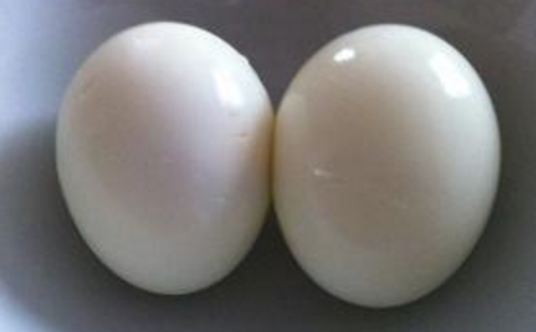
A caution shall be made when universal relation applied
NS vs QS
Raw egg vs Cooked egg
Different in deformability/rotating properties

Slide 11
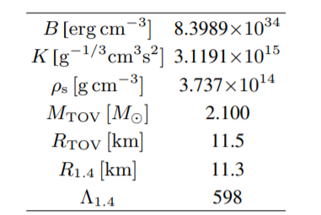
An obvious tension
M_max,spin = 3.10 M_sun
M_thr= [2.95,3.15] M_sun
(supposing the same universal relation as BNS cases)
Note: the exact number scales with Bag constant, but the relation holds.

Slide 12
Post-merger evolution channels for BNS
The relation between total mass and several threshold masses determines the evolution channel in the post-merger.
Hotokezaka & Shibata 2019

Slide 13
An obvious tension
Hotokezaka & Shibata 2019
Either, BQS does not follow the universal relation of BNS case.
Or, this scenario should be different for BQS mergers. Or both?

Slide 14
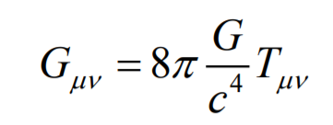
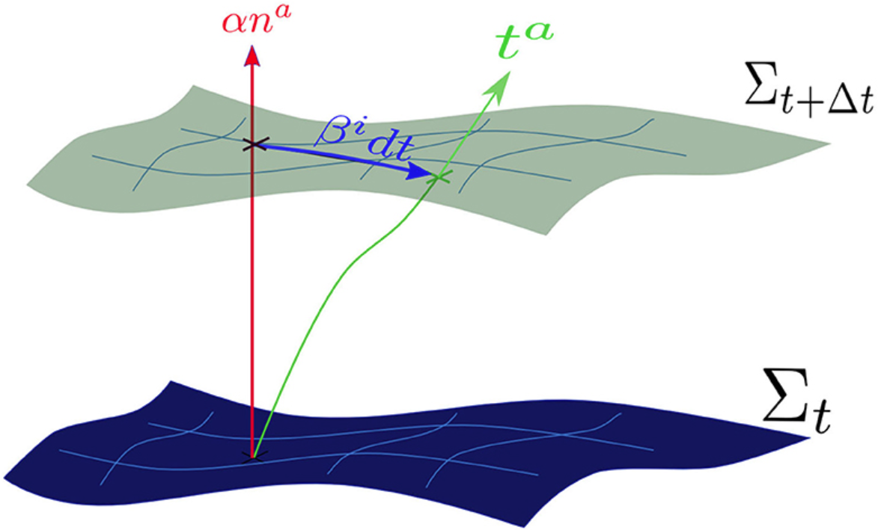
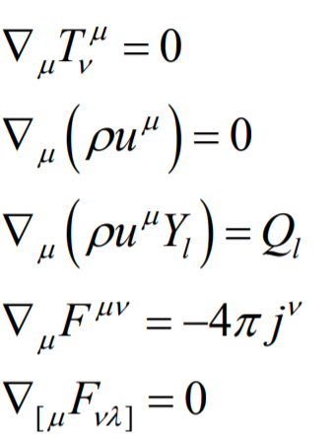
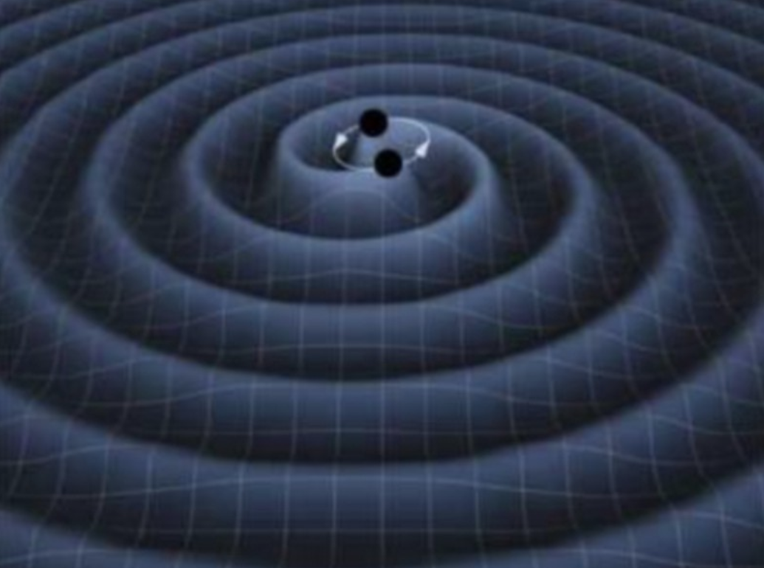
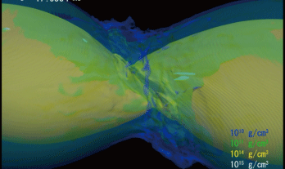
Technique
Numerical Relativity

Slide 15
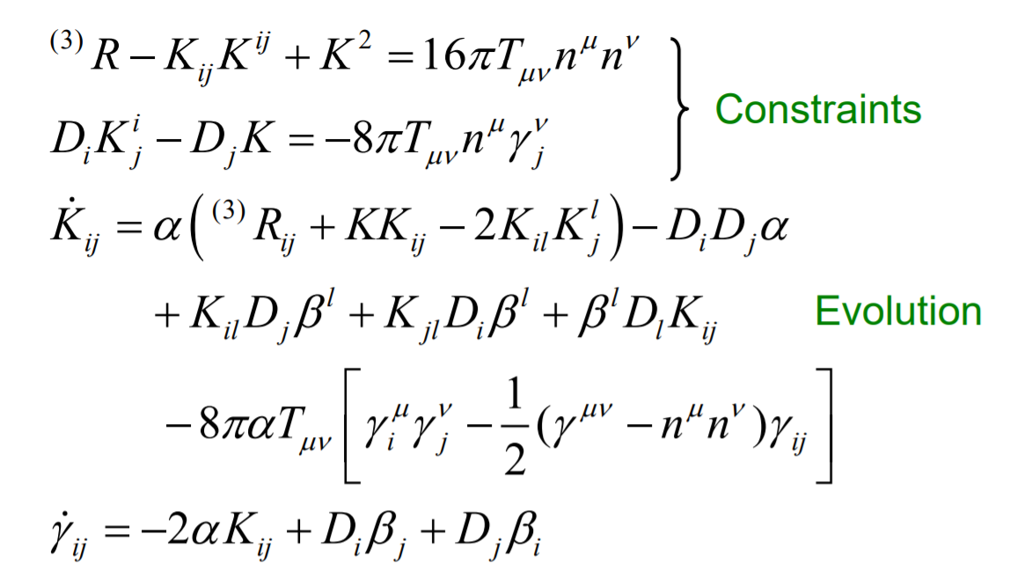
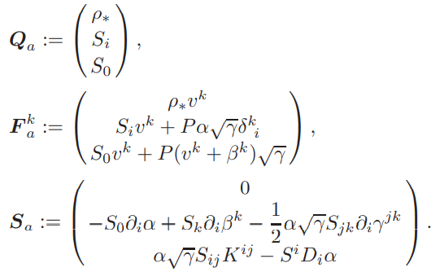
Technique
Numerical Relativity

Slide 16
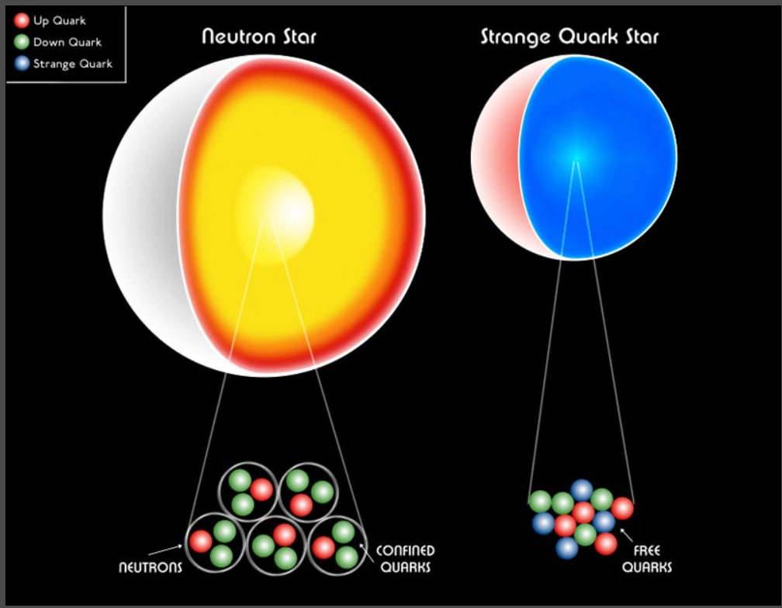
Difficulties in evolving QS
Finite surface density
Surface enthalpy smaller than unity

Slide 17
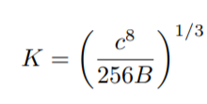
Difficulties in evolving QS
Finite surface density
Surface enthalpy smaller than unity

Slide 18
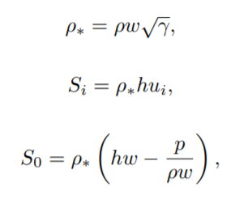
To evolve QS with NR
Primitive recovery (conserved variable -> primitive variable)
The Last Eq needed: Equation of State p=p(\rho, h)
Problem: before primitive recovery procedure, we do not know value of \rho, so we do not know whether we are recovering inside the star or outside, so we do not know which EoS to apply

Slide 19
To evolve QS with NR
EoS with thermal contribution:
For MIT bag model, if , the primitive recovery procedure is equivalent of solving the following quadratic equation
This provides us a rapid test for judging whether or not we are recovering inside the star or outside

Slide 20
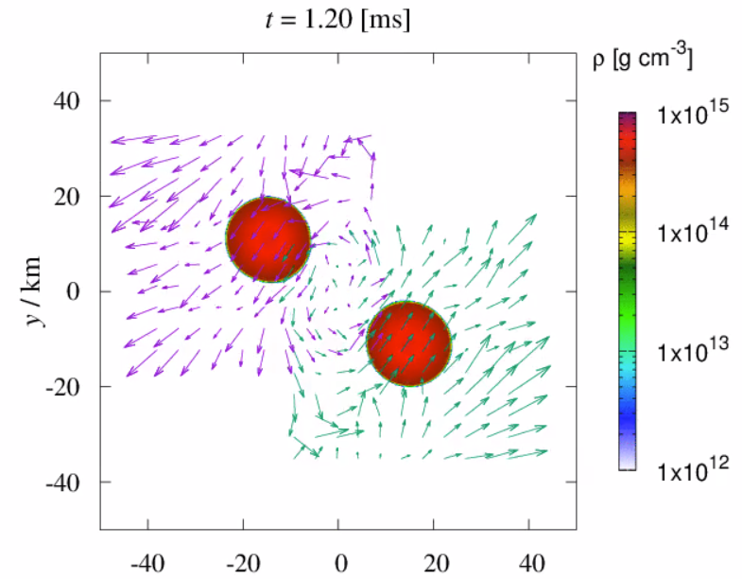
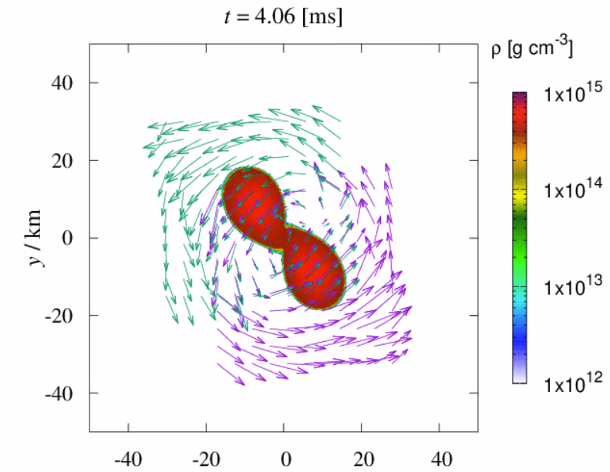
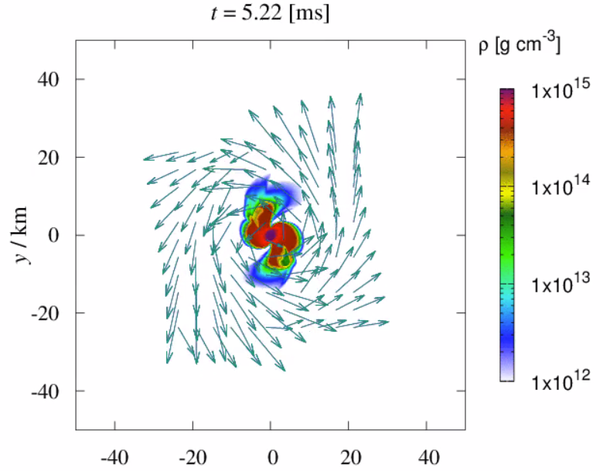
Threshold mass of BQS mergers
Collapse happens ~1 ms after merger, comparable to dynamical timescales.
MIT310 starts at ~ 40 km separation

Slide 21
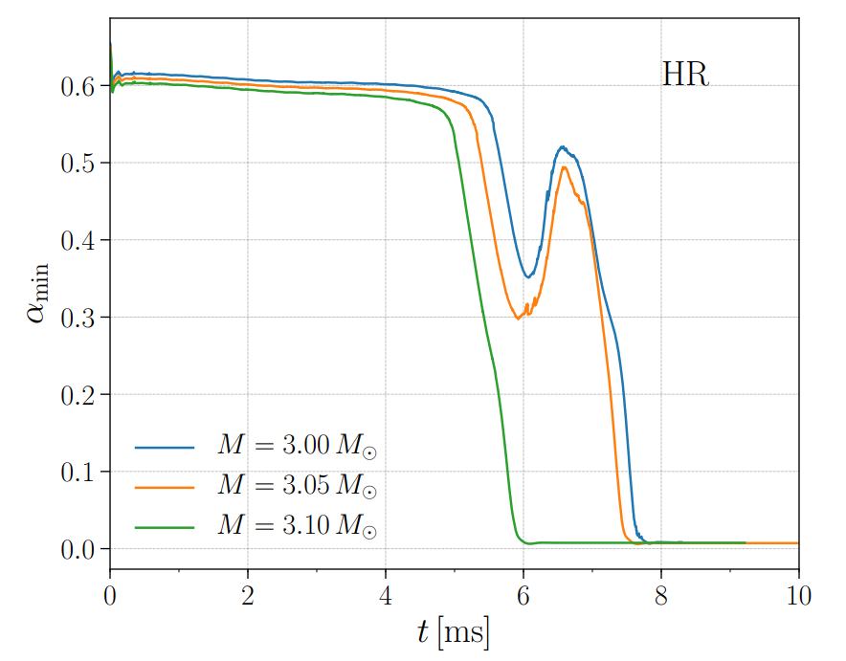
Threshold mass of BQS mergers
Quantitatively, the tt component of the spacetime
metric in the center shows the dynamics of the collapse.
Zhou et al. 2021

Slide 22
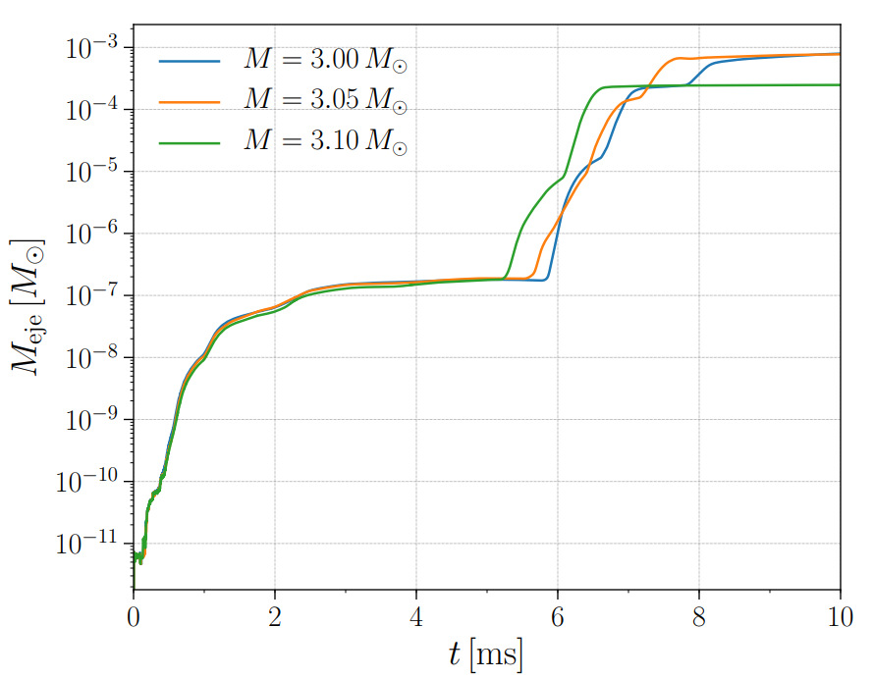
Threshold mass of BQS mergers
M_thr in between 3.05 and 3.10 solar mass
Consistent with BNS universal relation.
But why?
Zhou et al. 2021

Slide 23
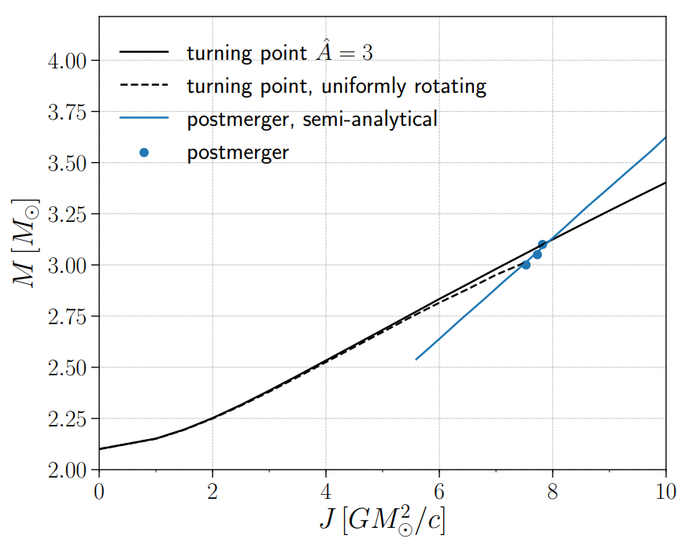
Threshold mass of BQS mergers
QSs could support more massive remnant, as long as the remnant could have enough angular moment.
However, the merger leaves similar amount of angular momentum, regardless of the EoS.
Zhou et al. 2021

Slide 24
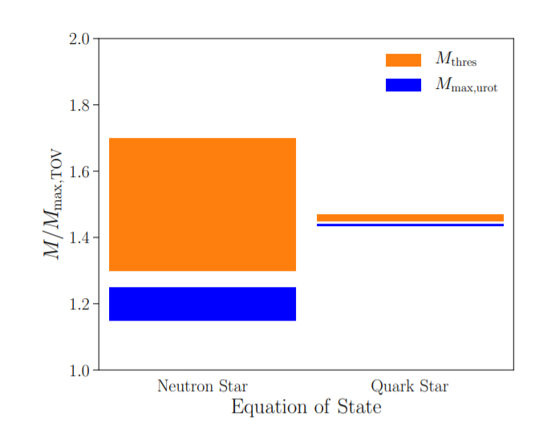
Critical mass for HMQS/SMQS
Either,
The parameter space for HMQS channel would be extremely narrow,
and we could verify this with future observations, statistically.
Or,
M_kep would not be the dividing mass for HMQS/SMQS.
We further evolve MIT280.

Slide 25
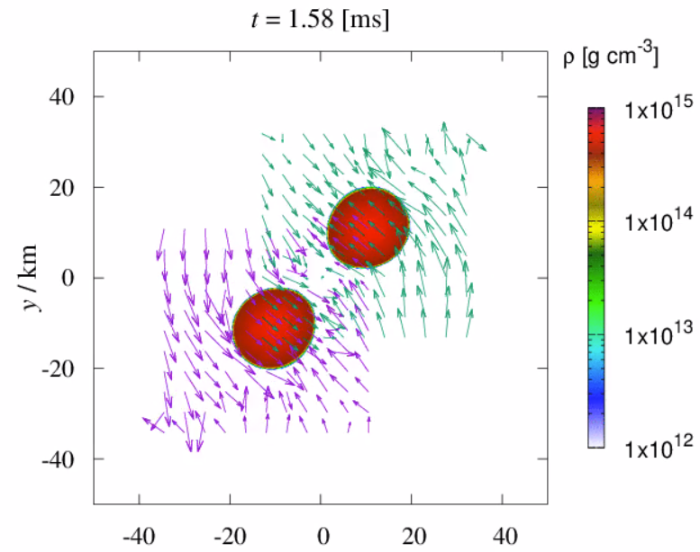
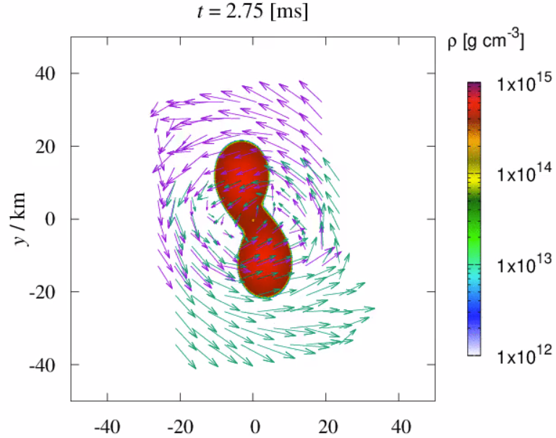
MIT280
Zhou et al. 2022 in prep

Slide 26
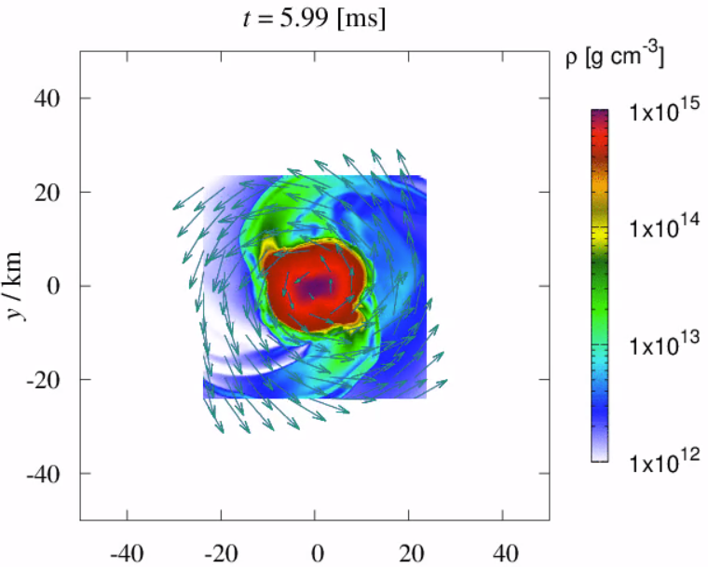
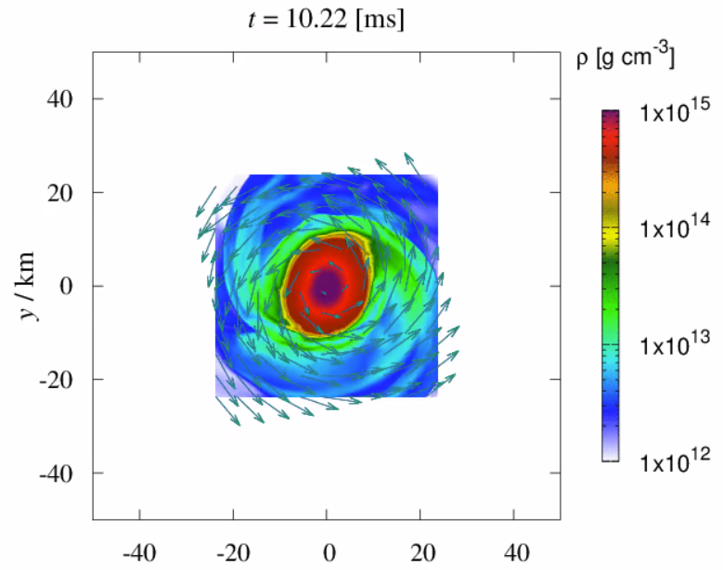
MIT280
GR hydro simulation of BQS reveals high density mass overflow in spiral arm structures.

Slide 27
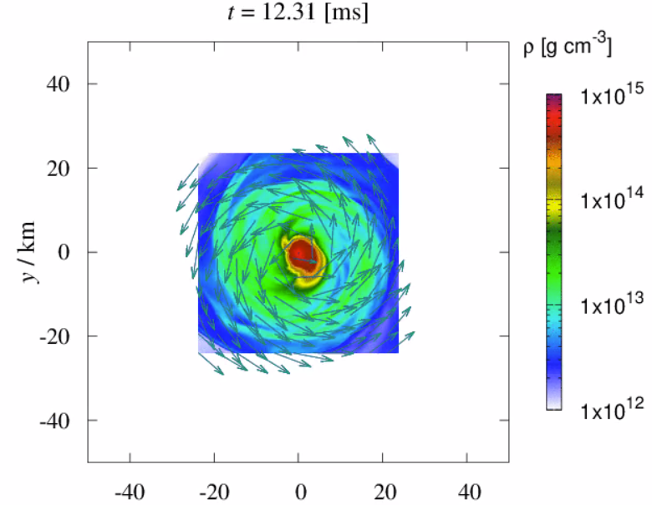
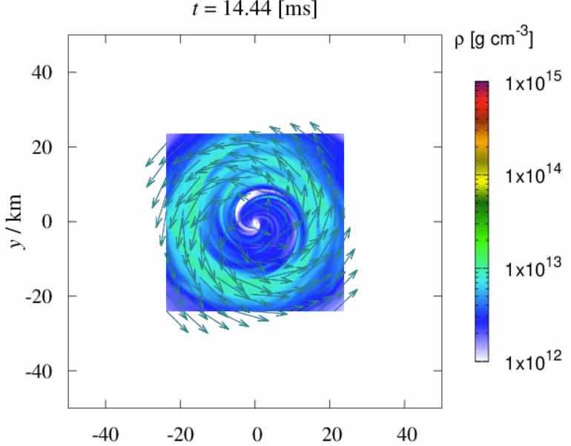
MIT280
Collapse happens for a BQS model with total mass much below its Keplerian limit in ~10 ms. Showing a BQS system in SMQS mass range undergoes HMQS channel.
Exceptionally heavy disc for equal mass binary (>0.2 solar mass, 0.01 solar mass unbound) is left outside the BH even ~30 ms after the collapse. But why?

Slide 28
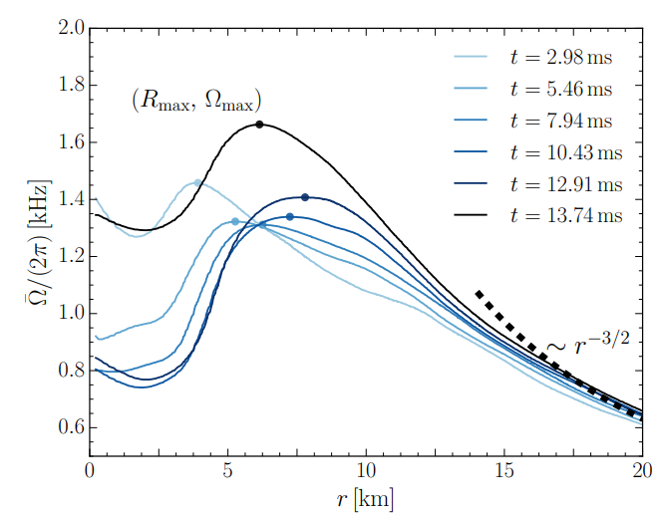
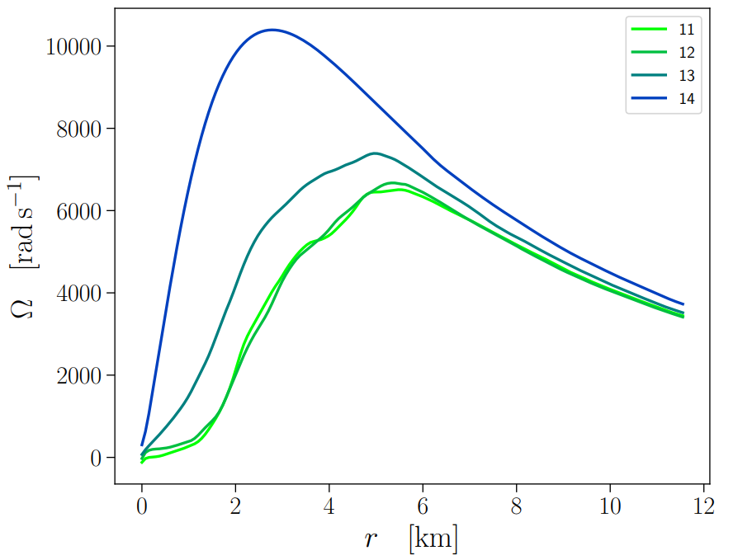
Rotation profile
Hanauske et al. 2016
Zhou et al. 2022, in prep
Rotation profile is qualitatively similar for BQS and BNS remnant, but quantitatively, BQS remnant is lacking angular momentum significantly inside the remnant.

Slide 29
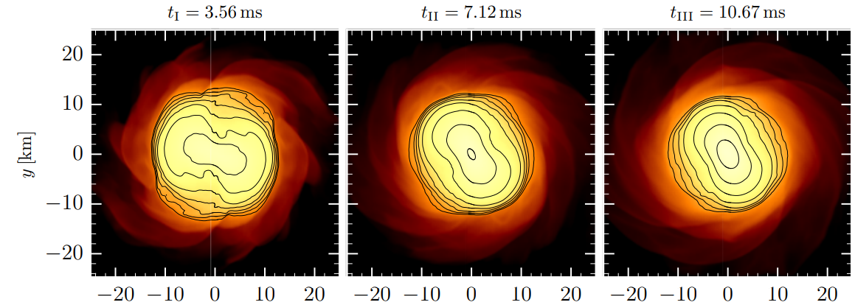
Rotation profile
For BNS, geometric center $≠$ density center. Angular momentum transport toward the inner part of the remnant is easier.

Slide 30
Rotation profile
For BQS, geometric center = density center. Angular momentum transport toward the outside of the remnant is much easier due to squeezing.

Slide 31
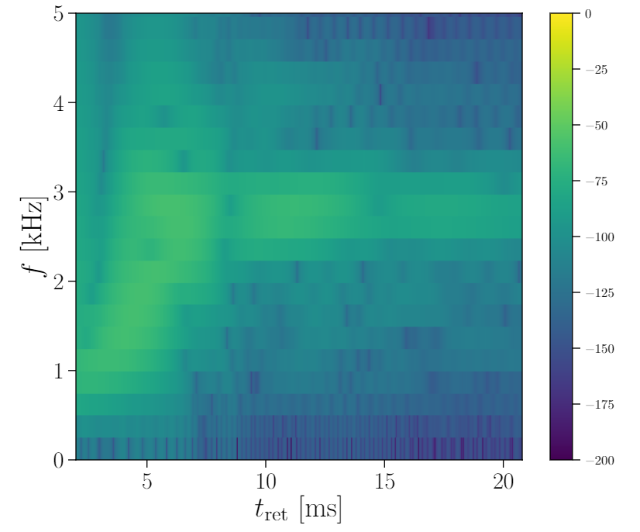
GW spectrogram
Preliminary results, waiting for more models to obtain the dividing mass for HMQS/SMQS.
MIT270 shows a stable remnant until ~20 ms after merger for now. GW spectrogram is similar with BNS cases.

Slide 32
Summary
Post-merger evolution channels for BQS and their comparison with BNS
BQS/BNS consistency | √ | ×
M_thr for prompt collapse | √
Dividing mass for remnant lifetime |  | ×
Ejecta mass/disc mass |  | ×
GW features | √
Potentially could be used to distinguish QS/NS

