Slide 1
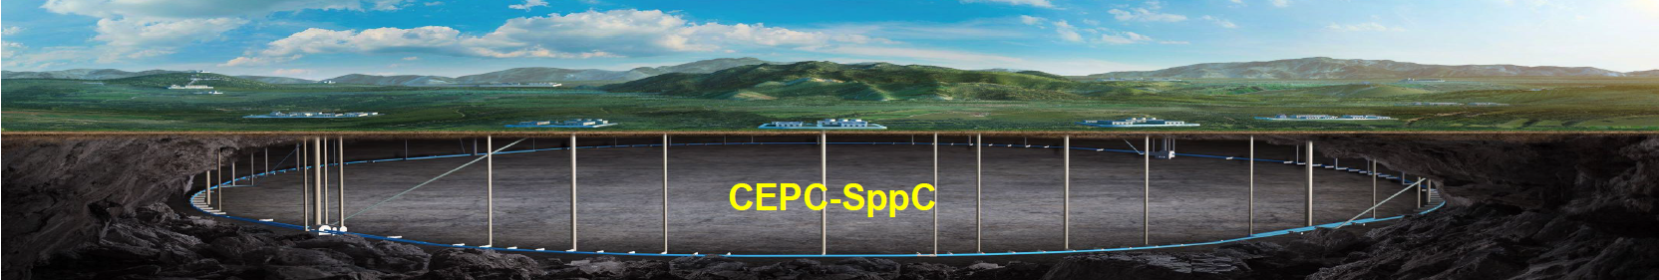

CEPC-TDR Status Overview
Yuhui Li
CEPC Accelerator TDR International Review
12-16. June. 2023, Hongkong

Slide 2
Content
CEPC General Status
  Evolutions from CDR to TDR
  CEPC Layout, upgradability and added values
  Primary design objectives and operation plan
  Machine design and technology readiness
  Tunnel, siting, industrialization,
  International collaborations and timeline
Glance of TDR content
  TDR report introduction

Slide 3
TDR Evolutions from CDR
Main Parameters (30MW)
CDR
TDR
 | Higgs | W | Z（3T） | Z（2T）
Number of IPs | 2
Circumference (km) | 100
Bunch number | 242 | 1524 | 12000
β function at IP β_{x}* / β_{y}* (m/mm) | 0.36/1.5 | 0.36/1.5 | 0.2/1.5 | 0.2/1.0
Emittance ε_{x}/ε_{y} (nm/pm) | 1.21/3.1 | 0.54/1.6 | 0.18/4.0 | 0.18/1.6
Energy acceptance requirement (%) | 1.35 | 0.4 | 0.23
Luminosity/IP L (10³⁴cm⁻²s⁻¹) | 2.93 | 10.1 | 16.6 | 32.1
 | Higgs | W | Z (2T) | ttbar
Number of IPs | 2
Circumference (km) | 100.0
Bunch number | 268 | 1297 | 11934 | 35
Beta functions at IP β _{x}*/β _{y}* (m/mm) | 0.3/1 | 0.21/1 | 0.13/0.9 | 1.04/2.7
Emittance ε_{x}/ε_{y} (nm/pm) | 0.64/1.3 | 0.87/1.7 | 0.27/1.4 | 1.4/4.7
Energy acceptance (DA/RF) (%) | 1.6/2.2 | 1.2/2.5 | 1.3/1.7 | 2.0/2.6
Luminosity per IP (1034/cm2/s) | 5.0 | 16 | 115 | 0.5
Key technology R&D
RF power supply and high efficiency klystron
SRF cavities (1.3G & 650MHz)
Positron source
High performance accelerator (S&C-band)
Novel magnets: Weak field dipole, dual aperture magnets
Injection/extraction
Electrostatic deflector
Vacuum chamber with NEG coating
Instrumentation, Feedback system
Cryogenic system

Slide 4
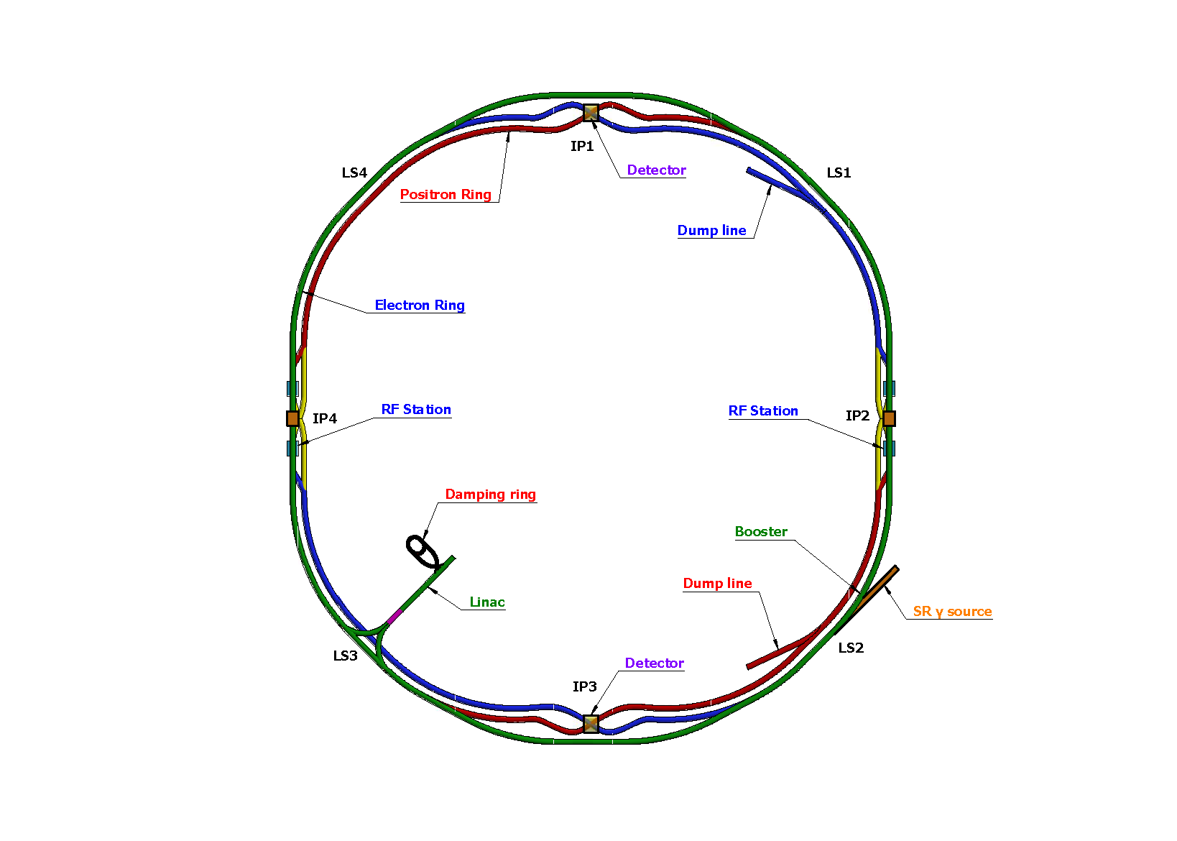
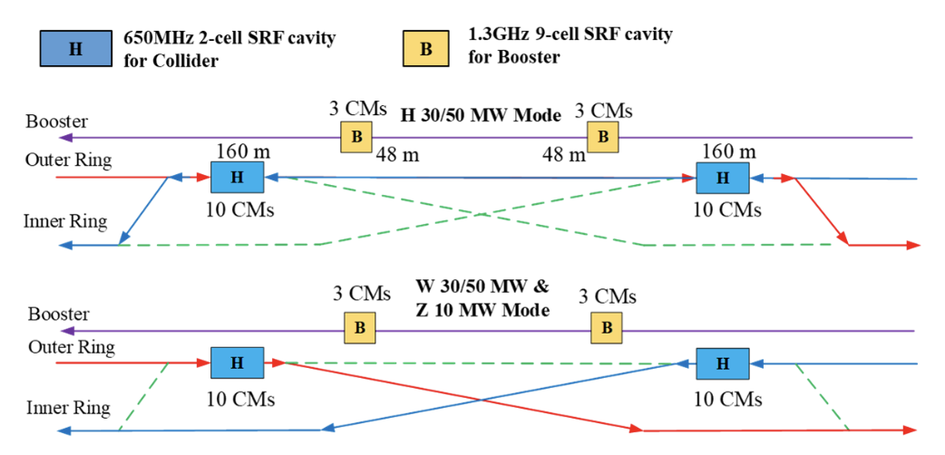
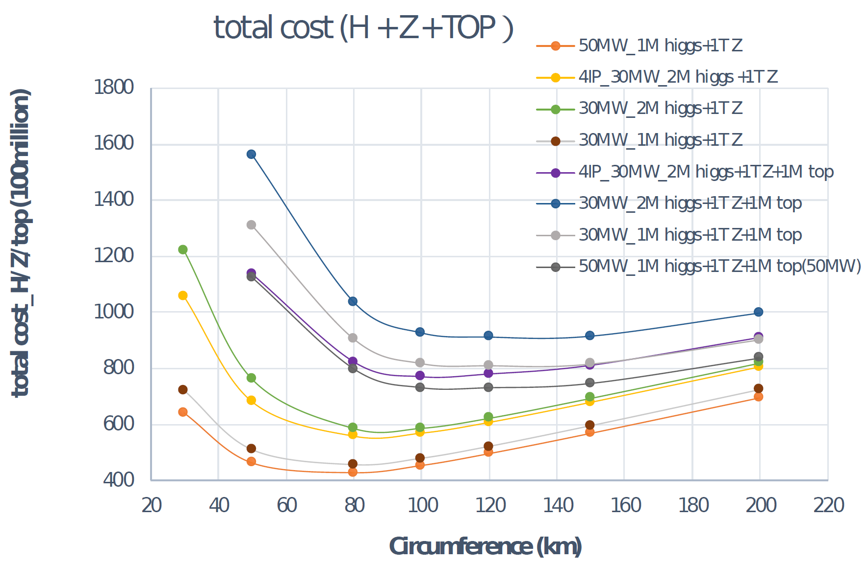
CEPC Layout and Design Essentials
Cost optimization v.s. circumference
Switchable operation for Higgs W and Z
D. Wang et al 2022 JINST 17 P10018
Circular collider: Higher luminosity than a linear collider
100km circumference: Optimum total cost
Shared tunnel: Compatible design for CEPC and SppC
Switchable operation: Higgs, W/Z, top
Common tunnel for booster/collider & SppC

Slide 5
Upgradability and Added Values
SR power per beam upgrade to 50 MW: High Luminosity (8E34 @ 240 GeV)
The center-of-mass energy can increase to 360 GeV: top quark data
Add a super proton-proton collider (SppC) with c.m.s >100 TeV
Expandability: High energy & high flux synchrotron light source provides gamma-ray energy up to 300 MeV, critical for multi-disciplinary science
Boost the developments of multiple technologies:
Fast electronics, mechanics, vacuum, beam, RF acceleration, cryogenic system, novel magnets, high-accuracy power supplies, control systems, big data, automation and intelligence, etc
Upgradable sceanrios to facilate the kick-off of construction
Can be upgraded in several highly valuable ways that further strengthen its discovery power; lifetime spans for decades
CEPC has significant spillover effects on multi-field and multidisciplinary scientific research and applications

Slide 6
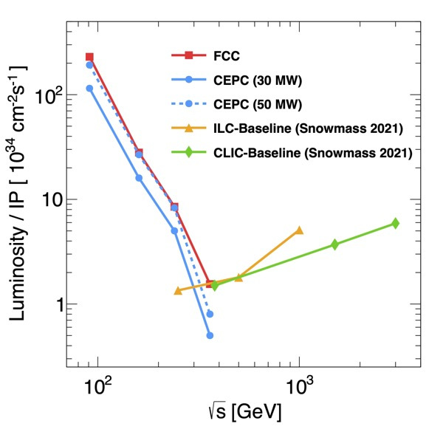
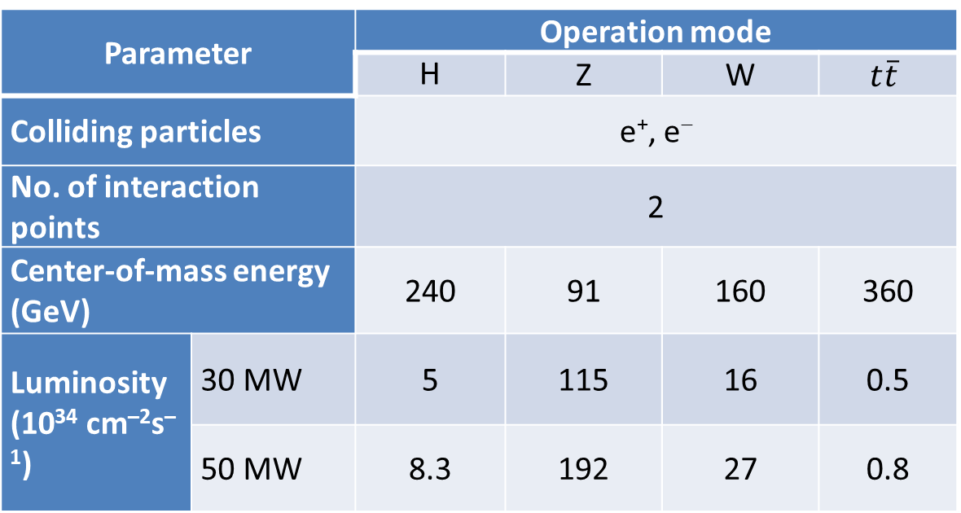
Primary Design Objectives
Parameter |  | Operation mode
 |  | H | Z | W | $$t\overline{t}$$
Colliding particles |  | e⁺, e⁻
No. of interaction points |  | 2
Center-of-mass energy (GeV) |  | 240 | 91 | 160 | 360
Luminosity (10³⁴ cm^{–2}s^{–1}) | 30 MW | 5 | 115 | 16 | 0.5
 | 50 MW | 8.3 | 192 | 27 | 0.8
CEPC covers the energy from Z to ttbar, with the priority operation for Higgs
The luminosity reaches state-of-the-art level

Slide 7
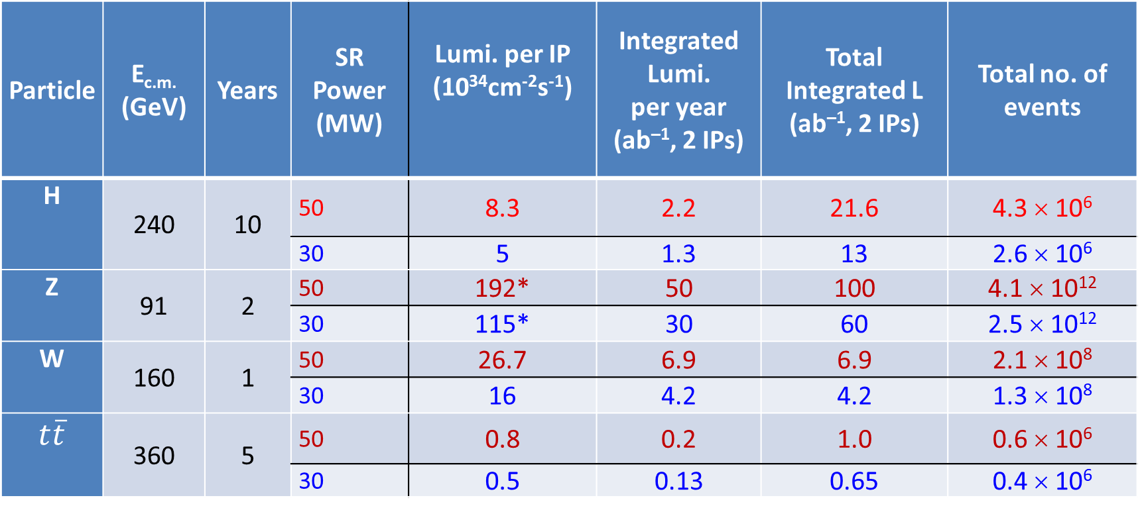
Operation Plan
Particle | E_{c.m.} (GeV) | Years | SR Power (MW) | Lumi. per IP (10³⁴cm⁻²s⁻¹) | Integrated Lumi. per year (ab^{–1}, 2 IPs) | Total Integrated L (ab^{–1}, 2 IPs) | Total no. of events
H | 240 | 10 | 50 | 8.3 | 2.2 | 21.6 | 4.3 × 10⁶
 |  |  | 30 | 5 | 1.3 | 13 | 2.6 × 10⁶
Z | 91 | 2 | 50 | 192* | 50 | 100 | 4.1 × 10¹²
 |  |  | 30 | 115* | 30 | 60 | 2.5 × 10¹²
W | 160 | 1 | 50 | 26.7 | 6.9 | 6.9 | 2.1 × 10⁸
 |  |  | 30 | 16 | 4.2 | 4.2 | 1.3 × 10⁸
$$t\overline{t}$$ | 360 | 5 | 50 | 0.8 | 0.2 | 1.0 | 0.6 × 10⁶
 |  |  | 30 | 0.5 | 0.13 | 0.65 | 0.4 × 10⁶
* Detector solenoid field is 2 Tesla during Z operation.
** calculated using 3,600 hours per year for data collection.

Slide 8
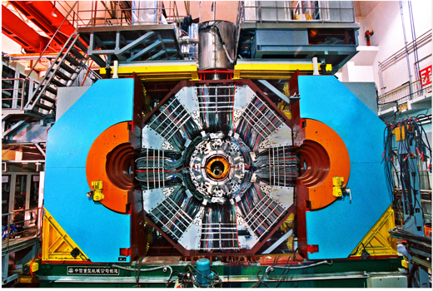
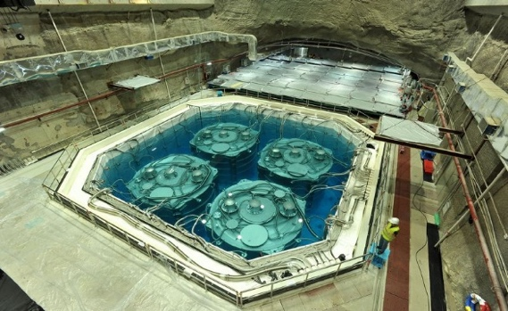
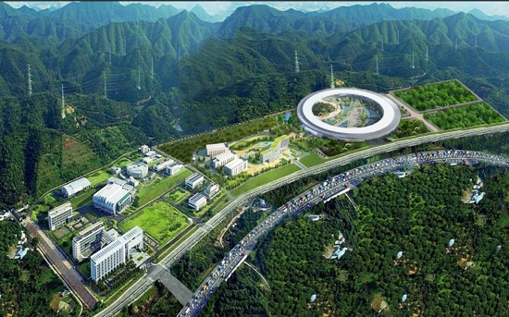
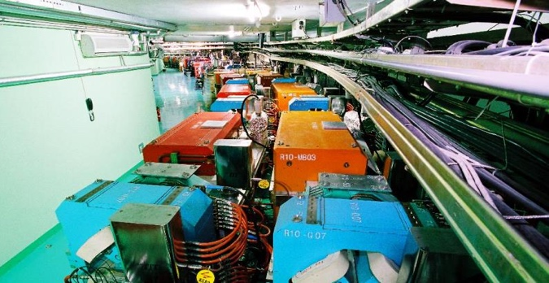
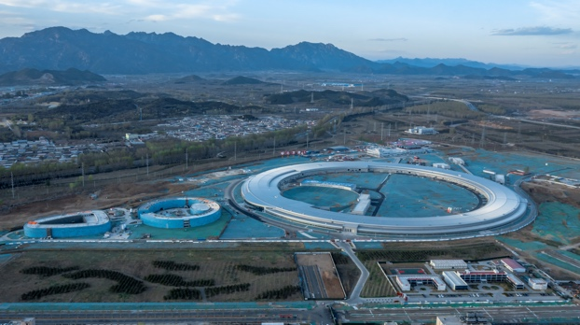
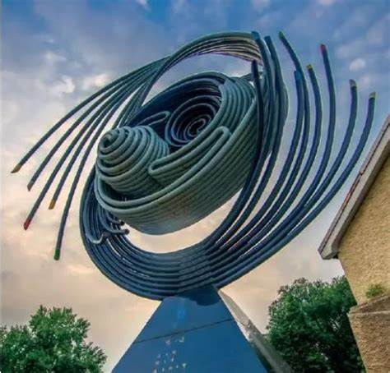
Experience and Existing Support
to be completed in 2025
BES III
BEPC II
HEPS
DayaBay
CSNS
One of the few institutes in the world that has a complete technical team and the infrastructure to design and build large scientific facilities
IHEP personnel has accumulated rich professional experiences with the electron-positron collider, detector technology and operations.
IHEP supports and has committed to CEPC
CEPC work plan approved by CAS

Slide 9
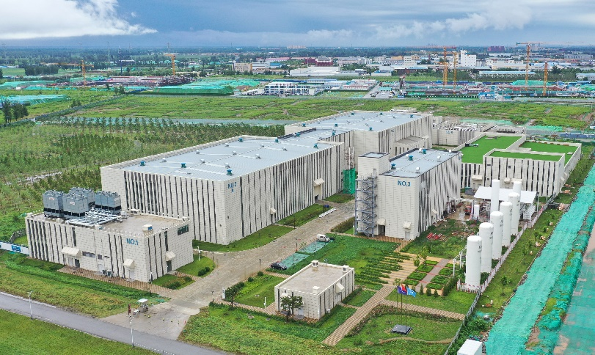
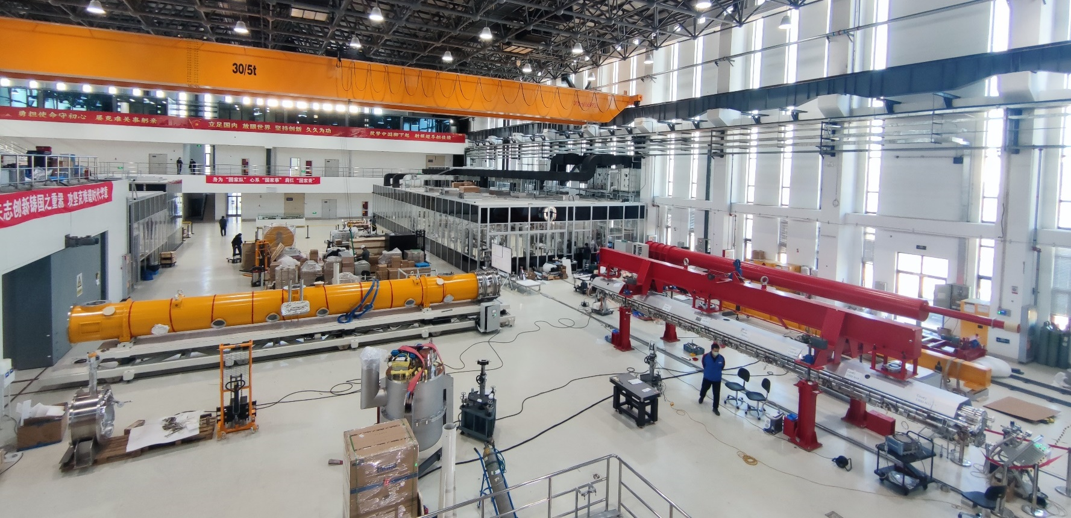
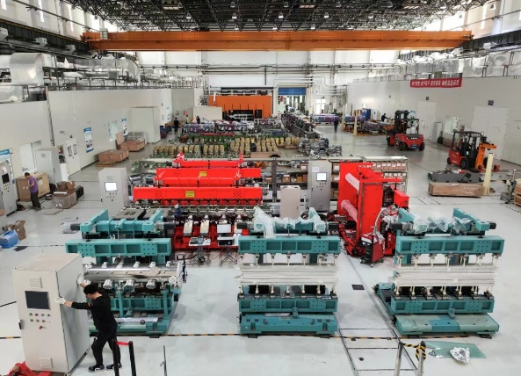
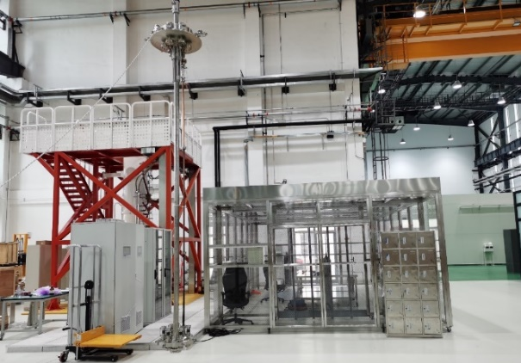
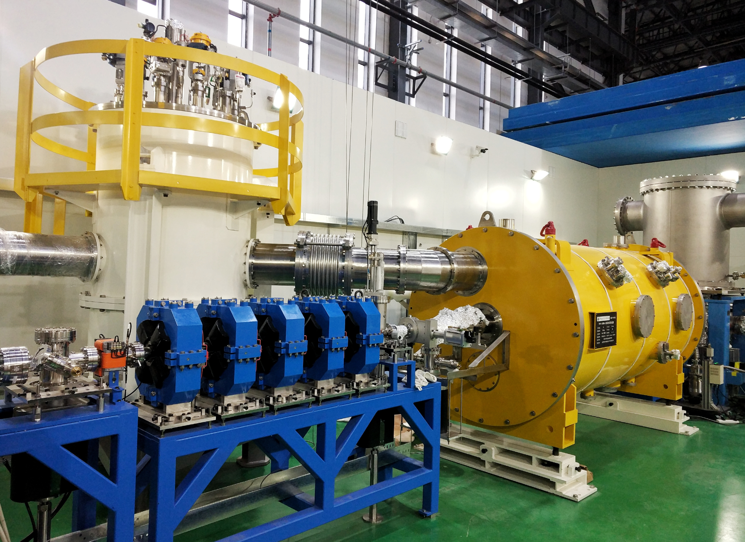
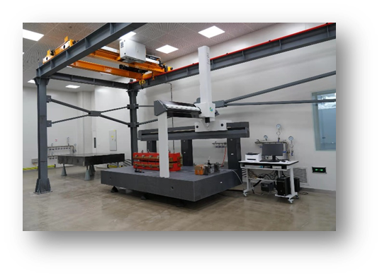
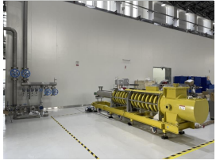
Platform for key technology R&D
SRF R&D facility
Magnet R&D
Mechanical & alignment
Klystron Test
Beam test hall
SRF test hall
Vacuum assembly & coating
Magnet R&D
Vacuum R&D
Cryogenic System
  Accelerator key technology R&D platform was established:
  ➢ SRF cavity and module ➢ High efficiency Klystron
  ➢ High precision magnet ➢ Mechanics and alignment
  ➢ Vacuum assembly & coating ➢ Beam test facility
Alignment
Beam test lab
Klystron R&D

Slide 10
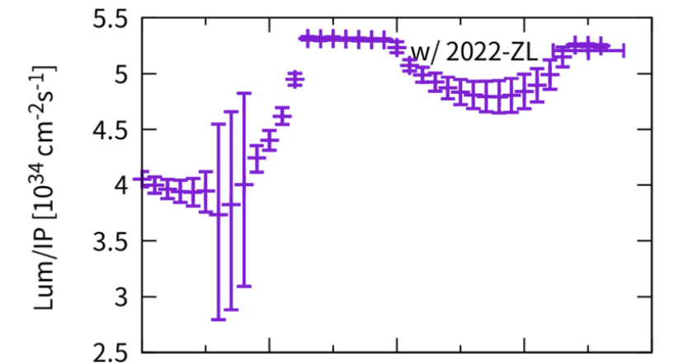
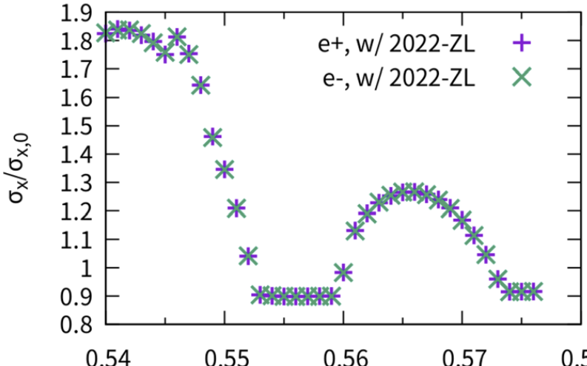
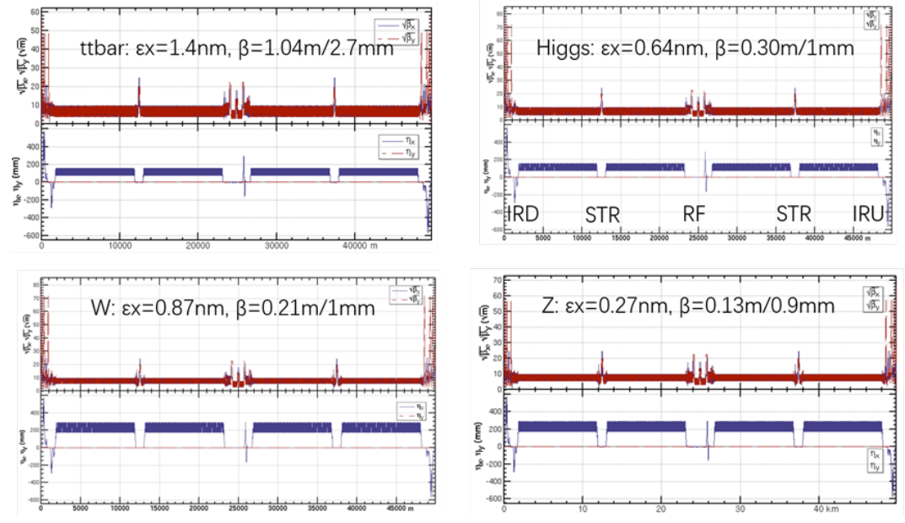
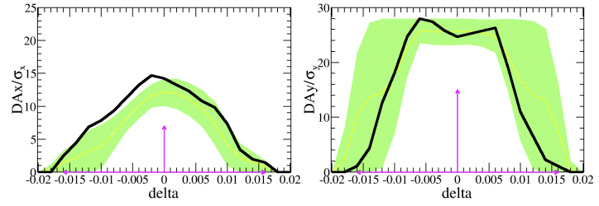

Feasible Designs for all operational modes
GOAL
Design
e+e- circular collider as a high lumi. Higgs factory
Accelerator complex comprised of Linac, 100 km booster and collider ring
Lattice optimization for all energies
Sufficient DA for all energies
Beam-beam & collective instability
Crab waist scheme with large cross angle and sextuples
Beam-beam effect study
Compatible operation for Higgs, W, Z and Top runs
Increasing Luminosity
Lattice for all energies
Dynamic Aperture (DA) optimization
Requirement met Higgs (w/error):
$7σ_{x}×15σ_{y}×1.6\%$

Slide 11
Key Technology Readiness
  CEPC received ~ 260 Million CNY from MOST, CAS, NSFC, etc for the key technology R&D
  Large amount of key technology validated in other project by IHEP: BEPCII, HEPS, …
Novel magnets: Weak field dipole, dual aperture magnets
Extremely fast injection/extraction
Electrostatic deflector
MDI
High efficiency klystron
SRF cavities
Positron source
High performance accelerator
CEPC R&D
~ 30% cost of acc. components
High precision magnet
Stable magnet power source
Vacuum chamber with NEG coating
Instrumentation, Feedback system
Survey & Alignment
Ultra stable mechanics
Radiation protection
Cryogenic system
MDI
BEPCII / HEPS
~ 60% cost of acc. components
~10% missing factor indicates the anticipated challenges in the machine integration, commissioning etc. and the corresponding international aid

Slide 12
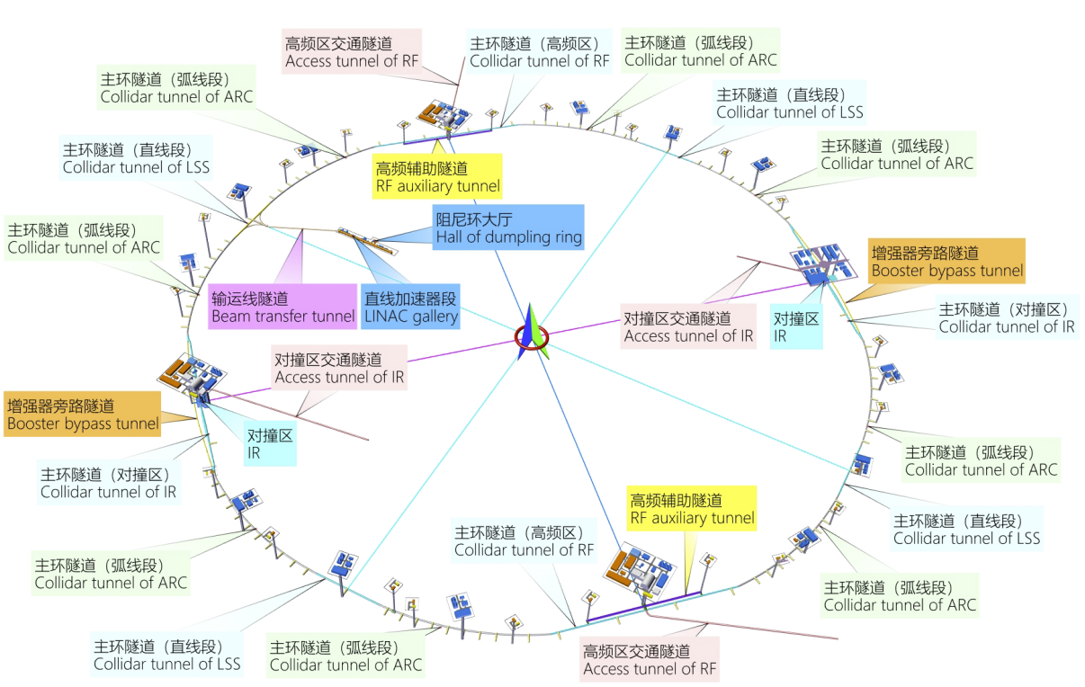
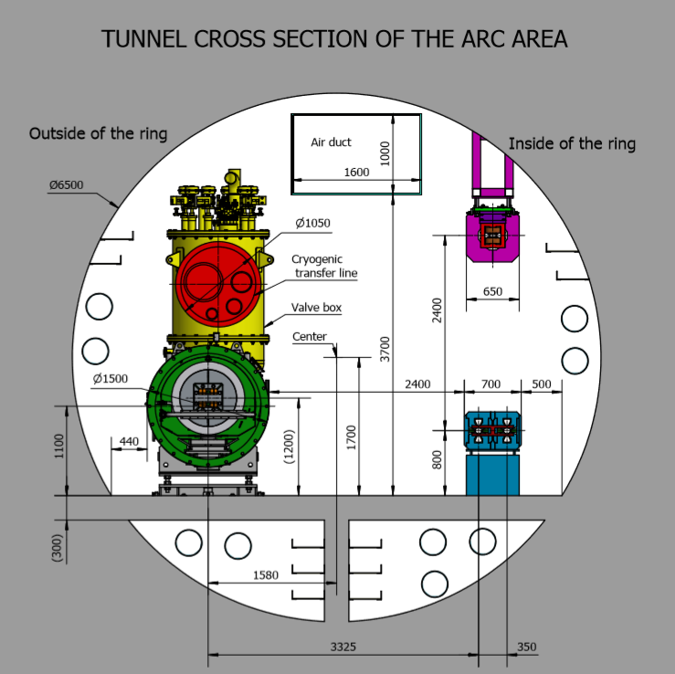
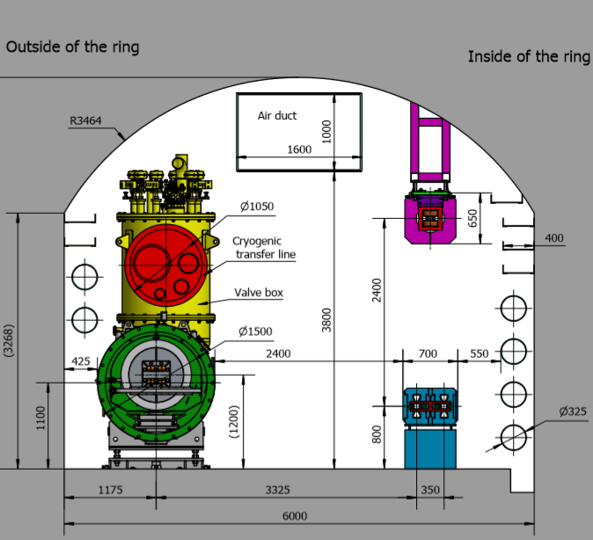
Tunnel Layout
  Experiment halls (including main and service caverns): IP1 and IP3 are experiment halls, and IP2 and IP4 are RF sections, which will also be the locations for future experiment halls for SPPC;
  RF auxiliary tunnels near IP2 and IP4, Booster bypass tunnels near IP1 and IP3;
  Vertical shafts in experiment halls and RF zones and along the ring tunnel;
  Surface structures such as auxiliary equipment structures etc., located within the main ring area .
  The CEPC tunnel follows a site-independent design strategy to facilitate the project;
  Collider tunnel design were made based on Tunnel Boring Machine or Excavated Drilling & Blasting method;

Slide 13
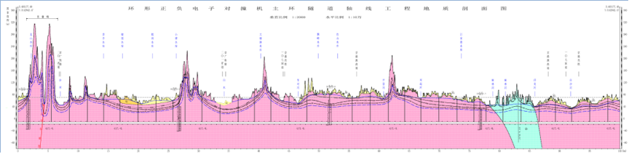
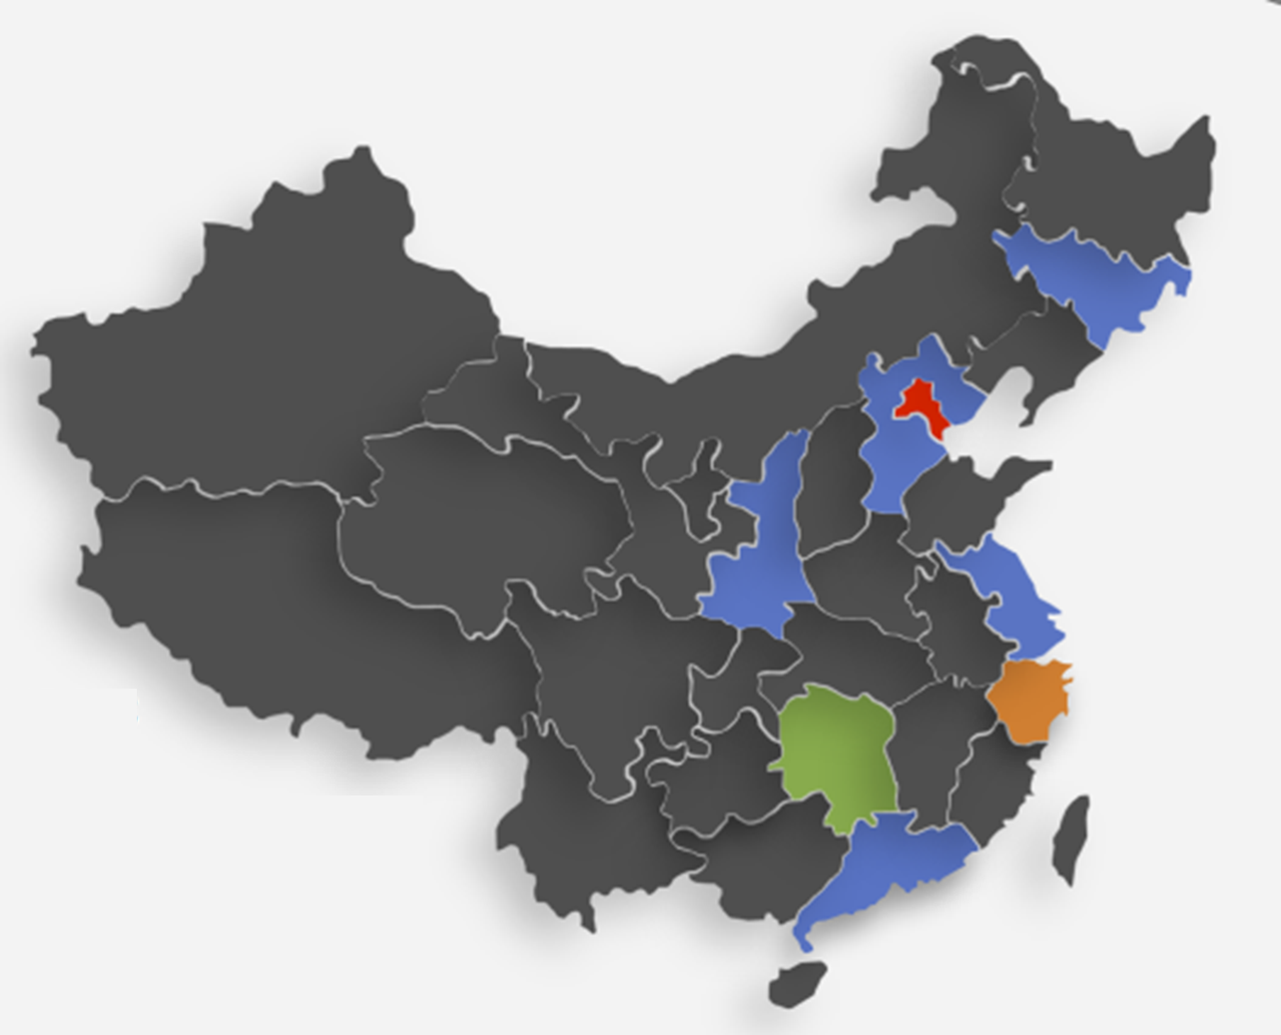
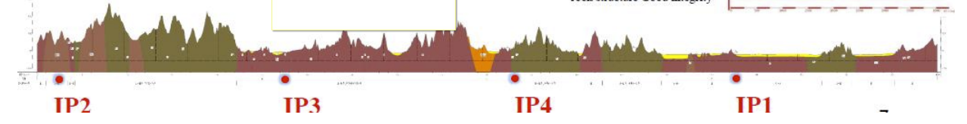
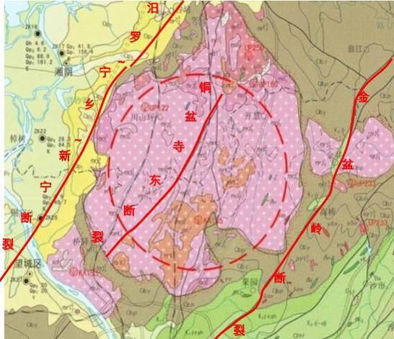
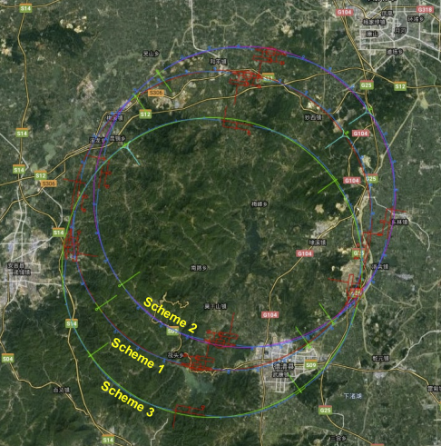
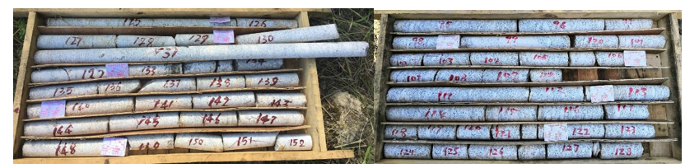
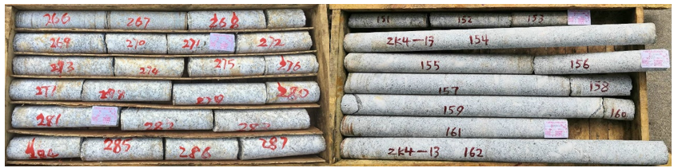

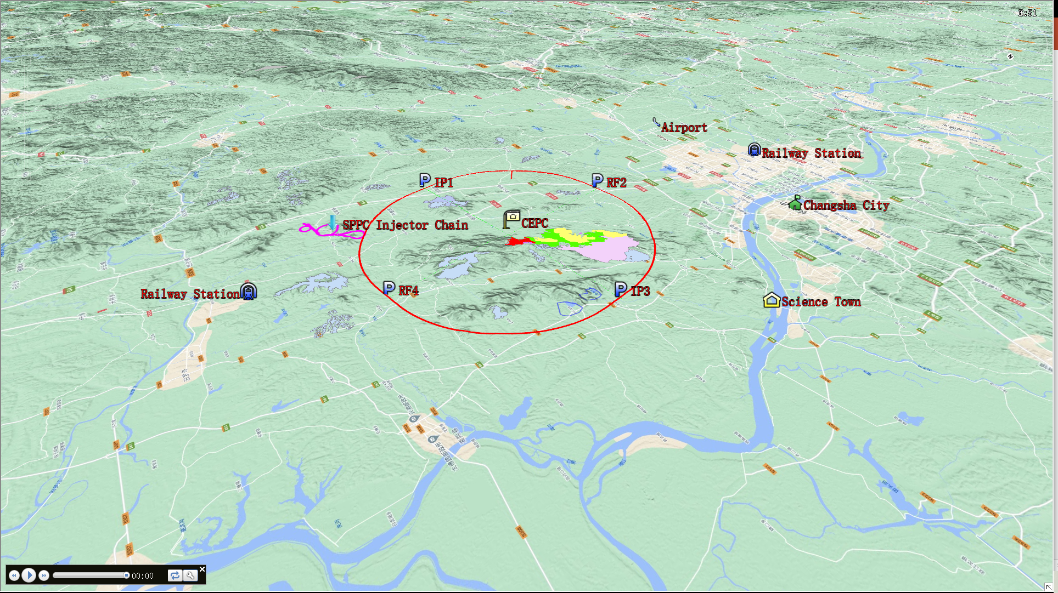
Site Selection
Changchun
Qinhuangdao
Huangling
Changsha
Huzhou
Science City Plan
Shenshan
  Six cities were investigated as potential site for the CEPC;
  Geological survey were conducted on all candidate sites
  Changsha and Huzhou are selected for demonstration;

Slide 14
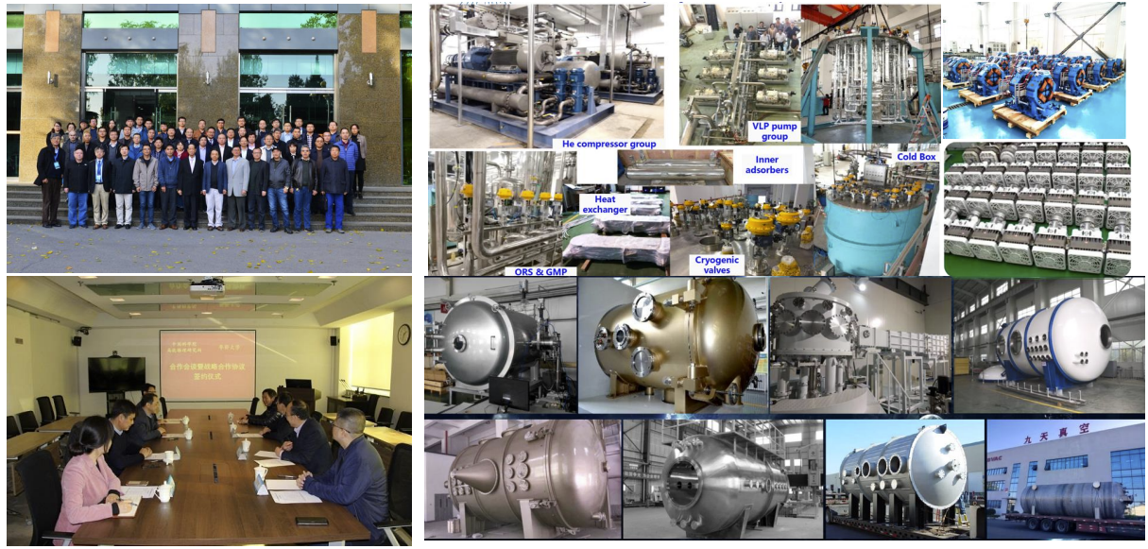
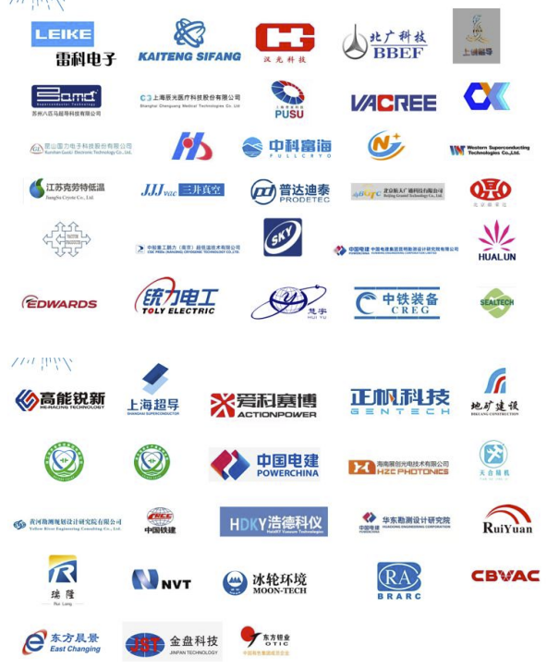
Industrial Collaborations
CIPC, established in 2017, consisting of ~ 70 high tech. enterprises, and participated the Key technology R&D and prepares for the mass production for the CEPC construction.
CEPC strongly promote these relevant technology development (cost-benefit)
CEPC study group is surveying main international suppliers.

Slide 15
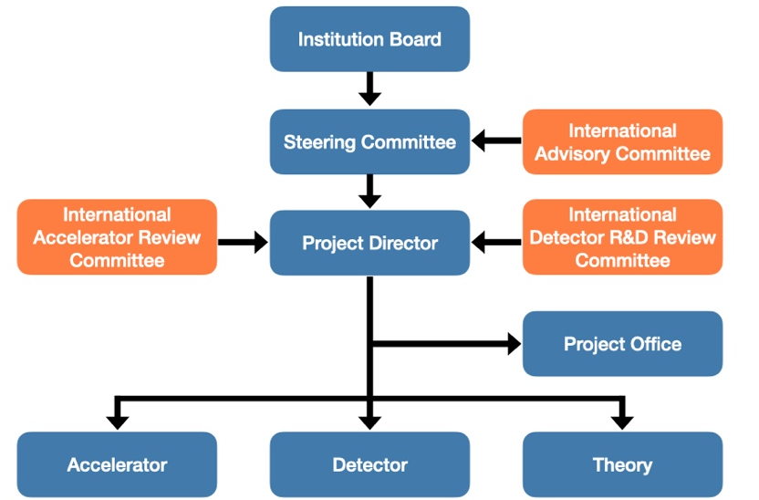
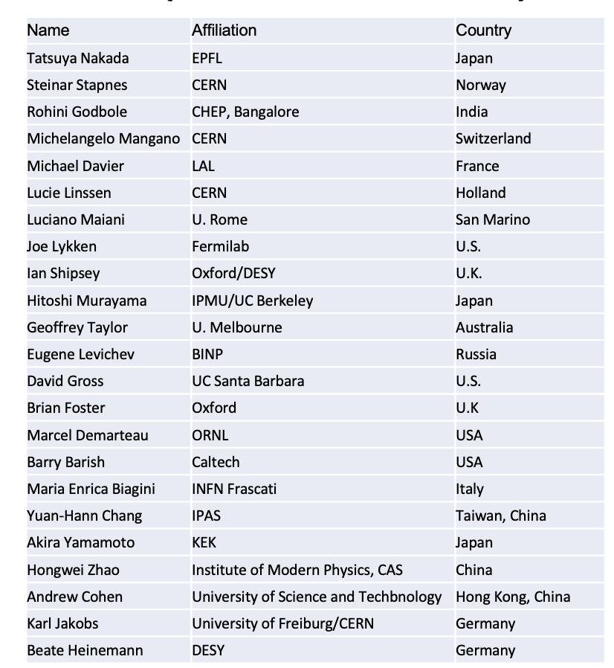
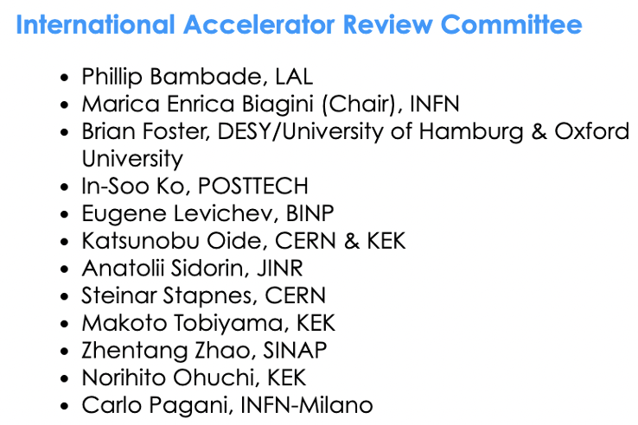
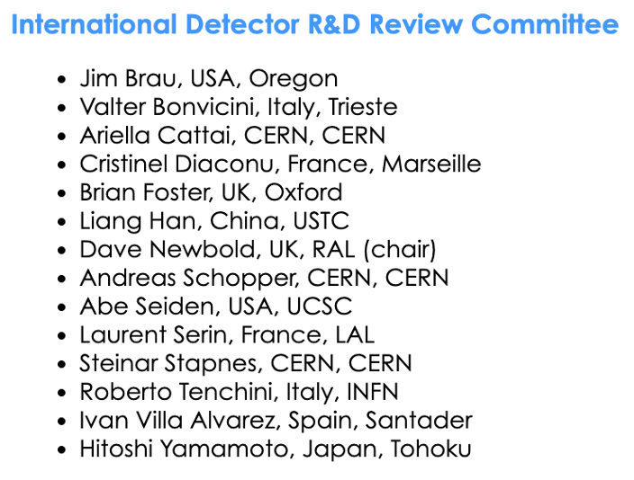
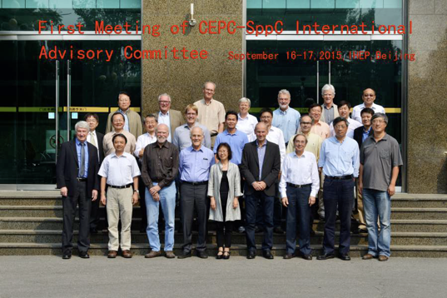
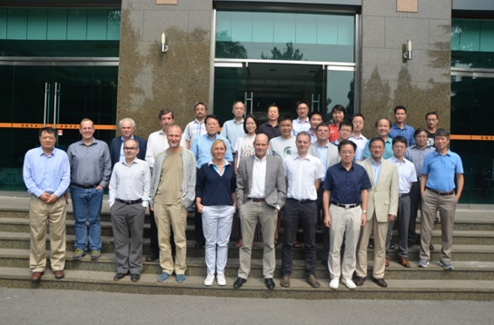
Organization and International Committees
IAC composed of global renowned scientists and top laboratory or project leaders who have ample experience in project management, planning, and execution of strategies, operating since 2015
IARC & IDRC composed of leading experts of this field, provide guide to the project director

Slide 16
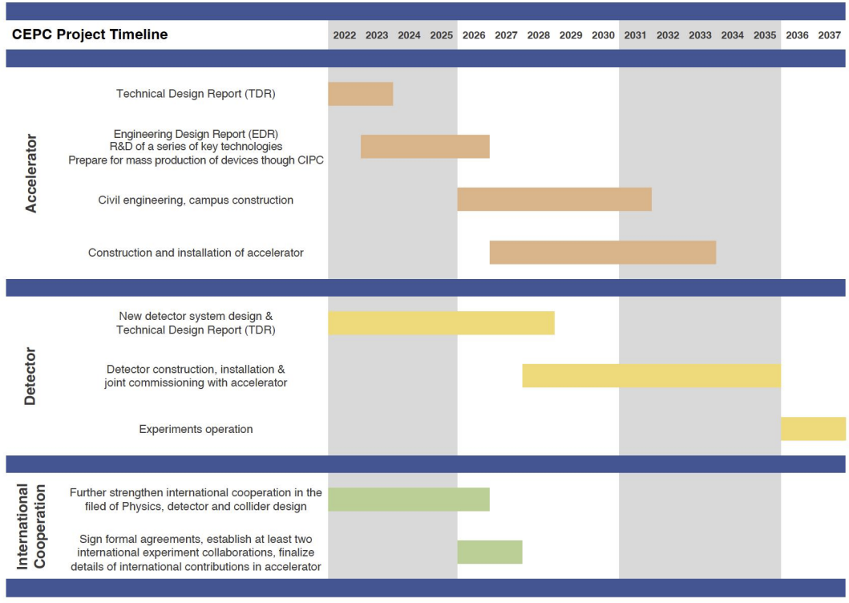
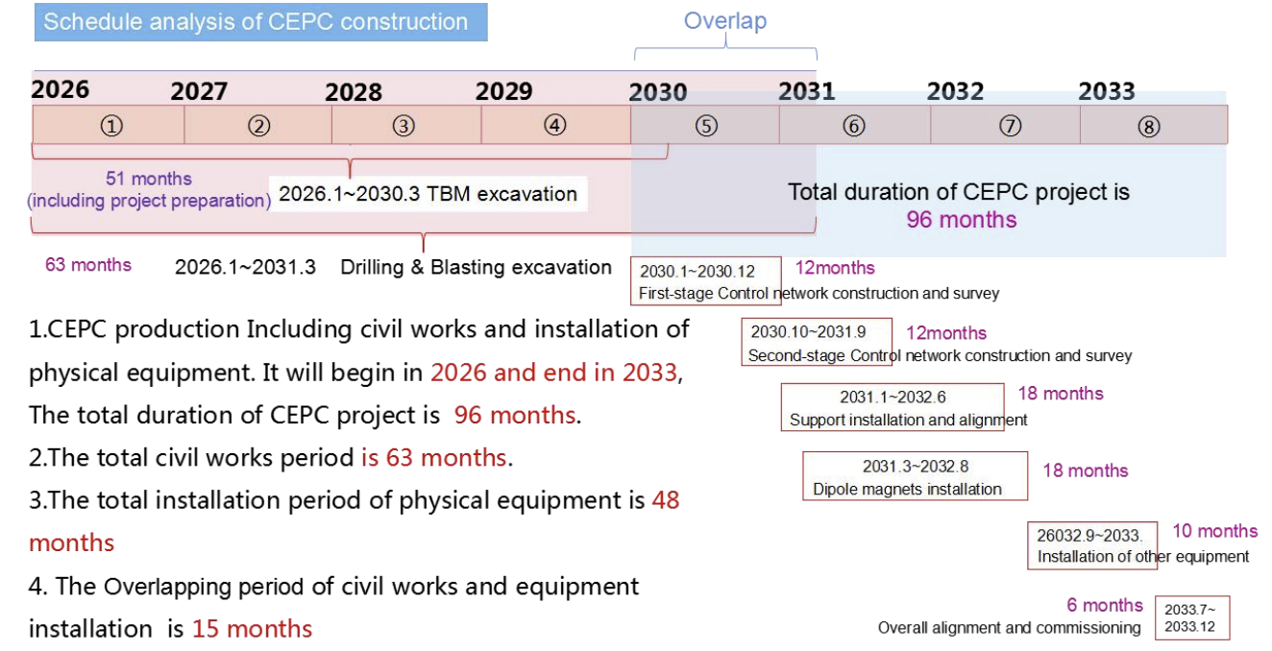
CEPC Timeline and Construction Plan
An EDR phase is implemented from 2023 to 2025, prior to the start of the CEPC construction:
Converge the CEPC sites to one or two with detailed feasibility studies
Engineering design of CEPC accelerator systems and components towards fabrication in an industrial way
Work closely with CAS and MOST to prepare CEPC be put in the “15th five year plan”; apply for the government’s approval of starting construction around 2026

Slide 17
TDR Content Overview

Slide 18
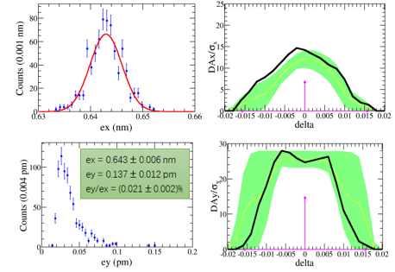
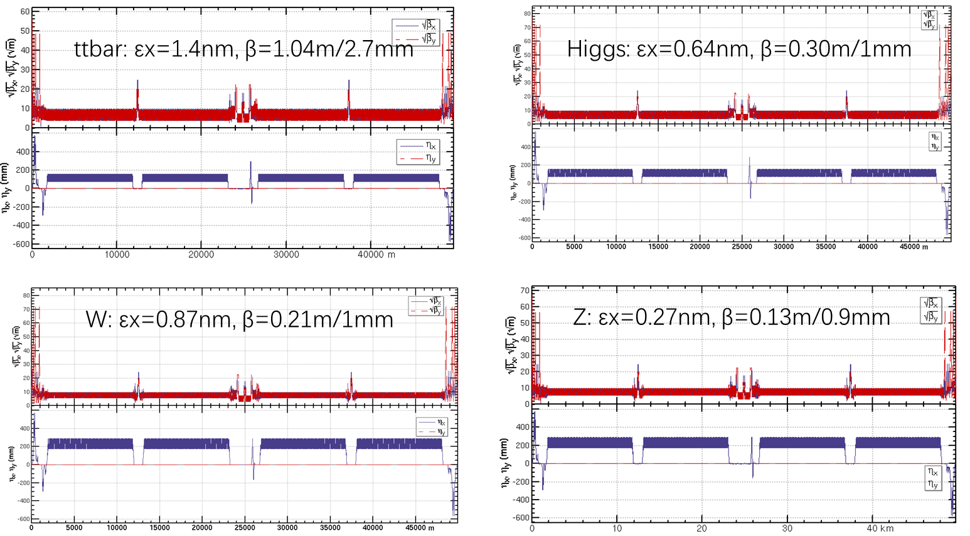
Collider Ring Design
Yiwei Wang
Session M1-2: #3
Emittance & DA with errors
Lattice design for MDI, Arc, straight line for all modes
The global lattice design for the regions of MDI, Arc, straight line, was conducted for all energies;
Emittance and DA for all modes were optimized. Errors were included and mitigation measures were carried out;
Based on the physical design, the CEPC main parameters, including luminosities, are calculated

Slide 19
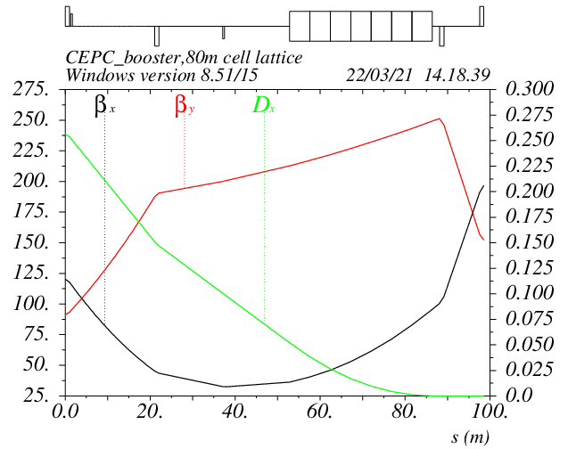
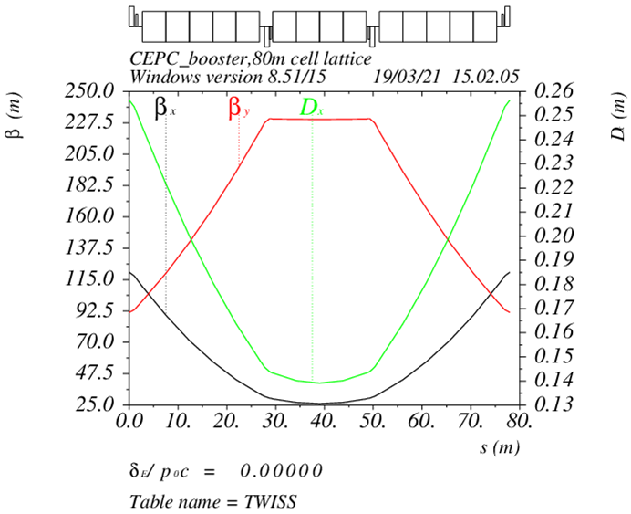
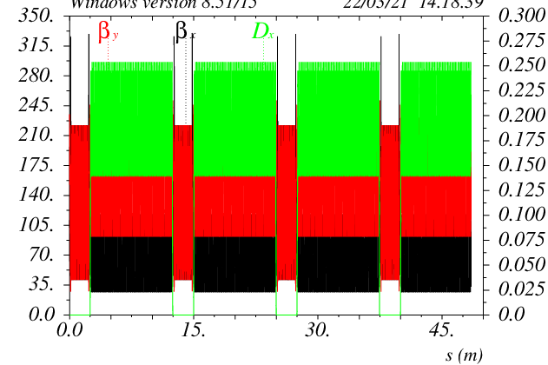




Booster Design
Dou Wang
Session A1-1: #1
30→180GeV
30GeV
TME like structure (cell length=78m)
Interleave sextupole scheme
Emittance@120GeV=1.26nm
Dispersion sup.
DA@30GeV
DA@45GeV
Arc cell
Half ring
DA@80GeV
DA@120GeV
30 GeV injection energy, Maximum extraction energy @ 180GeV
Lattice design with TME structure, lower emittance than CDR
Sufficient Dynamic Aperture for all energies with errors

Slide 20








Beam-beam effects studies
Yuanzhang
Session A1-1: #2
Luminosity simulations w/ZL
Transverse size simulations
ttbar
ttbar
Higgs
Higgs
W
Z
W
Z
Beam-beam simulation results are consistent with the main parameter table
Luminosity & Lifetime is evaluated by strong-strong simulation
X-Z instability is well suppressed even considering PWD
Lifetime optimization with both beam-beam\lattice nonlinearity could is done

Slide 21









Beam line arrangement and impact to collider
Sha Bai
Session A1-1: #3
MDI Layout
General Parameters
SR Calculation
Radiation background
Radiative barbar, Beam-Gas, beam thermal photon scattering
Injection background
Radiation Mitigation
Masker, collimator, shield

Slide 22





SRF System Design and Upgrade Plan
Jiyuan Zhai
Session A1-2: #1
650MHz Parameters
H/W/Z/ttbar bypass scheme
SRF power supply auxiliary tunnel
1.3GHz Parameters
CEPC TDR SRF layout and parameters are designed to meet physics run requirement;
RF system design optimized for Higgs 30/50 MW. Power and energy upgrade by adding cavities, RF power sources and cryogenic plants and other systems are compatible;
Use dedicated high current 1-cell cavity for 10-50 MW Z. Solve the FM & HOM CBI problems.

Slide 23





Collective Instabilities @ the CEPC
Impedance budget @ σ_{z}=3mm
Na Wang
Session A1-2: #2
Bunch lengthen and microwave instability
TMCI w/ZL
No apparent show stoppers exist for Higgs, W and ttbar;
Main constraints from the beam collective effects are mainly focused on Z;
The Booster show no apparent constraints from single bunch and CSR effect, however, bunch-by-bunch feedback is required to damp the TRWI;
No constraints observed from the Damping ring, and the impedance will lengthen the bunch by ~2%, which still meet the requirement from injections
Design
67μA (22.4nC)

Slide 24




Electron and positron injection linac designs
Cai Meng
Session A1-2: #3
Parameter | Symbol | Unit | Design value
Energy | E | GeV | 30
Repetition rate | f_{rep} | Hz | 100
Number of bunches per pulse |  |  | 1 or 2
Bunch charge |  | nC | 1.5
Energy spread | σ_{E} |  | 1.5×10^{–3}
Emittance | ε_{r} | nm | 6.5
Electron energy at target |  | GeV | 4
Electron bunch charge at target |  | nC | 10
Tunnel length | L | m | 1800
e- in linac
e+ in linac
Phase space @ SAS exit
Linac energy increases to 30 GeV, with C band Accelerator;
Start-to-end simulations were conducted for both electron/positron beam. The quality meet the requirement, with error impact.

Slide 25







Transport line and Timing
Xiaohao Cui
Session M2-1: #1
Linac to DR
Booster to collider
Lamberson
26 mrad
60m
26m
66m
68m
Injection to Booster
H injection timing
pulse
100Hz single bunch for H/W/tt
10ms
Higgs/ttbar
W/ Z
There are a number of transport lines in the CEPC accelerator complex.
All transport lines are designed;
Injection/ramping timing was figured out for different energies
t
100Hz double bunch for Z

Slide 26




Collider ring magnets development
Mei Yang
Session M2-1: #2
Full-length Dual aperture dipole
Dual aperture QUAD
Sextuple Design
Magnet name | B0B
Quantity | 1920 (*1.5)
Aperture [mm] | 66
Field strength [Gs] @180 GeV | 597
Field errors [×10⁻⁴] | ±3
Turns per magnet | 2
Current[A] @180GeV | 1629
Size of conductor [mm×mm] | 60×27-Al
Max current density [A/mm²] | 1.03
Core height [mm] | 160
Core width [mm] | 530
Core length [m] | 5.72m×4
Large quantity of dual-aperture dipoles (65km) are required;
Full length dual-aperture dipole and dual aperture QUAD (short length) have been fabricated;
Dipole/QUAD prototype meet the requirements.
Sextuples are conventional, and the design was made

Slide 27




Weak Field Dipole for Booster
Wen Kang
Session M2-2: #1
Booster requires ~15k pieces magnets (68km);
Booster dipoles are required to work at the low field of 31 Gs (10GeV) with error smaller than 5×10^{–4}
Two types of full length (4.7m) dipole were developed, the CT iron-free and diluted iron, both meet the field specification for 30GeV beam;

Slide 28





Possible Applications on Metals
Yingshun Zhu
Session M2-2: #2
SCQ Specifications
 | Q1a | Q1b | Q2
Field gradient | 142.3 | 85.4 | 96.7 | T/m
Magnetic length | 1210 | 1210 | 1500 | mm
Reference radius | 7.46 | 9.085 | 12.24 | mm
Mini. distance between aperture center | 62.71 | 105.28 | 155.11 | mm
High order field harmonics | ≤5×10⁻⁴ | ≤5×10⁻⁴ | ≤5×10⁻⁴
Dipole field | ≤3 | ≤3 | ≤3 | mT
Q1a
Q1b
Q2
CCT and Cos2θ type SCQs were modeled, and their fields were calculated to meet the CEPC specification;
A 0.5-m single aperture SCQ using Cos2θ technology were developed. The electro-magnet excitation test showed the highest current reached 2500A, which satisfies the CEPC requirement

Slide 29





Magnet Power Supply System Design
Bin Chen
Session M2-2: #3
    Counting the power supplies for collider, booster, linac, DR, Transport line, the total magnet quantity ：38435
Digital Power Supply Control Module (DPSCM)
Collider | Dipole |  | Quadrupole |  | Sextupole | Corrector | Magnet quantity
 | D-aperture | S-aperture | D-aperture | S-aperture
 | 3008 | 162 | 3016 | 1116 | 3144 | 7088 | 17534
Booster | Dipole |  | Quadrupole |  | Sextupole | Corrector
 | 14866 |  | 3458 |  | 100 | 1200 | 19624
Linac | Dipole |  | Quadrupole |  | Solenoids | Corrector
 | 15 |  | 364 |  | 37 | 275 | 691
Damping Ring | Dipole |  | Quadrupole |  | Sextupole | Corrector
 | 86 |  | 130 |  | 72 | 60 | 348
Transport Line | Dipole |  | Quadrupole |  | Sextupole | Corrector
 | 64 |  | 120 |  | 0 | 54 | 238
Total | 38435
Current Transducer
Stability test
  Power suppliers for different magnets were designed, with satisfactory stability
  Key components, such as the DPSCM and Current Transducer were developed, which are applied at HEPS

Slide 30








Injection & Extraction Hardwares
Jinhui Chen
Session A2-1: #1
Various kicker and septum are required
In-vacuum/half in-vacuum Septum
Slotted-pipe kicker
The same team is in charge of both HEPS and CEPC inj. & ext. system
Experience gained in HEPS applies for CEPC
HEPS has developed various types of devices including Septum, Fast Kick, and Pulser Generator, which are also compatible with the CEPC.
Fast kicker pulser

Slide 31




Vacuum System Key Technology R&D
Yongsheng Ma
Session A2-1: #2
Vacuum chamber prototypes, copper & aluminum, with different shape/length were fabricated;
NEG coating technology were developed;
RF shielding bellow manufactured
Vacuum technology applied and was tested at HEPS

Slide 32




SRF cavities R&D and Modules
Peng Sha
Session A2-1: #3
6.4E10@30MV/m, 2.3E10@41.6MV/m
Mid-T baking applied to 1.3GHz/650MHz cavities, resulting in High Q SRF cavity that meets the CEPC specification;
Completed SRF modules for both 1.3GHz and 650MHz cavities were assembled;

Slide 33


Cryogenic System
Rui Ge
Session A2-2: #1
Booster SRF
Collider SRF
Cryogenic system was optimized for the most economic operation
Heat load at different operation modes were calculated, accordingly the cooling capacity was designed: 4×15kW@4.5K

Slide 34







Electron & positron linac key technology R&D
Jingru Zhang
Session A2-2: #2
Flux concentrator for positron source
S band pulse compressor
High perform. S/C-band Acc. Struc.
pulsed magnetic field of 6 T to 0.5 T
15kA/15kV/50Hz solid state pulse source
34

Slide 35




RF power sources development
Zusheng Zhou
Session A2-2: #3
Klystron R&D
Power Step Module
RF distribution plan
3 prototypes 650MHz klystron are under development. The efficiency reaches 70%
PSM is developed with the industrial collaboration
RF tunnel distribution was planed

Slide 36






Beam Instrumentation
Yanfeng Sui
Session M3-1: #1
Feedthrough
FB system
BPM sensor & electronics
Various types of beam instrumentation were developed with funding from HEPS, BEPCII and CEPC
The CEPC requirements are met

Slide 37

Mechanical Supports and Installation Tools
Haijing Wang
Session M3-1: #2

Slide 38








Alignment and Installation Plan
Xiaolong Wang
Session A3-2: #2
Clear Alignment accuracy requirement
Component Pre-alignment
Wall Control Point
Ground Control Point
Backbone Control network (short line:300m; long line 600m)
Tunnel Control network (interval of 6 meters)
Surface Control network (14Points)

Slide 39
Other but not least Issues
Control system, by Gang Li
Radiation protection study, by Guangyi Tang
Site selections & civil engineering designs, by Yu Xiao
Auxiliary facility and power consumptions, by Jinshu Huang
SPPC compatible design, by Jingyu Tang
Superconducting high field magnet, by Qingjin Xu
CEPC applications as an advanced photon source, by Yuhui Li
Polarization application at CEPC, by Zhe Duan
e-/e+ plasma injector design (alternative), by Dazhang Li
Industrialization preparation and Deep-C documentation system, by Song Jin

Slide 40
Summary
The CEPC parameters optimization for high luminosity. 30MW and 50MW operation for all energies are simulated
CEPC accelerator key hardware R&D made important progresses, and CEPC are ready for the construction in “15th five-year-plan” (2026-2030)
CEPC siting, civil engineering, AC power consumptions, installation planning, international collaborations and CIPC collaborations are progressing well

Slide 41
Acknowledgements
Thanks go to CEPC-SppC accelerator team’s hard works,
international and CIPC collaborations
Special thanks to CEPC, IAC, IARC and TDR review committee’s critical comments,
suggestions and encouragement

