Slide 1
CEPC collider dynamic aperture calculation and error mitigation
Yiwei Wang, Bin Wang
for the CEPC Accelerator Physics Group
The Institute of High Energy Physics, Chinese Academy of Sciences
CEPC day
30 May 2023, IHEP

Slide 2
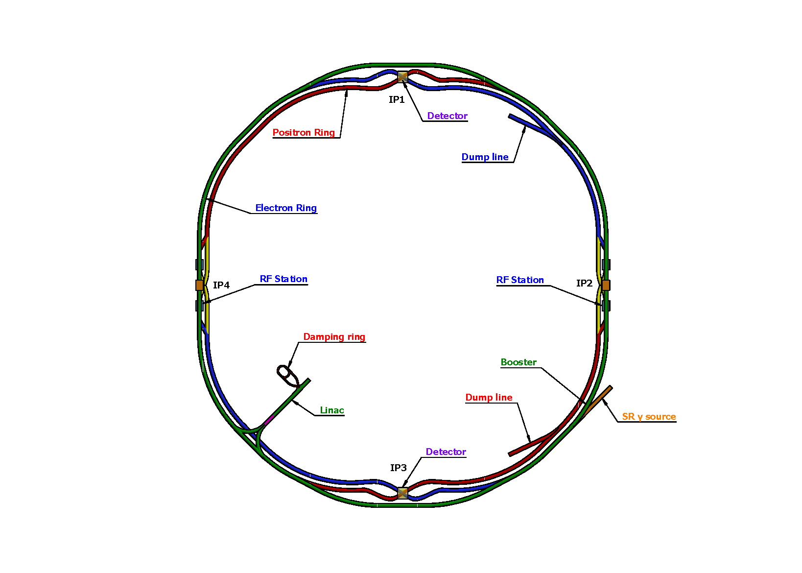
Lattice design of the CEPC collider ring
Basically 2 folded symmetry
2 interaction regions @ IP1 and IP3
crab waist collision
local chromaticity correction for the interaction region
asymmetric interaction region
2 RF acceleration regions @ IP2 and IP4
shared cavities for two beam @ ttbar, Higgs
flexible switching between compatible modes
8 arc sections
dual aperture dipole and quadrupole magnets
non-interleaved sextupoles
4 short straight section
on/off axis injection regions for different modes
beam dumping
Correction of energy sawtooth effects
LS4
LS1
LS3
LS2
ref: CEPC-CDR; CEPC pre-CDR; K. Oide, arXiv:1610.07170; M. Zobov et al, Phys. Rev. Lett. 104, 174801(2010); A. Milanese, PRAB 19, 112401 (2016);

Slide 3
Machine parameters of CEPC
 | Higgs | Z | W | $$t\overline{t}$$
Number of IPs | 2
Circumference (km) | 100.0
SR power per beam (MW) | 30
Half crossing angle at IP (mrad) | 16.5
Bending radius (km) | 10.7
Energy (GeV) | 120 | 45.5 | 80 | 180
Energy loss per turn (GeV) | 1.8 | 0.037 | 0.357 | 9.1
Damping time τ_{x}/τ_{y}/τ_{z} (ms) | 44.6/44.6/22.3 | 816/816/408 | 150/150/75 | 13.2/13.2/6.6
Piwinski angle | 4.88 | 24.23 | 5.98 | 1.23
Bunch number | 268 | 11934 | 1297 | 35
Bunch spacing (ns) | 591 (53% gap) | 23 (18% gap) | 257 | 4524 (53% gap)
Bunch population (10¹¹) | 1.3 | 1.4 | 1.35 | 2.0
Beam current (mA) | 16.7 | 803.5 | 84.1 | 3.3
Phase advance of arc FODO (°) | 90 | 60 | 60 | 90
Momentum compaction (10⁻⁵) | 0.71 | 1.43 | 1.43 | 0.71
Beta functions at IP β _{x}*/β _{y}* (m/mm) | 0.3/1 | 0.13/0.9 | 0.21/1 | 1.04/2.7
Emittance ε_{x}/ε_{y} (nm/pm) | 0.64/1.3 | 0.27/1.4 | 0.87/1.7 | 1.4/4.7
Betatron tune n_{x}/n_{y} | 445/445 | 266/267 | 266/266 | 445/445
Beam size at IP s_{x} /s_{y} (um/nm) | 14/36 | 6/35 | 13/42 | 39/113
Bunch length (natural/total) (mm) | 2.3/4.1 | 2.5/8.7 | 2.5/4.9 | 2.2/2.9
Energy spread (natural/total) (%) | 0.10/0.17 | 0.04/0.13 | 0.07/0.14 | 0.15/0.20
Energy acceptance (DA/RF) (%) | 1.6/2.2 | 1.3/1.7 | 1.2/2.5 | 2.0/2.6
Beam-beam parameters x_{x} /x_{y} | 0.015/0.11 | 0.004/0.127 | 0.012/0.113 | 0.071/0.1
RF voltage (GV) | 2.2 | 0.12 | 0.7 | 10
RF frequency (MHz) | 650
Longitudinal tune n_{s} | 0.049 | 0.035 | 0.062 | 0.078
Beam lifetime (Bhabha/beamstrahlung) (min) | 39/40 | 80/18000 | 60/700 | 81/23
Beam lifetime (min) | 20 | 80 | 55 | 18
Hourglass Factor | 0.9 | 0.97 | 0.9 | 0.89
Luminosity per IP (10³⁴ cm^{–2} s^{–1}) | 5.0 | 115 | 16 | 0.5
*CEPC AP group, TDR draft ch 4.1

Slide 4
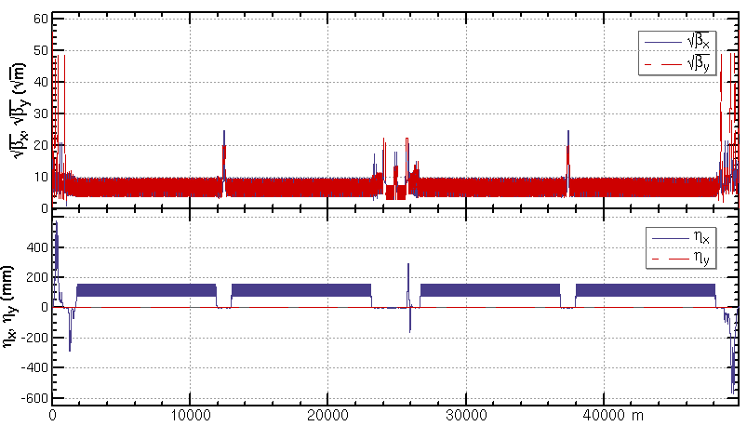
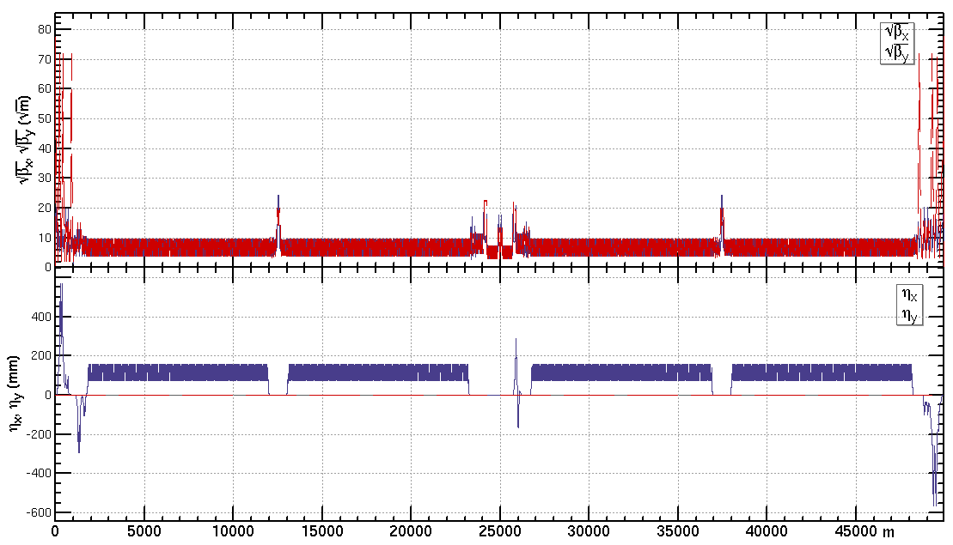
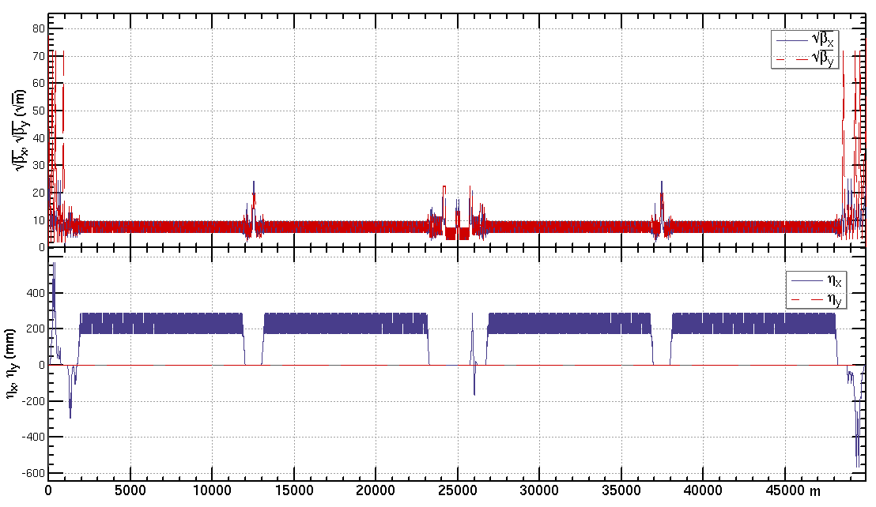
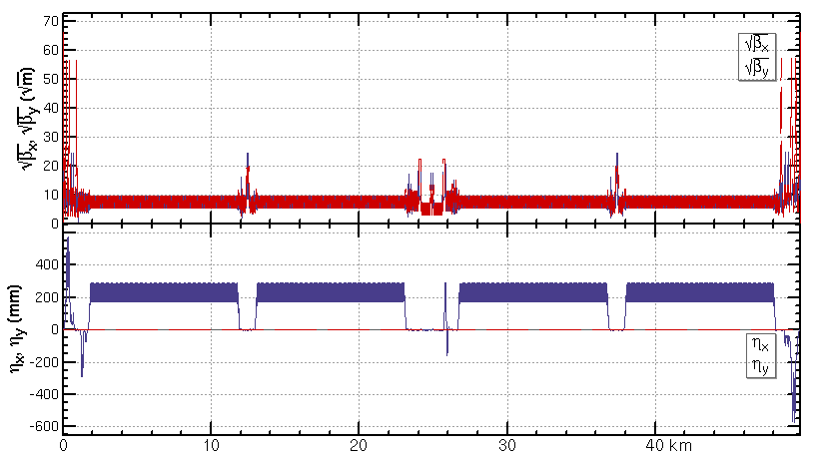
Lattice design of the CEPC half ring
ttbar: εx=1.4nm, β=1.04m/2.7mm
Higgs: εx=0.64nm, β=0.30m/1mm
W: εx=0.87nm, β=0.21m/1mm
Z: εx=0.27nm, β=0.13m/0.9mm

Slide 5
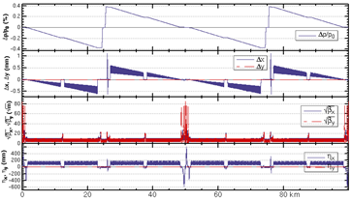
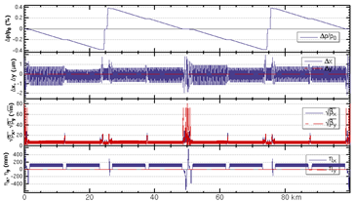
Energy sawtooth effects and correction
With only two RF stations, the energy sawtooth is around ±0.4% @ Higgs and 1.3 % @ ttbar
The closed orbit distortion in CEPC collider ring is around 1 mm and becomes 1um after tapering the magnet strength with beam energy.
adjusting range of magnets strength ±2.5%
Higgs: before tapering correction
Higgs: after tapering correction

Slide 6
Dynamic aperture requirement
by X. H. Cui, Y. Zhang, Y. Wang
 | ttbar | Higgs | W | Z
Horizontal DA requirement from injection | $${\text{1}1 σ}_{x}$$ off axis | $$13.6{ σ}_{x}$$ off axis $$7{ σ}_{x}$$ on axis | $${\text{8.4 }σ}_{x}$$ off axis | $${\text{11} σ}_{x}$$ off axis
Beam lifetime requirement from injection [min] | 16.3 | 17.2 | 20.5 | 74
DA requirement | ttbar | Higgs | W | Z
with on-axis injection | - | ${\text{7}σ}_{x}×15σ_{y}×$1.6% | - | -
with off-axis injection | ${\text{1}\text{1}σ}_{x}×{20σ}_{y}×$2.2% | ${\text{13.6}σ}_{x}×15σ_{y}×$1.6% | ${\text{8.4}σ}_{x}×9σ_{y}×$1.2% | ${\text{1}\text{1}σ}_{x}×9σ_{y}×$1.3%

Slide 7
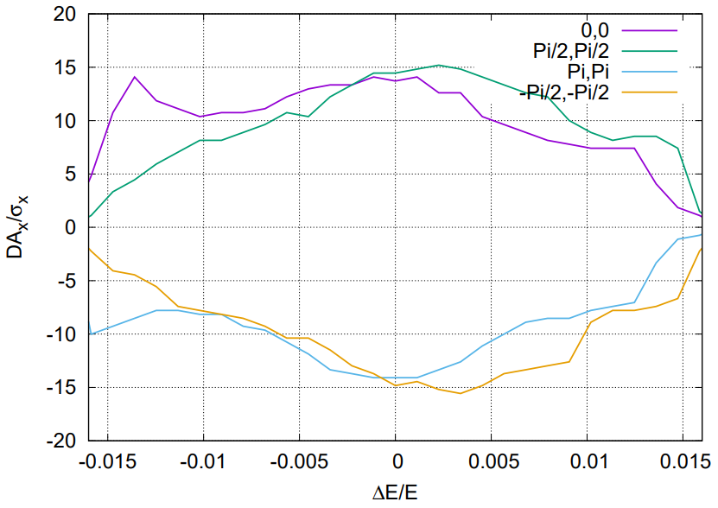
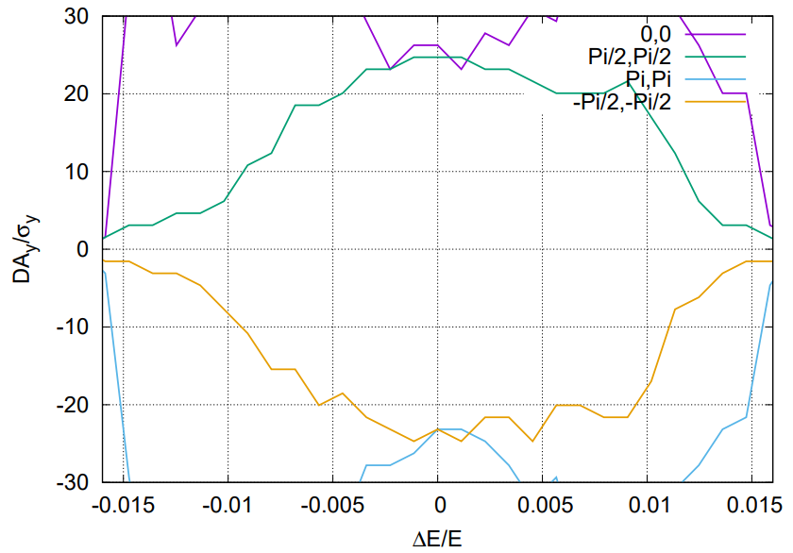
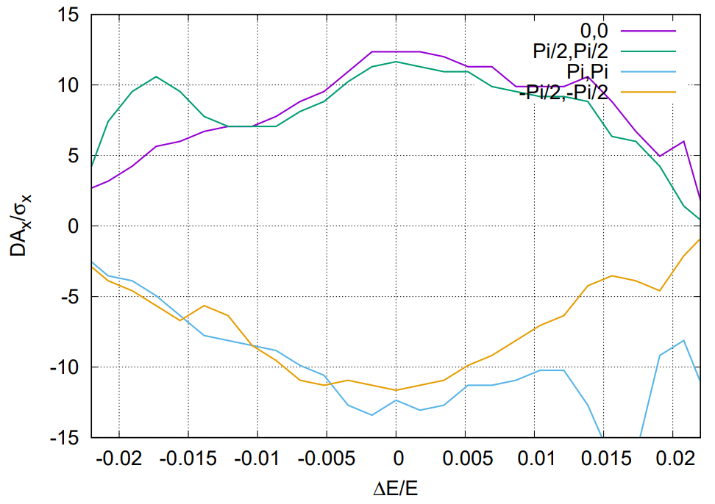
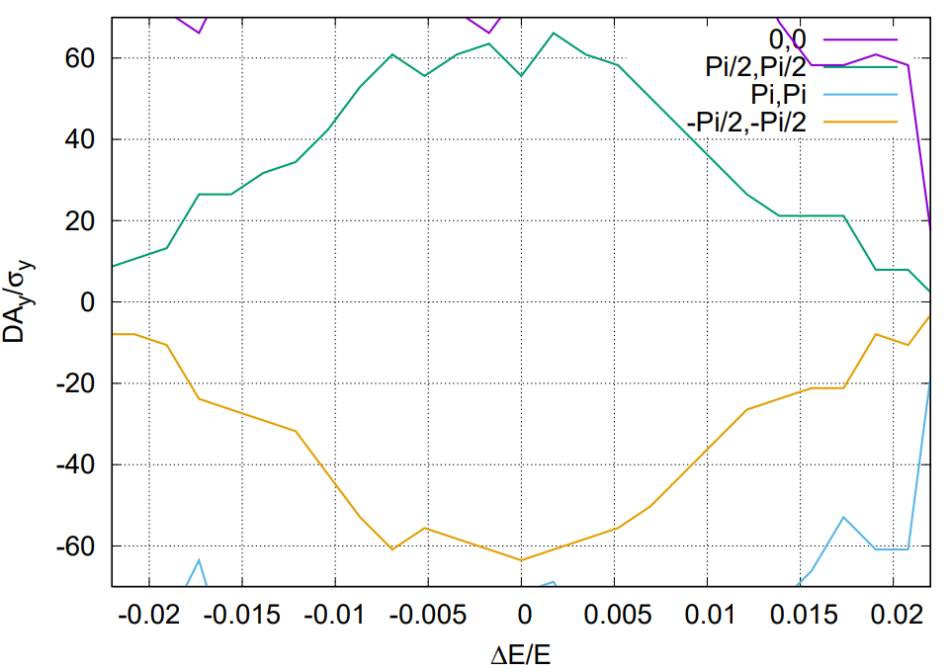
Dynamic aperture @ Higgs and ttbar
Tracking to get DA without errors, with turns for one transvers damping time, with 4 initial phases
DA optimized with 52 knobs (32 arc sextupole families + 8 IR sextupoles families + 4 multipoles families + 8 phase advance)
Totally, 256 arc sextupole families in the whole ring can be used.
The DA w/o errors fulfill the requirements @ Higgs and ttbar.
Effects included in tracking
Synchrotron motion
Radiation loss in all magnets
Tapering
Crab waist sextupole
Maxwellian fringes
Kinematic terms
Finite length of sextupole
Higgs
1.6 %
1.6 %
ttbar
2.2 %
2.2 %

Slide 8
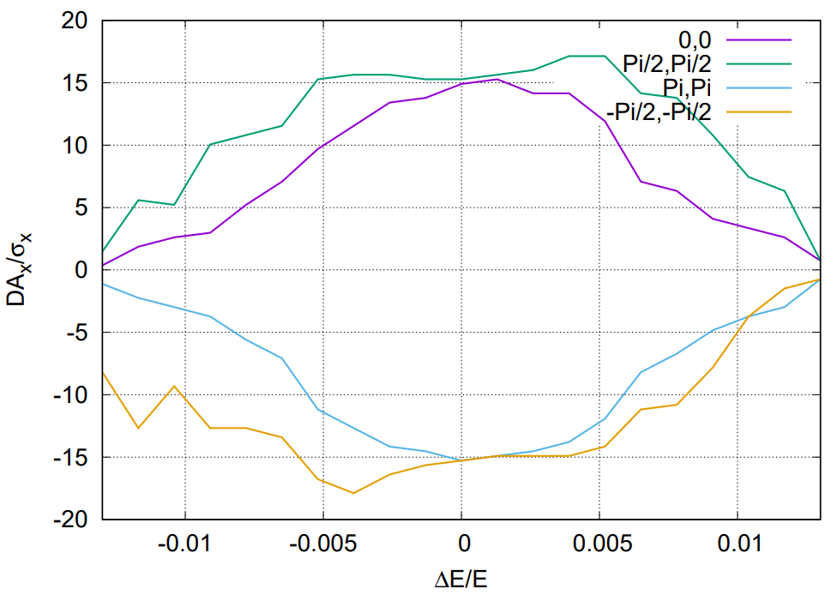
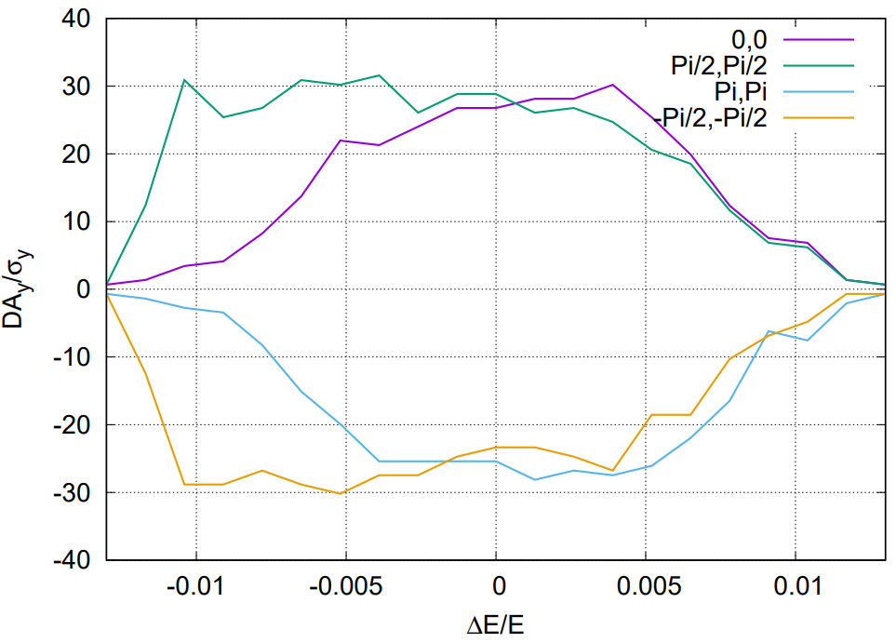
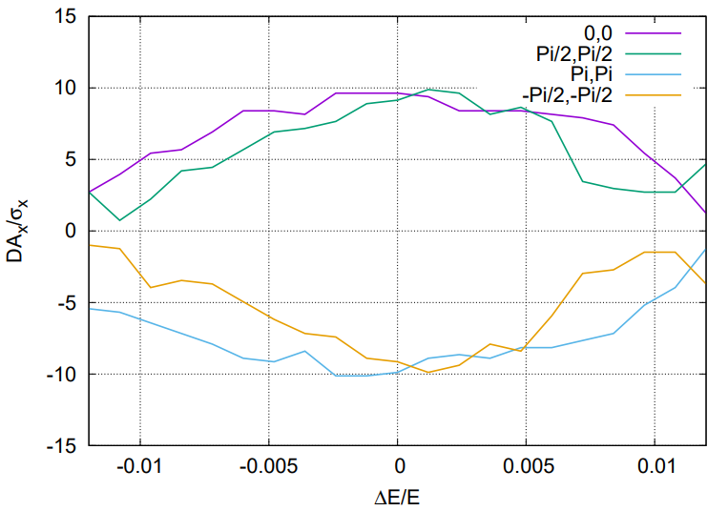
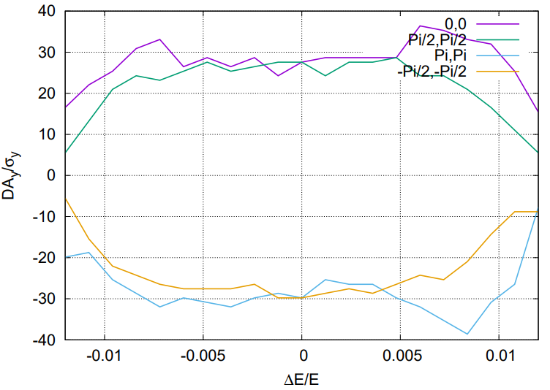
Dynamic aperture @ Z and W
Tracking to get DA without errors, with turns for one transvers damping time, with 4 initial phases
DA optimized with 68 variables (48 arc sextupole families + 8 IR sextupoles + 4 multipoles + 8 phase advance)
Totally, 96 arc sextupole families in the whole ring can be used.
The DA w/o errors fulfill the requirements @ Z and W.
Effects included in tracking
Synchrotron motion
Radiation loss in all magnets
Tapering
Crab waist sextupole
Maxwellian fringes
Kinematic terms
Finite length of sextupole
1.3 %
1.3 %
Z
W
1.2 %
1.2 %

Slide 9
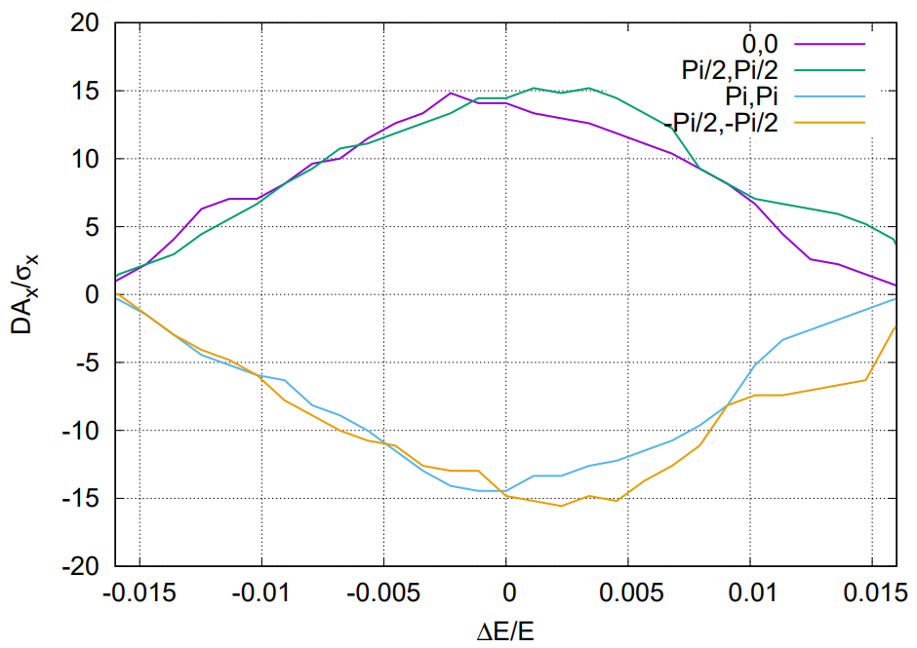
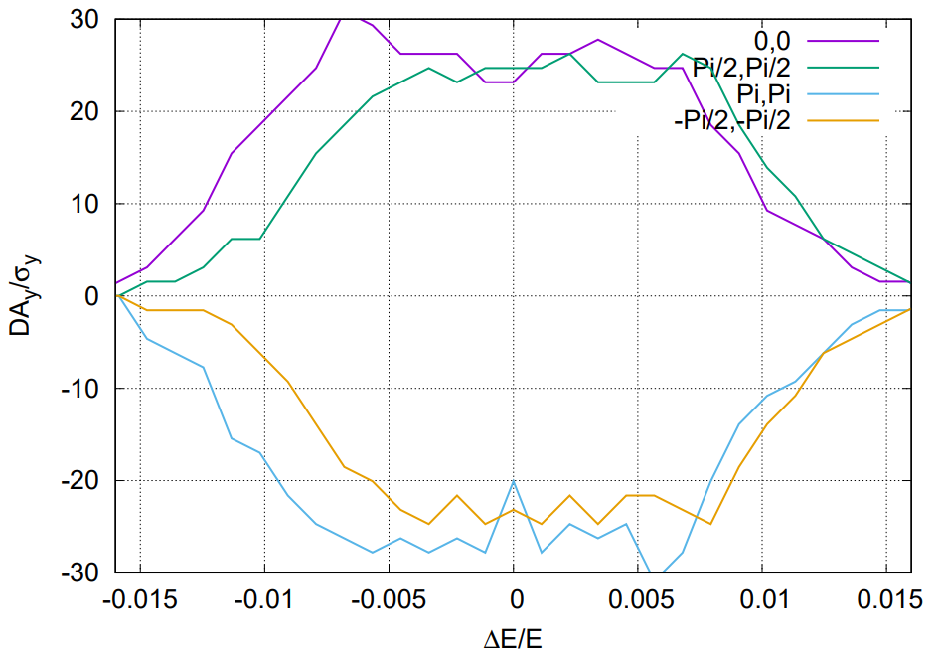
Solenoid effect on Dynamic aperture @ Higgs
The anti-solenoid cancel the ∫Bzdz between the IP and the faces of the final quadrupole
The Twiss function was corrected with final quadrupoles.
The solenoid effect on the dynamic aperture is small.
Effects included in tracking
Synchrotron motion
Radiation loss in all magnets
Tapering
Crab waist sextupole
Maxwellian fringes
Kinematic terms
Finite length of sextupole
Solenoid
Higgs
1.6 %
1.6 %
1.6 %
1.6 %
Higgs with sol

Slide 10
Correction procedures
Correction of the closed orbit distortion
Correction of the closed orbit distortion (COD) with sextupoles off is made firstly.
Turn on the sextupoles and perform COD correction again.
Orbit correction is applied using orbit response matrix and SVD method.
Dispersion correction
With dispersion free steering (DFS): orbit manipulation by knob correctors.
Beta-beating correction
Correct the beta functions with sextupoles on Based on AT LOCO
Coupling correction
Both coupling and vertical dispersion are controlled.
Using the trim coils of the sextupoles, which providing skew-quadrupole field, to perform emittance tuning for CEPC.

Slide 11
Error assumption
With assumption of 100 um transverse misalignments
BPMs placed at each quadrupoles
H/V correctors placed beside focusing/defocusing quadrupoles
The Higgs and ttbar lattices are similar, the Z and W lattices are similar.
1000 seeds used for the Higgs, 500 lattice seeds used for the Z
100 seeds used for both W and ttbar energy
Component | Δx (mm) | Δy (mm) | Δθ_{z} (mrad) | Field error
Dipole | 0.10 | 0.10 | 0.10 | 0.01%
Arc Quadrupole | 0.10 | 0.10 | 0.10 | 0.02%
IR Quadrupole | 0.10 | 0.10 | 0.10
Sextupole | 0.10* | 0.10* | 0.10
*implement beam-based alignment techniques to reach rms offsets in the order of 0.01 mm with respect to the beam
with a much larger beta @ IP
BPM resolution is less than 0.001mm

Slide 12
Result of four modes
RMS | Higgs | Z | W | $$t\overline{t}$$
Orbit ($μm$) | < 50 | < 50 | < 50 | < 50
Dispersion (mm) | 1.8/0.9 | 2.8/1.4 | 2.7/1.8 | 0.6/0.3
Beta-beating (%) | 1.0/2.8 | 2.0/3.0 | 0.5/2.5 | 1.1/1.2

Slide 13
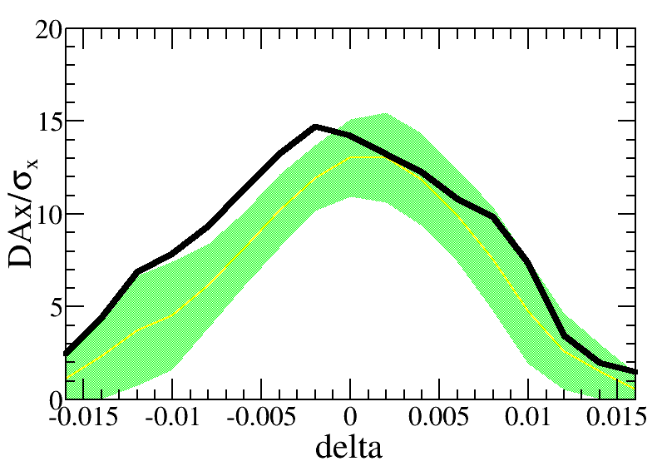
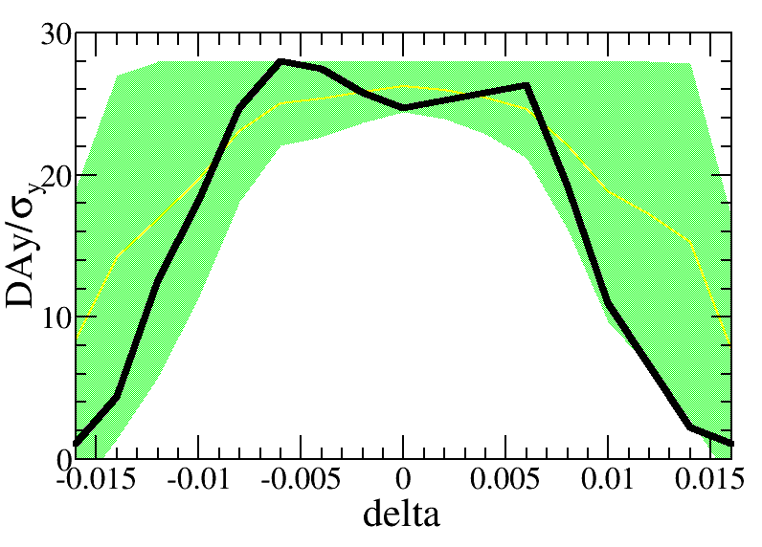
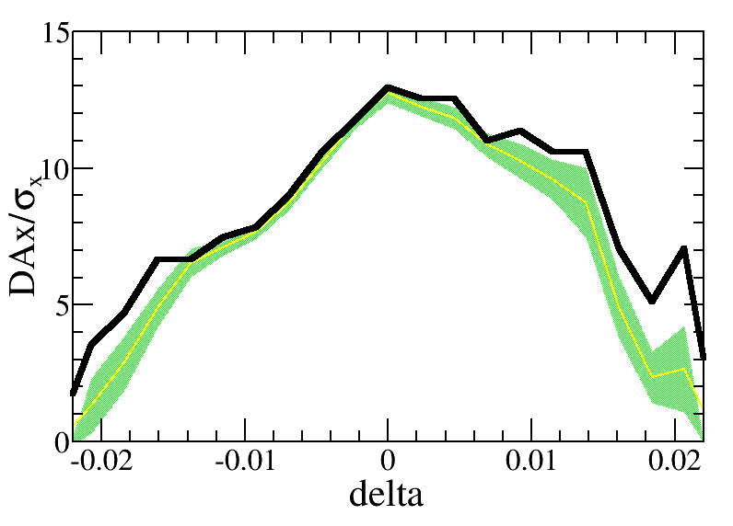
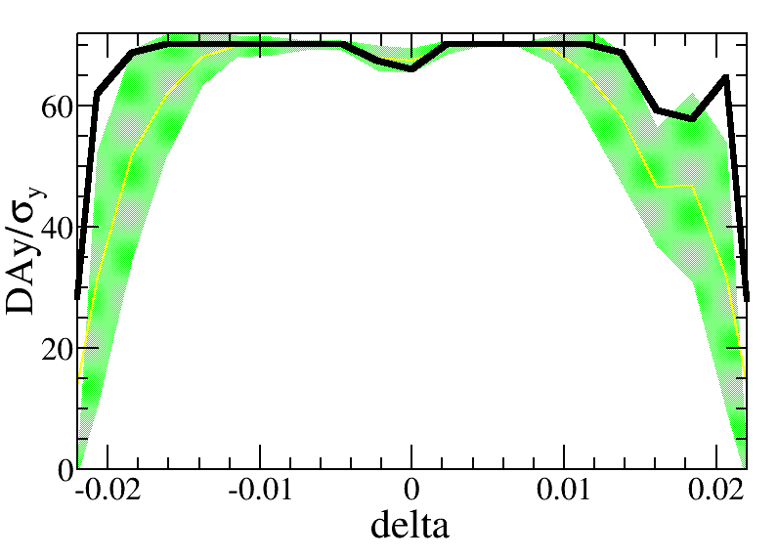
Dynamic aperture with error @ Higgs and ttbar
Effects included in tracking
Synchrotron motion
Radiation loss in all magnets
Tapering
Crab waist sextupole
Maxwellian fringes
Kinematic terms
Finite length of sextupole
Higgs
ttbar
—DA w/o error
—mean value
—statistic errors
—requirement
Further optimization is possible
With more families of sextupole: totally 256 arc sextupole families, only 32 arc sextupole families used
Recovery of the –I transformation for the IR sextupole: should help to increase the energy acceptance
With stricter error tolerance in IR: currently with same requirement for the IR and ARC

Slide 14
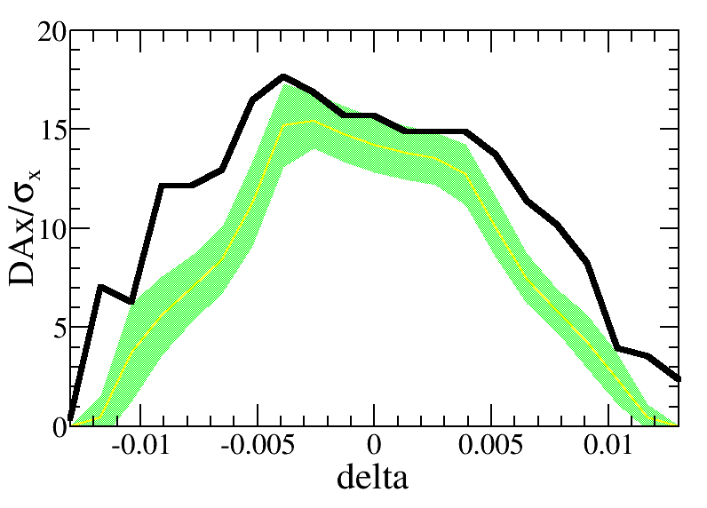
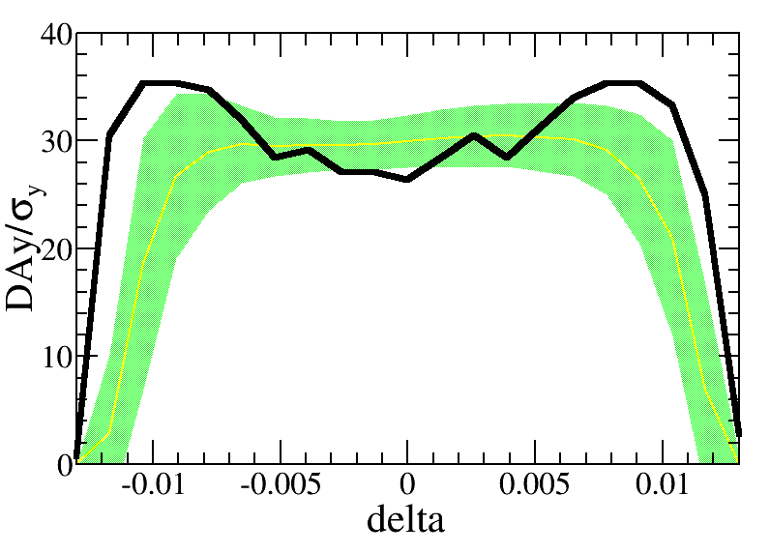
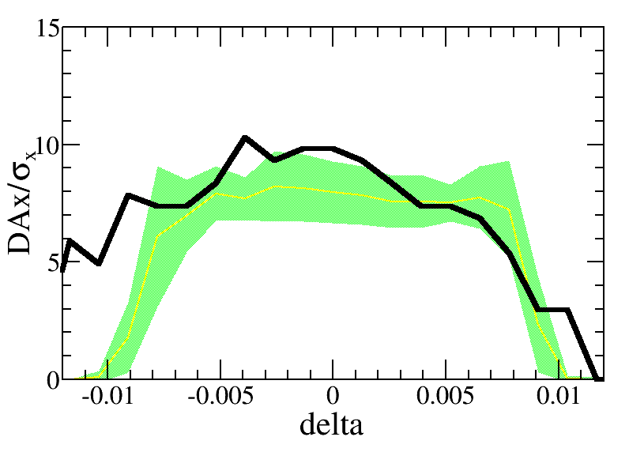
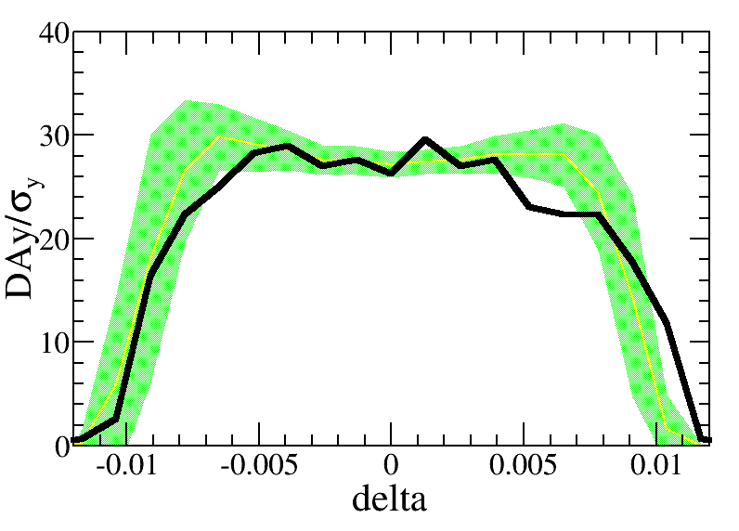
Dynamic aperture with error @ Z and W
Effects included in tracking
Synchrotron motion
Radiation loss in all magnets
Tapering
Crab waist sextupole
Maxwellian fringes
Kinematic terms
Finite length of sextupole
Z
W
—DA w/o error
—mean value
—statistic errors
—requirement
Further optimization is possible
With more families of sextupole: totally 96 arc sextupole families, only 48 arc sextupole families used
Recovery of the –I transformation for the IR sextupole: should help to increase the energy acceptance
With stricter error tolerance in IR: currently with same requirement for the IR and ARC

Slide 15
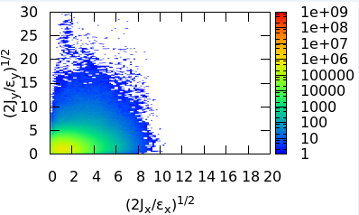
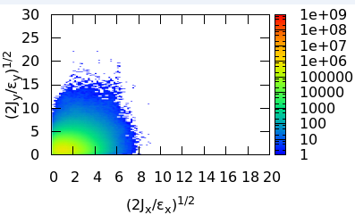
Dynamic aperture and beam lifetime
Larger dynamic aperture does not ensure longer lifetime.
Diffusion due to lattice nonlinearity affects the beam lifetime.
Optimize the beam lifetime and DA together.
Optimization for CEPC Higgs lattice w/o error made
It can be applied on the lattice w/ errors. More families of sextupoles are available for the optimization.
CEPC
Optimization for CEPC Higgs lattice w/o error
FCC-ee
Optimization for FCCee Z lattice w/o error
J. Wu, Y. Zhang, Q. Qin, Y. Wang, C. Yu, D. Zhou, NIMA 959 (2020) 163517.
J. Wu, Y. Zhang, Q. Qin, doi:10.18429/JACoW-IPAC2019-MOPGW051, IPAC19.
Y. Zhang et al, doi:10.18429/JACoW-eeFACT2018-TUYBA04, eeFACT2018.
K. Oide, FCCIS 2022 workshop, Dec. 06, 2022.

Slide 16
Summary
Lattice of the CEPC collider ring designed fulfilling requirements of the parameters list, geometry and key hardware. Nonlinearity correction is made.
Dynamic aperture w/o error for four modes achieved the requirements.
Dynamic aperture w/ main errors for four modes almost reach the requirements. Further optimization is possible.

Slide 17
backup

Slide 19
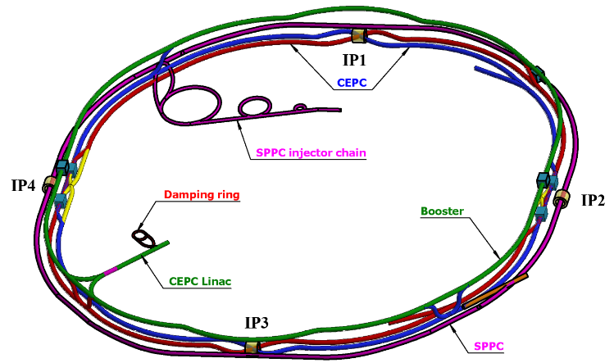
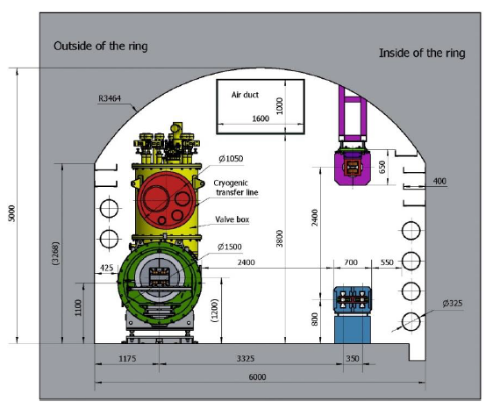
Overall design requirement of the CEPC collider ring
SR power per beam 30 MW (50 MW upgradable), 100 km, 2 interaction points
Compatible modes for H/Z/W/$t\overline{t}$runnig: provide high quality beam energy from 45.5 to 180 GeV
Compatible with SPPC: two machines share the most tunnels except the IP1-IP4
CEPC+SPPC complex
Tunnel in the arc regions
CEPC detectors

Slide 20
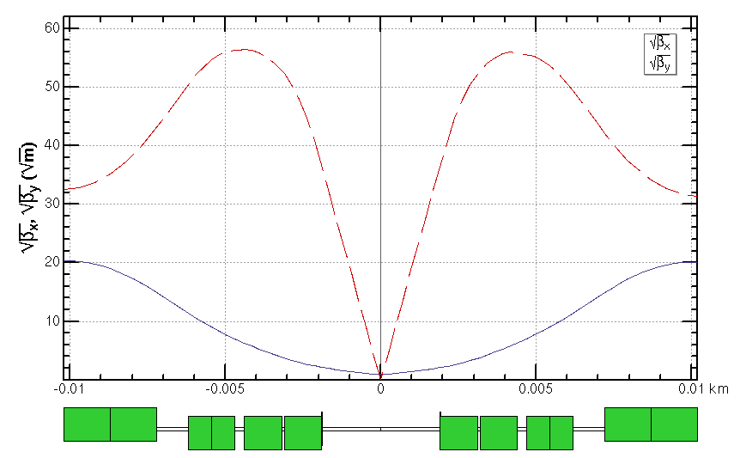
Interaction region for all modes
Crab waist collision, local chromaticity correction, asymmetric interaction region
Quadrupole | L [m] | Distance from IP [m] | Strength [T/m]
 |  |  | $$t\overline{t}$$ | Higgs | W | Z
Q1AIRU | 1.21 | 1.9 | -141 | -141 | -94 | -110
Q1BIRU | 1.21 | 3.19 | -59 | -85 | -56 | +65
Q2IRU | 1.5 | 4.7 | -51 | +95 | +63 | 0
Q3IRU | 3 | 7.2 | +40 | 0 | 0 | +2
Q1AIRD | 1.21 | -1.9 | -142 | -142 | -95 | -110
Q1BIRD | 1.21 | -3.19 | -64 | -85 | -57 | +65
Q2IRD | 1.5 | -4.7 | -47 | +96 | +64 | 0
Q3IRD | 3 | -7.2 | +40 | 0 | 0 | +2
ttbar
Strength of other modes doesn’t exceeded the one of Higgs mode.
Q3BIRU
Q3AIRU
Q2IRU
Q1BIRU
Q1AIRU
Q1AIRD
Q1BIRD
Q2IRD
Q3AIRD
Q3BIRD
 | QD | QF
Z | Q1A | Q1B
W/H | Q1A+Q1B | Q2
ttbar | Q1A+Q1B+Q2 | add quad Q3A and Q3B
 | L* [m] | LQ1 [m] | LQ2 [m] | GQ1 [T/m] | GQ2 [T/m] | d [m]
CDR | 2.2 | 2.0 | 1.5 | -136 | 111 | 0.3
TDR | 1.9 | 1.22/ 1.22 | 1.5 | -141/ -85 | +95 | 0.3
*ref: Y. Cai, IAS2016, HKUST; K. Oide, arXiv:1610.07170;
P. Raimondi, Proc. of the 2nd SuperB Workshop, Frascati, March 2006；M. Zobov et al, Phys. Rev. Lett. 104, 174801(2010);

Slide 21
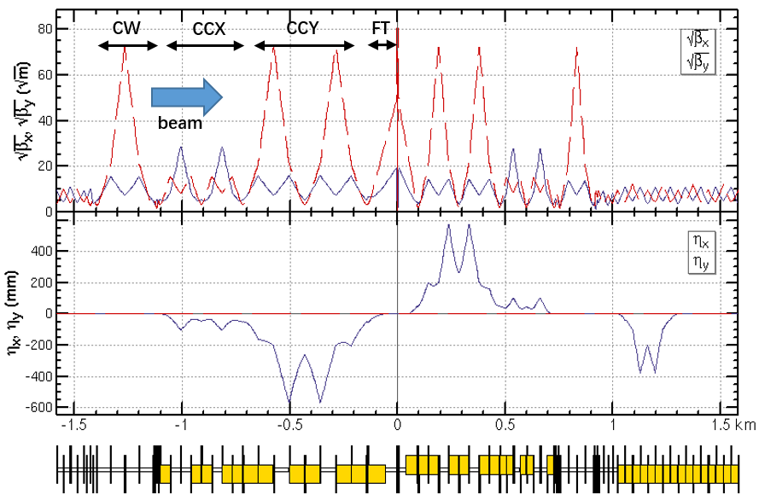
Interaction region for all modes (cont.)
Crab waist collision, local chromaticity correction, asymmetric interaction region
Quadrupole | L [m] | Distance from IP [m] | Strength [T/m]
 |  |  | $$t\overline{t}$$ | Higgs | W | Z
Q1AIRU | 1.21 | 1.9 | -141 | -141 | -94 | -110
Q1BIRU | 1.21 | 3.19 | -59 | -85 | -56 | +65
Q2IRU | 1.5 | 4.7 | -51 | +95 | +63 | 0
Q3IRU | 3 | 7.2 | +40 | 0 | 0 | +2
Q1AIRD | 1.21 | -1.9 | -142 | -142 | -95 | -110
Q1BIRD | 1.21 | -3.19 | -64 | -85 | -57 | +65
Q2IRD | 1.5 | -4.7 | -47 | +96 | +64 | 0
Q3IRD | 3 | -7.2 | +40 | 0 | 0 | +2
Strength of other modes doesn’t exceeded the one of Higgs mode.
 | QD | QF
Z | Q1A | Q1B
W/H | Q1A+Q1B | Q2
ttbar | Q1A+Q1B+Q2 | add quad Q3A and Q3B
 | L* [m] | LQ1 [m] | LQ2 [m] | GQ1 [T/m] | GQ2 [T/m] | d [m]
CDR | 2.2 | 2.0 | 1.5 | -136 | 111 | 0.3
TDR | 1.9 | 1.22/ 1.22 | 1.5 | -141/ -85 | +95 | 0.3
*ref: Y. Cai, IAS2016, HKUST; K. Oide, arXiv:1610.07170;
P. Raimondi, Proc. of the 2nd SuperB Workshop, Frascati, March 2006；M. Zobov et al, Phys. Rev. Lett. 104, 174801(2010);

Slide 22
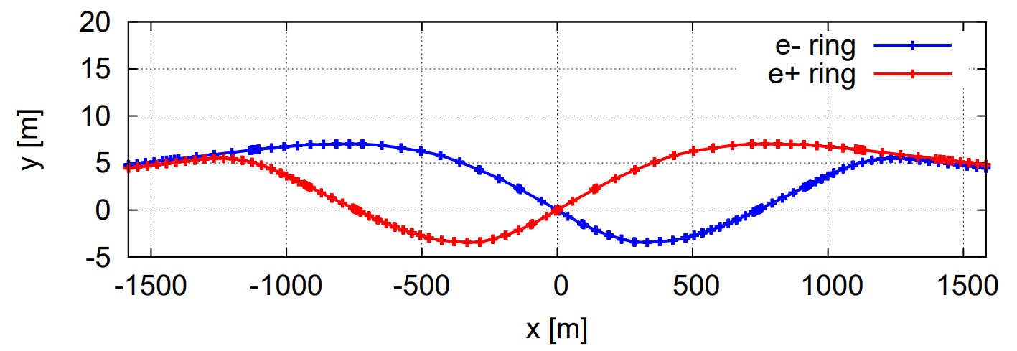
Interaction region for all modes (cont.)
Crab waist collision, local chromaticity correction, asymmetric interaction region
Up to 3rd order chromaticity is corrected with pairs of main sextupoles, phase tuning and additional sextupoles respectively.
Most of the resonance driving terms (RDT) due to sextupoles in 3rd and 4th order Lie operators are almost cancelled.
The tune shift due to the finite length of the main sextupoles is corrected with additional weak sextupoles.
*ref: Y. Cai, IAS2016, HKUST; K. Oide, arXiv:1610.07170;
P. Raimondi, Proc. of the 2nd SuperB Workshop, Frascati, March 2006；M. Zobov et al, Phys. Rev. Lett. 104, 174801(2010);

Slide 23
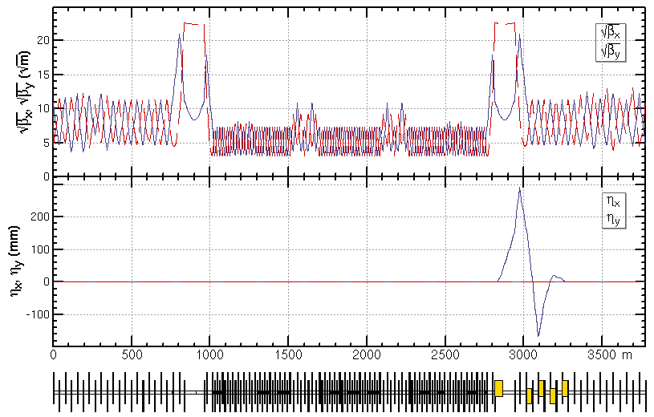
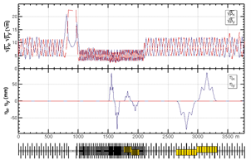
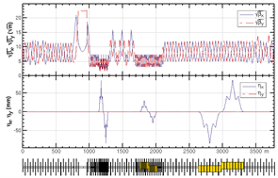
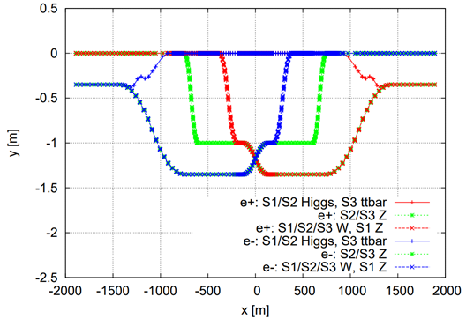
Lattice design and geometry of the RF region
An electrostatic separator combined with a dipole magnet* to avoid bending of incoming beam for the Higgs and ttbar energy running
*K. Oide et al, PRAB, vol. 19, no. 11, p. 111005
Higgs at stage 1/2
ttbar at stage 3
W at stage 1/2/3
Z at stage 1
Esep= 2.0 MV/m
Lsep= 4 m×10
Δx= 10 cm at entrance of quad
Z at stage 2/3
Details of the RF staging in Jiyuan ZHAI’s talk

Slide 24
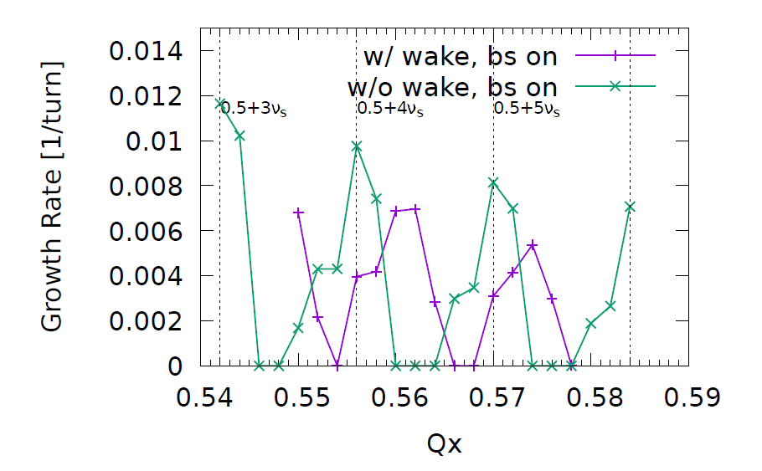
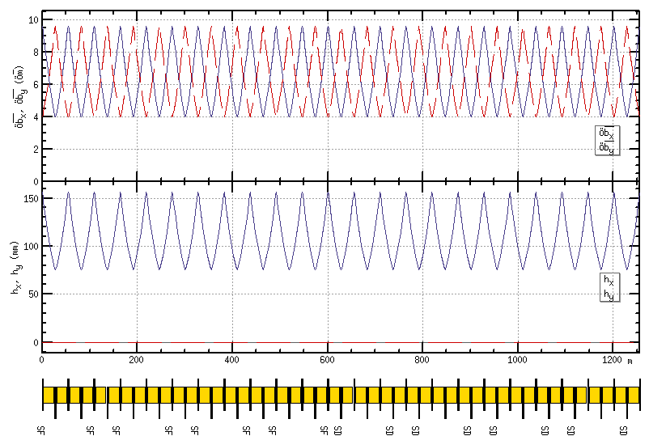
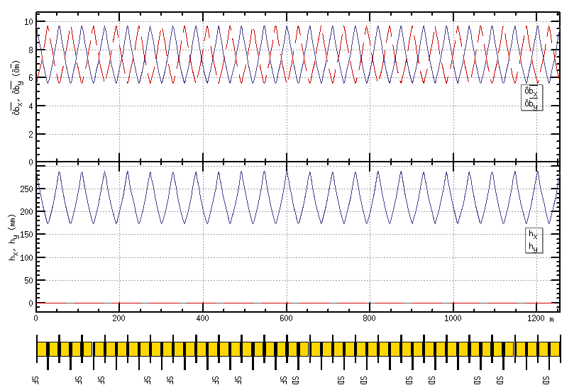
ARC region for all modes
Z and W modes need larger momentum compaction factor αp and thus larger emittance εx, Qs
To suppress the impedance induced instability at Z mode
To increase stable tune area if considering beam-beam effect and impedance consistently at W and Z modes
stable tune area with both beam-beam and impedance (Z mode 90/90)
Yuan Zhang
Phase advance reduced from 90° to 60° for W and Z modes
H/ttbar mode 90°/ 90°
W/Z mode 60°/ 60°

Slide 25
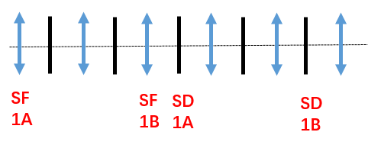
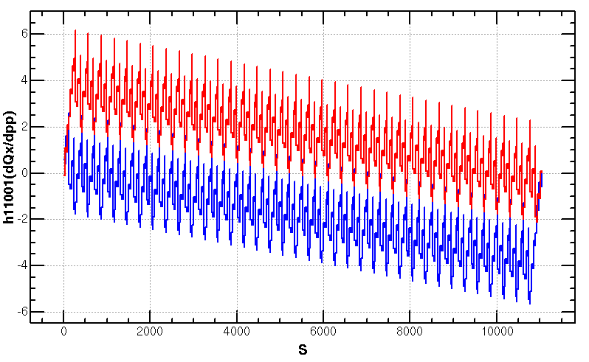
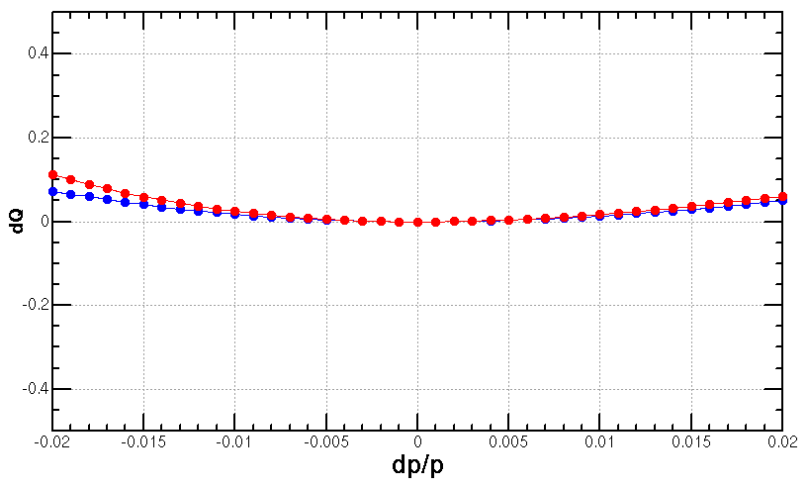
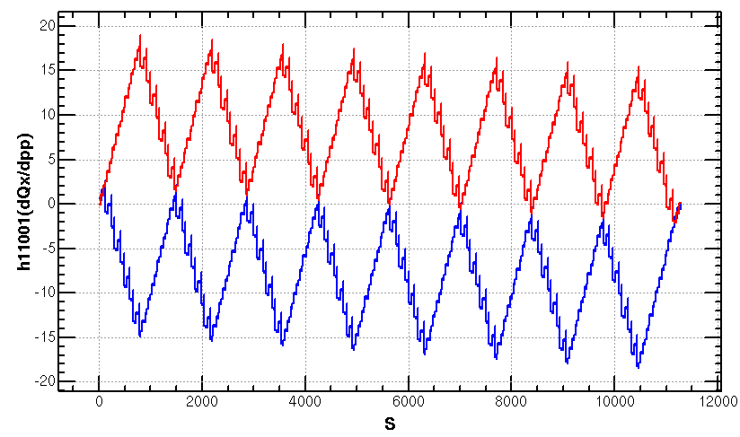
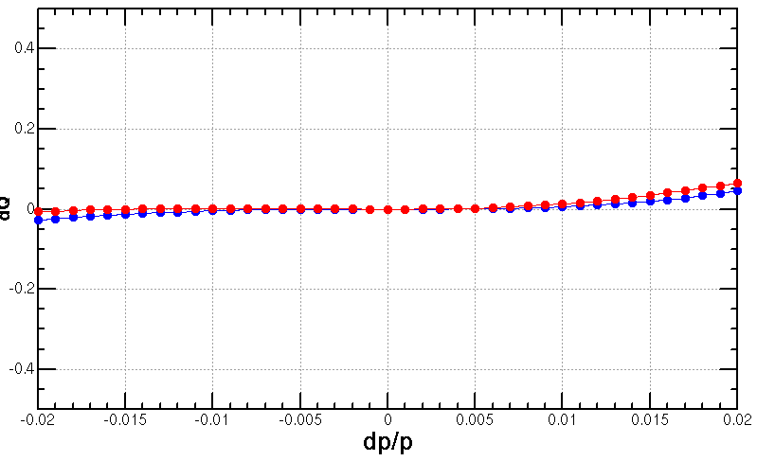
Optimization of ARC aberration for Higgs/ttbar modes
2nd order chromaticity is a main aberration for the optimization of momentum acceptance with one –I sextupole pair scheme.
In previous versions, 2nd order chromaticity generated in the ARC region are corrected with IR knobs (phase advance or K1).
However, the IR knobs will generate distortions at IP (beta, alfa and dispersion) especially for the horizontal plane.
A lattice with four –I sextupole pairs scheme for Higgs & ttbar modes
much less 2nd order chromaticity for the horizontal plane
Scheme with one –I sextupole pair
K. Oide, arXiv:1610.07170.
Q’’=313, 410
Q’’=9, 145
Scheme with four –I sextupole pairs
T. Bian, PhD thesis, 2018.

Slide 26
Optimization of ARC aberration for
W/Z modes
The distribution of sextupoles for Higgs & ttbar mode allowed to select –I sextupole pairs for W &Z mode.
6*6=36 cases for 23 cells
There are much more combinations if choose different cases in each arc section (184 cells)
SF
1A
SF
1B
SF
2A
SF
2B
SF3A
SF
3B
SF
4A
SF
4B
SD
1A
SD
1B
SD
2A
SD
2B
SD3A
SD
3B
SD
4A
SD
4B
-I
-I
-I
-I
2nd and 3rd order dQ@dp/p=1% in x, y
@ dp/p=1%
1st pair | 2nd pair
(1A, 2A) | (2B,3B) | (3A,4A) | (3B,4B)
(1B, 2B) | - | (3A,4A) | (3B,4B)
(2A, 3A) | - | - | (3B,4B)

Slide 27
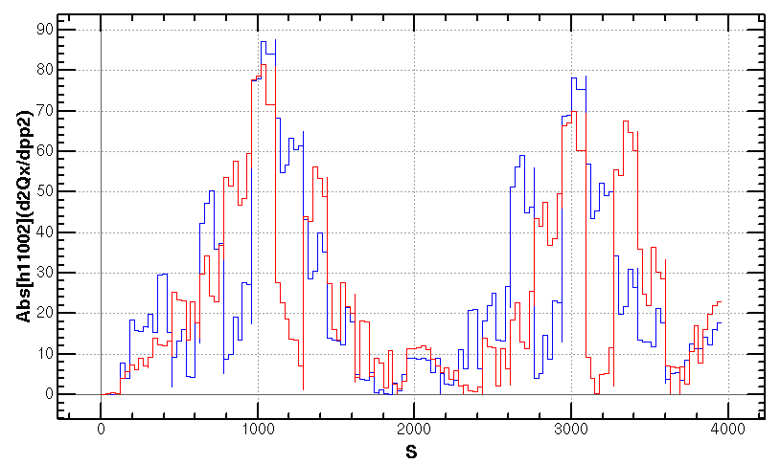
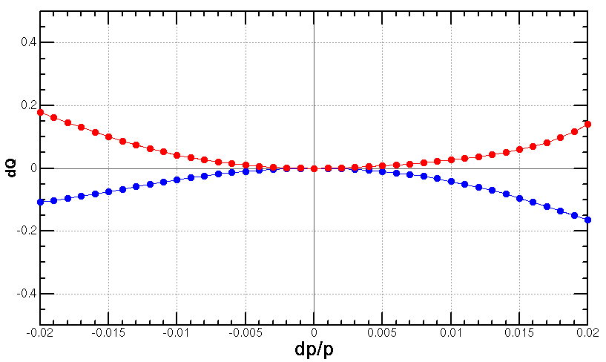
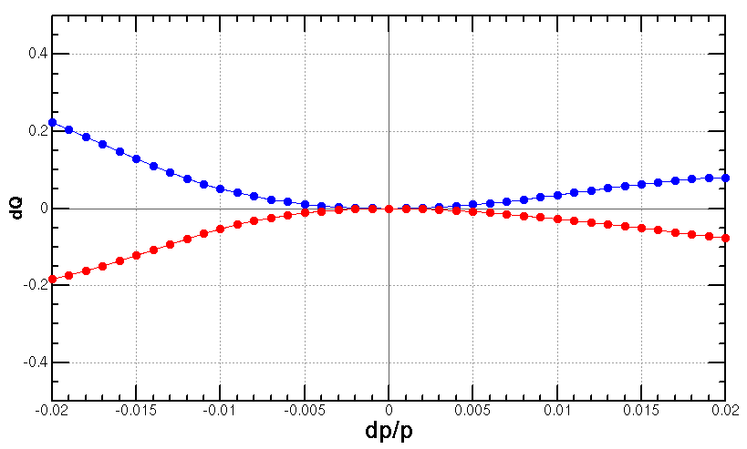
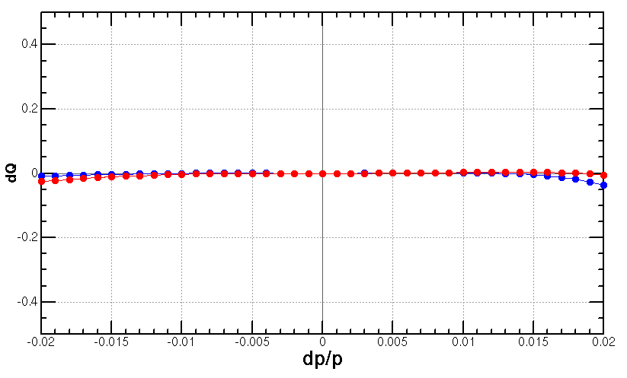
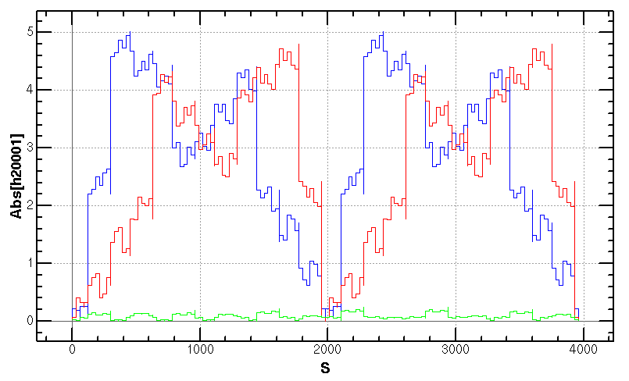
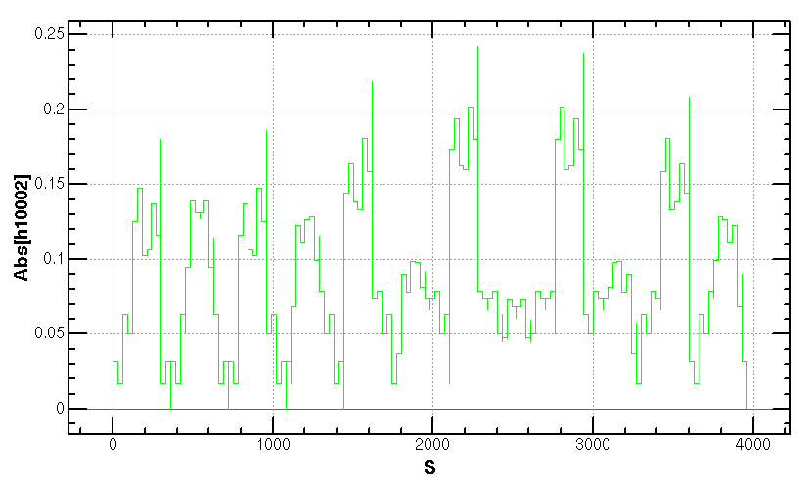
Optimization of ARC aberration for
W/Z modes (cont.)
Cancellation of main aberration has period of 23*3 cells.
case {4,3}
case {3,4}
case {4,3}+{3,4}
+

Slide 28
Vertical emittance generated by solenoid field
The detector solenoid are compensated locally with anti-solenoids
3T for $t\overline{t}$/Higgs/W, 2T for the Z
cancel the ∫Bzdz between the IP and the faces of the final quadrupole
exists a transverse fringe field esp. at the fringe of anti-solenoid
The vertical emittance increases due to the fringe field of the anti-solenoid combined with the horizontal crossing angle.
For the $t\overline{t}$ and Higgs, εy=0.05pm and 0.7 pm.
For the W and Z, the εy will be reduced with softer a bit longer anti-solenoid and keep cancelling of the ∫Bzdz between the IP and the faces of the final quadrupole (or replacing the cryo-module when running at the high luminosity Z).
Optics with solenoid field at Higgs
Composed field
Detector solenoid field
Anti-solenoid field

Slide 29
Correction scheme for magnets errors
by Bin WANG, Yuanyuan WEI, Yiwei WANG
Correction procedures
The closed orbit distortion (COD) correction with sextupoles off
Turn on the sextupoles and perform COD correction again.
Dispersion correction
Beta beating correction
Coupling and vertical dispersion correction
Uniform settings (corrector settings, BPM selection, iteration times, steps and so on) of the batched correction are optimized for all the lattice seeds.
Individual further correction (additional iteration and adjustment of the corrector settings according to correction result) are performed for those un-converged seeds.

Slide 30
Result of Higgs lattice functions
The strength of skew quadrupoles for a lattice seed.
${∆D}_{x,rms}$ decreased from 23.1 mm to 1.8 mm
${∆D}_{y,rms}$ decreased from 31.9 mm to 0.9 mm
${∆β/β}_{x,rms}$ decreased from 5.2% to 1.0%
${∆β/β}_{y,rms}$ decreased from 83.2% to 2.8%

Slide 31
Result of Z lattice functions
${∆D}_{x,rms}$ decreased from 23.1 mm to 1.8 mm
${∆D}_{y,rms}$ decreased from 31.9 mm to 0.9 mm
${∆β/β}_{x,rms}$ decreased from 5.2% to 1.0%
${∆β/β}_{y,rms}$ decreased from 83.2% to 2.8%

Slide 32
W
1.2 %
1.2 %
W with sol
1.2 %
1.2 %

