Slide 1
Radiation Resistance Test for TaiChu3
23.5.1 Yiming Hu

Slide 2
Motivation for Radiation Resistance test
Non-Ionization Energy Loss(NIEL) will leads to electronic device and chip’s forever damage. The continuous operation of the chip in a high dose irradiation environment will lead to its working performance gradually degradation and even damage.
During CEPC’s lifetime, basically, the ITK will been irradiated in high-energy, high-luminance environment for 5-10 years, and it is hard to update or replace it .
Radiation resistance test should be done to confirm whether our chips can perform well
after designed NIEL dose level.

Slide 3
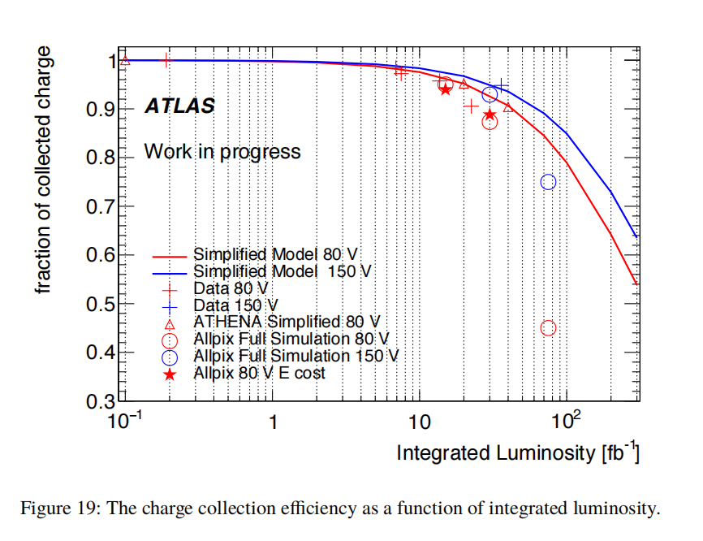
Previous Research
simulation and tests have been down on similar design-purpose chips before
In ATLAS ITK simulation, Charge Collection efficiency drops when integrated Luminosity increases.
1. Aaboud, Morad et al. “Modelling radiation damage to pixel sensors in the ATLAS detector.” Journal of Instrumentation 14 (2017): P06012 - P06012.

Slide 4
ToT drop

Slide 5
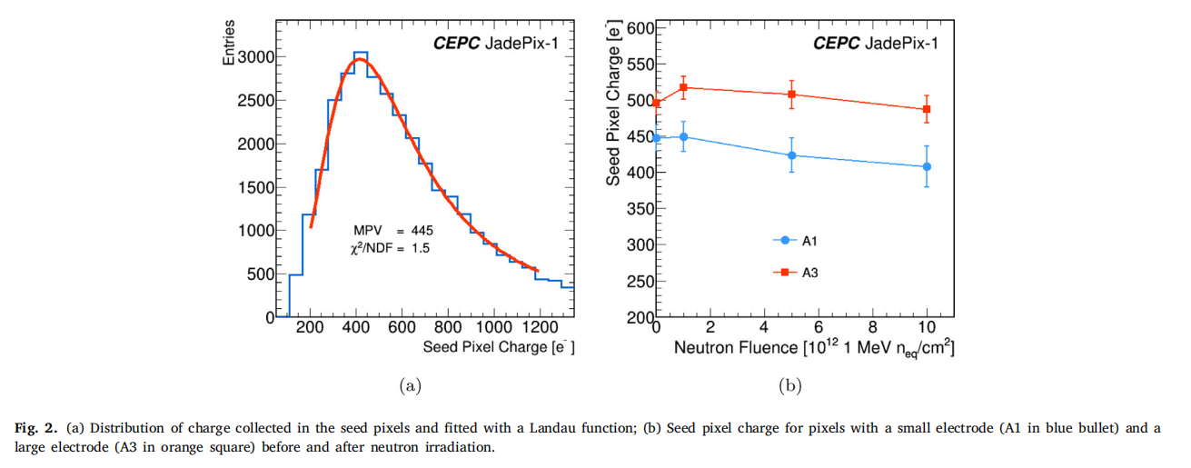
Real Tests
In used CEPC ITK JadePix-1, several features were tested after irradiation
2.Nuclear Inst. and Methods in Physics Research, A 977 (2020) 164267
Notes:
Presents a downward trend

Slide 6
Cluster size

Slide 7
Resolution

Slide 8
Efficiency
*No detection of efficiency drop was observed even up to the highest fluence level. This
might be explained by the rather low seed pixel charge threshold to register a hit.

Slide 9
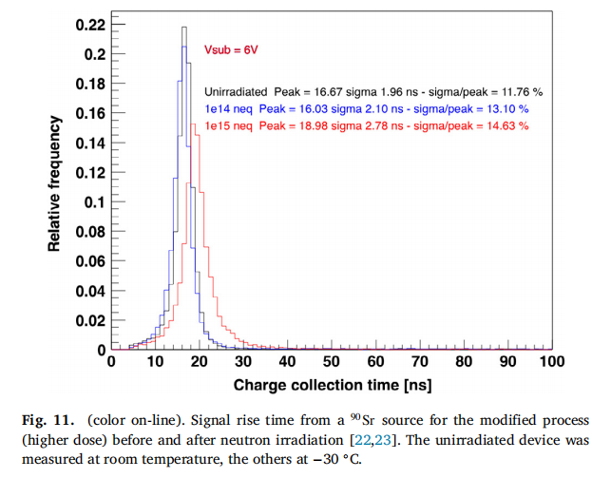
More can be tested
In ALICE’s tests, they also tested the Signal distribution and Charge collection time, which is more directly impacted by NIEL.
3.Nuclear Inst. and Methods in Physics Research, A 871 (2017) 90–96

Slide 10
Details of test process
Before beam test:
1. choice of chip test scheme
2. note for necessary information
Details of setting up platform
1.select and arrange suitable radiation time
2.install chips to proper location on the test platform
Details after beam test
1. check the radiation dose flux and rate
2. prepare for performance tests

Slide 11
Choice of chip test scheme
Scheme 1：Without wire bonding
Advantage ：Don’t need test board，less preparation and waiting time
Disadvantage：Unable to compare the performance of each chip before & after testing
Scheme 2：Wire bonding
Advantage ：Comparation of beginning and end status of each chip
Disadvantage：Need several test PCB boards, which contain Copper, leads to more waiting time
Using Scheme 1 this time to find the appropriate radiation resistance, which is slightly greater than the impact of expected dose flux

Slide 12
Note for necessary information
Beam Energy $E(MeV)$, beam rate $φ(s^{−1}∙{cm}^{−2})$
use E can get the $1MeV Si n_{eq}$ equivalence factor $k$： https://rd50.web.cern.ch/NIEL/protons.xls
$φ$ is determined by beam spot size ${S(cm}^{2})$, which isn’t simply linear
*$φ$ can’t be real-time monitoring，but it’s $about {10}^{9}s^{−1}∙{cm}^{−2}$，take lower&upper limit as 1~5*${10}^{9}s^{−1}∙{cm}^{−2}$
Equivalence irradiance rate：$φ’(S)=φ(S)∙k(E), [φ’(S)]=1MeV Si n_{eq}/(s∙{cm}^{2})$
80MeV Proton’s k is about 1.379

Slide 13
Plan and arrange suitable radiation time
We need adjust length of test time to let each chip get its radiation dose $N_{i}$
Time for each chip irradiation : $Δt=\frac{Ni}{φ’(S)}=\frac{N_{i}}{φ(S)∙k(E)}$(s)
2022 CEPC-CDR reported that the total irradiation dose is $7.07×{10}^{13}n_{eq}∙{cm}^{−2}$：https://doi.org/10.1007/s41605-022-00320-w
Upper limit of irradiation dose of this test: 7.$5×{10}^{13}n_{eq}∙{cm}^{−2}$

Slide 14
Irradiation dose and time
 | 1 | 2 | 3 | 4
$N_{i}$ Intergral dose（$1MeV Si n_{eq}/{cm}^{2}$） | $$1{∗10}^{12}$$ | $$5{∗10}^{12}$$ | $$1{∗10}^{13}$$ | $$7.5{∗10}^{13}$$
$Δt$ time(s) （lower~upper limit） | 206~726 | 1025~3625 | 2060~7260 | 15380~54387
`$Δt=\frac{Ni}{n}=\frac{N_{i}}{φ(S)∙k(E)}$(s)
S:Spot size${(cm}^{2})$, E:beam energy(MeV)
$φ:$beam flu$x(s^{−1}∙{cm}^{−2})$ $1\sim 5{×10}^{9}$
$k(E)$:equvialance factor 1.379 for 80 MeV proton
$N_{i}:$intergral dose
*The time is given for reference, we need to calculate it again according to site situation. And check
for the real dose after irradiation.

Slide 15
Install chips to right place
2.57cm*1.53cm Chips will be installed in 4.5cm*4.5cm box：
The chip box is opaque, so it needs marking the chipID & inner
position on its surface
Irradiate by order, move the platform away after the last chip
finishes irradiation
1
2
4
3
Notes:
1. 芯片盒和胶带都是特制的，不用担心在辐照照射下会变性脱落
2. 由于芯片盒是不透明的，并且不是完全和芯片一个尺寸，所以要在安装后标记出内部芯片位置以及标号
3. 固定时多黏贴几层，以防掉落

Slide 16
Details of Installation
To ensure other chips won’t be effected by testing chip,
the gap between each chip should be much more than the spot size,
determined to be 50cm temporarily.
1
2
50cm
50cm
4
3

Slide 17
Ensure the installation position
Using laszer to confirm the install position
After installation, moving test should be done
to ensure the spot can cover the chip
50cm
50cm

Slide 18
Check the radiation dose flux and rate
Using the Activation foil technique to check the dose flux and rate
then calculate the truely irradiation dose flux of each chip

Slide 19
Activation foil technique
The Al foil is activated via 27Al(p,x)——>22Na reaction. The physical half life of 22Na is 2.602 year and the spectrum will show a gamma-ray at 1274.5 keV.
$$\frac{N\left(t\right)}{ε}=N_{x,Al}∗σ_{27Al\left(p,x\right)22Na}∗φ_{proton}∗S_{IRR}∗\left(1−e^{−λ∗t_{IRR}}\right)∗e^{−λ∗t_{WAIT}}$$
Where:
$t_{IRR}$, $t_{WAIT}$: irradiation time and the time elapsed from the end of the irradiation until the foil is counted in the detector.
$ε$: the detector efficiency for detecting gamma-ray. $3.05×{10}^{−3}$
$N\left(t\right)$: the detector count rate at time t. which can be considered as our average Irradiation rate.
$N_{x,Al}$: surface atomic density of Al foil (cm^-2). $8.304×{10}^{−23}/cm^2$
$σ_{27Al\left(p,x\right)22Na}$: cross section fo 27Al(p,x)22Na. $20.4±0.9 mb$.
$S_{IRR}$: cross sectional area of the proton beam on the activation foil.
$λ$: decay constant of 22Na.$8.44×{10}^{9}/s$

Slide 20
Preparation for performance tests
Wait for the residual radiation to drop below the safe rate. In this experiment, we don’t need to wait for a long time to get the tested chips back.
Prepare the several PCB boards and send them to factory for the chips wire bonding
Test several performance mentioned before, like the seed charge distribution, the cluster-size, efficiency, special resolution and so on.
Finally, we will write a testing report for the project review and conclusion.

