Slide 1






国家重点研发计划
R&D and Verification of Key Technologies for a High Energy Circular Electron-Positron Collider
Zhijun Liang for CEPC MOST2 vertex detector team

Slide 2
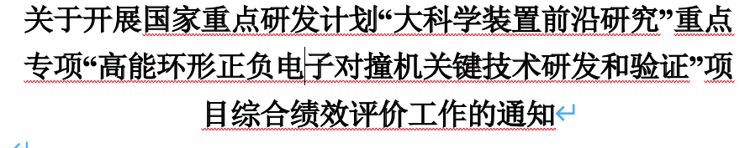
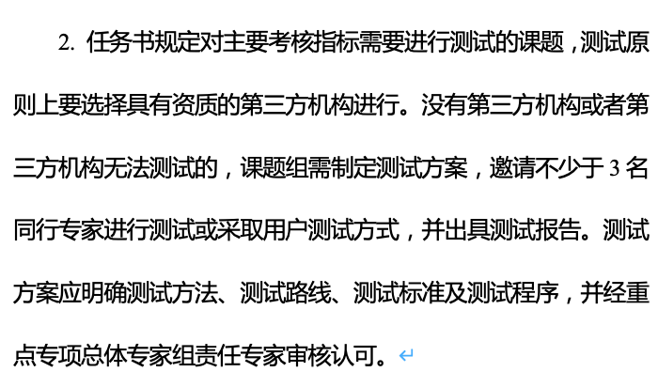
News on MOST2 project
Project timescale （执行期）： up to April 30th ,2023
June 20 –July 21: submission of final reports and review report into MOST2 system
  Reviews on silicon task 2 and reviews on MOST2 project are likely take place in May/June
  Final reports needs to be ready
  Reviews on key parameter (考核指标）
Oct 2023：
  MOST project review and defend

Slide 3
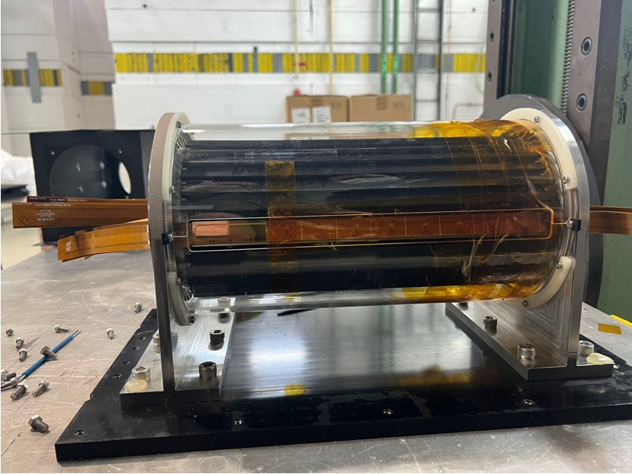
Testing Plan towards MOST project review
Build and test 1~2 full Ladders with 10 Taichu chips (before October)
  Laser or beta tests should be enough
  Mount them on the vertex detector prototype
TID tests using X ray machine
  In-situ tests of radiation
  Shielding
Proton irradiation in CSNS (End of may )
  Single chip radiation
  Wire bonding after irradiation

Slide 4
Publication plan
Taichu2 Laser test (NIMA): submitted
DESY Test beam 1st paper: submission date: submitted
Paper about vertex prototype testbeam : before June
Electronics for ladder and prototype (JINST): (should published before Sep 30th )
Paper about the prototype assembly : (should published before Sep )
Paper of TaichuPix3: (should published before Sep 30th ) 30th
Document about irradiation hardness: Middle of May
Final report (结题科技报告）

Slide 5
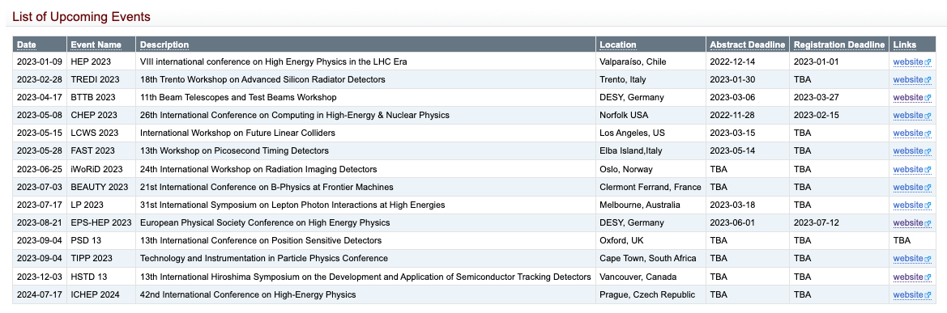
Conference
https://twiki.cern.ch/twiki/bin/view/CLIC/UpcomingConferences

