Slide 1
Design, Construction and Operation of the BESIII Detector
Yifang Wang
Institute of High Energy Physics

Slide 2
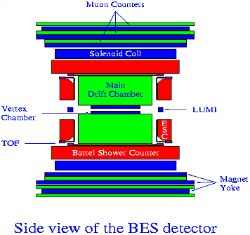
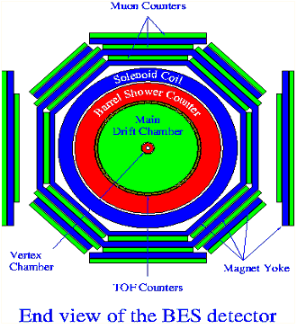
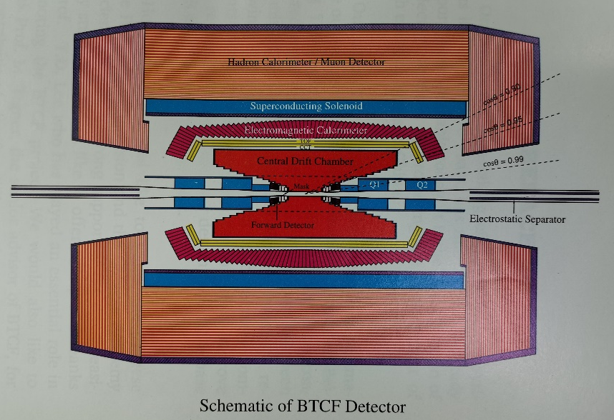
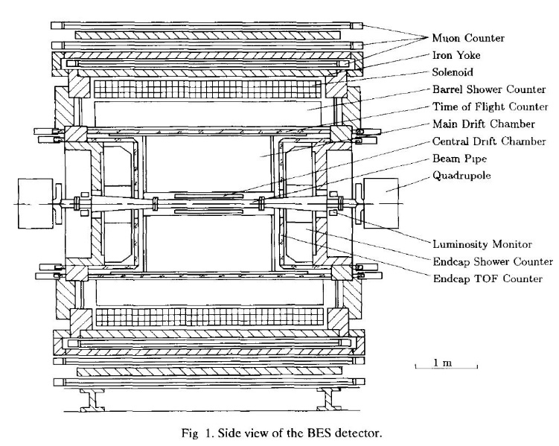
Origin of the BESIII
From BES, BESII and Tau-Charm factory
Experience from Babar, BELLE, CLEO/CLEO_c, KLOE etc.
Efforts by several generations of physicists
Goal: Much smaller systematic uncertainties(full coverage, good resolution, etc) and much higher data rate （~3 kHz @ J/ψ)

Slide 3
Design Evolution of BESIII
For cost considerations:
Original baseline design: A scintillating fiber (KLOE type) EM calorimeter with existing BESII magnet ➔
Superconducting magnet was an option if there are international contributions
A new possibility: L3 BGO crystals refurbished as the EM calorimeter ➔
CsI(Tl) crystals 24 cm long ➔ 28 cm long
Once we experienced a luxury life, we cannot go back: CsI(Tl) (28 cm) + Superconducting magnet by cost saving + budget increase

Slide 4
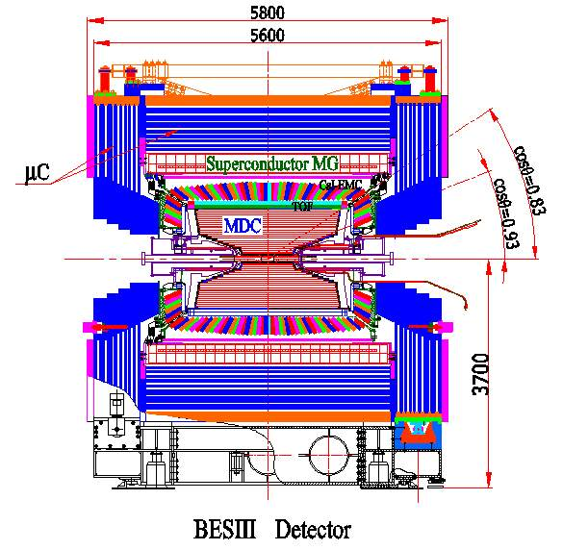
Main Mitigation Measures
The process was non-linear, with many iterations. A simplified summary:
Reduced the CsI(Tl) cost from 2.5$/cc to <1.8$/cc, at the support of SIC, thanks to Prof. Dongsheng Yan(严东生) and Prof. Renyuan Zhu ( ~5M$)
A hard decision to build the superconducting solenoid magnet by ourselves (cost ÷ 3, ~6M$)
Removed the scintillating fiber vertex detector (originally for trigger)
Reduced the budget for trigger and electronics (~1M$)
Budget increase of ~ 4M$
Design was started in ~1999 and finalized at ~2004

Slide 5
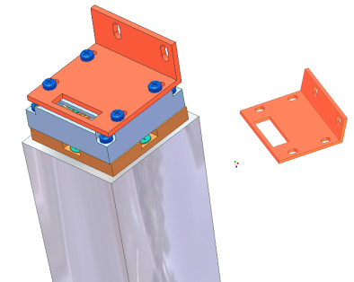
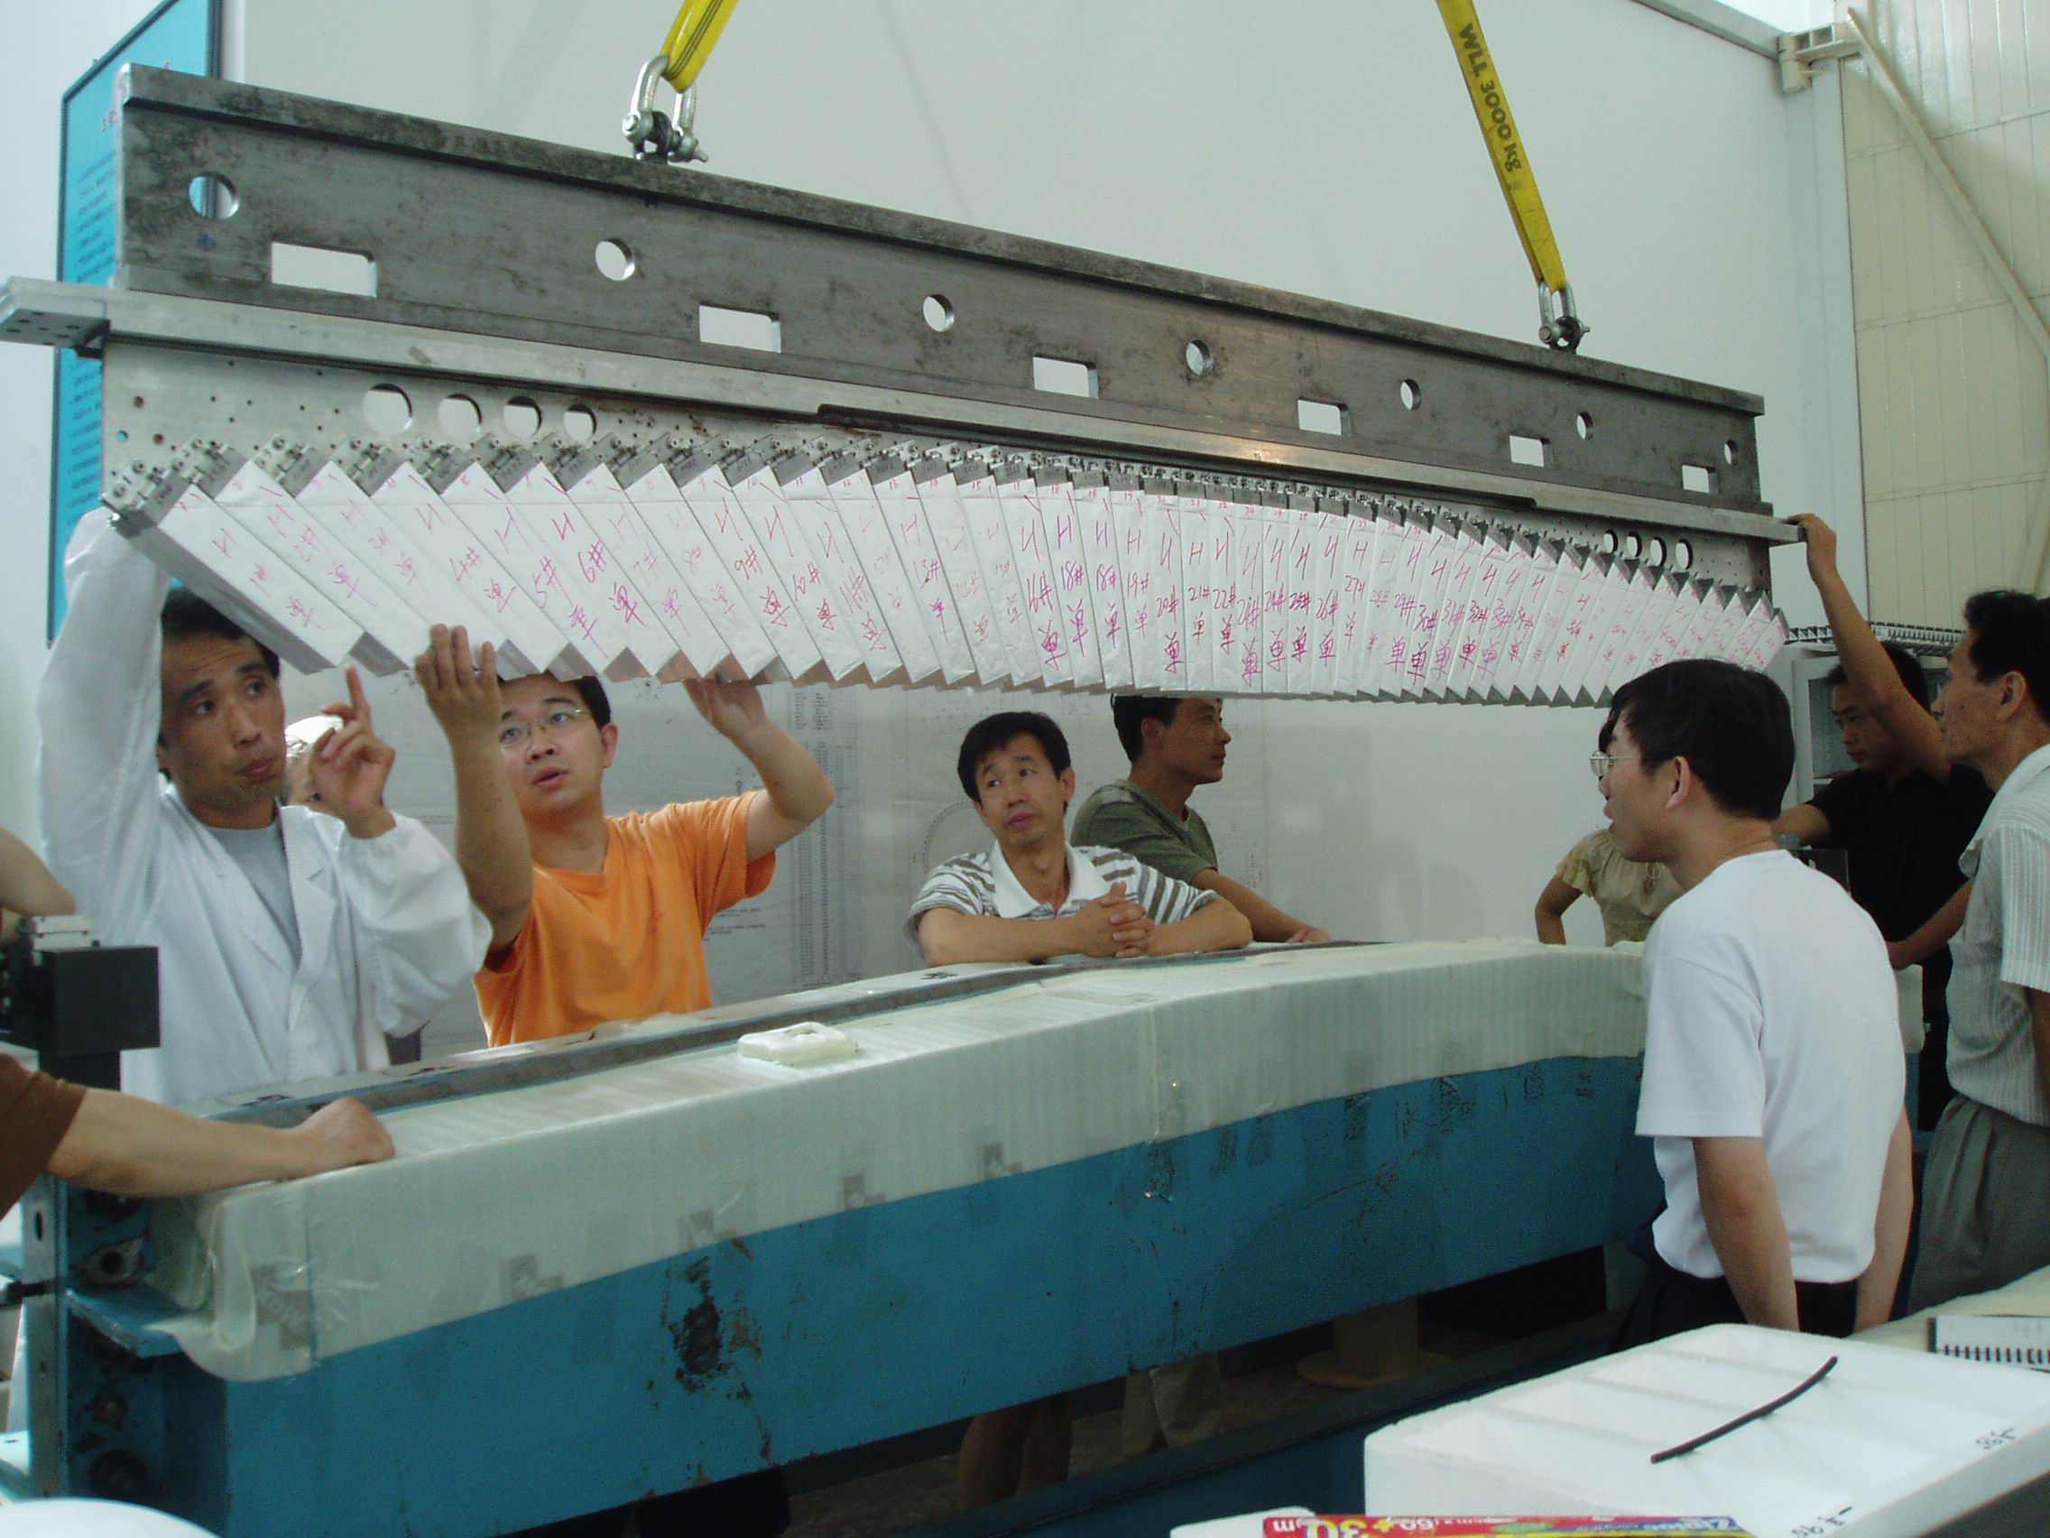
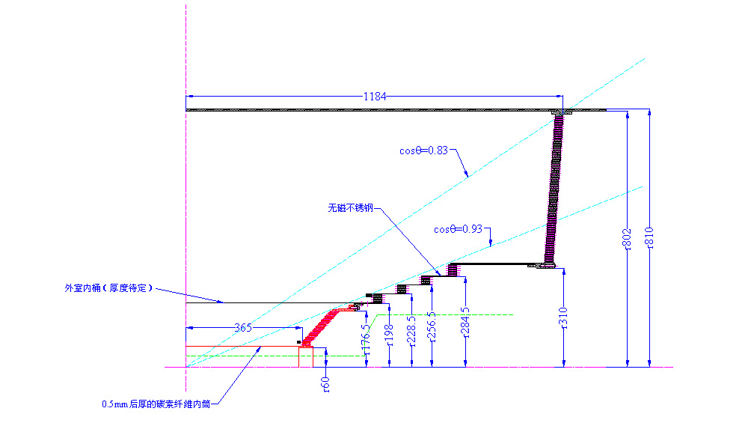
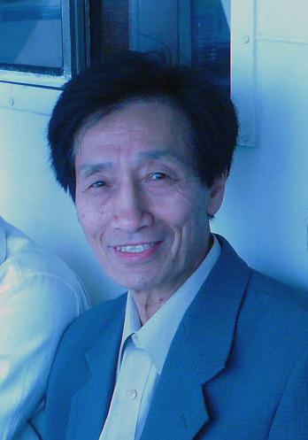
Major Design Issues
Overall mechanics design by Prof. Xuan Liu (and Shaowang Xu)
Superconducting magnet design helped by KEK
Innovative design of the supporting structure for the CsI(Tl) Crystal calorimeter by Prof. Lingshu Wang: using screws instead of honeycomb structure to hold crystals: much cheaper(>1M$) and much less dead materials between crystals
MDC: no outer wall for inner chamber and no inner wall for outer chamber to reduce materials: Two chambers are glued together at the end plates

Slide 6
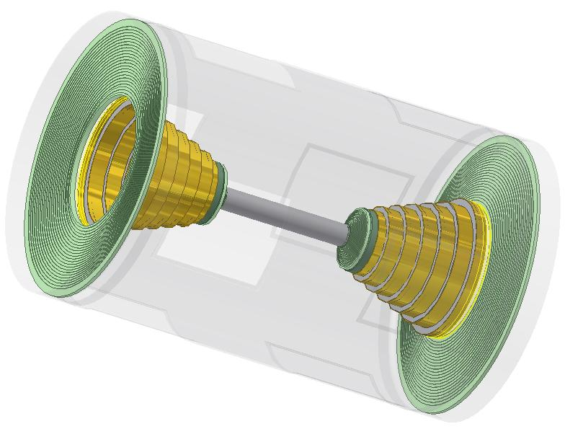
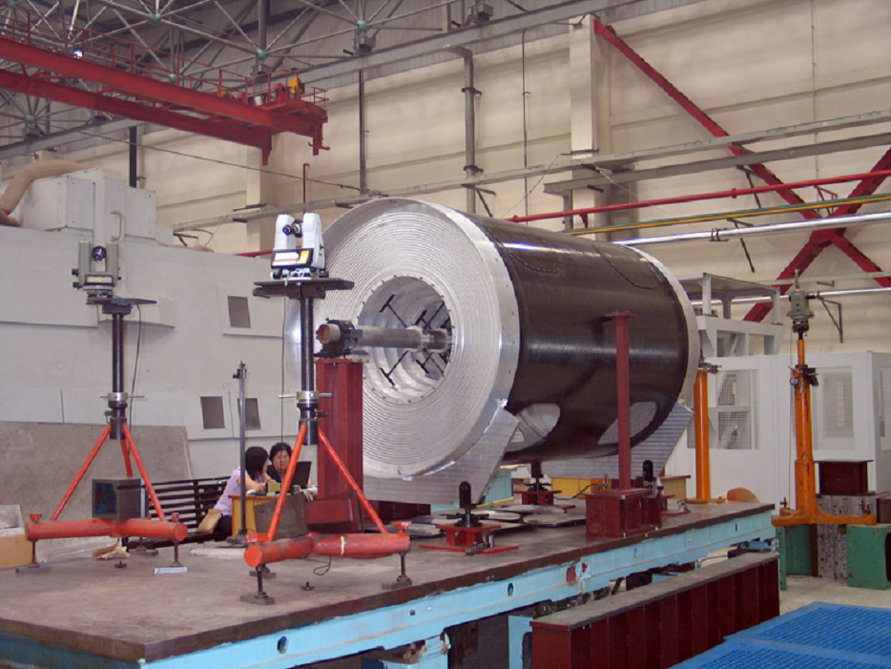
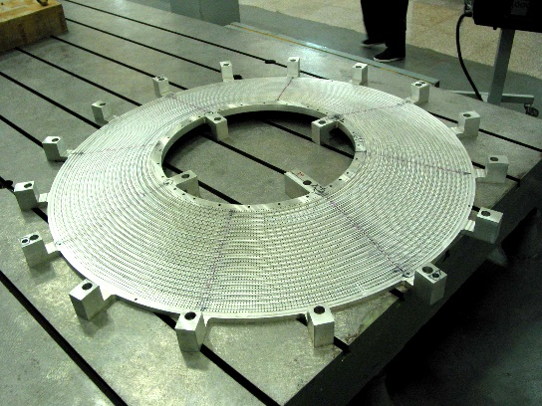
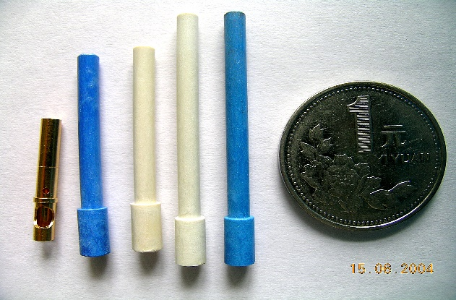
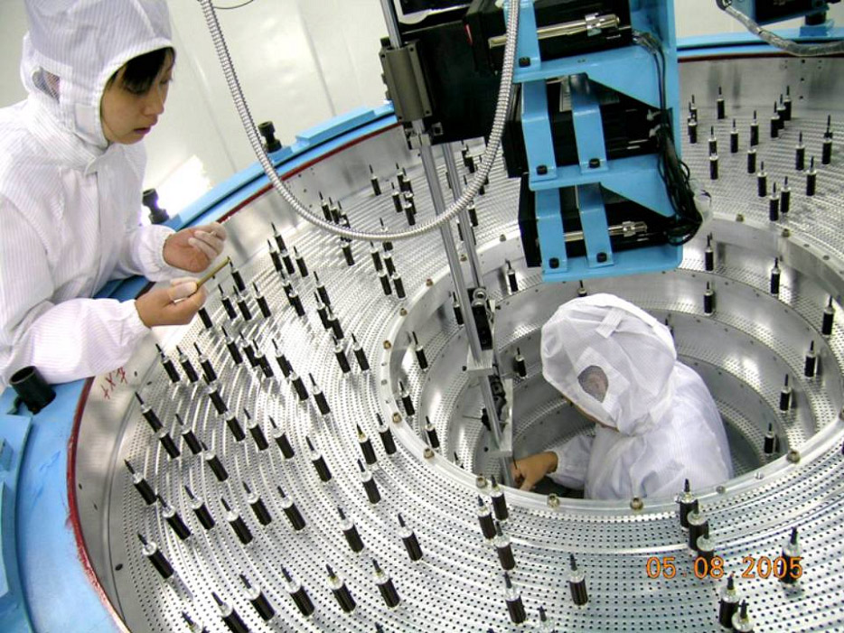
Construction: Main Drift Chamber
Led by Prof. Yuanbo Chen, electronics by Prof. Huayi Sheng
Main R&D:
  Materials: wire(tension, creeping, …), glue(aging, radiation hardness), feedthrough(precision, HV resistance), …
  Prototyping & test beam
Manufacturing:
  Precision of end-plates: failed twice and wondering around for a year
  Feedthrough: precision, contract dispute, …
  Wiring, carbon fiber cylinders, precision of assembly, gas tightness, …

Slide 7
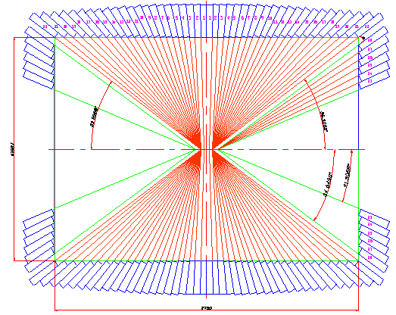
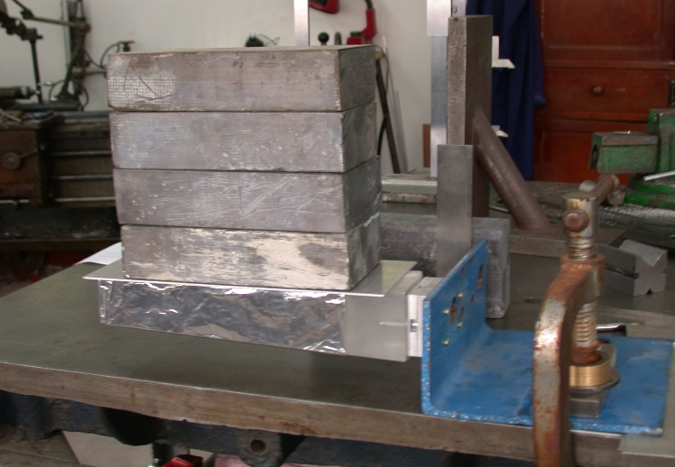
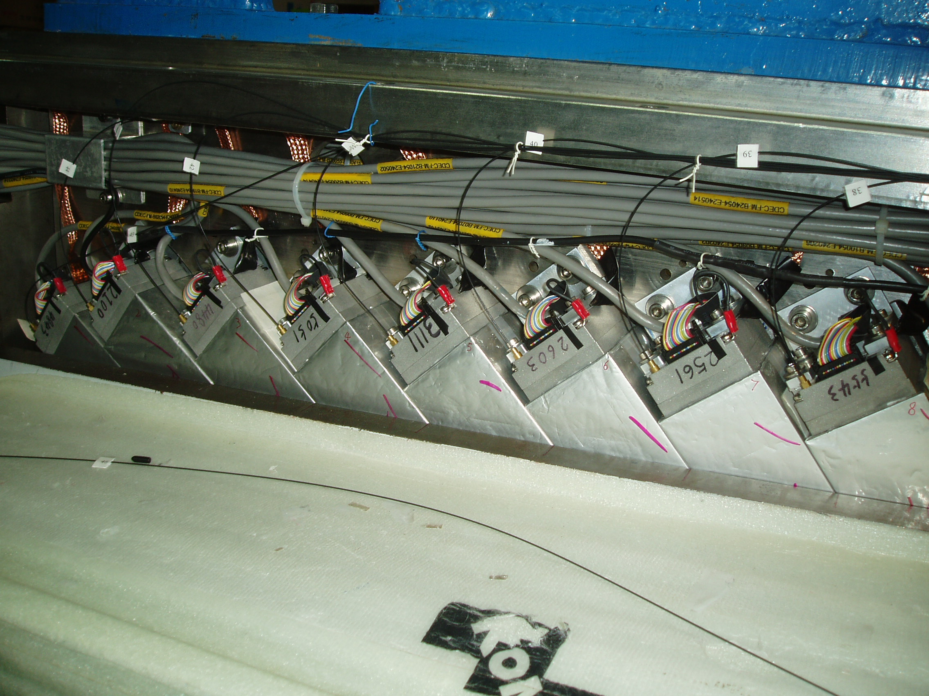
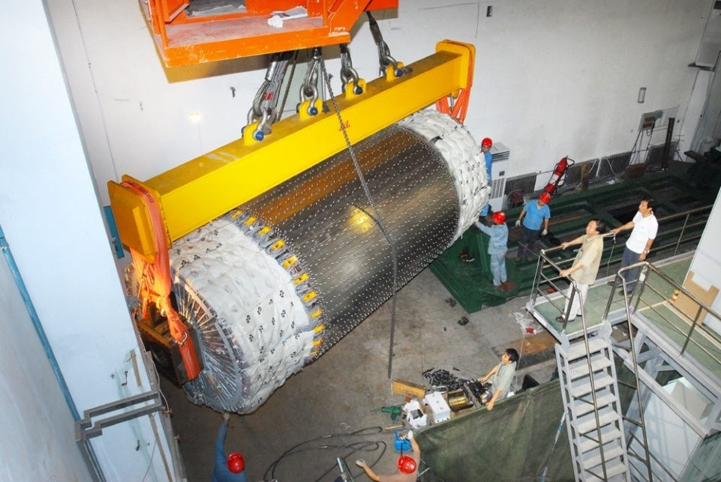
Construction: CsI(Tl) Crystal Calorimeter
Led by Prof. Junguang Lu, electronics by Prof. Peiliang Wang
R&D: light yield, uniformity, wrapping, PD, test beam,…
CsI(Tl) crystals produced from SIC, Hamamatsu and Saint-Gobain in order to control the risk, cost and quality
Low noise electronics: 1000 e equivalent ~ 220 keV

Slide 8
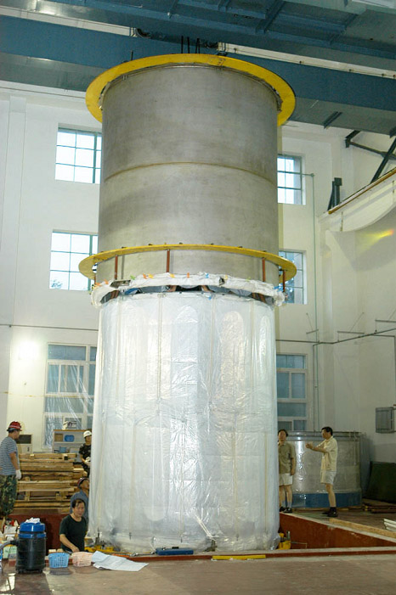
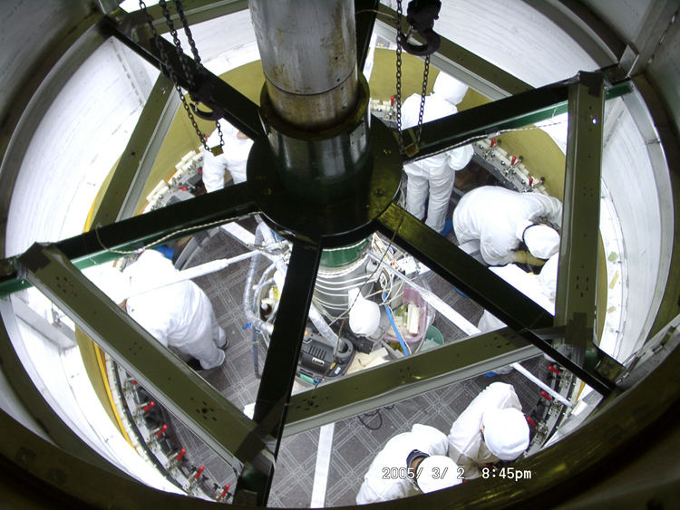
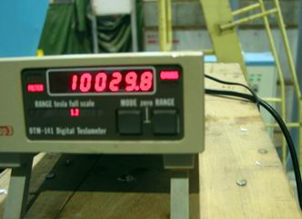
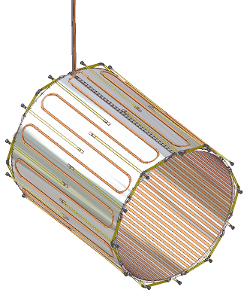
Superconducting Magnet
Led by Prof. ZiAn Zhu, in collaboration with WANG NMR INC.
Issues: structure, cable winding, assembly, valve box…
Huge risk: not possible to test before the final curing
  too late if we know it is not good
After 3 times of quenching, the magnet reached 1T
Field mapping: Δr < 0.5 mm, ΔB < 0.1%
1T magnet @3364A

Slide 9
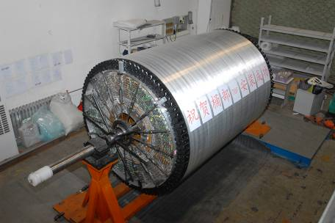
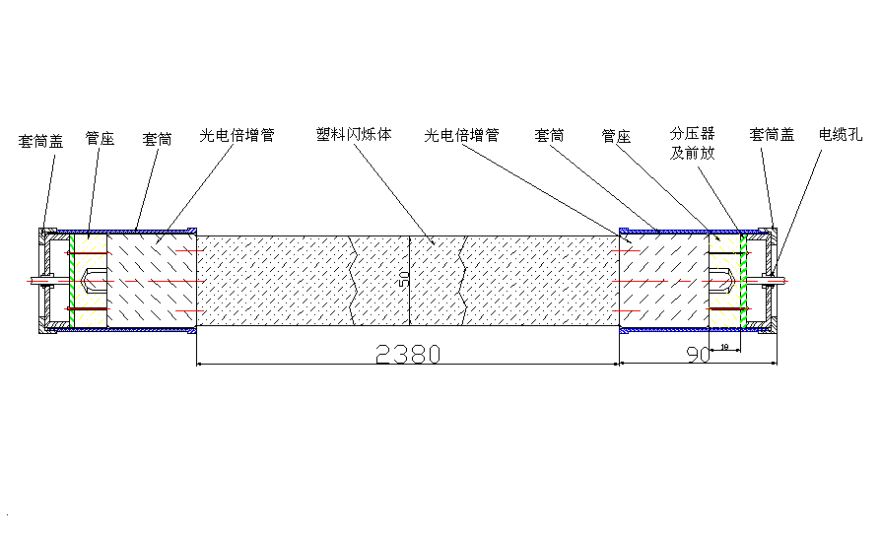
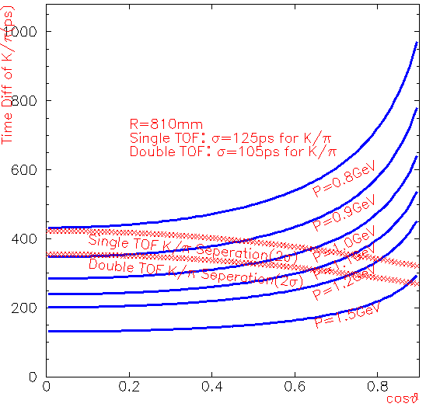
Construction: Time-Of-Flight
Led by Prof. Yuekun Heng, electronics by Prof. Qi An(USTC)
Careful choices of the Plastic scintillator and PMTs
R&D: radiation hardness, wrapping, optical coupling, effects of magnetic field, test beam, …

Slide 10
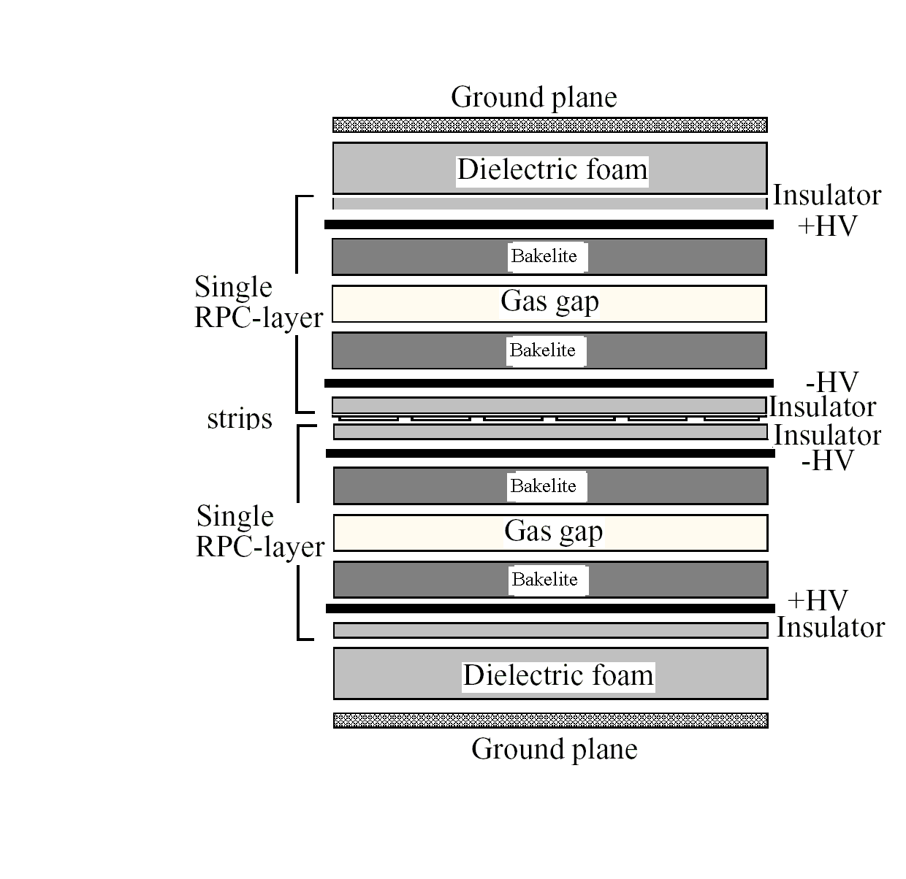
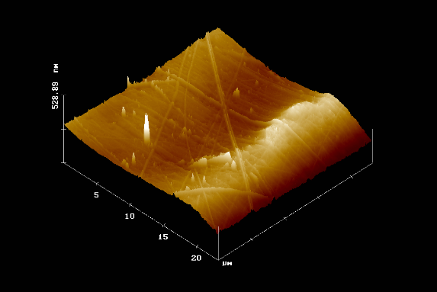
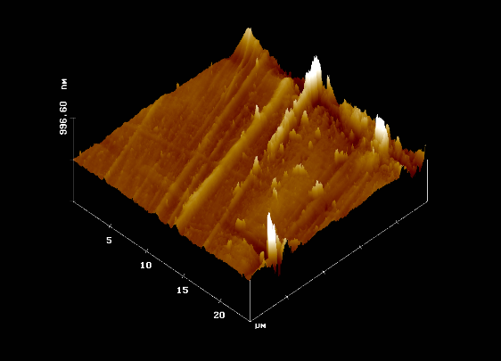
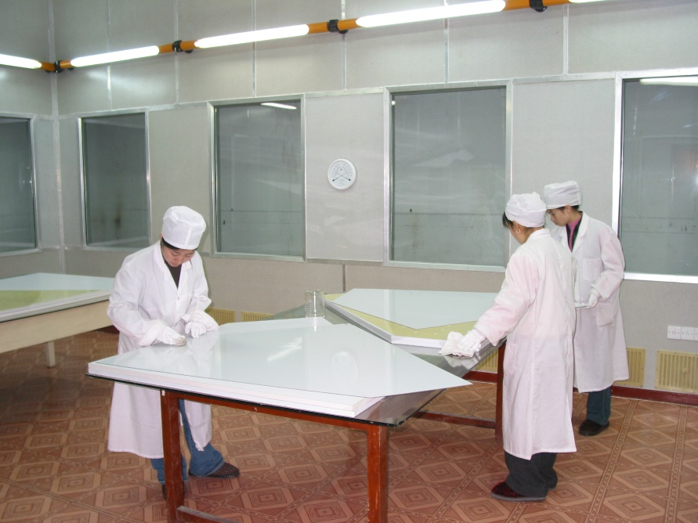
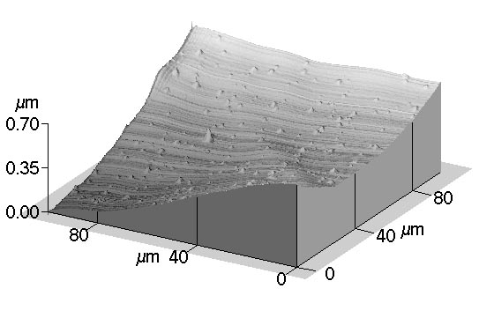
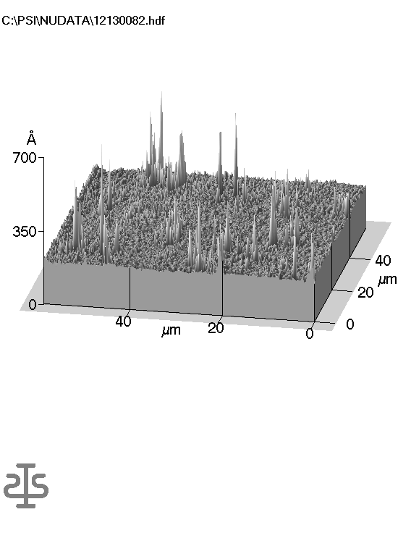
Construction: RPC muon chamber
Led by Prof. Jiawen Zhang, electronics by Prof. Yongzhao Zhou（USTC）
Invented a new type RPC made of Bakelite with a melamine surface. No linseed oil to avoid aging problem
Noise less than 0.1 Hz/cm²
RPC surface seen by the atomic force microscope
IHEP
Babar w/o oil
Babar w/ oil
Belle glass
C. Lu, Princeton University

Slide 11
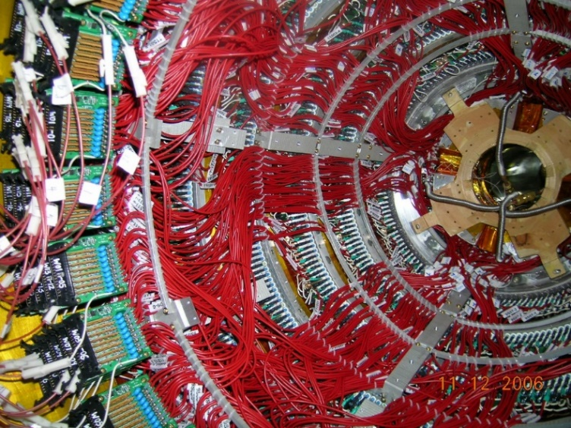
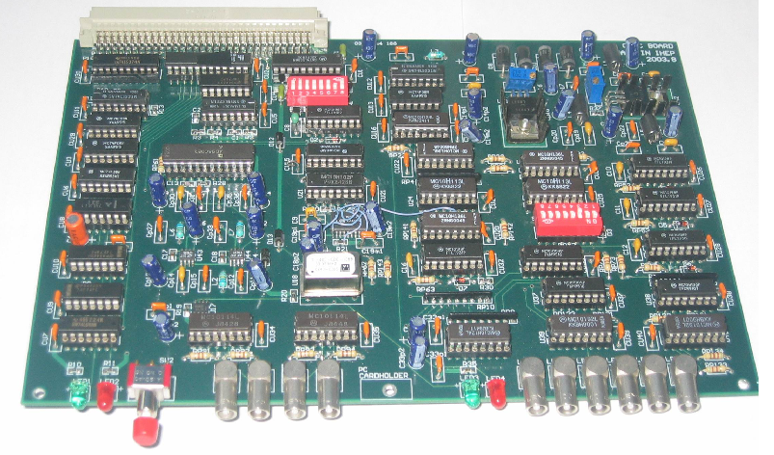
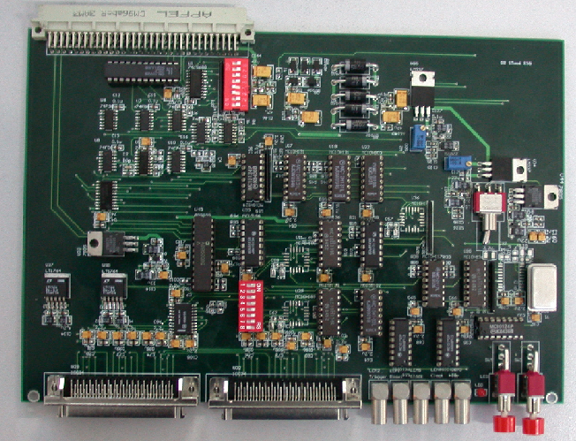
Electronics, Slow Control and Grounding
IHEP
Drift chamber：6500ch，σ_{t} ~ 500ps, σ_{q} ~ 5 fc, 10bit ADC
calorimeter: 6300ch, σ_{q} ~ 0.5fc, 3×10bit ADC, noise < 1000ENC
TOF：500ch，σ_{t} ~ 20 ps, 10bit ADC
RPC：10000ch, bit map
No major failures up to now, nor any need to major upgrade
Cleaning grounding was carefully designed to be isolated from dirty ground but:
  Ground of BESIII and BEPCII were connected by the cryogenic pipe for BESIII SC magnet
  RF signals may still couple to MDC from time to time
USTC

Slide 12
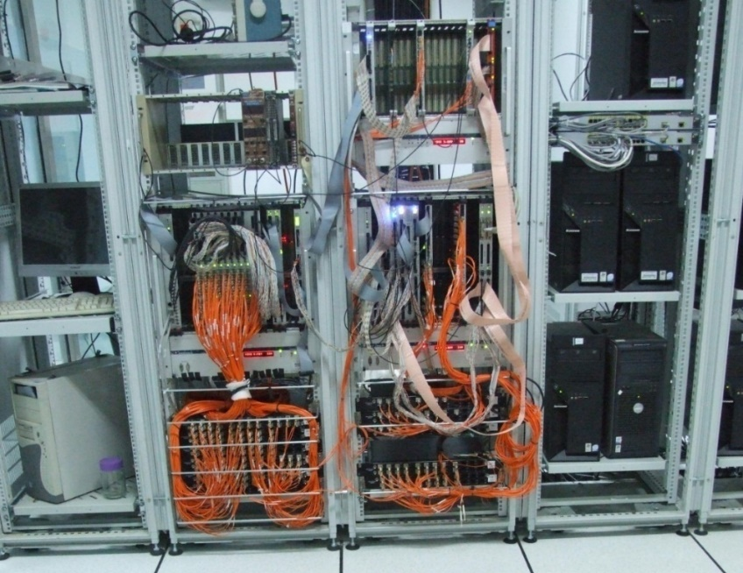
Trigger System
Scaler
fiber
Crate connection
Trigger controller
backplane
Trigger condition
CLK input
scaler
Self-defined
bus
Scaler signal
Crate CLK
6UVME
To fiber
NIM crate
Fan out
RD
TCL
BUS
CLK
Trigger condition processor
Trigger table
Main trigger controller
TDC
A compact system with：
4× 9UVME
1×6UVME
1×NIM
Based on RocketIO, FPGA and optical fiber technologies (late used for BELLE II and Panda)
RD
TCL
BUS
logic
MDC
RD
TCL
BUS
RD
TCL
BUS
RD
TCL
BUS
MDC
EMC
TOF
9UVME
From front electronics

Slide 13
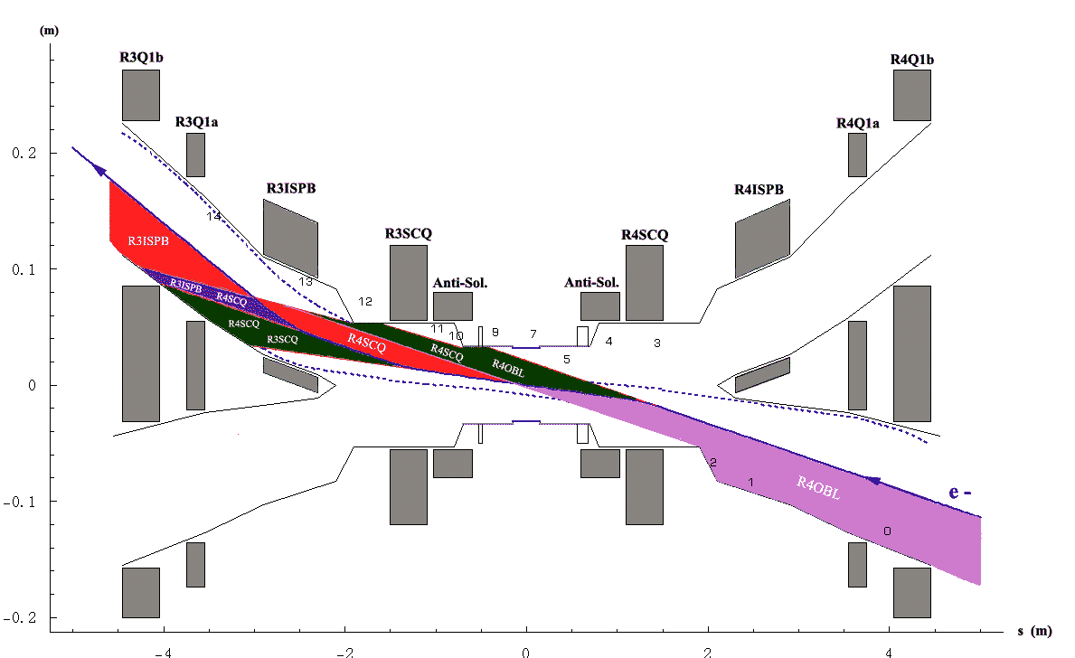
Beam related Background
Backgrounds:
SR photons
Beam-gas
Bremsstrahlung
Coulomb scattering
Mitigations:
Beam optics design
Gold plating of Be pipe
Masks
Movable masks
Results:
No issues after careful design and manufacturing

Slide 14
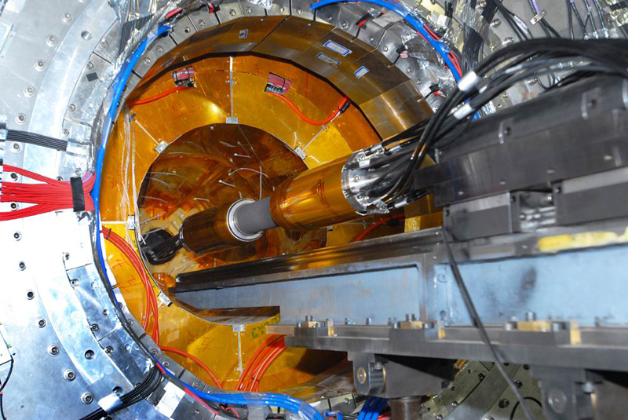
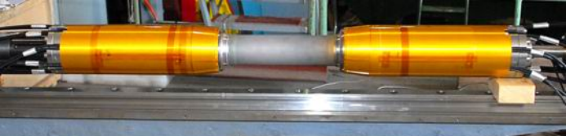
Be Beam-pipe
Led by Prof. Quan Ji
Original plan was to buy from Brush Wellman, not possible later on
Design:
  30 cm long Be pipe with 15 μm Gold plating to stop SR photons
  2 layers of Be pipe with oil cooling channel in between, coated with 20 μm BR127
  Total heat to be removed: HOM ~200W, SR < 24 W
R&D: structure, Be pipe manufacturing, cooling gap and material, gold plating, Be-Al welding, …

Slide 15
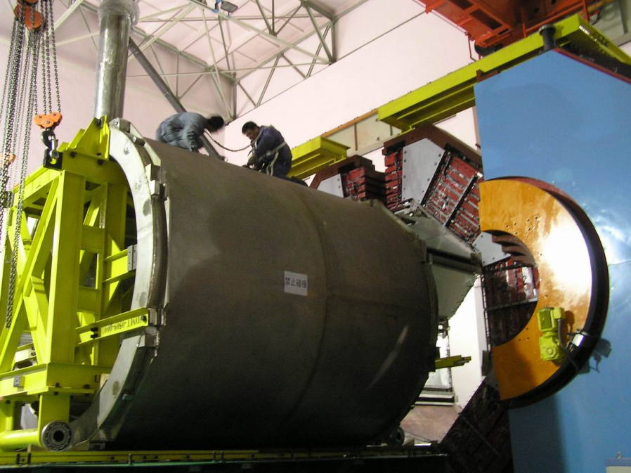
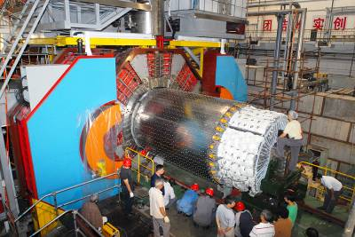
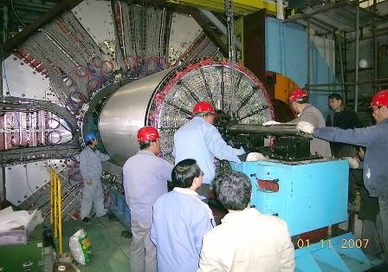
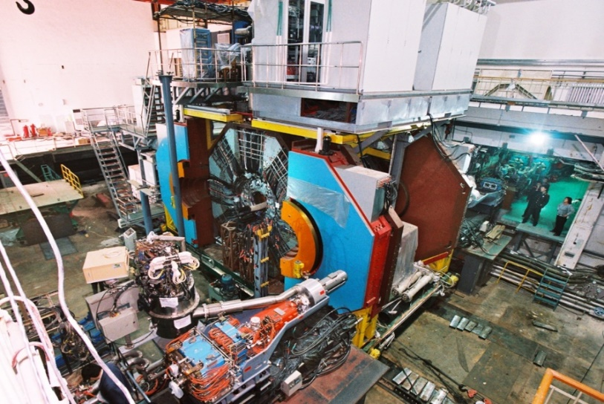
Installation
EMC clearance < 15 mm
MDC+TOF clearance < 10 mm

Slide 16
BESIII software and data flow
Online farm
Offline farm
DAQ;
Event filter
Offline
database
MC generator
MC simulation
detector
Data Quality monitoring;
Event display
Online
database
Raw Data
stream:
RAW/REC data:
Bhabha,
Dimuon
Hadron,
Beam gate …
Calibration
Slow control farm
Reconstruction
Slow control
database
Beam/envion. para.,
Luminosity, dose,
HV, Tem.…
Physics
analysis
Physics
tools
REC/DST
Data stream

Slide 17
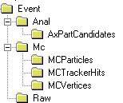
DAQ and Offline
calibUtil Services
Simulation
Calibrator
Register, write
Search
Read
Gaudi
services
Gaudi
Client
Calibration
FACS
Calibration &
Database
Gaudi
Reconstruction
Physics Analysis
Metadata (persistent)
MySQL rdbms
Event Display
Simulation
Reconstruction
Generator
Pre-tracking
Cal-MDC
Cal-TOF
Fast-track
Event-T0
Detector-Geo
Transient Event Store
Exp. data
MC data
Post-tracking
Cal-Data
Control-Data
Simulation
MDC-track
EMC(B/E)
TOF(B/E)
MUID
REC
Data
Digitization
V0FIND
Phy-tracking
Led by Prof. Kejun Zhu
specification：~ 50Mb/s, 4000 Hz, 10 ×B-factory, 1000 × BESII
Online monitoring，display and control
EVERTEX
DST
Made
DST
Data
Led by Prof. Weidong Li
CMT based BESIII software development and management
GAUDI based software framework
GEANT4 based Monte Carlo simulation
MYSQL based calibration and database

Slide 18
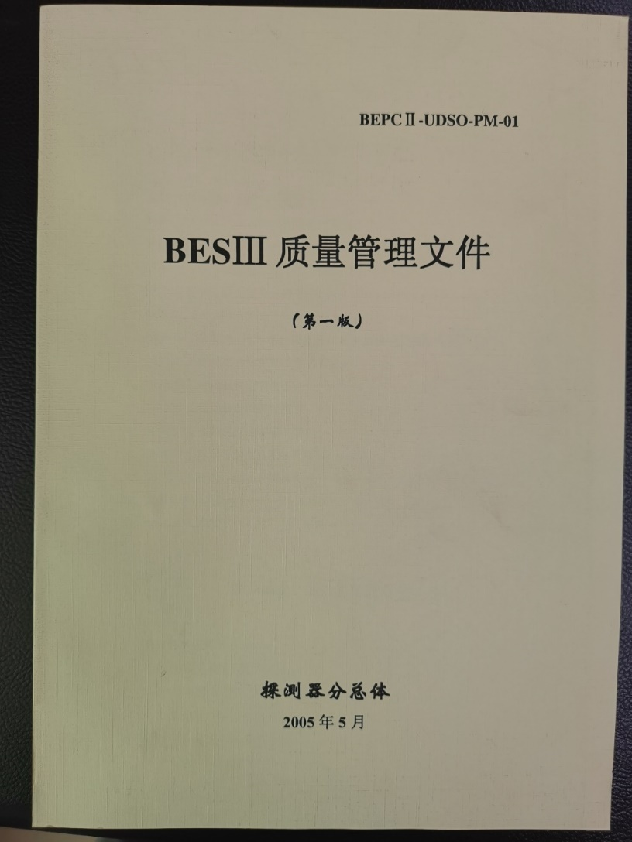
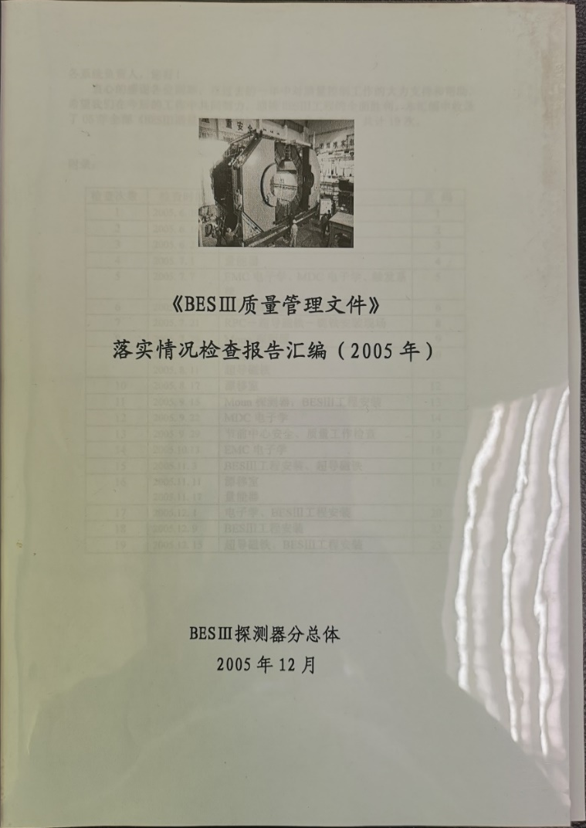
Quality Control
Rules and regulations
Documentation
Education
Process control
Regular inspection
Review

Slide 19
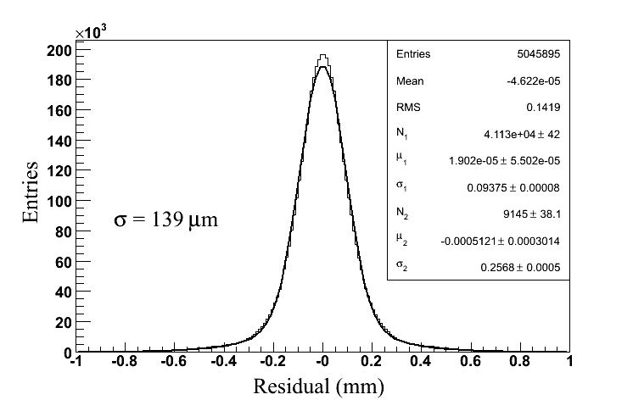
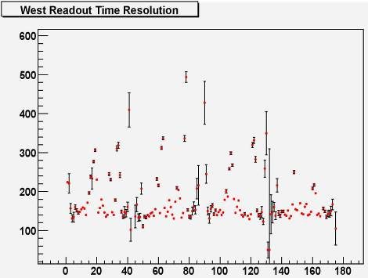
Cosmic-ray Test
Debug hardware problems
System tests
Detector Calibration
Results
  MDC single wire resolution:
    < design spec. ×110%
  EMC energy resolution
    < design spec. ×140%
  TOF time resolution
    < design spec. ×130%
  MUC efficiency
    < design spec. ×100%
We are ready for the first physics results

Slide 20
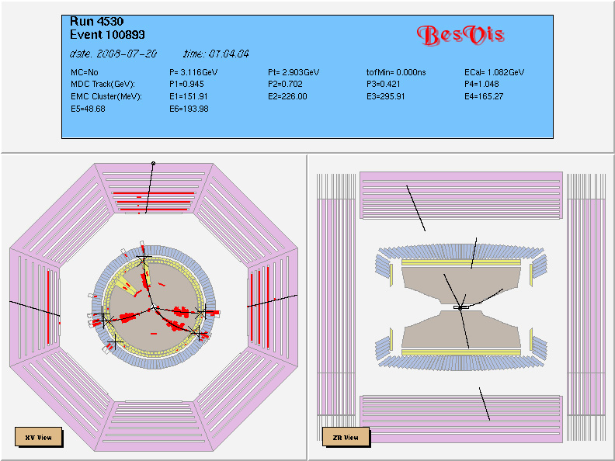
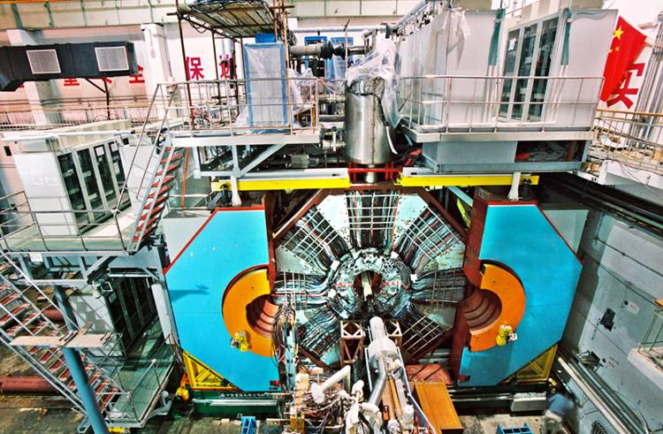
Commissioning Milestones
Nov. 18, 2007: first e+e- collision
Mar. 2008: Collision 500 mA × 500 mA, Lumi.: 1 ×10³² cm⁻²s⁻¹
April 30,2008: Move BESIII to IP
July 19, 2008: First event in BESIII
BESIII at the interaction point
Precision < 1 mm

Slide 21
Performance of the Detector
Exps. | MDC Wire reso. | MDC dE/dx Reso. | EMC Energy reso.
CLEO | 110 μm | 5% | 2.2-2.4 %
Babar | 125 μm | 7% | 2.67 %
Belle | 130 μm | 5.6% | 2.2 %
BESIII | 115 μm | <5% (Bhabha) | 2.3%
Exps. | TOF time reso.
CDFII | 100 ps
Belle | 90 ps
BESIII | 68 ps (Barrel) 98 ps (Endcap) 60 ps(Endcap, MRPC)
MUC: Eff. ~ 96%
Noise: < 0.04 Hz/cm²(Barrel), < 0.1 Hz/cm²(Endcap)

Slide 22
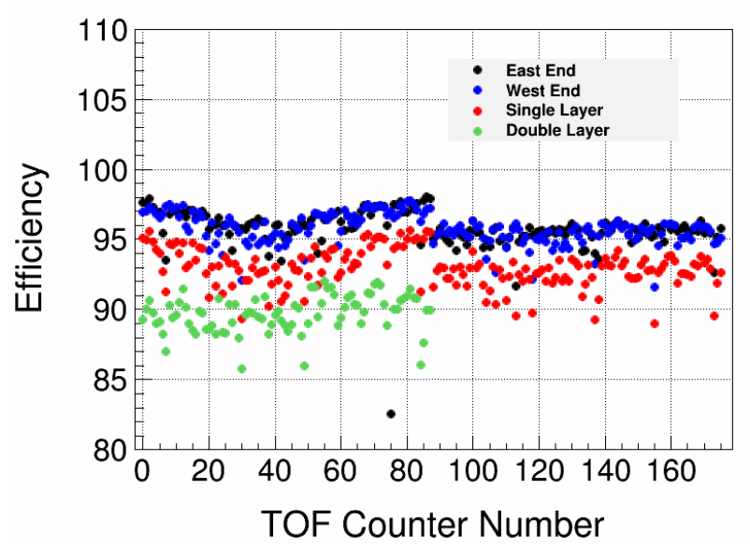
Stable Operation for 15 years
MDC :
  No broken wire. 33 dead channels in total, 30 channels can be repaired due to preamp issues
  Hit efficiency: 90%~97%, except for the first 3 layers
EMC:
  No dead crystal module. 27 unglued modules，light yield of 5 modules dropped to about 60-70%
  Efficiency : Almost 100%, except for the 5 unglued modules
BTOF:
  No dead channel
  Efficiency : 95%~97% for single end
ETOF:
  6 dead channels can be repaired due to preamp issues
  Efficiency : 98.5%, except for the dead channels
MUC:
  1 module dead (east endcap layer0)
  Efficiency : >90%
MDC hit efficiency vs layer
BTOF efficiency
No major failures

Slide 23

Integrated luminosity： 46.58 fb⁻¹

Slide 24

Collaboration
Drift chamber and its electronics (IHEP, Sichuan, Tsinghua)
CsI(Tl) calorimeter and its electronics(IHEP, Tsinghua)
TOF（IHEP, USTC，Tokyo，Hawaii）
TOF electronics （USTC）
RPC（IHEP, Uni. of Washington）
RPC electronics（USTC）
Trigger（IHEP, USTC, Giessen）
DAQ & online software (IHEP, Tsinghua)
Offline software （IHEP, Peking，Shangdong，Nanjing，JINR）
Superconducting magnet （IHEP）
Mechanics(IHEP)
Technical support ( IHEP, Tsinghua,BINP）
~300 members
From 29 institutions in 5 countries
USA (2)
University of Hawaii
University of Washington
Europe (4)
GSI, Germany
University of Bochum, Germany
University of Giessen, Germany
JINR, Dubna, Russia
China (22)
IHEP, CCAST, GUCAS，
Univ. of Sci. and Tech. of China
Shandong Univ., Zhejiang Univ.
Huazhong Normal Univ., Wuhan Univ.
Zhengzhou Univ., Henan Normal Univ.
Peking Univ., Tsinghua Univ. ,
Zhongshan Univ.,Nankai Univ.
Shanxi Univ., Sichuan Univ
Hunan Univ., Liaoning Univ.
Nanjing Univ., Nanjing Normal Univ.
Guangxi Normal Univ., Guangxi Univ.
Japan (1)
Tokyo University
New BESIII collaboration was established in Jan. 10, 2006

Slide 25



Current Collaboration
Europe (17/115)
Germany (6): Bochum University,
GSI Darmstadt, Helmholtz Institute Mainz, Johannes Gutenberg University of Mainz, Universitaet Giessen,University of Münster
Italy (4): Ferrara University, LNF/Perugia, University of Torino
Netherlands (1):KVI/University of Groningen
Russia (2): Budker Institute of Nuclear Physics, Dubna JINR
Sweden (1):Uppsala University
Turkey (1):Turkish Accelerator Center Particle Factory Group
UK (2): University of Manchester, University of Oxford
Poland (1)National Centre for Nuclear Research
Asia (6/10)
Pakistan (2): COMSATS Institute of Information Technology
University of the Punjab, University of Lahore
Mongolia (1): Institute of Physics and Technology
Korea (1): Chung-Ang University
India (1): Indian Institute of Technology madras
Thailand (1): Suranaree University of Technology
USA(4/8)
Carnegie Mellon University
Indiana University
University of Hawaii
University of Minnesota
China (55/367)
Institute of High Energy Physics (146), other units(221): Beijing Institute of Petro-chemical Technology, Beihang University,
China Center of Advanced Science and Technology, Fudan University,
Guangxi Normal University, Guangxi University,
Hangzhou Normal University, Henan Normal University,
Henan University of Science and Technology,
Huazhong Normal University, Huangshan College, Hunan University,
Hunan Normal University, Henan University of Technology
Institute of modern physics, Jilin University, Lanzhou University, Liaoning Normal University, Liaoning University, Nanjing Normal University, Nanjing University, Nankai University, North China Electric Power University,
Peking University, Qufu normal university, Shanxi University,
Shanxi Normal University, Sichuan University, Shandong Normal University,
Shandong University, Shanghai Jiaotong Univeristy, Soochow University,
South China Normal University, Southeast University, Sun Yat-sen University,
Tsinghua University, University of Chinese Academy of Sciences, University of Jinan, University of Science and Technology of China,
University of Science and Technology Liaoning,
University of South China, Wuhan University, Xinyang Normal University,
Zhejiang University, Zhengzhou University,YunNan University , China University of Geosciences , Yantai University,
South America (1/1)
Chile: University of Tarapaca
~600 members
From 83 institutions in 16 countries

Slide 26


Preparation for Physics
International Workshop on
tau-Charm Physics
Beijing, June 5-7, 2006
Charm2023 Siegen (Germany 2023)
Charm2020 Mexico City (Mexico 2020)
Charm2018 Novosibirsk (Russia, 2018)
Charm2016 Bologna (Italy, 2016)
Charm2015 Detroit (USA, 2015)
Charm2013 Manchester (UK, 2013)
Charm2012 Honolulu (USA, 2012)
Charm2010 Beijing (China, 2010)
Charm2009 Leimen (Germany, 2009)
Charm2007 Ithaca (USA, 2007)
Charm2006 Beijing (China, 2006)
conferences：
  Charm series
  China-US collaboration workshops
  Summer schools
hep-ex/0809.1869
IJMP A V24,No 1(2009) supp

Slide 27

Thanks to IHEP/BEPCII management, in particular,
Prof. Weiguo Li as the deputy manager for BESIII
And
Chief engineers Prof. Xuan Liu (and Prof. Shaowan Xu)
Chief technical support staff: Prof. Jingzhi Bai
All L2 & L3 sub-system managers
Run coordinators
And all collaborators

