Slide 1
Theoretical Review of Charmed Hadron Decays
Charmed Baryons
Hai-Yang Cheng (鄭海揚)
Academia Sinica, Taipei
Celebration Ceremony of the 500
Publications of BESIII Collaboration
May 31, 2023

Slide 2
Congratulations to BESIII for the great achievement of BESIII Collaboration on 500 publications!!!
Outline:
1. Hadronic decays of charmed mesons Hailong Ma
2. Hadronic decays of charmed baryons Xiao-Rui Lyu
H. B. Li and X. R. Lyu:
Study of the standard model with weak decays of charmed hadrons at
BESIII, Natl. Sci. Rev. 8 (2021) no.11, nwab181

Slide 3
Hadronic weak decays of charmed mesons

Slide 4
Dynamic approach based on effective Hamiltonian & factorization (generalized, 1/N_{c}). We don’t have QCD-inspired theory as in B physics
-- treat effective Wilson coefficients a₁ and a₂ as phenomenological parameters to account for nonfactorizable effects
-- cannot describe weak annihilation properly and tackle long-distance effects such as FSIs
Model-independent diagrammatical approach based on SU(3): strong-interaction effects included in topological amplitudes extracted from the data
They are complementary to each other for describing nonleptonic weak decays of heavy mesons
Bauer, Stech, Wirbel (’87)

Slide 5
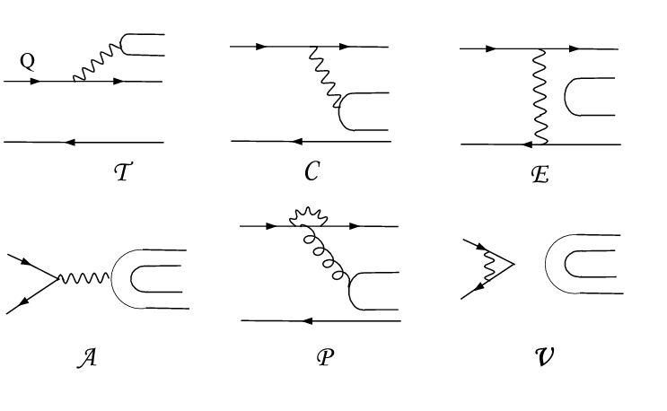
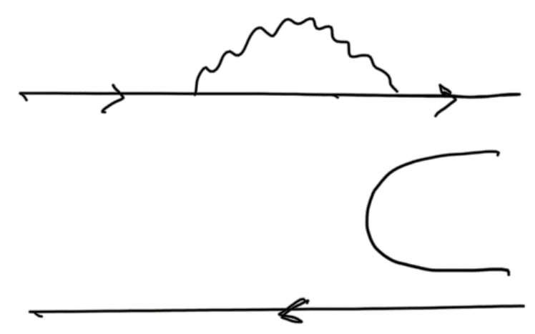
Topological Diagrammatic Approach
All two-body hadronic decays of heavy mesons can be expressed in
terms of six distinct topological diagrams [Chau (’80,’83); Chau, HYC (’86)]
(tree)
(color-suppressed)
(exchange)
(annihilation)
H (horizontal W-loop)
(vertical W-loop)
All quark graphs are topological, classified according to topologies of weak interactions and meant to have all strong interactions encoded and hence they are not Feynman graphs. That is, final-state interactions are included.

Slide 6
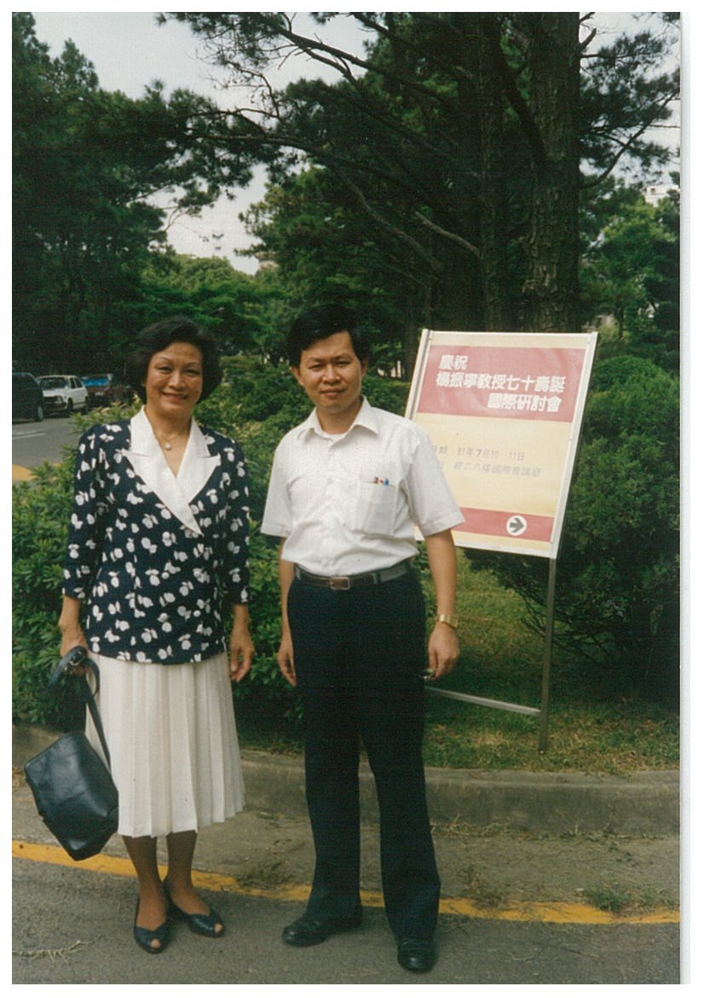
with Ling-Lie Chau (喬玲麗)
photo taken at Tsing-Hua University, Hsinchu at the occasion of a symposium of celebrating Prof. C.N. Yang’s 70 birthday

Slide 7
Topological tree amplitudes in D → PP decays
Data of D→PP decays dominated by CLEO with many being improved by BESIII
T = 3.113 ± 0.011 (taken to be real) (in units of 10⁻⁶ GeV)
C = (2.767 ± 0.029) exp[i (-151.3±0.3)º]
E = (1.48 ± 0.04) exp[i (120.9±0.4)º]
A = (0.55 ± 0.03) exp[i (23⁺⁷-10)º]
Rosner (’99)
Wu, Zhong, Zhou (’04)
Bhattacharya, Rosner (’08,’10)
HYC, Chiang (’10, ’19)
CF
Phase between C & T ~ 150º
W-exchange E is sizable with a large phase ⇒ importance of 1/m_{c} power corrections
W-annihilation A is smaller than E and almost perpendicular to E
E
C
A
T
The great merit & strong point of this approach ⇒ magnitude and strong phase of each topological tree amplitude are determined
⇒ Direct CP violation at tree level can be reliably estimated, e.g. $D_{s}^{+}→K^{0}π^{+}$
7

Slide 8


Naïve factorization
]
]
Under naïve factorization, all the predicted topological amplitudes except T are too small compared to the values extracted from the data, implying that topological amplitudes C, E and A are dominated by nonfactorizable long-distance effects.

Slide 9
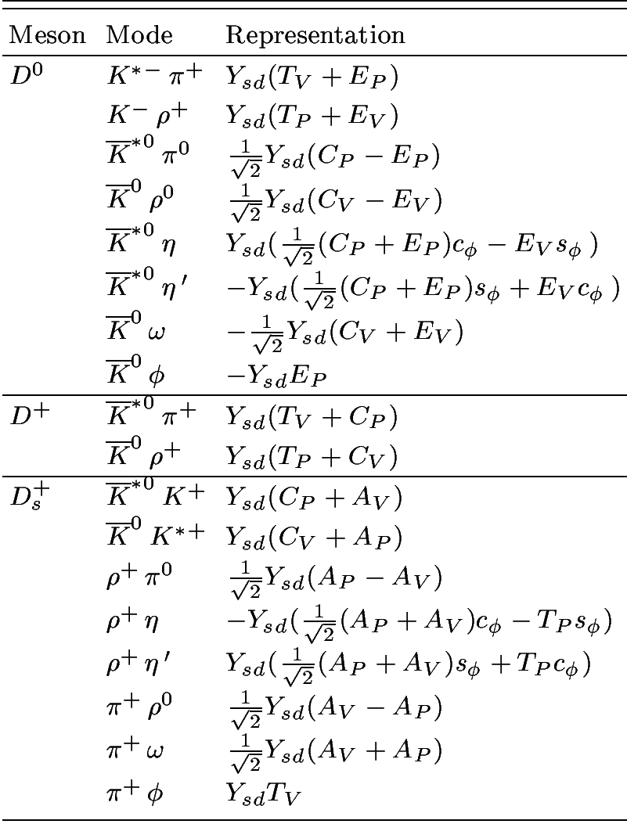
D→ VP decays
CF
T_{P}, C_{P}: P contains q of D meson
T_{V}, C_{V}: V contains q of D meson
E_{P}, A_{P}: P contains q₂ of q₁q₂
configuration
E_{V}, A_{V}: V contains q₂ of q₁q₂

Slide 10
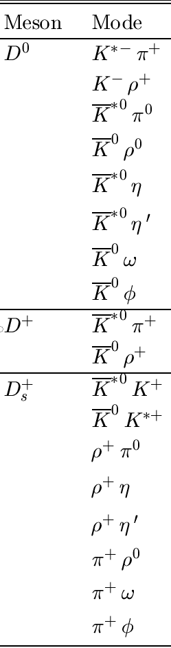
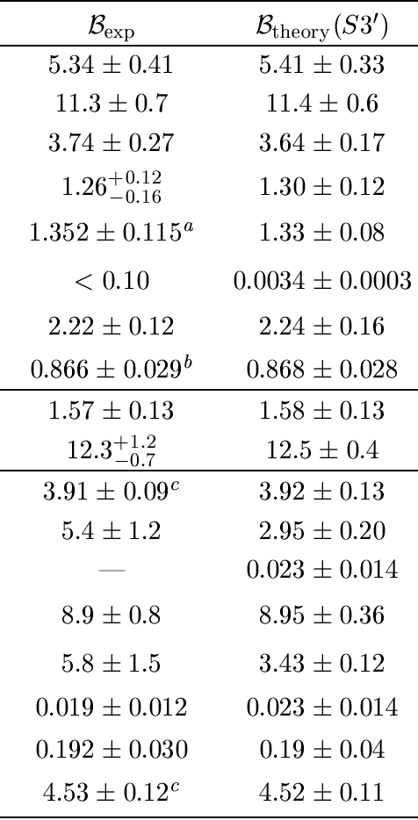
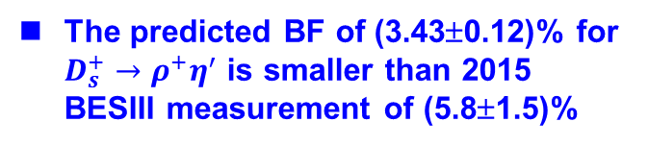
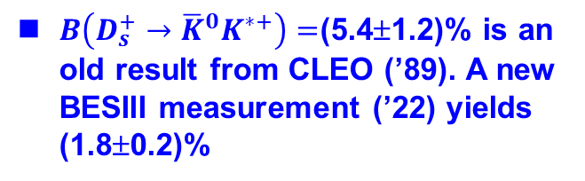
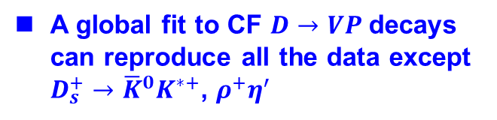
A global fit to CF $D→VP$decays can reproduce all the data except $D_{s}^{+}→{\overline{K}}^{0}K^{∗+}$, $ρ^{+}η^{′}$
$B\left(D_{s}^{+}→{\overline{K}}^{0}K^{∗+}\right)=$(5.4±1.2)% is an old result from CLEO (’89). A new BESIII measurement (’22) yields (1.8±0.2)%
CF
The predicted BF of (3.43±0.12)% for $D_{s}^{+}→ρ^{+}η^{′}$ is smaller than 2015 BESIII measurement of (5.8±1.5)%

Slide 11
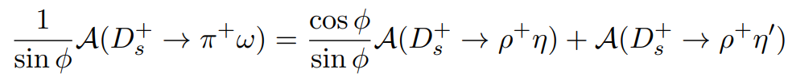
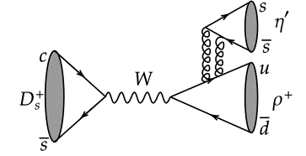
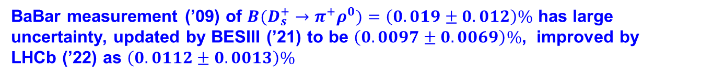
A sum rule follows from the topological approach
HYC, Chiang, Kuo (’16)
φ: η-η’ mixing angle
Measured rates of $D_{s}^{+}→π^{+}ω,ρ^{+}η$ ⇒ (2.2±0.3)%$<B(D_{s}^{+}→ρ^{+}η^{′})<$ (4.5±0.4)%
A new measurement of $D_{s}^{+}→ρ^{+}η^{′}$ by BESIII (’22) yields BF = (6.15±0.25±0.18)%. This seems to indicate an extra contribution from flavor-singlet topology S.
Chau, HYC, Tao Huang (’92)
Topological annihilation amplitudes $A_{P},A_{V} can be$ extracted from $D_{s}^{+}→π^{+}ω,π^{+}ρ^{0}$, $π^{0}ρ^{+}$ with amplitudes proportional to $A_{V}+A_{P, }$ $A_{V}−A_{P, }A_{P}−A_{V}$, respectively.
BaBar measurement (’09) of ${B(D}_{s}^{+}→π^{+}ρ^{0})=\left(0.019±0.012\right)\%$ has large uncertainty, updated by BESIII (’21) to be $\left(0.0097±0.0069\right)\%$, improved by LHCb (’22) as $\left(0.0112±0.0013\right)\%$

Slide 12
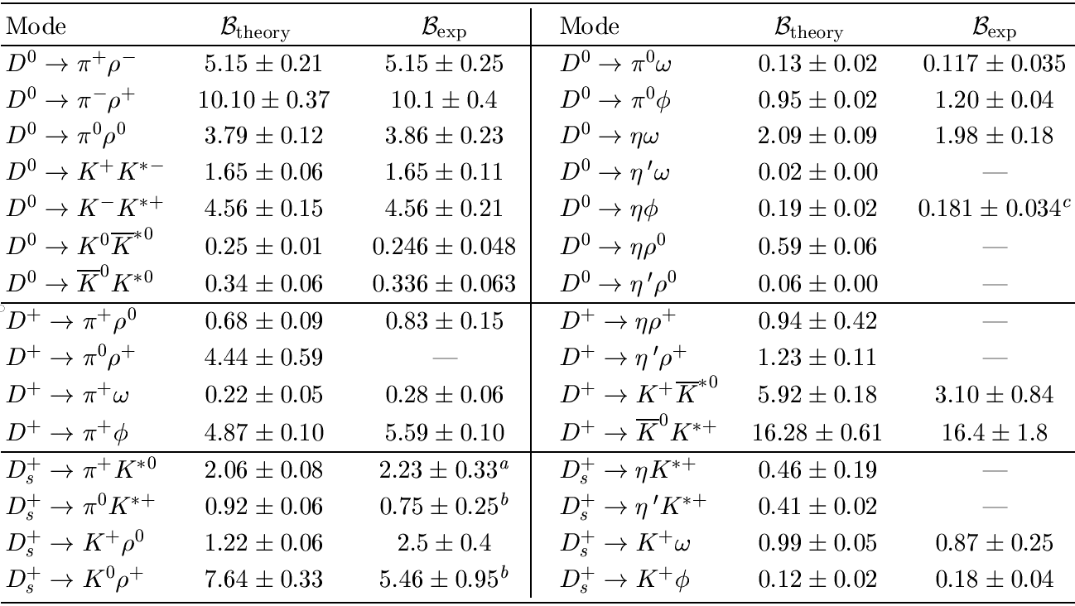

D→VP decays
in units of 10⁻³
SCS
PDG 2022
$${3.74}_{+0.20}^{−0.12}$$
0.52±0.14
34 ± 16
5.78±0.60
BFs of $D_{s}^{+}→π^{0}K^{∗+},K^{0}ρ^{+}$ absent in 2020 PDG, $B\left(D^{+}→{\overline{K}}^{0}K^{∗+}\right)=34±16$ poorly measured. The gap was filled up by BESIII in 2021.
BESIII results for $B\left(D^{+}→{\overline{K}}^{∗0}K^{+}\right)$ and $B\left(D^{+}→{\overline{K}}^{0}K^{∗+}\right)$ were cited in 2022 PDG with a factor of 6 and 3, respectively, missing!

Slide 13

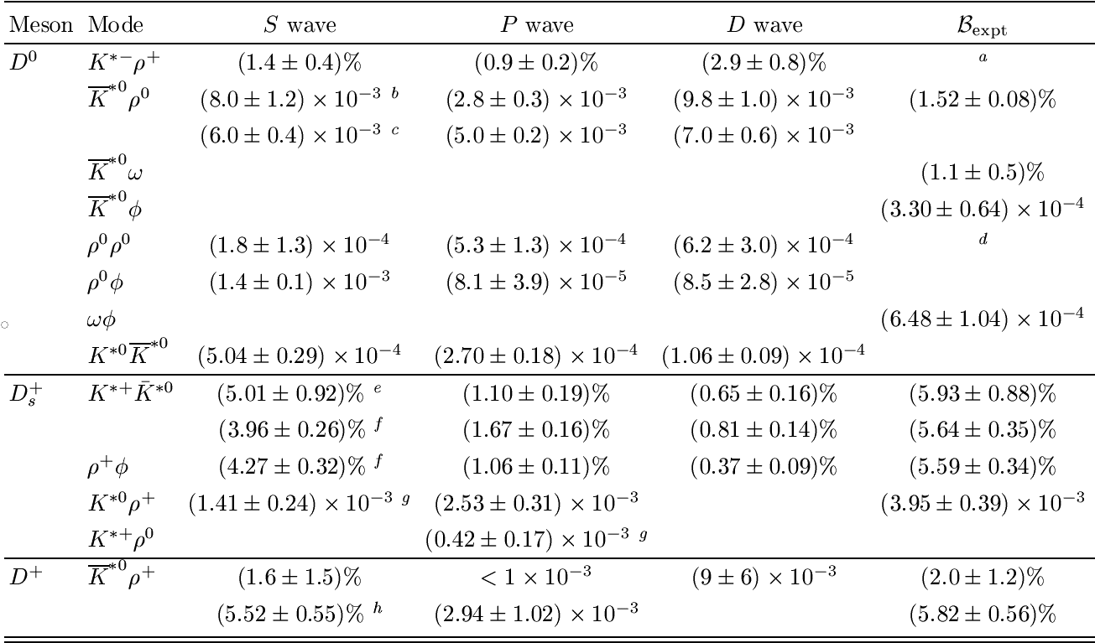
D → VV
Factorizable D →VV amplitudes ⇒
However, $D^{0}→K^{∗−}ρ^{+}, {\overline{K}}^{∗0}ρ^{0},ρ^{0}ρ^{0} seem$ to be D-wave dominated???
BESIII (’19)
BESIII (’17)
LHCb (’18)
FOCUS (’03)
CLEO data reanalysis (’17)
BESIII (’21)
LHCb (’19)
BESIII (’21)
BESIII (’21)
BESIII (’21)
BESIII (’22)
BESIII (’22)
BESIII (’23)

Slide 14



Contrary to charmless B→VV decays, where $f_{L}=1−O(m_{V}^{2}/m_{B}^{2}$), longitudinal polarization in charm sector is expected to be of order 0.5 or smaller
Factorizable D →VV amplitudes ⇒
Mark III (’92) ⇒ $f_{L}$ = 0.475 ± 0.271 in $D^{0}→K^{∗−}ρ^{+},$
transversely polarized in $D^{0}→ { \overline{K}}^{∗0}ρ^{0}$
BESIII (’21) ⇒ transversely polarized in $D^{0}→ωφ$ with $f_{L}<0.24$
If $D^{0}→ωφ$ and $D^{0}→ρ^{0}φ$ proceed only through internal W-emission, their branching fractions & polarizations are expected to be the same
$B(D^{0}→ρ^{0}φ\text{) = (1.56}\text{±0.13}\text{)}×{10}^{−3}, B(D^{0}→ωφ$) = (6.48±1.04)$×{10}^{−4},$
While $D^{0}→ρ^{0}φ$ behaves normal, $D^{0}→ωφ$ is transversely polarized

Slide 15
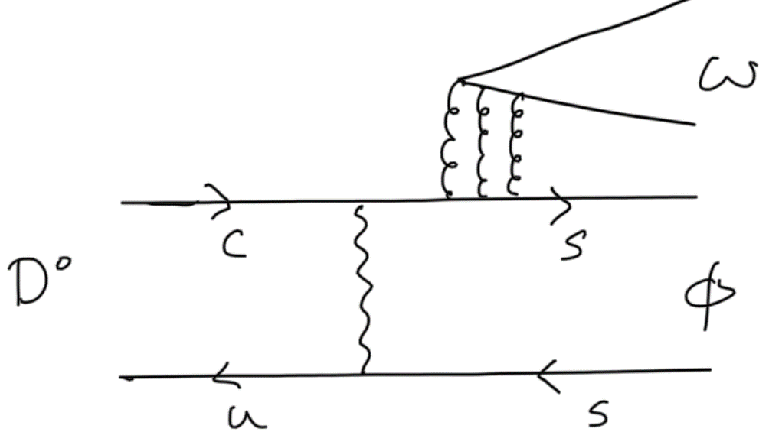
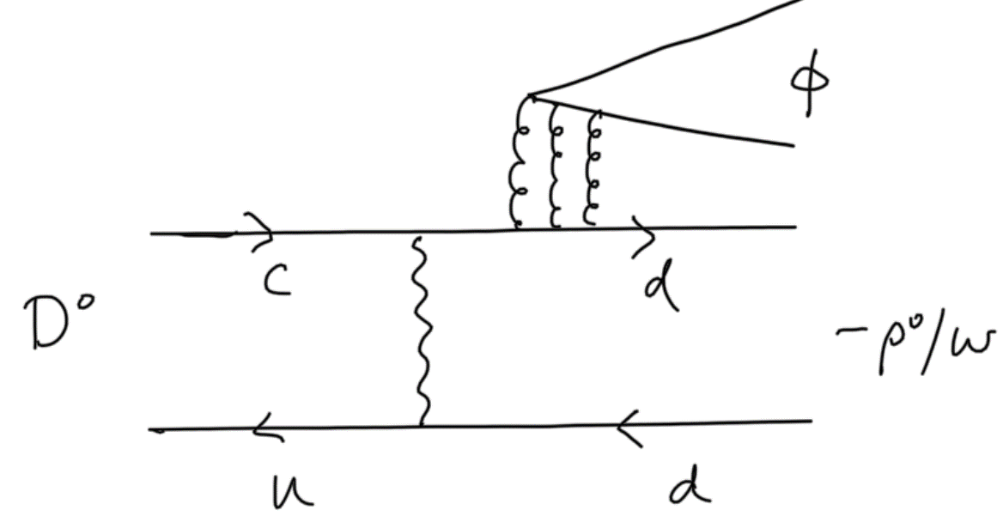


How to understand the puzzles with rate and polarization for $D^{0}→ωφ, ρ^{0}φ?$
Consider FSI through $K^{∗+}K^{∗−}$ which contributes to $D^{0}→ωφ$ and $D^{0}→ρ^{0}φ$ from external W-emission, but only to the former from W-exchange
Cao, Cheng, Zhao (2303.00535)
LD contributions to topological internal W-emission $C$ could be different for both $D^{0}→ωφ$ and $D^{0}→ρ^{0}φ.$
Another approach: $C$ topology is assumed to be the same for $D^{0}→ωφ, D^{0}→ρ^{0}φ$, but flavor-singlet contributions to them are different
$S_{h}^{φ}$:
$S_{h}^{ω}$:
Recall that flavor-singlet contribution is needed to explain $D_{s}^{+}→ρ^{+}η′$

Slide 16
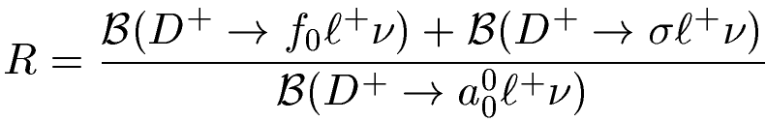
Two-quark or tetraquark picture for light scalars?
The 2-quark or 4-quark descriptions of light scalars $f_{0}\left(500\right),f_{0}\left(980\right),{ a}_{0}\left(980\right)$ can be discriminated in semileptonic charm decays
1.0±0.3, 2-quark
3.0±0.9, 4-quark
=
Wang, Lu (’10)
BESIII (’18)
⇒ R > 2.7 in favor of tetraquark nature for $f_{0}\left(500\right)$ and $f_{0}(980)$
Further support from the analysis of BESIII data of $D^{+}→π^{+}π^{−}e^{+}ν_{e}$and CLEO data of $D_{s}^{+}→π^{+}π^{−}e^{+}ν_{e}$
Achasov, Kiselev, Shestakov (’20)

Slide 17
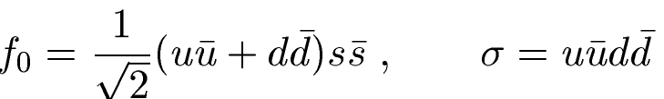
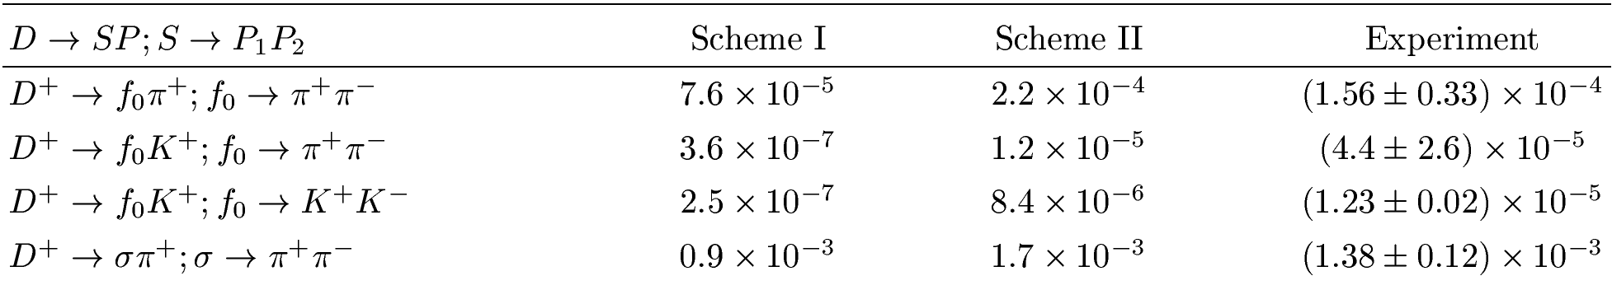
Three-body decays with D→ SP
1. scheme I: 2-quark scenario with mixing in isoscalars $f_{0}\left(980\right) \& σ/f_{0}(500)$
2. scheme II: tetraquark scenario with a tiny mixing close to π
Use Flatte line shape for $f_{0}\left(980\right)$ and pole line shape for $σ/f_{0}(500)$
HYC, Chiang (’22)
Scheme II agrees better with experiment for decays such as $D^{+}→f_{0}π^{+}; f_{0}→π^{+}π^{−},$ ${ D}^{+}→f_{0}K^{+}; f_{0}→K^{+}K^{−}$

Slide 18
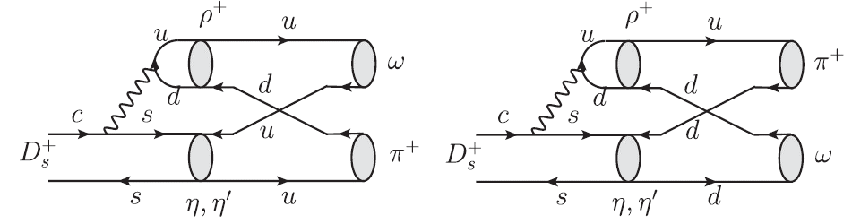
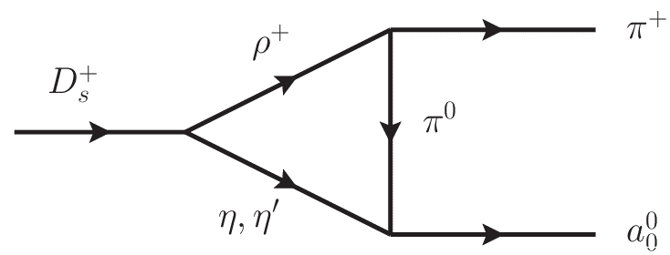
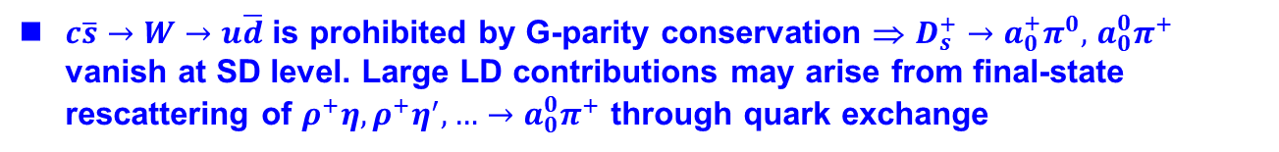

Three-body decays with D→ SP
$D_{s}^{+}→a_{0}^{+}π^{0},$ $a_{0}^{0}π^{+},ωπ^{+},ρ^{0}π^{+}$ can only proceed through W-annihilation
1%, 1%, 0.2%, 0.02% in BF ⇒ |$A_{SP}$| > |$A_{VP}$|
Large BF of $D_{s}^{+}→a_{0}^{+}π^{0}+$ $a_{0}^{0}π^{+}$ at a percent level was observed by BESIII (’19)
$c\overline{s}→W→u\overline{d}$ is prohibited by G-parity conservation ⇒ $D_{s}^{+}→a_{0}^{+}π^{0},$ $a_{0}^{0}π^{+}$ vanish at SD level. Large LD contributions may arise from final-state rescattering of $ρ^{+}η,ρ^{+}η^{′},…→a_{0}^{0}π^{+}$ through quark exchange
HYC, Chiang (’22)
$$a_{0}^{0}$$
$$a_{0}^{0}$$
Hsiao, Yu, Ke (’20) Ling, Liu, Lu, Geng, Xie (’21)
${\left|A/T\right|}_{SP}∼0.5,{ \left|A/T\right|}_{PP}∼0.18,{ \left|A_{V}/T_{P}\right|}_{VP}∼0.07$

Slide 19
Hadronic weak decays of charmed baryons

Slide 20
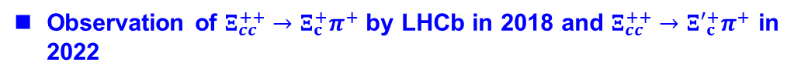
Hadronic weak decays
Progress was relatively slow for a long time, both theoretically & experimentally. Several major breakthroughs in recent experiments:
Absolute branching fraction BF(Λ_{c}⁺→ pK⁻π⁺), a benchmark for other BFs of $Λ_{c}^{+}$, was measured by Belle (’14), BESIII (’16), LHCb (’18)
Absolute BFs of $Λ_{c}^{+}$ measured by BESIII (’16) for the first time
Absolute BFs of $Ξ_{c}^{+,0}$ reported by Belle (’19)
Observation of $Ξ_{cc}^{++}→Ξ_{c}^{+}π^{+}$ by LHCb in 2018 and $Ξ_{cc}^{++}→{Ξ′}_{c}^{+}π^{+}$ in 2022
Decay asymmetries in many of $Λ_{c}^{+}$ modes by BESIII, then by Belle (’22)
SCS $Λ_{c}^{+}$ decays by BESIII since 2017, followed by Belle (’22)
Absolute BFs for semileptonic decays of $Λ_{c}^{+}$ first measured by BESIII (’15)
Absolute BFs for semileptonic decays of $Ξ_{c}^{0}$ measured by Belle (’21) & ALICE (’21)
20

Slide 21
_
Dynamical model calculation
1. Pole model:
Consider low-lying pole contributions:
s-wave is governed by ½⁻ resonances (very tedious, troublesome!)
p-wave is dominated by ½⁺ ground-state baryons
2. Relativistic QM: Korner, Kramer, Ivanov,…
overlap integrals
3. Current algebra: Kamal, HYC,…
s-wave is reduced to a commutator term in soft meson limit

Slide 22
Model-independent approach
1. Diagrammatic scheme
Chau, HYC, Tseng (’96); Kohara (’91); Zhao, Wang, Hsiao, Yu (’20); Hsiao, Wang, Zhao (’22)
Three different W- exchange diagrams
Need information of decay asymmetry to extract s-wave and p-wave amplitudes separately
2. SU(3) approach
Savage, Springer (’90); Sharma, Verma (’97); Lu, Wang, Yu (’16); Geng, Hsiao, Liu, Tsai (’17); Geng, Liu, Tsai (’19); Huang, Xing, He (’22); Zhong, Xu, Wen, Gu (‘23); Xing, He, Huang, Yang (’23)
Parameters for s- and p-waves obtained by performing a global fit to the data of BFs and decay asymmetries

Slide 23
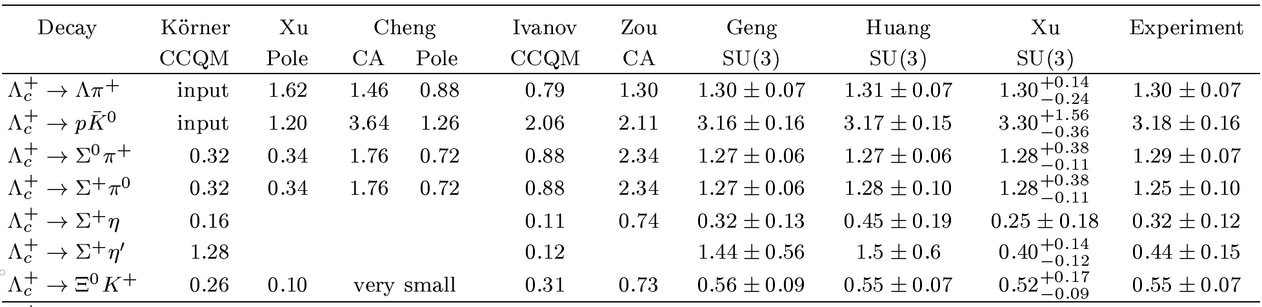
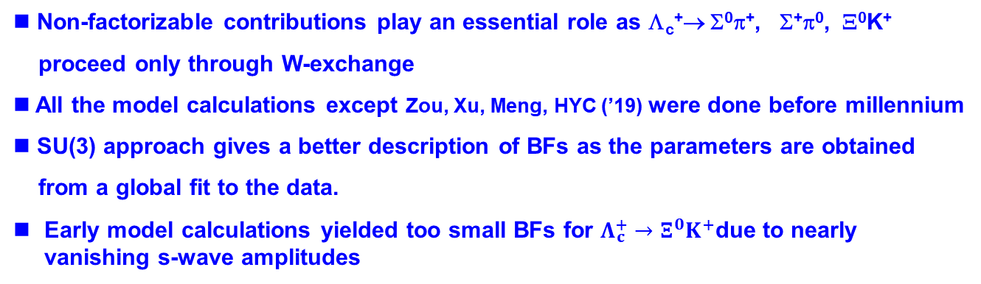
BFs of Cabibbo-favored decays of Λ_{c}⁺
(in %)
BESIII (’16)
BESIII (’16)
BESIII+ Belle
BESIII+ Belle
BESIII (’18)
Non-factorizable contributions play an essential role as Λ_{c}⁺→ Σ⁰π⁺, Σ⁺π⁰, Ξ⁰K⁺
proceed only through W-exchange
All the model calculations except Zou, Xu, Meng, HYC (’19) were done before millennium
SU(3) approach gives a better description of BFs as the parameters are obtained
from a global fit to the data.
Early model calculations yielded too small BFs for $Λ_{c}^{+}→Ξ^{0}K^{+}$due to nearly vanishing s-wave amplitudes

Slide 24



BFs of Cabibbo-allowed decays of Λ_{c}⁺
(in %)
Naively, it is expected that the rates of $Λ_{c}^{+}→Σ^{+}η^{ }$and $Λ_{c}^{+}→Σ^{+}η^{′}$ are comparable or the former is larger than the latter
$$\frac{B\left(Λ_{c}^{+}→Σ^{+}η^{′}\right)}{B\left(Λ_{c}^{+}→Σ^{+}η^{ }\right)}=$$
$3.5±2.1±0.4$ BESIII (’19)
$1.34±0.28±0.08$ Belle (’22)
Early SU(3) approach seems to predict too large BF for $Λ_{c}^{+}→Σ^{+}η^{′}$

Slide 25
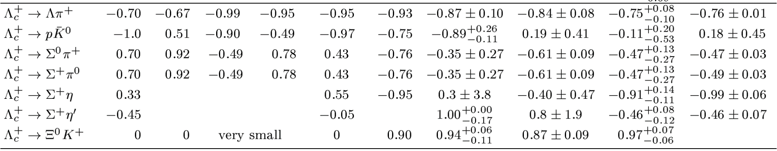
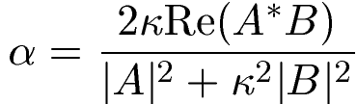

Decay asymmetry α for Cabibbo-favored decays
BESIII+Belle
BESIII (’19)
BESIII+ Belle
BESIII+ Belle
Belle (’22)
Belle (’22)
Non-trival relative strong phases between S- and P-waves may exist, but they are usually not considered in realistic model calculations of $α.$
Most models predict a large & negative $α\left(pK_{S}\right),$ which needs to be clarified.
The ambiguous negative sign of α in Λ_{c}⁺→ Σ⁺π⁰ measured by CLEO (’95) was confirmed to be negative by BESIII (’19). Early pole & QM predicted a wrong sign. This issue has been resolved recently.
Niu, Wang, Zhao (’21)

Slide 26
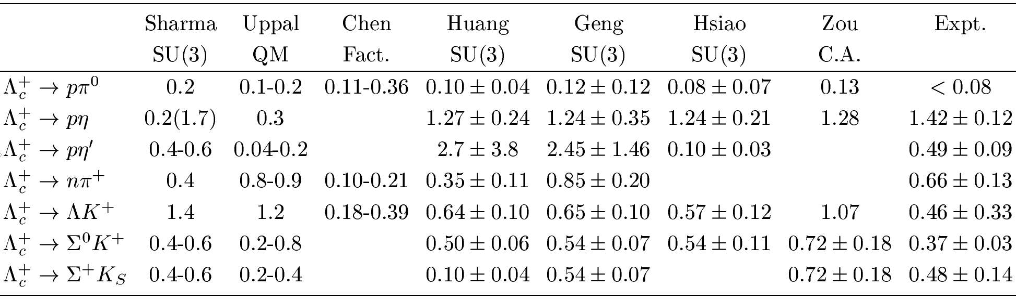




Singly Cabibbo-suppressed decays of Λ_{c}⁺
(in ${10}^{−3})$
BESIII +Belle
BESIII +Belle
BESIII (’22)
BESIII +Belle
BESIII +Belle
BESIII (’22)
New results $for Λ_{c}^{+}→nπ^{+},{ pη^{′}, ΛK^{+}, Σ}^{0}K^{+},Σ^{+}K_{S}$ from BESIII (’22) and $Λ_{c}^{+}→{ pη^{′}, ΛK^{+}, Σ}^{0}K^{+}$ from Belle (’22)
In general, SU(3) approach describes the data well (e.g. $pη, ΛK^{+}, Σ^{0}K^{+},Σ^{+}K_{S}$), but the early version predicts too large rate for $Λ_{c}^{+}→pη′$
4.73$±0.82±0.46±0.24$ Belle (’22)
$B\left(Λ_{c}^{+}→pη^{′}\right)=$
(in ${10}^{−4})$
${5.62}_{−2.04}^{+2.46}±0.26$ BESIII (’22)

Slide 27
Conclusions
Substantial progress has been made in the study of hadronic decays of charmed mesons and baryons, both experimentally and theoretically. BESIII has played an essential role towards the understanding of their underlying mechanism.

Slide 28
Back-up slides

Slide 29
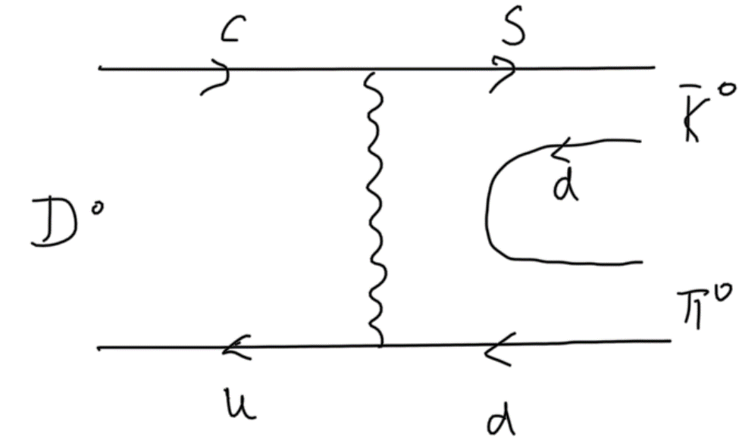
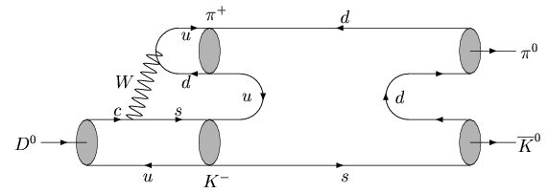
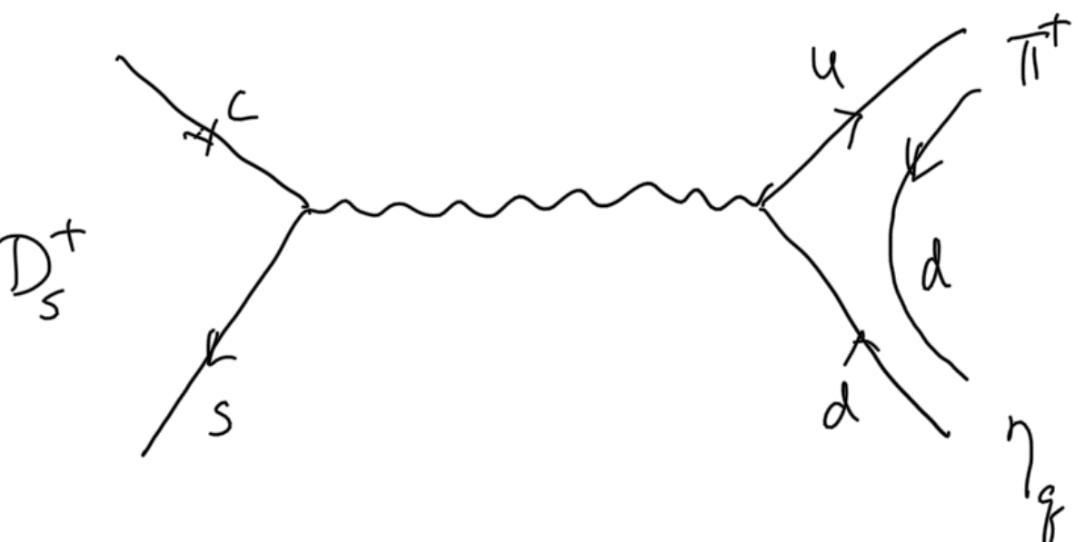
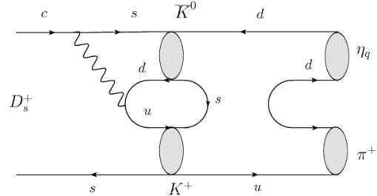
W-exchange & W-annihilation
E and A receive major contributions from final-state rescattering

Slide 30
$D_{s}^{+}→a_{0}^{+}(980)ρ^{0}$ was also seen by BESIII (’21)
$$B\left(D_{s}^{+}→a_{0}^{+}(980)ρ^{0}, a_{0}^{+}→π^{+}η\right)=\left(0.21±0.08±0.05\right)\%$$
$c\overline{s}→W→u\overline{d}$ is allowed by G-parity conservation ⇒ $D_{s}^{+}→a_{0}^{+}ρ^{0}$ doesn’t vanish at SD level.

