Slide 1
The reference AN
CADI | Analysis note | total
BPH-11-021 | AN-12-222 | Measurement of the Prompt Double J/ψ Production Cross Section in pp Collisions at √s = 7 TeV
BPH-14-008 | AN-14-138 | Observation of Υ(1S) pair production at CMS
BPH-18-002 | AN-17-341 | Search for a light resonance decaying to Υ(1S)μ+μ−, and measurement of the Υ(1S) pair production cross section with 2016 data

Slide 2
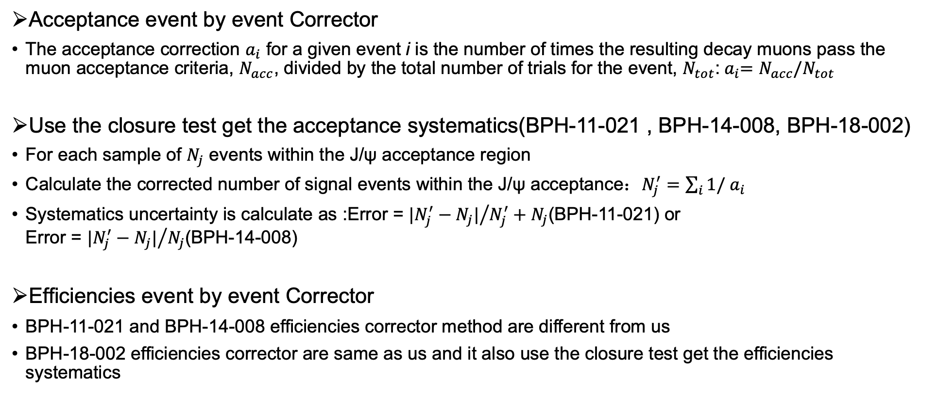
Acceptance and efficiency systematics
Acceptance event by event Corrector
The acceptance correction $a_{i}$ for a given event i is the number of times the resulting decay muons pass the muon acceptance criteria, $N_{acc}$, divided by the total number of trials for the event, $N_{tot}$:${{ a}_{i}=N}_{acc}/N_{tot}$
Use the closure test get the acceptance systematics(BPH-11-021 , BPH-14-008, BPH-18-002)
For each sample of $N_{j}$ events within the J/ψ acceptance region
Calculate the corrected number of signal events within the J/ψ acceptance：$N_{j}^{′}=\sum_{i}{1/}$ $a_{i}$
Systematics uncertainty is calculate as :Error = ${|N_{j}^{′}−N_{j}|}/{N_{j}^{′}+N_{j}}$(BPH-11-021) or Error = ${|N_{j}^{′}−N_{j}|}/{N_{j}}$(BPH-14-008)
Efficiencies event by event Corrector
BPH-11-021 and BPH-14-008 efficiencies corrector method are different from us
BPH-18-002 efficiencies corrector are same as us and it also use the closure test get the efficiencies systematics

