Slide 1






国家重点研发计划
R&D and Verification of Key Technologies for a High Energy Circular Electron-Positron Collider
Zhijun Liang for CEPC MOST2 vertex detector team

Slide 2
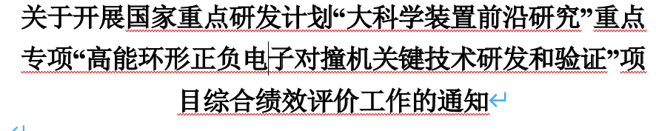
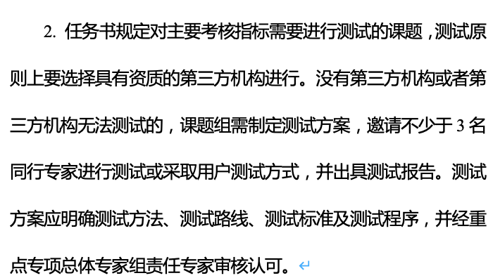
News on MOST2 project
Project timescale （执行期）： up to April 30th ,2023
First week of June: internal review meeting
June 19 -22: Project review meeting (1.5 days, 3 tasks together)
June 20 –July 21: submission of final reports and review report into MOST2 system
Oct 2023：
  MOST project review and final defend

Slide 3
material for final review
1. Main content 自评价报告正文（标红部分）
2. Final technical report 每个课题的最终科技报告
3. Accelerator test report 加速器关键技术测试报告
4. Detector test report 探测器测试报告
Prepared before May 31

Slide 4
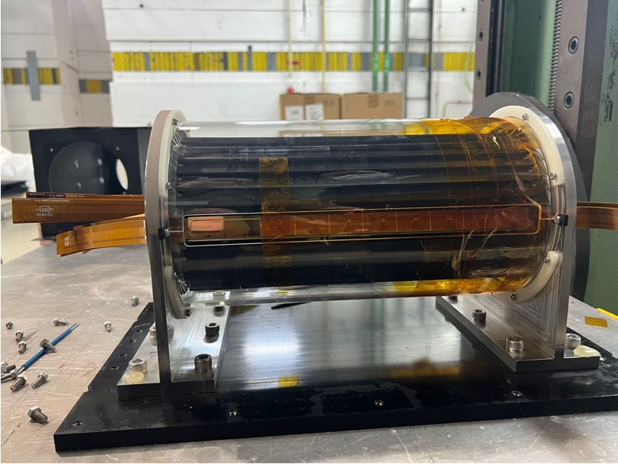
Testing Plan towards MOST project review
Build and test 1~2 full Ladders with 10 Taichu chips (before October)
  Laser or beta tests should be enough
  Mount them on the vertex detector prototype
TID tests using X ray machine
  In-situ tests of radiation
  Shielding
Proton irradiation in CSNS (End of may )
  Single chip radiation
  Wire bonding after irradiation

Slide 5
Publication plan
Taichu2 Laser test (NIMA): submitted
DESY Test beam 1st paper: submission date: submitted
Paper about vertex prototype testbeam : before June
Electronics for ladder and prototype (JINST): (should published before Sep 30th )
Paper about the prototype assembly : (should published before Sep )
Paper of TaichuPix3: (should published before Sep 30th ) 30th
Document about irradiation hardness: May 31st
Final report (结题科技报告） May 31st

Slide 6
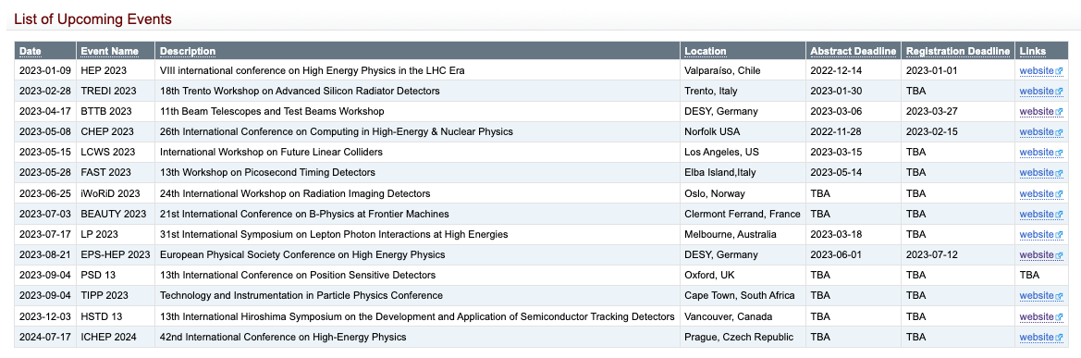
Conference
https://twiki.cern.ch/twiki/bin/view/CLIC/UpcomingConferences

