Slide 1
子任务4：CEPC Z能区极化束对撞设计
2018年国家重点研发计划项目“高能环形正负电子对撞机关键技术研发和验证”
课题一：高能环形正负电子加速器关键技术验证
段哲
中国科学院高能物理研究所
2023年6月20日

Slide 2
Outline
I. Introduction
  Background
  Indicators and tasks
  Beam polarization in the collider rings
II. Design of longitudinally polarized colliding beams
III. Other studies on polarized beams
IV. Summary

Slide 3
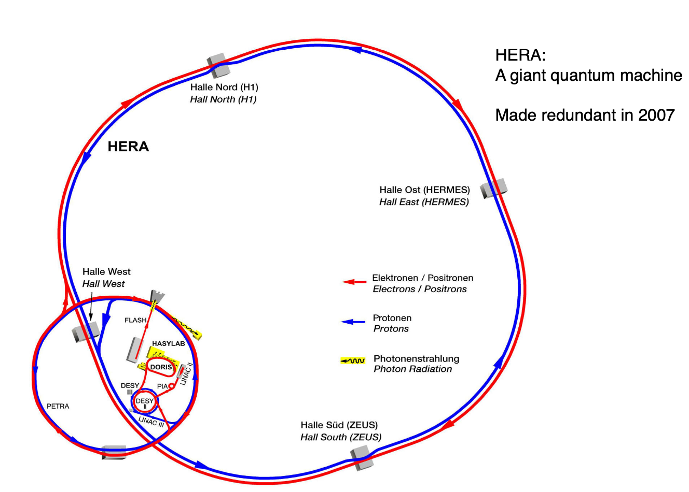
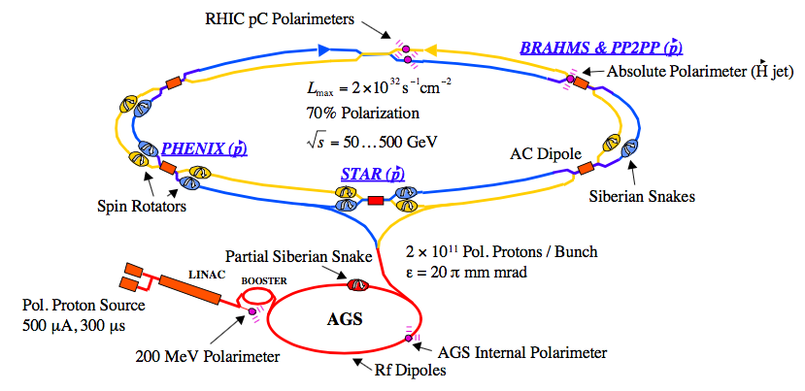
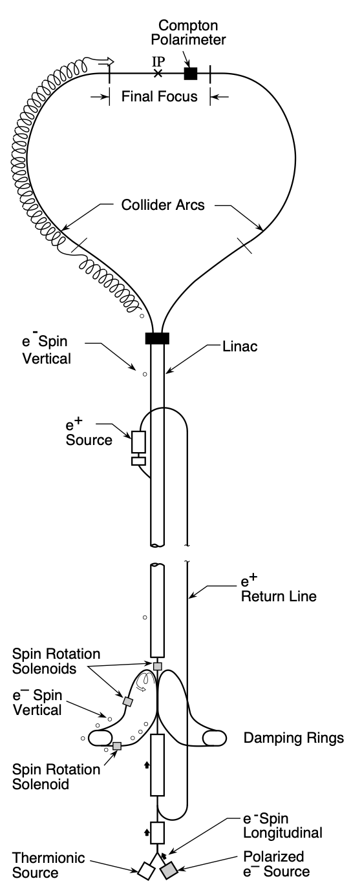
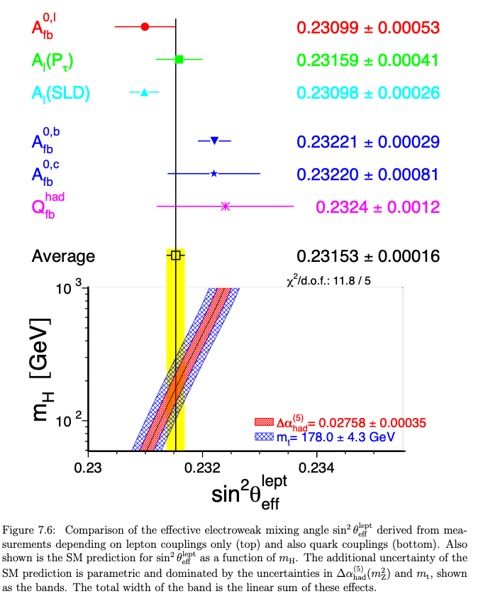
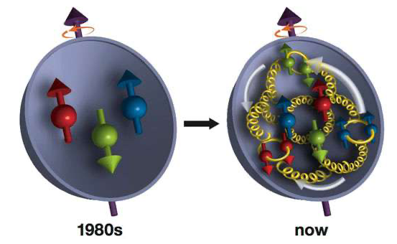
Longitudinally polarized beams in colliders
SLC: polarized e- & unpolarized e+
45.6 GeV vs. 45.6 GeV
HERA: polarized e- (e+) & unpolarized p
27.5 GeV vs. 820~920 GeV
RHIC: polarized pp collider
Up to 255 GeV
Most notably the measurement of the weak mixing angle
Proton (spin) structure
 | LEP | SLC
No. Z decays events | 17 million | 0.6 million
Longitudinal polarization | None | e- ~ 80%
Implementation of longitudinally polarized beams have been studied in recent colliders: SuperB, SuperKEKB, SuperT-C, ILC, EIC, EicC, NICA etc.

Slide 4
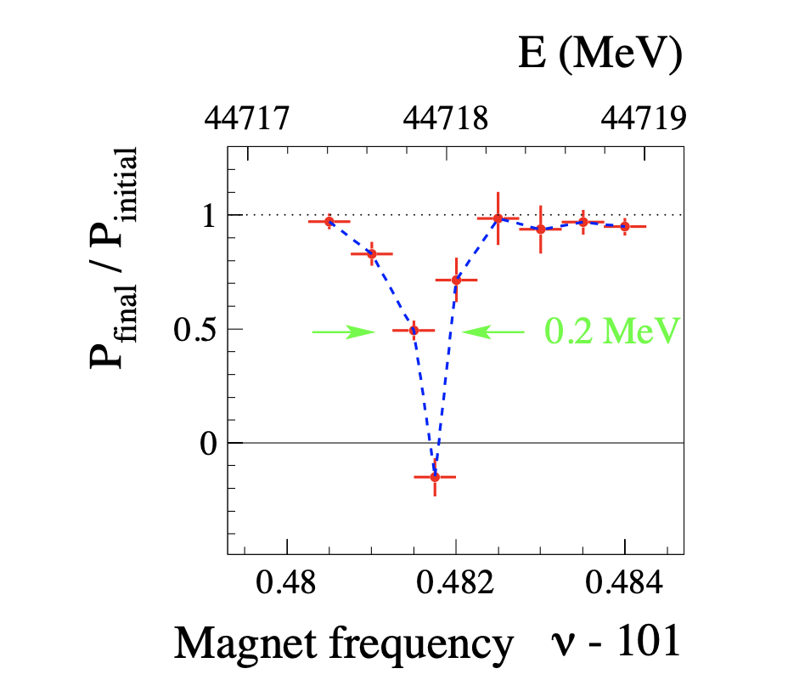
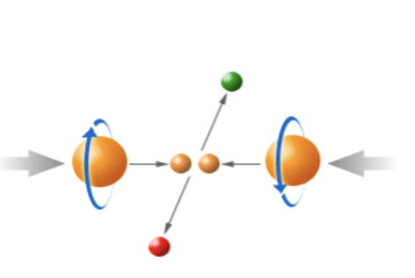
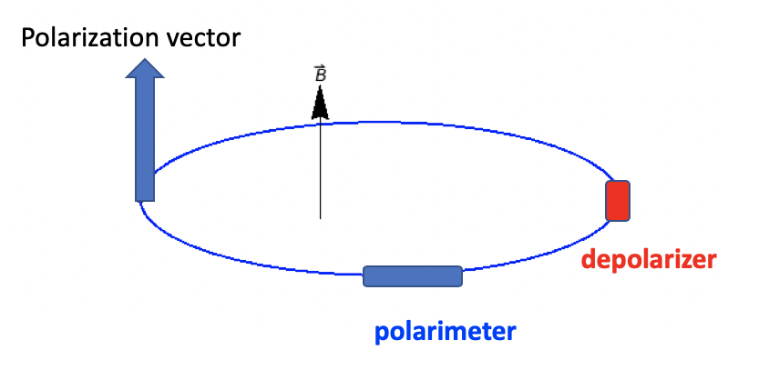
Motivation of CEPC polarized beam program
Vertical polarization in the arc
  Beam energy calibration via the resonant depolarization technique (RD)
  Essential for precision measurements of Z and W properties
  At least 5% ~ 10% vertical polarization, for both e+ and e- beams
Longitudinal polarization at IPs
  Beneficial to colliding beam physics programs at Z, W and Higgs
  Figure of merit: Luminosity * f( Pe+, Pe- )
  ~50% or more longitudinal polarization is desired, for one beam, or both beams
L. Arnaudon, et al., Z. Phys. C 66, 45-62 (1995).
FCC-ee (CERN) focuses on vertical polarization for beam energy calibration. The FCC-ee Energy and Polarization Working Group, arXiv:1909.12245v1, 2019.
Both aspects are being pursued at the CEPC.

Slide 5
Indicators and tasks
Indicators(考核指标):
  a complete design of polarized colliding beams at Z-pole, beam polarization>50%, beam lifetime > 60 min.
Tasks(任务书):
  Overall design of polarized beam operation at Z-pole.
    Longitudinal polarized colliding beams
    Transverse polarization for resonant depolarization-based beam energy calibration
The studies are based on the lattice and parameters of the CEPC Conceptual Design Report (2018).
The results are included as an Appendix Chapter of CEPC Technical Design Report (~40 pages).

Slide 6
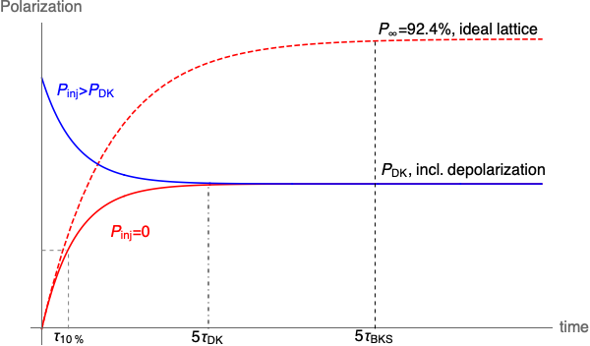
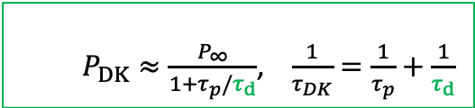

Beam polarization in the collider rings
Non-colliding “pilot” bunch: decay mode
Colliding bunch: top-up injection
Bunch charge
Polarization
  $P_{DK}≈\frac{P_{∞}}{1+τ_{p}/τ_{d}}$, $\frac{1}{τ_{DK}}=\frac{1}{τ_{p}}+\frac{1}{τ_{d}}$
  If $τ_{DK}≫τ_{b}$, then $P_{avg}≈P_{inj}$
time
Self-polarization can be utilized for RD measurements using pilot bunches
  Employ asymmetric wigglers to reduce the polarization time @Z [1]
To achieve a high-level polarization for colliding bunches without significantly sacrificing luminosity [2]
  Injection of polarized beams is mandatory
CEPC CDR parameters | 45.6 GeV (Z, 2T) | 80 GeV (W) | 120 GeV (Higgs)
Polarization build-up time w/o radiative depolarization $τ_{BKS}$ (hour) | 253 | 15.2 | 2.0
Beam lifetime $τ_{b}$ (hour) | 2.5 | 1.4 | 0.43
[1] The FCC-ee Energy and Polarization Working Group, arXiv:1909.12245v1, 2019.
[2] Zhe Duan, talk on 2nd FCC EPOL Workshop, Sep 29, 2022

Slide 7
Outline
I. Introduction
  Background
  Indicators and tasks
II. Design of longitudinally polarized colliding beams
III. Other studies on polarized beams
IV. Summary

Slide 8
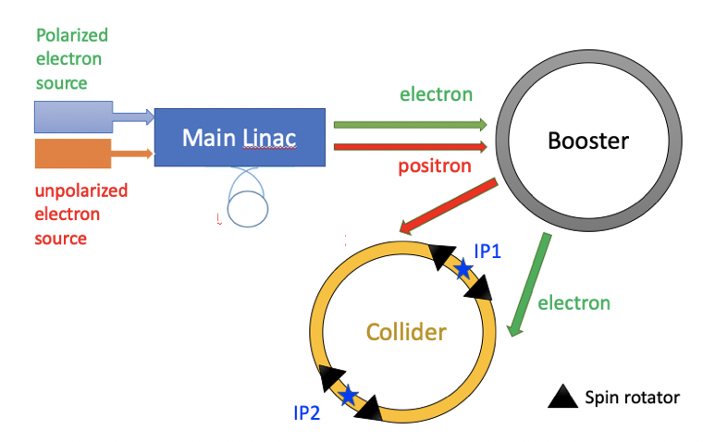

Preparation and injection of polarized electron beam
Compton polarimeter
Assumption: Polarized e- vs. unpolarized e+
State-of-the-art polarized e+ source cannot meet the requirements of top-up injection for CEPC [1]
The design is applicable to e+ when the polarized e+ source becomes technically ready.
Compton polarimeter
[1] P. Musumeci et al., Positron Sources for Future High Energy Physics Colliders, ArXiv:2204.13245 Phys. (2022).

Slide 9
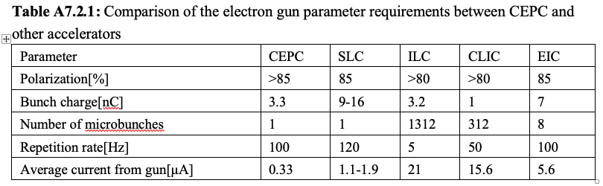
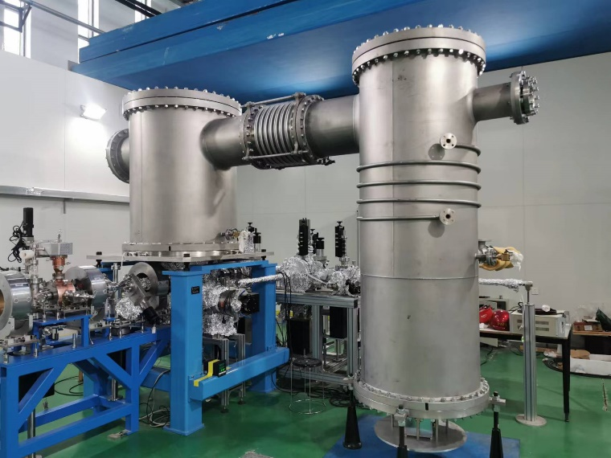
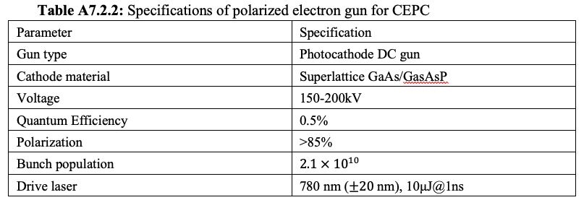
Polarized electron source
Using state-of-the-art technology, polarized electron gun can supply > 85% polarization and satisfy injection requirements of CEPC.
Photocathode DC gun @ PAPS can provide a basis for R&D of polarized electron beam generation.
Polarized electron gun
Wien filter
Mott polarimeter
bend
Main linac
Unpolarized electron gun
bend
Photocathode DC gun @ PAPS

Slide 10
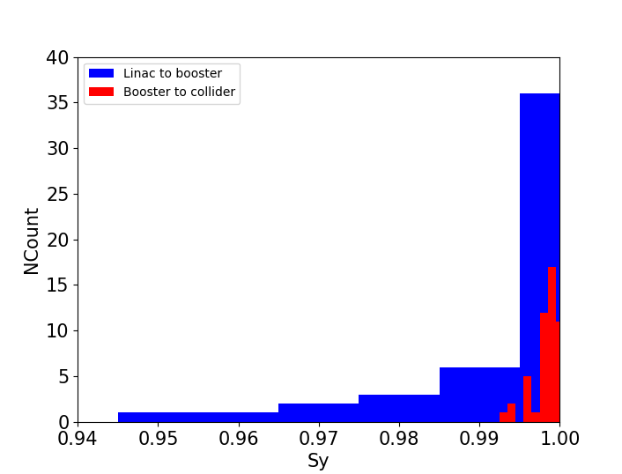
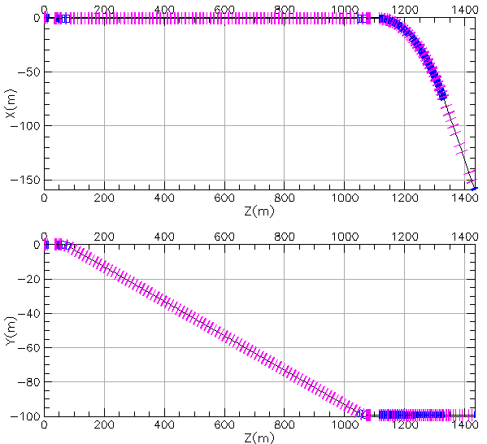
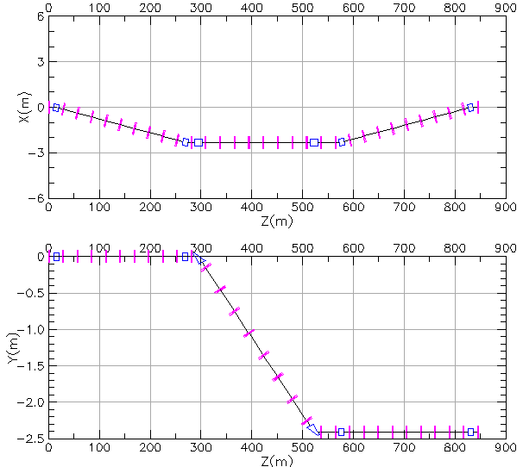


Polarization transmission in the linac & transport lines
  Depolarization in the linac is expected to be negligible[1,2].
  Transport lines (polarization loss < 10%)
    non-interleaved horizontal bending & vertical bending
    Typical errors without trajectory correction
$$\hat{n}$$
$$\vec{S}$$
Mismatch at injection
Linac to booster transport line
Booster to ring transport line
[1] G. Moortgat-Pick, et al., Polarized positrons and electrons at the linear collider, Physics Reports 460 (2008) 131-243.
[2] M. Woods, The polarized electron beam for the SLAC Linear Collider, arXiv:heps-ex/9611006v1, 1996

Slide 11
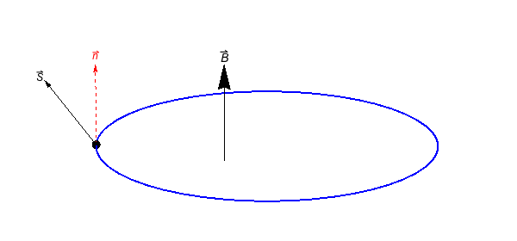
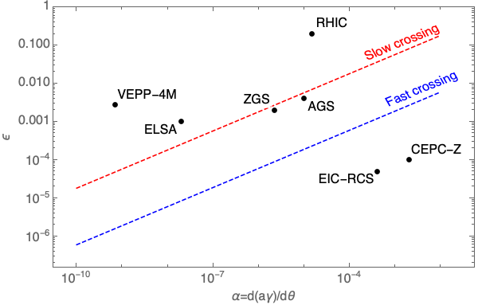
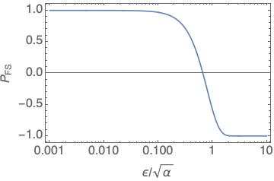
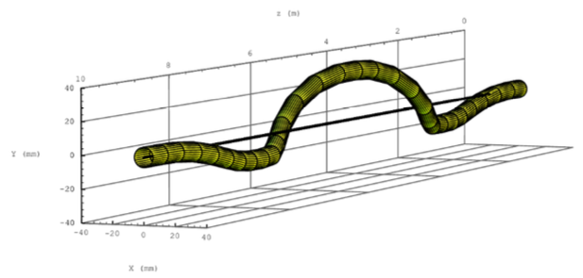
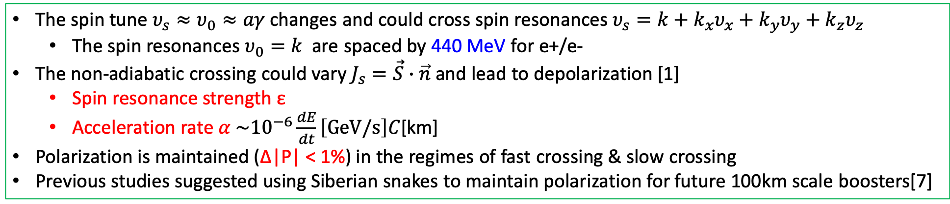
Depolarization in the booster
The spin tune $υ_{s}≈υ_{0}≈aγ$ changes and could cross spin resonances $υ_{s}=k+k_{x}υ_{x}+k_{y}υ_{y}+k_{z}υ_{z}$
  The spin resonances $υ_{0}=k$ are spaced by 440 MeV for e+/e-
The non-adiabatic crossing could vary $J_{s}=\vec{S}∙\vec{n}$ and lead to depolarization [1]
  Spin resonance strength ε
  Acceleration rate $α \sim {10}^{−6}\frac{dE}{dt}\left[GeV/s\right]C$[km]
Polarization is maintained (Δ|P| < 1%) in the regimes of fast crossing & slow crossing
Previous studies suggested using Siberian snakes to maintain polarization for future 100km scale boosters[7]
Fast crossing
Slow crossing
Spin precession
Orbit motion in a helical snake @ RHIC
[1] Froissart and Stora, NIM 7, 297 (1960) [2] A. K. Barladyan, et al., PRAB 22, 112804, (2019)
[3] S. Nakamura, et al., NIM A 411, 93 (1998) [4] T. Khoe et al., Part. Accel. 6, 213 (1975)
[5] Configuration Manual: Polarized Proton Collider at RHIC, 2006 [6] V. Ranjbar, et al., PRAB 21, 111003 (2018)
[7] I. Koop et al., Phys. Part. Nucl. Lett. 13. 7 (2016); S. Nikitin, IJMPA 34, 1940004(2019); IJMPA 35, 2041001 (2020).
Data from Ref [2-6]

Slide 12
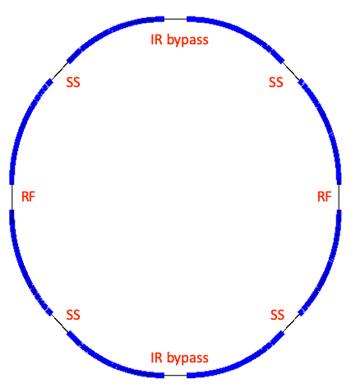
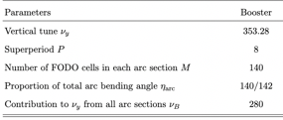
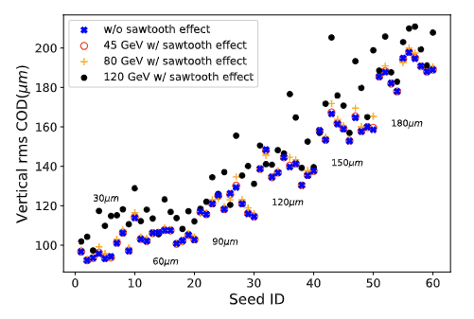
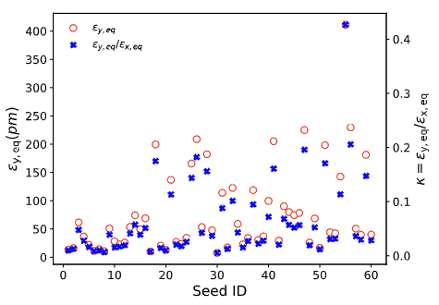
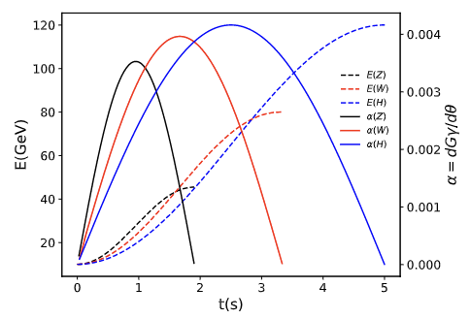
Setup of CEPC booster lattice
Arc region covers ~ 80% of circumference
General structure of the CEPC booster lattice (an alternative design)
  8 arcs each containing 140 FODO cells
  interleaved with 8 straight sections
60 imperfection lattice seeds
  Misalignment error & field error, scan BPM offset
  Closed orbit correction & tune correction
Multi-particle tracking in Bmad
  Energy and RF ramping in the whole process
  Element-by-element tracking with radiation damping & quantum excitation
[1] T. Chen, Z. Duan, D. H. Ji, D. Wang, Phys. Rev. Accel. Beams, 26, 051003 (2023).

Slide 13
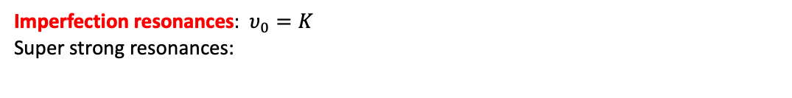
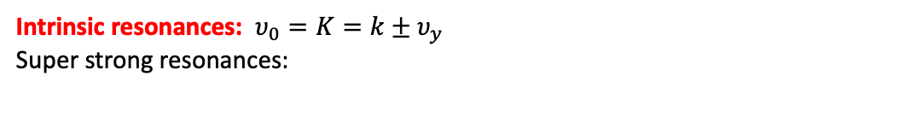
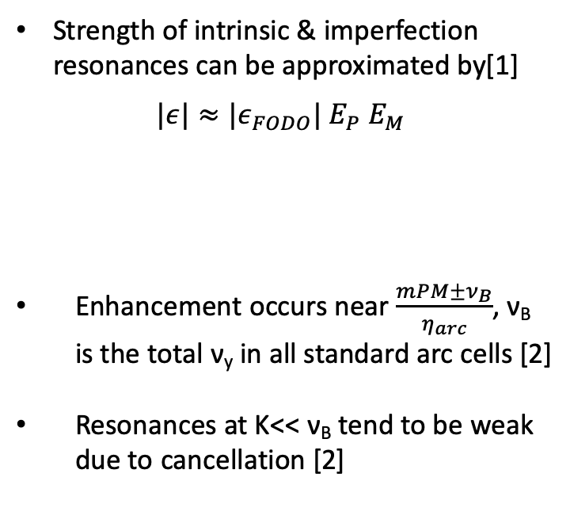
Spin resonance structure
Strength of intrinsic & imperfection resonances can be approximated by[1]
$$|ε|≈{|ε}_{FODO}| E_{P} E_{M}$$
Enhancement occurs near $\frac{mPM±ν_{B}}{η_{arc}}$, ν_{B} is the total ν_{y} in all standard arc cells [2]
Resonances at K<< ν_{B} tend to be weak due to cancellation [2]
Intrinsic resonances: $υ_{0}=K=k±υ_{y}$
Super strong resonances:
due to M identical FODOs in each arc
due to P superperiods
Imperfection resonances: $υ_{0}=K$
Super strong resonances:
[1] S. Y. Lee, Spin dynamics and snakes in synchrotrons (World Scientific, 1997).
[2] T. Chen, Z. Duan, D. H. Ji, D. Wang, Phys. Rev. Accel. Beams, 26, 051003 (2023).

Slide 14
Depolarization effects: simulation vs. estimation
In the acceleration to Z & W
  The spin resonances are generally weak
  Polarization is mostly maintained
  Simulations agree fairly well with estimations
In the acceleration H
  The spin resonances become stronger at higher energies
  Severe depolarization occurs
  Mitigation methods to be explored
Z-mode, 45.6 GeV
W-mode, 80 GeV
H-mode, 120 GeV
This study supports injecting highly polarized beams into the collider rings as a very attractive solution, for applications @ Z & W.
[1] T. Chen, Z. Duan, D. H. Ji, D. Wang, Phys. Rev. Accel. Beams, 26, 051003 (2023).

Slide 15
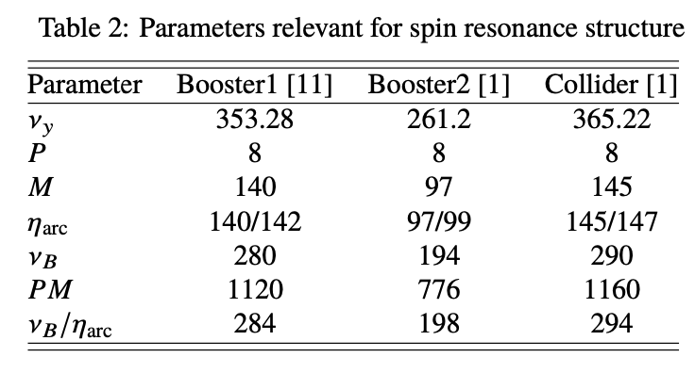
More on spin resonance structure
A general feature of 100-km-scale booster & collider rings
Collider ring design shall avoid super-strong resonances near 45 GeV, 80 GeV & 120 GeV
CEPC CDR Collider ring spin resonance spectrum
Intrinsic resonance
Imperfection resonance

Slide 16
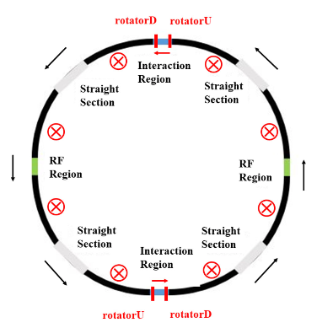
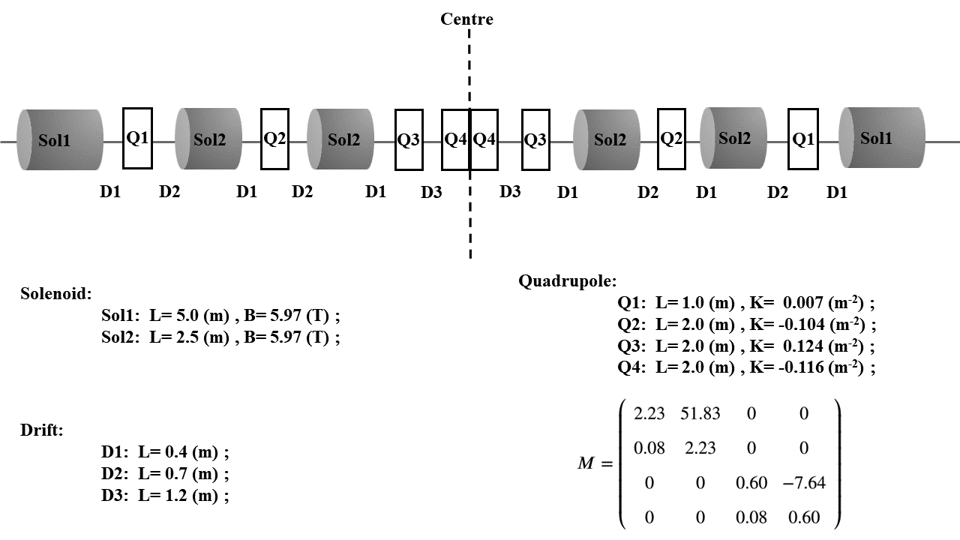
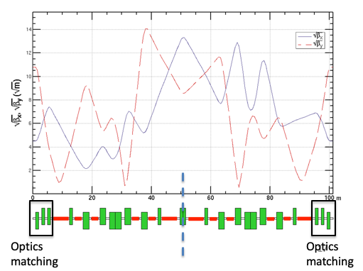
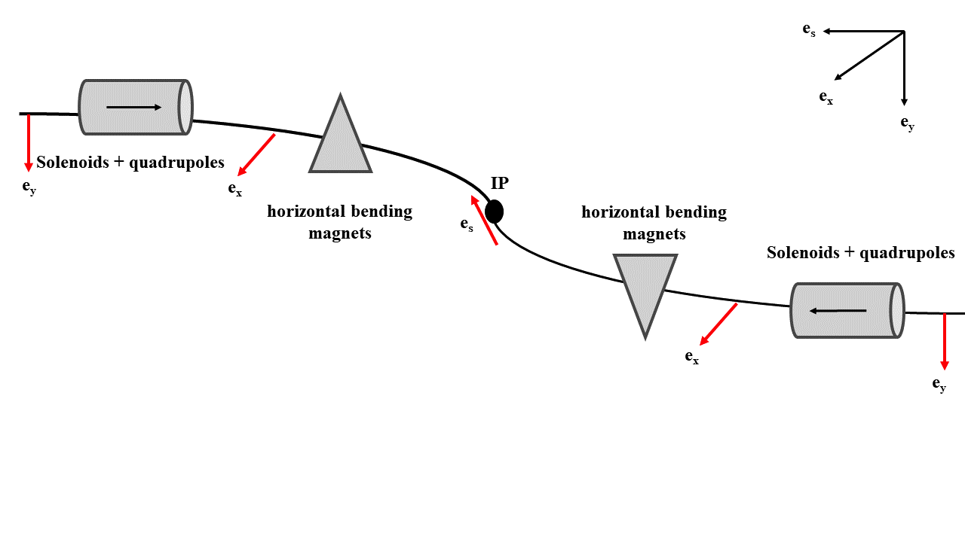
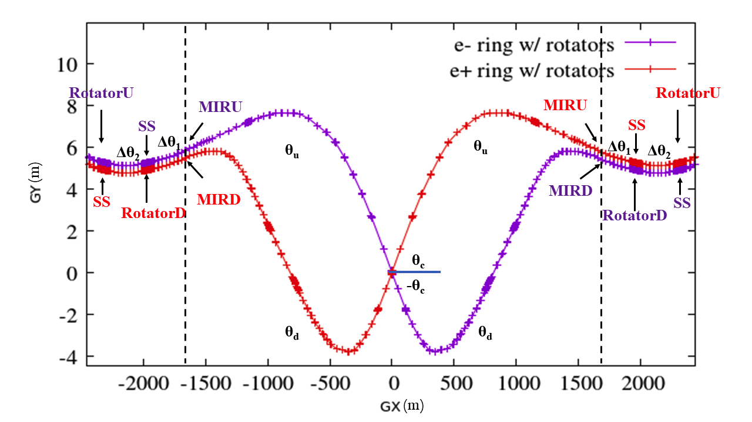
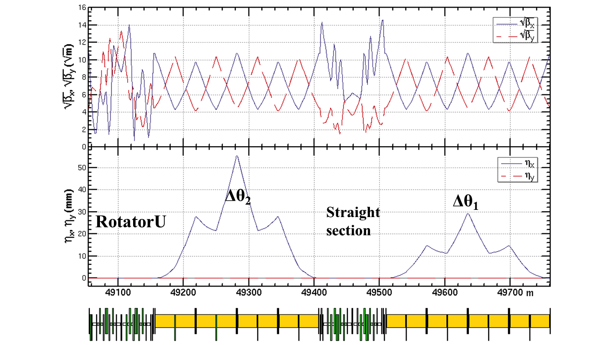
Spin rotators in the collider ring at Z-pole
Solenoid-based spin rotator + anti-symmetric arrangement [1,2,3,4]
solenoids: 240 T m, Lsol = 40m @ 6T
two modules: ~100 m
2.65 mrad
1.39mrad
[1] D. Barber, et al., A solenoid spin rotator for large electron storage rings. Part. Accel. 17 (1985) 243. [2] I. Koop, Longitudinally polarized electron in SuperB, eeFACT’08 [3] S. Nikitin, Opportunities to obtain polarization at CEPC, IJMPA, 34, 194004 (2019) [4] W. Xia et al., Radiat. Det. Tech. Meth. 6:490 (2022).

Slide 17
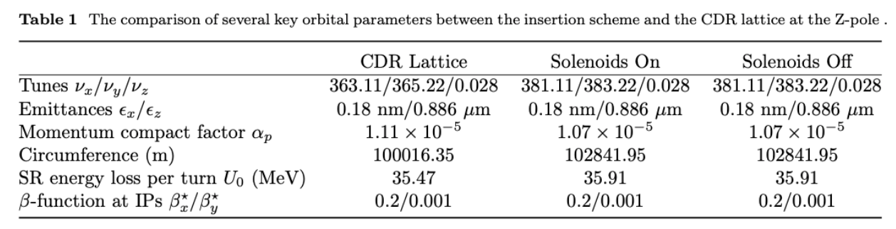
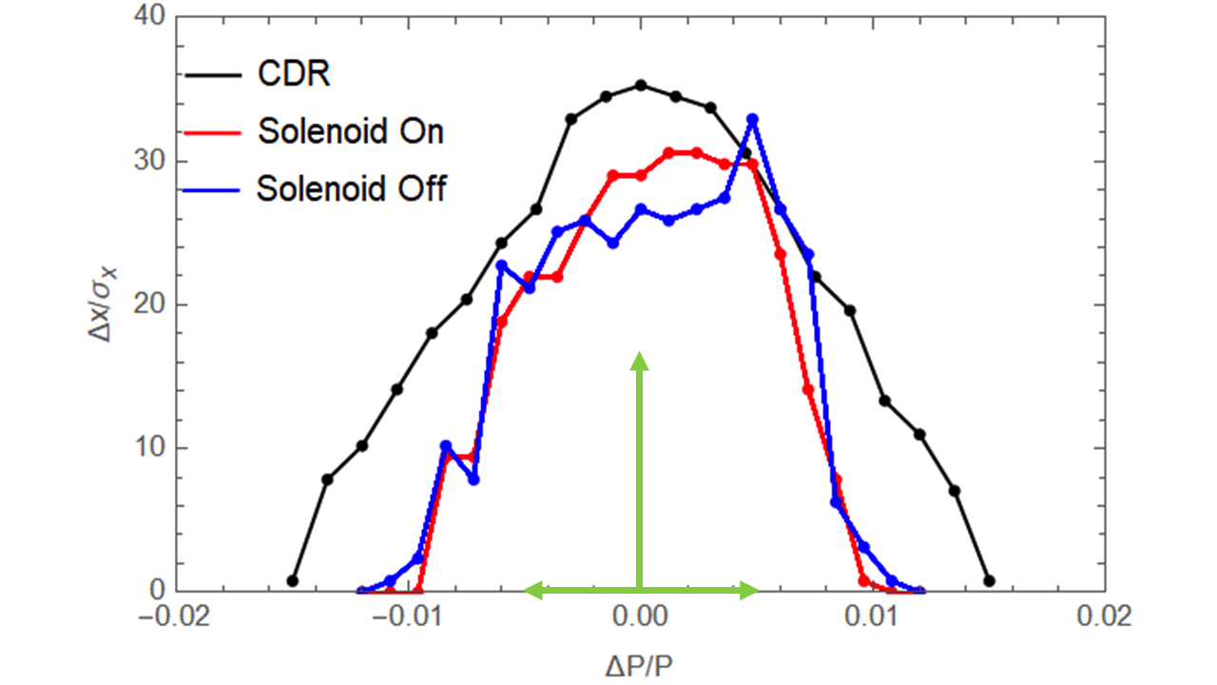
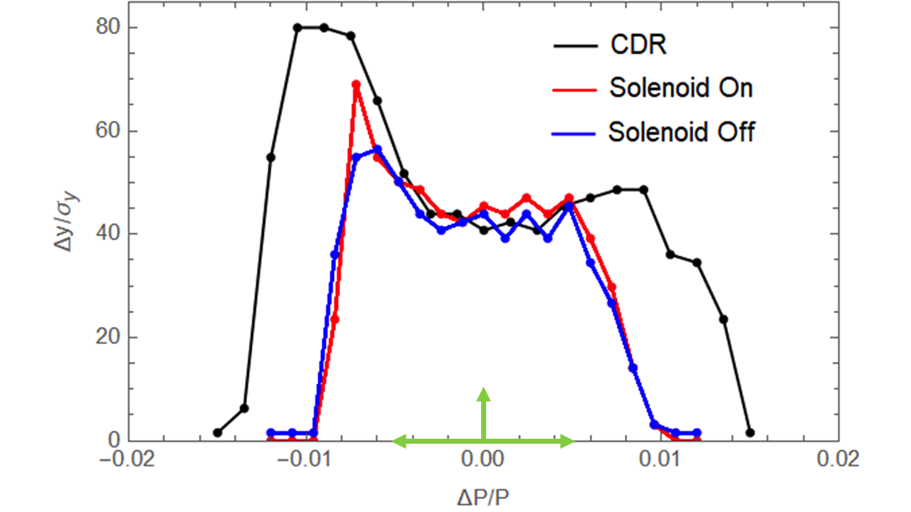
Performance evaluation: orbital motion
Changes in optics parameters
  Increase of circumference ~ 2.8 km, can be optimized.
  Increase of integer betatron tunes by 18 units
Moderate reduction in dynamic aperture and local momentum acceptance
Further optimization using more sextupole families could help recover
[1]W. Xia et al., Radiat. Det. Tech. Meth. 6:490 (2022).

Slide 18
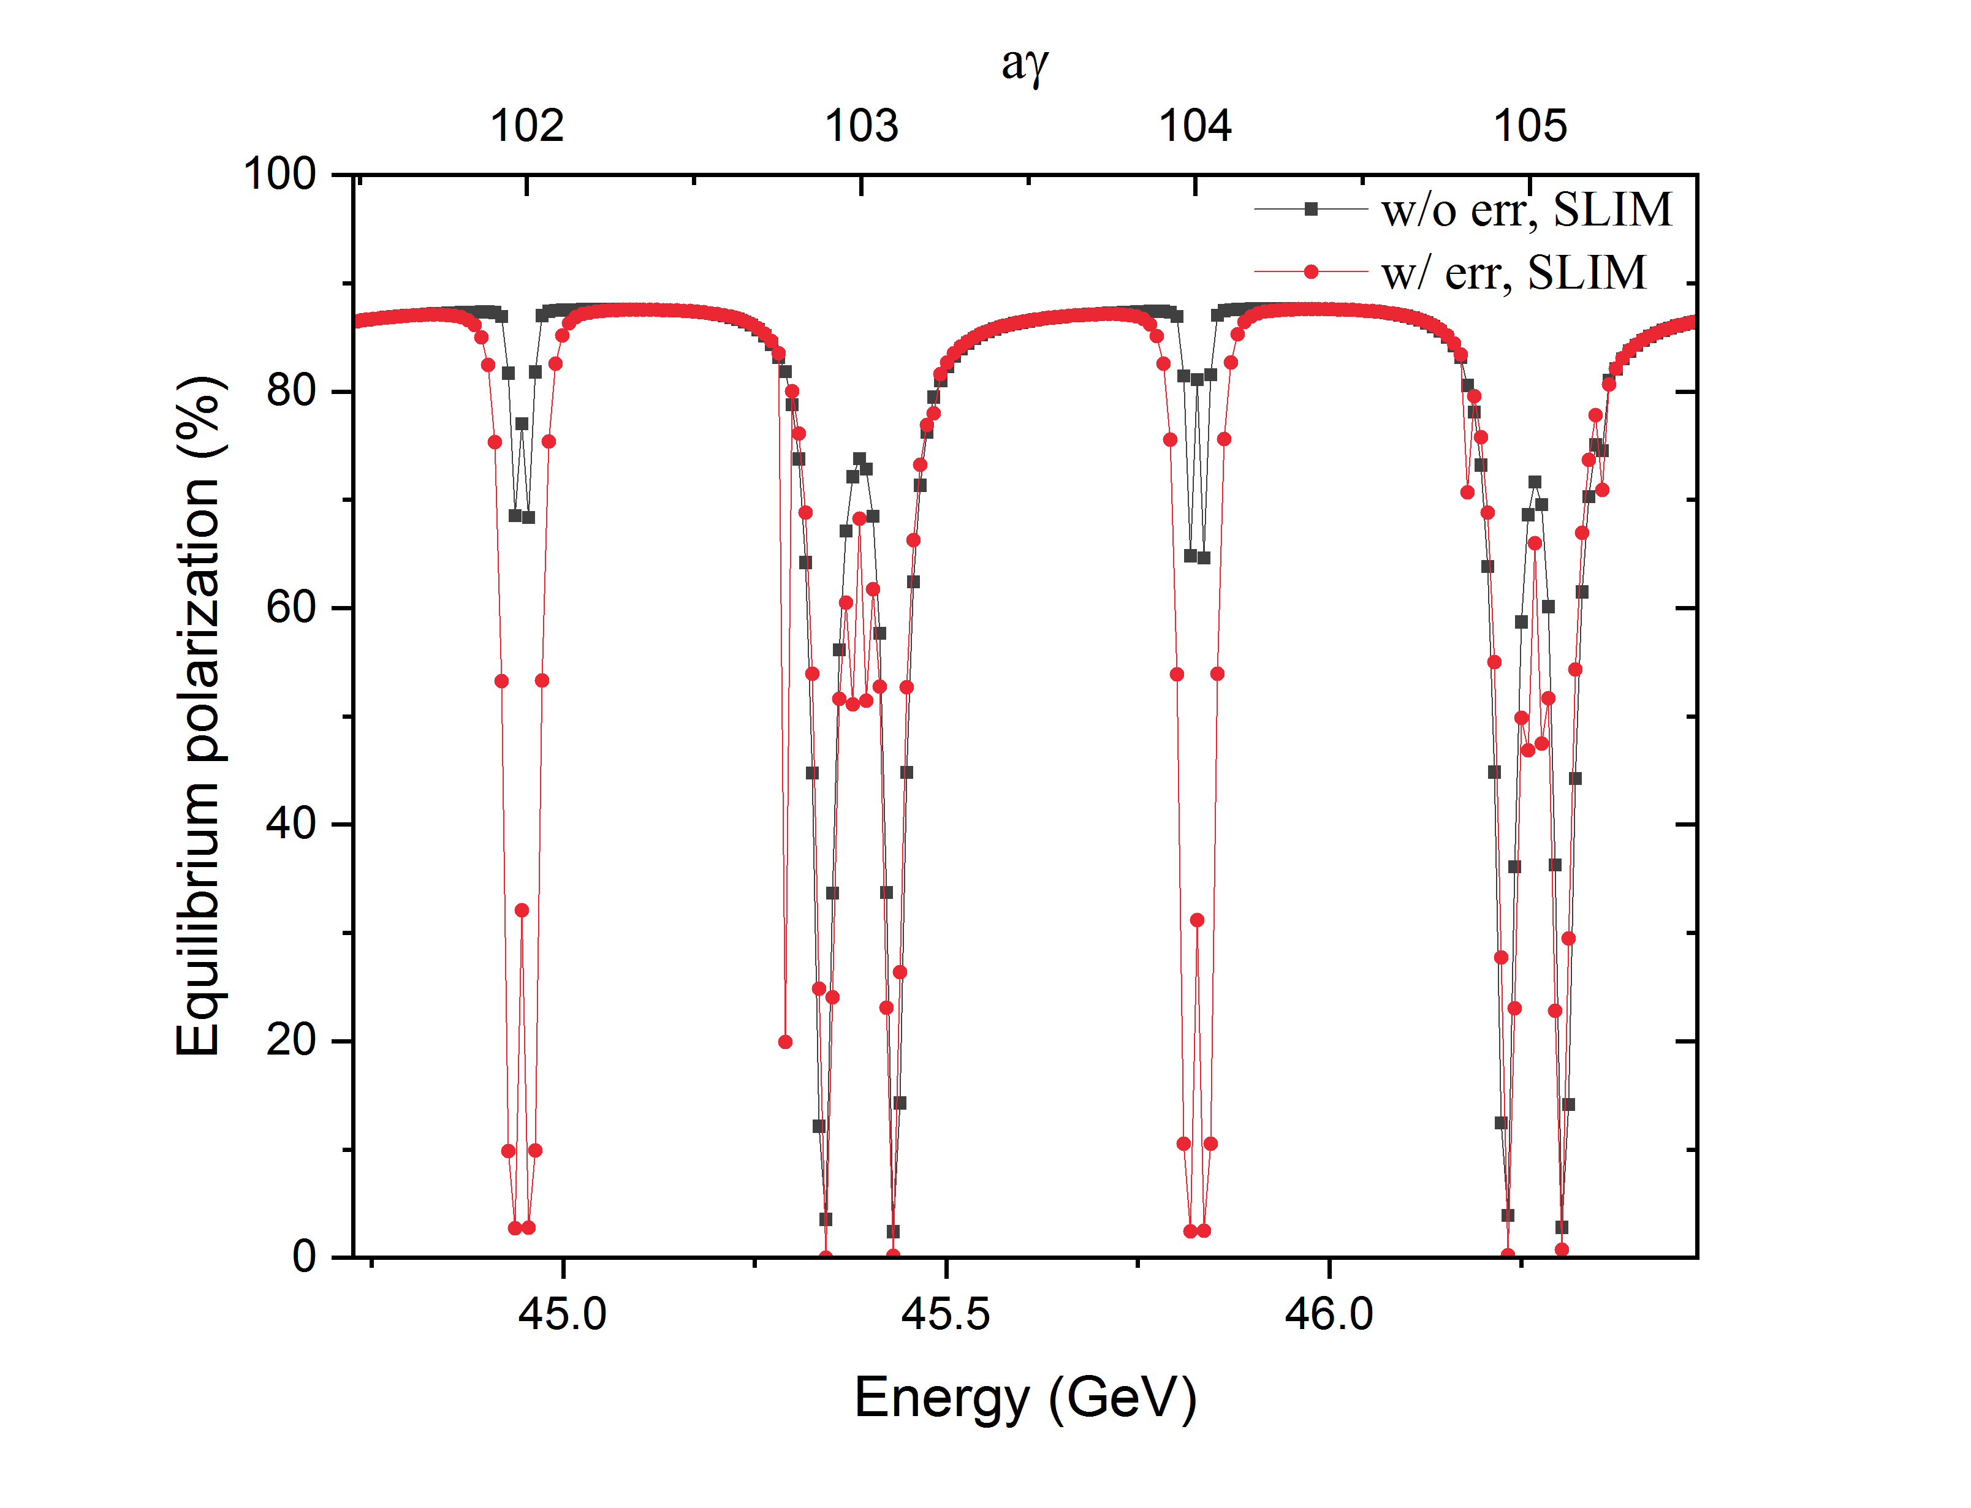
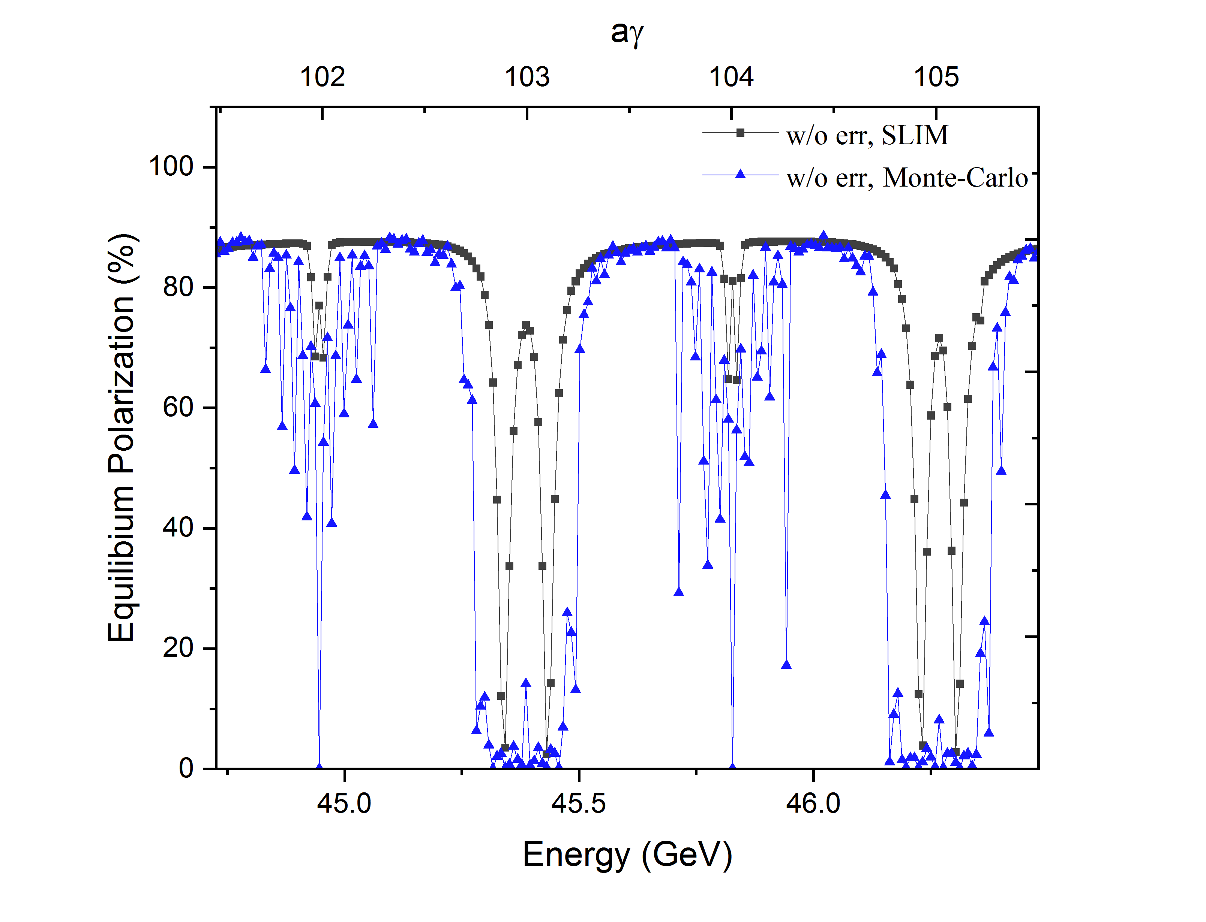
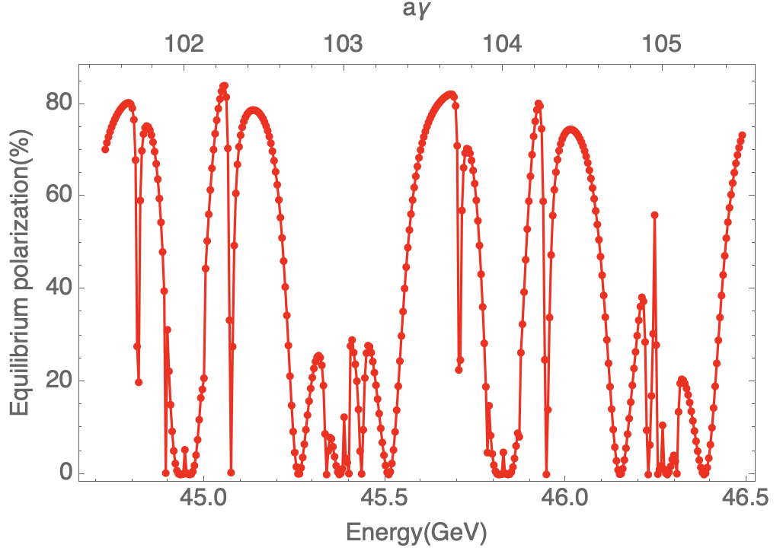
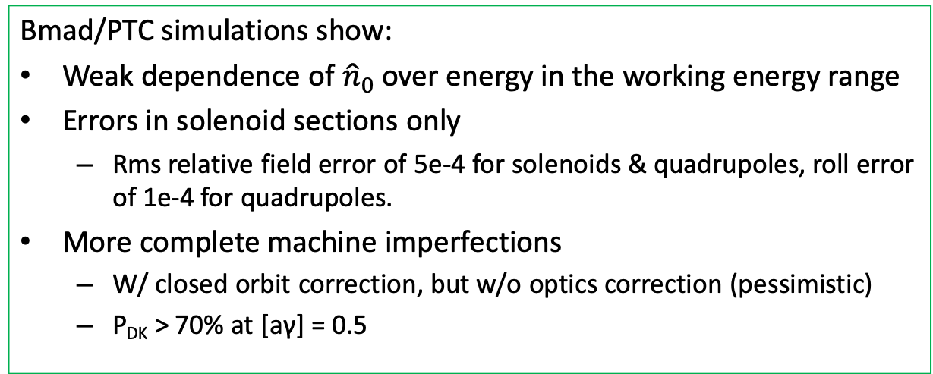
Performance evaluation: polarization
Bmad/PTC simulations show:
Weak dependence of ${\hat{n}}_{0}$ over energy in the working energy range
Errors in solenoid sections only
  Rms relative field error of 5e-4 for solenoids & quadrupoles, roll error of 1e-4 for quadrupoles.
More complete machine imperfections
  W/ closed orbit correction, but w/o optics correction (pessimistic)
  P_{DK} > 70% at [aγ] = 0.5
w/ errors in solenoid sections
w/ more complete imperfections and closed orbit correction
[1]W. Xia et al., Radiat. Det. Tech. Meth. 6:490 (2022).

Slide 19
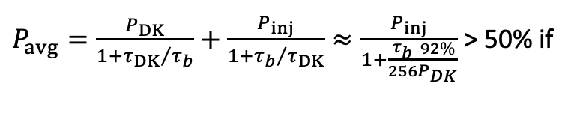
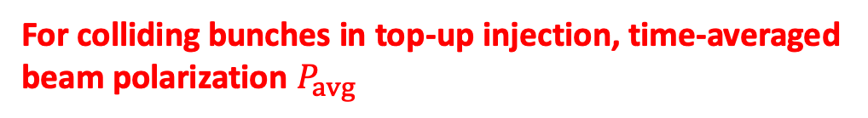
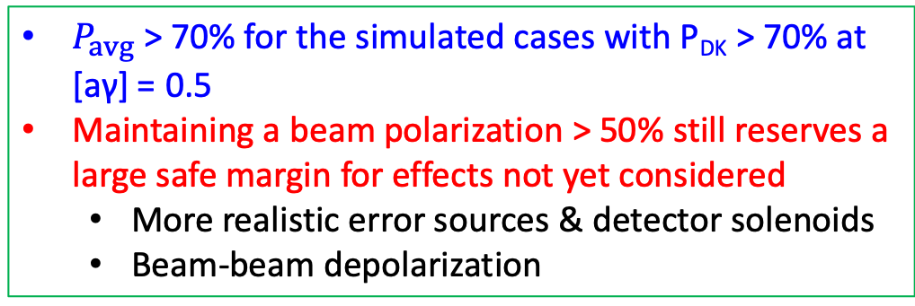
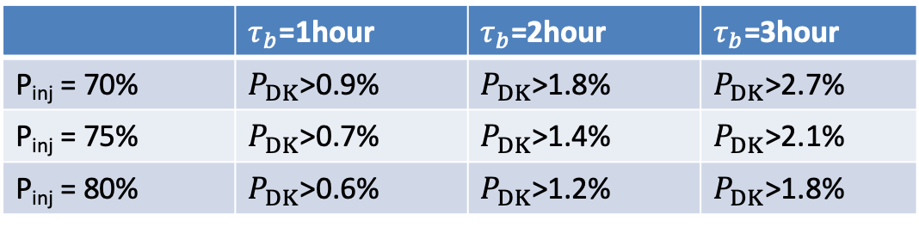
Polarized colliding beams: beam polarization > 50%
Polarization transmission
For colliding bunches in top-up injection, time-averaged beam polarization $P_{avg}$
Polarized e- source
Polarization >85%
Ref: ILC, EIC
Linac and transport lines
Polarization loss < 10%
Ref: SLC, ILC
Booster
Polarization loss < 5%
Collider
P_{inj} > 70% after considering these factors
$P_{avg}=\frac{P_{DK}}{1+{τ_{DK}}/{τ_{b}}}+\frac{P_{inj}}{1+{τ_{b}}/{τ_{DK}}}≈\frac{P_{inj}}{1+\frac{τ_{b}}{256}\frac{92\%}{P_{DK}}}$ > 50% if
 | $τ_{b}$=1hour | $τ_{b}$=2hour | $τ_{b}$=3hour
P_{inj} = 70% | $P_{DK}$>0.9% | $P_{DK}$>1.8% | $P_{DK}$>2.7%
P_{inj} = 75% | $P_{DK}$>0.7% | $P_{DK}$>1.4% | $P_{DK}$>2.1%
P_{inj} = 80% | $P_{DK}$>0.6% | $P_{DK}$>1.2% | $P_{DK}$>1.8%
$P_{avg}$ > 70% for the simulated cases with P_{DK} > 70% at [aγ] = 0.5
Maintaining a beam polarization > 50% still reserves a large safe margin for effects not yet considered
  More realistic error sources & detector solenoids
  Beam-beam depolarization

Slide 20
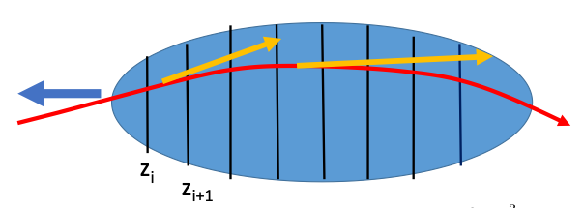
Beam lifetime issues for the CDR lattice w/ spin rotators
Beam Parameter | H/V emittance | Bunch population | Energy spread (w/ Beamstrahlung) | Bunch length (w/ Beamstrahlung)
Value | 170/1.6 pm | 8e10 | 8e-4 | 8.5e-3
Beam lifetime contribution | CDR lattice w/ spin rotators | Comments
Radiative Bhabha | 2.9 hour | ref: CEPC TDR
Vacuum lifetime | 3 hour | ref: CEPC TDR
Touschek lifetime | 4.64 hour | CDR lattice w/o rotators: 8.9 hour
Lifetime limited by dynamic aperture | 5.3 second | Tracking simulations
Beamstrahlung
The lifetime limited by the dynamic aperture [1]
  Combined effects: beam-beam, beamstrahlung, radiation damping and quantum excitation, 6D dynamic aperture
  Can be alleviated by reducing the bunch population (luminosity)
  Direct optimization using sextupoles is also effective (recent finding)
e+
e-
w/o BB
w/ BB
diffusion
diffusion
Blow up
DA
[1] K. Oide, talks on FCC Week, 2022 & 2023.

Slide 21
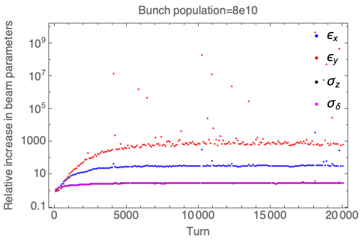



Beam lifetime limited by the dynamic aperture
Element-by-element tracking in SAD of 1000 particles (Gaussian) for 20000 turns (6.8 s), w/ weak-strong BB, BS and SR
Substantial beam blow-up & particle loss at nominal bunch population.
No particle loss for bunch population <= 4e10, at a reduced luminosity ($×$¼)
Dedicated optimization of sextupoles are under way
Bunch population | No of lost particles | Estimated lifetime
8e10 | 601 (20000 turns) | 5.3 s
7e10 | 188 (20000 turns) | 20.8 s
6e10 | 14 (20000 turns) | 328 s
5e10 | 1 (50000 turns) | ~4.6 hours
<=4e10 | 0 (50000 turns) | > 4.6 hours

Slide 22

Latest optimization of the lifetime
Direct optimization of the lifetime w/ BB+BS+lattice
  using 254 families of sextupoles
  no loss in 100k turns, beam lifetime limited by DA > 9.53 hours
Before optimization
After optimization

Slide 23
Polarized colliding beams: beam lifetime > 60 min
For the CDR lattice + spin rotators, the beam lifetime is longer than 60 min at a bunch population of 4e10, and a reduced luminosity (~ $×$¼ )
Beam lifetime contribution | CDR lattice w/ spin rotators | Comments
Radiative Bhabha | 11.6 hour | ¼ design luminosity
Vacuum lifetime | 6 hour | ref: CEPC TDR, ½ beam current
Touschek lifetime | 5.8 hour | ½ bunch population, w/o beamstrahlung
Lifetime limited by dynamic aperture | >4.6 hour | ½ bunch population, no loss in 50 k turns
Total beam lifetime | > 1.56 hour
For the CDR lattice + spin rotators + optimized sextupole settings, the beam lifetime is longer than 60 min at a bunch population of 8e10, and the nominal luminosity
Beam lifetime contribution | CDR lattice w/ spin rotators | Comments
Radiative Bhabha | 2.9 hour | ref: CEPC TDR
Vacuum lifetime | 3 hour | ref: CEPC TDR
Touschek lifetime | 4.63 hour
Lifetime limited by dynamic aperture | > 9.53 hour | no loss in 100 k turns
Total beam lifetime | > 1 hour

Slide 24


On the indicators
Indicator | Results | Comments
Design longitudinally polarized colliding beams | Done | Injecting polarized beams, spin rotators in collider rings
Beam polarization > 50% | $P_{avg}$ > 70% for the simulated cases with P_{DK} > 70% at [aγ] = 0.5 | A large safe margin for effects not considered yet
Beam lifetime > 60 min | Beam lifetime > 60 min | >100 min for 4e10 (1/2 nominal setting) with a reduced luminosity (~ $×$¼); recent optimization obtains a lifetime > 60 min for the nominal setting

Slide 25
Outline
I. Introduction
  Background
  Indicators and tasks
II. Design of longitudinally polarized colliding beams
III. Other studies on polarized beams
  Polarized Beams for Resonant Depolarization
  Radiative Depolarization Mechanism @ Ultra-high energies
IV. Summary

Slide 26





Polarized beams for Resonant Depolarization at Z-pole
Scenario 1: Self-polarization enhanced by asymmetric wigglers [1]
Implementation of the asymmetric wigglers into the CDR lattice w/ spin rotators
The lifetime limited by the dynamic aperture is not an issue for the above wiggler settings
[1] The FCC-ee Energy and Polarization Working Group, arXiv:1909.12245v1, 2019.

Slide 27


Polarized beams for Resonant Depolarization at Z-pole
Scenario 2: Injecting polarized e+/e- beams [2]
Scenarios |  | Self-polarization in the collider[1] | Injection of polarized beams[2]
Hardware | Polarized electron gun | None | Yes
 | Asymmetric wigglers | In the colliders | In the e+ damping ring
Polarization level |  | 5% ~ 10% | > 70% for e-, > 20% e+
Dead time for physics |  | Initial 1~2 hours in each fill | None
Frequency of RD measurements |  | Every ~10 min per beam | More frequent for e- beam
RD on colliding beams |  | None | Possible at lower bunch charge
[1] The FCC-ee Energy and Polarization Working Group, arXiv:1909.12245v1, 2019.
[2] Zhe Duan, talk on 2nd FCC EPOL Workshop, Sep 29, 2022

Slide 28






e+ damping/polarizing ring
DR V4.0 | unpolarized e+ | polarized e+
Energy (Gev) | 1.542
Circumference (m) | 144.2
Number of trains | 2(4)
Number of bunches/trian | 1(2)
Total current (mA) | 12.4
Bending radius (m) | 3.44
Dipole strength B₀ (T) | 1.07
Wiggler strength B₊ (T) | 1.8
Wiggler cell length (m) | 1.5
U₀ (kev/turn) | 190.9
Damping time x/y/z (ms) | 7.77/7.77/3.89
Momentum compaction | 0.015
Storage time | 20 ms | 10 min
δ₀ (%) | 0.072
ε₀ (mm.mrad) | 138
injection σ_{z} (mm) | 6
Extract σ_{z} (mm) | 5.7 | 5.6
ε_{inj} (mm.mrad) | 2500
ε_{ext x/y} (mm.mrad) | 151/15 | 138/14
δ_{inj} /δ_{ext} (%) | 0.18 /0.072
RF acceptance (%) | 1.8
f_{RF} (MHz) | 650
V_{RF} (MV) | 3.95
Longitudinal tune | 0.044
Asymmetric wigglers
B₊=1.8T=-5 B₋
cell length=1.5m
16 such cells
+1(2)
[1] Z. Duan and D. Wang, in preparation.

Slide 29




Radiative depolarization effects in electron storage rings
Radiative depolarization characterized by $τ_{d}$ exhibits two phenomena :
  Dips near spin resonances
  More difficult to achieve a high polarization at higher energies
    Stronger first-order spin resonances $υ_{0}±ν_{z}=k$
    Higher-order resonances further enhance radiative depolarization
      $ν_{0}±mν_{z}=k$
  $P_{DK}≈\frac{P_{∞}}{1+τ_{p}/τ_{d}}$, $\frac{1}{τ_{DK}}=\frac{1}{τ_{p}}+\frac{1}{τ_{d}}$
The SPEAR electron polarization for different beam energies[1]
Electron polarization measurements in different machines [2]
[1] J. R. Johnson, et al., Nucl. Instrum. Meth 204, 261 (1983).
[2] R. Assmann, et al., AIP Conference Proceeding, 570, 169 (2001).

Slide 30






Radiative depolarization in ultra-high-energy storage rings
Two distinct spin diffusion mechanisms were proposed in [1] in 1970s, regarding the regimes of spin resonance crossing, in the combined effects of synchrotron oscillation and synchrotron radiation
Regime | Correlated regime (consistent with existing measurements) | Uncorrelated regime (not yet confirmed by experiments)
Condition | $$κ=\frac{υ_{0}^{2}λ_{p}}{υ_{z}^{3}}≪1$$ | $κ=\frac{υ_{0}^{2}λ_{p}}{υ_{z}^{3}}≪1$ is violated and $\frac{υ_{0}σ_{δ}}{υ_{z}}≫1$
Theory | Non-resonant spin diffusion & perturbative treatment of $\frac{∂\hat{n}}{∂δ}$ | Resonant spin diffusion
Depolarization effect | Higher-order synchrotron sideband spin resonances | No dependence on $υ_{z}$, weaker depolarization
Monte-Carlo simulations were compared with these theories in the energy range of CEPC [2]
  showing a gradual evolution from the correlated regime to the uncorrelated regime in parameter scan
This study suggests existing theories are incomplete, requiring further development
Case A: dependence on beam energy
Case B: influence of harmonic RF cavity
Z
Higgs
optimal lengthening condition
Scan harmonic RF voltage
$$κ=\frac{{\text{ν}}_{0}^{2}λ_{p}}{{\text{ν}}_{z}^{3}}→∞$$
[1] Derbenev, Kondrantenko and Skrinsky, Part. Accel. 9, 247 (1979)
[2] W. H. Xia, Z. Duan, D. P. Barber, Y. W. Wang, B. Wang, J. Gao, accepted by Phys. Rev. Accel. Beams.

Slide 31
Outline
I. Introduction
  Background
  Indicators and tasks
II. Design of longitudinally polarized colliding beams
III. Other studies on polarized beams
IV. Summary

Slide 32
The team
In the task book
  4 staffs: 段哲、李小平、王毅伟、王逗
Other main contributors
  Staffs: 季大恒、王斌、黄永盛（中山大学）、唐光毅
  Graduate students: 夏文昊（2022年博士毕业），陈姗红（2023年博士毕业），陈涛（2023年硕士毕业）
International collaborators
  D. P. Barber (DESY & UME): collaboration on one PRAB paper and proofreading of other papers
  S. Nikitin (BINP): discussions & proofreading of the papers.
Acknowledgement:
Colleagues in the AP Group and the CEPC design team for support and discussions.
D. Sagan (Cornell) and E. Forest (KEK) for help with the Bmad/PTC codes.

Slide 33
Publications
Journal papers
  G. Y. Tang et al., The circular electron-positron collider beam energy measurement with Compton scattering and beam tracking method, Rev. Sci. Inst. 91, 033109 (2020).
  W. H. Xia et al., Investigation of spin rotators in CEPC at the Z-pole, Radiat. Det. Tech. Meth. 6:490 (2022).
  S. H. Chen, Y. S. Huang, et al., A toy Monte Carlo simulation for the transverse polarization of high-energy electron beams, JINST 17 P08005, (2022).
  T. Chen, et al., Booster free from spin resonance for future 100-km-scale circular e+e- colliders, Phys. Rev. Accel. Beams, 26, 051003 (2023).
  W. H. Xia, et al, Evaluation of radiative depolarization in the future Circular Electron-Positron Collider, accepted by Phys. Rev. Accel. Beams, 2023.
Conference proceedings
  Z. Duan et al., Concepts of longitudinally polarized electron and positron colliding beams in the Circular Electron Positron Collider, Proc. IPAC 2019.
  Z. Duan et al., Longitudinally polarized colliding beams at the CEPC, Proc. eeFACT 2022.
  Z. Duan et al., Beam polarization studies at the CEPC, Proc. IPAC 2023.
  T. Chen et al., A Booster Free From Spin Resonances For Future 100 km-scale Circular e+e- Colliders, Proc. IPAC 2023.

Slide 34

Workshop oral presentations

Slide 35
Some peer review comments
Booster polarization maintenance paper in Physical Review Accelerator and Beams
Referee A:
This paper represents an important first step in the consideration of the polarization performance for such types of machines and will be of extreme value for the future lepton rings which are being planed to be
built both in China and in Europe. This work demonstrates the feasibility of building such machines and achieving high level of polarization for both energy calibration and actual experiments. It also shows the energy limits and design considerations which should go into such a machine. As such I think it would be an important paper for PRAB to publish.
Referee B:
I like particularly their explicit formulae for the intrinsic resonance strengths that go substantially beyond S. Y. Lee's book [51] concerning the detail and generality.
The authors treatment proves a high degree of fundamental understanding of resonant beam depolarization.
In summary I consider this a very nice, innovative, original, and readable paper, and I recommend to publish the manuscript without changes.

Slide 36



Some peer review comments
CEPC TDR International Review (June 11- 17, Hong Kong)

Slide 37
子任务专家评审意见
2023年6月3日，“2018年国家重点研发计划：高能环形正负电子对撞机关键技术研发和验证”项目课题1（高能环形正负电子加速器关键技术验证）在北京组织了子任务“Z能区极化束对撞设计”的任务评审。来自中国科学技术大学、中科院近代物理研究所、中科院高能物理研究所的6位专家（名单见附件）听取了任务组的设计报告，经认真质询和讨论，形成评审意见如下：
任务组围绕任务书要求和研究目标，在未来高能环形正负电子对撞机极化束设计研究方面取得了系列创新性成果。
提出并研究了从源头产生极化束流，经直线注入器、增强器到对撞环，实现极化束对撞和共振退极化束流能量测量的初步可行方案。
基于CEPC概念设计报告的磁聚焦结构和关键参数，完成了Z能区纵向极化束对撞的完整设计。模拟研究显示，对撞束流时间平均极化度可达到50%以上，在对撞环中加入非对称扭摆器和自旋旋转器对束流寿命没有显著影响，束流寿命大于60分钟。
针对具有高度周期性的环形加速器，拓展了自旋共振结构的理论模型，首次解释了自旋共振强度增强和削弱的物理机理。
针对超高束流能量电子储存环，模拟验证了退极化效应存在非相干共振穿越区域，揭示了现有理论在处理相关问题时存在缺陷。
以上研究成果被写入CEPC技术设计报告的附录章节，为其他环形正负电子对撞机的设计提供了良好借鉴。
专家组认为，任务组圆满完成了任务书规定的所有研究任务，实现了预期研究目标，同意通过任务评审。

Slide 38
Summary
Achievements
  Propose and study preparation-from-the-source and injecting high-polarized beams as an attractive solution for both longitudinally polarized colliding beams and resonant depolarization in future 100km-scale e+e- colliders
  Complete a preliminary feasible design of longitudinally polarized colliding beams for CEPC at Z-pole with promising performance
Innovations
  Deepen the understanding of spin depolarization mechanism at utrahigh energy electron circular accelerators
    Expand the theoretical model of spin resonance structure and explain the mechanism of enhancement and cancellation of spin resonance strengths
    simulations verify the uncorrelated regime of spin resonance crossing and suggest the incompleteness of existing theories of radiative depolarization.

Slide 39
Thank you for your attention！

Slide 40




Spin resonance structure
Intrinsic resonance strength
$$|ε|≈E_{P}（ε_{arc}+ε_{ss}+ε_{DOM}）$$
$$ε_{arc}{=|ε}_{FODO}| E_{M}$$
Near superstrong resonances, $ε_{arc}$ dominates
Away from superstrong resonances, $ε_{ss}+ε_{DOM}$ becomes more important
  For small K << ν_{B}, the phasor includes a slow wave KΦ and a fast wave ν_{y}φ_{y} , leading to effective cancellation among all cells (arc, SS and DOM)

Slide 41






Cancellation at small K
$$υ_{0}=K=k±υ_{y}$$
$$υ_{0}=K$$
Intrinsic resonances:
Imperfection resonances:

Slide 42

Setup of CEPC booster lattice
Arc region covers ~ 80% of circumference
General structure of the CEPC booster lattice (an alternative design)
  8 arcs each containing 140 FODO cells
  interleaved with 8 straight sections
60 imperfection lattice seeds
  Misalignment error & field error, scan BPM offset
  Closed orbit correction & tune correction
Multi-particle tracking in Bmad
  Energy and RF ramping in the whole process
  Element-by-element tracking with radiation damping & quantum excitation
[1] T. Chen, Z. Duan, D. H. Ji, D. Wang, Phys. Rev. Accel. Beams, 26, 051003 (2023).

Slide 43



Simulations for CEPC parameters: long sweep
Cases | CEPC-Z pilot bunch | CEPC-Z colliding bunch | CEPC-W pilot bunch
aγ₀ | 103.4921 | 103.4921 | 181.5123
σ_{δ} | 3.847e-4 | 1.3e-3 | 6.79e-4
ν_{z} | 0.03448 | 0.03448 | 0.062
Modulation index | 1.15 | 3.9 | 2.0
Resonance strength ω_{Κ} (Koop’s definition) | 1e-4 | 1e-4 | 1.5e-4
Scan rate ε’=dν/dn | 1e-8 | 1e-8 | 2e-8
ω_{Κ}²/ε’ | 1 | 1. | 1.125
Scan time (s) | 130 | 130 | 65
CEPC-Z pilot bunch
CEPC-Z colliding bunch
CEPC-W pilot bunch

Slide 44

















Non-resonant spin diffusion in a planar ring at high beam energies
First-order “parent” spin resonance
  $υ_{0}±ν_{z}=k$ are more important
Higher-order synchrotron sideband spin resonances[1,3]
  $ν_{0}±mν_{z}=k$ are more important
  Modulation index
Vertical projection of ${\vec{ω}}_{z}$ onto ${\hat{k}}_{0}$, tilt of ${\hat{n}}_{0}$ from vertical due to integer spin resonances.
For vanishing ν_{z}, reduces to [1]
Horizontal projection of ${\vec{ω}}_{z}$ onto ${\hat{k}}_{0}$, due to vertical dispersions [2]
$$\text{ν}\text{0}σ_{δ}$$
[1] Derbenev, Kondrantenko and Skrinsky, Part. Accel. 9, 247 (1979)
[2] Montague, Phys. Rep, 113, 1 (1984). [3] Yokoya, Part. Accel. 13, 85 (1983)
$$\text{ν}\text{z}$$

Slide 45

Potential optimization in terms of longitudinal space
Bends in Δθ₁ and Δθ₂ sections are ~8 times weaker than arc bends, length of Δθ₁ and Δθ₂ sections can be reduced to ~1/2 with additional of triplets for optics matching
Δθ₁ can be incorporated into the IR
If spin rotators are only implemented for e- beam
Longitudinal space | RotatorU/RotatorD | Δθ₁ | Δθ₂ | SS | Total
The current design | (100m + 100m) * 2 | 250m*4 | 250m*4 | 100m*4 | 2.8km
Refine Δθ₁ & Δθ₂ | (100m + 100m) * 2 | 130m*4 | 130m*4 | 100m*4 | 1.8km
Implement Δθ₁ into IR | (100m + 100m) * 2 | 0 | 130m*4 | 100m*4 | 1.3km
Spin rotators for e- only | (100m + 100m) * 2 | 0 | 130m*4 | 0 | 0.7km
Crossing angle -> 2*15.17mrad | (100m + 100m) * 2 | 0 | 0 | 0 | 0.4km

Slide 46







Correlated and uncorrelated regime of spin resonance crossing
Follow the “dynamical picture” [1] that the instantaneous spin precession rate ν is dependent on the instantaneous energy deviation δ, underlying spin resonances could be crossed as a result of synchrotron oscillations
The following two regimes of spin resonance crossing were also proposed in [1]
Correlated regime:
  Non-resonant spin diffusion & perturbative treatment of $\frac{∂\hat{n}}{∂δ}$ applies
Uncorrelated regime:
  is violated and
  Resonant spin diffusion
$$\frac{\text{ν}\text{0}σ_{δ}}{\text{ν}\text{z}}≫1$$
[1] Derbenev, Kondrantenko and Skrinsky, Part. Accel. 9, 247 (1979)

Slide 47



