Slide 1
Budget status and future events
Zhaoru Zhang
2023/06/07

Slide 2
Budget status
Expense details collected on Apr. 30th has been submitted to Audit company
Now preparing unpaid/future expense list
  The amount of some unpaid international trip expenses need to be confirmed
  Not allowed unpaid/future expenses
    Without contract signed before Apr. 30th
    Future trips NOT related to assessment review

Slide 3
Final implementation of Task 1
EXPECTED | Expected Total expense | Ratio
Total | 1393460 | 83.9%
final payment of maget prototype磁铁样机尾款 | 140000
final payment of separator prototype静电分离器样机尾款 | 942500
Dec 2022 Joao's DESY trip | 22000
2022.7.8-7.15 Joao's trip to Italy and Spain. | 14000
2023 April Joao DESY trip | 24,300.00
trip of 5 experts attending task final assessment meeting: 24,300.00元 | 50000
review fee for final assessment：2400元/人/天×8人×2天 = 38400元 | 38400
trip of 5 people attending separator final assessment meeting at Shanghai 19,300.00元 | 19,300.00
trip of 5 people attending polarization final assessment meeting at Shanghai 19,300.00元 | 19,300.00
1 separator key member will go to Shanghai for checking prototype performance 2,660.00元 | 2,660.00
sub-tasks review fee: 2400元/人/天×5人×1天 x 4 sub-tasks= 48000元 | 48,000.00
audit fee审计费用 | 48700
printing fee 复印装订资料预计5,000.00元 | 5,000.00
 | Total Expense | budget | Ratio
Total | 678.15 | 974.00 | 69.63%
（1） Direct costs | 593.782 | 878.19 | 67.61%
1. Equipment cost | 418.914 | 456 | 91.87%
(1) Equipment cost | 129.794 | 140 | 92.71%
(2) Trial production equipment cost | 289.12 | 296 | 97.68%
(3) Equipment renovation cost | 0 | 20 | 0.00%
2. Material cost | 28.7331 | 116 | 24.77%
3. Test and laboratory processing fee | 10.986 | 76.2 | 14.42%
4. Fuel and power cost | 0 | 18 | 0.00%
5. Travel / conference / international cooperation and exchange fee | 55.9089 | 131.1 | 42.65%
6. Publication / literature / information dissemination / intellectual property service fee | 7.19368 | 20.29 | 35.45%
7. Labor fee | 70.1056 | 51 | 137.46%
8. Expert consultation fee | 1.9409 | 9.6 | 20.22%
9. Other expenses | 0
（2） Indirect costs | 84.3661 | 95.81 | 88.06%

Slide 4
Final implementation of Task 2
 | Total expense | budget | Ratio
（1） Direct costs | 1002.02 | 1200.00 | 83.50%
（1） Direct costs | 853.40 | 1047.71 | 81.45%
1. Equipment cost | 137.47 | 196.30 | 70.03%
(1) Equipment cost | 137.47 | 196.30 | 70.03%
(2) Trial production equipment cost
(3) Equipment renovation cost
(4) Equipment rental fee
2. Material cost | 131.09 | 235.66 | 55.63%
3. Test and laboratory processing fee | 330.36 | 299.80 | 110.19%
4. Fuel and power cost |  | 20.64
5. Travel / conference / international cooperation and exchange fee | 92.89 | 123.81 | 75.03%
6. Publication / literature / information dissemination / intellectual property service fee | 3.66 | 8.50 | 43.09%
7. Labor fee | 148.40 | 157.00 | 94.52%
8. Expert consultation fee | 7.19 | 6.00 | 119.89%
9. Other expenses
Indierect fee | 148.62 | 152.29
EXPECTED | Expected Total expense | Ratio
Total | 445896 | 87.22%
2023年4月份Zhijun DESY trip -- 39200 | 39200
2023年4月份 4 students' DESY trip subsidy | 64000
4 students DESY trip flight+hotel | 92196 | NJU
2 students’ subsidy of DESY trip | 32000
Jingyu main mechanic support processing fee | 139000
trip of 3 experts attending task final assessment meeting: 14500.00元 | 14500
Audit fee 审计费用 | 60000
pringting 复印装订资料预计5,000.00元 | 5000

Slide 5
Final implementation of Task 2 - IHEP
IHEP | Total expense | budget | Ratio
Total | 666.78 | 728.10 | 91.58%
Direct costs | 588.83 | 650.15 | 90.57%
1. Equipment cost | 123.09 | 170.50 | 72.19%
(1) Equipment cost | 123.09 | 170.50 | 72.19%
(2) Trial production equipment cost
(3) Equipment renovation cost
(4) Equipment rental fee
2. Material cost | 28.48 | 87.24 | 32.65%
3. Test and laboratory processing fee | 324.13 | 263.50 | 123.01%
4. Fuel and power cost |  | 18.44
5. Travel / conference / international cooperation and exchange fee | 37.51 | 55.36 | 67.75%
6. Publication / literature / information dissemination / intellectual property service fee | 2.38 | 2.11 | 112.68%
7. Labor fee | 70.68 | 47.00 | 150.39%
8. Expert consultation fee | 2.55 | 6.00 | 42.53%
9. Other expenses
Indirect fee | 77.95 | 77.95 | 100.00%
EXPECTED | Expected Total expense | Ratio
Total | 353700 | 96.44%
2023年4月份Zhijun DESY trip -- 39200 | 39200
2023年4月份 4 students' DESY trip subsidy | 64000
2 students’ subsidy of DESY trip | 32000
Jingyu main mechanic support processing fee | 139000
trip of 3 experts attending task final assessment meeting: 14500.00元 | 14500
Audit fee 审计费用 | 60000
pringting 复印装订资料预计5,000.00元 | 5000

Slide 6
Final implementation of Task 2 - NWPU
NWPU | Total expense | budget | Ratio
Total | 96.91 | 150.70 | 64.31%
（1） Direct costs | 76.86 | 127.02 | 60.51%
1. Equipment cost | 1.90 | 8.60 | 22.09%
(1) Equipment cost | 1.90 | 8.60 | 22.09%
(2) Trial production equipment cost
(3) Equipment renovation cost
(4) Equipment rental fee
2. Material cost | 41.55 | 42.00 | 98.93%
3. Test and laboratory processing fee |  | 4.95
4. Fuel and power cost
5. Travel / conference / international cooperation and exchange fee | 9.12 | 21.84 | 41.75%
6. Publication / literature / information dissemination / intellectual property service fee | 0.59 | 2.13 | 27.93%
7. Labor fee | 23.53 | 47.50 | 49.54%
8. Expert consultation fee | 0.17
9. Other expenses
Indirect fee | 20.05 | 23.68

Slide 7
Final implementation of Task 2 - NJU
NJU | Total expense | budget | Ratio
Total | 78.64 | 103.31 | 76.12%
（1） Direct costs | 62.90 | 87.53 | 71.86%
1. Equipment cost | 8.59 | 8.60 | 99.88%
(1) Equipment cost | 8.59 | 8.60 | 99.88%
(2) Trial production equipment cost
(3) Equipment renovation cost
(4) Equipment rental fee
2. Material cost | 1.72 | 2.40 | 71.61%
3. Test and laboratory processing fee | 6.23 | 31.35 | 19.86%
4. Fuel and power cost | 2.34 | 2.20 | 106.44%
5. Travel / conference / international cooperation and exchange fee | 32.83 | 25.85 | 127.01%
6. Publication / literature / information dissemination / intellectual property service fee | 0.01 | 2.13 | 0.33%
7. Labor fee | 11.18 | 15.00 | 74.53%
8. Expert consultation fee
9. Other expenses
(2) Indirect costs | 15.74 | 15.78 | 99.75%
EXPECTED | Expected Total expense | Ratio
Total | 92196 | 0.85
4 students DESY trip flight+hotel | 92196

Slide 8
Final implementation of Task 2 - SDU
SDU
Total | 159.69 | 217.89 | 73.29%
（1） Direct costs | 124.81 | 183.01 | 68.20%
1. Equipment cost | 3.89 | 8.60 | 45.23%
(1) Equipment cost | 3.89 | 8.60 | 45.23%
(2) Trial production equipment cost
(3) Equipment renovation cost
(4) Equipment rental fee
2. Material cost | 59.33 | 104.02 | 57.04%
3. Test and laboratory processing fee
4. Fuel and power cost
5. Travel / conference / international cooperation and exchange fee | 13.43 | 20.76 | 64.70%
6. Publication / literature / information dissemination / intellectual property service fee | 0.68 | 2.13 | 32.09%
7. Labor fee | 43.00 | 47.50 | 90.53%
8. Expert consultation fee | 4.47
9. Other expenses
(2) Indirect costs | 34.88 | 34.88

Slide 9
Final implementation of Task 3
 | Total Expense | budget | Ratio
total | 794.64 | 971.00 | 81.84%
（1） Direct costs | 669.07 | 840.50 | 79.60%
1. Equipment cost | 127.83 | 135.60 | 94.27%
(1) Equipment cost | 127.83 | 135.60 | 94.27%
(2) Trial production equipment cost | 0.00
(3) Equipment renovation cost
(4) Equipment rental fee
2. Material cost | 343.11 | 379.46 | 90.42%
3. Test and laboratory processing fee | 30.30 | 45.00 | 67.33%
4. Fuel and power cost | 0.00 | 4.60 | 0.00%
5. Travel / conference / international cooperation and exchange fee | 53.86 | 128.34 | 41.96%
6. Publication / literature / information dissemination / intellectual property service fee | 16.01 | 6.00 | 266.75%
7. Labor fee | 94.82 | 137.50 | 68.96%
8. Expert consultation fee | 3.14 | 4.00 | 78.56%
9. Other expenses | 0.00 | 0.00
Indirect fee | 125.57 | 130.50
EXPECTED | Expected Total expense | Ratio
total | 548703.00 | 87.49%
shipping to CERN | 209715.00
trip for 6 people CERN beam test | 240145.00
3 people will go to IHEP for task final assessment meeting | 6884.00
(10%)Final payment of PMT | 7112.00
trip to CERN in April 23-May 2 | 35297.00
material printing 复印、装订资料预计 | 1000.00
Audit fee 审计服务费，于审计报告出具后支付 | 48550.00

Slide 10
Final implementation of Task 3 - USTC
USTC
 | Total Expense | budget | Ratio
total | 447.75 | 539.24 | 83.03%
（1） Direct costs | 375.25 | 466.74 | 80.40%
1. Equipment cost | 58.03 | 58.20 | 99.70%
(1) Equipment cost | 58.03 | 58.20 | 99.70%
(2) Trial production equipment cost | 0.00 | 0.00
(3) Equipment renovation cost | 0.00 | 0.00
(4) Equipment rental fee | 0.00 | 0.00
2. Material cost | 230.34 | 235.14 | 97.96%
3. Test and laboratory processing fee | 24.99 | 45.00 | 55.54%
4. Fuel and power cost | 0.00 | 3.10 | 0.00%
5. Travel / conference / international cooperation and exchange fee | 12.01 | 60.00 | 20.02%
6. Publication / literature / information dissemination / intellectual property service fee | 1.88 | 2.00 | 93.98%
7. Labor fee | 44.91 | 61.30 | 73.26%
8. Expert consultation fee | 3.09 | 2.00 | 154.63%
9. Other expenses | 0.00 | 0
(2) Indirect costs | 72.50 | 72.5 | 100%
EXPECTED | Expected Total expense | Ratio
total | 506294.00 | 92.42%
shipping to CERN | 209715.00
trip for 6 people CERN beam test | 240145.00
3 people will go to IHEP for task final assessment meeting | 6884.00
material printing 复印、装订资料预计 | 1000.00
Audit fee 审计服务费，于审计报告出具后支付 | 48550.00

Slide 11
Final implementation of Task 3 - IHEP
IHEP
total | 199.01 | 282.88 | 70.35%
（1） Direct costs | 165.94 | 244.88 | 67.76%
1. Equipment cost | 56.41 | 64.00 | 88.13%
(1) Equipment cost | 56.41 | 64.00 | 88.13%
(2) Trial production equipment cost | 0.00
(3) Equipment renovation cost | 0.00
(4) Equipment rental fee | 0.00
2. Material cost | 59.88 | 96.38 | 62.13%
3. Test and laboratory processing fee | 5.31 | 0.00
4. Fuel and power cost | 0.00 | 0.50 | 0.00%
5. Travel / conference / international cooperation and exchange fee | 11.53 | 36.00 | 32.02%
6. Publication / literature / information dissemination / intellectual property service fee | 14.06 | 2.00 | 703.02%
7. Labor fee | 18.76 | 45.00 | 41.70%
8. Expert consultation fee | 0.00 | 1.00
9. Other expenses | 0.00
(2) Indirect costs | 33.07 | 38.00 | 87.03%
EXPECTED | Expected Total expense | Ratio
Total | 42409.00 | 71.85%
(10%)Final payment of PMT | 7112.00
trip to CERN in April 23-May 2 | 35297.00

Slide 12
Final implementation of Task 3 - SJTU
SJTU
total | 147.88 | 148.88 | 99.33%
（1） Direct costs | 127.88 | 128.88 | 99.22%
1. Equipment cost | 13.40 | 13.40 | 100.00%
(1) Equipment cost | 13.40 | 13.40 | 100.00%
(2) Trial production equipment cost |  | 0.00 | 0.00%
(3) Equipment renovation cost | 0.00 | 0.00 | 0.00%
(4) Equipment rental fee | 0.00 | 0.00 | 0.00%
2. Material cost | 52.90 | 47.94 | 110.34%
3. Test and laboratory processing fee | 0.00 | 0.00 | 0.00%
4. Fuel and power cost | 0.00 | 1.00 | 0.00%
5. Travel / conference / international cooperation and exchange fee | 30.32 | 32.34 | 93.75%
6. Publication / literature / information dissemination / intellectual property service fee | 0.07 | 2.00 | 3.25%
7. Labor fee | 31.15 | 31.20 | 99.84%
8. Expert consultation fee | 0.05 | 1.00 | 5.00%
9. Other expenses | 0.00 | 0.00
(2) Indirect costs | 20.00 | 20 | 100%

Slide 13
Timeline for future events
Before June 19th
  Review report of test report for each task ( silicon and HCAL missing)
  Draft of task self-assessment report (better to have IHEP signature) ( silicon and HCAL missing)
  Draft of task review comments ( before June 15th)
  List of papers (MOST should be labeled as first support fund)
On June 19th
  Get signed review comment form from reviewers
From June 20-July 20
  3 Task self-assessment report (Polish and submit to MOST system)
  1 Project self-assessment report (Polish and submit to MOST system)
  6 Technical report (1 project final progress report, 3 task final progress report, 1 acc test report, 1 detector test report)
  1 Audit report
  List of 5 typical papers: MOST should be labeled as first support fund
  List of other papers
  Data collection certificate (before Sep. 30th)
Around mid of Oct.: Project assessment review organized by MOST
  submit a full set of documents to MOST in advance

Slide 14
Review report of test report
write test plan 编写测试方案
invite reviewer and they write review report of test plan 邀请专家评审测试方案，编写评审报告并签字
write test report 编写测试报告
invite reviewer and they write review report of test report 邀请专家评审测试报告，编写评审报告并签字
need at least 3 reviewers, 2 review reports

Slide 15
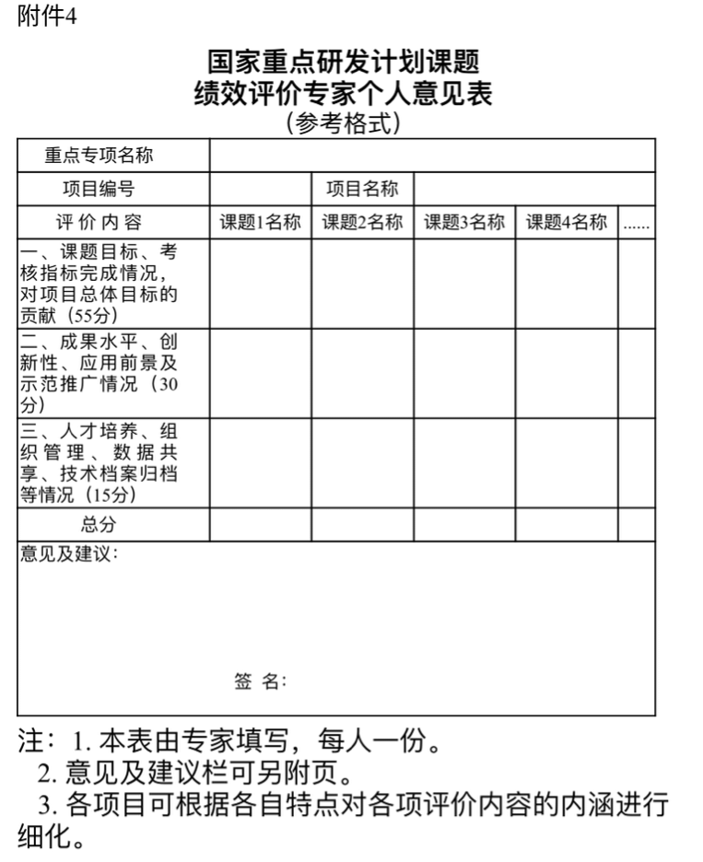
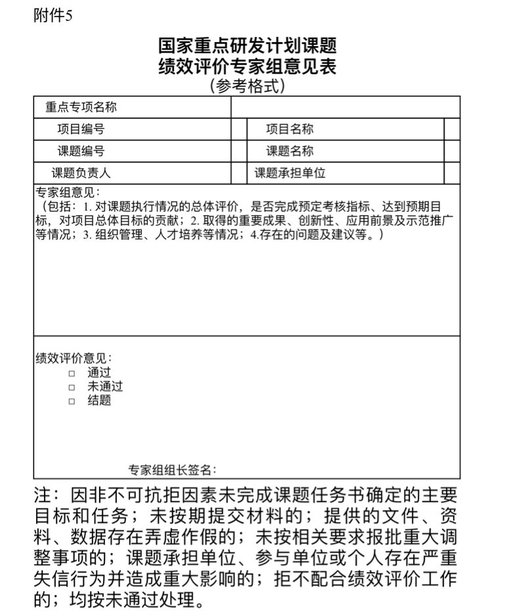
请在此处添加标题
请在此处添加文本

