Slide 1
Readout Electronics Development and Performance
Anshun Zhou
Particle Detection and Electronics State Key Laboratory
USTC
2023/06/06
Notes:
Good morning everyone. First let me introduce myself. I am Anshun Zhou from the Nuclear Detection and Nuclear Electronics Laboratory of the USTC. I’m glad to be here and make a brief presentation of the …. to you.

Slide 2
contents
Single-layer Readout Electronics Design
Data Acquisition Electronics Design

Slide 3
contents
Single-layer Readout Electronics Design
  Design
  Test
Data Acquisition Electronics Design

Slide 4
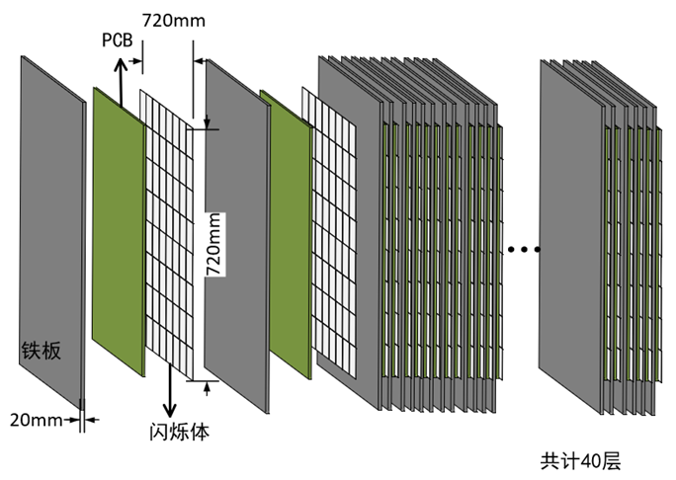
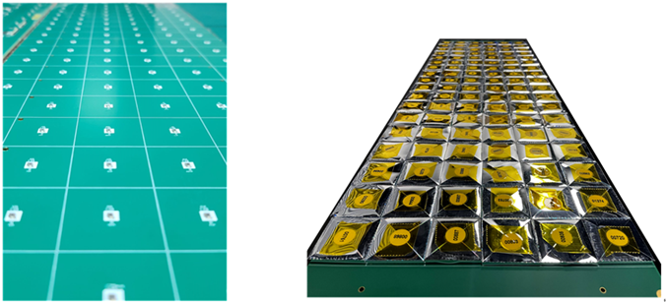
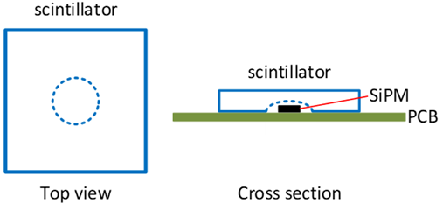
Baseline
Detector
  Plastic scintillator
  SiPM
Readout
  Spiroc2E
Parameters
  324 channels per layer
  720mm×720mm sensitive area
  40 layers
  12960 channels in total
iron
Basic Structure for Prototype
SiPMs & Scintillators tiled on PCB
Notes:
Let me start by giving you some baseline introduction. Absorber PCB sensitive are assembled like sandwitch. Tiled on the PCB.
A dome-shaped cavity is processed in the center of the bottom surface of each scintillator such that the SiPMs could be mounted on the PCB
under the scintillators.

Slide 5
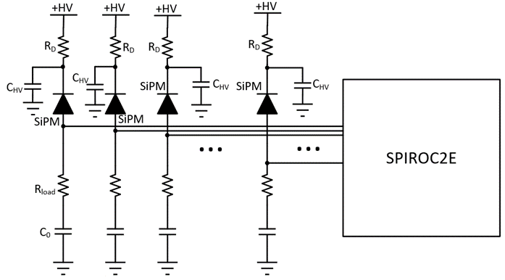
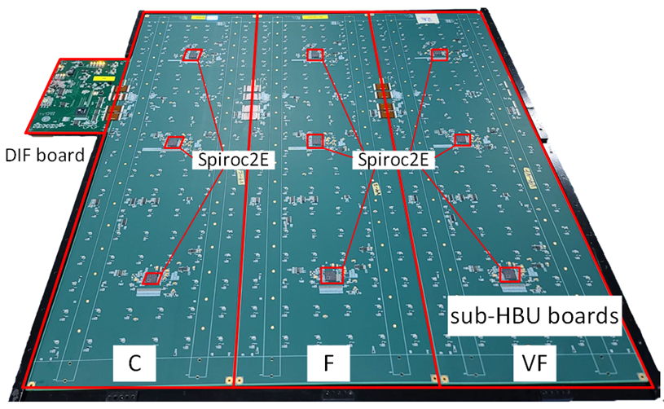
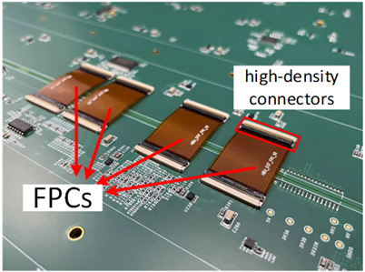
Sub HBU Board Design
Sub HBU Board Design
  3 sub board for each layer
  3 Spiorc2Es per sub board
  108 channels per sub board
SiPM Readout
  Shared High Voltage plane
  Voltage signal injected to Spiroc2E
Notes:
As the sensitive area is really big, we proposed the design of the sub board to cover it. Every FEE board is separated to 3 sub HBU board with same size. There . We use flexible printed circuit. This kind of connection is with better vibration resistance.

Slide 6
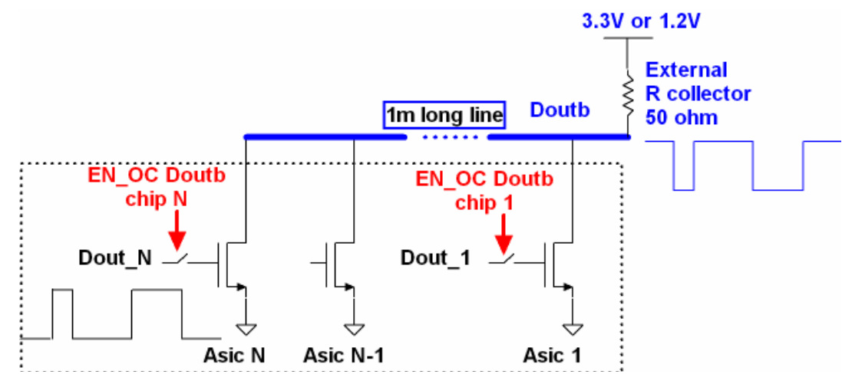
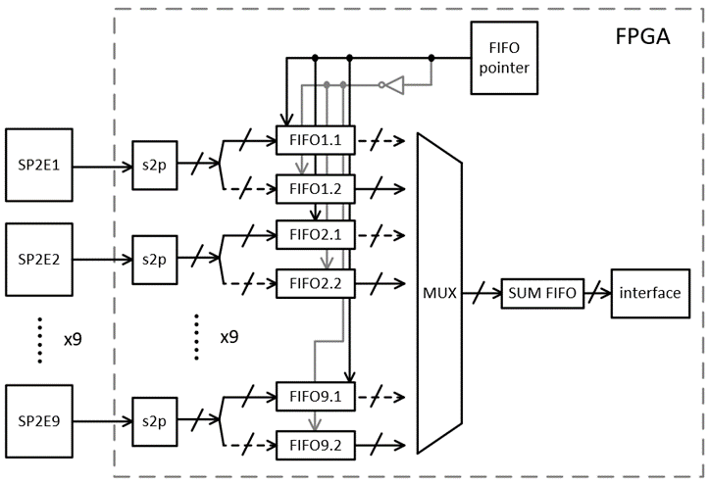
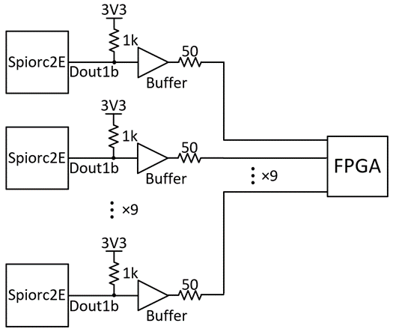
Digital Data Readout
Serial Readout
  Default usage
  Daisy chain
  <83Hz
Parallel Readout
  Ping-pong readout in FPGA
  >1kHz in beam test
Serial Readout Circuit
Revised
Ping-Pong Readout Logic
Parallel Readout Circuit
Notes:
Let us move on to the digital data readout design. 2 main reasons. Distributed capacitance. prevent the influence of the large distributed capacitance. To reduce the readout time, we come up with the ping-pong readout logic. There are 2 separated FIFOs in the FPGA for each Spiroc2E, so when one of the FIFOs are being read the other one could be used to write the data of Spiroc2E.

Slide 7
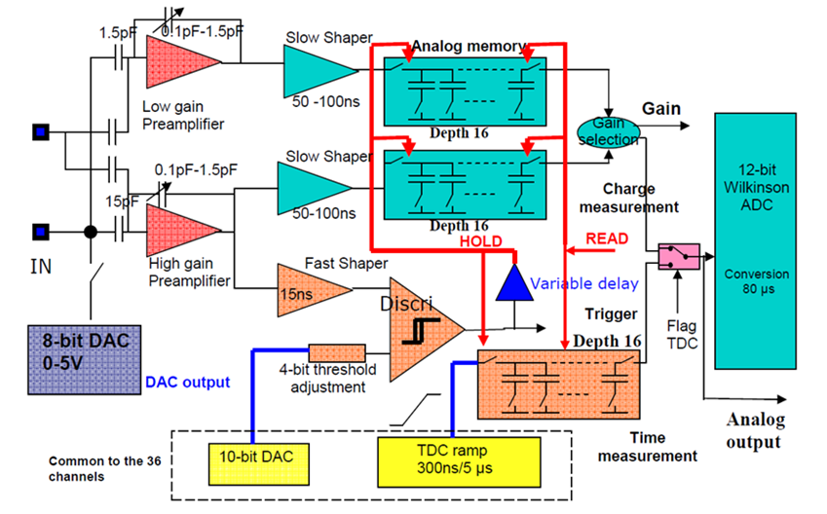
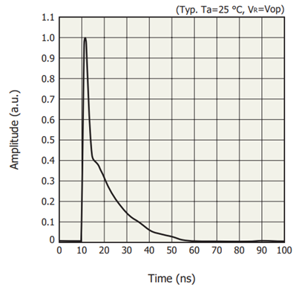
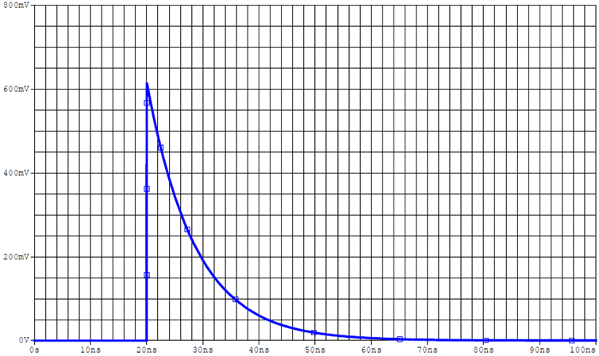
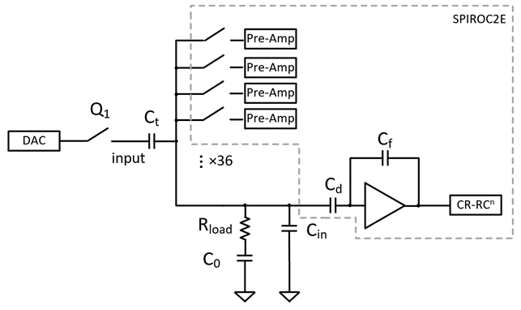
Electrical Calibration Circuit
Analog Circuit of Spiroc2E
  High Gain & Low Gain
  Channel difference
Calibration circuit
  Same waveform with SiPM
  Charge Injection to Probe
Analog Circuit of Spiroc2E
SiPM waveform
20ns 40ns 60ns
Calibration signal waveform (pspice)
Electrical Calibration Circuit

Slide 8
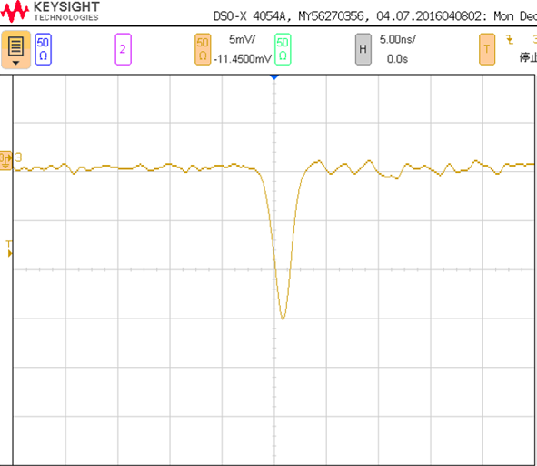
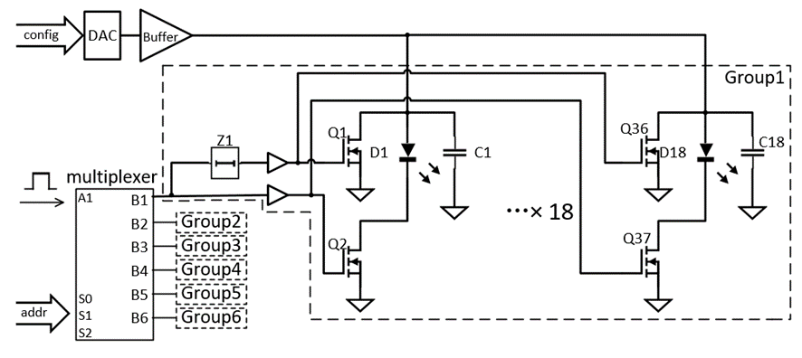
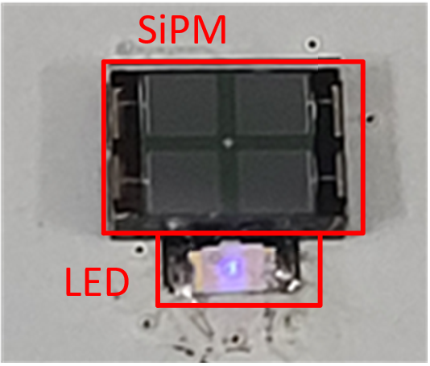
LED Calibration Circuit
SiPM
  Sensitive to Temperature
  Single photoelectron peak spectrum
LED calibration circuit
  Light pulse of LED
  6 groups
<10ns
LED Waveform
LED Calibration Circuit
LED & SiPM

Slide 9
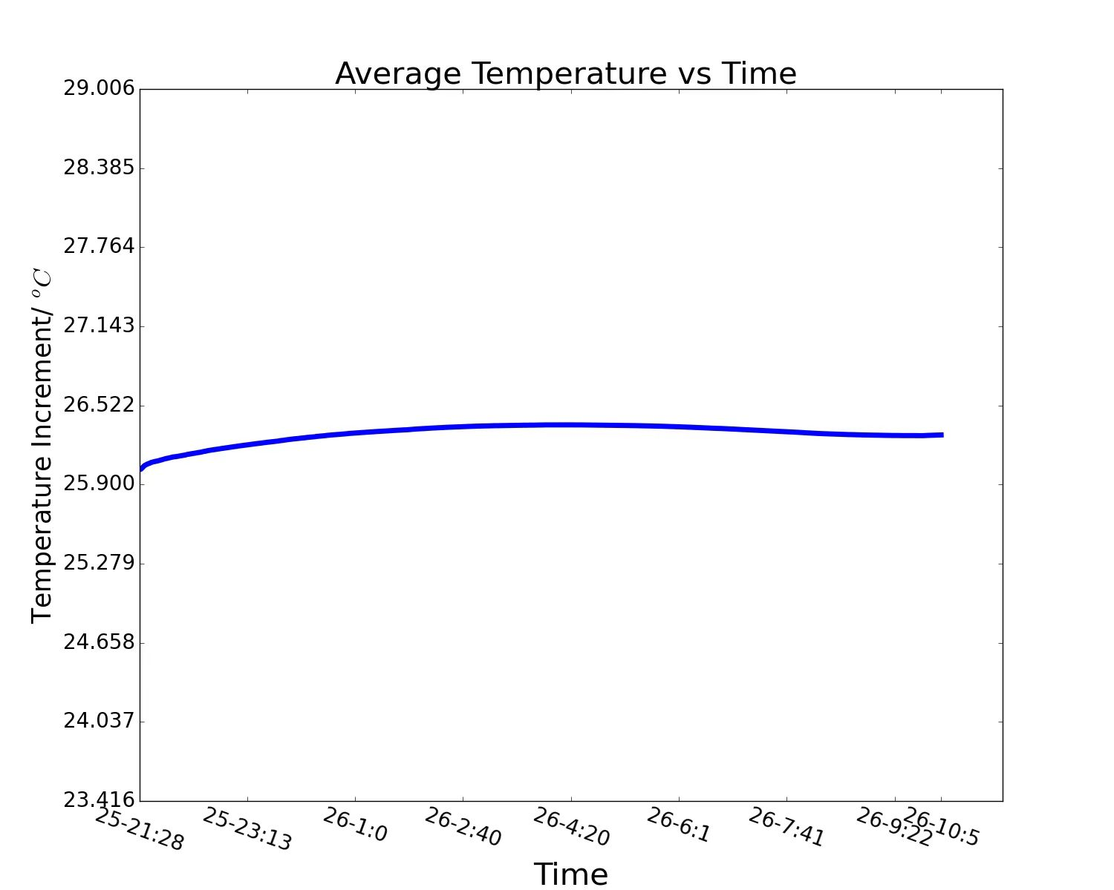
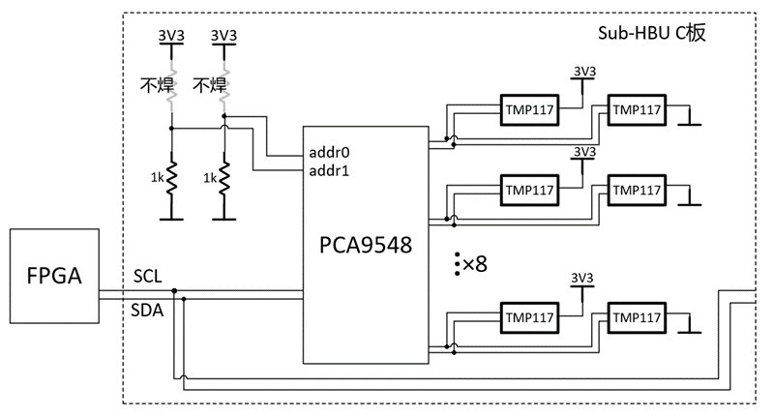
Temperature Monitor Circuit
Temperature Monitor Circuit
  48 probes per layer
  Resistor soldered selectively
NC
NC
Temperature Monitor Circuit
Notes:
multiplexer

Slide 10
contents
Single-layer Readout Electronics Design
  Design
  Test
Data Acquisition Electronics Design

Slide 11
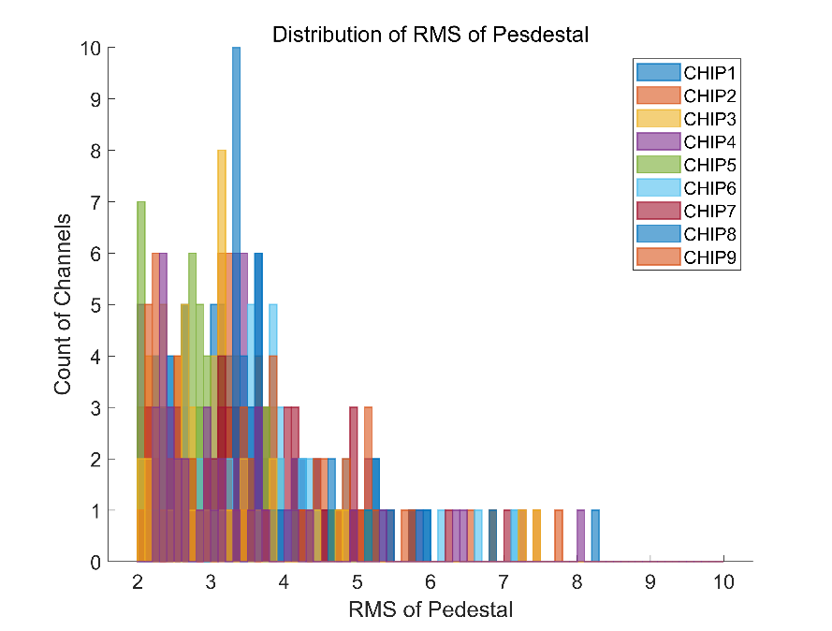
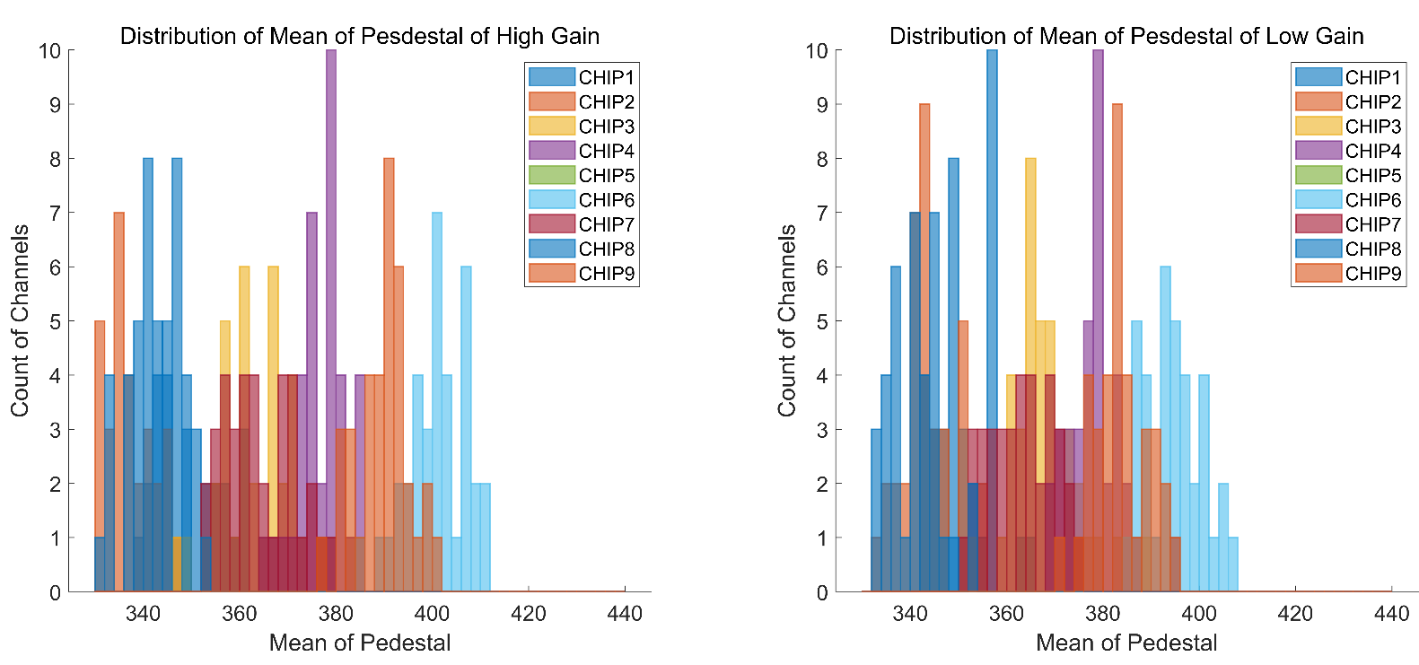
Pedestal
RMS
RMS < 10 ADC code
Mean
  Channels of same chip are close
High Gain
Low Gain

Slide 12
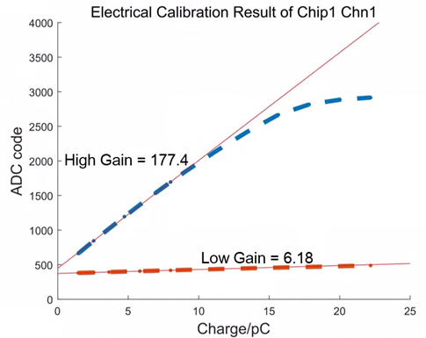
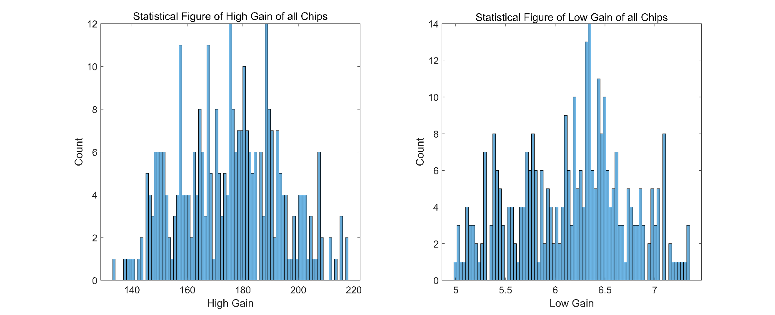
Electrical Calibration
Gain
  High Gain: ~180 ADC code/pC
  Low Gain:~6 ADC code/pC
Noise
  10/180<80fC

Slide 13
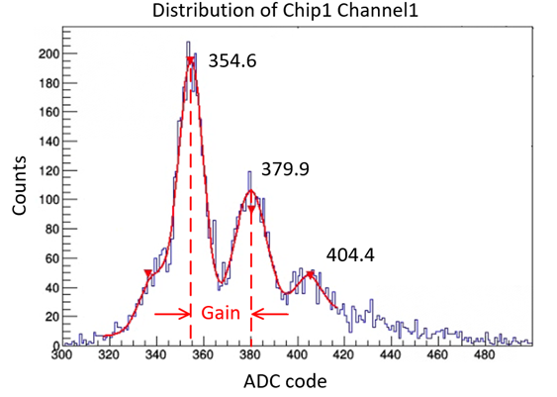
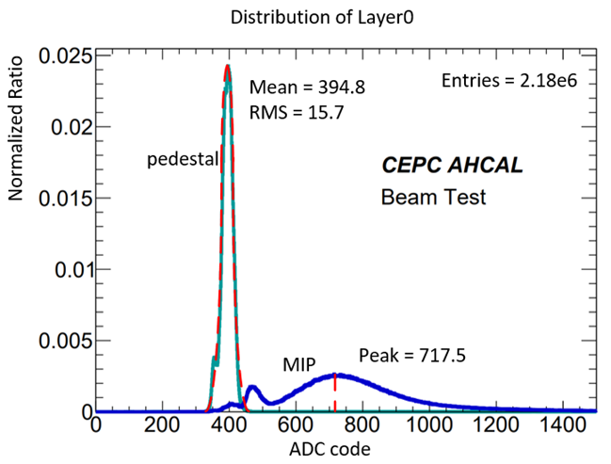
LED Calibration & MIP
Gain
  ~25 ADC code/p.e.
MIP Result
  SNR>20
  Single Photoelectron Peak Spectrum
  MIP

Slide 14
contents
Single-layer Readout Electronics Design
  Design
  Test
Data Acquisition Electronics Design

Slide 15
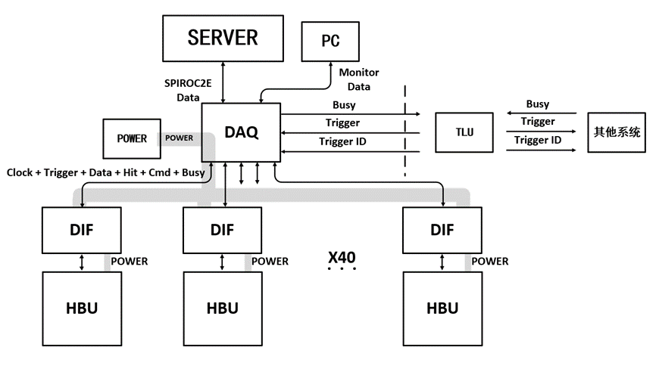
Structure
Data Acquisition
  Independent Data link for Monitor Data
  Clock, trigger from TLU to sync with other system
Power Supply
  Power -> DAQ board -> DIF board -> HBU
  TLU: Trigger Logic Unit
  DAQ: Data Acquisition Board
  DIF: Data Interface Board
Other
System

Slide 16
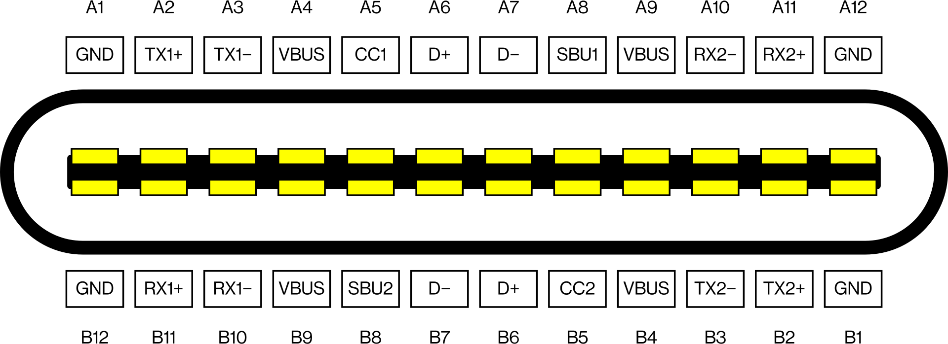
typeC interface
Data link
  clock: B2,B3
  command: B7,B6
  ccientific data:A2,A3
  temperature:A8,B8
  busy:A10,A11
Power link
  VBUS,GND

Slide 17
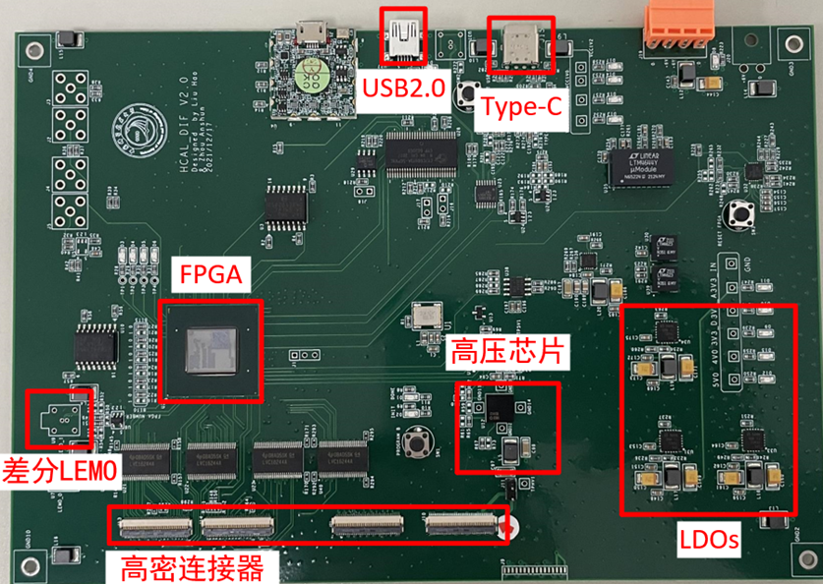
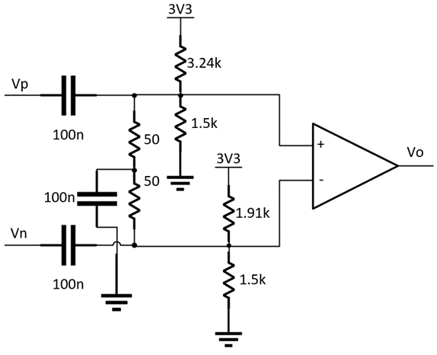
DIF
PCB Design
  typeC interface & USB3.1 cable
  Power & Data on same cable
  LVDS Center tap termination
High Voltage
LEMO
  LVDS center tap termination
High-density connector

Slide 18
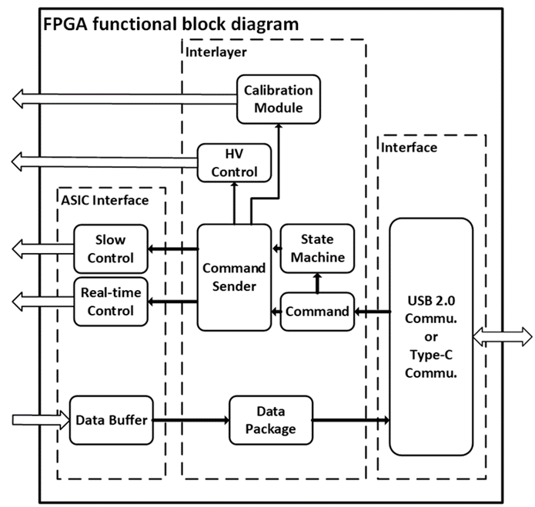
DIF
FPGA Logic
  Analyze command from DAQ
  Data packing
  Control Spiorc2E

Slide 19
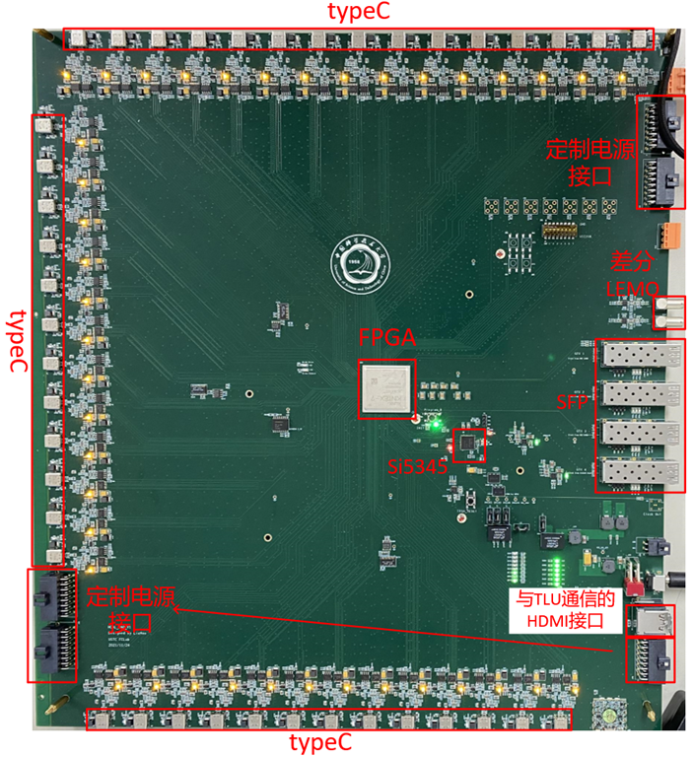
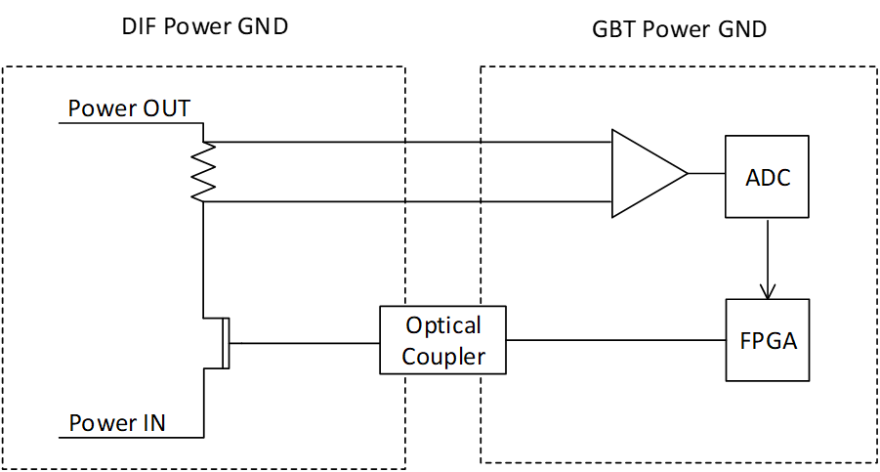
DAQ
PCB Design
  40 typeC interfaces
  4 SFP
  Power interface for DIF
  Current monitor circuit
Power
interface
LEMO
Power
interface
HDMI for TLU
  Current monitor circuit

Slide 20
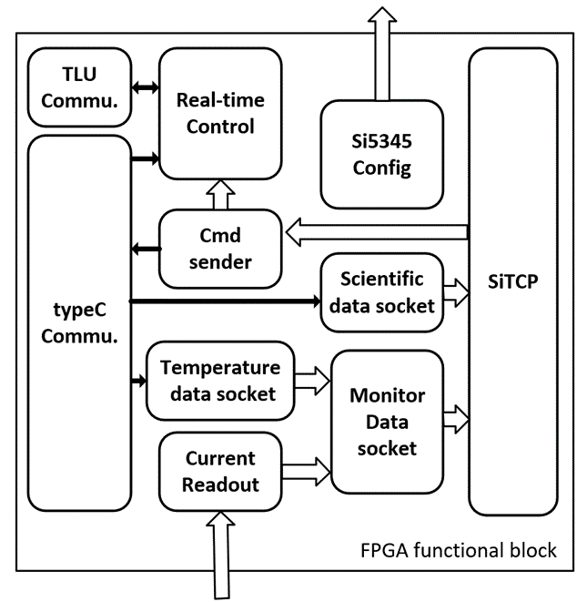
DAQ
FPGA Logic
  2 SiTCP links
  Scientific data packing
  Monitor data packing
  Cherenkov signal
Cherenkov signal

Slide 21
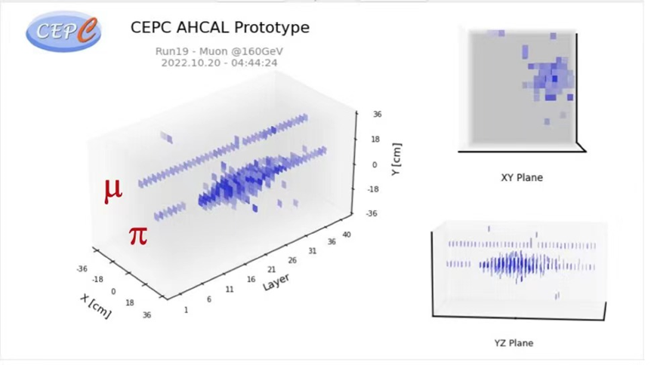
Beam Test
Particle Track

Slide 22
THANKS!

