Slide 1
Progress of Prototype Dipole Magnet for CEPC Booster
Wen Kang
2023-06-07

Slide 2
Contents
Introduction
The subscale prototype dipole magnets
The full-scale CT coil prototype dipole magnet
Summary

Slide 3
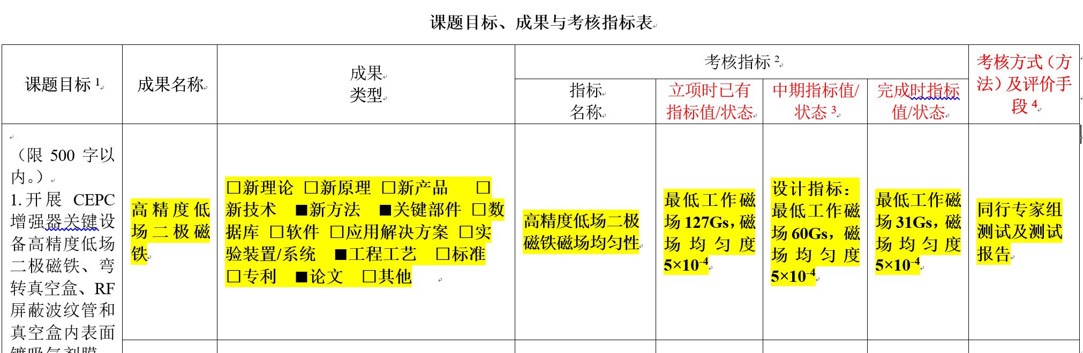
Introduction
At the CDR stage, the CEPC Booster is equipped with 16320 dipoles, most of the them are 4.7m long. The dipole magnets have a minimum working field of only 31 Gs @10 GeV injection energy, and the field precision must be better than 5×10^{–4}@GFR=45mm.
Since such a low field long dipole magnet with high precision has never been designed and produced before, R & D of the high precision low field dipole magnet was chose as one of the projects supported by the MOST from 2018.

Slide 4
Introduction
More than 74% of the Booster's circumference(100km) will be covered with dipole magnets. So the cost of magnets is a significant concern in the design of the magnets.
The absolute field error of the magnets is 31*(0.05%)=0.016Gs, but the remnant field of the conventional low carbon steel laminations is about 4-6Gs. The non-uniformity of the remnant field will much larger than 0.016Gs.
At such low field, the BH curve accuracy of the iron core material and the simulation precision of the computer programs are not good enough to be trusted. The traditional measures of the field design and optimization can not be used.
The production of a 4.7m long magnet with a small cross section of 0.4m is a another big challenge for us.
To search a feasible design scheme, two kinds of dipole magnets with and without an iron core was proposed and designed, and two subscale prototype magnets had been firstly developed in the past years.

Slide 5
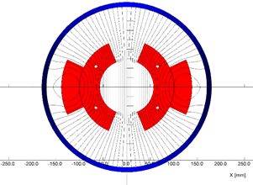
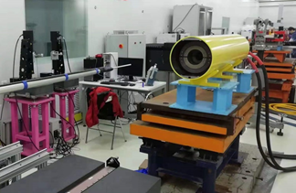
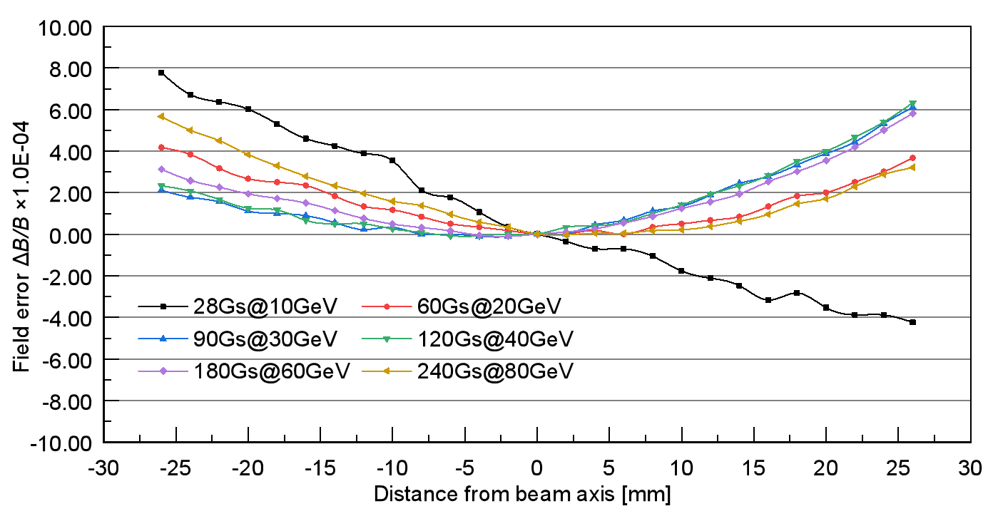
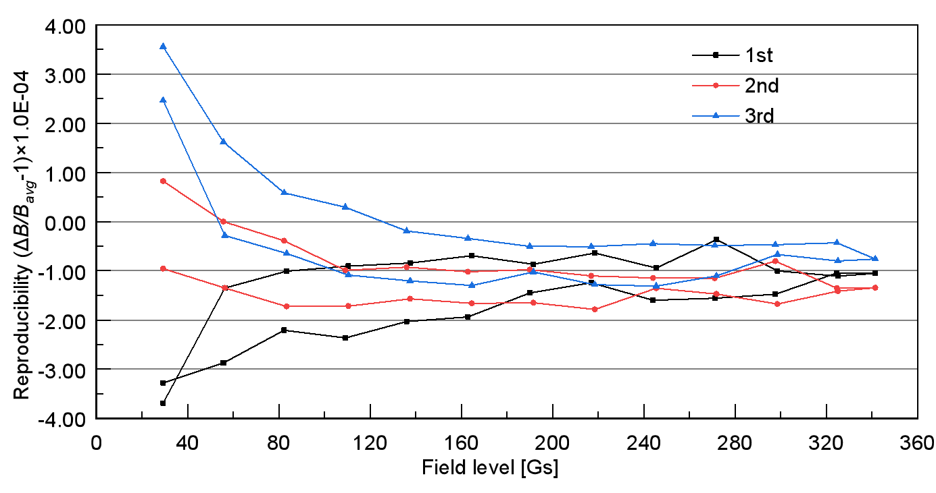
The subscale prototype dipole magnets
The Cosine-Theta (CT) coil subscale prototype dipole magnet without an iron core is 1.4m long, its cross-section and test results are shown as follows.
The dipole magnet is comprised of two half coils and a shielding tube.
Each half coil has two layers and three turns, which are formed by aluminium conductors.
The shielding tube is made from a long iron tube.
The test results show that the field precision at all field levels, particularly at 31Gs, are satisfied with the requirements.

Slide 6
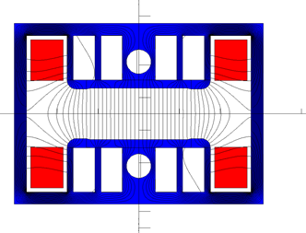
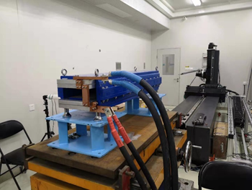
The subscale prototype dipole magnets
The subscale prototype iron-core dipole magnet is also 1.4m long, its cross-section and test results are shown as follows.
The magnet consists of one core and two coils.
To achieve better shielding effectiveness from the earth's field, a closed H-type core was chosen.
To increase the field and decrease the weight of the core, the cores of the magnet are stacked by silicon steel laminations and aluminium laminations in a 1:1 ratio, the return yoke of the core is made as thin as possible, and in the pole areas of the laminations, some holes are punched.
The coil per pole of the magnet has two turns, which are formed by long aluminium bars.

Slide 7
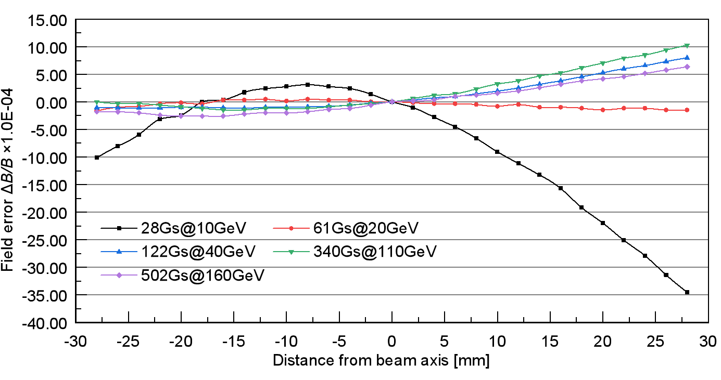
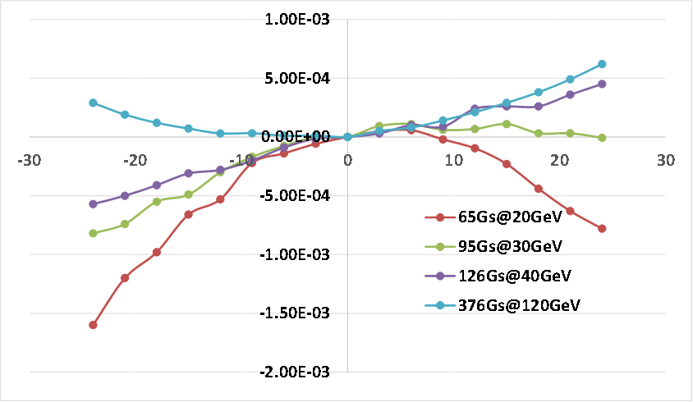
The subscale prototype dipole magnets
The subscale prototype iron-core dipole magnet is also 1.4m long, its cross-section and test results are shown as follows.
The test results show that the field precision @28Gs is about 3.5×10^{–3}, much larger than the required value of 5×10^{–4}.
In order to reach the field precision of 5×10^{–4}, the minimum field of the dipole magnet made by grain-oriented silicon steel laminations should be higher than 60 Gs @20 GeV while that made by non-oriented silicon steel laminations higher than 90 Gs @30 GeV.
Field precision @ oriented
Field precision @ non-oriented

Slide 8
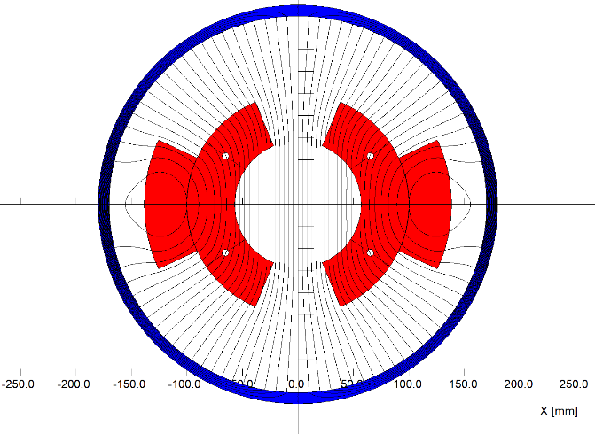
The full-scale prototype CT coil dipole magnet
As the test results of the subscale prototype dipole magnets showed that only CT coil dipole magnet could meet the precision requirement at the field level of 31Gs, so this kind of magnet is taken as the first the design for the CEPC booster.
To explore the processing technologies of the production, a full-scale prototype dipole magnet is designed and developed.

Slide 9
The full-scale prototype CT coil dipole magnet
The total length of the magnet is 5.1m, it consists of the coil and shielding tube.
The coil has two half coils, each half coil has two layers and three turns, which are formed by the pure aluminum conductors.
The shielding tube is made by a long steel tube. In order to install the coils, it can be split into upper and lower halves.
The water cooling tubes are inserted between two conductors in the inner layer of half coil.

Slide 10
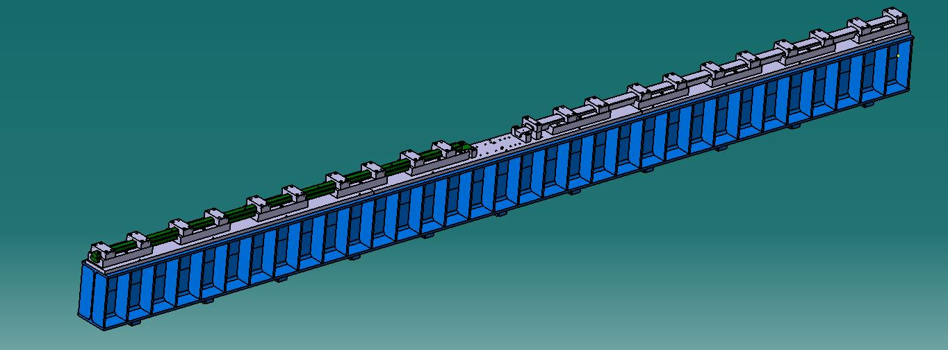
The full-scale prototype CT coil dipole magnet
However, it is very difficult to fabricate a 5m long conductor with the size dimension tolerance less than 0.05mm, so the long conductor has to be pieced by two 2.5m short ones, of which the touch surfaces are coated with the silver film to reduce the contact resistance.

Slide 11
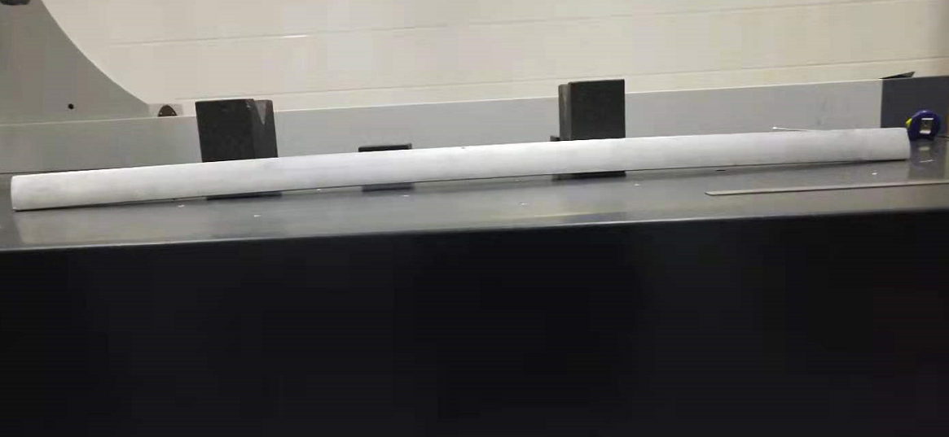
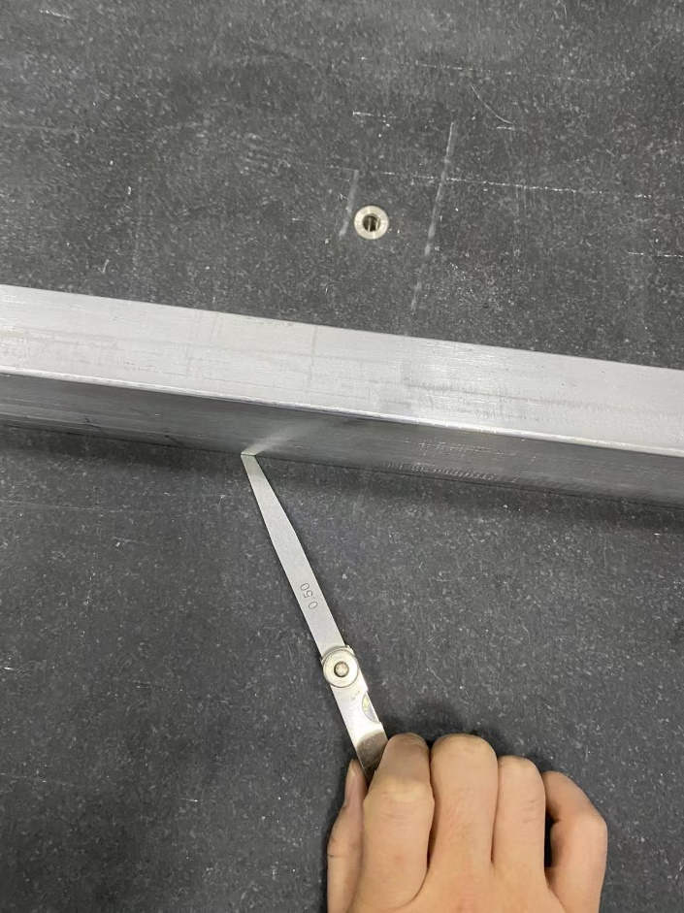
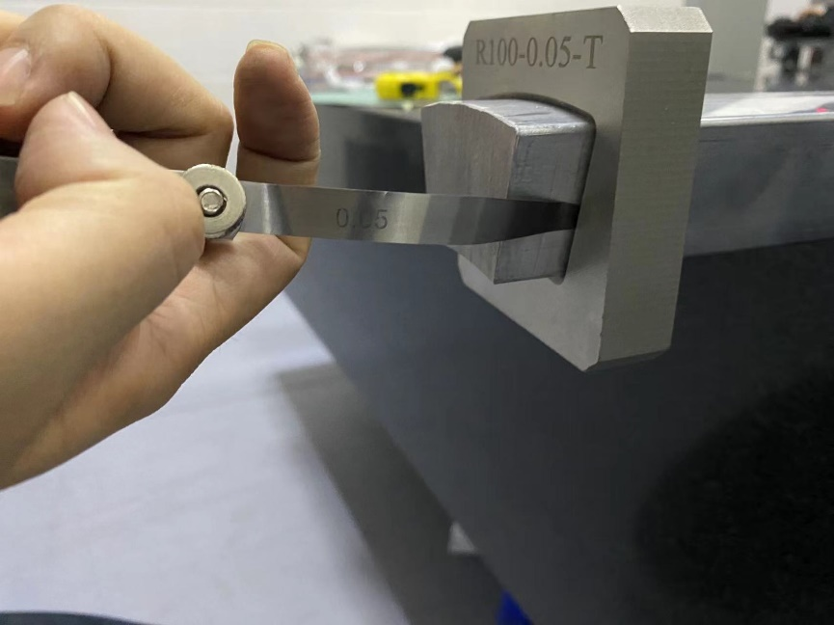
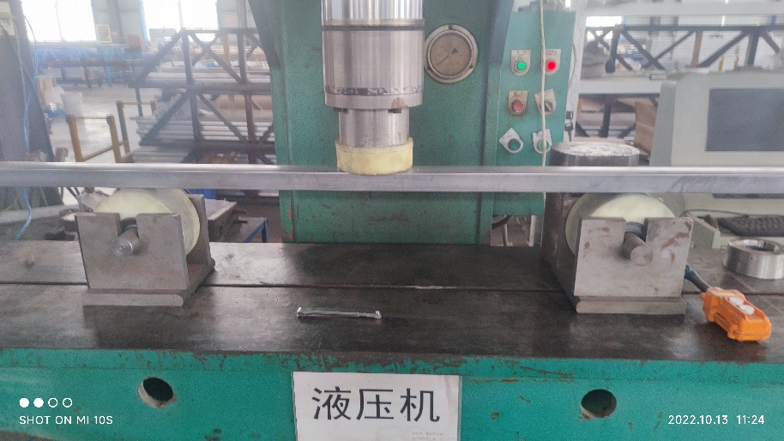
The full-scale prototype CT coil dipole magnet
To reduce the production cost, the 2.5m long conductors are made by extrusion instead of by direct fabrication. But in the process of extrusion, the deformation along the conductors was found to be serious, so the conductors had to be reformed by a specially made device.
.
Before reformation
After reformation

Slide 12
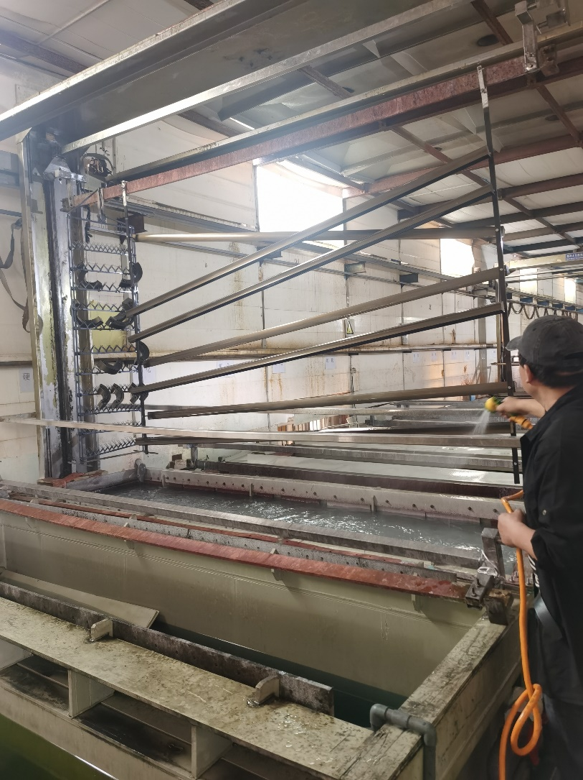
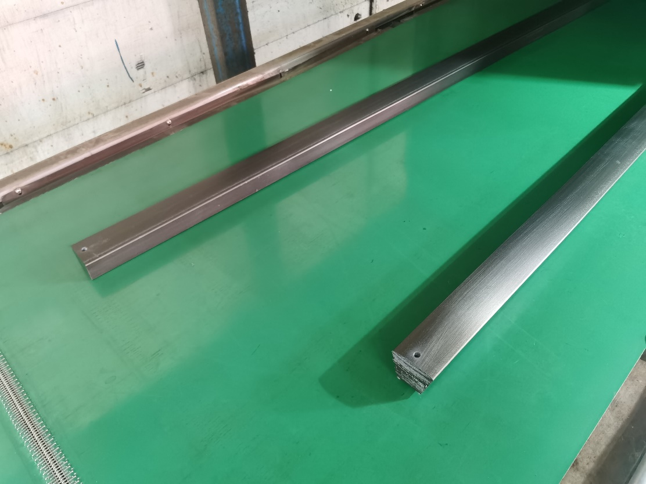
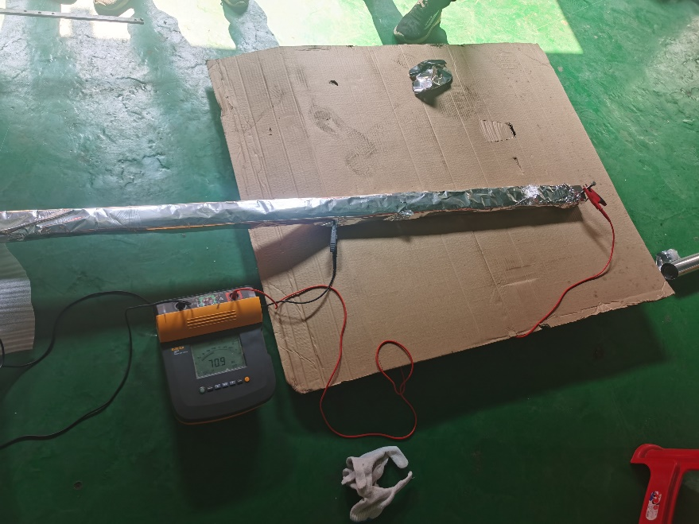
The full-scale prototype CT coil dipole magnet
The insulation from turn to turn of the coils could be made by the technology of surface anodization. The insulation resistance of the anodized film is larger than 50 MΩ@500V. The film on the touch surfaces is gotten rid of before coated with silver film.

Slide 13
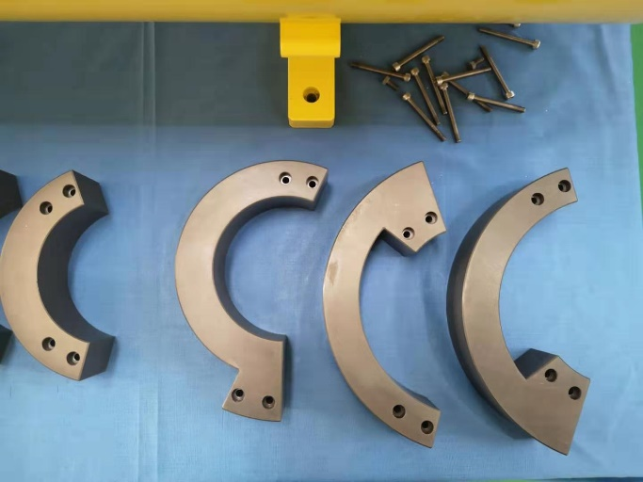
The full-scale prototype CT coil dipole magnet
The conductors of the coils from turn to turn are connected by the by-pass circular conductors at the ends of the magnet. The water cooling tubes are inserted between two inner turns and led out at one end of the magnet.

Slide 14
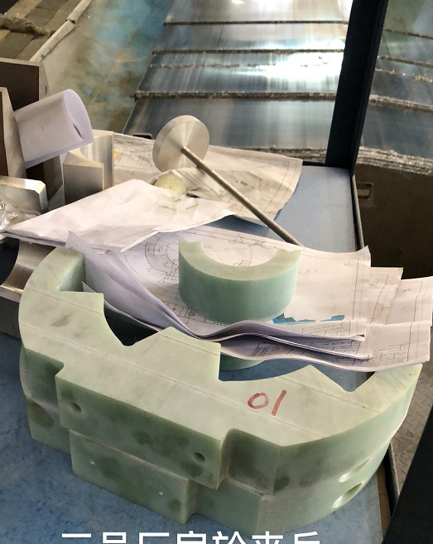
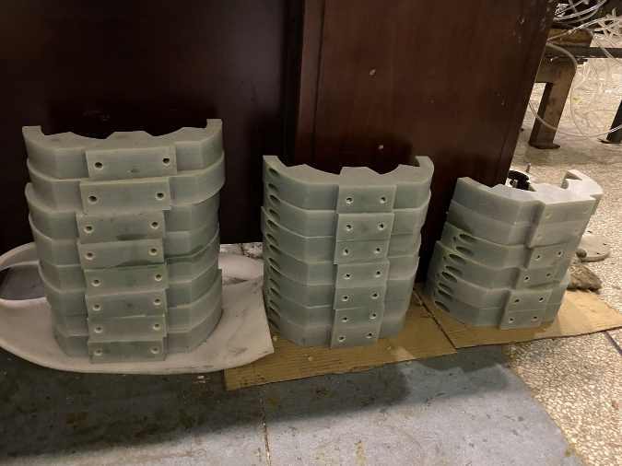
The full-scale prototype CT coil dipole magnet
To insure the conductors of the coils at their right position, the supporters every 415mm in longitudinal direction are assembled. The positions of the shielding tube that support the supporters of the coils are machined carefully and precisely.

Slide 15
The full-scale prototype CT coil dipole magnet
In the assembly process, the lower coil is directly installed in the lower half shielding tube, the upper half coil should be firstly assembled in an assembling tooling and then rotated 180 degree. After it is put together with the lower coil, the upper shielding tube is assembled with the lower one by the same assembling tooling.

Slide 16
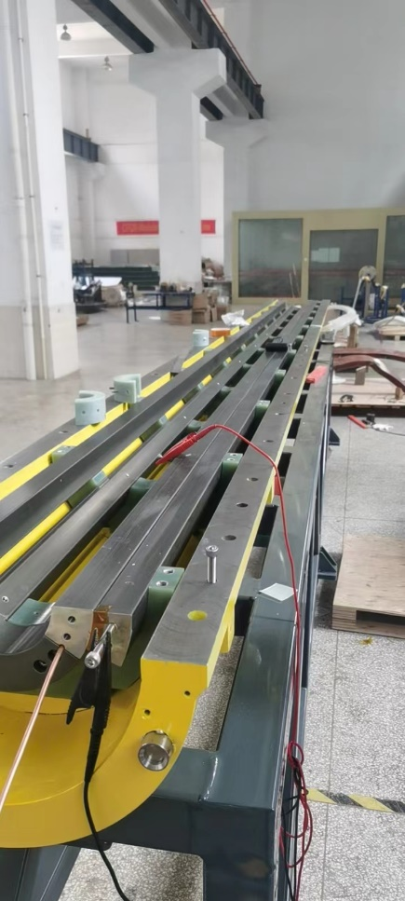
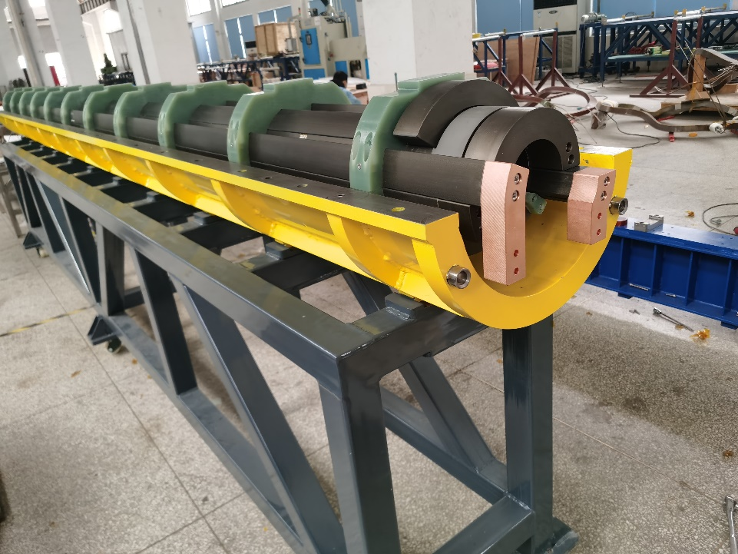
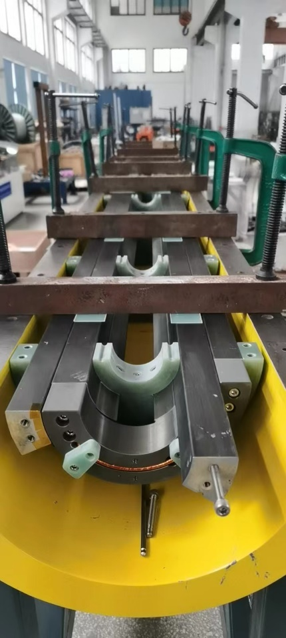
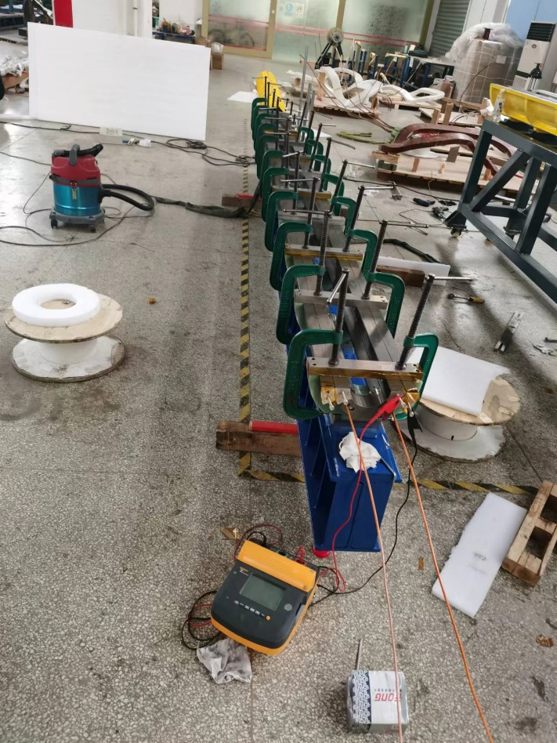
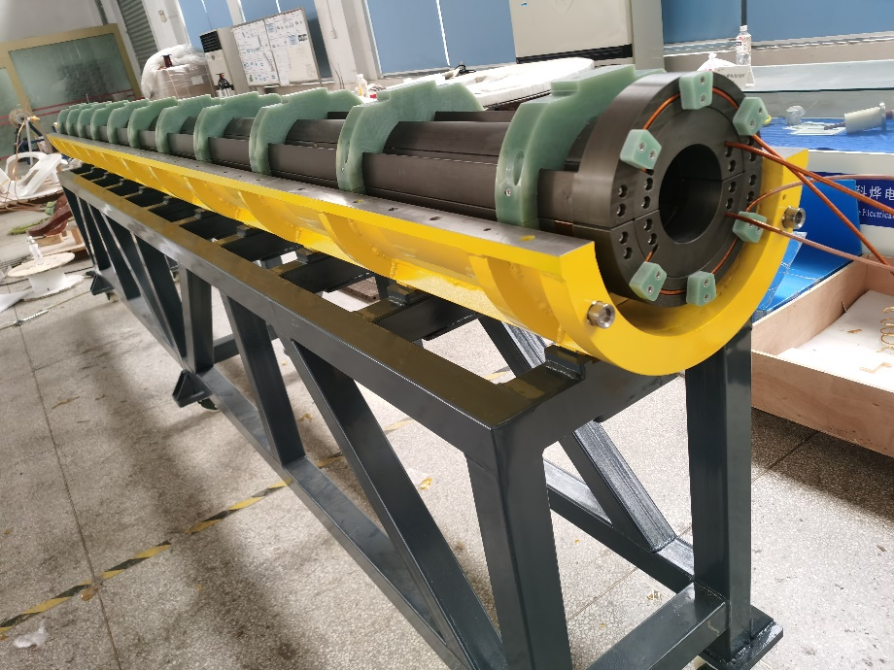
The full-scale prototype CT coil dipole magnet
The pictures in the process the magnet assembly.

Slide 17
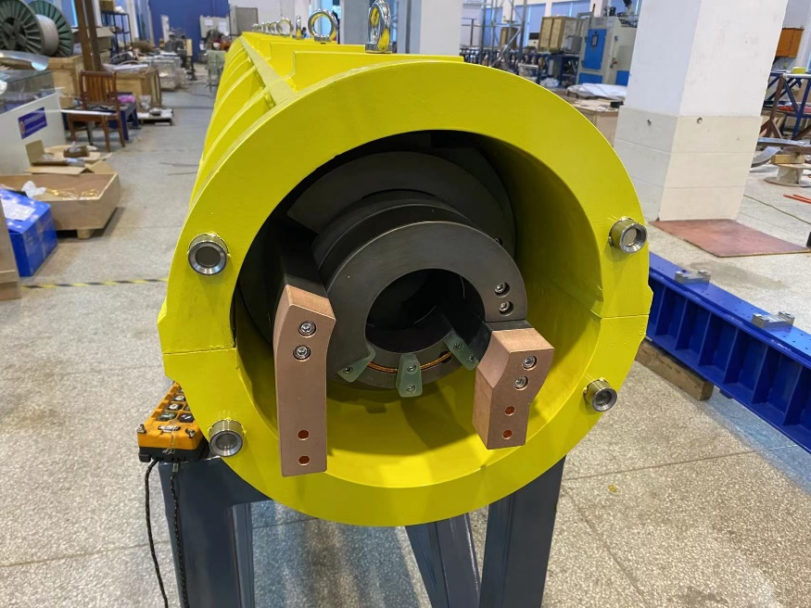
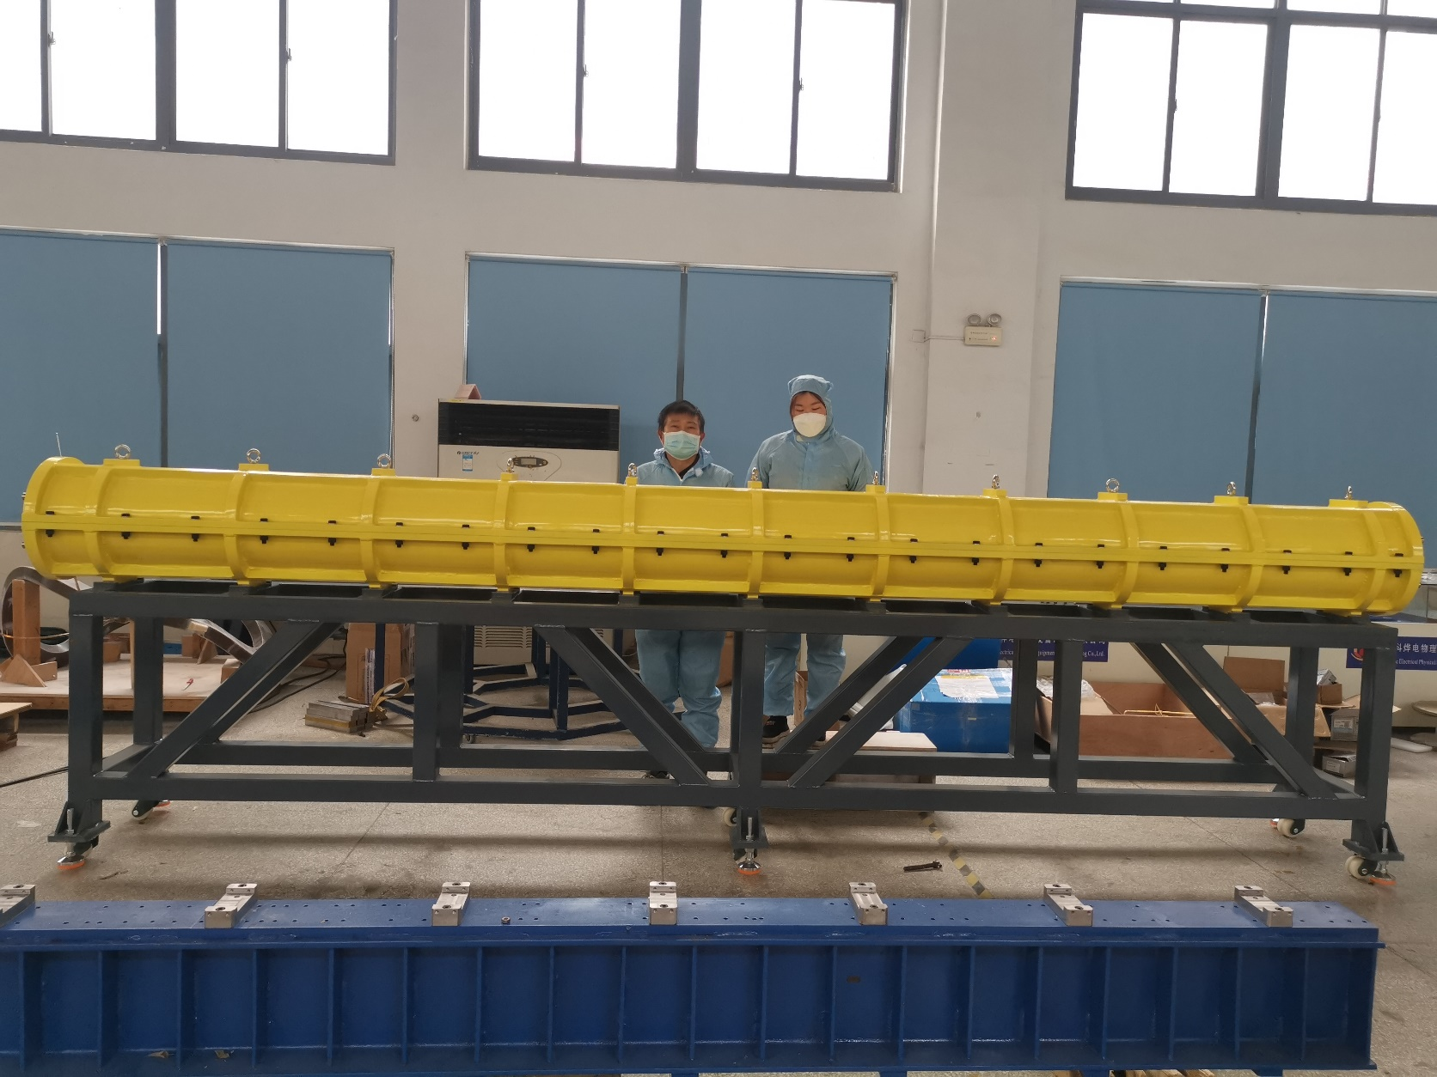
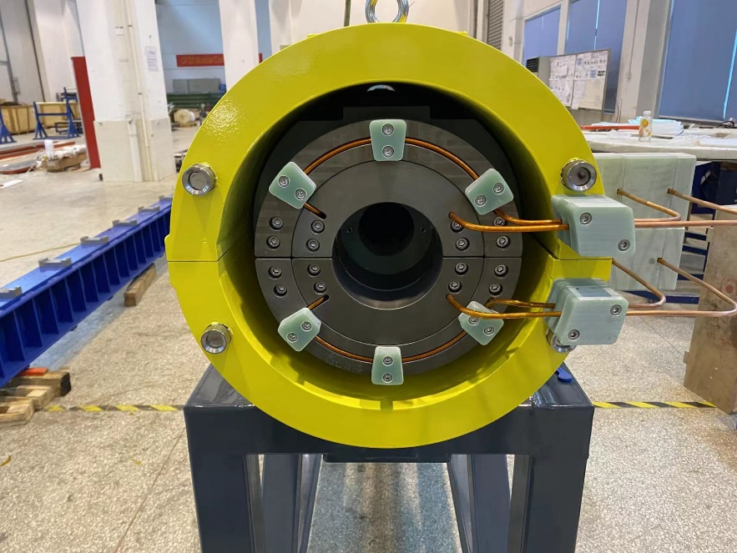
The full-scale prototype CT coil dipole magnet
The pictures of the finished CT coil dipole magnet

Slide 18
The full-scale prototype CT coil dipole magnet
Unfortunately, the final assembly tolerance of the coils are more than 0.3mm which is three time larger than the required value of 0.1mm although the company has tried their best to control the mechanical errors of the magnet.
技术指标实现情况
序号 | 名称 | 技术要求 | 实现情况
1 | 线圈长度 | 4700mm | 4700mm
2 | 线圈R1 | 57mm | 57mm
3 | 线圈R2 | 100mm | 100mm
4 | 线圈R3 | 138.46mm | 138.28mm
5 | 线圈匝间绝缘 | 250V | 250V
6 | 屏蔽筒内径 | 340mm | 340mm
7 | 屏蔽筒外径 | 360mm | 360mm
8 | 直流电阻 | 0.94658mΩ | 1.2131mΩ 注：36个接触面，单个接触面接触电阻约为7.4μΩ
9 | 线圈直线度 | 0.1mm | 上线圈平面度：0.48mm
 |  |  | 上线圈左：0.44mm
 |  |  | 上线圈右：0.38mm
 |  |  | 下线圈平面度：0.39mm
 |  |  | 下线圈左：0.38mm
 |  |  | 下线圈右：0.32mm

Slide 19
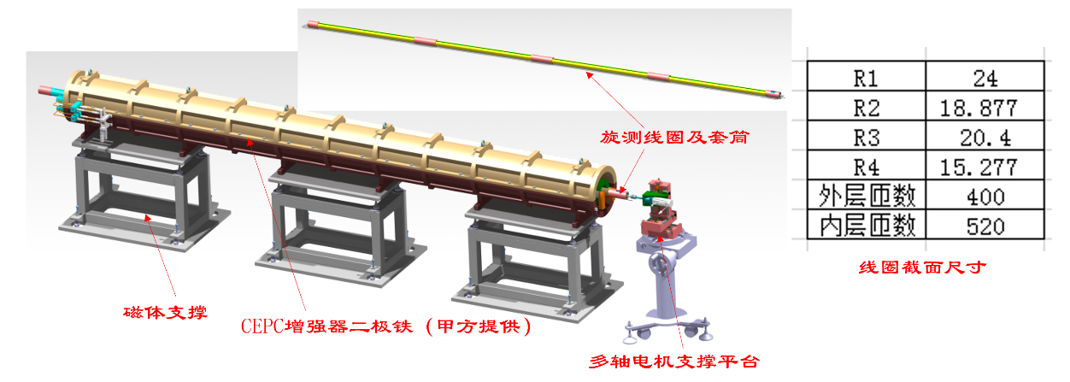
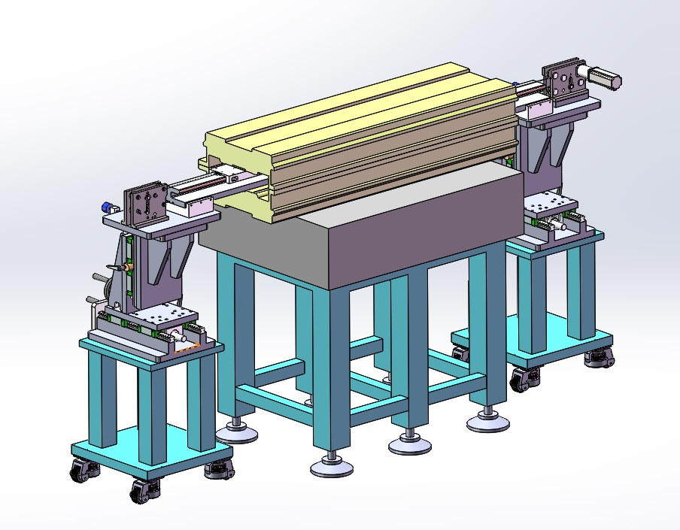
The full-scale prototype CT coil dipole magnet
To measure the field of the full-scale prototype dipole magnets, a long rotating coil field measurement system and a hall probe field measurement system are developed.

Slide 20
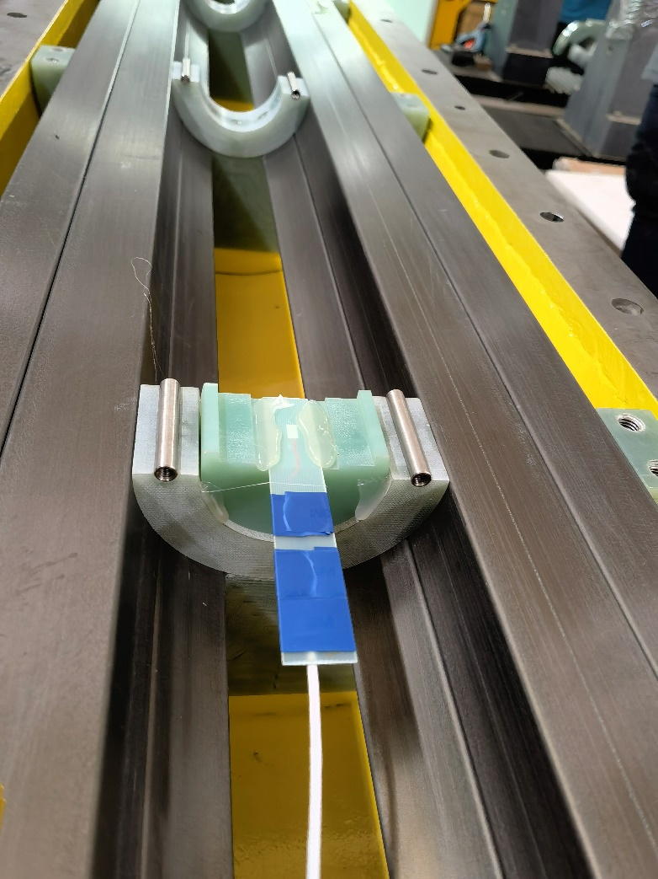
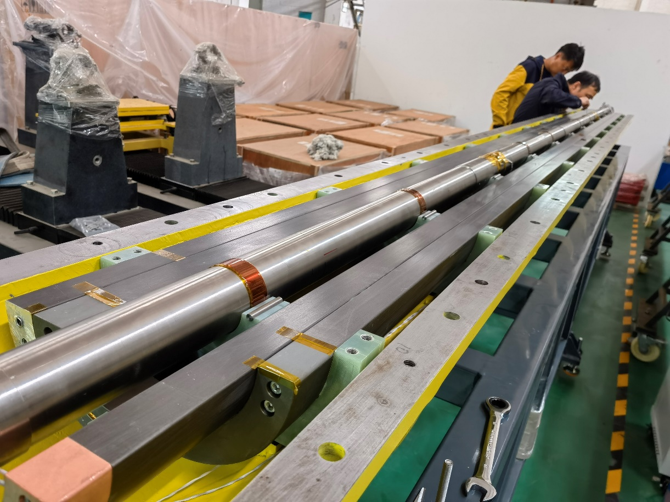
The full-scale prototype CT coil dipole magnet
The long rotating coil field measurement system is used to measure the integral field and its uniformity. The hall probe field measurement system is used to measure the central field and its excitation curves.

Slide 21
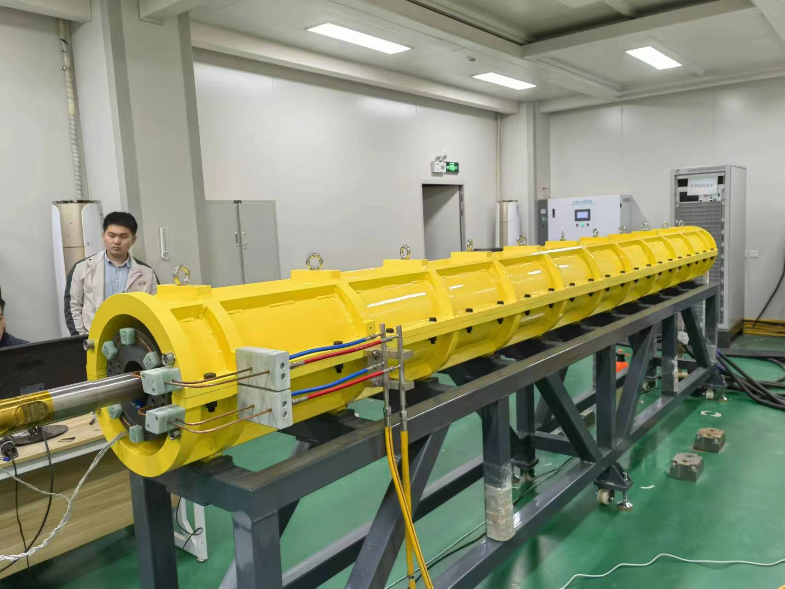
The full-scale prototype CT coil dipole magnet
The dipole magnet was measured in the lab constructed for the HEPS booster.

Slide 22
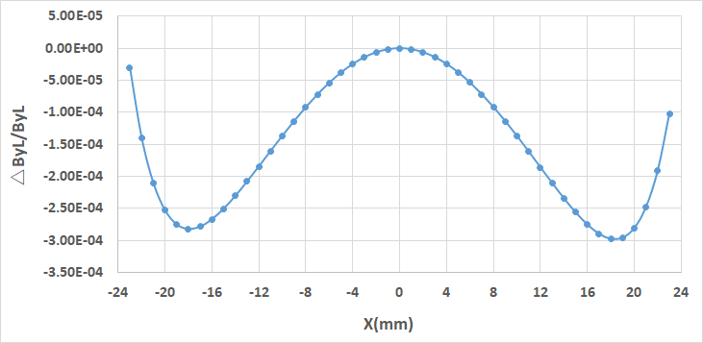
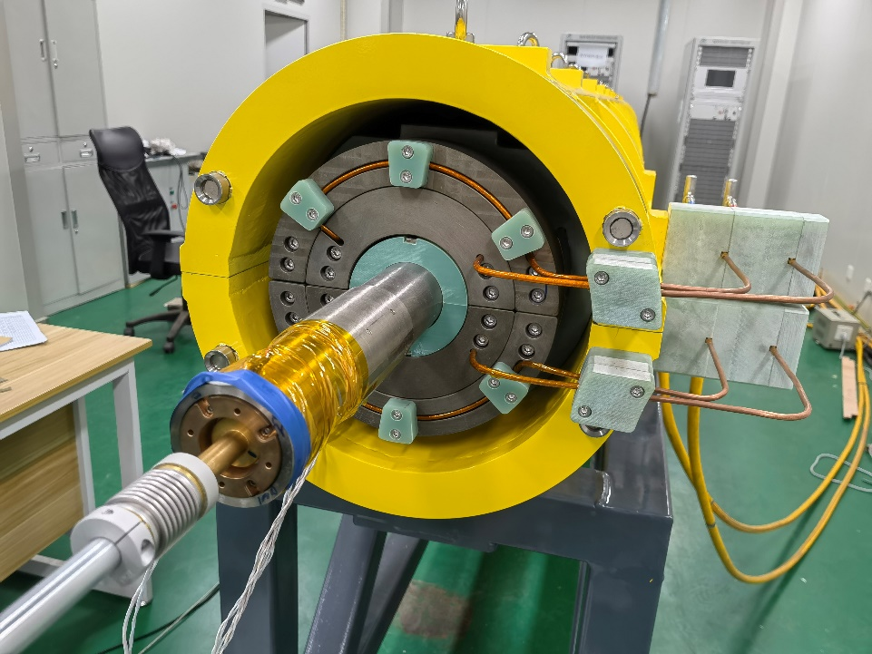
The full-scale prototype CT coil dipole magnet
The initially measured integral field uniformity at 31Gs of the dipole magnet is worse than the required value of 5×10^{–4}.
After field adjustment by using two small permanent field blocks at one end of the magnet, the measured field uniformity reaches 3×10^{–4}, which meets the requirement at low field level of 31 Gs.

Slide 23
The full-scale prototype CT coil dipole magnet
The measured excitation curve of the central field shows that the field of the dipole magnet can reach 360Gs when the current increases to 1340A and exceed 500Gs after the current increases to 1850A.

Slide 24
The full-scale prototype CT coil dipole magnet
The field requirements and the measured results are listed in the table.
 | Requirements | Measured results
Min. working field | <31Gs | 28.5Gs(@100A)
Max. working field | >360Gs | 500.9Gs(@1850A)
Field error@31Gs | <5E-4 | 3E-4(@28.5Gs)
Magnet length | >4.7m | 5.1m(@shielding tube)

Slide 25
Summary
The target of this task is to design and develop a 4.7m long dipole magnet with the min. working field less than 31Gs and high precision better than 5×10^{–4} .
To search a feasible scheme, the CT coil and iron core subscale prototype dipole magnets were designed and developed. The test results showed that only the CT coil dipole magnet could meet the requirements.
And then a 4.7m long full-scale CT coil prototype dipole magnet have been designed and manufactured. Two sets of the field measurement systems are used to check the field performance of the magnet.
Although the final mechanical assembly errors and initial field errors of the magnet are larger than the required values, the low field(@31Gs) precision of the dipole magnet could reach to 3×10^{–4} after making some kind of field adjustment at one end of the magnet.

Slide 26
Thank you for your attention.

