Slide 1
  Progress of Prototype Electrostatic Separator
  for CEPC
  Bin Chen
  CEPC Project Final Assessment Internal Preparation Meeting ( Jun 7th , 2023 )

Slide 2
Content
  Introduction
  Design of dipole magnet
  Design of electrostatic separator
  Mechanical design of electrostatic separator
  Development process of electrostatic separator
  Acceptance test

Slide 3
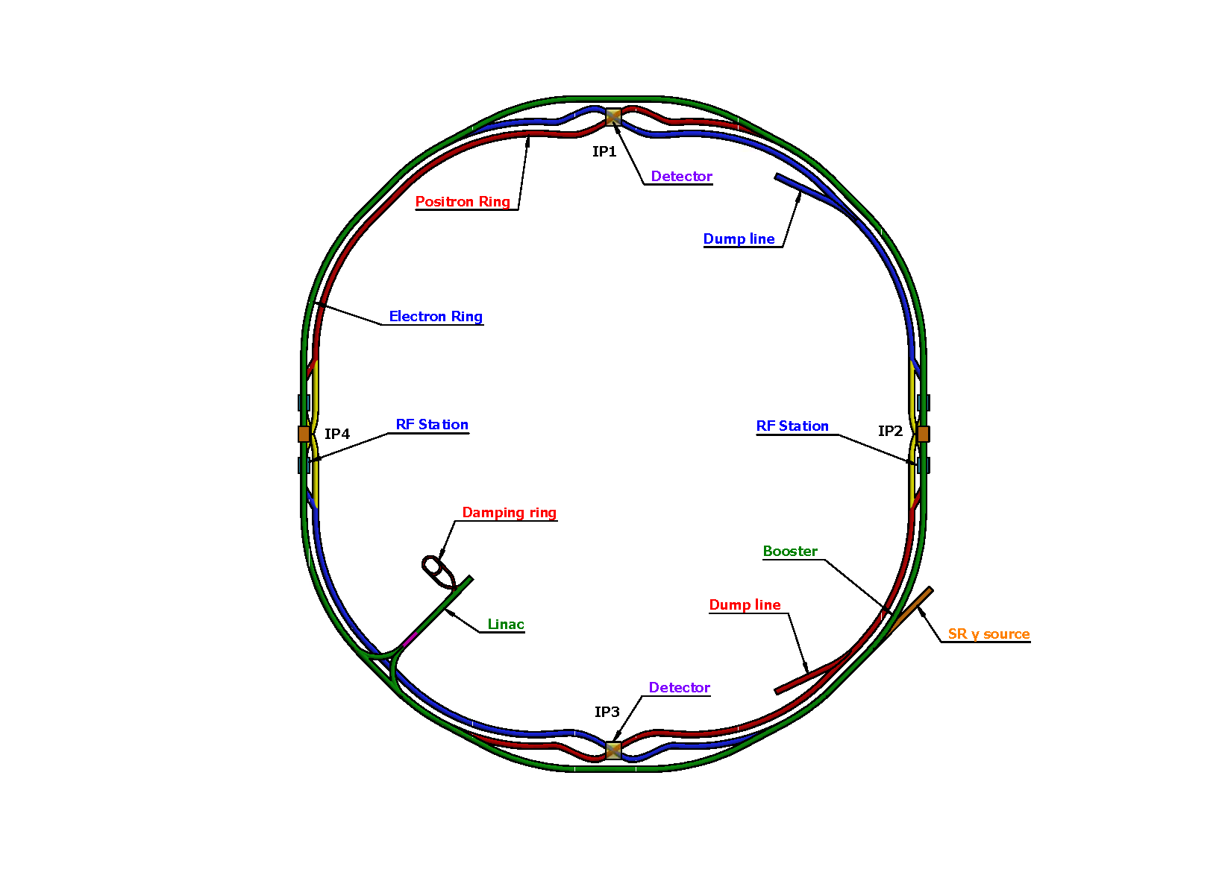
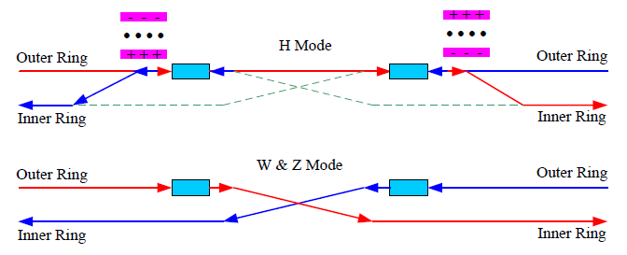
  Introduction
    In the RF region, A set of electrostatic separator combined with dipole magnet (Electro-Magnetic Separator ) are installed downstream of the RF cavities.
    They are used to avoid bending of incoming beam and deflect the outgoing beam in H mode. After the Separators, the positive and negative electron beams of the outer ring passing through the RF cavities are deflected to their respective inner rings.
Layout of RF region
Layout of CEPC
  Optics of the RF region for Higgs (left), W and Z (right) modes

Slide 4
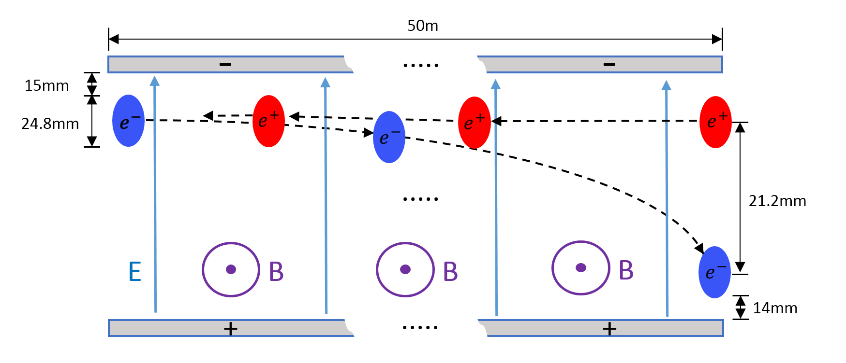
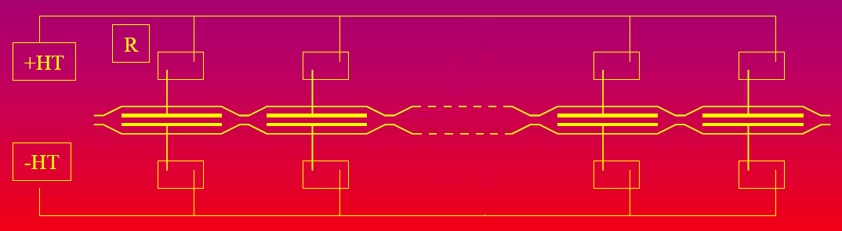
  Introduction
    The Electro-Magnetic Separator is a device consisting of perpendicular electric and magnetic fields.
    One set of Electro-Magnetic Separators including 8 units, total 32 units will be need for CEPC.

Slide 5
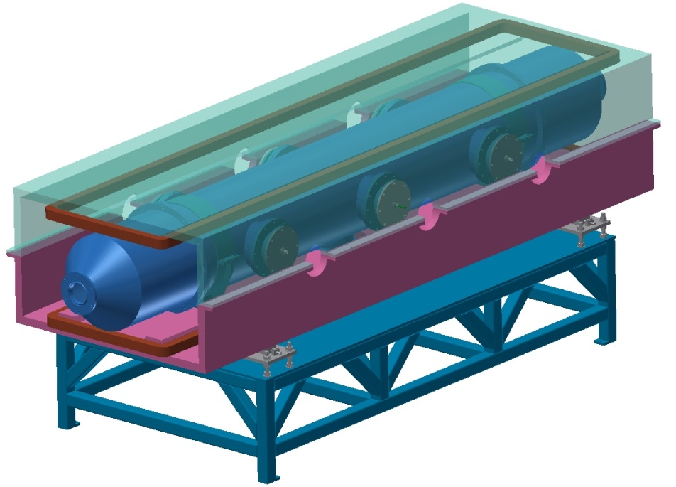
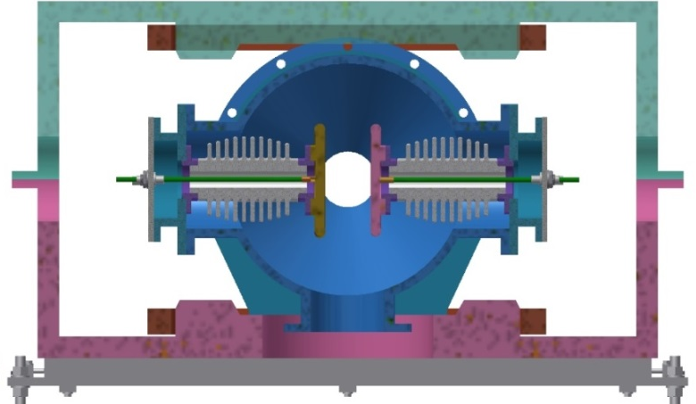
  Introduction
    Parameters of Electrostatic-Magnetic Separator
 | Filed | Effective Length | Stability
Electrostatic separator | 2.0 MV/m | 4 m | 5x10⁻⁴
Dipole | 66.7 Gauss | 4 m | 5x10⁻⁴
Metal-ceramic support
High voltage feedthrough
UHV tank
Support
Magnet
Coil
Electrode
  Structure drawing of Electrostatic-Magnetic Separator

Slide 6
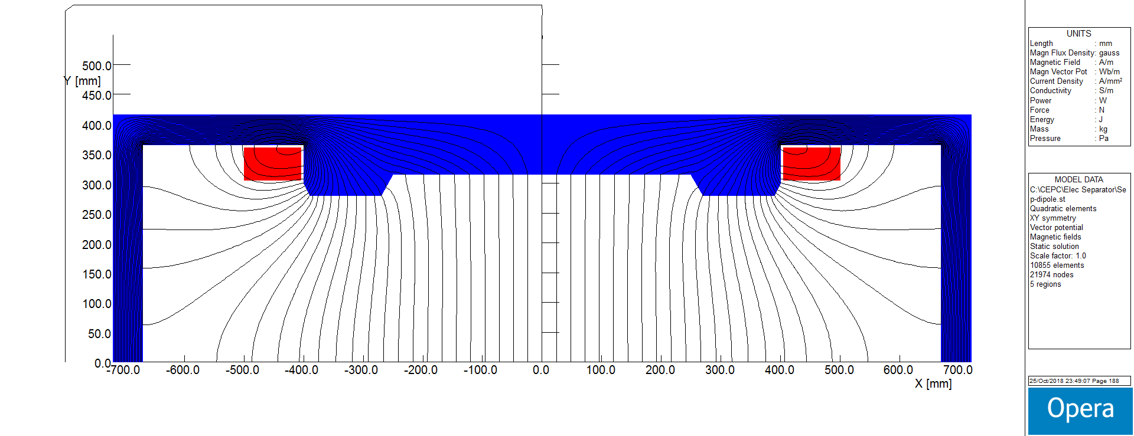
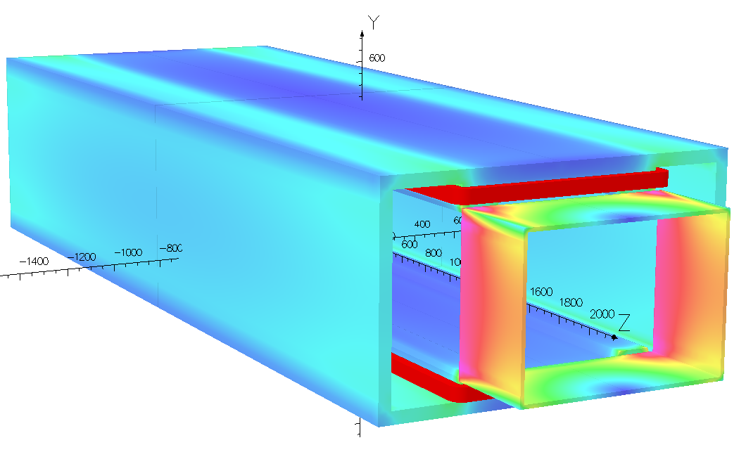
  Design of dipole magnet
    The magnet yoke is H-type, because of the higher field integrals uniformity and installation consideration of the electro-static system.
Magnet Name | ESM
Center field [Guass] | 75.5
Magnet Length [m] | 4.4
Current [A/turn] | 10.8
Turns [H×V] | 12×17
Field Clamp Size [H×V, mm] | 830×610
Field Clamp Wall Thickness [mm] | 10
Field Clamp Number | 2
Coil Number | 2
Conductor Size [H×V, mm] | 3×3
Current Density [A/mm^2] | 1.2
Magnet Resistance [Ω] | 7.82
Magnet Voltage [V] | 84.4
Magnet Power [W] | 660
Magnet Inductance [H] | 2.42
Cooling Method | Air
Yoke Weight [Ton] | 11
Coil Weight [Ton] | 0.328
Magnet Weight [Ton] | 11.328
Field Distribution
Magnetic flux density distribution in 3D Model
Parameters of the magnet

Slide 7
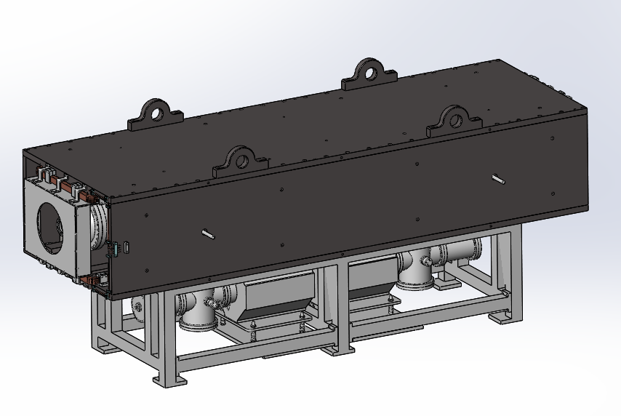
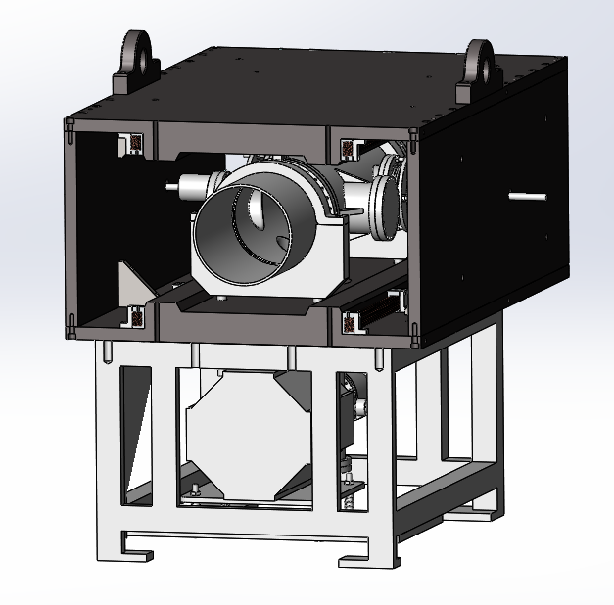
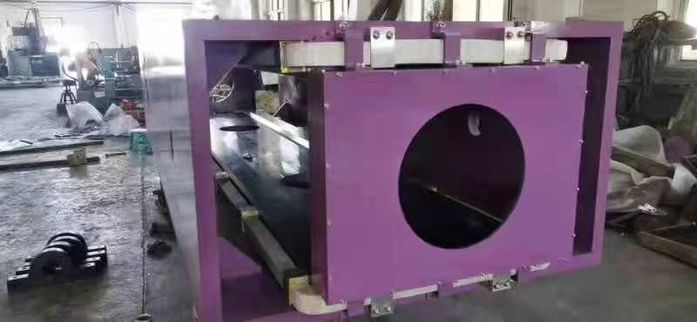
  Design of dipole magnet
    The prototype of the magnet has been developed.
    The field measurement of the prototype will be made.

Slide 8
  Design of electrostatic separator

Slide 9
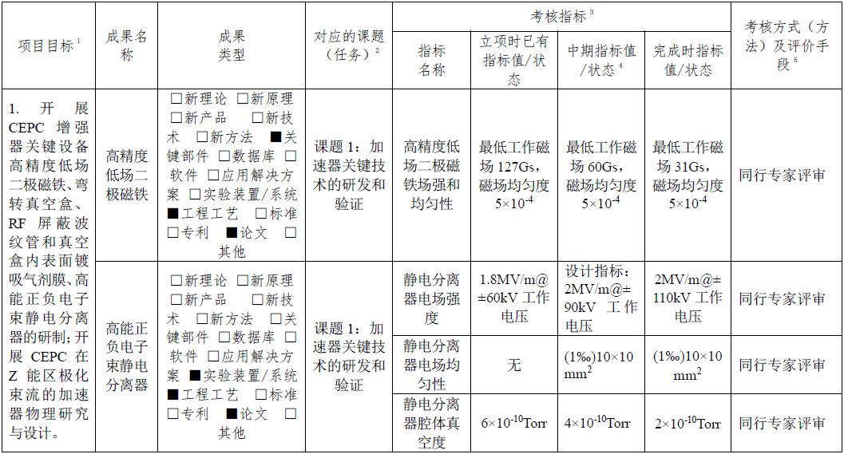
  Design of electrostatic separator
    Project goals and indicators

Slide 10
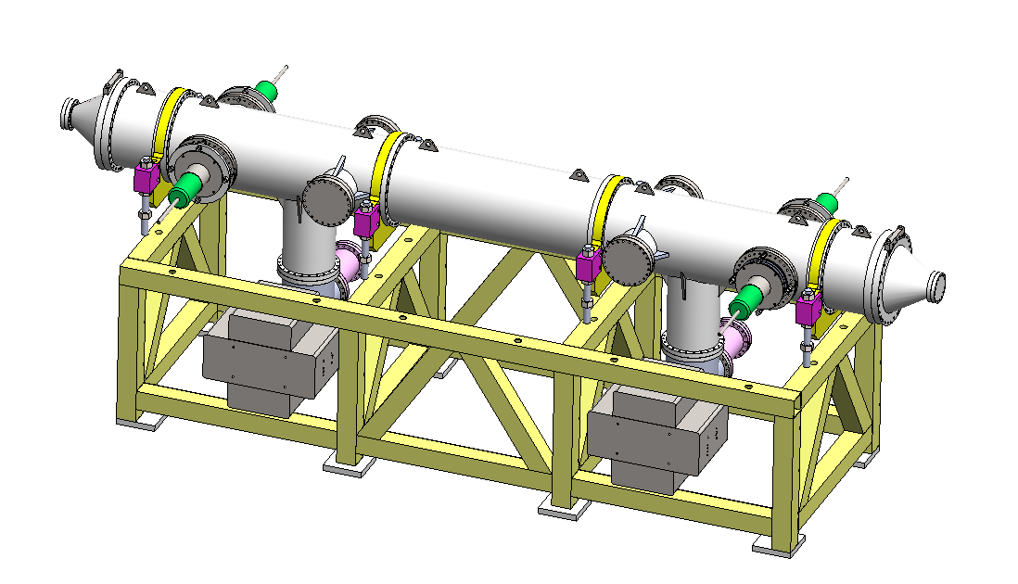
  Design of electrostatic separator
    An electrostatic separator comprise a pair of electrodes, UHV tank, metal-ceramic supports, high voltage feedthrough, High voltage circuit and vacuum system, etc.
    In order to reduce the beam impedance of the electrostatic separator, the gap between the two electrodes was changed from 110mm to 75mm.
Separator length | 4.5m
Inner diameter of separator tank | 540mm → 380mm
Electrode length | 4.0m
Electrode width | 260mm → 180mm
Nominal gap | 110mm → 75mm
Maximum operating field strength | 2MV/m
Maximum operating voltage | ±110kV → ±75kV
Maximum conditioning voltage | ±160kV → ±135kV
Good field region (0.5‰ limit) | 46mm ×11mm
Nominal vacuum pressure | 2.0×10⁻¹⁰Torr
  Structure drawing of Electrostatic Separator
  Parameters of electrostatic separator

Slide 11
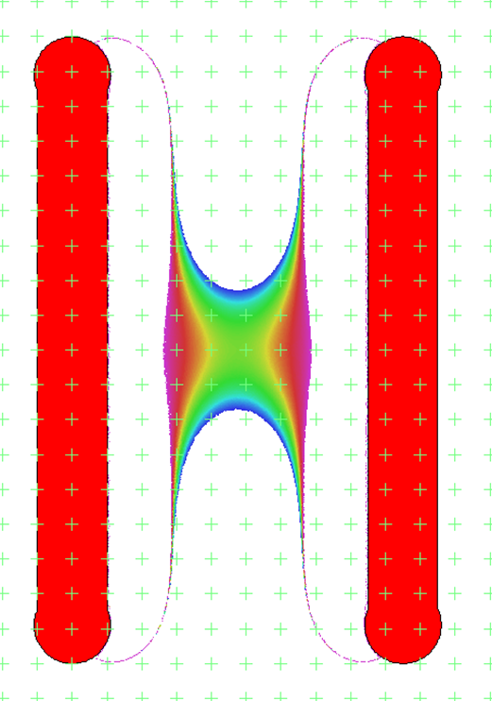
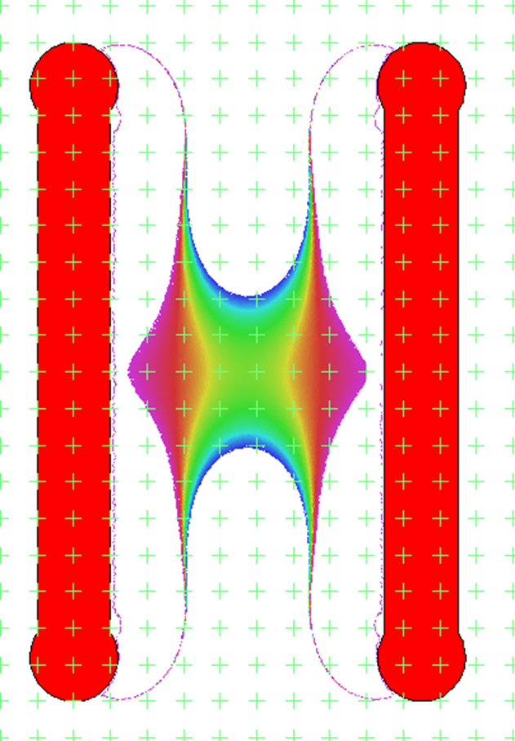
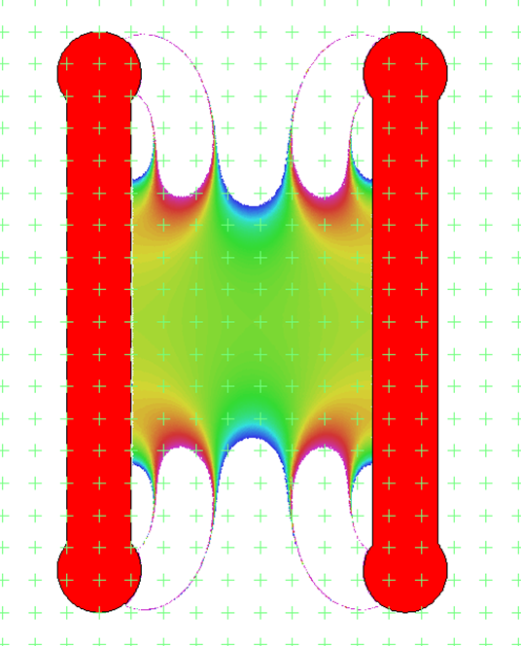
  Structure and electric field design
    Electrode plate design (The edges are designed in a thick circular arc to improve field uniformity )
11mm
12mm
13.87mm
场均匀性：0.5‰
40mm×30mm
40mm×40mm
75mm×70mm

Slide 12
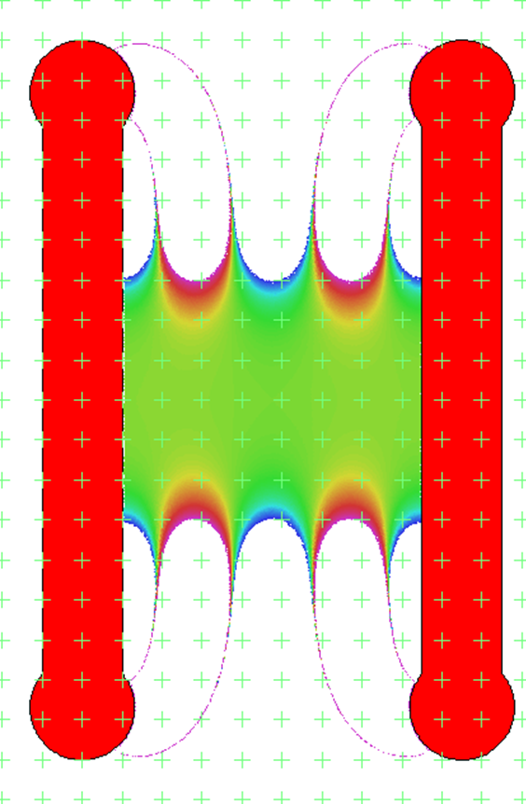
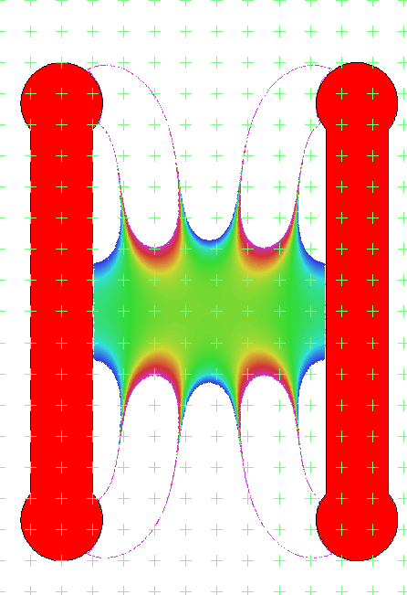
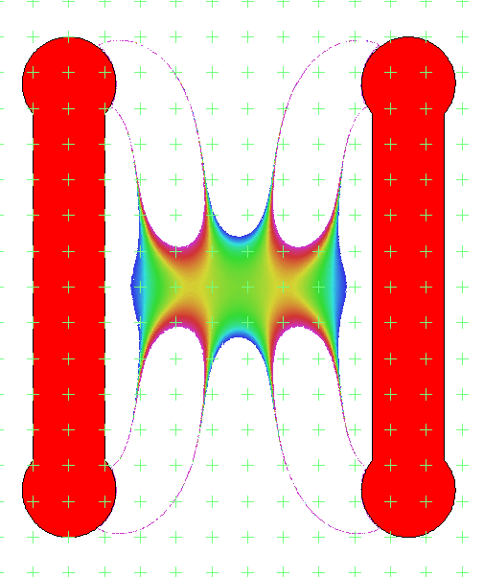
  Structure and electric field design
    Electrode width design
180mm
160mm
140mm
0.5‰ 75mm×60mm
0.5‰ 75mm×30mm
0.5‰ 50mm×20mm

Slide 13
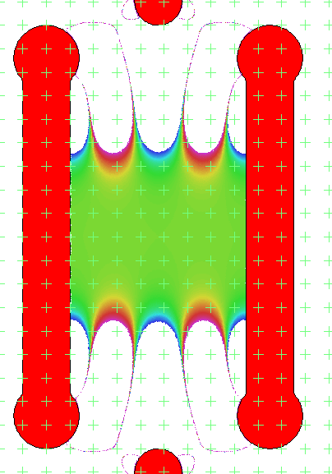
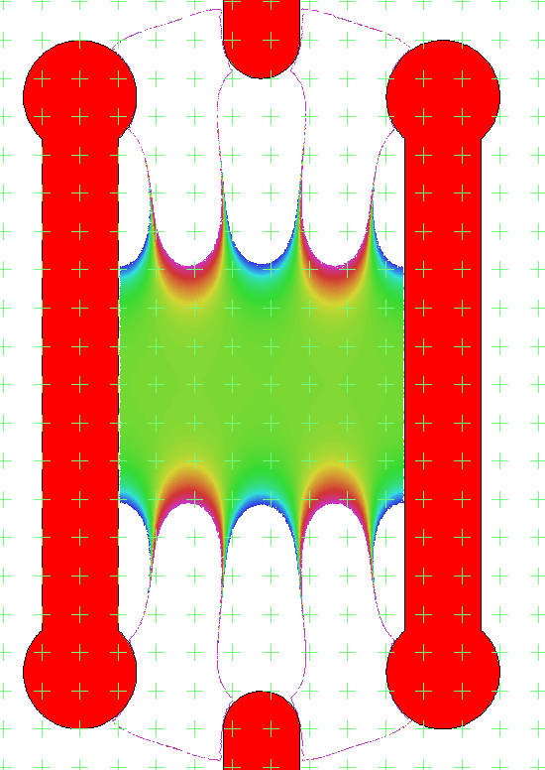
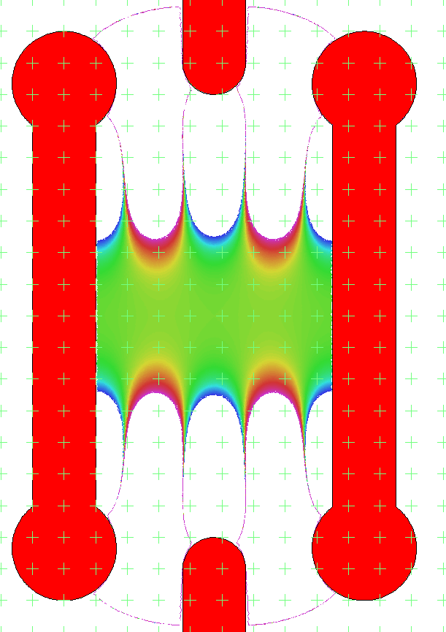
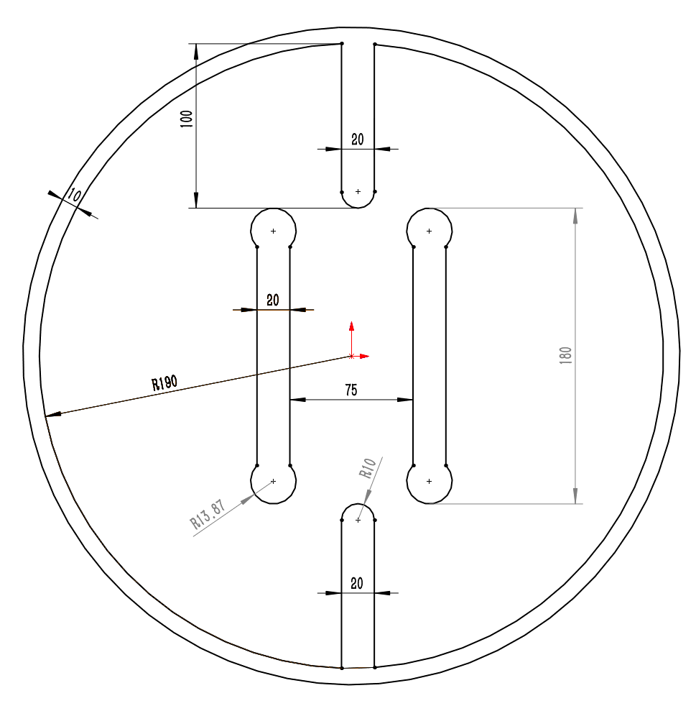
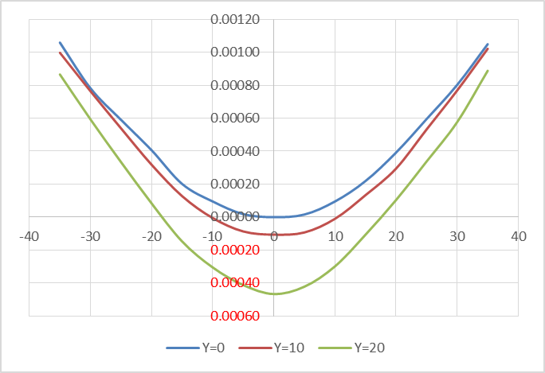
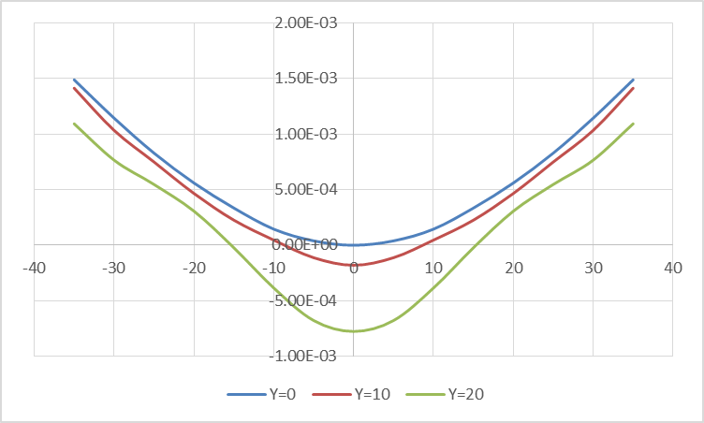
  Structure and electric field design
    Height of ground electrode ( thickness 2cm )
地电极长度100mm
地电极长度110mm
地电极长度120mm
积分均匀性0.5‰范围： 46mm×30mm
积分均匀性0.5‰范围： 40mm×20mm
积分均匀性0.5‰范围：30mm×20mm

Slide 14
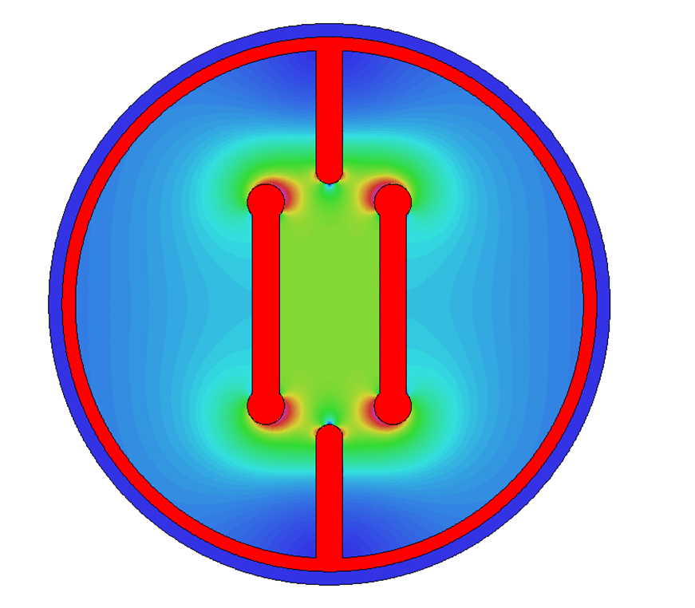
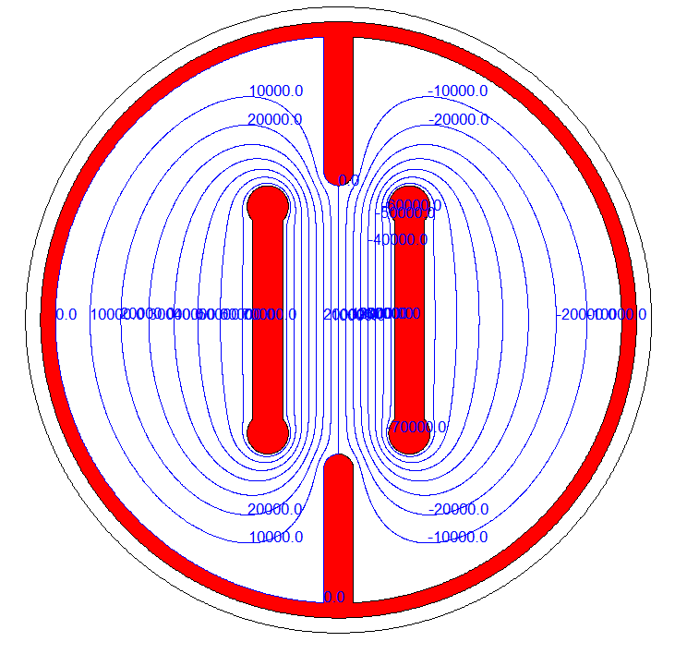

  Structure and electric field design
    Electric field distribution and maximum field intensity
    $WE^{2}exp(−1.7×{10}^{5}/E)=1.8×{10}^{14}$
    @270kV，E_{max}=7.7MV/m
电场分布 最大场强：3.86MV/m @150kV
6.96MV/m @270kV
“Kilpatrick's criterion”
基尔帕特里克准则
等势线

Slide 15
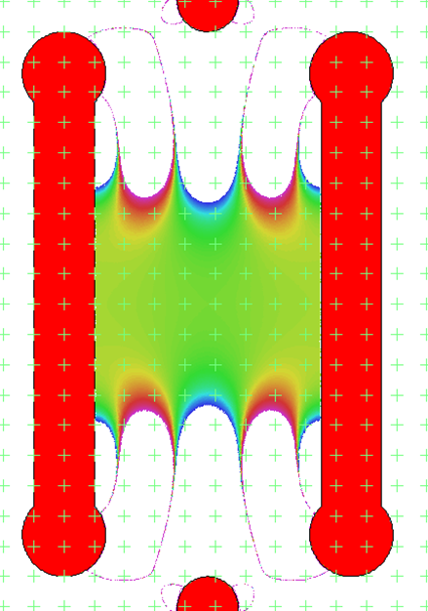
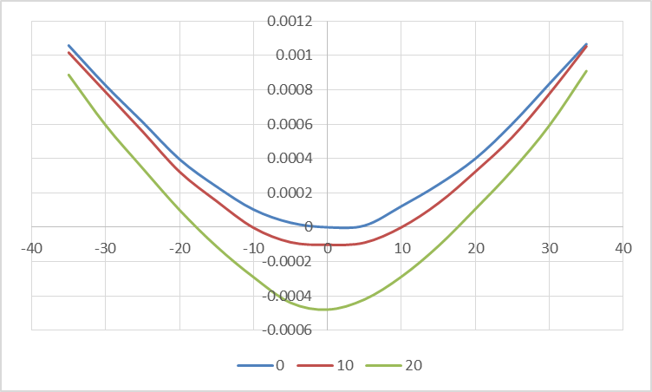


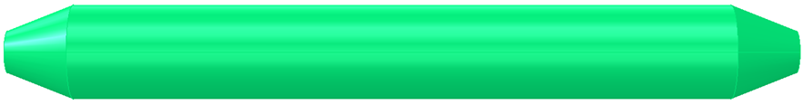
  Structure and electric field design
    Electrode ( a pair of metal flat plate )
    Dimension : 4m long and 180mm wide
    Material : Pure Titanium
    Field strength : 2MV/m
    UHV tank
    4.5m long and 38cm inner diameter
Field homogeneity：7.5cm*5cm 0.5‰
Calculated integrated electrical field uniformity ：4.6cm*3cm 0.5‰
Length：400cm
With：18cm
Thickness：2cm
Radius：1.5cm
Density：4.54g/cm³
Weight：≈65kg
18cm
400cm
25cm
400cm
ID：9.5cm
ED：7.5cm
thickness：1cm

Slide 16
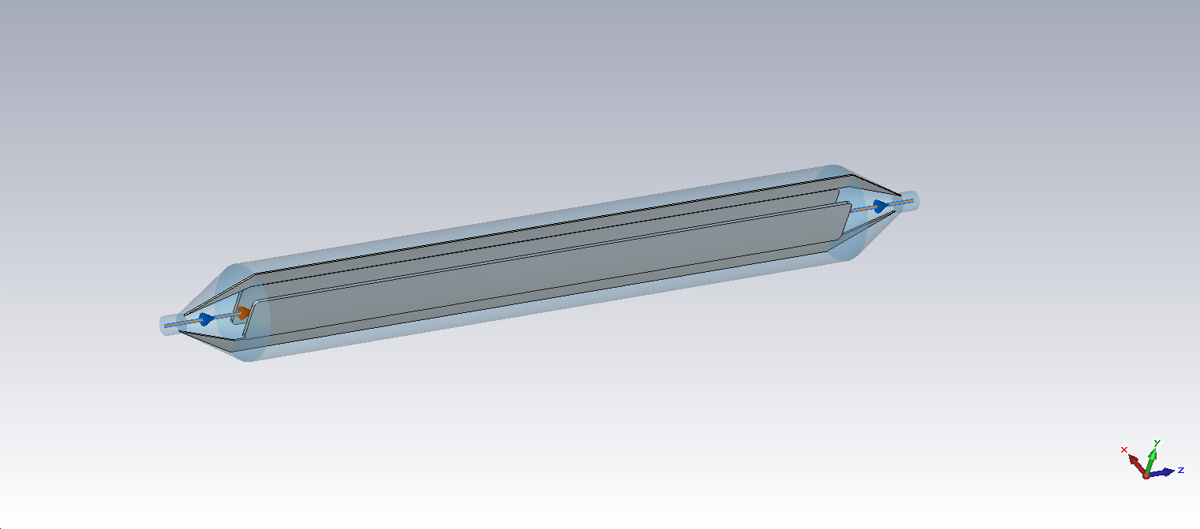

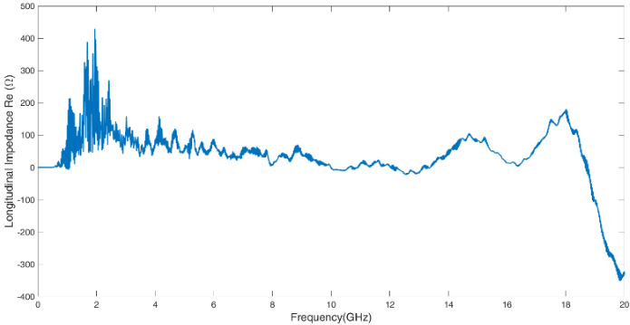
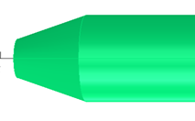
  Structure and electric field design
    The electrostatic separators are large contributors to the overall impedance. There are two methods implemented in the design of the separator which reduce the loss factor
    Ground electrodes
    Tapered ends
σ_{z}=5mm: Loss factor @k_trap: 0.032v/pc
Separator tank length | 4000mm
Inner diameter of separator tank | 380mm
Electrode height | 180mm
Electrode gap | 75mm
Electrode thickness | 15mm
Taper length | 231mm
Taper end diameter | 98mm
Ground plate length | 4462mm
Ground plate height | 100mm
Ground plate thickness | 20mm
Ground electrodes
 | Higgs(w) | W (kw) | Z(w) | ttbar（w）
HOM power(30MW) | 385 | 1.87 | 18.6 | 107
HOM power(50MW) | 643 | 3.13 | 31.0 | 178
Tapered ends

Slide 17
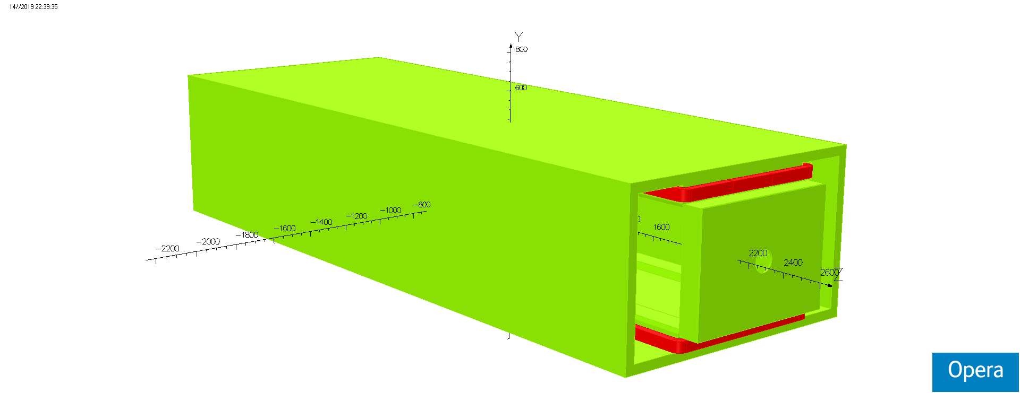
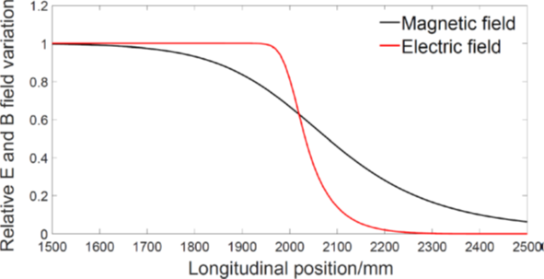
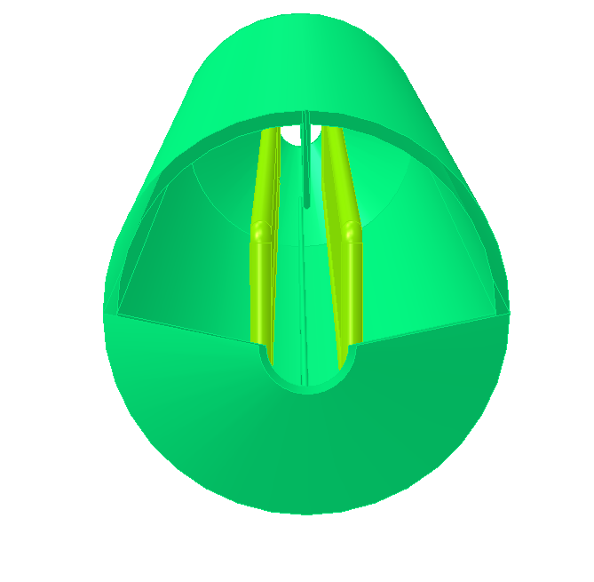
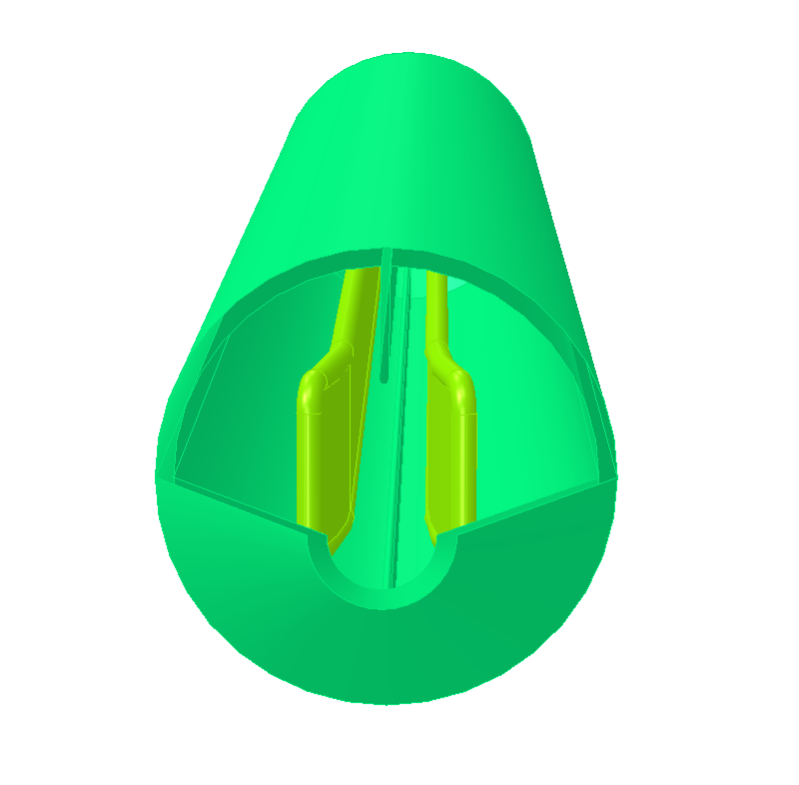
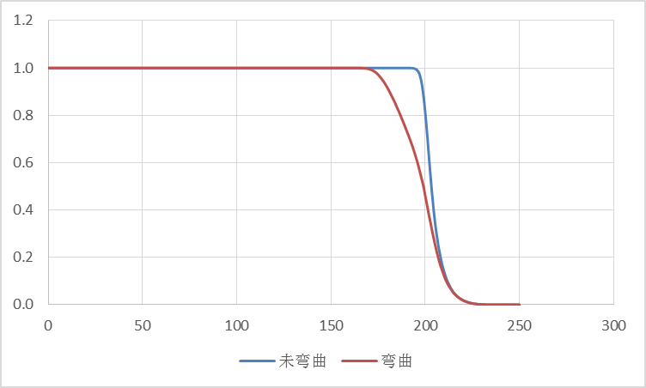
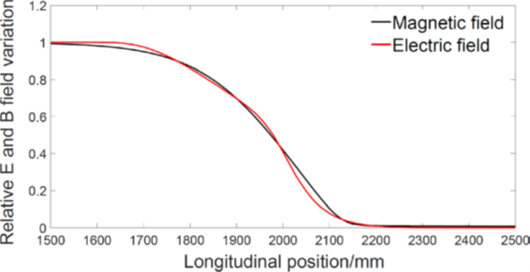
  Methods to maintain E/B ration in fringe field region
    In this fringe ﬁeld region, the ratio of E/B differs from that inside the separator, and this can result in a synchrotron radiation from the Separation Region, which will affect the down stream RF cavities.
    Magnet: addition of ﬁeld clamps, along with the mirror plates.
    Separator: ﬂaring open the electrode ends progressively.
The normalized longitudinal E and B field profiles before optimization
Feld clamp
Mirror plate

Slide 18
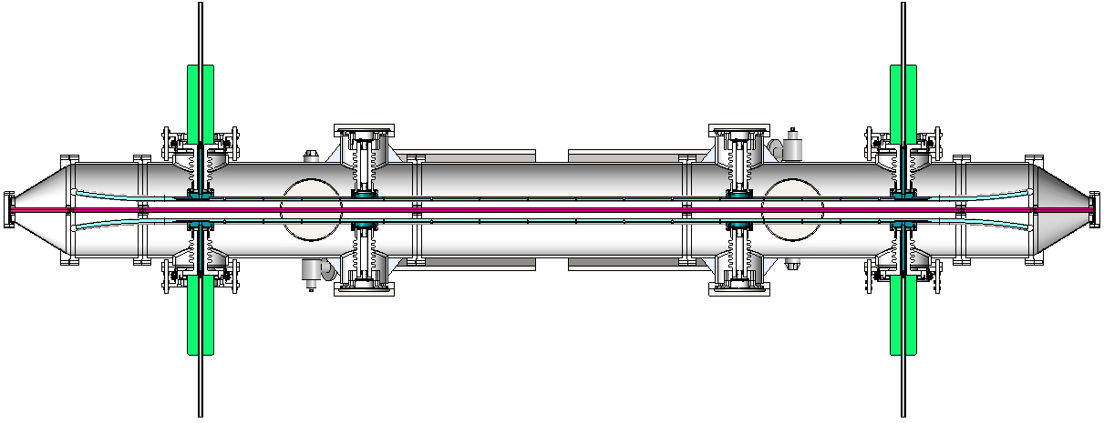
  Mechanical design
    Including electrodes, UHV tank, metal-ceramic supports, high voltage feedthrough, High voltage circuit and vacuum system, etc.
高压馈电馈液装置
绝缘支撑
地电极
电极板
泵室通道
真空腔

Slide 19
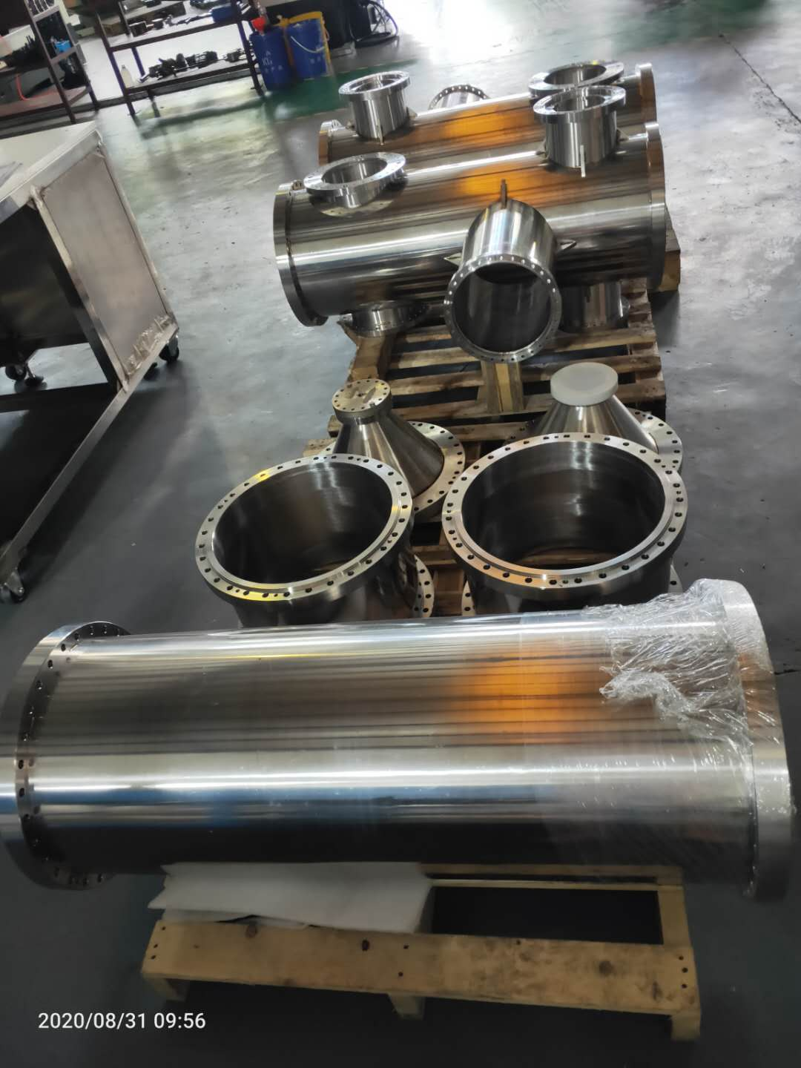
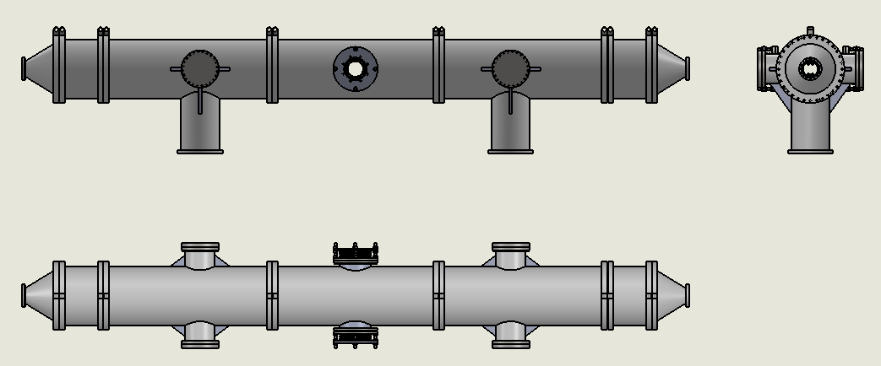
  Mechanical design
    UHV tank
    The vacuum chamber is made of stainless steel 316L, which is a non-magnetic material, so it can effectively reduce the interference to the magnetic field of the dipole.
    Split into 7sections, step positioned to ensure installation accuracy.
    Electrochemical polishing treatment to make the HV sparking rate as low as possible.
    High temperature vacuum degassing treatment to achieve ultra high vacuum.
    Adopt metal seal to keep low leak rate of vacuum.

Slide 20
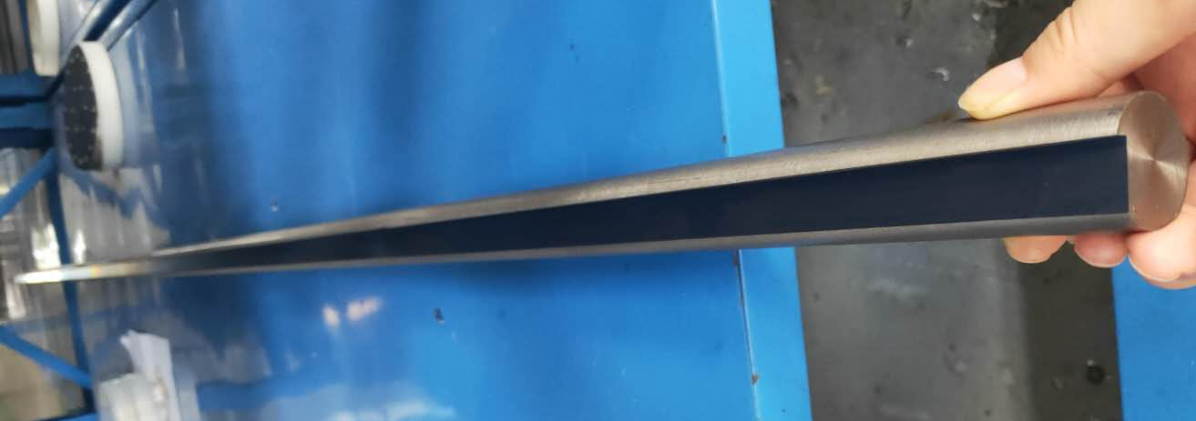
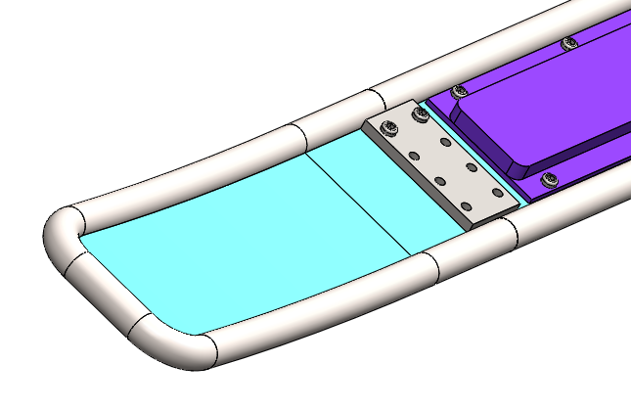
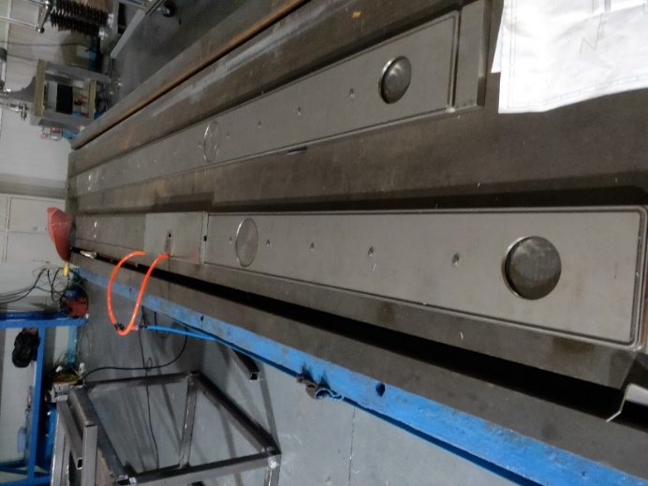
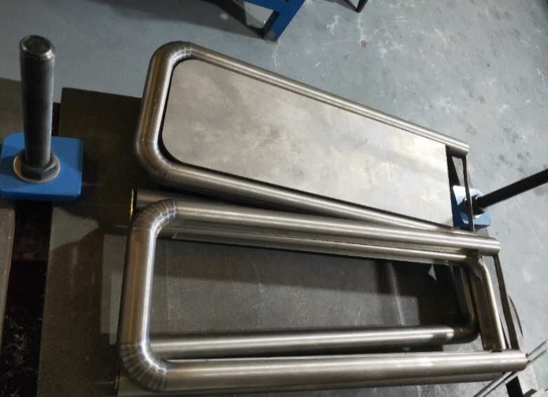
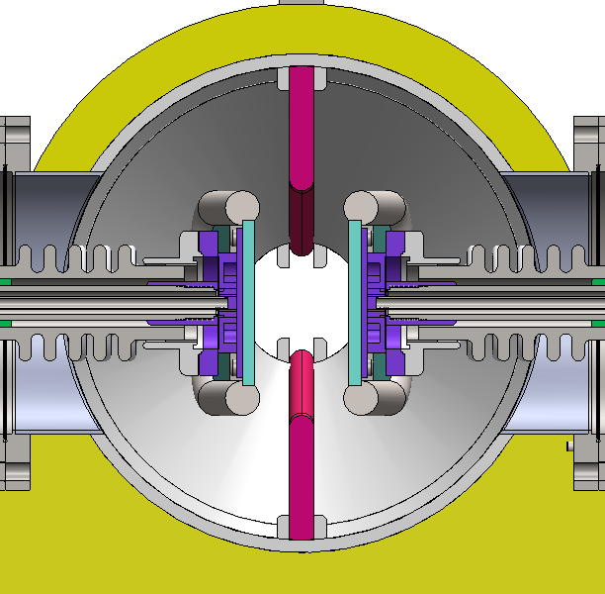
  Mechanical design
    Electrodes
    The electrode plate is made of pure titanium.
    The whole electrode plate is divided into three parts, including the middle straight plate part and the two arc plate on both ends, and bolted connection. In this way, the dimensional accuracy of the middle part and the curved part on both sides is easy to be realized.

Slide 21
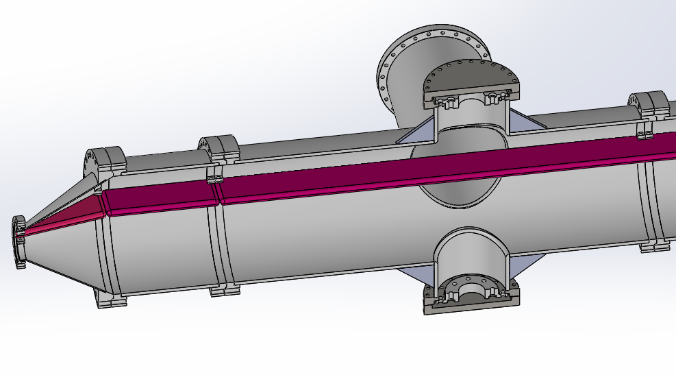
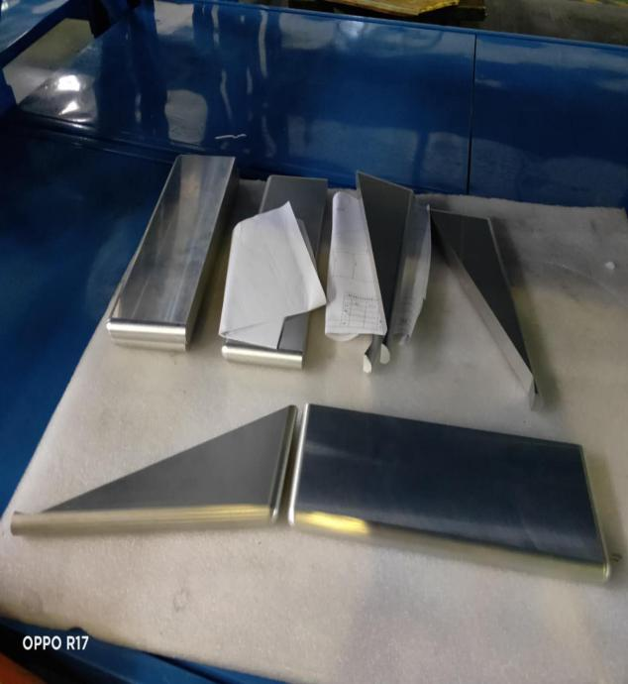
  Mechanical design
    Ground Electrode
    The material of ground electrode is aluminum 6061 T6.
    The ground electrode is divided into 5 sections: 2 sections of triangle, 2 sections of short rectangle and 1 section of long rectangle. The purpose of segmentation is to facilitate machining and installation
    The ground electrode is fixed with a fixed clamp welded on the vacuum chamber.

Slide 22



设计方案
  Mechanical design
    HV metal-ceramic support
    The ceramic parts are made of 95% alumina ceramics.
    The ceramic ends are metallized , and the metal flanges are welded for fixation, which has the advantage of high mechanical strength.

Slide 23




设计方案
  Mechanical design
    High voltage feedthrough
    The feedthrough device of each electrode plate , both feed HV and cooling liquid.
    The inside of the ceramic tube is atmosphere, with feedthrough cable and liquid pipe, and the outside is vacuum.
    Bellows are soft connections for easy installation and position adjustment.
冷却通道

Slide 24



设计方案
  Vacuum design
    To minimize the breakdown rate, the vacuum in all separators will be kept at the low pressure of about about 2×10⁻¹⁰Torr. However, the size of the whole prototype is very large, so special care will be taken to the welding, sealing of the separator components in vacuum system design.
    Including: two sputter ion pump ( pumping speed 1000l/s), and two sublimation pump ( pumping speed 1000l/s).
离子泵的抽速曲线
升华泵的抽速曲线

Slide 25
  Development process
    The design scheme review of "Electrostatic Separator Prototype" was held in IHEP on July 18, 2019
    The tender for the prototype was held on February 28, 2020
    The factory test was carried out in company on April 15, 2021
    From 2021 to 2023, the prototype electrostatic separator was commissioning in IHEP
    Subject acceptance was held on May 25, 2023

Slide 26




  Development process
    The factory test was carried out in company on April 15, 2021

Slide 27


  Factory test results
  Improvement scheme : 1. carve annular groove on the outer surface of ceramic parts to increase the creepage distance; 2. Electrode probe is coated with insulation bushing and sealed to block the creepage path on the air side of the HV feedthrough.
Index | indicators | Factory test | Test results
Vacuum leakage rate |  | ≤1×10⁻¹⁰Pa.m3/s | 2×10-13Pa·m3/s
Vacuum pressure | ≤2.0×10⁻¹⁰Torr | ≤4.0×10⁻¹⁰Torr | ≤1.0×10⁻¹⁰Torr
Maximum conditioning voltage |  | ±135KV，稳定工作8小时无故障打火，真空度≤4.0×10⁻¹⁰Torr | －108KV ＋97.6KV
改进方案
打火位置
陶瓷件改进方案示意图

Slide 28






  From 2021 to 2023, the prototype electrostatic separator was commissioning in IHEP
    Install vacuum chamber and electrode plate vacuum leak detection.

Slide 29





  From 2021 to 2023, the prototype electrostatic separator was commissioning in IHEP
    Molecular pump unit for crude pumping.
    Vacuum baking.

Slide 30




  From 2021 to 2023, the prototype electrostatic separator was commissioning in IHEP
    High voltage test
    Due to the arc occurred at the air side of feedthrough during the factory test, Some methods implemented in the HV feedthrough : 1. carve annular groove on the outer surface of ceramic parts to increase the creepage distance; 2. Electrode probe is coated with insulation bushing and sealed to block the creepage path on the air side of the HV feedthrough.

Slide 31



  From 2021 to 2023, the prototype electrostatic separator was commissioning in IHEP
    High voltage test
    The arc occurs at ±90kV

Slide 32



  From 2021 to 2023, the prototype electrostatic separator was commissioning
    High voltage test
    Increase the length of ceramic parts on the air side
    Add smooth cover on the outside of the feedthrough (avoid increasing field strength on the edge of mounting screw)
    The high voltage was achieved to ±118kV
32

Slide 33

  Assessment indicator
    Final index
    Electric field uniformity (1‰)10×10 mm2 (simulation result);
    Vacuum degree ≤2.7×10-8 Pa;
    Electric field intensity 2MV/m@±110kV.

Slide 34



  Test equipment
    Simulation software：Opera
    Instrument: vacuum gauge, vacuum gauge, leak detector
氦质谱检漏仪：莱宝Phoenix Quaro参数
氦气的最小可检漏率（真空检漏） | 1.0×10⁻¹² | mbar·L/s
最大进气口测试压力 | 15 | mbar
粗检能力 | 2.5 | m³/h
进气口 | DN 25 | ISO KF
氦气在进气口的抽气速度 | 1.2 | L/s
预热时间 (20° C) | < 110（带自动校准） | s
响应时间（吸枪检测） | < 1 | s
真空计XGS-600主要参数
量程 | 5×10⁻¹²Torr to 1mTorr (UHV24)
发射电流 | 0.1 to 10 mA
灵敏度范围 | 0.1 to 99.9/Torr
响应时间 | 20
真空规UHV-24p ION 主要参数
测量下限 | 5×10⁻¹¹ Torr
测量上限 | 1×10⁻³ Torr
最大烘烤温度 | 450 ℃
除气时最大功耗 | 40W
真空计XGS-600
真空规UHV-24p I GAUGE
检漏仪Phoenix Quaro

Slide 35


  Test equipment
海泽PNC 150000-1.5pos电源主要参数
型 号 | PNC 150000-1.5pos
极性 | 正高压
输入 | 220V±10%，1P
输出 | 0-150000V，0-1.5mA
电压稳定度 | ≤0.01% Unom
温度系数 | ≤0.01% Unom/K
纹波 | ≤0.01% Unom±50mV
工作环境 | 温度:0°C~40°C，湿度:35%~70%RH
GLASSMANN PS/KT 150N10-220电源主要参数
型 号 | PS/KT 150N10-220
极性 | 负高压
输入 | 220V±10%，1P
输出 | 0-150000V，0-10mA
电压稳定度 | 0.01% after 1/2 hour warm-up, 0.05% per 8 hours.
温度系数 | 0.01% /K
纹波 | ≤0.025% of rated voltage at full load (0.1% RMS for >100kV)
工作环境 | 温度:-20°C~40°C

Slide 36
  Test result
    Electric field uniformity (0.5‰)46×30 mm2 (simulation result)
Field homogeneity：7.5cm*5cm 0.5‰
Calculated integrated electrical field uniformity ：4.6cm*3cm 0.5‰

Slide 37

  Test result
    Vacuum degree ≤2.6××10⁻⁸ Pa

Slide 38

  Test result
    Electric field intensity 3.15MV/m@±118kV

Slide 39
  The test results shows that the uniformity of electric field, the ultimate vacuum of vacuum chamber and electric field intensity all meet the final indexes and meet the acceptance requirements.
序号 | 技术指标名称 | 预期结果 | 测试结果 | 测试人及测试时间 | 结论
1 | 电场均匀性 | (1‰)10×10 mm² | (0.5‰)46×30 mm² | 朱建斌2019.6 | 电场均匀性 优于要求技术指标
2 | 真空腔室总漏率 | ≤1×10-10Pa·m3/s | 1×10-13Pa·m3/s | 张宁波2021.4 | 真空腔漏率优于要求技术指标
3 | 真空盒极限真空 | ≤2.7×10⁻⁸ Pa | ≤2.6×10⁻⁸ Pa | 张宁波2021.4 | 极限真空达到要求技术指标
4 | 电场强度 | 2MV/m@±110kV | 3.15MV/m@±118kV | 张宁波2023.5 | 电场强度 优于要求技术指标

Slide 40

  Subject acceptance test

Slide 41
Thank You!

