Slide 1
Overview of Vertex Detector R& D
Zhijun Liang
(IHEP, Chinese Academy of Sciences)

Slide 2
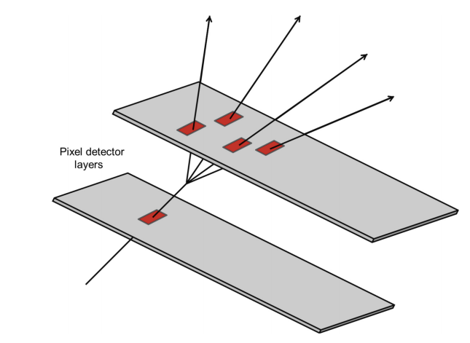
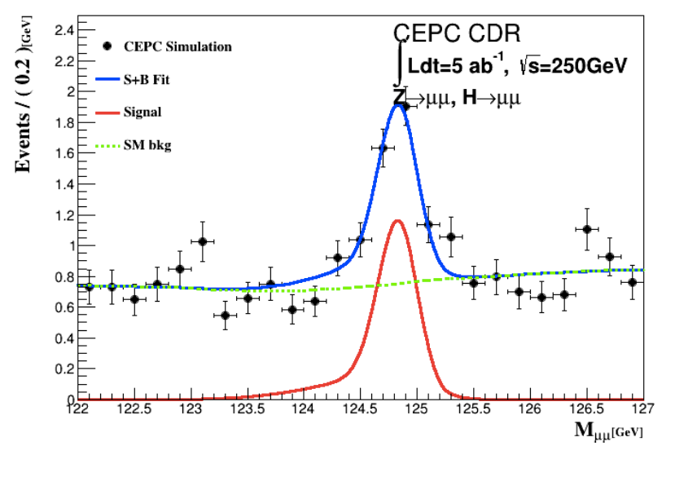
Vertex detector: Physics goal
Higgs precision measurement
H → bb precise vertex reconstruction
H → μμ (precise momentum measurement)
Main technology
High spatial resolution technology → pixel detector
Low-mass detector technology
Radiation resistance technology
Need tracking detector with
high spatial resolution, low material

Slide 3
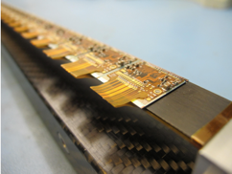
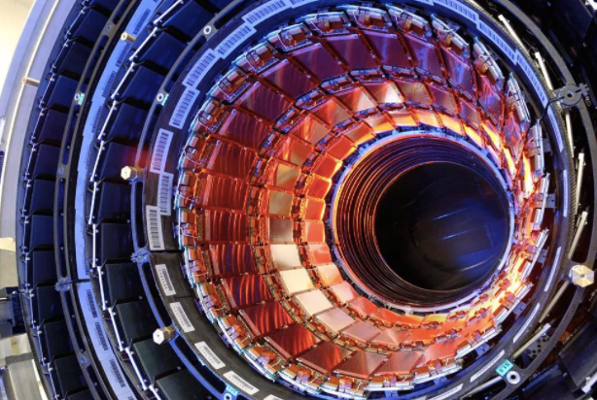
MOST2 vertex detector R & D: Research Goal
Typical module
Produce a world class vertex detector prototype
Spatial resolution 3~5 μm (pixel detector)
Radiation hard (>1 MRad)
Preliminary design of prototype
Three layer, double size ladders
Typical tracker
Resolution
ATLAS/CMS upgrade
（~15 μm）
Alice upgrade
（5~10 μm）
World
leading
This project（3~5 μm）
Notes:
General description highlighting major points and assessment indicators

Slide 4
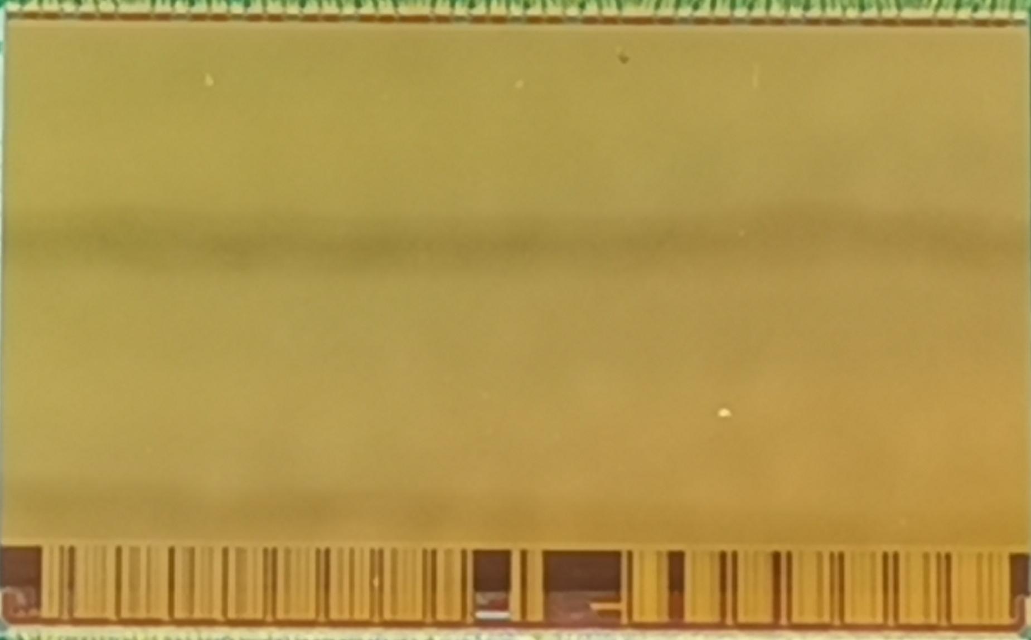
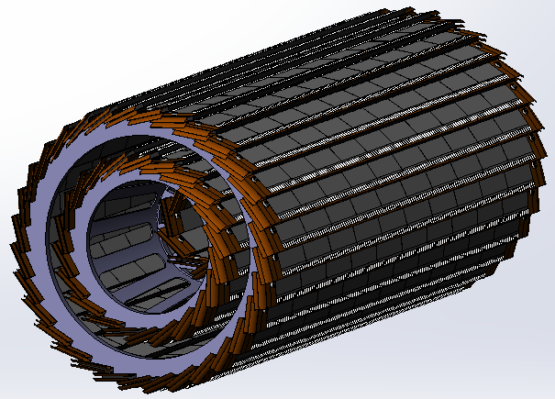
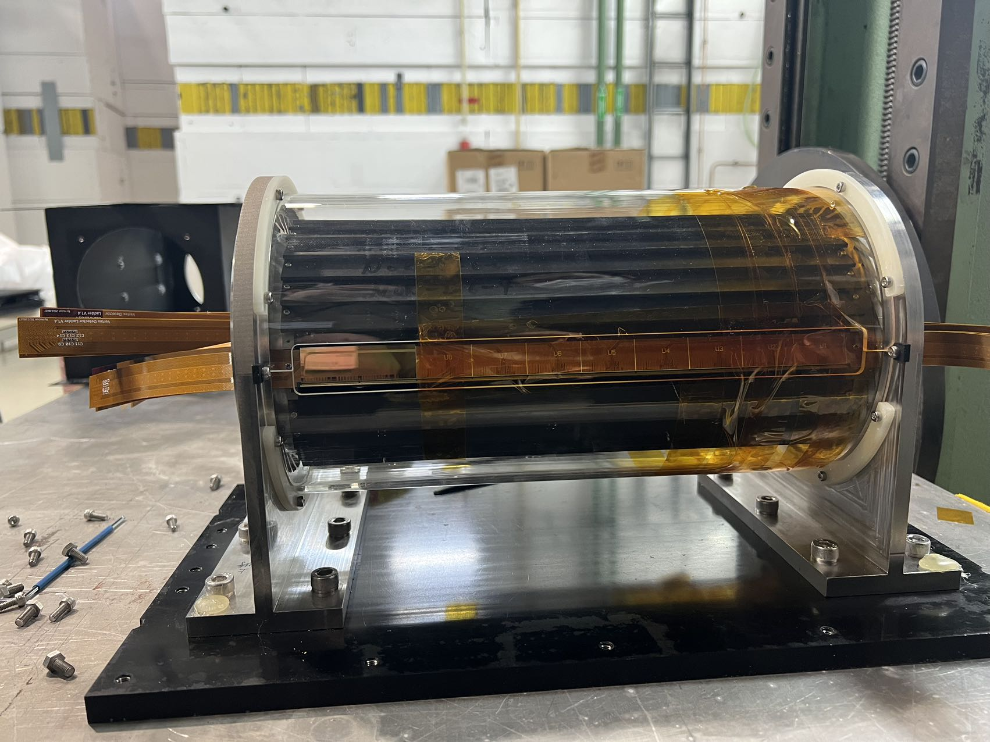
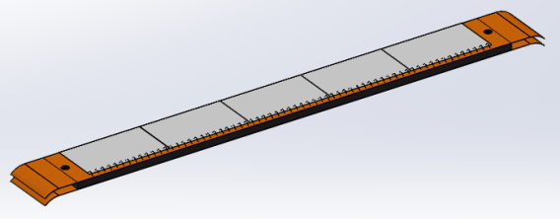
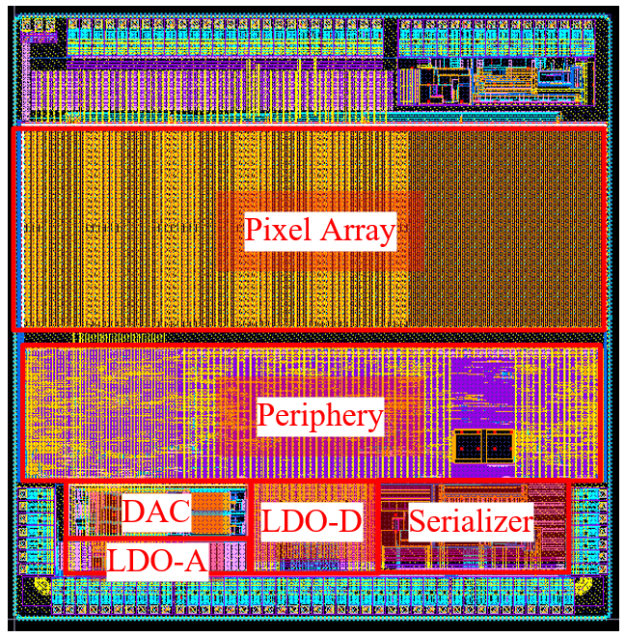
Overview of MOST2 vertex detector R & D
Can break down into sub-tasks:
CMOS imaging sensor chip R & D
Detector layout optimization, Ladder and vertex detector support structure R & D
Detector assembly
Data acquisition system R & D
CMOS imaging
sensor prototyping
Detector module (ladder)
Prototyping
Full size vertex detector Prototype
Notes:
Full size vertex detector

Slide 5
Research Team in MOST2 silicon project
4 institutes
课题2：IHEP - 中国科学院高能物理研究所
SDU - 山东大学
NJU - 南京大学
NWU - 西北工业大学
Institutes | Tasks
IHEP | Full CMOS chip modeling, Pixel Analog, PLL block Detector module (ladder) prototyping Data acquisition system R & D Vertex detector assembly and commissioning
CCNU/IFAE | CMOS sensor chip: Pixel Digital
NWPU | CMOS sensor chip: Periphery Logic, LDO
SDU | CMOS sensor chip: Bias generation, TCAD simulation Sensor test board design
NJU | Irradiation, test beam organization
Notes:
Total 51, average age is 39
Acc: 39=703/18
Silicon: 39=866/22
HCAL: 40=440/11
Total: 39

Slide 6
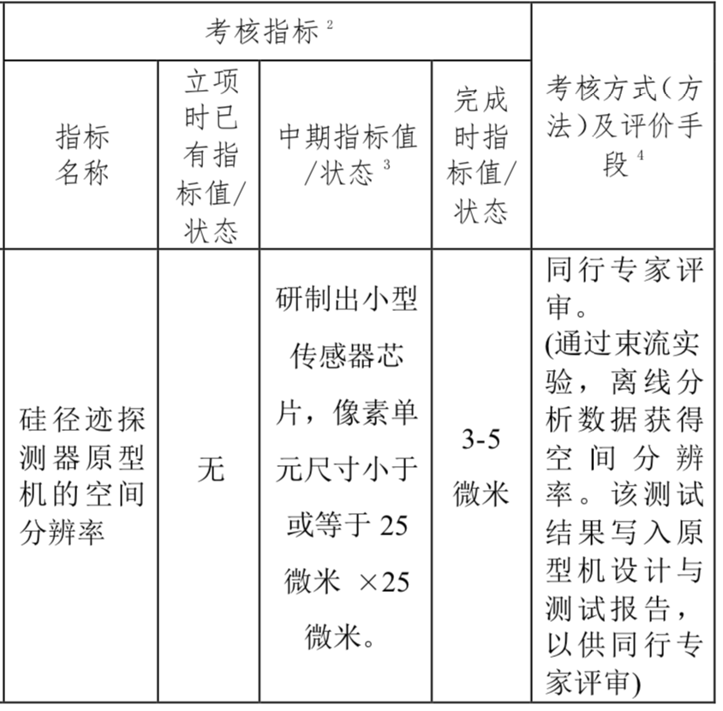
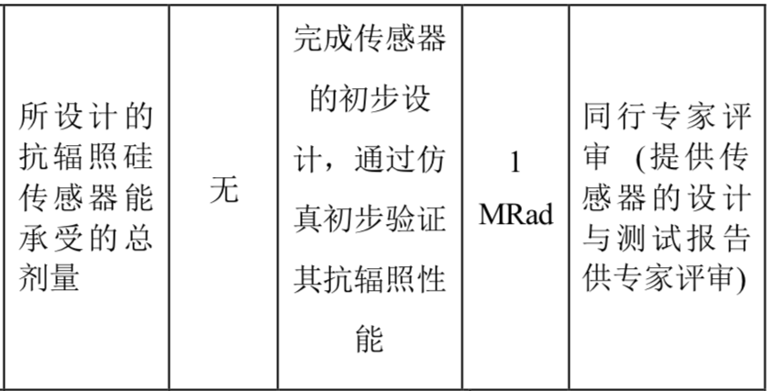
Achievement Presentation and Assessment Methods
Assessment index
Spatial resolution
- Mid-term: produce 25*25 μm pixel size chip
- Final : 3-5 μm resolution in Beam test
Silicon Detector
Radiation hardness
- mid-term: verified by TCAD simulation
- Final : Total ionization dose >1 Mrad

Slide 7
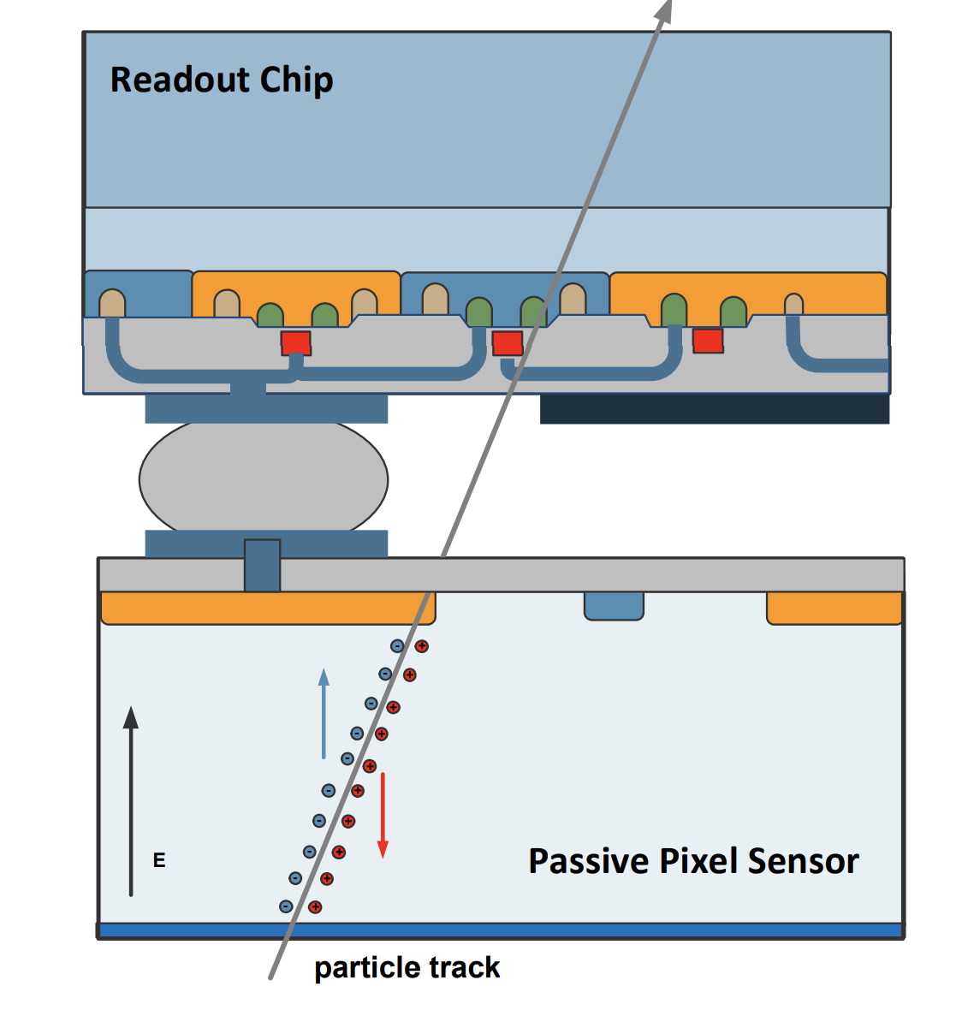
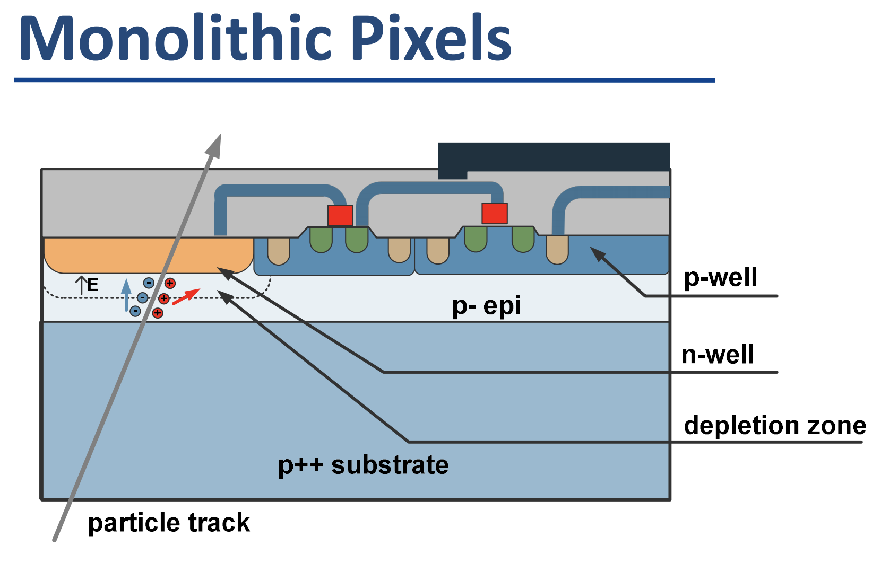
CMOS Monolithic pixel sensor
CMOS Monolithic pixel (CIS process) is ideal for CEPC application
low material budget (can be thin down to 50μm)
This project use TowerJazz CIS 180nm technology
Hybrid pixel technology developed by ATLAS and CMS
Thickness of sensor is about 200~300 μm
Need to bump bonding with readout ASIC (ASIC thickness is about 300μm)
Material budget about silicon sensor is about 10 times larger than CIS process
Hybrid pixel

Slide 8
CMOS Sensor chip R & D
The existing CMOS monolithic pixel sensors can’t fully satisfy the requirement
Major Challenges for the CMOS sensor
Small pixel size -> high resolution (3-5 μm)
High readout speed (<500ns deadtime @40MHz at Z pole) -> for CEPC Z pole high lumi
Radiation tolerance (per year): ~1 MRad

Slide 9
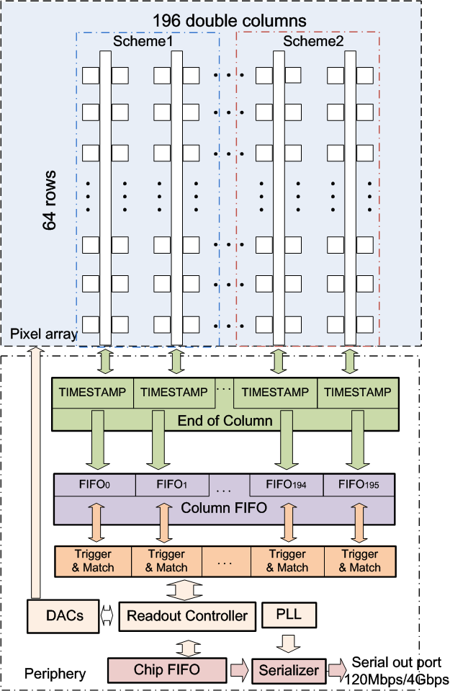
New proposed readout architecture in TaichuPix
New readout architecture
→ reduce power consumption and reduce pixel size
CEPC readout time requirement:
<500ns deadtime @40MHZ(Z pole)
Taichu-1 Column-drain readout
Priority based data driven readout; time stamp at EOC
Dead time: 2 CLK for each pixel (50ns @40MHz CLK)
Two digital pixel designs: FEI3-like and ALPIDE-like design
2-level FIFO architecture
L1: column level, to de-randomize injecting charge
L2: chip level, to match in/out data rate between core and interface
Trigger readout:
Coincidence by time stamp, matched event read out
df

Slide 10
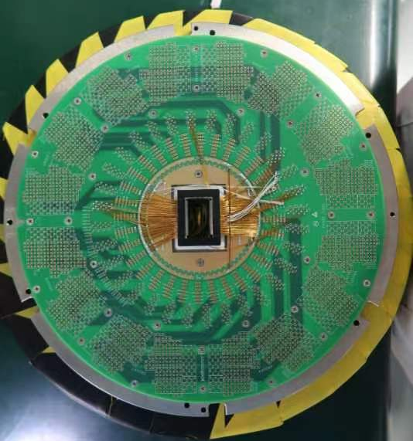
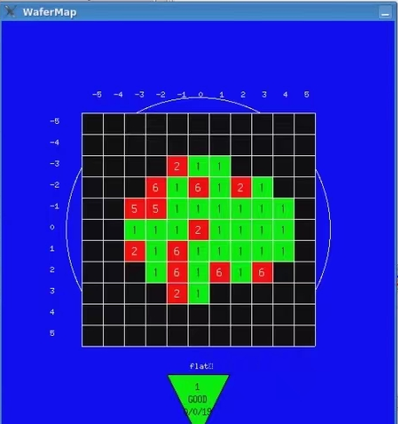
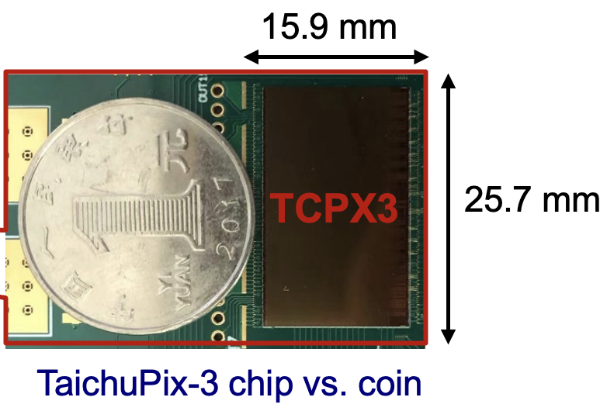
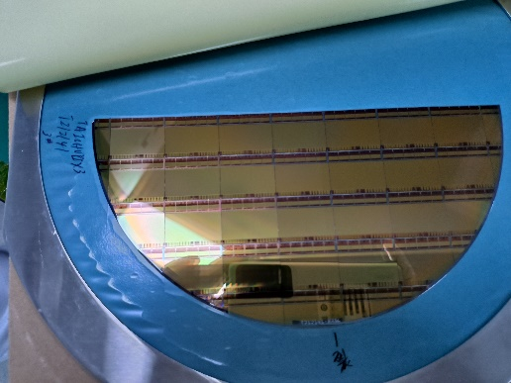
Full-size TaichuPix3 design (engineering run)
Full-size full-functionality Taichu pixel
1024×512 Pixel array (25μm×25μm pixel size), Process: Towerjazz 180nm
Size： 15.9*25.7mm
FE-I3 like Periphery digital readout , high speed data interface
Time stamp precision: 25ns (modified process）
Wafer T212141-02E3
8-inch wafer

Slide 11
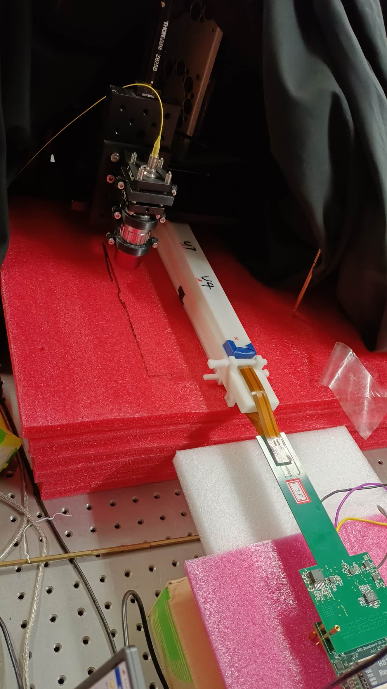
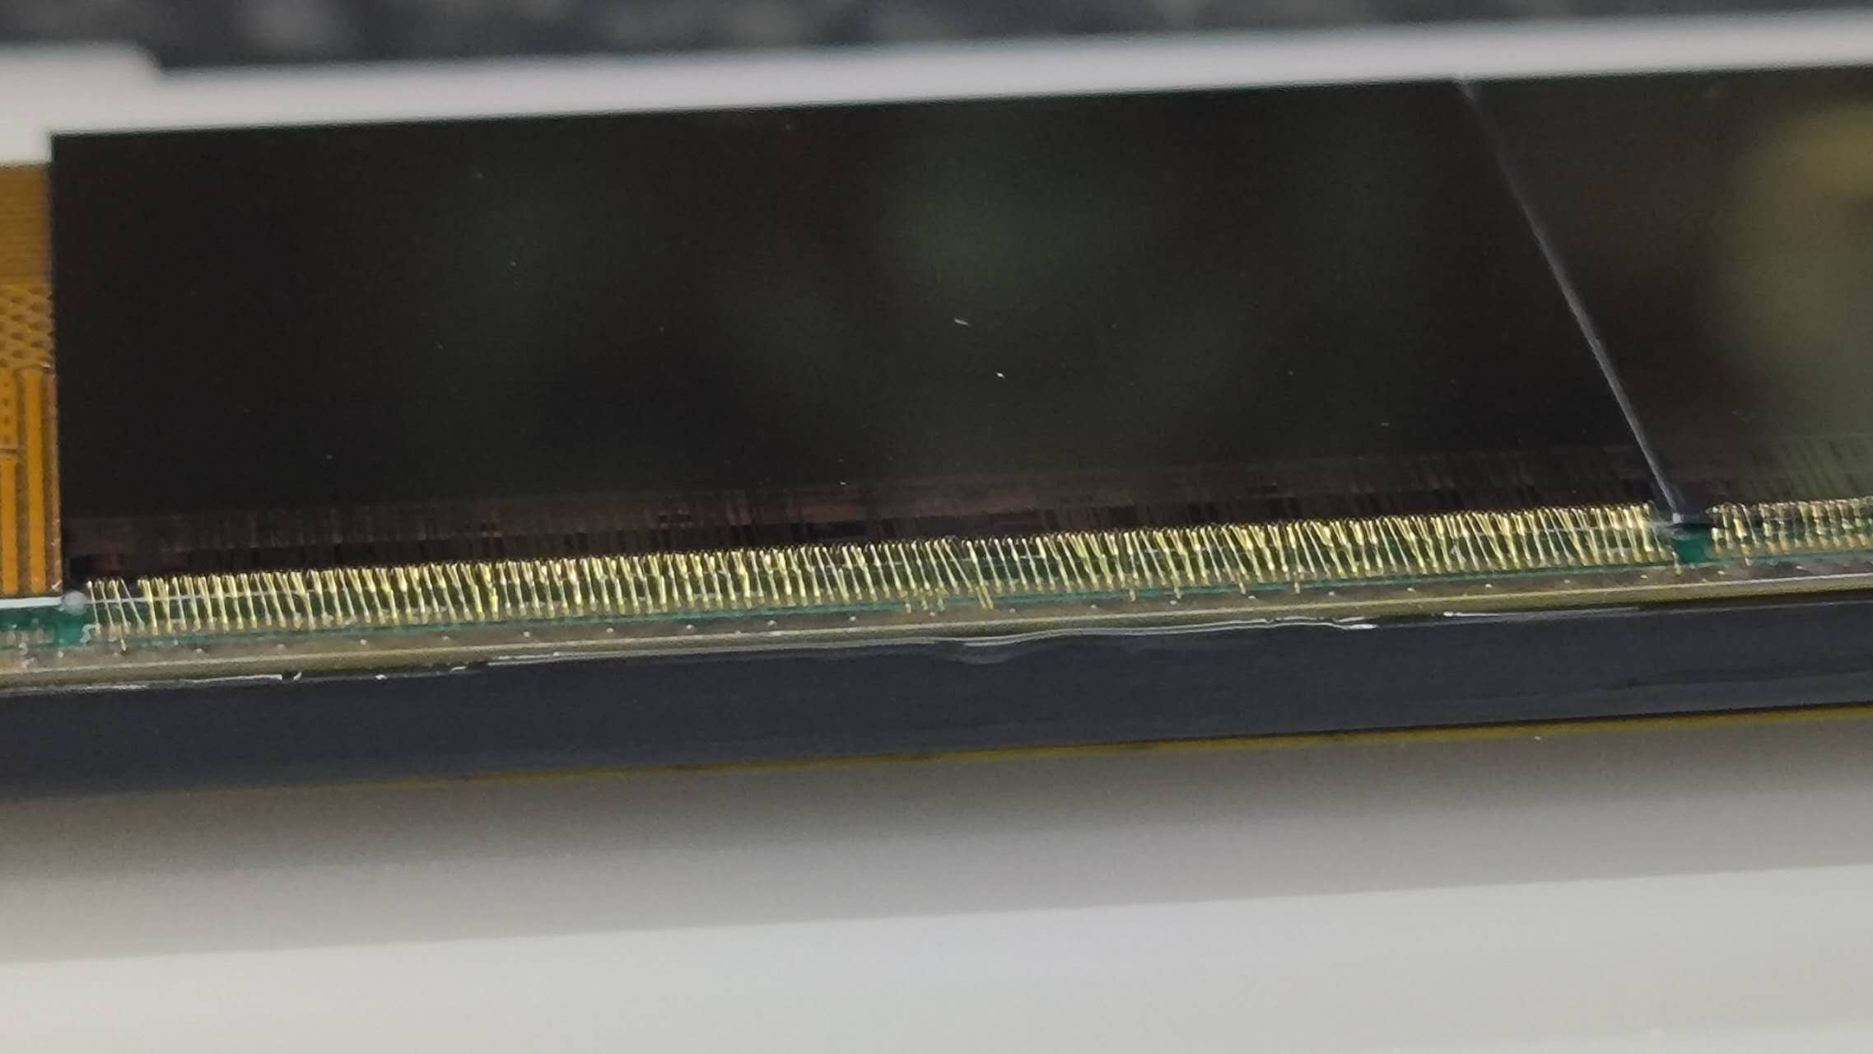
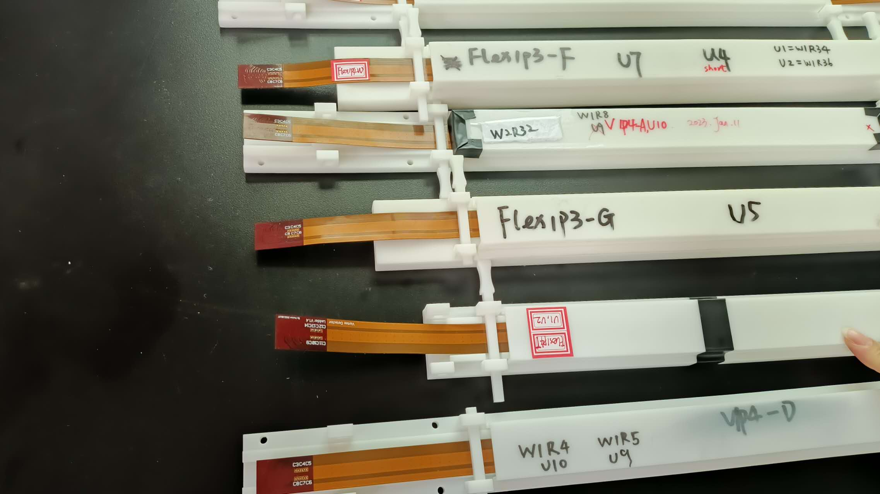
Detector module (ladder) R & D
Completed preliminary version of detector module (ladder) design
Detector module (ladder)= sensors + support structure+ flexible PCB+ control board
Sensors will be glued and wire bonded to the flexible PCB
Flexible PCB will be supported by carbon fiber support structure
Signal, clock, control , power, ground will be handled by control board through flexible PCB
3D model of the ladder
Double-side ladder testing
Taichupix chip wire bonded
on FlexPCB

Slide 12
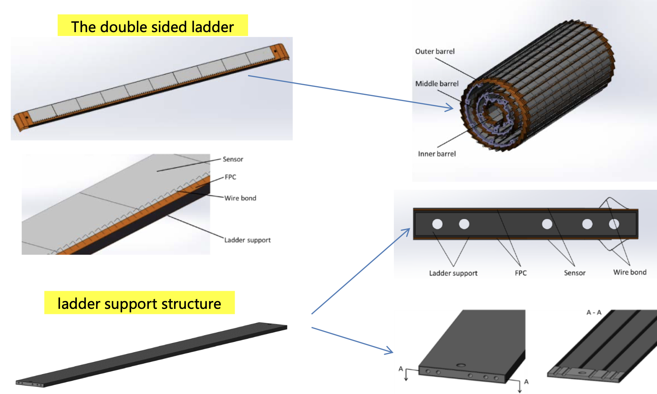
Detector module (ladder) R & D
Detector module (ladder)= sensors + support structure+ flexible PCB+ control board
Sensors will be glued and wire bonded to the flexible PCB
Flexible PCB will be supported by carbon fiber support structure
Signal, clock, control , power, ground will be handled by control board through flexible PCB

Slide 13
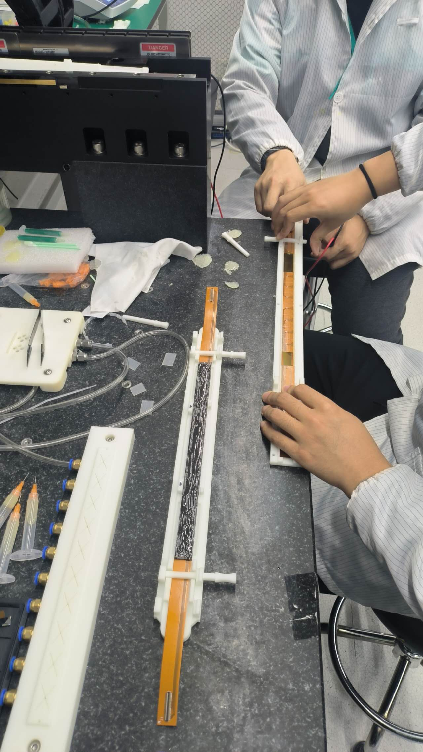
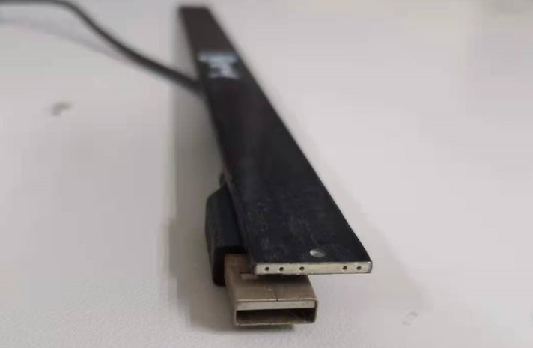
Support structure of the ladder
Fabricated support structure prototype of the ladder (IHEP designed)
Both side of ladder has wire-bonding on chip → Challenging
Dedicated tooling for double-side ladder assembly
Double-Side
ladder assembly

Slide 14
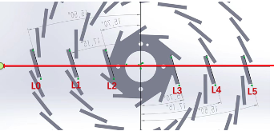
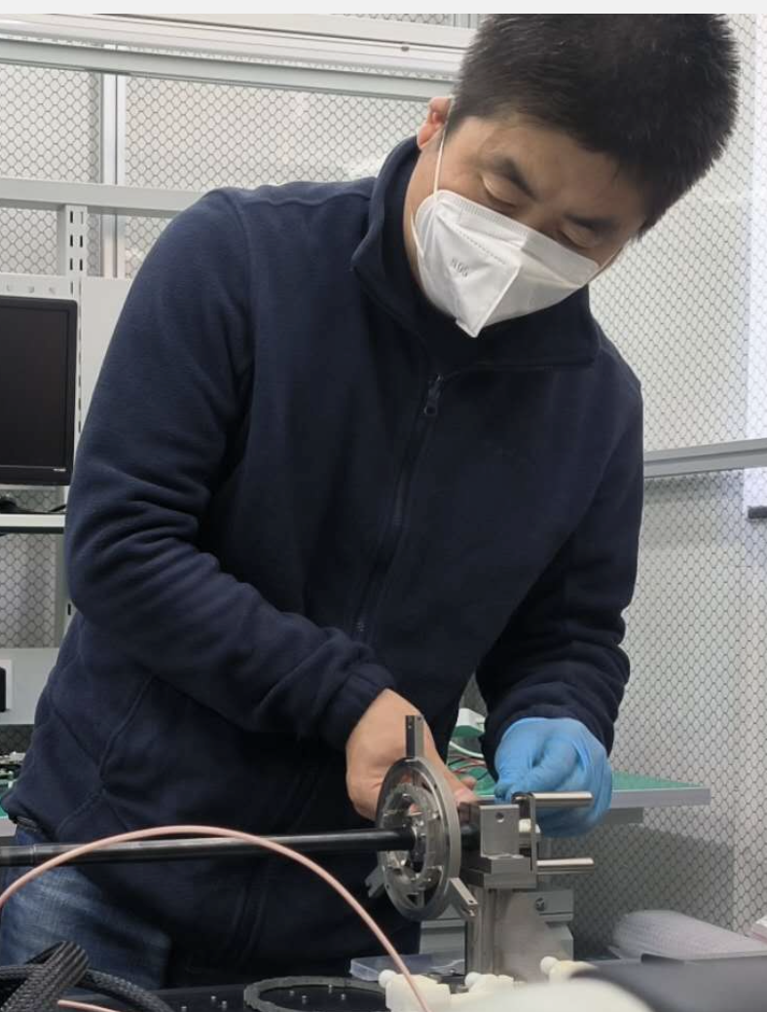
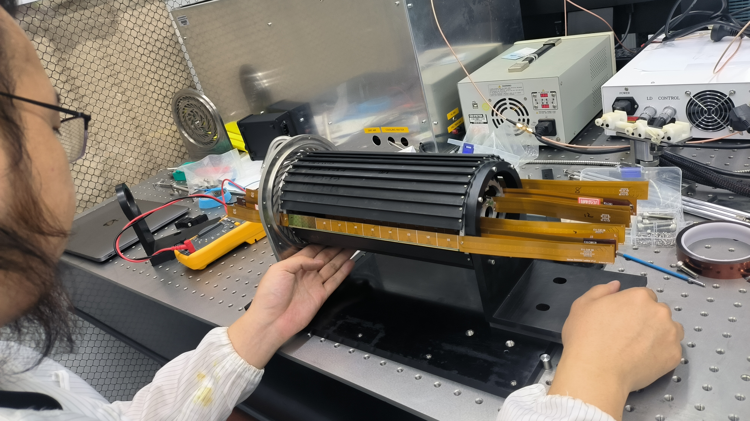
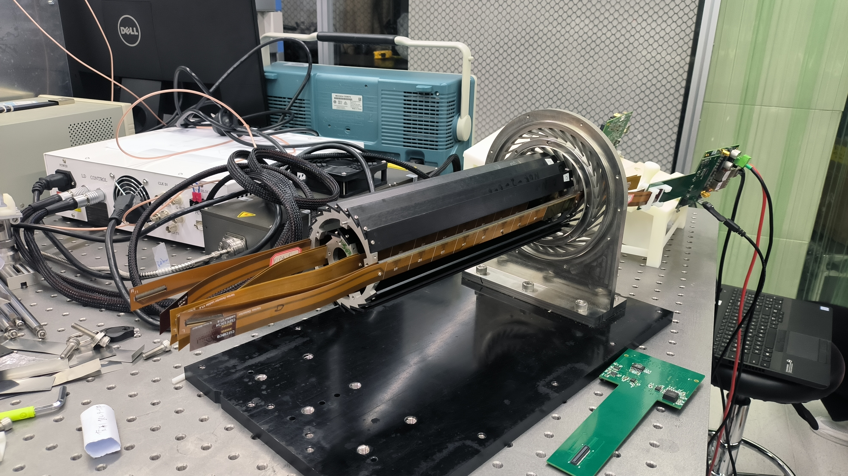
Vertex detector Prototype assembly
6 double-side ladders installed on the vertex detector prototype for DESY testbeam
DESY beam spot is about 2*2cm
12 flex PCB , 24 Taichupix chips installed

Slide 15
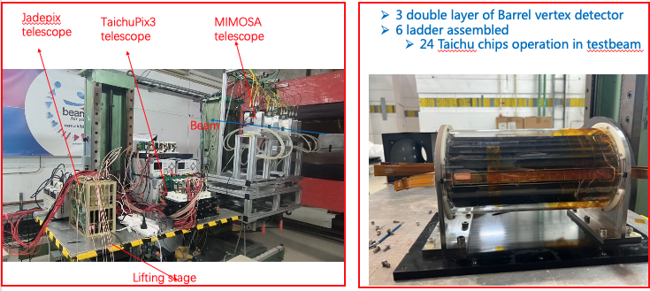
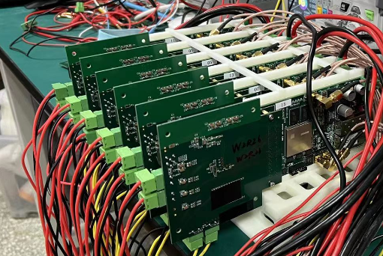
Test beam @ DESY
Two round of test beam at DESY (4~6GeV electron)
1st round (Dec 2022): Taichupix beam telescope → study Taichupix chip level resolution
2nd round (April 2023) : vertex detector prototype → detector-level performance study
Dec 2022 testbeam:
Taichupix beam telescope
April 2023 testbeam:
Vertex detector prototype

Slide 16
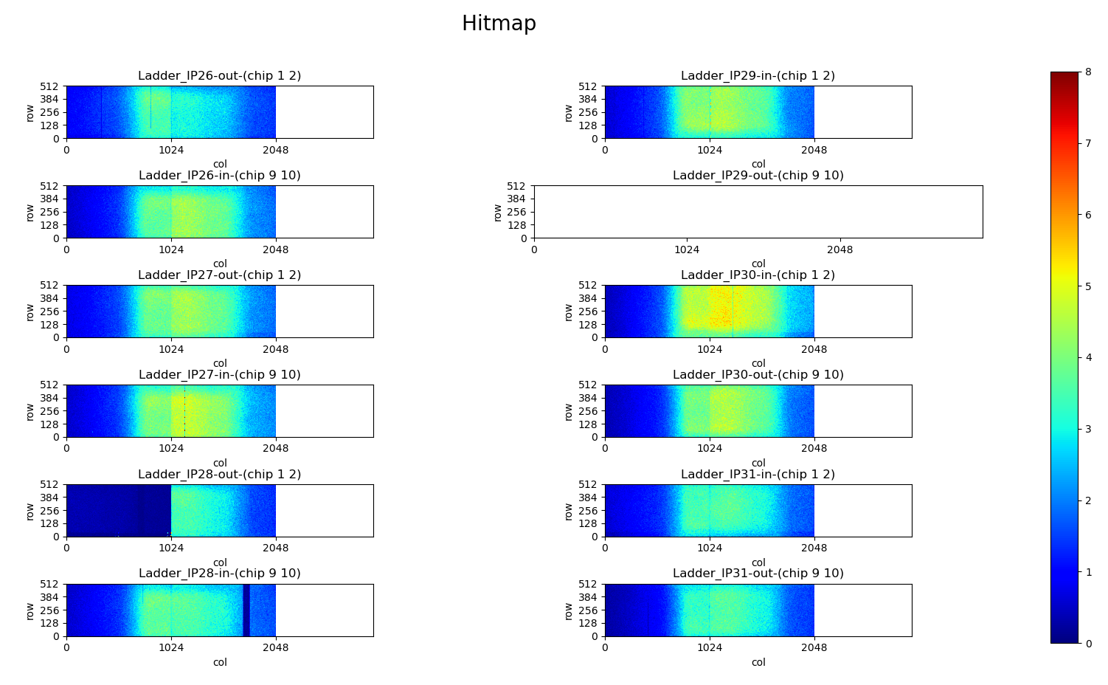
Test beam @ DESY (detector-level testbeam)
Beam is going through 6 double layers of TaichuPix chip
Fully captured the Beam spot
TaichuPix
Electron beam

Slide 17
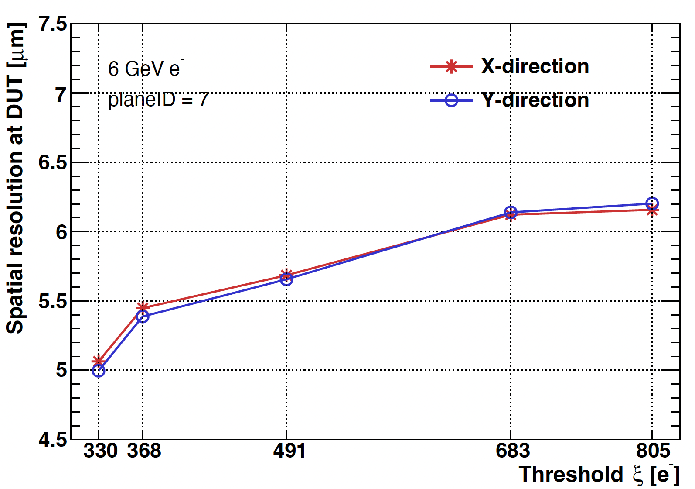
Test beam results
The spatial resolution improved by lowering the threshold
Can reach better than 5μm spatial resolution
Dec 2022 testbeam:
Spatial Resolution Vs threshold
April 2023 testbeam:
Spatial Resolution Vs threshold

Slide 18
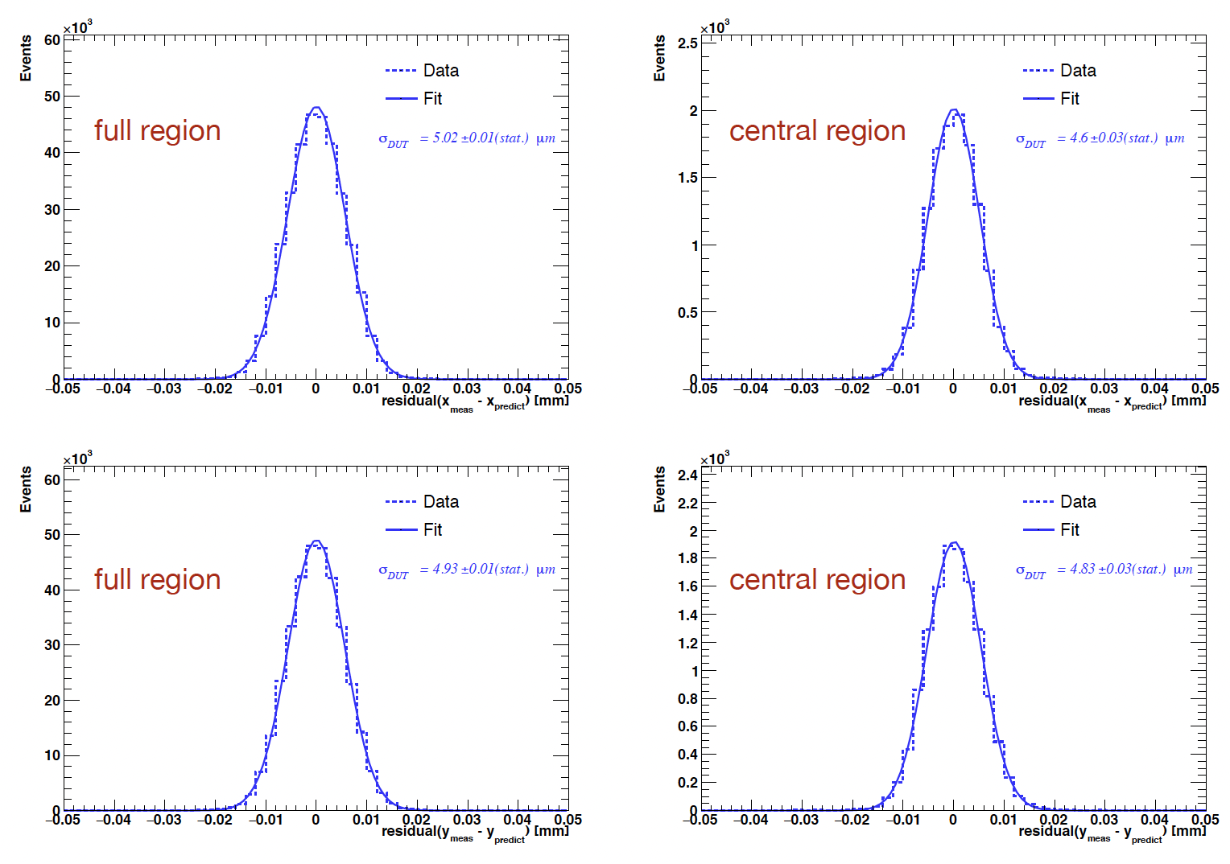
Test beam results (April 2023)
Compared to 1st testbeam
More material in support structure of prototype
Higher noise in flex compared to PCB (more sensitive to threshold)

Slide 19
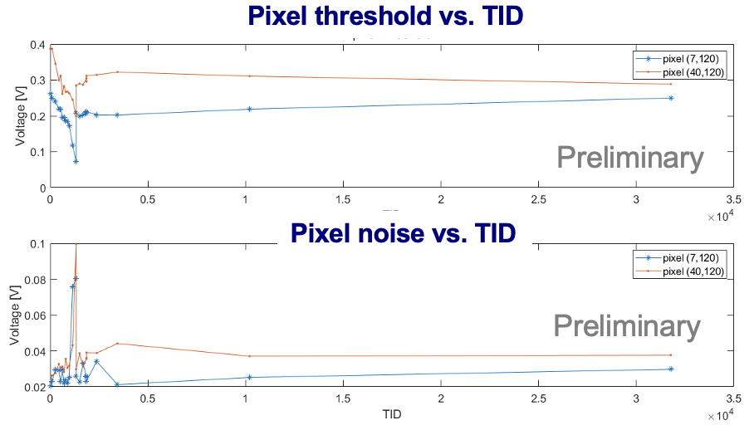
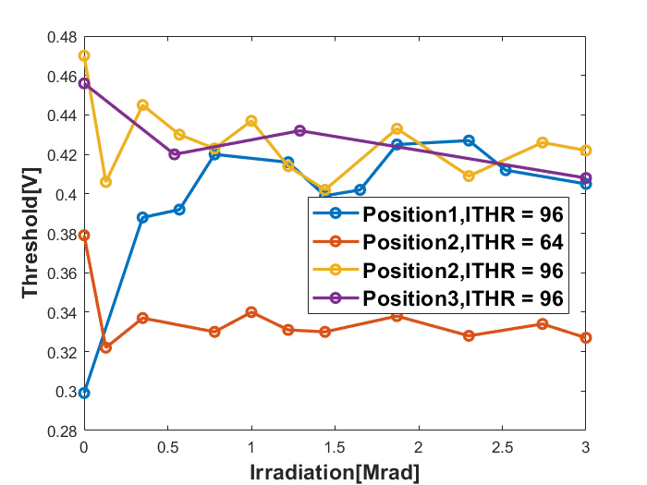
Radiation hardness
Taichupix3 was irradiated in-situ tested up to 3 Mrad
Taichupix2 was irradiated in-situ tested up to 30 Mrad
Normal chip functionality and reasonal noise performance
Taichupix3 irradiation test
Pixel threshold vs. TID
Taichupix2 irradiation test

Slide 20
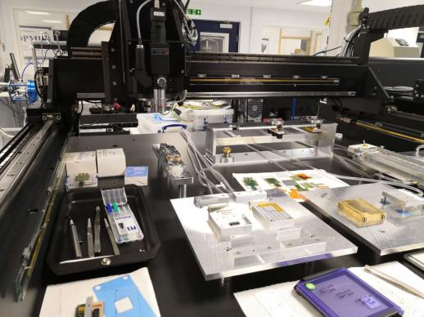
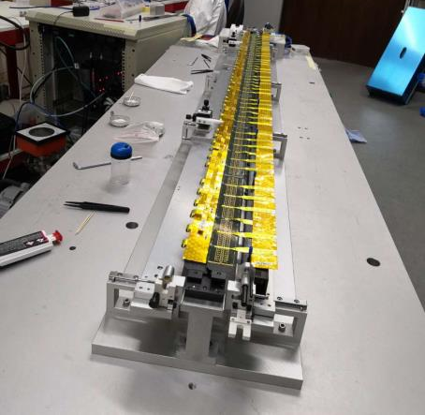
International collaboration
IFAE(Spain): very active in CMOS Sensor design and testing
Liverpool (UK): Tracker mechanical design,
Oxford(UK): CMOS sensor design validation, thermal design
RAL(UK): Pixel module design
Queen Mary(UK): module mechanical design (Zero mass concept)
Strasbourg (FR): CMOS sensor design, Tracker mechanical design
University of Massachusetts (US): Tracker mechanical design, thermal design
In 2019, we have one engineer visited Oxford and Liverpool for 4 weeks, learned a lots about silicon.
Lab visit in Oxford
Labs visit in Liverpool
Mu3e ladder, Atlas barrel strip stave prototype.
Module of Alice’s OB tracker,
Advance material Lab

Slide 21
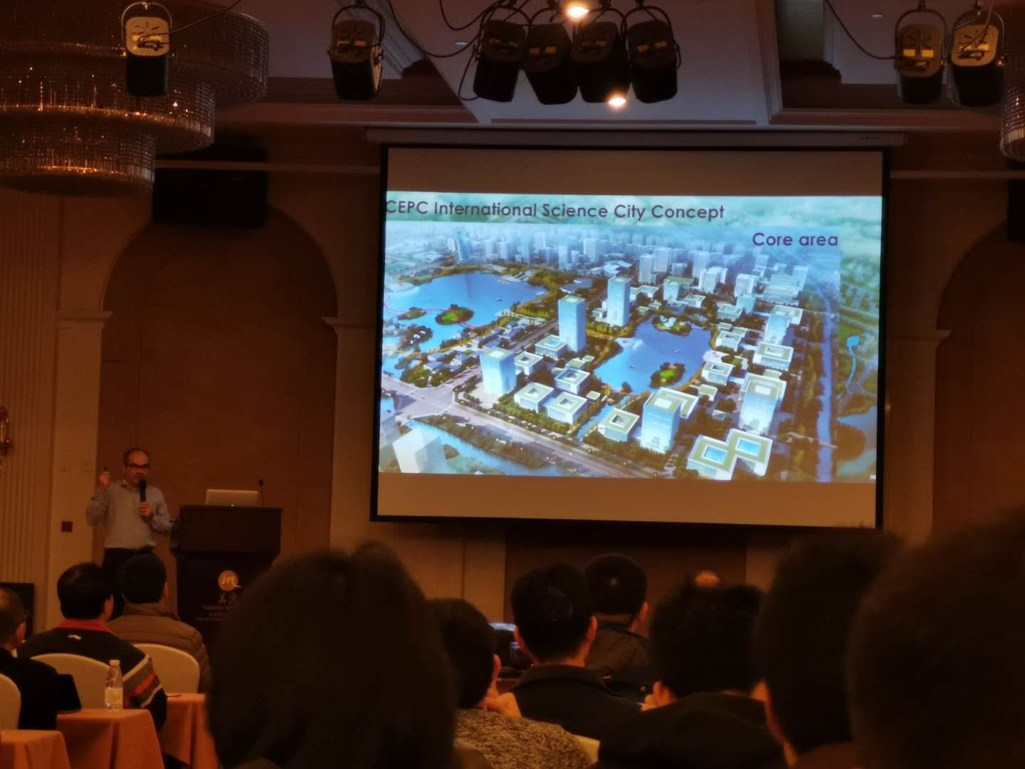
Publications and International talks
Publication:
JINST 14 (2019) C12012
IEEE ICECS (doi: 10.1109/ICECS46596.2019.8965105.)
International conference talks:
Joao Guimaraes Da Costa, CepC phys/detectors, Workshop on the Circular Electron-Positron Collider,EU Edition, April 15 - 17, 2019, Oxford, UK
T. Wu , A full functional Monolithic Active Pixel Sensor prototype for the CEPC vertex detector, in proceeding of International Conference on Electronics Circuits and Systems, Nov. 27-29, 2019, Genova, Italy.
Xiaomin Wei, High data-rate readout logic design for 1024*512 CMOS pixel array dedicated for CEPC experiment, International workshop on radiation imaging detectors, International workshop on radiation imaging detectors, July 2019, Crete, Greece
Ying Zhang, Overview of the chip design for the MOST2 CEPC vertex project, Workshop on the Circular Electron-Positron Collider,EU Edition, April 15 - 17, 2019, Oxford, UK
Wei Wei, Full size pixel chip for high-rate CEPC Vertex Detector，Workshop on the Circular Electron-Positron Collider,EU Edition, April 15 - 17, 2019, Oxford, UK

Slide 22
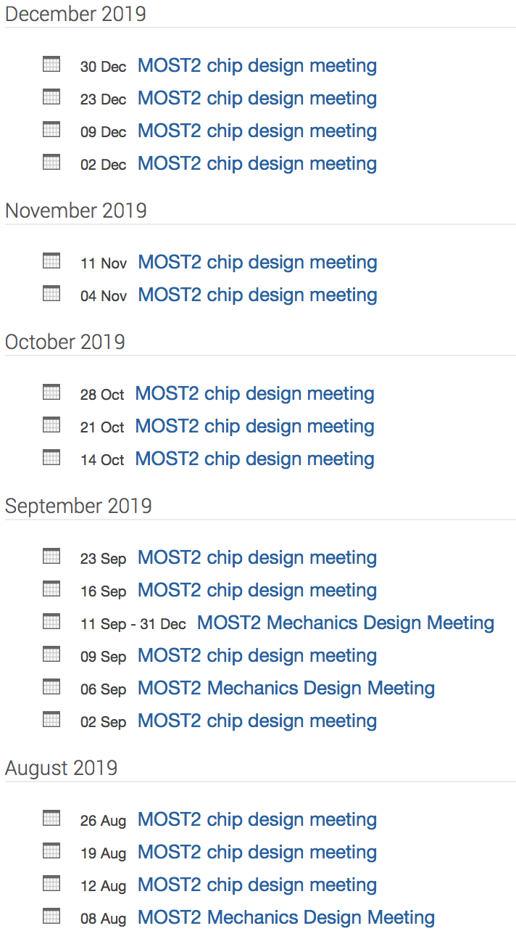
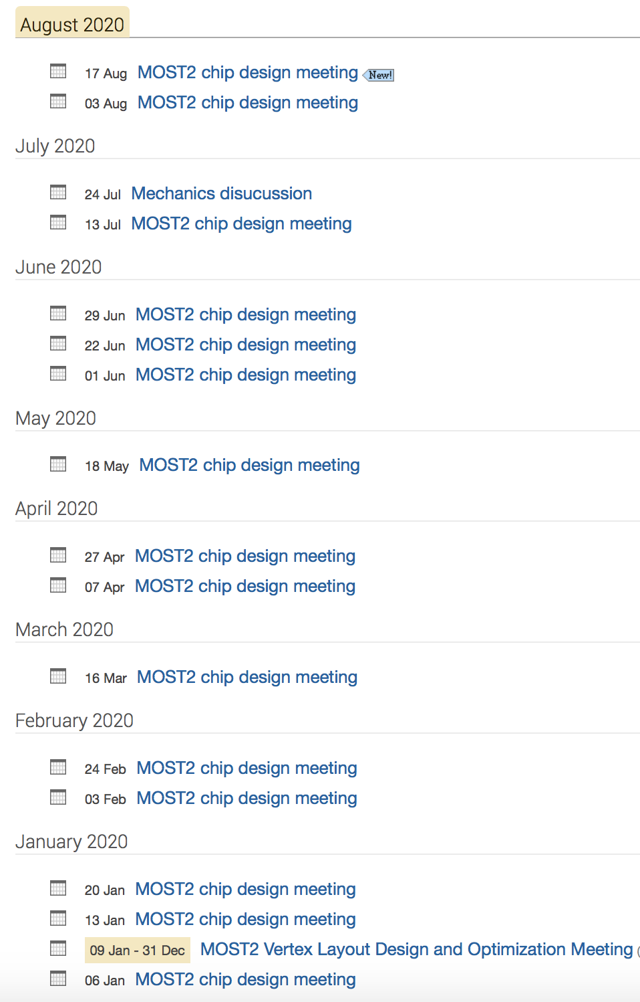
Internal organization
Task 2 meetings
Task 2 meetings
CMOS sensors chip design meeting (weekly )
Vertex detector overall design meeting (weekly)
Full-day internal review meeting (every 3 months)
Institutes worked closely
Project leader followed closely the progress

Slide 23
Summary of CMOS Sensor chip R & D
Major achievement: completed the vertex detector prototype and testbeam
High Spatial resolution
→better than 5um resolution
Radiation hardness
Can survive >3Mrad TID radiation

Slide 24
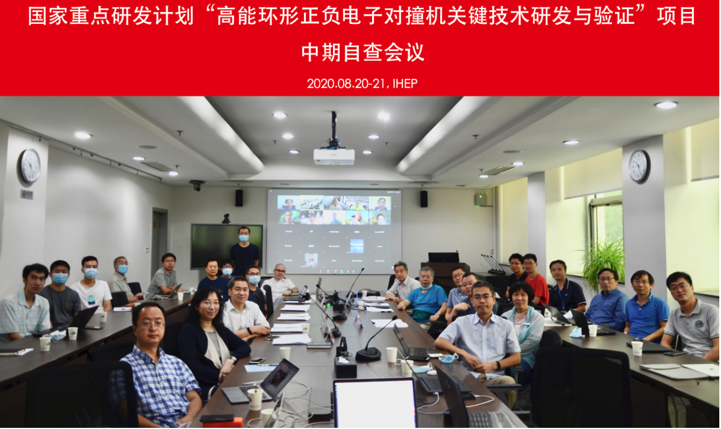
Mid-term review of MOST2 project
Midterm review meeting (Aug 20-21)

Slide 25
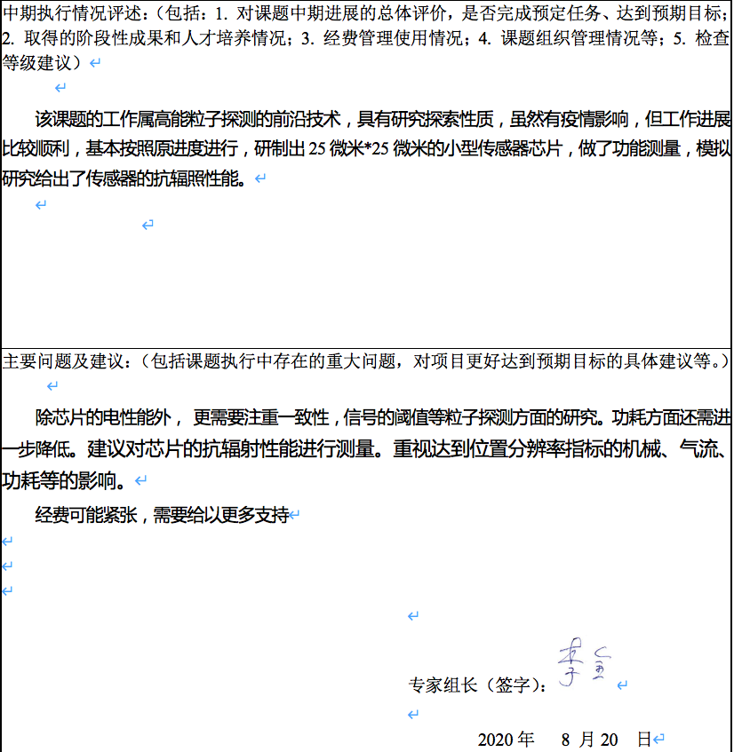
Mid-term review of MOST2 project

Slide 26
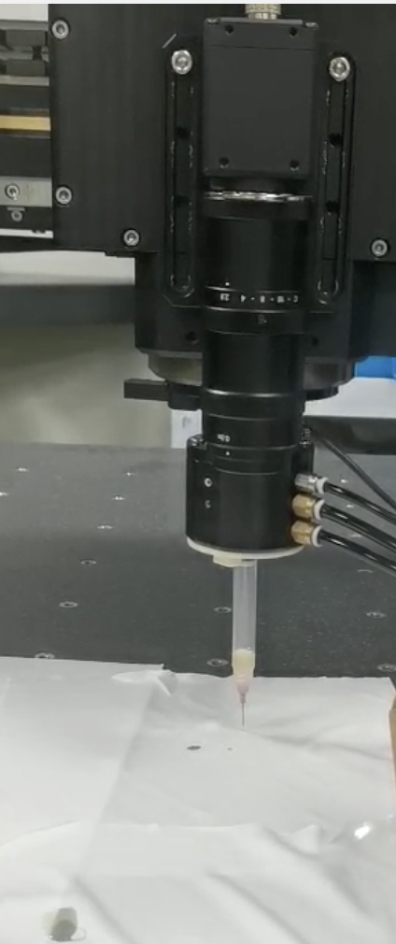
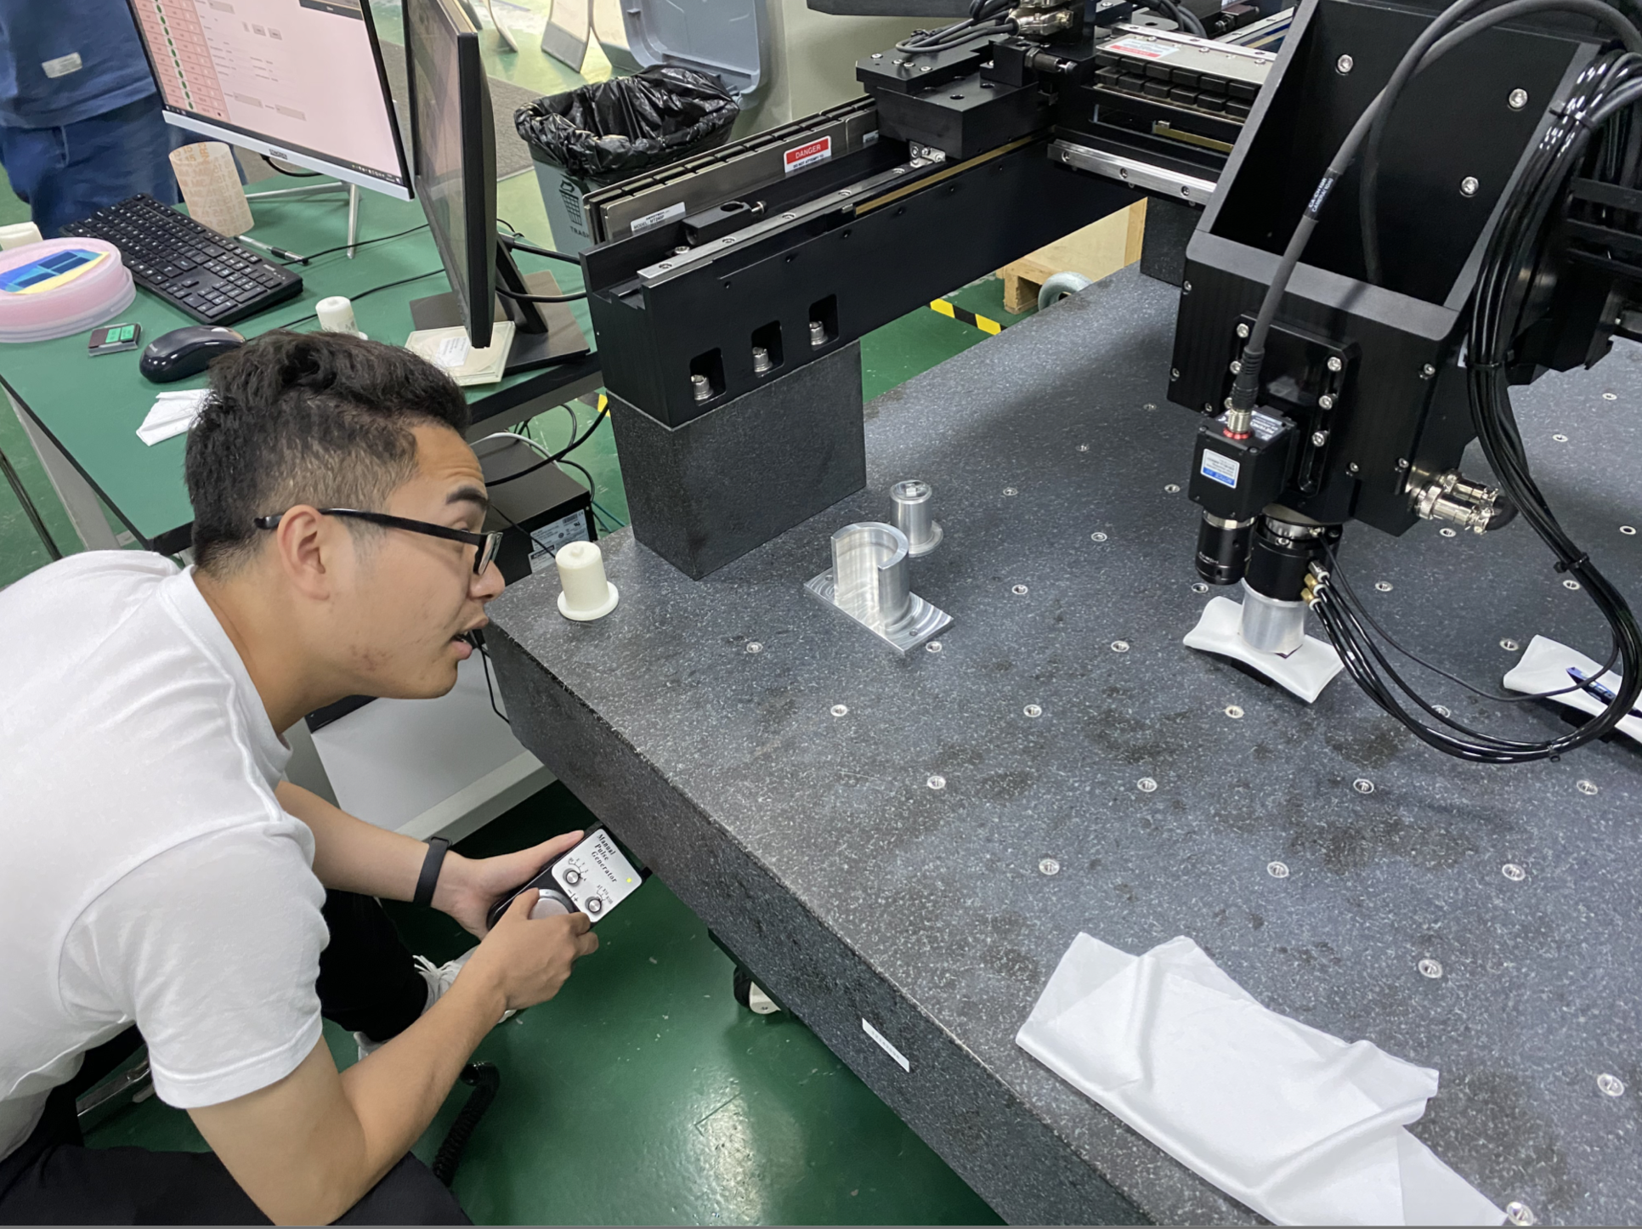
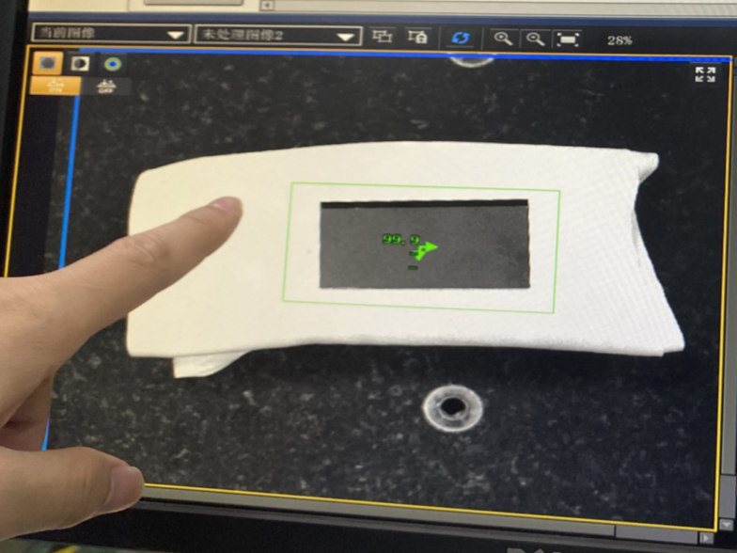
Gantry for vertex detector prototype assembly
3~5um good position resolution require high assembly precision
Cooperate with domestic company on R & D Gantry automatic module assembly.
Pattern recognition with high resolution camera
Automatic chip pick-up and positioning
Automatic Glue dispending
automatic glue dispending
Gantry system
Pattern recognition

Slide 27
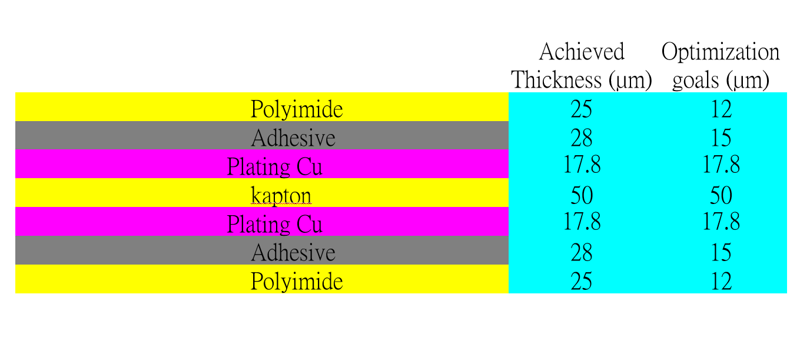
Detector module (ladder) R & D
Completed preliminary version of detector module (ladder) design
Detector module (ladder)= 10 sensors + support structure+ flexible PCB+ control board
Sensors will be glued and wire bonded to the flexible PCB
Flexible PCB will be supported by carbon fiber support structure
Signal, clock, control , power, ground will be handled by control board through flexible PCB
3D model of the ladder
Schematic of ladder electronics
Profile of flexible PCB
Flexible PCB prototype

Slide 28
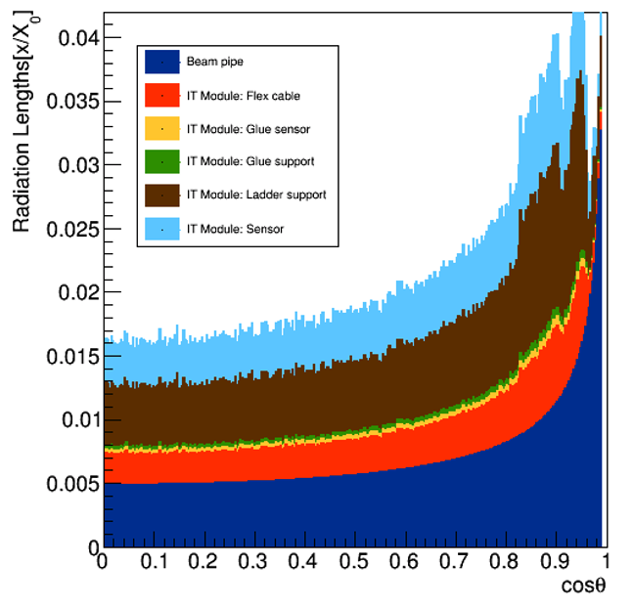
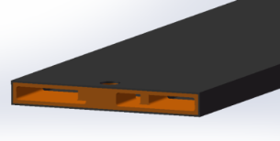
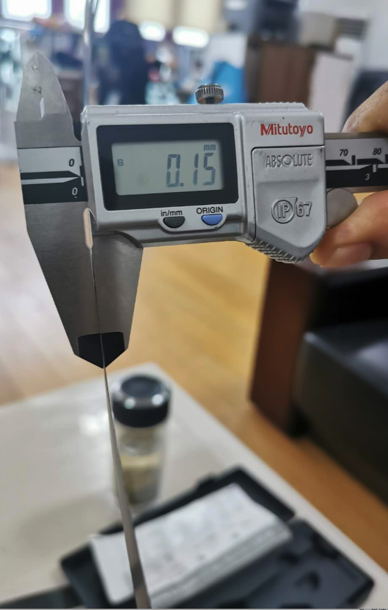
Support structure of the ladder
Support structure of the ladder: 3 layer of carbon fiber, 0.15mm thick
3 time thinner than conventional carbon fiber
A few times more rigid than conventional carbon fiber
for tracks with small cosθ, radiation length ~0.015 X0 (reduce multi-scattering )
Ladder support
structure 3D model
Conventional carbon fiber
0.15mm (1 layer)
Flexible PCB prototype
Finite elements analysis
Max def. under full load: 5.3 um

Slide 29
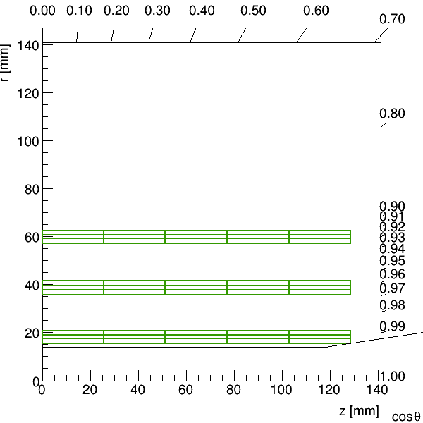
Vertex Detector Prototype R & D
Completed preliminary version of detector engineering design
3 double layer barrel design
10 modules in inner layer, 22 modules in 2nd layer, 32 modules in outer layer
Start thermal design (air cooling)
Physics simulation to optimize vertex detector layout design.
The length of inner layer pixel should be the same as other two layers
Inner pixel radium should be as close to beam pipe as possible
Impact parameter resolution
Vs beam pipe radius
Vertex detector layout
(R-Z view)
3D Model of vertex detector
Dead area in detector

Slide 30
Cooling design
Air cooling is baseline design for CEPC vertex detector
Sensor Power dissipation:
Taichupix : ≤ 100 mW/cm². (trigger mode)
CEPC final goal : ≤ 50 mW/cm²
Cooling simulations of a single complete ladder with detailed FPC were done.
Need 2 m/s air flow to cool down the ladder to 30 ℃
Testbench setup has been designed for air cooling , vibration …
Test setup for ladder cooling
Use compressed air for cooling

Slide 31
Future plan
3rd Year:
3rd CMOS sensor fabricated and tested
→ may be skipped if 2nd MPW chip is fully working
Final support structure engineering design completed
Fabricated support structure for ladders
4th Year:
Competed R & D large area sensor
Manufactured the support structure for whole detector
Assembling and installing the detector prototype
Completed DAQ system for whole detector
5th Year:
Completed detector assembly and commissioning
Test beam and data analysis
Finish assembling of prototype

Slide 32
International collaboration
IFAE(Spain): very active in CMOS Sensor design and testing
Liverpool (UK): Tracker mechanical design,
Oxford(UK): CMOS sensor design validation, thermal design
RAL(UK): Pixel module design
Queen Mary(UK): module mechanical design (Zero mass concept)
Strasbourg (FR): CMOS sensor design, Tracker mechanical design
University of Massachusetts (US): Tracker mechanical design, thermal design
In 2019, we have one engineer visited Oxford and Liverpool for 4 weeks, learned a lots about silicon.
Lab visit in Oxford
Labs visit in Liverpool
Mu3e ladder, Atlas barrel strip stave prototype.
Module of Alice’s OB tracker,
Advance material Lab

Slide 33
backup

Slide 34
Backup:外围电路模块——高速数据接口

Slide 35
Power managements in TaichuPix chip

Slide 41
Goal for the second year
Achieve the target in task book for the 1st and 2nd years
Completed preliminary engineering designs of support structure for vertex detector prototype
Completed second sensor CMOS chip prototyping
Completed data acquisition system for sensor testing

Slide 42
Main specs of the full size chip for high rate vertex detector
Bunch spacing
CEPC Z+Higgs (240GeV): 680ns;
WW threshold scan (160GeV): 210ns;
CEPC Z pole runing (90GeV) Z: 25ns
High Hit density
2.5hits/bunch/cm² for Higgs/WW runs
0.2hits/bunch/cm² for Z pole running

Slide 43
Sensor prototyping
Taichupix1
Chip size：5mm×5mm
Pixel size：25μm×25μm
Completed two round of sensor prototyping
1st Multi-wafer project chip (Taichupix1)
Submitted in June 2019, received in November 2019
Test functional blocks
pixel array ( in-pixel amplifier and digital logic )
Periphery block: digital readout architecture
Periphery block：PLL and Serializer
Periphery block： LDO and power supply
2nd Multi-wafer project chip(Taichupix2)
Submitted in Feb 2020, received in July 2020
Major bugs fixed in Taichupix1
Radiation hard design (enclosed gate) in pixel analog
Taichupix2
Chip size：5mm×5mm
Pixel size：25μm×25μm
Taichupix2 on test board

Slide 44
CEPC vertex detector R & D
Three on-going R & D programs on vertex detector
Previous update in CEPC day (June 15th) https://indico.ihep.ac.cn/event/11875/
This talk focuses on MOST2 project
MOST2 aims to build full-size vertex detector prototype
Funding agency | Process | International collaborators | Objectives of the project | schedule
MOST1 | CMOS | Strasburg IPHC | Small pixel size design with in-pixel digitization and low power frontend | 2016.6-2021.5
MOST2 | CMOS | IFAE/Oxford/ Livepool … | full-size vertex detector prototyping ( Full-size sensor support structure, module …) | 2018.5-2023.4
NSFC | SOI | KEK/SOIPIX collaboration | Verification of SOI process with small pixel size and low noise design | 2016-

