Slide 1




Sensor and electronics design and tests
Ying Zhang
On behalf of the CEPC MOST2 Vertex detector design team
2023-6-8

Slide 2
Outline
Sensor prototypes design
Readout electronics design
Single chip and multi-chips test results
Summary

Slide 3
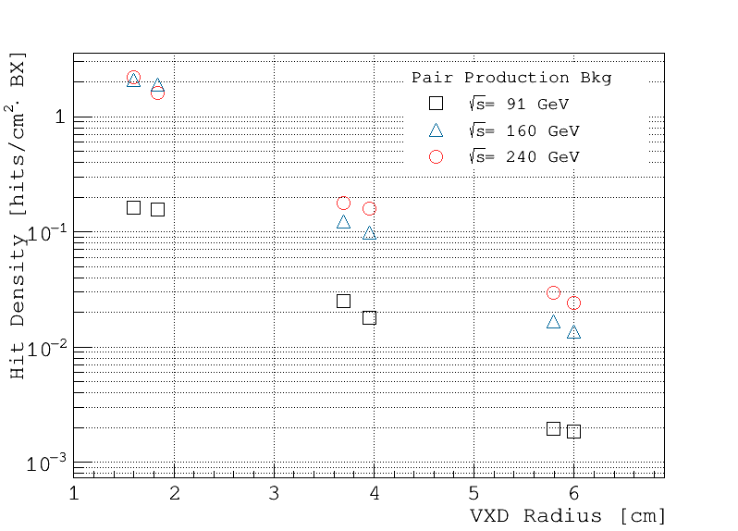
Main specs of the full-scale chip for high rate vertex detector
Bunch spacing
  Higgs: 680 ns; W: 210 ns; Z: 25 ns
  Max. bunch rate: 40 M/s
Hit density
  2.5 hits/bunch/cm² for Higgs/W; 0.2 hits/bunch/cm² for Z
Cluster size: ~3 pixels/hit
  Epi-layer thickness：> 18 μm
  Pixel size：25 μm × 25 μm
Hit Density vs. VXD Radius
Ref: CEPC Conceptual Design Report, Volume II
Sensor prototype design specifications
For Vertex | Specs. | For High rate Vertex | Specs. | For Ladder Prototype | Specs.
Pixel pitch | ≤ 25 μm | Hit rate | 120 MHz/chip | Pixel array | 512 row × 1024 col
TID | >1 Mrad | Data rate | 3.84 Gbps (triggerless) ~110 Mbps (trigger) | Power Density | < 200 mW/cm² (air cooling)
 |  | Dead time | < 500 ns (for 98% efficiency) | Chip size | ~1.4 × 2.56 cm²

Slide 4
TaichuPix sensor architecture
Pixel 25 μm × 25 μm
  Continuously active front-end, in-pixel discrimination
  Fast-readout digital, with masking & testing config. logic
Column-drain readout for pixel matrix
  Priority based data-driven readout
  Time stamp added at EOC
  Readout time: 50 ns for each pixel
2-level FIFO architecture
  L1 FIFO: de-randomize the injecting charge
  L2 FIFO: match the in/out data rate between core and interface
Trigger-less & Trigger mode compatible
  Trigger-less: 3.84 Gbps data interface
  Trigger: data coincidence by time stamp, only matched event will be readout
Features standalone operation
  On-chip bias generation, LDO, slow control, etc.
Monolithic pixel sensor based on a CMOS process → collection electrode & readout elec. on the same Si-substrate

Slide 5
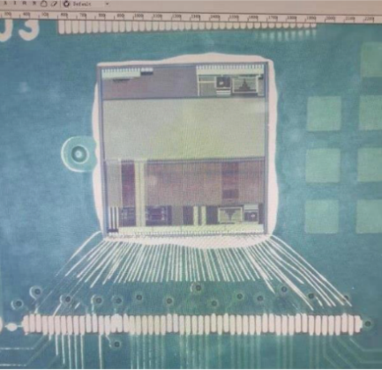
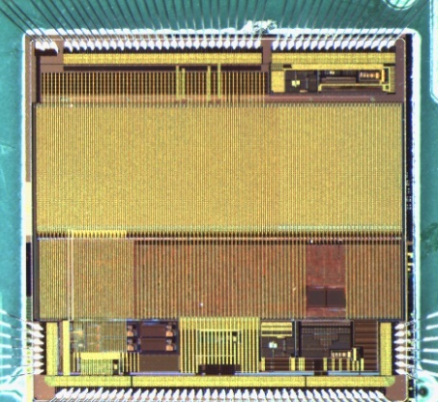
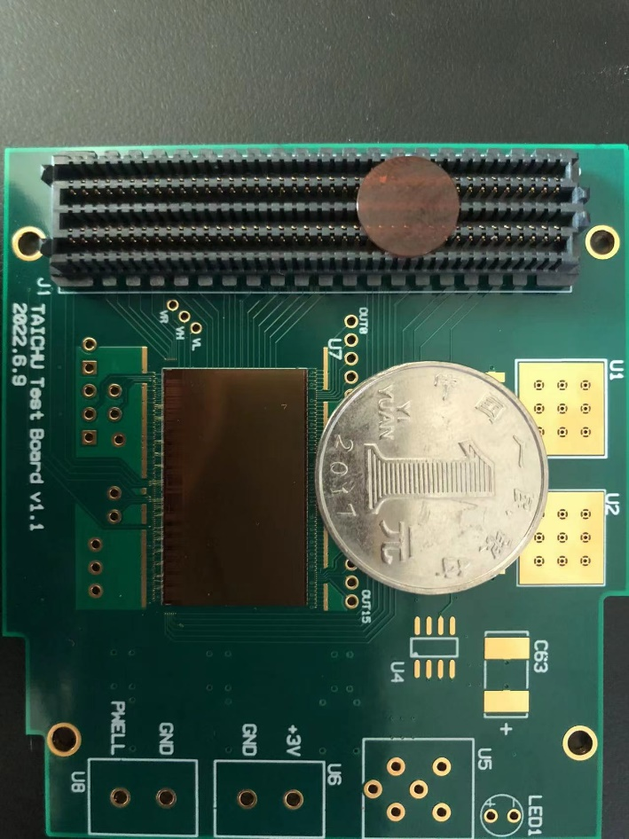
TaichuPix prototypes overview
Major challenges for the sensor design
  Small pixel size → high resolution (3-5 μm)
  High readout speed (dead time < 500 ns @ 40 MHz ) → for CEPC Z pole
  Radiation tolerance (per year): 1 Mrad TID
Completed 3 rounds of sensor prototyping in 180 nm CMOS process
  Two MPW chips (5 mm × 5 mm )
    TaichuPix-1: 2019.06 ‒ 2019.11
    TaichuPix-2: 2020.02 ‒ 2020.06
  1st engineering run
    Full-scale chip: TaichuPix-3, received in July 2022 & March 2023
15.9 mm
6 design variations
TCPX3
25.7 mm
TaichuPix-3
Pixel size：25 μm × 25 μm
TaichuPix-1
TaichuPix-2

Slide 6
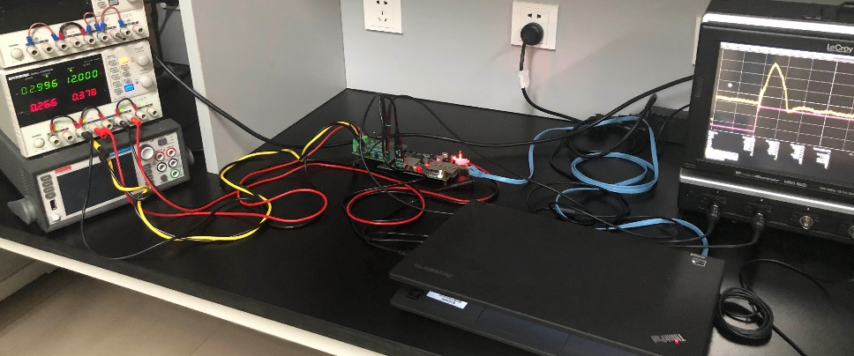
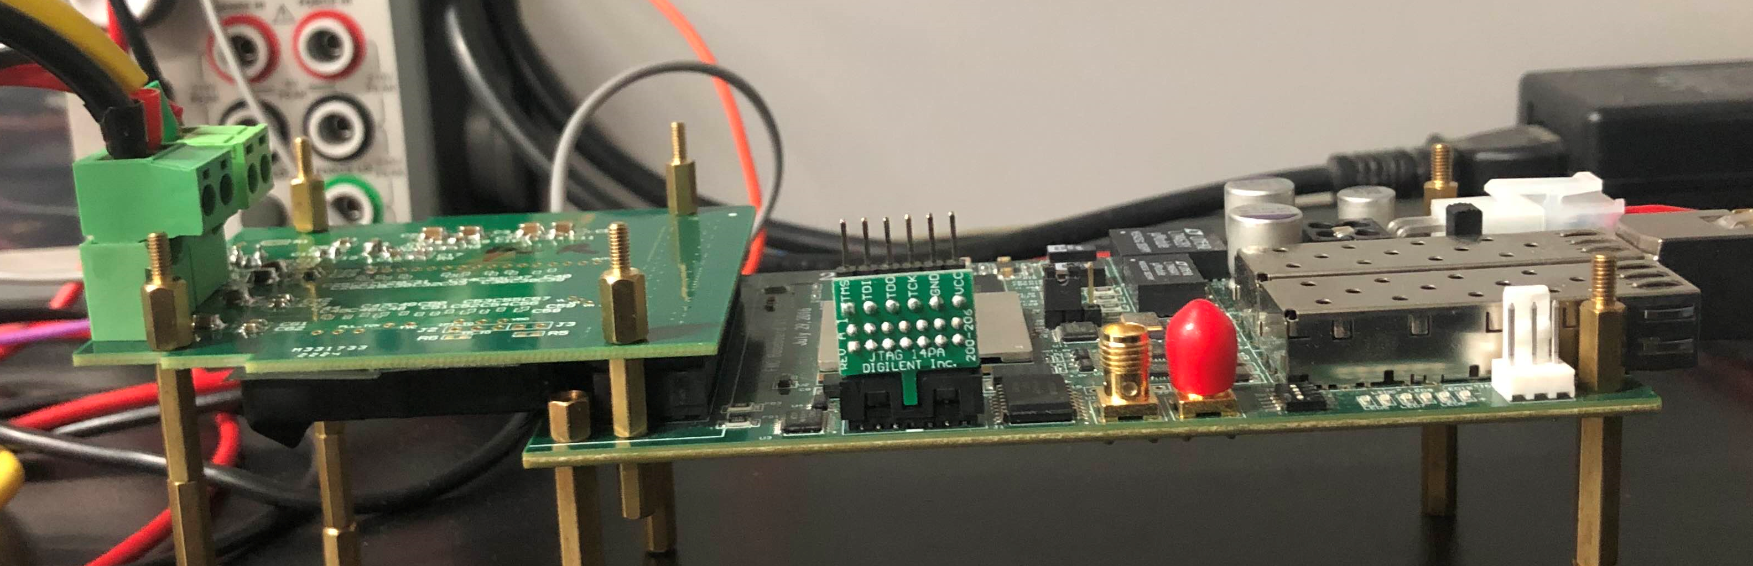
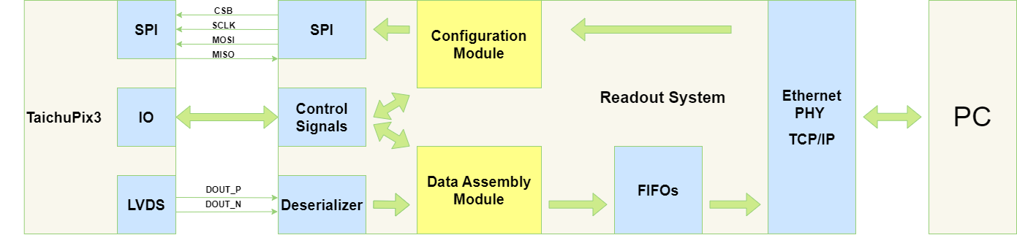
Readout system of TaichuPix chips
Readout system for single-chip includes
  A dedicated test board for chip wire-bonding and power link
  A readout board loaded with a FPGA to perform chip configuration and data readout
  A DC power supply
  A PC
Test board
Readout board
Structure of the readout system

Slide 7


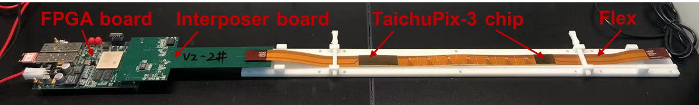
Ladder readout
Completed detector module (ladder) design
  Detector module (ladder) = 10 sensors + readout board + support structure + control board
  Sensors are glued and wire bonded to the flexible PCB
  Flexible PCB will be supported by carbon fiber support structure
  Signal, clock, control, power, ground will be handled by control board through flexible PCB
Challenges
  Long flex cable → some issue with power distribution and delay
  Limited space for power and ground placement → bad isolation between signals
  No debug testing point → hard to debug the flex readout system
853 mm
Ladder readout system
U10
U9
U8
U7
U6
U5
U4
U3
U2
U1

Slide 8
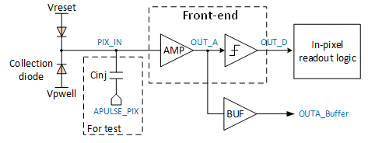
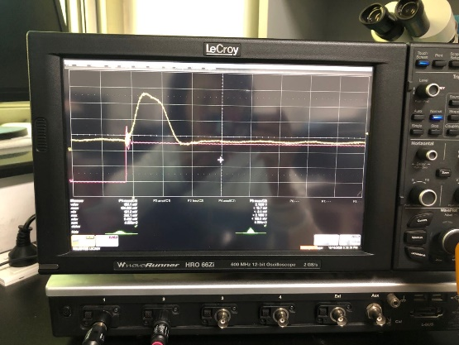
Electrical test
Electrical performance verified by injecting external voltage pulses into pixel front-end
Chip periphery
Threshold dispersion
Threshold
Noise (peak-to-peak )
Analog output of a pixel @ Vin = 0.9 V
Measured “S-curve” for 128 pixels

Slide 9
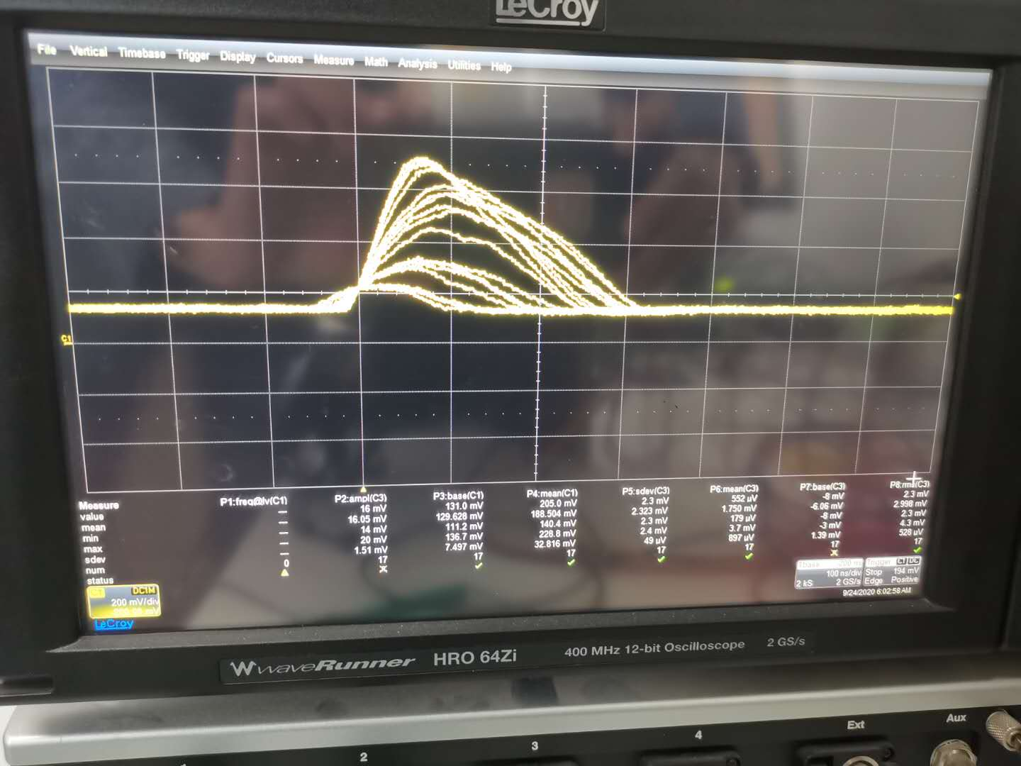
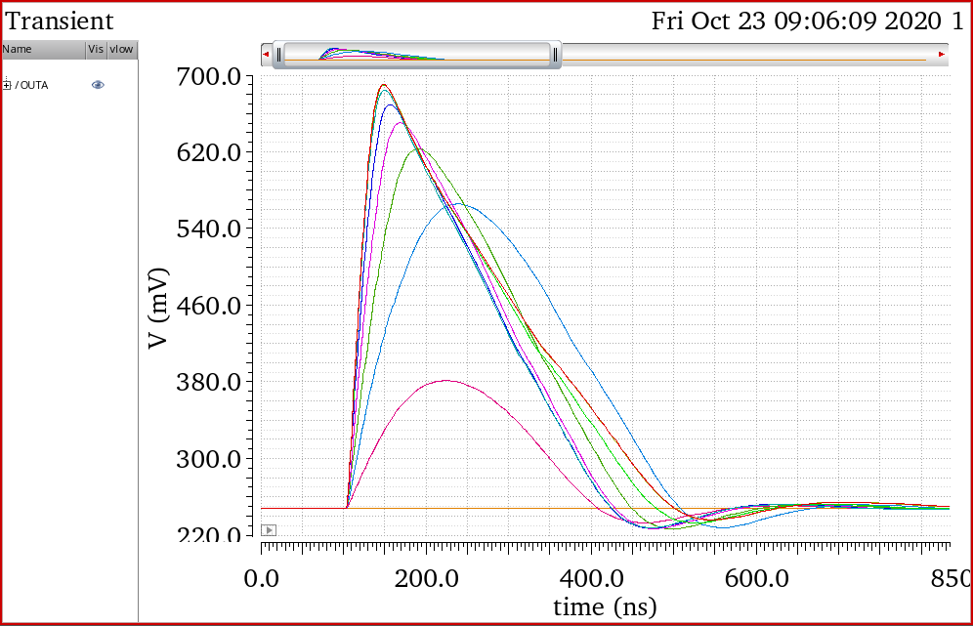
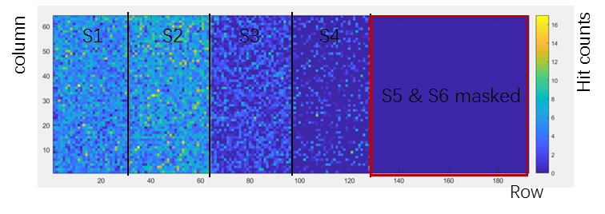
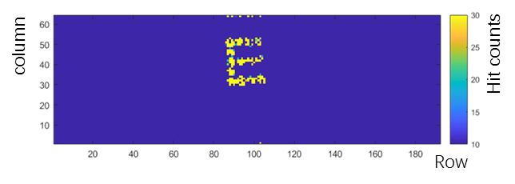
Functionality of complete signal chain of TaichuPix2
Functionality of the complete signal chain (including sensor, analog front-end, in-pixel logic readout, matrix periphery readout and data transmission unit) was firstly proved with an X-ray source and a laser source.
Measured
TaichuPix2 response to X-ray tube (cutting energy @ 6keV)
Simulated analog output with different input signal
Measured
TaichuPix-2
Hit map of the TaichuPix-2 under X-ray from the X-tube voltage of 8 kV for 5 min.
Letter imaging obtained with a 1064 nm laser spot scanning on the TaichuPix-2

Slide 10
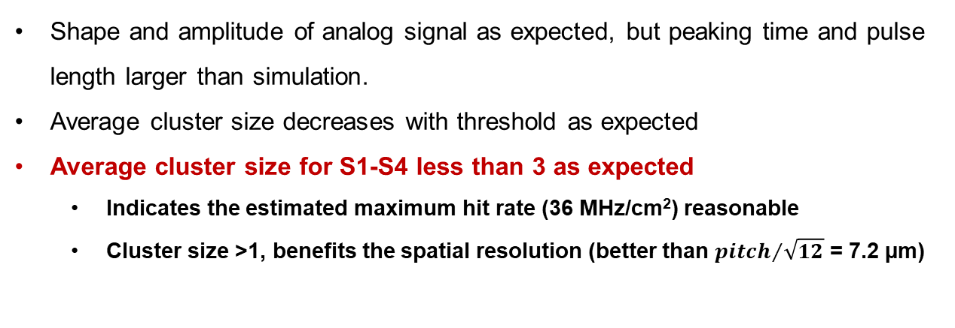
TaichuPix2 test with ⁹⁰Sr
TC2 exposure to ⁹⁰Sr source at different threshold setting (ITHR)
Analog output of one pixel under ⁹⁰Sr exposure
Average cluster size vs. threshold
S1-S4 features different thresholds for the same DAC code
Shape and amplitude of analog signal as expected, but peaking time and pulse length larger than simulation.
Average cluster size decreases with threshold as expected
Average cluster size for S1-S4 less than 3 as expected
  Indicates the estimated maximum hit rate (36 MHz/cm²) reasonable
  Cluster size >1, benefits the spatial resolution (better than ${pitch}/{\sqrt{12}}$ = 7.2 µm)

Slide 11
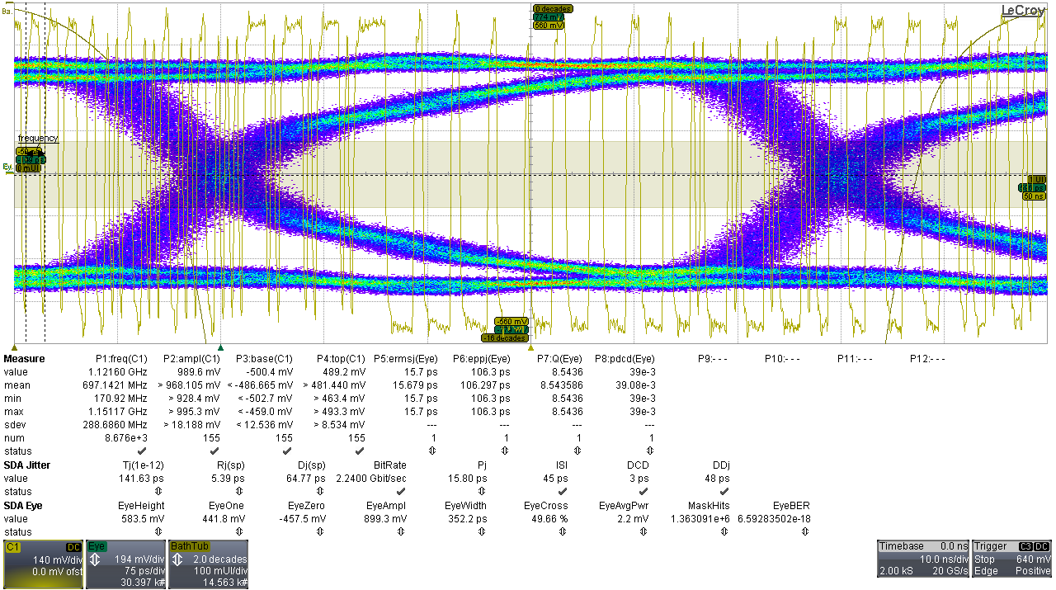
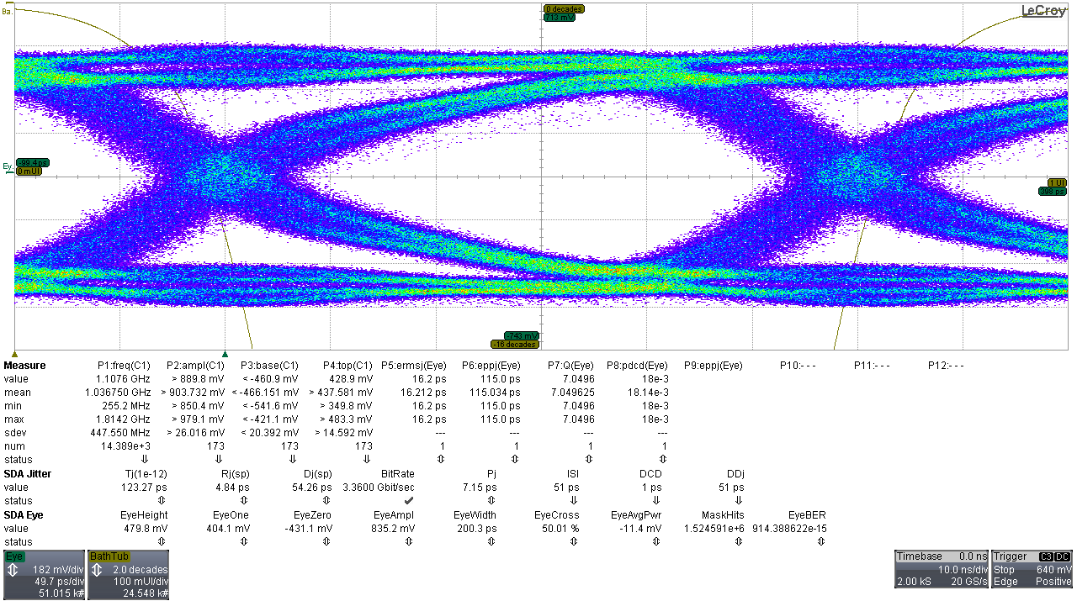
Test of the data interface (TaichuPix-1)
Bit rate | 2.24Gbps | 3.36Gbps | 4.48Gbps
Clk freq | 1.12GHz | 1.68GHz | 2.24GHz
BER | 6.59e-18 | 9.14e-13 | 3.23e-5
Tj@e-12 | 141.63ps | 123.27ps | 147.14ps
Rj | 5.39ps | 4.84ps | 5.35ps
Dj | 64.77ps | 54.26ps | 70.90ps
@2.24Gbps
Data readout in DDR mode
Data interface was tested by the on-chip PRBS source, a high speed oscilloscope (@16Gsps), and code stream verified in FPGA
BER qualified till 3.36 Gbps, failed at 4.48 Gbps
Concerning the highest data rate for triggerless at 4 Gbps, at least 2 SER interface ports needed
Thus bit rate @2.24 Gbps is safe and power optimized
@3.36Gbps

Slide 12
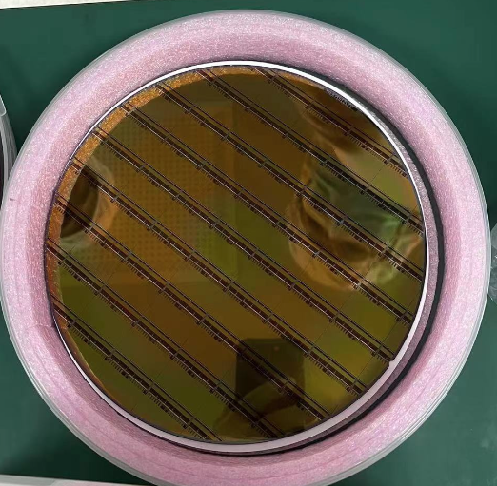
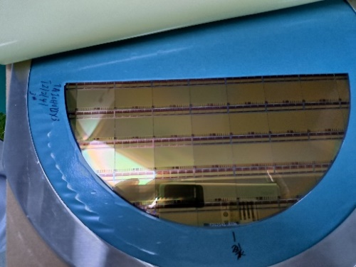
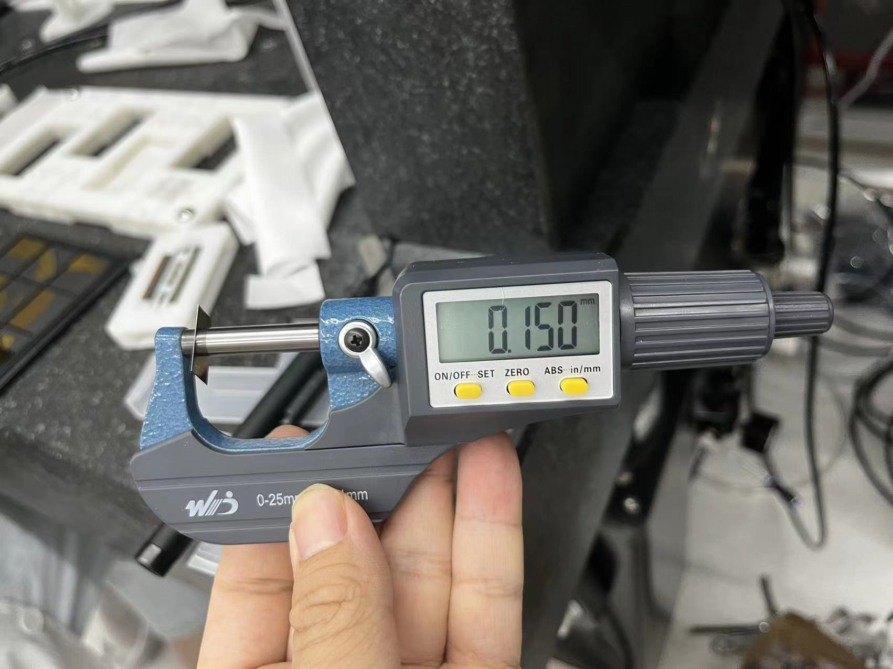
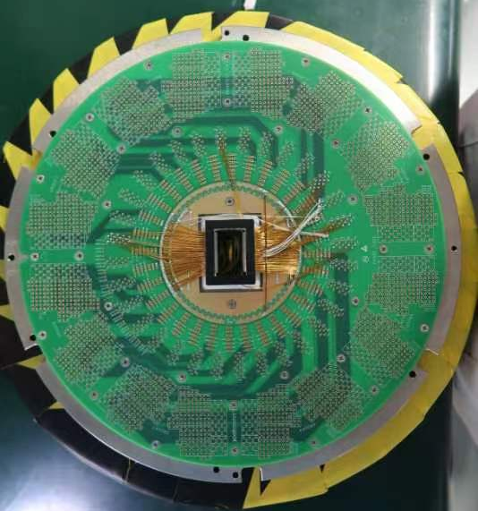
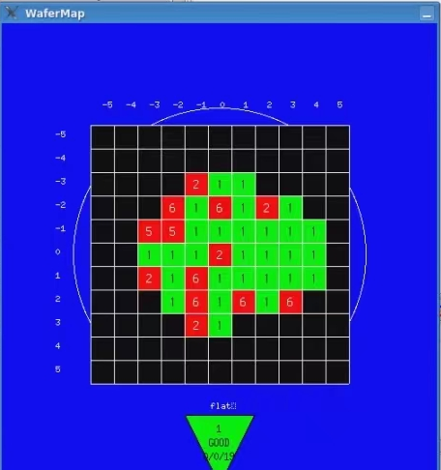
Large-scale sensor TaichuPix-3
12 TaichuPix-3 wafers produced from two rounds
  One wafer thinned down to 150 μm and diced
  11 wafers were tested on probe-station before dicing → chip selecting & yield evaluation
Wafer #3
8-inch wafer
Wafer after thinning and dicing
Thickness after thinning
Wafer num. | Yield | Wafer num. | Yield
1 | 0.65 | 4 | 0.475
2 | 0.725 | 5 | 0.625
3 | -- | 6 | 0.525
7 | 0.775 | 10 | 0.675
8 | 0.725 | 11 | 0.6
9 | 0.275 | 12 | 0.35
Wafer T212141-02E3
8-inch wafer
Probe card for wafer test
An example of wafer test result
1st round
2nd round

Slide 13
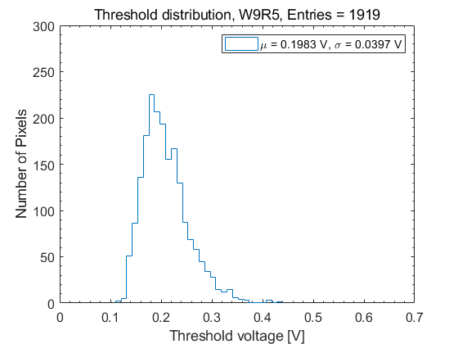
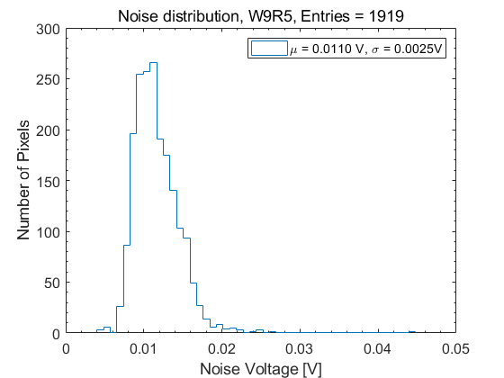
Threshold and noise of TaichuPix-3
Pixel threshold and noise were measured with selected pixels
  Average threshold ~215 e⁻, threshold dispersion ~43 e⁻, temporal noise ~12 e⁻ @ nominal bias setting
Measured
Measured

Slide 14
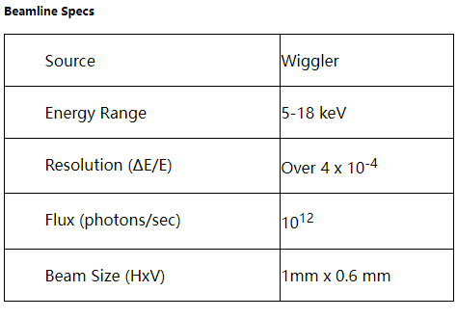
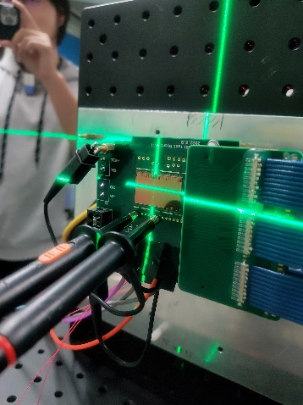
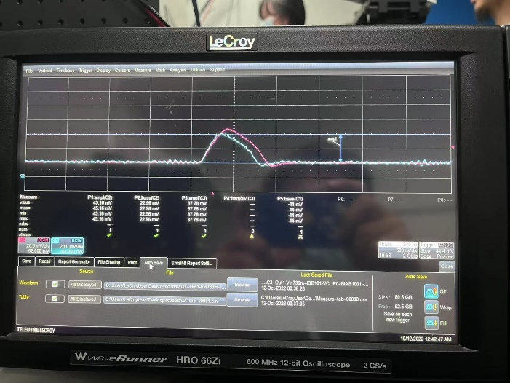
TID test on TaichuPix-3
Beamline Specifications
Analog signal of the pixel monitored by the oscilloscope
Aluminum (Al) | Irradiation dose rate
96 layers | 0.02rad/s
64 layers | 3 rad/s
32 layers | 394 rad/s
28 layers | 722 rad/s
24 layers | 1321.6 rad/s
1 layers | 42927 rad/s
  The energy of X-ray is set to 12 KeV
  Ionization chamber is used to calibrate irradiation dose rate
  The irradiation dose is regulated by aluminum foil
Dose rate（Gy/s）
Attenuation of Aluminum (thickness of Al foil is 0.01 mm/layer)
Al thickness (mm)

Slide 15
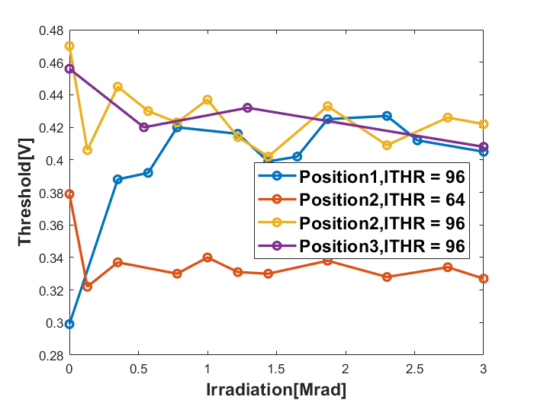
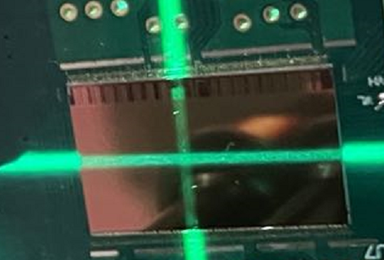
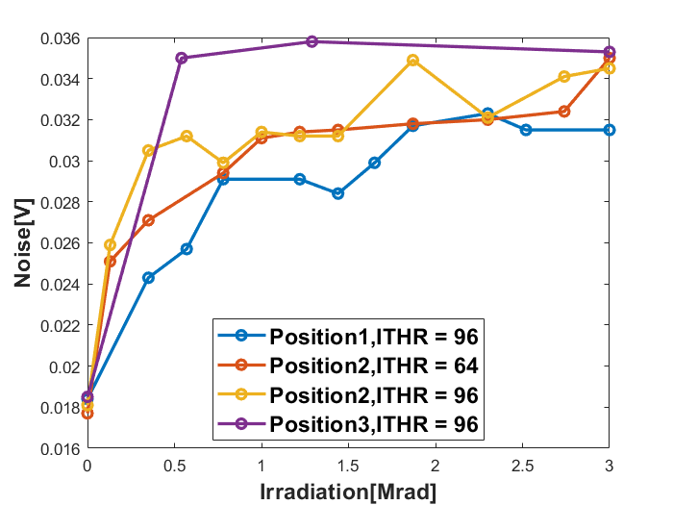
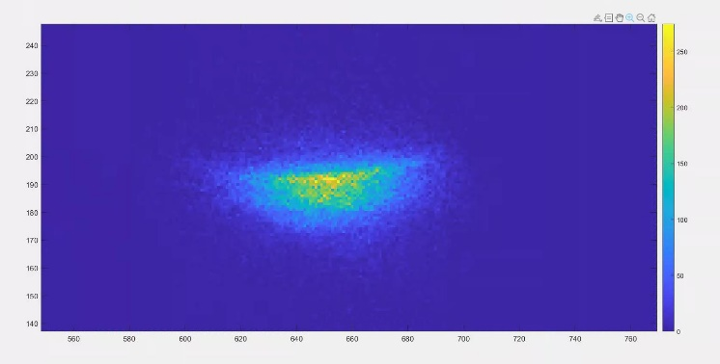
TID test on TaichuPix-3
Pixel threshold vs. TID
Position1
Position3
Position2
Chip was exposed with full working condition: power, bias, clk, …
Dose rate ~1.2 rad/min for the first 12 min, in order to find the position of beam spot.
  → The size of beam spot agrees with the expectation of 1 mm × 0.6 mm
Dose rate ~43.3 krad/min for 69 min until total dose over 3 Mrad.
All three irradiation regions indicated a good performance to 3 Mrad TID
Preliminary
TaichuPix-3 irradiated at BSRF 1W2B beamline (12 keV X-ray)
Pixel noise vs. TID
Preliminary
Full image of the X-ray beam spot(position 1)

Slide 16
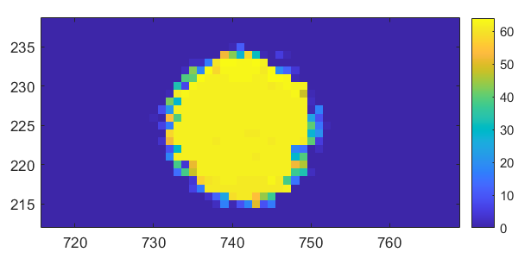
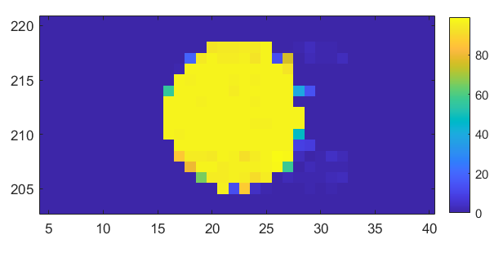
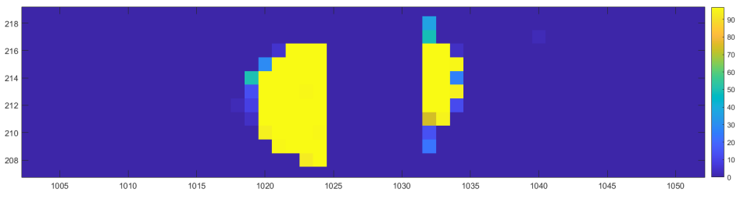
Laser test result of ladder flex with two chips
One flex equipped with chip U10 & U9
  Config U9/U10 respectively: minimum ITHR is 64 for U10, 96 for U9
  Laser test: U9 and U10 can work simultaneously, NO error code/cross-talk found
U10 @ ITHR=64
U9 @ ITHR=96
Gap ≈ 175 um = 7 pixels
U10
U9
U9 & U10 @ ITHR = 96

Slide 17
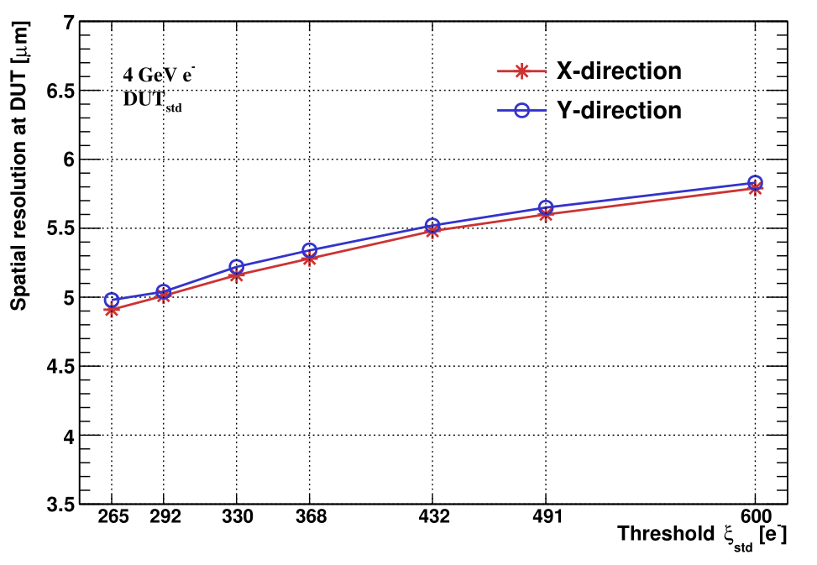
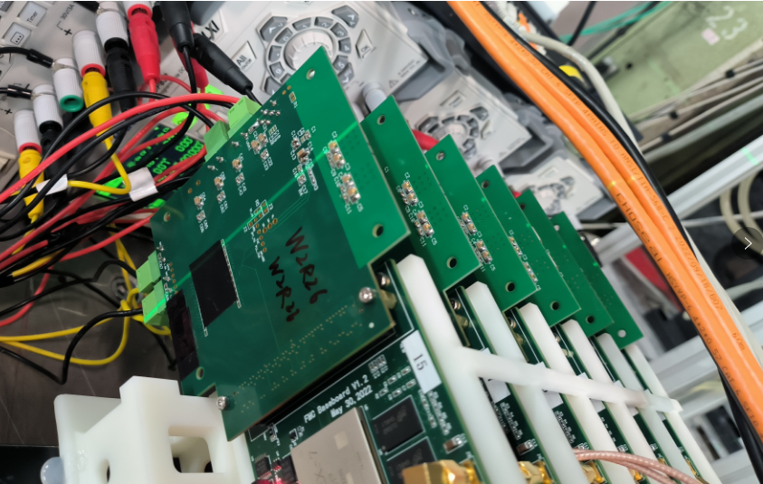
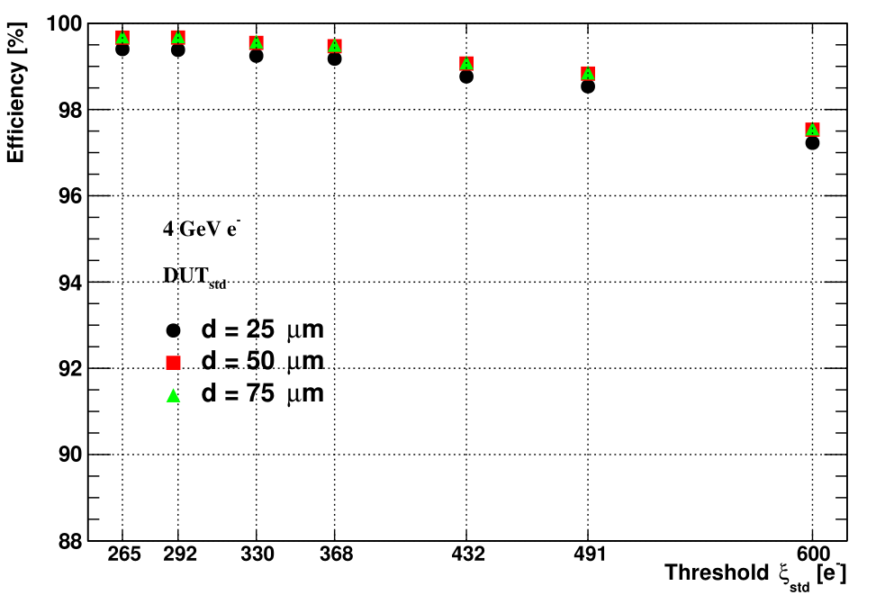
TaichuPix-3 telescope
The 6-layer of TaichuPix-3 telescope built
  Each layer consists of a TaichuPix-3 bonding board and a FPGA readout board
TaichuPix-3 telescope achieved the expected goal in the DESY testbeam
  Basically works well during the beam test time
  The preliminary offline results indicate the best spatial resolution could be < 5 μm
TCPX3 chip
preliminary
Spatial resolution vs. pixel threshold
6-layer TaichuPix-3 telescope
preliminary
Details go to talk ”test beam and results”
Detection efficiency vs. pixel threshold

Slide 18
Summary
The full-scale and high granularity pixel sensor prototype, TaichuPix-3, has been designed and tested
The main design indicators achieved
Readout electronics for the sensor test and the ladder readout was developed
  Performed the sensor characterization in the lab successfully
  Completed beam tests for the sensor prototype and the detector prototype at DESY
 | Project indicators | Test results
Spatial resolution | 3-5 μm | 4.8 μm (best)
TID | > 1Mrad | > 3 Mrad

Slide 19
Backup

Slide 20
Pixel architecture – Analog
D. Kim et al. DOI 10.1088/1748-0221/11/02/C02042
Amplification
Discrimination
Y. Zhang for the CEPC Vertex MOST2 group meeting
Digital-in-Pixel scheme: in pixel discrimination & register
Pixel analog is derived from ALPIDE (and benefit from MIC4 for MOST1)
  As most of ATLAS-MAPS sensors’ scheme
Biasing current has to be increased, for a peaking time of ~25ns
  Now in MOST1 ~2us peaking time was designed, too slow for 40MHz BX
Consequence:
  Power dissipation increased
  Modified TJ process for ATLAS has to be used
    With faster charge collection time, otherwise only fast electronics is of no meaning

Slide 21
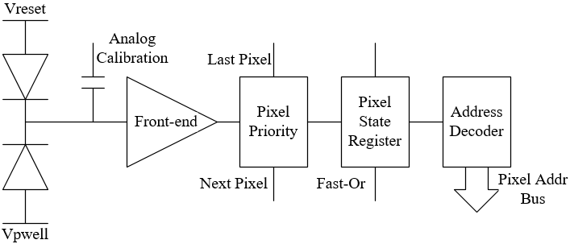
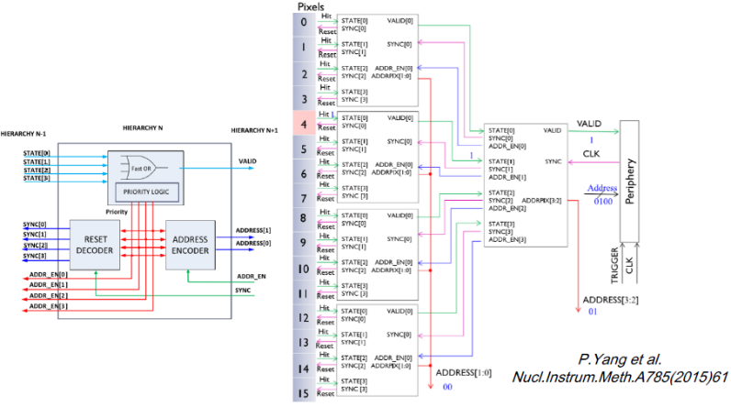
Pixel architecture – parallel digital schemes
Simplified column-drain readout:
  Each double column shares a common Fast-Or bus for hit indication
  Common time stamp register @40MHz will record the hit arrival time
  Hit pixels in the same cluster will share a common time stamp as the Trigger ID
Two parallel digital readout architectures were designed:
  Scheme 1：ALPIDE-like: benefit from the proved digital readout in small pixel size
    Readout speed was enhanced for 40MHz BX
  Scheme 2：FE-I3-like: benefit from the proved fast readout @40MHz BX (ATLAS)
    Fully customized layout of digital cells and address decoder for smaller area

Slide 22
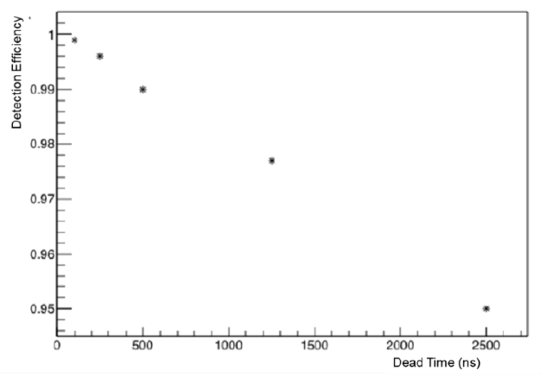
Readout & Periphery
Time stamp recorded when Fastor is valid
Each pixel readout by 2 clocks (50ns)
  Worst delay ~ 25ns
    Sim by 512 rows (full size)
    TDA: read sent –addr come
  Address latch @ 37.5ns
    @1.5 clock
    Enough headroom for all corners
Designed for low power
  Only the hit (fastor) info & address are fannout from the pixel array
  Only the read (acquisition) signal is fanned in to the pixel array
    Clock & time stamp are localized only in the EOC, different from FE-I3
Optimized @ CEPC hit rate
  Common time stamp recorded for a full double column
    For low power
    Column is hit every 8.3us / pixel is readout in 2 clocks (50ns) / cluster size 3 pixels
    Dead time 500ns – 98% trigger efficiency

Slide 23
Performance of threshold and noise of TaichuPix2
Pixel array includes 4 sectors with different transistor parameters/layout for analog front-end, S1 chosen for the full-scale design.
Threshold can be tuned by changing ‘ITHR’ (a global current bias)
Mean threshold of Sector1 vs. ITHR setting
Sector1
Noise hit rate < 10⁻¹⁰/event/pixel for the measured threshold range
Chip4 | Threshold Mean (e⁻) | Threshold rms (e⁻) | Temporal noise (e⁻) | Total equivalent noise (e⁻)
S1 | 267.0 | 49.8 | 29.3 | 57.8
S2 | 293.4 | 54.5 | 26.9 | 60.8
S3 | 384.9 | 58.4 | 24.4 | 63.3
S4 | 411.9 | 56.6 | 26.5 | 62.5

Slide 24
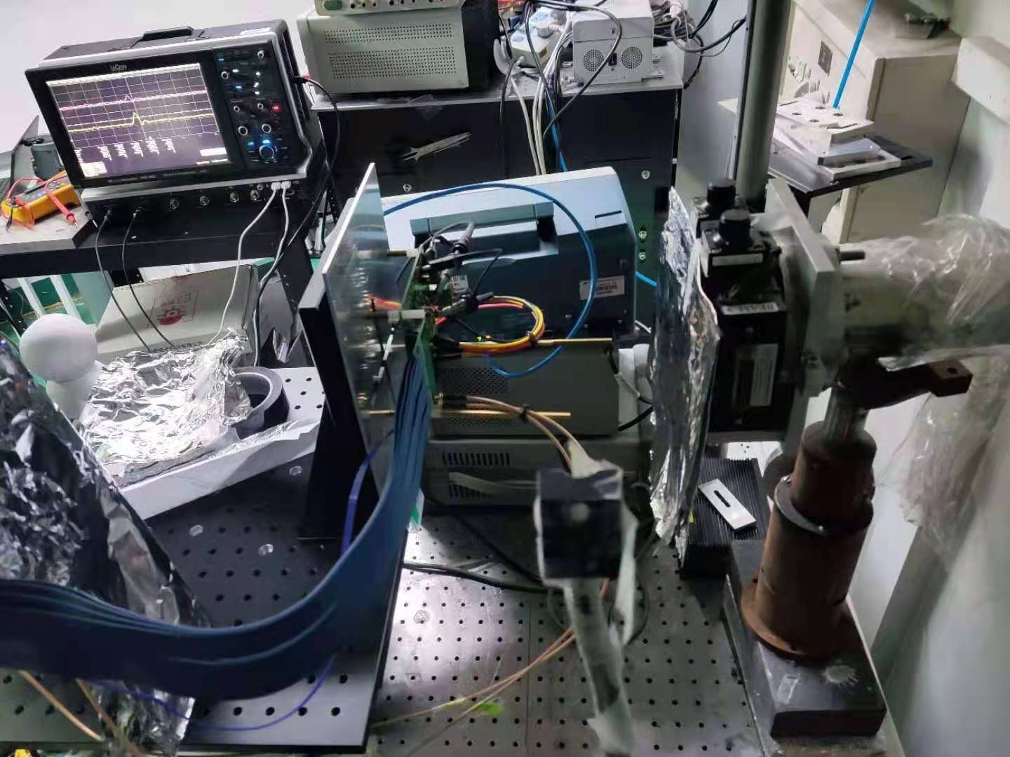
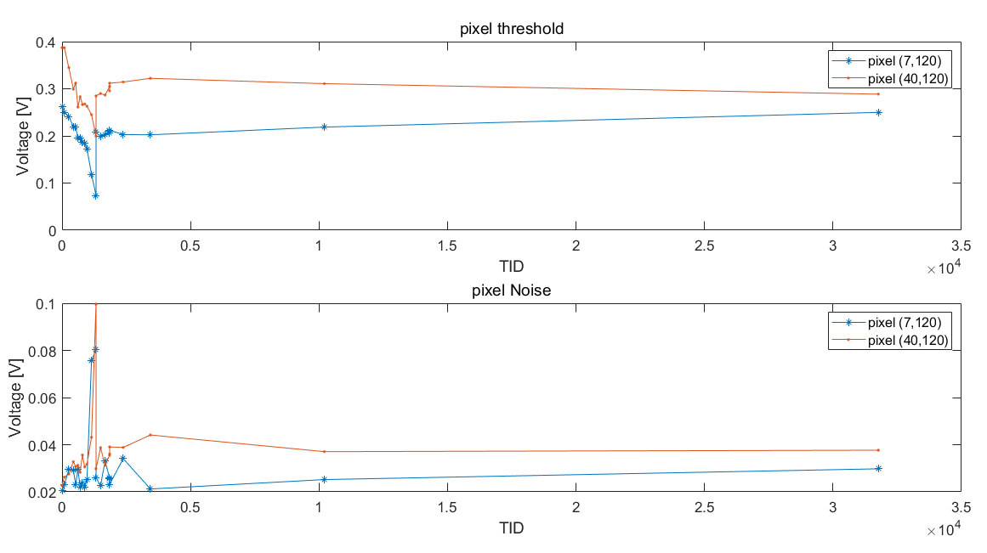
TID test on TaichuPix-2
Chip was exposed with full working condition: power, bias, clk, …
Dose rate ~17.63 krad/min for the first 2.5 Mrad, then 211.56 krad/min for 51 min, then 1.24 Mrad/min for 15 min
Normal chip functionality and good noise performance proved up to 30 Mrad TID
Pixel threshold vs. TID
Pixel noise vs. TID
TaichuPix-2
beam
TaichuPix-2 irradiated at BSRF 1W2B beamline (6 keV X-ray)

Slide 25
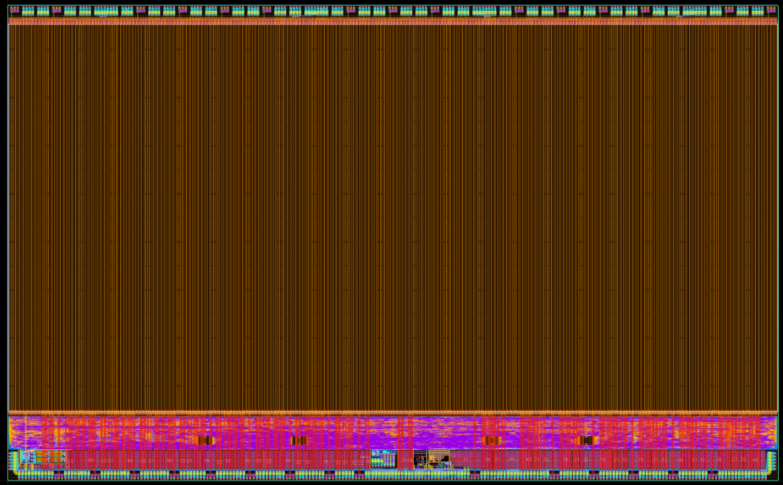
Overview of the full-scale prototype
0.6 mm
7
Pixel array 1024*512
Periphery
DAC & Bias generation
Data interface
LDO (test blocks)
Chip inter-connection features
Scribe-able top power connection features
1
15.2 mm
2
3
5
4
6
25.7 mm
Process: 180 nm CMOS Imaging Sensor process (7 metal layers)
Pixel cell copied exactly from MPW + scaled logic with new layout Periphery + debugged/improved blocks + enhanced power network

Slide 26
TaichuPix-3 specification & performance
 | Design specs. | Measured
Spatial resolution* | 3~5 μm | 4.8 μm (best)
TID* | > 1 Mrad | > 3 Mrad
Pixel pitch | ≤ 25 μm | 25 μm
Chip size | ~1.4 × 2.56 cm² | 1.59 × 2.57 cm²
Dead time | < 500 ns | ~ 300 ns
Data rate | 110 Mbps (trigger) 3.84 Gbps (triggerless) | Not tested Currently 160 Mbps tested
Power density | < 200 mW/cm² | 89 – 164 mW/cm²
*project indicator

Slide 27
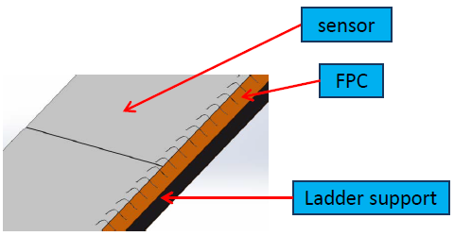
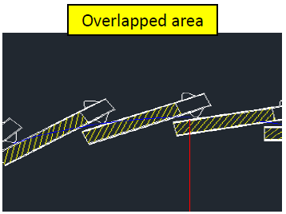
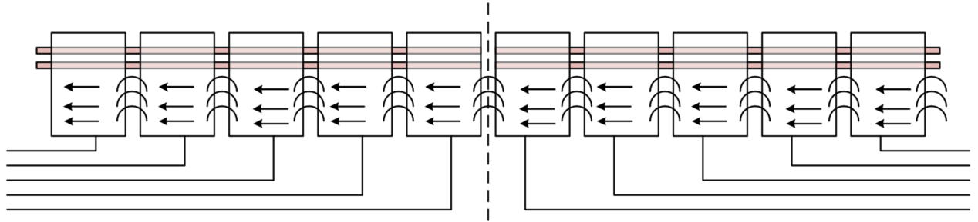
Flex cable design consideration
2mm margin for wire bonding and PCB Pads
Power
Slow bus
Signals
Design goals & considerations for the Flex PCB
  Minimum material budget
    Minimum dead zone extension, limited height of PCB
      Minimum set of signals on Flex
      Inter-chip connection for slow controls through wire bonding → save some space & metal on PCB
    Robust power supply
  Manufacturability

Slide 28


Design of the flex board
Option1
  2 layers + stiffener
  Inter-conn signal used
  worse signal integrity
    Noise
    Ground bounce
Thickness: ~0.2mm
Option2
  4 layers flex + stiffener
  Dedicated GND and power plane
  better signal integrity
Thickness: 0.38+/-0.08mm

Slide 29
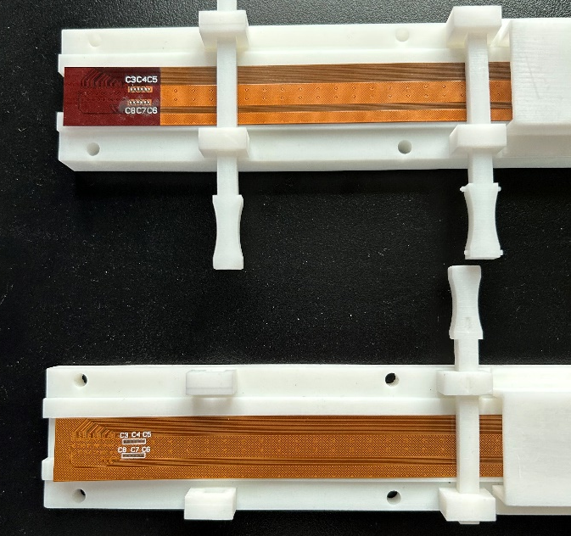
New batch of flex boards
25 2-layer flex from FASTPRINT company received, same as previous bunch
  Thickness: 0.31 mm (from the delivery list)
15 2-layer flex and 15 4-layer flex from SCC company received
  Thickness: 0.161 mm for 2-layer; 0.213 mm for 4-layer (from the final inspection report)
Old 4-layer
stiffener on backside of socket
New 4-layer
No stiffener

Slide 30
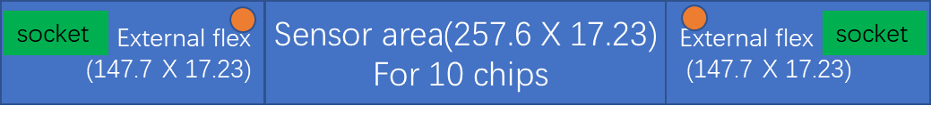
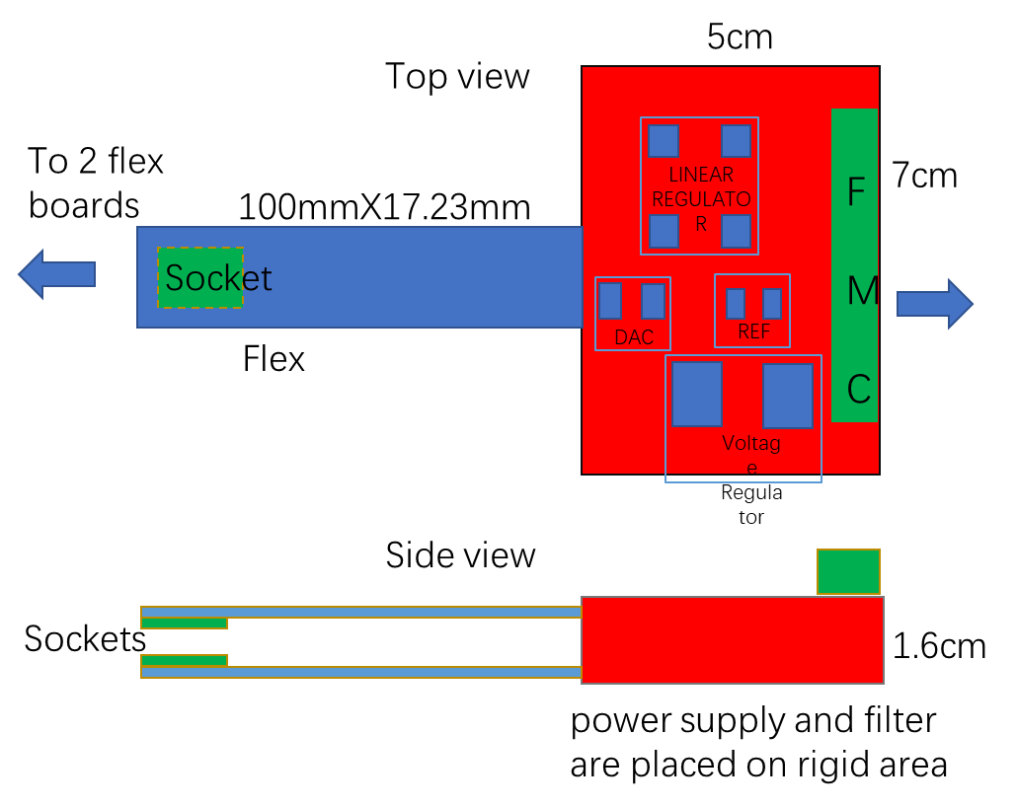
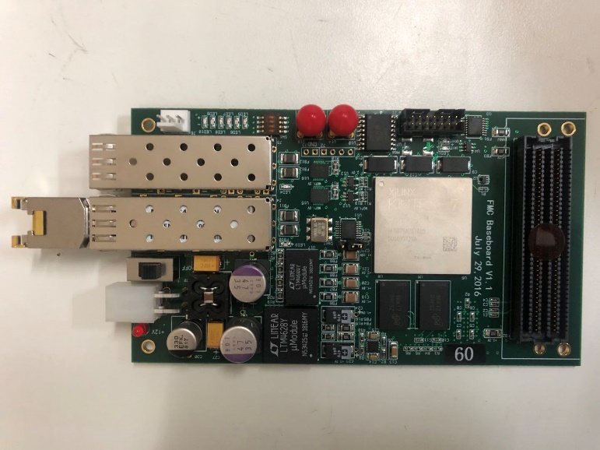

Ladder readout design
Two versions of flex board designed
  Version 1 (baseline): 2 layers, less material, limited layout space leads to worse signal integrity, thickness ~0.2 mm, in production
  Version 2: 4 layers, more material dedicated GND and power plane gain better signal integrity, thickness ~0.4 mm, production done
Interposer board
553 mm
FPGA board
  Communication with chips
  Data processing and package data
  Readout to PC via 1Gbps Ethernet
  Capability of 6 Gbps readout and 2GB internal DDR memory

Slide 31

Design of DAQ
Considering 6 double-sided ladders

Slide 32

TowerJazz process
Standard & modified process

