Slide 1
Beam test of a baseline vertex detector for the CEPC
Tianya Wu
on behalf of CEPC vertex detector group
wuty@ihep.ac.cn
2023/06/08

Slide 2
OUTLINE
Overview of the baseline vertex detector
Beam test of the telescope
Beam test of the prototype
Summary

Slide 3
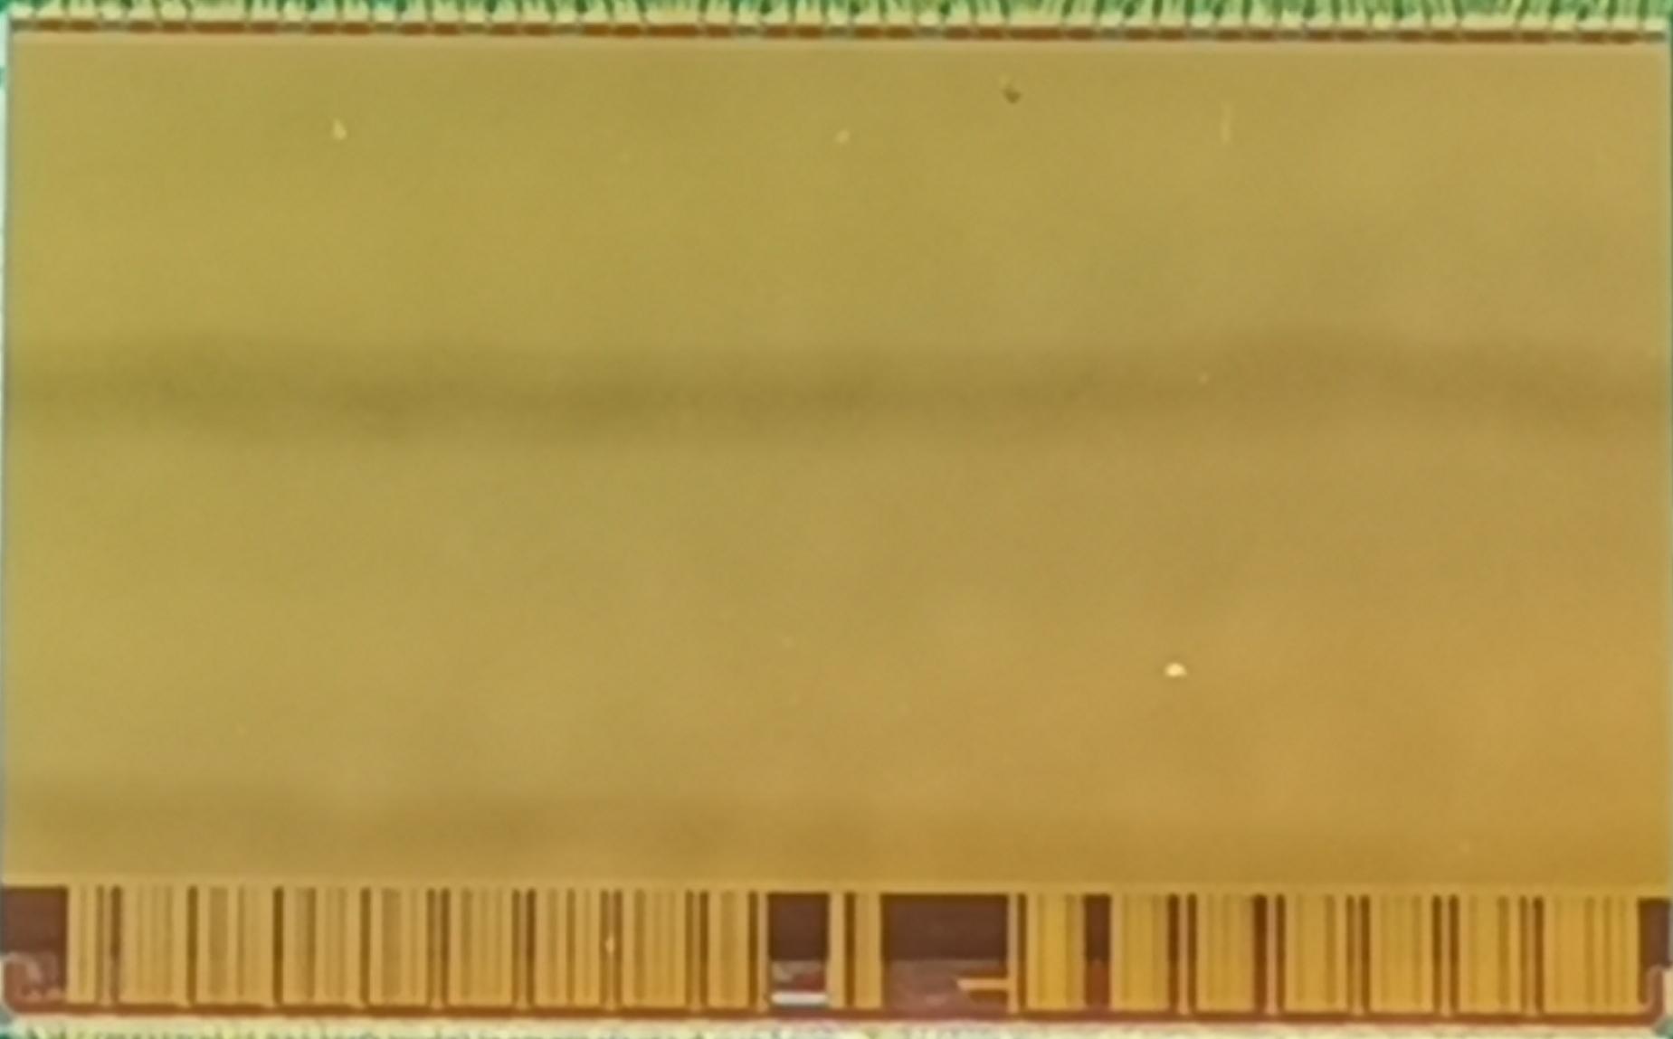
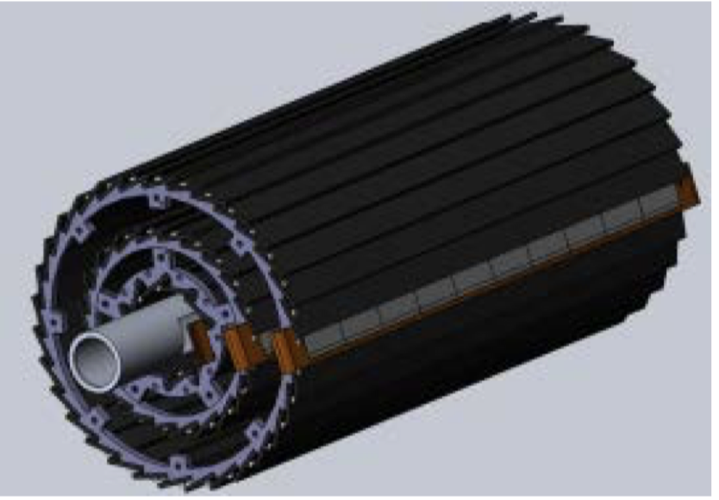
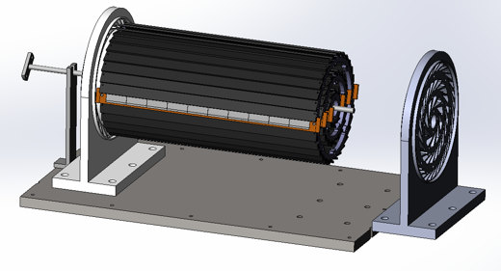
Overview of a baseline vertex detector R&D
Can break down into sub-tasks
CMOS Pixel Sensor chip R&D
Detector Module prototyping
Detector assembly
CMOS pixel sensor prototyping
Full size vertex detector prototype
Detector module (ladder) prototyping
TaichuPix-3
Beam test to verify its spatial resolution
Double sided ladder; 10 sensors on each side;
Read out from both ends.
Electron beam

Slide 4
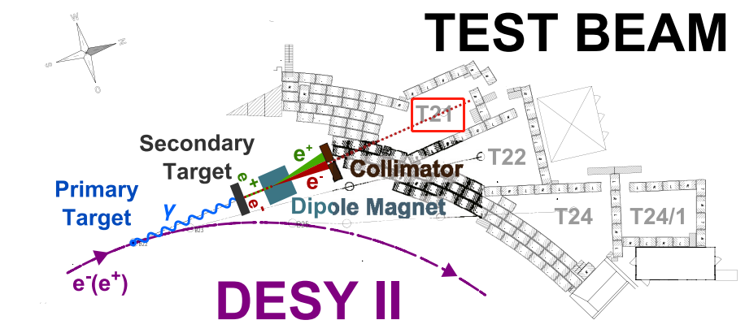
Introduction of DESY TB21
Electron-positron synchrotron DESY II
Beams are converted bremsstrahlung beams from carbon fibre targets
Up to 1000 particles per cm²
Energies from 1 to 6 GeV,
Energy spread of ~5% and a divergence of ~1mrad.

Slide 5
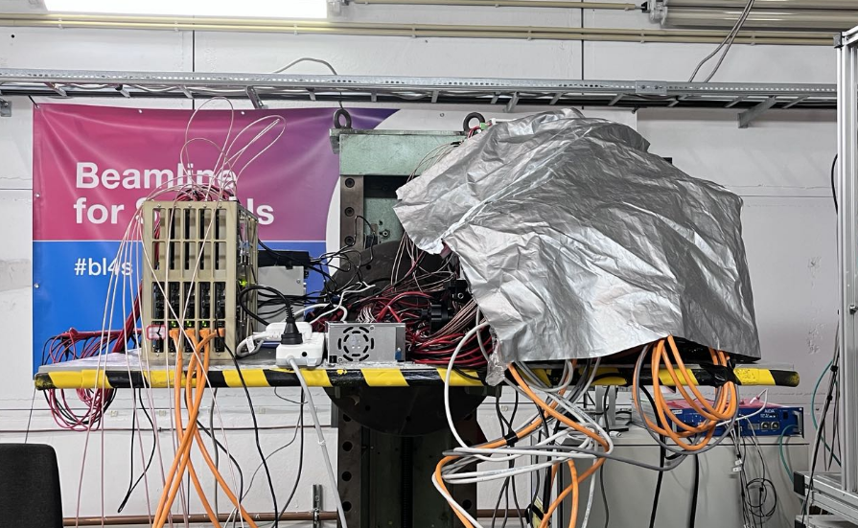
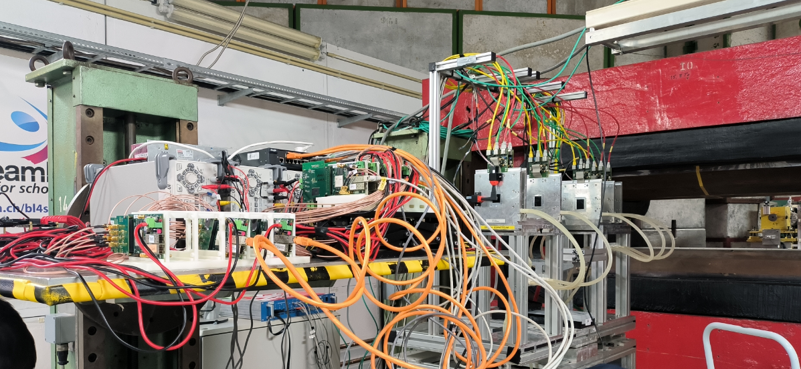
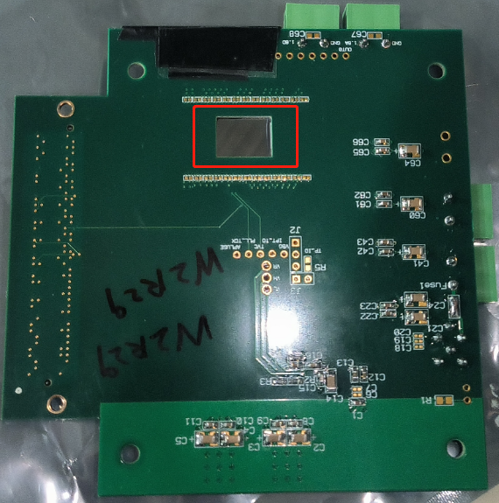
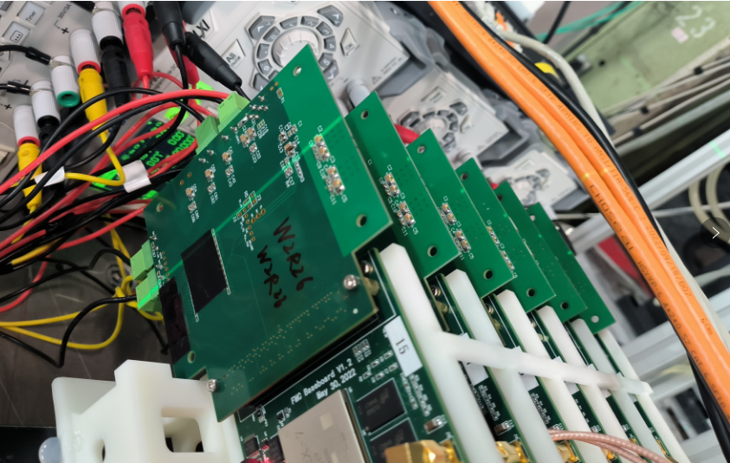
Setup of the telescope
MIMOSA Telescope
Board6
Board3
Board2
Board5
Board1
Board4
Jadepix telescope
An open window in backside of PCB with a size of 12mm x 9mm
15.9 mm
25.7 mm
TCPX3

Slide 6
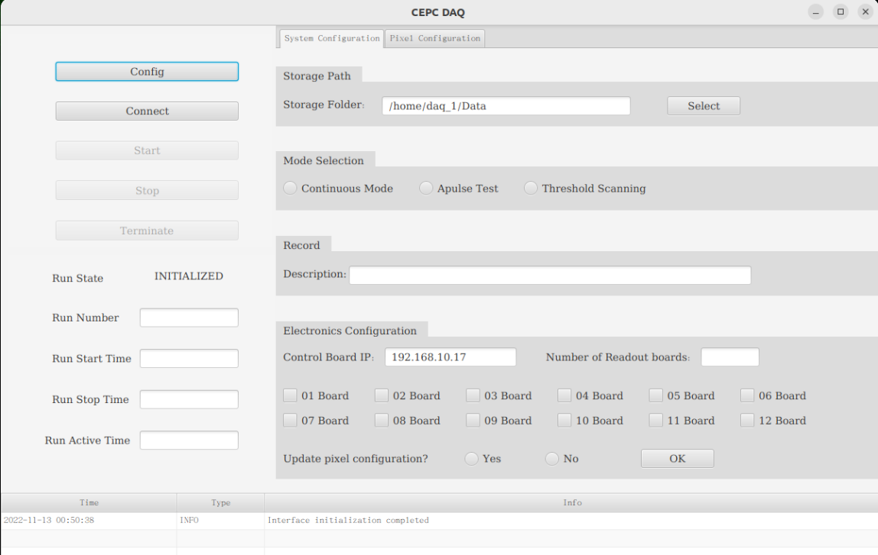
4 GeV beam hitmap acquired by DAQ
User interface of DAQ
Designed by Jia Zhou
DAQ software is developed before the test beam
It can be used to configure each chip in parallel and is caple of satisfying the amount of data.
Beam energy is set to 4GeV
The online hitmap of 6 chips from the Taichupix3 telescope drawn by the DAQ.

Slide 7
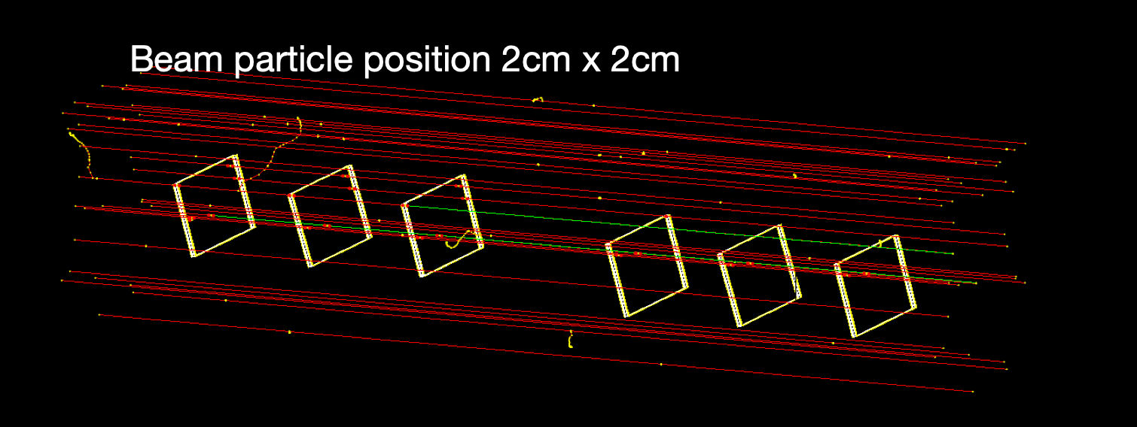
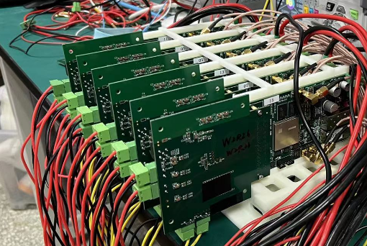
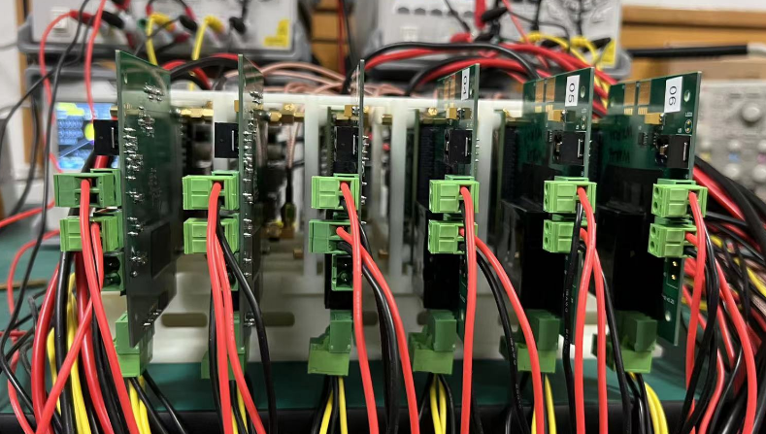
Offline reconstruction and alignment
Track Reconstruction
No magnetic field
Least squares fitting (Straight line fit)
No considering multi-scattering now
Alignment
Using Millepede (c++ version) matrix method
Correct for the misalignment chip position
Evaluate the influence of different alignment parameters on spatial resolution
Designed by Shuqi Li

Slide 8
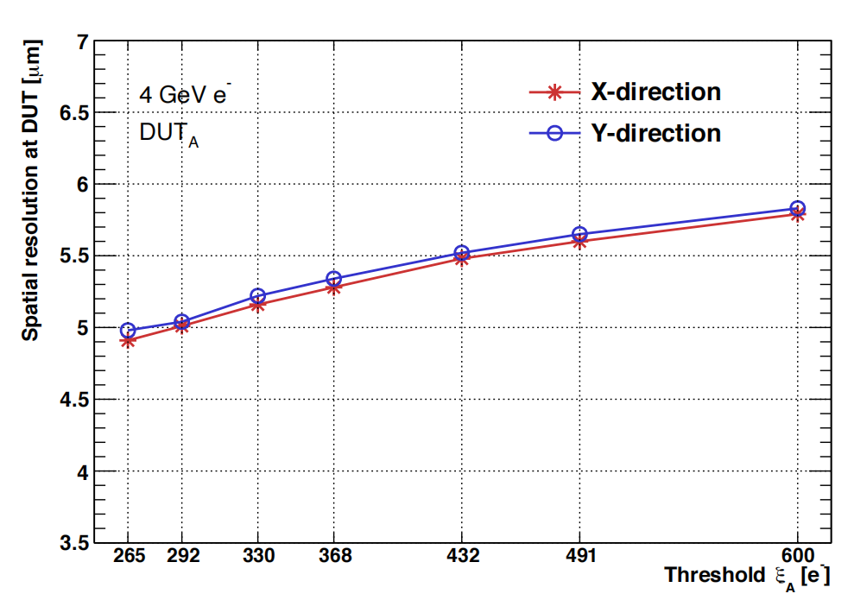
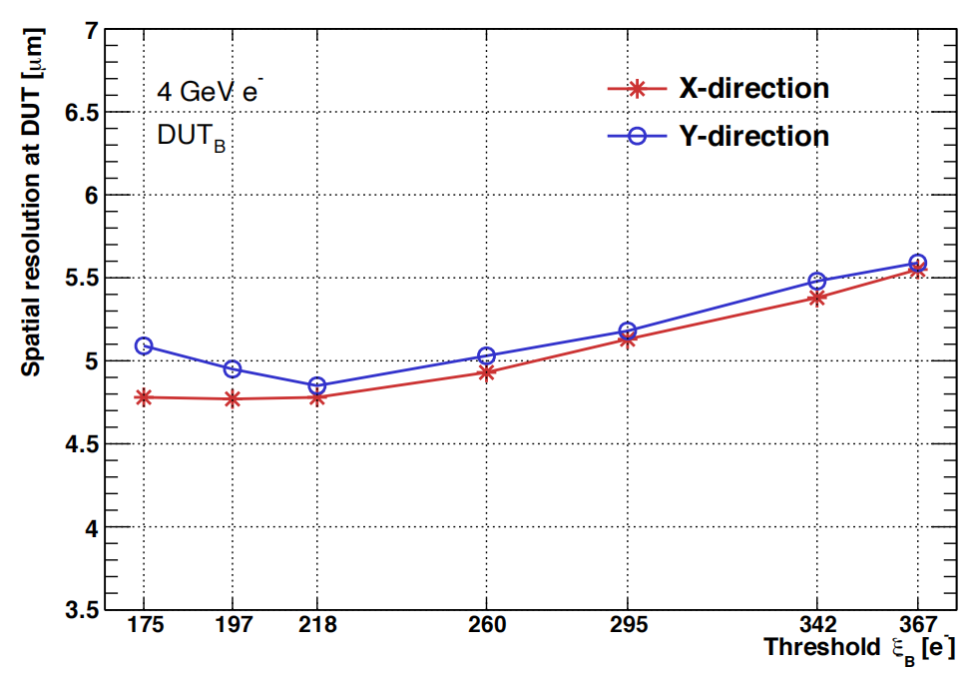
Threshold scan
Scan ITHR of board 5（DUT_{A}）with10 16 24 32 48 64 96; 4GeV ;30min for each run; keep the rest of boards unchanged (Modified CMOS process)
Scan ITHR of board 2（ DUT_{B} ）with16 24 32 48 64 96; 4GeV ;30min for each run; keep the rest of boards unchanged (Standard CMOS process)
DUT_{A} （W2R29）: the resolution goes to 4.9 at ITHR10 when chi2 < 6
DUT_{B} （W9R5）: the spatial resolution is 4.8 at ITHR16 when chi2 <6
Board2 has a lower threshold at the same setting of ITHR
Made by Shuqi Li

Slide 9
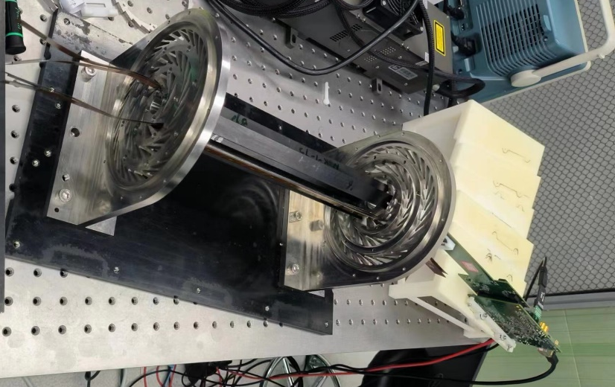
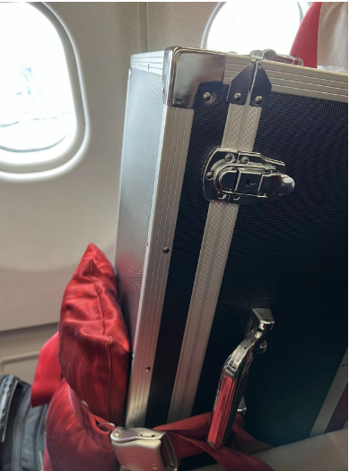
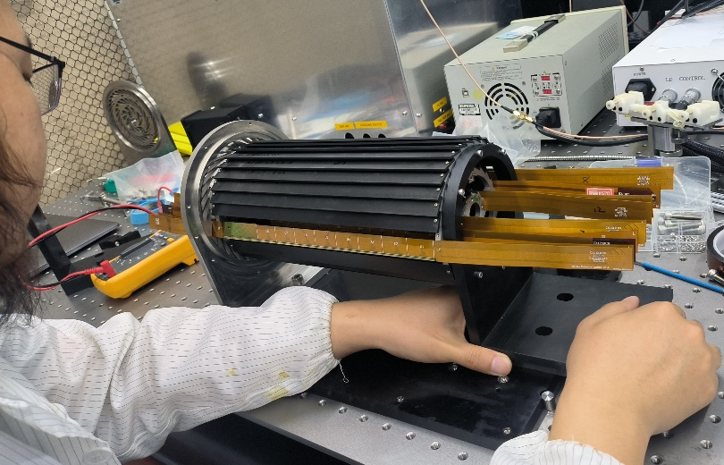
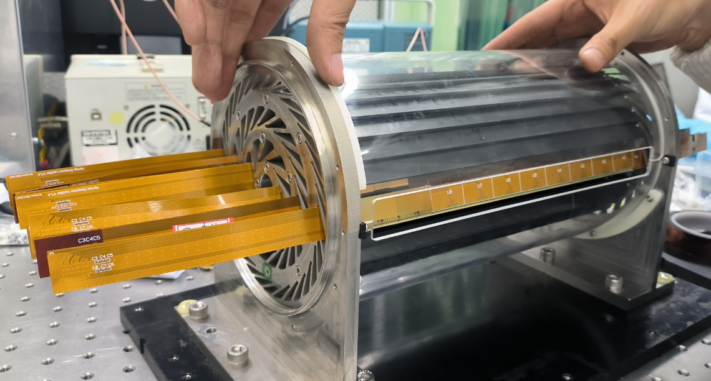
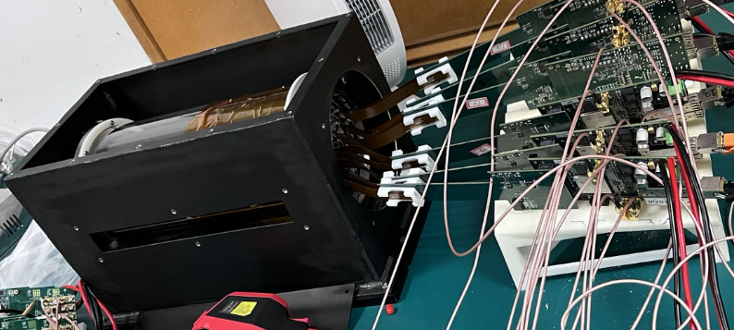
Preparation for the VTX prototype
1，After installation, flex boards were tested one by one
2，The endcap is under installation
Special flight ticket was bought for VTX prototype
3，The transparent cover is used to protect the VTX
4，The full VTX setup was measured at IHEP

Slide 10
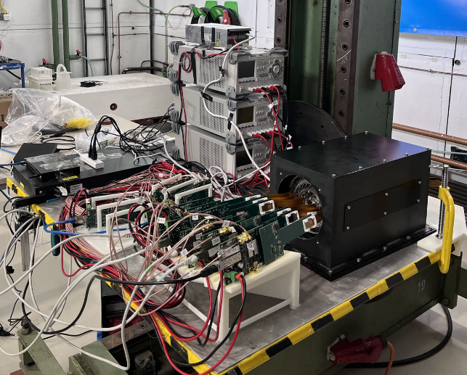
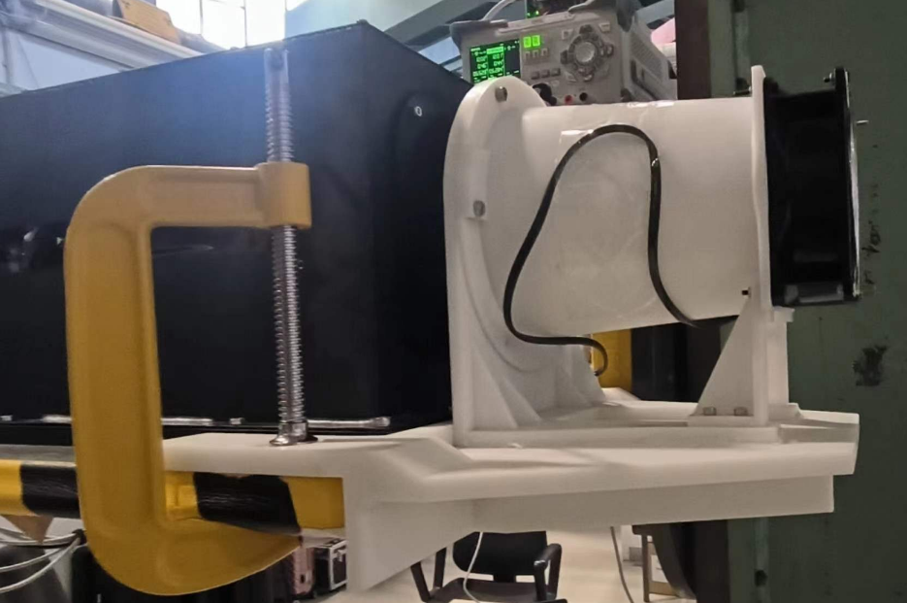
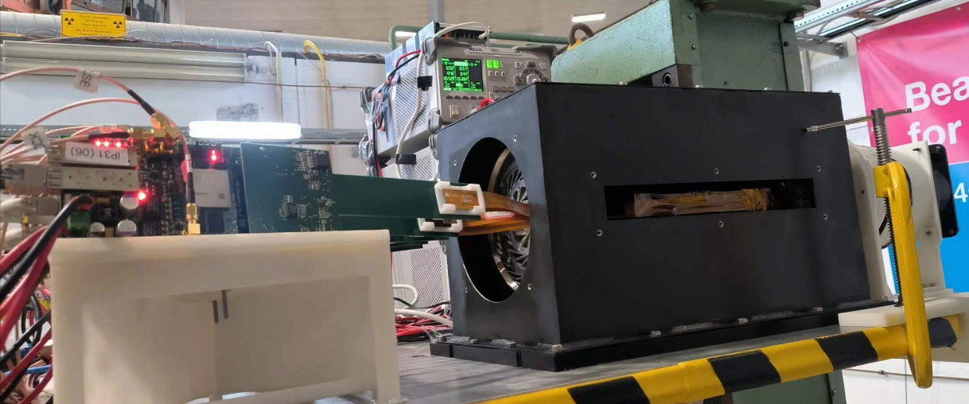
SETUP at DESY TB21
All equipment fits in the 3D stage at DESY TB21 hut.
A bigger collimator (2.5x2.5cm²) was used to focus on the center of two TaichuPix3 chips.
Only two chips were assembly on one flex board
Size of 2.5cmx2.5cm
Beam spot Collimator

Slide 11
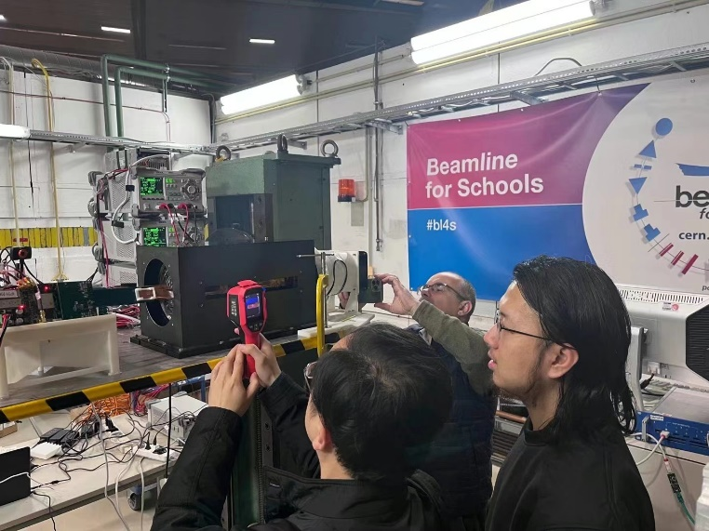
Overview of testbeam
Period: April 11 2023 -April 24 2023
April 11-14:The fully system was set and move the detector to the center of beamline
April 15: An electricity fan is operating to cool down the system
April 18: Try to use dry ice to cool down the detector system
April 24: Finish beam test at 1:30 AM ; Pack everything up till 6:00 AM
The outermost layer temperature was reduced to 28℃ from 40℃ with the fan or dry ice.
3 sensors are not working correctly, and they were totally shielded.
Threshold scan for inner layer ladder and middle layer ladder on 4 GeV、5 GeV and 6 GeV
Operating 21 sensors /11 sensors together with different energies.

Slide 12
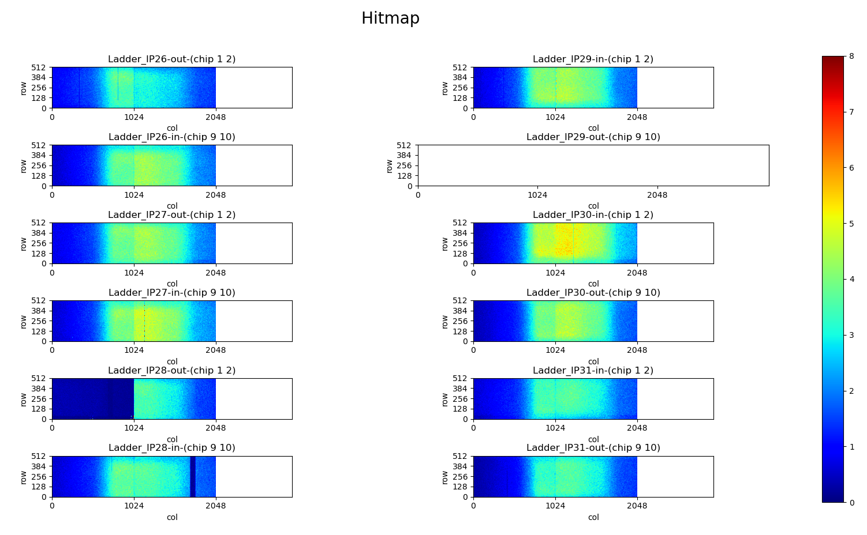
Hitmap of 4 GeV beam
One flex is broken and unreplaceable in DESY
One sensor on Ladder_IP 28 was sending bad data that cannot be decoded
The beamline energy is 4GeV
The threshold is ITHR240 to each sensor.
The data rate for DAQ is about 12.5MB/s
No data
Bad data

Slide 13
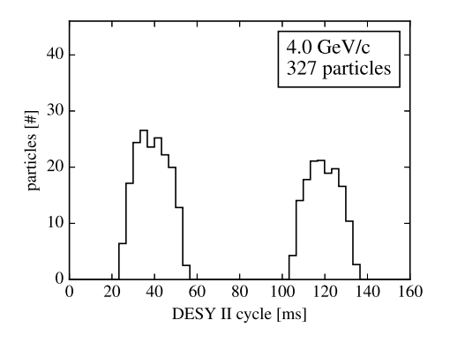
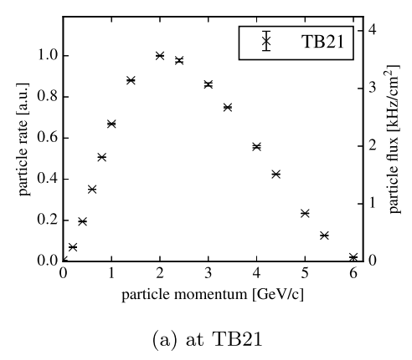
Energy Option
4 GeV/5GeV /6GeV are used for Threshold scan
The valid coincidence tracks are preliminary calculated with around 2223 tracks/s,1944 tracks/s and 967 tracks/s under 4/5/6 GeV respectively.
The sensors are working for the full beam time except for the chip replacement. Totally about 4.3TB valid data were recorded
To the baseline prototype, the higher energy could obtain a better spatial resolution, comparing with the telescope’s results that we did last December.
Refer from:The DESY II test beam facility”
https://doi.org/10.1016/j.nima.2018.11.133
NIMA, Volume 922, 1 April 2019, Pages 265-286

Slide 14
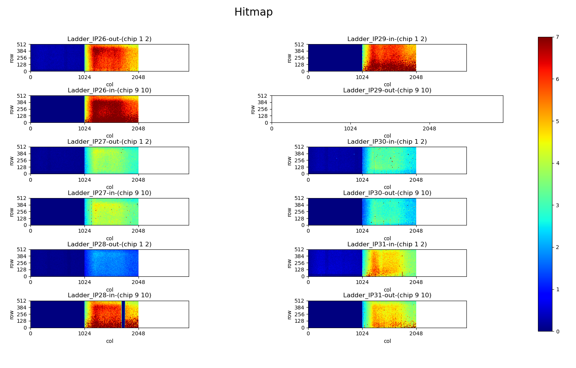
Offline analysis
The beamline energy is 5GeV
The threshold is set as a low level to all sensors, which is less than ITHR48 except for plane5 of ITHR254
Only half of sensors were turned on
The data rate for DAQ is about 6.77MB/s
Single point spatial resolution of Plane7 is around 4.93 µm.
Plane 9
Plane 4
Plane 10
Plane 7
Plane 3
Plane 8
Plane 2
Plane 5
Plane 1
Plane 6
Plane 0
Run670, 5GeV running for 30min

Slide 15
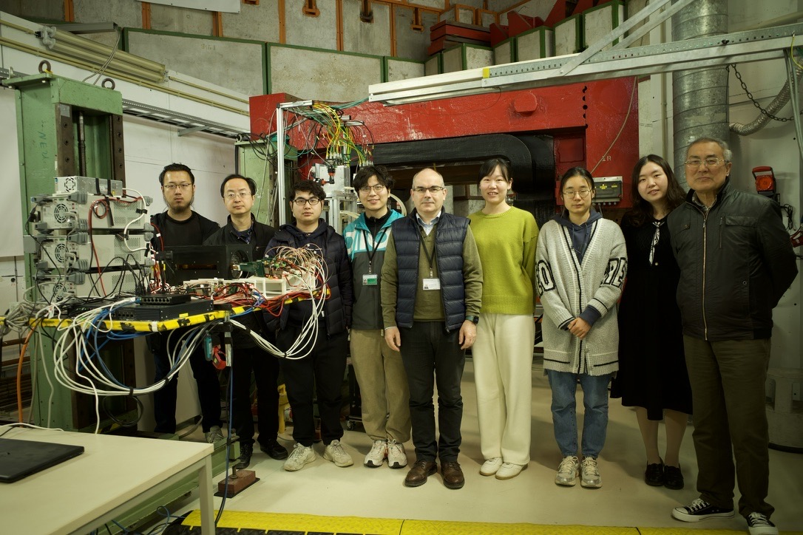
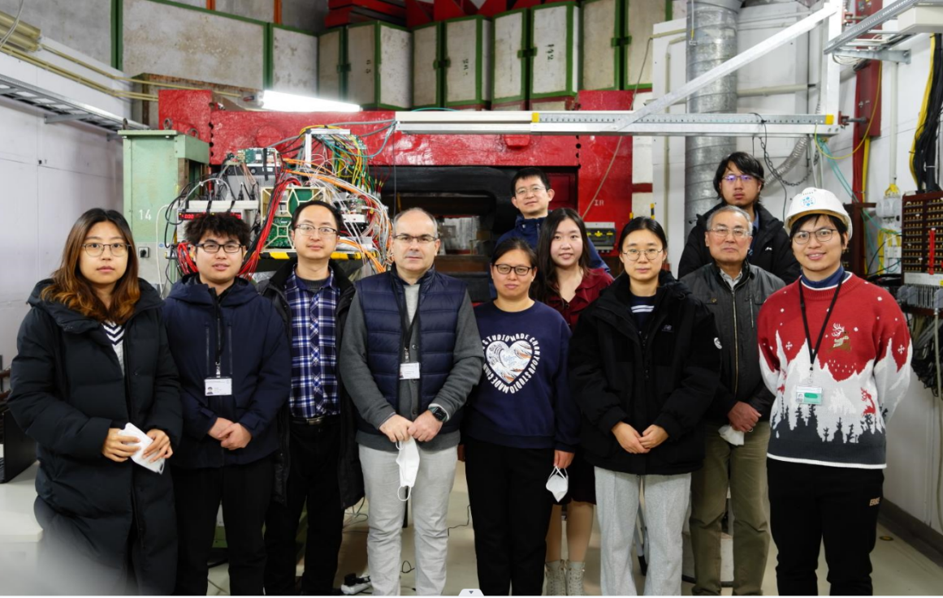
Testbeam contribution at DESY TB21
Remote support
WeiWei, Ying Zhang (IHEP) ASIC
Jun Hu, Ziyue Yan（IHEP）firmware
Hongyu Zhang（IHEP）DAQ
Jinyu Fu, Mingyi Dong（IHEP） Assembly
Gang Li, Linhui Wu（IHEP）Offline
Yiming Hu, Xiaoxu Zhang (NJU)…
On Site team (DESY)
Joao （IHEP）Project leader
Zhijun Liang (IHEP) test beam coordinator
Tianya Wu（IHEP）Shift leader , ASIC expert
Ming Qi（NJU） Shift leader
Lei Zhang（NJU） Shift leader
Xiaomin Wei（NWPU） ASIC experts
Jia Zhou（IHEP） DAQ
Xinhui Huang（IHEP）Assembly
Shuqi Li（IHEP) Offline
Wei Wang (IHEP) Offline
Hao Zeng（IHEP） Offline
XueWei Jia (IHEP) Offline
April 2023
December 2022

Slide 16
Summary
Two setups are tested in DESY II TB21 beamline
→6 layers telescope made by TaichuPix3 chips is tested in Dec. 2022
Baseline vertex detector prototype is tested in April, 2023
Over 800 million valid tracks are collected.
The single point spatial resolution is better than 5 µm at the set threshold
The impact parameter of the baseline vertex prototype is on analysis and will be presented by Shuqi Li
The publications are under reviewing.

Slide 17
Thanks for your attention!

Slide 18
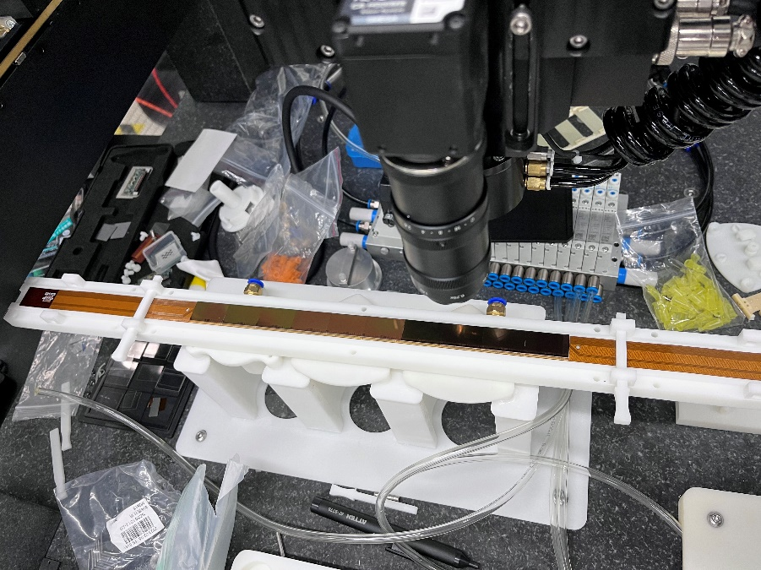
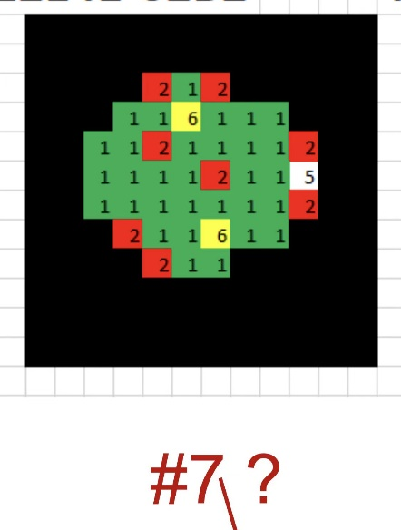
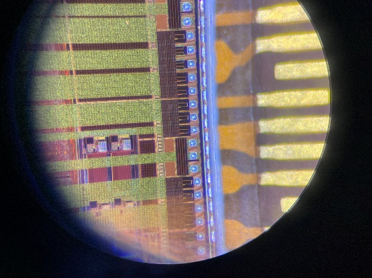
Gluing 10 chips
Position | AVDD AVSS | DVDD DVSS | Wafer7
U1 | OL | 457Ω | W1R1
U2 | OL | OL | R38
U3 | OL | 390Ω | R35
U4 | OL | 464Ω | R32
U5 | OL | 383Ω | R20
U6 | OL | 167Ω | R17
U7 | OL | OL | R16
U8 | OL | OL | R11
U9 | OL | 387Ω | R6
U10 | OL | 7Ω | R2
Do wire bonding for U2/U9/U6, U2 is short after wire-bonding, the same with wafer test results
Probe stage was used before wire-bonding

Slide 19
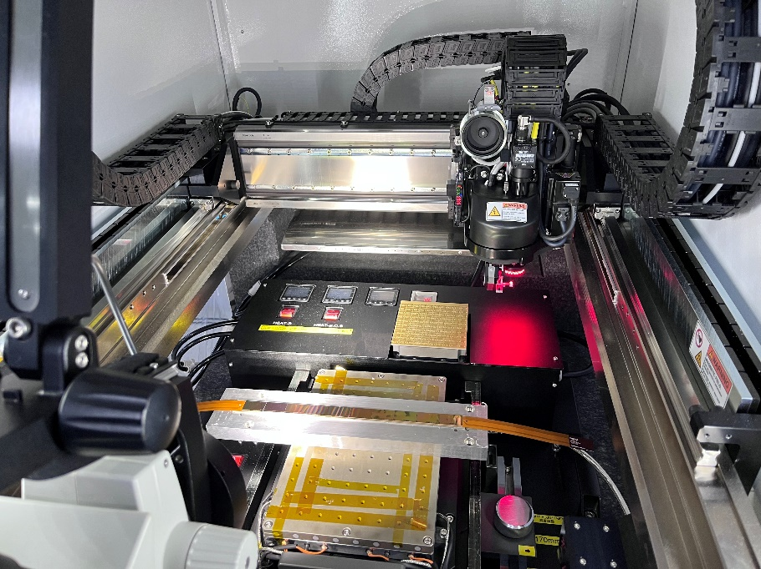
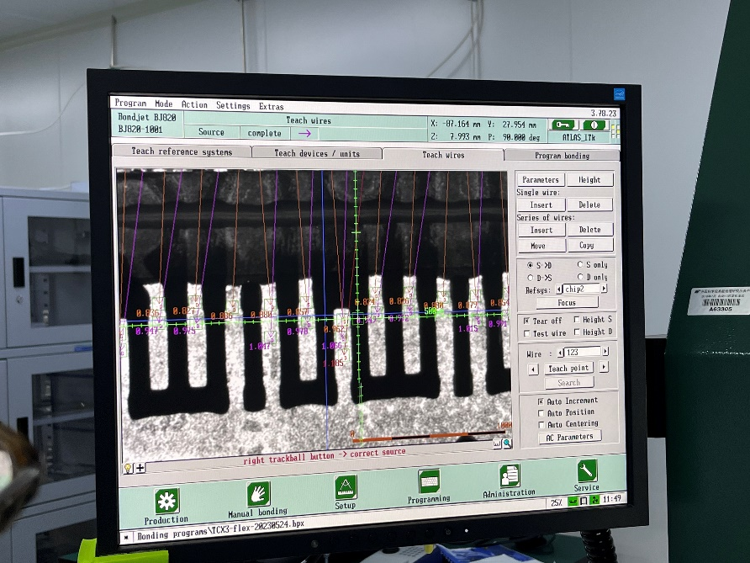
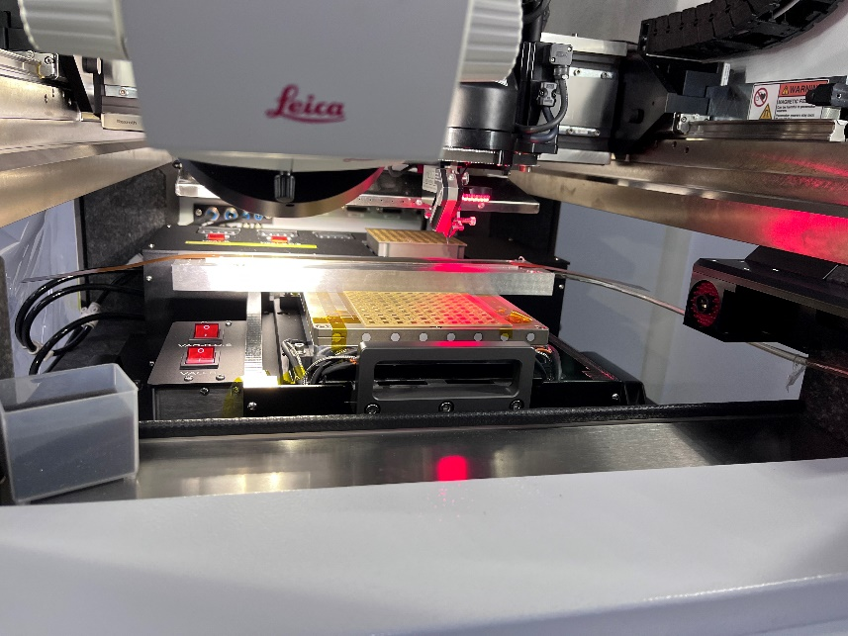
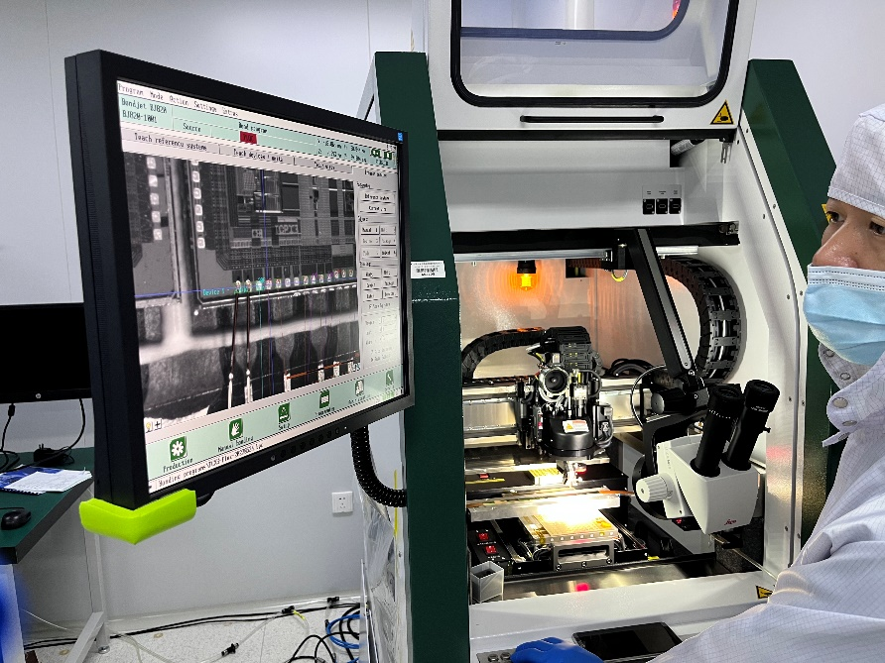
Do wire-bonding

Slide 20
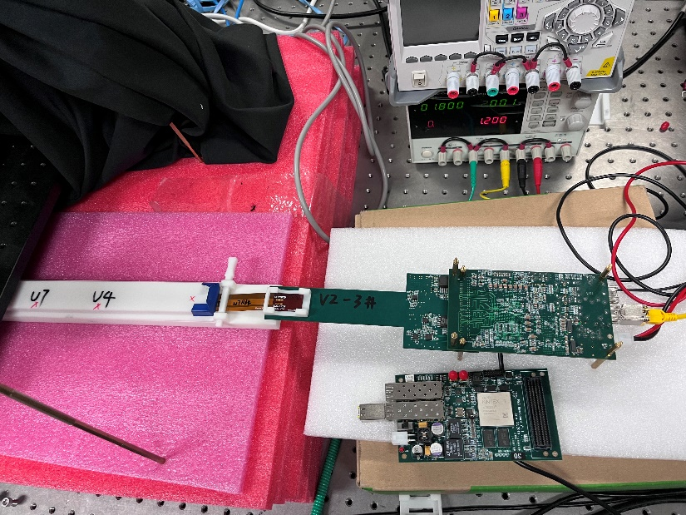
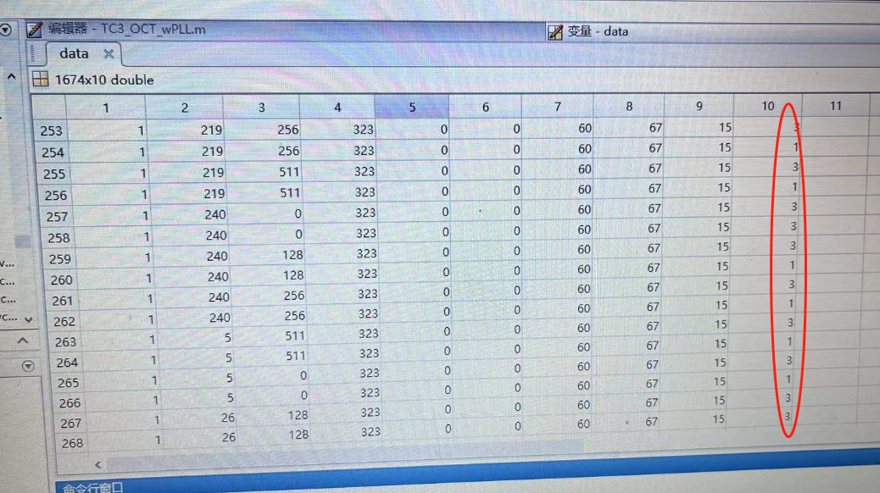
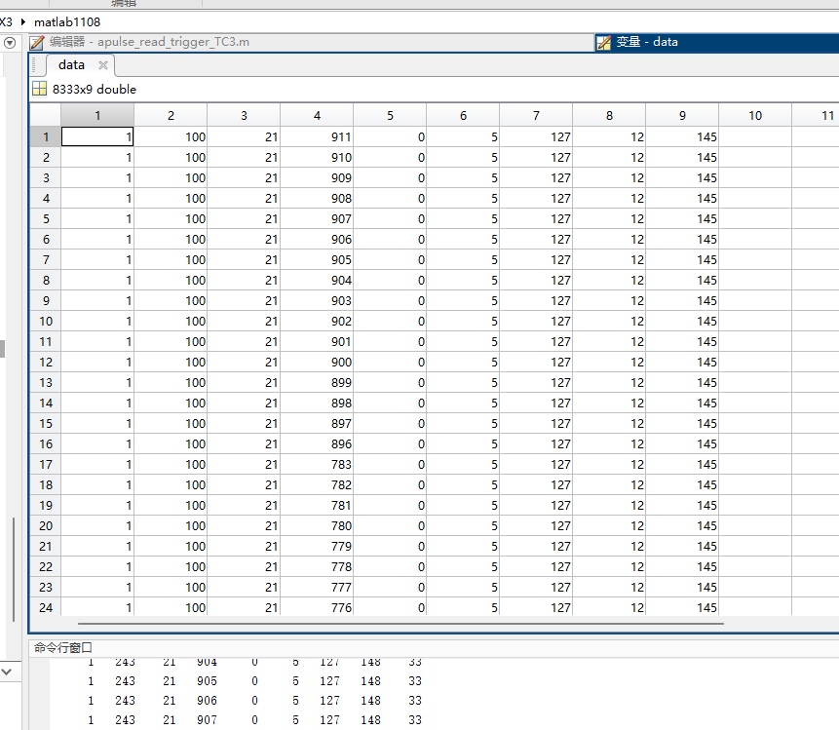
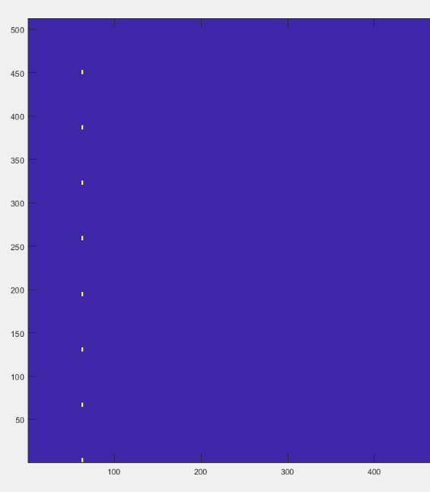
Chip test after wire bonding
Current for OCT: 0.487A
Current for Apulse: 0.515A
Current for both config: 0.542A

Slide 21
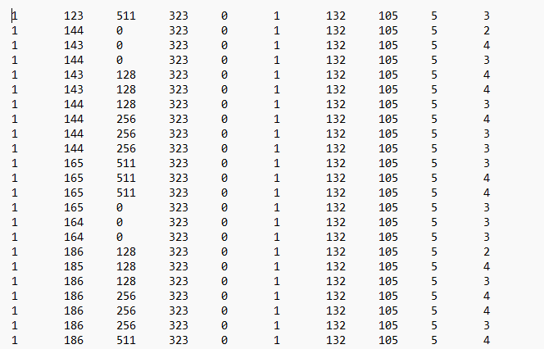
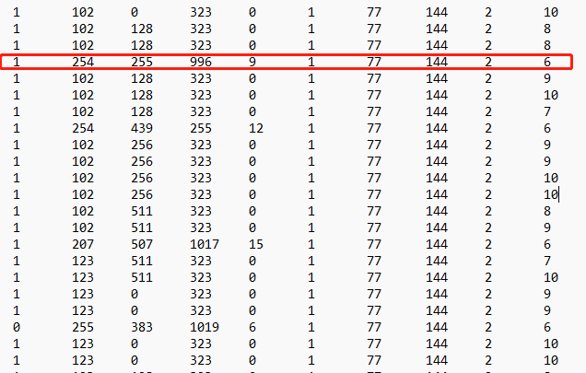
OCT test for 10 chips
Current for OCT(chip1-5): 0.487A
Current for OCT(chip6-10): 0.624A
Remove chip6 wires: 0.51A
No apulse can be configured to any chip.
Chip 6, chip 5 and chip 1 is not working on one flex.
To set the ITHR to 255, the current is 0.59A, the chip7 is too noisy to the interface.

