Slide 1
Chiral Magnetic Wave
at finite baryon density and the electric quadrupole moment of quark-gluon plasma in heavy ion collisions
Y.~Burnier, D.~E.~Kharzeev, J.~Liao and H.~U.~Yee, Phys. Rev. Lett. 107, 052303 (2011) doi:10.1103/PhysRevLett.107.052303
[arXiv:1103.1307 [hep-ph

Slide 2
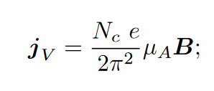
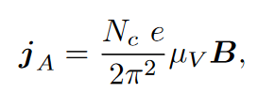
The Chiral Magnetic Effect (CME) is the phenomenon of electric charge separation along the axis of the applied magnetic field in the presence of fluctuating topological charge
The Chiral Separation Effect (CSE) refers to the separation of chiral charge along the axis of external magnetic field at finite density of vector charge (e.g. at finite baryon number density)
The coupling between the density waves of the electric and chiral charges called ”the Chiral Magnetic Wave” (CMW)

Slide 3

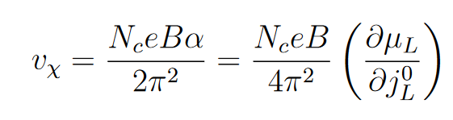
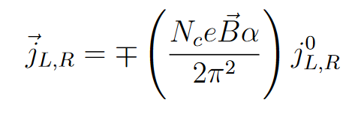
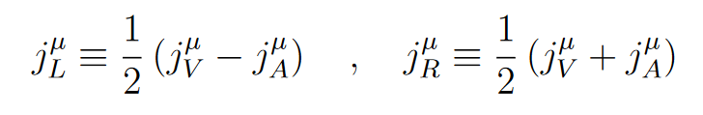
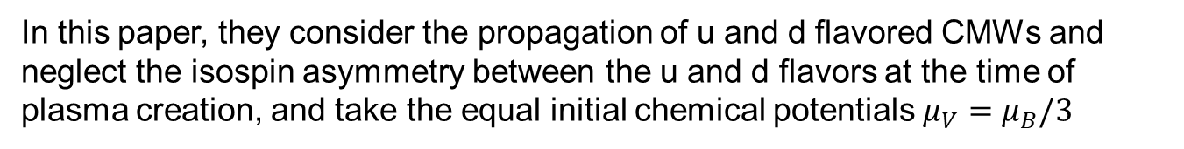
CMW is a long wavelength hydrodynamic mode of chiral charge densities; their propagation in space-time is described by the following equation
where $υ_{χ}$is the wave velocity and DL is the longitudinal diffusion constant
In this paper, they consider the propagation of u and d flavored CMWs and neglect the isospin asymmetry between the u and d flavors at the time of plasma creation, and take the equal initial chemical potentials $μ_{V}=μ_{B}/3$
Detail in
D. E. Kharzeev, H. -U. Yee, arXiv:1012.6026

Slide 4
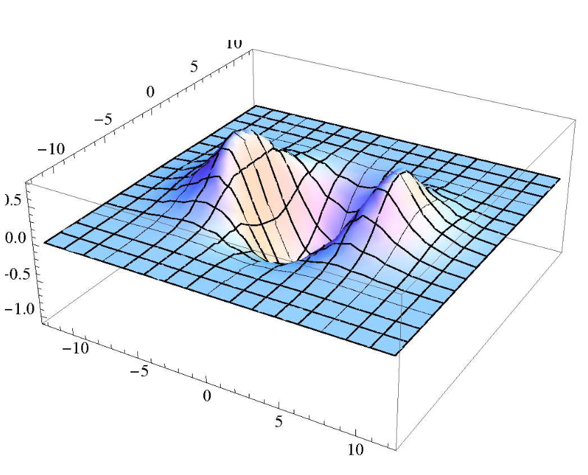
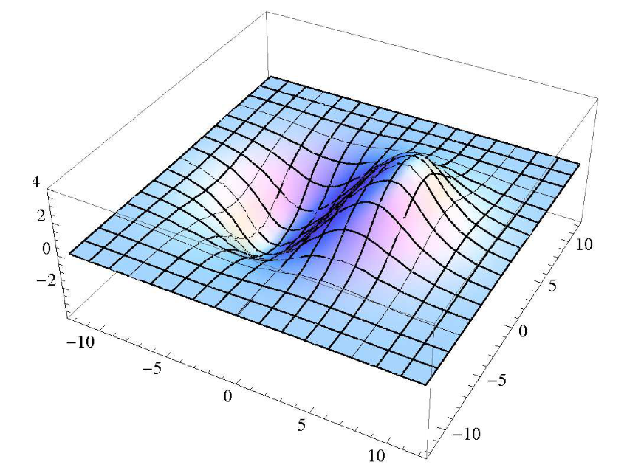
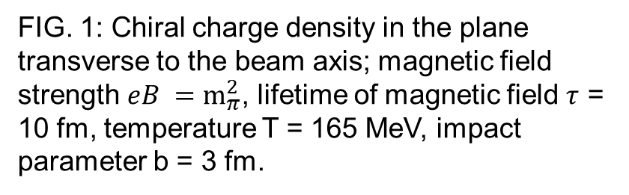
quadrupole
pole
FIG. 1: Chiral charge density in the plane transverse to the beam axis; magnetic field strength $eB =m_{π}^{2}$, lifetime of magnetic field $τ$ = 10 fm, temperature T = 165 MeV, impact parameter b = 3 fm.
FIG. 2: Electric charge density in the transverse plane (background subtracted, see text); same parameters as in Fig. 1.

Slide 5
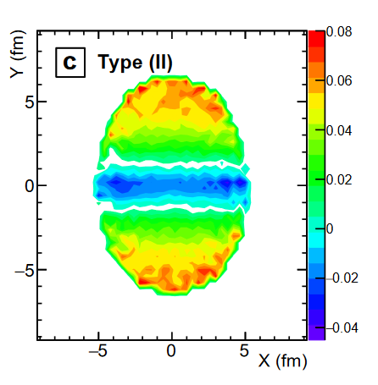
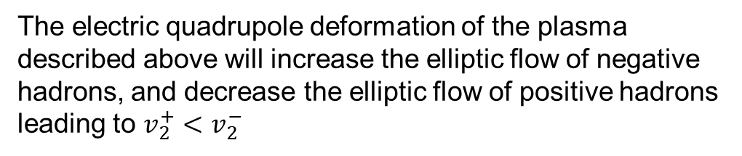

The electric quadrupole deformation of the plasma described above will increase the elliptic flow of negative hadrons, and decrease the elliptic flow of positive hadrons leading to $v_{2}^{+}<v_{2}^{−}$
$$v_{2}=\left\langle cos⁡(2φ_{ })\right\rangle$$
the net electric charge distributions of partons in the transverse plane
Figure from Diyu Shen, Charge asymmetry dependence of flow and a novel correlator to detect the chiral magnetic wave in a multiphase transport model

Slide 6
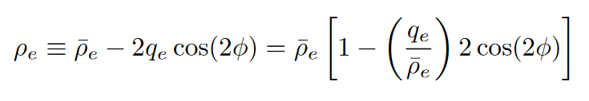
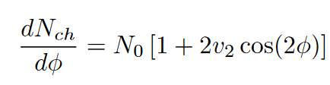
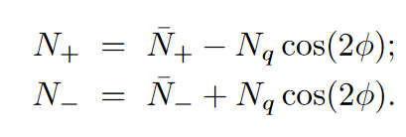
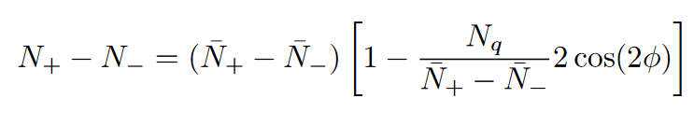
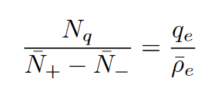

The net electric charge density is a sum of the initial charge density and the modulation caused by the propagating CMW. Keeping the leading term in the multipole expansion, we thus write
the total charged hadron distribution is still given by
a non-zero $φ$-dependent difference between N+ and N−
Where $N_{q}$ and $q_{e}$ shuffles initial charges
charged hadron distribution is just charge distribution

Slide 7
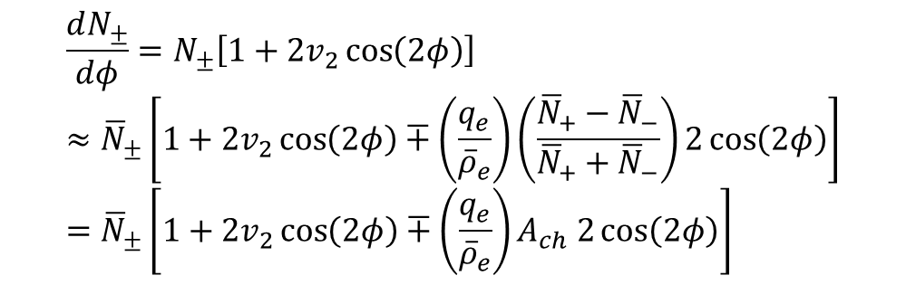
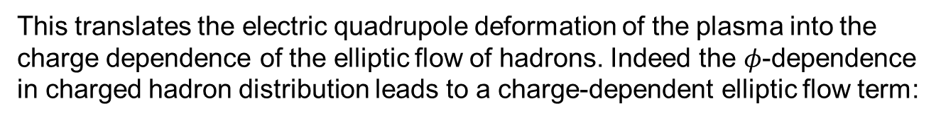
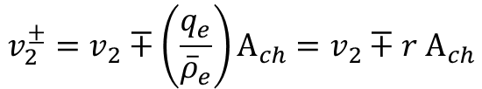
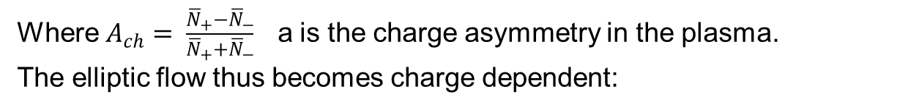
This translates the electric quadrupole deformation of the plasma into the charge dependence of the elliptic flow of hadrons. Indeed the $φ$-dependence in charged hadron distribution leads to a charge-dependent elliptic flow term:
$$\frac{dN_{±}}{dφ}=N_{±}\left[1+2v_{2}\cos\left(2φ\right)\right]≈{\overline{N}}_{±}\left[1+2v_{2}\cos\left(2φ\right)∓\left(\frac{q_{e}}{{\overline{ρ}}_{e}}\right)\left(\frac{{\overline{N}}_{+}−{\overline{N}}_{−}}{{\overline{N}}_{+}+{\overline{N}}_{−}}\right)2\cos\left(2φ\right)\right]={\overline{N}}_{±}\left[1+2v_{2}\cos\left(2φ\right)∓\left(\frac{q_{e}}{{\overline{ρ}}_{e}}\right)A_{ch} 2\cos\left(2φ\right)\right]$$
Where $A_{ch}= \frac{{\overline{N}}_{+}−{\overline{N}}_{−}}{{\overline{N}}_{+}+{\overline{N}}_{−}}$ a is the charge asymmetry in the plasma.
The elliptic flow thus becomes charge dependent:
$$v_{2}^{±}=v_{2}∓\left(\frac{q_{e}}{{\overline{ρ}}_{e}}\right)A_{ch}=v_{2}∓r A_{ch}$$

Slide 8
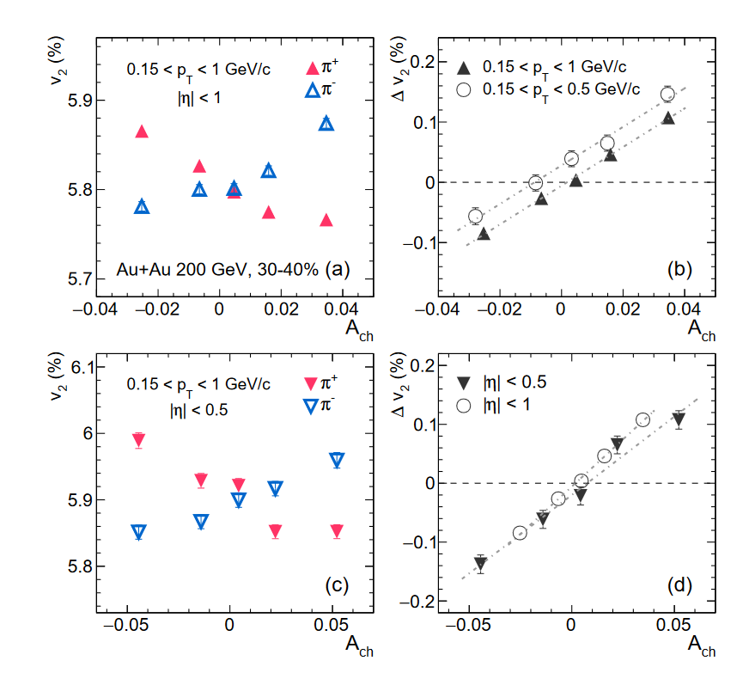
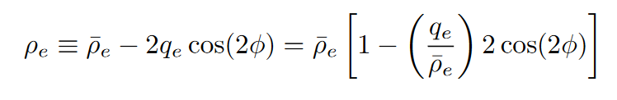
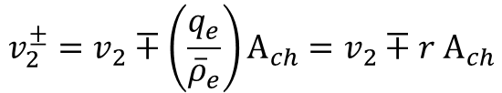
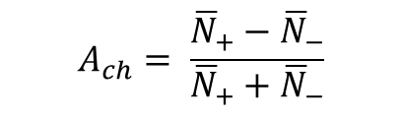
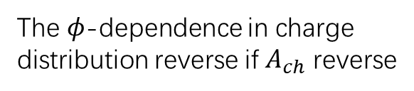
$$v_{2}^{±}=v_{2}∓\left(\frac{q_{e}}{{\overline{ρ}}_{e}}\right)A_{ch}=v_{2}∓r A_{ch}$$
Beacuae $r=\frac{q_{e}}{{\overline{ρ}}_{e}}>0$, ${\overline{ρ}}_{e}$ is initial total charge density.
$$A_{ch}= \frac{{\overline{N}}_{+}−{\overline{N}}_{−}}{{\overline{N}}_{+}+{\overline{N}}_{−}}$$
The 𝜙-dependence in charge
distribution reverse if $A_{ch}$ reverse

Slide 9
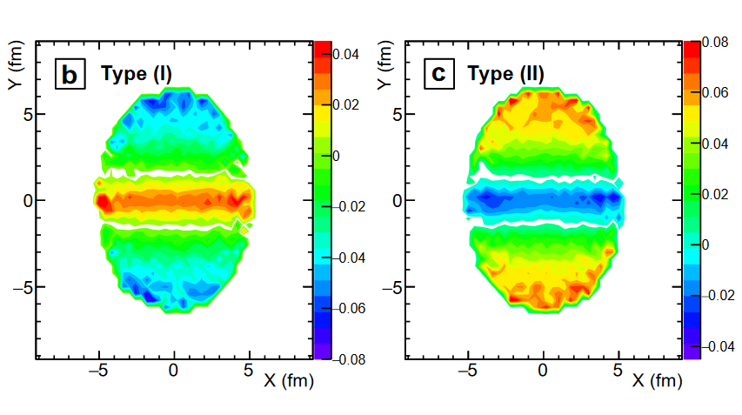

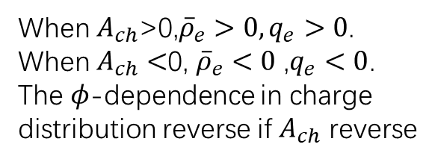

When $A_{ch}$>0,${\overline{ρ}}_{e}>0,q_{e}>0$.
When $A_{ch}<$0, ${\overline{ρ}}_{e}<0$ ,$q_{e}<0$.
The 𝜙-dependence in charge
distribution reverse if $A_{ch}$ reverse
$A_{ch}<0$
$A_{ch}>0$

Slide 10
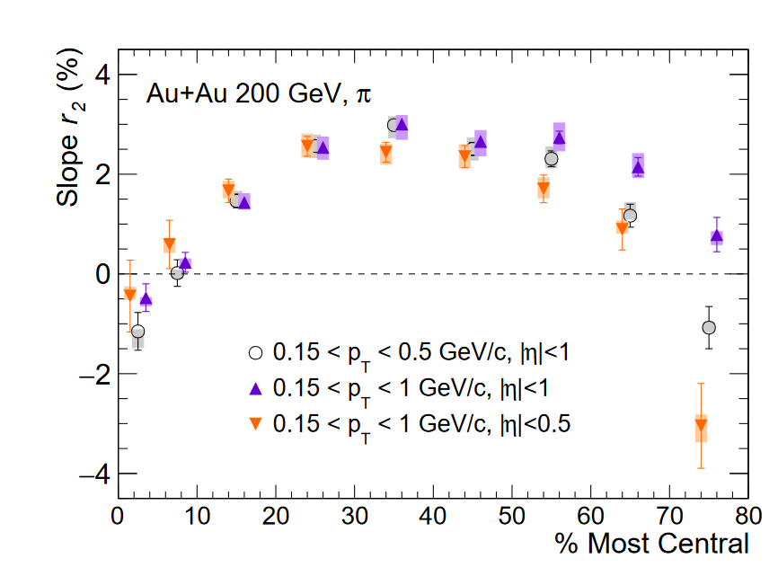
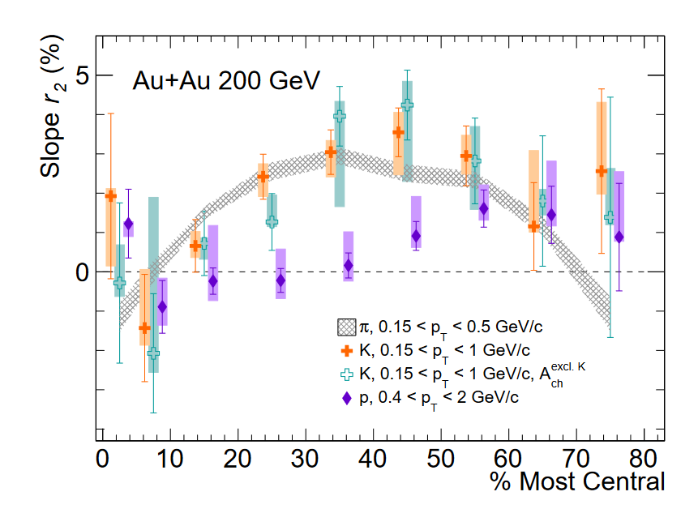
The r2 slopes obtained with different pT and η ranges as a function of centrality
Centrality dependence of the r2 for kaons and protons

Slide 11
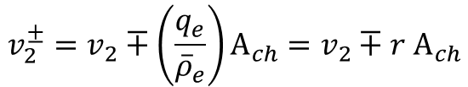


What confuses me: how we get the equation.
$$v_{2}^{±}=v_{2}∓\left(\frac{q_{e}}{{\overline{ρ}}_{e}}\right)A_{ch}=v_{2}∓r A_{ch}$$
First, we assume the total charge distribution not change with Ach
But, the charge distribution is related to Nq
Then, $r=\frac{q_{e}}{{\overline{ρ}}_{e}}$ is a constant
So that the charge distribution is related to Ach
Ach is not consistent with $μ_{A},μ_{V}$

Slide 12
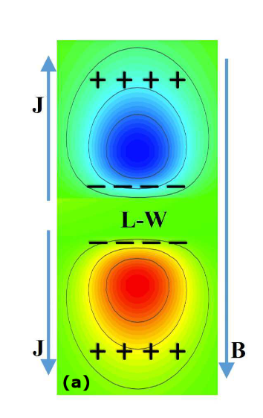
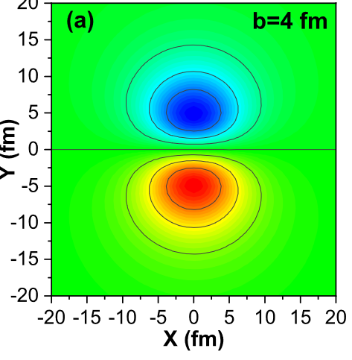

Electromagnetic anomaly in the presence of electric and chiral magnetic conductivities in relativistic heavy-ion collisions
Irfan Siddique, Shanshan Cao, Uzma Tabassam, Mohsin Saeed, and Muhammad Waqas
Quadrupole not only come from CMW
${μ_{V}∼∆N}_{5}=\frac{e^{2}}{4π^{2}}\int{dtd^{3}x E∙B}$
The spatial distributions of E · B and generation of an electric quadrupole moment from coupling between E · B and B
The spatial distributions of E · B

Slide 13
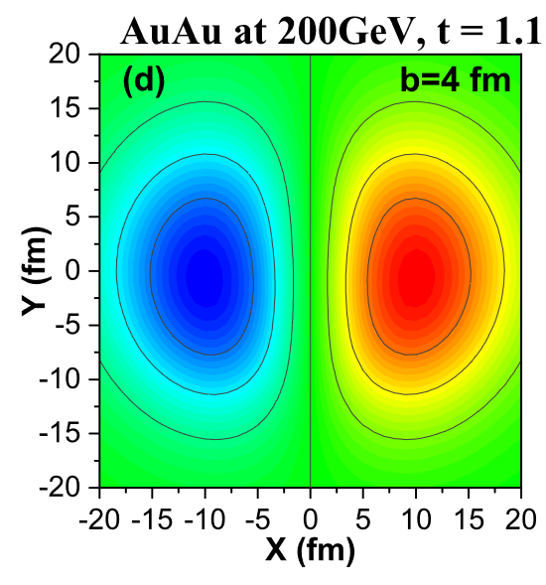
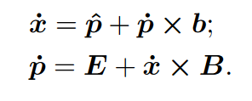
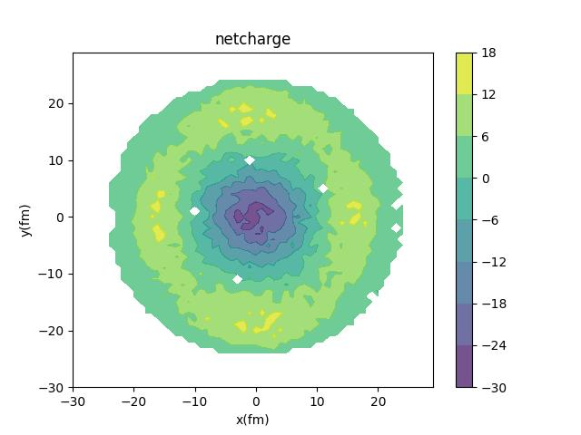
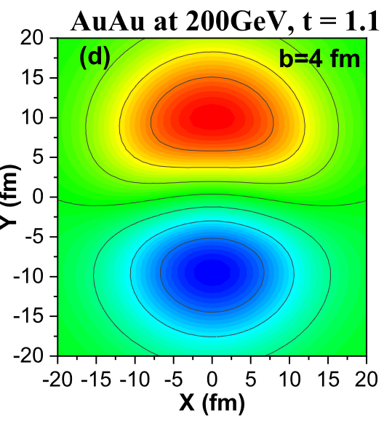
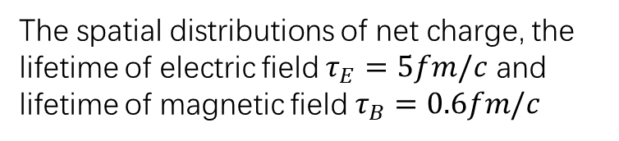
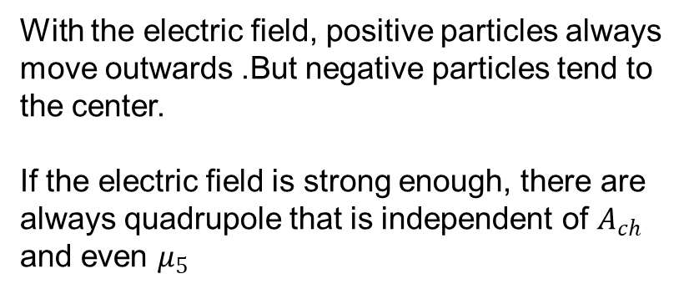
Chiral Kinetic Theory
With the electric field, positive particles always move outwards .But negative particles tend to the center.
If the electric field is strong enough, there are always quadrupole that is independent of $A_{ch}$ and even $μ_{5}$
The spatial distributions of net charge, the lifetime of electric field $τ_{E}=5fm/c$ and lifetime of magnetic field $τ_{B}=0.6fm/c$
The spatial distributions of Ex(up) and Ey(low)

Slide 14
Thanks

Slide 15
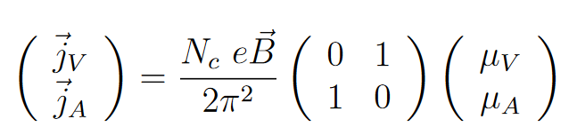
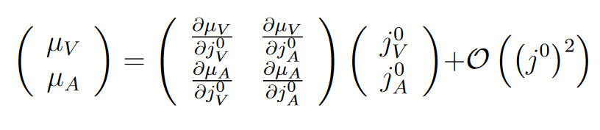
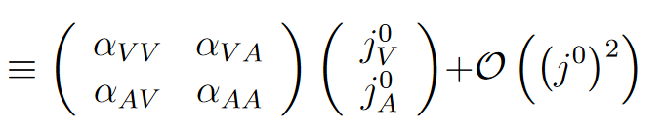
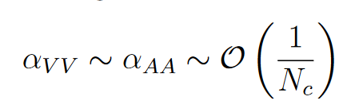

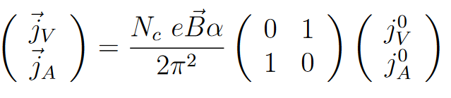
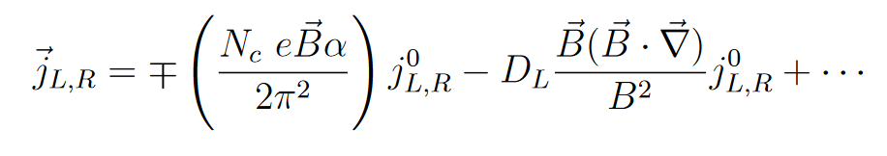
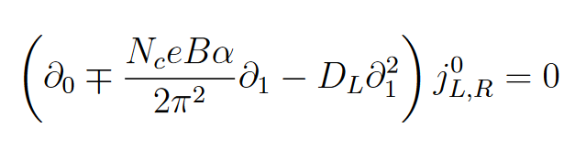


Slide 16
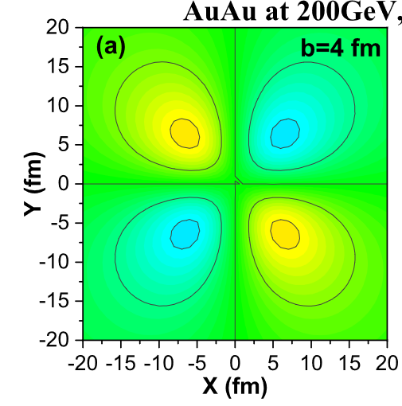
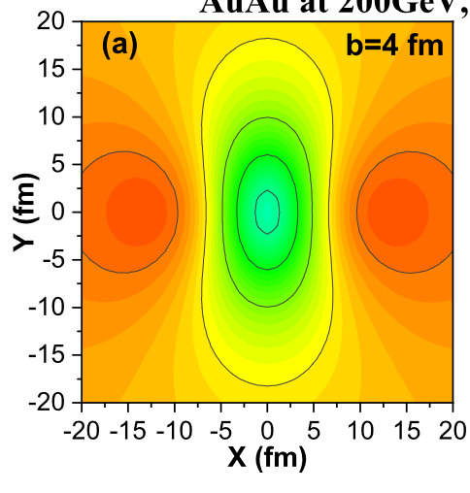
Ex
Ey
Generation of an electric quadrupole moment from coupling between E · B and B
Electromagnetic anomaly in the presence of electric and chiral magnetic conductivities in relativistic heavy-ion collisions
Irfan Siddique, Shanshan Cao, Uzma Tabassam, Mohsin Saeed, and Muhammad Waqas
Ex
Ey

Slide 17
Electromagnetic anomaly in the presence of electric and chiral magnetic conductivities in relativistic heavy-ion collisions
Irfan Siddique, Shanshan Cao, Uzma Tabassam, Mohsin Saeed, and Muhammad Waqas

Slide 18
$=A_{ch} N_{q}[1−\frac{1}{A_{ch}}2\cos\left(2φ\right)]$=$A_{ch} N_{q}−N_{q}2\cos\left(2φ\right)$

