Slide 1
国家重点研发计划
R&D and Verification of Key Technologies for a High Energy Circular Electron-Positron Collider
Zhijun Liang for CEPC MOST2 vertex detector team

Slide 2
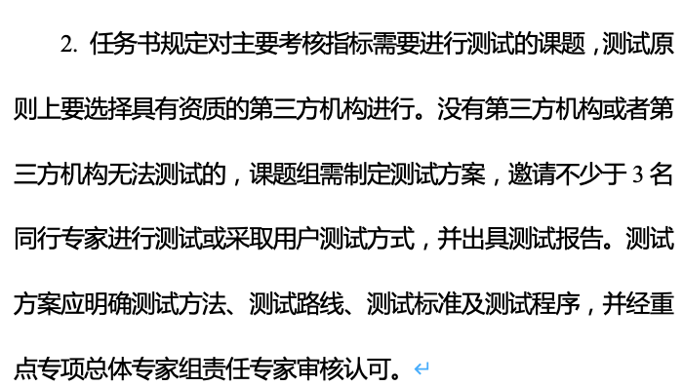
News on MOST2 project
Project timescale （执行期）： up to April 30th ,2023
First week of June: internal review meeting (June 7-8)
https://indico.ihep.ac.cn/event/19781/. ( registered before June 2nd)
June 19 -21: Project review meeting (1.5 days, 3 tasks together)
https://indico.ihep.ac.cn/event/19779/. (( registered before June 14th )
June 20 –July 21: submission of final reports and review report into MOST2 system
Oct 2023：
MOST project review and final defend

Slide 3
Material for final review
1. Main content 自评价报告正文（标红部分）
2. Final technical report 每个课题的最终科技报告
3. Accelerator test report 加速器关键技术测试报告
4. Detector test report 探测器测试报告
5. Data of test beam (raw data数据提交高能所数据中心）
https://www.nhepsdc.cn/resource/particle?ignorehead

Slide 4
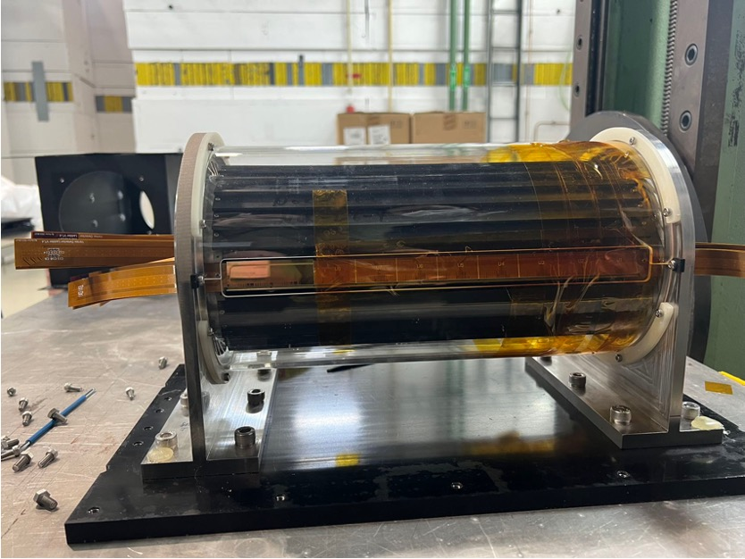
Testing Plan towards MOST project review
Build and test 1~2 full Ladders with 10 Taichu chips (before October)
Laser or beta tests should be enough
Mount them on the vertex detector prototype
Proton irradiation in CSNS (End of may )
Single chip radiation
Wire bonding after irradiation

Slide 5
Publication plan
Taichu2 Laser test (NIMA): submitted
DESY Test beam 1st paper: submission date: submitted
Paper about vertex prototype testbeam : before June
Electronics for ladder and prototype (JINST): (should published before Sep 30th )
Paper about the prototype assembly : (should published before Sep )
Paper of TaichuPix3: (should published before Sep 30th ) 30th
Document about irradiation hardness: May 31st
Final report (结题科技报告） May 31st

Slide 6
Conference
https://twiki.cern.ch/twiki/bin/view/CLIC/UpcomingConferences

