Slide 1
工作进展
刘梦瑶

Slide 2
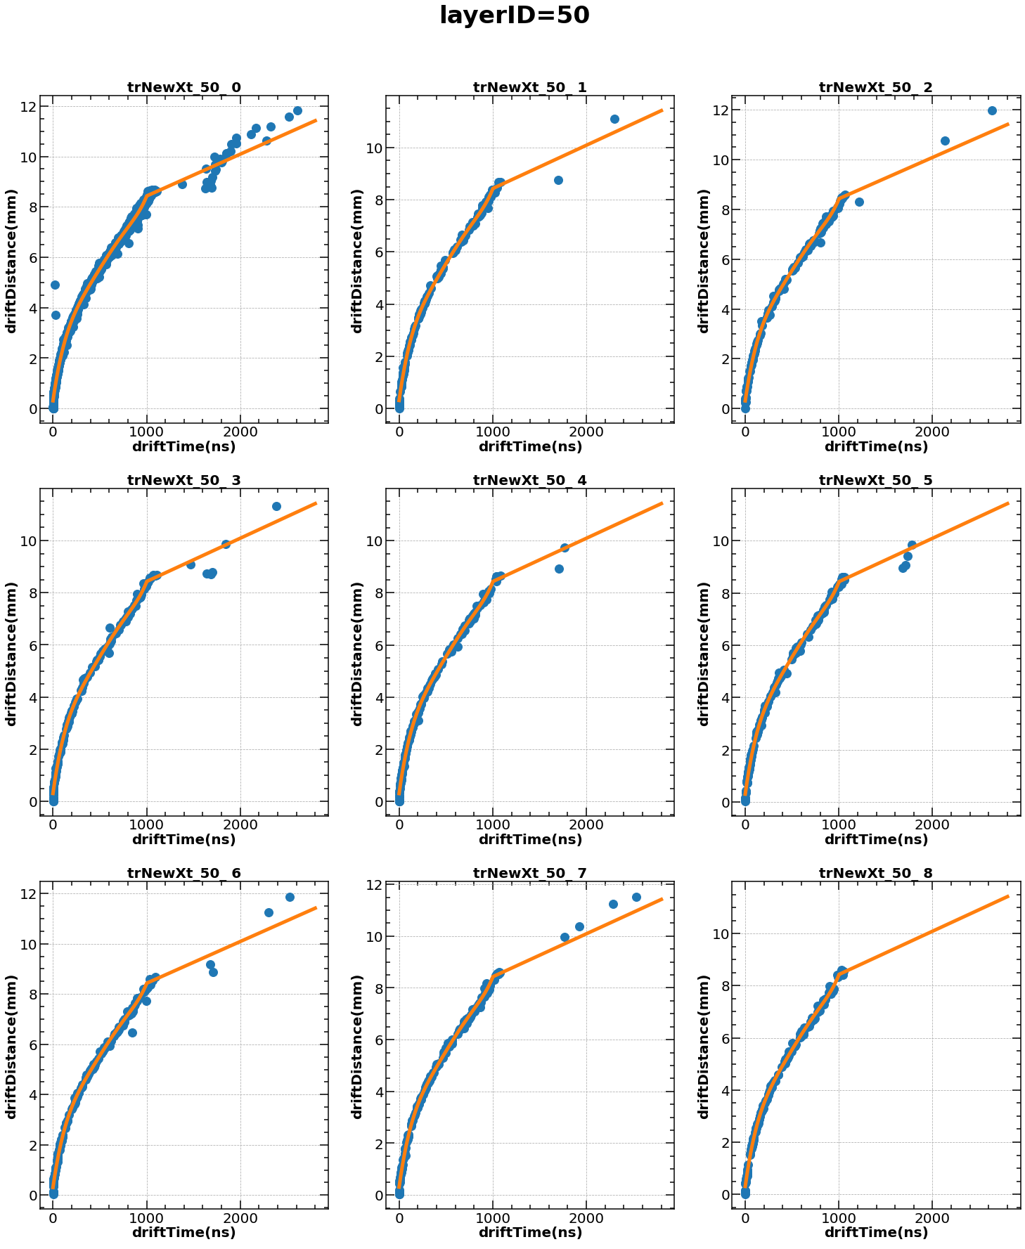
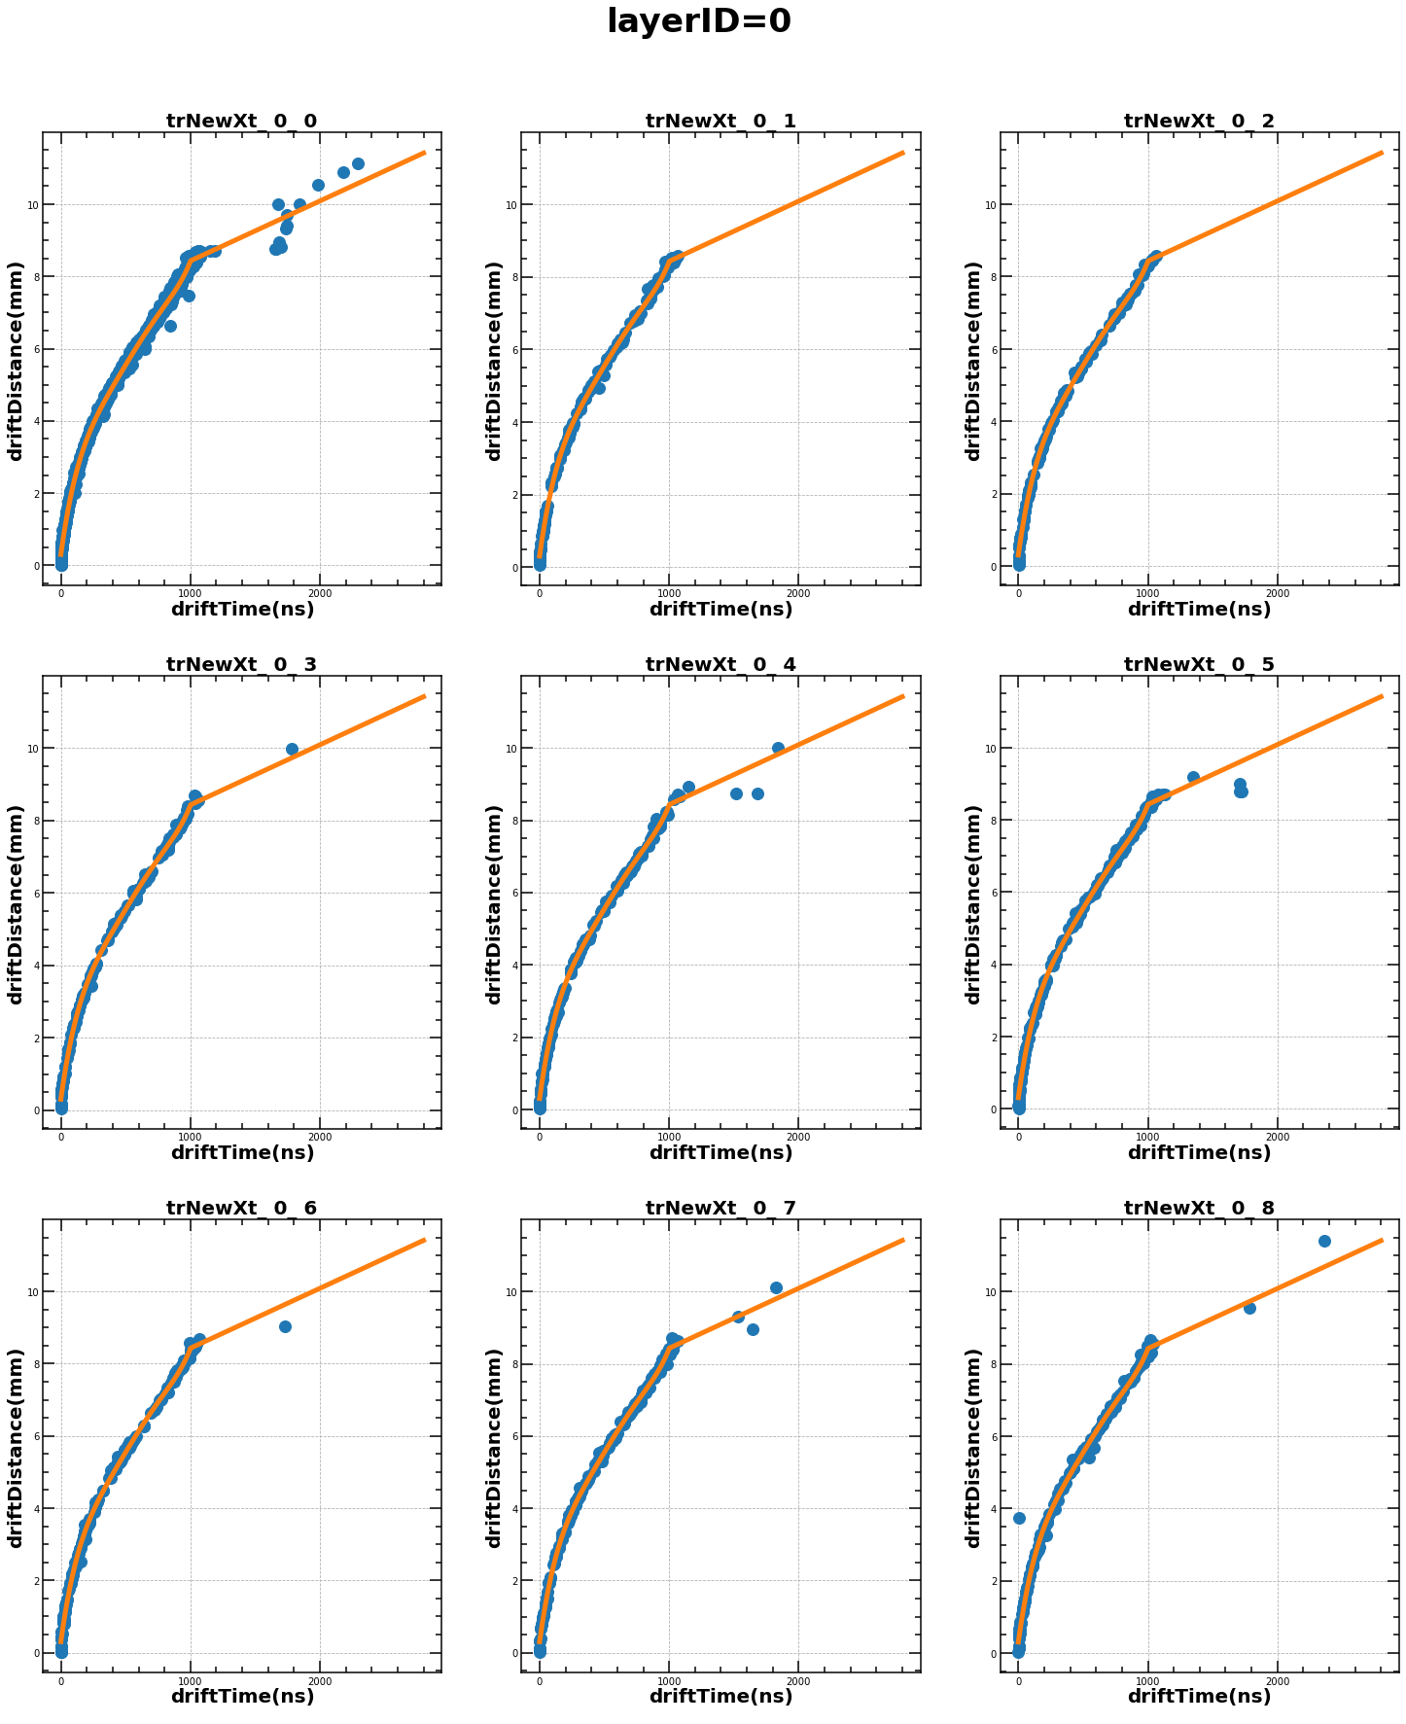
拟合X-T曲线
5阶(Near+Mid)+1阶(Far)
layerID, eangle

Slide 3
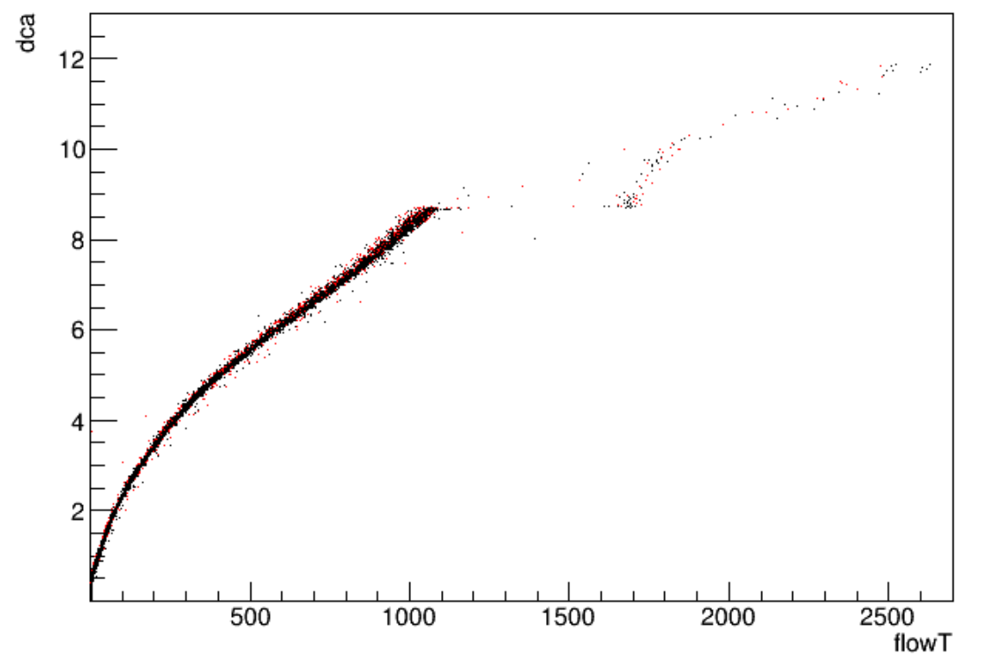
拟合函数：
layerID | iEtr | A1 | B1 | C1 | D1 | E1 | F1 | A2 | B2
14 | 13 | 3.943092E-14 | -1.135220E-10 | 1.272693E-07 | -7.093322E-05 | 2.586412E-02 | 3.050370E-01 | 1.658607E-03 | 6.771483
14 | 14 | 3.943092E-14 | -1.135220E-10 | 1.272693E-07 | -7.093322E-05 | 2.586412E-02 | 3.050370E-01 | 1.658607E-03 | 6.771483
14 | 15 | 3.943092E-14 | -1.135220E-10 | 1.272693E-07 | -7.093322E-05 | 2.586412E-02 | 3.050370E-01 | 1.658607E-03 | 6.771483
14 | 16 | 3.943092E-14 | -1.135220E-10 | 1.272693E-07 | -7.093322E-05 | 2.586412E-02 | 3.050370E-01 | 1.658607E-03 | 6.771483
14 | 17 | 3.943092E-14 | -1.135220E-10 | 1.272693E-07 | -7.093322E-05 | 2.586412E-02 | 3.050370E-01 | 1.658607E-03 | 6.771483
15 | 0 | 3.943092E-14 | -1.135220E-10 | 1.272693E-07 | -7.093322E-05 | 2.586412E-02 | 3.050370E-01 | 1.658607E-03 | 6.771483
15 | 1 | 3.943092E-14 | -1.135220E-10 | 1.272693E-07 | -7.093322E-05 | 2.586412E-02 | 3.050370E-01 | 1.658607E-03 | 6.771483
15 | 2 | 3.943092E-14 | -1.135220E-10 | 1.272693E-07 | -7.093322E-05 | 2.586412E-02 | 3.050370E-01 | 1.658607E-03 | 6.771483
15 | 3 | 3.943092E-14 | -1.135220E-10 | 1.272693E-07 | -7.093322E-05 | 2.586412E-02 | 3.050370E-01 | 1.658607E-03 | 6.771483
15 | 4 | 3.943092E-14 | -1.135220E-10 | 1.272693E-07 | -7.093322E-05 | 2.586412E-02 | 3.050370E-01 | 1.658607E-03 | 6.771483
15 | 5 | 3.943092E-14 | -1.135220E-10 | 1.272693E-07 | -7.093322E-05 | 2.586412E-02 | 3.050370E-01 | 1.658607E-03 | 6.771483
15 | 6 | 3.943092E-14 | -1.135220E-10 | 1.272693E-07 | -7.093322E-05 | 2.586412E-02 | 3.050370E-01 | 1.658607E-03 | 6.771483

Slide 4
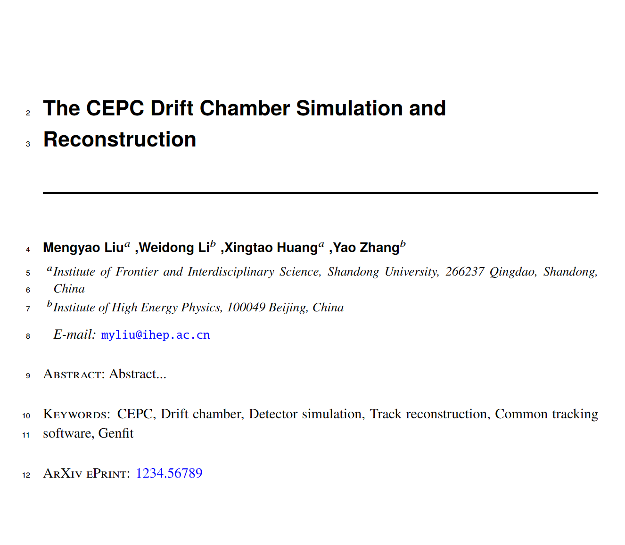
CEPC Drift chamber Simulation and Reconstruction

