Slide 1


ML for BESIII offline data processing
Yuan Ye
20230817
CEPC Phy/Det @ Fudan

Slide 2
Outline
ML & BESIII
Simulation
Tracking
PID
Dataset
Summary

Slide 3
Why Machine Learning?
More than 10 years past since first physics version of offline data processing
Continuously hard working,
continuously improving,
fruitful achivements!
But
Harder and harder…
no significant improving for a long time
It’s time to find anther way!
MDC tracking eff. Discrepancy
2% 0.5%
TOF time resolution
88ps 65ps
……

Slide 4
ML & BESIII
It has been applied on HEP and brings significant outcome （HEP ML Living Review）
Key points of ML
Data Model Training
Aha, we have DATA

Slide 5
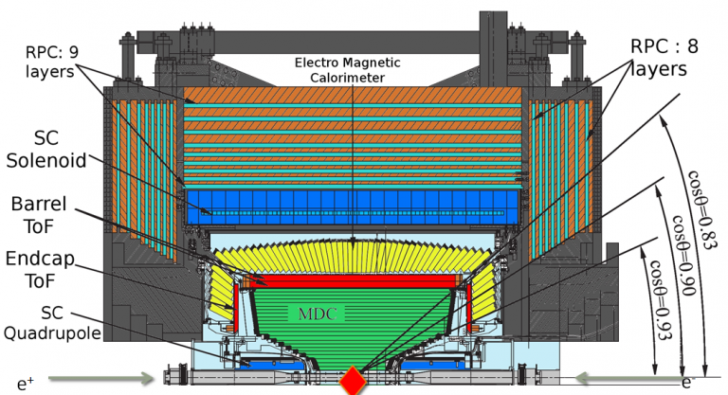
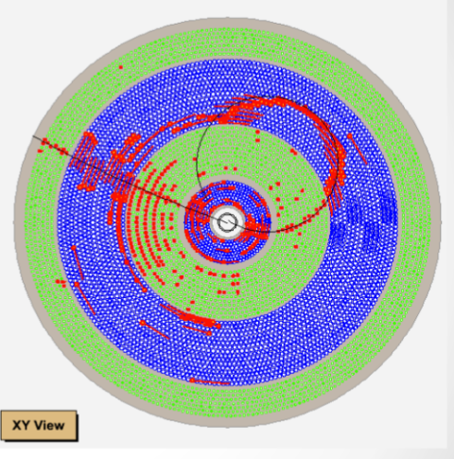
BESIII
Started physics data taking from 2009, BESIII has collected the largest electron positron collision data in the τ -charm region in the world, including
10 Billion J/ψ events, 2 Billion ψ(2S) events…
Comprehensive studies are carrying out

Slide 6
Simulation

Slide 7
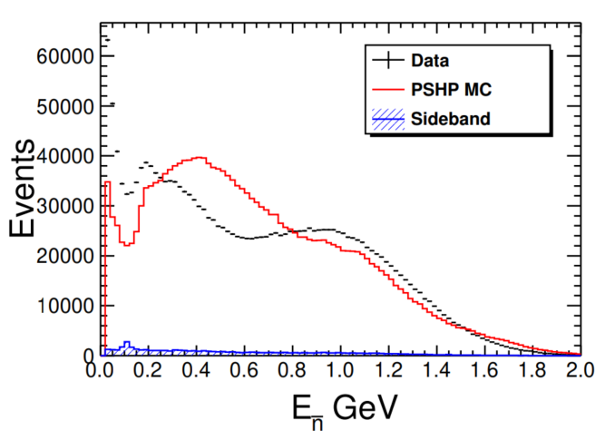
Neutron Sim. for Calorimeter
Yuan Sicheng（IHEP）
Neutron can’t be well simulated by Geant4
NN Model：
  GAN
  CaloFlow:（Claudius Krause / CaloFlow · GitLab）

Slide 8
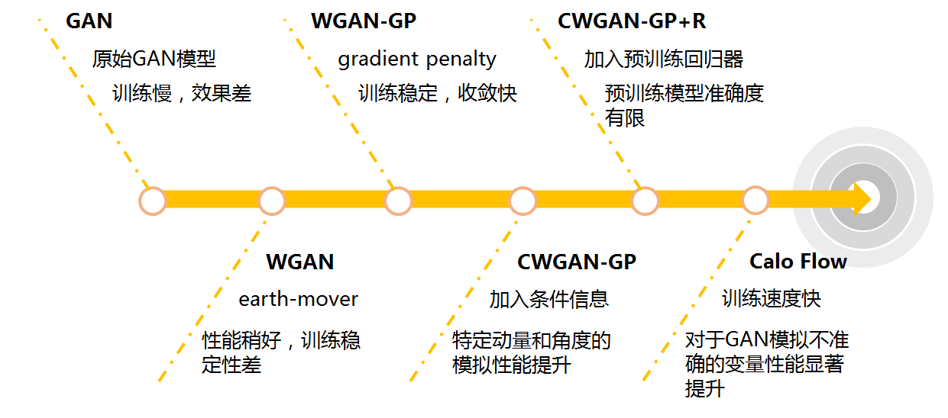
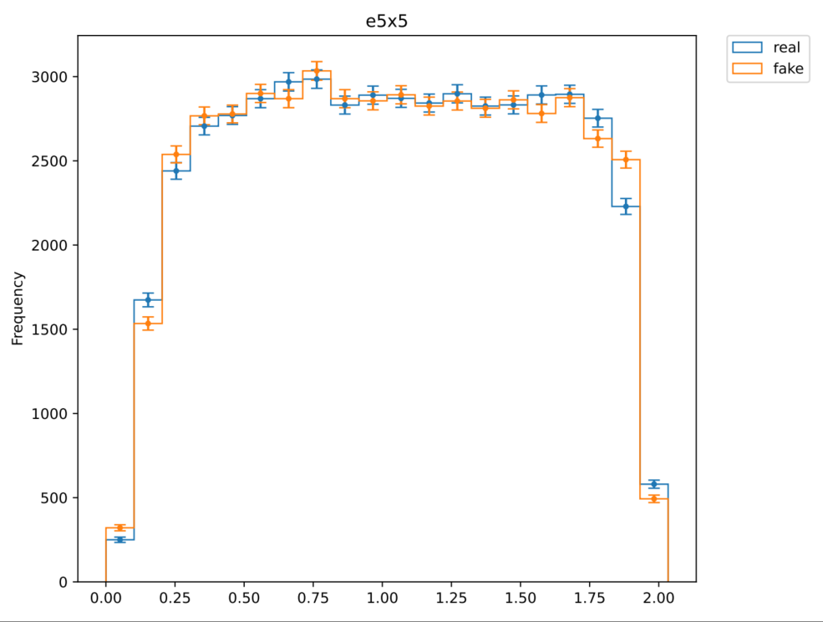
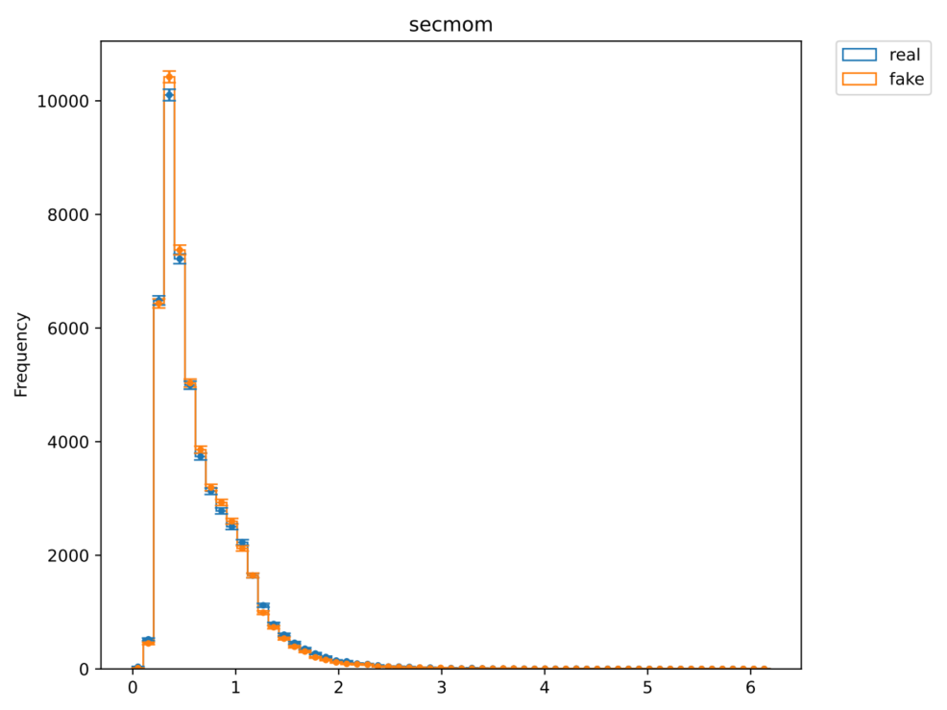
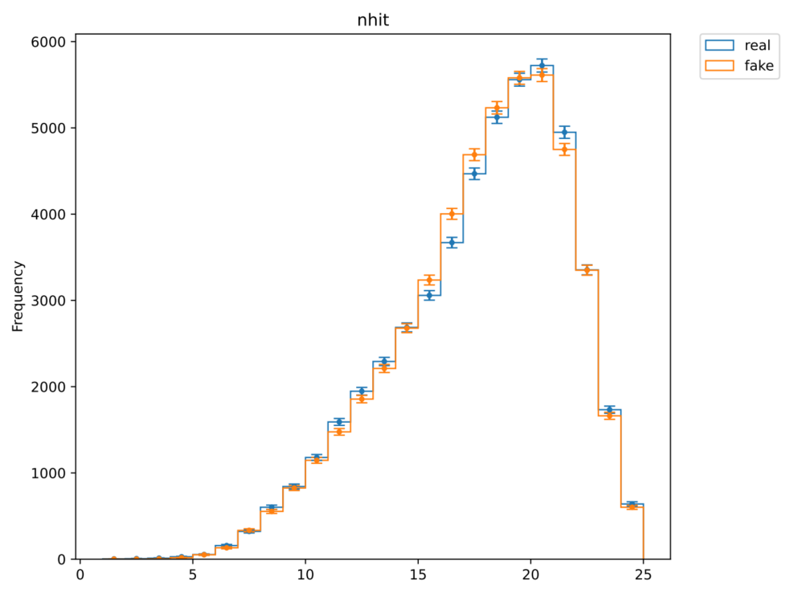
Tranining of Leading Shower（5x5）：
  Promising performance

Slide 9
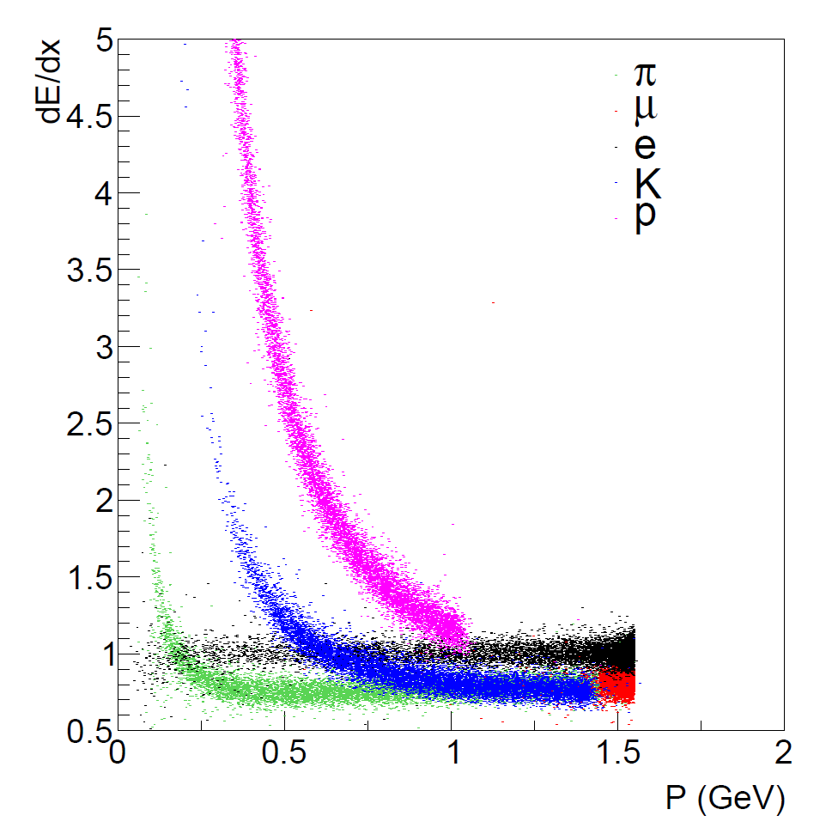
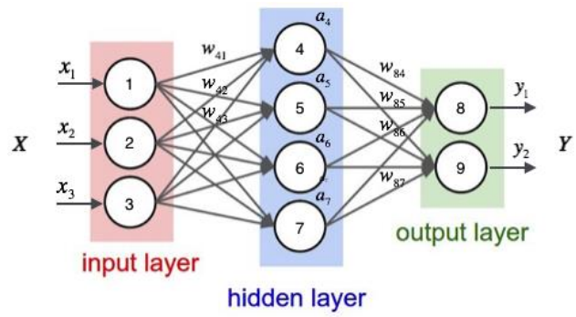
MDC dE/dx
Fang Wenxing（IHEP）
Very difficult to improve by traditional way
Try by full connection network.

Slide 10
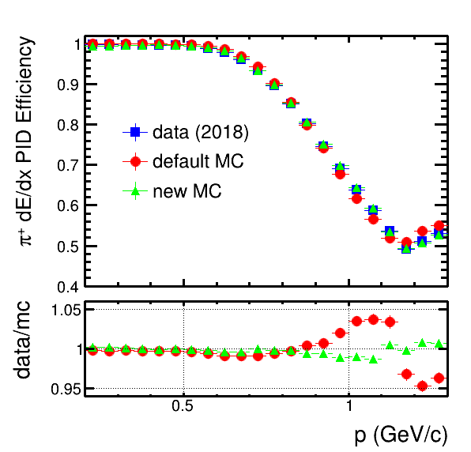
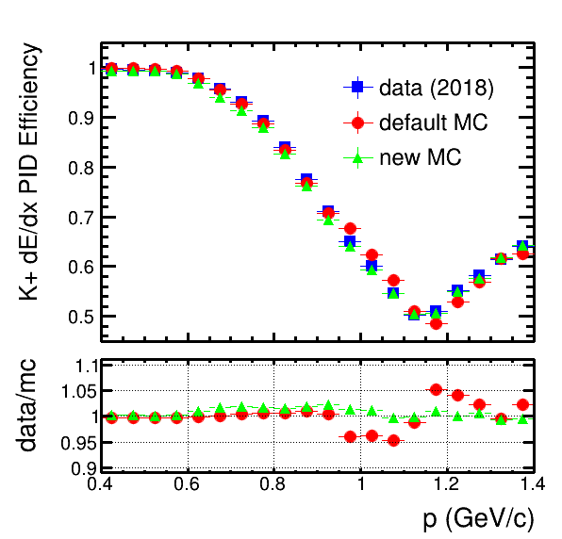
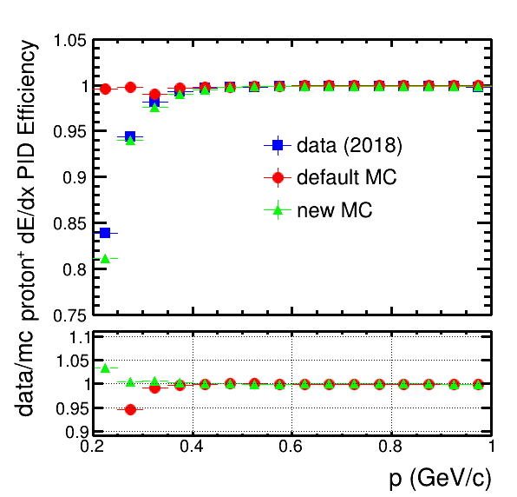
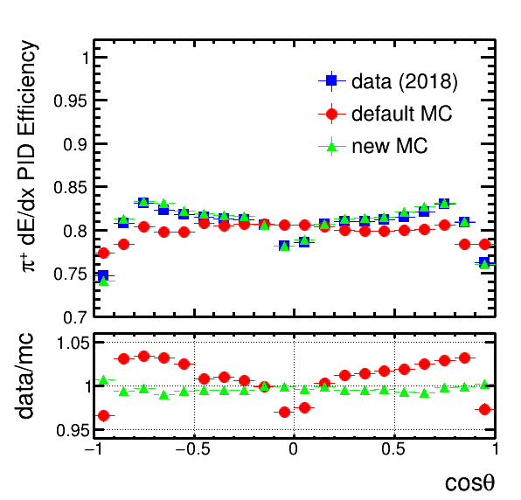
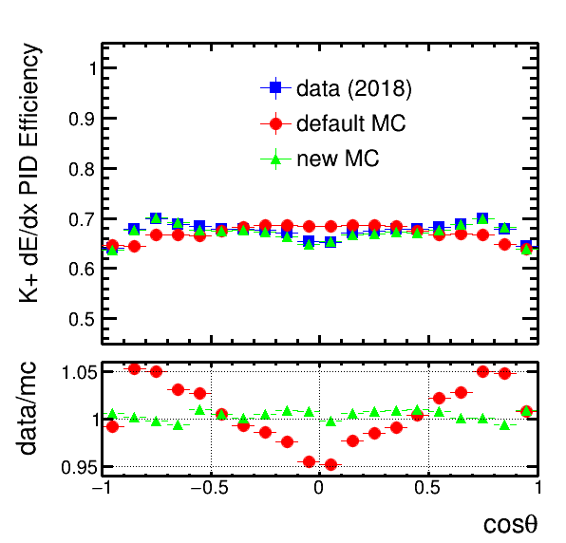
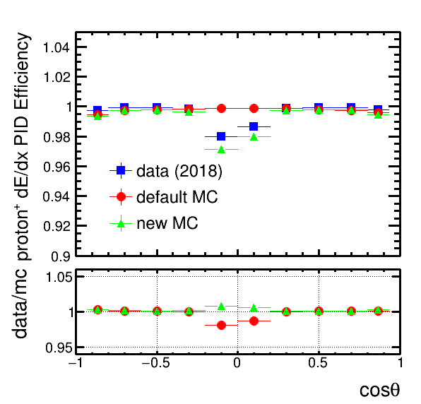
dE/dx PID eff.
π
k
p
Consistence between simulation & data is better by ML

Slide 11
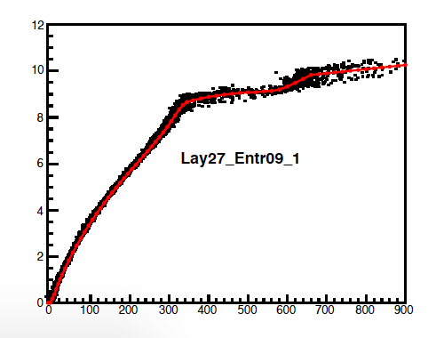
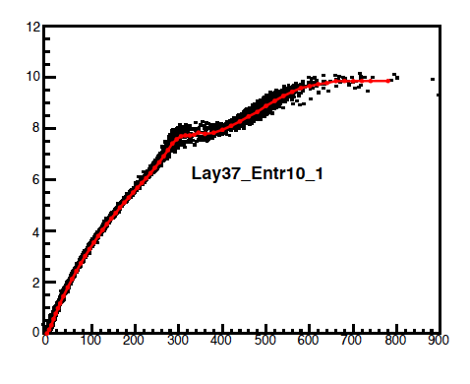
MDC T
Liu Mengyao（Shandong U.）
DOCA-T（X-T）relation is the main source of system error
No improve for many years

Slide 12
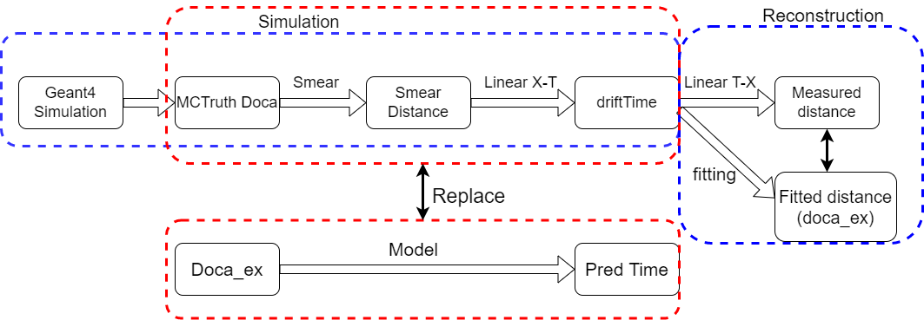
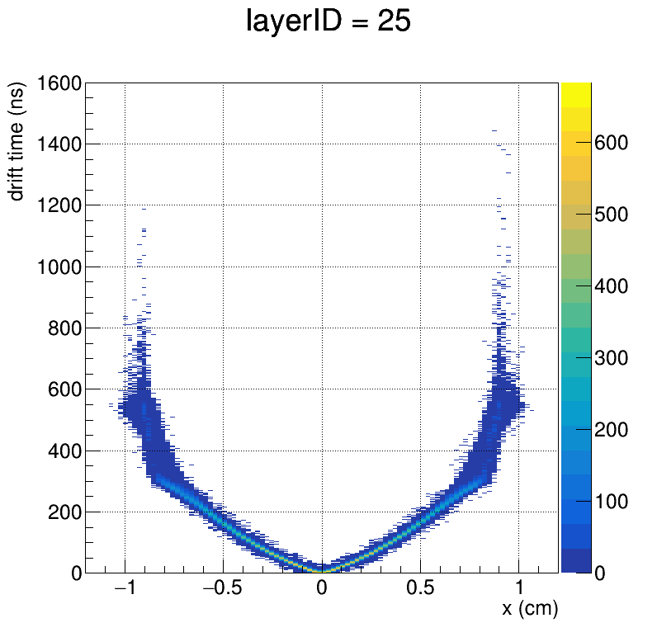

  network：Normalization Flow
  input：doca_ex，eangle output：driftTime
  Demonstated that ML can learn X-T relation from data, get its structure
doca vs driftTime
doca vs PredTime

Slide 13
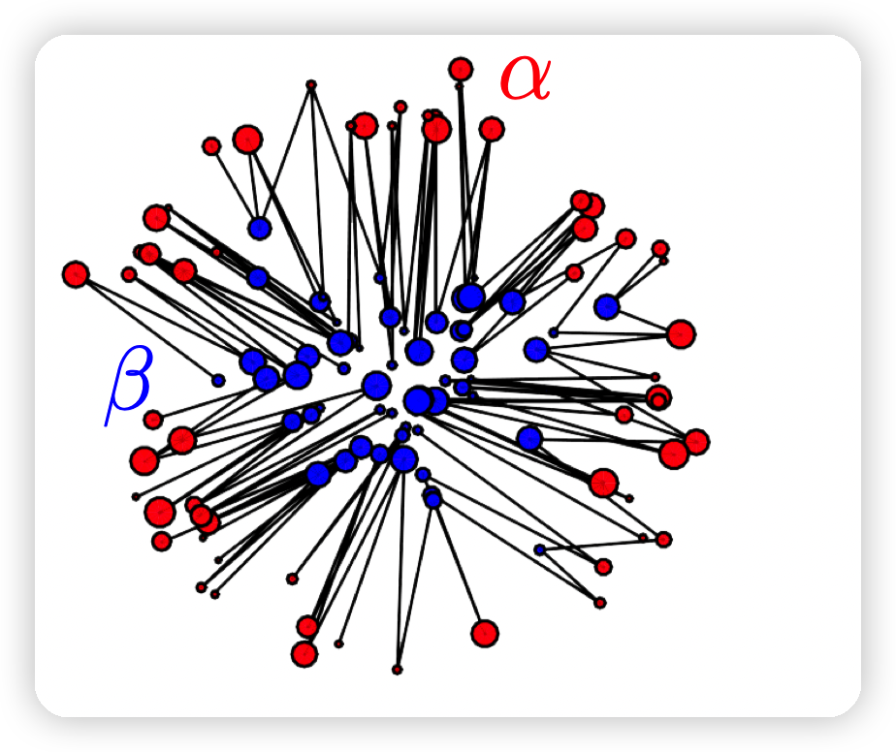
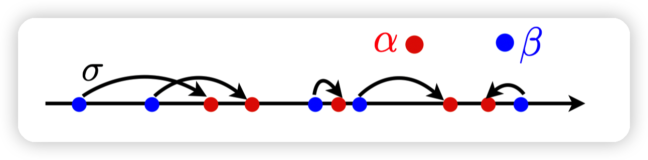
Highlight
Precise fast simulation
Cai Hao（Wuhan U.）
VAE, GAN had beed widely used in HEP, but the consistence between data and sim. Is not good enough
Based on Best Transportation Theory, use distance within high dimension space as loss function, a new approach is put forward

Slide 14
State-of-art precision, well promising

Slide 15
Reconstruction

Slide 16
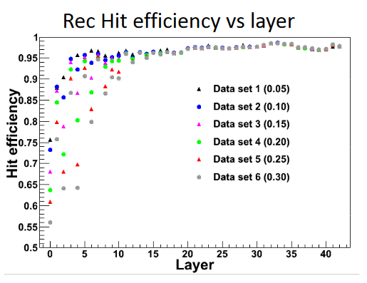
MDC tracking
Key part of reconstruction
Worse @ Low Pt, large angle
Noise dependence

Slide 17
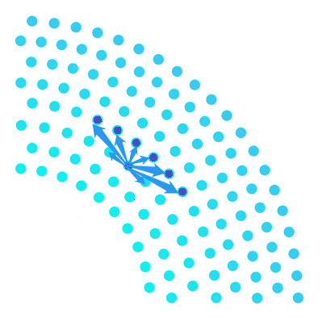

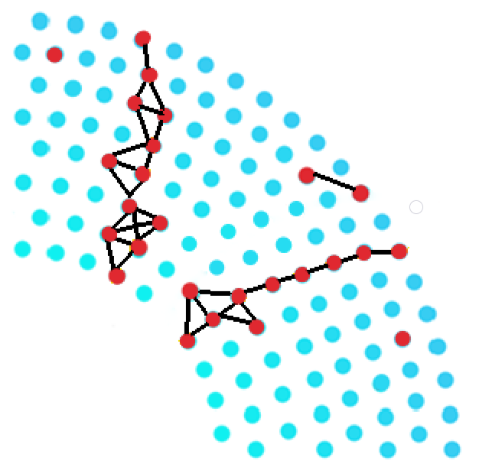
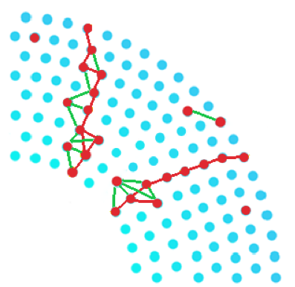
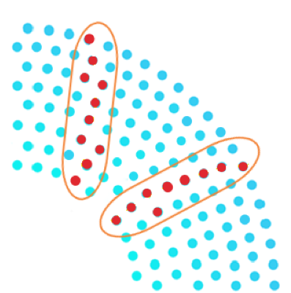
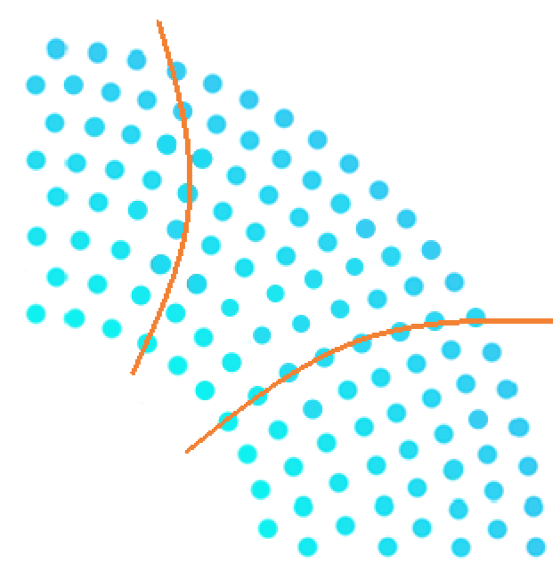
1. Track finding by GNN
Jia Xiaoqian（Shandong U.）
Construct the graph based on the Pattern Map
Classify the graph edges by GNN
Cluster the selected hits
Track fitting
MDC hits produced by charged particles

Slide 18
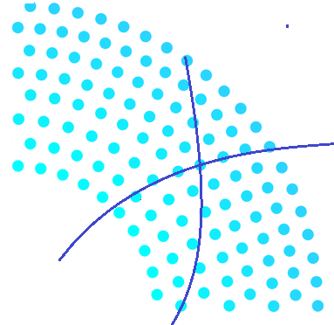
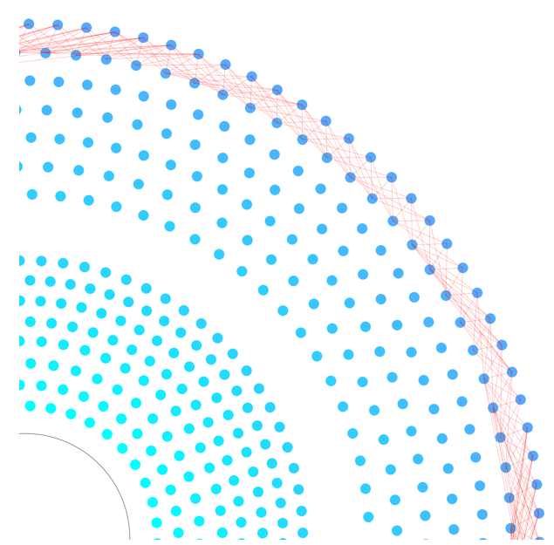
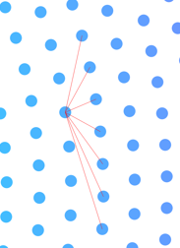

Pattern Map based on MC simulation & calculation
To reduce the number of fake edges during graph construction
Definition of valid neighbors
  Hits on the same layer
  Two adjacent sense wires on the left and right
  Hits on the next layer
  The collection of sense wires that could potentially represent
  two successive hits on a track
B
A
C

Slide 19
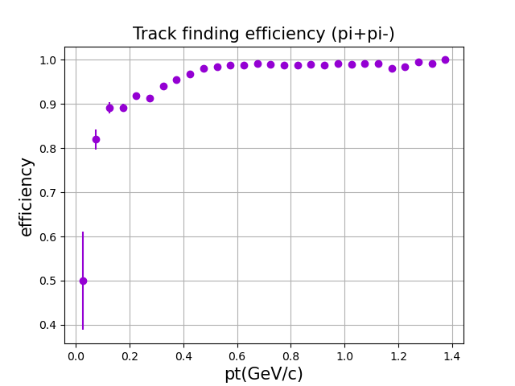
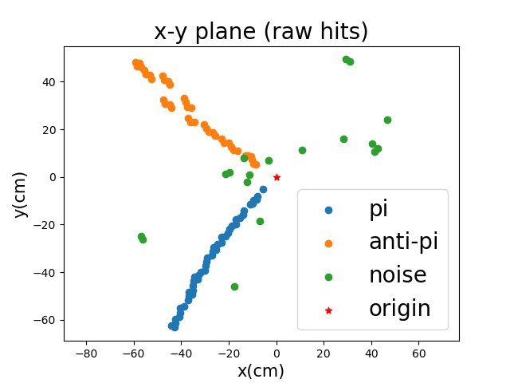

  Track finding efficiency
    track eff = $\frac{N_{rec tracks}}{N_{total tracks}}$
    Pt > 0.2 GeV/c , track eff > 90%
    Pt > 0.45 GeV/c , track eff > 98%

Slide 20
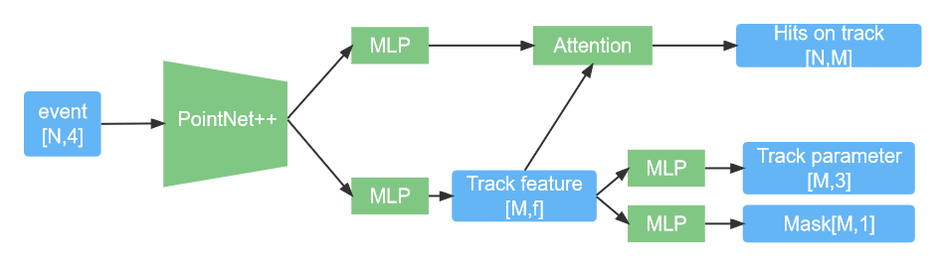
2. Tracking by PointNet model
Yang Zhibin（IHEP & UCAS）
  1. track index prediction for each hit (clustering)
  2. track parameters for each predicted track (fitting)

Slide 21
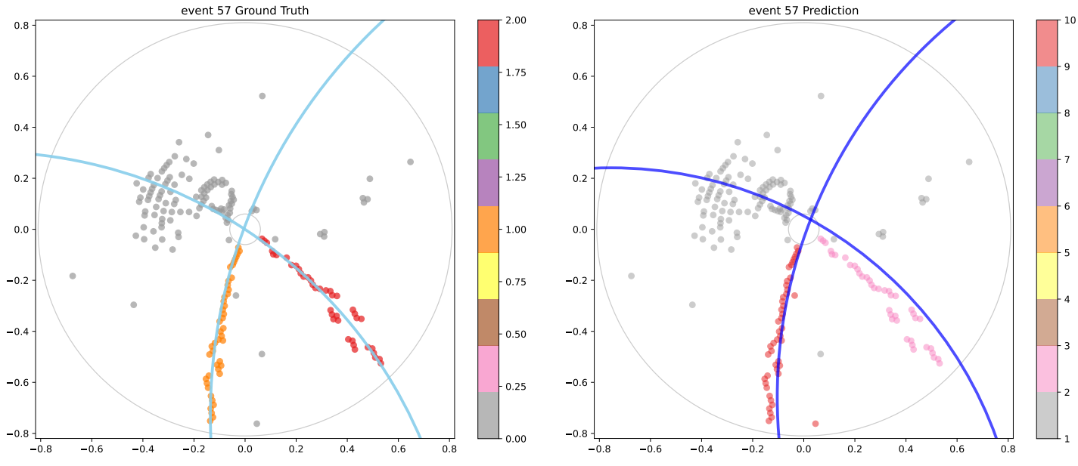
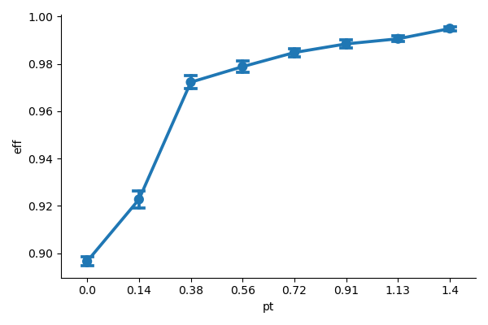
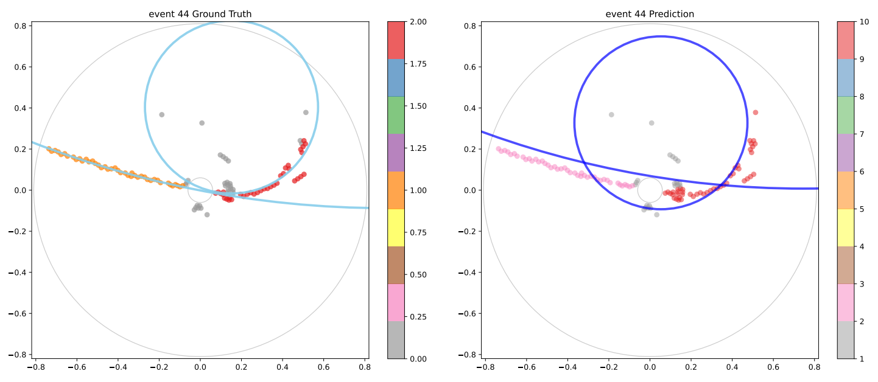
Clustering results：
Training data set: 120k events (J/ψ−>ρπ)
Test set (15k events)：
    Hit eff: 96.41%
    Hit purity: 94.7%
    Track eff: 97.17%

Slide 22
PID

Slide 23
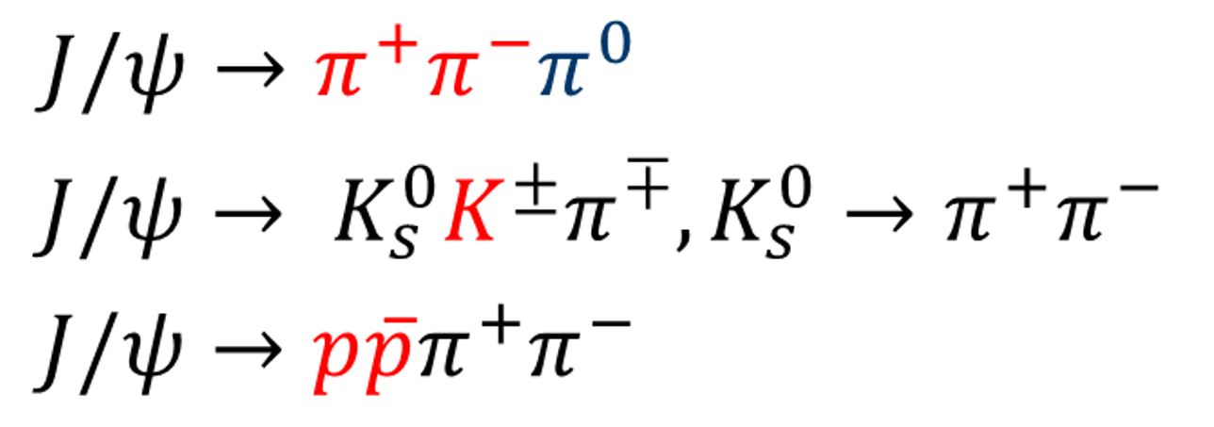
PID of π/k/p
Chen Zhengyuan（IHEP）
Model:BDTG
High purity(>99.4%) data sample
We find a well distribution, high purity
data sample is very important

Slide 24
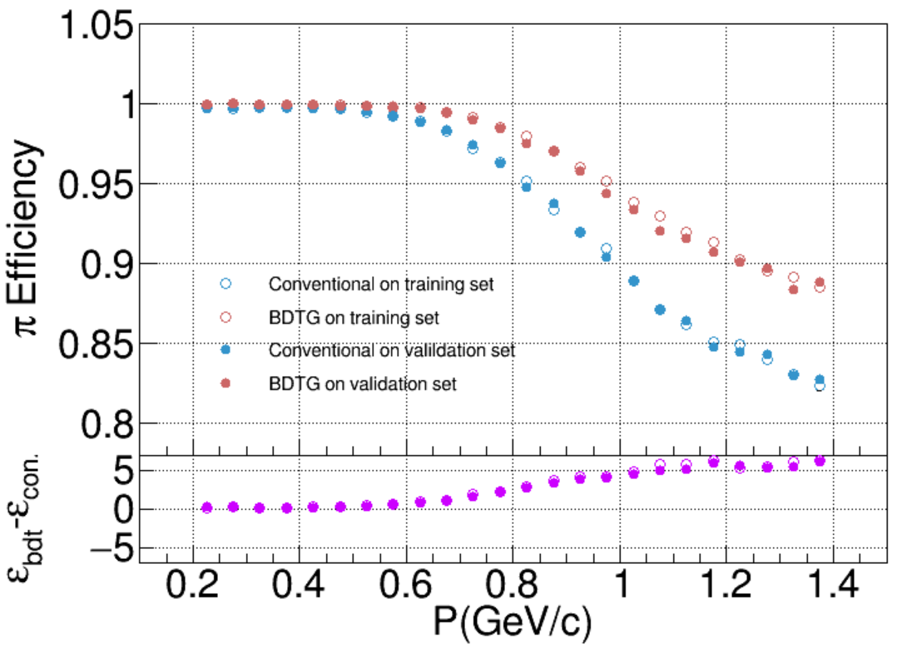
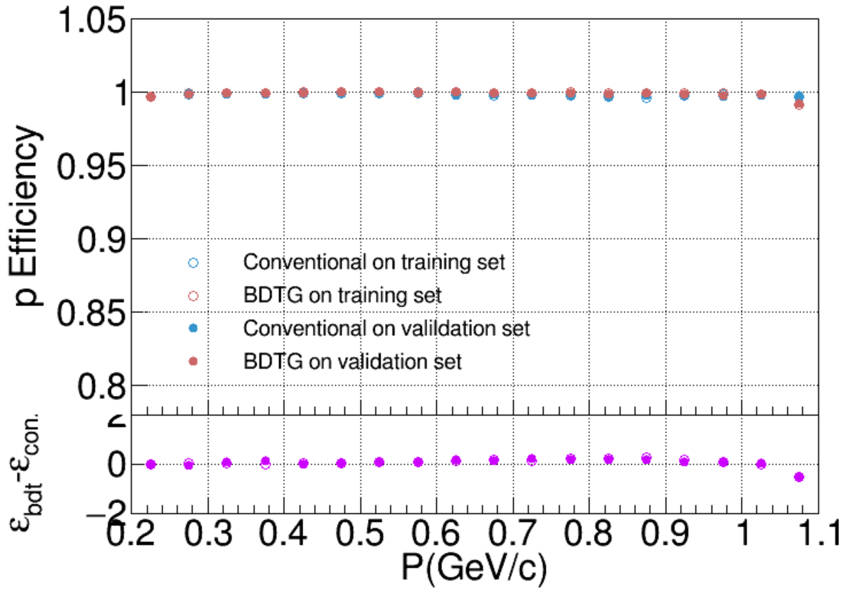
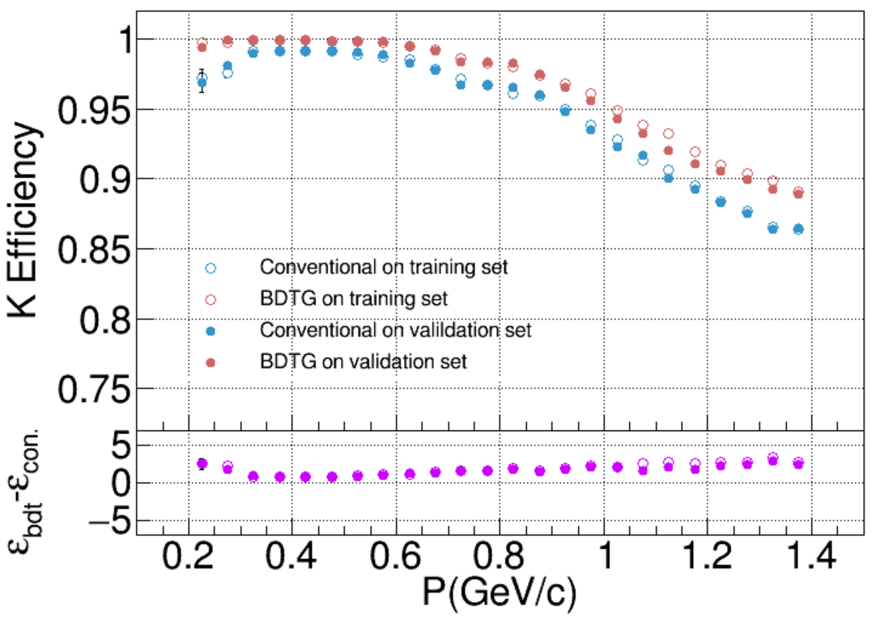
pion
PID efficiency using real data samples
proton
kaon
Significant improvement
than traditional way

Slide 25
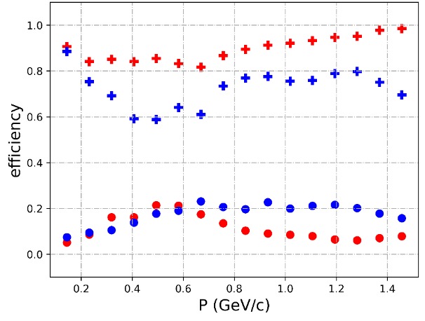
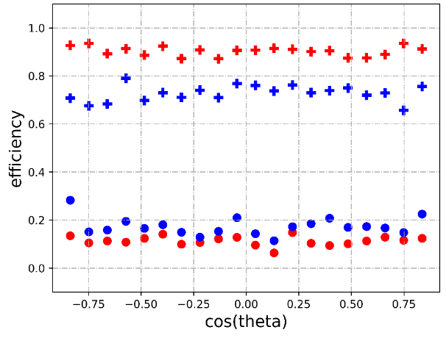
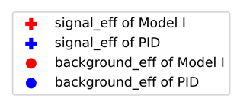
PID of μ/π
Zhai Yuncong（Shandong U.）
XGBoost Model
μ efficiency
μ efficiency
Marvelous improvement than traditional way

Slide 26
Dataset

Slide 27
Why we need a standard dataset?
    Large statistic, high purity, well distribution dataset is essential for ML
    Convenience: benchmark/validation
    Coorperation: Can be processed directly by ML experts who don’t need to know about the BESIII
    Common way: computer vision, LHC…..

Slide 28
BESIII tracking dataset for ML - Expectation
Tasks
  Signal / Noise classification
  Hits to tracks clustering
  Track parameters fitting
Evaluation
  Provide evaluation standards
  Traditional method performance
Data Requirements
  Evenly spaced（phi，theta）
  Enough amount of events
  All event types
  MC and data
FAIR Principle
  Findable
  Accessible
  Interpretable
  Reusable
High Energy Physics Artificial Intelligence Platform, HepAI

Slide 29
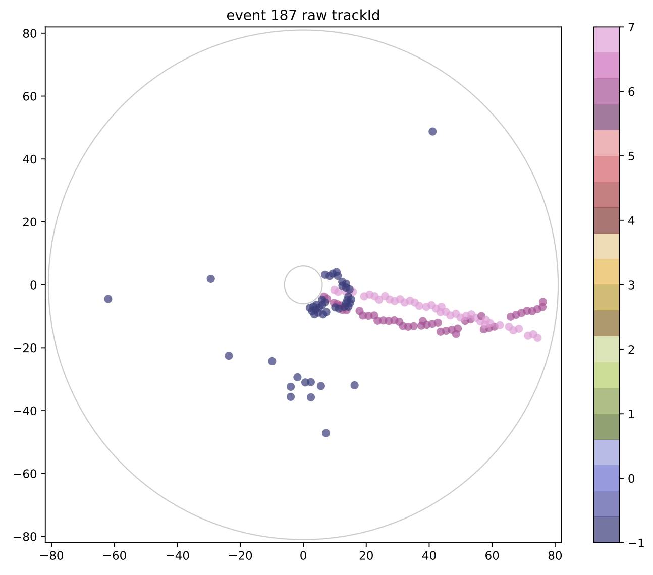
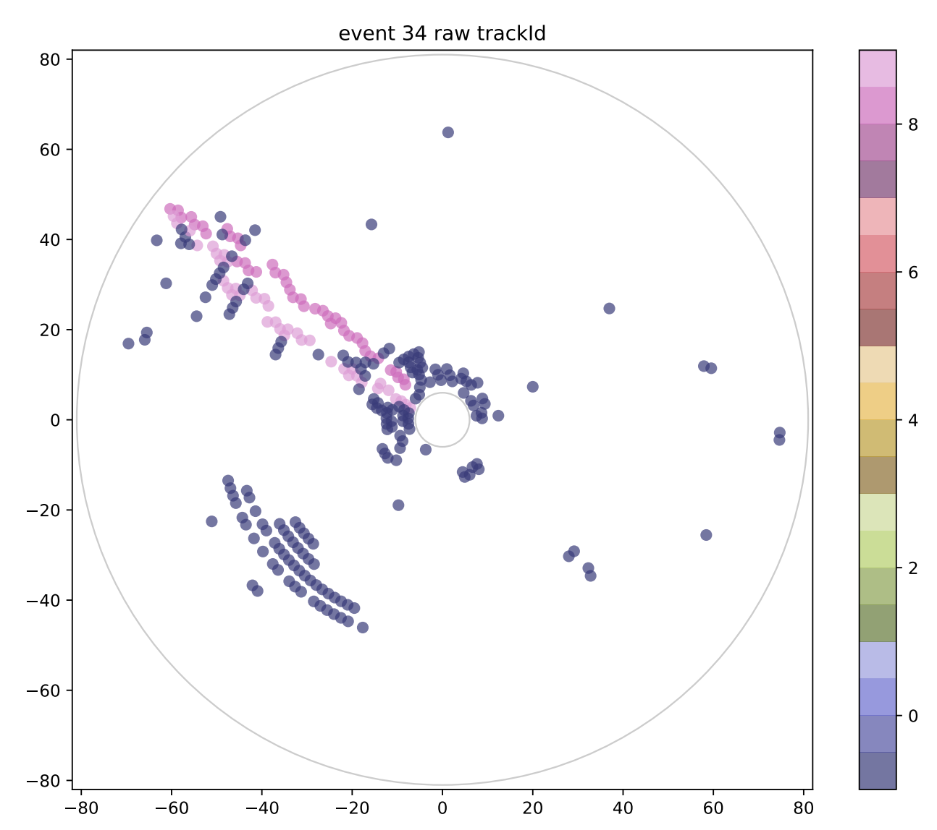
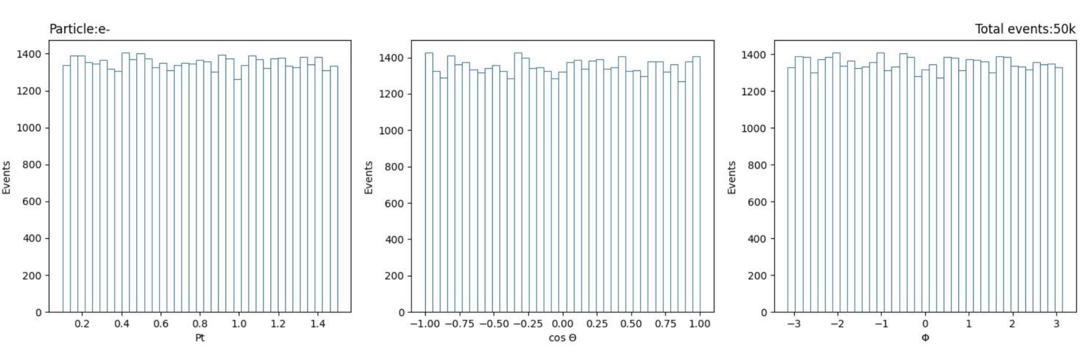
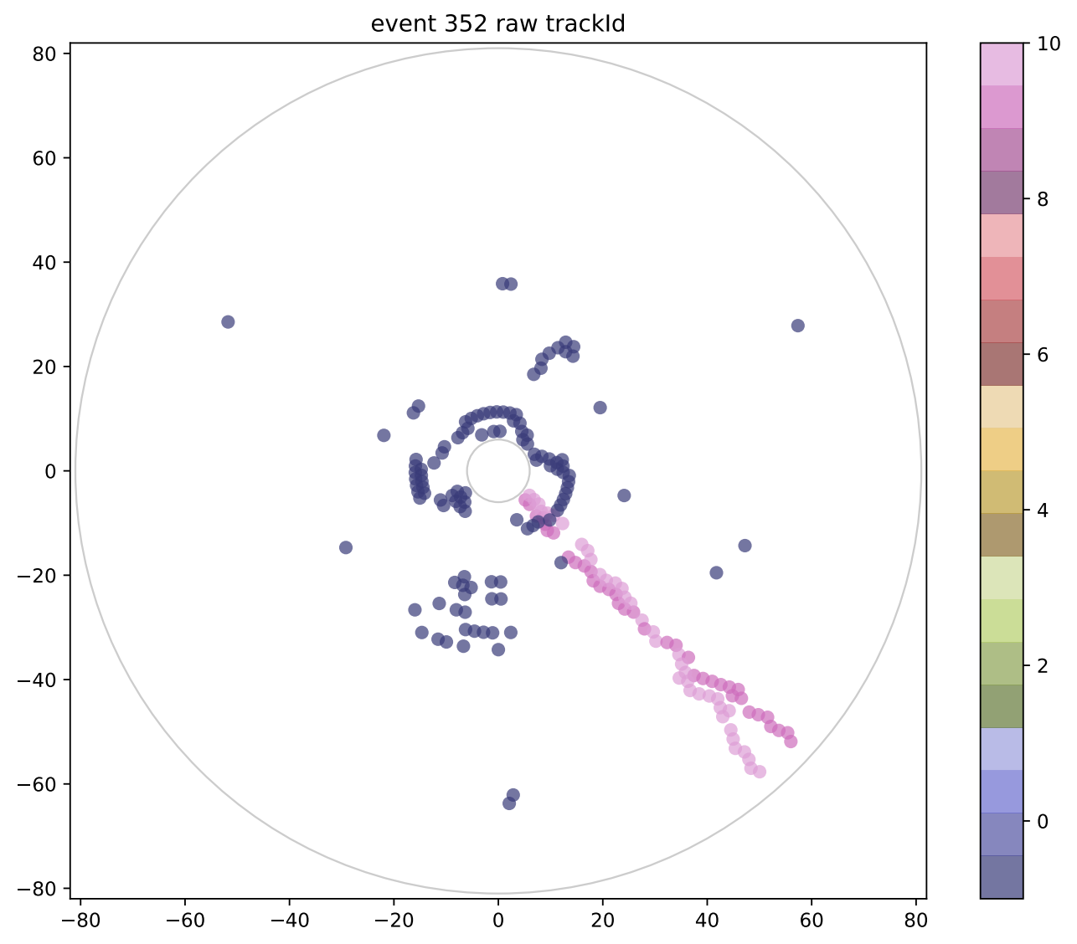
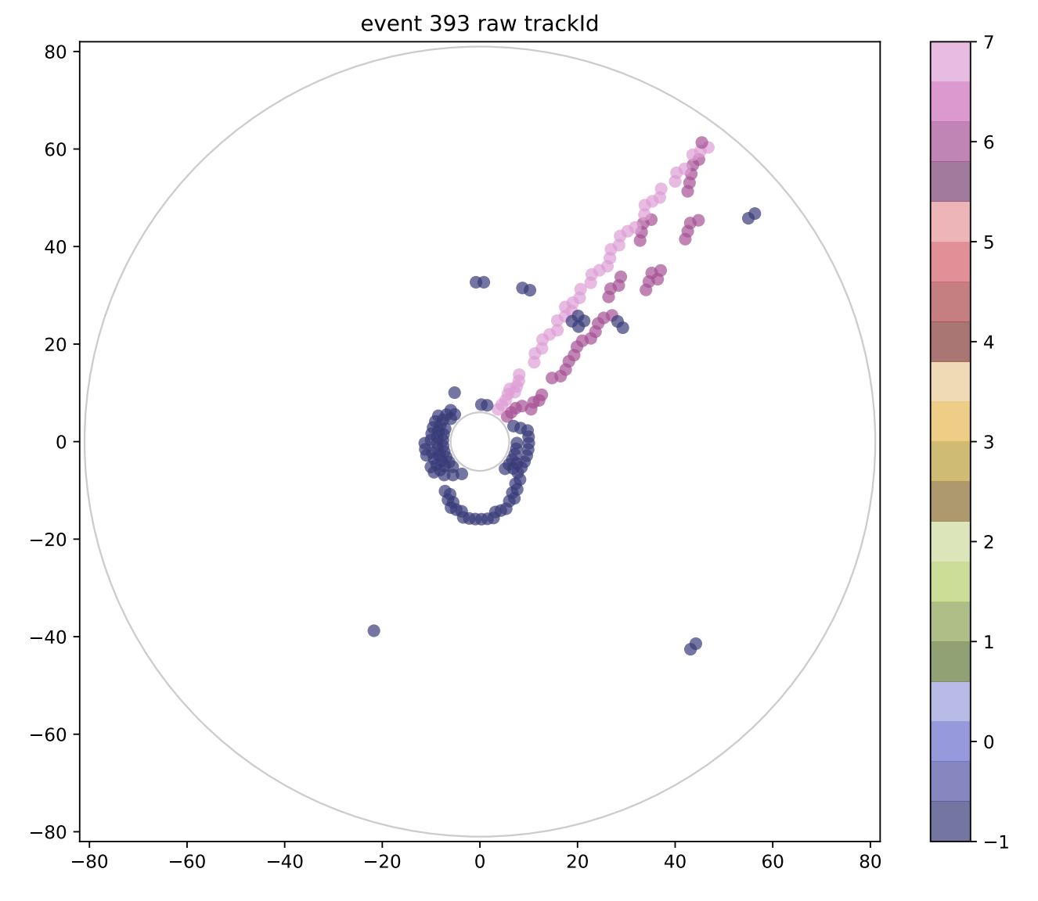
Yang Zhibin &Qian Liyan（IHEP ）
  Existing dataset MC: Single track dataset
    Total amount: 500,000 events
    flatten in Pt, cosθ, and Φ
    Links: https://ihepbox.ihep.ac.cn/ihepbox/index.php/s/k6CwLKJD8mclnxr Password：JD10Auoo
Working on nearby tracks dataset （special condition）
29

Slide 30
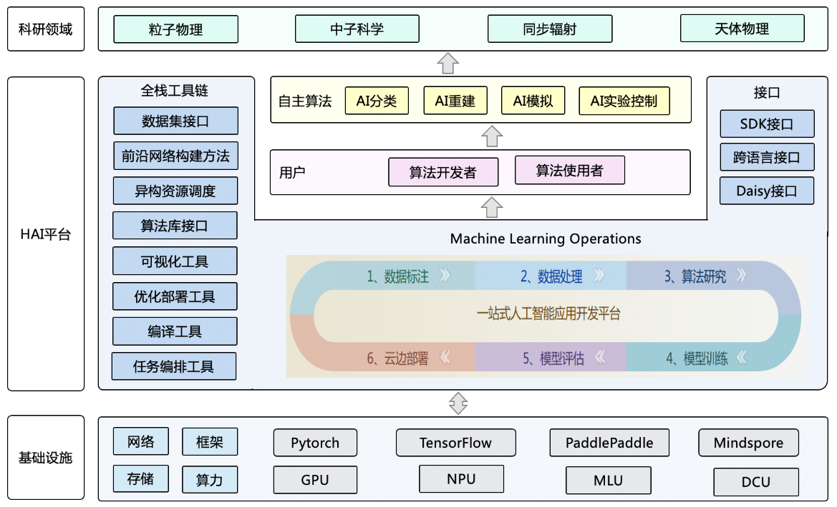
HepAI人工智能平台
An advertisement
人工智能平台可以加速多学科场景下的科学研究、简化模型迭代和流动，是发展AI算法及应用的共性基础设施。
HepAI软件框架（50%）
AI算法库：4个
AI数据集：3个
算力资源
工具链：
  标注工具
  开发GUI和WebUI框架
愿景：让AI For HEP
更加简单、水平更高
开源地址：https://code.ihep.ac.cn/zdzhang/hai
HepAI平台架构
Notes:
基于Machine Learning Operations(MLOps)设计理念和模块-管道-流(MPS)方案自主研发，支持模块化、可扩展、全流程，特别考虑科学计算的深度学习框架不同执行模式转换技术和高效的运行实现技术；AI科学计算平台的基准测试方法和指标体系;不同自然科学领域科学计算的通用范式和共性特征等。
先进人工智能算法的重构和集成，领域数据集接口，前沿神经网络构建方法和快速便捷的算法应用部署方案，支撑未来面向科学发现的人工智能方法学发展和应用生态。

Slide 31

Summary
  AI for BESIII has been introduced to every aspects
  Many promising results have been achieved
  我们都有光明的前途
Thanks！

Slide 32

国际前沿 – Connecting the Dots 2022
主要工作集中在: GNN (Exa.TrkX project)
多数是基于硅探测器数据的研究，漂移室数据尚缺少成熟的工作
GNN Pipeline

