Slide 1
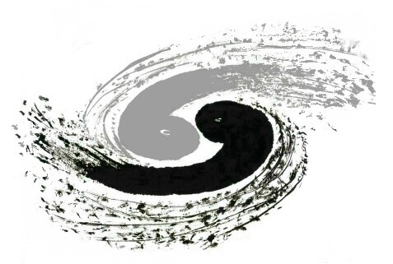
Improve Mass Resolution with Software Method
Yuanzhan Wang¹, Junchi He¹, Gang Li², Weimin Song¹
Jilin university¹
IHEP²

Slide 2
OUTLINE
Ⅰ
Motivation
Method and its significance
Summary
Ⅱ
Ⅲ

Slide 3
Ⅰ
Ⅰ
Motivation

Slide 4
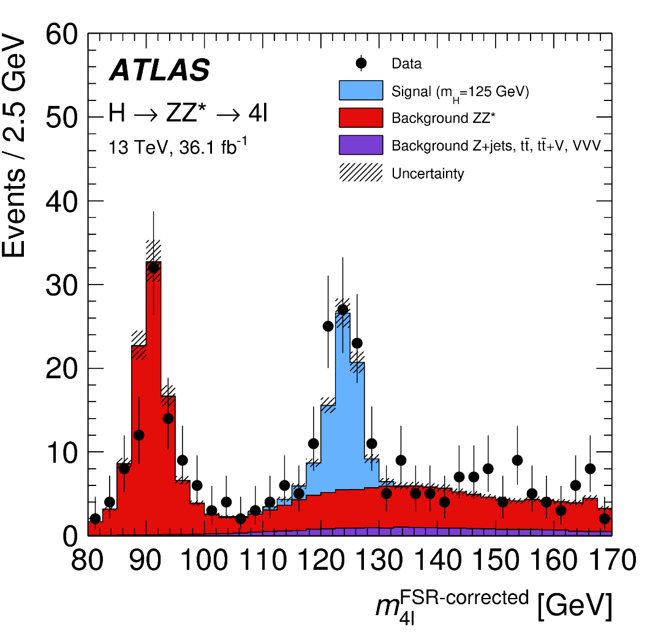
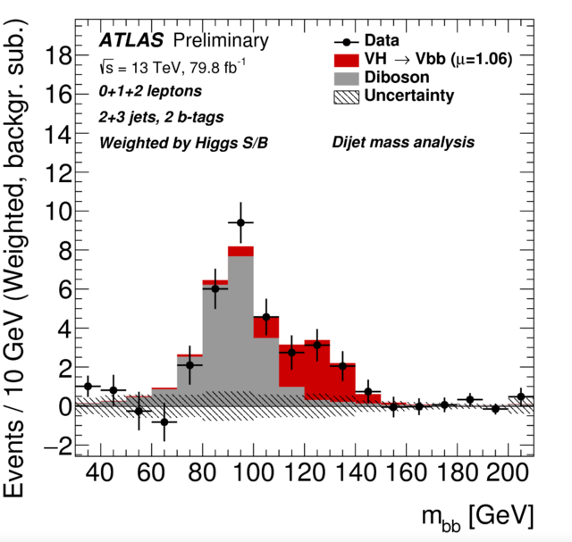
Resolution is important
Good resolution: 2012
Poor resolution: 2017
It is used to discover the Higgs in 2012,
even though its branching ratio is rather small
The Higgs boson's dominant branching ratio (~58%) was observed in 2017.
Notes:
Higgs发现的时候是在两光子与四轻子（右）两个过程中发现的，higgs到四轻子的分支比十万分之一，到两光子是千分之二，左图是到bb是最大分支比的衰变过程。关键就是右图分辨好于左图，如何在硬件不变的情况下改善分辨

Slide 5
There are several methods for improving mass resolution
Kinematic fitting: complicate software tool
2. Unfolding: lots of MC simulated samples
3. Mass constraint method: this report aims to prove it and demonstrate
its effectiveness using error propagation
Notes:
要说明这样的情况很多，需要改进，两种方法，一种是拟合，是个比较复杂的工具，现在这个方法大家都在用，我们现在在做什么事情，让方法更清楚，多样性，更可靠。

Slide 6
Ⅱ
Methods

Slide 7
Error propagation of mass resolution in two-body decay
In a detector, the momenta and energies of particles are measured, PID can determine the masses → We can calculate invariant mass of some intermediate states.
Start from this formula
Neglect masses in high energy
The error propagation gives

Slide 8
Error propagation of mass resolution in two-body decay
The smaller angle (the larger initial momentum, the smaller angle between the products), the greater contribution to mass resolution.
The better energy (momentum) resolution, the smaller error.
Potential correlations neglected

Slide 9
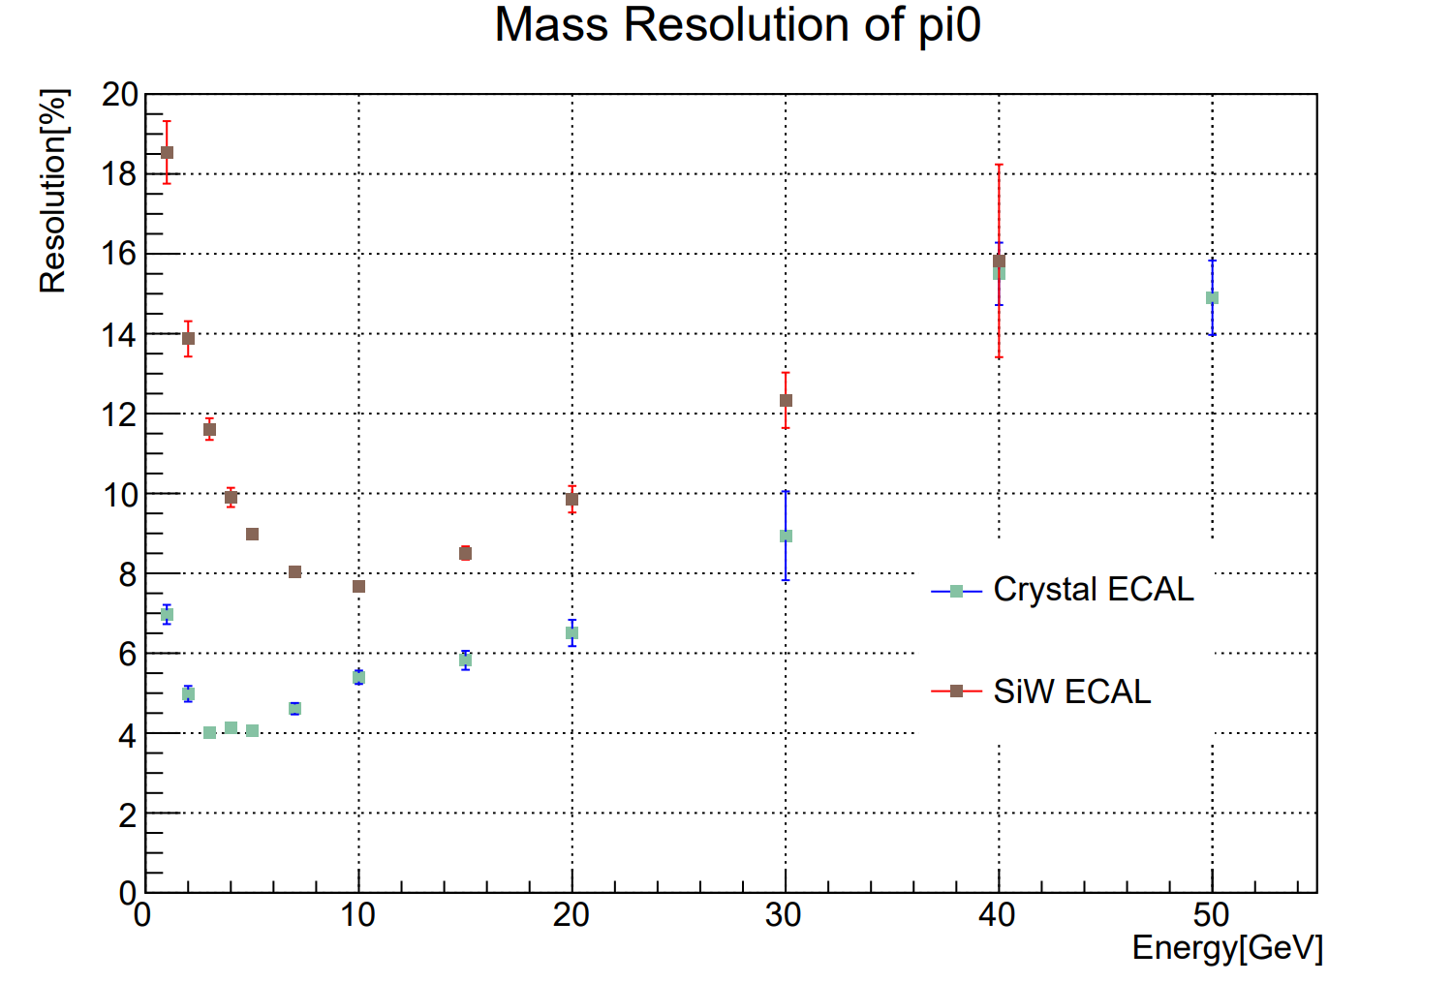
Error propagation of mass resolution in two-body decay
The error propagation formula
$B^{0}→π^{0}π^{0}→γγγγ$ measurement
The larger the initial momentum/energy, the larger mass resolution
The smaller angle between the initial momenta and the worse angular resolution causes larger mass resolution.
Change the mother energy.

Slide 10
Error propagation of mass resolution in multiple-body decay
1
12
0
2
13
3
23
Technique1: Using the nominal mass of an intermediate particle can (significantly) improve the mass resolution.
When the mass of the intermediate particle is larger, its contribution to the error is also larger.
(fake) intermediate particles

Slide 11
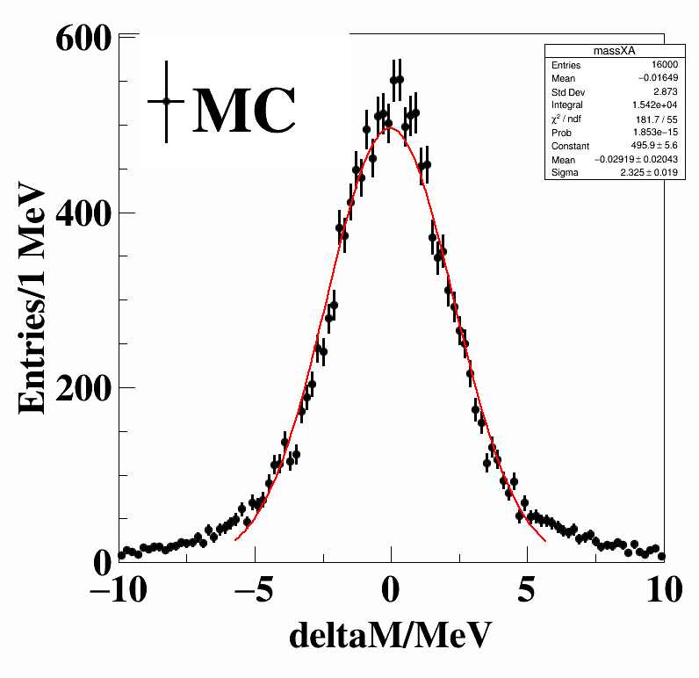
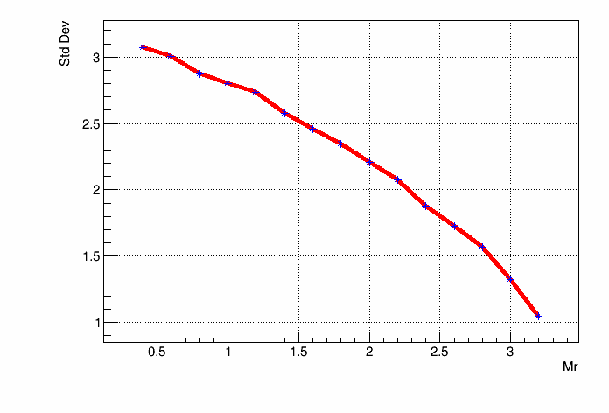
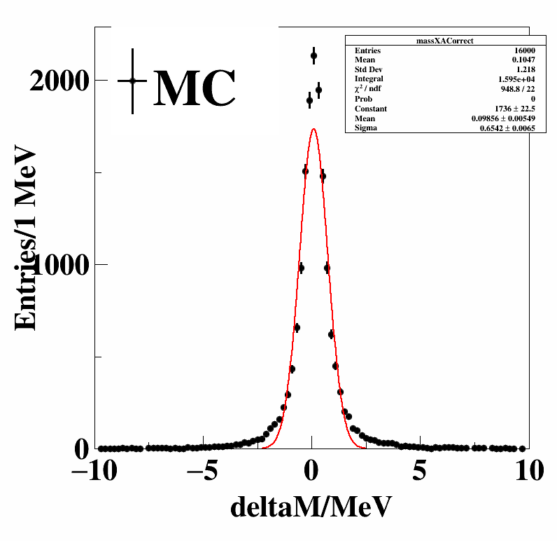
Technique 1
Std Dev: 2.8
Change$the mass of A$
M_{ππμμ} – M_{μμ} + M_{A}
Std Dev: 1.2
When the mass of the intermediate particle is larger, it contributes more to the error.

Slide 12
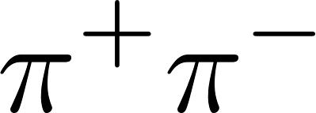
Improving resolution using recoil
1, Calculate with muon pair.
Measuring the invariant mass of
2,Recoil against
Which one is better?

Slide 13
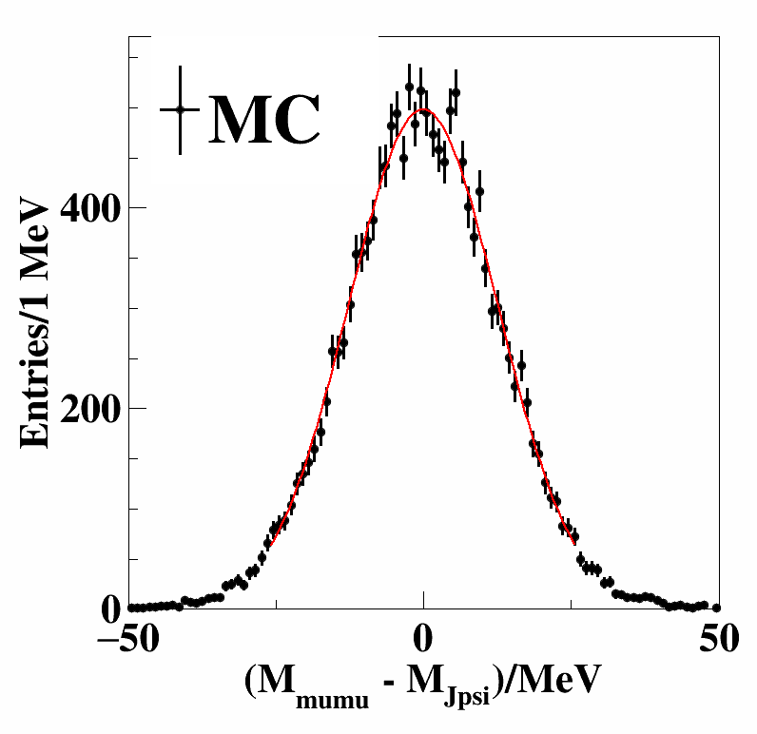
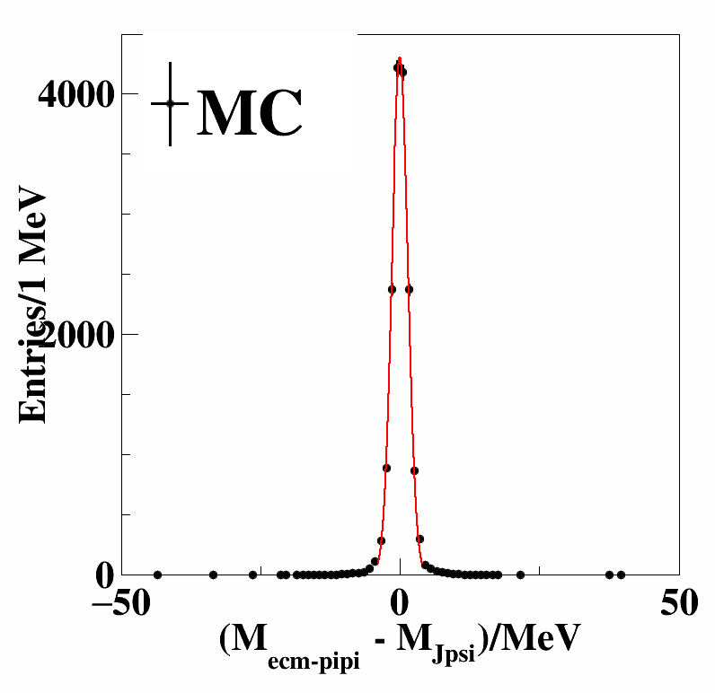
The one with lower momenta!

Slide 14
Improving recoil resolution by utilizing another intermediate particle
Measuring the mass of with recoil method
Recoil mass against $π−D0, its uncertainty$
Using the intermediate D0 to reduce the error.
Technique 2: The recoil mass, plus the mass obtained from the four-momentum of $Kπ$,
minus the invariant mass of the intermediate particle.
M_{rec} + M_{Κπ} - M_{D0}

Slide 15
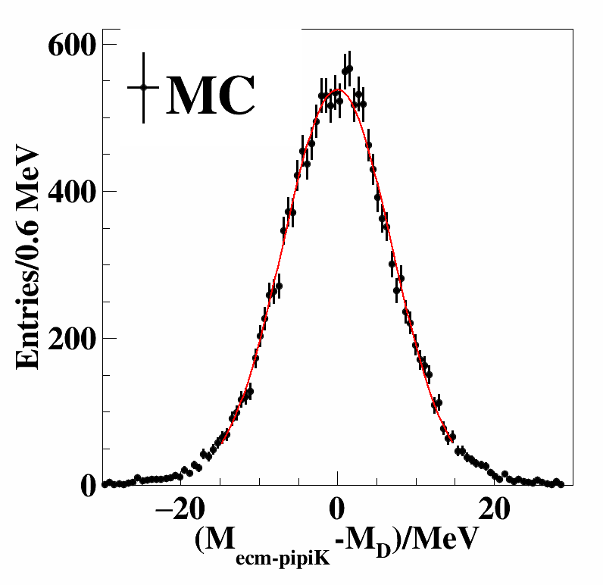
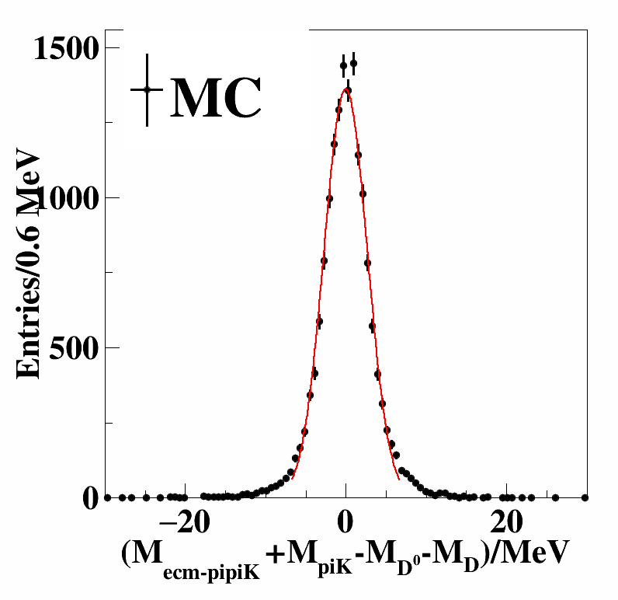
Technique 2
Recoil against pi- D0
Utilizing an intermediate particle

Slide 16
Ⅲ
Summary

Slide 17
Summary
Analytical relationships between momentum/energy, angular resolution and invariant mass derived
Several useful techniques obtained to understand and improve mass resolutions
The correctness and effectiveness proved using simulation
Technique1: Using the nominal mass of an intermediate particle can (significantly) improve the mass resolution.
Technique2: The similar technique also applies in recoil mass.

Slide 18
Outlook
With good B and/or D tagging tools, we can achieve
Better resolution with open charm decays at BESIII
Better boson mass resolution at CEPC

Slide 19
Invariant mass: M_{ππμμ} – M_{μμ} + M_{A}
Recoil mass: M_{rec} + M_{Kπ} - M_{D}
THANK YOU

Slide 20
Ⅳ
Backup

Slide 21
Technique1
M_{X} – (M_{μμ} – M_{J/psi})
Technique2
M_{rec} + (M_{Κπ} – M_{D0})
Since it is recoil, to eliminate the cross-term resolution from the total resolution, the plus sign is used.

Slide 22
Summary
Conclusion 1
The lower momentum/energy, the better resolution
Conclusion 2
The smaller angles among the daughters, the larger contribution to the mass resolution

Slide 23
Summary
Conclusion 3:
Using the nominal mass of an intermediate particle can (significantly) improve the mass resolution.
The larger mass of the intermediate particle, the more contribution to mass resolution.
M_{ππμμ} – M_{μμ} + M_{A}
Conclusion 4:
The similiar technique also applies in recoil mass
M = M_{rec} + M_{Κπ} - M_{D0}

Slide 24
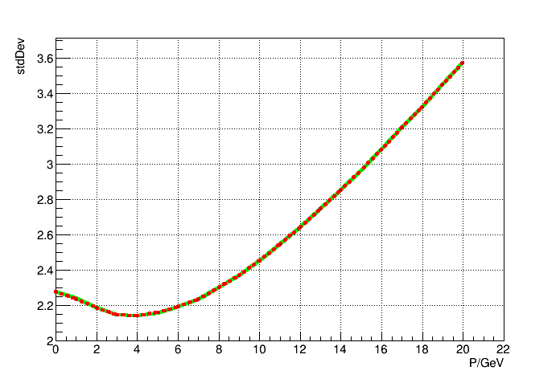
Validate the results with MC
—— Fast MC
Calculation

