Slide 1
Properties of dense matter and quark stars
Wen-Li Yuan (苑文莉)
Nanjing University and Xiamen University
June 2, 2023

Slide 2
Contents:
Dense matter and compact stars
Equation of state and self-bound quark stars
Color superconducting quark matter
Static properties of Skyrmions
Summary and outlook

Slide 3
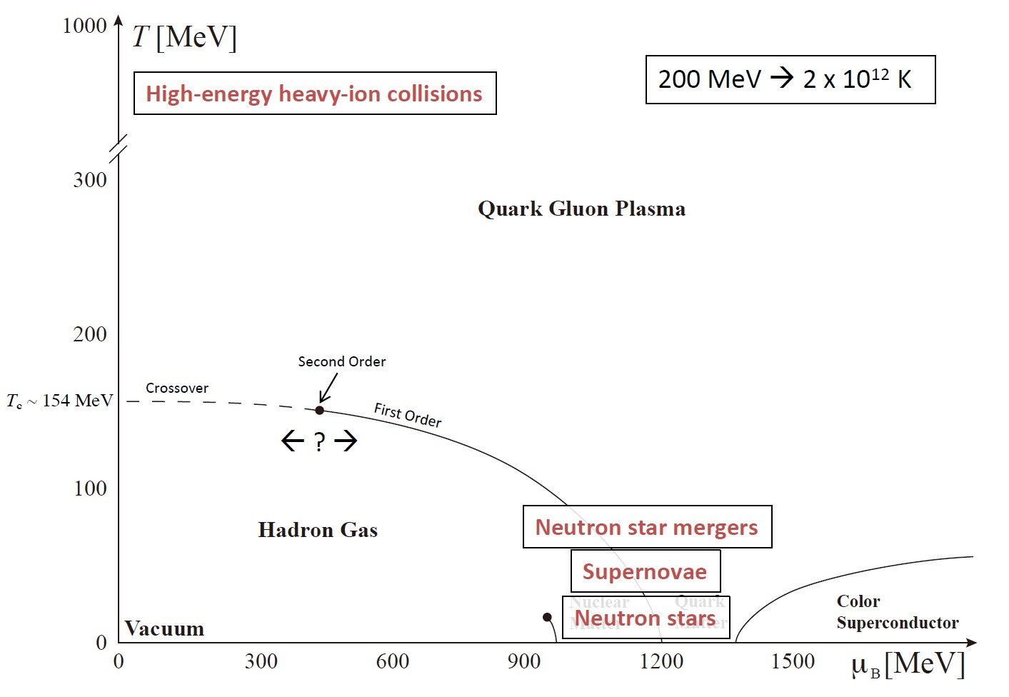
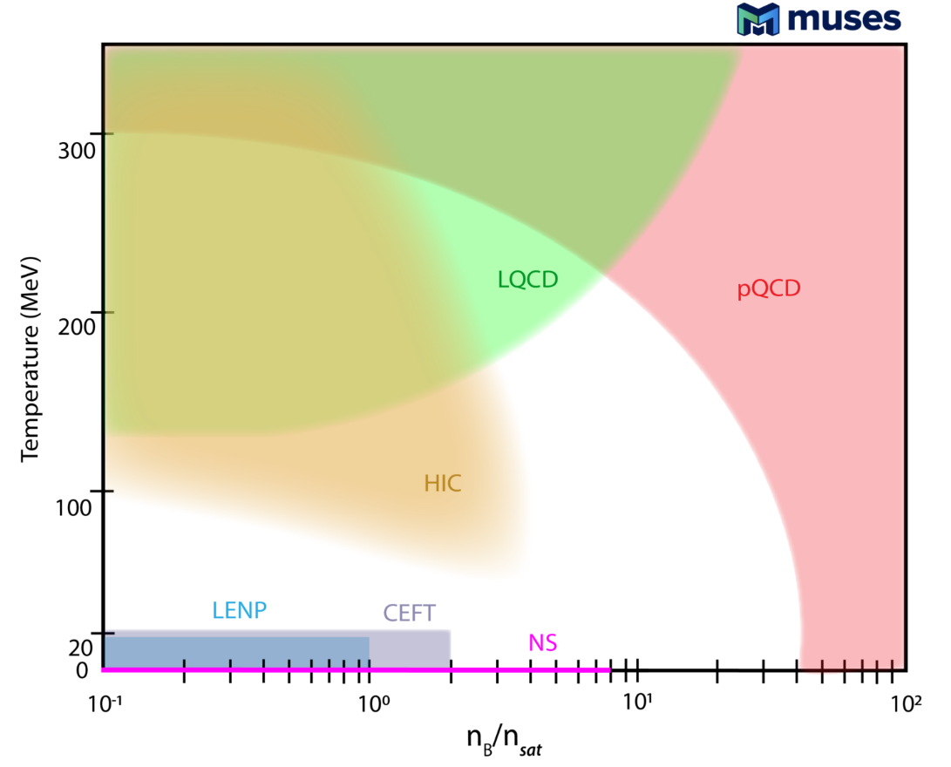
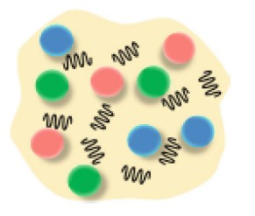
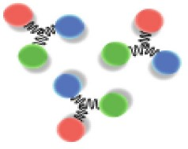
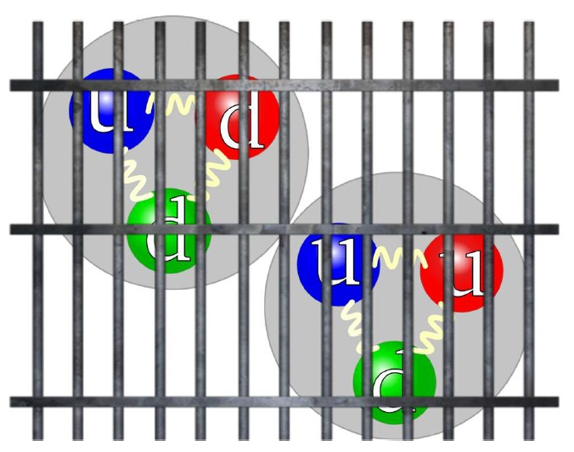
1. Dense matter and compact stars
1.1 Conjectured QCD phase diagram
Theoretical (LQCD, pQCD etc.) and experimental constraints
M. Strickland

Slide 4
1. Dense matter and compact stars
1.2 Theoretical and experimental constraints
Theoretical difficulties
High energy scale: perturbative QCD
Low energy scale : lattice QCD (T),
effective field theory etc.
Cold dense matter:
Terrestrial experiment: hard to reach
Neutron stars: natural laboratory
What is the state of supra-nuclear matter?

Slide 5
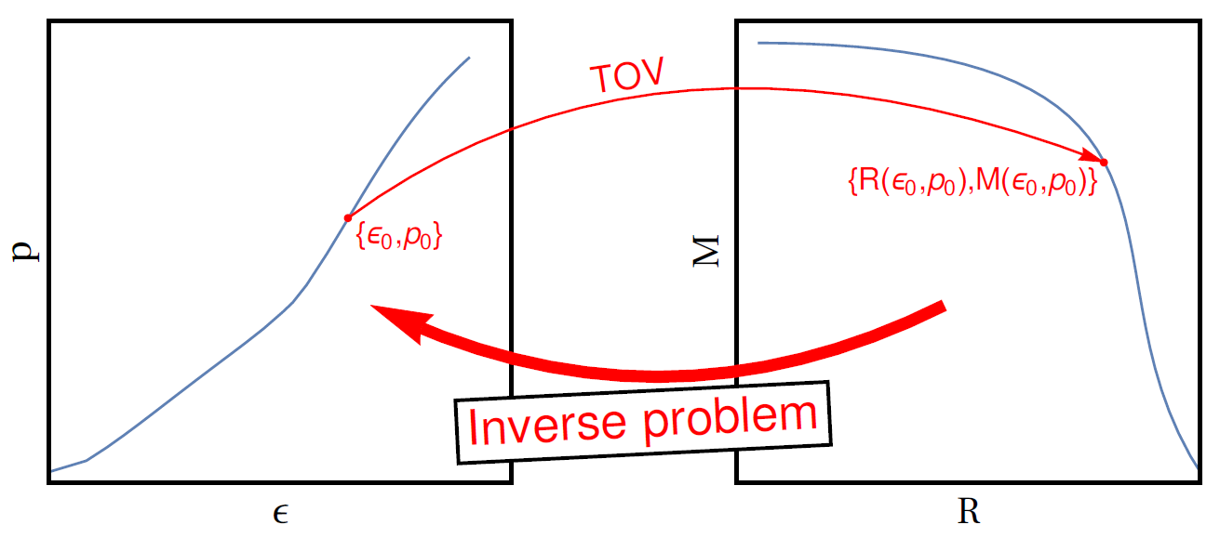



1. Dense matter and compact stars
1.3 Constraints from
neutron stars (NSs)
CEP
The unique mapping between the EOS and the M-R relation (Abdelsalhin, T, 2019)
Astronomical observation:
GW170817 (the ‘golden’ event)
PSR J0030+0451
PSR J0740+6620
(currently most massive NS)
(Miller et al. 2019)
(Riley et al. 2019)
M. Strickland
What is the state of supra-nuclear matter?
(Miller et al. 2021)
(Riley et al. 2021)

Slide 6
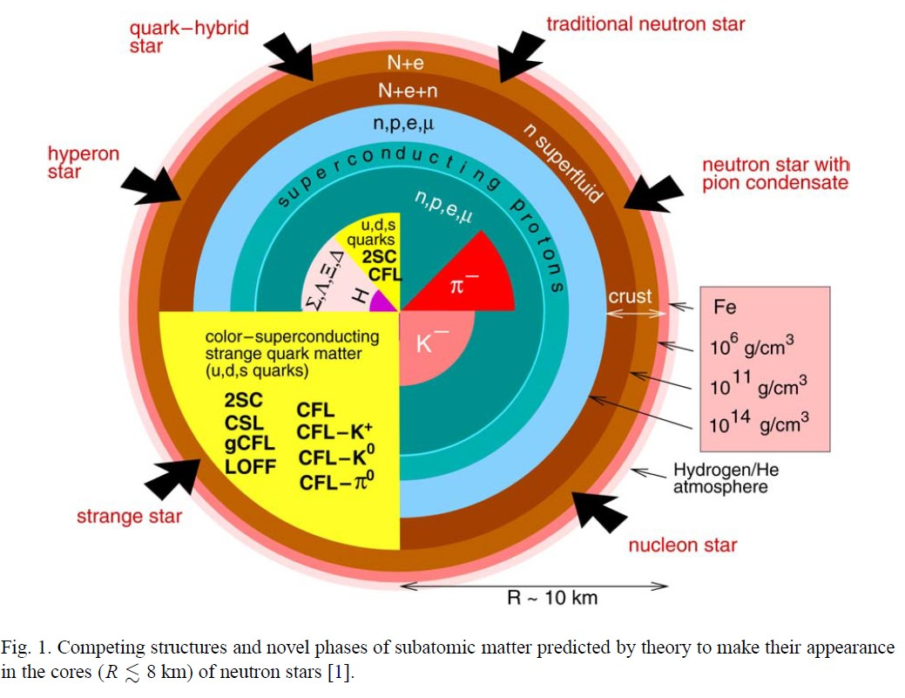
1. Dense matter and compact stars
1.4 The structure and composition of NSs
Composition:
Outer crust：ionized nuclei
Inner crust: neutrons drip out from nucleus
Outer core: neutrons with some admixture of protons, electrons and muons (homogeneous nuclear matter)
Inner Core: poorly unknown
Weber 2005

Slide 7
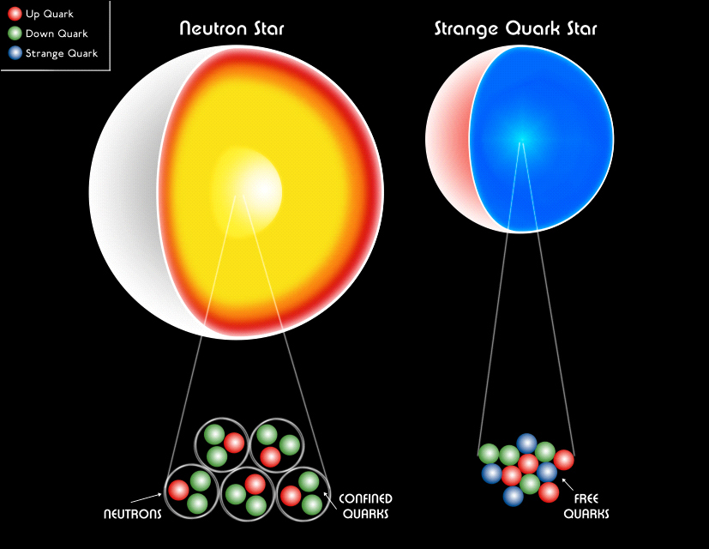

1. Dense matter and compact stars
1.5 The absolutely stable strange quark matter hypothesis
Phys. Rev. D 4, 1602 (1971)
Phys. Rev. D 30, 272 (1984)
MIT bag model
Witten hypothesis:
Strange quark matter may be the true ground state of baryonic matter which has a lower
energy per baryon than iron nucleus (Fe).
Then all compact objects
would be strange quark stars instead of neutron stars.
(Credit: NASA/CXC/M.Weiss)

Slide 8
1. Dense matter and compact stars
1.6 The absolutely stable nonstrange quark matter
Neutron star:
Gravity-bound
Quark star:
Self-bound by strong interactions
Whether quark matter is absolutely stable :
A recent study:
ud quark matter could be in general more stable than uds quark matter.
Phys. Rev. Lett. 120,222001 (2018)
Consider the flavor-feedback dependent of the quark gas on the QCD vacuum.
Important for various astrophysics and cosmological problems:
Supernovae, gamma-ray bursts, pulsar glitch, cosmic rays etc.
Nonstrange quark stars exist.
What is the true ground state of baryonic matter?

Slide 9
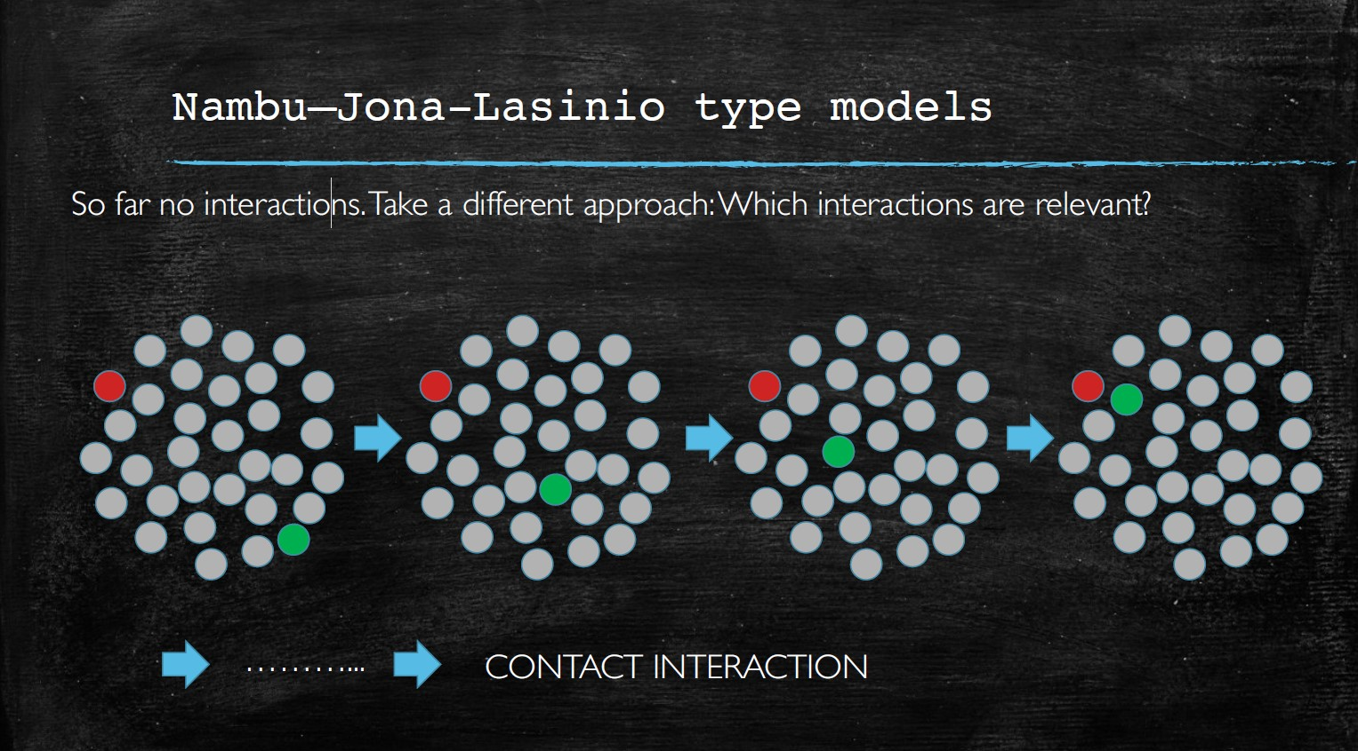
2. Equation of state and self-bound quark stars
PhysRevD.105.123004
2.1 Interacting quark matter at finite densities
Nambu–Jona-Lasinio (NJL) model
An important and valid effective quark theory ( a suitable approximation to QCD
in the low-energy and long-wavelength limit)
Reproduce the basic symmetries of QCD
Dynamical chiral symmetry breaking (DCSB)
Confinement

Slide 10




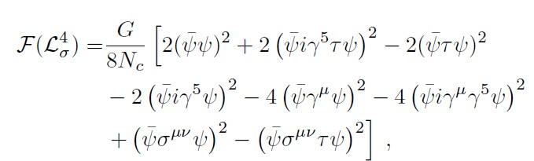
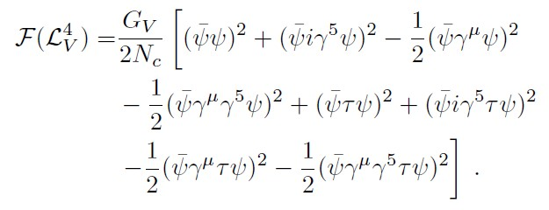
2. Equation of state and self-bound quark stars
The formalism:
PhysRevD.105.123004
1) Two-flavor NJL model:
the Fierz transformation mathematical technique
+
Consider the effect of a rearrangement of fermion field operators.
Introduce a parameter , the effective Lagrangian becomes:

Slide 11






2. Equation of state and self-bound quark stars
2) (2 + 1)-flavor NJL model:
PhysRevD.105.123004
+
Apply the Fierz transformation：
The effective Lagrangian becomes:

Slide 12
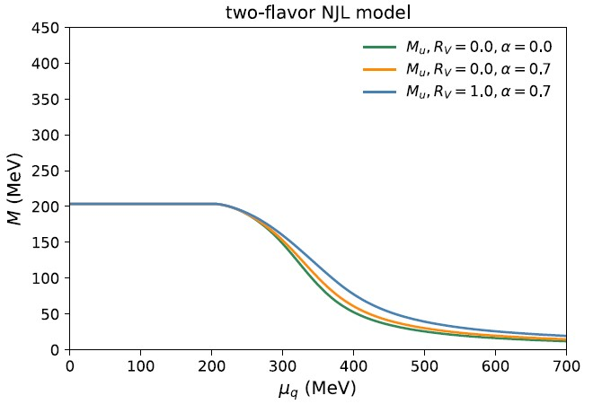
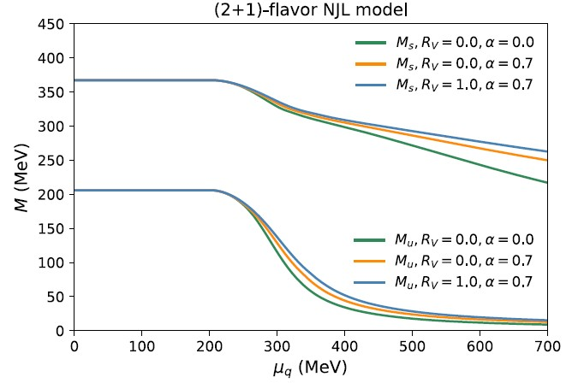
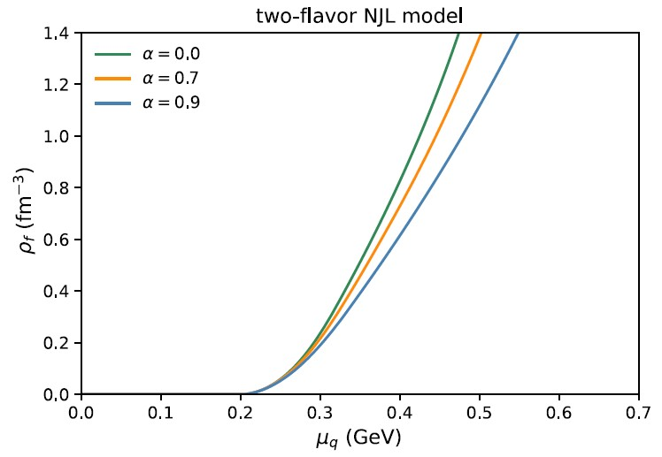
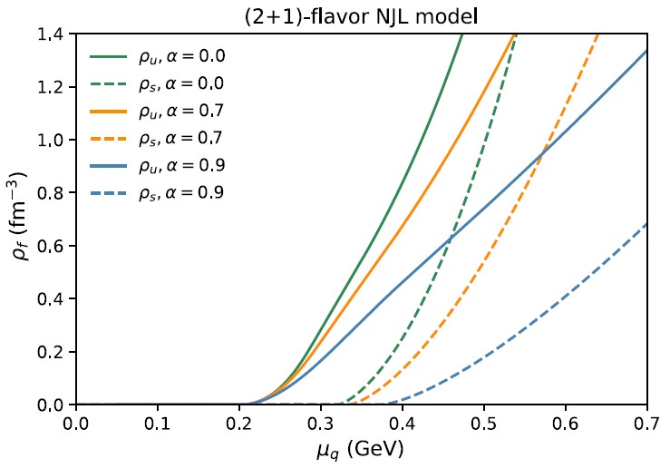
2. Equation of state and self-bound quark stars
Dynamical mass generation and quark number densities
a crossover

Slide 13
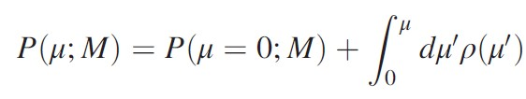
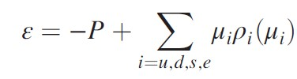




2. Equation of state and self-bound quark stars
2.1 Equation of state of quark matter (QM):
1) Equation of state
-B
vacuum bag constant
2.2 The self-bound quark matter
1) For self-bound uds quark matter:
3-flavor quark matter is more stable than Fe nuclei.
2-flavor quark matter cannot be more stable than Fe nuclei.
2) For self-bound ud quark matter:

Slide 14



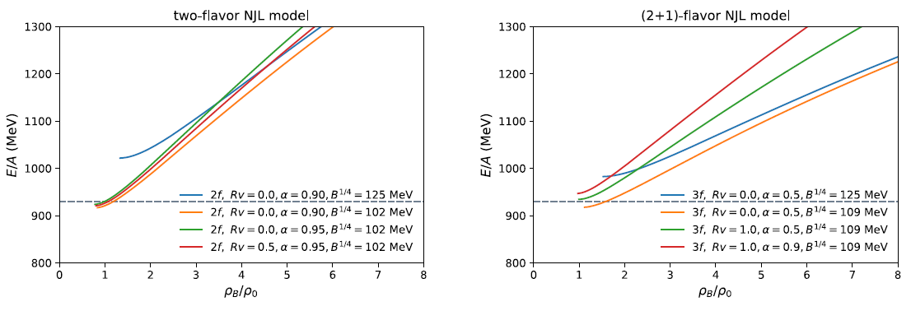
2. Equation of state and self-bound quark stars
2.3 Results without the stability conditions
larger and ;
larger
larger , smaller

Slide 15
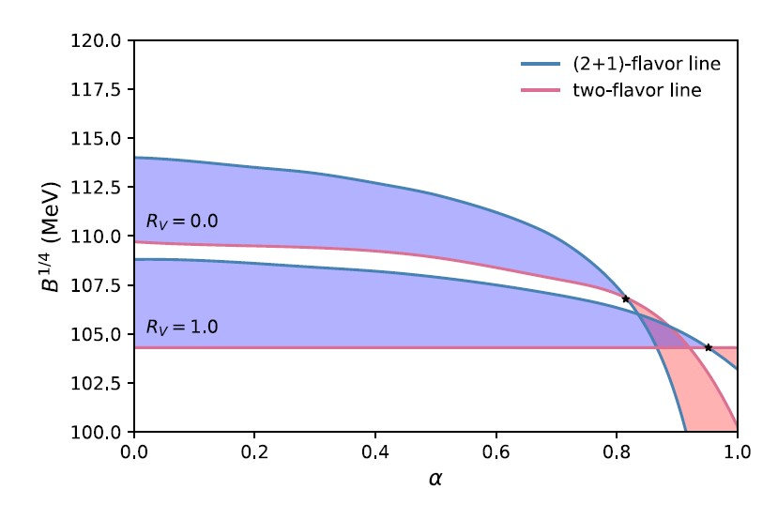
2. Equation of state and self-bound quark stars
2.3 The self-bound quark matter
1) For self-bound uds quark matter: ;
2) For self-bound ud quark matter:
stability window
enough parameter space to allow absolutely stable quark matter

Slide 16
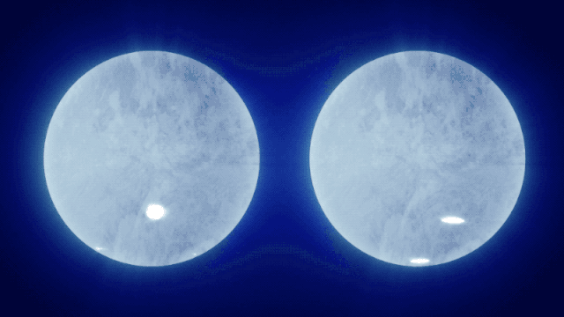
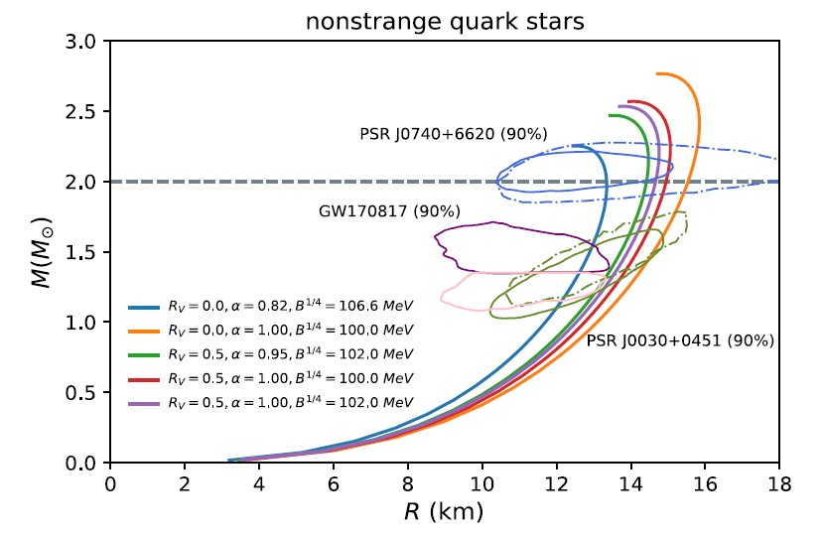
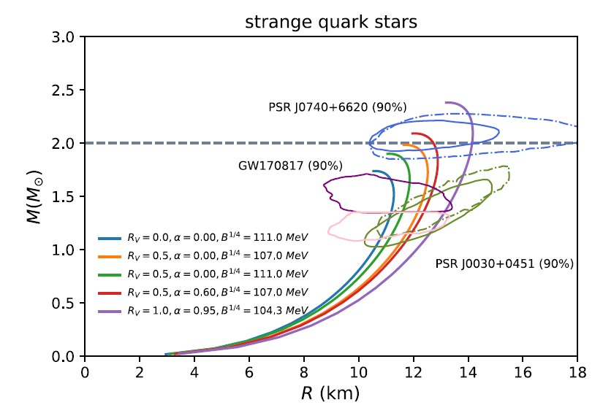


2. Equation of state and self-bound quark stars
2.4 The quark stars:
M-R relations
NICER
PSR J0740+6620; PSR J0030+0451
LIGO/Virgo
$$M_{TOV}^{ud}=2.76M_{sun}$$
$$M_{TOV}^{uds}=2.1M_{sun}$$

Slide 17
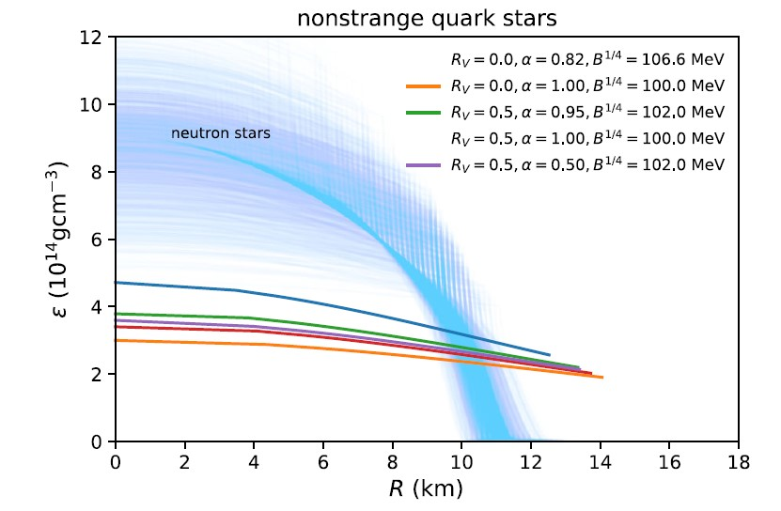
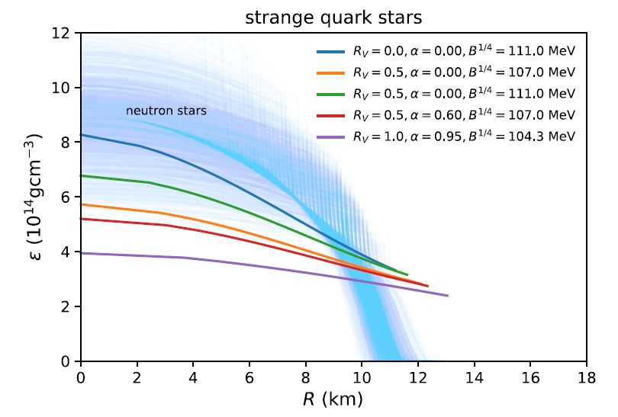
2. Equation of state and self-bound quark stars
The mass density within a $1.4M_{sun}$ star as a function of radial coordinate
Quark stars: The central density is a few times higher than the surface one.
nonstrange quark stars: <2.0
strange quark stars: <2.5
Neutron Stars：~14 orders of magnitude

Slide 18
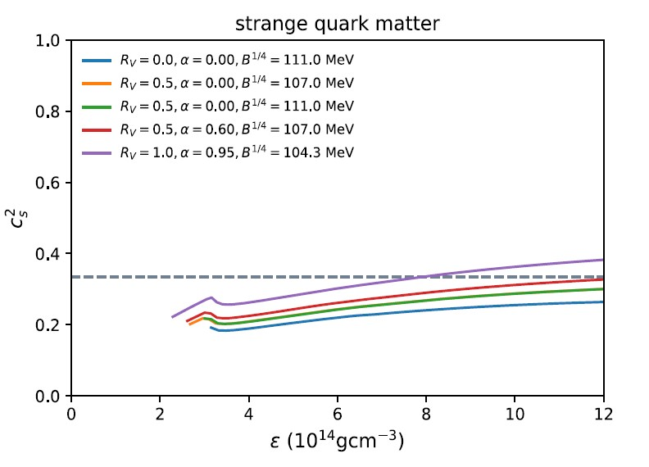
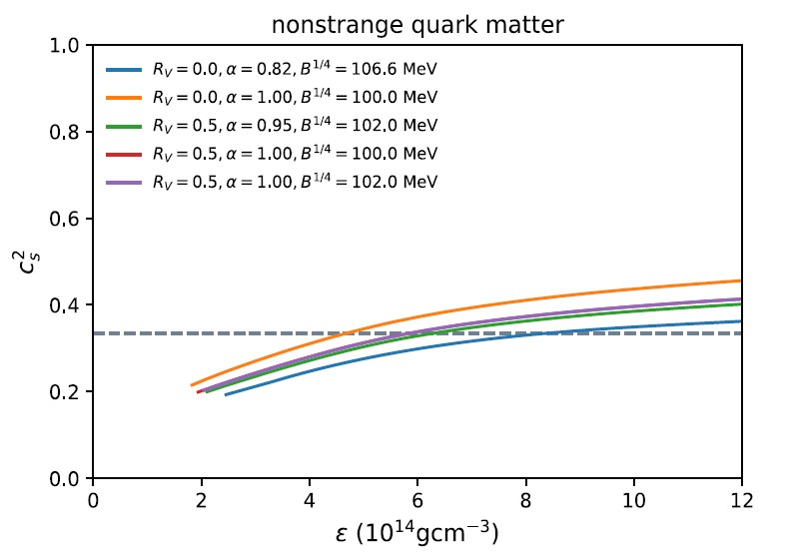
2. Equation of state and self-bound quark stars
The speed of sound of quark matter:
conformal limit
Both exceed the conformal limit at large densities (1.5—3 $ρ_{0}$).

Slide 19
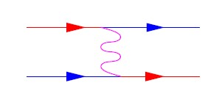
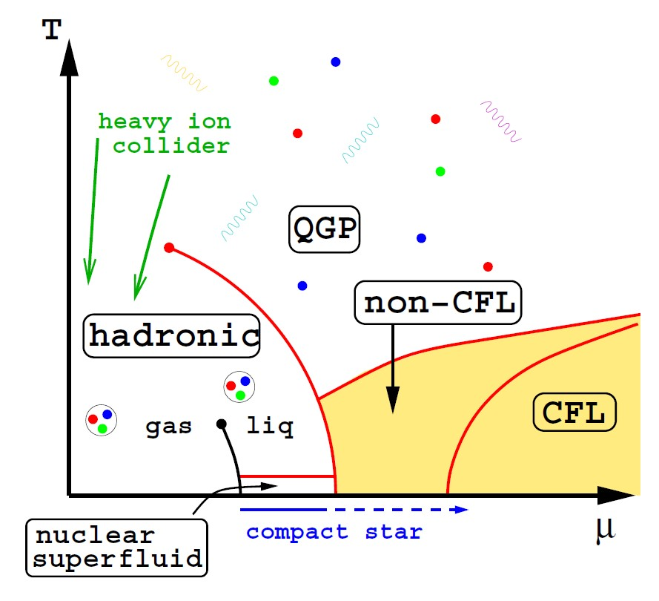
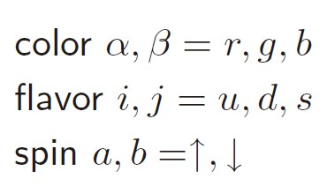

3. Color superconducting quark matter
QCD predicts color superconducting phase at low temperature and sufficiently high density—might exists in the core of neutron stars.
one-gluon exchange
attractive interaction: in the color antitriplet quark-quark channel in QCD
quarks condensate into Cooper pair
Alford 1999
pairing gaps:~100 MeV

Slide 20

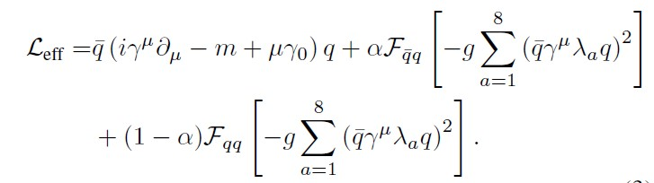

3. Color superconducting quark matter
3.1 NJL model with diquark interaction:
?
$$G_{D}=3/4G_{S}$$
Previous studies usually use this relation.
3.2 NJL-type model: consider the diquark interactions self-consistently
systematically and
self-consistently
Two types of Fierz transformation

Slide 21
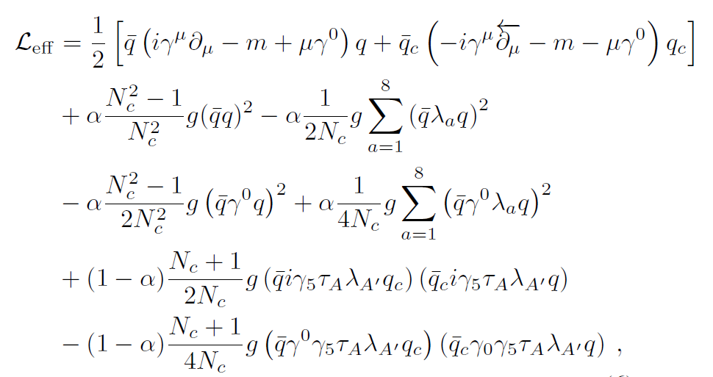
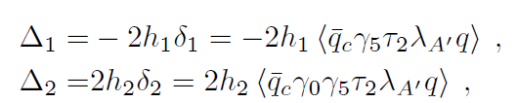
3. Color superconducting quark matter
3.1 NJL model with diquark interaction:
$$G_{D}=3/4G_{S}$$
Previous studies usually use this relation.
3.2 NJL-type model: consider the diquark interactions self-consistently

Slide 22
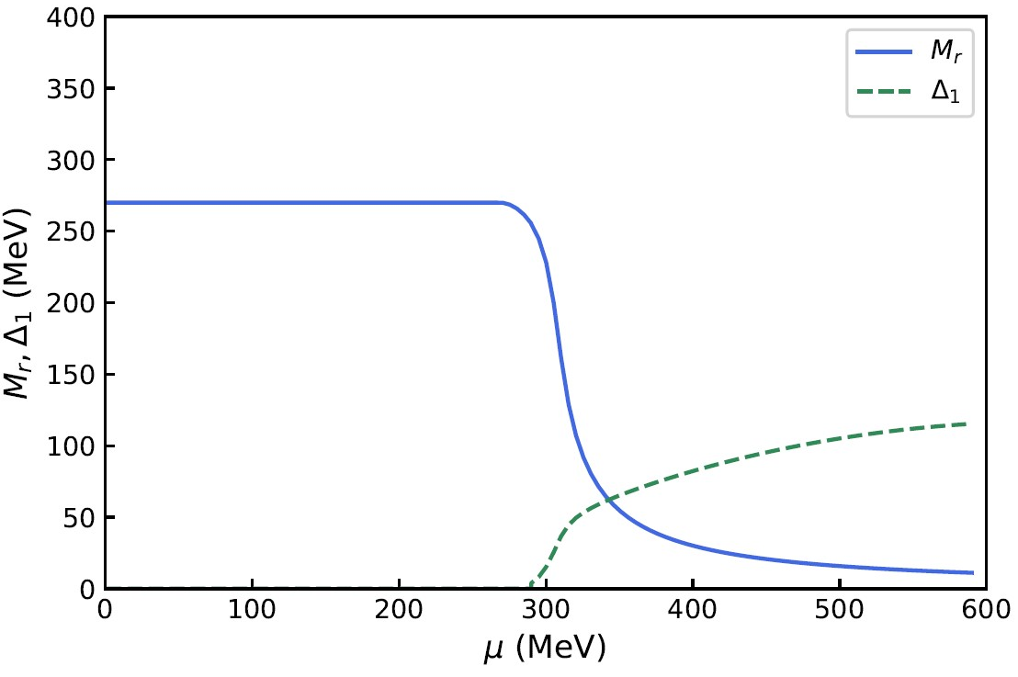
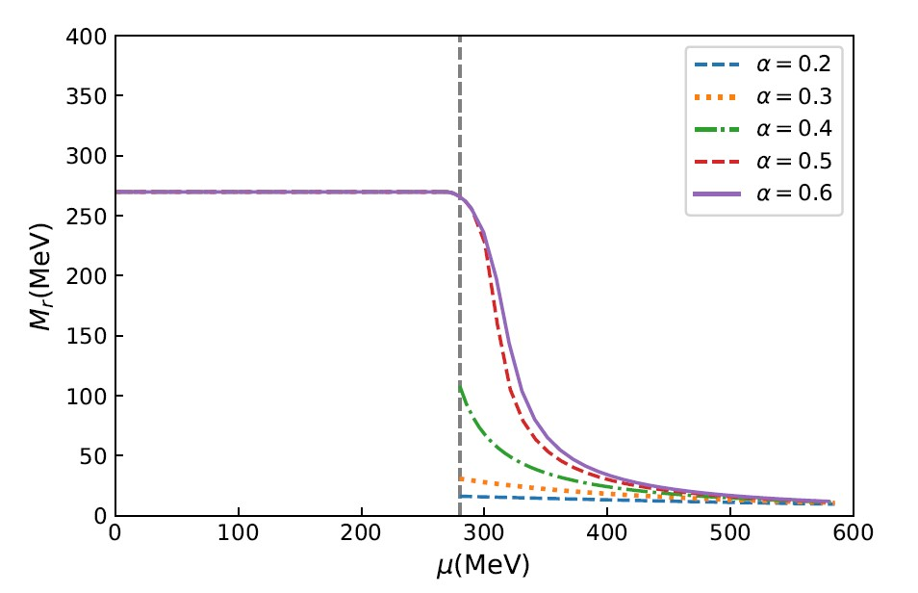
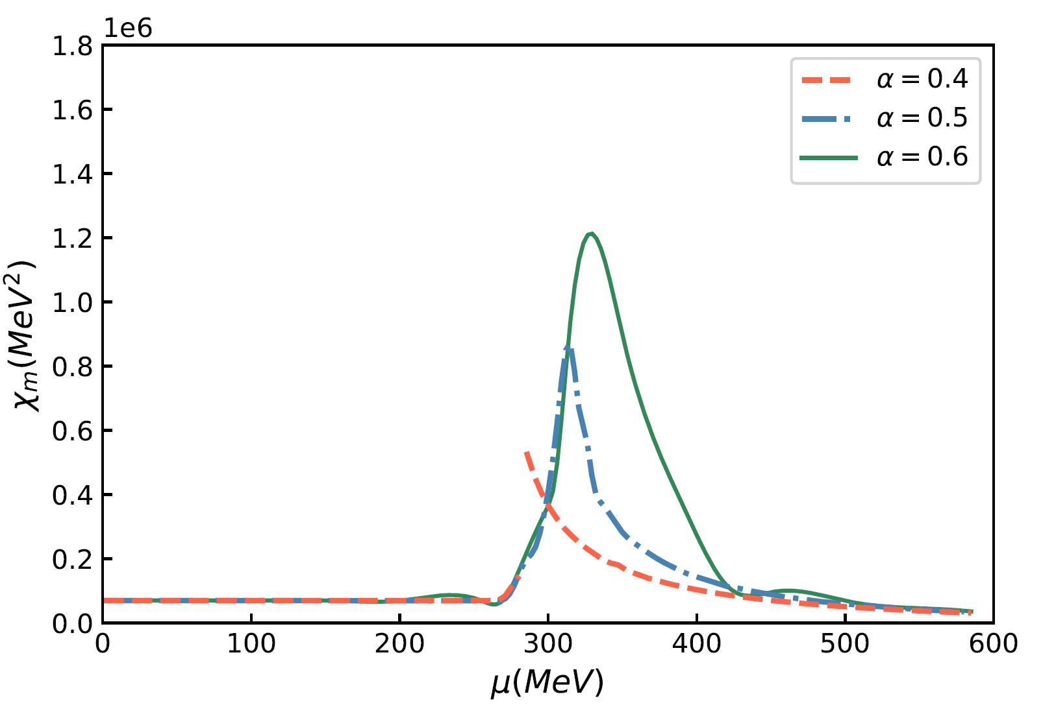
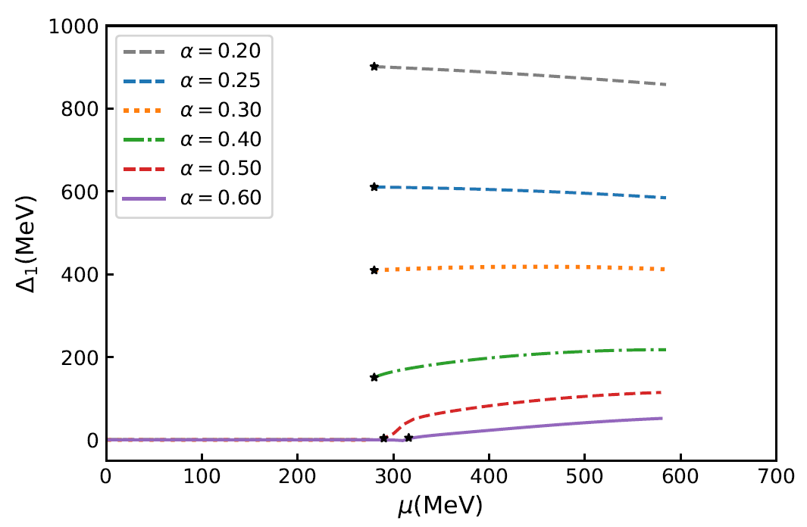


3.3 The phase transition properties of quark matter:
$$α=0.5$$
$$G_{D}=3/4G_{S}$$
crossover
first-order
first-order
crossover

Slide 23


3.3 The phase transition properties of quark matter:
$$α=0.25, …0.5, …,0.6$$
crossover
$$G_{D}/G_{S}=2.25, …3/4, …,1/2$$
first-order
first-order
crossover

Slide 24
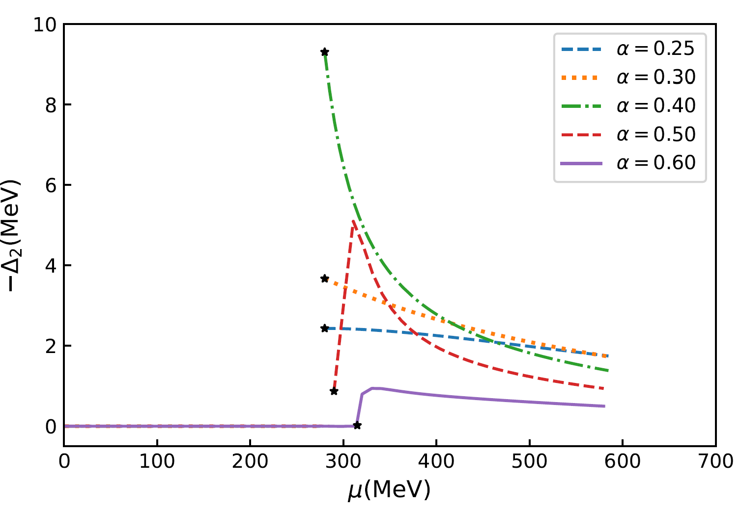
3.3 The phase transition properties of quark matter:
$$α=0.25, …0.5, …,0.6$$
crossover
$$G_{D}/G_{S}=2.25, …3/4, …,1/2$$
first-order
first-order
crossover

Slide 25

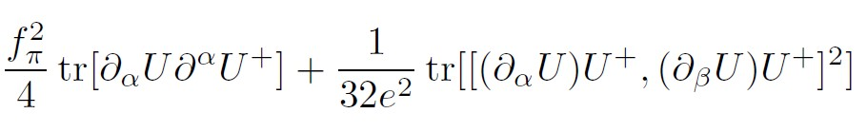
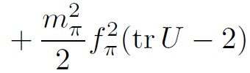
4. Static properties of Skyrmions
4.1 The Skyrme model
The Skyrme model with pion mass term:
Baryons appear as topological solitons, known as skyrmions.
The introduction of isospin chemical potential :
DSCB
Skyrme term
topological current
topological charge

Slide 26
4. Static properties of Skyrmions
The hedgehog ansatz:
The boundary conditions:
The dimensionless soliton mass:
The minimization of leads to the equation of motion of the skyrmion profile:
Norberto Scoccola,
LARGE Nc QCD AND THE SKYRME MODEL

Slide 27
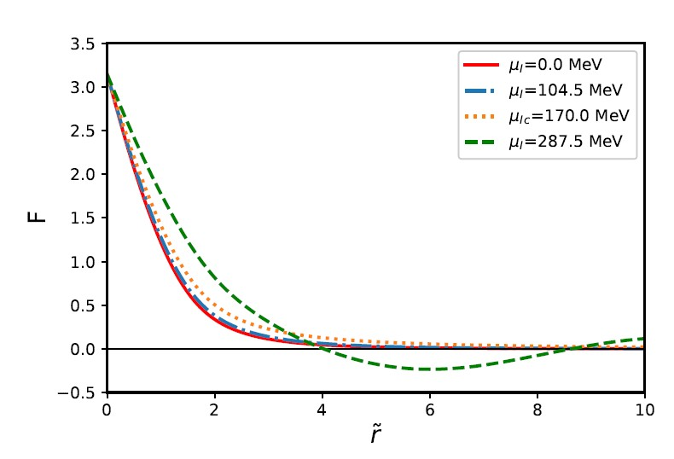
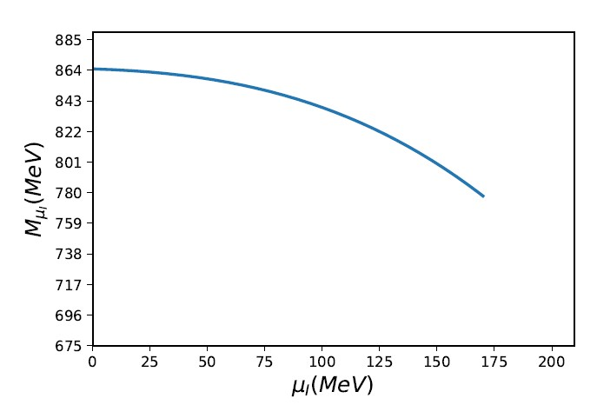
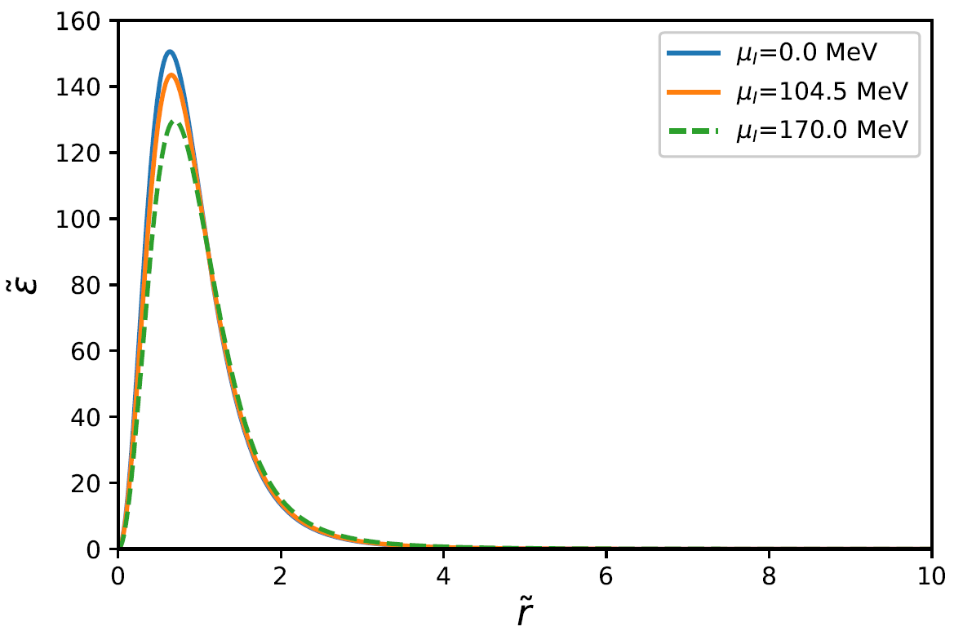
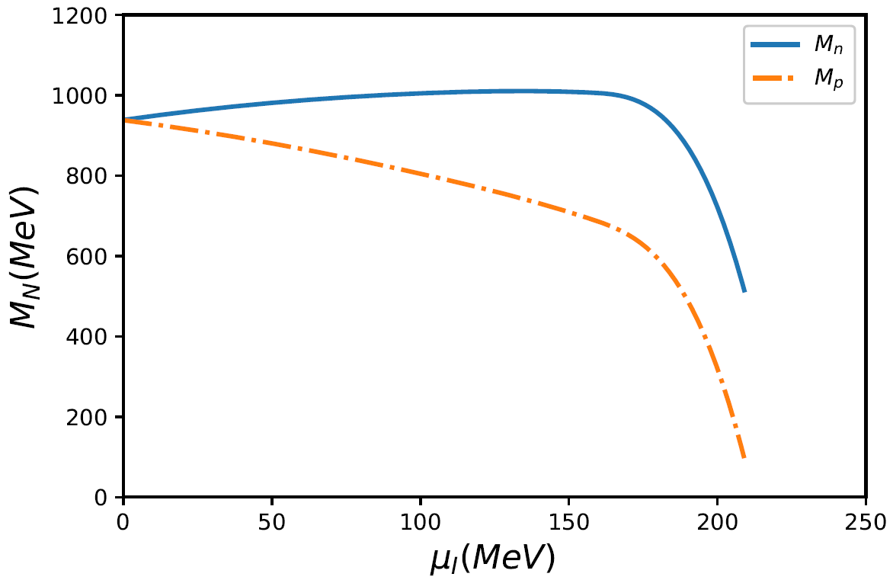


4. Static properties of Skyrmions
4.2 A phase transition from normal phase to a pion condensed phase
Stable soliton solutions do not exist!
Critical value: $μ_{I}=\sqrt{3/2}m_{π}$
Not equal to $m_{π}?$

Slide 28
4. Static properties of Skyrmions
4.2 A phase transition from normal phase to a pion condensed phase
Stable soliton solutions do not exist!
Critical value: $μ_{I}=\sqrt{3/2}m_{π}$
Not equal to $m_{π}?$

Slide 29
5. Summary and outlook
We find that there is an ample parameter space in the NJL-type model calculations for stable quark matter .Theoretically supports quark stars as viable alternative physical model for neutron stars.
Both nonstrange and strange quark stars can, in general, reconcile with the available mass and radius constraints from observational data.
For the study of including the diquark channels for superconducting phase in NJL-type model, the competition between diquark condensates and chiral condensates result in changing the properties of phase transition. For future studies, neutral conditions should be imposed the application to the CSC compact stars.
Consider the axial deformation of soliton configuration at finite isospin chemical potential.

Slide 30
Thank you!

Slide 31
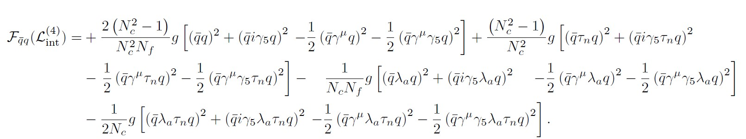
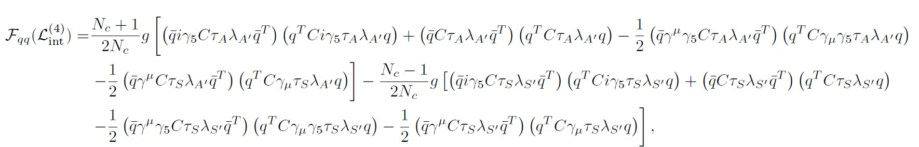
Color superconducting quark matter
Two flavor color superconductivity:
NJL-type model: consider the diquark interactions self-consistently

Slide 32
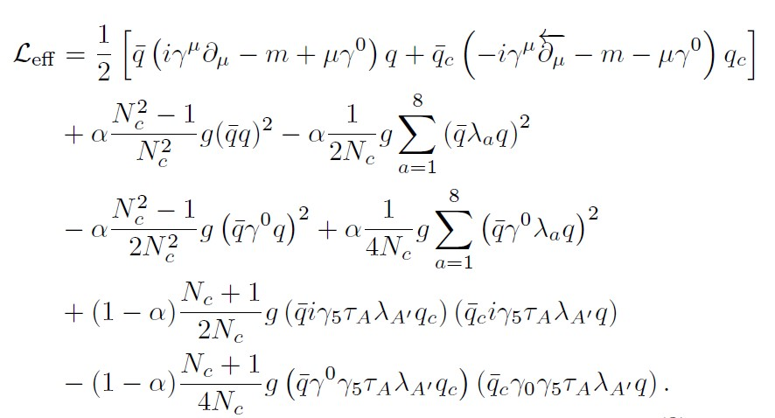






Color superconducting quark matter
Two flavor color superconductivity:
NJL-type model: consider the diquark interactions self-consistently
Under mean field approximation:
$$G_{S}^{(0)}$$
$$G_{S}^{(8)}$$
The quark-antiquark channels: chiral condensate
The quark-quark channels:
diquark condensate
$$G_{V}^{(0)}$$
$$G_{V}^{(8)}$$
$$G_{D1}$$
$$G_{D2}$$

