Slide 1

第十五届QCD相变与相对论重离子物理研讨会
The QCD phase transition intrigued by turbulence
报告人：黄安平
合作者：黄梅
中国科学院大学 核科学与技术学院
2023年12月17日
Notes:
My topic is thermal production of charms and charmonia in quark-gluon plasma. This work is collaborated with Kai Zhou, Carsten Greiner and Pengfei Zhuang.

Slide 2
Outline
Introduction
Framework
Results
Conclusion and Future
Notes:
This is the outline of my talk. Firstly, I will give a introduction. Then I will describe thermal production of charms in QGP. Subsequently, the mechanism of thermal charmonium production in QGP will be also indicated. I will present our numerical results on thermal production of charms and charmonia at LHC energy 2.76TeV and 5.5TeV and FCC energy 39TeV. At the end I will give summary for our work.

Slide 3
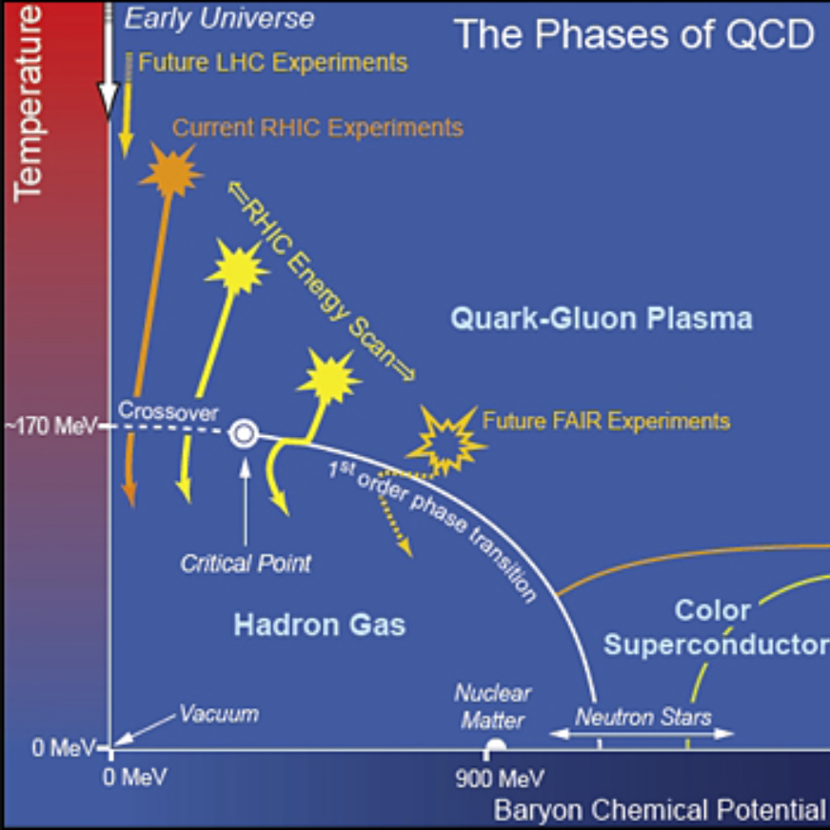
Introduction-background
USA-NSAC 2007 Long-range Plan

Slide 4
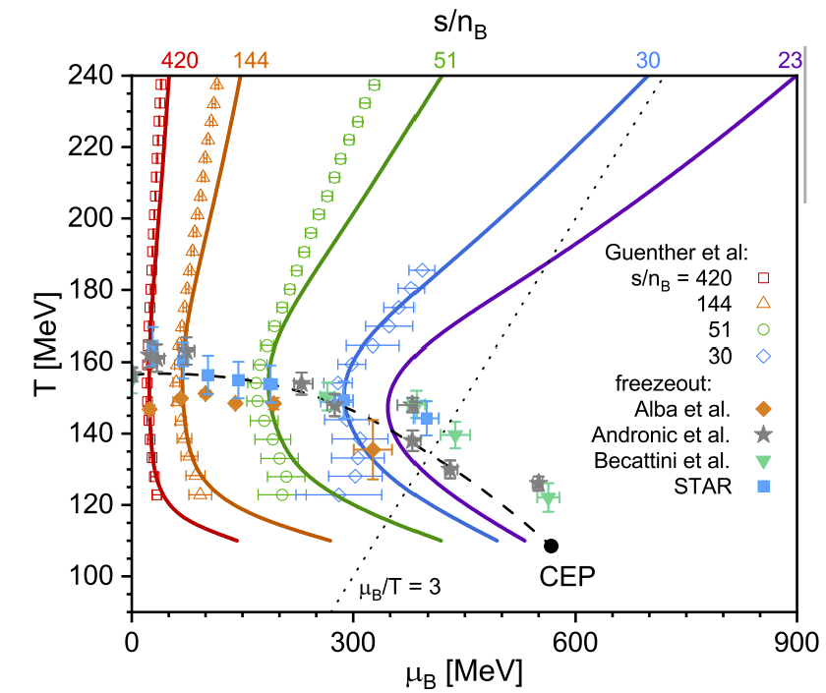
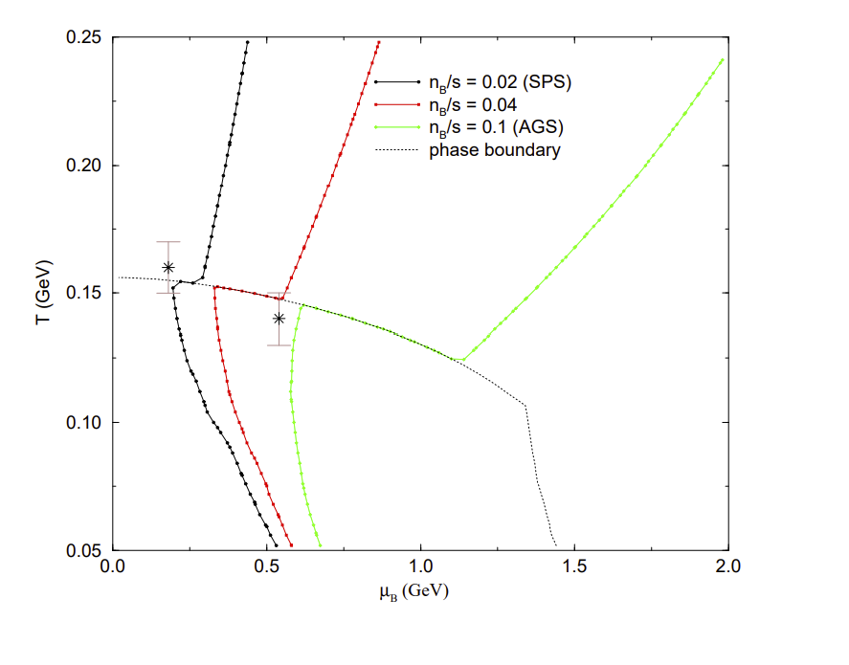
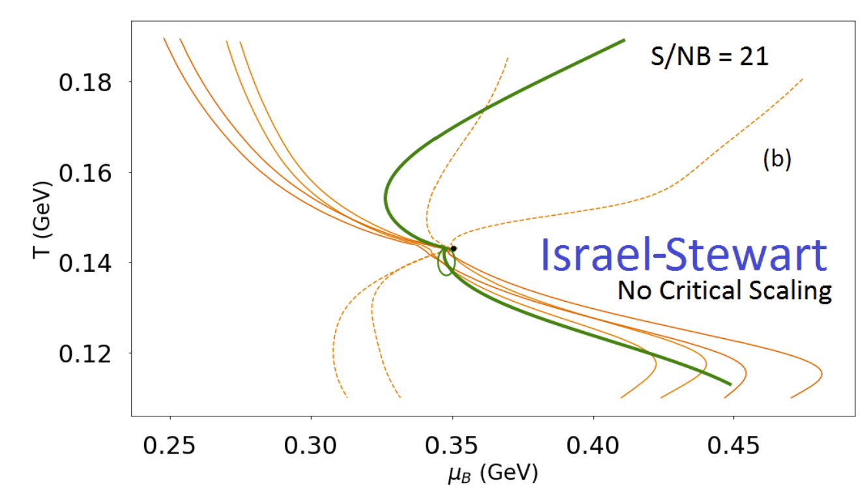
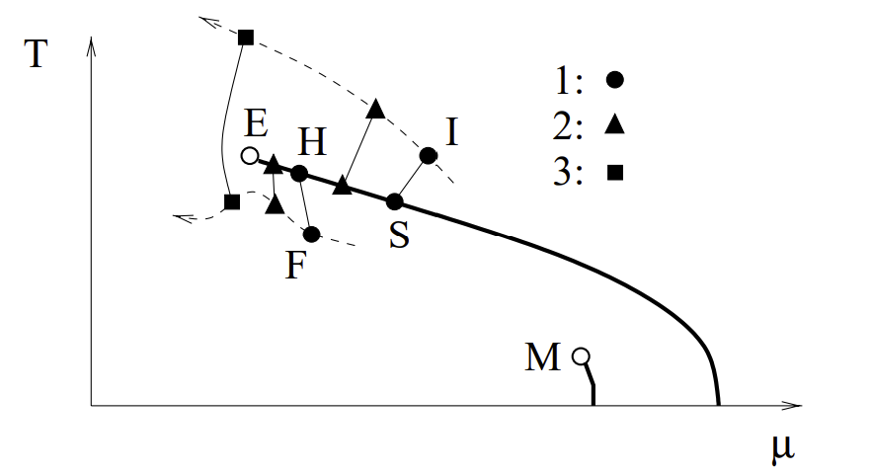
Introduction-background
Yi Lu, Fei Gao, etc, 2310.18383
C. M. Hung, E. Shuryak, Phys. Rev. C 57, 1891 (1998).
M Stephanov，Phys.Rev.Lett. 81 (1998) 4816-4819
J. N.Hostler:2007.15083

Slide 5
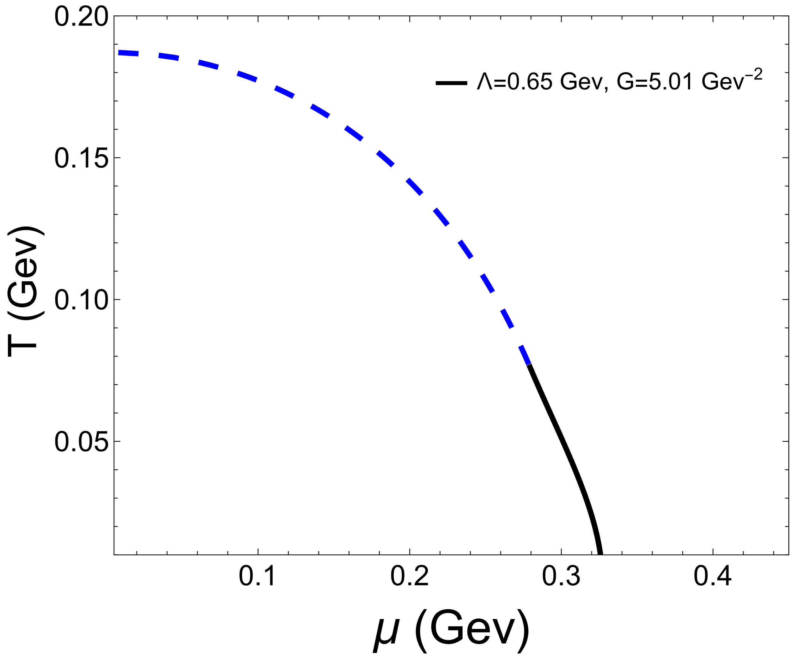
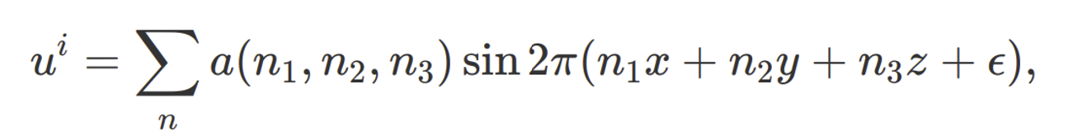
Introduction-motivation
Fluctuations induced by turbulence
Let's explore how the QCD system evolves in the presence of fluctuations around the phase transition line, caused by turbulence, as follows.

Slide 6
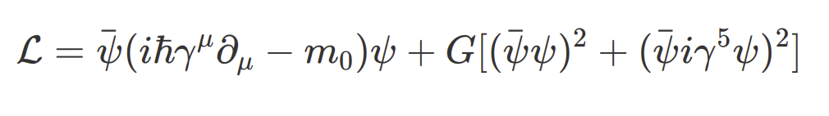

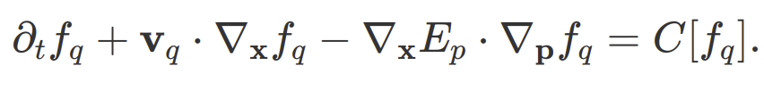
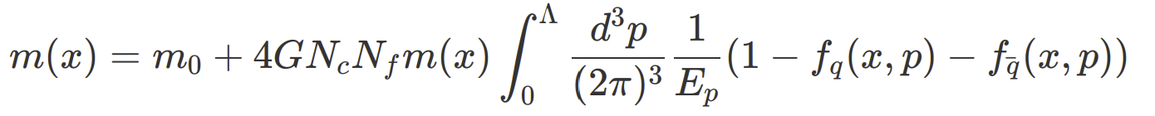
Framework
Our theoretical framework relies on the integration of the transport equation with the gap equation.
transport equation:
Gap equation:
Che Ming Ko, et al, Nucl.Phys.A 928 (2014) 234-246.
P. Rehberg, et al, Nucl.Phys.A 653 (1999) 415-435.
WeiMin Zhang, et al, Phys.Rev.C 45 (1992) 1900-1917.
Pengfei Zhuang, et al, Quantum transport theory and nonequilibrium chiral condensates.
Abdellatif Abada, Chiral Phase Transition in an Expanding Quark-Antiquark Plasma.

Slide 7
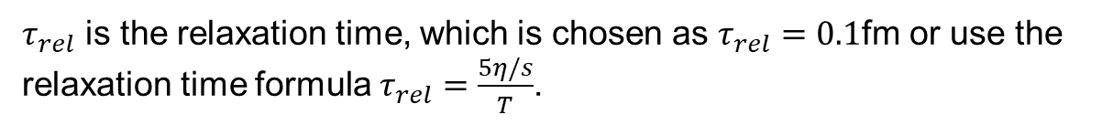
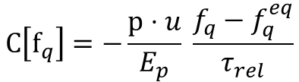

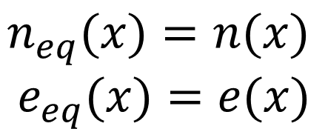

Framework
For simplicity, we chose the collision term with the relaxation time model.
$$C\left[f_{q}\right]=−\frac{p⋅u}{E_{p}} \frac{f_{q}−f_{q}^{eq}}{τ_{rel}}$$
$τ_{rel}$ is the relaxation time, which is chosen as $τ_{rel}=0.1$fm or use the relaxation time formula $τ_{rel}=\frac{5η/s}{T}$.
$$f_{q/\overline{q}}^{eq}=\frac{1}{e^{(p⋅u∓μ(x))/T(x)}+1}$$
herein, the temperature and chemical potential are fixed by the matching conditions for number density and energy at every space-time point, i.e
$$n_{eq}(x)=n(x)$$
$$e_{eq}(x)=e(x)$$
$$μ\left(x\right), T(x)$$

Slide 8
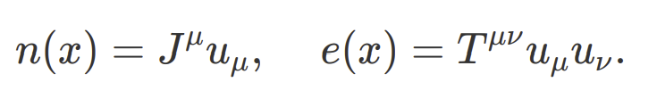
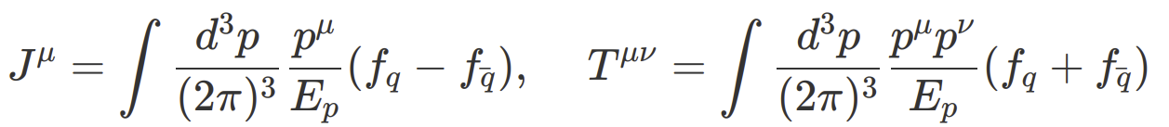
Framework
While the number density n(x) and energy density e(x) are defined by the following
The current density $J^{μ}(x)$and stress tensor density $T^{μν}(x)$are defined by the following,

Slide 9
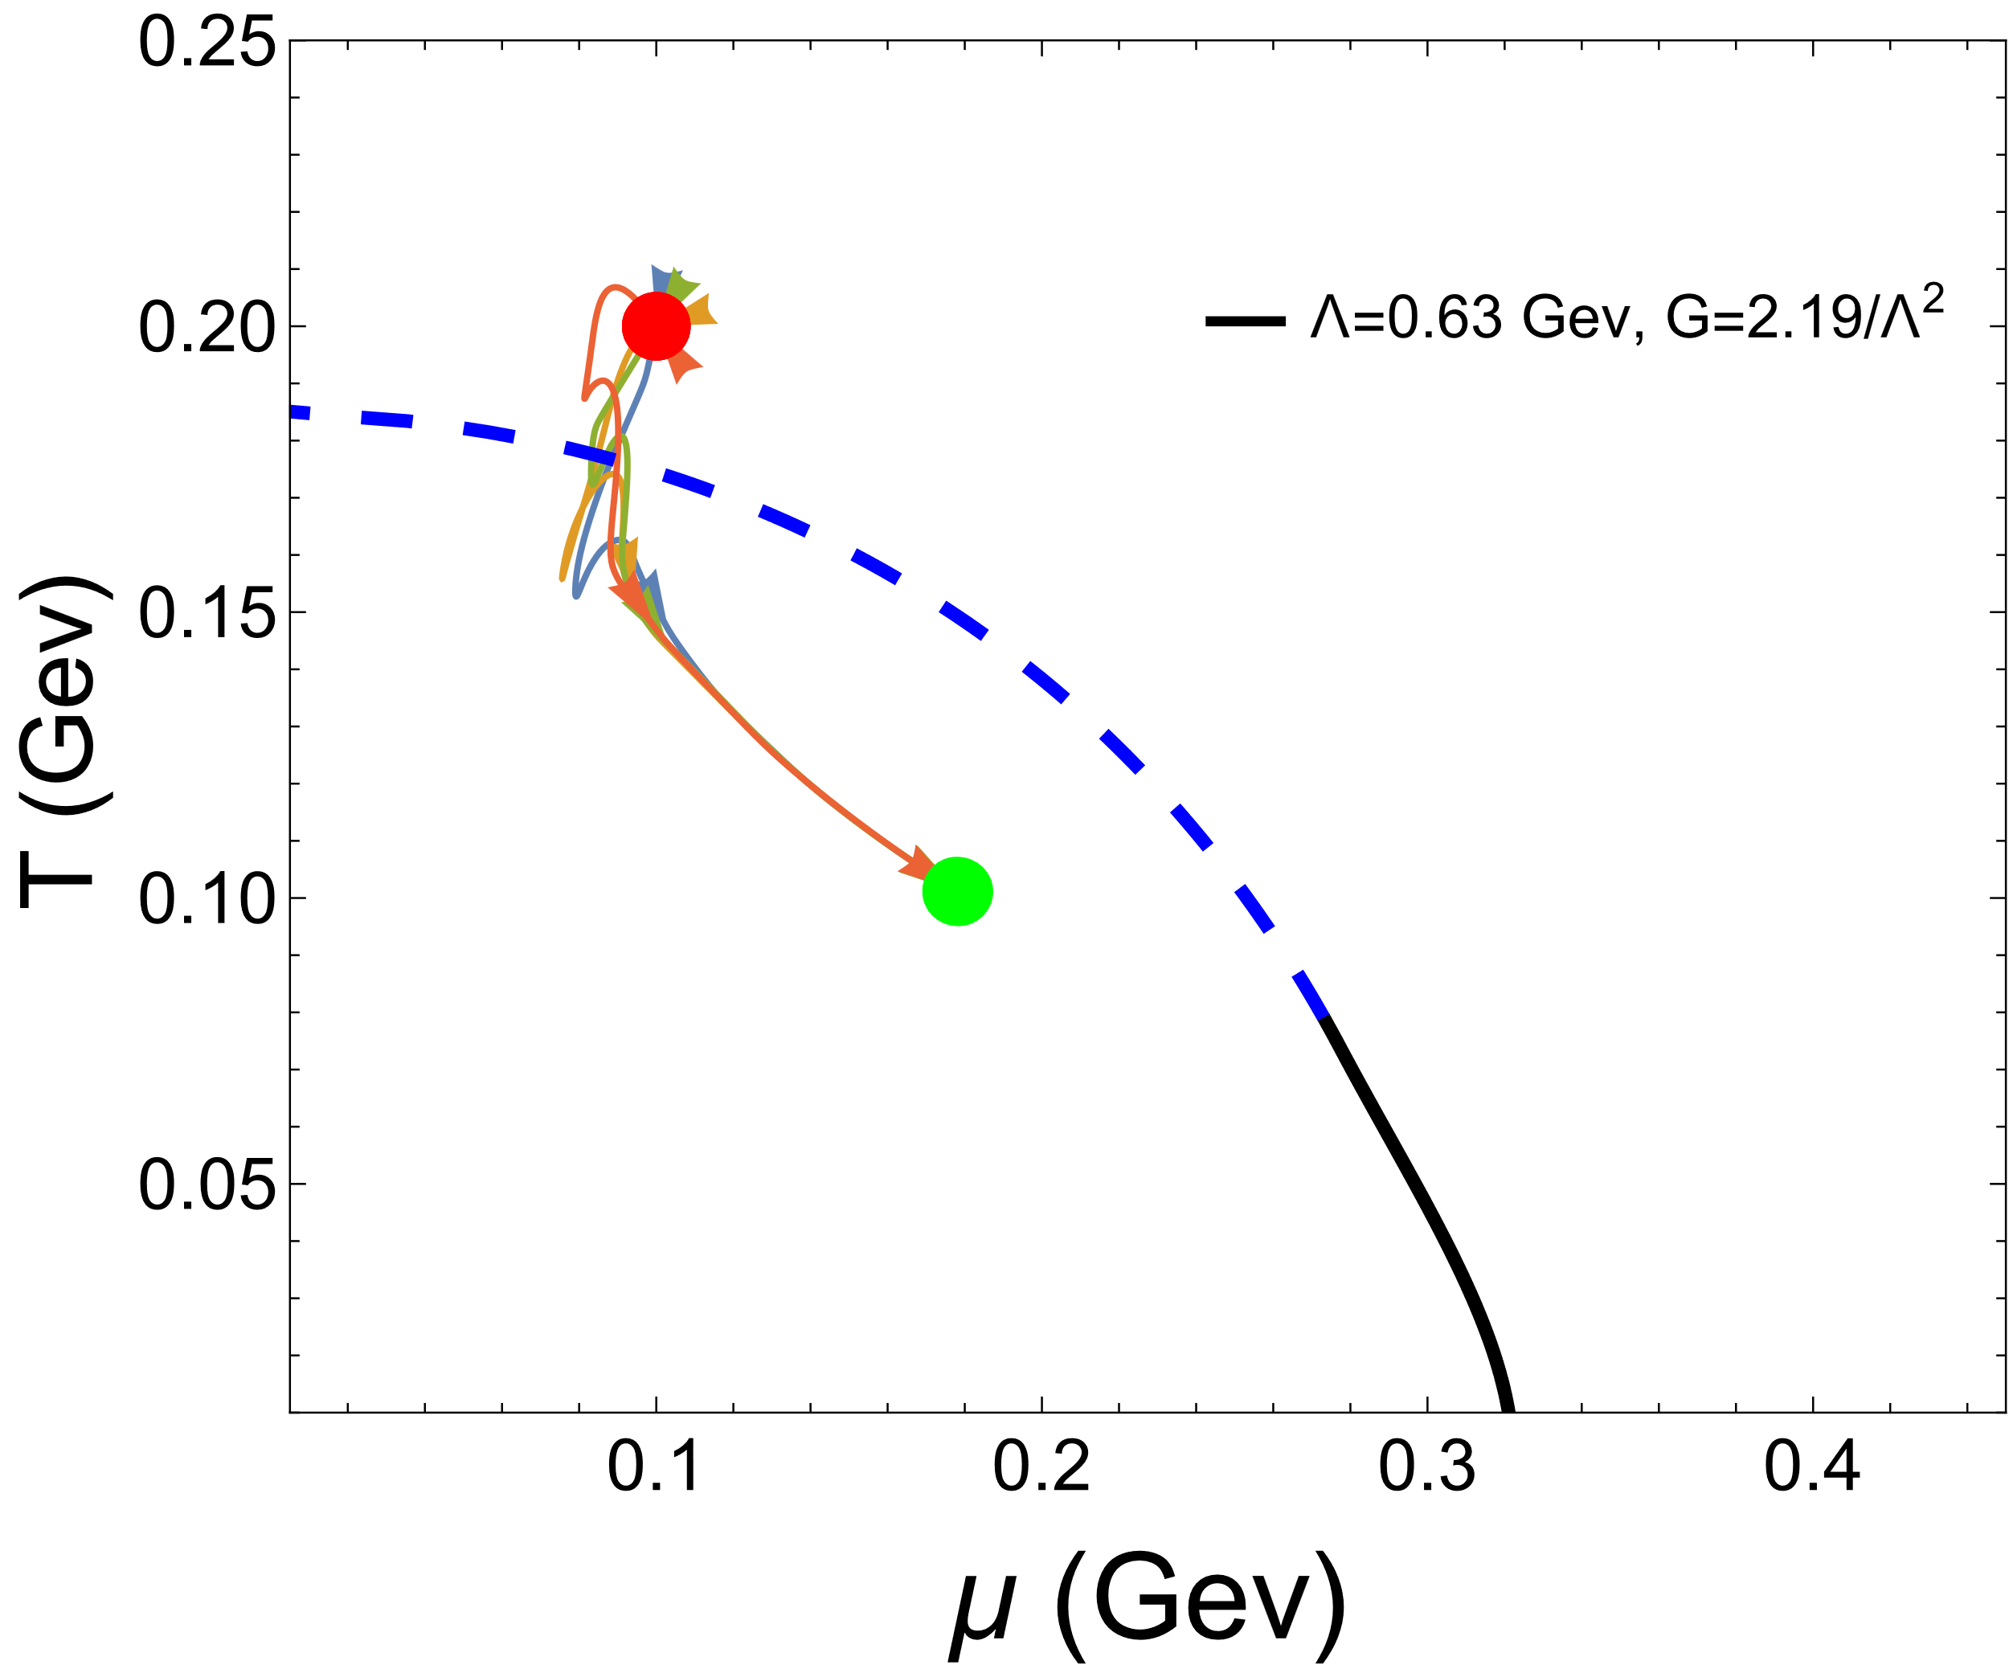
Results
1. The evolution of the system on the plane of (T-$μ$)
Red point is starting point, green point is end point.
Each trajectory represents the evolutionary path of a point within a system.

Slide 10
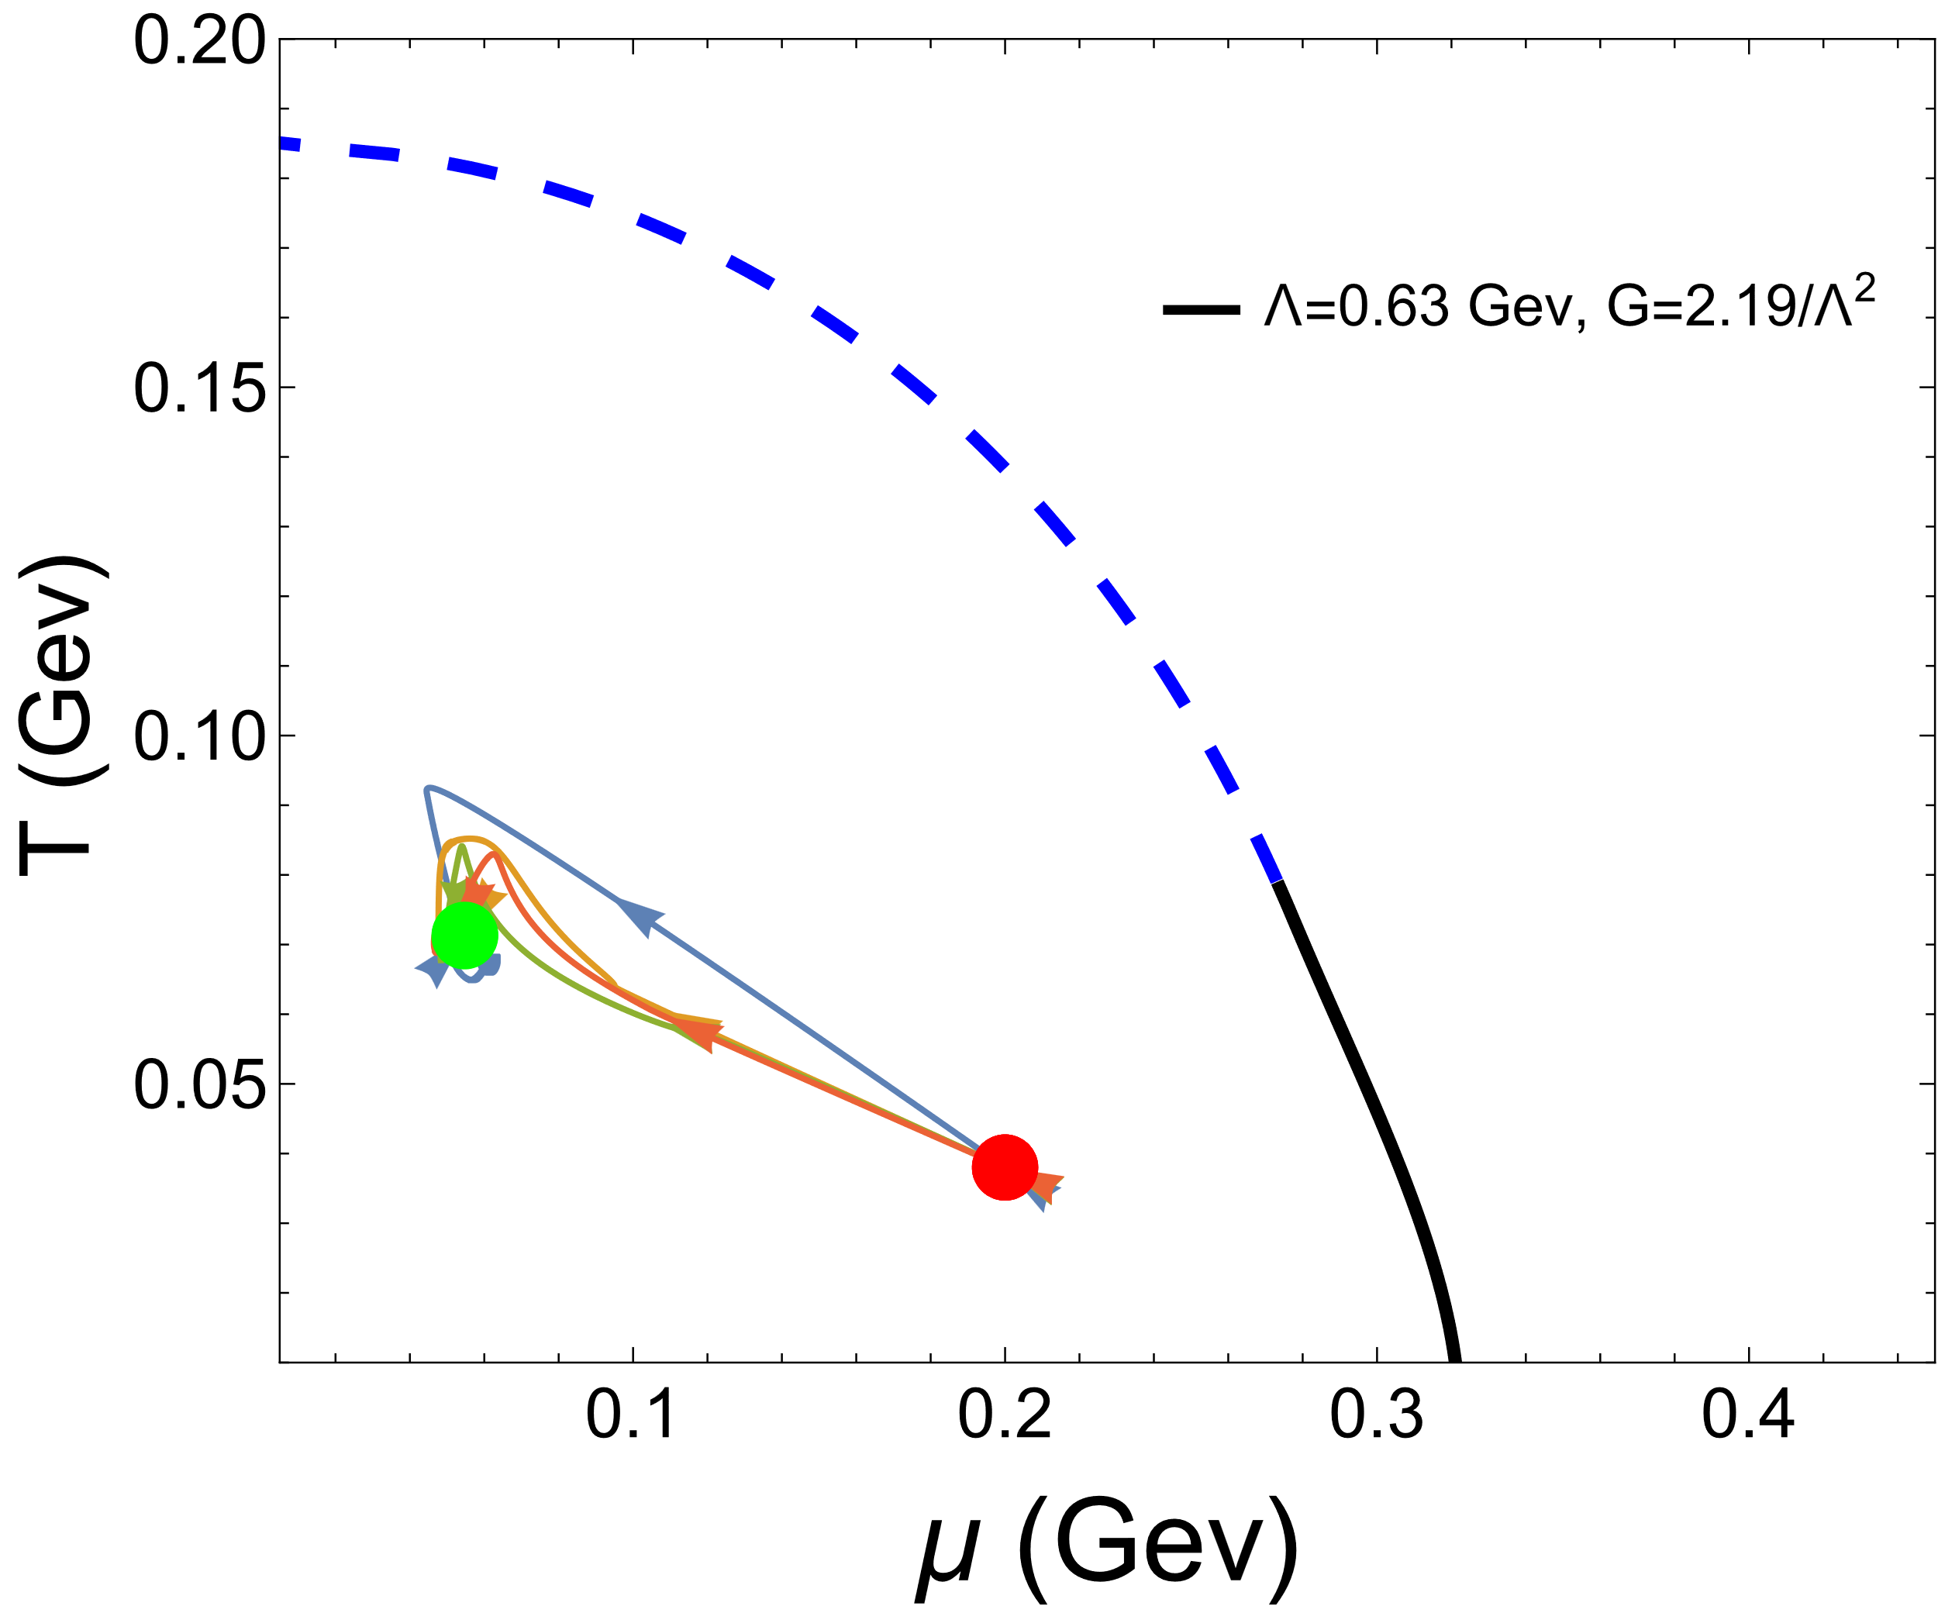
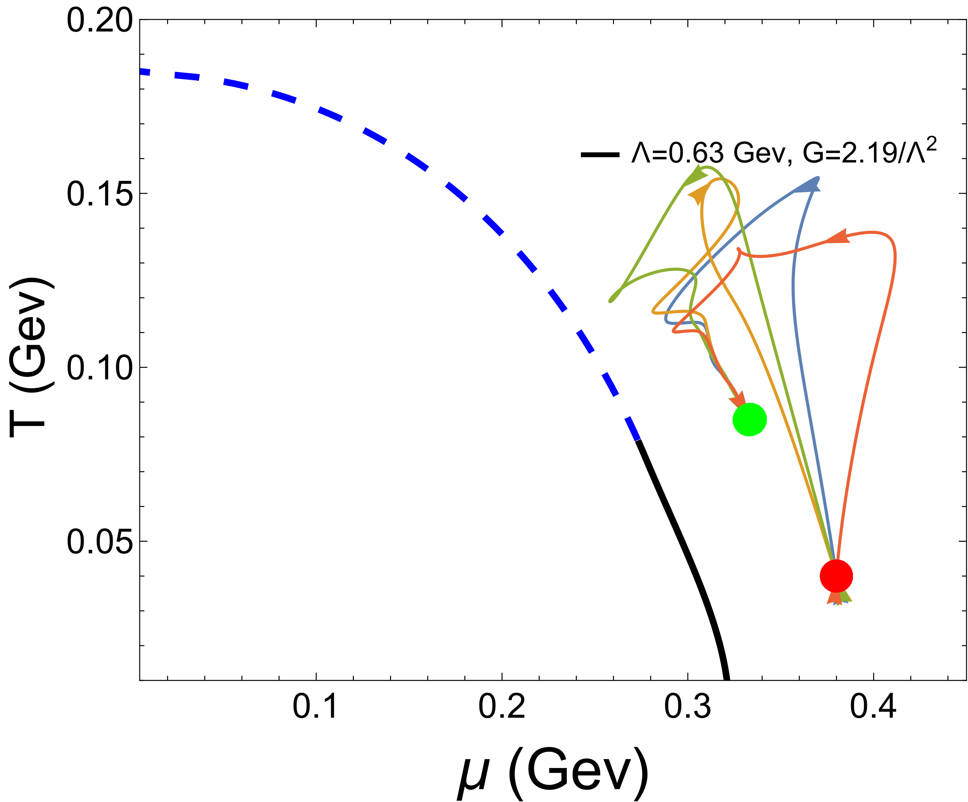
Results
1. The evolution of the system on the plane of (T-$μ$)
far from PT line at hadron phase
far from PT line at QGP phase
Each trajectory represents the evolutionary path of a point within a system.

Slide 11
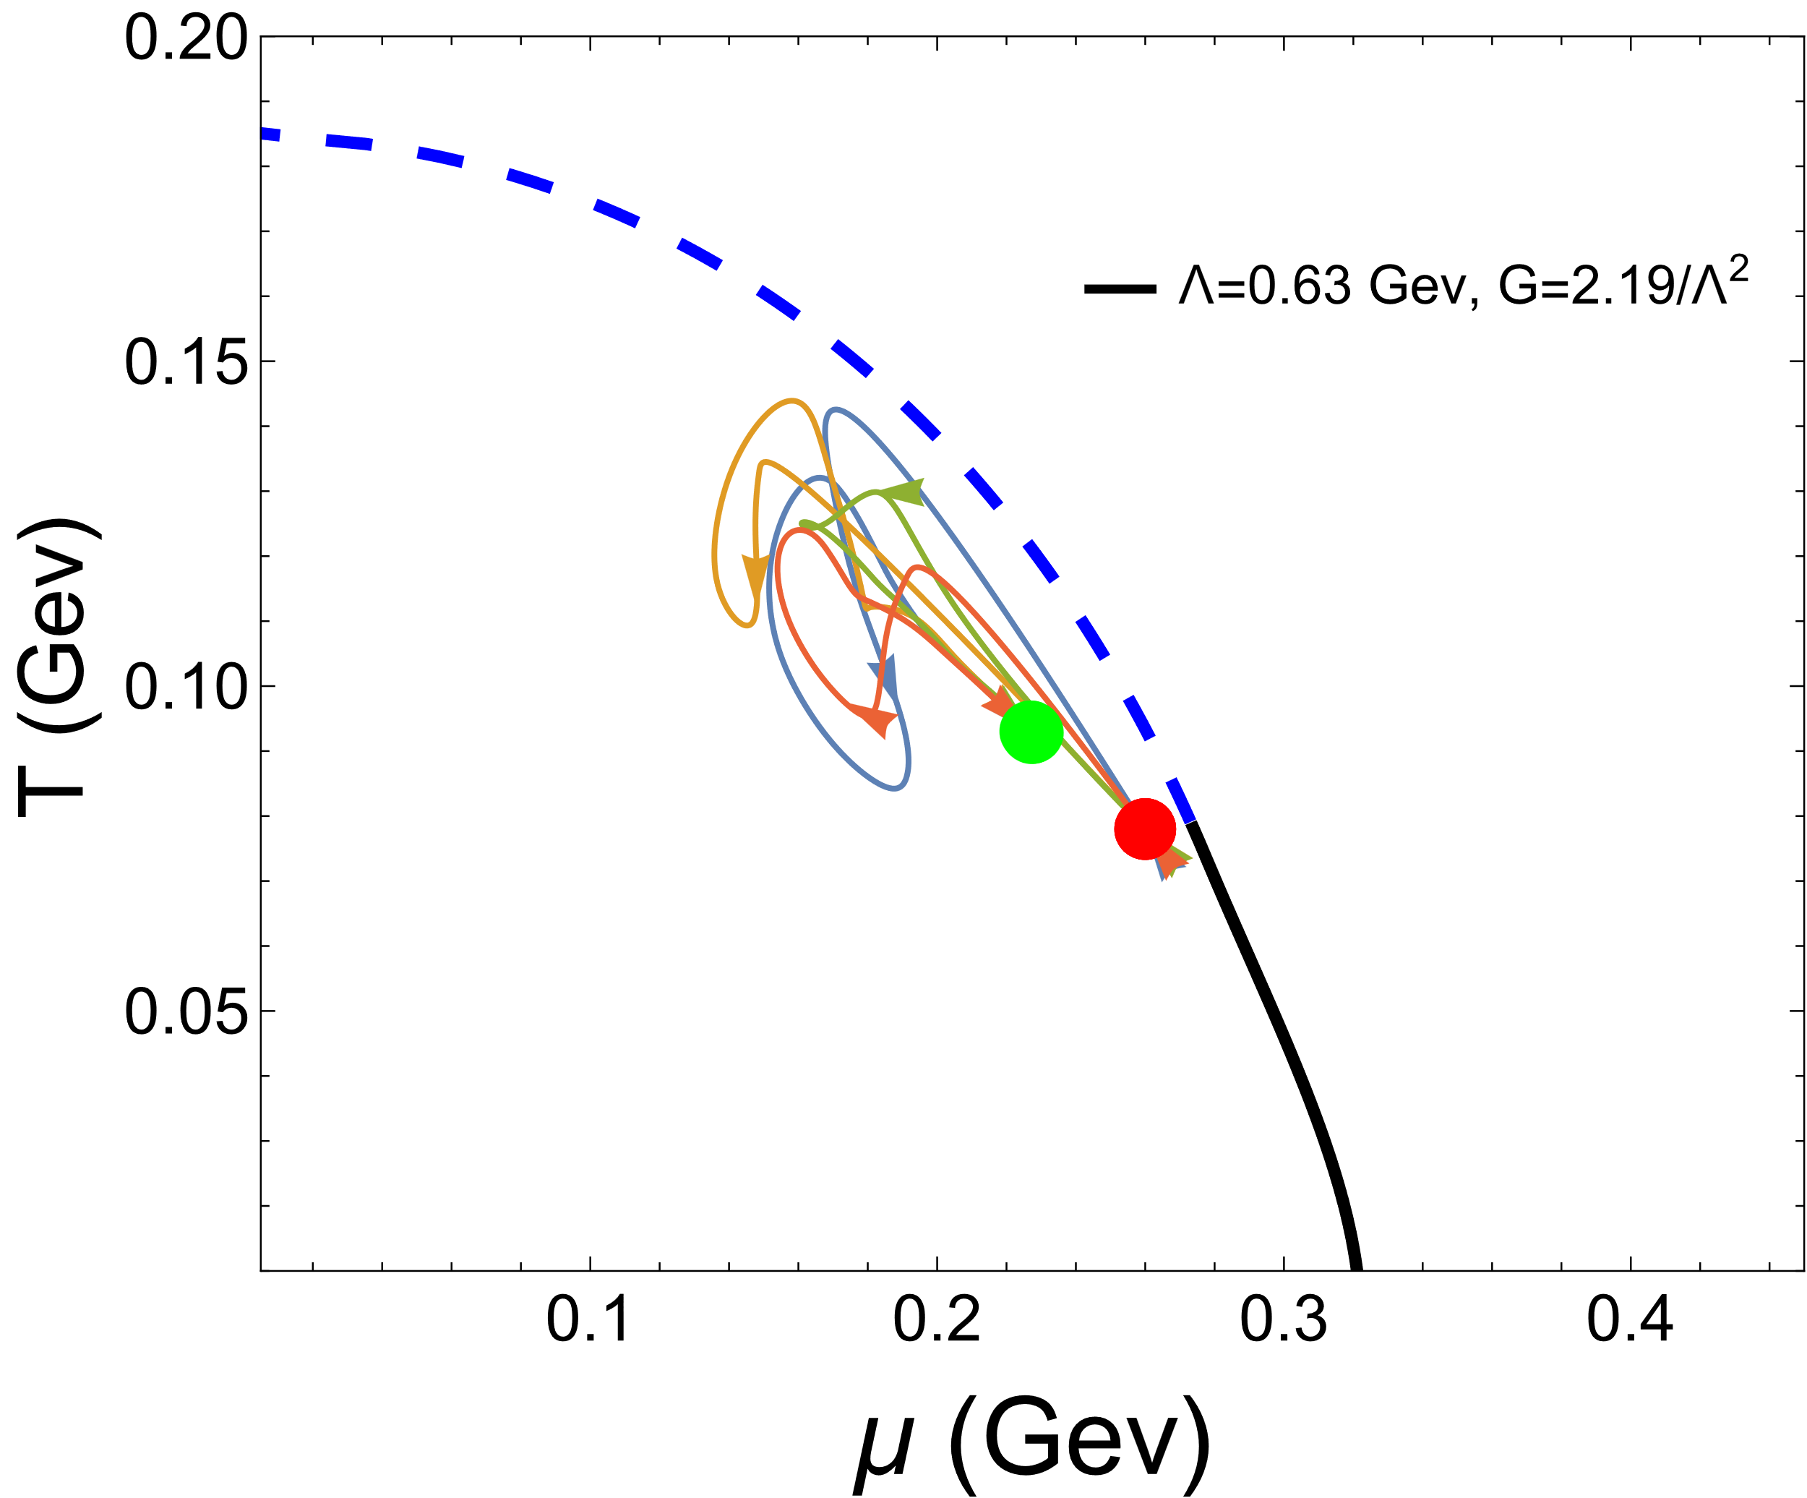
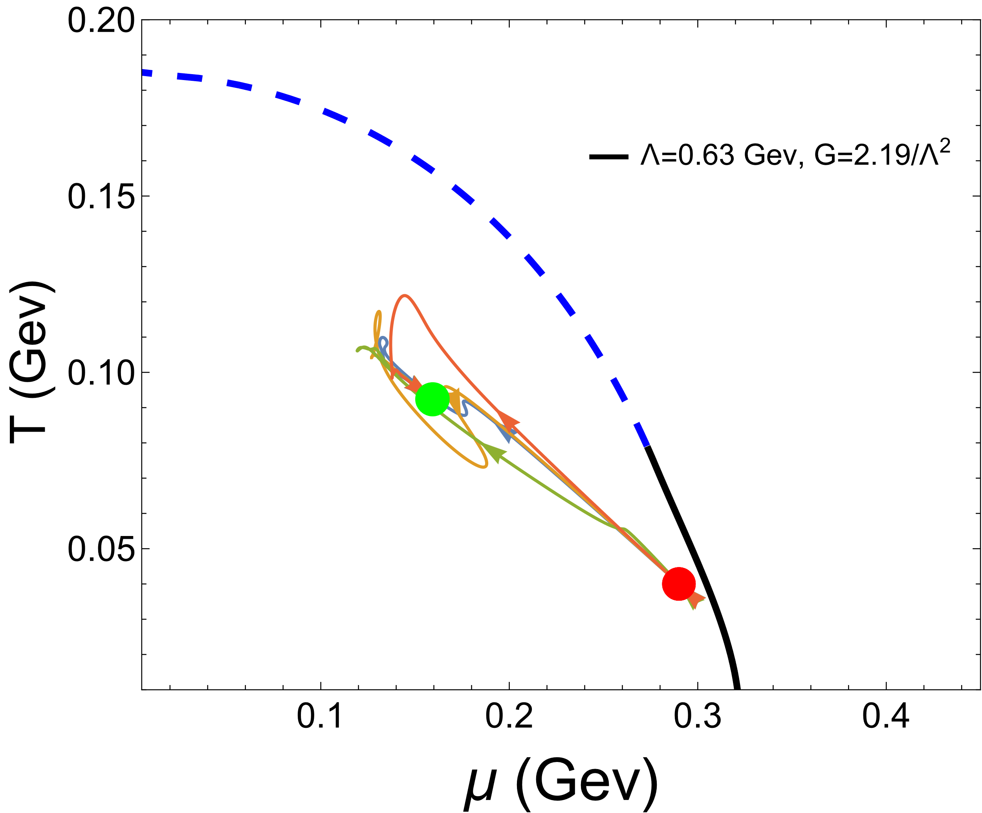
Results
1. The evolution of the system on the plane of (T-$μ$)
near the CEP at left-hand side
far from the CEP at left-hand side
Each trajectory represents the evolutionary path of a point within a system.

Slide 12
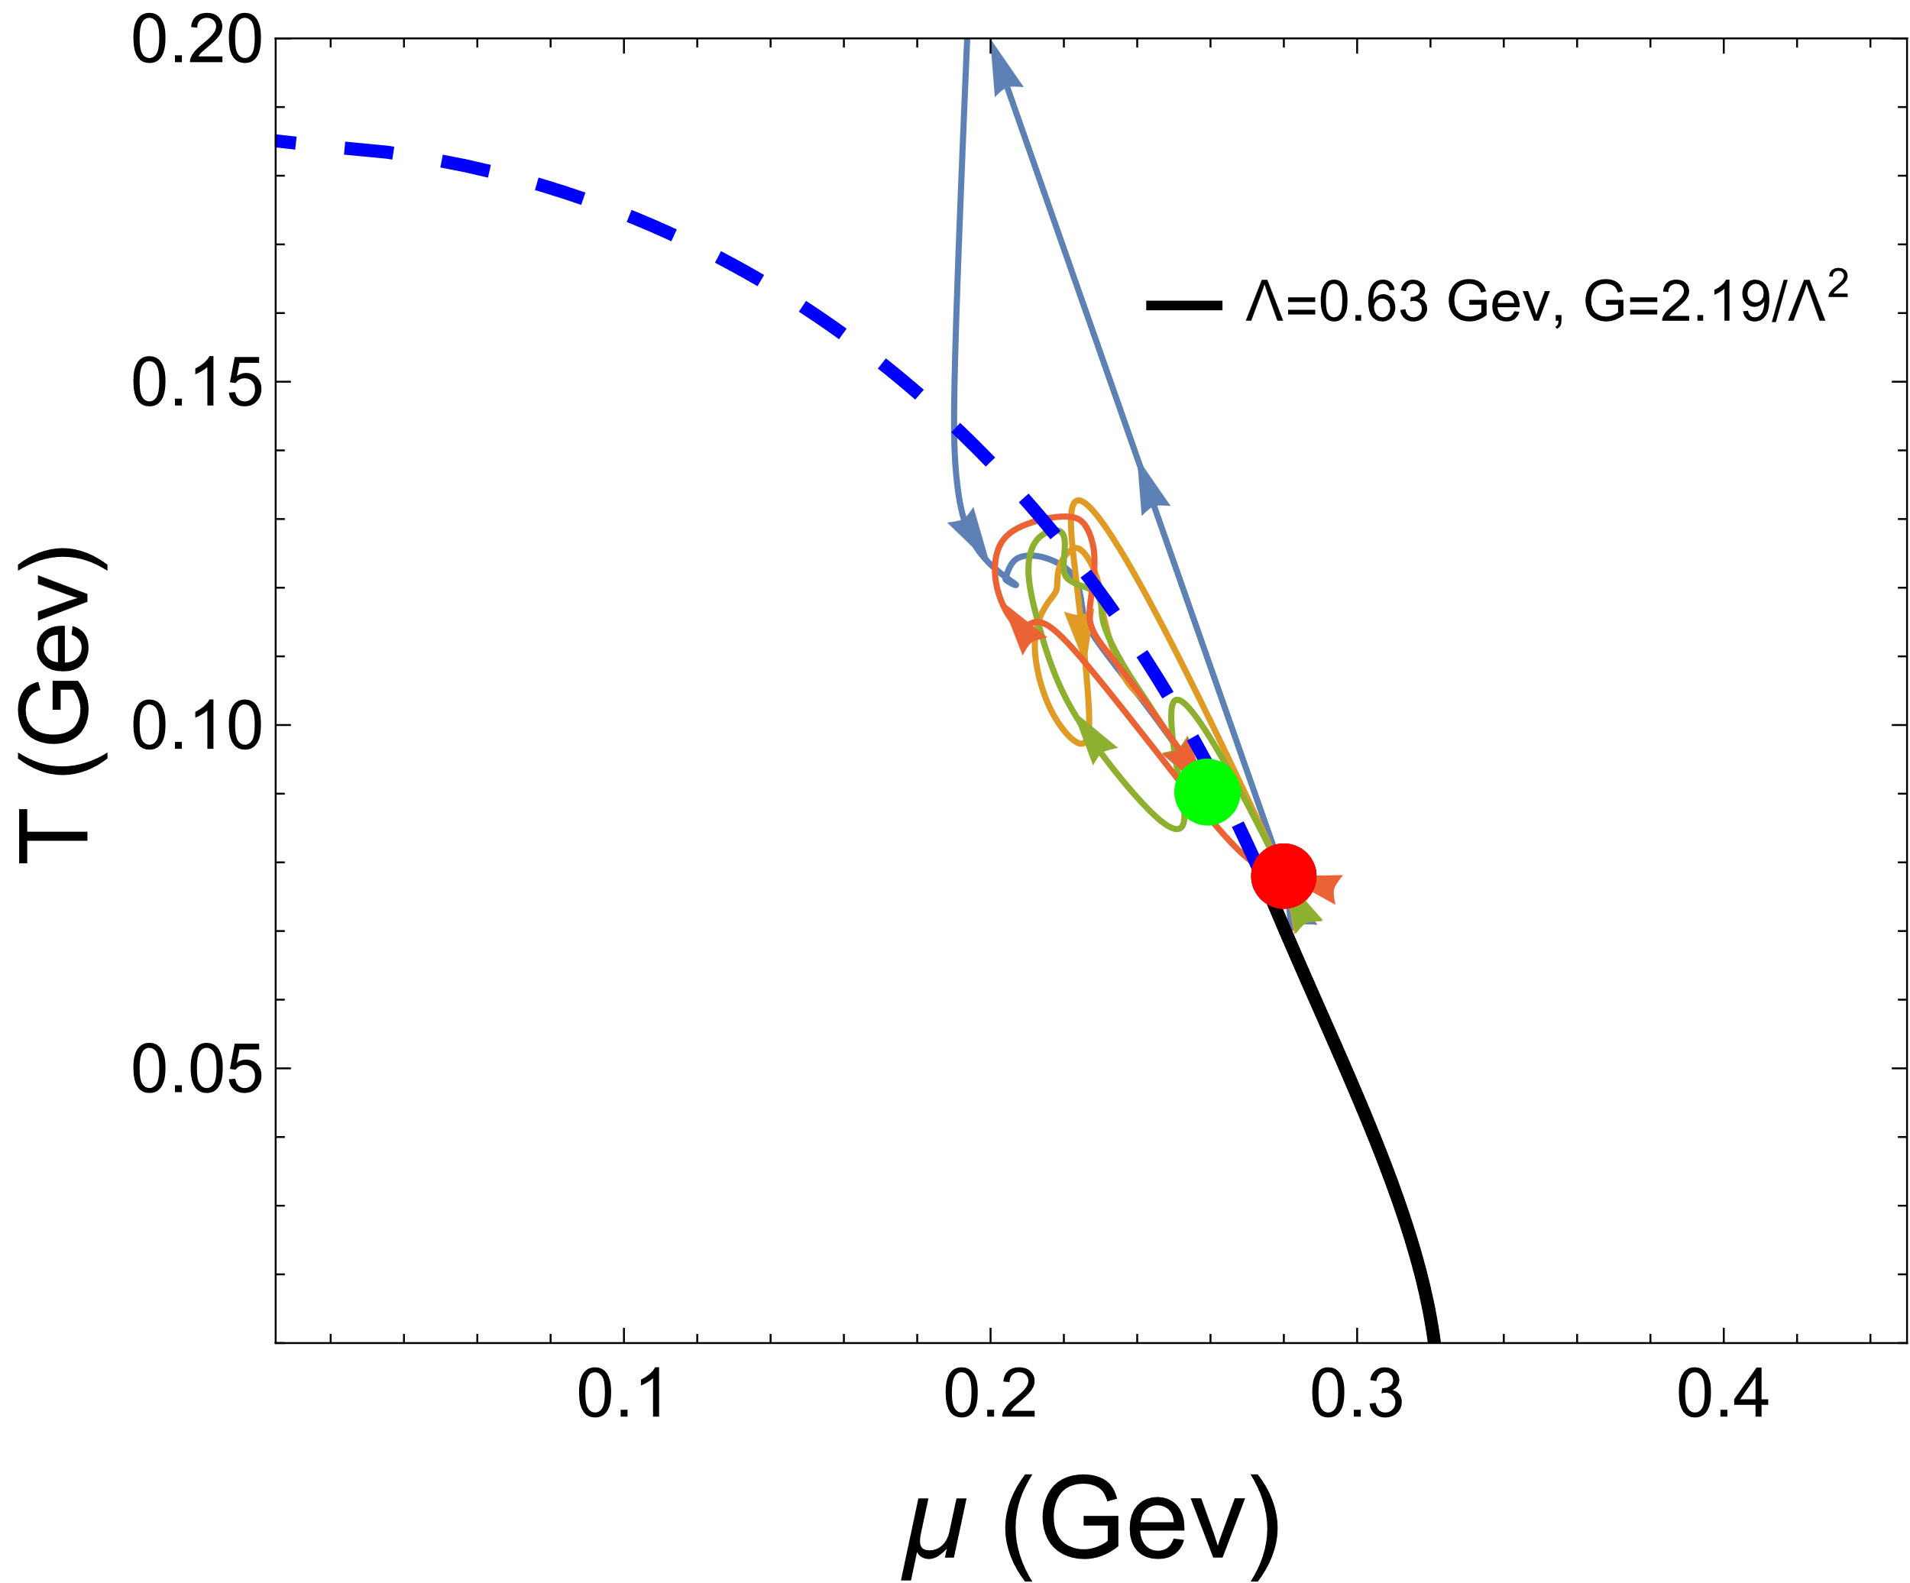
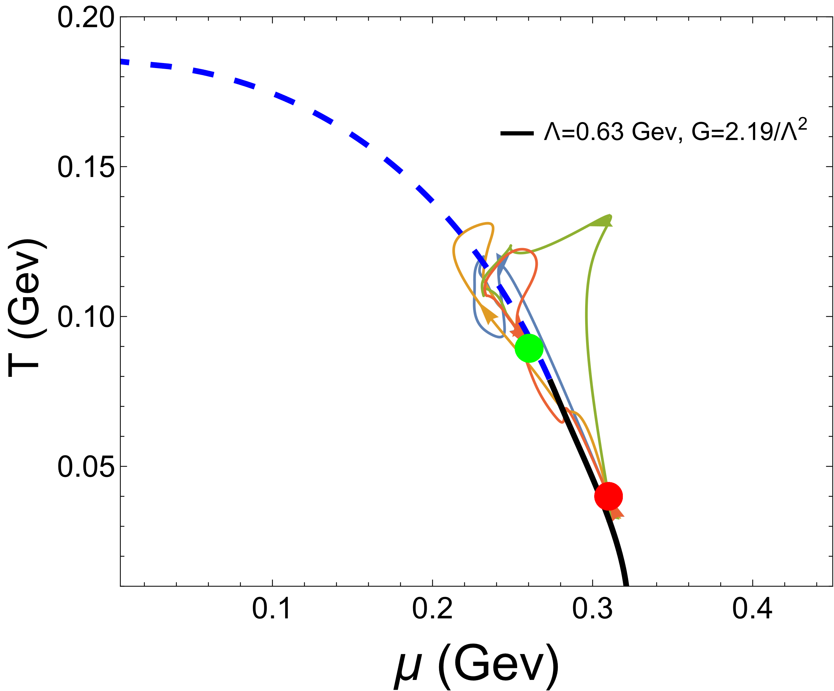
Results
1. The evolution of the system on the plane of (T-$μ$)
The CEP acts as an attractor.
near the CEP at right-hand side
far from the CEP at right-hand side
Each trajectory represents the evolutionary path of a point within a system.

Slide 13
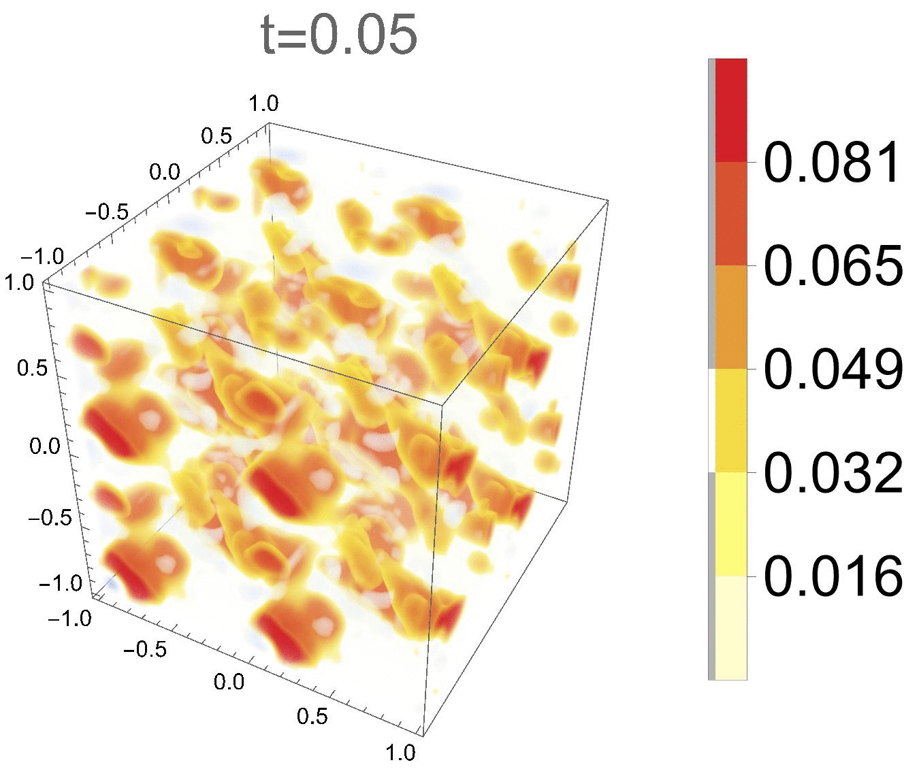
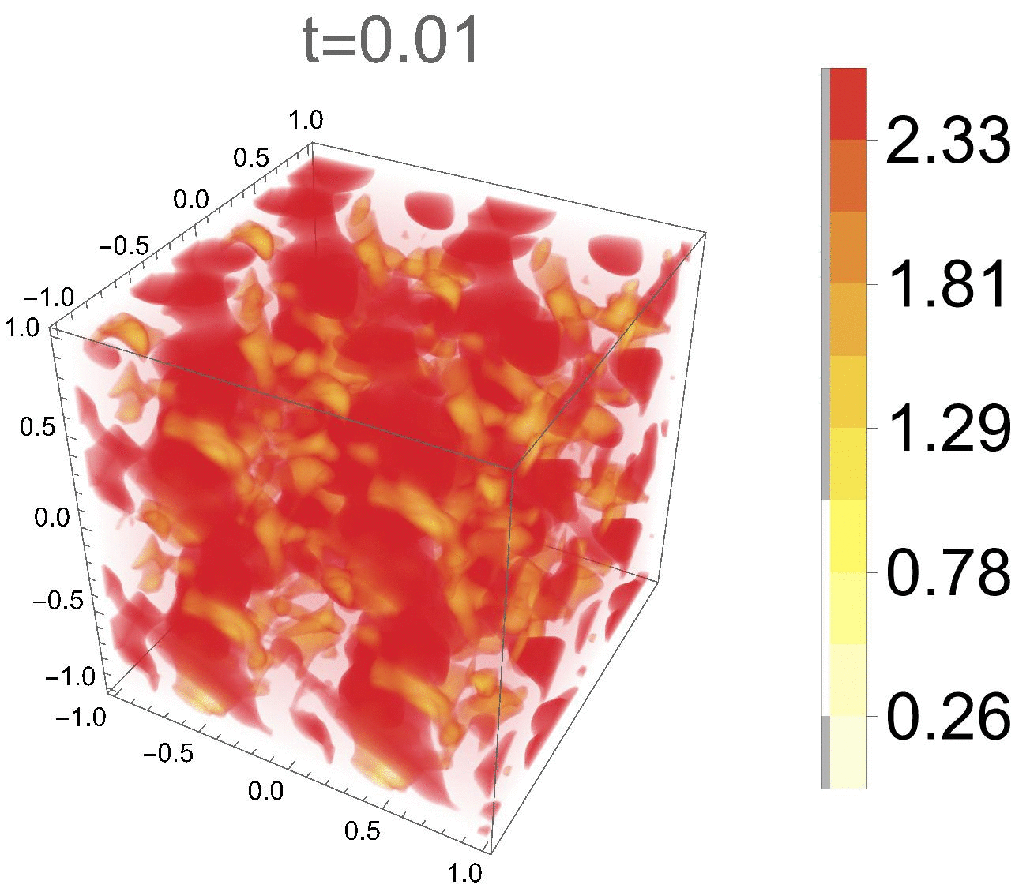




Results
2.The evolution of number density and vorticity
$$n(x,y,z)$$
$$ω(x,y,z)$$
The evolution of the system tends to a stable state.
$$ω={\left(ω_{x}^{2}+ω_{y}^{2}+ω_{y}^{2}\right)}^{1/2}$$

Slide 14
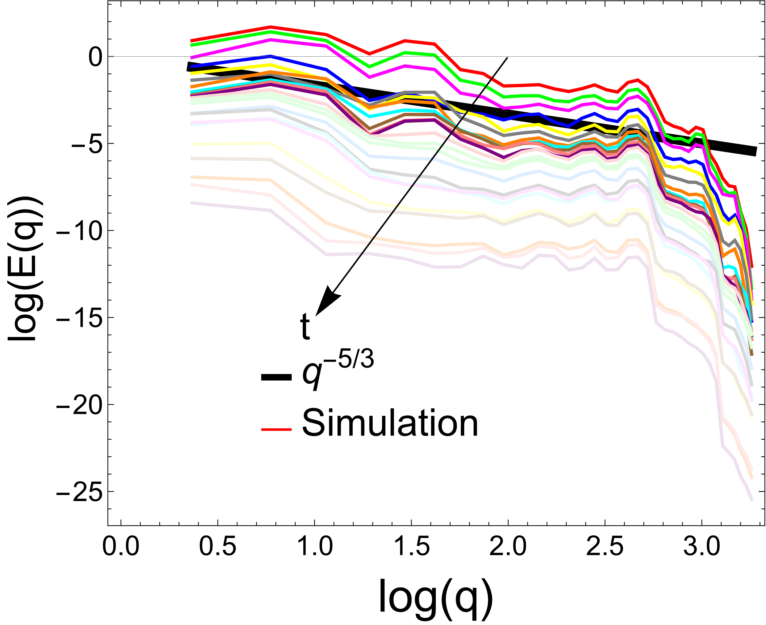
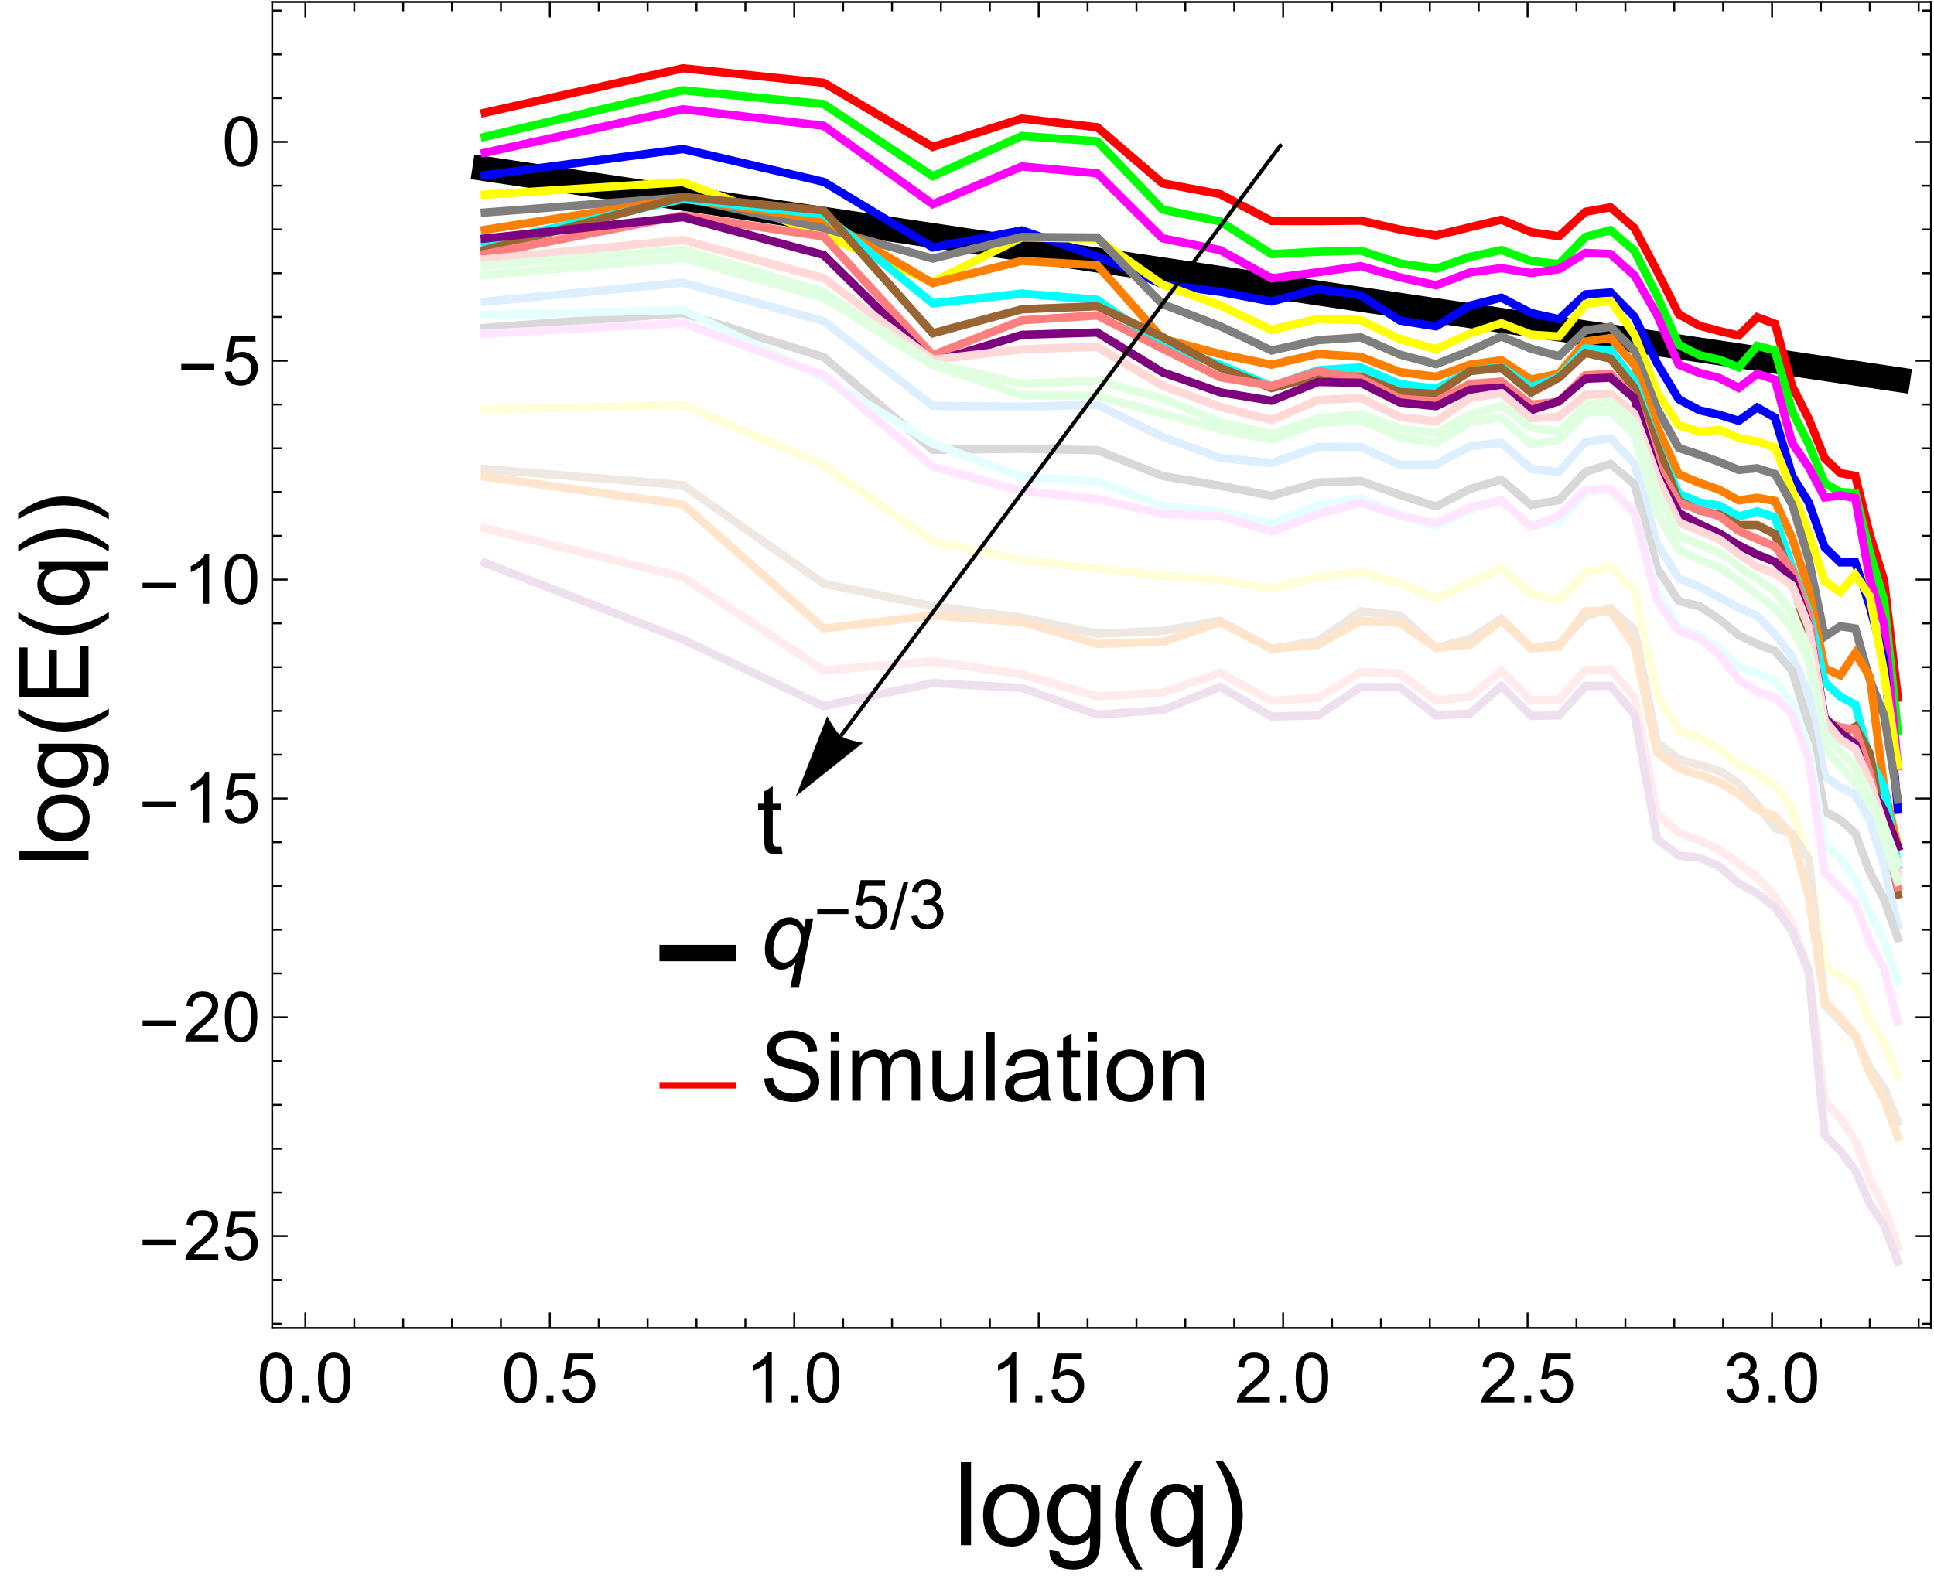
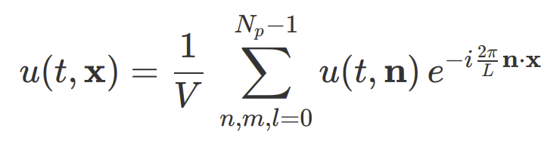
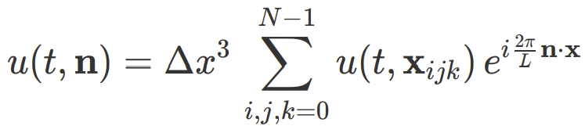

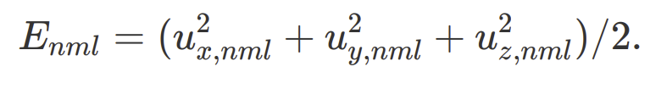
Results
4.The turbulence properties
Initialized near PT line
Initialized above cross-over line

Slide 15
Conclusion and Future
We plot the evolutionary trajectory of the QCD system on the phase diagram under the influence of turbulence-induced fluctuations.
The CEP acts as an attractor, but the mechanics behind this are not yet fully understood. We are currently endeavoring to comprehend it through the non-linear equations of temperature and chemical potential.

Slide 16
Thank You!

Slide 17
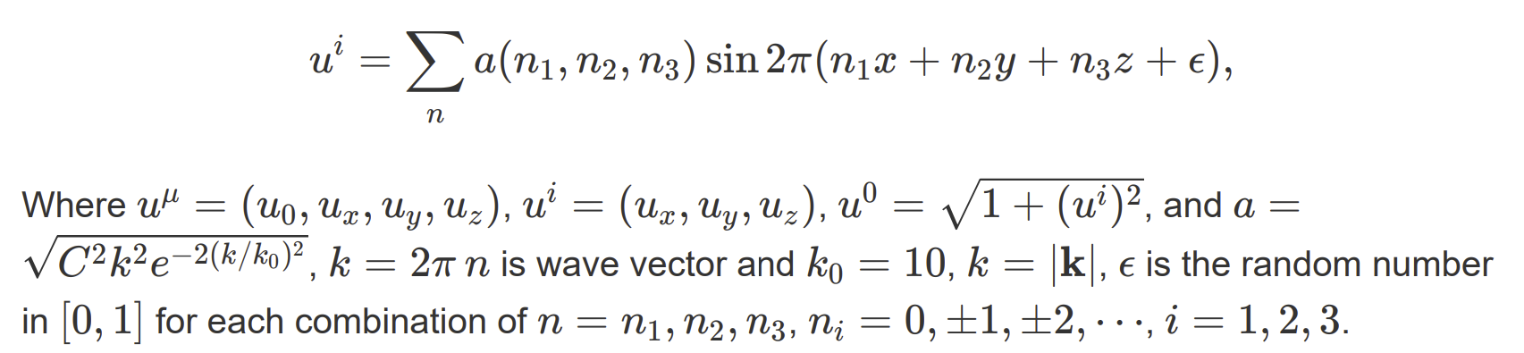
Appendix: turbulence
The isotropic turbulence can be given by the following
1. A. Sakurai and F. Takayama. Molecular kinetic approach to the problem of compressible turbulence.
2. V.V. Aristov and O.I. Rovenskaya. Application of the Boltzmann kinetic equation to the eddy problems.

Slide 18
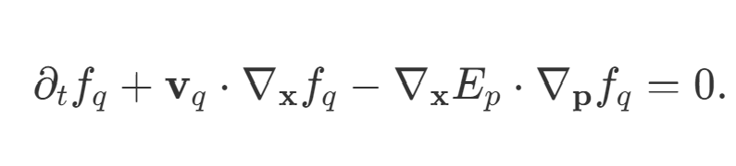
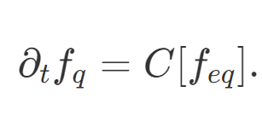
Appendix: Algorithm
The transport equation will be split into two steps.
1. The first step is to describe the free-streaming of particles.
To solve this part, we can use the QUICK algorithm or WENO method.
2. The second step is collision term

Slide 19

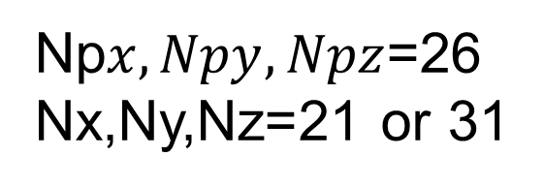
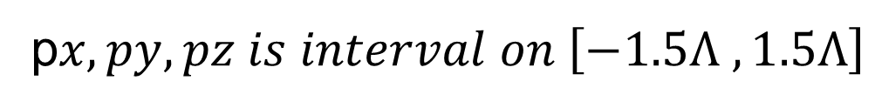
Appendix: Algorithm
We use the boundary conditions as follows
f$\left(x+1,y+1,z+1, \vec{p}\right)=f(x,y,z, \vec{p})$
The grid of phase space
$$x,y, z is interval on \left[−1,1\right]fm$$
p$x,py, pz is interval on \left[−1.5Λ ,1.5Λ\right]$
Np$x,Npy, Npz$=26
Nx,Ny,Nz=21 or 31

Slide 20
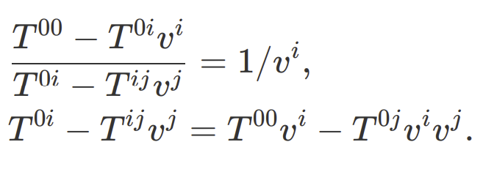




Appendix: velocity
Let use the perturbation method to solve velocity, first let the velocity expanded order by order like as

Slide 21

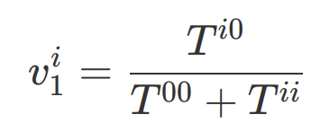
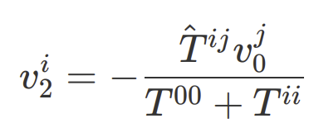
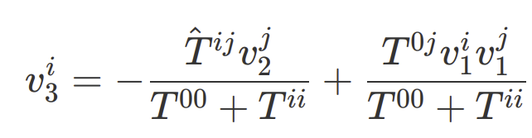
Appendix: velocity
Let assume
Where ${\hat{T}}^{ij}=T^{ij}−T^{ii}$, Then we can now solve the velocity order by order.
the first order
the second order
the third order

Slide 22
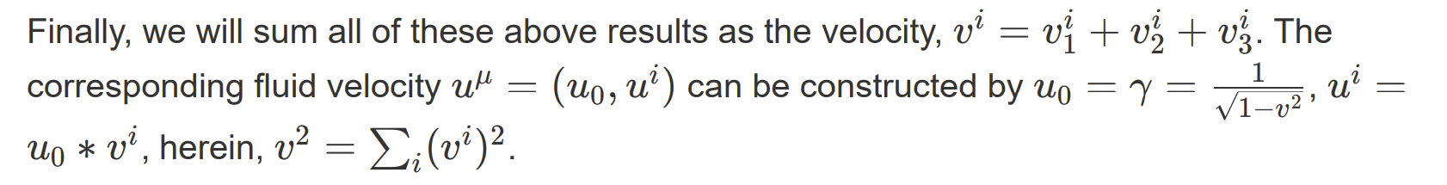
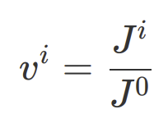
Appendix: velocity

Slide 23
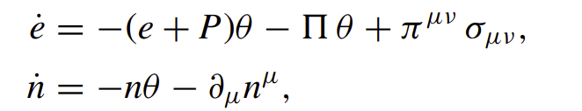
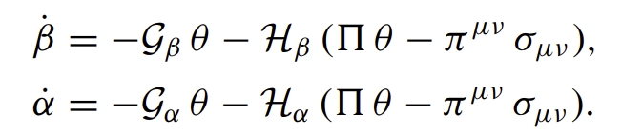
Appendix: Non-linear equations
The Isentropic and Attractor is not easy get in hydro case than the global equilibrium case.
PhysRevC.107.044905

