Slide 1

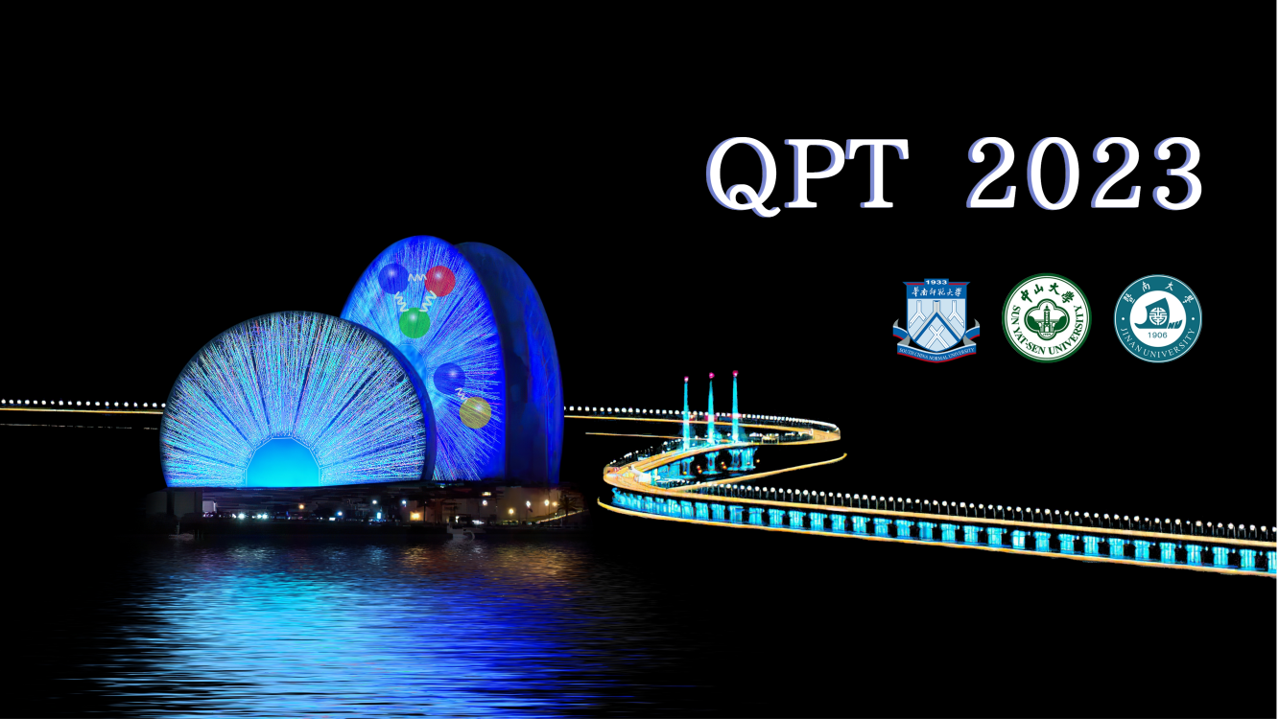
The quark-meson model under magnetic fields within FRG approach
Rui Wen
University of Chinese Academy of Sciences
Based on: Rui Wen, Shi Yin, Wei-jie Fu, Mei Huang
Phys.Rev.D 108 (2023) 7, 076020 arXiv:2306.04045

Slide 2
Outline
Introduction
The quark-meson model within FRG
The effective action
Regulators and propagators
Flow equations
Numerical results
Summary

Slide 3
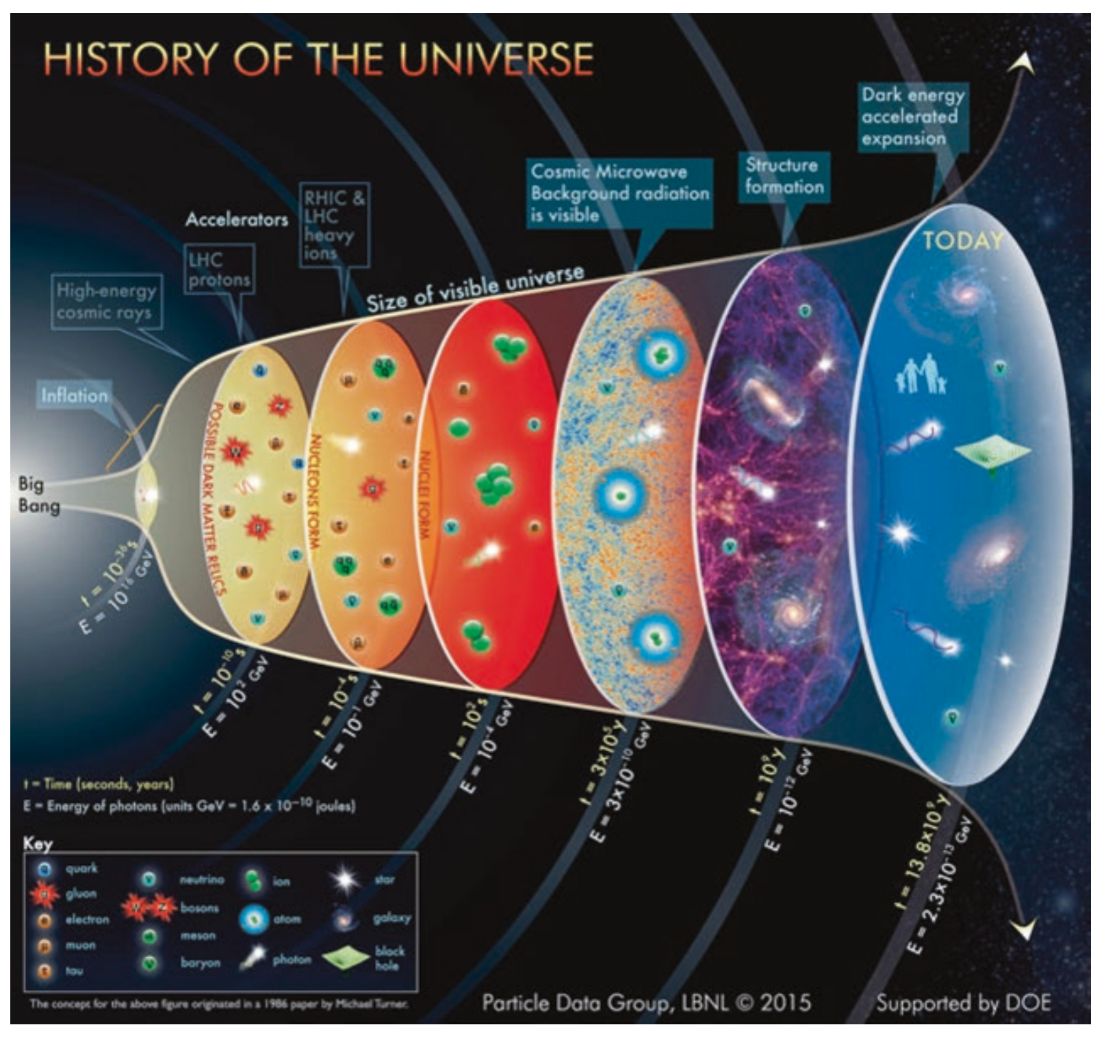
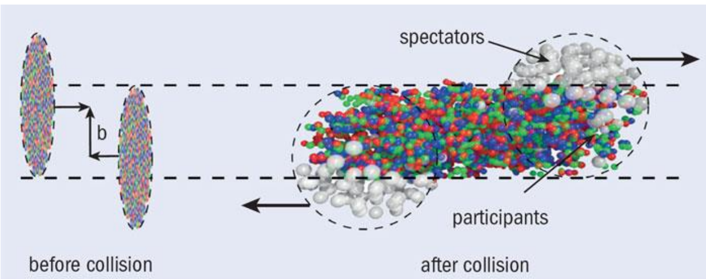
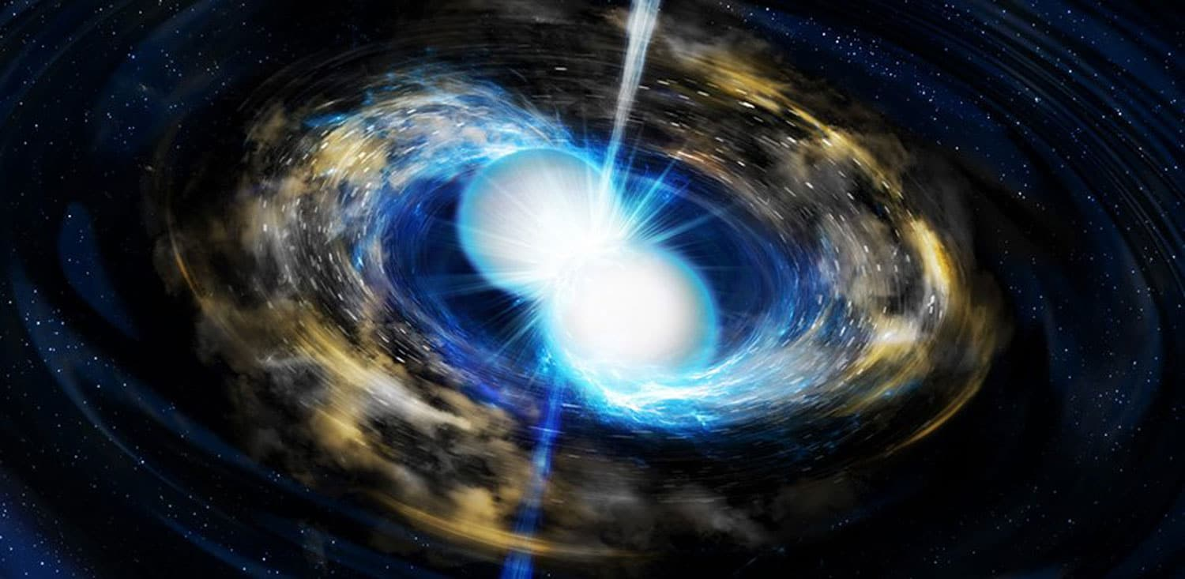
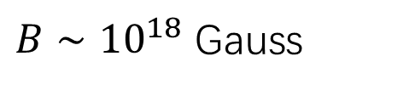
Introduction
early universe
Toia A 2013 CERN Courier April 31
$B∼{10}^{18}$ Gauss
magnetars

Slide 4
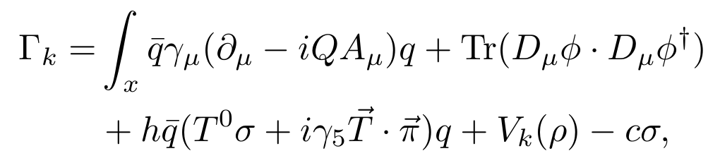
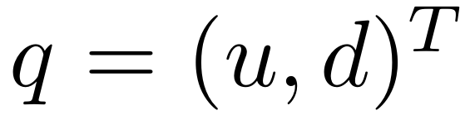
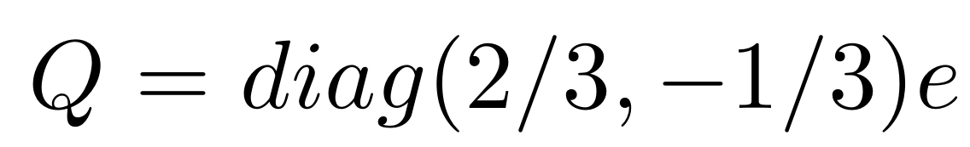
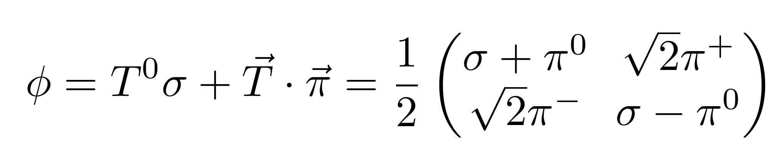
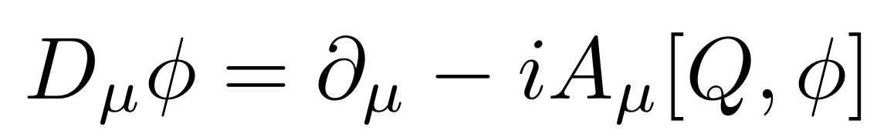

The effective action
The effective action of two-flavor quark-meson model in Euclidean space
The quark fields
The meson fields
The covariant derivative of meson fields
magnetic field along z-direction

Slide 5
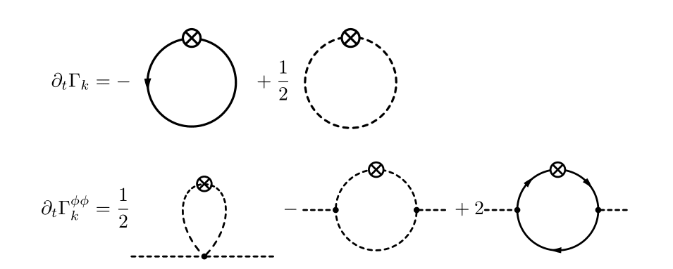
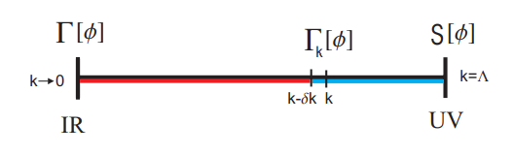
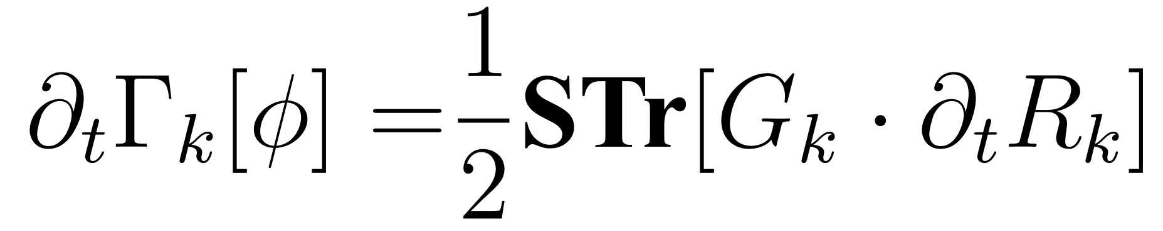

Functional renormalization group
and flow equations
Wetterich equations

Slide 6
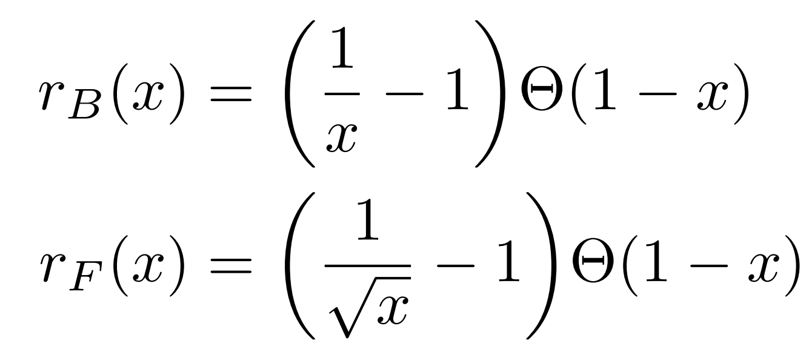
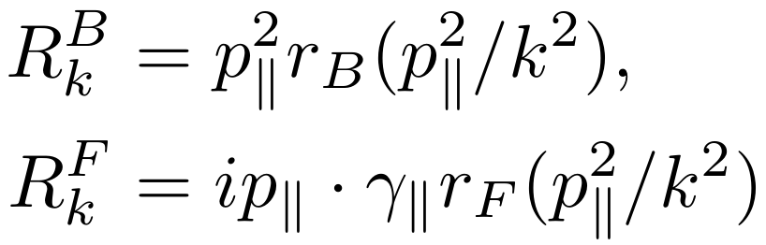
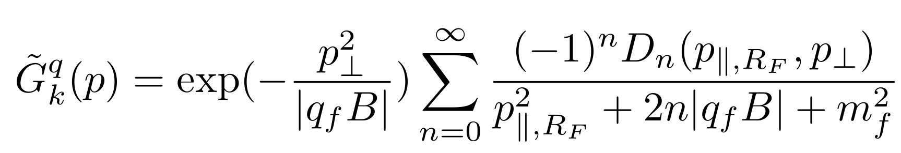
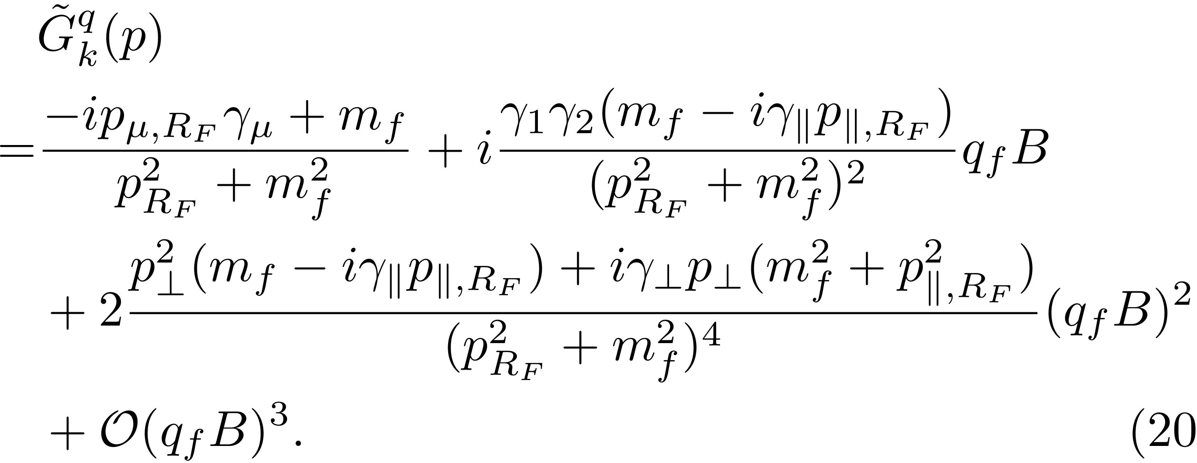
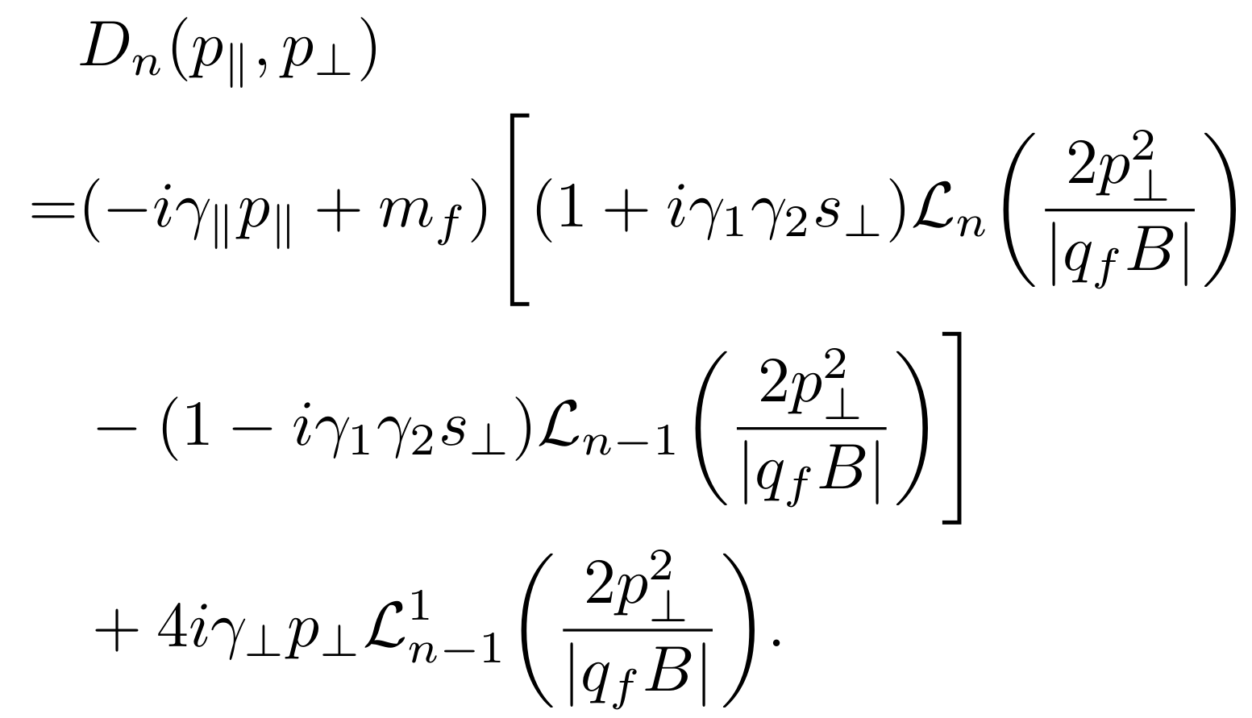
The regulators
The quark propagator
Landau levels representation
weak-field expansion

Slide 7
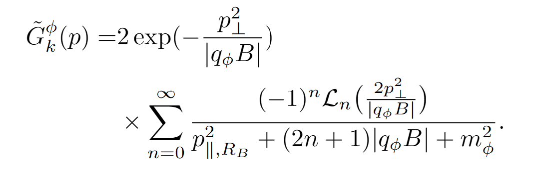
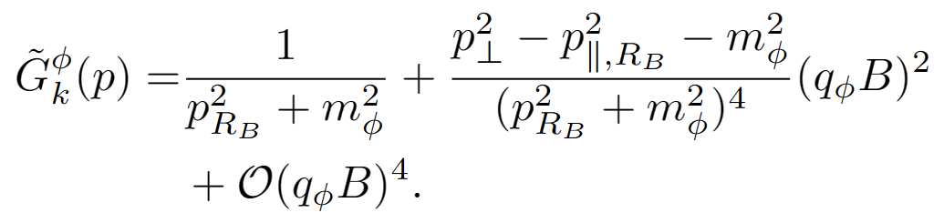
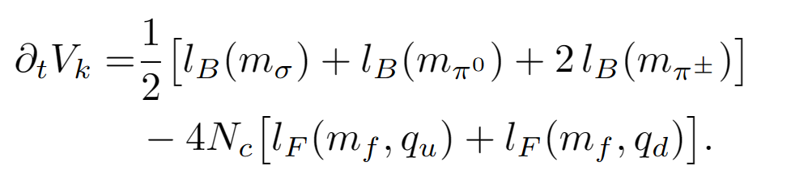
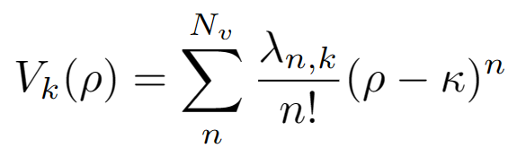
The charged meson propagators
Landau levels representation weak-field expansion
The flow equations of the effective potential

Slide 8
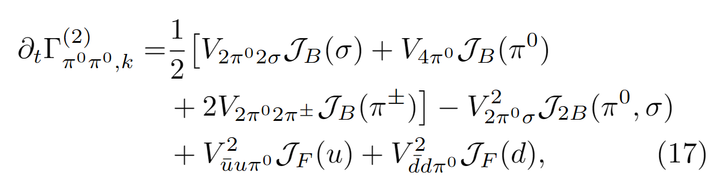
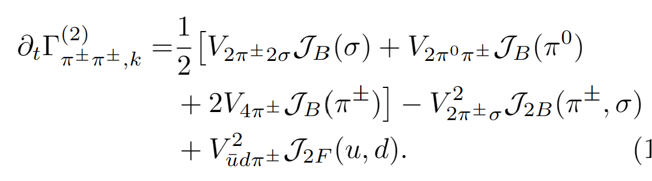
The flow equation of two-point correlation function

Slide 9
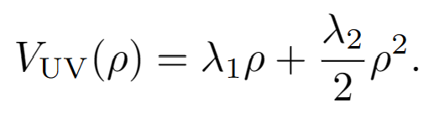

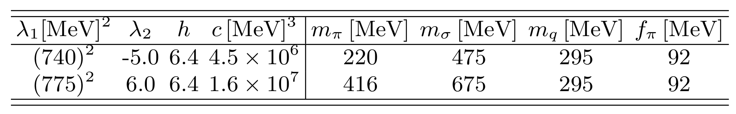
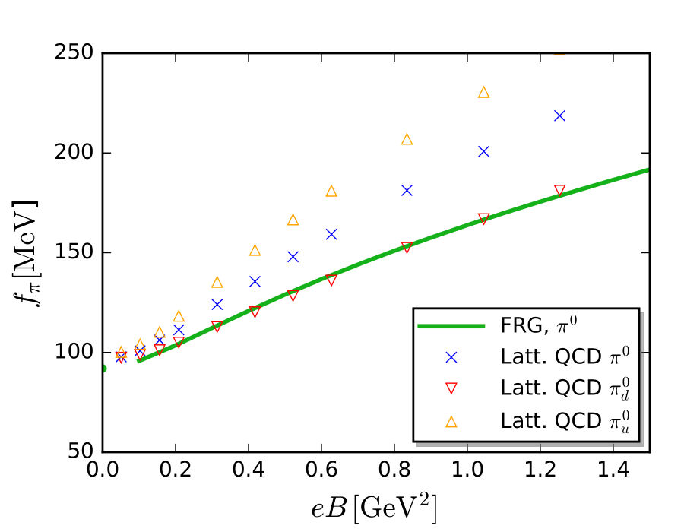
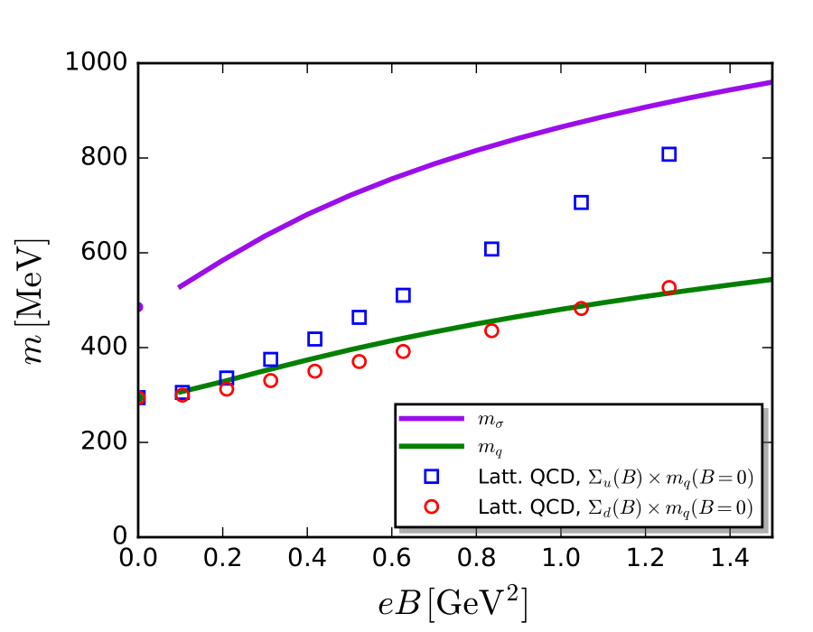
Numerical results
Pion decay constant
Quark mass and σ meson mass
magnetic catalysis
H. T. Ding, S. T. Li, A. Tomiya, X. D. Wang, and Y. Zhang Phys. Rev. D 105, 034514 (2022)

Slide 10
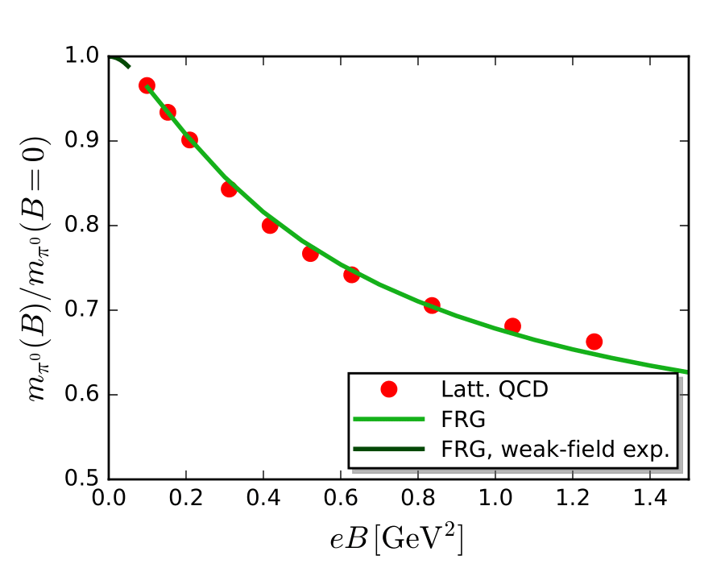

The neutral pion mass ${\text{m}}_{π^{0}}$
H. T. Ding, S. T. Li, A. Tomiya, X. D. Wang, and Y. Zhang Phys. Rev. D 105, 034514 (2022)

Slide 11
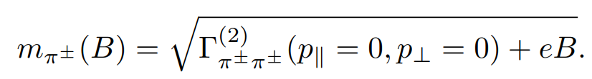
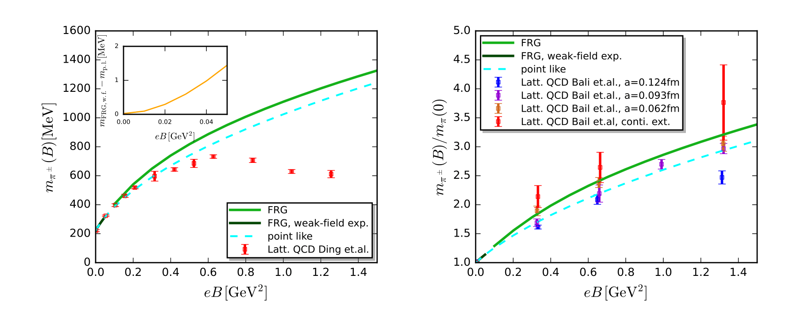




Charged pion mass ${\text{m}}_{π^{±}}$
${\text{m}}_{π}$(0) = 220 MeV
${\text{m}}_{π}$(0) =416 MeV
H. T. Ding, S. T. Li, A. Tomiya, X. D. Wang, and Y. Zhang Phys. Rev. D 105, 034514 (2022)
G. S. Bali, B. B. Brandt, G. Endrödi, and B. Gläßle Phys. Rev. D 97, 034505 (2018)

Slide 12
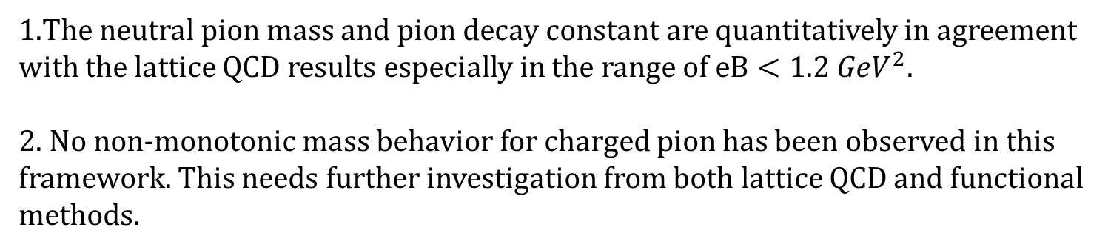
Summary and outlook
1.The neutral pion mass and pion decay constant are quantitatively in agreement with the lattice QCD results especially in the range of $eB<1.2 {GeV}^{2}$.
2. No non-monotonic mass behavior for charged pion has been observed in this framework. This needs further investigation from both lattice QCD and functional methods.
We will go beyond the LPA truncation and include the strange quark
and vector meson in future work.
Thanks for your attention

Slide 13
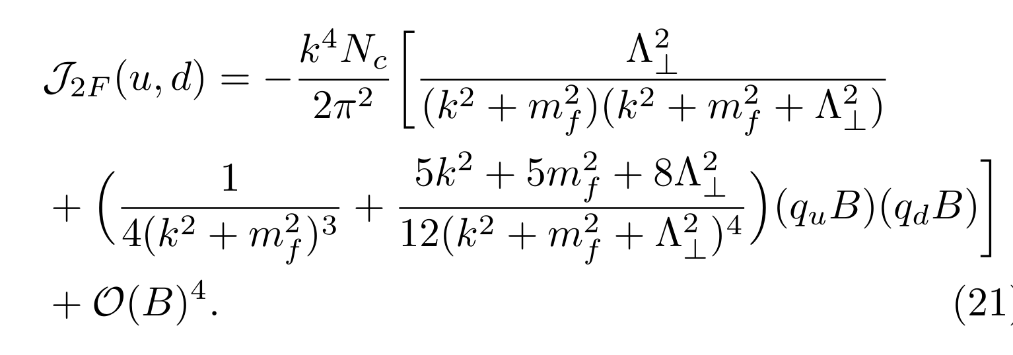
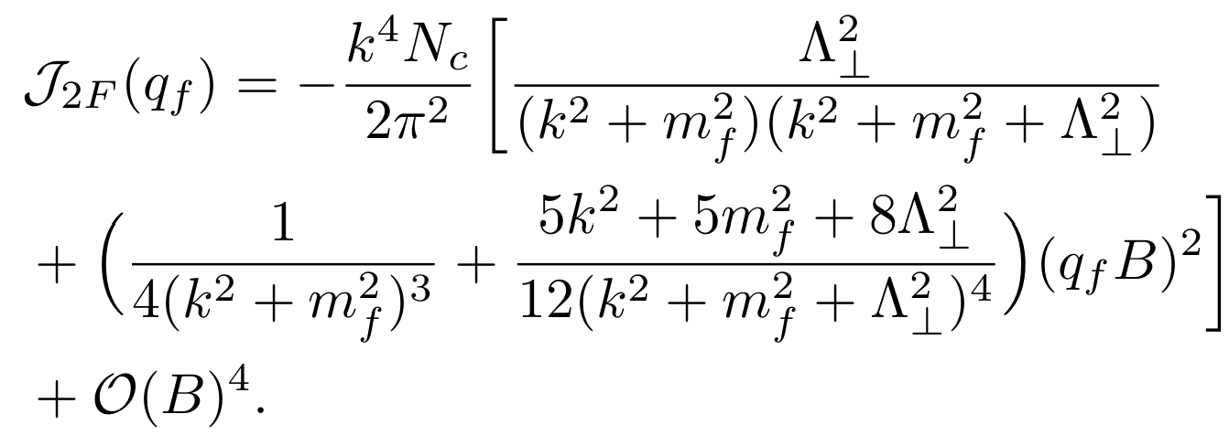
Backup

