Slide 1


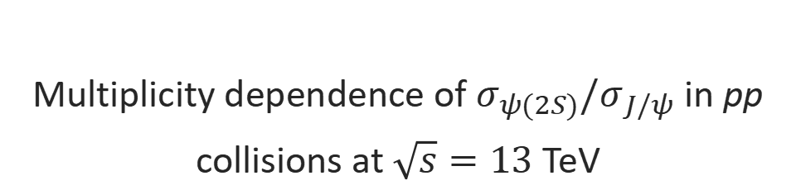
Multiplicity dependence of $σ_{ψ(2S)}/σ_{J/ψ}$ in pp collisions at $\sqrt{s}=13$ TeV
Speaker: Youen Kang
(on behalf of the LHCb collaboration)

Slide 2
Outline
Introduction
Analysis
Summary and outlook

Slide 3
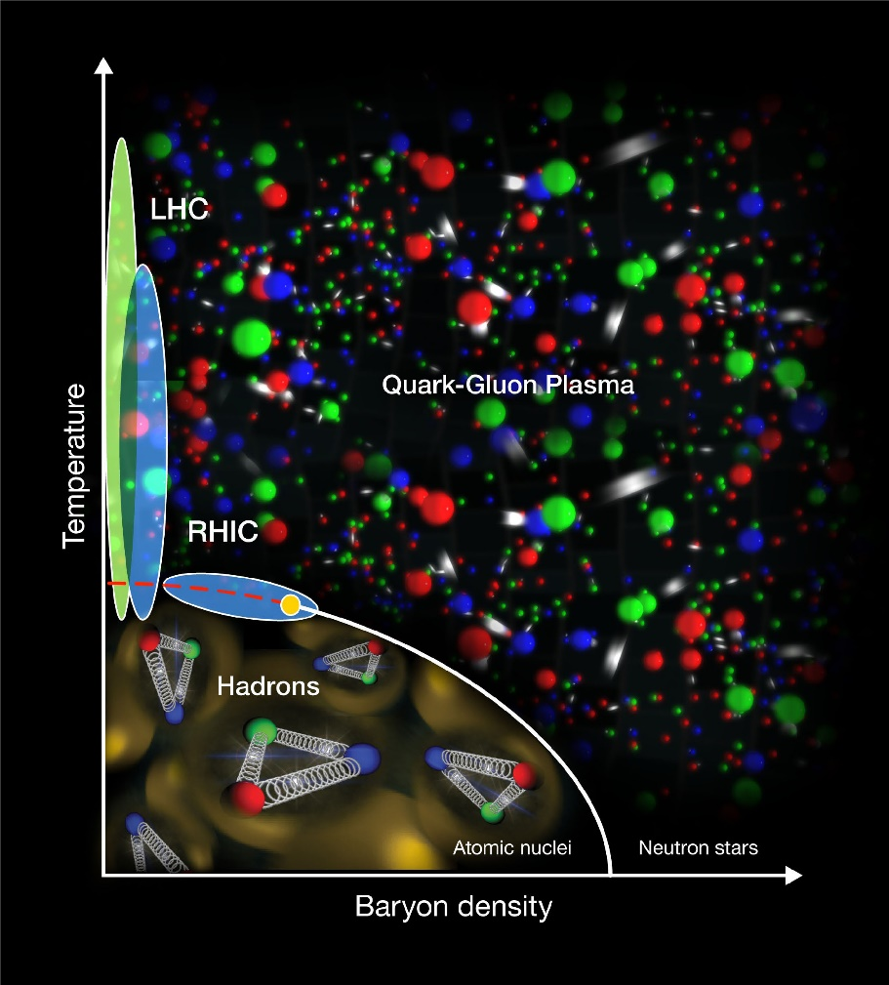
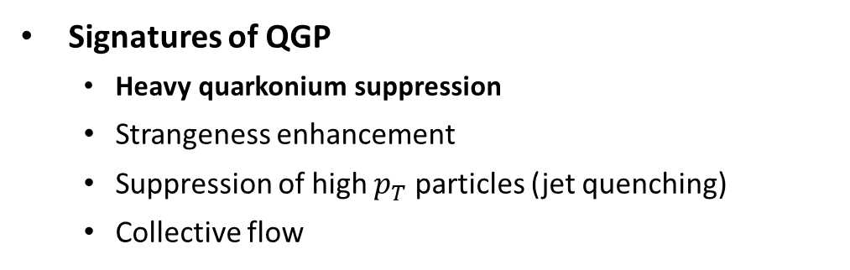
Quark-gluon plasma
Quark-Gluon Plasma (QGP):
  A thermally equilibrated system where partons are deconfined
  Achieve either by heating or compression of nuclei
  Exist in the early stage of universe and ultra-relativistic energy heavy ion collisions (Big & Little Bang)
Signatures of QGP
  Heavy quarkonium suppression
  Strangeness enhancement
  Suppression of high $p_{T}$ particles (jet quenching)
  Collective flow

Slide 4
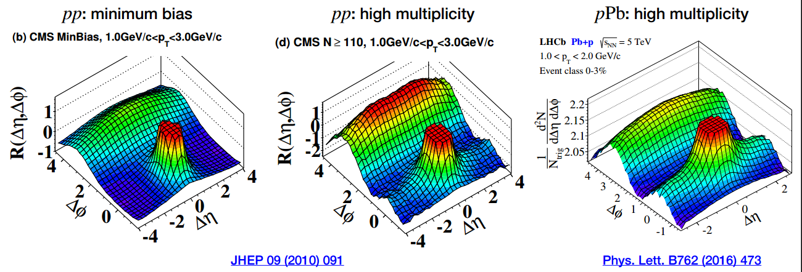
Nuclear matter effect & collision systems
Collision systems
  A-A collisions: Both Hot Nuclear Matter (HNM) effects (related to the QGP formation and evolution) and Cold Nuclear Matter (CNM) effects exist
  p-A collisions: CNM effects dominate
  pp collisions: No nuclear matter effect expected to exist
Large systems
Small systems
QGP-like signatures found in high-multiplicity small system collisions:
  Collectivity (as shown in the right figure)
  Strangeness enhancement (arXiv:2311.08490v1 [hep-ex])
  Heavy quarkonium suppression (Phys.Rev.C 105 (2022) 6, 064912)

Slide 5
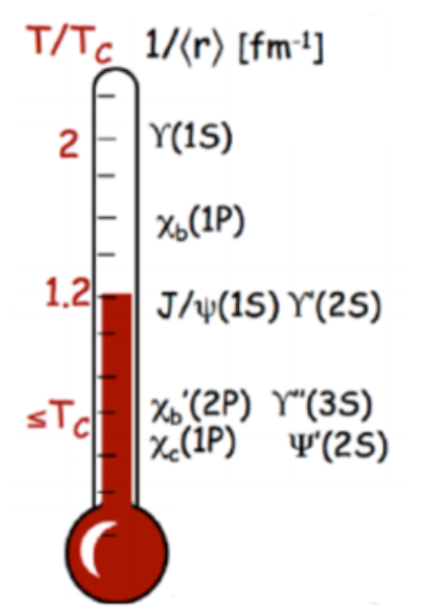
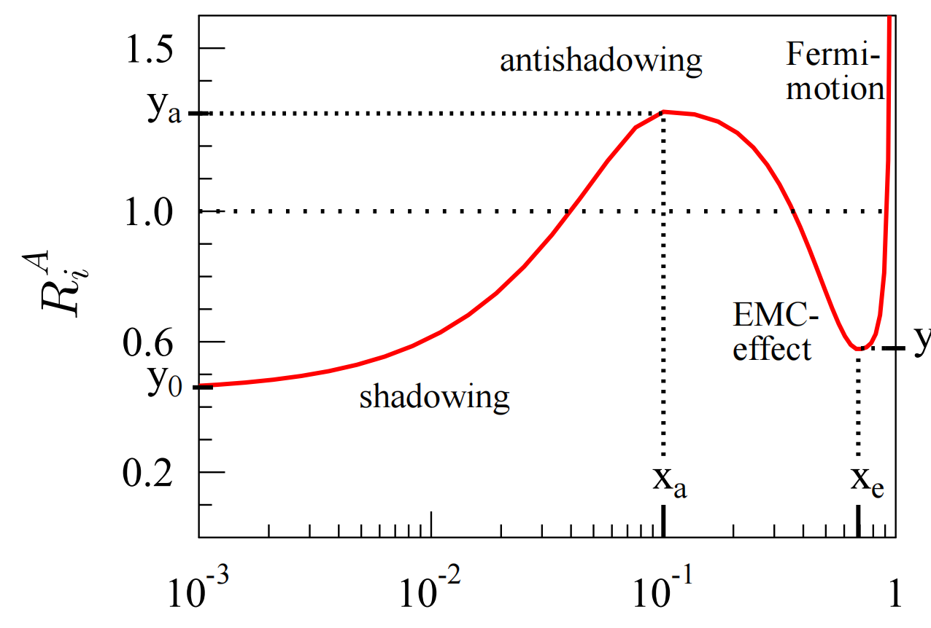
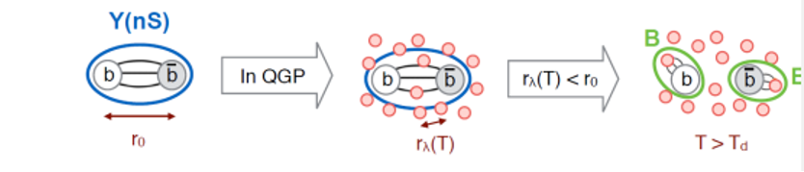
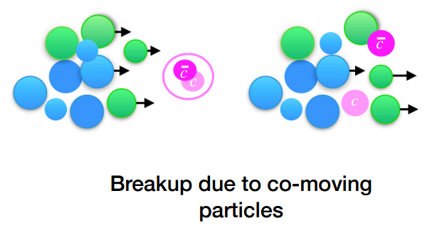

Heavy quarkonium production
Why $q\overline{q}$? :
  1. Color screening
  2. Sequential melting
  3. Sensitive to initial-state effect
  4. Probe for final-state effect
2.
3.
1.
  4. Co-mover effect: Quarkonia are suppressed by interaction with the co-moving medium, constituted by particles with similar rapidities.’ [JHEP 03 (2019) 063]

Slide 6
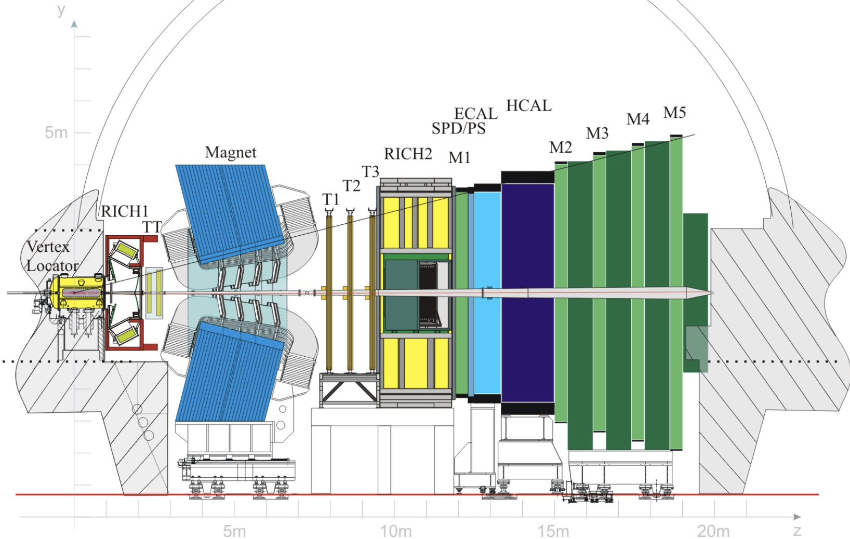
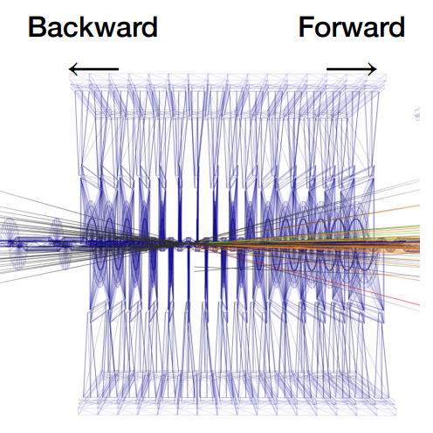
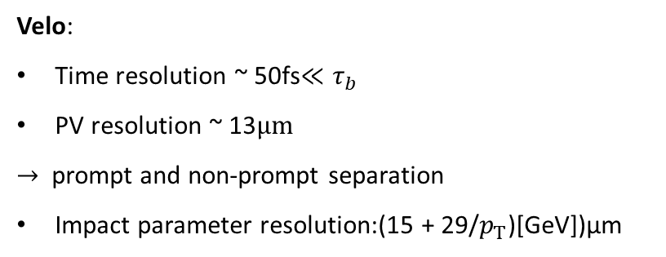
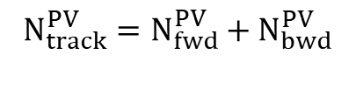


LHCb detector
The LHCb detector is a single-arm forward spectrometer covering the pseudorapidity range 2 < η < 5
Designed primarily for the study of particles containing b or c quarks.
Velo:
Time resolution ~ 50fs$≪τ_{b}$
PV resolution ~ 13$μm$
$→$ prompt and non-prompt separation
Impact parameter resolution:(15 + 29/$p_{T}$)[GeV])μm
$$N_{bwd}^{PV}$$
$$N_{fwd}^{PV}$$
$$N_{track}^{PV}=N_{fwd}^{PV}+N_{bwd}^{PV}$$
Muon detector:
High Muon ID ~ 97 %,
Mis ID for Pion to Muon 1%~3%

Slide 7
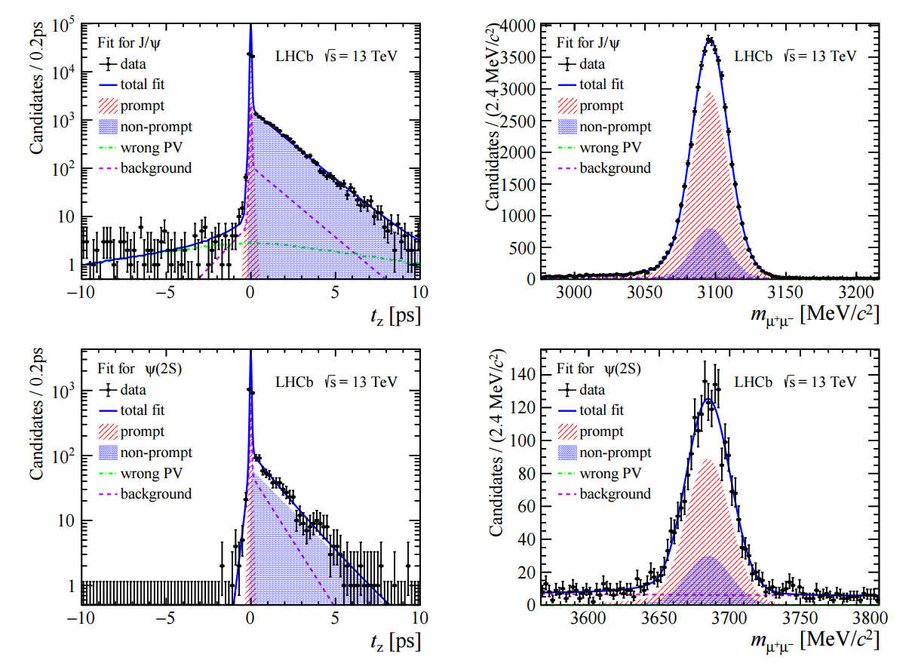
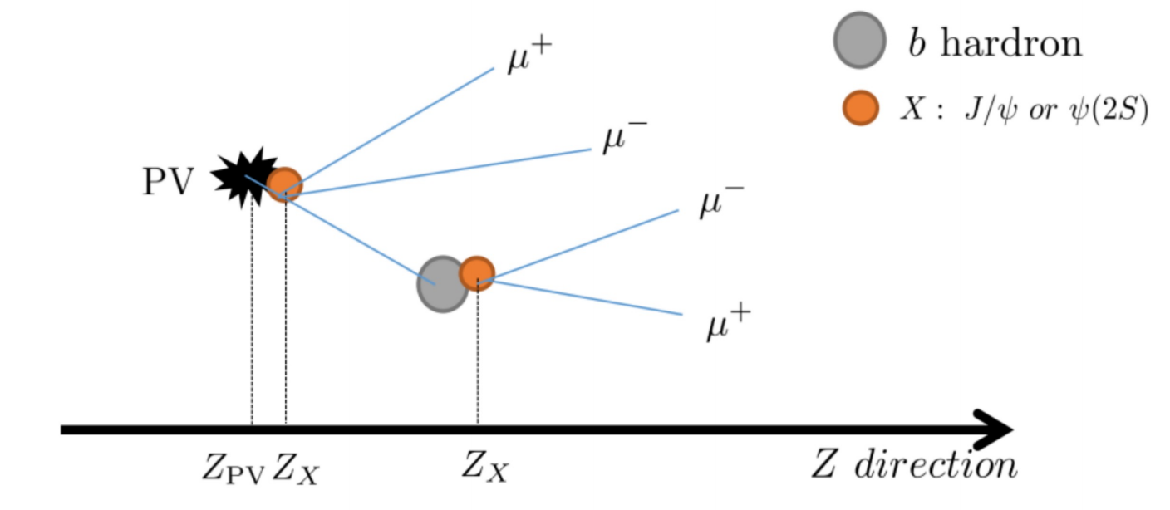




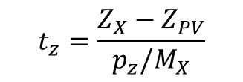

Data set and signal extraction
Data sample: pp collisions at $\sqrt{s}=13 TeV$ collected in 2016
Decay channel: $J/ψ→μ^{+}μ^{−}$ and $ψ(2S)→μ^{+}μ^{−}$
Signal extraction: Two-dimensional fit is performed to invariant mass and pseudo-decay time spectrum to extract prompt components
$$J/ψ$$
$$J/ψ$$
preliminary
preliminary
$$ψ(2S)$$
$$ψ(2S)$$
preliminary
preliminary
$$t_{z}=\frac{Z_{X}−Z_{PV}}{p_{z}/M_{X}}$$
LHCb-PAPER-2023-035 in preparation

Slide 8
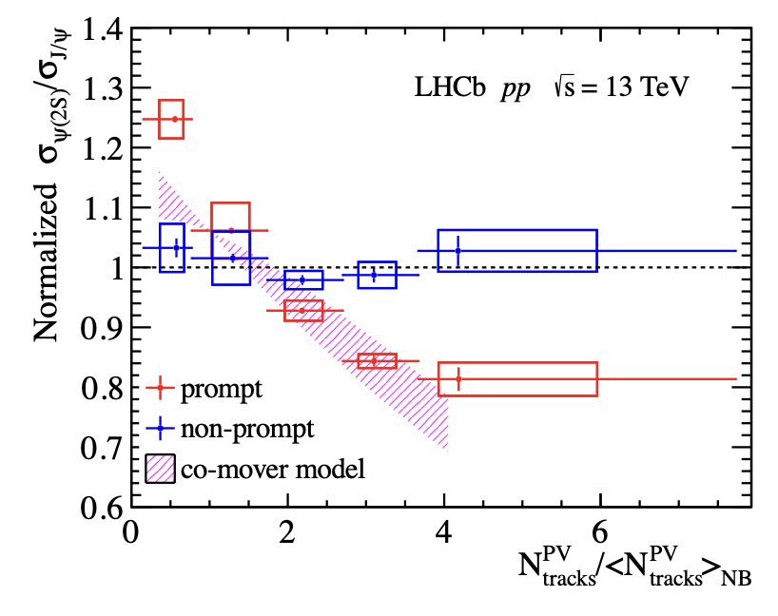
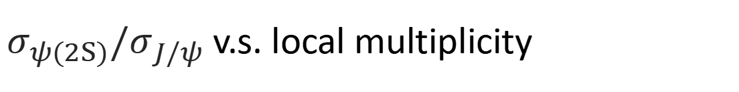
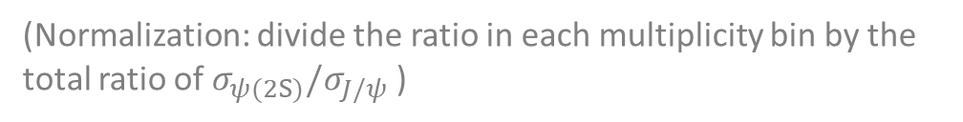
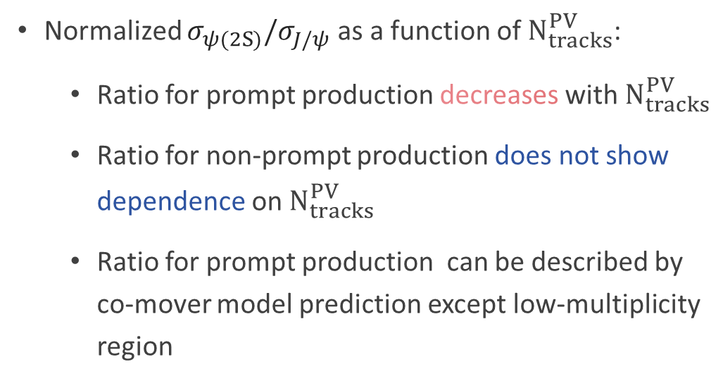
$σ_{ψ(2S)}/σ_{J/ψ}$ v.s. local multiplicity
Normalized $σ_{ψ(2S)}/σ_{J/ψ}$ as a function of $N_{tracks}^{PV}$:
  Ratio for prompt production decreases with $N_{tracks}^{PV}$
  Ratio for non-prompt production does not show dependence on $N_{tracks}^{PV}$
  Ratio for prompt production can be described by co-mover model prediction except low-multiplicity region
LHCb preliminary
(Normalization: divide the ratio in each multiplicity bin by the total ratio of $σ_{ψ(2S)}/σ_{J/ψ}$ )
LHCb-PAPER-2023-035 in preparation
Notes:
After considering all the systematic uncertainties.
We give the normalized ratio of psi(TwoS) to Jpsi production as a function of PVNTRACKS in the right graph.
PVNTRACKS on the x-axis is re-scaled by dividing the mean value of PVNTRACKS from no-bias data.
The height of box is systematic uncertainties, length of vertical line segment is the statistical uncertainties
We can clearly see that the ratio for prompt production decreases with multiplicity
while the ratio of non-prompt production does not show dependence on multiplicity.
It is within expectation since b hadron production should not depend on multiplicity.
While PVNTRACKS is a multiplicity variable who has an overlap kinematic range within which the production of charmonium is measured.
To avoid the bias resulting from the correlation, we calculate the ratio according to nBackTracks
and as a comparison, to nForwardTracks.

Slide 9
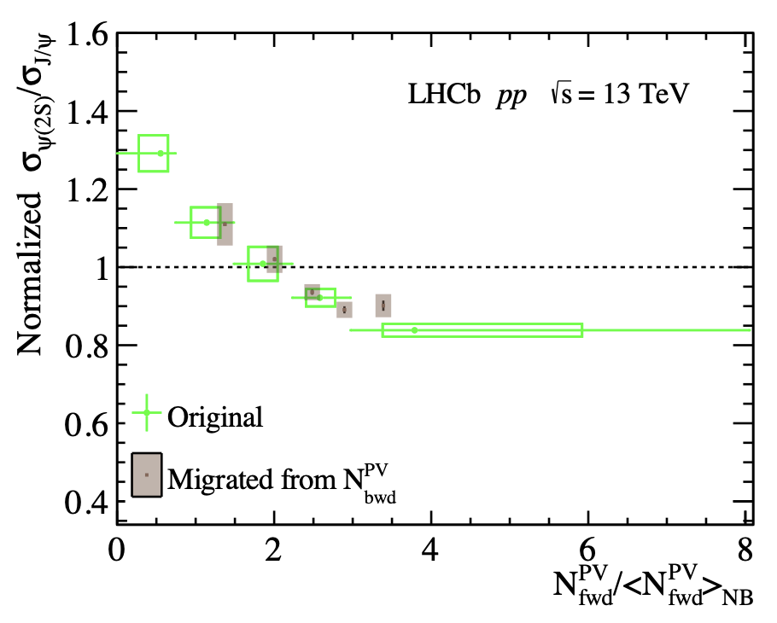
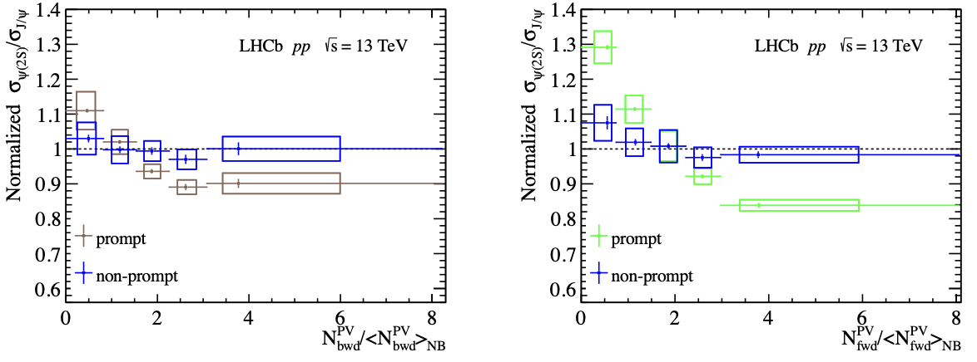
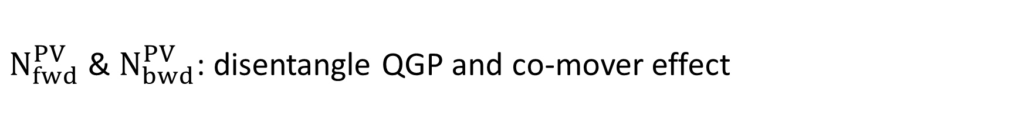

$N_{fwd}^{PV}$ & $N_{bwd}^{PV}$: disentangle QGP and co-mover effect
Normalized $σ_{ψ(2S)}/σ_{J/ψ}$ as functions of $N_{fwd}^{PV}$ and $N_{bwd}^{PV}$:
  Prompt ratio decrease with $N_{fwd}^{PV}$ and much slower decreasing trend with $N_{bwd}^{PV}$
  Non-prompt ratio are independent of multiplicity
  Slight decreasing trend for prompt ratio with $N_{bwd}^{PV}$ could result from the correlation between $N_{bwd}^{PV}$ and $N_{fwd}^{PV}$
LHCb preliminary
LHCb preliminary
LHCb preliminary
LHCb-PAPER-2023-035 in preparation
Notes:
We can see that the when we divide multiplicity classes by nBackTracks,
the decreasing trend for prompt production become moderate compared to the results with nForwardTtracks.
Which means the correlation due to the overlap of kinematic range where we measure the multiplicity and production do has an effect on the final results.
The rapidity range for where the nBackTracks is measured is minus five point two to minus one point five. And that for nForwardTracks is measured in one point five to five point two.
Yet, within uncertainties, no matter which variable we use to divide the multiplicity calsses, the ratio for non-prompt production doesn’t vary according to multiplicity.

Slide 10
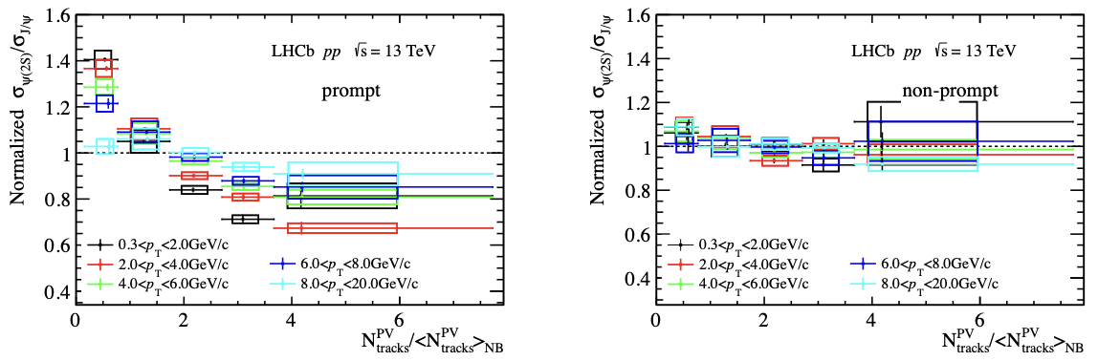


Result in different $p_{T}$ bin
Normalized ratio v.s. $N_{tracks}^{PV}$ in different $p_{T}$ bin: Decreasing trend gets slower, could result from less comover in high $p_{T}$ region.
LHCb preliminary
LHCb preliminary
LHCb-PAPER-2023-035 in preparation
Notes:
Finally we calculate the ratio in different pt bins and ybins.
We find that in high pt region, the ratio for prompt region becomes flat. The suppression become similar for both charmonia.
It may due to that there is less co-mover in high pT region.

Slide 11
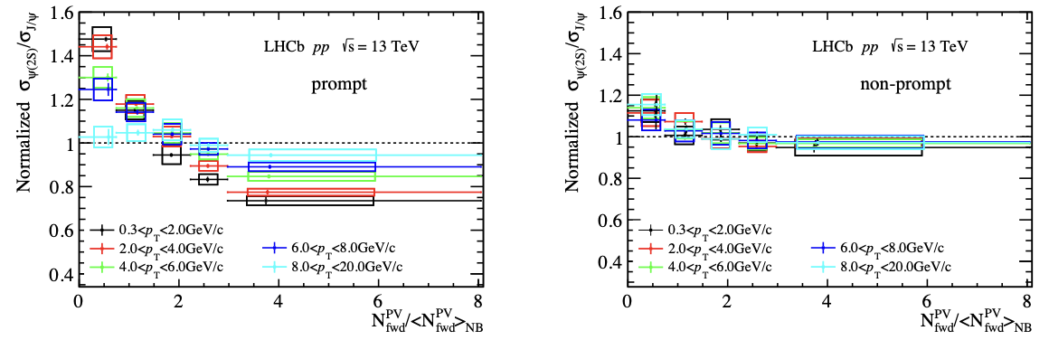

Result in different $p_{T}$ bin
Normalized ratio v.s. $N_{fwd}^{PV}$ in different $p_{T}$ bin: Decreasing trend gets slower, could result from less comover in high $p_{T}$ region.
LHCb preliminary
LHCb preliminary
LHCb-PAPER-2023-035 in preparation
Notes:
Finally we calculate the ratio in different pt bins and ybins.
We find that in high pt region, the ratio for prompt region becomes flat. The suppression become similar for both charmonia.
It may due to that there is less co-mover in high pT region.

Slide 12
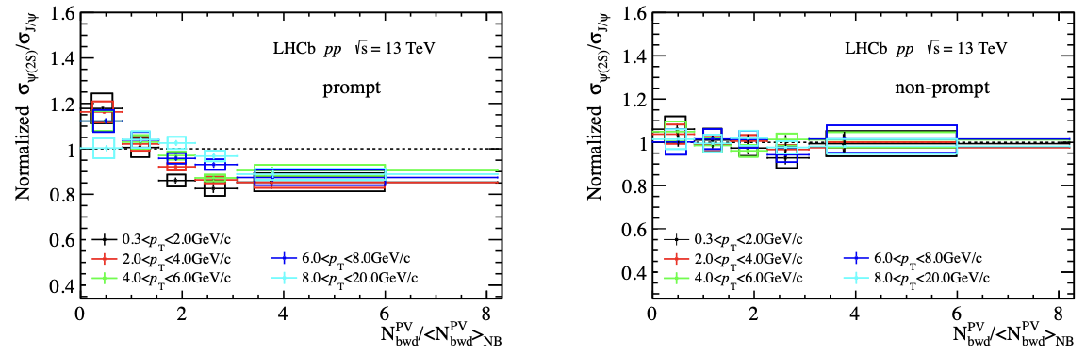
Result in different $p_{T}$ bin
Normalized ratio v.s. $N_{tracks}^{PV}$ in different $p_{T}$ bin: Decreasing trend gets slower, could result from less comover in high $p_{T}$ region.
LHCb preliminary
LHCb preliminary
LHCb-PAPER-2023-035 in preparation
Notes:
Finally we calculate the ratio in different pt bins and ybins.
We find that in high pt region, the ratio for prompt region becomes flat. The suppression become similar for both charmonia.
It may due to that there is less co-mover in high pT region.

Slide 13
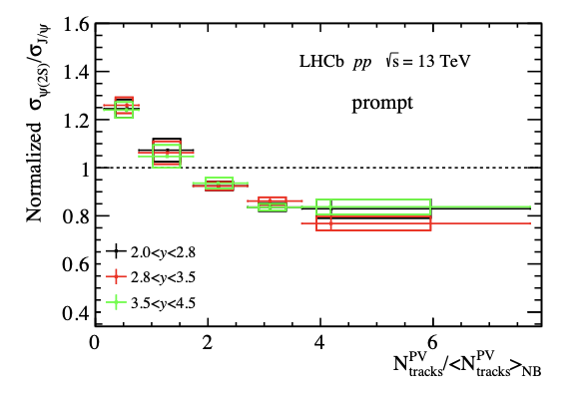
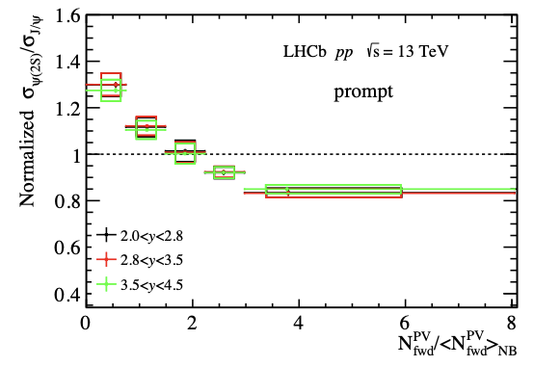
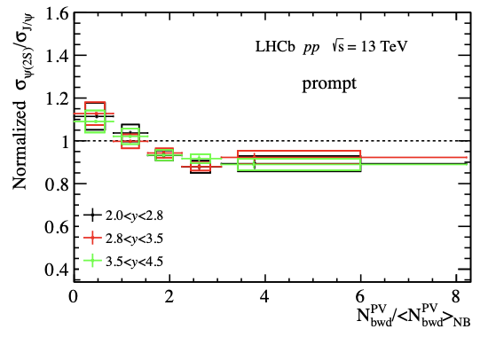
Result in different rapidity bin
Ratio of prompt production as function of multiplicity in different rapidity bin: The suppressions for both charmonia in different rapidity region are almost the same.
LHCb preliminary
LHCb preliminary
LHCb preliminary
LHCb-PAPER-2023-035 in preparation
Notes:
And the result in different rapidity bins seems quite the the same.

Slide 14
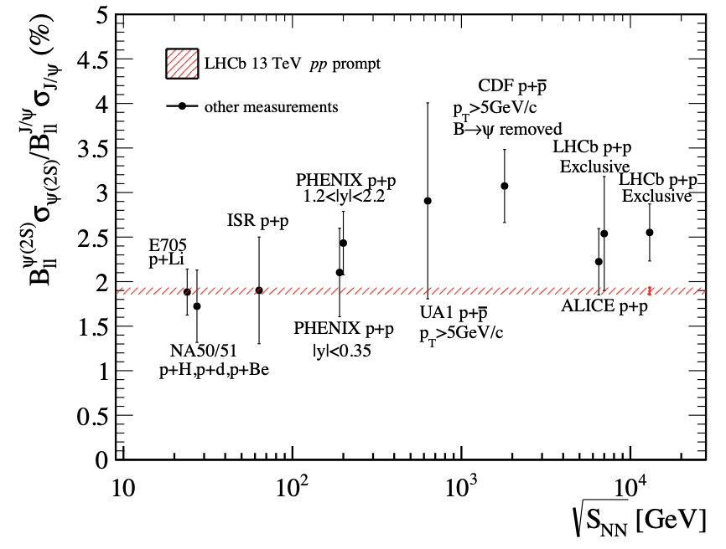
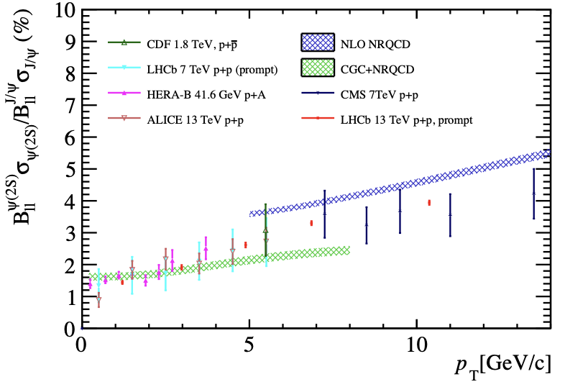

Comparison to world data
The production ratio shows good agreements with other measurements.
The $p_{T}$ spectrum of ratio is consistent with NRQCD and CGC model predictions and other measurements
LHCb preliminary
LHCb preliminary
LHCb-PAPER-2023-035 in preparation

Slide 15
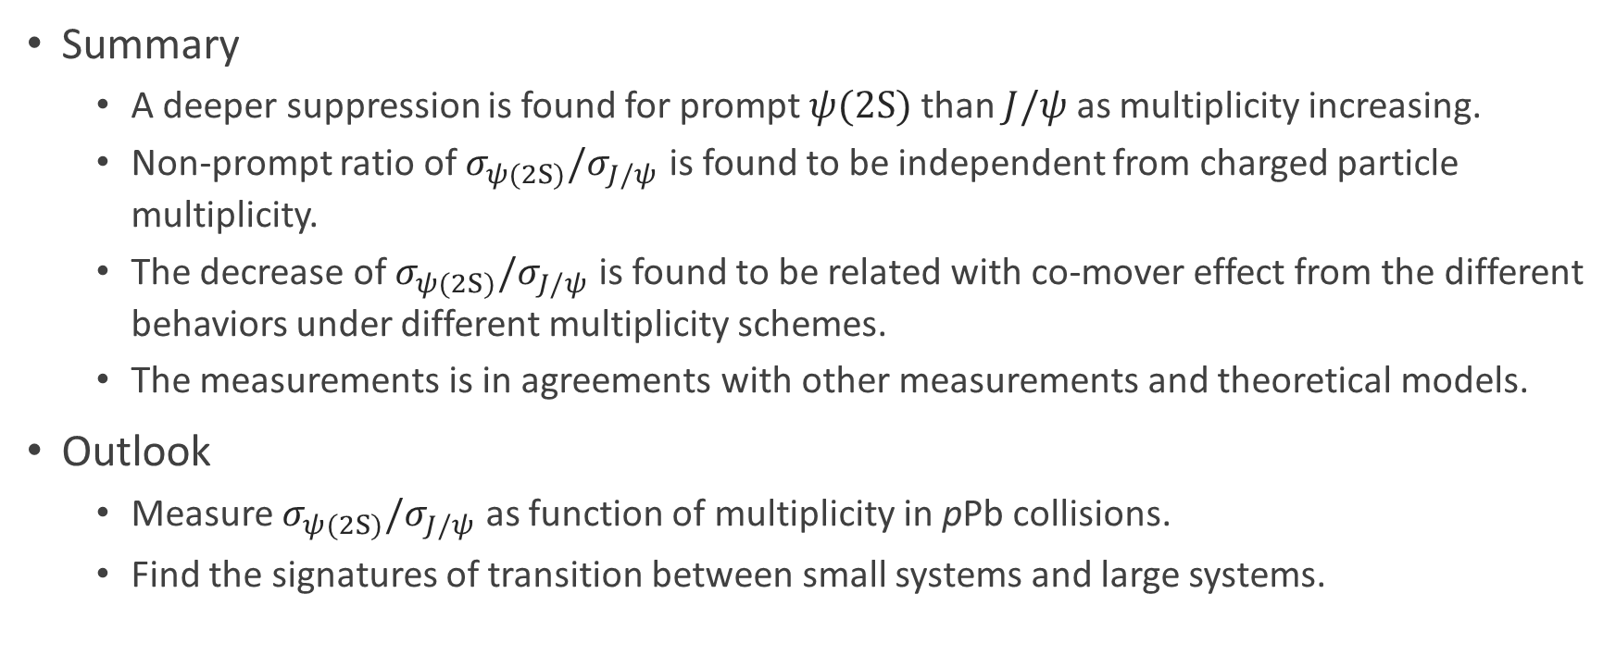
Summary & Outlook
Summary
  A deeper suppression is found for prompt $ψ(2S)$ than $J/ψ$ as multiplicity increasing.
  Non-prompt ratio of $σ_{ψ(2S)}/σ_{J/ψ}$ is found to be independent from charged particle multiplicity.
  The decrease of $σ_{ψ(2S)}/σ_{J/ψ}$ is found to be related with co-mover effect from the different behaviors under different multiplicity schemes.
  The measurements is in agreements with other measurements and theoretical models.
Outlook
  Measure $σ_{ψ(2S)}/σ_{J/ψ}$ as function of multiplicity in pPb collisions.
  Find the signatures of transition between small systems and large systems.

Slide 16
Thanks for your attention!

Slide 17
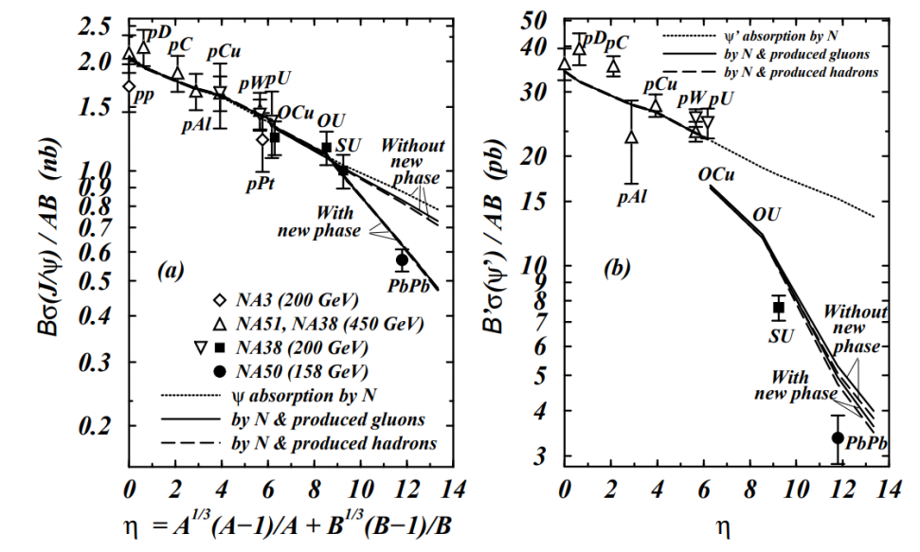
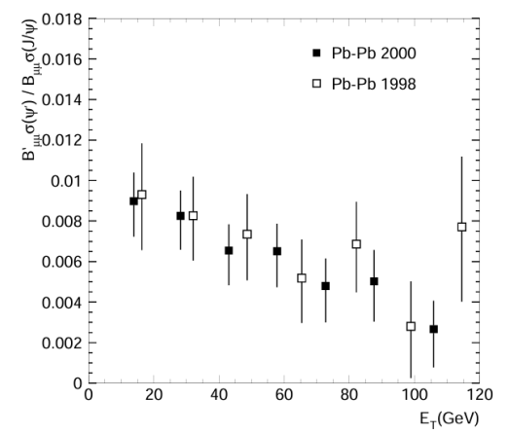
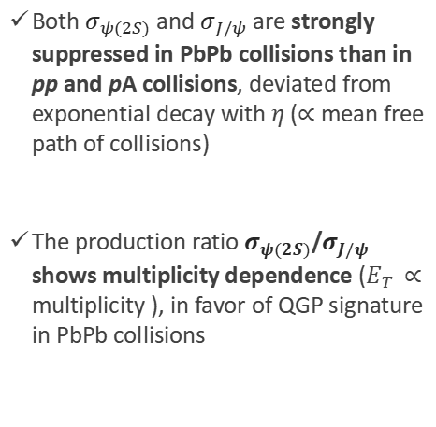
Experimental overview: NA50
Both $σ_{ψ(2S)}$ and $σ_{J/ψ}$ are strongly suppressed in PbPb collisions than in pp and pA collisions, deviated from exponential decay with $η$ ($∝$ mean free path of collisions)
The production ratio $σ_{ψ(2S)}$/$σ_{J/ψ}$ shows multiplicity dependence ($E_{T}$ $∝$ multiplicity ), in favor of QGP signature in PbPb collisions
[Nucl.Phys.A 630 (1998) 487-498] [Eur.Phys.J.C 49 (2007) 559-567]
Figure 1. Production (left) and production ratio (right) as function of multiplicity measured in different collision systems measured by SPS.

Slide 18
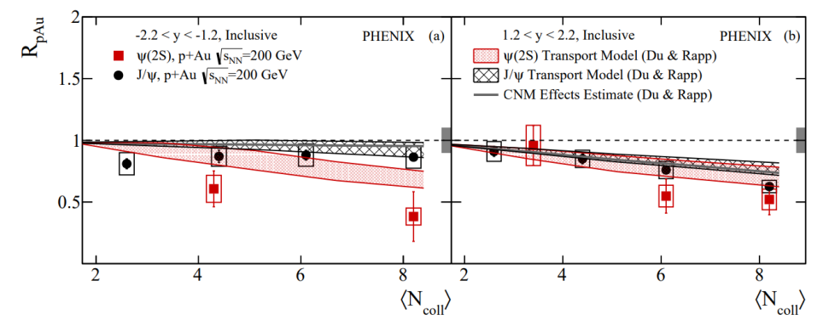
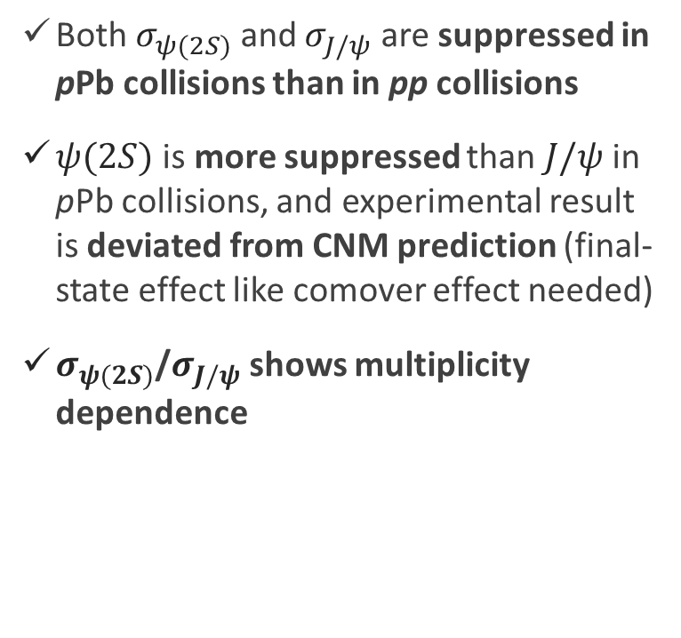
Experimental overview: PHENIX
Both $σ_{ψ(2S)}$ and $σ_{J/ψ}$ are suppressed in pPb collisions than in pp collisions
$ψ(2S)$ is more suppressed than $J/ψ$ in pPb collisions, and experimental result is deviated from CNM prediction (final-state effect like comover effect needed)
$σ_{ψ(2S)}$/$σ_{J/ψ}$ shows multiplicity dependence
[Phys.Rev.C 105 (2022) 6, 064912]
Figure 2. Nuclear modification factor for $J/ψ$ and $ψ(2S)$ as function of multiplicity in backward (left) and forward (right) rapidity.

Slide 19
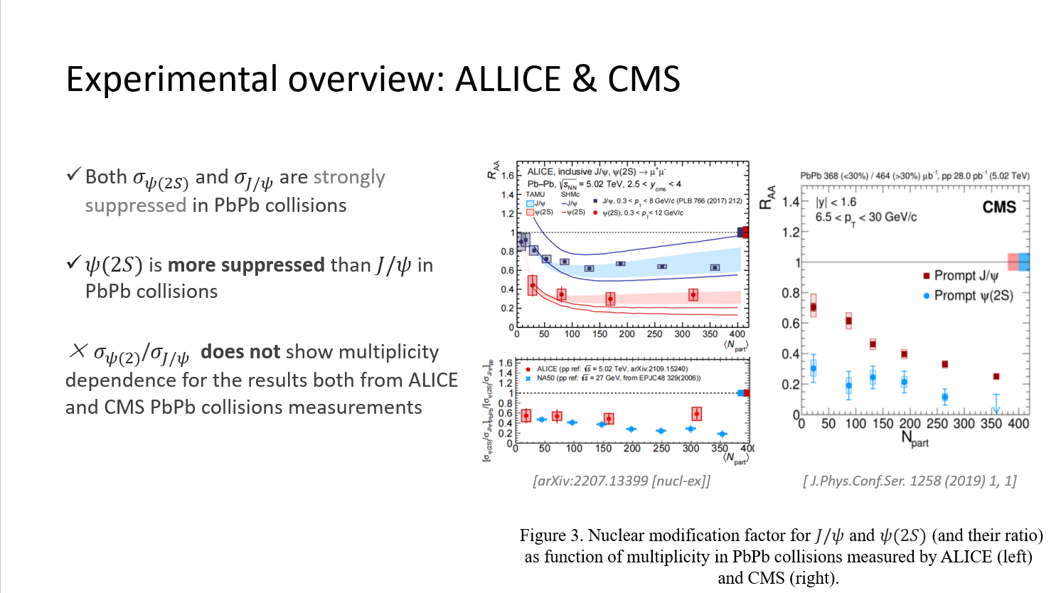

Slide 20
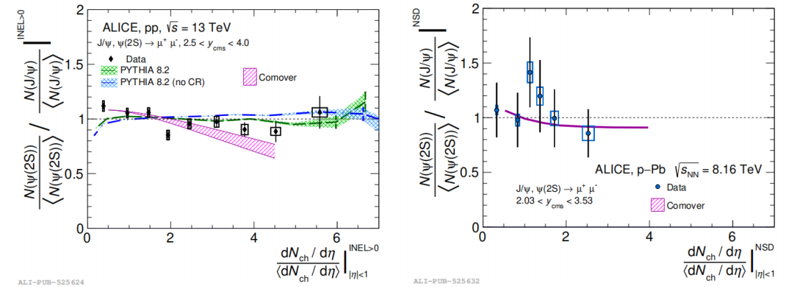
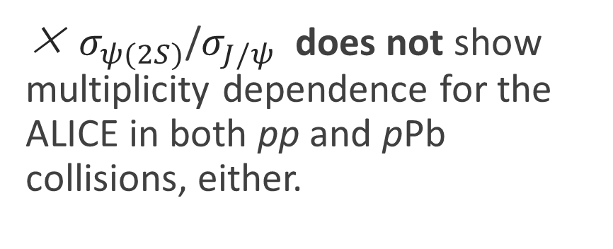
Experimental overview: ALLICE
× $σ_{ψ(2S)}$/$σ_{J/ψ}$ does not show multiplicity dependence for the ALICE in both pp and pPb collisions, either.
[arXiv:2207.13399 [nucl-ex]]
Figure 4. Nuclear modification factor for $J/ψ$ and $ψ(2S)$ (and their ratio) as function of multiplicity in pp (left) and pPb (right) collisions measured by ALICE.

