Slide 1
Imaging Constituent Quark Shape of Proton
Wenchang Xiangª, Yanbing Cai^{b}, Daicui Zhou^{c}
a.Guangzhou Maritime University
b.Guizhou University of Finance and Economics
c.Central China Normal University
Dec 17th 2023

Slide 2
Outline
Motivation
Proton Shape Fluctuations
Numerical results
Summary and discussions
Wenchang Xiang
Constituent quark shape
Dec 17, 2023 / QPT2023

Slide 3
01.Motivation
Hydrodynamic simulations

Slide 4
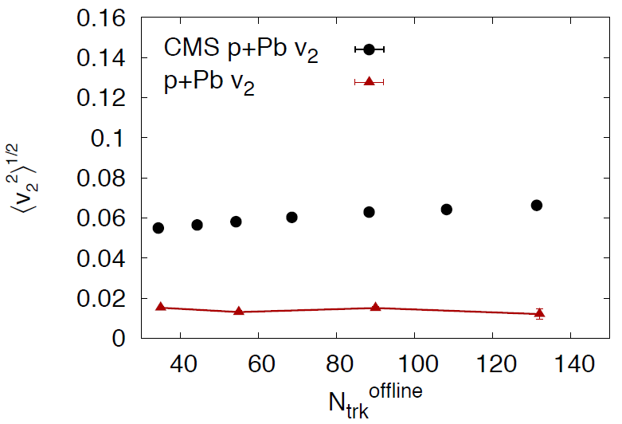
Implications from collective flow in proton-lead collisions
Round proton: hydrodynamic calculations
cannot reproduce v2 data in proton-lead collisions
IP-Glasma, arXiv:1405.3605
Round Proton
Wenchang Xiang
Constituent quark shape
Dec 17, 2023 / QPT2023

Slide 5
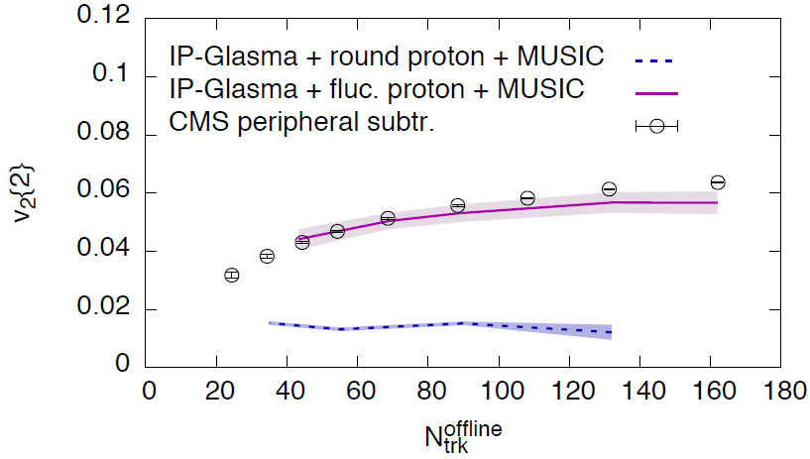
Implications from collective flow in proton-lead collisions
Hydrodynamic with proton
Shape fluctuations
Successful description
data!
arXiv:1705.03177
Wenchang Xiang
Constituent quark shape
Dec 17, 2023 / QPT2023

Slide 6
02. Proton Shape Fluctuations
Hot spot model

Slide 7
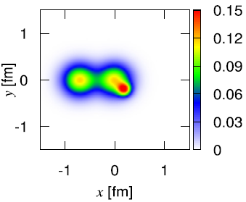
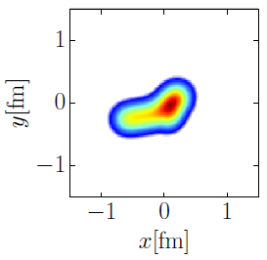
Beyond round proton
Basic questions
Hot spot model
How are partons of the proton distributed
spatially?
Gaussian, Exponential or Others?
Width?
How do the parton positions fluctuate
event-by-event?
Gaussian, Exponential or Others?
Width?
Stringy model
How do the deformation of the proton
construct?
Hot spot model?
Stringy model?
Wenchang Xiang
Constituent quark shape
Dec 17, 2023 / QPT2023

Slide 8
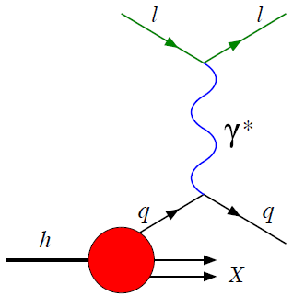
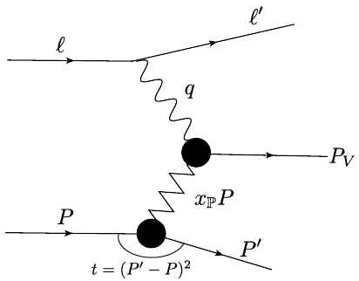
Probe of proton structure
------ Deep Inelastic Scattering
Deep Inelastic Scattering
Diffractive Deep Inelastic Scattering
e + p e + X
$σ \sim$ total parton density
No t, integrated over geometry
e + p e + p + V
Measure total momentum transfer
Fourier conjugate to impact parameter
probe spatial density profile of proton
Wenchang Xiang
Constituent quark shape
Dec 17, 2023 / QPT2023

Slide 9
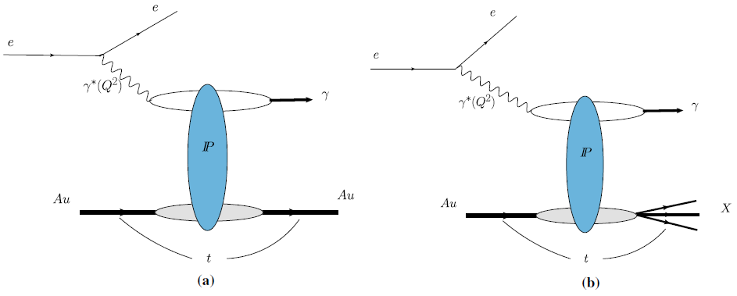
Exclusive diffractive vector meson production
$$A^{γ^{∗}p→Vp}$$
=i$\int{d^{2}r\int{d^{2}b}\int{\frac{dz}{4π}}}ψ^{γ^{∗}}ψ^{V}$
$$⋅e^{−ib⋅△}\left\langle N(r,x,b)\right\rangle$$
$$J/ψ$$
$$J/ψ$$
Virtual photon wavefunction$ψ^{γ^{∗}}$:
Precisely calculate with QED
Vector meson wavefunction $ψ^{V}$:
Boosted Gaussian
Gauss-LC
p
p
p
Coherent process
Incoherent process
Proton keeps intact
$\frac{dσ}{dt} \sim {|\left\langle A^{γ^{∗}p→Vp}\right\rangle |}^{2}$
Cross section probe average
shape of the protn
Proton dissociated
$\frac{dσ}{dt} \sim \left\langle {{|A}^{γ^{∗}p→Vp}|}^{2}\right\rangle −{|\left\langle A^{γ^{∗}p→Vp}\right\rangle |}^{2}$
Probe the detailed structure of the proton
Wenchang Xiang
Constituent quark shape
Dec 17, 2023 / QPT2023

Slide 10
Dipole scattering amplitude
$A^{γ^{∗}p→Vp}$=i$\int{d^{2}r\int{d^{2}b}\int{\frac{dz}{4π}}}ψ^{γ^{∗}}ψ^{V}⋅e^{−ib⋅△}\left\langle N(r,x,b)\right\rangle$
Dipole Amplitude: IP-sat model
$$N=1−Exp\left[−r^{2}F\left(x,r^{2}\right)T_{p}\left(b\right)\right]$$
F$\left(x,r^{2}\right)=\frac{π^{2}}{2N_{c}}α_{s}\left(μ^{2}\right)xg(x,μ^{2})$
Proton spatial profile function
Gaussian distribution:
$$T_{p}\left(b\right)=\frac{1}{2πB_{p}}Exp\left[−b^{2}/2B_{p}\right]$$
Exponential distribution:
$$T_{p}\left(b\right)=\frac{1}{8πB_{p}^{3}}Exp\left[−b/2B_{p}\right]$$
Other models: b-CGC, Balitsky-Kovchegov equation……
Wenchang Xiang
Constituent quark shape
Dec 17, 2023 / QPT2023

Slide 11
Modeling fluctuations by constituent quark picture
Proton spatial profile function
Hot spots model
A proton includes 3 valence quarks, uud
$$T_{p}\left(b\right)=\frac{1}{N_{q}}\sum_{i=1}^{N_{q}}{T_{q}(b−b_{i})}$$
$$N_{q}=3$$
a naive treatment, uud with same width
a refined approach, up quark $B_{u}$, down quark $B_{d}$
$$T_{q}\left(b−b_{i}\right)=\frac{1}{2πB_{q}}Exp\left[−{(b−b_{i})}^{2}/2B_{q}\right]$$
Simulations
Sample quark positions by Gaussian distribution with width $B_{p}$
Sample valence quark profile density by Gaussian distribution with width $B_{q}$
Combination of $B_{p}$ and $B_{q}$ sets degree of proton shape fluctuations
Wenchang Xiang
Constituent quark shape
Dec 17, 2023 / QPT2023

Slide 12
03. Numerical results
Vector meson productions at HERA

Slide 13
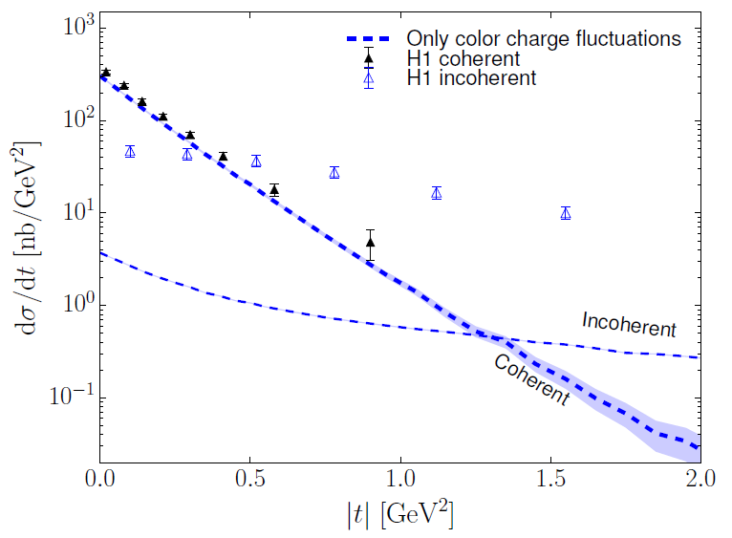
Proton shape from vector meson productions
Compare with $J/ψ$ production data at HERA
Round proton + color charge fluctuations
Incoherent calculations:
several magnitude smaller than the data
arXiv:1607.01711
Wenchang Xiang
Constituent quark shape
Dec 17, 2023 / QPT2023

Slide 14
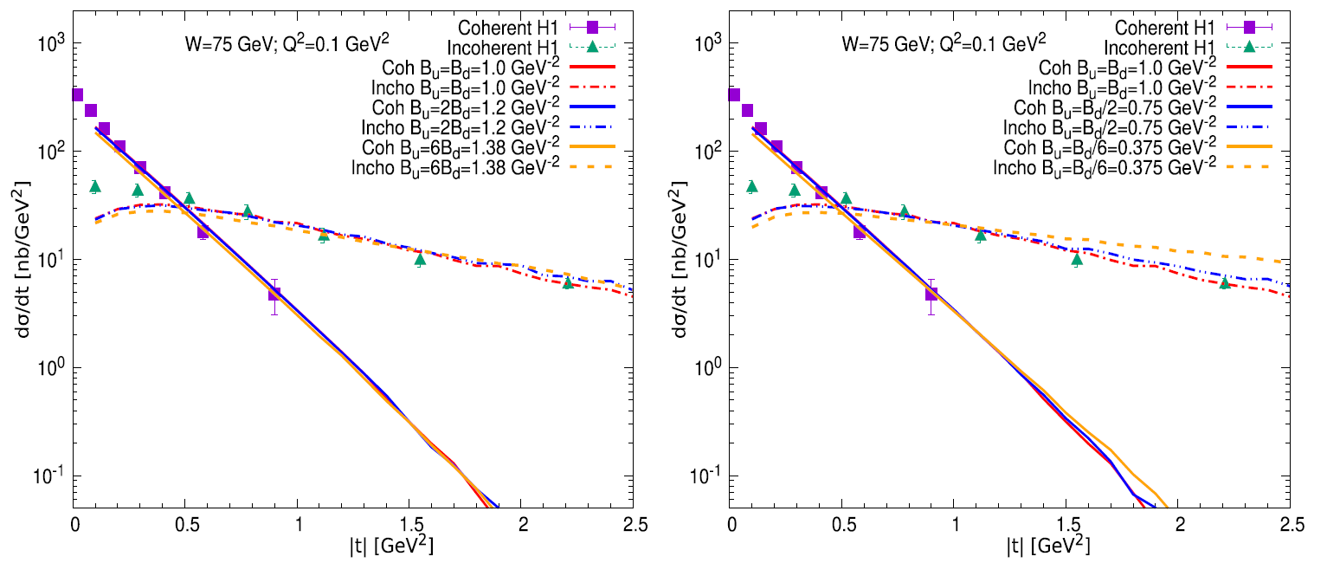
Different widths for up and down quark ($B_{u}>B_{d}$ and $B_{u}<B_{d}$)
Compare with $J/ψ$ production data at HERA
$B_{u}>B_{d }$is favored by the HERA data.
NPA1042(2024)122810
Wenchang Xiang
Constituent quark shape
Dec 17, 2023 / QPT2023

Slide 15
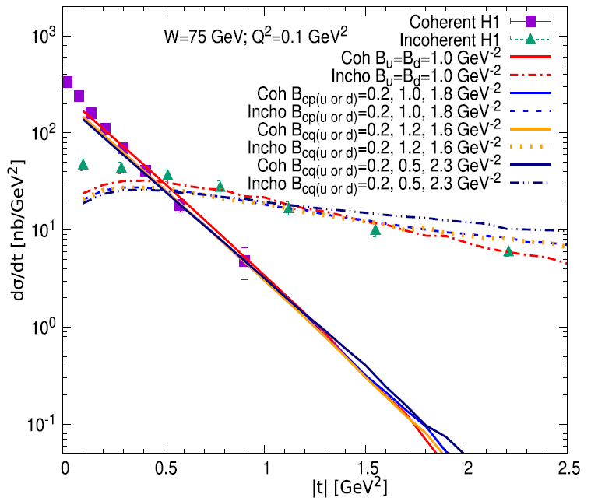
Different widths for up and down quark ($B_{u}≠B_{u}^{′}≠B_{d}$)
Compare with $J/ψ$ production data at HERA
Valence quark distribution widths:
6 sets
Incoherent process: inconsistent with
each other
Coherent process: agreement with each
other
NPA1042(2024)122810
Wenchang Xiang
Constituent quark shape
Dec 17, 2023 / QPT2023

Slide 16
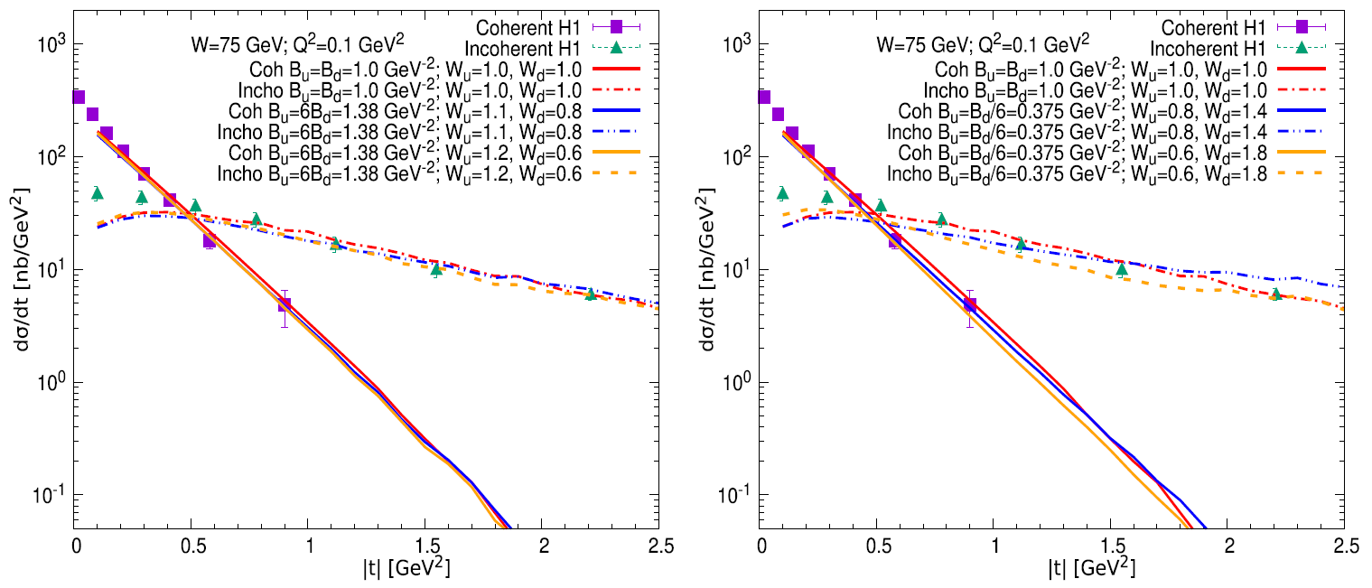
Different widths for up and down quark ($W_{u}>W_{d} \text{and} W_{u}<W_{d}$)
Compare with $J/ψ$ production data at HERA
NPA1042(2024)122810
$W_{u}>W_{d}$ consistent with each other
$W_{u}<W_{d}$incoherent: inconsistent with each other
Wenchang Xiang
Constituent quark shape
Dec 17, 2023 / QPT2023

Slide 17
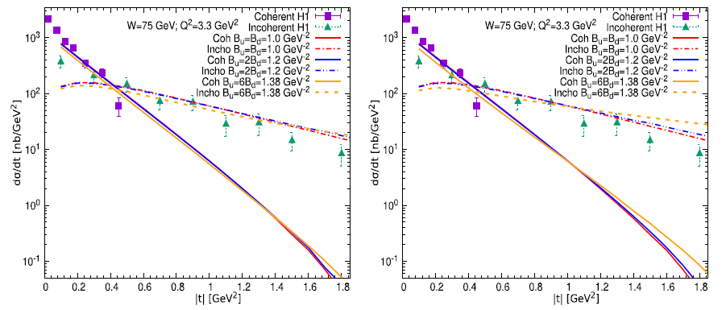
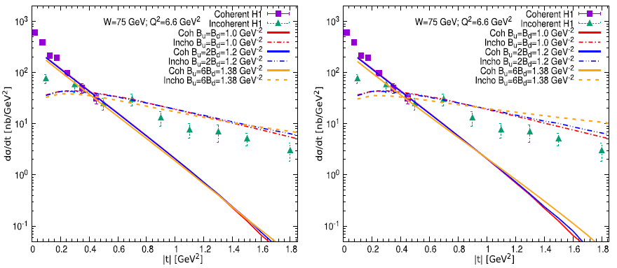
Different widths for up and down quark ($B_{u}>B_{d}$ and $B_{u}<B_{d}$)
Compare with $ρ$ production data at HERA
$$Q^{2}=3.3{GeV}^{2}$$
$B_{u}>B_{d}$ agree with data
$B_{u}<B_{d}$ dsagree with data
$$Q^{2}=6.6{GeV}^{2}$$
$B_{u}>B_{d}$ agree with data
$B_{u}<B_{d}$ dsagree with data
NPA1042(2024)122810
Wenchang Xiang
Constituent quark shape
Dec 17, 2023 / QPT2023

Slide 18
04. Summary and discussion

Slide 19
Summary and discussions
How to constructure proton shape fluctuations, hot spot model
Refined treatment of the width of the valence quarks
Show up quark width larger than down quark width
Valence quark distribution different from its profile density distribution
Extend the nuclear deformation at EIC
Wenchang Xiang
Constituent quark shape
Dec 17, 2023 / QPT2023

Slide 20
Thank You !!!

