Slide 1
Hyperon polarization and its relation with directed flow in heavy ion collisions
Ze-Fang Jiang
Collaborators: Shanshan Cao, Xiangyu Wu, Ben-Wei Zhang
Presented on 17th Dec. 2023, QPT2023, Zhuhai China
Based on Phys. Rev. C 108, 064904 (2023) and Phys. Rev. C 107, 034904 (2023)

Slide 2
Outline
1. Introduction
2. Theory framework
• tilted initial condition
• (3+1)-D hydrodynamic CLVisc
• spin polarization
3. Numerical results
4. Summary

Slide 3
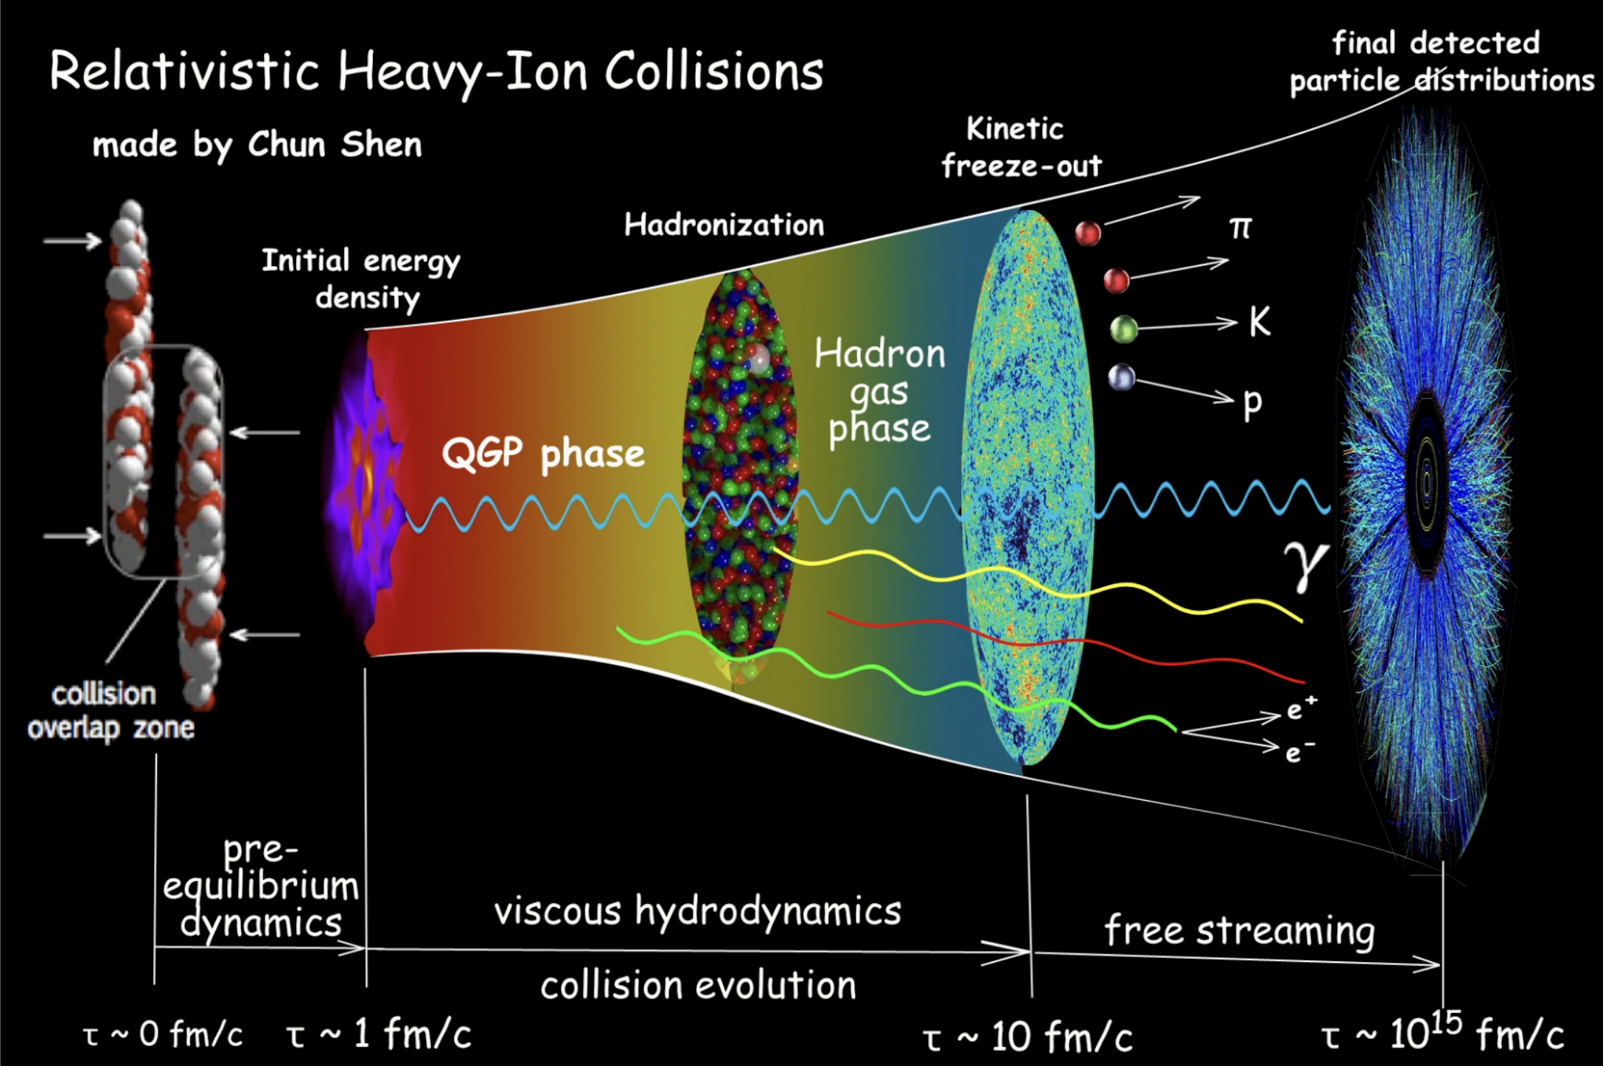
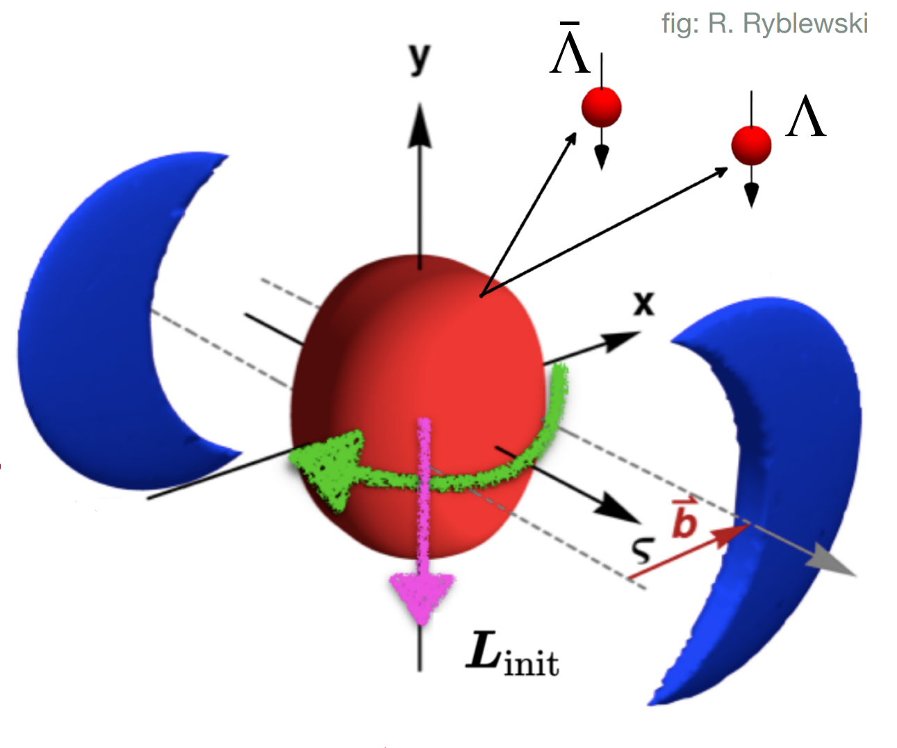
Introduction
B
Spin physics in a strongly
coupled system.
CKT: CVE, CVW and
spin-hydrodynamic.
“ Standard Model ” of
heavy ion collision

Slide 4
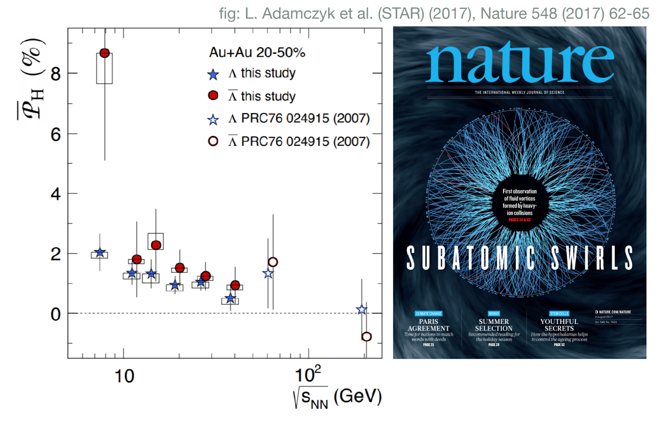
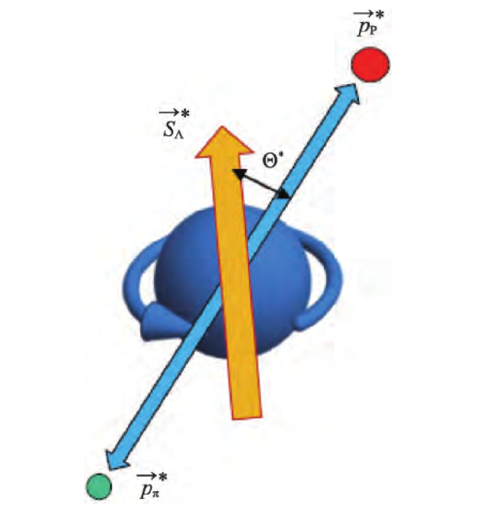
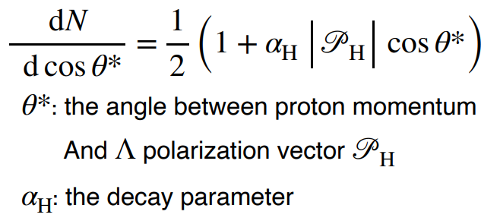
Introduction: global polarization
Using screened potential model to calculate the global quark polarization
Z. T. Liang, X. N. Wang, Phys. Rev. Lett. 94 (2005) 102301
$Λ$ and $\overline{Λ}$ hyperons are “self-analysing”, $Λ→p+π$, the proton tends to be emitted along the spin direction of the parent hyperons
…the hottest, least viscous –
and most votrical-
fluid produced in the laboratory…

Slide 5
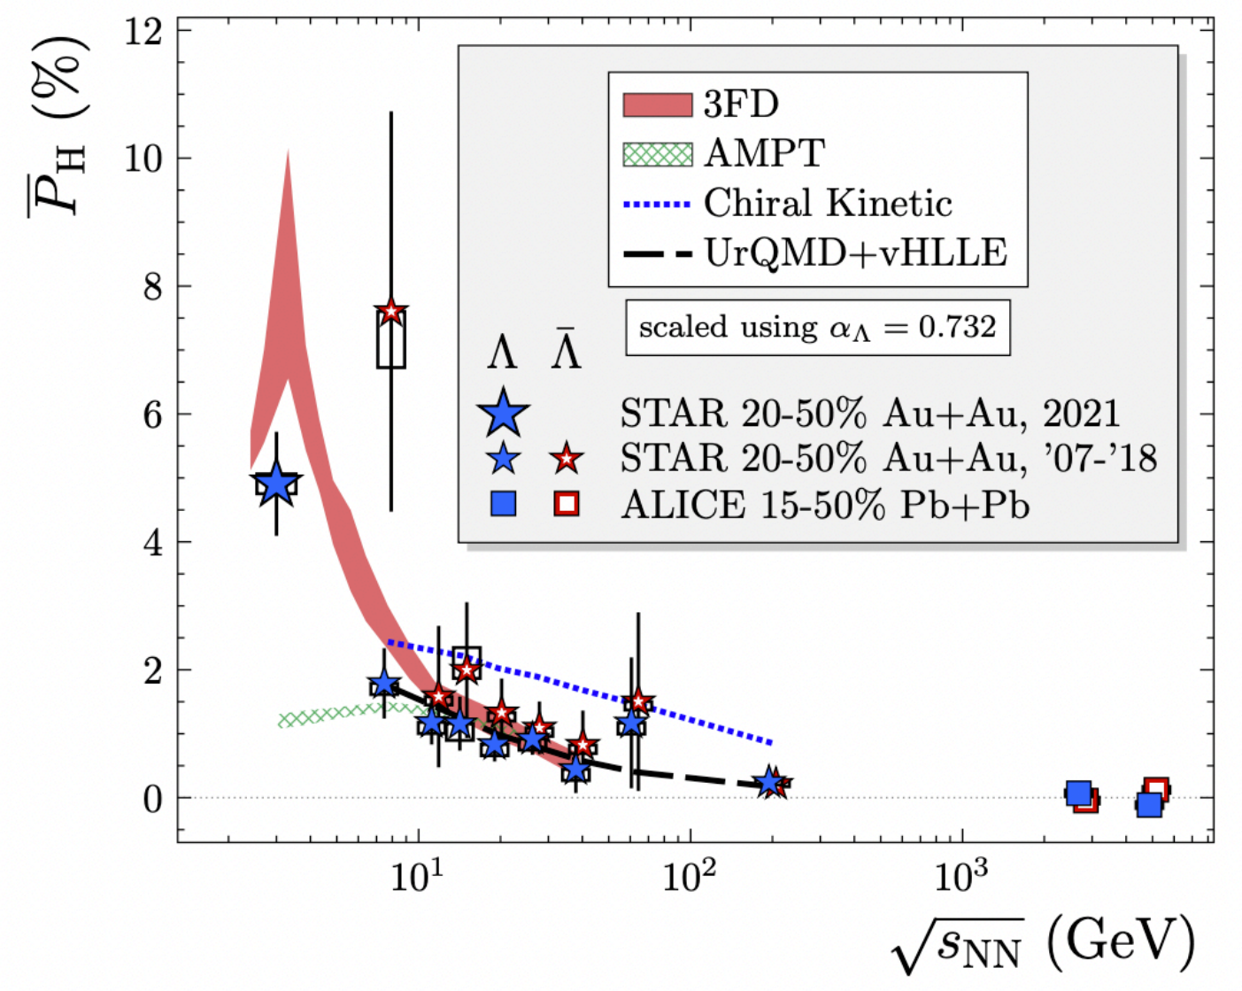
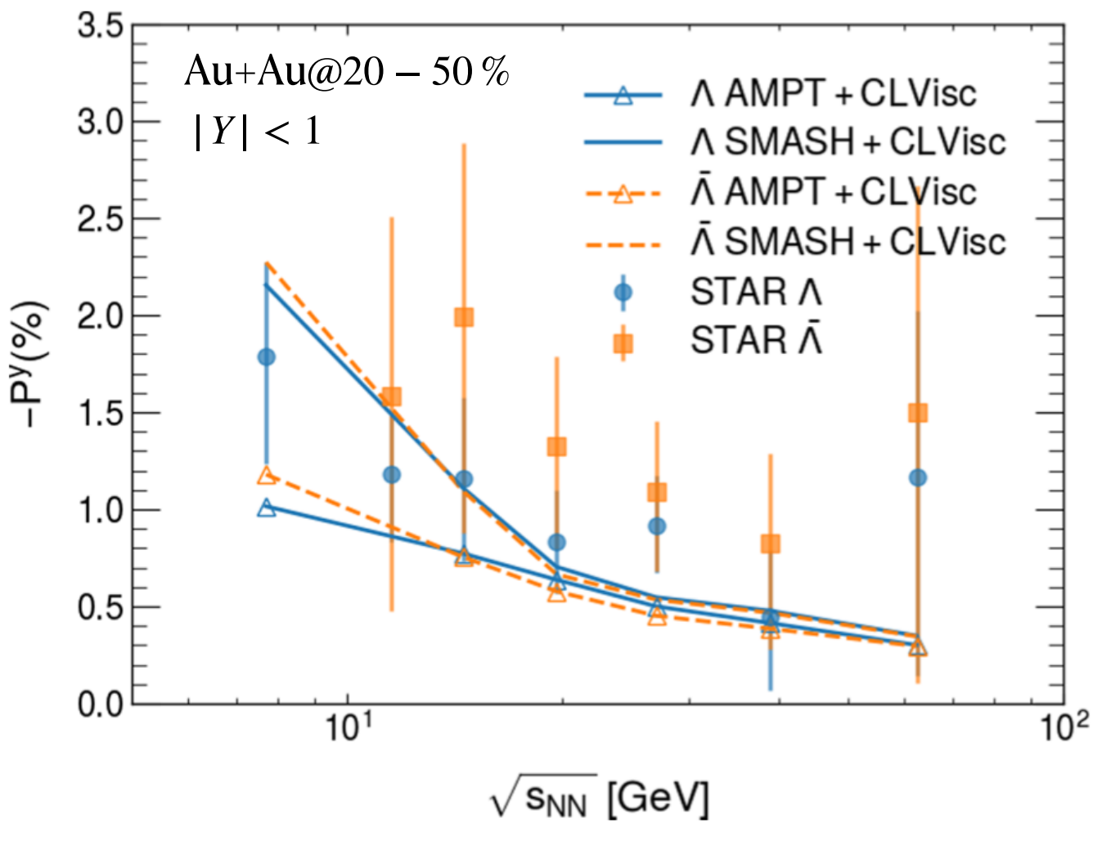
Introduction: global polarization
Fig: CLVisc 2.0, Xiangyu Wu
Hydrodynamic model and transport model reproduce the global polarization of $Λ$ hyperons above 7.7 GeV
The global and local polarization are sensitive to the initial state of the system

Slide 6
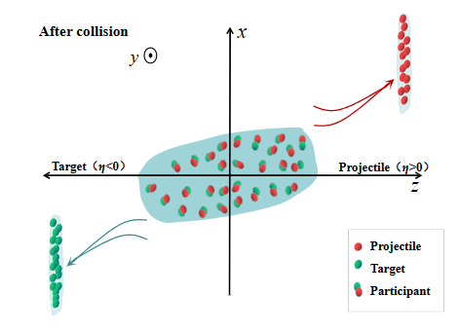
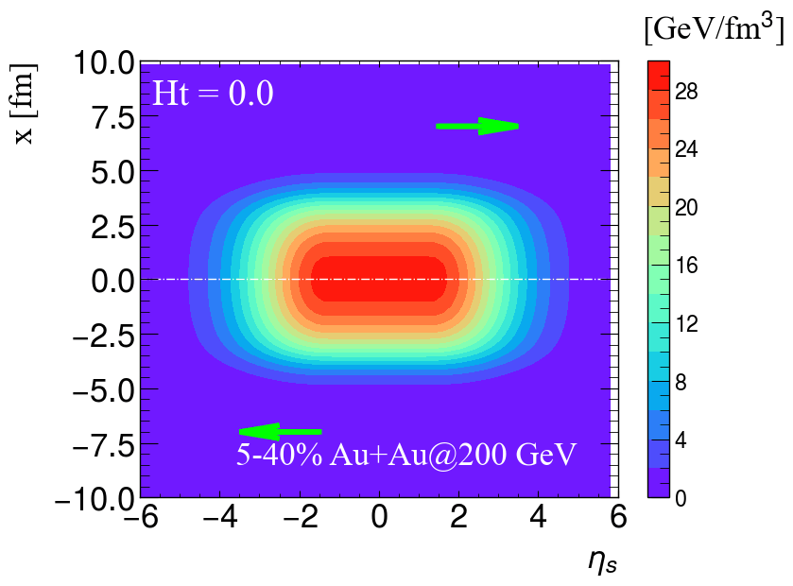
Initial condition: tilted geometry of QGP
Based on the results of directed flow v₁, a counter-clockwise tilted of the medium profile is expected in the reaction plane
Phys. Rev. C 107, 034904 (2023)
A larger value of Ht gives a more tilted fireball in the reaction plane.
Ht
The total weight function:
The initial energy density:
The initial local baryon density:

Slide 7
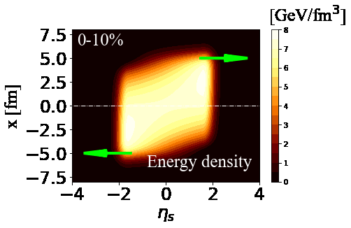
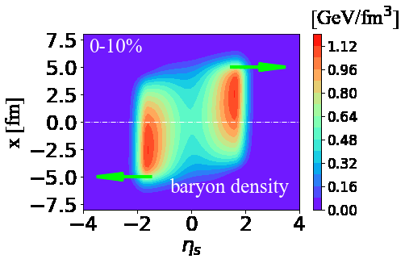
Initial condition: initial fluid velocity field
Ryu, Jupic, Shen, Phys. Rev. C 104 (2021) 5, 054908
At the initial proper time $τ_{0}$, the initial energy-momentum tensor components are:
This $f_{v} ∈[0,1]$ parameter controls the magnitude of the longitudinal flow velocity gradient.
The transverse expansion is ignored:
$T^{τx}=T^{τy}=0$ at $τ=τ_{0.}$
Au+Au @ 27 GeV

Slide 8
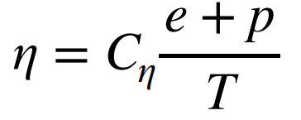
Hydro evolution: (3+1)-D CLVisc
Wu, Qin, Pang, Wang, Phys. Rev. C 105 (2022) 3, 034909
Energy-momentum conservation and net baryon current conservation:
Equation of motion of dissipative current:
The shear viscosity:
The baryon diffusion:
Equation of state: NEOS-BQS

Slide 9
Spin polarization
Yi, Pu, Yang, Phys. Rev. C 104 (2021) 6, 064901
The polarization pseudo vector for spin$\frac{1}{2}$ particles
axial charge current density
fermions number density
For massless fermions, S(p) can be decomposed into different sources

Slide 10
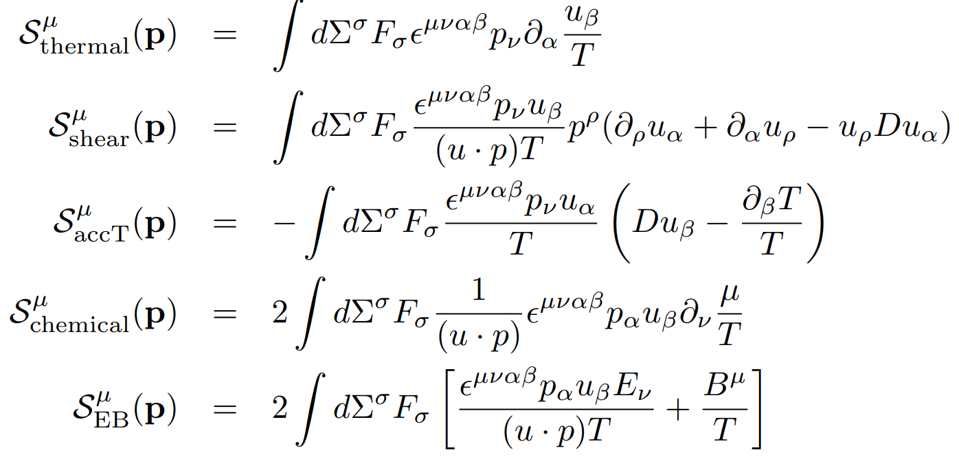
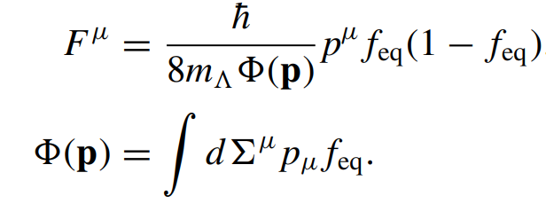
Spin polarization
Yi, Pu, Yang, Phys. Rev. C 104 (2021) 6, 064901
Thermal vorticity
Shear viscous tensor
Fluid acceleration
Gradient of chemical potential
Electromagnetic Fields
Here,

Slide 11
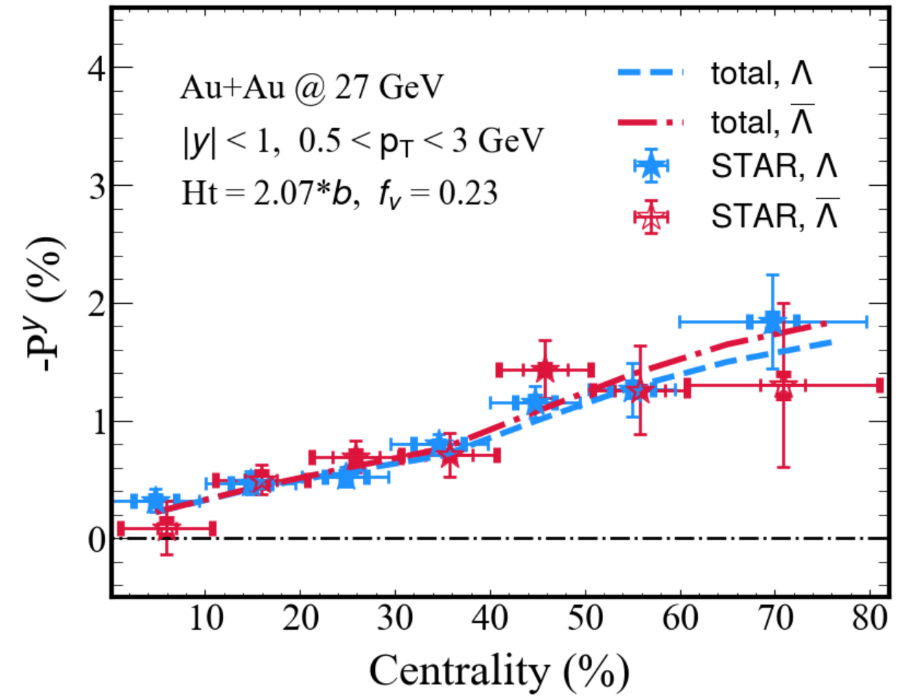
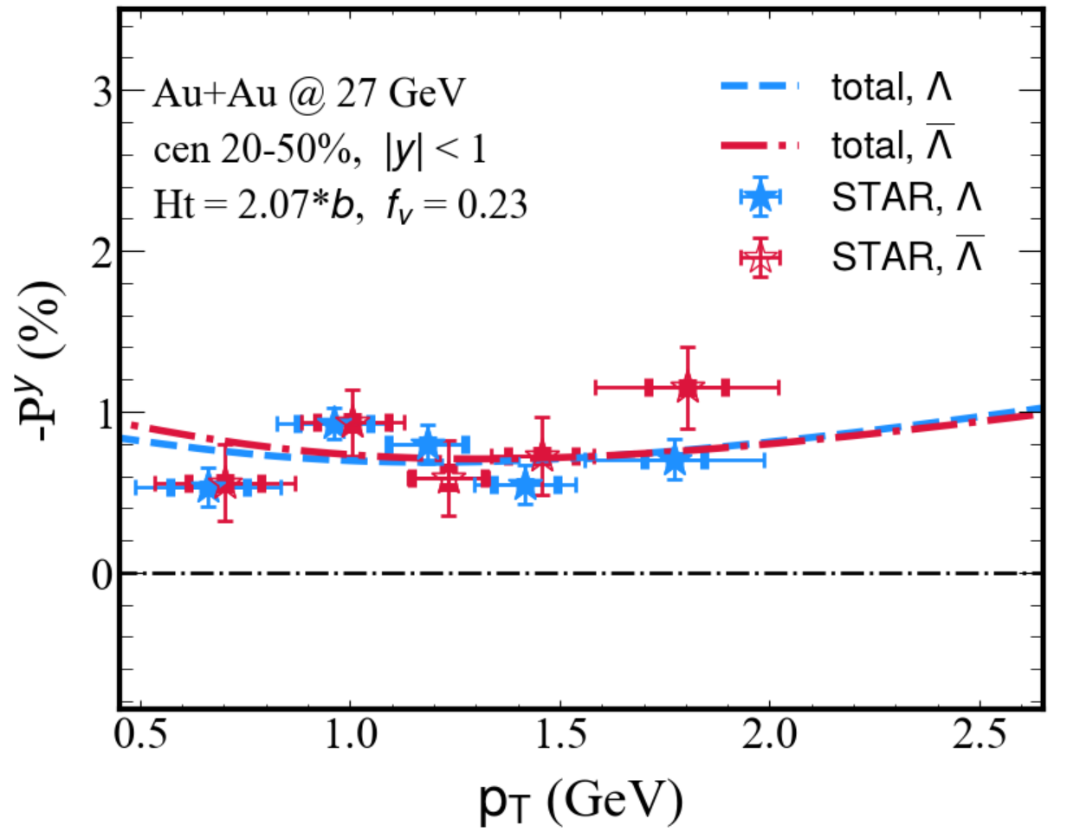
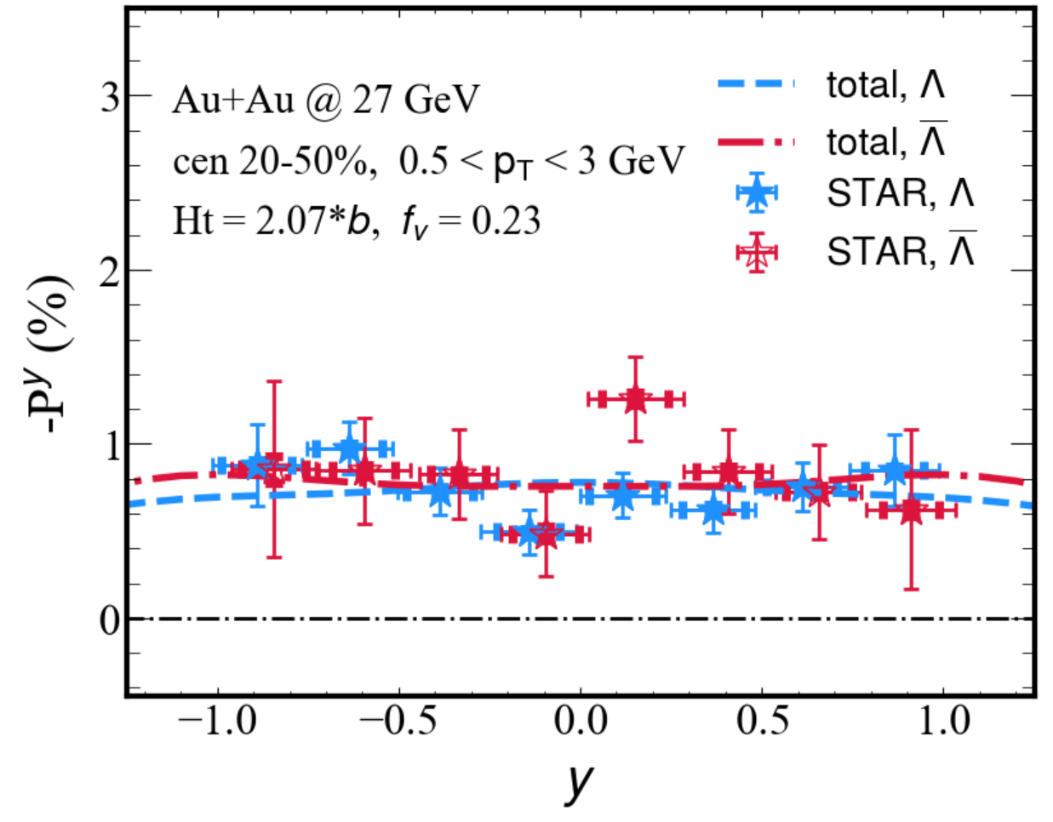
Global polarization at 27 GeV
STAR, arXiv: 2305.08705
Phys.Rev.C 108 (2023) 1, 014910
Phys. Rev. C 108, 064904 (2023)
Modified optical Glauber model coupled with CLVisc reproduce the STAR data.
Total = thermal + shear + accT + Chemical

Slide 12
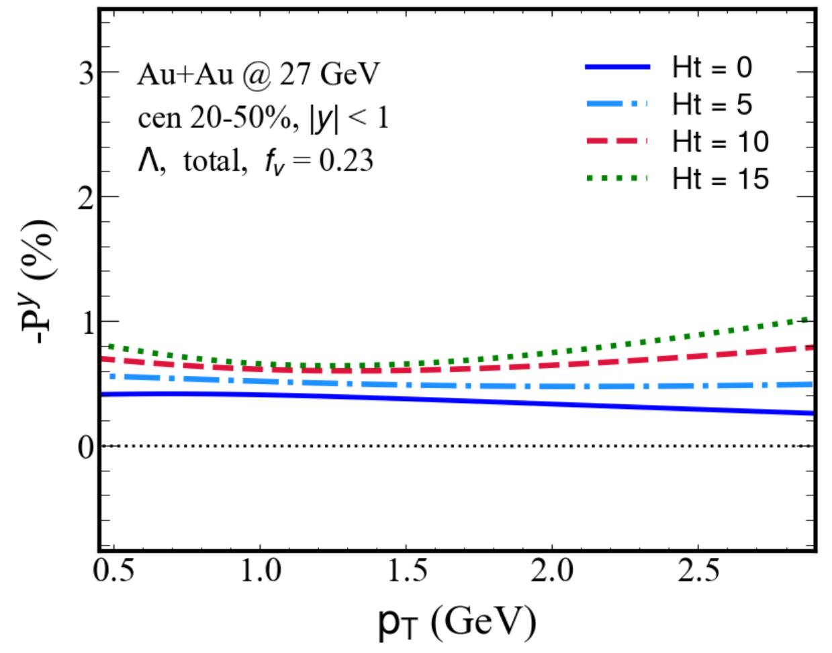
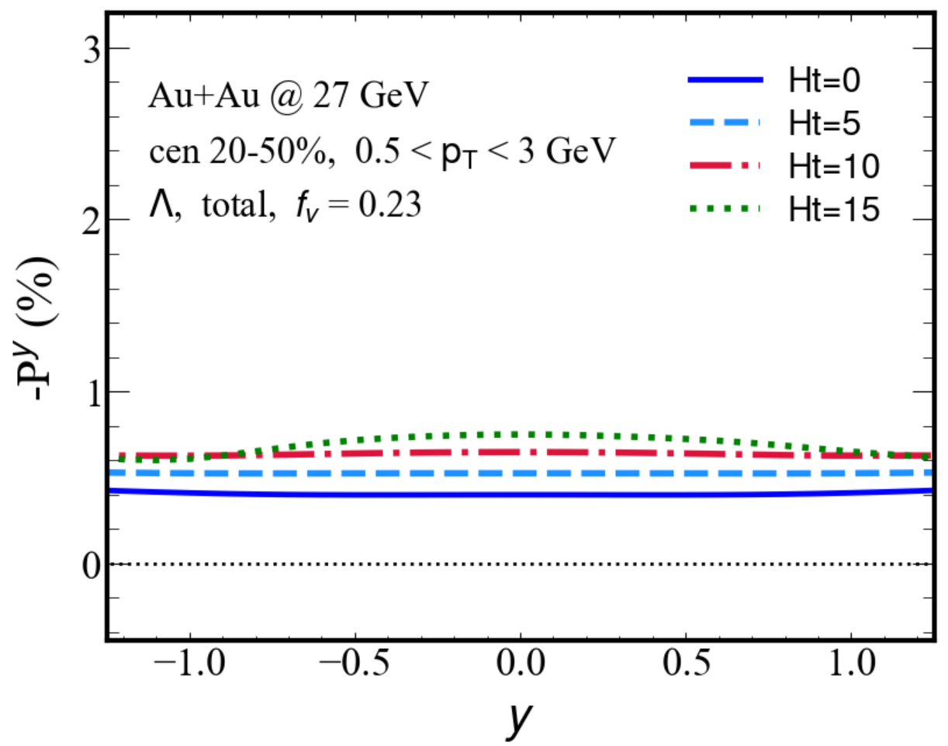
Global polarization (impact of tilted QGP)
Phys. Rev. C 108, 064904 (2023)
The magnitude of -P^{y} is amplified with increasing Ht from 0 to 15.
A non-monotonic behavior of polarization with respect to p_{T} appears when Ht is large.

Slide 13
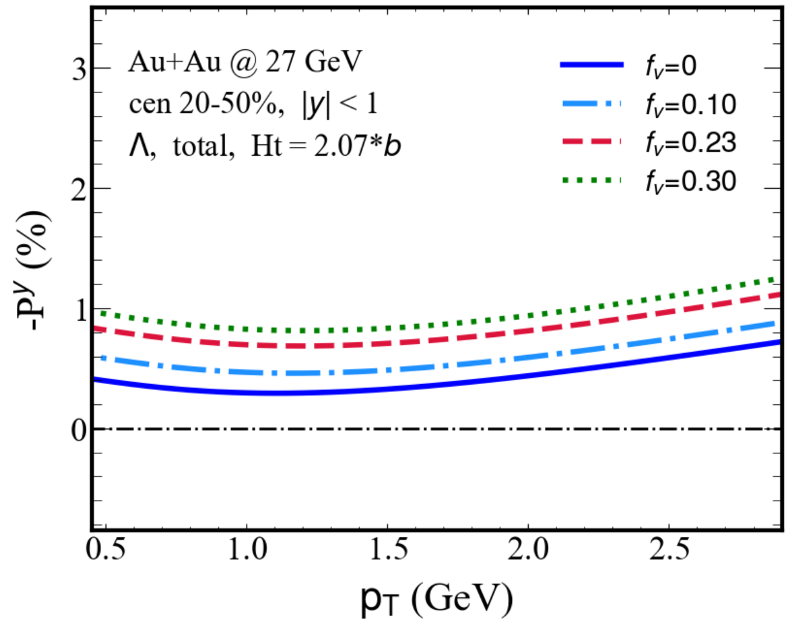
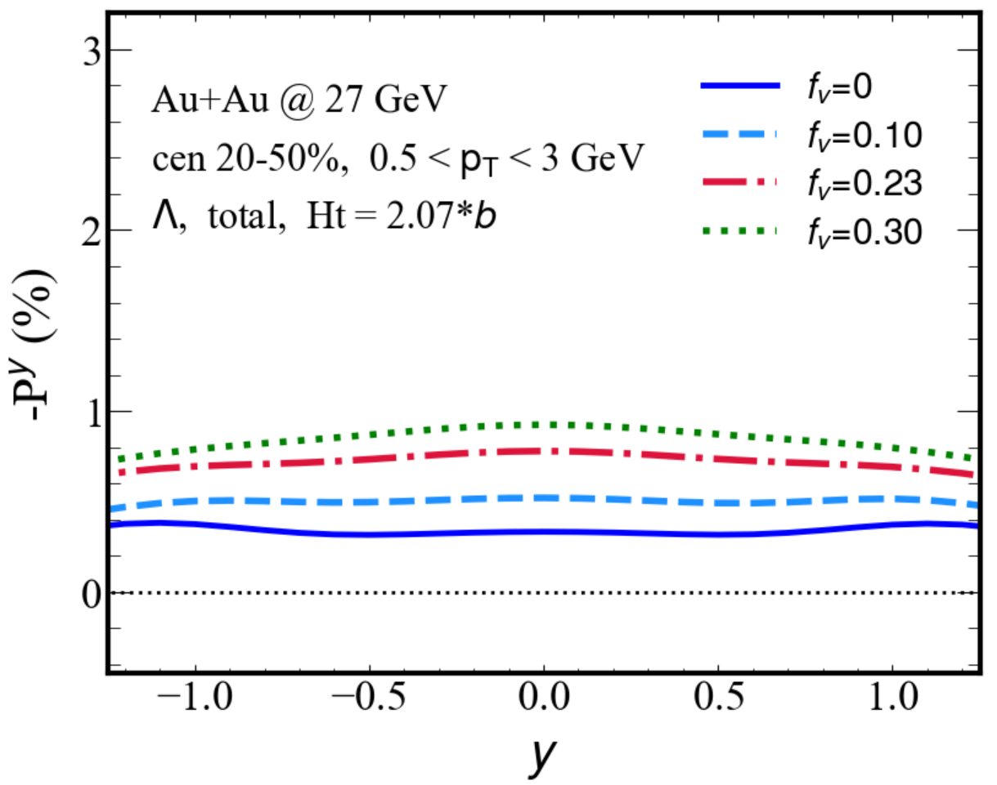
Global polarization (impact of velocity gradient)
Phys. Rev. C 108, 064904 (2023)
The stronger longitudinal velocity gradient (or larger f_{v}) leads to a larger magnitude of the global vorticity and therefore the global polarization of hyperons.

Slide 14
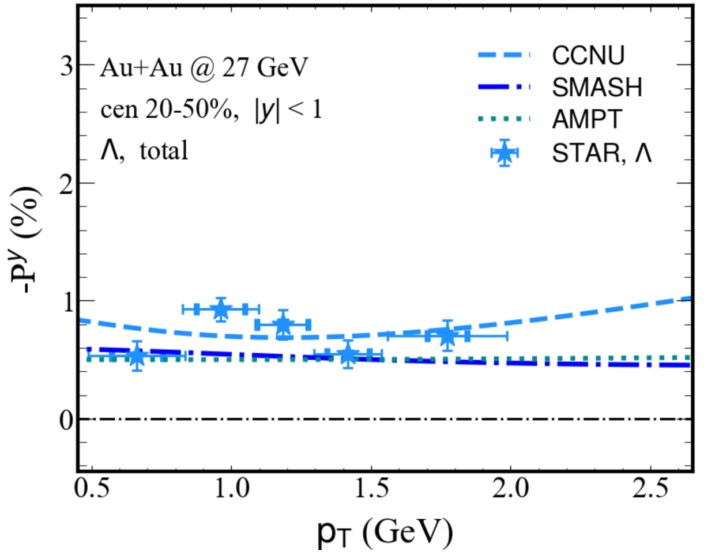
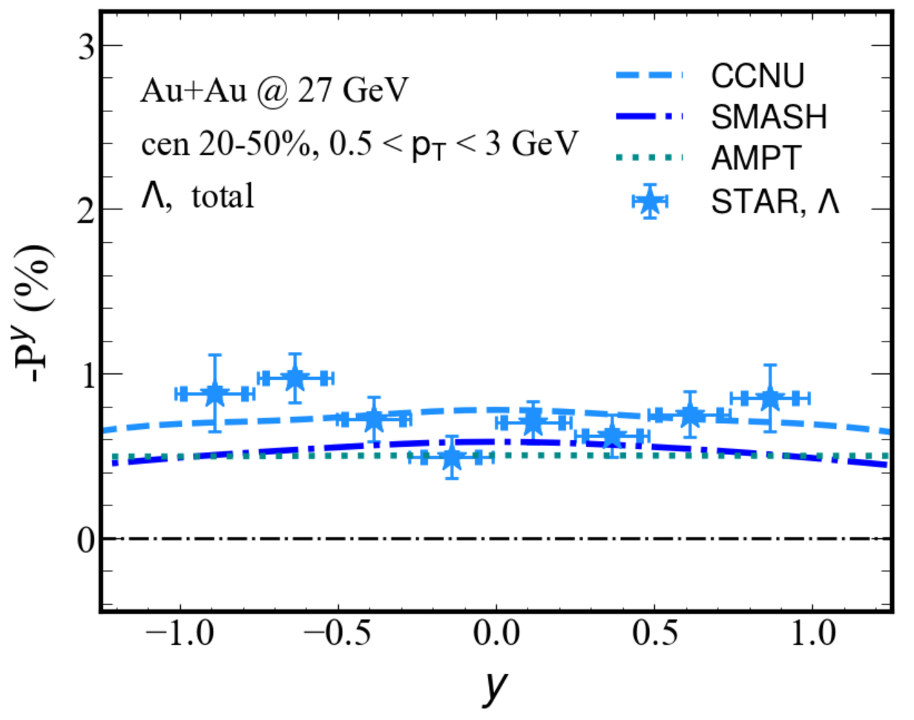
Global polarization (initial conditions)
Phys. Rev. C 108, 064904 (2023)
The tilted initial condition (CCNU) generates a larger -P^{y} than the SMASH and AMPT models in both transverse momentum and rapidity distribution
All three initial conditions are capable of describing the STAR data

Slide 15
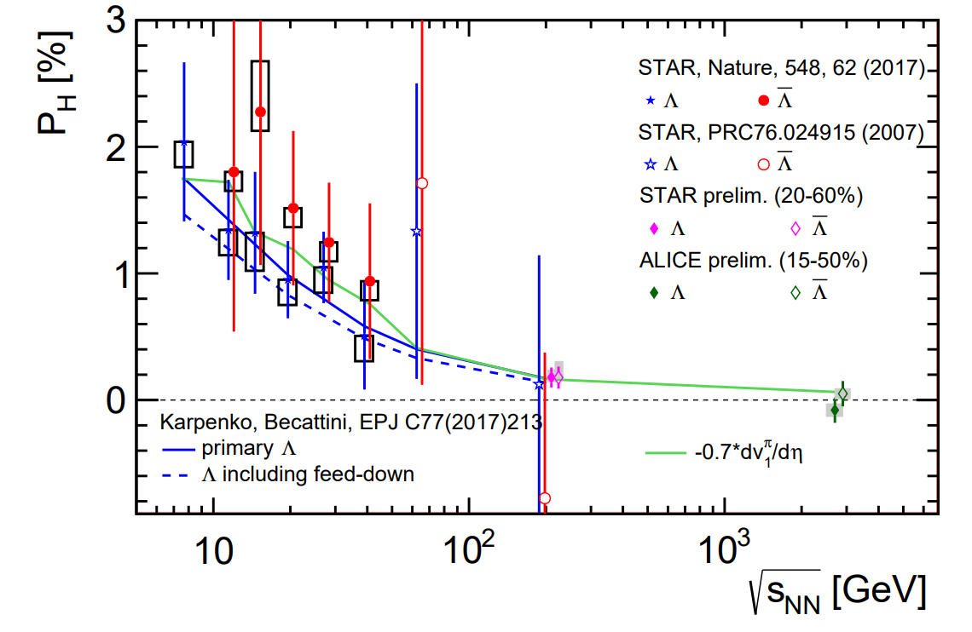
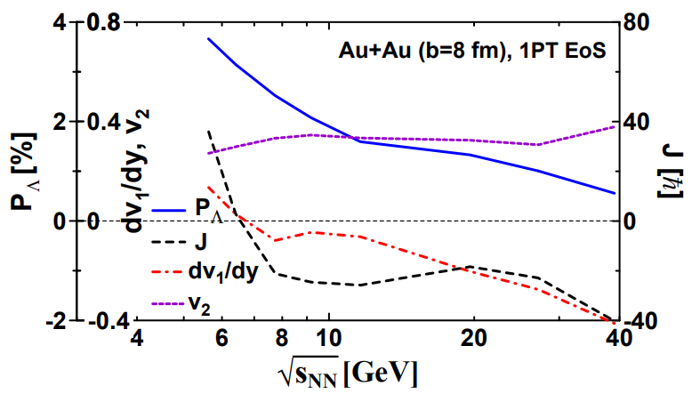
Relation of global polarization and directed flow
Sergei A. Voloshin EPJ Web Conf. 171 (2018) 07002
Yu. B. Ivanov Phys. Rev. C 102 (2020) 2, 024916
Can we use the available data on v₁ slope for an estimate of the global polarization at different collisions?

Slide 16
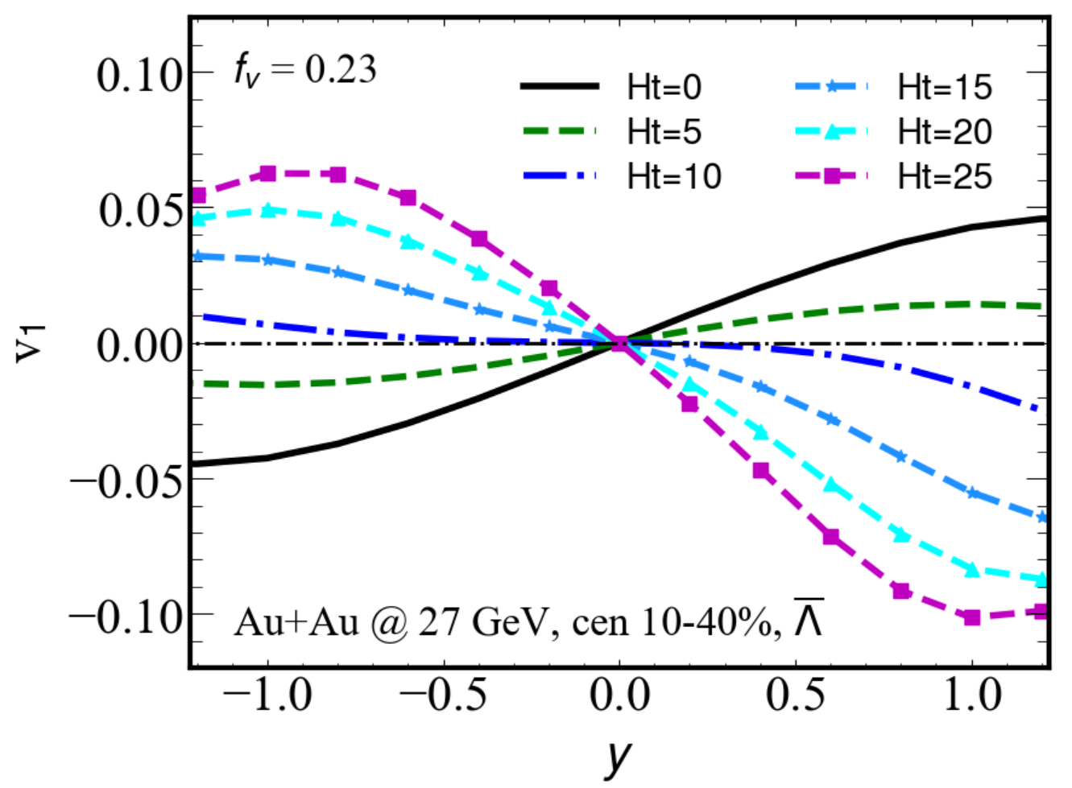
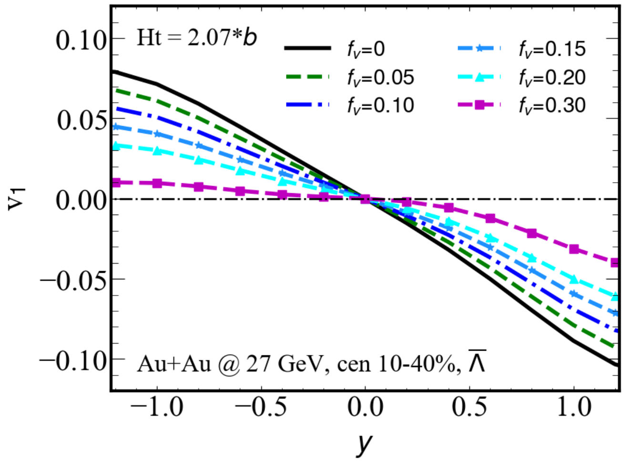
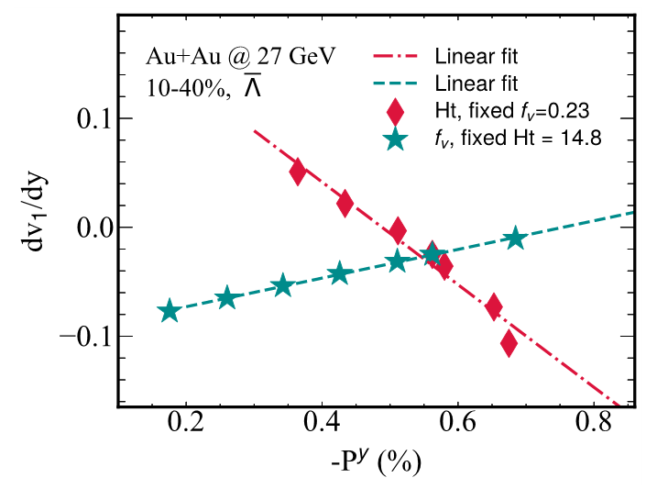
Relation of global polarization and directed flow
Phys. Rev. C 108, 064904 (2023)
When Ht is fixed, increasing f_{v} increases dv₁/dy and -P^{y}, resulting in a positive relation.
When f_{v} is fixed, increasing Ht increases -P^{y} but decreases dv₁/dy.

Slide 17
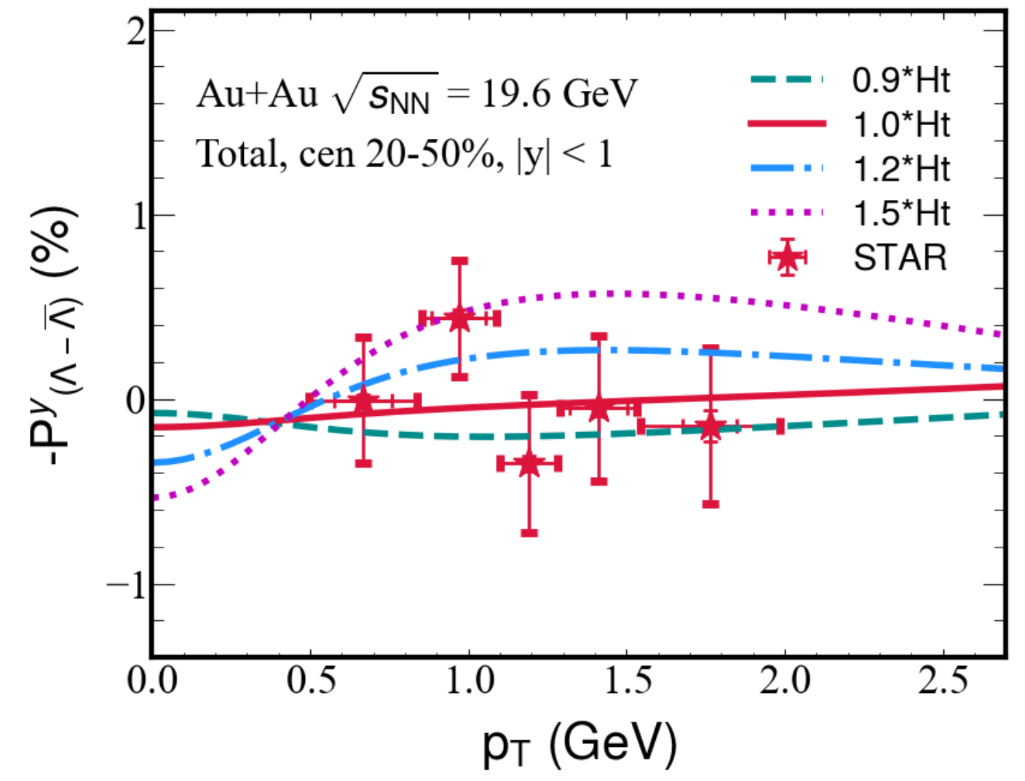
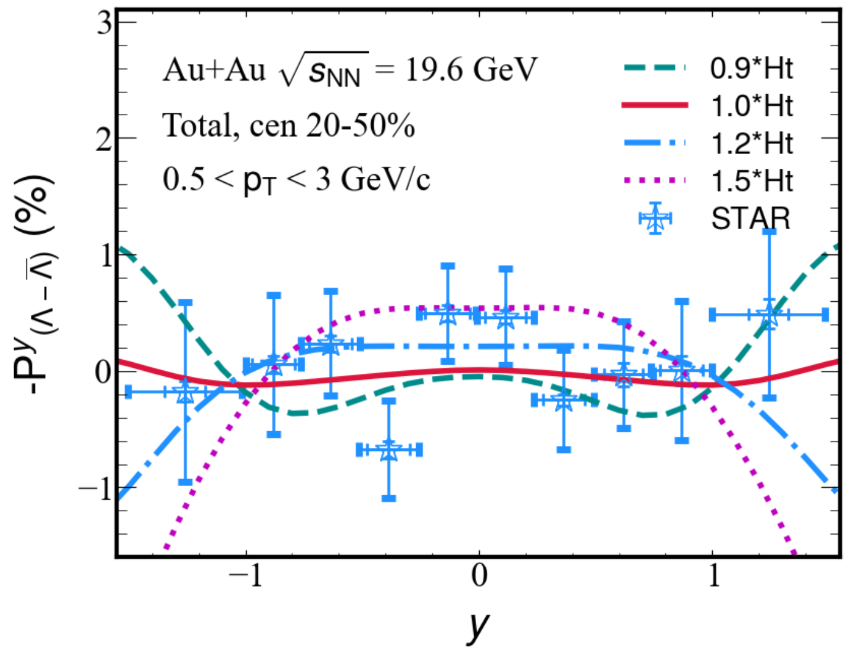
Splitting of the global polarization
A more tilted baryon density generates a larger splitting of global polarization in both transverse momentum and rapidity distribution
To better constrain the initial condition, more accurate measurement data is required.

Slide 18
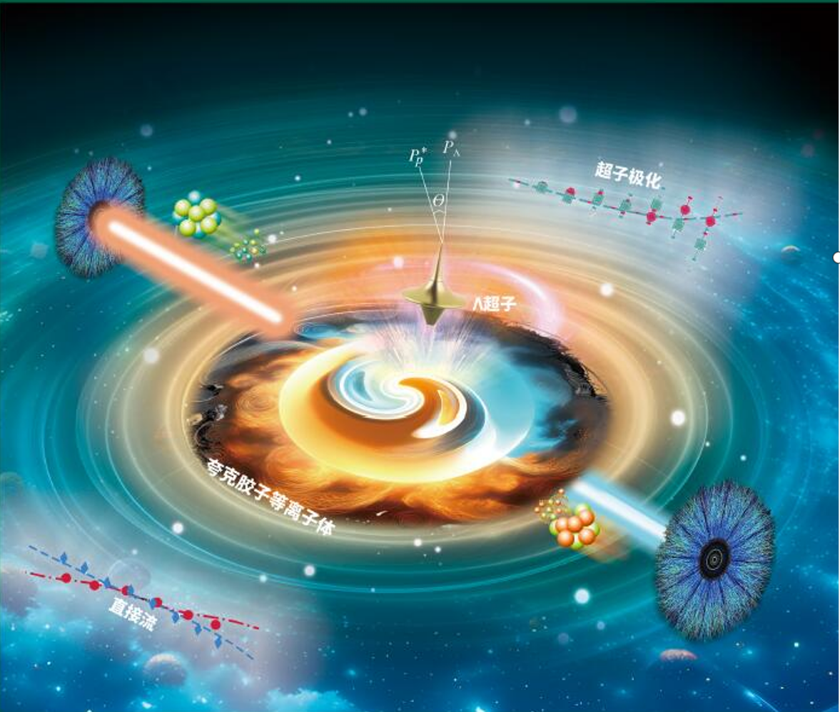
Summary
We discuss the effects of tilted geometry and initial longitudinal flow of the QGP on the hyperon polarization.
We propose a possible relation between hyperon polarization and directed flow.
Thank you!
谢 谢!
Phys. Rev. C 108, 064904 (2023) and Phys. Rev. C 107, 034904 (2023)

Slide 19
Backup

Slide 20
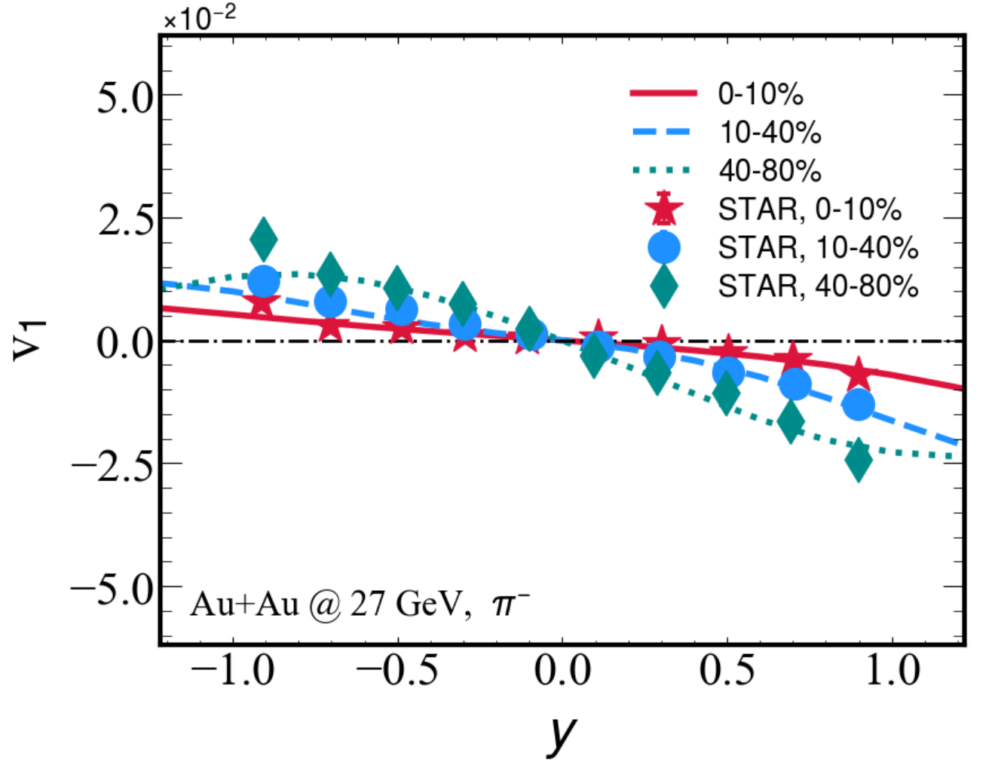
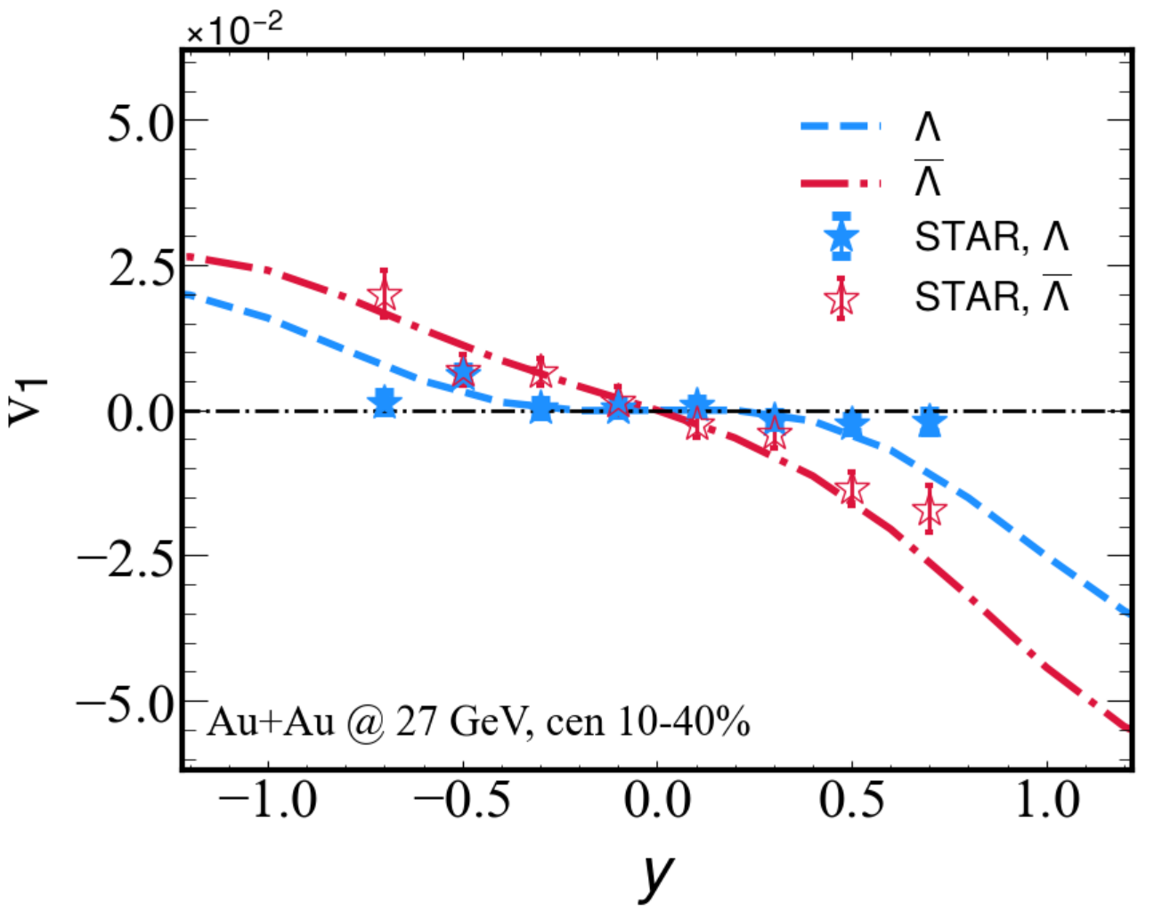
directed flow v₁
Jiang, Wu, Cao, Zhang, Phys. Rev. C 107, 034904 (2023)
v₁ is sensitive to the QGP volume, size, asymmetry shape and velocity field in transverse plane.
Longiduianl shape and size of the QGP can be reconstructed from v₁ data!

Slide 21
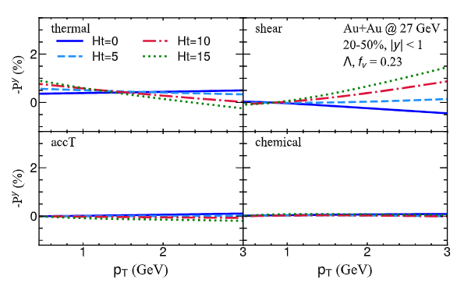
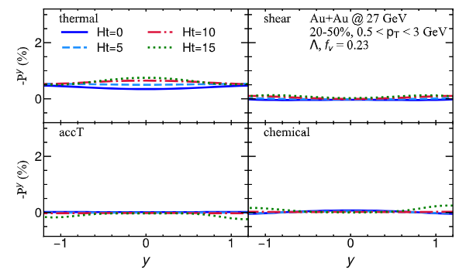
Global polarization (different tilted fireball)

Slide 22
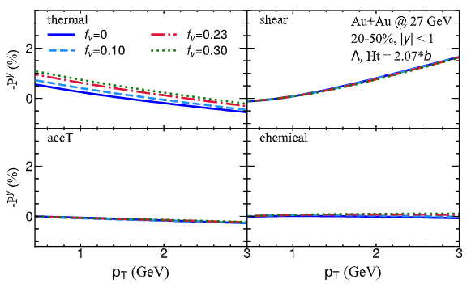
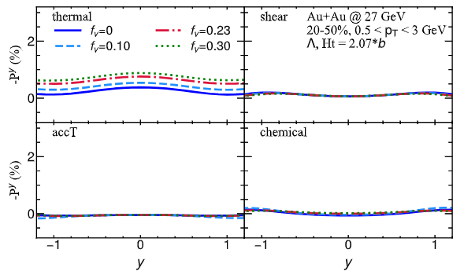
Global polarization (different velocity field)

Slide 23
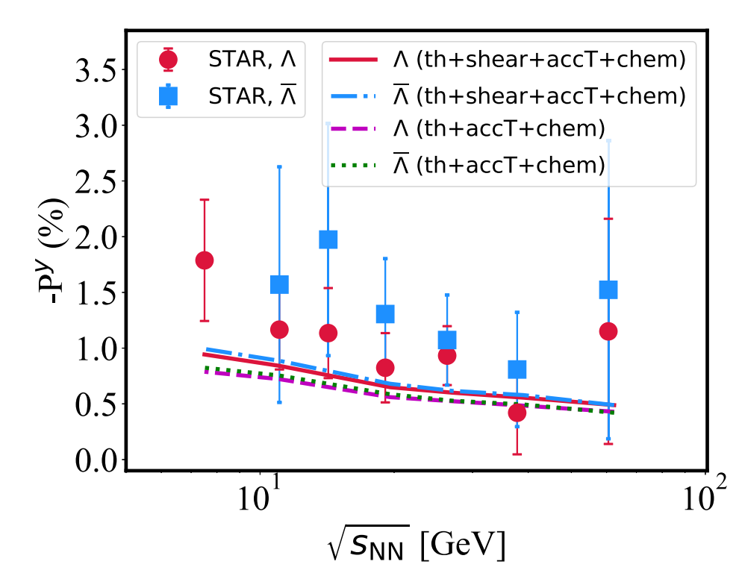
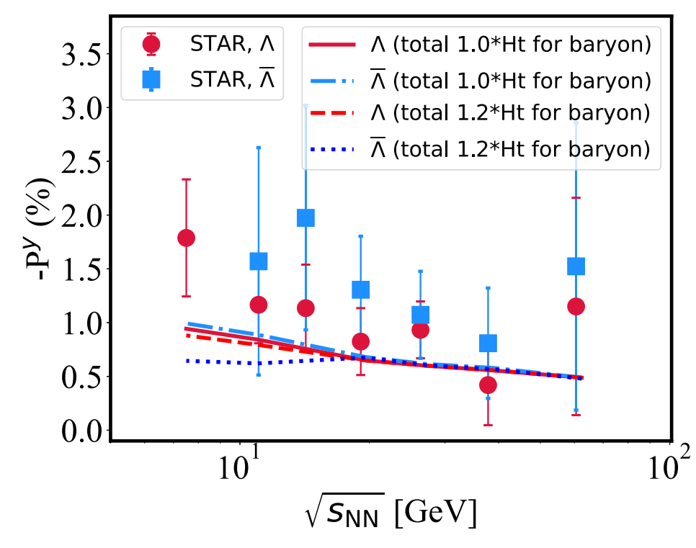
Global polarization
Notes:
一方面认为它携带了高能核核碰撞极早期的信息；
另一方面，它可以帮助人们寻找和了解自然界费米尺度下可能存在的强电磁场。

