Slide 1
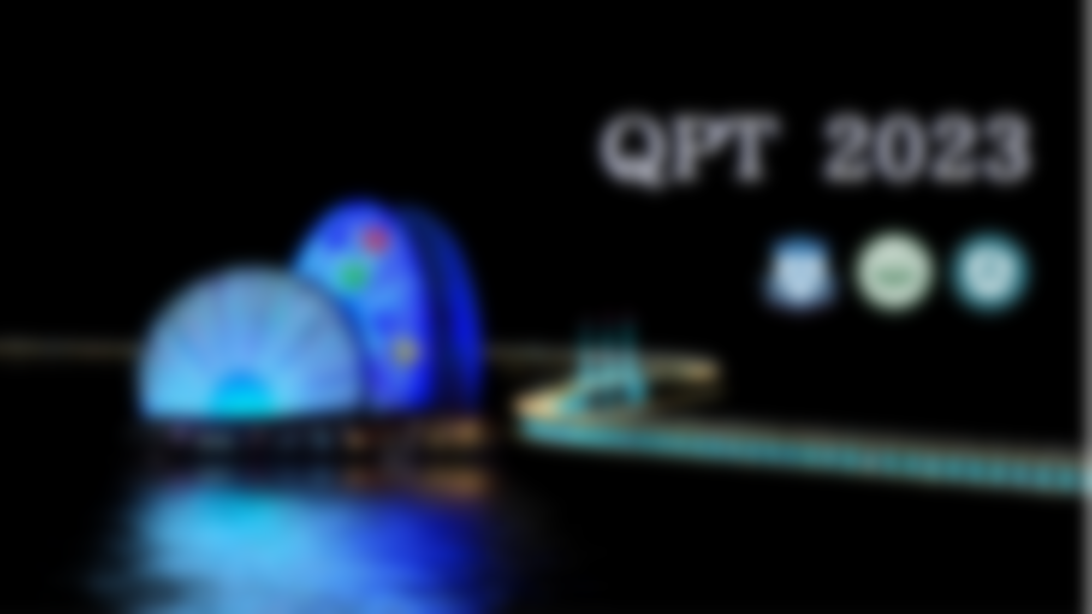
Spin alignment of vector mesons induced by spin density fluctuation
Kun Xu
Kun Xu, Mei Huang, paper in preparation…
12/18/2023 @ Zhuhai
第十五届QCD相变与相对论重离子物理研讨会，2023/12/14-19

Slide 2
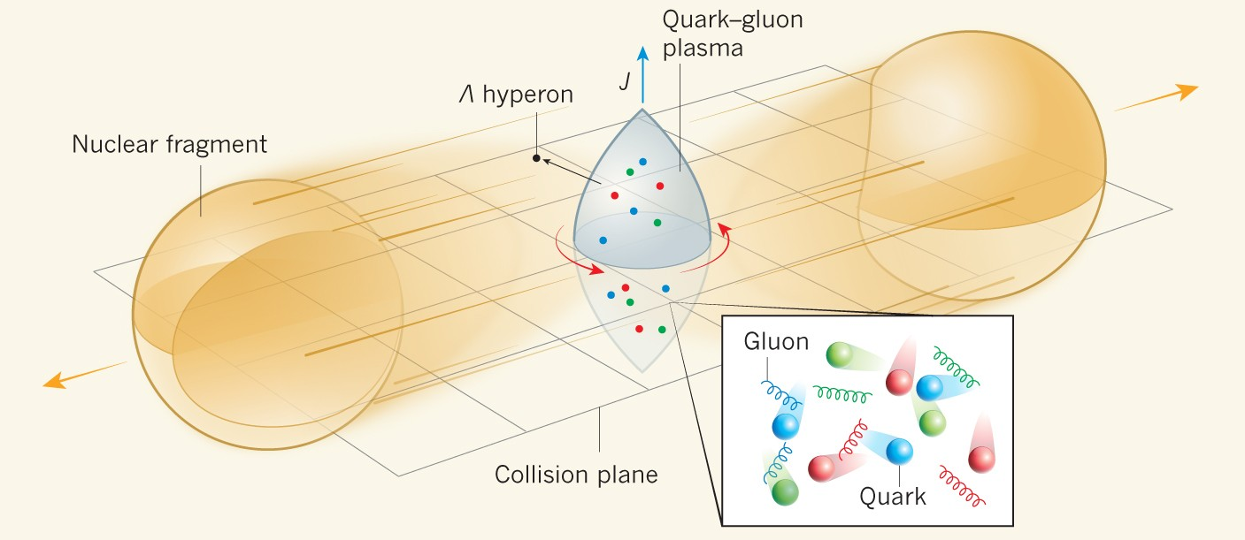
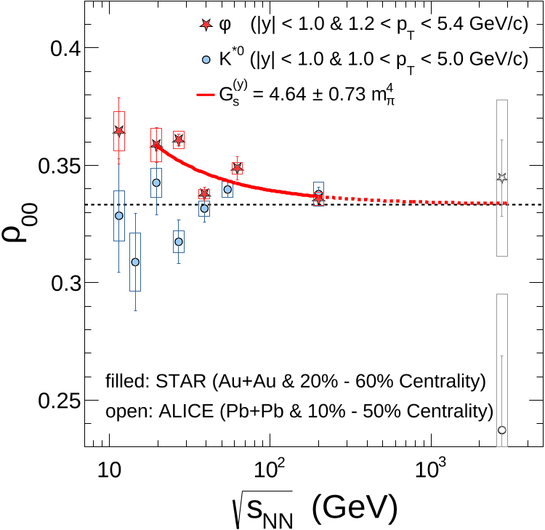
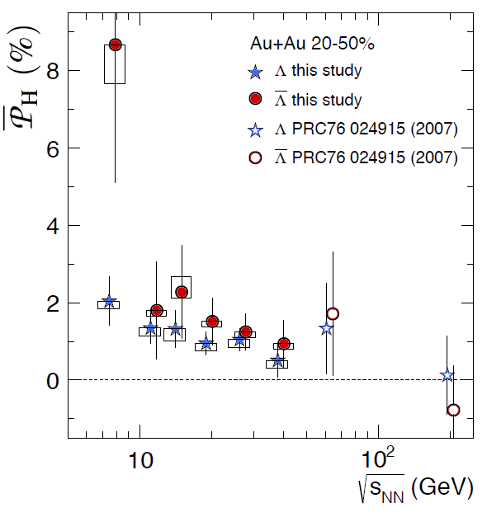
Non-central collision
Relativistic Heavy Ion Collision
T$\sim 150MeV$
The fastest rotation: $ω\sim {10}^{21}s^{−1}$
The strongest magnetic field: $eB\sim {10}^{18}G$
➔ Spin polarization
Spin alignment
of vector mesons
Spin polarization
of Hyperon
Rotation
Magnetic field
$ρ_{00}=\frac{1}{3}$
if no spin alignment
STAR.
Nature 614 (2023) 7947, 244-248
$$\frac{4}{9}P_{Λ}P_{\overline{Λ}}\sim {10}^{−5}$$
Why spin alignment?
Nature 548, 62–65 (2017).
Phys.Lett.B 629 (2005) 20-26
Phys.Rev.Lett. 94 (2005) 102301
Rotation➔ $ρ_{00}<\frac{1}{3}$, Magnetic field ➔ $ρ_{00}>\frac{1}{3}$

Slide 3
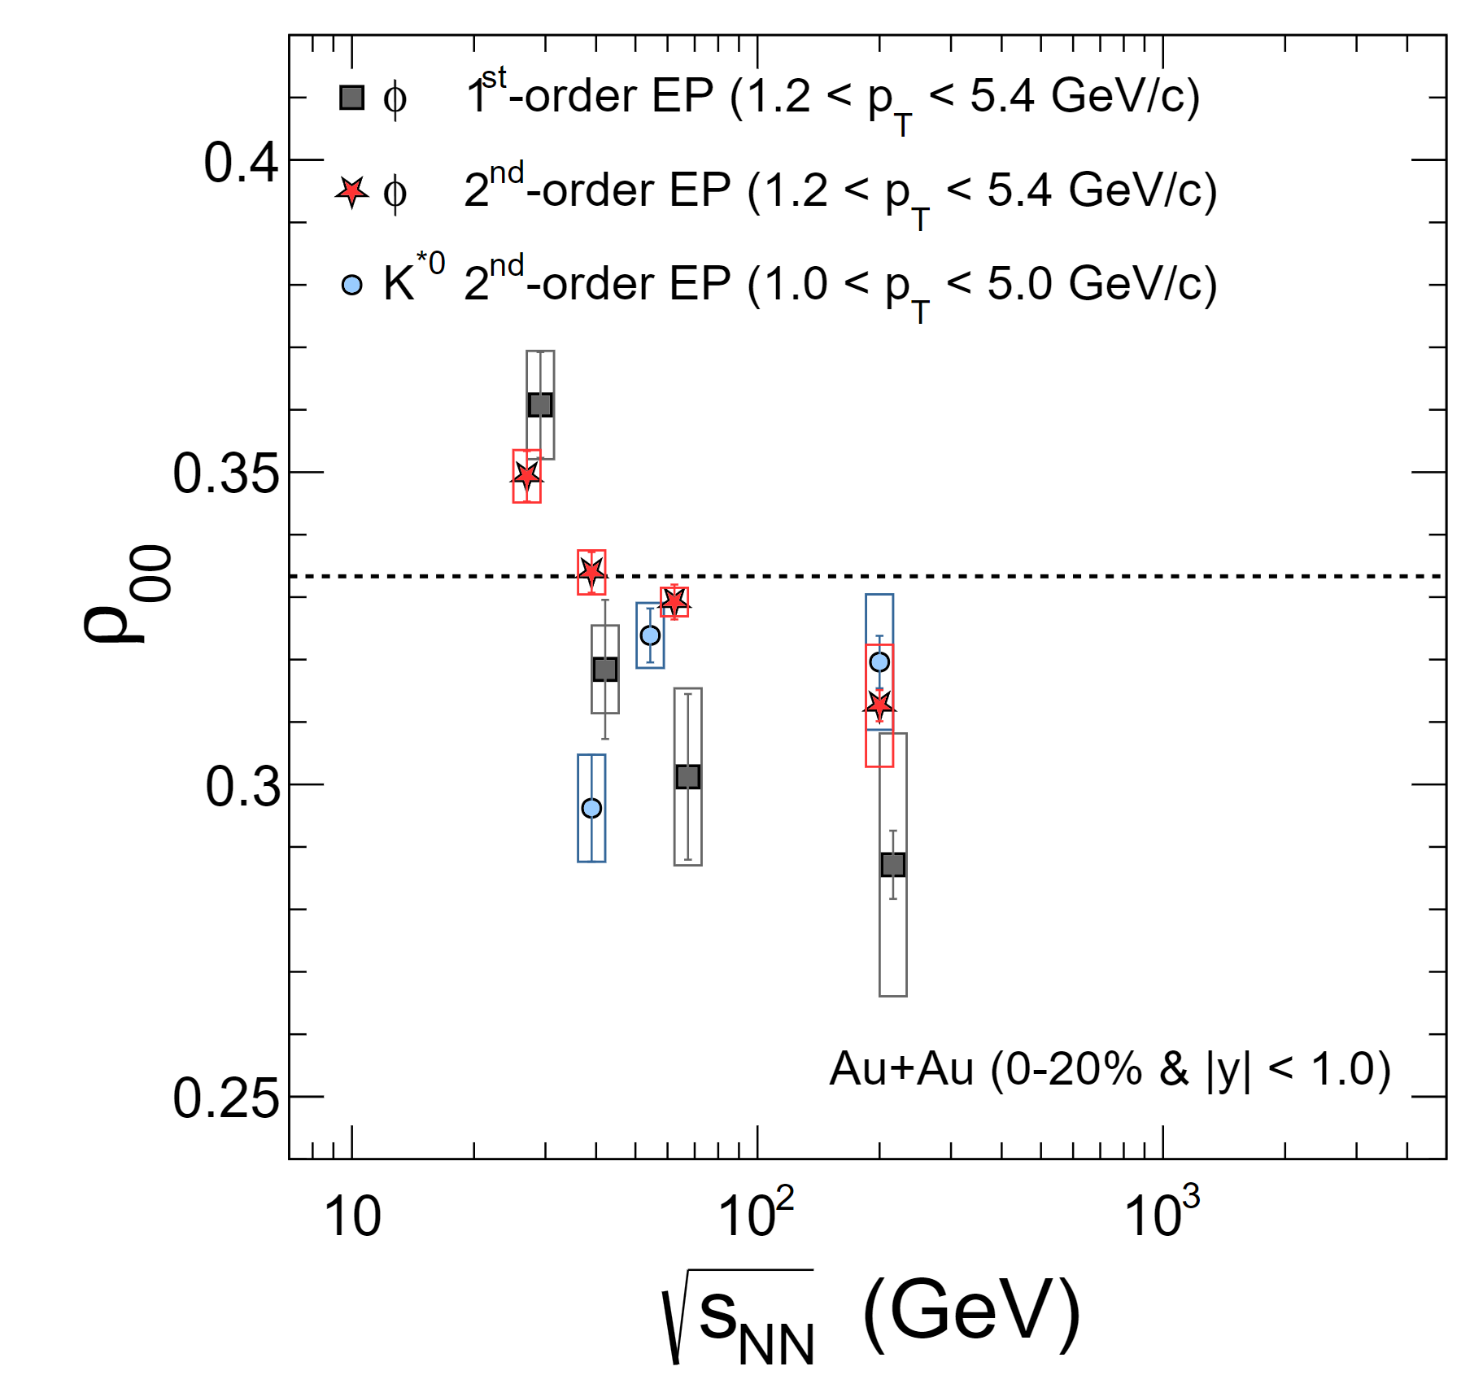
From Prof. Qun Wang’s Talk
Most-central high energy collision:
No Rotation,
No Magnetic field,
No net baryon number,
…
Why spin alignment???

Slide 4
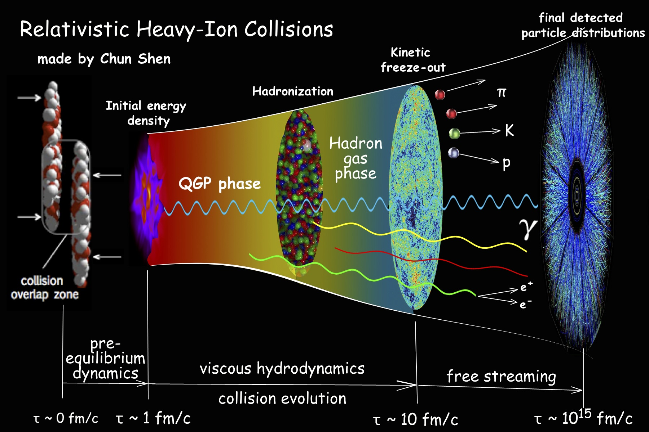
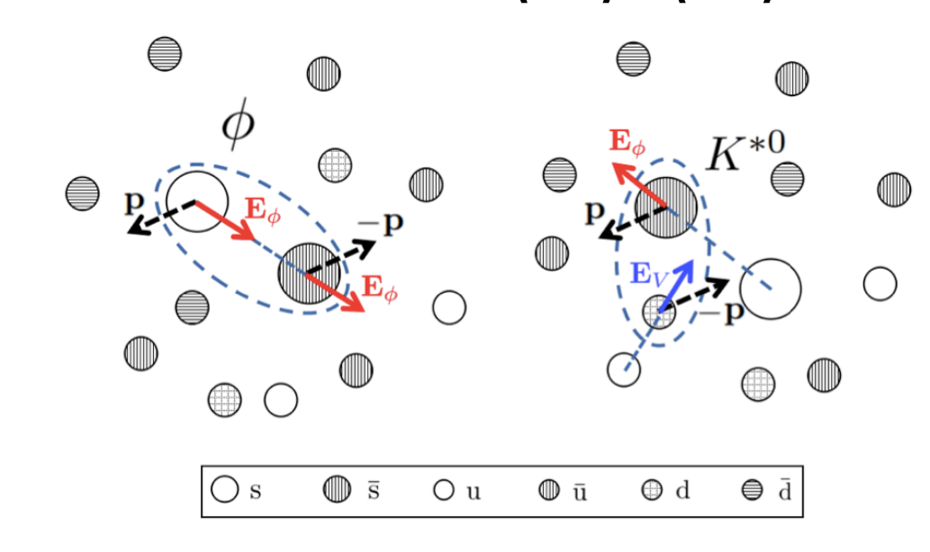
Any other possible mechanism?
Without any environment conditions, such as, rotation or magnetic field or…
Only the nature of QCD?
Spin density fluctuation
As a thermal and quantum system
Mesons emitted from QGP locally
Effective Interactions of quarks, (NJL-type interaction)
scalar, vector, tensor, pseudo-s, axial-vector
scalar interaction: effective mass, chiral symmetry
pseudo-s: pseudo scalar meson, pion…
Spin alignment from the local polarization

Slide 5
Axial-Vector operator | Tensor operator
$${(\overline{ψ}γ^{μ}γ^{5}ψ)}^{2}$$ | $${(\overline{ψ}{iγ}^{1}γ^{2}ψ)}^{2}$$
$$\int{d^{3}x\overline{ψ}(x)γ^{μ}γ^{5}ψ(x)}\sim N_{+}^{↑}−N_{+}^{↓}\text{+} N_{−}^{↑}−N_{−}^{↓}$$ | $$\int{d^{3}x\overline{ψ}\left(x\right)iγ^{1}γ^{2}ψ(x)}\sim N_{+}^{↑}−N_{+}^{↓}−(N_{−}^{↑}−N_{−}^{↓})$$
The number of spin-up minus the number of spin-down | The number of MM-up minus the number of MM-down
$$N_{+}^{↑}=\int{\frac{d^{3}p}{{(2π)}^{3}}\frac{Ep_{z}^{2}+mp_{⊥}^{2}}{E{\overset{⃑}{p}}^{2}}}a_{p}^{†}a_{p}$$ | $$N_{+}^{↑}=\int{\frac{d^{3}p}{{(2π)}^{3}}\frac{Ep_{⊥}^{2}+mp_{z}^{2}}{E{\overset{⃑}{p}}^{2}}}a_{p}^{†}a_{p}$$
Spin Polarization(SP) | Magnetic Moment Polarization(MMP)
Effective Rotation | Effective Magnetic Field

Slide 6
Quarks under SP background
Dispersion relation:
Zero momentum:
$$m^{′}=m−sa$$
$$ℒ=\overline{ψ}(i∂−m+aγ^{3}γ^{5})ψ$$
$$ω^{2}={(\sqrt{m^{2}+p_{t}^{2}}−sa)}^{2}+p_{z}^{2}$$
Mean field $a$
What happens to $φ$ meson?
Consider it in a constituent quark model:
Number difference between spin-up and -down
$M_{φ}=$ $m_{s}+m_{\overline{s}}$
$$s=0$$
$$s=1$$
$$s=−1$$
Without SP background
Distribution function:
$$f\left(M_{φ}\right)=\int{\frac{1}{e^{\frac{\sqrt{{(M_{φ}+2sa)}^{2}+p^{2}}}{T}}−1}}$$
$$a>0$$
With SP background
$$a<0$$
Mass splitting
$$m_{s}+m_{\overline{s}}$$
$$m_{s}+m_{\overline{s}}−2a$$
$$m_{s}+m_{\overline{s}}+2a$$

Slide 7
Spin alignment of $φ$, $ρ_{00}=\frac{N_{0}}{N_{0}+N_{1}+N_{−1}}$
Assume $a≪M_{φ}\sim 1GeV$, $M_{φ}≫T\sim 0.15GeV$
Under SP background | Under MMP background
Lead to $ρ_{00}<\frac{1}{3}$ | Lead to $ρ_{00}>\frac{1}{3}$
Similar to rotation | Similar to magnetic field
$ρ_{00}−\frac{1}{3}\sim {(\frac{a}{T})}^{2}$ | $$\frac{1}{3}−ρ_{00}\sim \frac{|κ|}{T}$$
This conclusion does not depend on the sign of SP/MMP background

Slide 8
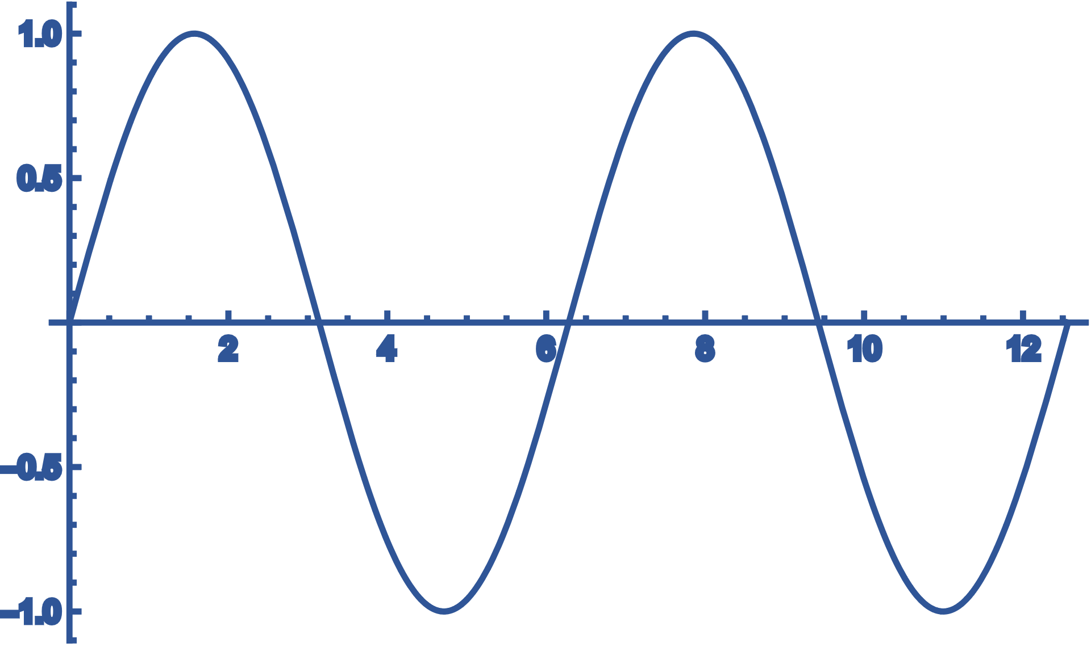
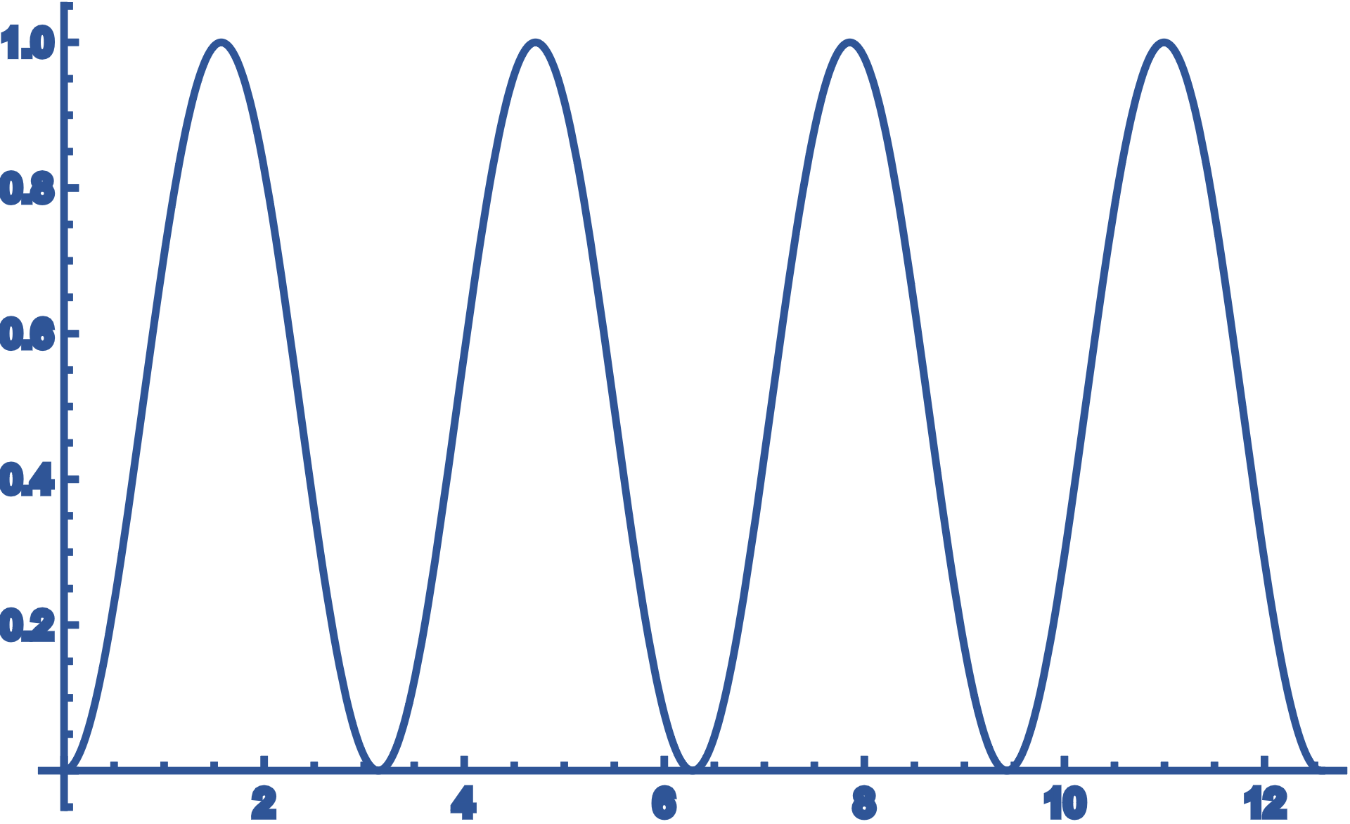
SP background $a$ and MMP background $κ$ lead to spin alignment of vector meson
which does not depend on the sign $a/κ$
local SP/MMP is enough, instead of global and homogeneous background(Mean Field)
Fluctuation, none zero locally, zero on average
Instead of MF, i.e., $\left\langle 𝒪\right\rangle =0$
Lagrangian with scalar and tensor interaction:
$$ℒ=\overline{ψ}\left(i∂−m\right)ψ+{G_{S}(\overline{ψ}ψ)}^{2}+{G_{A}(\overline{ψ}γ^{3}γ^{5}ψ)}^{2}$$
For $G_{A}≲2G_{S}$, $\left\langle \overline{ψ}γ^{3}γ^{5}ψ\right\rangle =0$
No Mean Field Background!
No GLOBAL Background!
we consider, $\left\langle 𝒪^{2}\right\rangle ≠0$

Slide 9
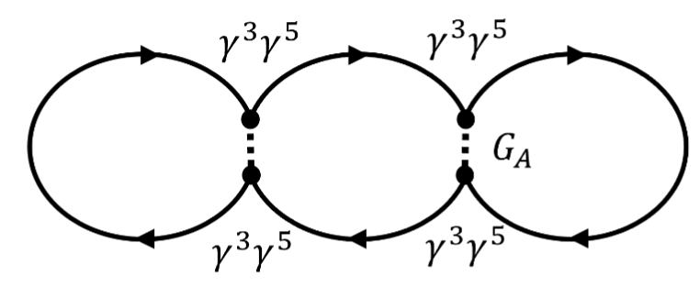
Lagrangian with axial-vector interaction:
$$ℒ=\overline{ψ}\left(i∂−m\right)ψ+{G_{A}(\overline{ψ}γ^{3}γ^{5}ψ)}^{2}$$
The averaged spin density square:
$$x$$
$$y$$
4-fermion interaction
$$\sim N^{↑}−N^{↓}$$
$$\sqrt{\left\langle ρ_{A}^{2}\right\rangle } \sim δN_{s}$$
$$\sim {(N^{↑}−N^{↓})}^{2}$$
Spin density fluctuation with AV leads to $ρ_{00}<1/3$ for $φ$

Slide 10
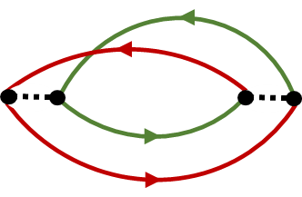
Spin alignment of $K^{∗0}$, flavor-mixing
Correlation between spin density of s and d quark:
$$C=\left\langle \overline{s}γ^{μ}γ^{5}s \overline{d}γ^{μ}γ^{5}d\right\rangle$$
Two possible flavor-mixing interactions:
$$ρ_{00}≈\frac{1}{3}+\frac{2}{9N}(δ_{1}−2δ_{2})$$
$$δ_{1}=(a_{d}−a_{s})\frac{M}{T}\int{\frac{e^{−E/T}}{E}}$$
$$y$$
$$δ_{2}=(a_{d}a_{s})\frac{M}{T}\int{\frac{M^{2}E−p^{2}T}{E^{3}T^{2}}}e^{−E/T}$$
$$x$$
$$y$$
$$x$$
$$G$$
$$G$$
Depends on the relative magnitude of $a_{d}$ and $a_{s}$
Sign is most important, which determines the direction of SP background of s and d, parallel or anti-parallel

Slide 11
where is the interaction?
1. One-Gluon-Exchange(OGE)
2. Instanton-induced interaction
Phys.Rev.D 51 (1995) 1267-1281
Low temperature:
Non-interacting $I\overline{I}$ Gas
tensor interaction
Fierz transformation
Low T-> tensor interaction-> $ρ_{00}>1/3$
High temperature $T≳T_{c}$:
$I\overline{I}$-Molecule
Axial-vector interaction
Axial-vector interaction
Tensor interaction also could be induced
at finite temperature and density through OGE
High T-> AV interaction-> $ρ_{00}<1/3$

Slide 12
where is the interaction?
2. Instanton-induced interaction
Phys.Rev.D 51 (1995) 1267-1281
Low temperature:
Non-interacting $I\overline{I}$ Gas
tensor interaction
Low T-> tensor interaction-> $ρ_{00}>1/3$
High temperature $T≳T_{c}$:
$I\overline{I}$-Molecule
Axial-vector interaction
High T-> AV interaction-> $ρ_{00}<1/3$

Slide 13
Thank you
Summary
Axial-vector and tensor interaction are corresponding to SP and MMP
Spin Polarization induces $ρ_{00}<1/3$, Magnetic Moment Polarization induces $ρ_{00}>1/3$
Spin density fluctuation generates local SP/MMP
Instanton-induced interactions could be the sources for the spin alignment of both $φ$ and $K^{∗0}$

