Slide 1


Magneto-birefringence and axial Ward
identity at finite temperature and density
Based on a series of papers with Kaz. Itakura.
“In-medium polarization tensor in strong magnetic fields”
2205.04312; 2205.06411
Cf. Review paper in PPNP, 2305.03865
Koichi Hattori
Zhejiang University
15th workshop on QCD Phase Transition and Relativistic Heavy Ion Collisions (QPT2023)
Dec 14-19, 2023 in Zhuhai
koichi.hattori@@@zju.edu.cn

Slide 2
Quantum vacuum probed by strong fields
Quantum fluctuations in strong external fields
Strong-field QED/nonlinear QED
Schwinger mechanism
Vacuum birefringence/dichroism
etc
Not confirmed or controversial yet
Challenges in several ongoing experiments/observations.
Sauter (1931)
Euler-Heisenberg (1935)
Schwinger (1951)
Toll (1952)
…
…

Slide 3
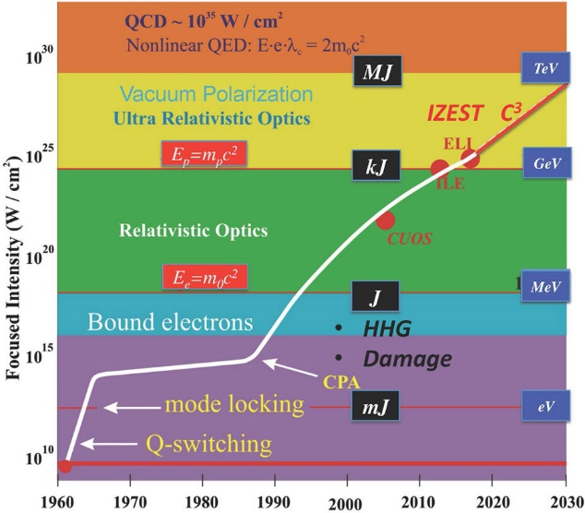
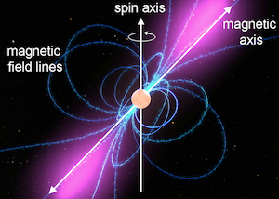
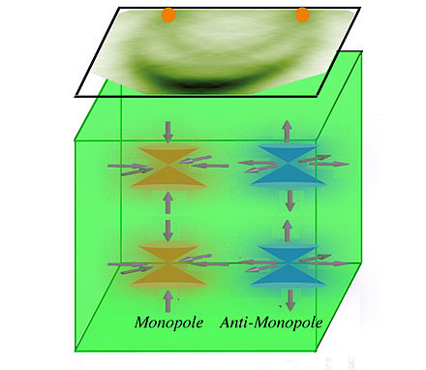
Strong EM fields in nature and laboratory
Magnetospheres of neutron stars/magnetars
High-intensity laser field
(Ultra)peripheral collisions
B
Z
Z
RHIC, LHC
Z
Z
Weyl/Dirac semimetals

Slide 4
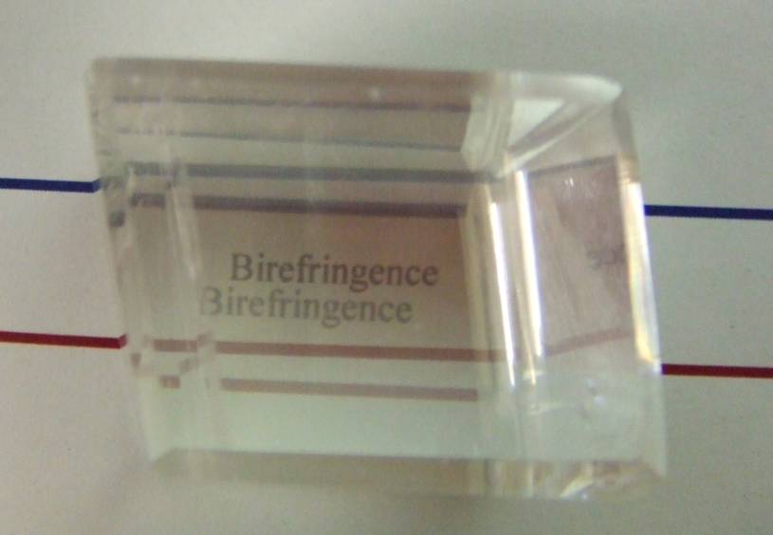
Birefringence
Response of electrons to incident lights
electrons
B
Birefringence (複屈折)
= Polarization-dependent refractive indices
ions
Bunch of cyclotron orbits
Structured ions
→ Anisotropic spring constants
Polarization 1
Polarization 2
Birefringent substance
“Calcite” (方解石)
Lesson: Refractive indices are manifestation of the fermion spectrum.

Slide 5
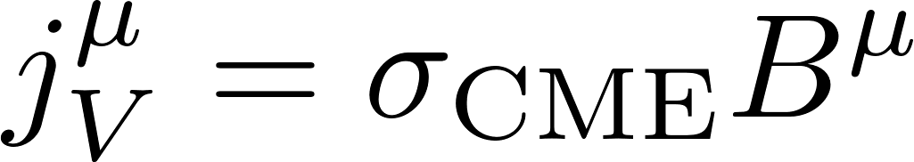
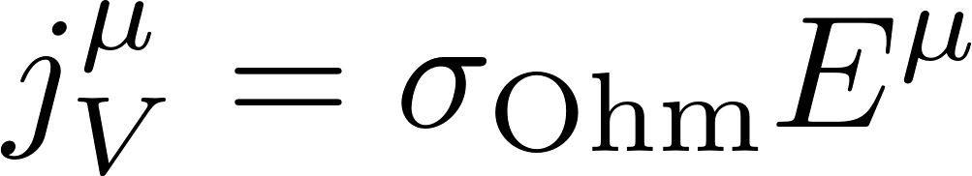
Chirality production in E and B
Anomaly-induced transport phenomena,
e.g., Chiral magnetic effect
Vilenkin
Nielsen-Ninomiya
Kharzeev-McLerran-Warringa
Fukushima-Kharzeev-Warringa
…..
Cf. Experimental searches in heavy-ion collisions and Dirac/Weyl semimetal.
Production of chirality imbalance
C_{A} : Anomaly coefficient
Chiral magnetic effect
Ohmic current
Chirality production is closely related to the spin and momentum polarization.
Anti-particles
Particles
Spin polarization by B
Parity
Odd
Odd
Even
Odd
Even
Odd
Charge polarization by E
Momentum
E
B
E and B force a particular helicity/chirality configuration.
Nonzero chirality proportional to E・B. (Helicity = - nA for antiparticles)

Slide 6
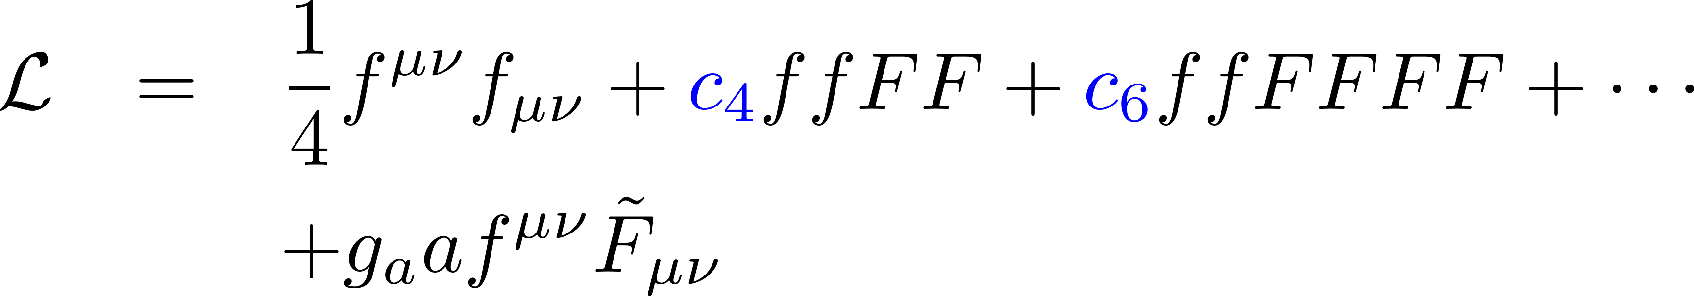
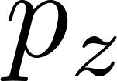
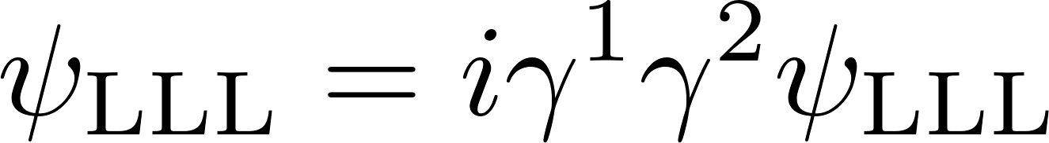
Resummed polarization tensor
=
＋
＋ ・・・
＋ ・・・
To all orders in a nonperturbative constant B
Perturbative E/B
n
Can be written as another series expansion wrt the Landau levels.
n’
Cf. 1209.2663 ; 1212.1897
Chiral anomaly in the lowest Landau level (n=0)
⇔
B_{z}
Spin eigenstate
V
V
A
V
Helicity-momentum locking due to the spin polarization in the LLL
Fourier transf.

Slide 7
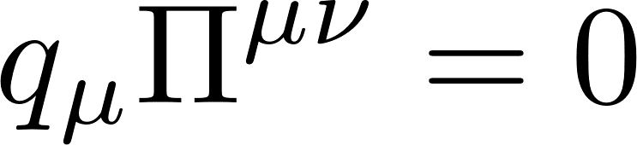

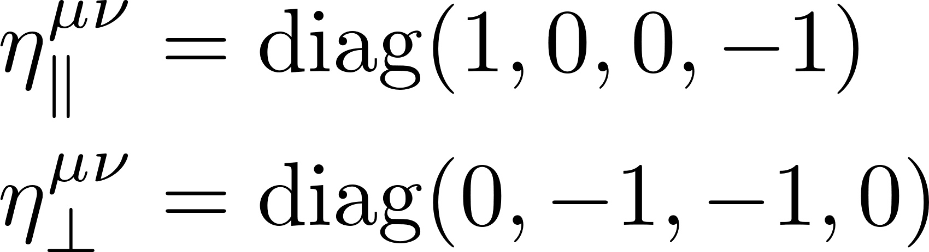
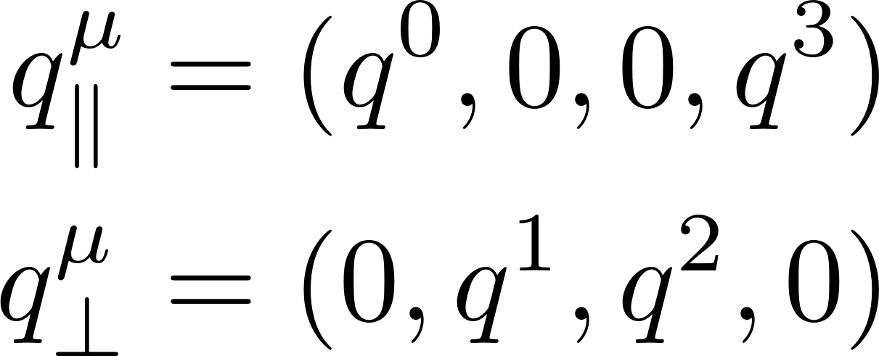
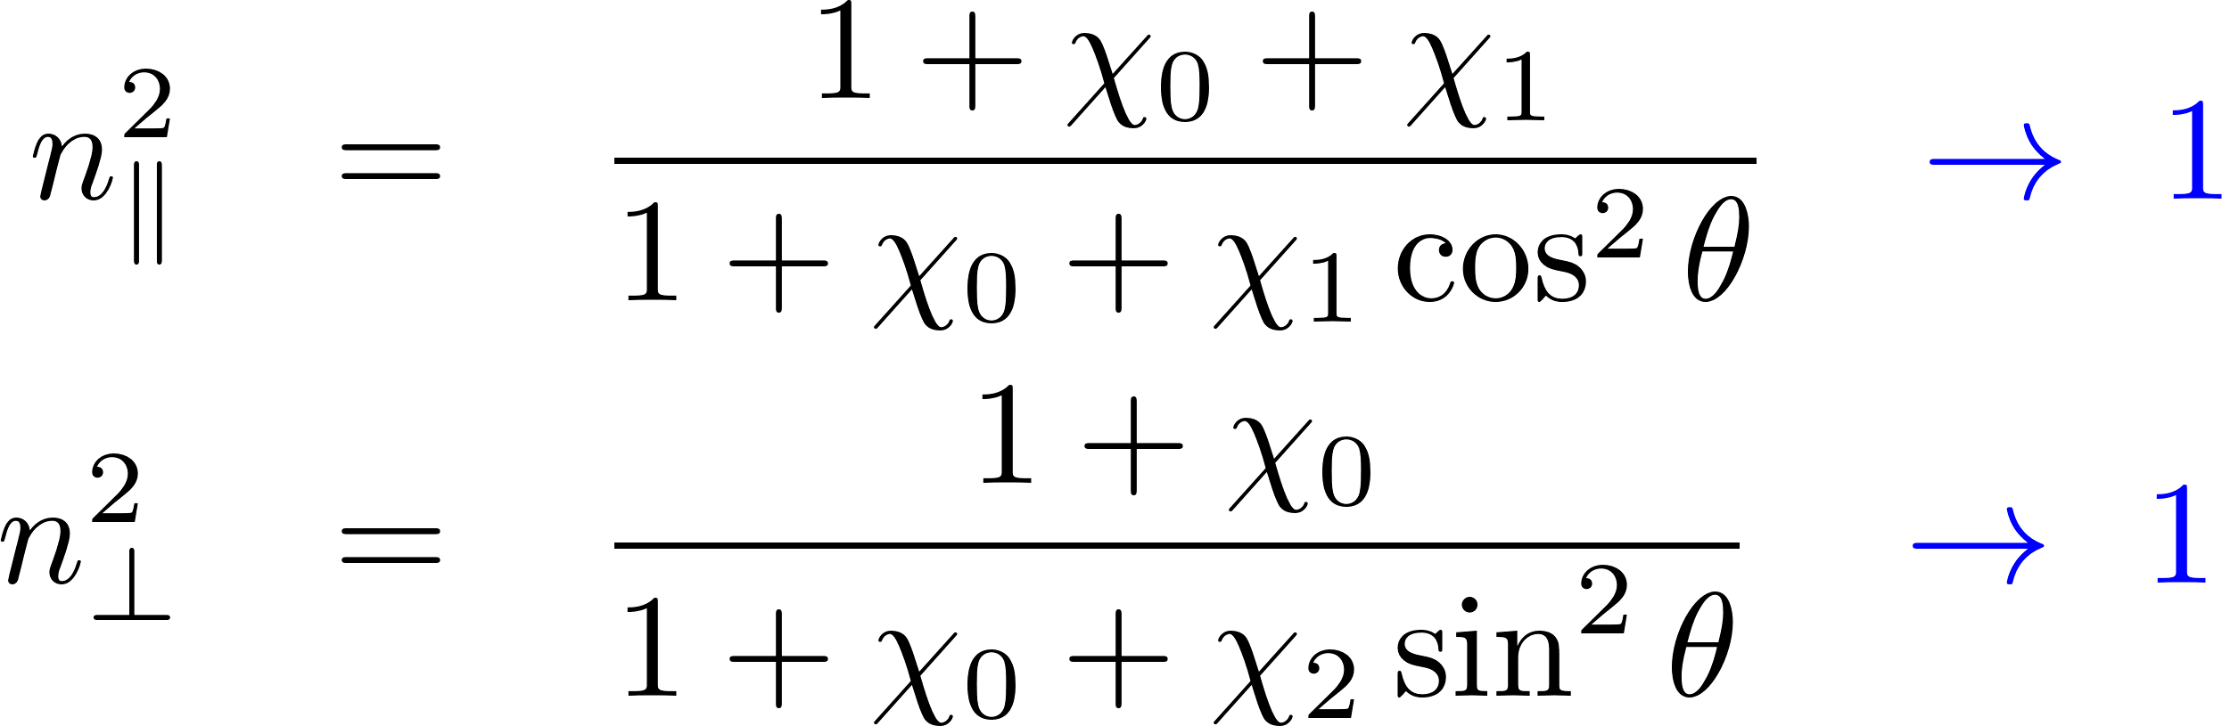
Maxwell eq. w/ quantum corrections:
U(1) gauge symmetry constrains
possible tensor structures
Preferred orientation in B
B-induced structures
Refractive indices from the Maxwell eq.
Two (physical) polarization modes in || and ⊥ to B.
Direct consequence of the gauge symmetry and the breaking of one spatial rotational symmetry.
Vanishing B limit:
Cf. 1209.2663

Slide 8

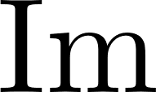

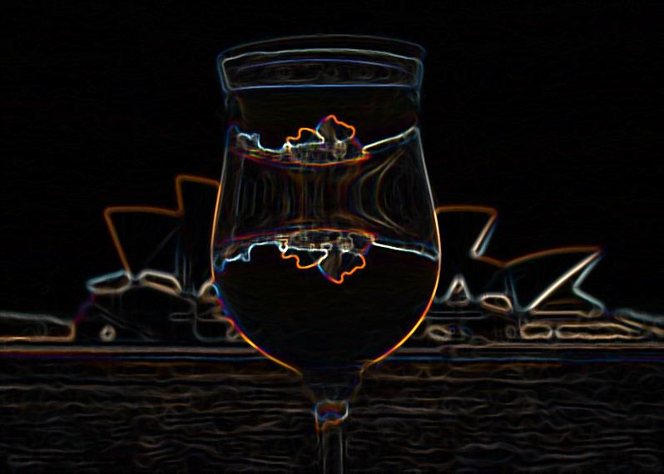

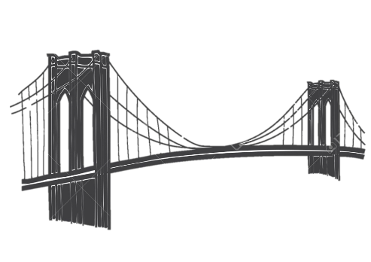
Complex refractive indices
Refraction (real part of the index of refraction)
Decay cross-section
Optical theorem for the imaginary part
Strong B provides a preferred orientation.
→ “Vacuum birefringence”: Polarization dependent refractive indices
=
＋
=
＋
＋
＋ ・・・
B-field opens 1-to-2 kinematics
Lorentz & gauge symmetries → n ≠ 1 in general
Both sides of a coin
Photon refraction
Dispersion integral
Di-fermion production
Imaginary part = On-shell processes
Simpler to understand
(than the real part)

Slide 9
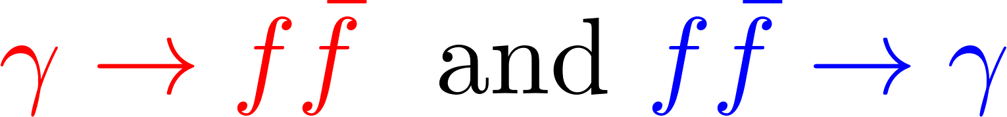

Expected effects: Pauli-blocking effect & Landau damping
Vacuum:
No Pauli blocking in the final state
No inverse process
Pauli blocking & detail balance
(light-like and time-like regions)
Landau damping
(space-like region)

Slide 10
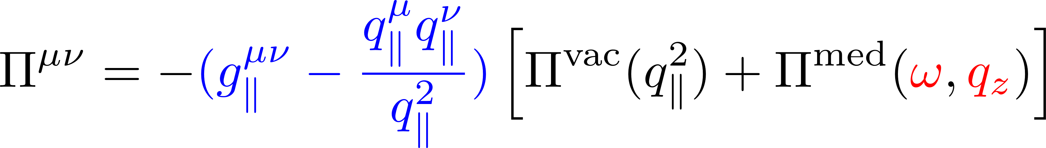

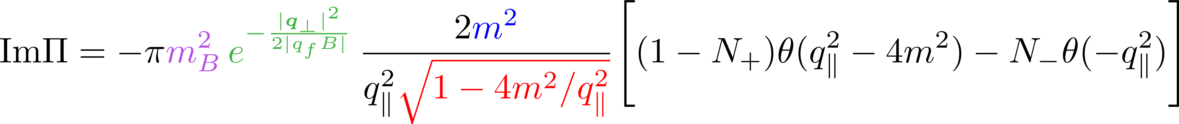
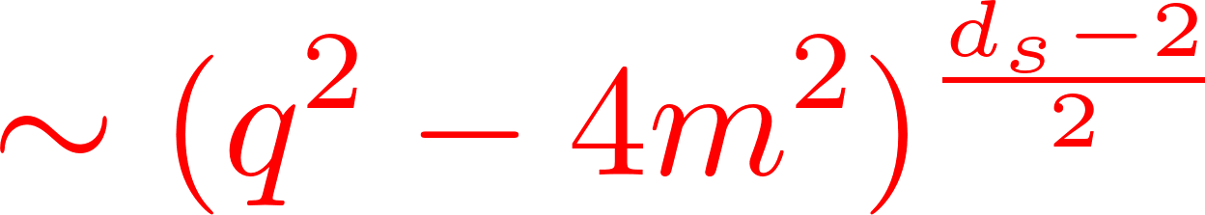
In-medium polarization tensor in the lowest Landau level
at finite T and μ
One can use either the imag.- or real-time formalism.
No modification in the tensor structure.
Separate dependences on the photon energy and momentum.
Time-like region
Space-like region
Common factor to the vacuum contribution
Wave functions in B-fields
Mass suppression for chiral anomaly
Threshold behavior in (1+1) d
Medium modification by fermion distribution functions

Slide 11
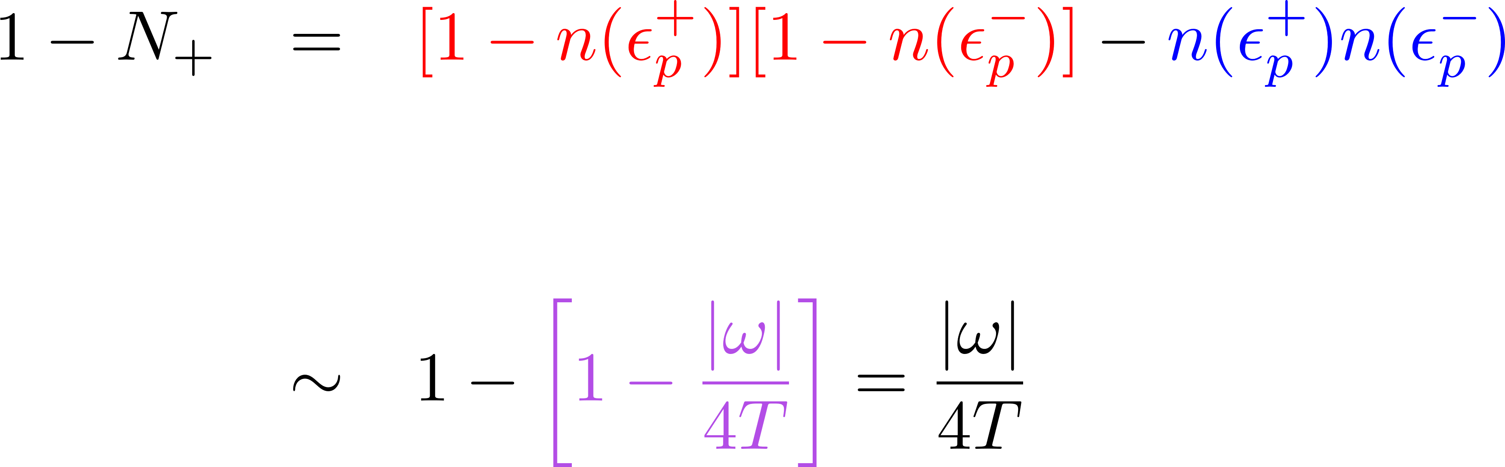
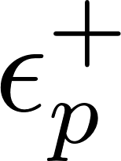
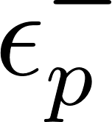
Detail balance & Pauli blocking
n(ε): Fermi-Dirac distribution function
Time-like region
Vacuum - Medium
Cancellation in the LO → Suppressed in high T limit
Space-like region
Pure medium effect (No vacuum contribution)

Slide 12
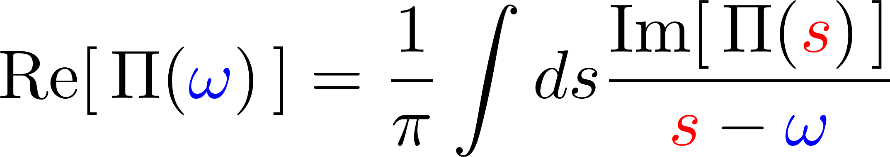
Peak structures at finite temperature
Finite temperature: [T = 2m, μ = 0]
Vacuum
Vac. + Medium
Consistent with the dispersion integral
from the analyticity
The weight has a peak at s = ω.
Peak positions in the real and imag. parts
are correlated with each other.

Slide 13
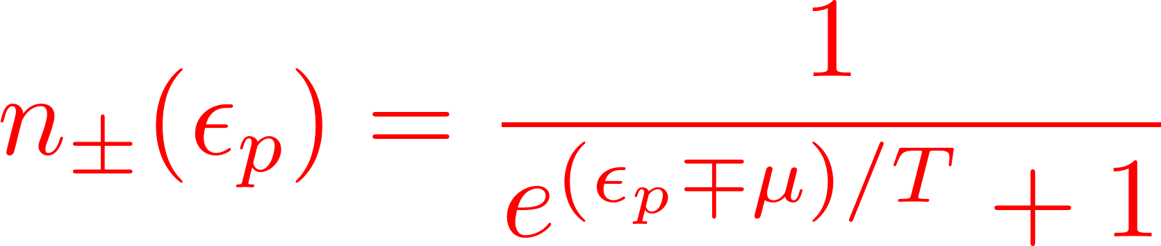
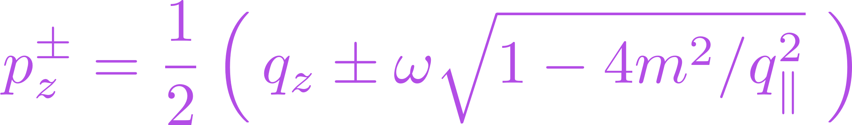
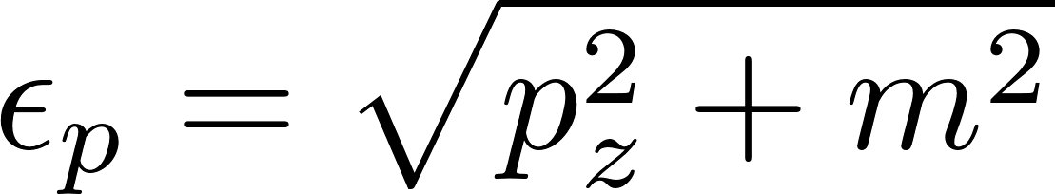
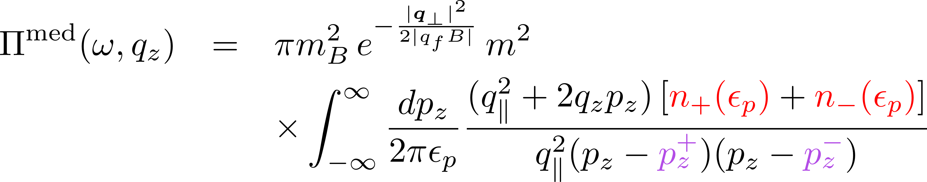
Polarization tensor in the LLL
at finite temperature (T) and chemical potential (μ)
LLL, T, μ
Vacuum part cannot be thrown away
even high T or mu limit for the dimensional reason in (1+1) d.
Breaking of the boost invariance

Slide 14

Photon pole mass
+
+
Only one mode is modified by the LLL polarization
Pole position:
Cyclotron motion in B field
NB) Two limits (ω, q → 0) do not commute with each other in general.
Debye screening mass
Plasma frequency
Screening in the steady state
Energy gap in the photon dispersion relation
E_{ind}
E
ω
ω_{p}
0 ← q
q
No vacuum contribution

Slide 15
Debye screening mass m_{D}
* Massless limit
∝ Schwinger mass in (1+1) dim. QED
High density
μ > m
The larger the degeneracy is, the larger the Debye mass.
T/m
μ ＜ m
No excitations at zero T
* Low-T behavior strongly depends on the DoS near the Fermi surface.

Slide 16
Plasma frequency ω_{p}
Massless theory
Schwinger mass
Massless LLL ≠ Massless limit
(Singularity in m→0 in (1+1) dim.)
“Massless limit”
High T/m
Low T/m

Slide 17
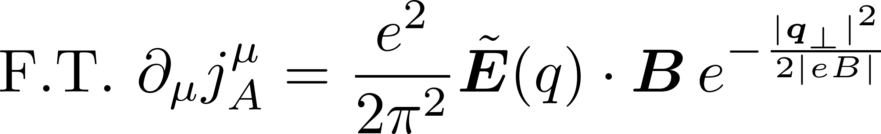
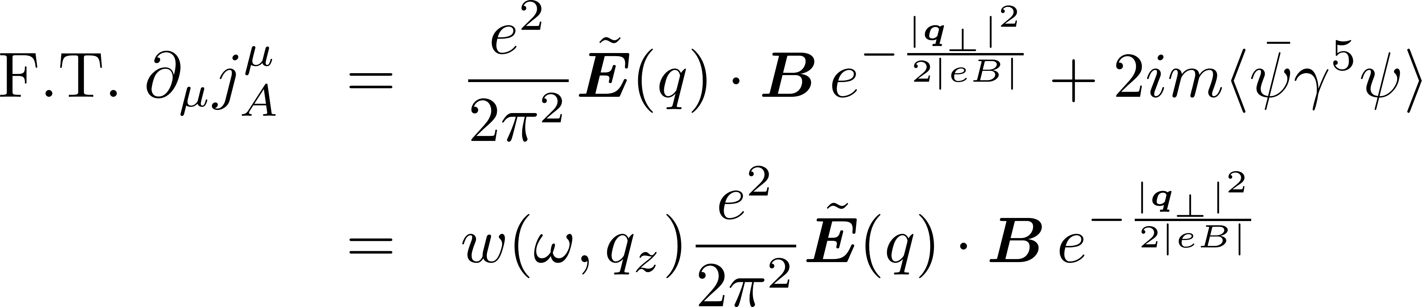
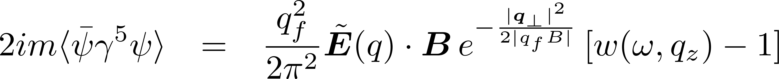
Axial charge production
in constant strong B and perturbative E
Key eq.
Massless theory
No corrections in massless theory
Medium modification in massive theories
Chiral anomaly in (3+1) d up to the Guassian factor
Can be interpreted as the diagonal spectral flows
0. Chiral anomaly is always there, but the total RHS depends on details.
Adiabatic limit (spectral flow patterns) in vacuum and medium are quite different.
Diabatic processes are even more different from the adiabatic limit.

Slide 18
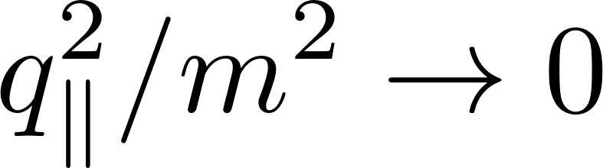
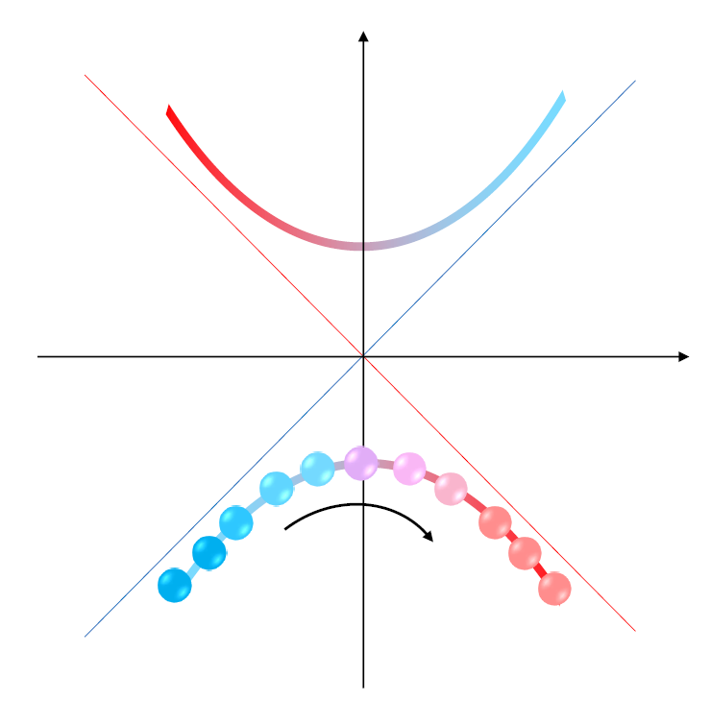
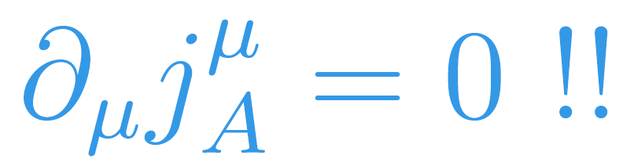
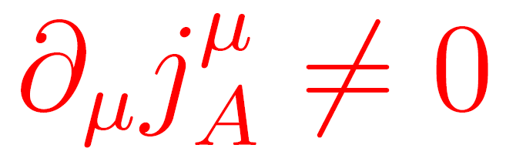
Axial charge production in Massive theory (1)
Adiabatic limit
Vacuum
No transition over the fermion mass gap.
Cf. Spectral flow of massless fermions
Horizontal shift + Vertical shift
at the same time.
Conserved in spite of chiral anomaly
Ambjorn-Greensite-Peterson
Copinger-Fukushima-Pu

Slide 19
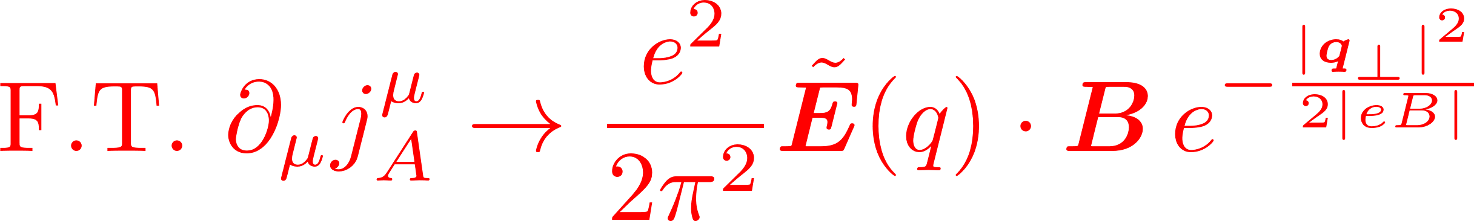
Axial charge production in Massive theory (1)
Adiabatic limit
Vacuum
Medium
No transition over the fermion mass gap.
Horizontal spectral shift
→ Momentum flip
L
R
Helicity flip
Conserved in spite of chiral anomaly
Nonzero div. in spite of the vanishing vacuum contribution.
Ambjorn-Greensite-Peterson
Copinger-Fukushima-Pu
In high T or mu limit.

Slide 20
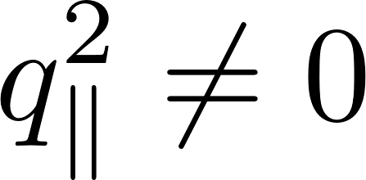
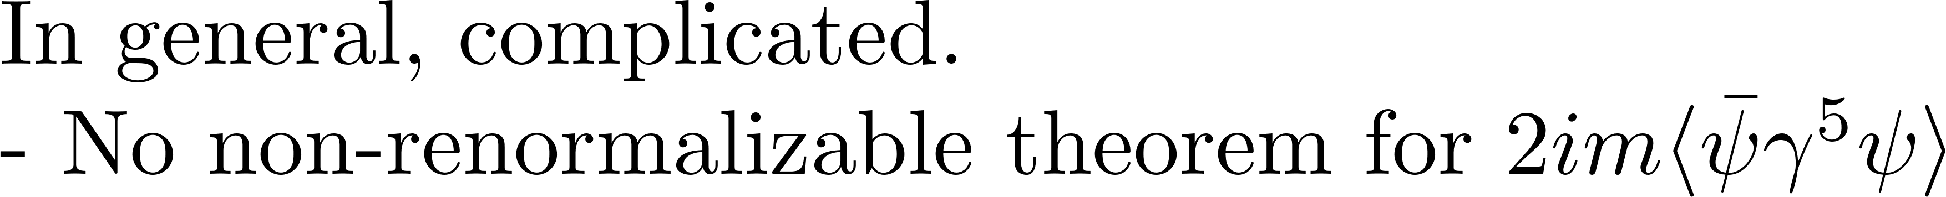
Axial charge production in Massive theory (2)
Diabatic processes
Pair production
Landau damping (scattering)
Chirality damping in various set-ups:
Grabowska, Kaplan, Reddy
Boyarsky, Cheianov, Ruchayskiy, Sobol
Hanai, KH, Yamamto, In progress.

Slide 21
Summary
We studied polarization phenomena in constant magnetic fields.
Medium contributions:
- Pauli blocking effect suppresses the vacuum polarization.
- Contribution of the Landau damping (pure medium effect) is identified.
- There are two distinct photon masses (Debye mass & plasma frequency).
Massless LLL ≠ Massless limit
- The div. of axial current depends on mass, T, and mu, while chiral anomaly itself is always there and does not depend on those parameters.
Prospects
Contribution of the higher Landau levels to the div. of the axial current.
KH, Di-Lun Yang, In preparation.

Slide 22
Back-up slides

Slide 23
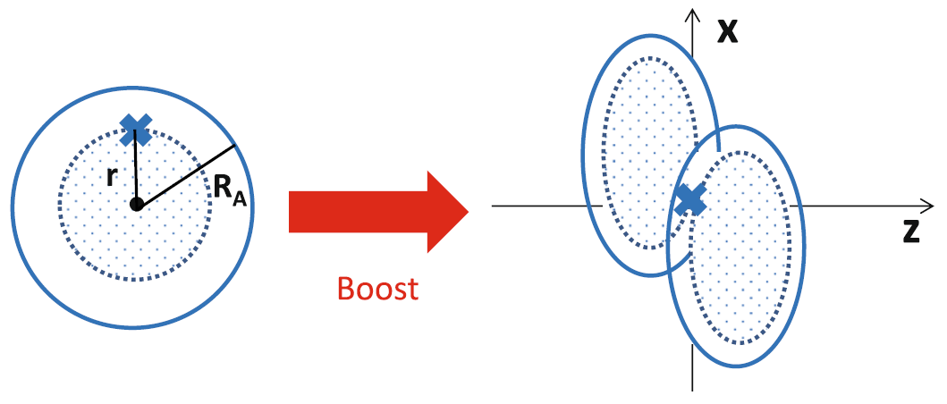
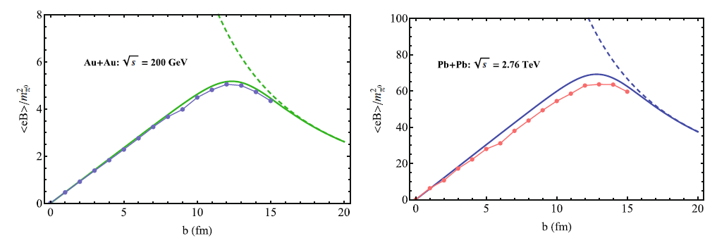
Strong magnetic fields induced by relativistic heavy-ion collisions
B
Z
Z
Z
Z
Static Coulomb field
Boost → Lienard-Wiechert potential
Free streaming
HIJING
Central coll.
Peripheral coll.
Deng & Huang; KH & Huang [1609.00747]

Slide 24
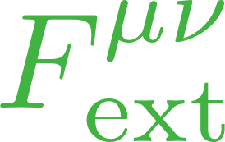
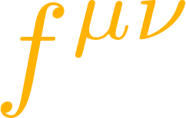
Oriented couplings among EM fields
Preferred orientation along B
QFT provides the coefficients
Fermion loops
axion
Cf. 1305.7224 [hep-ph]
All-order computation by the proper-time method
KH and K.Itakura, “Vacuum birefringence in strong magnetic fields”(2013)
1209.2663 [hep-ph]; 1212.1897 [hep-ph] and refs. therein published since 1952.

Slide 25
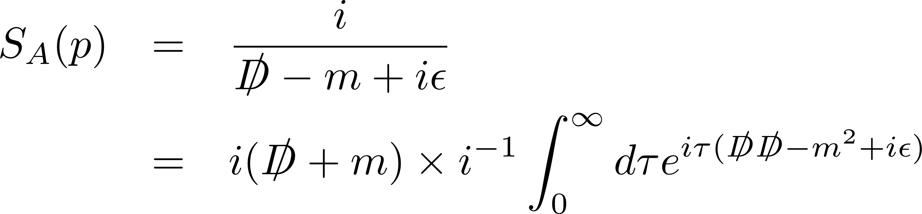

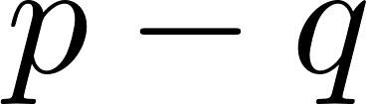
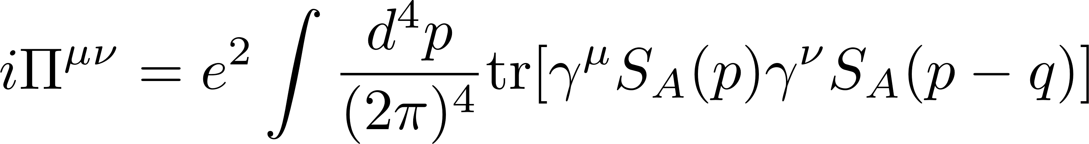
Resummation for external-field insertions
Resummed propagator
eB
eB
eB
eB
eB
eB
eB
eB
eB
eB
eB
eB
eB
=
＋
＋
＋ ・・・
＋ ・・・
Furry’s theorem: The odd-order diagrams cancel in C-even systems.
Fock (1937), Schwinger (1951)
＋
＝ ０
Charge flows
Resummed polarization tensor
=
＋
＋ ・・・
＋ ・・・

Slide 26
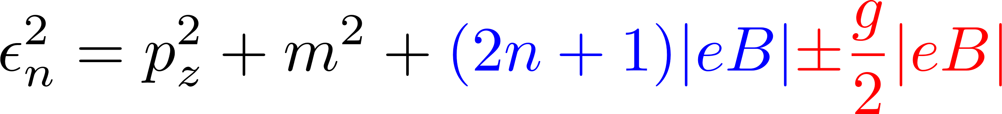
Fermion spectrum in a magnetic field
Remember the lesson: Photon spectrum depends on the fermion spectrum.
Landau quantization
Landau degeneracy
B_{z}
B_{z}
Classical motion
No effects on the longitudinal motion
Cyclotron motion ～ Harmonic oscillation
Spin polarization (Zeeman effect)
Energy spectrum
No energetically favored position.
→ Degeneracy
Fermion transverse momentum is NOT a good quantum number.
No transverse momentum conservation (due to momentum supply from external B-fields).

Slide 27
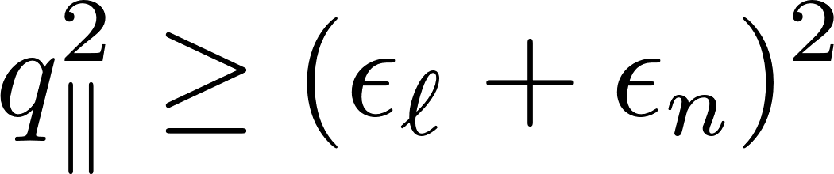
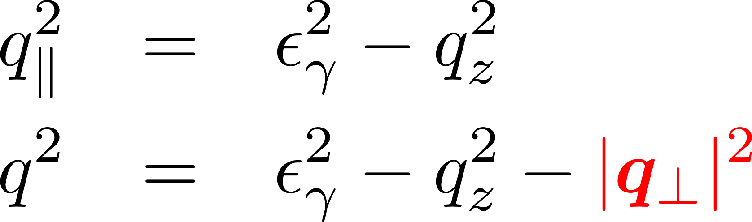
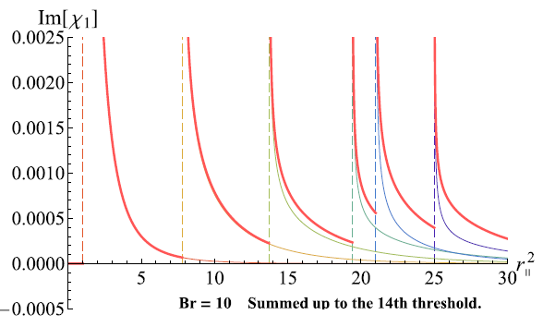
Fermion spectrum encoded in the threshold conditions
Landau quantization
Threshold conditions
Imaginary part appears when
Fermion transverse momentum is NOT a good quantum number.
No transverse momentum conservation (due to momentum supply from external B-fields).
B_{z}
Classical motion
No effects on the longitudinal motion
Cyclotron motion ～ Harmonic oscillation
Spin polarization (Zeeman effect)
Infinite # of thresholds
Photon transverse momentum works
like a “photon mass” in the (1+1)-d kinematics.
Energy spectrum

Slide 28
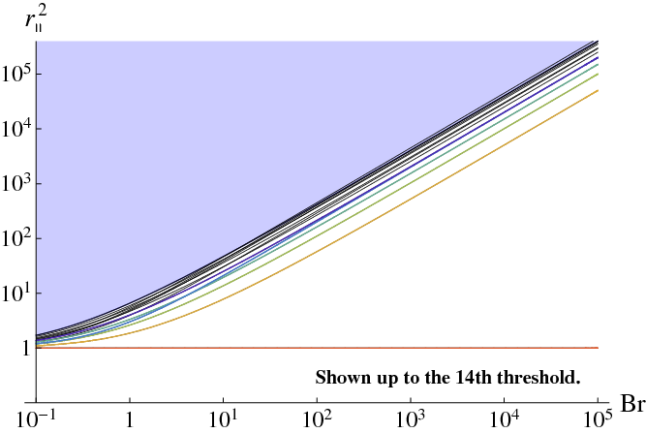



Summary of relevant scales and preceding calculations
Narrowly spaced Landau levels
Strong field limit (LLL approx.)
(Tsai&Eber; Shabad; Gusynin, Miransky, Shovkovy; Fukushima; KH&Itakrua, etc.)
Lowest Landau level →
No imaginary part→
Soft photon & weak field limit (Adler, etc.)
Numerical computation
below the LLL threshold (Kohri and Yamada)
Numerical computation
in the soft photon regime
Strong field limit (LLL approx.)
Soft photon & weak field limit

Slide 29

Refractive indices and decay rate

Slide 30

Refractive indices with the LLL fluctuations
Refractive indices at the LLL(ℓ=n=0)
(1+1)-dimensional fluctuations
Polarization excites only along the magnetic field
``Vacuum birefringence’’
B
← No modification in the ⊥ mode

Slide 31

Thresholds at finite density and zero temperature
Pauli blocking on particles
No blocking on antiparticles

Slide 32
Peak structures at finite density
Finite density: [T = 0, μ = 1.2*(2m)]

Slide 33
Temperature effects
→ Smearing the step singularities at zero temperature
T /μ = 0
T/μ = 0.05
T/μ = 0.1
T/μ = 0.5
The threshold goes back to 4m^2 a.s.a. T gets finite.
However, strong suppression near the threshold at low T.

Slide 34
Finite temperature
Debye screening mass
Plasma frequency
Massless limit
Schwinger mass
T/m

Slide 35

Finite density
Debye screening mass
Plasma frequency
μ/m

