Slide 1
The role of neutral and charged pions in (inverse) magnetic catalysis and diamagnetism
Speaker: Jie Mei
Collaborator: Mei Huang, Rui Wen, Shijun Mao
and Kun Xu (Paper in preparation…)
2023.12.18
The 15th workshop on QCD Phase Transition and Relativistic
Heavy Ion Collisions

Slide 2
Outline
The 15th workshop on QCD Phase Transition and Relativistic
Heavy Ion Collisions
Motivation
The Model
Numerical Results
Without finite propagating velocities
With finite propagating velocities
Conclusion

Slide 3
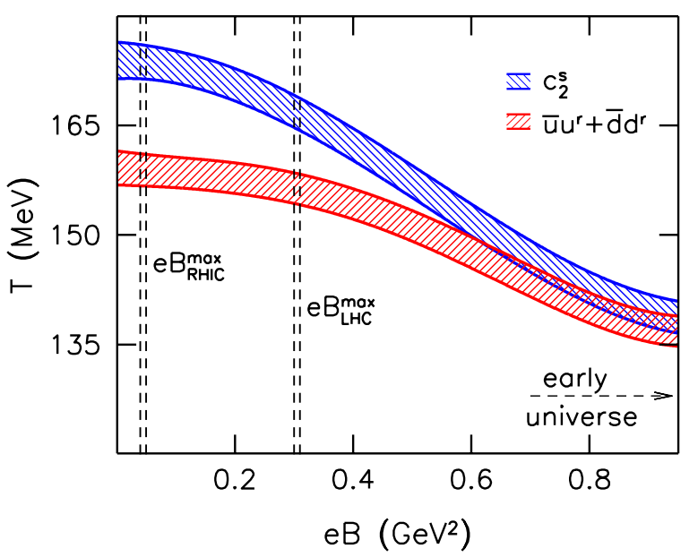
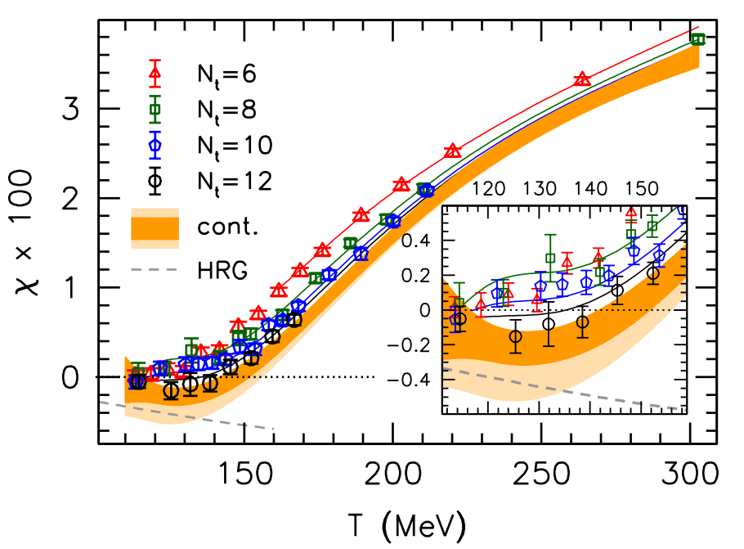
Motivation
Results from lattice simulation: Inverse magnetic catalysis, diamagnetism

Slide 4
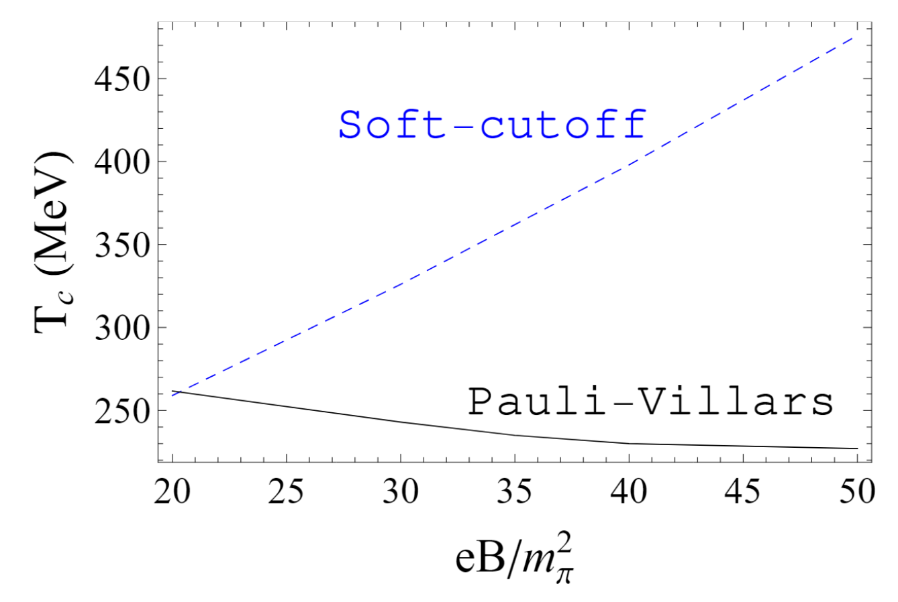
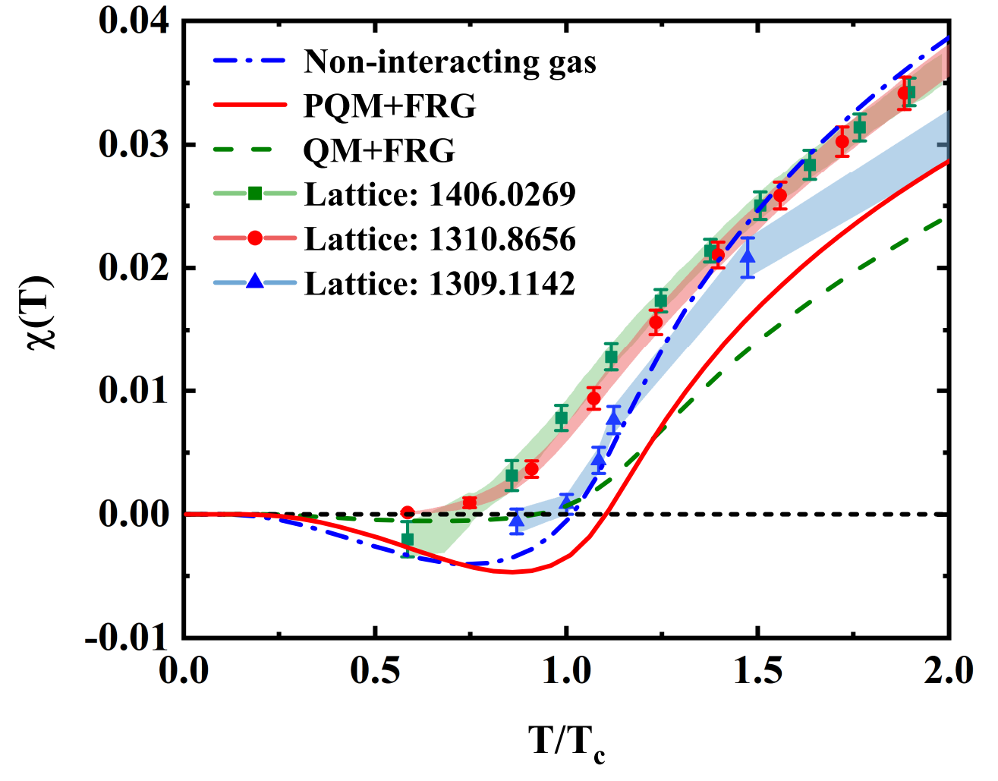
Motivation
In previous calculation of NJL model beyond mean field, the inclusion of $π_{0}$ leads to IMC;
In Quark-Meson model, once considering in contribution of neutral and charged pions, diamagnetism at low temperature can be achieved;
What’s neutral and charged pions’ roles in inverse magnetic catalysis and diamagnetism?
S. Mao, Physics Letters B 758, 195 (2016)
X. Li, W. Fu, and Y. Liu, Physical Review D 99, (2019)

Slide 5
The Model
NJL model beyond mean-field approximation
Chiral condensates in mean field level
Using RPA method with mean field result, calculate the pole mass of neutral and charged pions, as well as the propagating velocity
Calculating the corrected quark mass beyond mean field approximation
Weak-field expansion: neutral and charged pions have the similar mass, and have similar contributions to the system; charged meson can be treated as translational invariant.

Slide 6
The Model
The Lagrangian of magnetized SU(2) Nambu-Jona-Lasinio model
The thermodynamic potential in mean field approximation
Here, the quark propagator

Slide 7
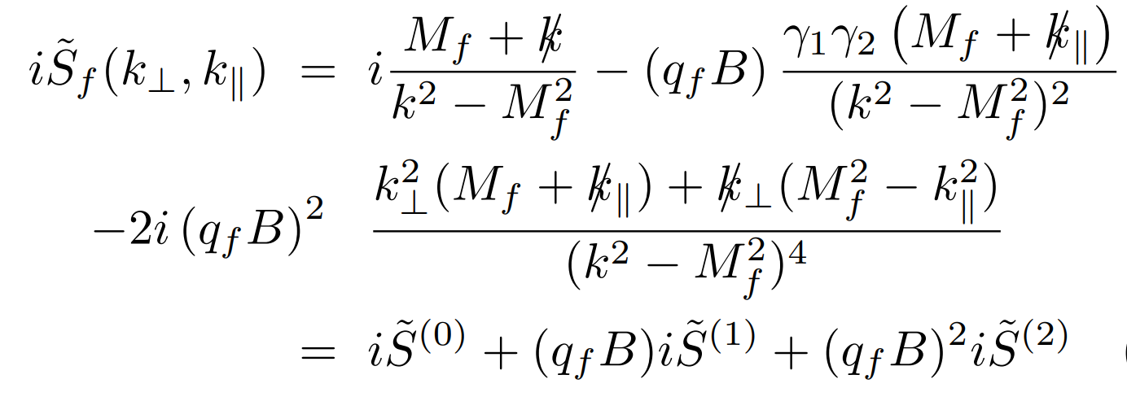
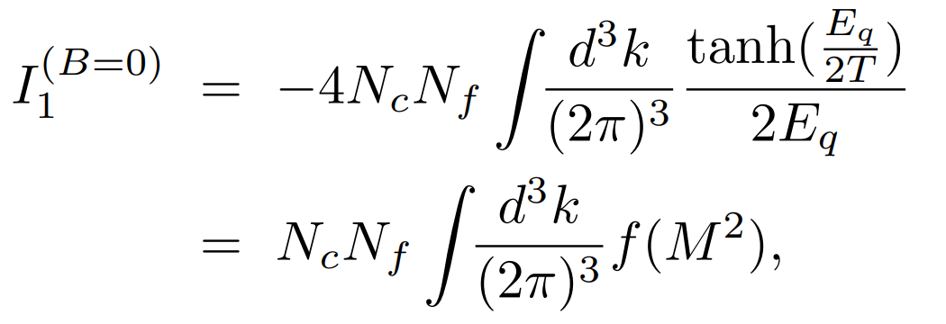
The Model
Weak field expansion of quark propagator
Schwinger phase can be discarded
Calculate the chiral condensate in mean-field approximation through gap eq.

Slide 8
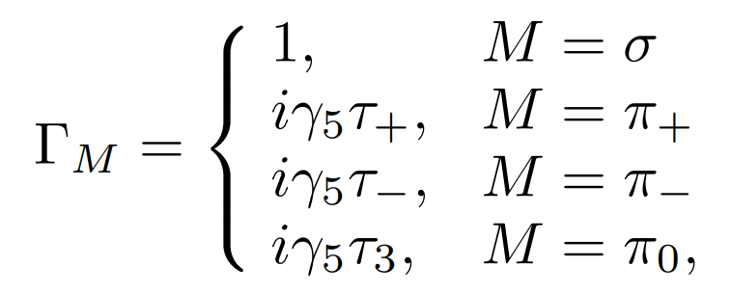
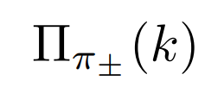
The Model
In NJL model, mesons are treated as the fluctuation above the mean field, and can be “constructed” through the RPA method
Similarly, substituting the weak-field form of quark propagator, the polarization function
With the definition

Slide 9
The Model
The pole and screening masses in specific direction
The propagating velocities in specific direction is defined by
In this work, we calculate the neutral and charged pions’ contribution on the critical temperature with and without considering the finite pion propagating velocities

Slide 10
The Model
In NJL model beyond mean field, the thermodynamic potential
with
Without propagating velocities
With propagating velocities

Slide 11
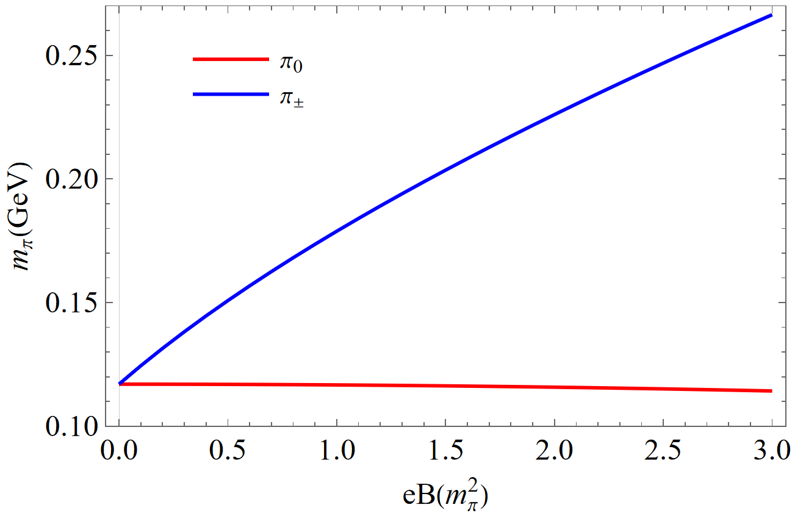
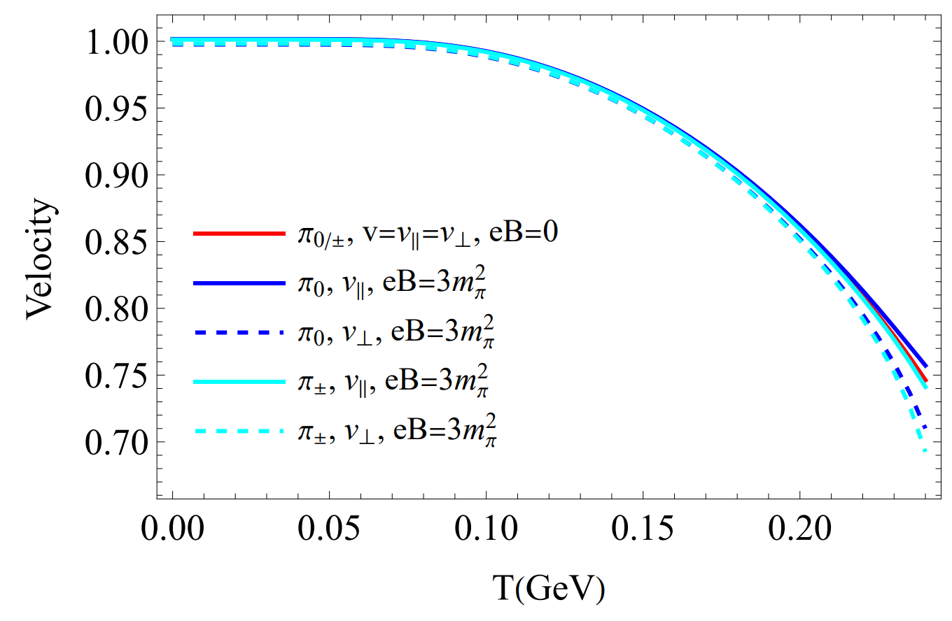
Numerical Result
The mass of $π_{0}$ decreases with magnetic field and the mass of $π_{±}$ increases with magnetic field.
Generally the propagating velocites of pions decreases with the increment of temperature.
Splitting between longitudinal and transverse propagating velocity.

Slide 12
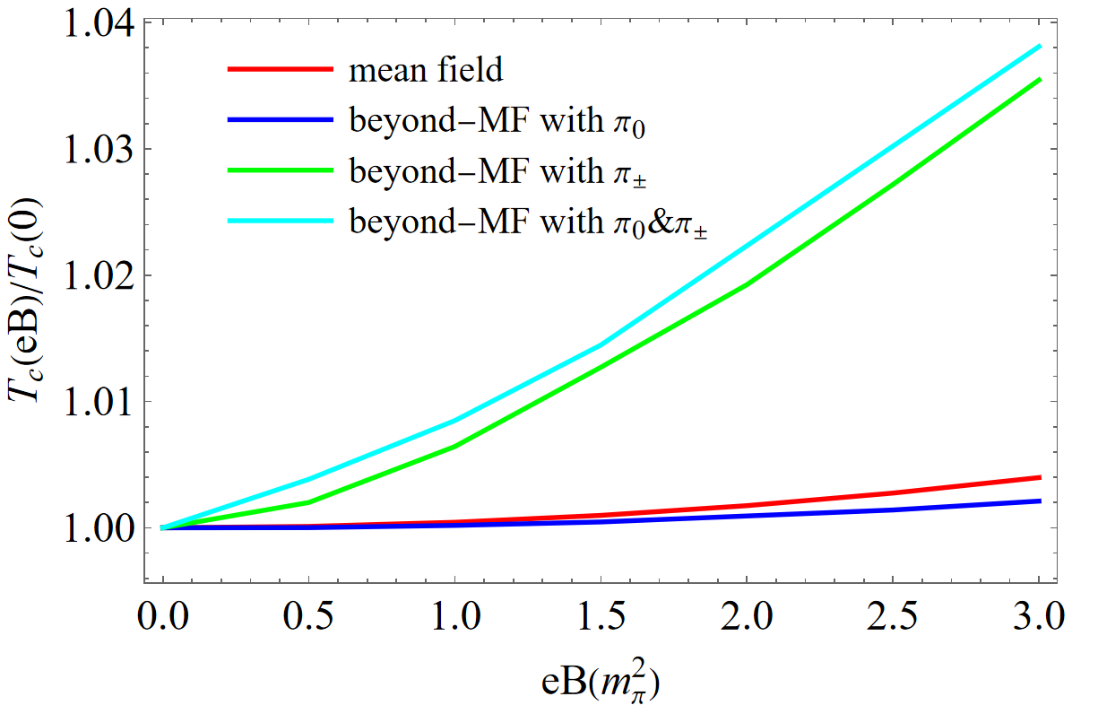
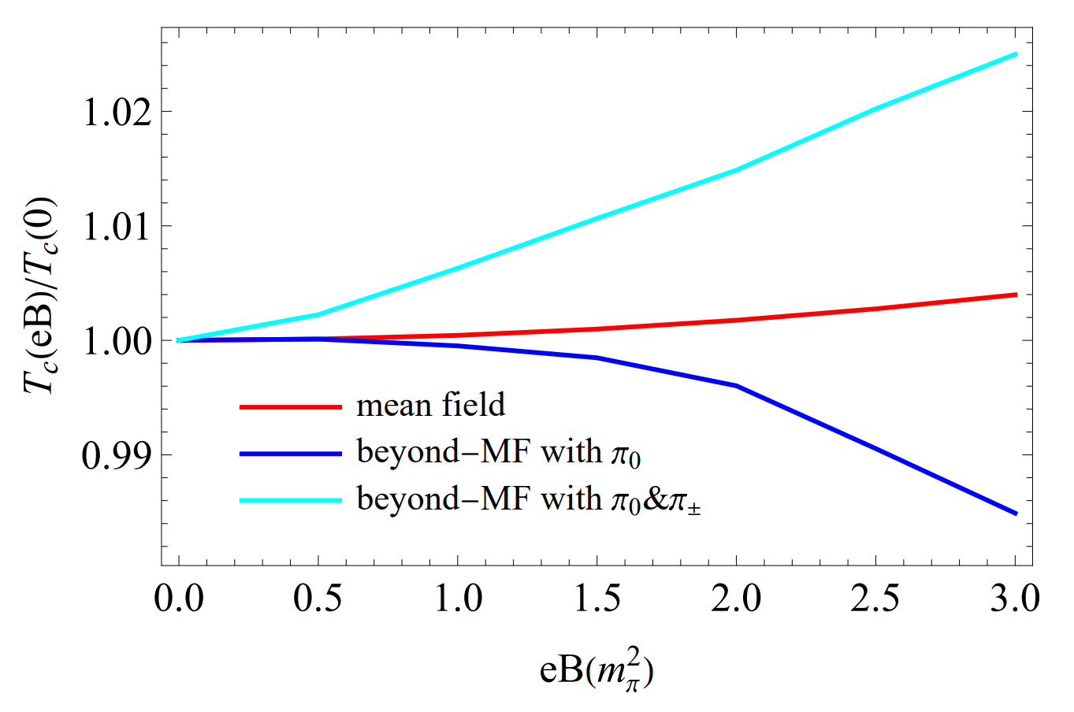
Numerical Result
Without finite velocities
With finite velocities
For critical temperature, $π_{0}$ weakens the MC effect but $π_{±}$ enhances the MC effect.
IMC is achieved if only $π_{0}$ with finite propagating velocities is included.

Slide 13
Numerical Result
after including pions
$m_{π_{0}}$ ↓
dominance ↑
“drag force” ↑
IMC
M
before including pions
B ↑
T
$m_{π_{±}}$ ↑
dominance ↓
“drag force” ↓
MC
“Drag force” from pions

Slide 14
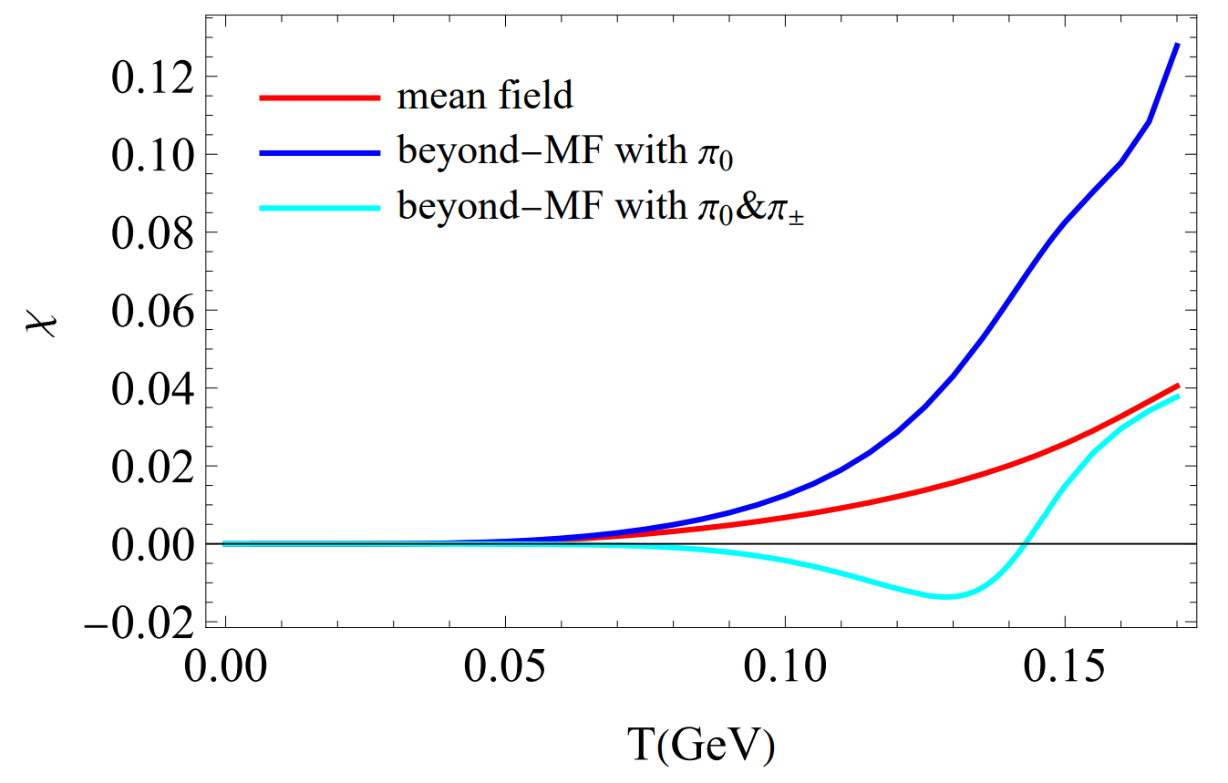
Numerical Result
Our explanation:
quark: Pauli paramagnetism > Landau diamagnetism
$π_{0}$: not magnetized
$π_{±}$: only Landau diamagnetism
At low temperature, $π_{±}$ being dominant, the system is diamagnetic; at high temperature, quark being dominant, the system is paramagnetic.
In MFA or only including $π_{0}$, paramagnetic
Including $π_{±}$ as well, diamagnetic at low temperature region

Slide 15
Conclusion
The responses of neutral and charged pions to magnetic field are opposite, which is why $π_{0}$ contribute to IMC effect and $π_{±}$ to MC effect;
The dominance of charged pions at low temperature region leads to the diamagnetism.
Outlooks
Would system go back to IMC at strong field case? (charged pion decoupled/the lattice result for charged pion masses)
Thank you!

Slide 16
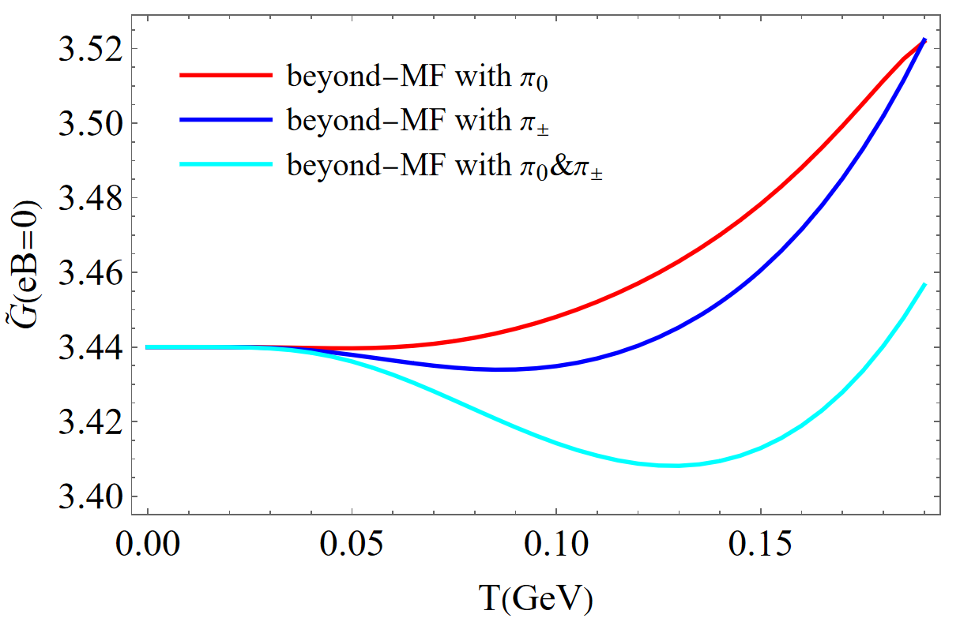
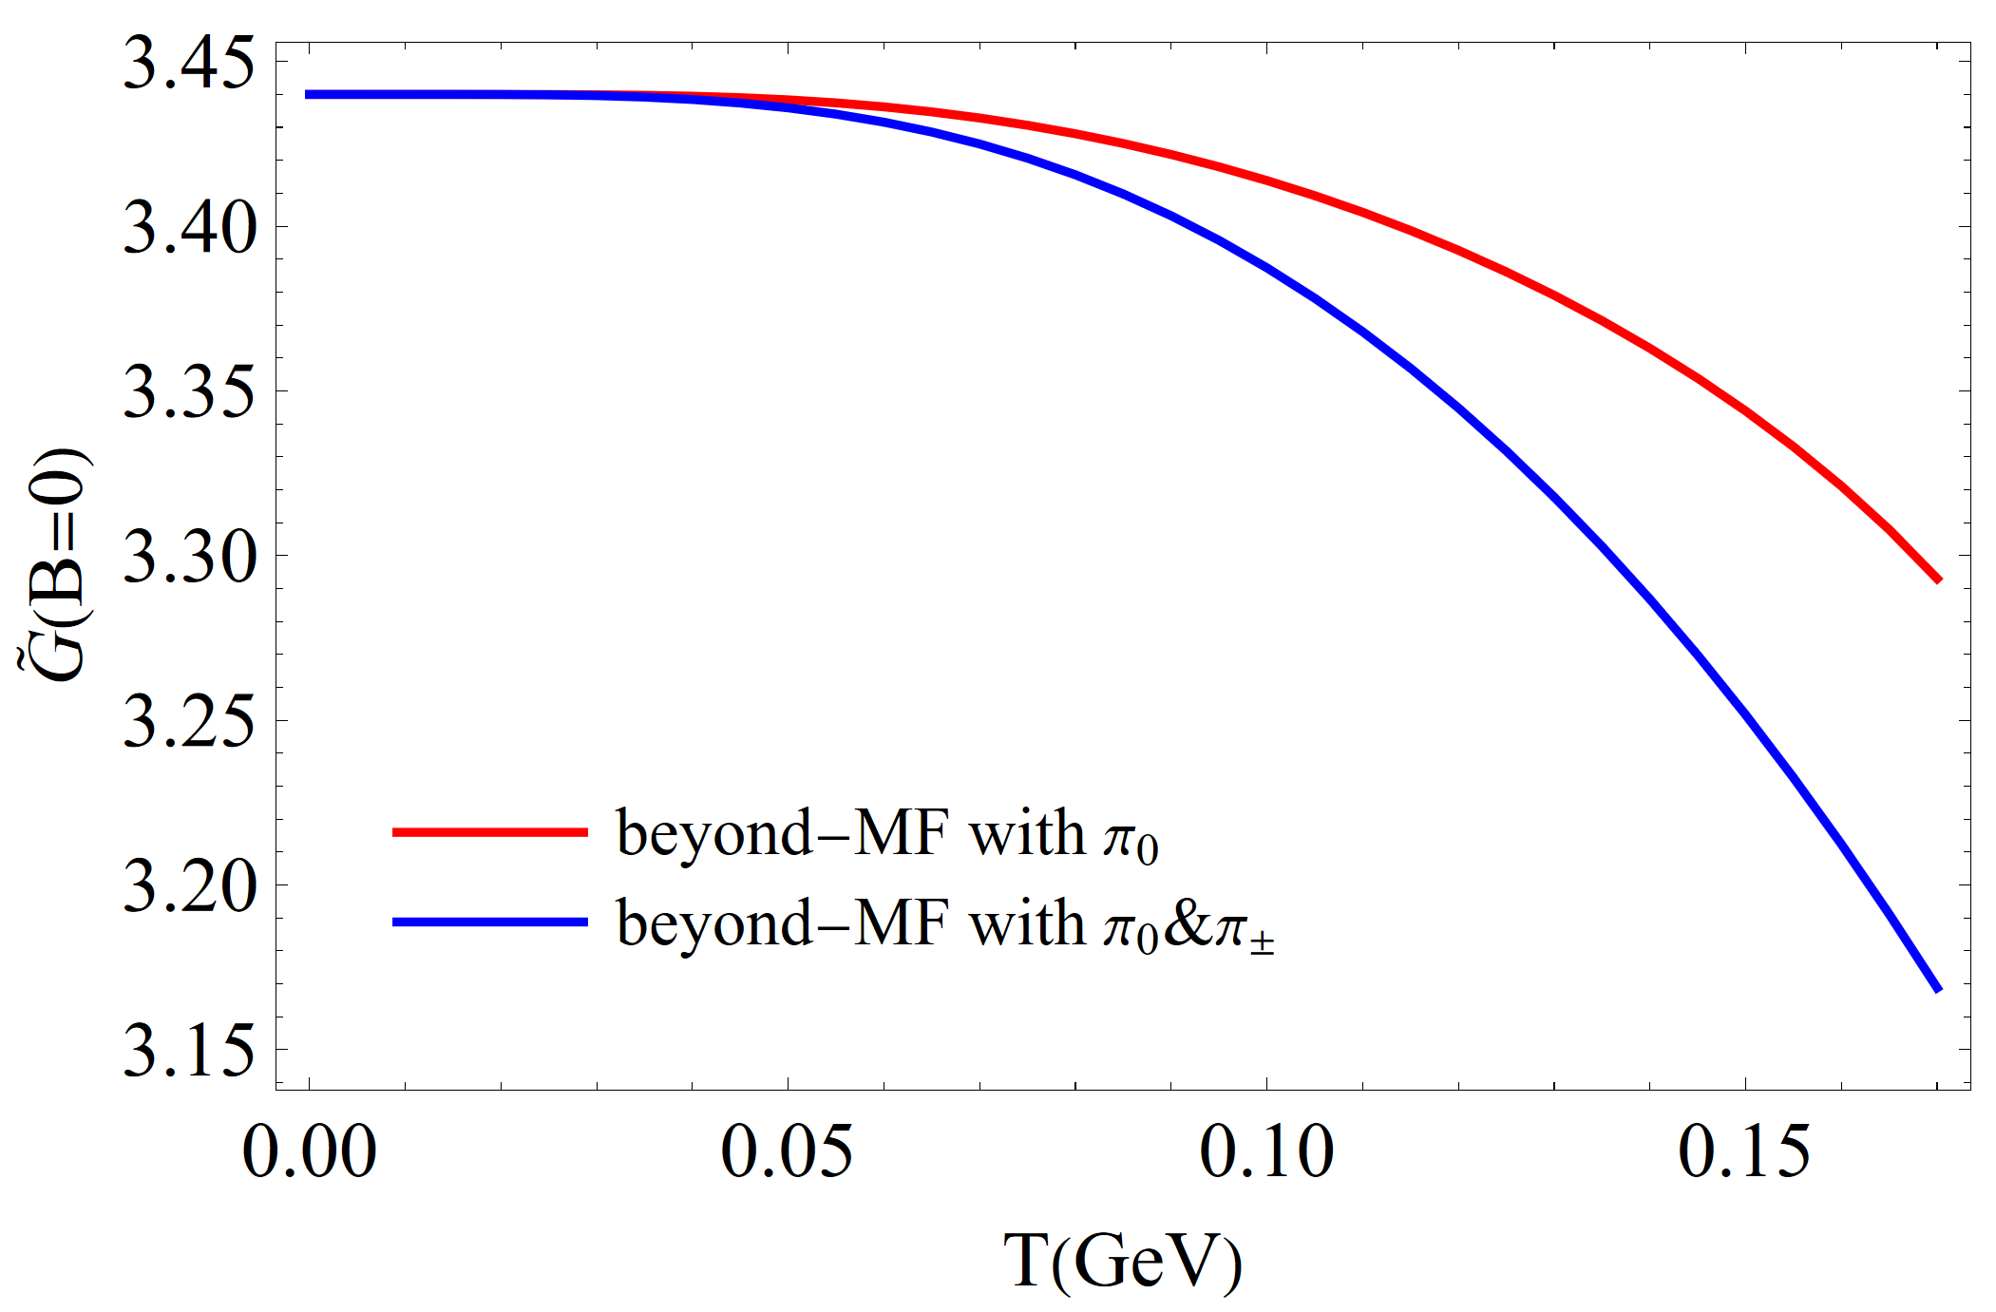
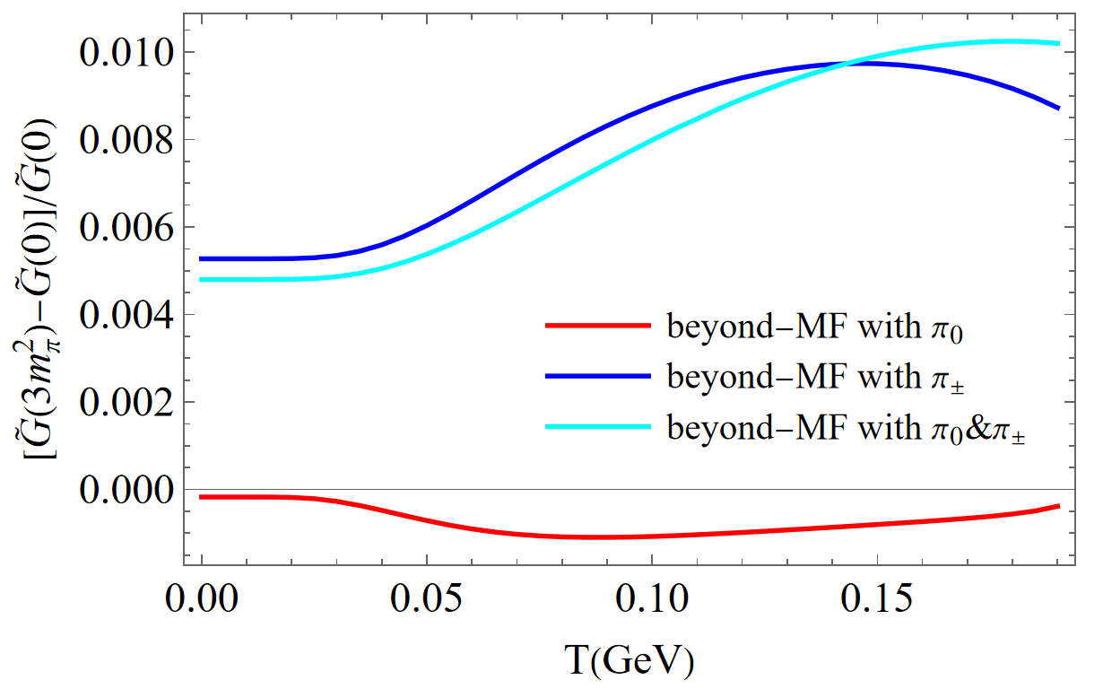
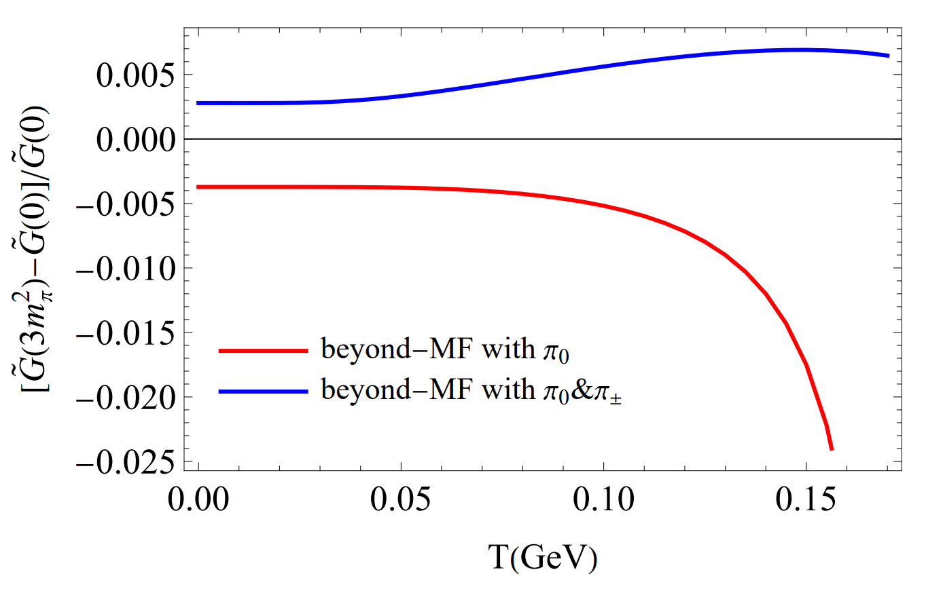
Numerical Result
The effective coupling
Without finite velocities
With finite velocities

