Slide 1
$Bubble nucleation$ $$and gravitational wave from holography \\ in the probe approximation$$
Yidian Chen(陈亦点)
School of Physics, Hangzhou Normal University
Collaborators: Danning Li, Mei Huang
Based on JHEP 07 (2023) 225[arXiv: 2212.06591]
Dec. 18, 2023

Slide 2
Introduction
5D Setup, bounce solution and bubble wall velocity
III. Gravitational waves
IV. Summary

Slide 3
I. Introduction

Slide 4
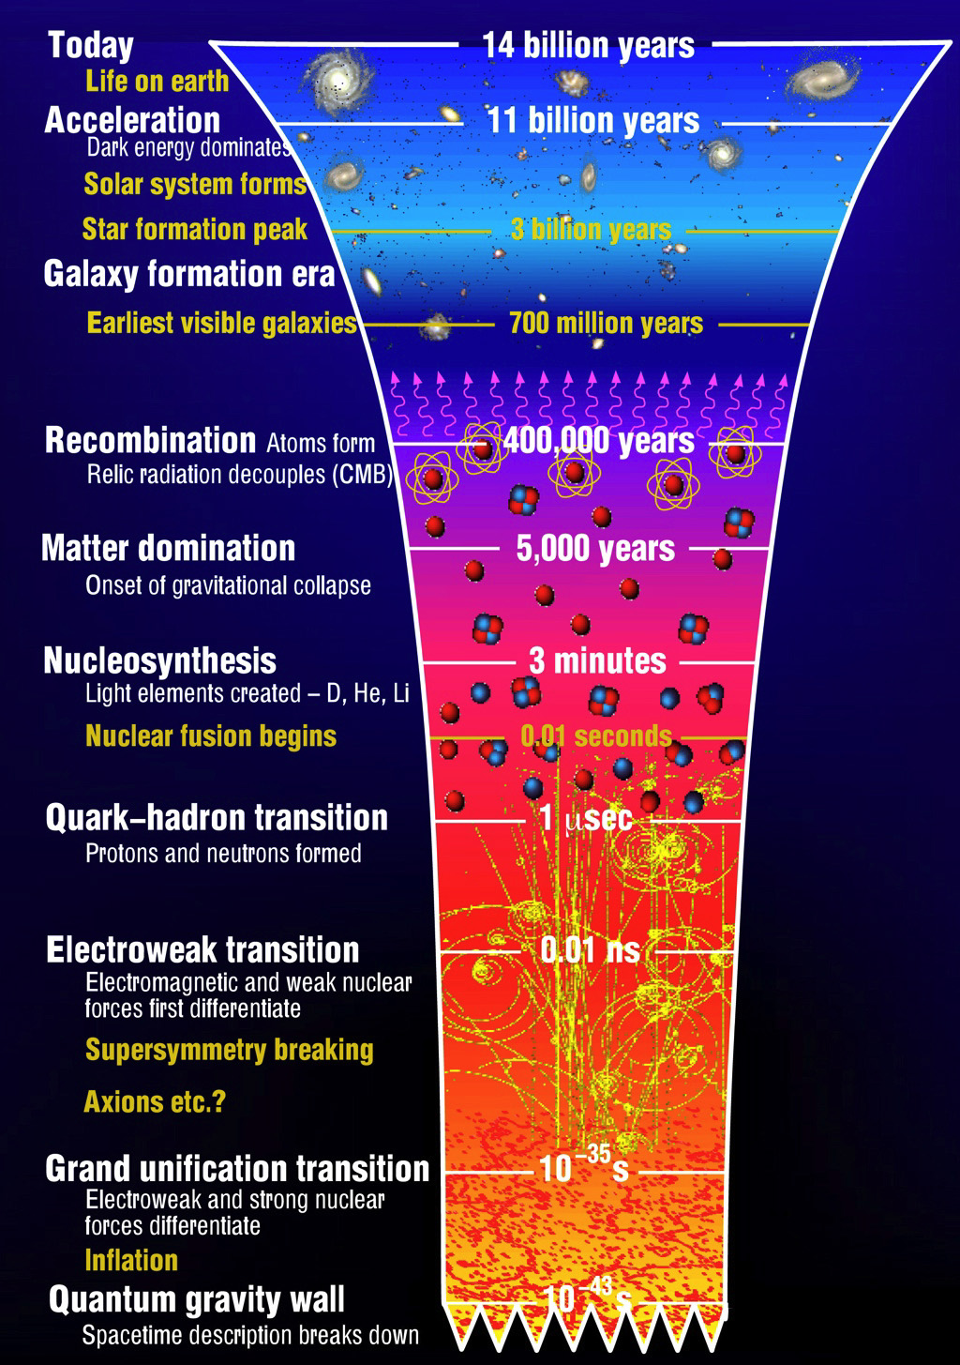
Baryon asymmetry puzzle
Sakharov conditions:
A.D. Sakharov, Pisma Zh. Eksp. Teor. Fiz.(1967)
1) Baryon number B violation.
2) C-symmetry and CP-symmetry violation.
3) Interactions out of thermal equilibrium.
First-Order Phase Transition
GWs, primordial magnetic field, primordial black holes, dark matter…

Slide 5
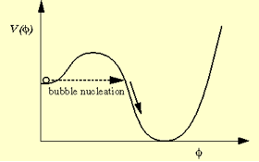
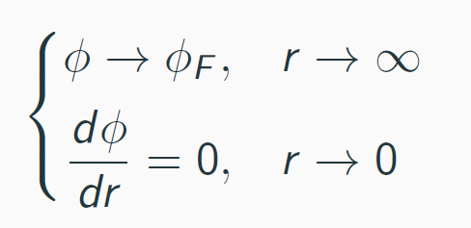
S. Coleman, Phys. Rev. D 15, 2929 (1977); ($T=0$)
A. D. Linde, Nucl. Phys. B216, 421 (1983). ($T≠0$)
Nonequilibrium first-order transition
Quantum Nucleation Theory
Bounce Solution
At sufficiently high temperatures, the least-action solution has O(3) symmetry [Linde, 1983]. The O(3)-symmetric bubble is governed by
J.I.Kapusta and C.Gale, Finite-temperature field theory: Principles and applications,
Cambridge University Press, 2011
with boundary conditions

Slide 6
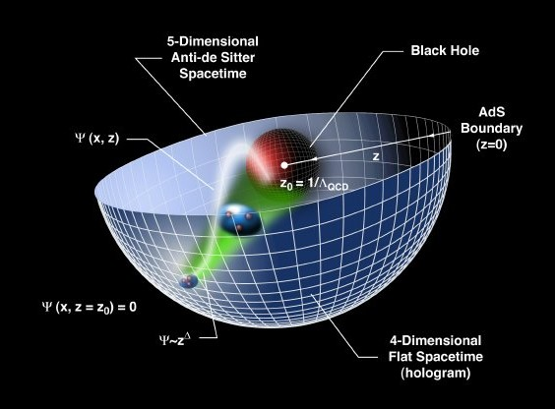
Holographic dictionary
Boundary QFT Gravity
Local operator Field
conformal dimension $Δ$, p-form field $p$
$$z^{4−Δ}Φ_{0}\left(x\right)+z^{Δ}⟨𝒪(x)⟩ =Φ(x,r→0)$$
Strongly coupled Weakly coupled semi-classical

Slide 7
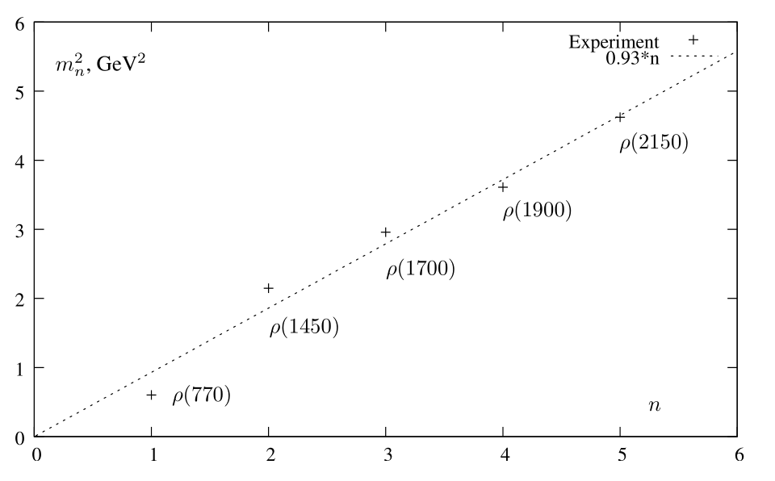
KKSS model (soft-wall model)
Karch et al., arXiv: 0602229[hep-ph]
5D action
Dilaton profile
Conformal AdS₅
e.o.m

Slide 8
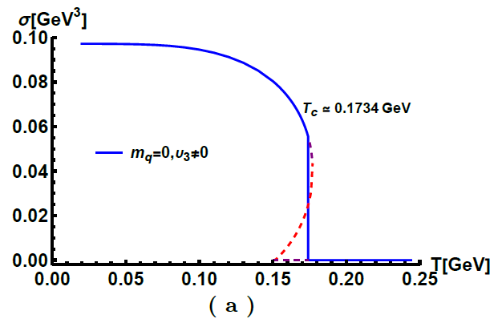
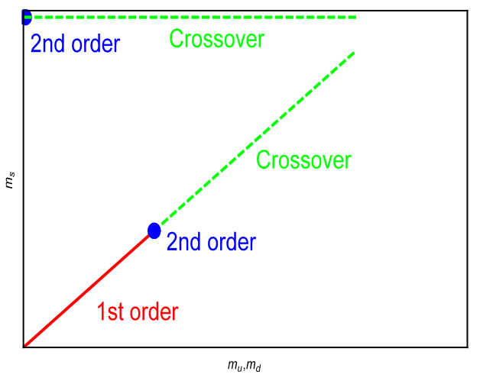
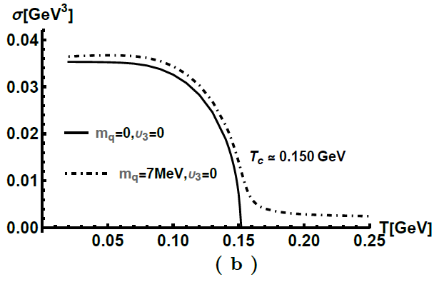
Chiral condensate
Chelabi et al., PRD(2016), arXiv: 1511.02721
Chelabi et al., JHEP(2016), arXiv: 1512.06493
5D action

Slide 9
II. 5D Setup, bounce solution and bubble wall velocity

Slide 10
5D Model
Y. Chen, Danning Li and M. Huang arXiv: 2212.06591
Φ denotes the dilaton field and the complex scalar field X corresponds to the quark condensation or fermionic condensate of BSMs.
$$X=\frac{χ}{\sqrt{2N_{f}}}I_{N_{f}}⇔⟨\overline{Q}Q⟩$$
5D action
Dilaton profile
Metric
Potential

Slide 11
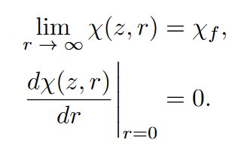
Bounce solution
Y. Chen, Danning Li and M. Huang arXiv: 2212.06591
the equations of motion of the scalar field X can be obtained from action
The solution requires the following boundary conditions

Slide 12
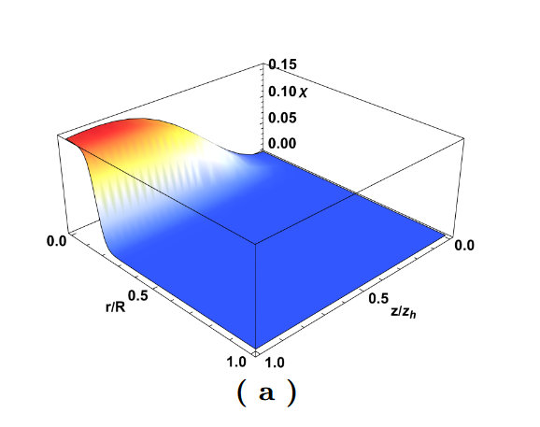
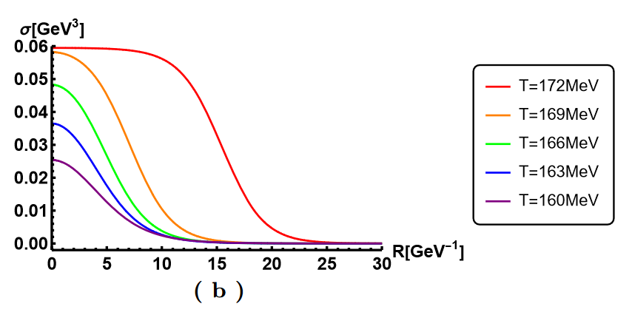
Bounce solution
Y. Chen, Danning Li and M. Huang arXiv: 2212.06591
the condensate σ as a function of the radial coordinate r at different temperatures.
the bounce solution of the scalar field χ as a function of the fifth dimensional coordinate z and the radial coordinate r

Slide 13
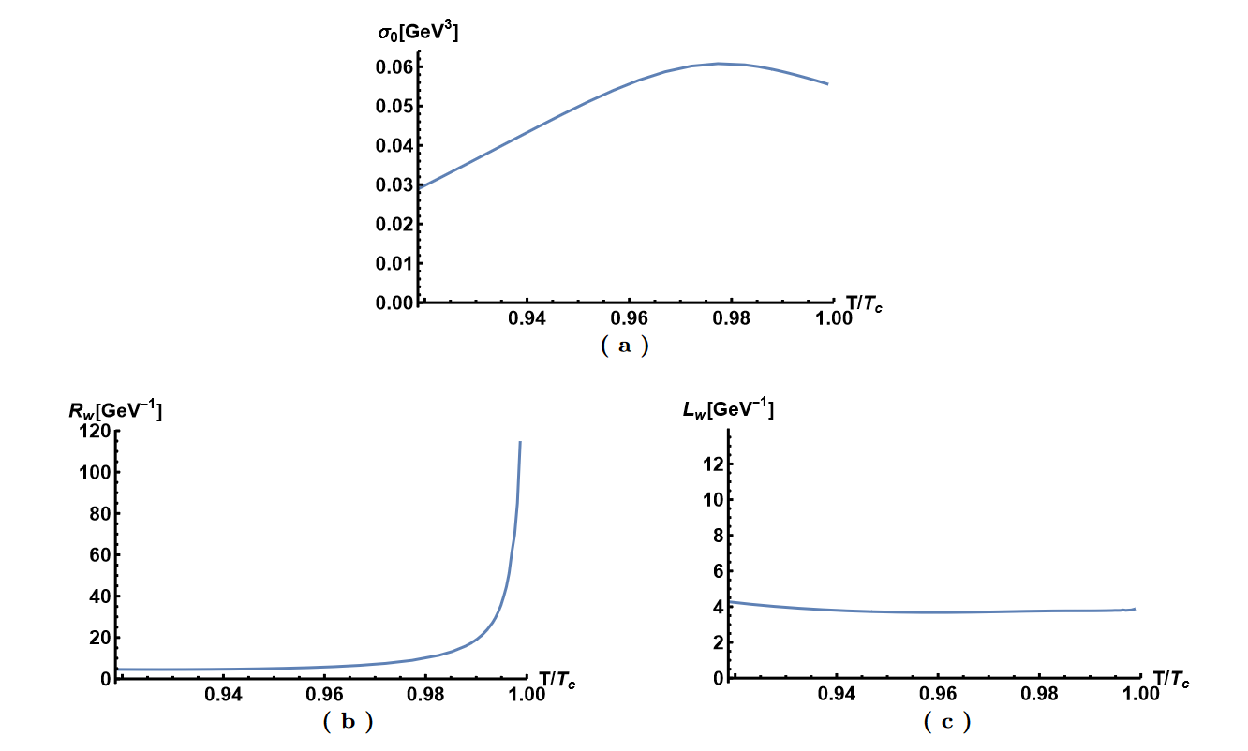
Thin-wall approximation
Y. Chen, Danning Li and M. Huang arXiv: 2212.06591
we use hyperbolic tangent function interpolation condensation as a function of the radial r, shown following
where σ0 is the condensation value at the center, Rw denotes the radius of the bubble, and Lw represents the thickness of the bubble wall.

Slide 14
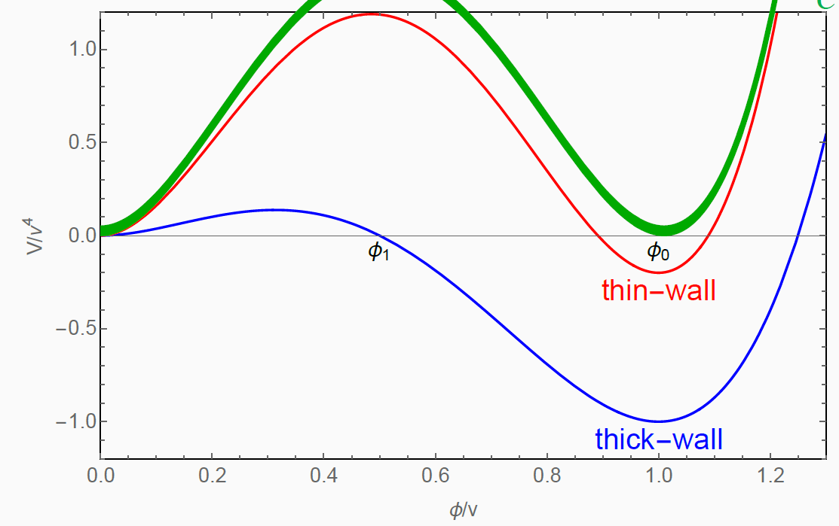
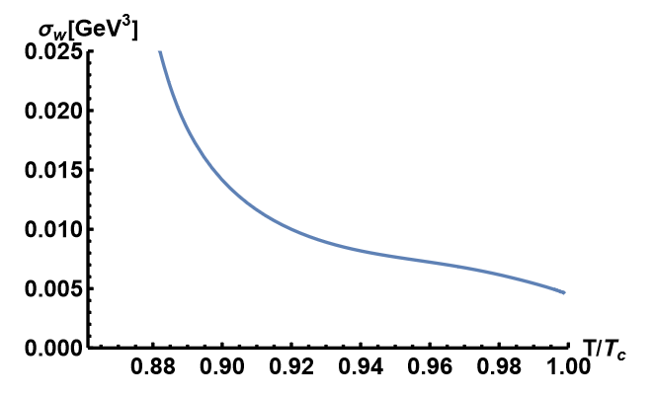
Thin-wall approximation
Y. Chen, Danning Li and M. Huang arXiv: 2212.06591
As in Ref. [A. Eichhorn, et al., JCAP (2021)], for Lw ≪Rw (thin-wall approximation), we can estimate the surface tension and the parameters α and β/H using the Euclidean action.

Slide 15
Real-time evolution
Y. Chen, Danning Li and M. Huang arXiv: 2212.06591
To investigate the real-time evolution, we transform the framework to the ingoing Eddington-Finkelstein coordinate, then the metric becomes
Under the coordinate transformation, the scalar field χ is invariant, and its equation of motion becomes as follows
We choose the following boundary conditions

Slide 16
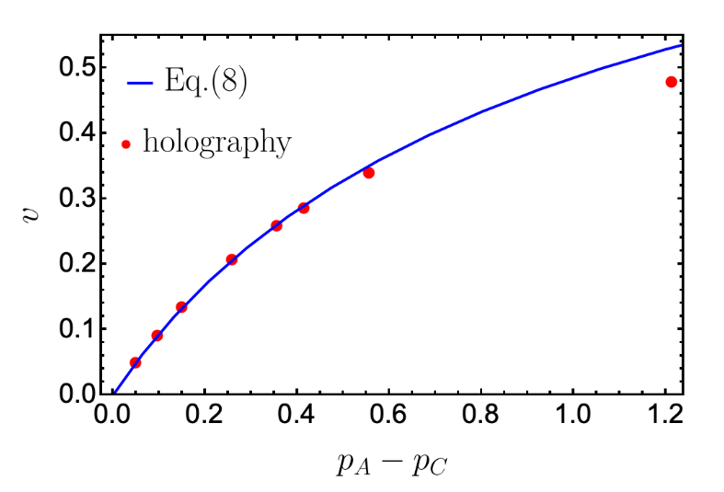
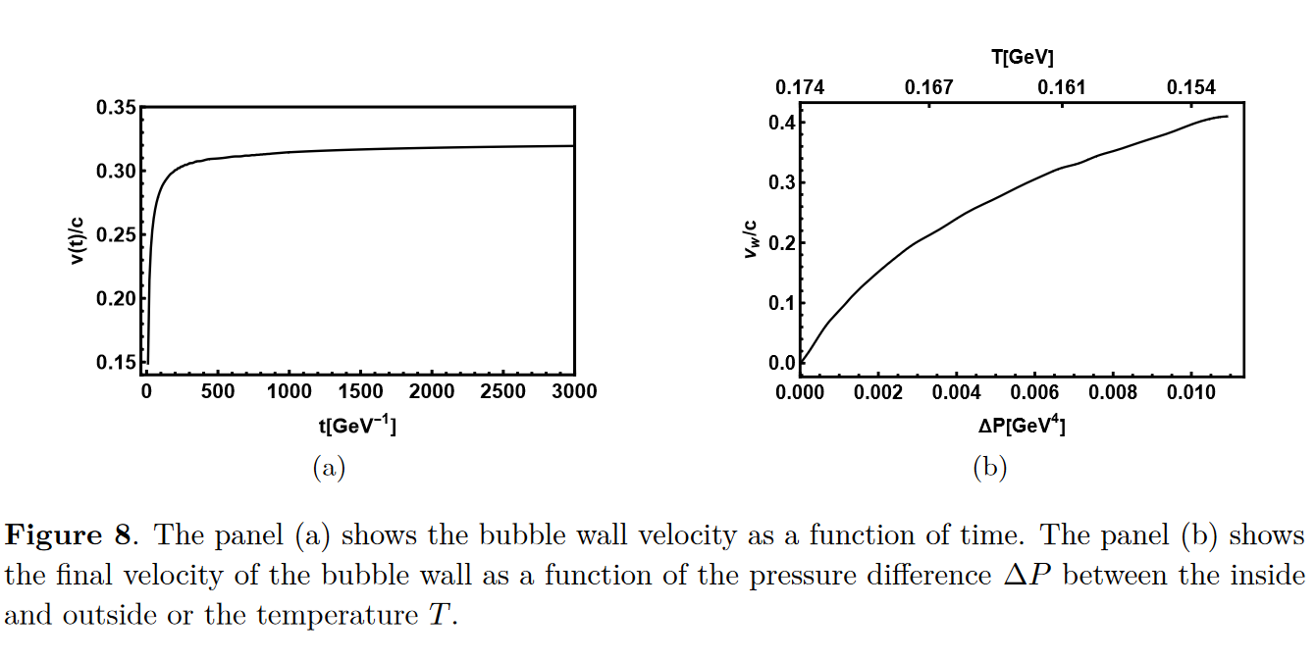
Bubble velocity
Y. Chen, Danning Li and M. Huang arXiv: 2212.06591
The final velocity of the bubble wall $v_{w}$ is defined as
$$c_{s}=\frac{1}{\sqrt{3}}$$
R. A. Janik et al., Phys Rev Lett(2022)

Slide 17
III. Gravitational waves

Slide 18
GW power spectra
Y. Chen, Danning Li and M. Huang arXiv: 2212.06591
Within the linear approximation, the total GW power spectra can be written as
we have found that for the holographic model, the final velocity of the bubble wall is less than the speed of sound, i.e., the non-runaway case. According to Ref. [C. Caprini et al., JCAP(2016)], the GWs generated by collisions in the non-runaway case can be neglected with respect to acoustic waves and magnetohydrodynamic turbulence. Therefore, the total power spectrum is approximated to
Due to the complexity of turbulence, the contribution from the turbulence is dropped in this paper to make a conservative estimate.

Slide 19
GW power spectra
Y. Chen, Danning Li and M. Huang arXiv: 2212.06591
The key quantities which determine these power spectra are the following:
The percolation temperature Tp is defined as the temperature at which the probability to have the false vacuum is about 0.7.
The phase transition strength parameter α, which is related to the scalar potential energy released during the phase transition
The bubble wall speed vw
The transition rate parameter β, which can be thought of as the inverse phase transition duration

Slide 20
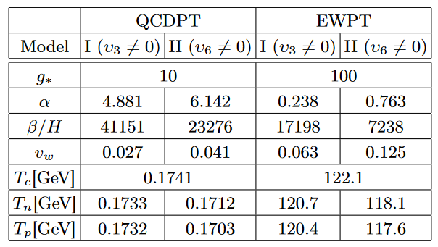
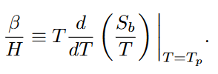
GW power spectra
Y. Chen, Danning Li and M. Huang arXiv: 2212.06591
The parameter α is defined as
Near-conformal model α~O(1)
The inverse of the duration time is defined as
Strongly coupled theory β~10000 ?
F.R. Ares et al., Phys.Rev.Lett.(2022);
J. Shao, Mei Huang, Phys.Rev.D(2023)

Slide 21
GW power spectra
Y. Chen, Danning Li and M. Huang arXiv: 2212.06591
From numerical simulations, the power spectrum from sound waves has the form of
the suppression factor is

Slide 22
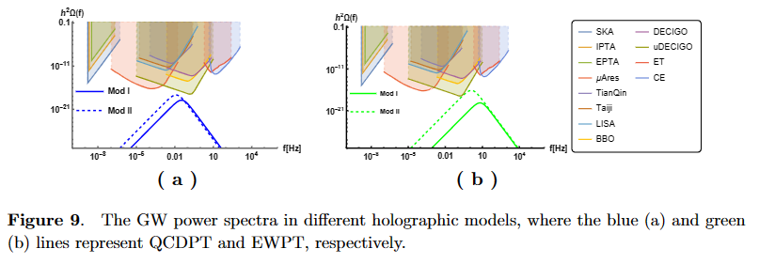
GW power spectra
Y. Chen, Danning Li and M. Huang arXiv: 2212.06591
NANOGrav-15
β ⇧
α ⇧

Slide 23
IV. Summary

Slide 24
Summary
Y. Chen, Danning Li and M. Huang arXiv: 2212.06591
We investigate the bounce solution in the holographic QCD and electroweak models with first-order phase transition. The strength parameter α, inverse duration time β/H and bubble wall velocity vw are calculated by holographic bounce solution.
We find the parameter α is about O(1) and β/H is about 10000. The critical, nucleation and percolation temperatures of the phase transition are close to each other in the holographic model. In addition, the velocity vw is found to be less than the sound speed.

Slide 25
Summary
Y. Chen, Danning Li and M. Huang arXiv: 2212.06591
3) The GW signal is strongly suppressed due to the presence of the factor $Υ$, making it difficult to be detected by the experiment. The signal may be detected by Ultimate-DECIGO only when the appropriate parameters are selected in Model II for EWPT.
4) The primordial black hole is not favorable for formation due to the large parameter β/H and small velocity vw.

Slide 26
Thanks！

