Slide 1
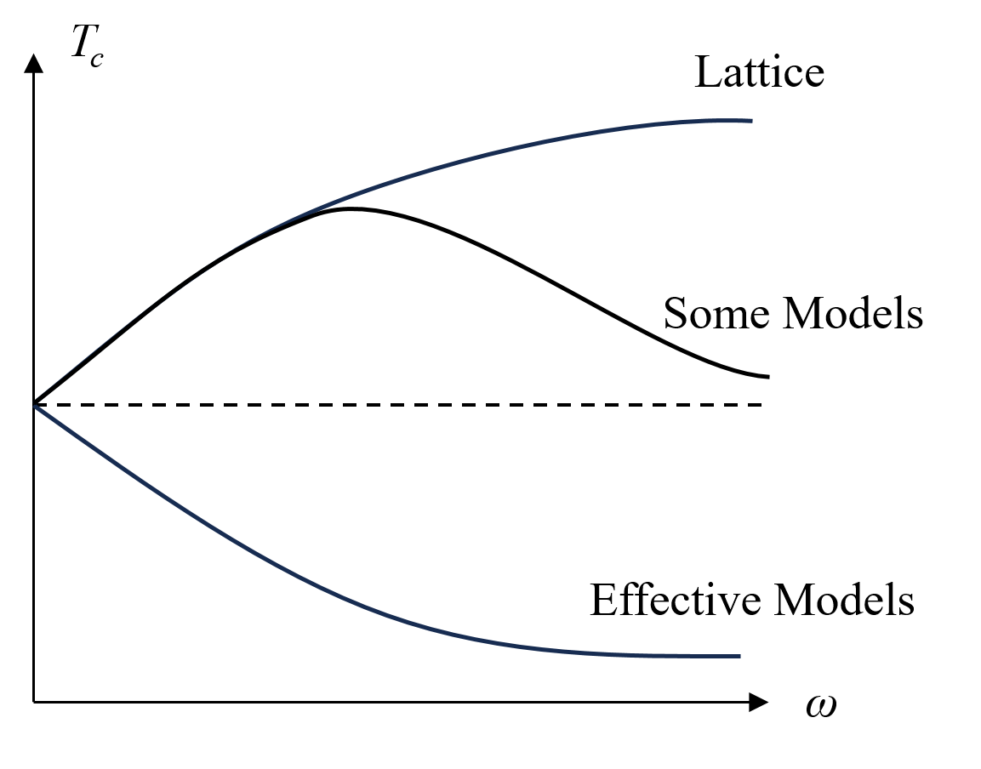
HENPIC200 1. Rotation:
What is the rotation effect on $T_{c}$?
Enhancement or suppression? It is still an open question !
Workshop on QCD under rotation, Shanghai, 20231111
We need more lattice simulations (with $ω/T$ expansion) and precise model calculations (including fluctuations)!
We should consider seriously the boundary condition due to causality condition.

Slide 2
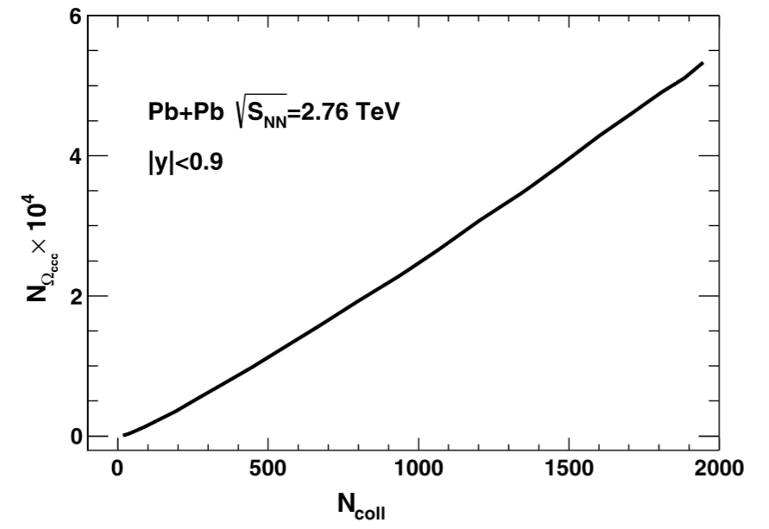
HENPIC200 2. Heavy Flavors:
Searching for the new particle $Ω_{ccc}$!
Coalescence prediction via solving 3-body Schrodinger equation:
Theory Prediction:
Ωccc production in high energy nuclear collisions, H.He, Y.Liu and PZ, PLB746, 59(2015);
Searching for Ξcc in Relativistic Heavy Ion Collisions, J.Zhao, H.He and PZ, PLB771, 349(2017); Exotic Quantum States for Charmed Baryons at Finite Temperature,
J.Zhao and P.Zhuang, PLB775, 84(2017);

Slide 3
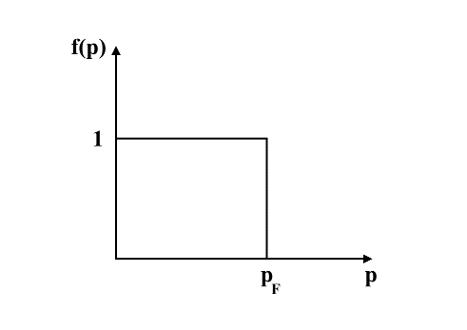
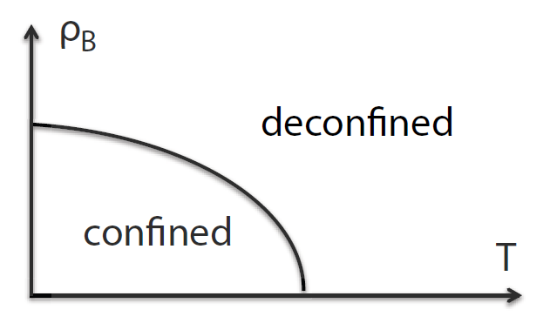
HENPIC200 3. High Baryon Density:
Pay more attention to the jump induced phase transition itself !
Focusing on signatures of the new phase, like Jet, Heavy flavor, Flow, ……

