Slide 1
Dark matter filtering-out effect in FOPT
DianWei Wang
2023.06.09

Slide 2
Reference
1912.02830
1912.04238
1904.11503

Slide 3
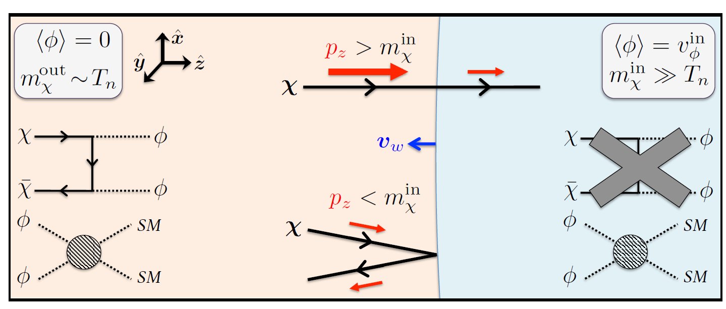
Filtering-out effect
Schematic picture

Slide 4
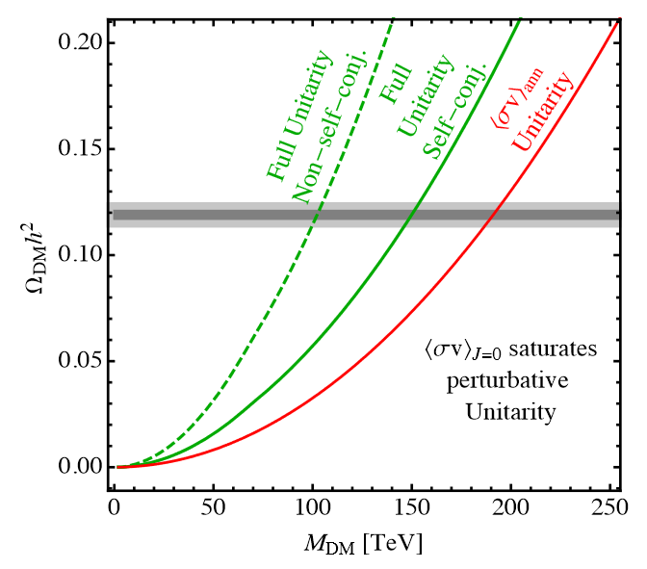
Freeze-out mechanism
Freeze-out
$H<Γ=n_{χ}^{eq}\left\langle σ_{χχ⟷SM }v\right\rangle ⇒χ$ in thermal equilibrium
$H>Γ=n_{χ}^{eq}\left\langle σ_{χχ⟷SM }v\right\rangle ⇒χ$ freeze out
e.g.
$n_{χ}^{eq}≃g_{χ}{\left(\frac{m_{χ}T}{2π}\right)}^{3/2}e^{−\frac{m_{χ}}{T}}$
$\left\langle σv\right\rangle ≃\frac{9y_{χ}^{4}T}{64πm_{χ}^{3}}$
G-K bound
unitarity
$$Ω_{DM}^{obs.}h^{2}∼0.12→$$

Slide 5
Boltzmann equation
Distribution function
Liouville operator
Collision integral

Slide 6
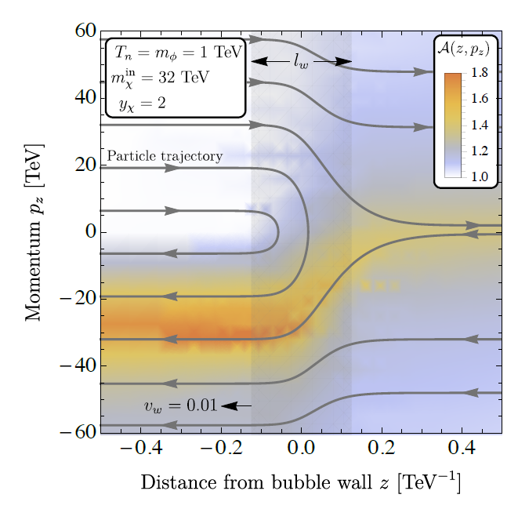
Boltzmann equation
Boltzmann equation
Characteristic method
profile ansatz

Slide 7
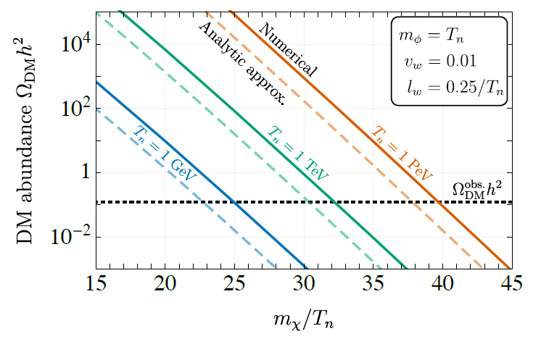
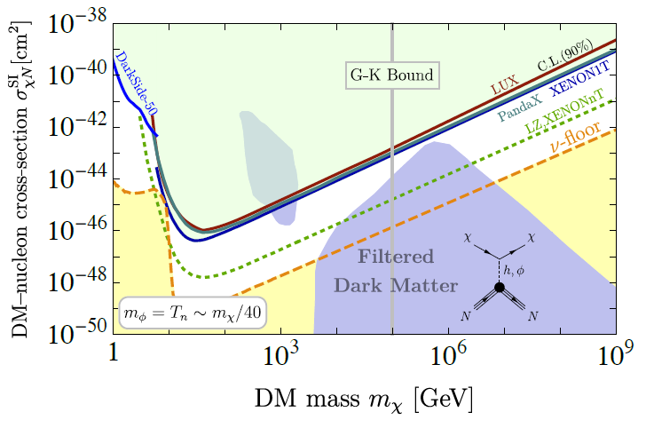
Result
G-K forbidden

Slide 8
Thanks for your listening!
DianWei Wang
2022.06.09

