Slide 1
TAICHU3 Irradiation Test
2023/6/15
Yiming Hu

Slide 2
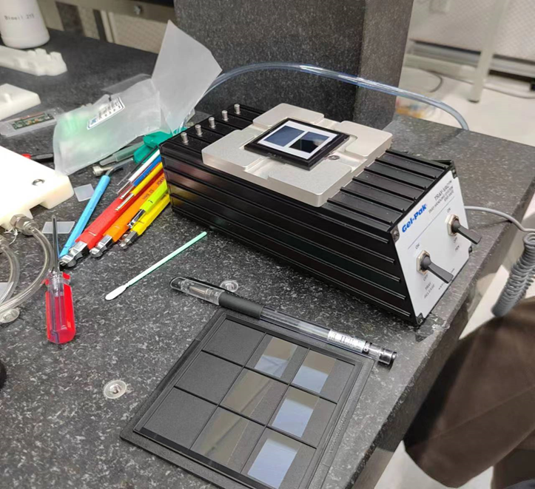
Install chips
1st-4th chips are the TAICHU3 chips. They are placed in self-priming plastic boxes, and two pieces are placed in each plastic box in the direction of up and down, and the 1-4# samples are a total of 8 pieces;
5# sample is a PCB board that has been measured in the previous period. Each sample is positioned more than 50 cm apart to ensure that these samples are not subjected to additional effects by irradiated samples as much as possible.

Slide 3
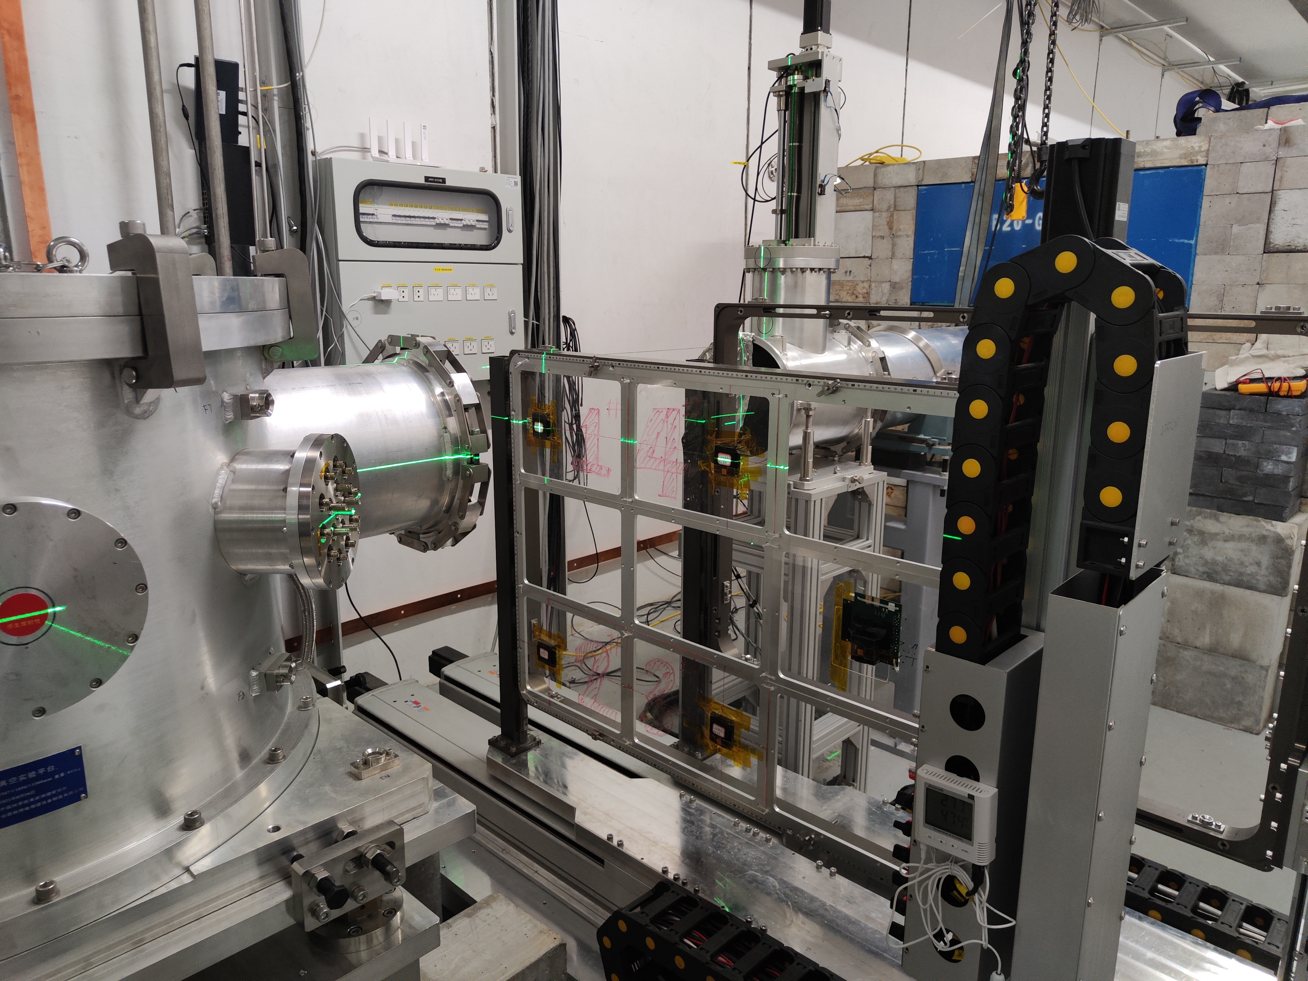
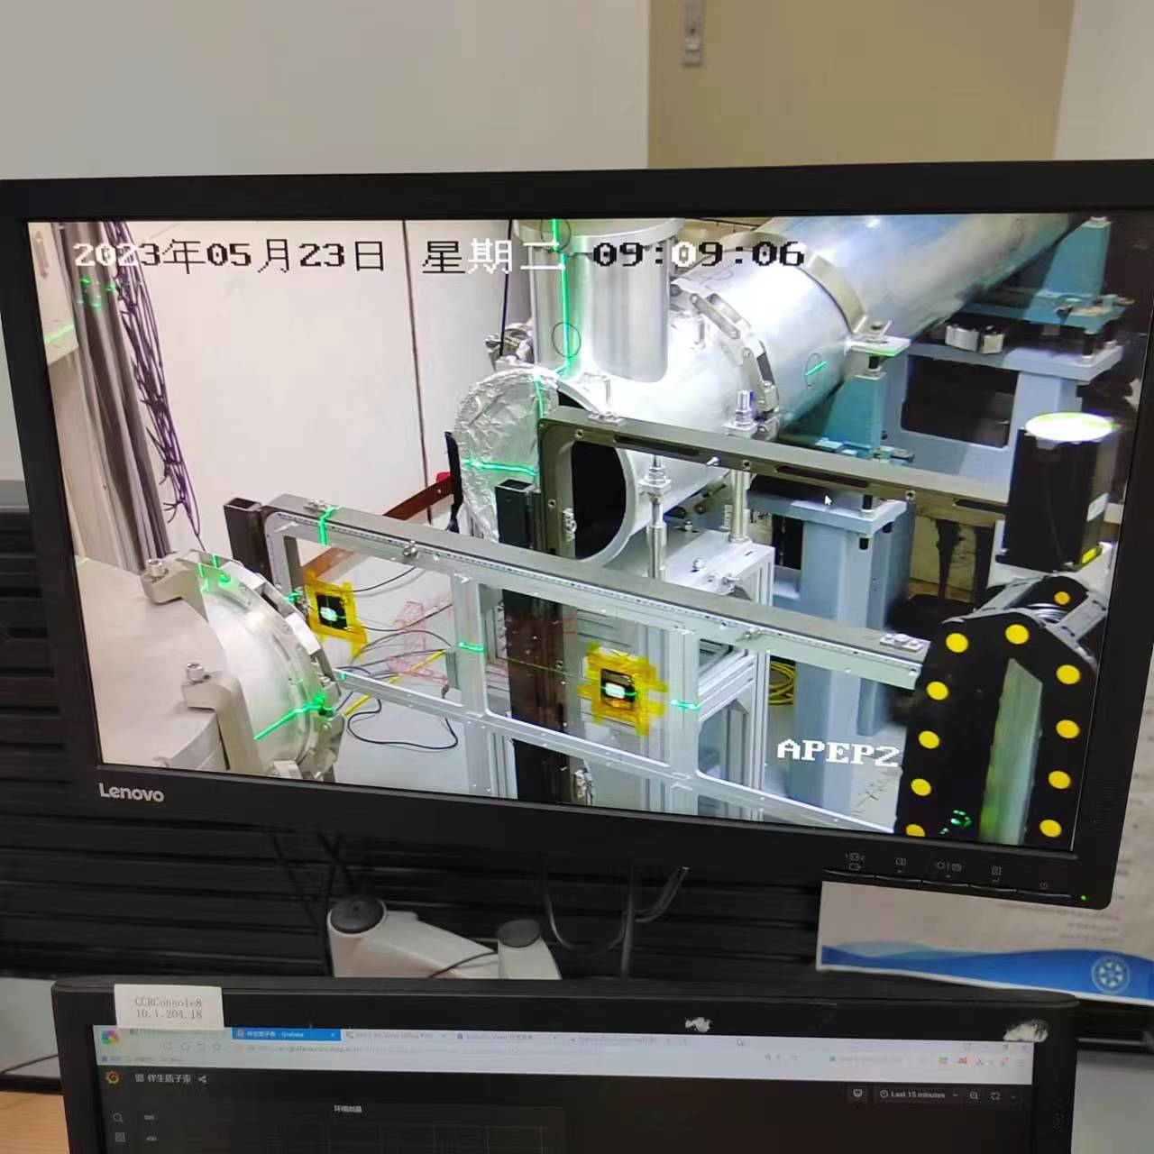
Movement calibration
Ensure the laser spot in the middle of the chip

Slide 4
Dose arrangement
 | 1 | 2 | 3 | 4 | 5（testboard）
$N_{i}$ integrated dose（$1MeV Si n_{eq}/{cm}^{2}$） | $$5{∗10}^{11}$$ | $$5{∗10}^{12}$$ | $$5{∗10}^{13}$$ | $$7.5{∗10}^{13}$$ | $$7.5{∗10}^{13}$$
$Δt$ radiation time(s) | 450 | 4502 | 45024 | 67536 | 67536
using $7.16{×10}^{8}pps$ as expected rate，mutiplied it by 1.551 which is the equivalent neutron factor, using 70MeV, 5*5cm spot size
$Δt=\frac{Ni}{n}=\frac{N_{i}}{φ(S)∙k(E)}$(s)
The rate is referred to the CT value = 10 uA’s situation, when we begin irradiation the actual CT value is about 13uA, it may lead to a bit higher dose than we expected.

Slide 5
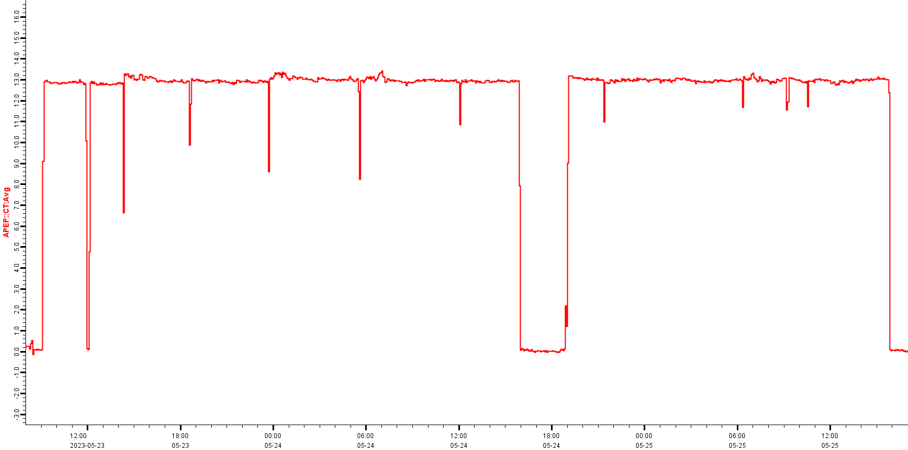
Beam working status
shutdown 3h09min
CT value maintain 13uA in most time, except one long time shutdown(3h) on 5/24, other shutdowns are less than 10min.

Slide 6
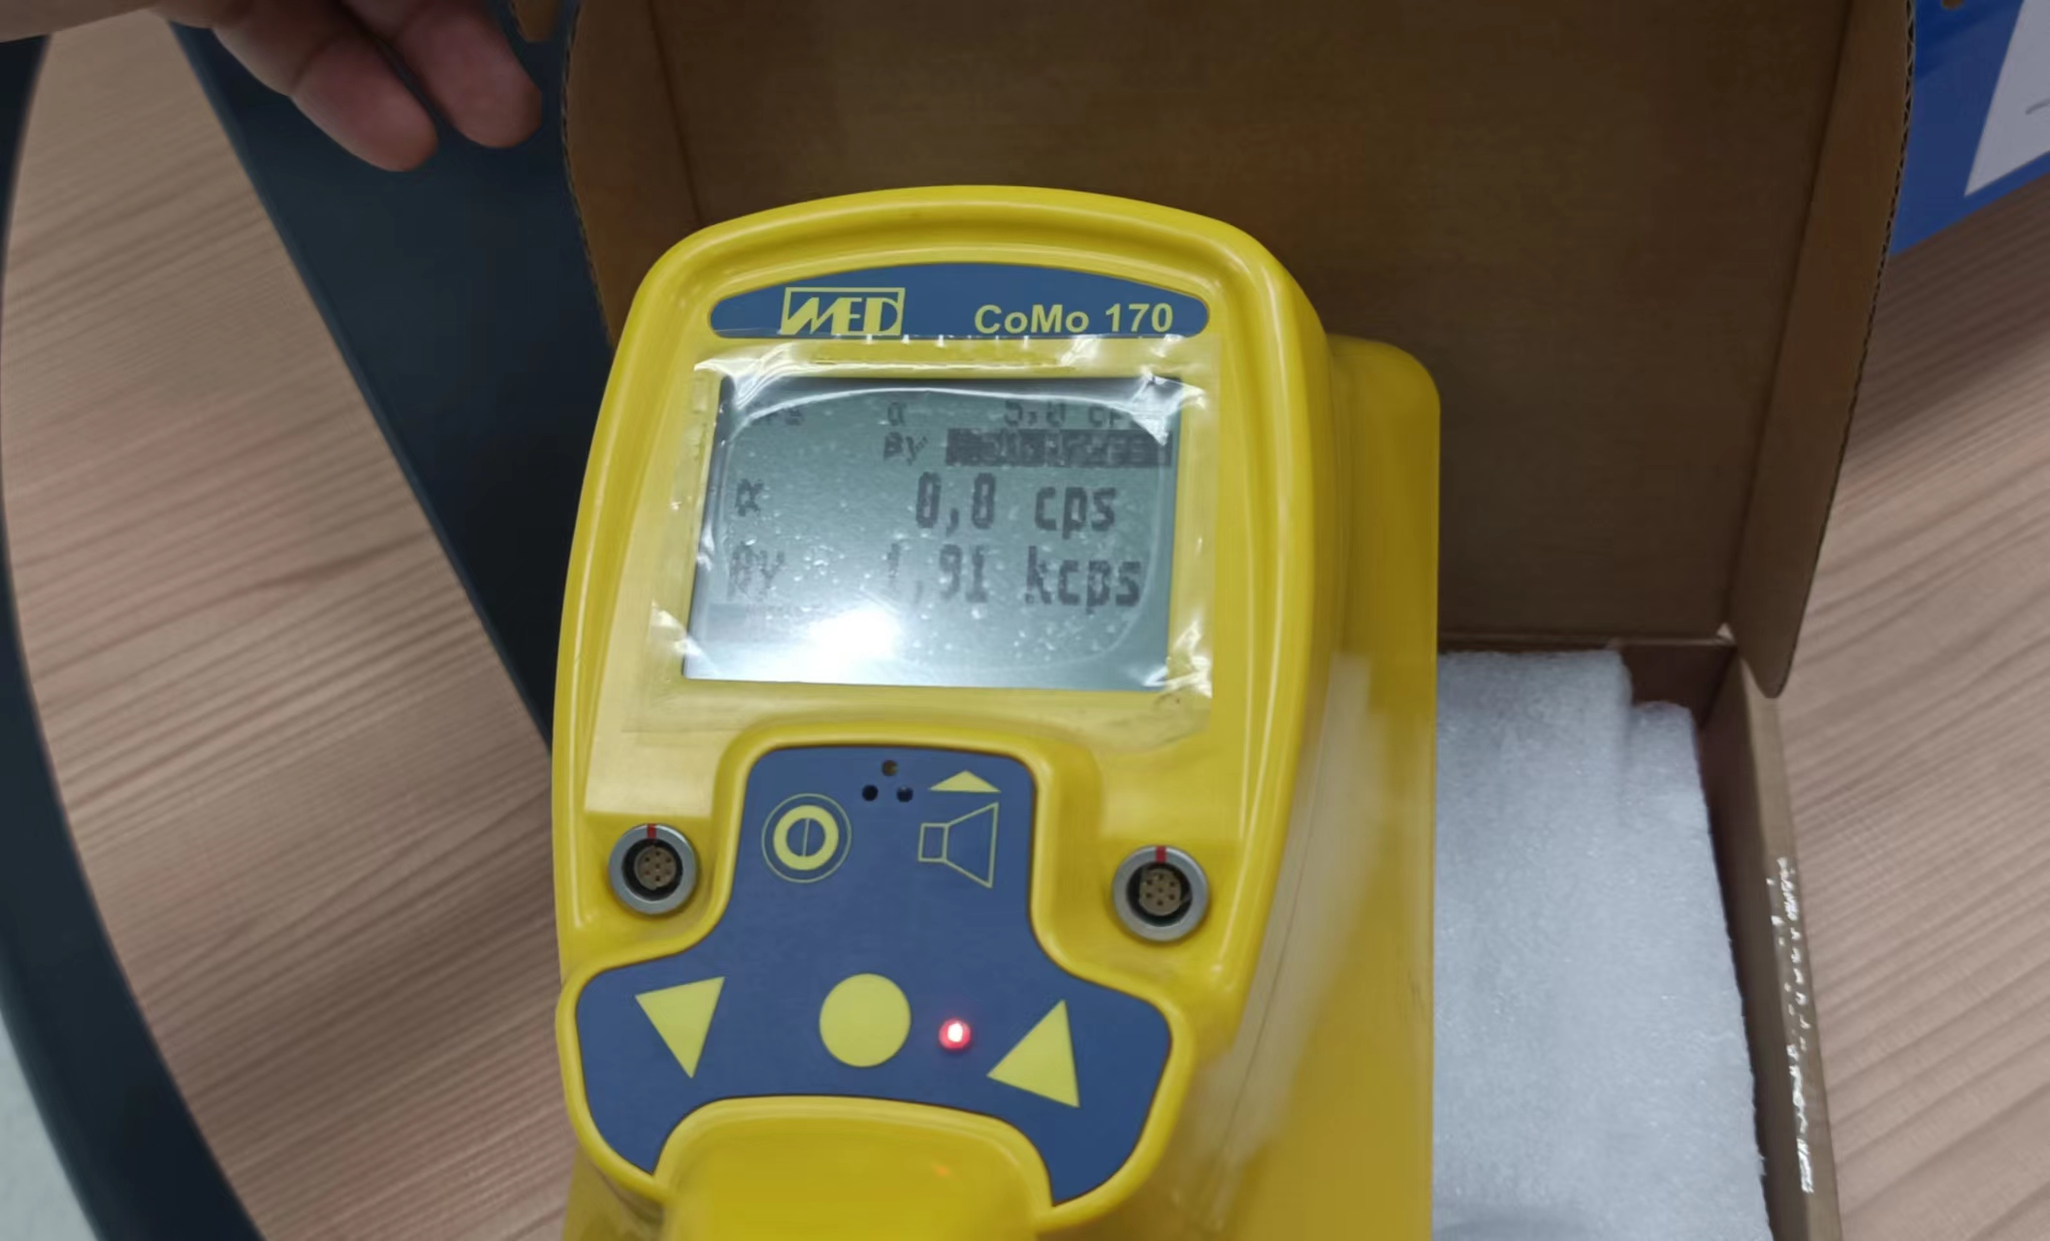
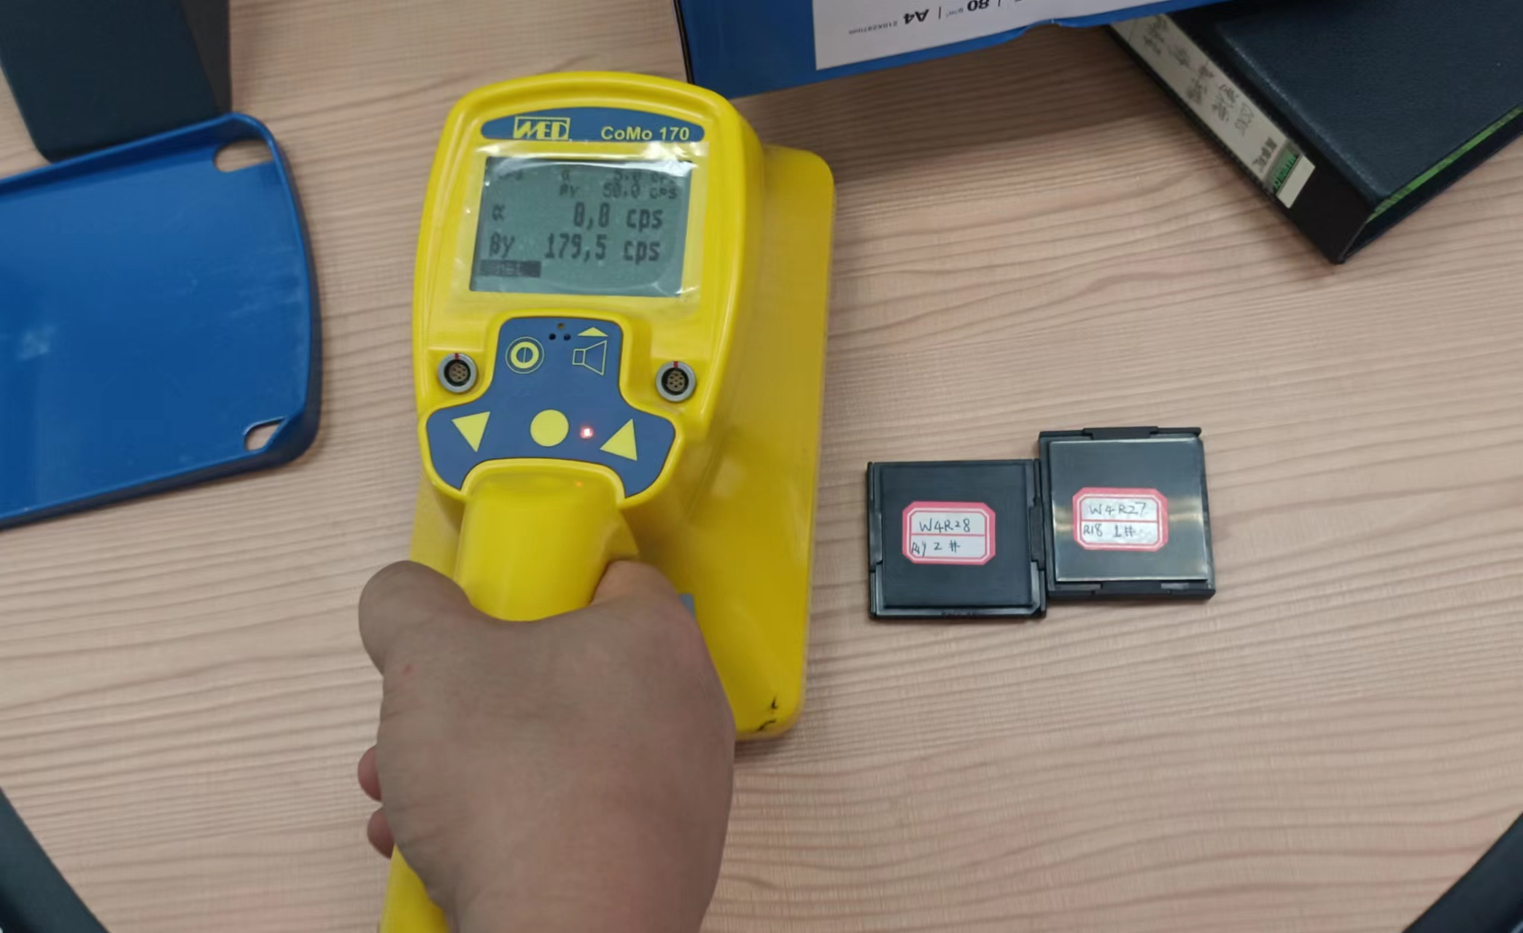
Residual radiation
testboard：1.91kcps（βγ） 3rd chip：179.5cps
Safe index is 115cps

Slide 7
Dose check
3rd，4thchip and testboard were pasted Copper foil. By counting the certain gamma spectrum, we can calculate the average rate during radiation of the related chip
$\frac{N\left(t\right)}{ε}=N_{x,Cu}∗σ_{Cu}∗φ_{proton}∗S_{IRR}∗\left(1−e^{−λ∗t_{IRR}}\right)∗e^{−λ∗t_{WAIT}}$
$t_{IRR}$, $t_{WAIT}$:radiation time，waiting time
$N\left(t\right):$gamma count rate
$ε$:count efficiency
$N_{x,Cu}$：Copper foil areal density (${cm}^{−2}）$
$σ_{Cu}$：cross section
$φ_{proton}$：Target protron rate
$S_{IRR}$：area of copper foil
$λ$：decay constant

Slide 8
Chips’ radiation time
ID | expected radiation time(s) | Begin time | End time | note
1 | 450 | 2023/5/23 09:09:30 | 2023/5/23 09:16:00
2 | 4502 | 2023/5/23 09:16:37 | 2023/5/23 10:31:39
3 | 45024 | 2023/5/23 10:32:27 | 2023/5/23 23:03:51
4 | 67536 | 2023/5/23 23:04:39 | 2023/5/24 20:59:15 | shutdown 3h9min
5 | 67536 | 2023/5/24 21:00:48 | 2023/5/25 15:46:26

Slide 9
Computative chips’ radiation dose from mearsure value and CT value
1st and 2nd chips don’t paste foil, since their radiation time are too short
we can computative their dose from other chips mearsure value, when we get their integrated CT value
But we should check such function’s accuracy
Sample\REF chip | 3 | 4 | 5
3 | 9.32 | 9.27 | 9.59
4 | 14.33 | 14.26 | 14.75
5 | 14.27 | 14.20 | 14.69
Red value is the measure value, Black value is the value computatived from measure value and CT value. unit is (E+13 1MeV neq/cm^2)

Slide 10
Apply the function to 1st，2nd chip
Sample\REF chip | 3 | 4 | 5
1 | 0.08 | 0.08 | 0.08
2 | 0.94 | 0.94 | 0.97
3 | 9.32 | 9.27 | 9.59
4 | 14.33 | 14.26 | 14.75
5 | 14.27 | 14.20 | 14.69

Slide 11
Real dose comparation
 | 1 | 2 | 3 | 4 | 5（测试板）
$N_{i}$ expected dose （$1MeV Si n_{eq}/{cm}^{2}$） | $$5{∗10}^{11}$$ | $$5{∗10}^{12}$$ | $$5{∗10}^{13}$$ | $$7.5{∗10}^{13}$$ | $$7.5{∗10}^{13}$$
$N_{i}$ real dose(from simulation data) | $$6.5{∗10}^{11}$$ | $$6.5{∗10}^{12}$$ | $$6.5{∗10}^{13}$$ | $$9.75{∗10}^{13}$$ | $$9.75{∗10}^{13}$$
$N_{i}$ real dose(from measured data)） | $${ 8.34∗10}^{11}$$ | $${ 9.53∗10}^{12}$$ | $${9.32 ∗10}^{13}$$ | $${14.26∗10}^{13}$$ | $${ 14.69∗10}^{13}$$
The second line: According to the previous measurement of CT=10uA, rate = 7.16×10^8pps, and the average CT value of this experiment is 13uA. the actual irradiation dose should be about 1.3 times the original expected value
The third line: According to the data of this activation foil, combined with the CT value integration ratio of different time periods, the results of chip 1 and 2 are estimated. The average is 1.9 times the original expected value.
1.9/1.3 ≈ 1.4 The extra 40% may come from the influence of protons reflected by the target material on the activation foil measurements

Slide 12
Follow-up plans
8 chips have been sent to Beijing, and are ready to wire bondin for further measurements
Prepare to do wire bonding on the PCB board,and solder it for further measurement
Measure chip resolution, efficiency, cluster size, dark noise, etc
Compare and analyze the relevant performance parameters before and after chip irradiation
Wait for the irradiated PCB board (5# sample) to reach the safe dose index, and then take back for later measurement and analysis

