Slide 1
TaichuPix3 wire-bonding at IHEP
Tianya Wu
wuty@ihep.ac.cn
2023.06.15

Slide 2
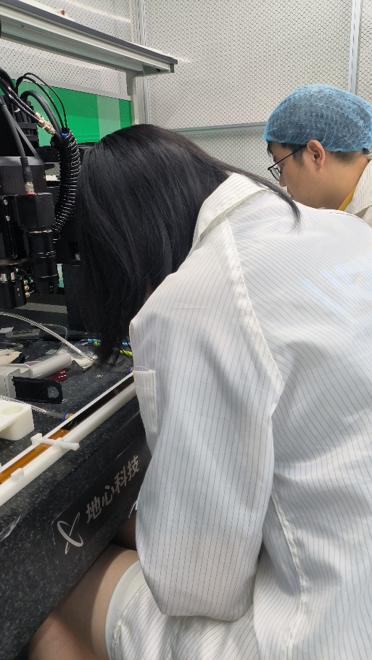
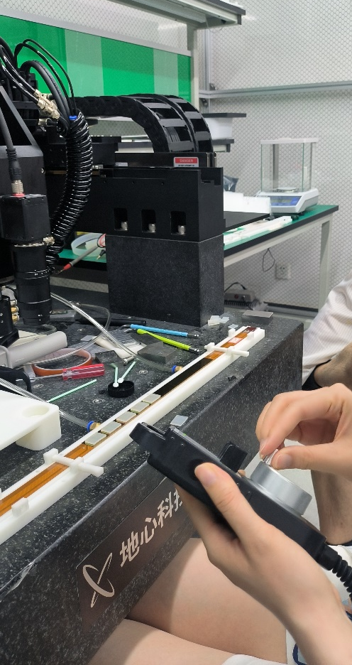
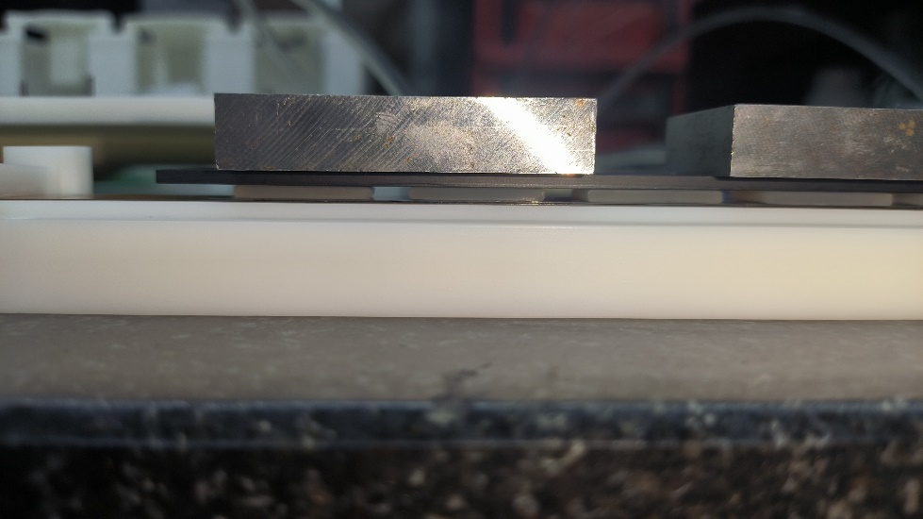
Gluing full flex
Gluing 10 chips by Wei Wang
To make the glue uniform and paste sensors tightly, a soft polymer placed between sensors and metals with certain weight.

Slide 3
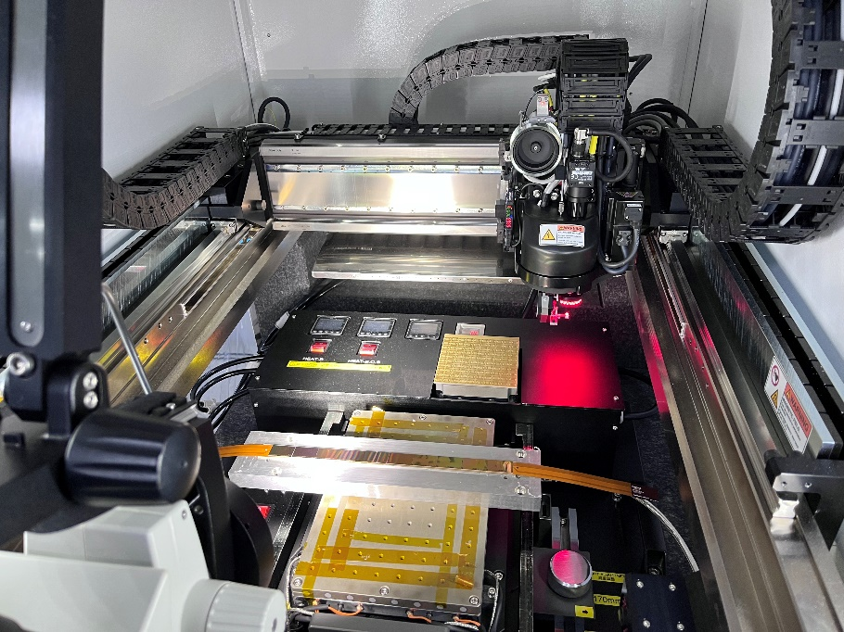
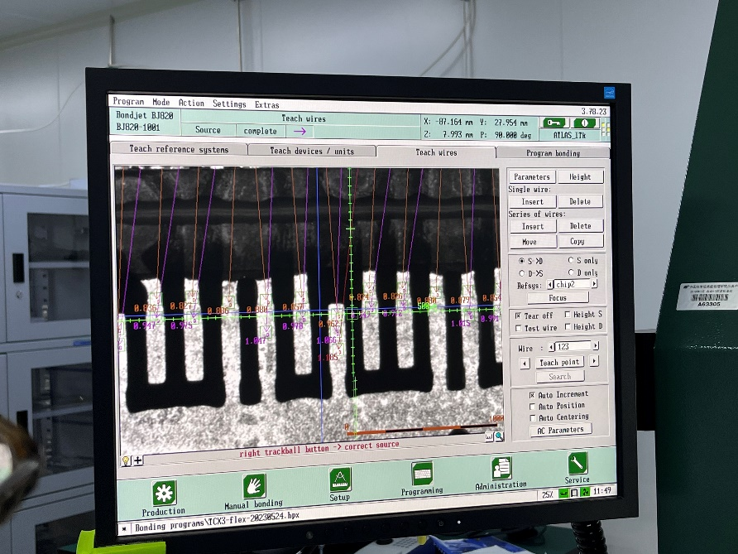
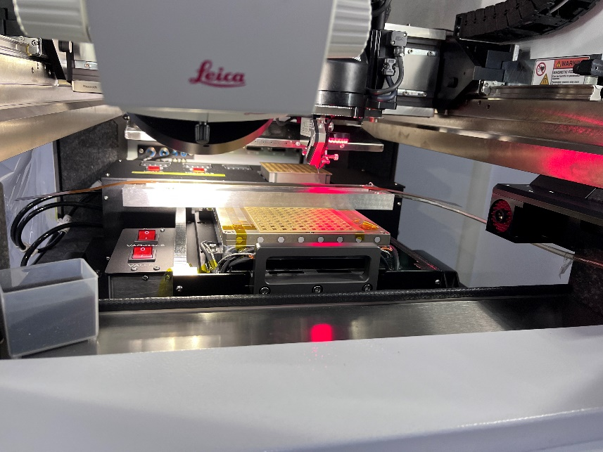
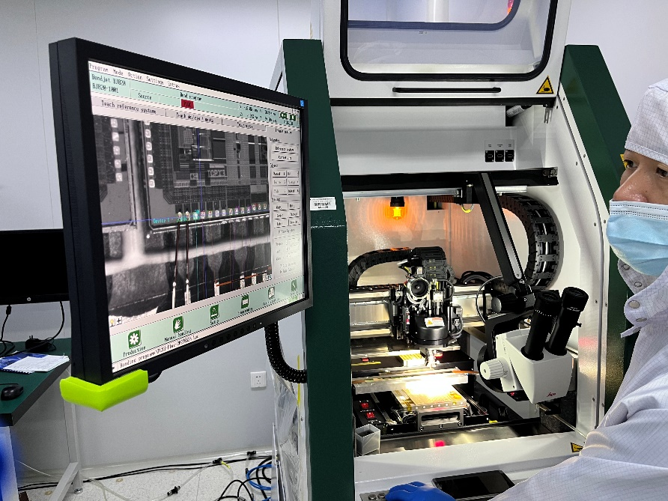
Do wire-bonding

Slide 4
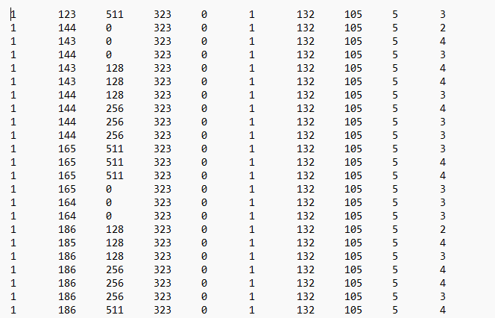
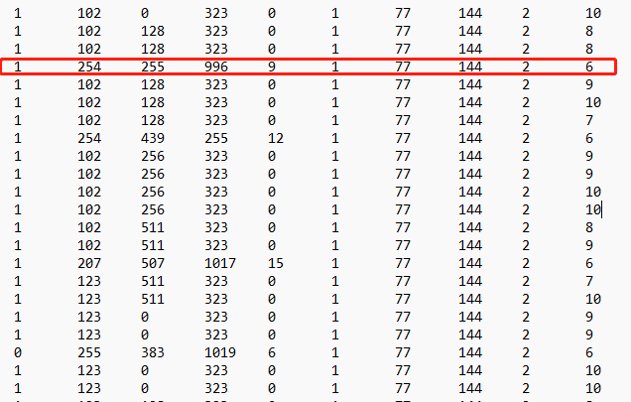
OCT test for 10 chips
Current for OCT(chip1-5): 0.487A
Current for OCT(chip6-10): 0.624A
Remove chip6 wires: 0.51A
No apulse can be configured to any chip.
Chip 6, chip 5 and chip 1 is not working on flex.
To set the ITHR to 255, the current is 0.59A, the chip7 is too noisy to the interface.

Slide 5
Sr90 test for 10 chips

Slide 6
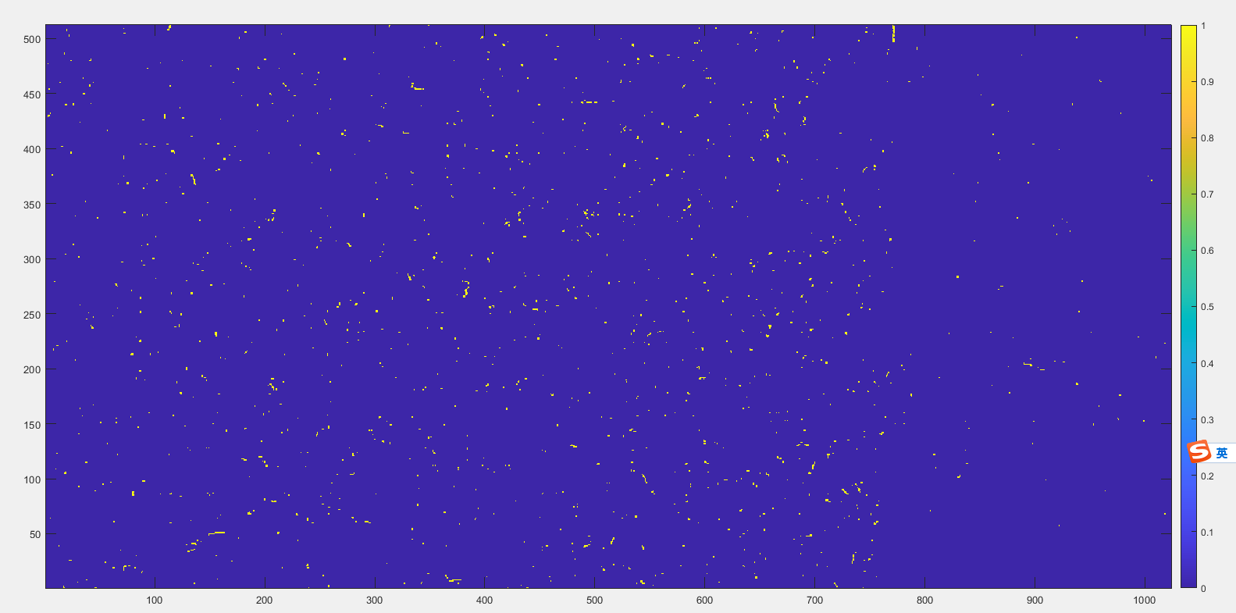
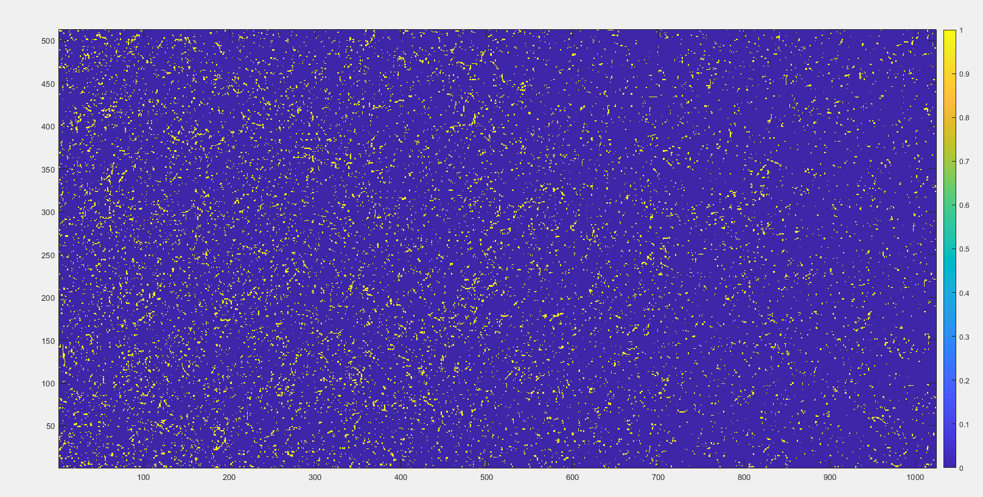
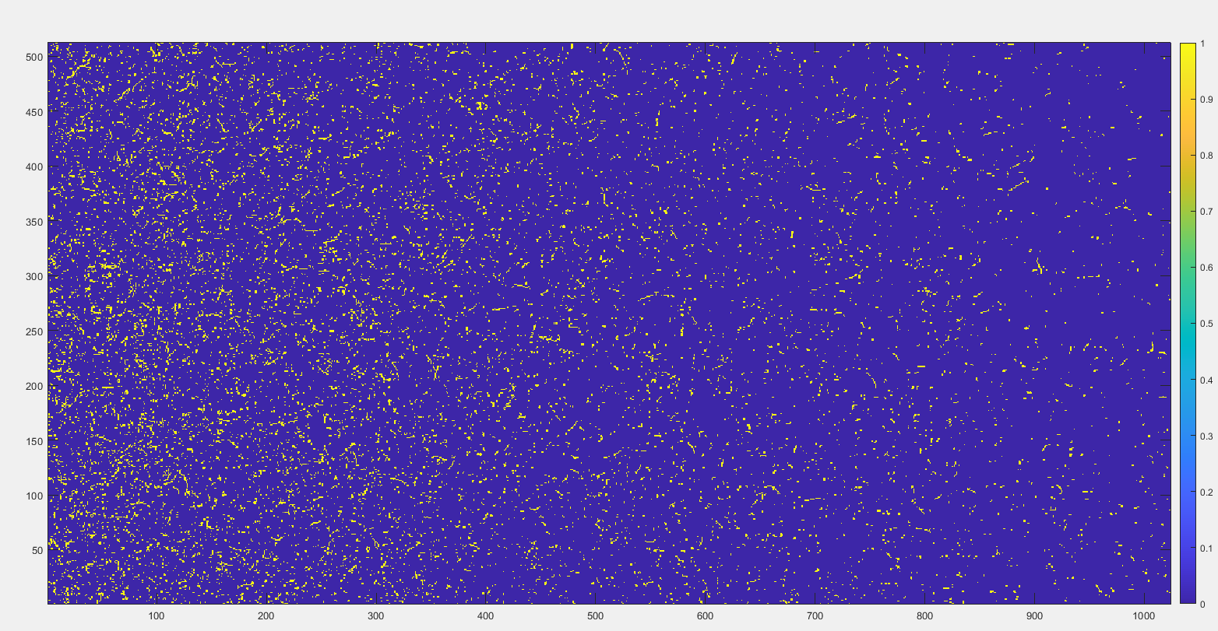
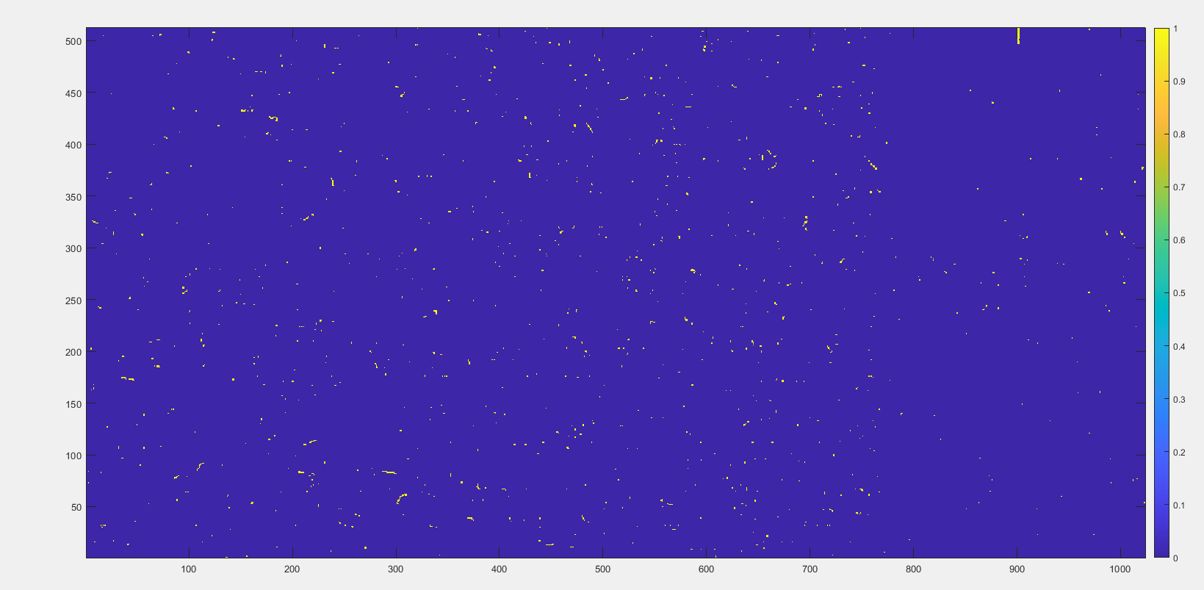
Sr90 test for 10 chips
U10
U9
U8
U7
2 layer flex （V1.3）
With ITHR 255 U7-U10 can be configured one by one.
U9 and U8 can work together, U7 and U10 have noisy pixels and cannot be masked. So it is impossible to configure 3 chips working at the same time.

Slide 7
4 layer flex
4 layer flex （made by the company of SCC）
Wirebonding will be finished today.
I will go to test it after meeting.

Slide 8
Thanks for your attention!

