Slide 1
Recent progress of the 3D polarimeter
Yuting Wang
Jun 29, 2023

Slide 2
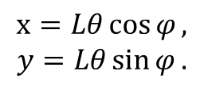
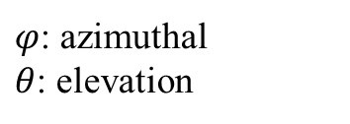
Model Explanation (W/O bending magnet)
y
x
y
Observer
x
$$L$$
$$(x,y)$$
$$x=Lθ\cos{φ},$$
$$y=Lθ\sin{φ}.$$
$$θ$$
$$φ$$
z
$φ$: azimuthal
$θ$: elevation

Slide 3
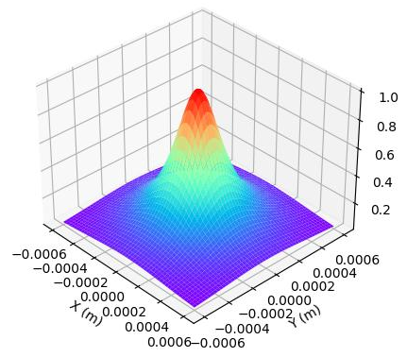
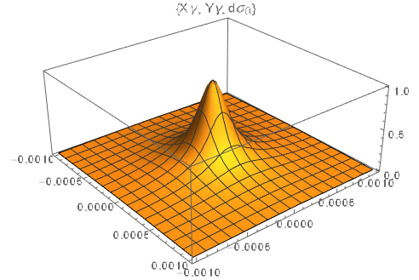
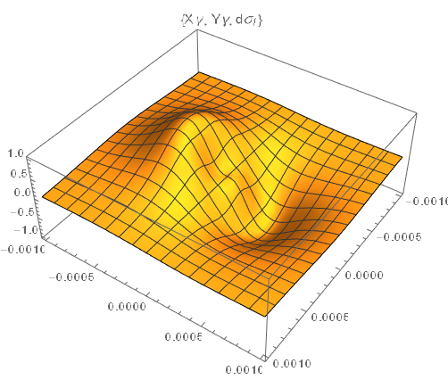
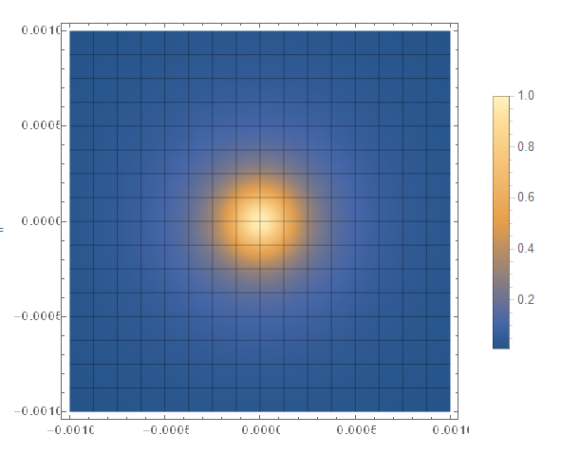
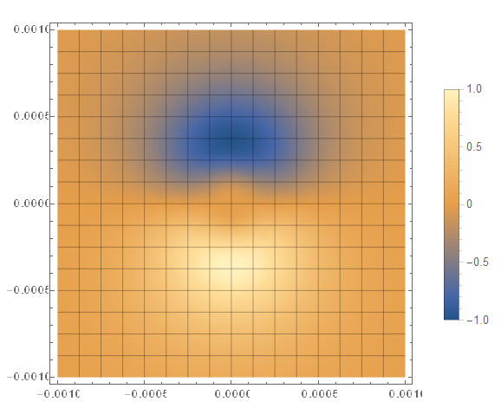
Scattering Photon
Ek=120 GeV L=60 m

Slide 4
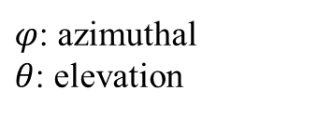
Model Explanation (With bending magnet)
y
x
$$L_{1}$$
$$θ$$
$$φ$$
z
$$L_{2}$$
y
Observer
x
$$(x,y)$$
$φ$: azimuthal
$θ$: elevation
Z’
$$x=L_{1}θ\cos{φ}+uθ_{0}L_{2},$$
$$y=L_{1}θ\sin{φ}.$$

Slide 5
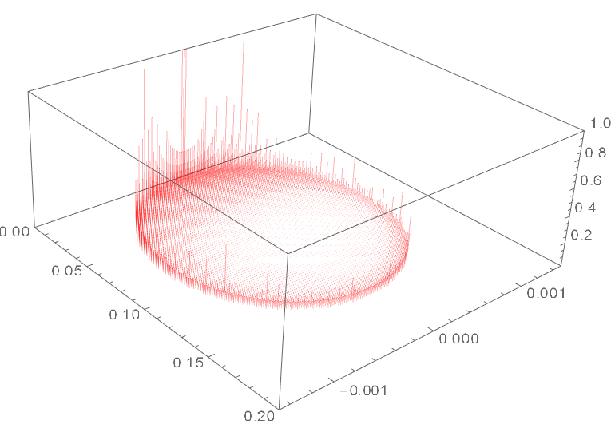
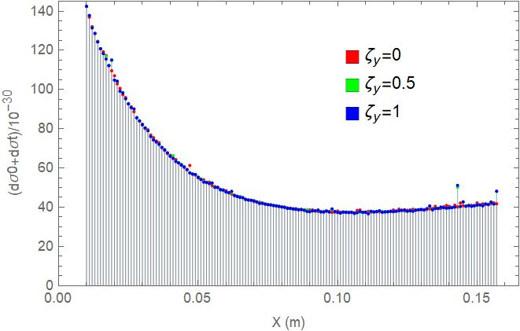
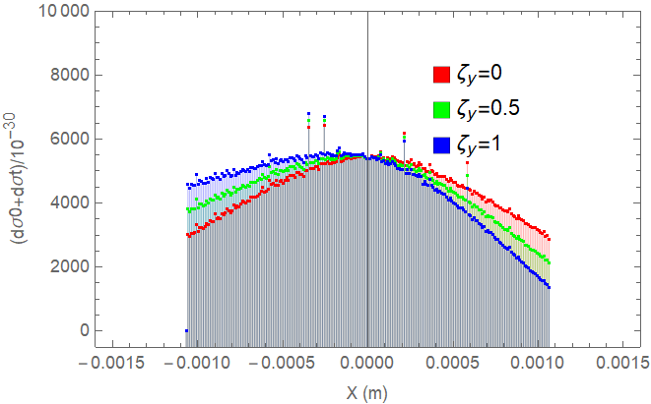
Scattering Electron

Slide 6
$$x=L_{1}θ\cos{φ}+uθ_{0}L_{2},$$
$$y=L_{1}θ\sin{φ}.$$
In order to change the coordinate variables into (x,y) plane, it’s necessary to calculate (u,ϕ) in form of (x,y). According to the relation between two coordinates, one-to-two mapping occurs, which may not physical in fact.
Possible solution:
Monte Carlo method
Find the new variables to analytically express coordinate transformation

Slide 7
Work flow of the Monte Carlo method
PDF: Build the distribution function from the cross section
(u,ϕ) : Generate (u,ϕ) according to PDF
(X,Y): Obtain (X,Y) according to the relation between two coordinates
Analysis
Substitute (x,y) into ICS cross section (in form of (x,y))

Slide 8
Backup

Slide 9
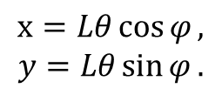
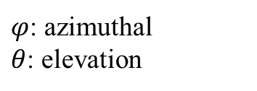
y
x
Observer
$$L$$
$$θ$$
$$φ$$
z
$$x=Lθ\cos{φ},$$
$$y=Lθ\sin{φ}.$$
$φ$: azimuthal
$θ$: elevation

