Slide 1


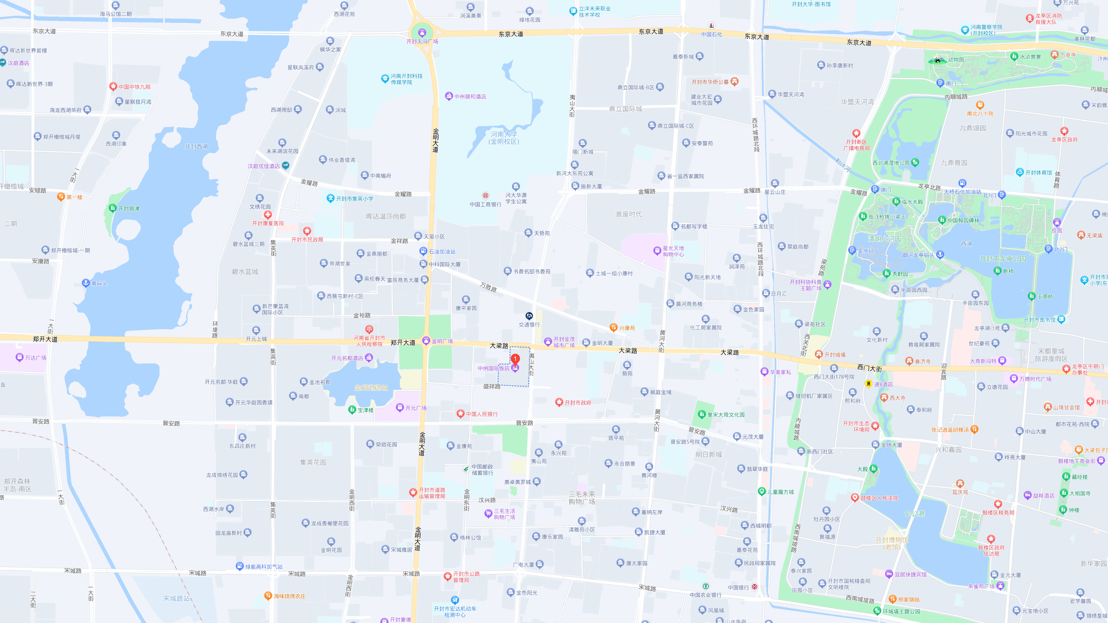
Chiral EFT and heavy hadronic molecules
Bo Wang(王波)
Hebei University
2023年10月30日@开封

Slide 2

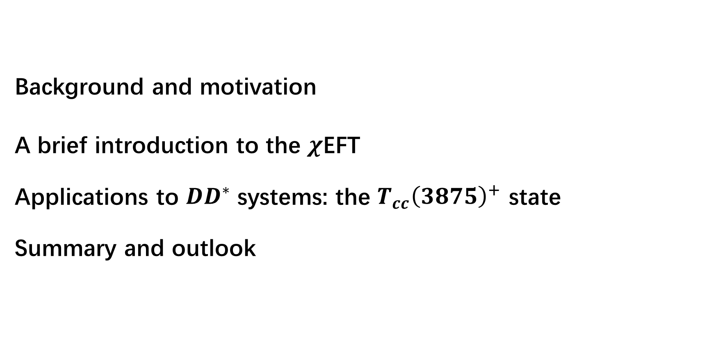
Outline
Background and motivation
A brief introduction to the $χ$EFT
Applications to $DD^{∗}$ systems: the $T_{cc}{\left(3875\right)}^{+}$ state
Summary and outlook

Slide 3
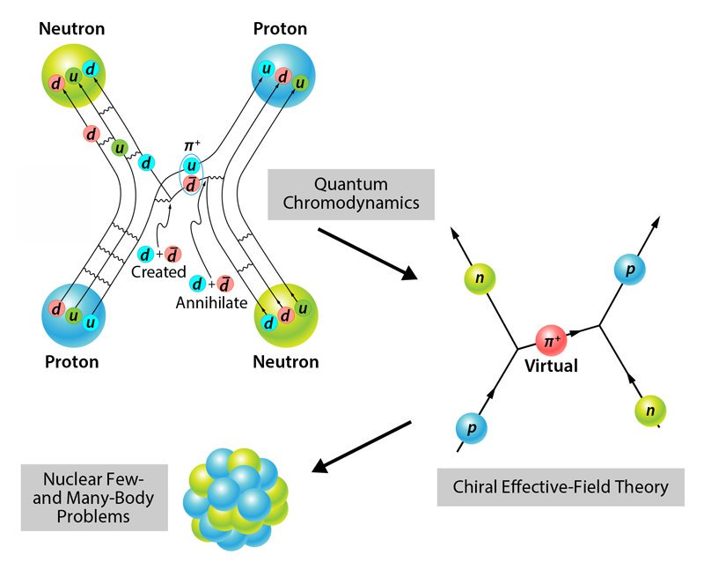



Background and motivation
A brief introduction to the history of nuclear force
Prog. Theor. Phys. 39 (1967)
Phys. Rep. 13C (1974) 191
Adv. Nucl. Phys. 19 (1989) 189
Nucl. Phys. A335 (1980) 203
Nucl. Phys. A352 (1981) 301
Prog. Theor. Phys. 66 (1981) 551
Proc. Phys. Math. Soc. Japan 17 (1935) 48
Multi pion: $σ, ρ, ω…$
OBE model, success
Discovery of QCD. Quark models
Yukawa: Meson theory
1935
1950’s
1960’s
1970’s
1980’s
1990’s-now
The ‘‘Pion Theories’’. OPE: good; TPE: bad
Diverse TPE models:
Paris, Bonn models, $…$
Discovery of $χ$EFT: Weinberg, van Kolck, $…$
Lattice QCD
Prog. Theor. Phys. 7 (1952) 45
Phys. Rev. 90 (1953) 699
Phys. Rev. C 21 (1980) 861
Phys. Rev. D 2 (1970) 1999
Phys. Rep. 149 (1987) 1
Physica 96A (1979) 327
Phys. Lett. B 251 (1990) 288
Phys. Rev. Lett. 72, 1982 (1994)
Phys. Lett. B 424 (1998) 390
Physics Reports 503 (2011) 1–75

Slide 4
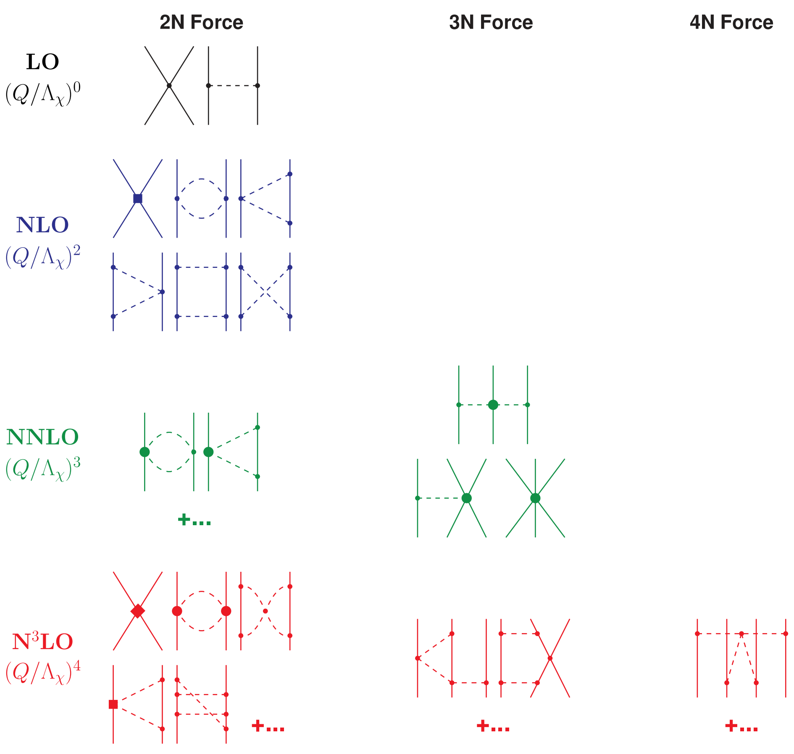
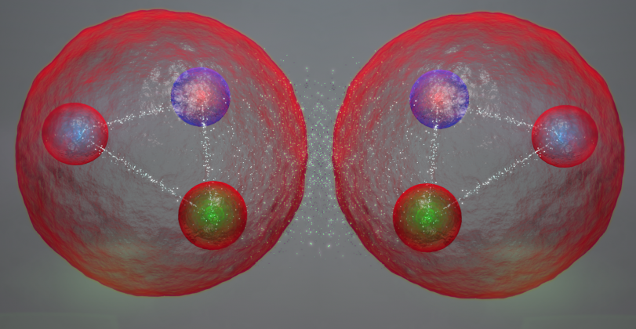
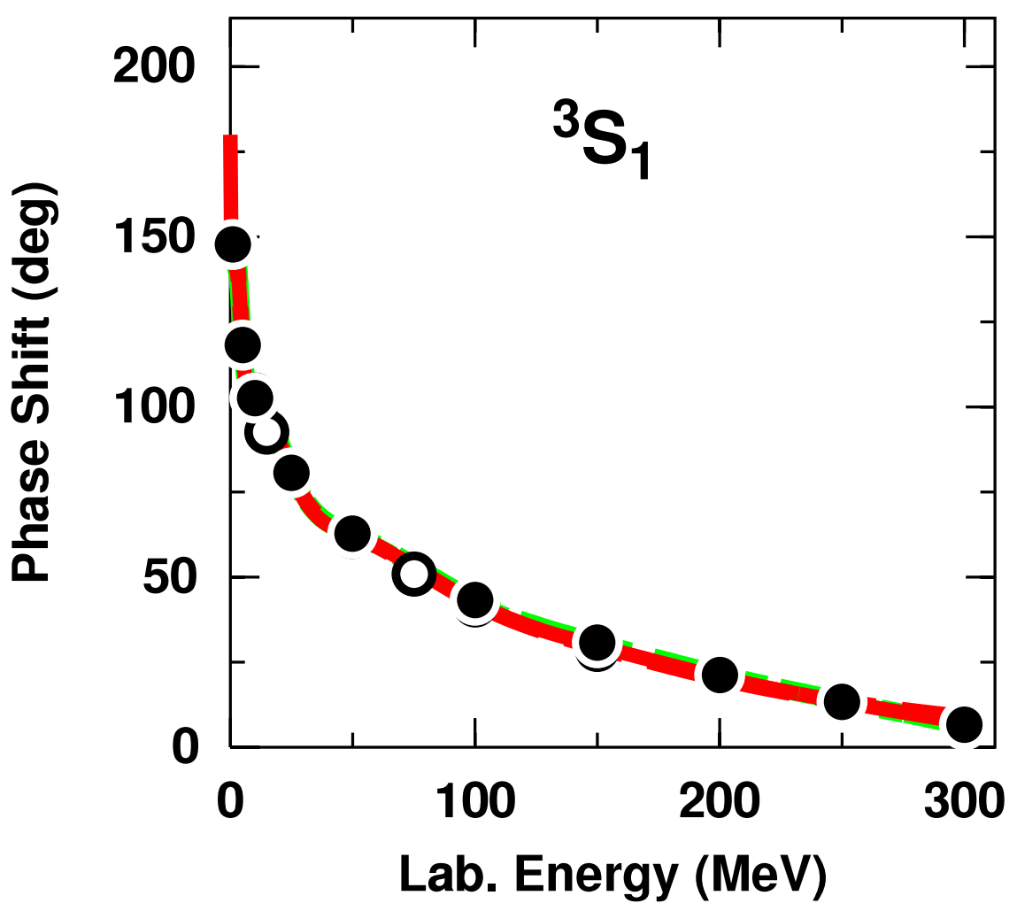
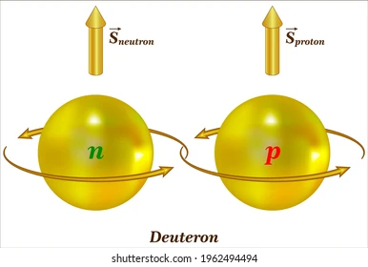


Background and motivation
$χ$EFT: modern theory of nuclear forces
For beginners, see: Rev. Mod. Phys. 81, 1773, Phys. Rept. 503, 1–75
NN scattering data (phase shift) can be satisfactorily described in $χ$EFT.
Characteristics of deuteron can be precisely reproduced.
Chiral three-nucleon forces, the triton.
Provide important inputs for the few-nucleon reactions, structure of light- and medium-mass nuclei .
NN interaction has been calculated up to $N^{5}LO$ in $χ$EFT.
very successful!

Slide 5
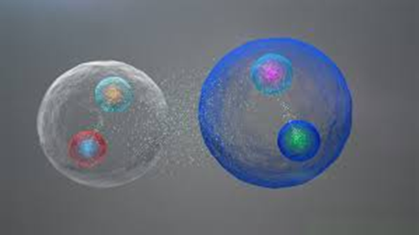
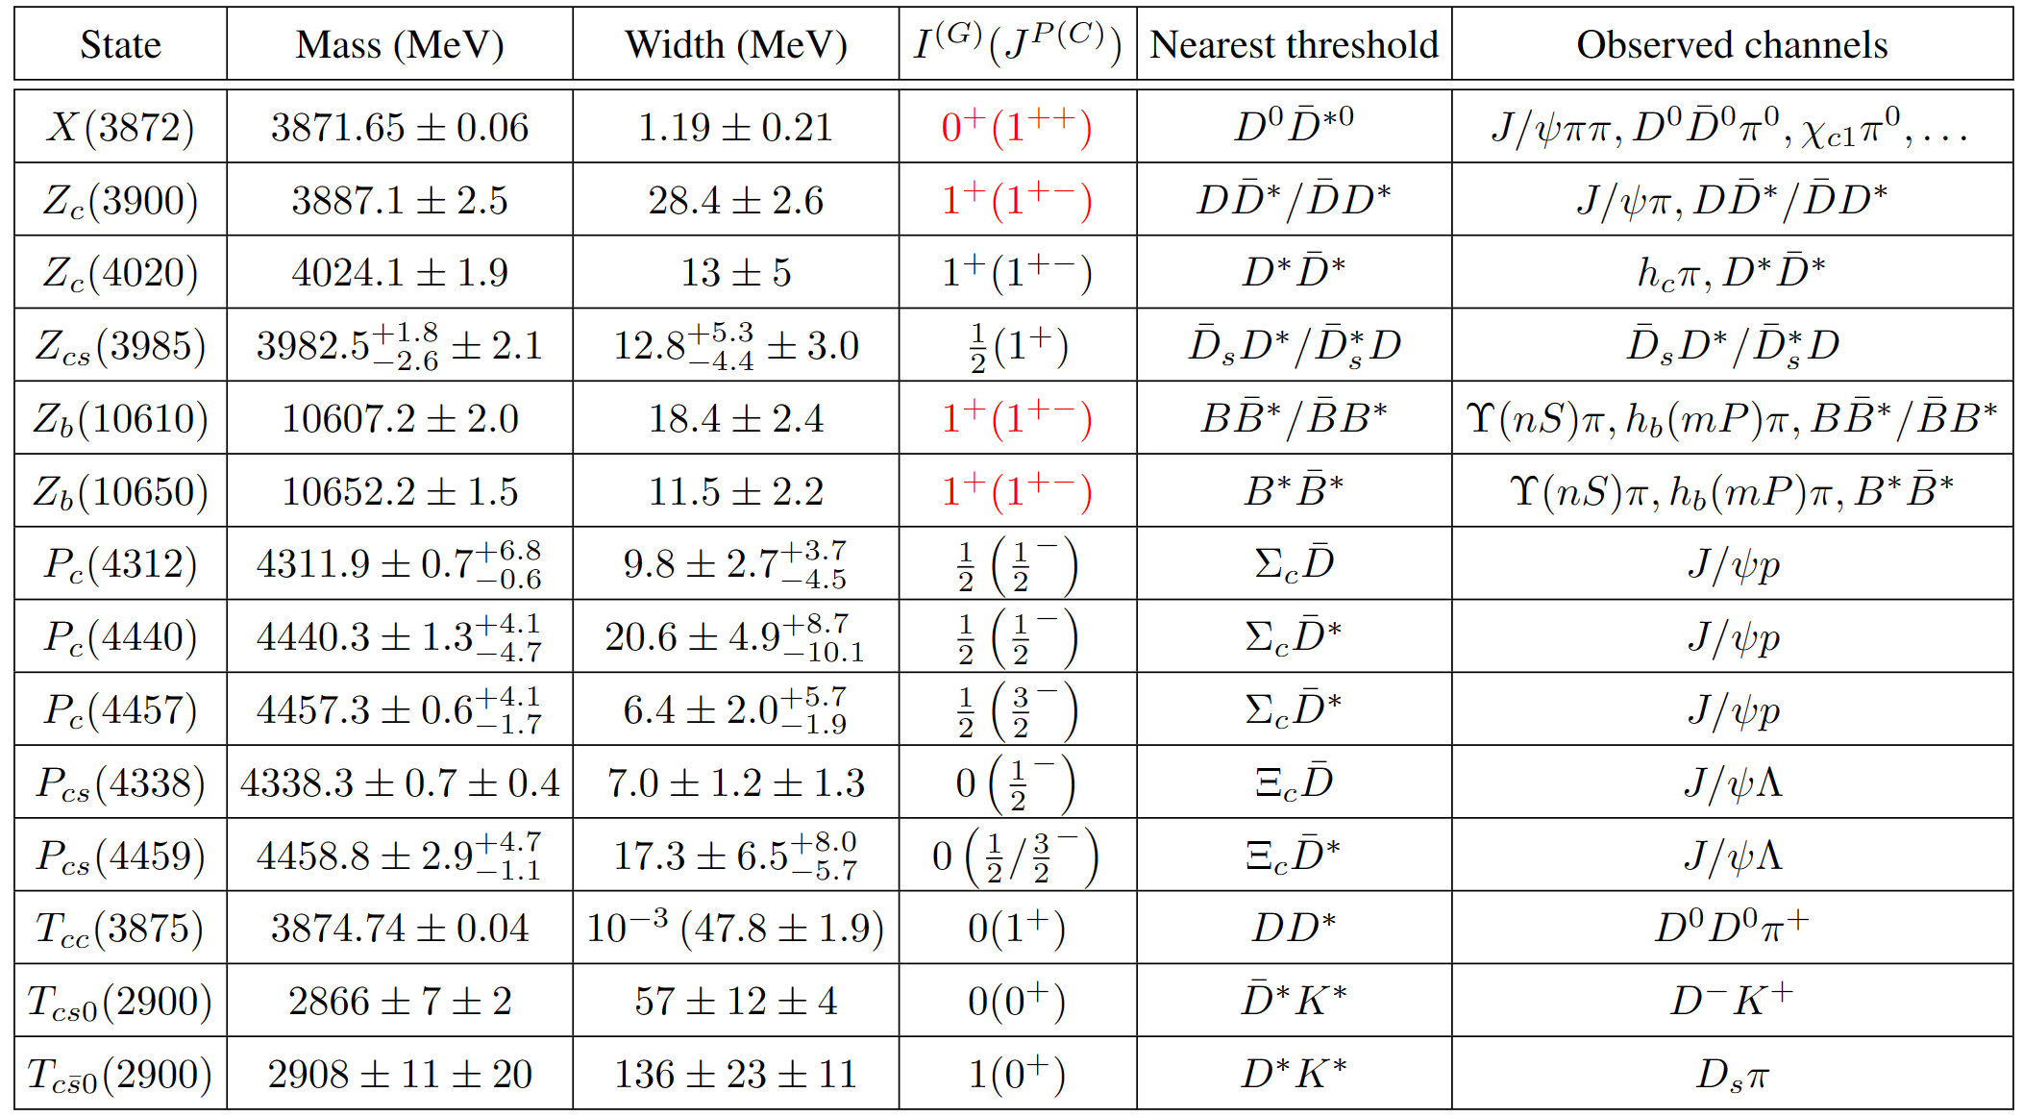
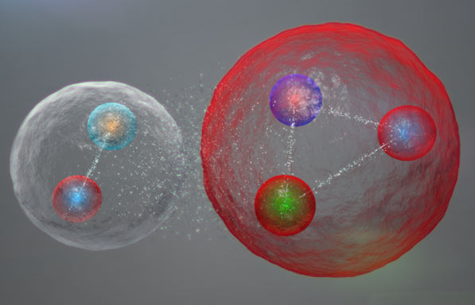
Background and motivation
Exotic hadrons in heavy flavor sectors
For reviews, see:
Phys. Rept. 639, 1 (2016)
Rev. Mod. Phys. 90, 015004 (2018)
Prog. Part. Nucl. Phys. 107, 237 (2019)
Rept. Prog. Phys. 86, 026201 (2023)
Phys. Rept. 1019, 1-149 (2023)

Slide 6


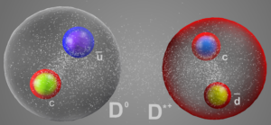
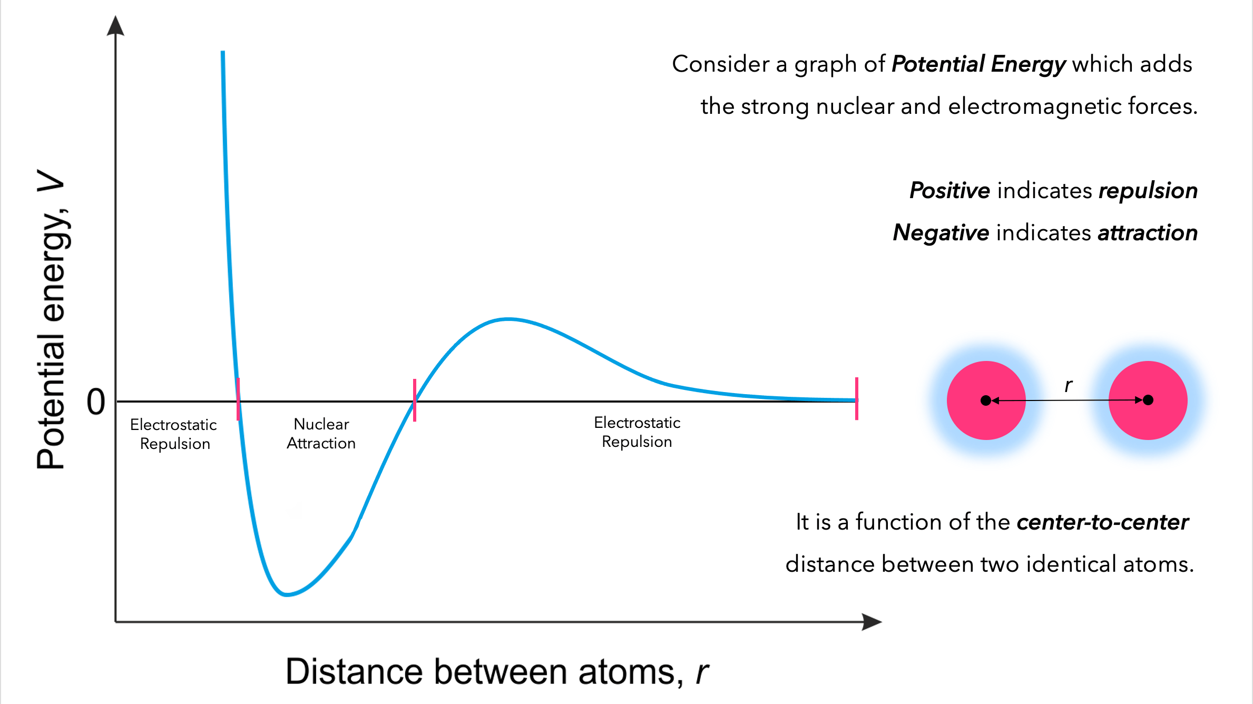


Background and motivation
Fertile soils for the growing of 𝝌EFT
3N force
$N^{5}LO$ potential
nuclei
$N^{2}LO$ potential
mass spectrum
NN phase shift
deuteron
renormalization
transplant
Heavy hadronic molecule spectrum
Nuclear force and abundant exp. data

Slide 7
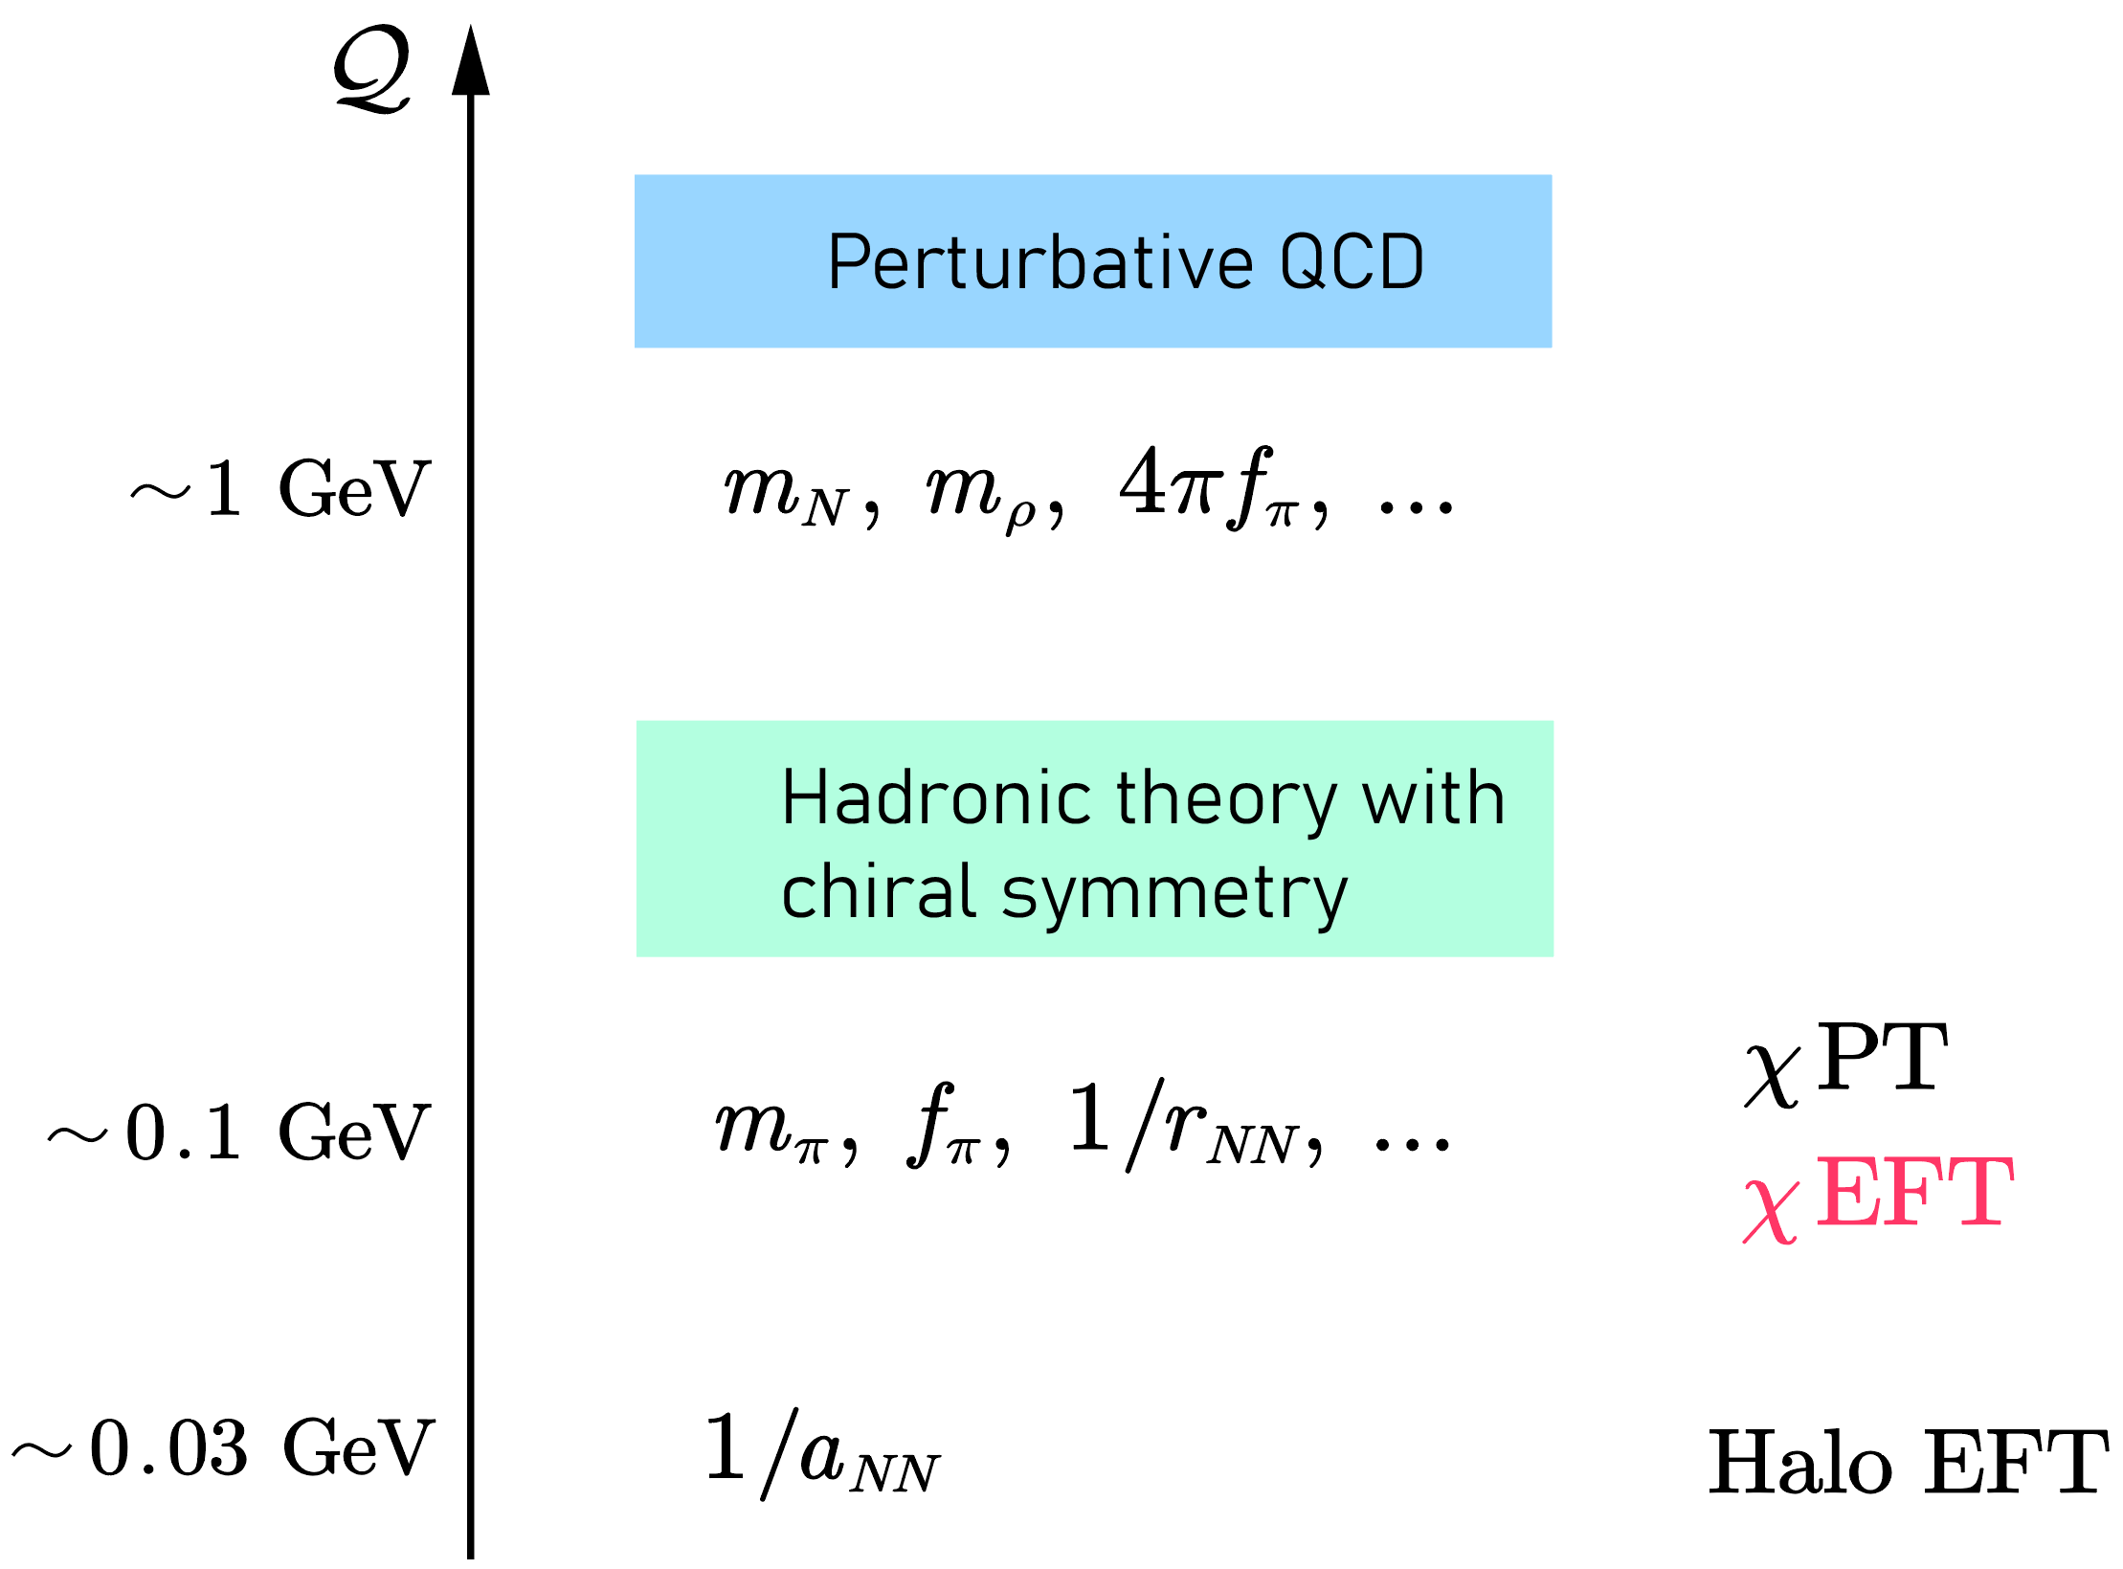
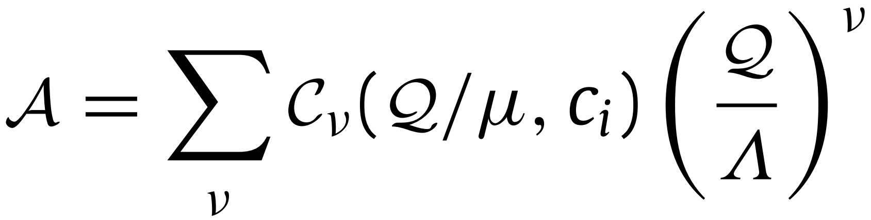


A brief introduction to the 𝝌EFT
Effective field theory (EFT) is designed for systems with widely separated energy scales.
Expansion coefficient at order $ν$
Low energy constants (LECs)
Regularization scale in loop diagrams, e.g.,

Slide 8
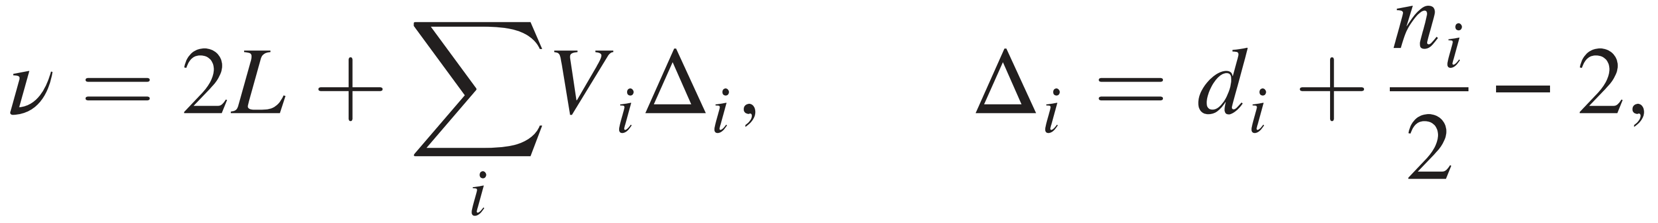
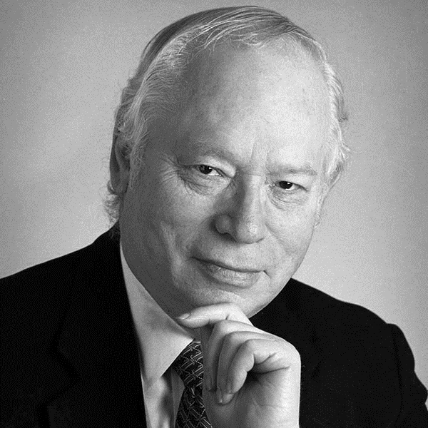




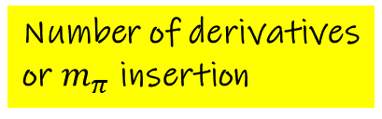
A brief introduction to the 𝝌EFT
Two schemes for $χ$EFT
Kaplan–Savage–Wise (KSW) scheme [Phys. Lett. B 424 (1998) 390–396, Nucl. Phys. B 534 (1998) 329–355]
Weinberg scheme [Nucl. Phys. B 363 (1991) 3–18, Phys. Lett. B 251 (1990) 288–292]:
Expansion order
Number of loops
Number of vertices
with type $i$
Number of heavy
matter fields
Number of derivatives
or $m_{π}$ insertion

Slide 9
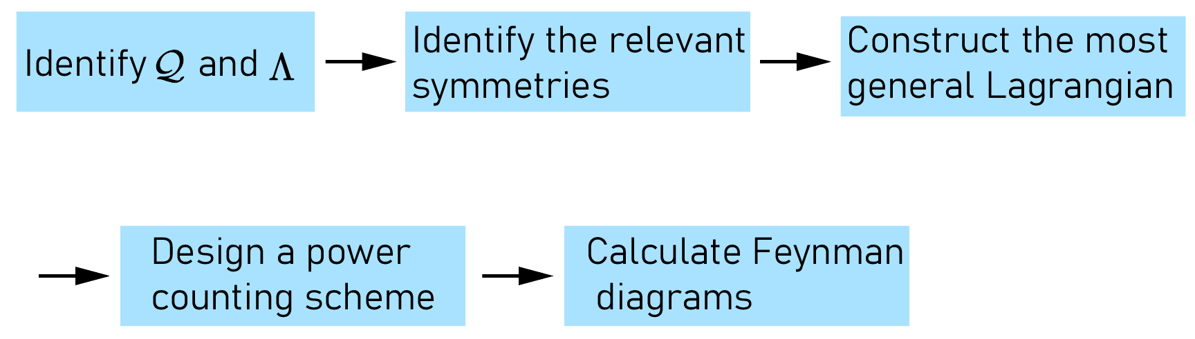
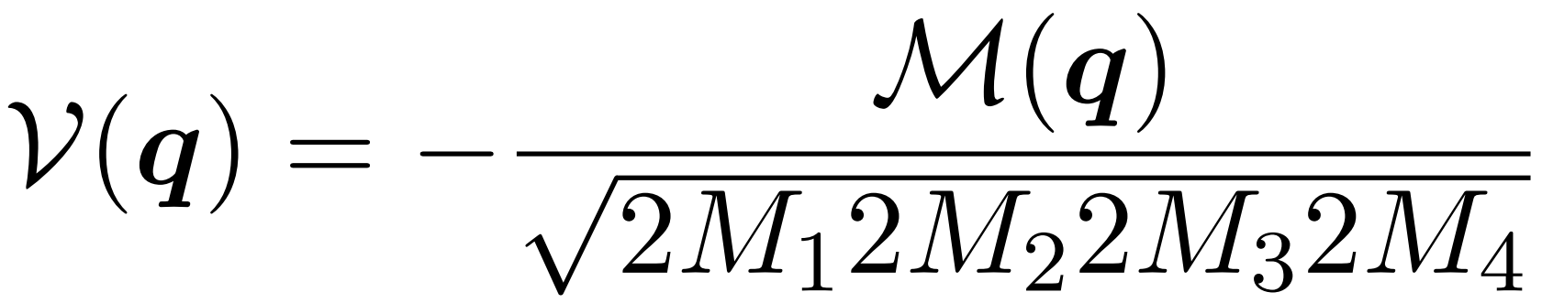
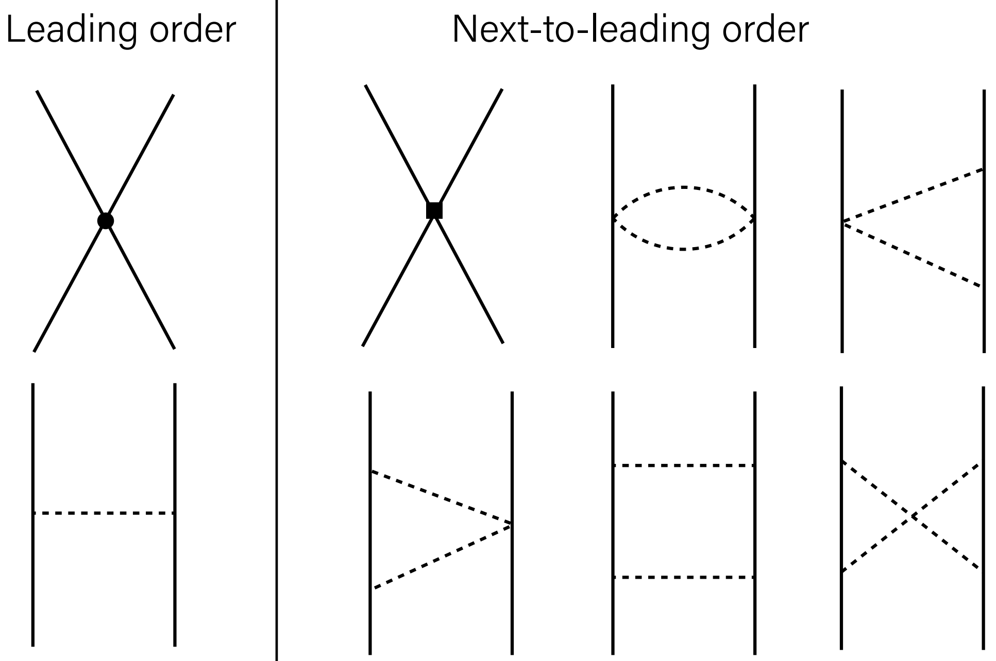
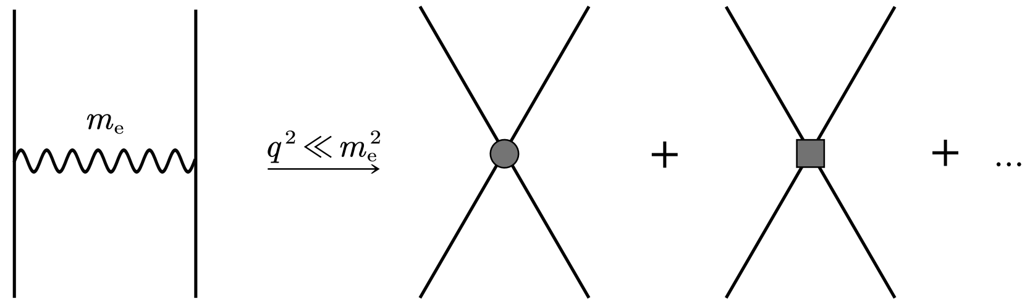


A brief introduction to the 𝝌EFT
Effective potentials in the Weinberg scheme
reducible diagram

Slide 10









Recent applications
Applications of $χ$EFT in heavy-heavy systems
PhysRevD.99.036007
PhysRevD.100.014031
JHEP11(2019)108
PhysRevD.103.L021501
PhysRevD.103.116017
Eur. Phys. J. C 82, 419
PhysRevD.89.074015
PhysRevD.107.094002
$$BB$$
$$B^{(∗)}B^{(∗)}$$
$$Σ_{c}^{(∗)}{\overline{D}}^{(∗)}$$
$$D{\overline{D}}_{s}^{∗}+D^{∗}{\overline{D}}_{s}$$
$Σ_{c}^{(∗)}D^{(∗)}$, ${\overline{D}}^{∗}K^{∗}$
$$DD^{∗}$$
2014
2017
2019
2020
2021
2022
2023
$$DD^{∗}$$
$Σ_{c}N$, $Ξ_{c}^{(′,∗)}{\overline{D}}^{(∗)}$
$D^{\left(∗\right)}N$, $D^{(∗)}{\overline{D}}^{(∗)}$, $B^{(∗)}{\overline{B}}^{(∗)}$
$$Σ_{c}Σ_{c}$$
PhysRevD.99.014027
arXiv: 2204.13316
PhysRevC.101.064002PhysRevD.101.034018
PhysRevD.101.094035
PhysRevD.102.114019
For reviews, see Chiral perturbation theory for heavy hadrons and chiral effective field theory for heavy hadronic molecules, Physics Reports 1019 (2023) 1–149

Slide 11
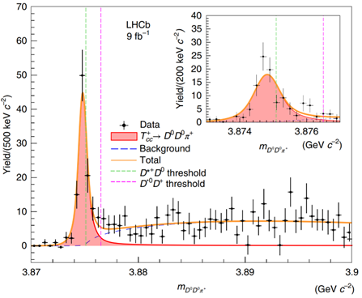
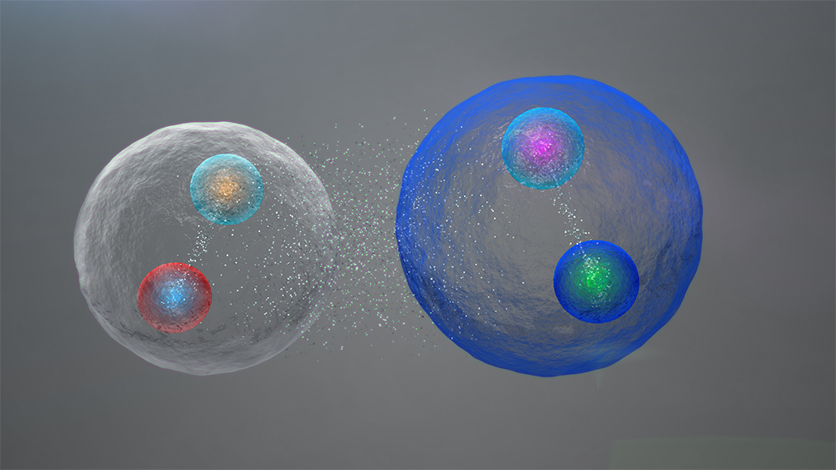



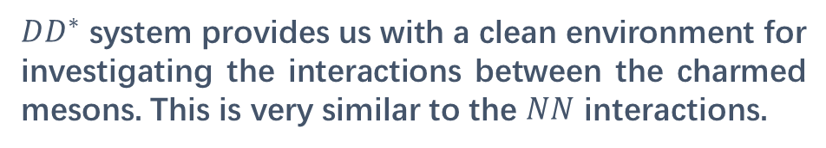



$DD^{∗}$ scattering and $T_{cc}$ state in 𝝌EFT
$$T_{cc}(3875)$$
$$\overline{d}$$
$$\overline{u}$$
$$c$$
$$c$$
Nature Phys. 18 (2022) 7, 751-754
$T_{cc}(3875)$ is a very good candidate of $DD^{∗}$ molecules
For new reviews, see
Phys. Rept. 1019 (2023) 1-149
Rept. Prog. Phys. 86, 026201 (2023)
$DD^{∗}$ system provides us with a clean environment for investigating the interactions between the charmed mesons. This is very similar to the $NN$ interactions.

Slide 12
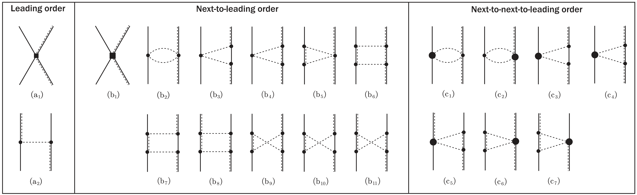
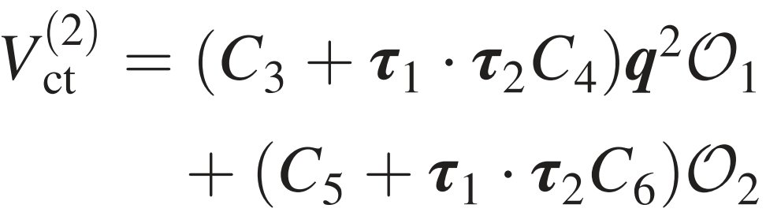
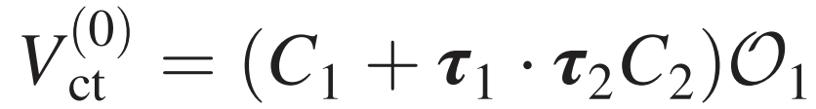


$DD^{∗}$ scattering and $T_{cc}$ state in 𝝌EFT
$DD^{∗}$ potentials are calculated up to the $N^{2}LO$ for the first time
PhysRevD.107.094002

Slide 13
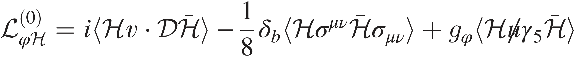
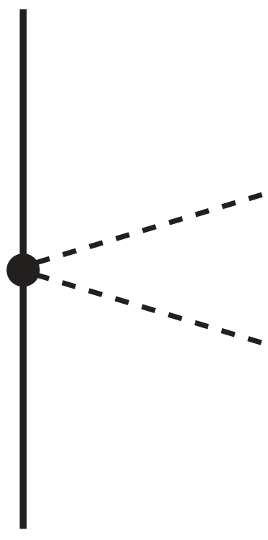

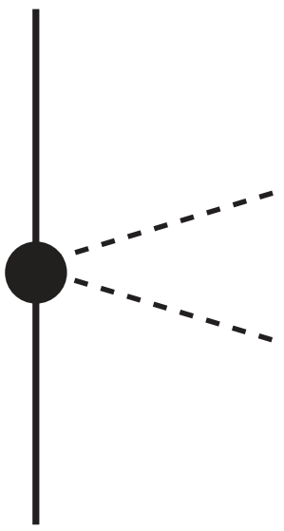
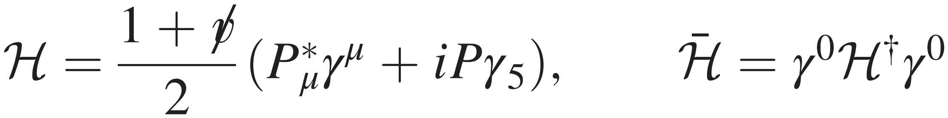

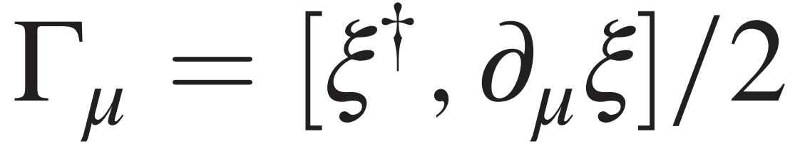
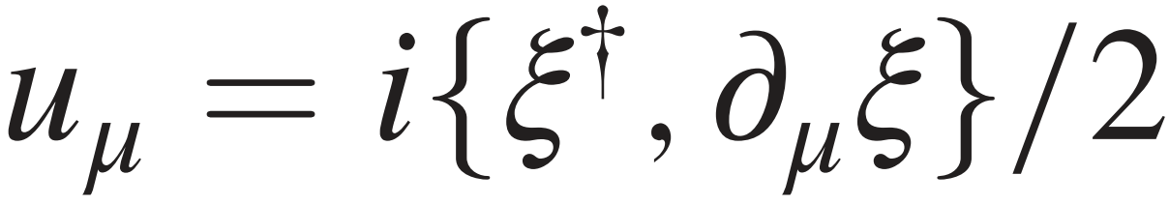
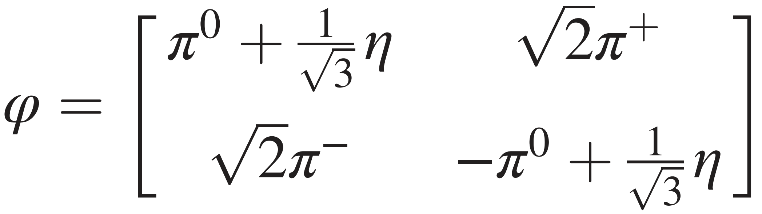
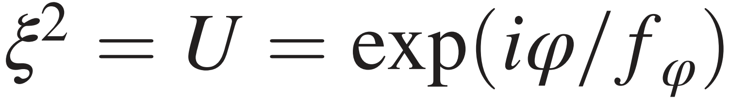
$DD^{∗}$ scattering and $T_{cc}$ state in 𝝌EFT
chiral connection:
axial-vector current:

Slide 14

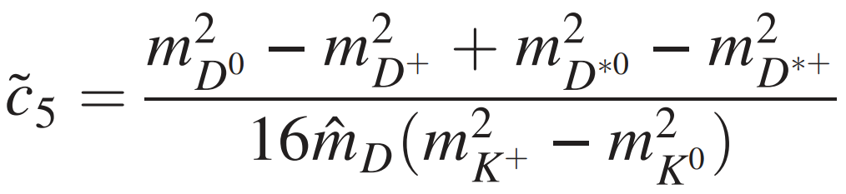
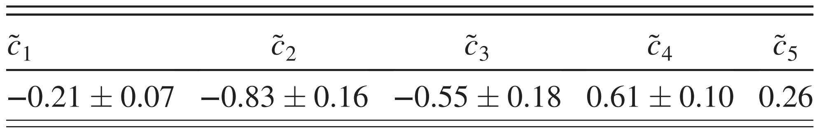

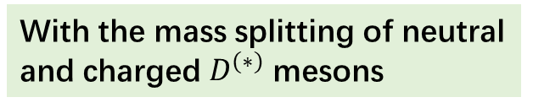


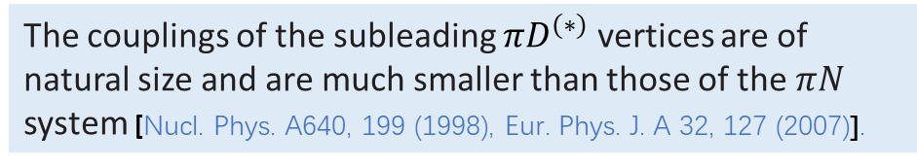

$DD^{∗}$ scattering and $T_{cc}$ state in 𝝌EFT
Determining the subleading $πD^{(∗)}$ couplings
With the $σ$ exchange
With the $ρ$ exchange
With the $D_{0}^{∗}(2300)/D_{1}(2430)$ exchange
With the mass splitting of neutral and charged $D^{(∗)}$ mesons
The couplings of the subleading $πD^{(∗)}$ vertices are of natural size and are much smaller than those of the $πN$ system [Nucl. Phys. A640, 199 (1998), Eur. Phys. J. A 32, 127 (2007)].

Slide 15
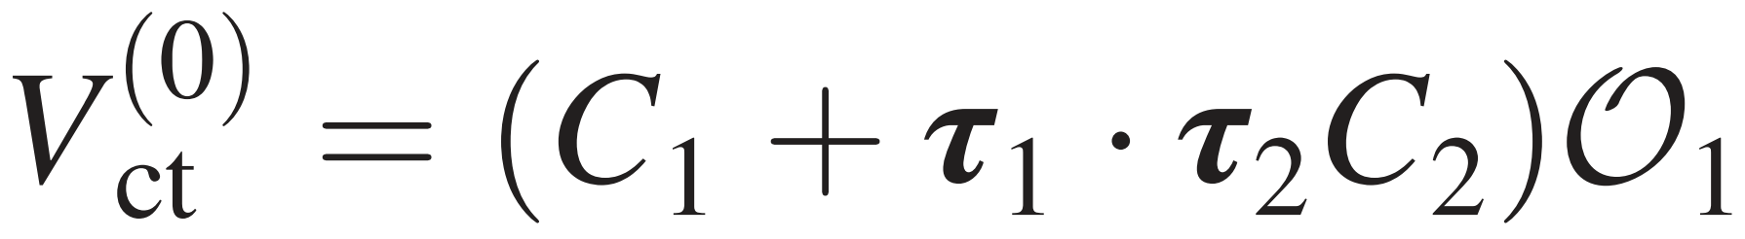
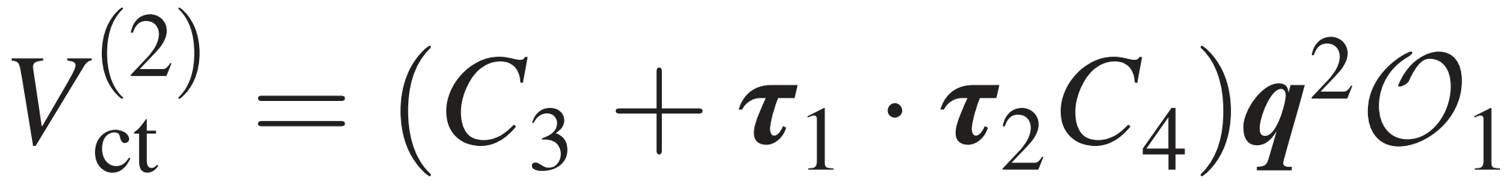
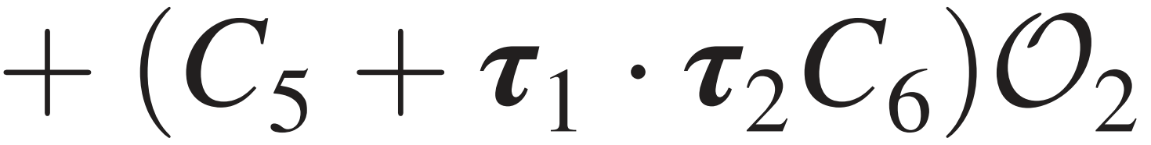
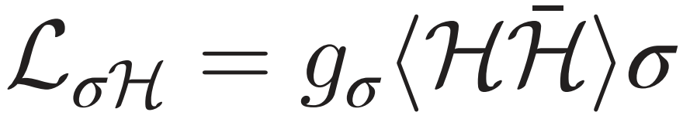





$DD^{∗}$ scattering and $T_{cc}$ state in 𝝌EFT
Determining the LO and NLO LECs
Scalar exchange: $σ, a_{0}, f_{0}$ mesons
Pseudoscalar exchange: $η$ meson
Vector exchange: $ρ, ω$mesons
Axial-vector exchange: $a_{1}, f_{1}$mesons

Slide 16


















$DD^{∗}$ scattering and $T_{cc}$ state in 𝝌EFT
Long-range OPE interaction
$$D^{∗}$$
$$D$$
split into central+tensor terms
$$D$$
$$D^{∗}$$
OPE interaction dominates at
an artifact arising from the idealized point-like $πD^{(∗)}$ coupling
$δ(r)$ in coordinate space
T. E. O. Ericson and W. Weise, 《 Pions and Nuclei 》, 1988
subtraction scheme in [Eur. Phys. J. A 54, 86 (2018)]

Slide 17







$DD^{∗}$ scattering and $T_{cc}$ state in 𝝌EFT
Intermediate-range TPE interactions (NLO)

Slide 18




$DD^{∗}$ scattering and $T_{cc}$ state in 𝝌EFT
Intermediate-range TPE interactions ($N^{2}LO$)

Slide 19




$DD^{∗}$ scattering and $T_{cc}$ state in 𝝌EFT
Local momentum-space (LMS) regularization
The subtraction terms and are determined with the requirements:

Slide 20






$DD^{∗}$ scattering and $T_{cc}$ state in 𝝌EFT
TPE potentials in the coordinate space
With the residue theorem
same with that of the lattice QCD result PhysRevLett.131.161901
slightly different than that of NN Nucl. Phys. A625, 758 (1997)

Slide 21






$DD^{∗}$ scattering and $T_{cc}$ state in 𝝌EFT
Comparisons between dimensional and LMS regularizations
$Λ=$400 MeV
$Λ=$ 550 MeV
$Λ=$ 700 MeV
$Λ=$ 800 MeV
$Λ=$ 900 MeV

Slide 22






$DD^{∗}$ scattering and $T_{cc}$ state in 𝝌EFT
Central potentials up to the $N^{2}LO$
very weak due to the
suppression of $u_{π}^{2}$

Slide 23





$DD^{∗}$ scattering and $T_{cc}$ state in 𝝌EFT
The convergence of chiral expansion
The convergence of expansion with $χ$EFT in $DD^{∗}$ systems is very good!

Slide 24








$DD^{∗}$ scattering and $T_{cc}$ state in 𝝌EFT
Pole trajectory of the $DD^{∗}$ bound state
Mass and width of the $T_{cc}$ state
Pole trajectory of the $DD^{∗}$ bound state in the physical
Riemann sheet with the change of cutoff $Λ∈[520, 600]$MeV
Nat. Commun. 13, 3351 (2022)
S-D wave coupling
Considering the effective width of $D^{∗}, Γ\left[D^{∗}\right]∼50$ keV
The pole appears when $Λ ≈ 520$MeV, and the pole mass approaches the experimental value when $Λ ≃ 560$ MeV

Slide 25

Summary and outlook
$χ$EFT is a powerful tool for the nuclear physics and hadron physics.
Nuclear forces and exotic hadrons provide the fertile soils for the growing of 𝝌EFT.
The transplant of $χ$EFT to the heavy-heavy systems is also very successful.
The $DD^{∗}$ chiral potentials are calculated up to the $N^{2}LO$ for the first time.
Our calculation supports the $DD^{∗}$ molecular explanation of $T_{cc}{\left(3875\right)}^{+}$ state.
From the special nuclear force to the general nuclear force?
Thanks!

