Slide 1
Laser test for TaichuPix3 FLEX BOARD
Tianya Wu，Xiaomin Wei，Wei Wang
wuty@ihep.ac.cn
2023.06.29

Slide 2
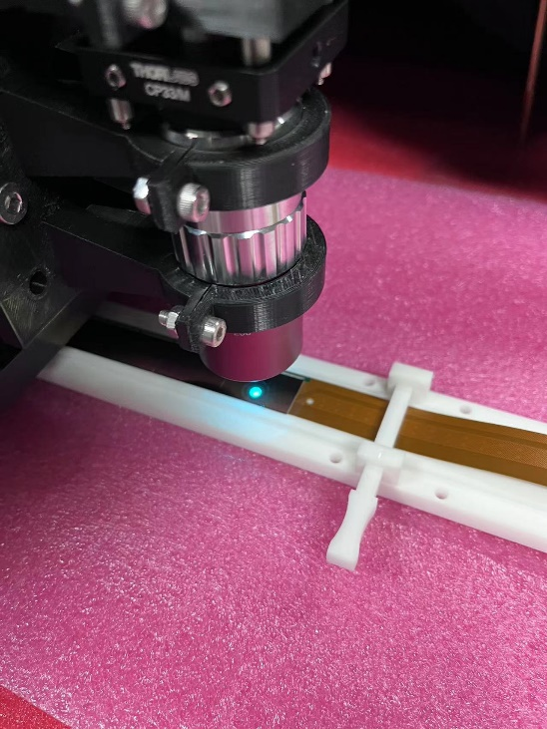
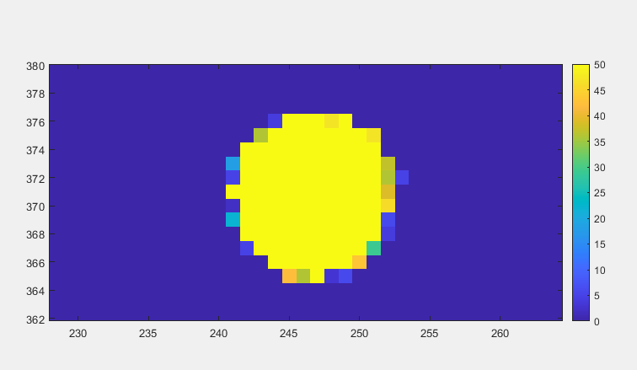
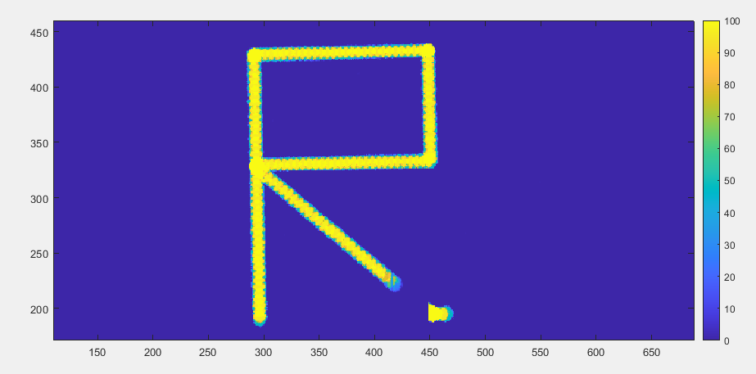
Setup
U10 –U6 are turned on
ITHR is set to 11111000
Laser scans on chip U9 with a step of 50 µm
Current is 0.479A&0.278A
Only configuring U9, then Current goes to 0.476A&0.078A

Slide 3
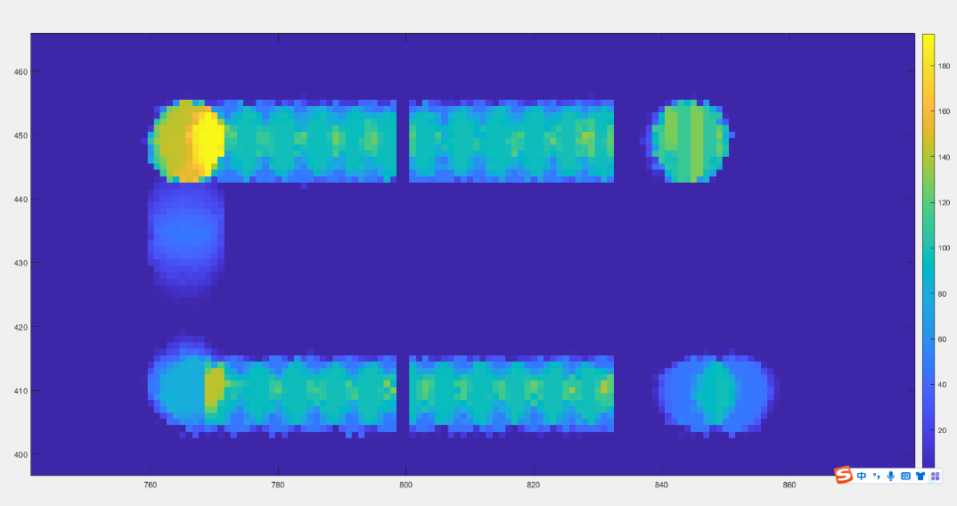
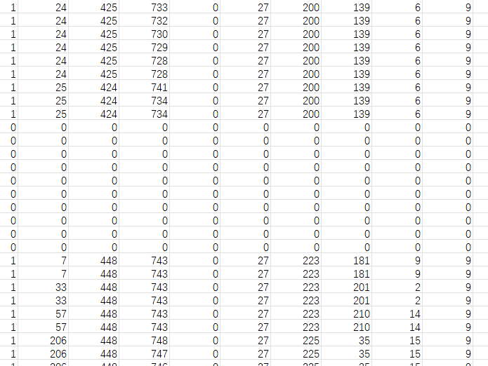
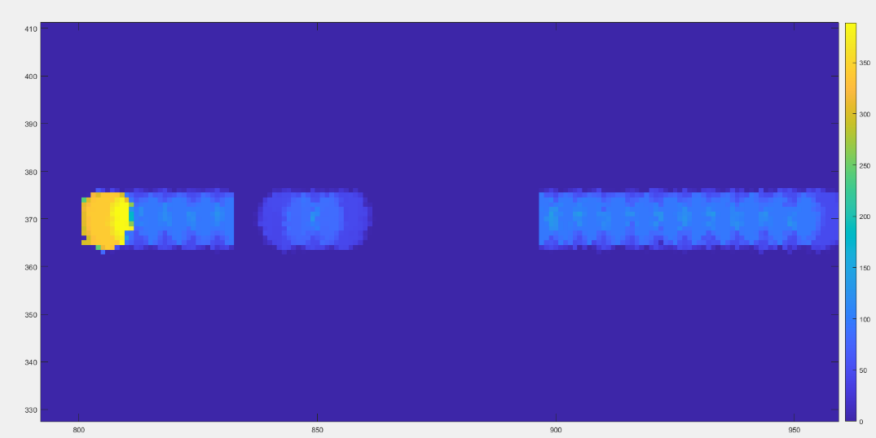
Data lose

Slide 4
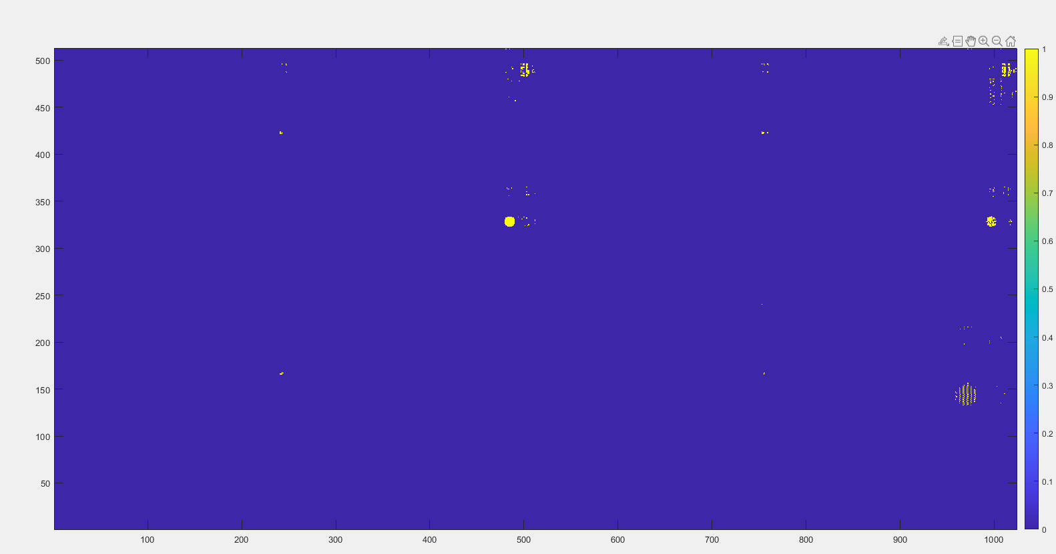
Ghost hit
Set position
Ghost hit
Data output when
Valid=0

Slide 5
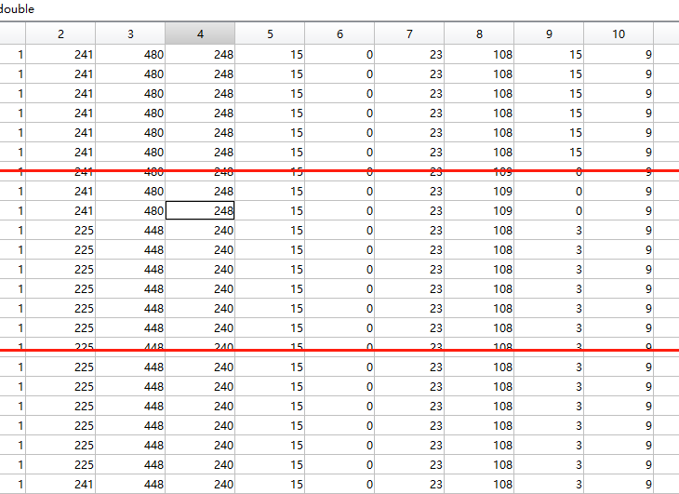
ENTP mode
ENTP is used to generate fixed pattern to serializer
20 MHz Clock has error data
15.625 MHz is stable
When register “11000” set to “00001111”
The 32bit data was readout with:
“1111 0000 1111 0000 0000 1111 0000 1111”
When register “11000” set to “00000000”/“11111111”；both of situations have the same results:
“1111 1111 1111 1111 0000 0000 0000 0000”
“1111 0000 1111 0000 0000 1111 0000 1111”
“1111 1000 1111 0000 0000 1111 0000 1111”
“1111 1000 0111 1000 0000 0111 1000 1111”

Slide 6
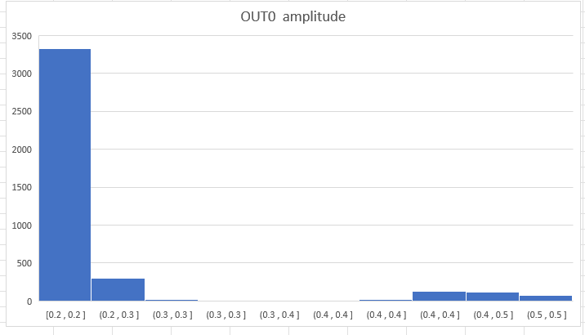
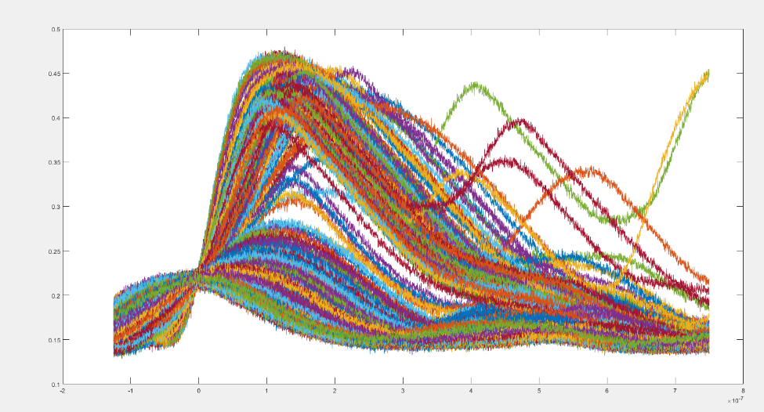
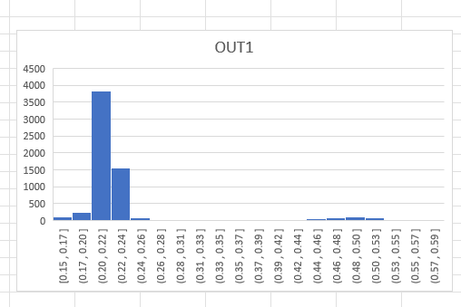
Fe55 test
ITHR set to 11100 with TCX2
Most of amplitude is around 50 mV

Slide 7
Thanks for your attention!

