Slide 1






The quantum computing and it’s application
Zhiguang Yan (闫智广)
zhiguang.yan@riken.jp
日本理化学研究所 (RIKEN)
2023 5 21

Slide 2
Contents
01
The classical & quantum computing
02
Quantum algorithms and applications
03
Physical platforms to realize the quantum computing
04
Open questions & discussions

Slide 3
Contents
01
The classical & quantum computing
02
Quantum algorithms and applications
03
Physical platforms to realize the quantum computing
04
Open questions & discussions

Slide 4
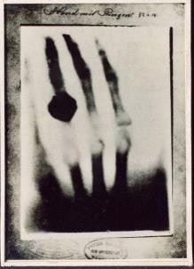
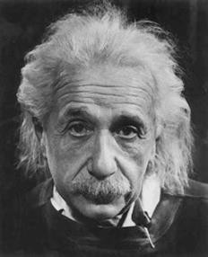
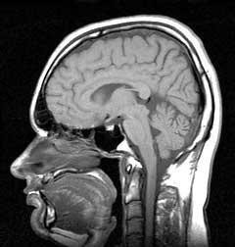
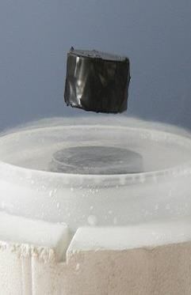




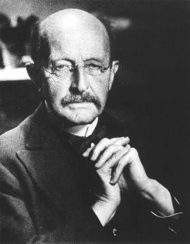
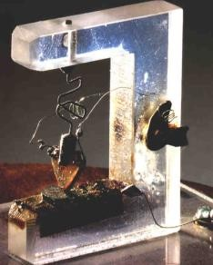
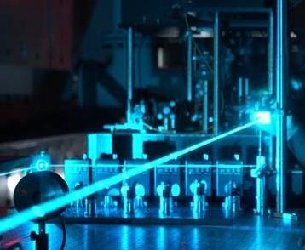



The first quantum revolution
Classical technology developed based on quantum mechanics
1895
X-ray, nuclear power
1905
Einstein proposed the concept of light quantum
晶体管
1946
NMR was found
晶体管
1986
High temperature superconductivity was
discovered
1900
Planck's Quantum Theory
1916
lasers were discovered
1947
transistor
1988
giant magnetoresistance

Slide 5
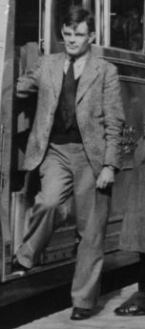
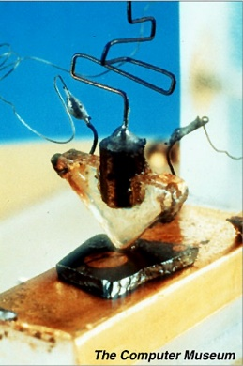
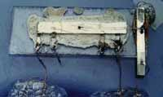
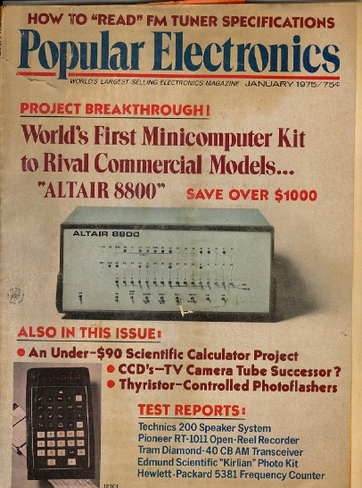
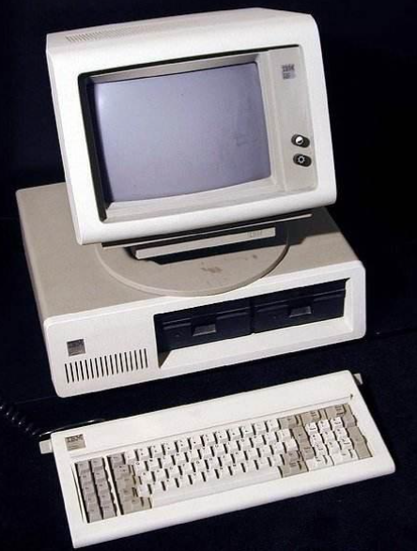
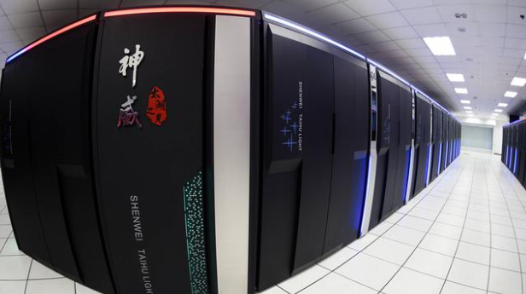
1936- Alan Turing: <<On computable numbers, with an application to the Entscheidungs problem>>
1947- First transistor
1958- First integrated
circuit
1975- Altair 8800
Till now

Slide 6

Why quantum computing?
What’s the limitation of the classical computing
How can quantum computing beyond the limitation of classical computing

Slide 7
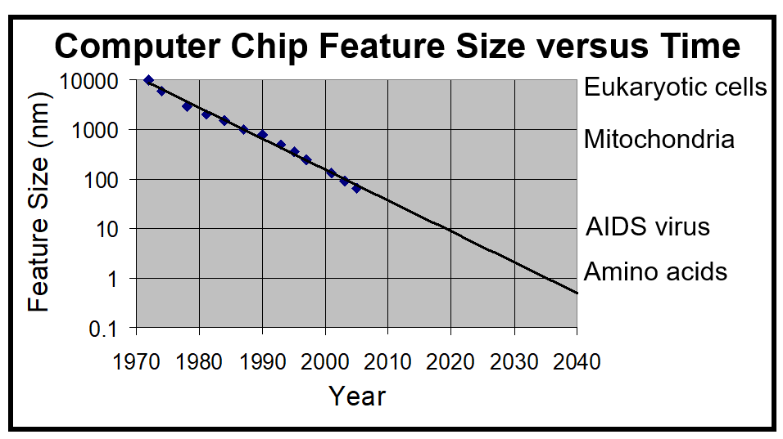
Moore’s Law
This is the End?
How do machines of atomic size operate?
Classical computer meet its limitation where quantum theory is need

Slide 8
The imbalance : computing power demand / computing power growth
AI and machine learning (ML) - AI has more than 100 billion parameters, the training of AI is very energy consumption (a lot of money and low efficiency)
Financial modeling - two many parameters and data, it’s hard for classical computer to construct a model to process so many data to find the optimization parameters.
Route and traffic optimization & disordered database search problem (large database)
Manufacturing. Quantum computers can run more accurate and realistic prototyping and testing. In the manufacturing space, this could help reduce the cost of prototyping and result in better designs that don't need as much testing.
Drug and chemical research - classical computing is hard to analysis the many-body quantum system
Batteries -
……

Slide 9
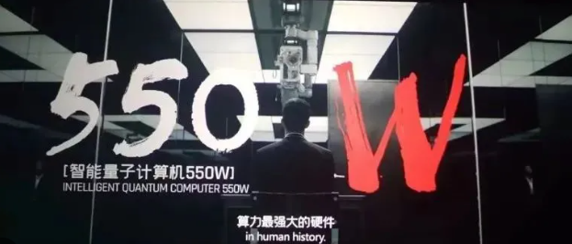
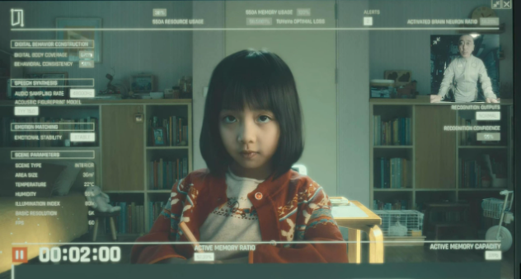

The Wandering Earth
Artificial intelligence / Digital life
Optimize resources to build planetary engines

Slide 10
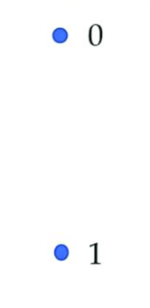
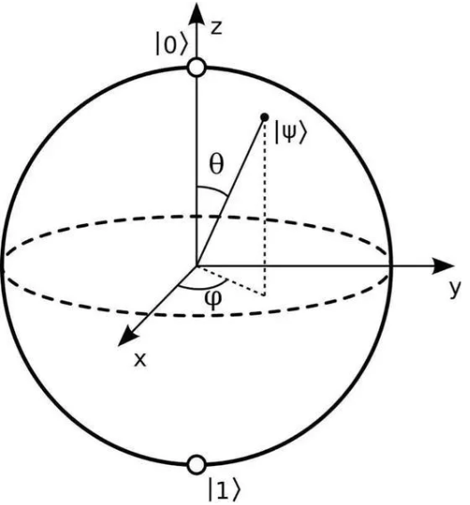
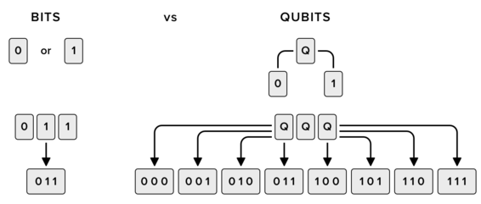


The difference and relationship between classical computing and quantum computing
Either 0 or 1
$$|Ψ> =e^{iφ }(α |0> +β |1>)$$
Classical bit
Quantum bit
If your computer memory is 8 GB (8⋅2^30 = 2^33 bytes), you’re able to emulate a quantum computer with no more than 33 qubits.
Then, for 60 qubits, we need $2^{27}$ 8GB classical computers. (more than one billion)
Storage& memory

Slide 11
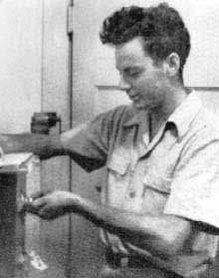
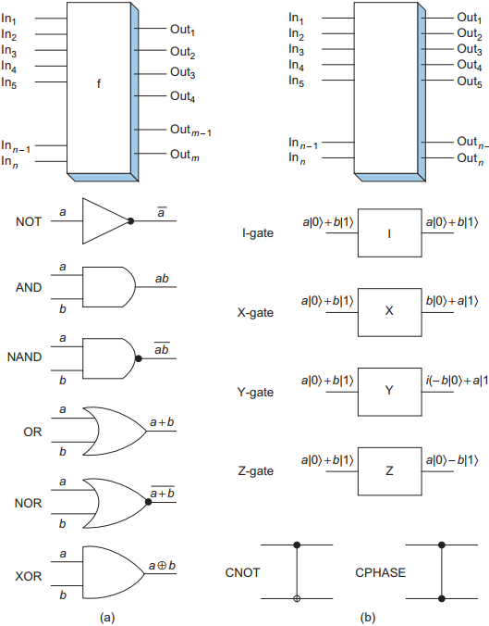
Richard
Feynman
“Can Quantum Systems be Probabilistically Simulated by a Classical Computer?”
Classical computer
Quantum computer

Slide 12
Contents
01
The classical & quantum computing
02
Quantum algorithms and applications
03
Physical platforms to realize the quantum computing
04
Open questions & discussions

Slide 13
Quantum algorithms
QAOA - Quantum approximate optimization algorithm
Deutsch-Jozsa - a designed algorithms to prove quantum computing has exponential speed up compared to classical algorithm
Grover search algorithm
HHL - widely used in Ai training model
Quantum Walk - Search algorithm and universal quantum computing
Quantum annealing algorithm - optimization
Shor - large prime factorization
VQE - eigenstate calculation of quantum system
Analogy quantum simulation
……..

Slide 14
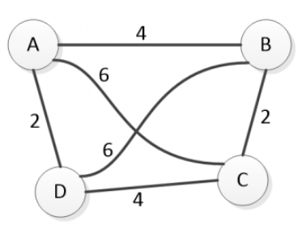


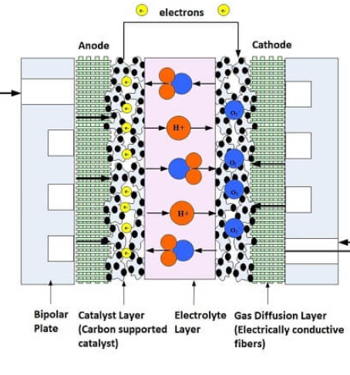

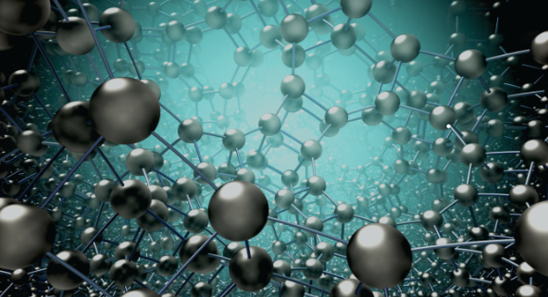
Grover search algorithm
Search & Optimization
traveling salesman problem
Large database search
Cryptanalysis
Machine learning
Quantum chemistry
Battery design

Slide 15
Problem: How to found the data we want in a large disorder database
( One may need to try all the possibilities to found the final solutions)
Suppose we have N data, the probobility to found one data by classical ways:
1 : 1/N
2: (N-1)/N * 1/(N-1) = 1/N
….
N: (N-1)/N * (N-2)/(N-1) * ……*1/2 = 1/N (no difference for all the data)
The mean steps we can found the solution (one special data) is int((1+N)*N/2*1/N) = int((1+N)/2) -
So, this means if the size of the database is exponential increased, with the current classical search algorithm we also need exponential increased time!
O(N)

Slide 16
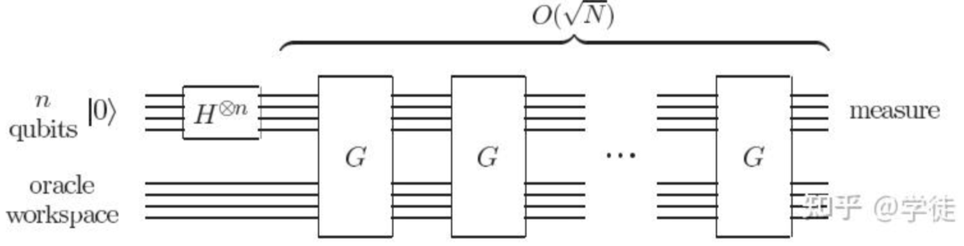
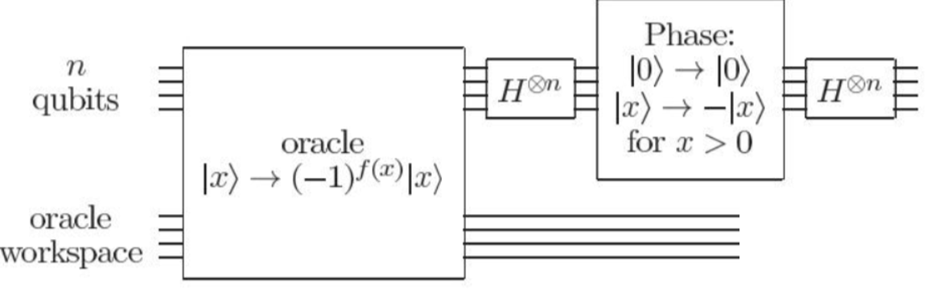
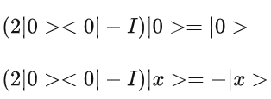




How Grover algorithm works to solve this problem :
$$2^{n}=N$$
16

Slide 17
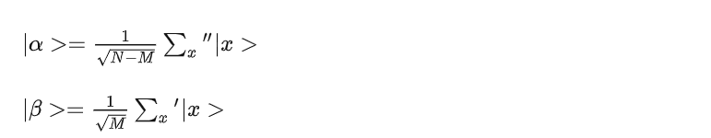

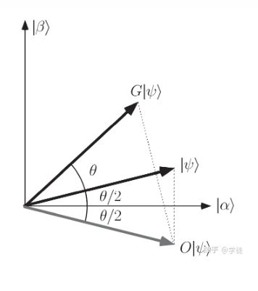






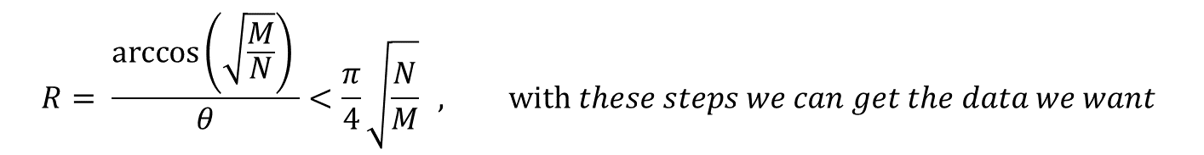
$$β is the solution$$
Imaging !
$$R= \frac{arccos\left(\sqrt{\frac{M}{N}}\right) }{θ}<\frac{π}{4}\sqrt{\frac{N}{M}} , with these steps we can get the data we want⁡$$
O(√N )

Slide 18
Similar way to realize quantum computing speedup is Shor algorithm, quantum HHL algorithm, … and so on
Based on gate based quantum operation

Slide 19
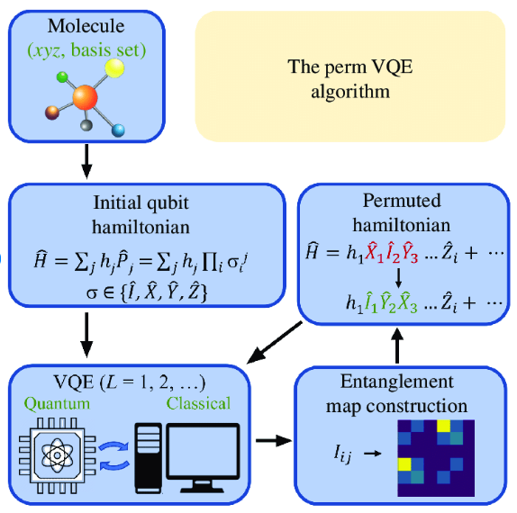
VQE algorithms

Slide 20
Contents
01
The classical & quantum computing
02
Quantum algorithms and applications
03
Physical platforms to realize the quantum computing
04
Open questions & discussions

Slide 21

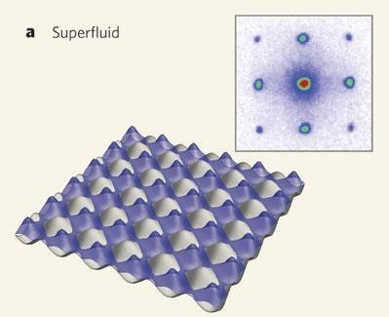
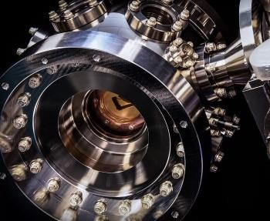
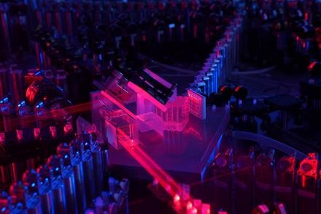
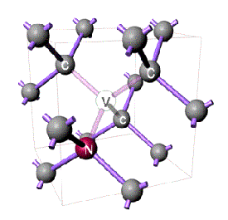
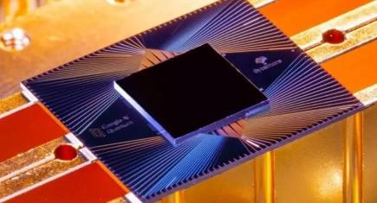
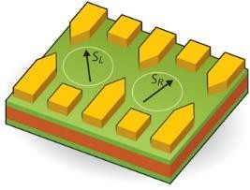
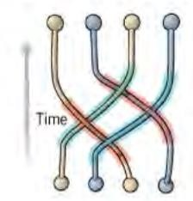
Physical realization of quantum bits
Natrue particles
Utracold atoms
Ion trao
optical
lattice defect
N-V center
Collective
excitation
Superconducting qubits
Quantum dots
Topological Quantum Computing

Slide 22
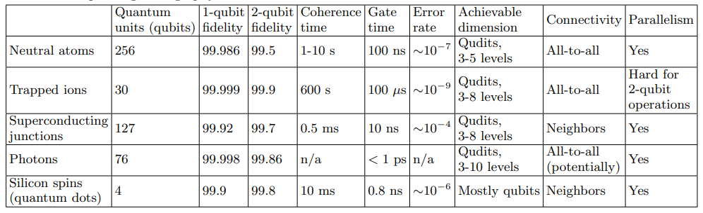
Fedorov, A. K., et al. "Quantum computing at the quantum advantage threshold: a down-to-business review." arXiv preprint arXiv:2203.17181 (2022).
Shi, X. Quantum logic and entanglement by neutral rydberg atoms: methods and fidelity. Quantum Science and Technology (2021)

Slide 23
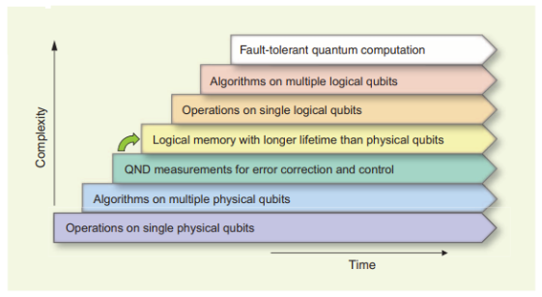

M. H. Devoret R. J. Schoelkopf Superconducting Circuits for Quantum
Information: An Outlook.Science339,1169-1174(2013)
Scalability : 1000 physical qubits = one logical qubit (superconducting qubit)
Chip level scalability - package, modular, optimized chip structure
Fridge level scalability - current cooling technology can not meet the need
Control level scalability – very hard problem, no solvable methods now
Longer coherence time (new design + material engineering)
Higher readout fidelity (Cryo-engineering + new readout technology)
Developing more efficient code for quantum error correction
Challenge in the superconducting quantum computing

Slide 24
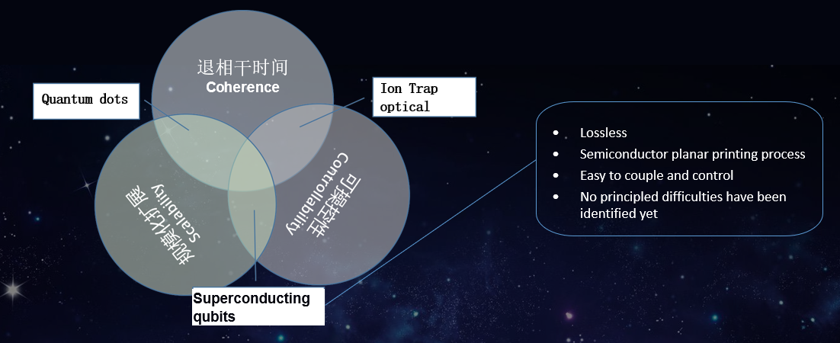

Slide 25
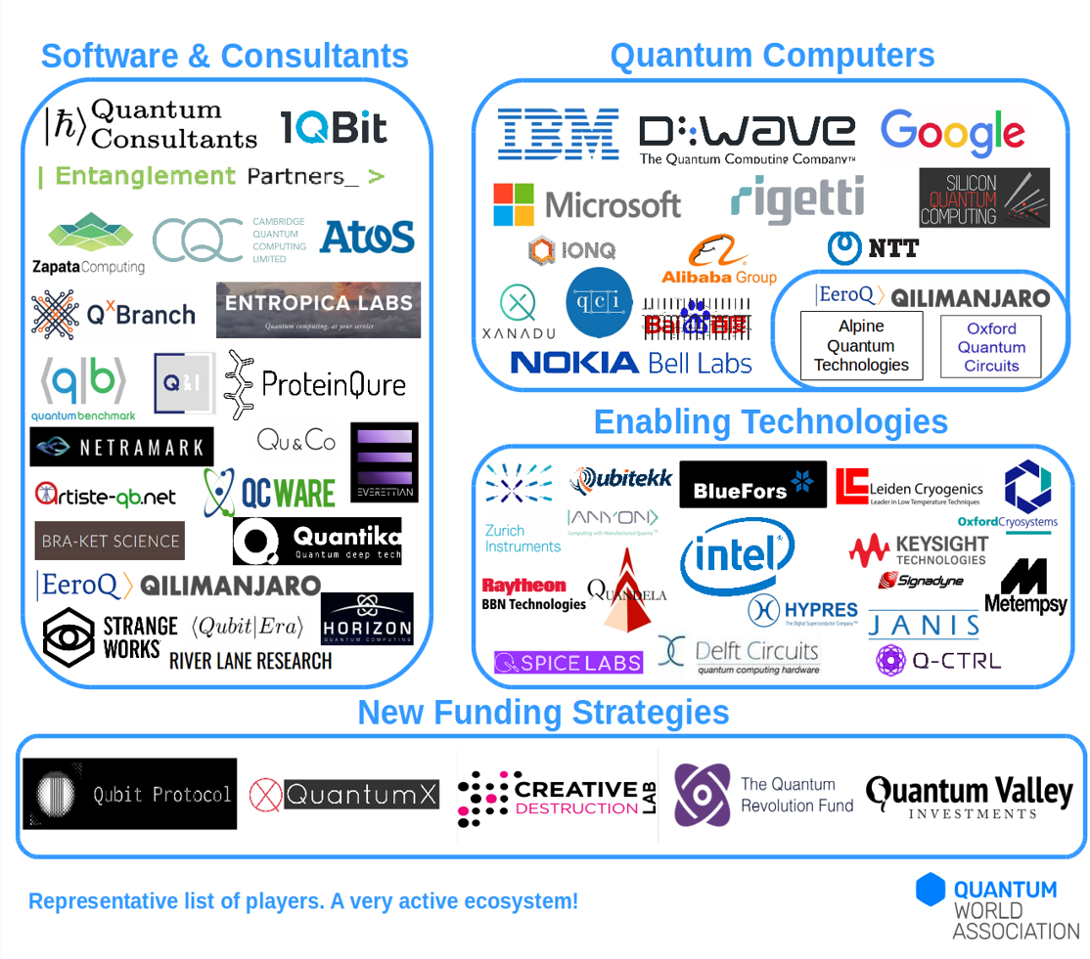
Quantum computing has made impressive strides in recent years, but building practical quantum computers is still a significant challenge

Slide 26
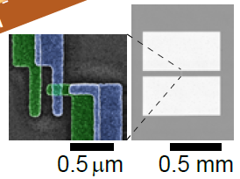


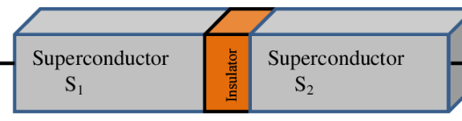





Superconducting qubit – nonlinear resonator
LC resonator
Josephson junction resonator
Josephson junction = nonlinear inductor
anharmonicity ⇒ effective two-level system
energy
inductive energy = confinement potential
charging energy = kinetic energy ⇒ quantized states

Slide 27
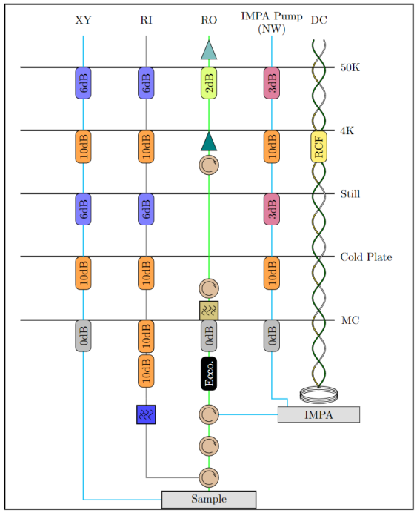
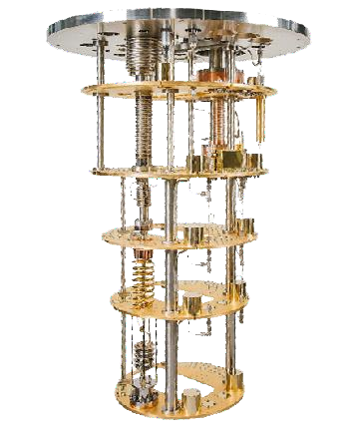
50K
Even single photo leakage can totally destroy our qubits
4K
1K
100mK
10mK

Slide 28
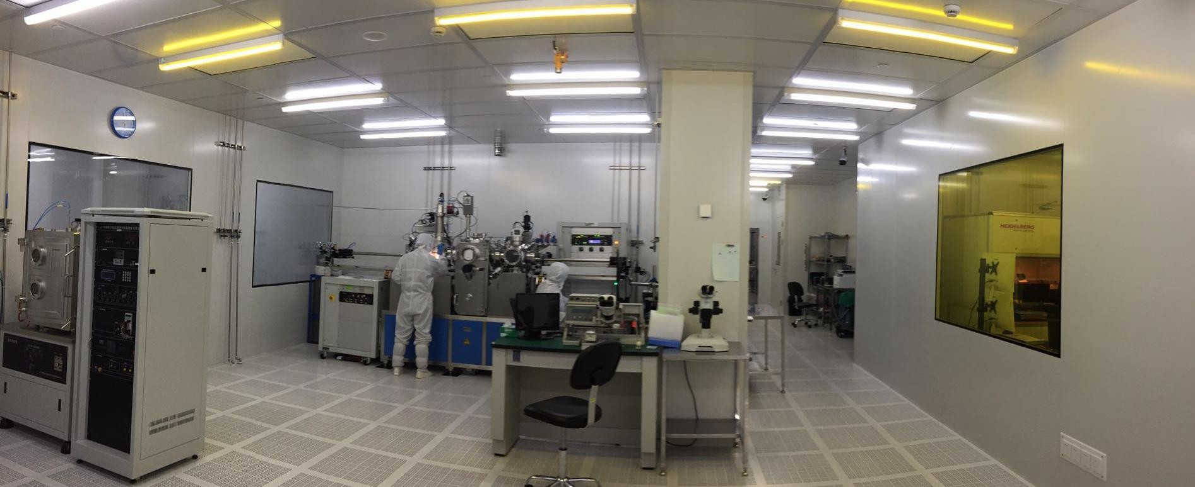
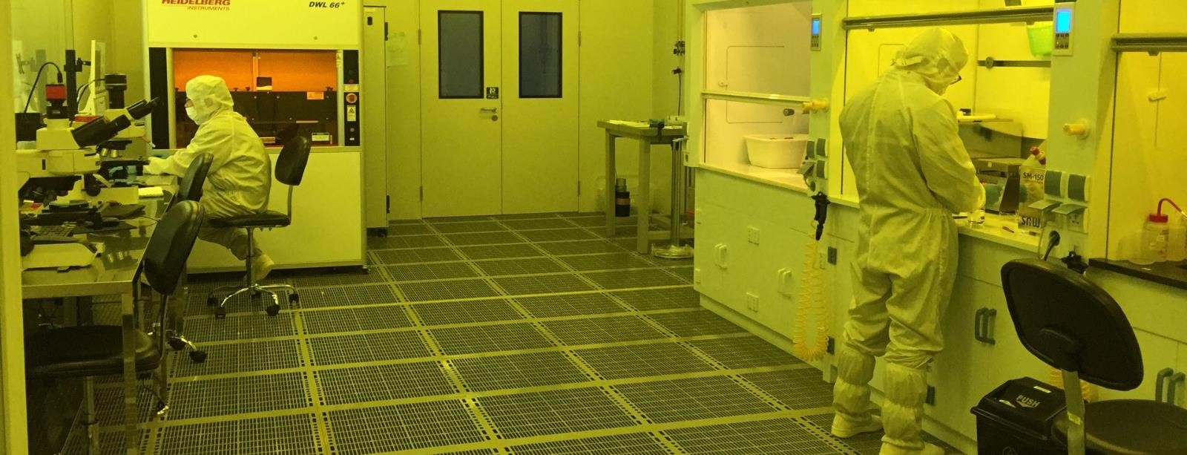
evaporator, exposure, etching,……

Slide 29
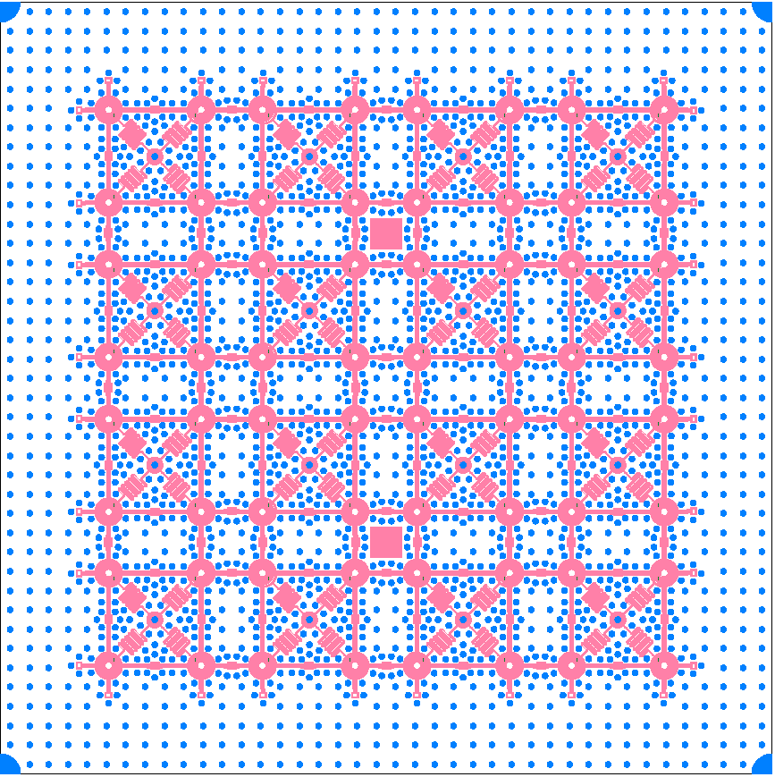
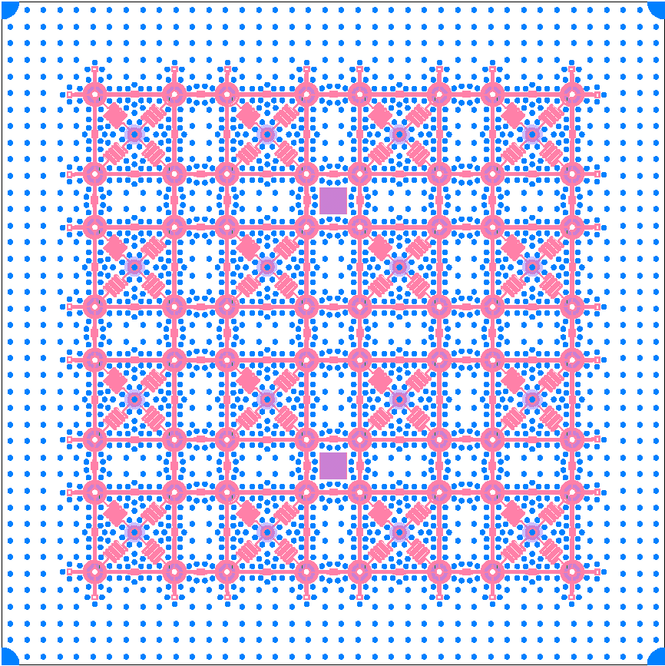




2D integrated quantum circuits
8×8＝64 qubits chip
Readout resonator
Qubit
Flip-chip cover
1 mm
20 mm × 20 mm

Slide 30










Integrated qubits:
World-wide activities
Till Now:
IBM : 443
Google: 72
UCSB: 56
BIOQR: 144
RIKEN: 64
Data qubits
Syndrome qubits

Slide 31
Contents
01
The classical & quantum computing
02
Quantum algorithms and applications
03
Physical platforms to realize the quantum computing
04
Open questions & discussions

Slide 32
what kind of problems can quantumcomputer solve, and it's limitation?
2. What final practical quantum computer be like?
3. Is quantum computing theoretically possible?

Slide 33

What problems can quantum computer solve?
P = NP?
P: Problems solvable in polynomial time
NP: Problems verifiable in polynomial time
NPC: Hardest problems in NP
Maybe also hard for quantum computer
Quantum computer solvable

Slide 34
What final practical quantum computer be like?
Hybrid / one of them win / all of them win in some applications

Slide 35
Is quantum computing theoretically possible?
Currently, the limitation in theory is unknow. But be careful that:
microscopic
Unknow
macroscopic

Slide 36


Slide 37

THANK YOU

