Slide 1
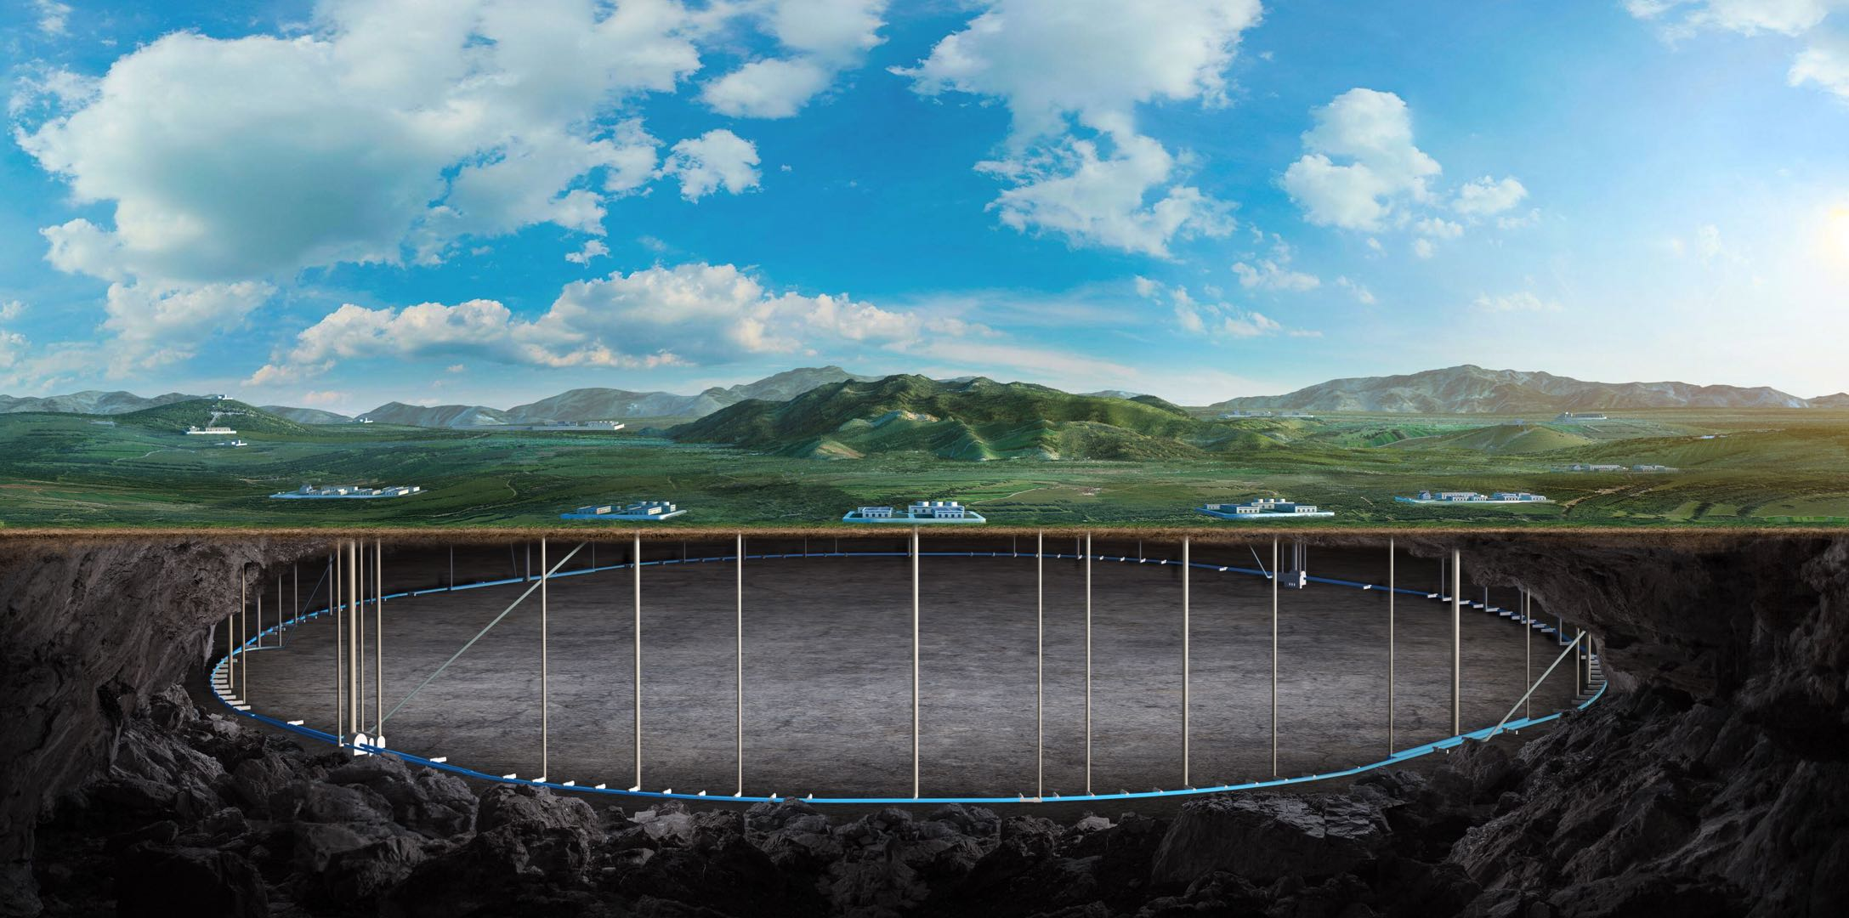
Study plan and status for the CEPC collimation
Yuting Wang
Contributors:
G.Y. Tang, H.Y. Shi, H.J. Wang, X.H. Cui, D. Wang, Y.H. Li, et al.
2023 CEPC DAY, July 13 2023

Slide 2
Content
Motivation
Method for simulation studies
Preliminary arrangement of the global collimators
Current simulation studies
Summary

Slide 3
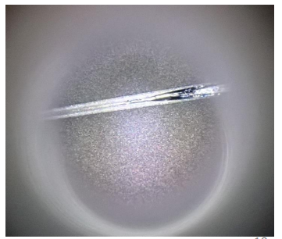
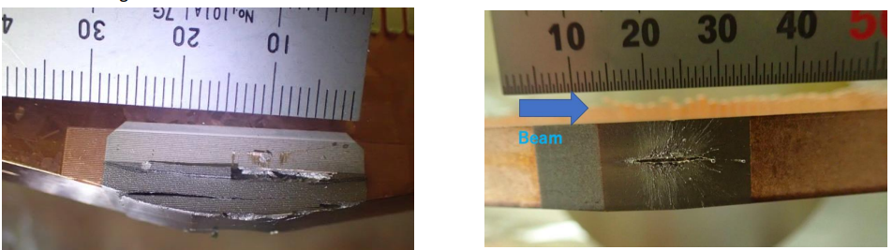
Motivation
CEPC is e⁺e⁻ collider designed for 4 beam operation modes
The energy stored in the machine is very high
Such beam is highly destructive
Priority of machine Protection
Global equipment protection
Reduce the background near IP
Method of machine protection
Active protection (beam dump)
Response time of CEPC active machine protection system ~1ms
Passive protection(collimators, shielding)
Very fast beam loss, beam halo, synchrotron radiation (SR)…
Table 1: Parameters for the CEPC machine protection (@ 50MW)
 | $$Higgs$$ | $$Z$$ | $$W$$ | $$t\overline{t}$$
Beam Energy (GeV) | 120 | 45.5 | 80 | 180
Bunch Population/10¹⁰ | 13 | 21.4 | 13.5 | 20
Number of Bunches | 446 | 13104 | 2162 | 58
Total Energy (MJ) | 1.1 | 20 | 3.7 | 0.33
[1]T. Ishibashi and S. Terui, SuperKEKB collimator design, FCC-EIC Joint & MDI Workshop 2022
X.H. Cui
Fig.1 Beam dump system
Fig.2 Damage to collimator jaw due to accident beam loss in the SuperKEKB

Slide 4
Motivation
Method for simulation studies
Preliminary arrangement of the global collimators
Current simulation studies
Summary

Slide 5
Method for Simulation studies
Requirements for simulation studies:
Multi-turns particle tracking (6D) using the full lattice
Synchrotron radiation, optics tapering, beam-beam effect
Aperture model (geometry + beam-stay-clear region + momentum acceptance)
Beam loss recording (turn, location, phase space)
Particle-matter interaction inside the collimators
Deposition and thermomechanical studies
Workflow
Lattice, Aperture model
Particle tracking
Record beam profile
$$SAD$$
Particles
Particles
Different scenarios
Collimator model
Particle-matter interaction
$$FLUKA$$

Slide 6
Simulation studies
SAD simulations
Different scenarios
Optimum/acceptable/particular operating conditions:
Beam halo/tails, Top-up injection
Change of optics, tuning, collimator aperture setting, etc
Fast beam loss
Standard equipment failure, fast equipment, other accident beam loss, etc
Injection failure, SuperKEK fast beam loss (should be understand if possible)
Different operation modes
Higgs, Z, W, ttbar
FLUKA simulations
Beam-matter interactions inside collimators
Optimization by coupling simulations
Multi-stage collimation
Collimator: location, gap, length, quantity, material, deposition, taper
Impedance budget (nonlinear collimators also provide a way to reduce the impedance)
Movable collimators

Slide 7
Motivation
Method for simulation studies
Preliminary arrangement of the global collimators
Current simulation studies
Summary

Slide 8
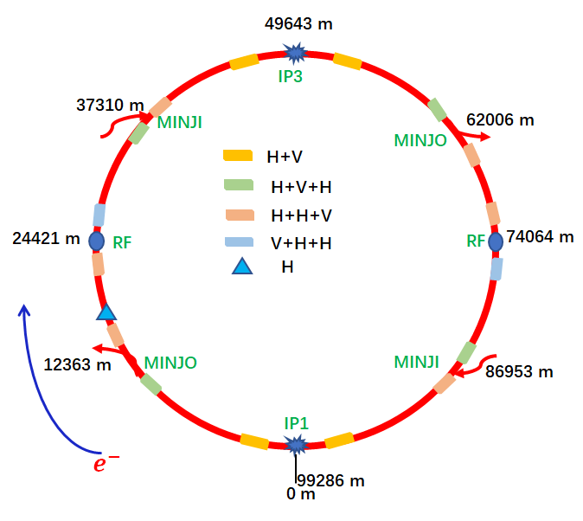
Preliminary arrangement of the global collimators
CEPC collimation system
Collimator type
Betatron collimators - high beta function
Momentum collimators - high dispersion function
Dedicated collimators with the phase advance of π
SR collimators near IPs
Arrangement
Only single stage collimators for the preliminary design
~50 collimators are inserted into the collider ring
Collimators are inserted both near IPs, RF region, injection/extraction region
All the collimators in the drift sections

Slide 9
CEPC aperture model
Finding the momentum acceptance and beam stay clear region will allow us to identify the loss locations and the bottlenecks
The bottlenecks must be protected
Beam loss near IPs can cause the background
Quench risk for RF
Quench risk for SCQ
Beta functions
The beam-stay-clear region
Geometry aperture
The momentum acceptance

Slide 10
Motivation
Method for simulation studies
Preliminary arrangement of the global collimators
Current simulation studies
Summary

Slide 11
Current studies
CEPC beam loss
Scenarios of the fast equipment failures
Critical RF failures
Quenches of superconducting quadrupole magnets
Powering failures of normal magnets
bending magnets
quadrupole magnets
sextupole magnets
Failure model:
One turn for CEPC ~ 331 𝝁𝒔
$τ=10 ms$ for the magnet failures in our simulations
$$τ≈773 μs$$
J.Y Zhai
$$τ: 10\sim 100 ms$$
Y.S Zhu
$$τ: 10\sim 100 ms$$
B. Chen
$$Q=Q_{0}e^{−t/τ}$$

Slide 12
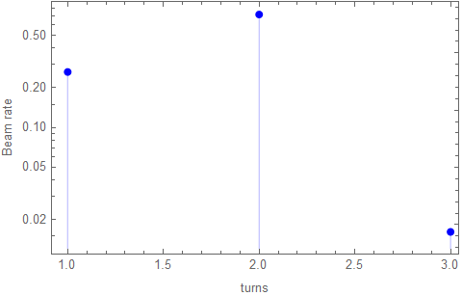
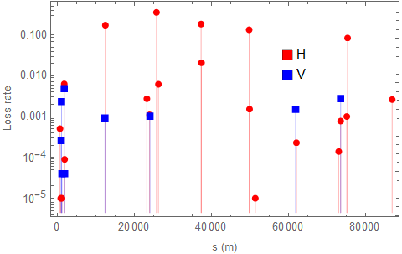
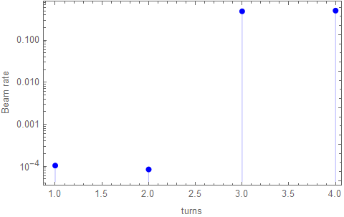
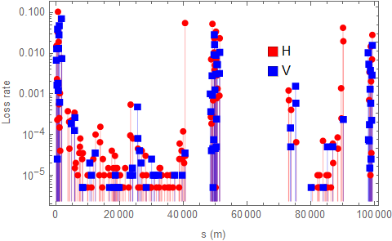
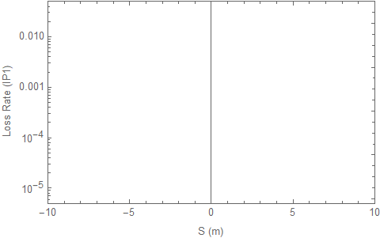
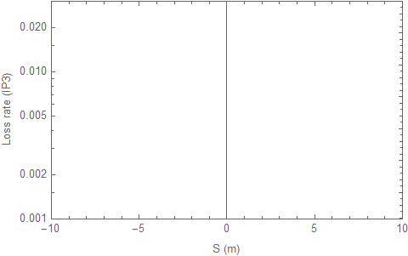
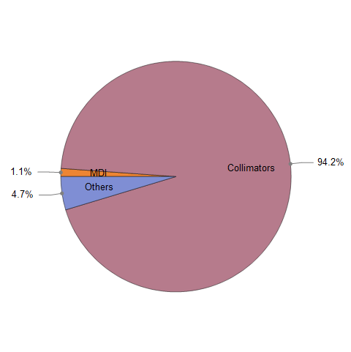
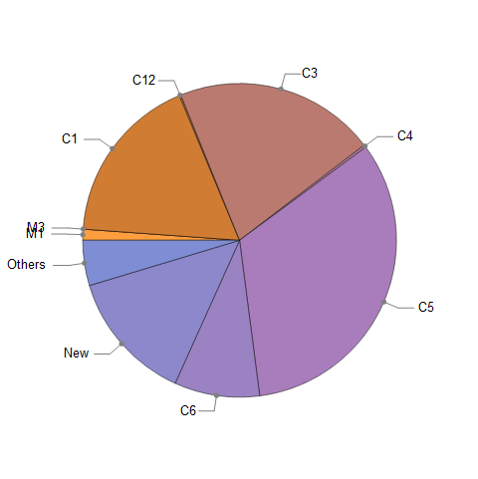
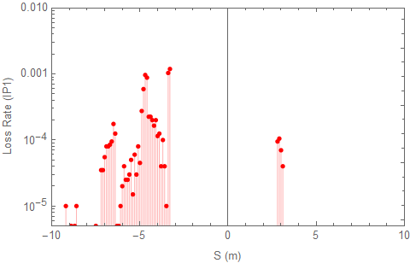
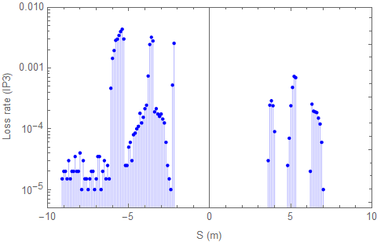
Critical RF failures
With collimators
$τ≈773 μs$
Very fast beam loss can be observed
Clean IP regions with the collimation system
Clean RF regions with the collimation system
Without collimators
Beam loss turn
Beam loss location
Beam loss turn
Beam loss location
0.79%
4.45%

Slide 13
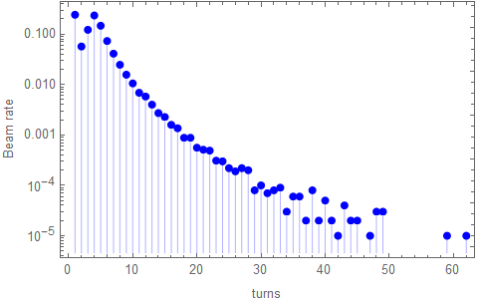
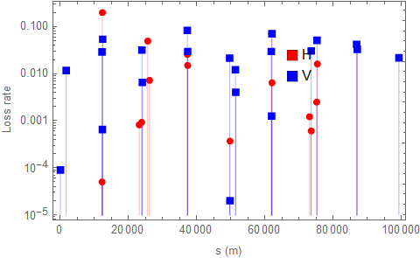
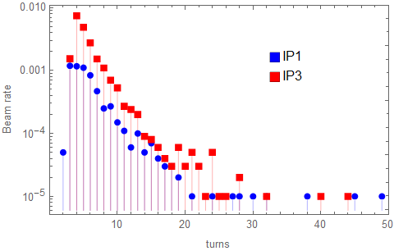
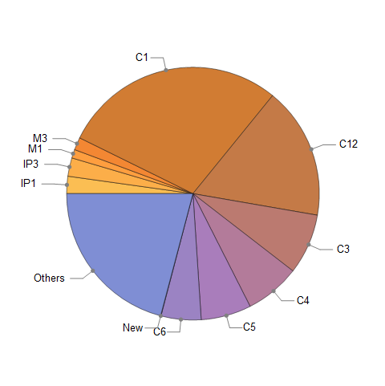
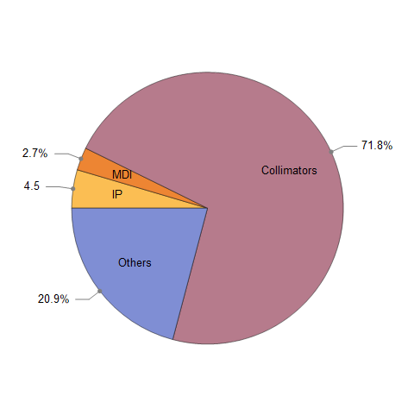
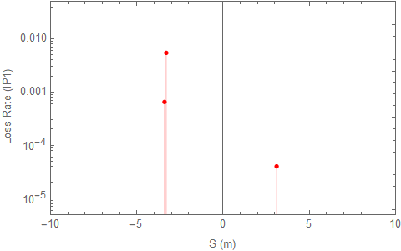
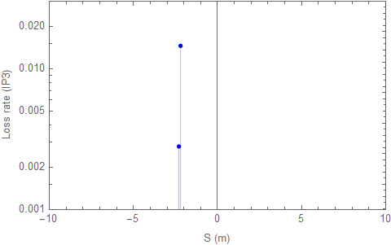
Failures of bending magnets
$τ=10 ms$
Beam loss in IP region can be observed
Clean RF regions
Risk for the SCQs
Beam loss turn
Beam loss location
0.61%
2.17%

Slide 14
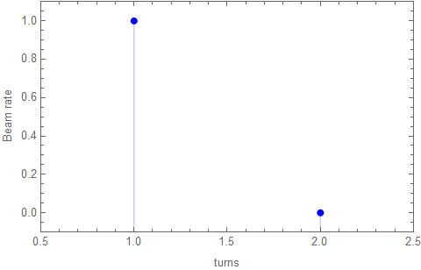
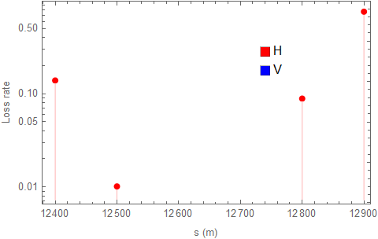
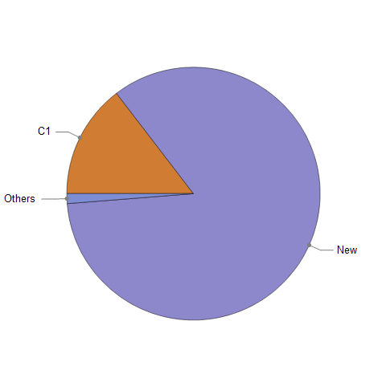
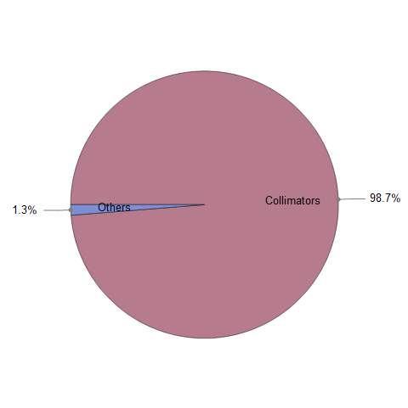
Failures of normal quadrupole magnets
$τ=10 ms$
Clean RF regions and IP regions
Tight gaps of collimators
Beam loss turn
Beam loss location

Slide 15
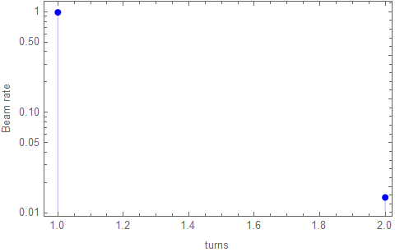
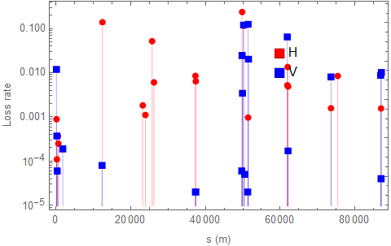
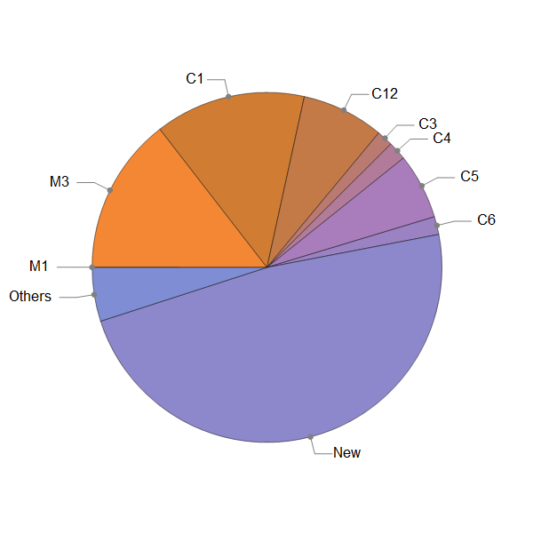
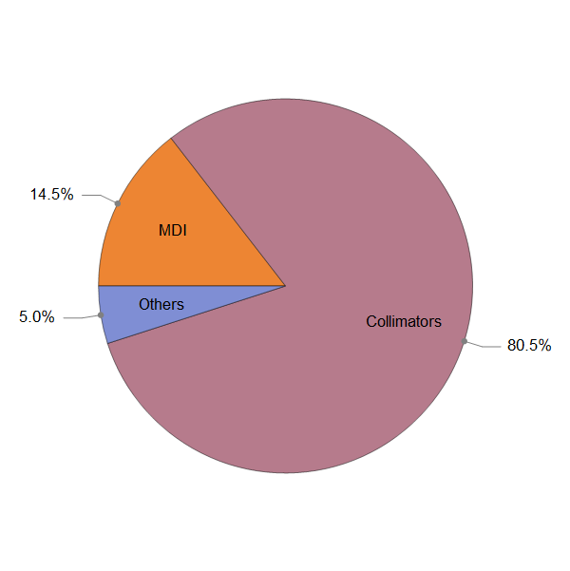
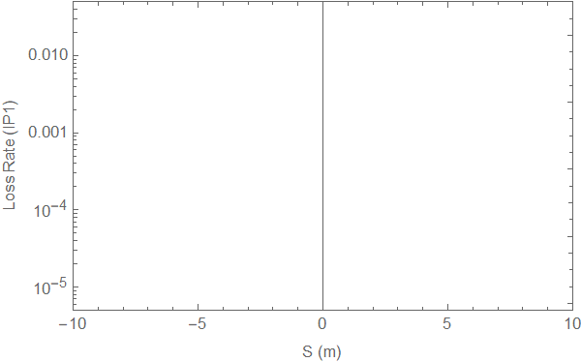
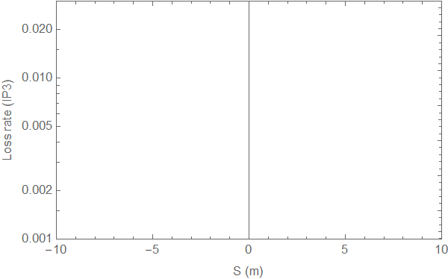
Quenches of SCQs
$τ=10 ms$
Very fast beam loss can be observed
Clean IP regions and RF regions
Risk for the collimator tolerance
Beam loss turn
Beam loss location

Slide 16
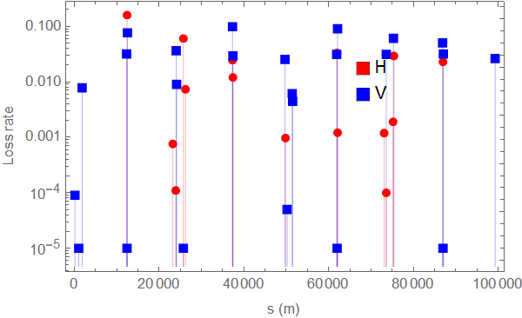
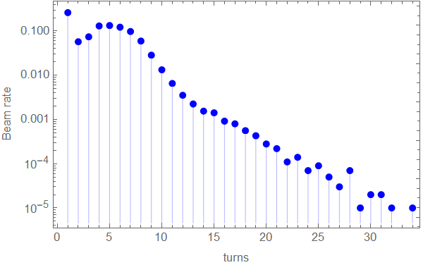
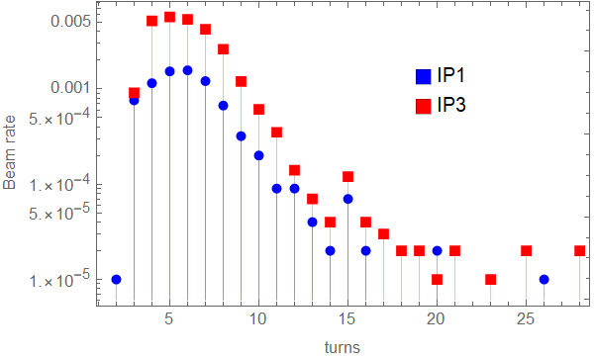
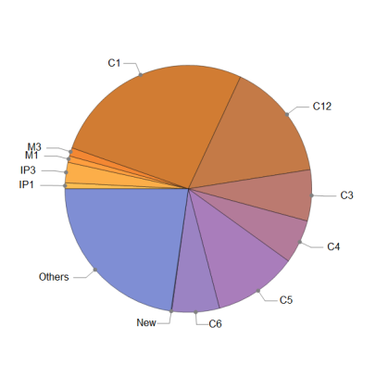
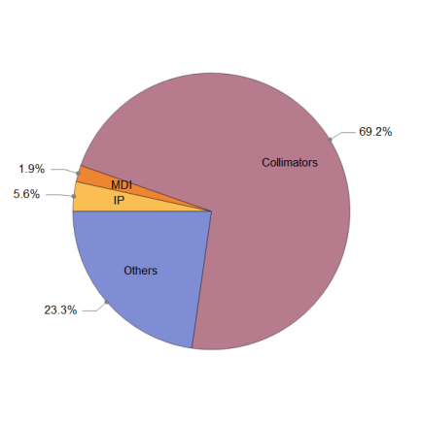
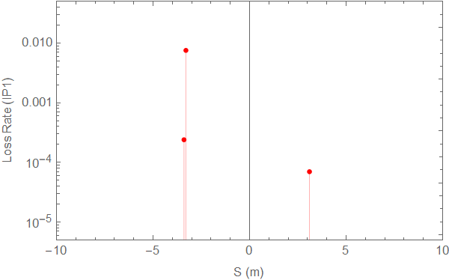
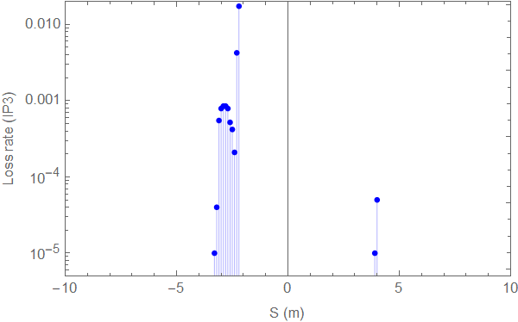
Failures of sextupole magnets
$τ=10 ms$
Beam loss in IP region can be observed
Clean RF regions
Risk for the SCQs
Beam loss turn
Beam loss location
0.79%
2.67%

Slide 17
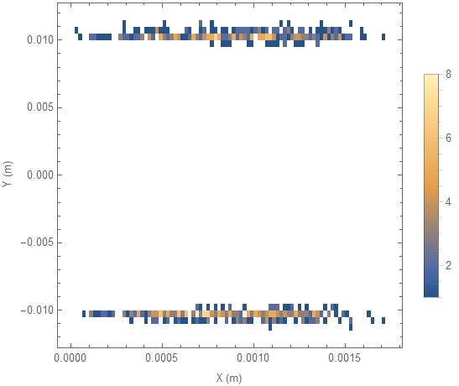
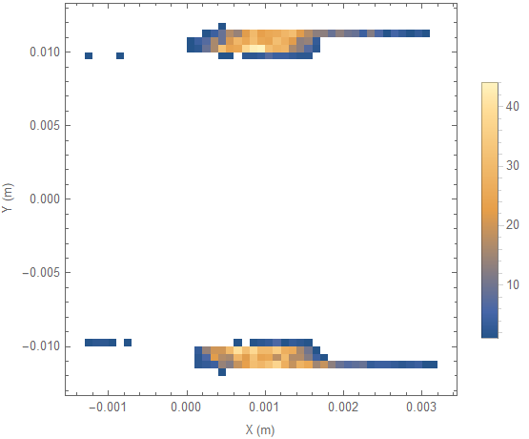
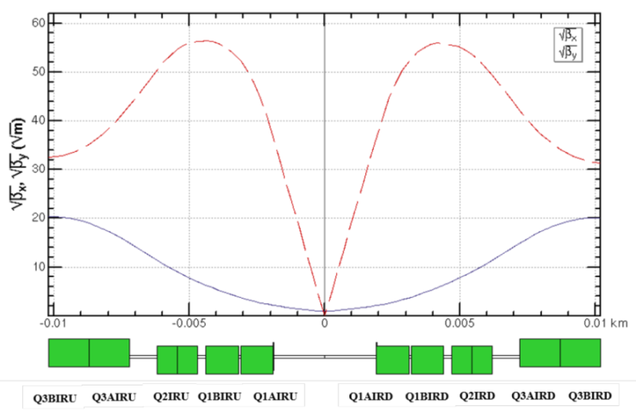
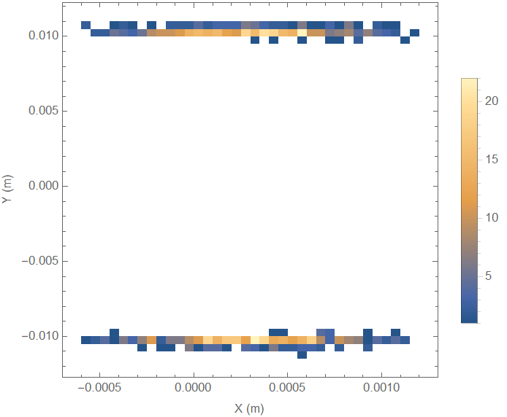
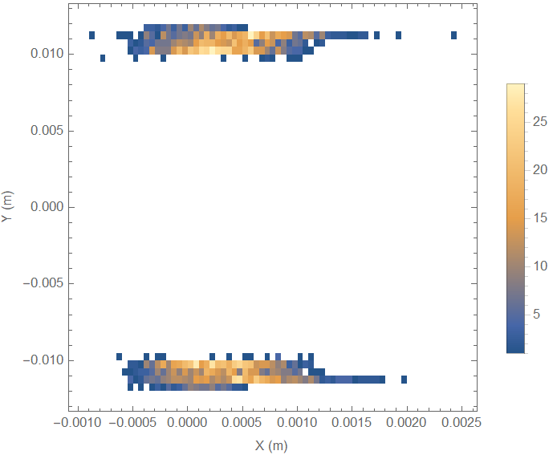
Challenge
Failure cases: bending magnets (A) and sextupole magnets (B)
Beam loss in IP regions
Risk for the SCQ both in conditions of bending and sextupole magnets
High vertical beta function and small pipe size
Dedicated collimators are required (eg. phase advance of π)
Further study is required
IP1
IP3
(A)
(B)
IP1
IP3
Layout of the quadrupole in IP

Slide 18
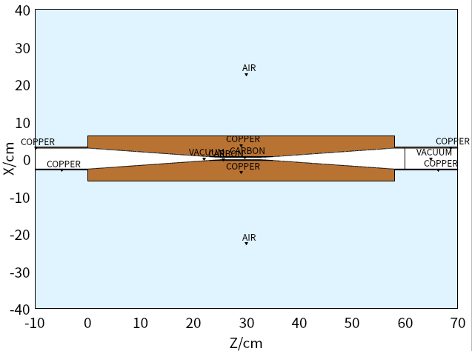
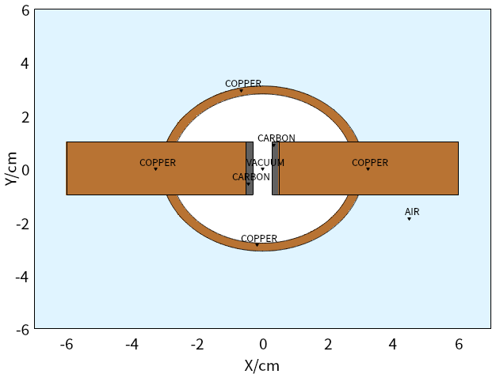
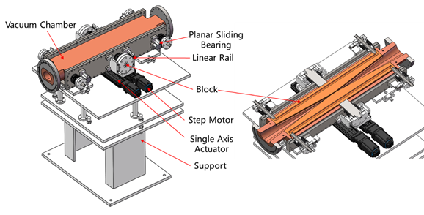
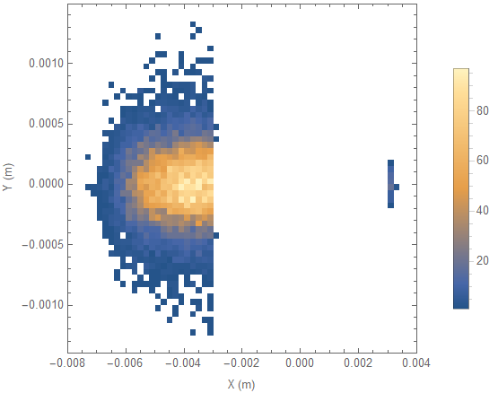
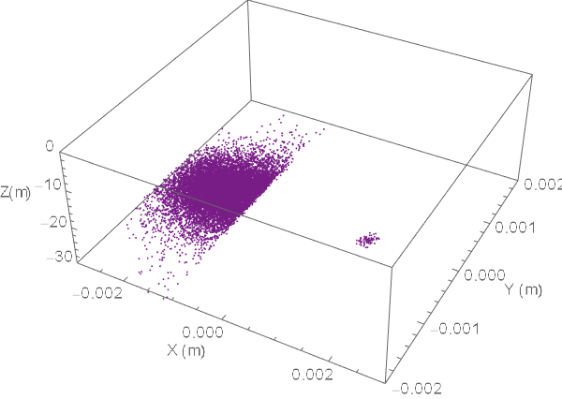
Coupling simulations
G.Y. Tang and H.J. Wang
Collimator: toy model
Geometry: like HEPS Coll.
Two layer: Copper + Carbon
Gap: 6mm
Thickness of carbon: 2mm
Beam loss record in collimator
RF failure
RF region, downstream IP1
Collimator model in FLUKA
Mechanical structure of the collimator

Slide 19
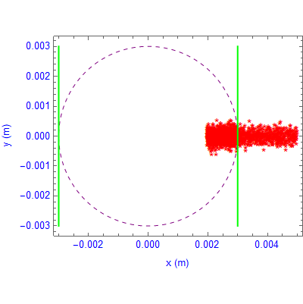
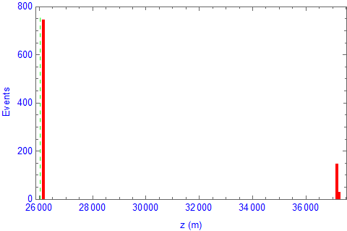
Particles back to SAD
FLUKA
Selection
SAD simulation
Collimator
26053 m
Selection:
Energy Acceptance: 1.7%
Horizontal beam: $4ε_{x}$
Vertical beam: $5ε_{x}$
Collimator
Energy acceptance: 1.7%

Slide 20
Summary
Methods for the collimation simulation study
SAD+FLUKA coupling
The preliminary collimation system is studied
Particle simulations
Powering failures of the magnets, quenches of SCQs and RF are studies
Very fast beam loss can be observed in some scenarios
After the beam-matter interaction, the secondary particles may transfer very long

Slide 21
Next step
SAD simulations
Different scenarios
Optimum/acceptable/particular operating conditions:
Beam halo/tails, Top-up injection
Change of optics, tuning, collimator aperture setting, etc
Fast beam loss
Standard equipment failure, fast equipment, other accident beam loss, etc
Injection failure, SuperKEK fast beam loss (should be understand if possible)
Different operation modes
Higgs, Z, W, ttbar
FLUKA simulations
Beam-matter interactions
Optimization by coupling simulations
Multi-stage collimation
Collimator: location, gap, length, quantity, material, deposition, taper
Impedance budget (nonlinear collimators also provide a way to reduce the impedance)
Movable collimators

Slide 22
Thank you

Slide 23
Backup

Slide 24
The complexity of the collimation system
LHC
SuperKEKB
[1] https://inspirehep.net/literature/727805
[2] DOI:10.1103/PhysRevAccelBeams.23.053501

Slide 25
Effects such as synchrotron radiation and optics tapering are required
Details of tapering in BMAD still under study [2]
Tapering: modulating the magnetic strengths around the ring to account for SR energy loss
Lattice translation between accelerator simulation codes[3]
[1] https://kds.kek.jp/event/44647/
[2] https://indico.cern.ch/event/1015718/
[3] https://conference-indico.kek.jp/event/75/

