Slide 1

中国科学院高能物理研究所
Institute of High Energy Physics, CAS
Progress of CEPC Detector Magnet
Ning Feipeng
2023.07

Slide 2

Outline
Introduction of CEPC detector magnet
Progress of HTS cable
Other progress
Other HTS detector magnets
Summarize

Slide 3
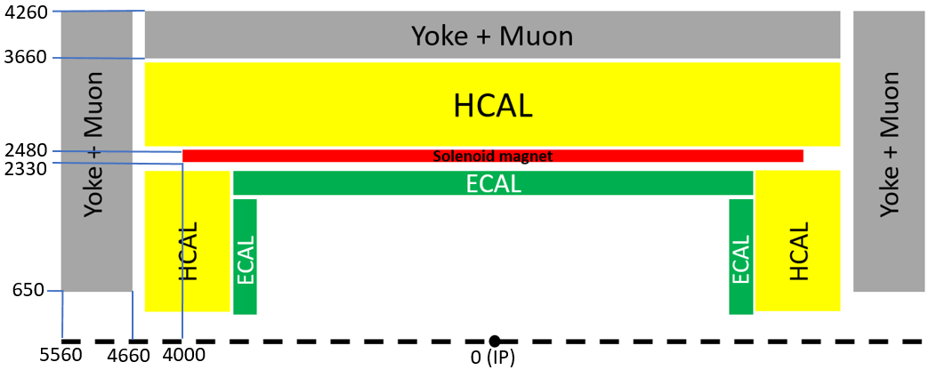
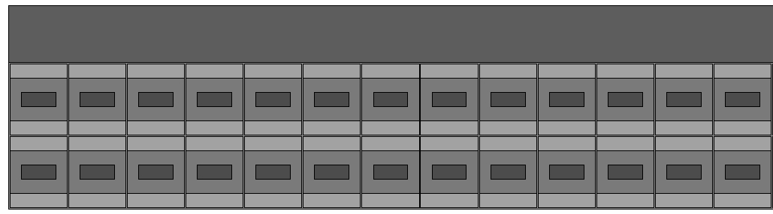
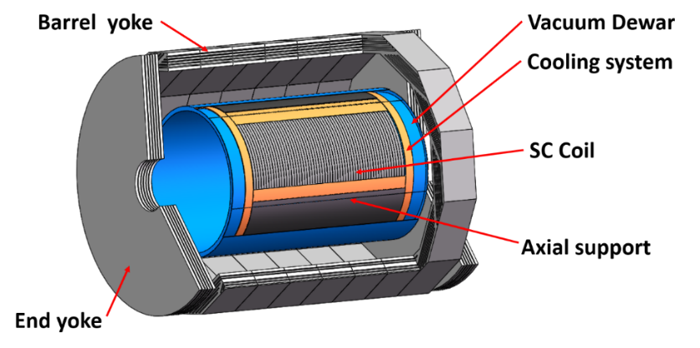
1. Introduction of CEPC Detector Magnet
The 4th Conceptual Detector Design: The solenoid magnet locates between Hcal and Ecal.
A large ultra-thin & transparent HTS solenoid magnet:
Coil layout
support
Magnetic field | 3 T | Current | 28000 A
Inner diameter | 4660 mm | Inductance | 1.27 H
Outer diameter | 4960 mm | Stored energy | 500 MJ
Magnet thickness | 150 mm | Cold mass | 27 ton
Length | 8000 mm | HTS cable length | 10.7 km
Total weight | 48 ton | ASTC weight | 16.6 ton
IEEE TRANSACTIONS ON APPLIED SUPERCONDUCTIVITY, VOL. 33, NO. 6, SEPTEMBER 2023

Slide 4
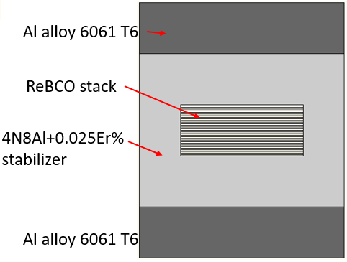
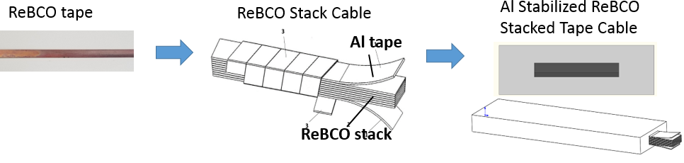
2. Progress of HTS cable
铝稳定体高温超导叠型电缆
ASTC(Al stabilized HTS Stacked Tape Conductor) development
Pure Al stabilizer
Advantage: Simple structure, easy to process, has experience and processing equipment;
Disadvantage: uneven current distribution, High dynamic loss, great influence of shielding current, large AC loss, and so on.

Slide 5
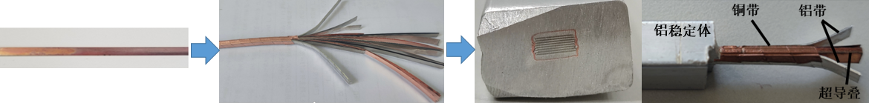
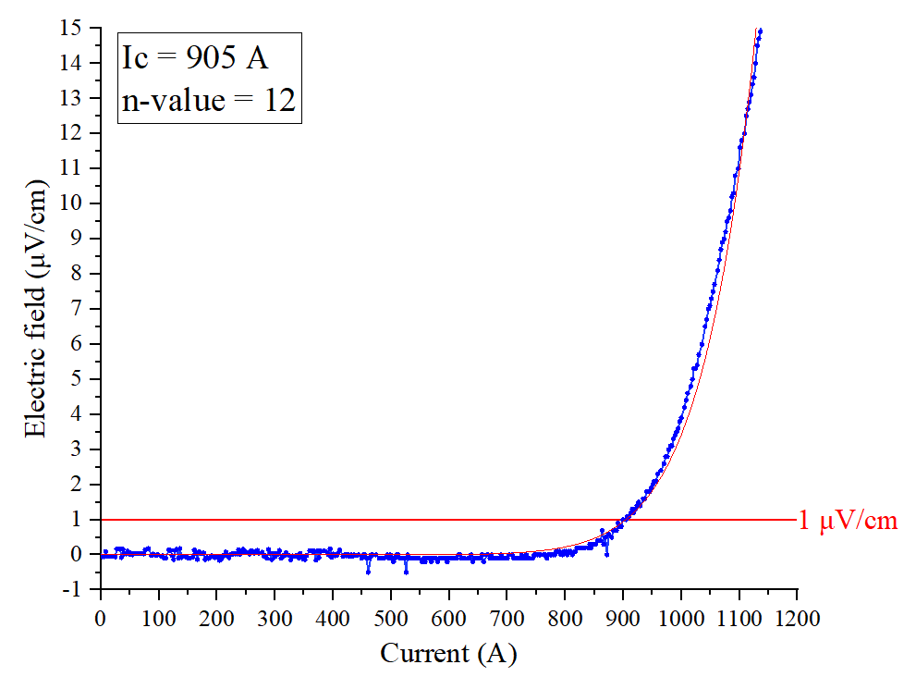
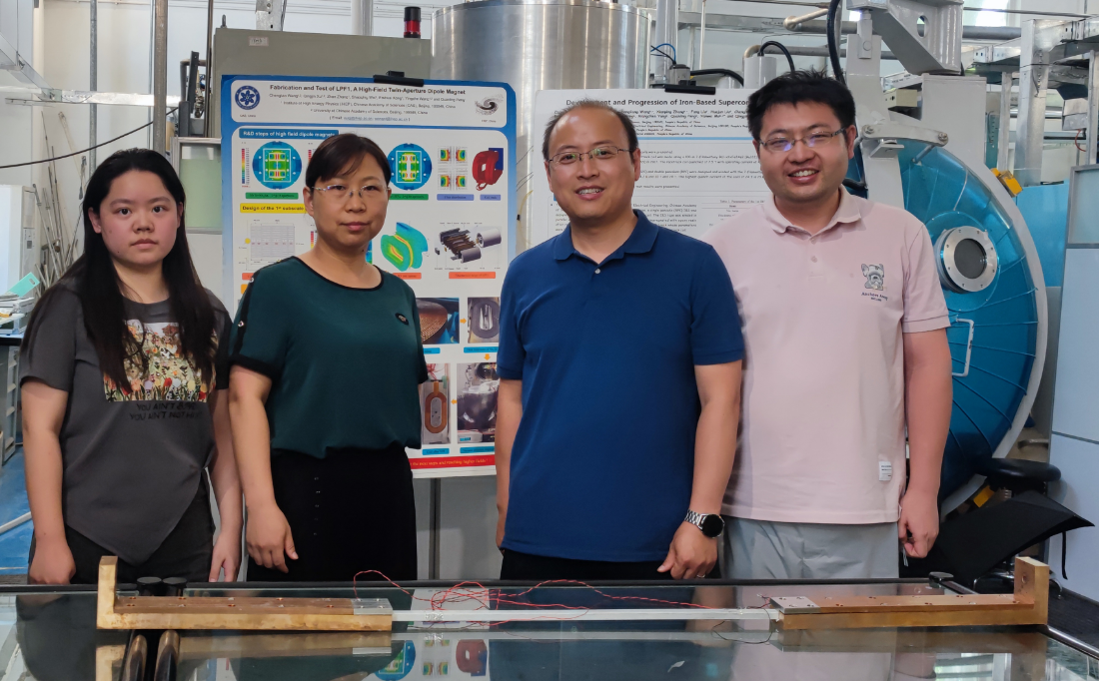
2. Progress of HTS cable
ASTC(Al stabilized HTS Stacked Tape Conductor) cable development
Small size cable: 15*10mm² , Tape Width: 4 mm, tape thickness: 80 μm, tape Ic > 120A@77K;
HTS tape
HTS stack
Pure Al stabilizer
Significant progress has been made in the development of HTS cable.
Object：single tape core Ic > 100 A@77K；14-core cable Ic > 830 A@77K, self-field.
Ic = 905A

Slide 6
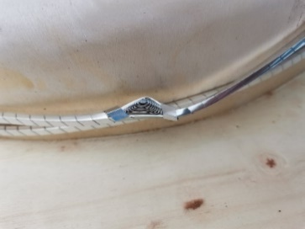
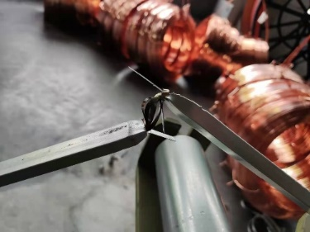
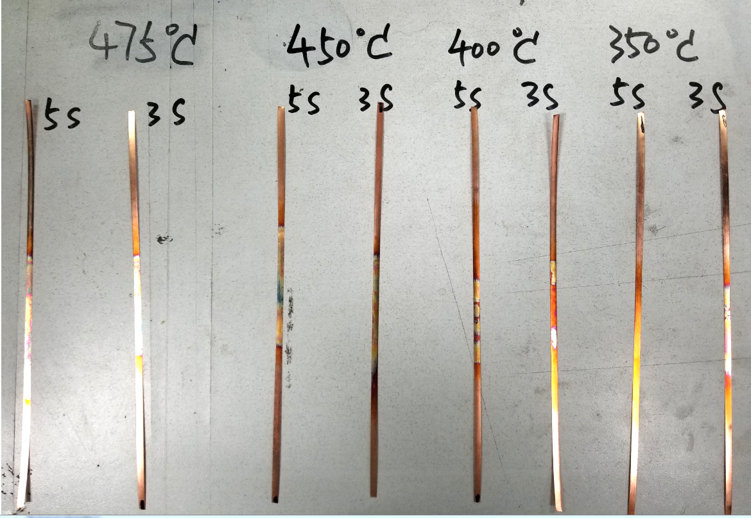
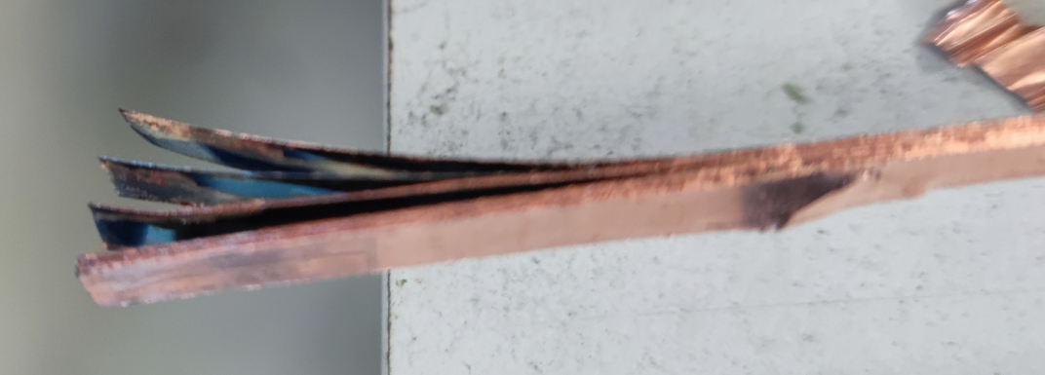
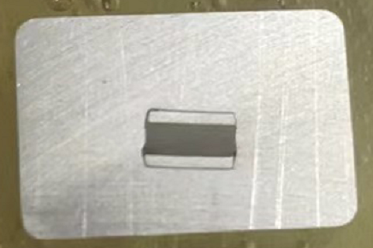
2. Progress of HTS cable
ASTC(Al stabilized HTS Stacked Tape Conductor) cable development
The process of cable development in the past three years:
1，How to process cables?
2，How to improve cable performance?
Problems during development:
Wrapping tape breakage
Core wire breakage
High temperature duration too long
Adhesion of Superconducting tape
Core twisting and misalignment

Slide 7
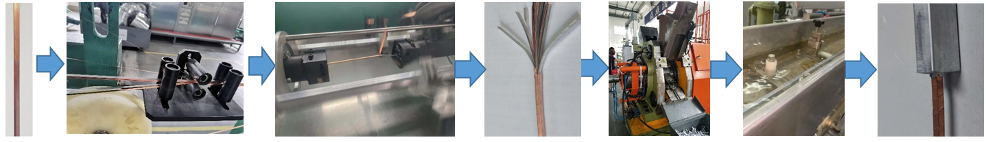
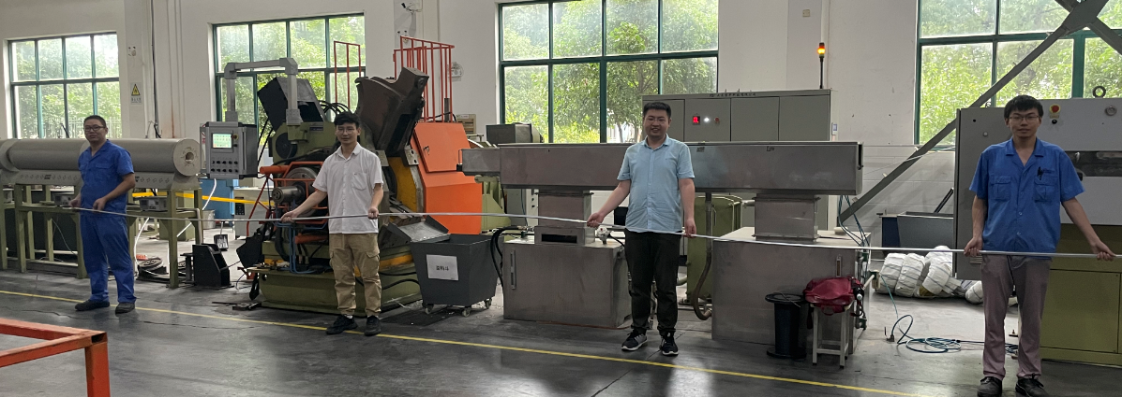
2. Progress of HTS cable
1，How to process cables?
Small size cable: 15*10mm² , Tape Width: 4 mm, thickness: 80 μm
10 m ASTC prototype cable
2021.09.29

Slide 8
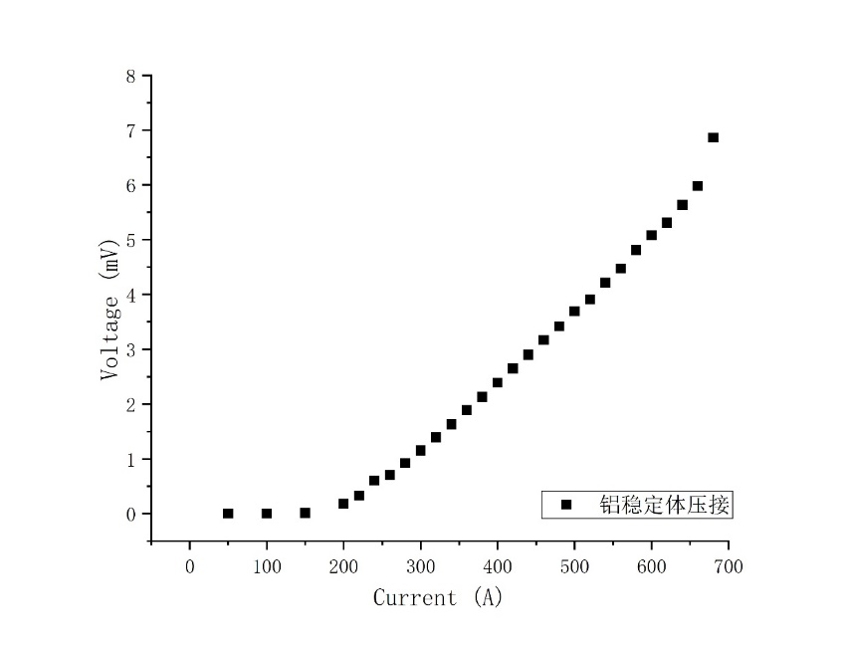
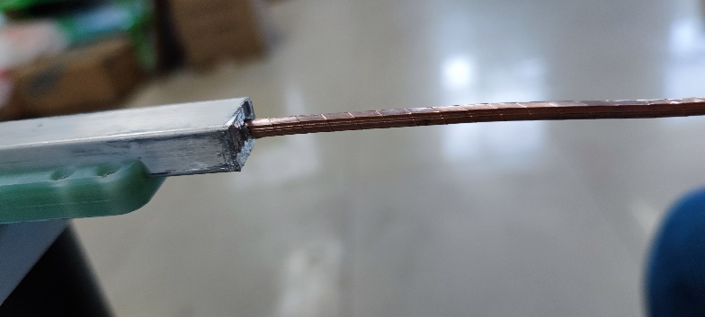
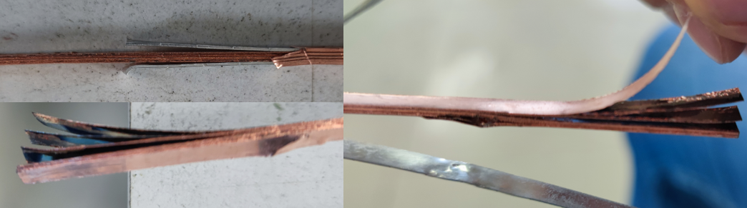
2. Progress of HTS cable
2，How to improve cable performance?
The critical current of 20-layer cable is only 180A, Severe degradation of superconducting tape performance.
High temperature and high pressure caused severe performance degradation of HTS superconducting tapes

Slide 9
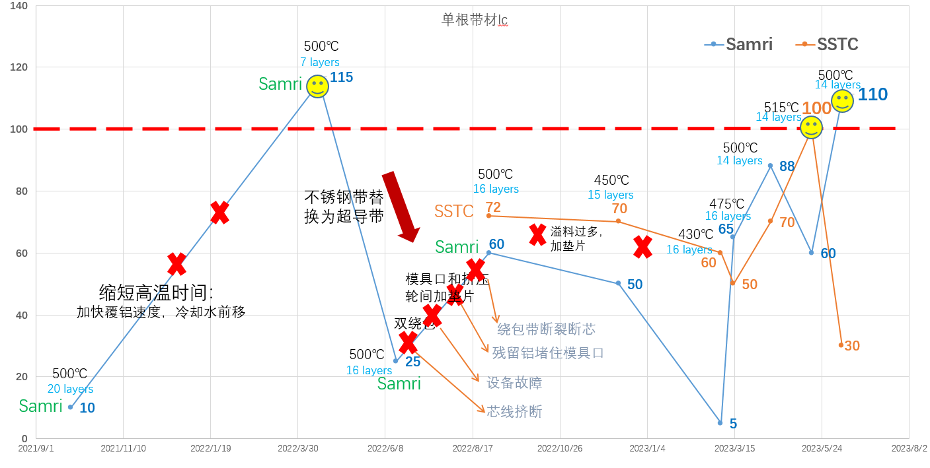
2. Progress of HTS cable
cable performance improvement
single tape core Ic > 100 A@77K, self-field

Slide 10
2. Progress of HTS cable
cable performance improvement：The performance of the cable meets the expected requirements.
Object：single tape core Ic > 100 A@77K；considering the self-field effect, The critical current of a 14-core cable is larger than 830 A@77K, self-field.
14 layers
16 layers
14 layers
16 layers
14 layers
7 layers
16 layers
14 layers
15 layers
16 layers
20 layers

Slide 11
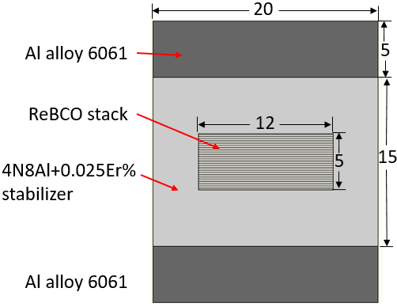
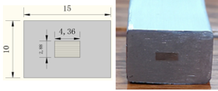
2. Progress of HTS cable
Future work of HTS cable: From small size cable to full size cable
  Continued optimization of cable performance;
  Aluminum coating of large-sized superconducting stack using high-strength pure aluminum;
  Research on High Strength Pure Aluminum, 4N8Al+0.025Er%？Other choices？
  Welding of aluminum coating cables and high-strength aluminum alloys, electron beam welding? Friction welding?

Slide 12
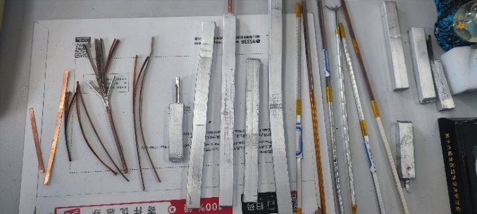
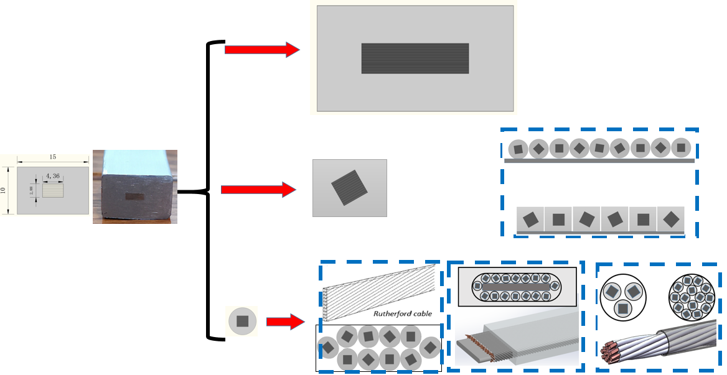
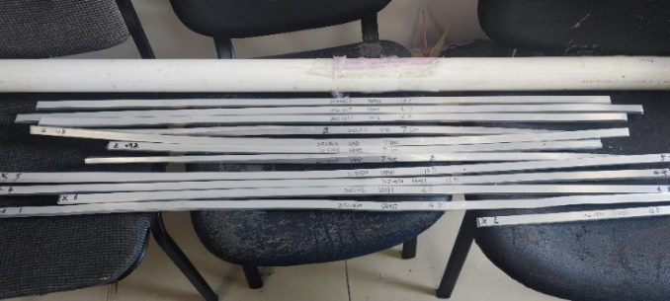
Future plan of ASTC cable
Detector magnet
Small magnet
Accelerator magnet
Fusion magnet

Slide 13
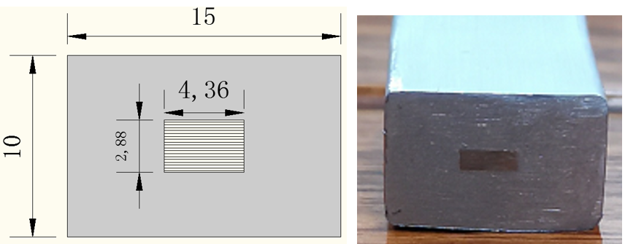
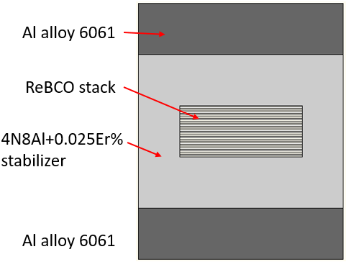
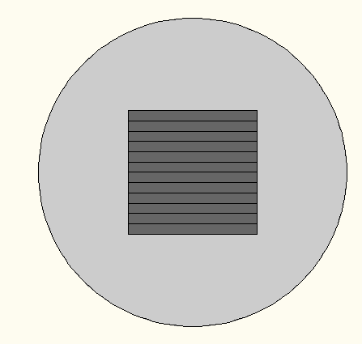

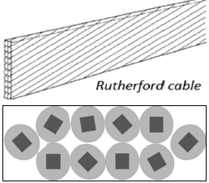
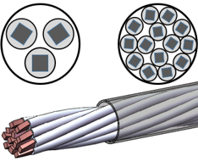
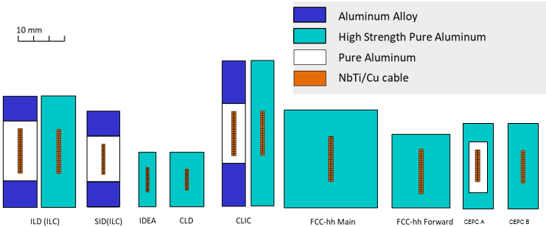
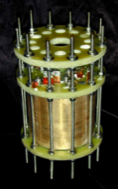
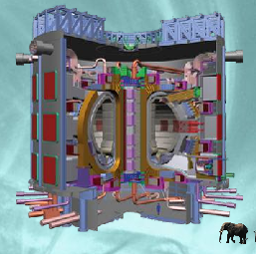

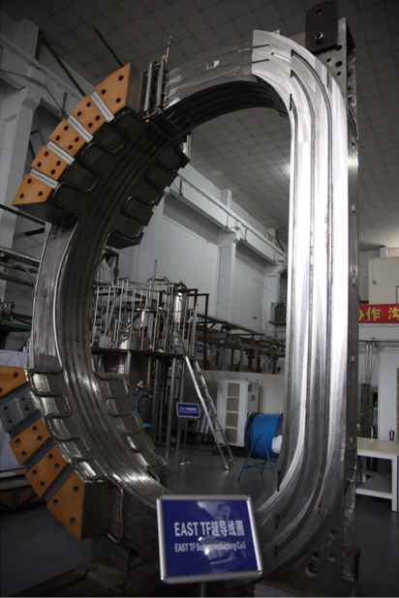
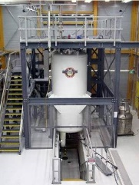
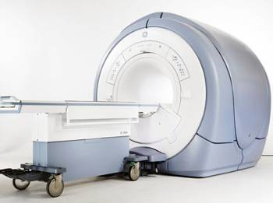
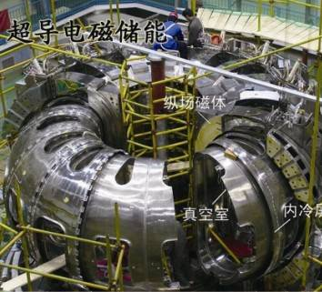
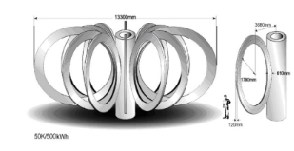
ASTC (Al stabilized Stacked ReBCO Tape Conductor)
Rutherford Cable
CICC
High Energy physics, detector magnets
Small magnets, high field
insert coil, Instead of NbTi
Fusion magnets
High field accelerator magnets, SMES
ITER
NMR
MRI
CMS
CEPC
SMES
EAST

Slide 14
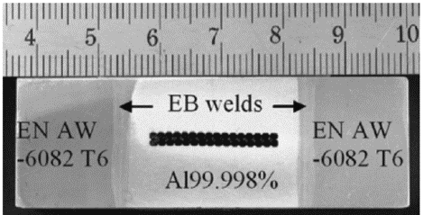
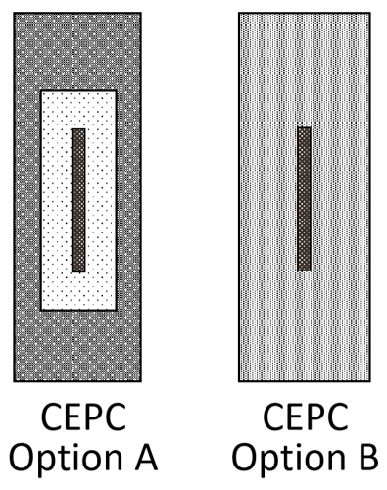
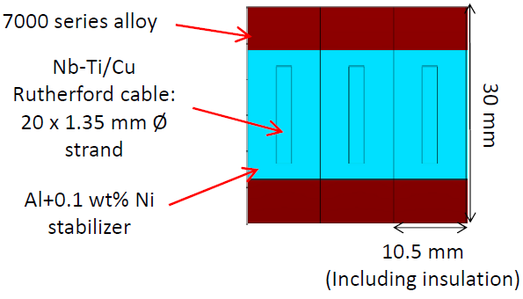
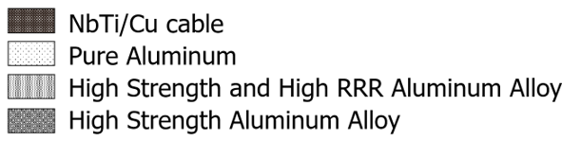
Other process of HTS cable
High strength and High RRR pure aluminum stabilizer
CMS
CEPC HTS
Fcc IDEA

Slide 15
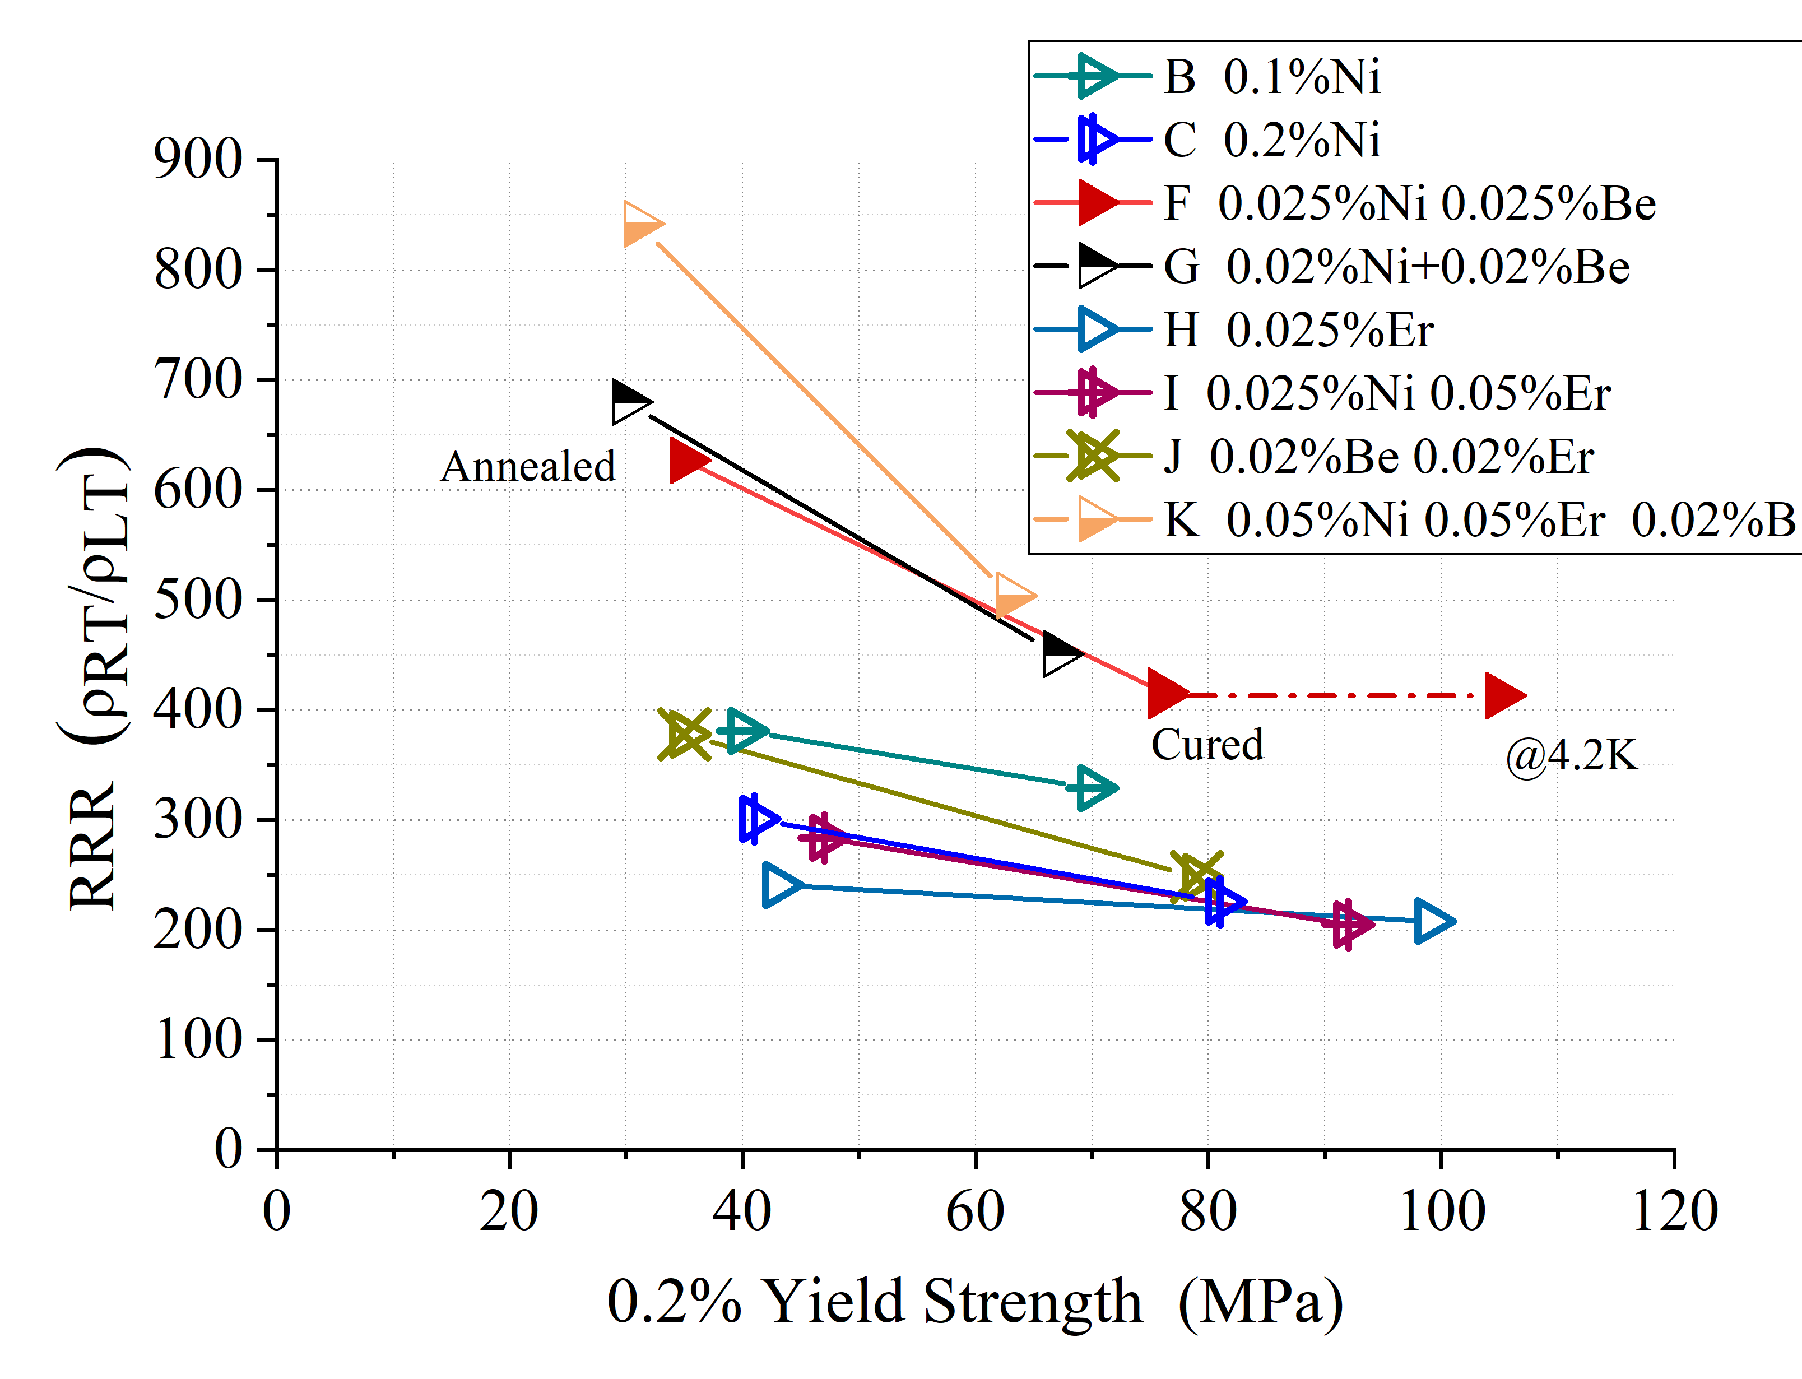
Other process of HTS cable
R&D of High Strength and High RRR Aluminum- Stabilizer for Superconducting Cable
LTS: Yield strength > 100 MPa@4.2K, 74 MPa at room temperature, RRR value > 400
By doping Ni-0.025% Be-0.025%, annealing, cold-working and curing.
The Al-0.025%Ni-0.025%Be alloy prepared from 4N8-aluminum achieved high 0.2% yield strength of 75MPa (R.T.) with RRR of 417 after cold working of 21% and annealing at 130℃ for 15hrs.
HTS: Yield strength > 140 MPa, RRR value > 200
By doping Er-0.025.
The 4N8Al-0.025%Er achieved high 0.2% yield strength of 144MPa with RRR of 208
IEEE TRANSACTIONS ON APPLIED SUPERCONDUCTIVITY, VOL. 33, NO. 2, MARCH 2023

Slide 16
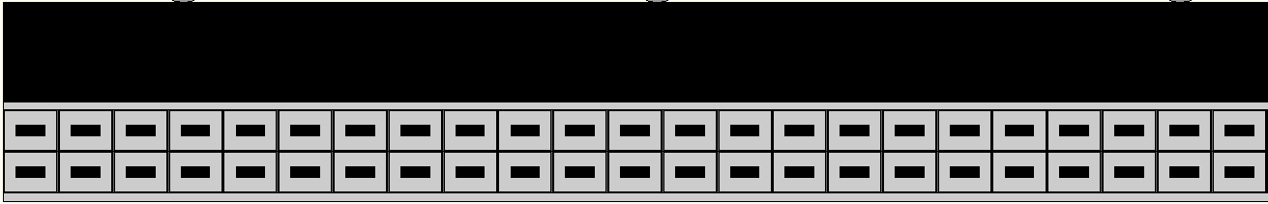
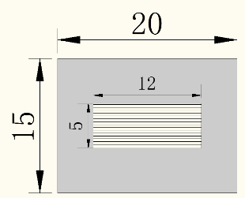
Optimization of HTS detector magnet
Optimization of HTS cable structure.

Slide 17
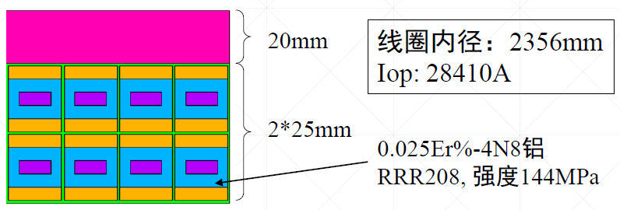

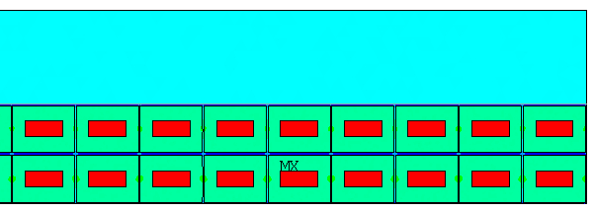
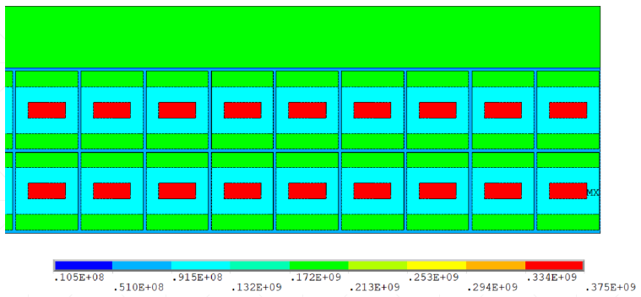
Optimization of HTS detector magnet
Why we changed the HTS cable structure:
Need high strength cable.
30mm
2*15mm
Maximum stress on the coil
 | Before optimization (MPa) | After optimization (MPa)
ReBCO tape | 461 | 375
Pure Al | 239 | 114
Al-alloy in cable | / | 182
Al-alloy support | 167 | 176

Slide 18
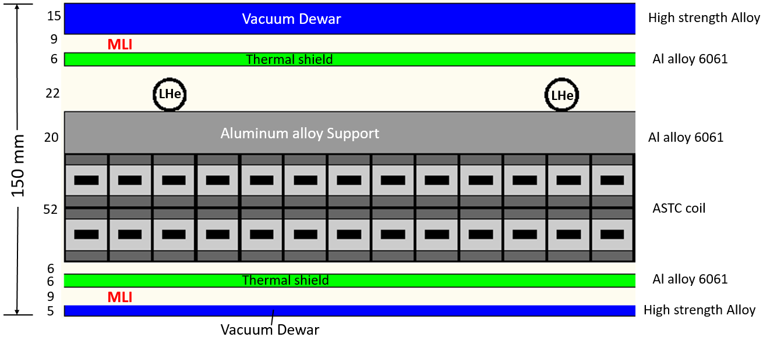
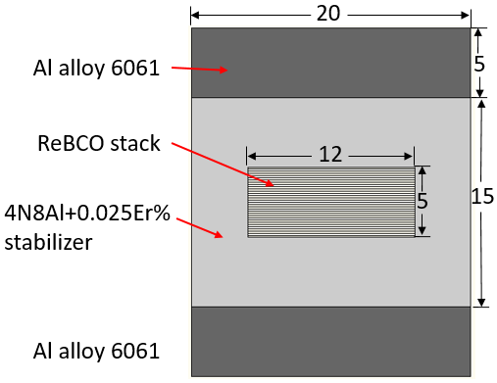
Mechanical structure
How to layout the 150mm thickness：
Including: vacuum cryostat, thermal shield, cold mass, Multi-layer insulation, support structure, liquid helium pipe, liquid nitrogen pipe, wires and so on.
Cable: 20*25mm²
Aluminum alloy support

Slide 19
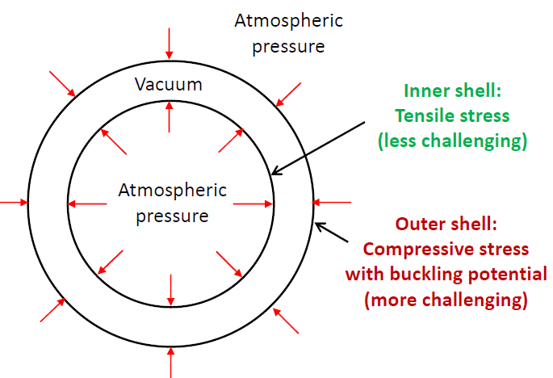
Mechanical structure
Three working conditions: vacuum, cooling, and excitation
vacuum：

Slide 20


Mechanical structure
cooling：
Cooling to 4.2k, radial deformation
Cooling to 4.2k, axial deformation

Slide 21


Mechanical structure
excitation：
Cooling to 4.2k, excitation, radial deformation
Cooling to 4.2k, excitation, axial deformation

Slide 22



Winding method of Large HTS coil
Research of winding method of large HTS coil：
  Much difference from LTS. Research on coil winding technology that more suitable for large HTS magnets.
  No epoxy impregnation? No-insulation?
HTS长缆

Slide 23




Wind method study
Is No-insulation winding method suitable for large coil using cable？
No epoxy impregnation? No-insulation?
NI
NI
Insulation
Insulation
MI
Epoxy impregnation & insulation
No-epoxy impregnation & No-insulation

Slide 24



Cable joint study
Research on HTS cable Joint Technology：
  Cable-cable joints
    Inner joint：turn the cable joints into tape joints, evenly distributed in the cable.
    Realize long cables.
    Outer joints：coil-coil joints
    Making joints between cables with small volume, low resistance, and convenient processing.

Slide 25




Cable joint study
Cable-current leads joints
    Step welding allows each tape contact with the copper lead, the current evenly enter the cable

Slide 26




Cable joint study
Other HTS cable joints：
Bridge-type mechanical lap joint of HTS STARS conductors
HTS Stacked Tapes Assembled in Rigid Structure (STARS) conductors
IEEE TRANSACTIONS ON APPLIED SUPERCONDUCTIVITY, VOL. 26, NO. 2, MARCH 2016

Slide 27



Cable joint study
Bridge-type mechanical lap joint of HTS STARS conductors
IEEE TRANSACTIONS ON APPLIED SUPERCONDUCTIVITY, VOL. 26, NO. 2, MARCH 2016

Slide 28



Cable joint study
Bridge-type mechanical lap joint of HTS STARS conductors
The joint resistance was 1.8 nΩ at 100 kA, 4.2 K,0.45 T.
Heat per joint：Q = 18W
Fusion Engineering and Design 146 (2019) 590–593
IEEE TRANSACTIONS ON APPLIED SUPERCONDUCTIVITY, VOL. 26, NO. 2, MARCH 2016

Slide 29


Cable joint study
BES III LTS cable joint：
Cable-cable joint
Cable-current leads joints

Slide 30



Cable joint study
CMS LTS cable joint：
In order to achieve joint electrical resistance lower than 10⁻⁹Ω, Metal Inert Gas (MIG) welding are performed.
The reinforcement of the conductors must be machined out in the joint area as the weld is performed to join the pure aluminum stabilizing matrix of both conductors. The conductor lengths are welded together side by side on a length of about 2 m.
0.39 n at B=0T and B=1T, and 0.454 n at B=2T
IEEE TRANSACTIONS ON APPLIED SUPERCONDUCTIVITY, VOL. 16, NO. 2, JUNE 2006

Slide 31


Quench detection and protection
Quench detection study：
quench propagation characteristics of the ASTC cable, quench propagation speed, minimum quench energy，the role of aluminum stabilizer.
Partial quench or overall quench? Quench propagation speed？
CMS Equivalent electrical circuit

Slide 32

Detector magnet needed in the future
 | Experiments | Site | B [T} | Size, ID x L [m] | Note | Fabrication Expected
Collider | EIC-Detector | BNL | 1.5~3 | 2.5~3.2 x 8.5 | Solenoid | 2025 ~
 | ILC-ILD | Japan | 4 | 6.88 X 7.35 | Solenoid | 2030 ~
 | ILC-SiD | Japan | 5 | 5 X 5 | Solenoid | 2030 ~
 | CLIC-ILD | CERN | 4 | 6.8 X 8.3 | Solenoid | 2035 ~
 | CLIC-SiD | CERN | 5 | 5.4 X 6.5 | Solenoid | 2035 ~
 | CLIC | CERN | 4 | 7 X 8.3 | Solenoid | 2035 ~
 | FCC-ee IDEA | CERN | 2 | 4.2 X 6.0 | Solenoid | 2035 ~
 | FCC-ee CLD | CERN | 2 | 7.4 X 7.4 | Solenoid | 2035 ~
 | FCC-hh | CERN | 4 | 10 X 20 | Solenoid | 2060 ~
 | ALICE-3 | CERN | 2 | 3 x 7.5 | Solenoid | 2027 ~
Others | M2e | Fermilab | 5 ~ 2.5 | 1.5 X 4 | Production | Under construction
 | Muon-g-2 | Fermilab | 1.473 | 0.09 X 14.22▪2π | Storage solenoid | Reuse after BNL
 | COMET | J-PARC | 5 ~ 3 | 1.3 X 1.6 | Capture Sol. | Under const.
 | Muon-g-2 | J-PARC | 3 | 0.66 X 0.33 | Solenoid | 2025 ~
 | BabyIAXO | DESY | 2 | 0.7 X 10 | D. Racetrack | TBD
 | IAXO | DESY | 5 - 6 | 5 X 25 | Toroid | TBD
 | Panda | GSI | 2 | 1.8 x 3.1 | Solenoid | TBD
 | Madmax | DESY | 9 | 1.35 x 1.2 | Dipole | TBD

Slide 33

Aluminum stabilized superconducting cables
Future

Slide 34


FCC-ee HTS detector magnet design
IDEA detector
IEEE TRANSACTIONS ON APPLIED SUPERCONDUCTIVITY, VOL. 33, NO. 5, AUGUST 2023

Slide 35


FCC-ee HTS detector magnet design
IEEE TRANSACTIONS ON APPLIED SUPERCONDUCTIVITY, VOL. 33, NO. 5, AUGUST 2023

Slide 36





AMS-100 HTS detector magnet
AMS-100 Alpha Magnetic Spectrometer on the International Space Station
Magnetic Spectrometer to be send to Lagrange Point 2 (1.5 Mkm from earth).
Probing high energy cosmic rays, in particular anti-protons and anti-deuterons.
Geometric acceptance of 100 m² sr.
Main magnet is a 6 m long, 4 m diameter HTS ultra-thin solenoid.
No active cooling, only passive cooling using radiators.
Electrical/thermal/mechanical challenge.
Compensation coil needed to correct magnetic torque during operation.
Comp. coil is a 1.5 m long, 8 m diameter HTS solenoid.
4 mm
12 mm
12 mm
12 mm

Slide 37


Summarize
Significant progress has been made in the development of HTS cable.
Many other challenges need to be studied:
  From small size cable to full size cable；
  Ultra-thin and transparent mechanical structure；
  Winding methods of large HTS solenoid, No-insulation?
  Joint of HTS cables；
  Quench detection and protection of HTS.

