Slide 1
Monte Carlo simulation for the 3D polarimeter
Yuting Wang
July 3, 2023

Slide 2
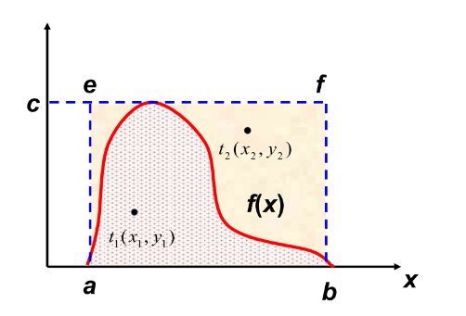
1. Monte Carlo method
Two method to generate the events:
acceptance-rejection sampling or Monte Carlo rejection sampling
Probability density function
Probability density function
Construct the probability density function based on ICS formulae
Generate the random numbers, following PDF
Acceptance-rejection sampling
Generate a random sample from the proposal distribution.
Evaluate the ratio of the target distribution to the proposal distribution for the generated sample.
Generate a random number from a uniform distribution between 0 and 1.
If the ratio is greater than or equal to the random number, accept the sample. Otherwise, reject it.
Repeat steps 1-4 until the desired number of samples is obtained.
geometric interpretation:
x, y: the uniform distribution
d

Slide 3
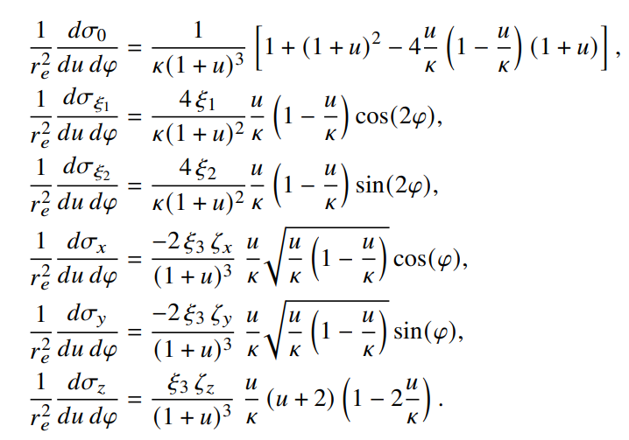
2. Monte Carlo simulation
ICS cross section
Parameters inputs
E=45.5 GeV | λ=532 nm | L1=117 m
L2=100 m | θ₀=0.97 mrad | N=1,000,000
ξ_{1,2}=0 | ξ₃=1 | ω0=2.33 eV

Slide 4
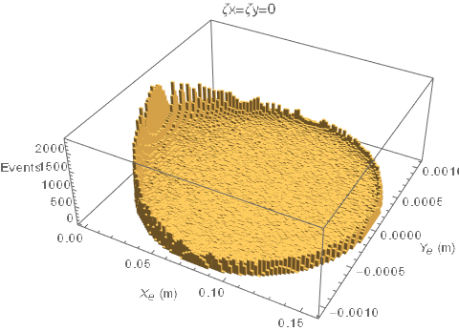
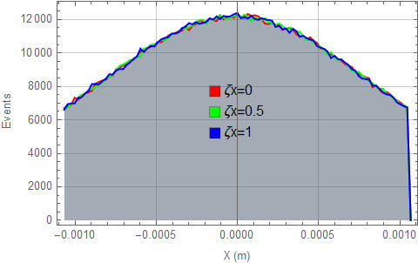
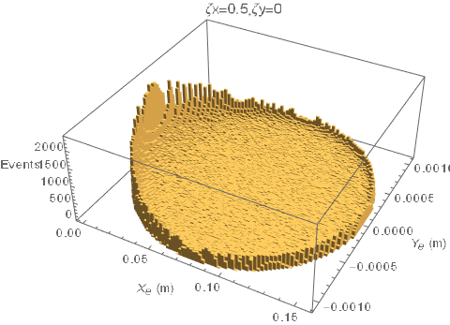
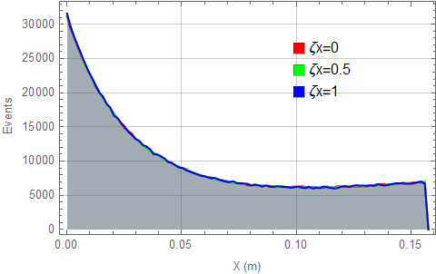
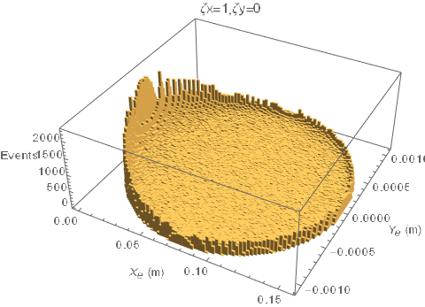
Horizontal polarization

Slide 5
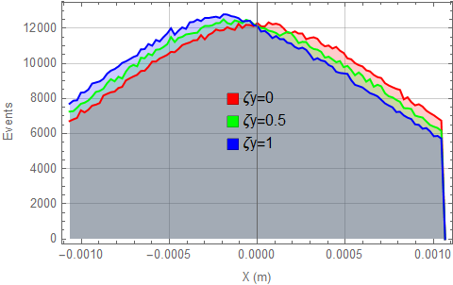
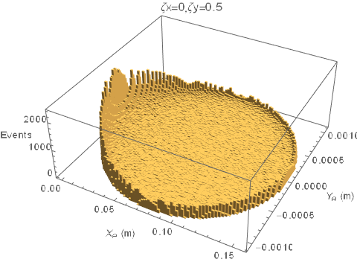
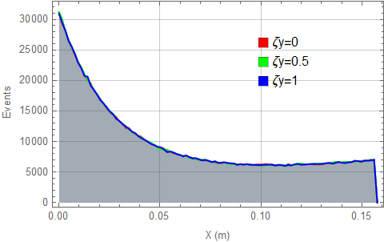
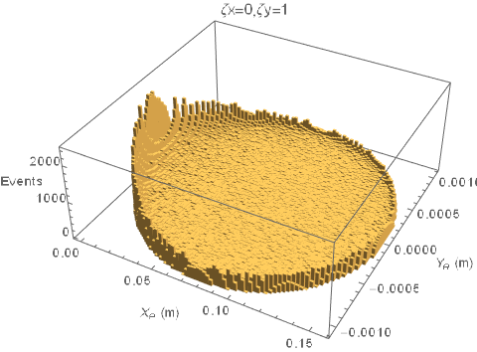
Vertical polarization

Slide 6
3. Rotation
y
Model Explanation (With bending magnet)
x
$$φ$$
z
$$θ$$
$$L_{2}$$
y
$$L_{1}$$
Observer
x
$$(x,y)$$
$φ$: azimuthal
$θ$: elevation
Z’
$$x=L_{1}θ\cos{φ}+uθ_{0}L_{2},$$
$$y=L_{1}θ\sin{φ}.$$

Slide 7
y
$$x=0$$
$$x^{′}=0$$
$$x$$
$$x^{′}=x/cos⁡\frac{π}{4}$$
$$(x,y)$$
$$α$$
x
$$x=L_{1}θ\cos{φ}+uθ_{0}L_{2},$$
$$y=L_{1}θ\sin{φ}.$$
$$x=(L_{1}θ\cos{φ}+uθ_{0}L_{2})/cos⁡\frac{π}{4},$$
$$y=L_{1}θ\sin{φ}.$$

Slide 8
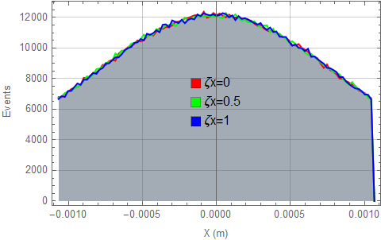

Slide 9
Backup

Slide 11
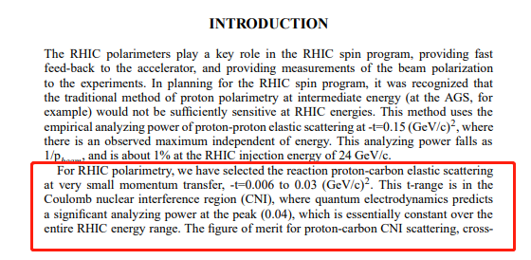
[1] O.Jinnouchi, RHIC pC CNI Polarimeter: Status and Performance from the First Collider Run, 2003

Slide 13
