Slide 1
组会汇报
6.13 杨雷

Slide 2

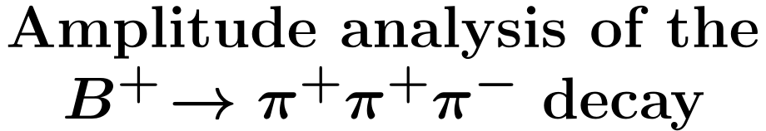
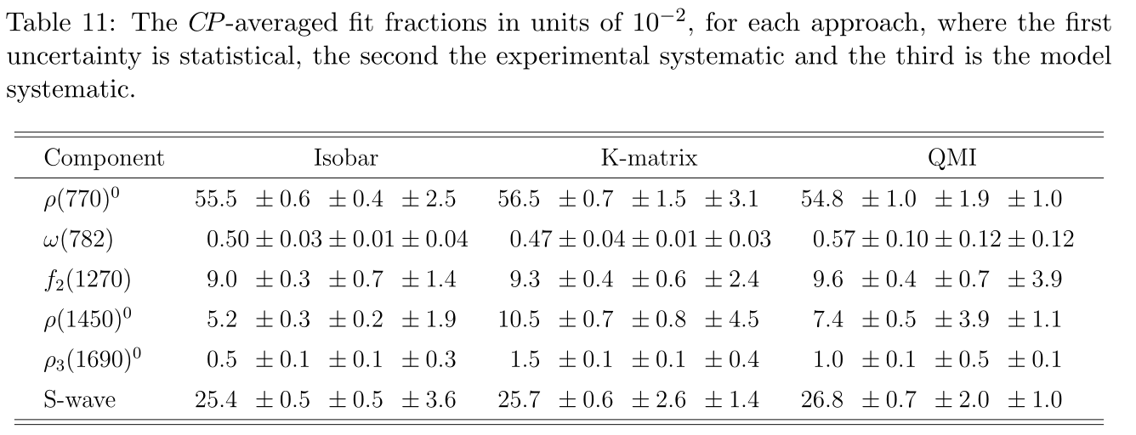
准两体衰变
衰变道

Slide 3
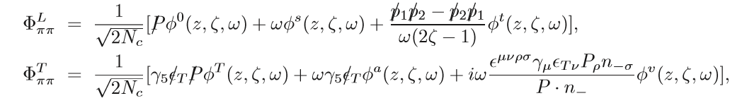
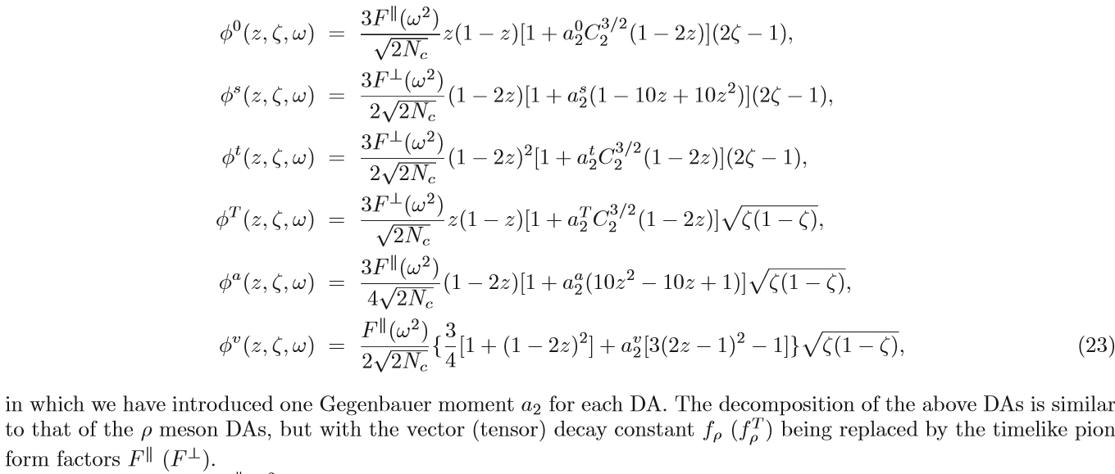

对于准两体衰变
$$𝒜\text{=}{\text{ϕ}}_{\text{B}}\text{⊗}\text{H}\text{⊗}{\text{ϕ}}_{\text{ππ}}\text{⊗}{\text{ϕ}}_{\text{π}}$$
P波两介子波函数

Slide 4
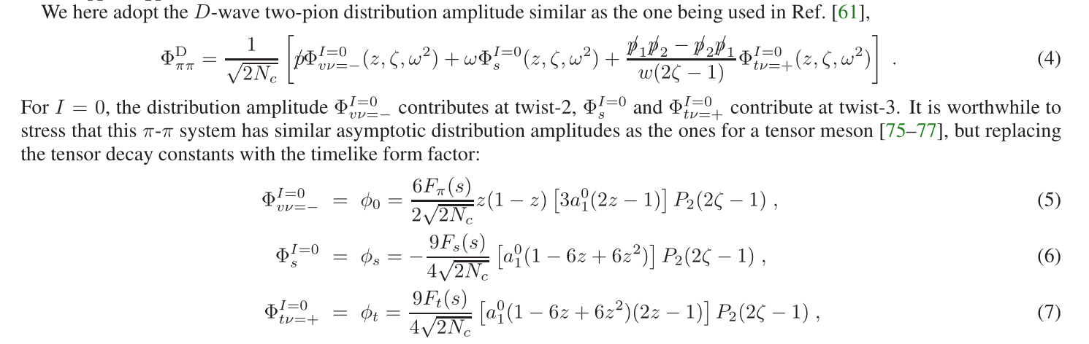
D波两介子波函数

Slide 5
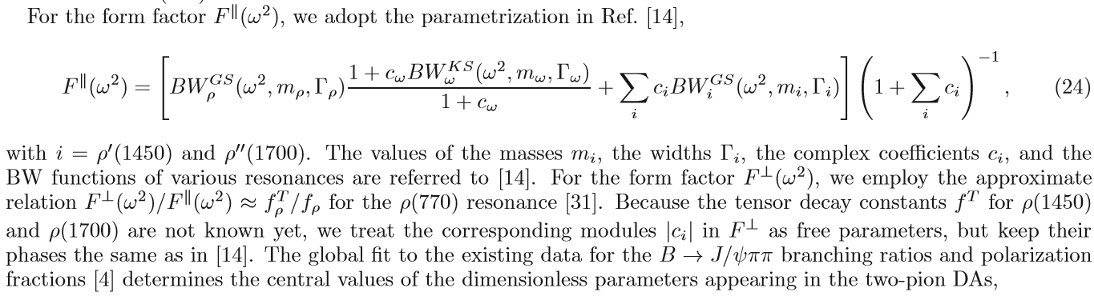
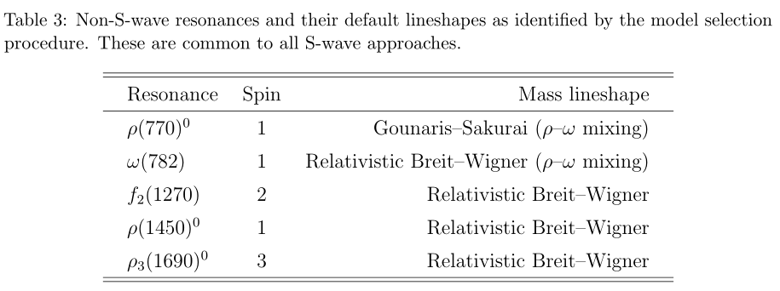

Slide 6
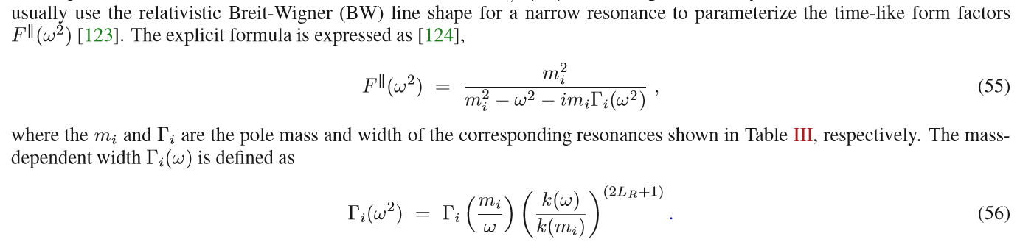
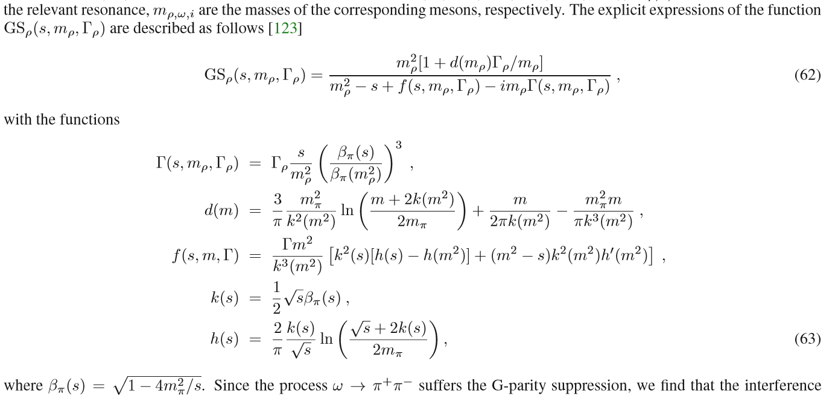

Slide 7
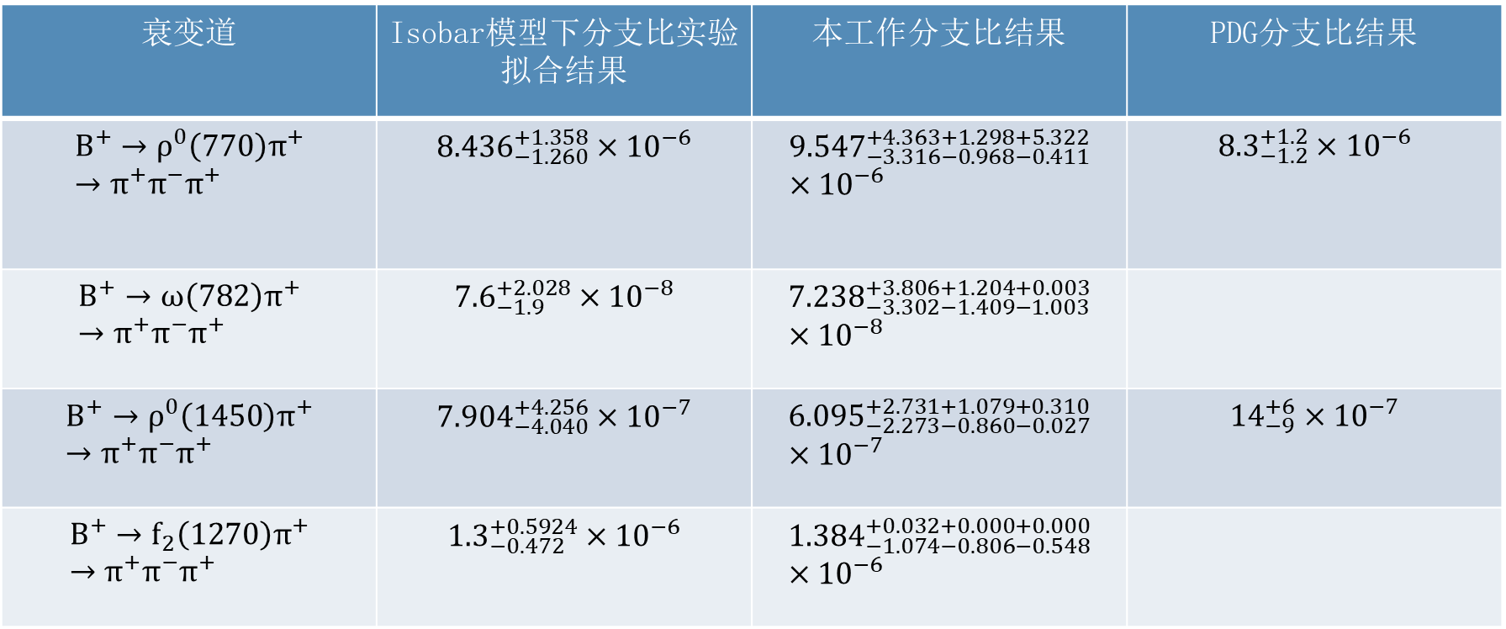
$a_{2}^{0}=−0.7,$ $a_{2}^{s}=0.8,$ $a_{2}^{0}=−1.3,\left|c_{ρ}\right|$=0.11, $\left|c_{ω}\right|$=0.01 混合角$θ=$9 rad, $a_{D}^{0}$=1.1
衰变道 | Isobar模型下分支比实验拟合结果 | 本工作分支比结果 | PDG分支比结果
$$B^{+}→ρ^{0}{\left(770\right)π}^{+}→π^{+}π^{−}π^{+}$$ | $${8.436}_{−1.260}^{+1.358}×{10}^{−6}$$ | $${9.547}_{−3.316−0.968−0.411}^{+4.363+1.298+5.322}×{10}^{−6}$$ | $${8.3}_{−1.2}^{+1.2}×{10}^{−6}$$
$$B^{+}→ω{\left(782\right)π}^{+}→π^{+}π^{−}π^{+}$$ | $${7.6}_{−1.9}^{+2.028}×{10}^{−8}$$ | $${7.238}_{−3.302−1.409−1.003}^{+3.806+1.204+0.003}×{10}^{−8}$$
$$B^{+}→ρ^{0}{\left(1450\right)π}^{+}→π^{+}π^{−}π^{+}$$ | $${7.904}_{−4.040}^{+4.256}×{10}^{−7}$$ | $${6.095}_{−2.273−0.860−0.027}^{+2.731+1.079+0.310}×{10}^{−7}$$ | $${14}_{−9}^{+6}×{10}^{−7}$$
$$B^{+}→f_{2}{\left(1270\right)π}^{+}→π^{+}π^{−}π^{+}$$ | $${1.3}_{−0.472}^{+0.5924}×{10}^{−6}$$ | $${1.384}_{−1.074−0.806−0.548}^{+0.032+0.000+0.000}×{10}^{−6}$$

Slide 8
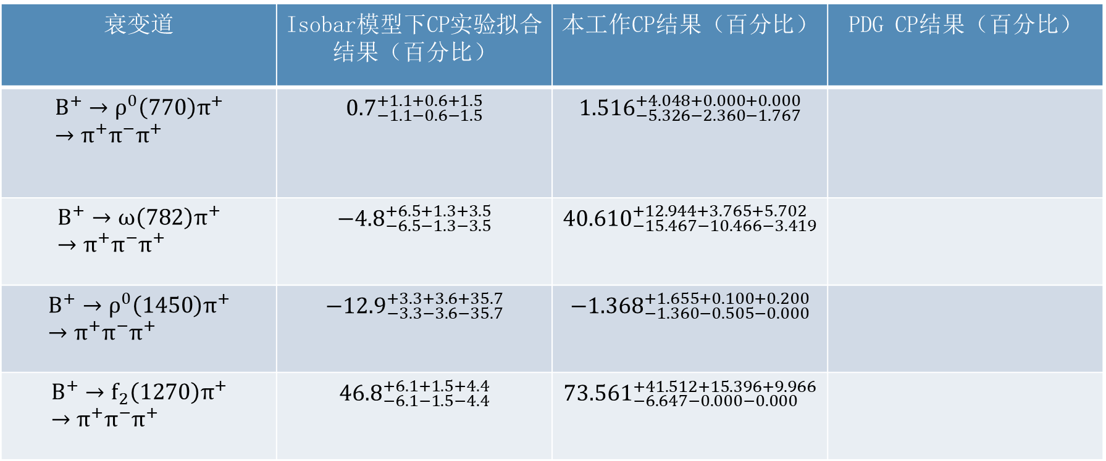
衰变道 | Isobar模型下CP实验拟合结果（百分比） | 本工作CP结果（百分比） | PDG CP结果（百分比）
$$B^{+}→ρ^{0}{\left(770\right)π}^{+}→π^{+}π^{−}π^{+}$$ | $${0.7}_{−1.1−0.6−1.5}^{+1.1+0.6+1.5}$$ | $${1.516}_{−5.326−2.360−1.767}^{+4.048+0.000+0.000}$$
$$B^{+}→ω{\left(782\right)π}^{+}→π^{+}π^{−}π^{+}$$ | $${−4.8}_{−6.5−1.3−3.5}^{+6.5+1.3+3.5}$$ | $${40.610}_{−15.467−10.466−3.419}^{+12.944+3.765+5.702}$$
$$B^{+}→ρ^{0}{\left(1450\right)π}^{+}→π^{+}π^{−}π^{+}$$ | $${−12.9}_{−3.3−3.6−35.7}^{+3.3+3.6+35.7}$$ | $${−1.368}_{−1.360−0.505−0.000}^{+1.655+0.100+0.200}$$
$$B^{+}→f_{2}{\left(1270\right)π}^{+}→π^{+}π^{−}π^{+}$$ | $${46.8}_{−6.1−1.5−4.4}^{+6.1+1.5+4.4}$$ | $${73.561}_{−6.647−0.000−0.000}^{+41.512+15.396+9.966}$$

Slide 9
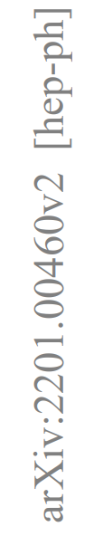
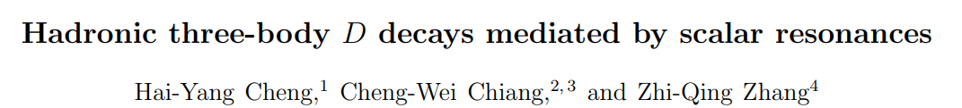
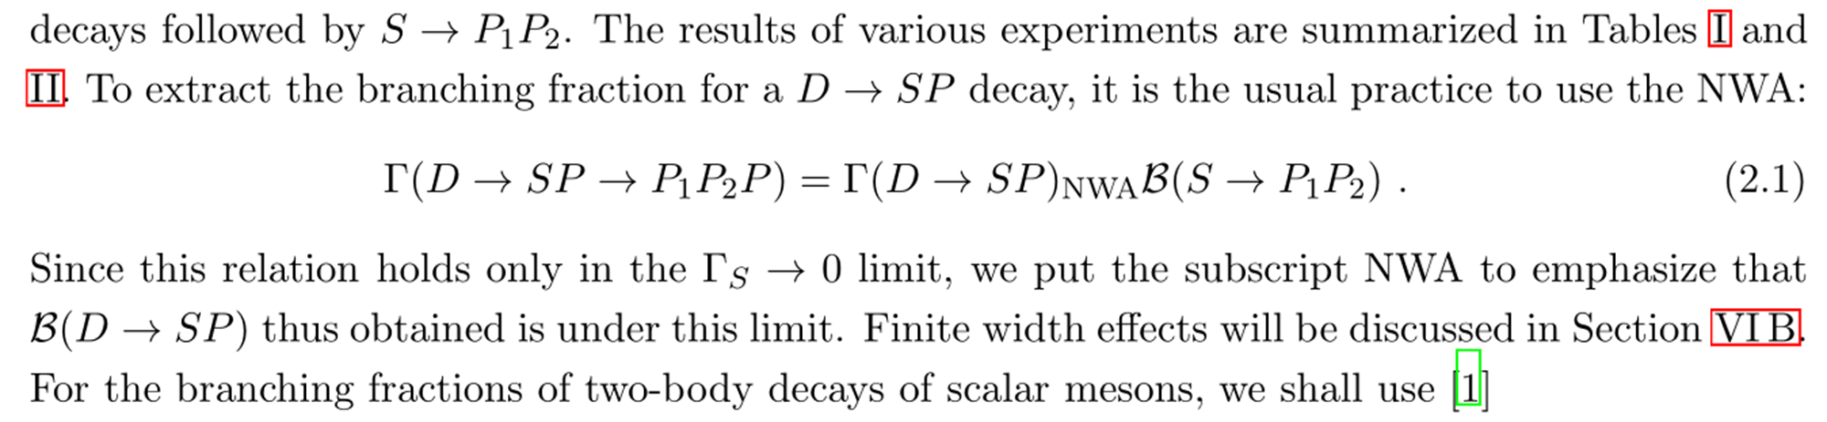
文献分享

Slide 10
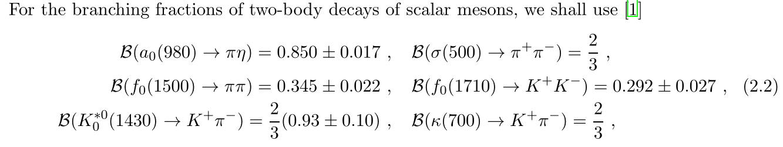

Slide 11
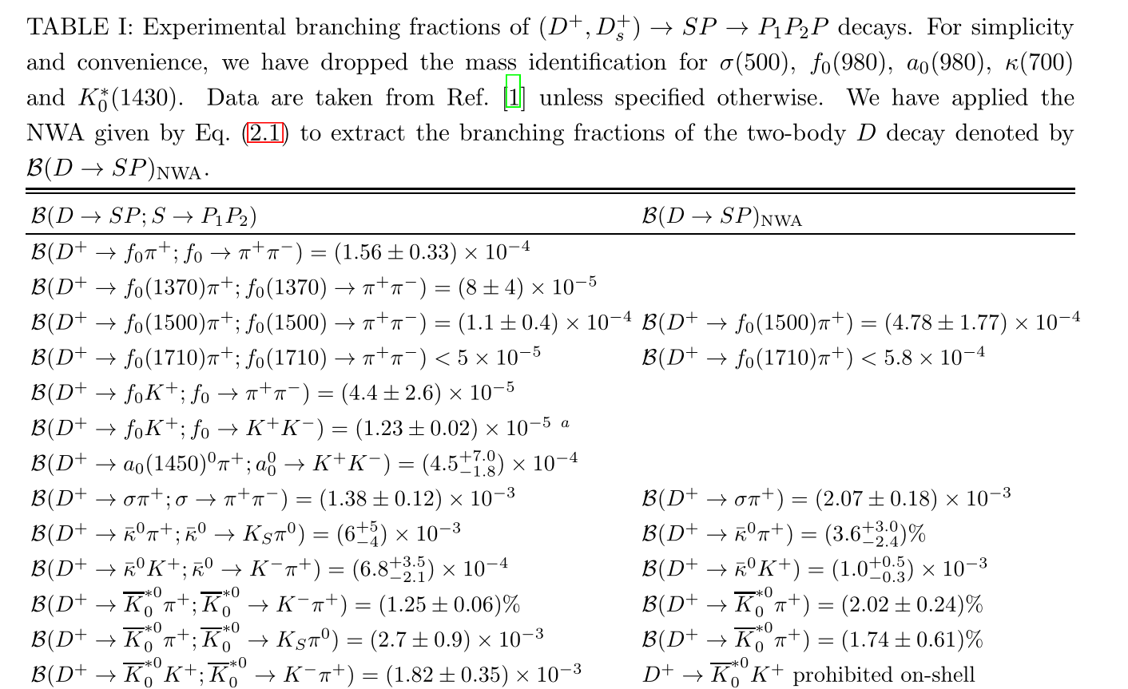

Slide 12
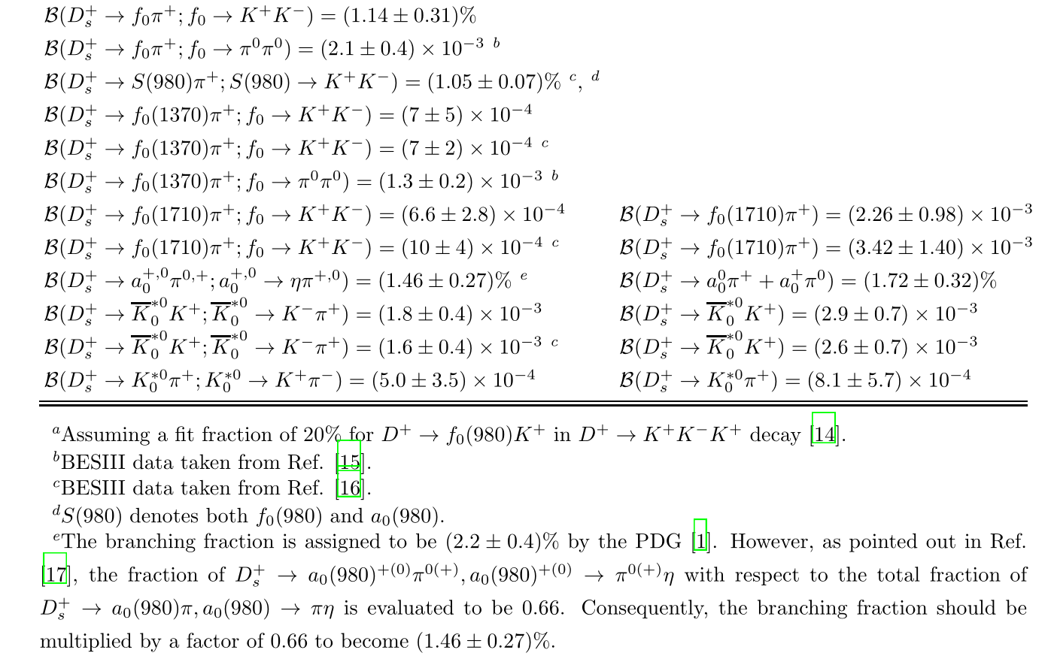

Slide 13
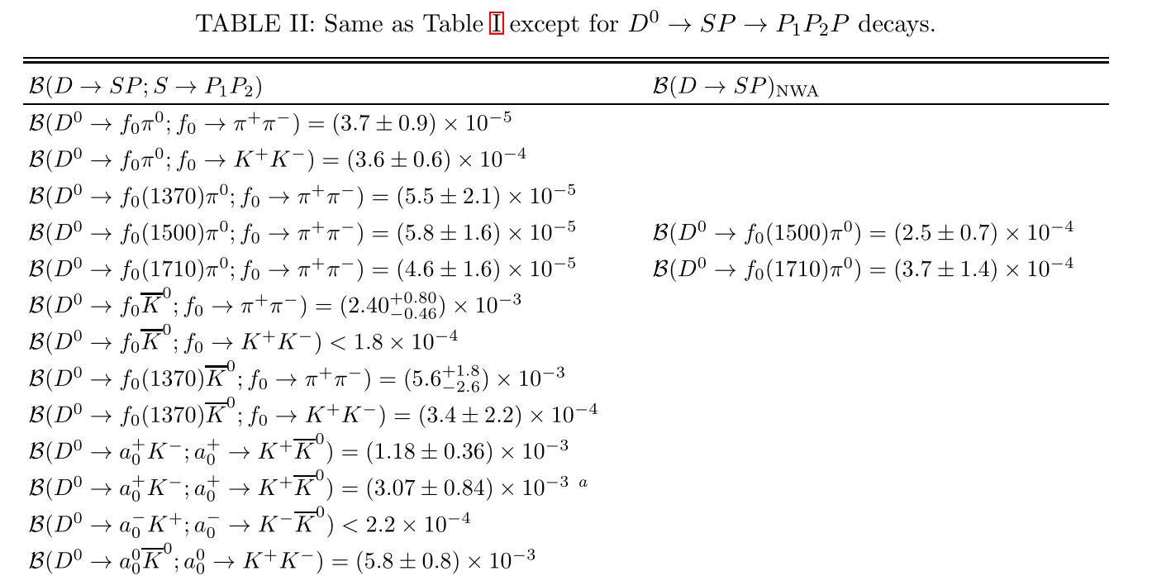

Slide 14
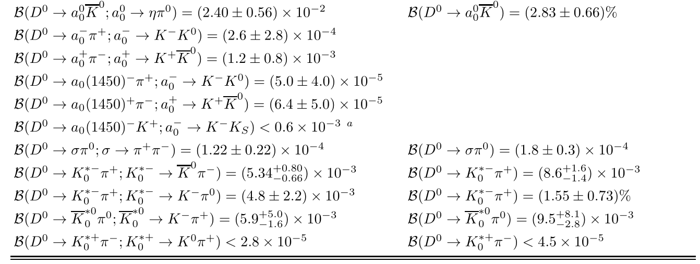

Slide 15
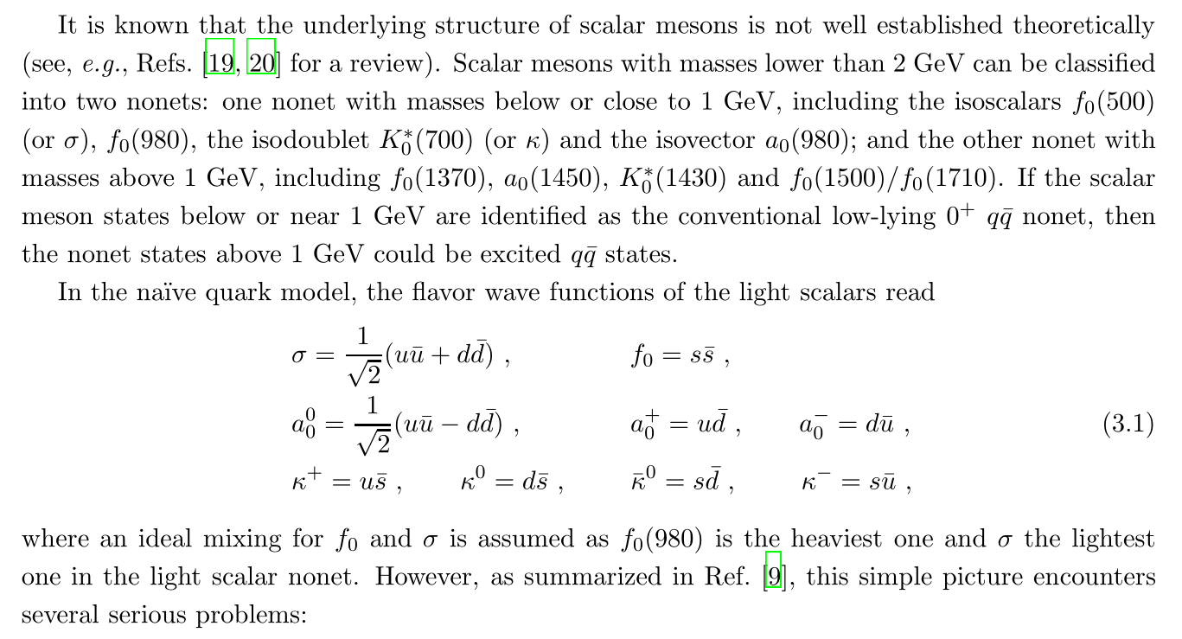

Slide 16
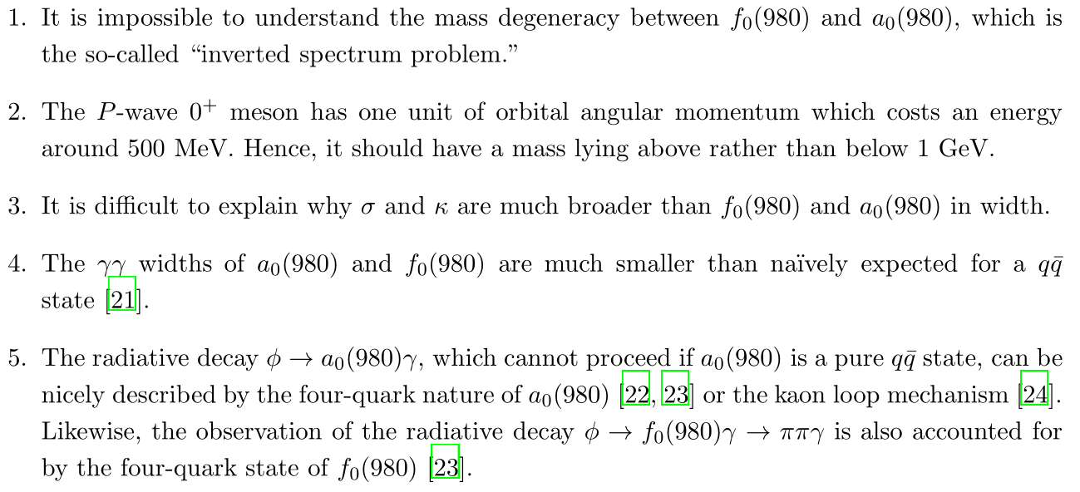

Slide 17
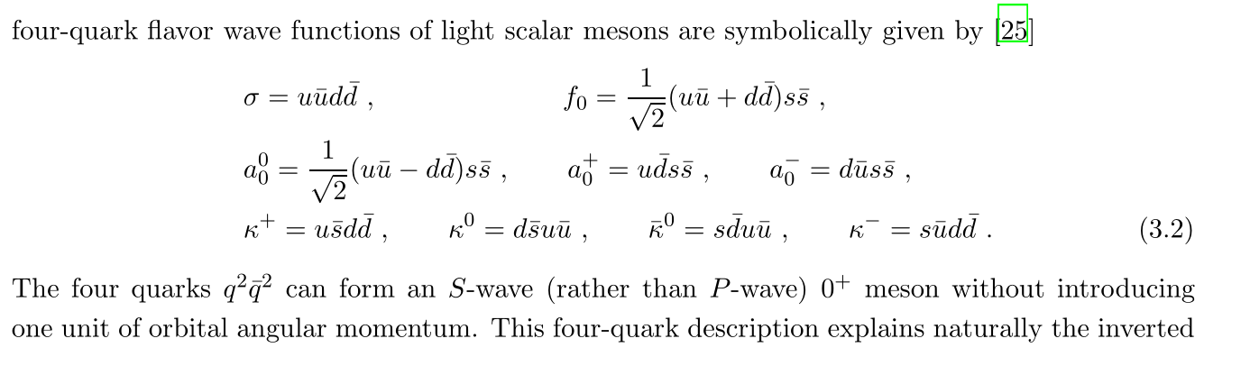
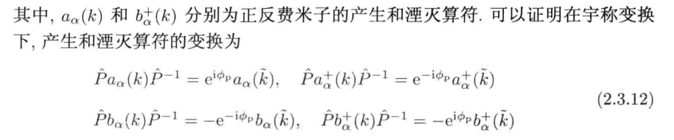

Slide 18
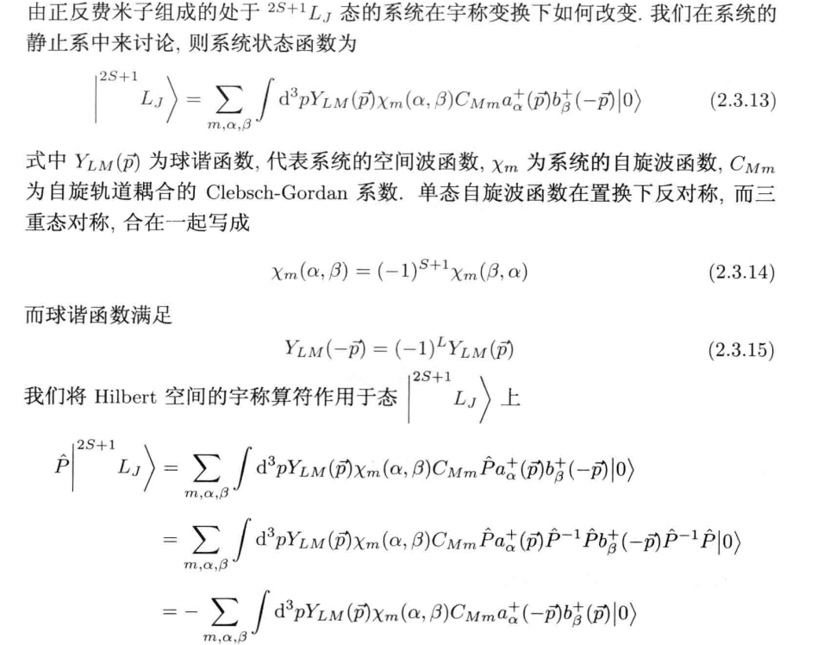

Slide 19
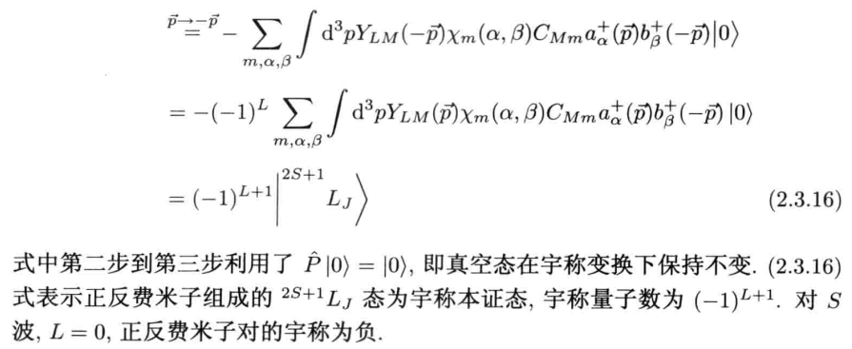

Slide 20
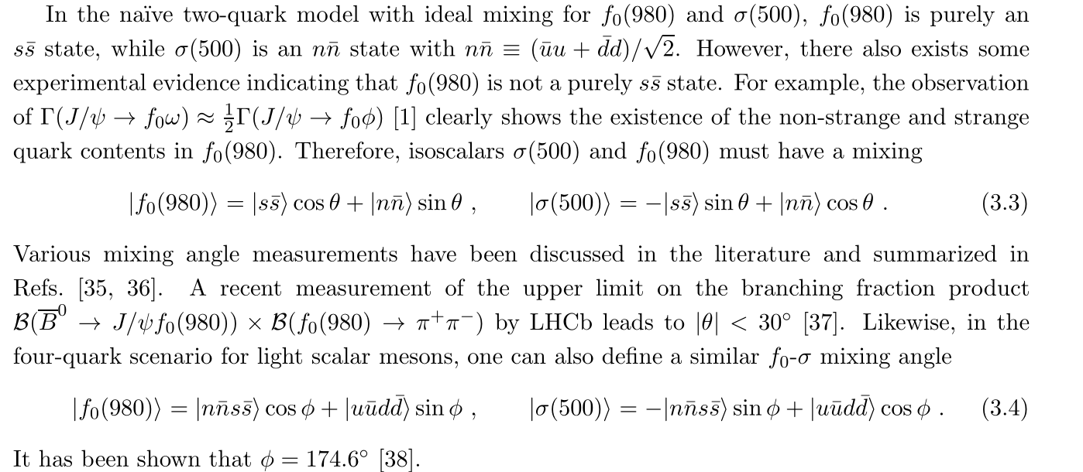

Slide 21
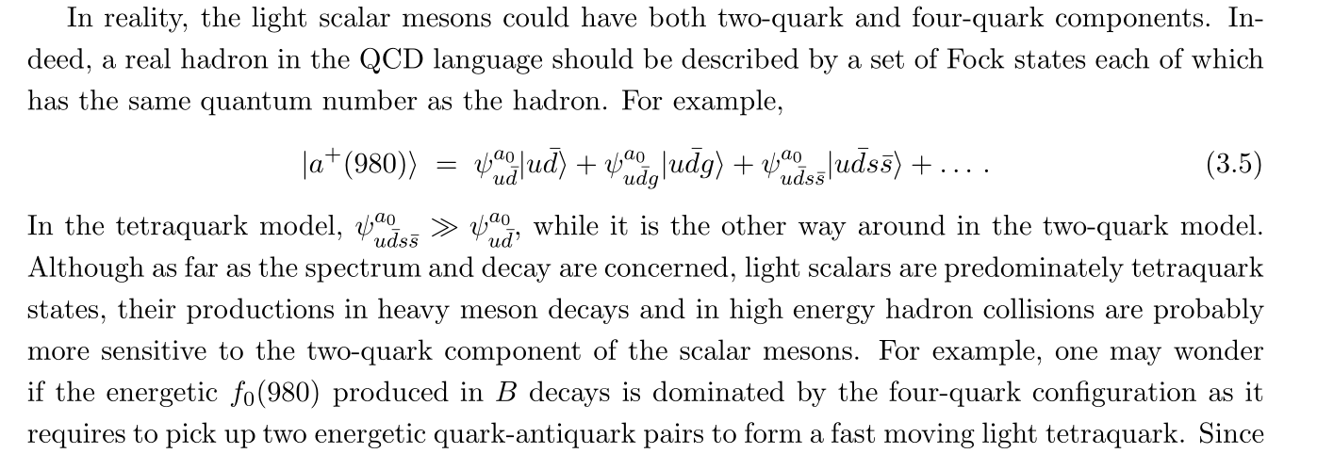

Slide 22
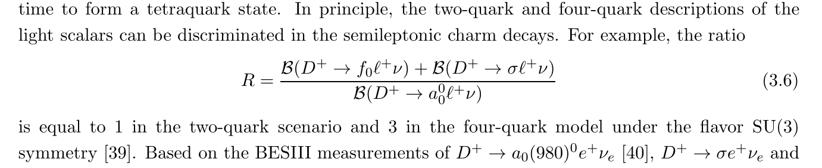
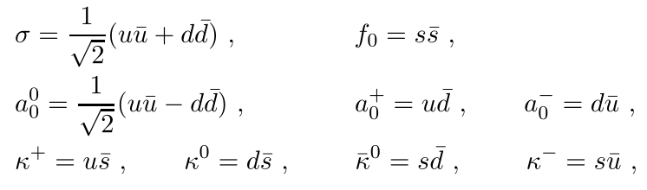
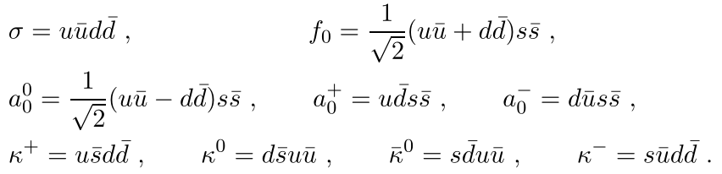
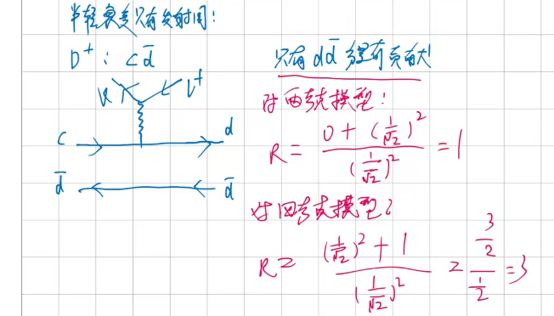

Slide 23
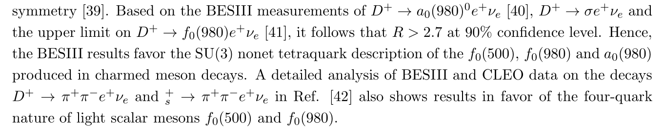
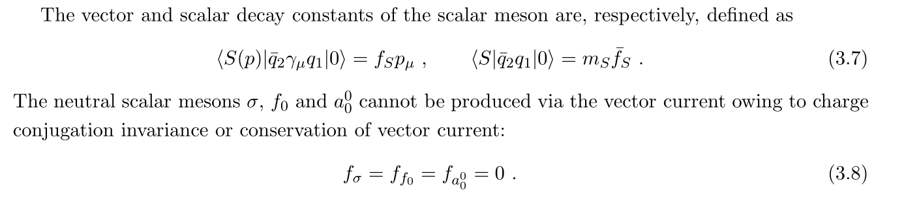

Slide 24
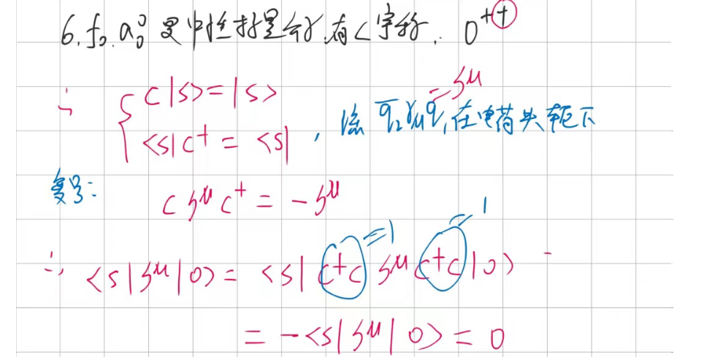
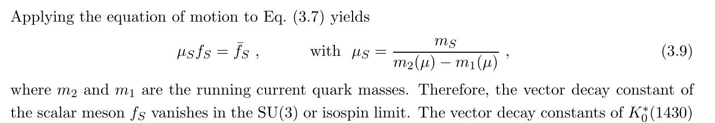

Slide 25
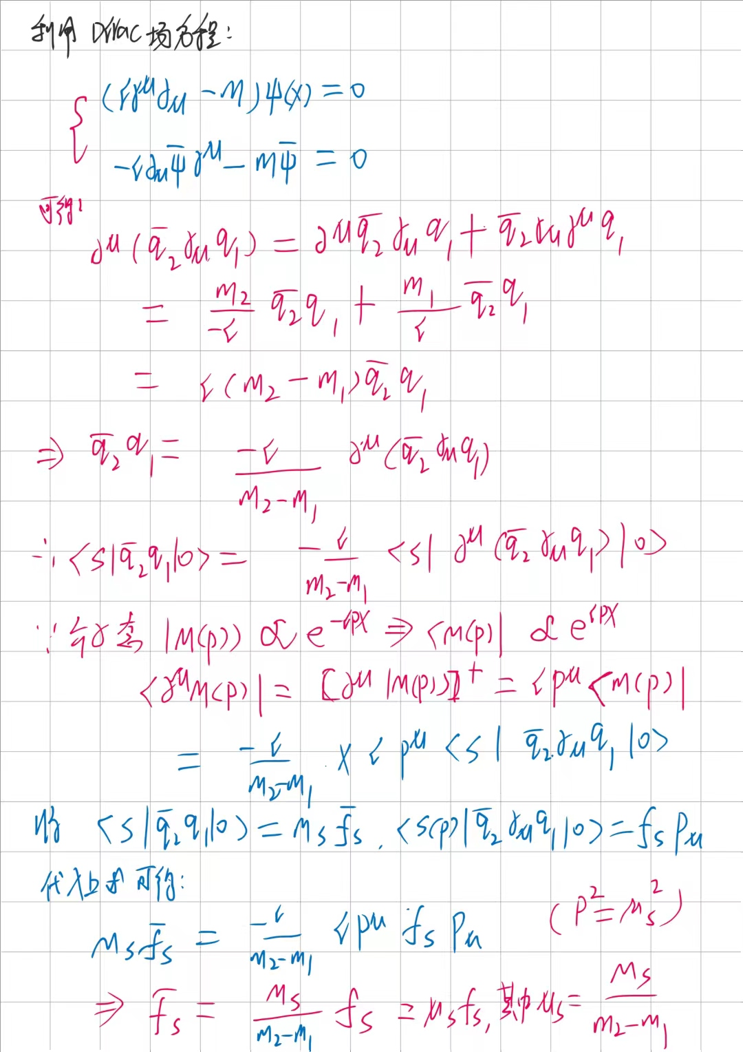

Slide 26
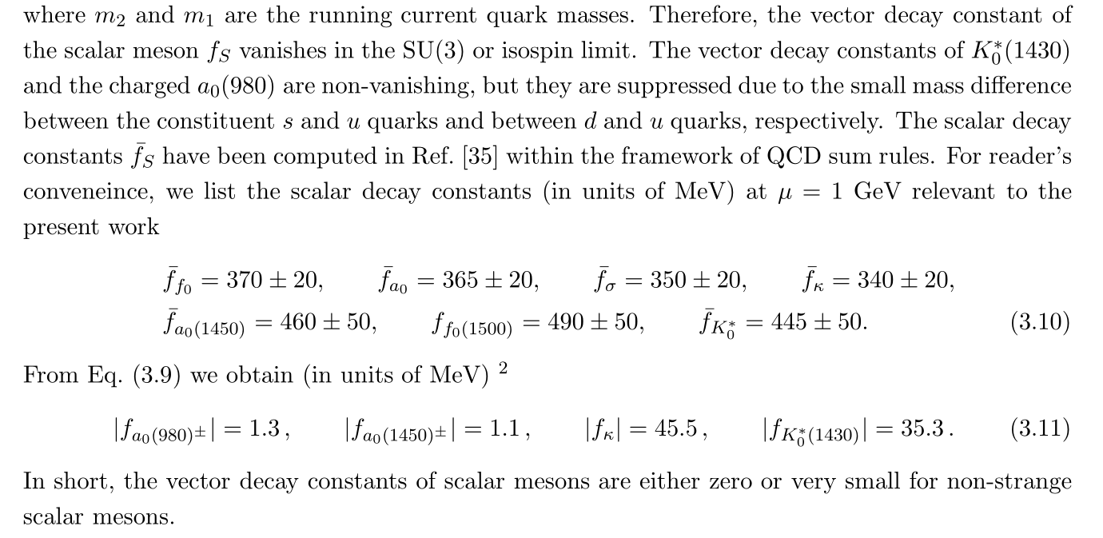

Slide 27
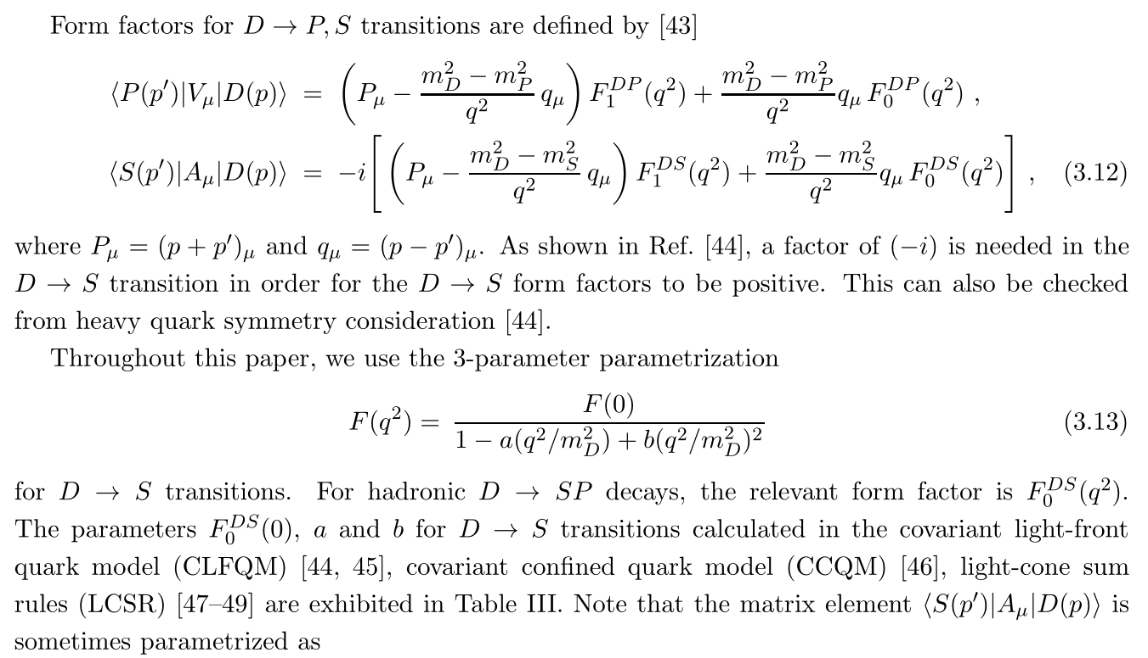

Slide 28
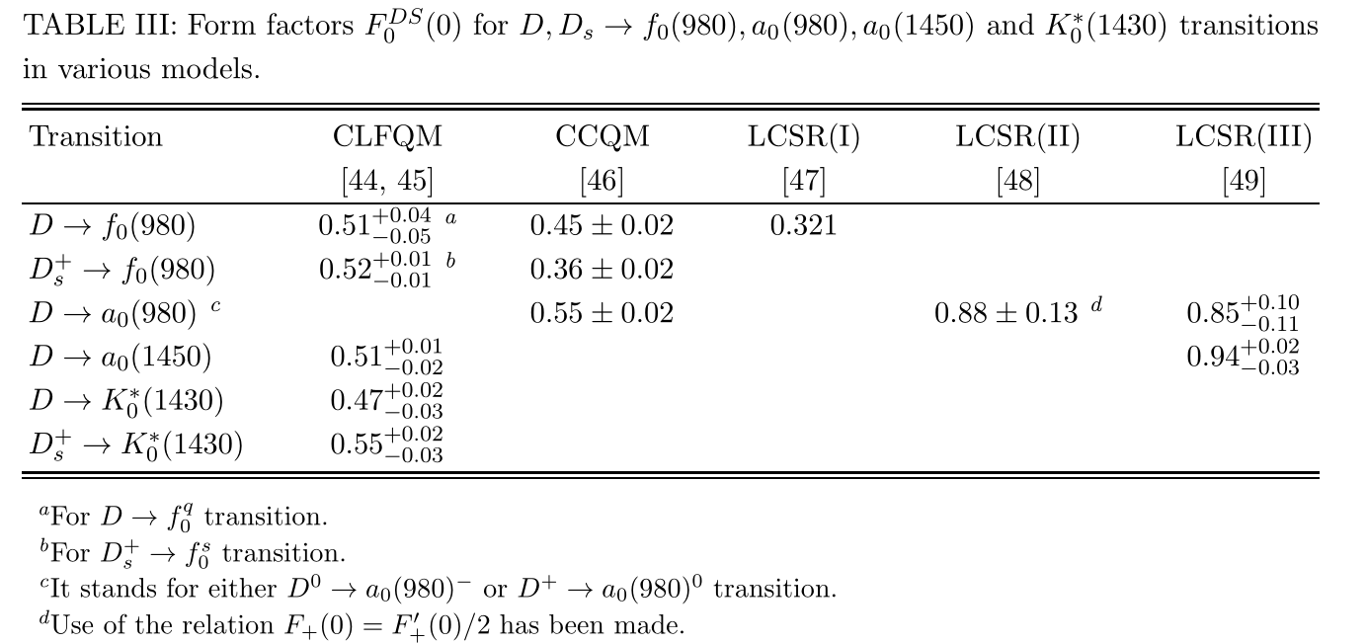

Slide 29
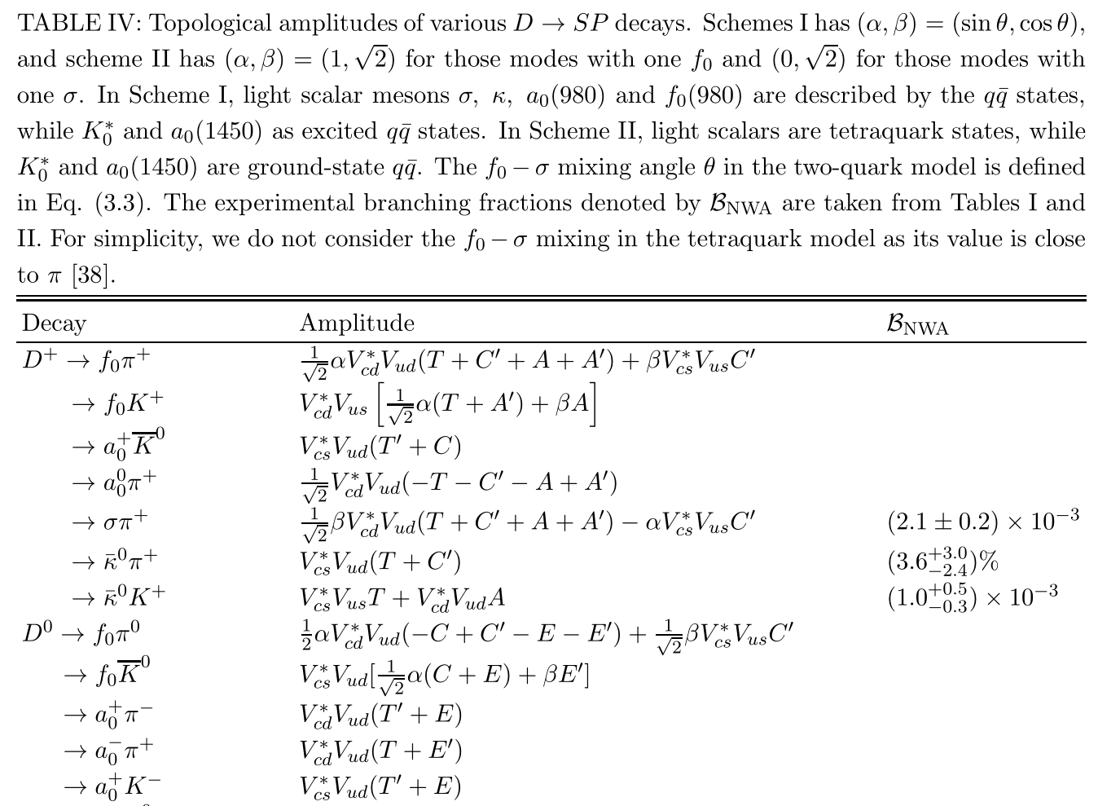

Slide 30
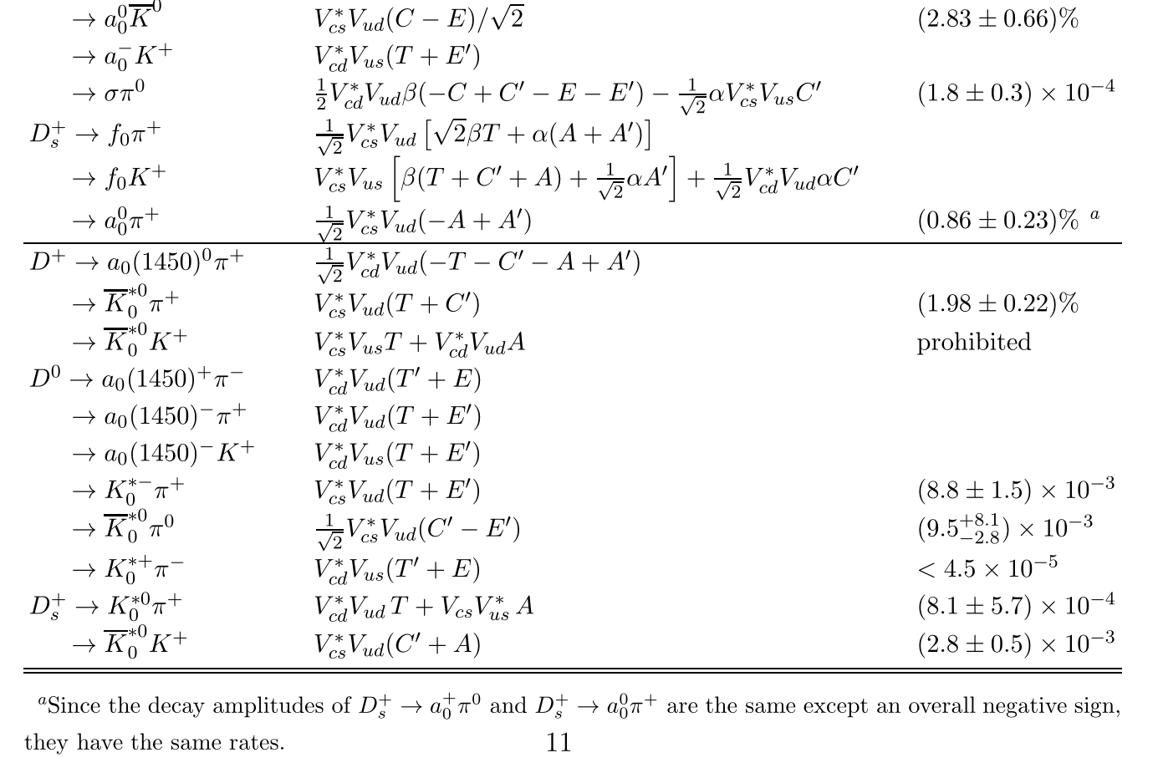

Slide 31
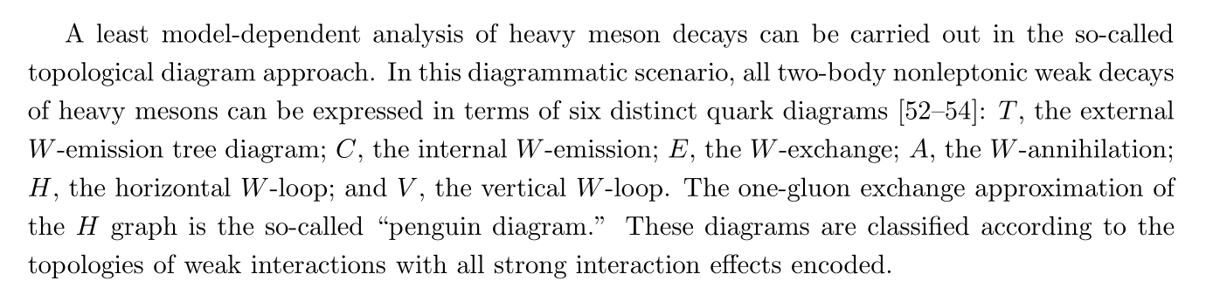
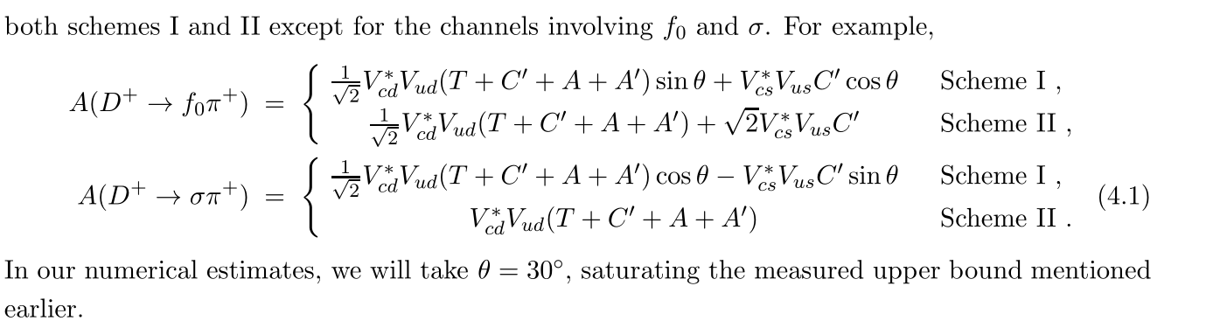

Slide 32
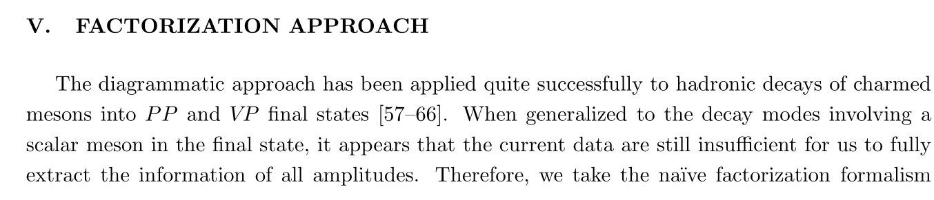

Slide 33
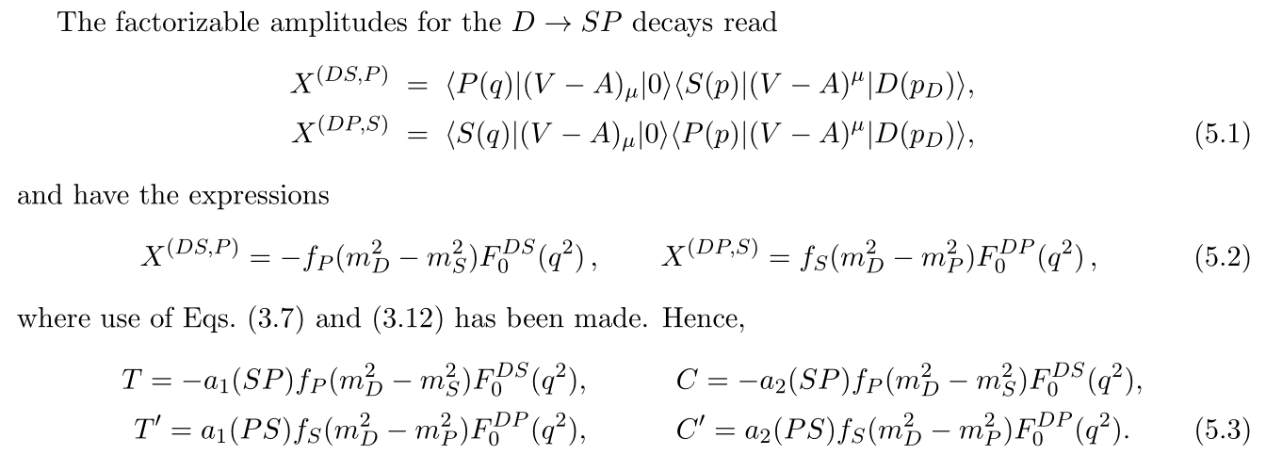
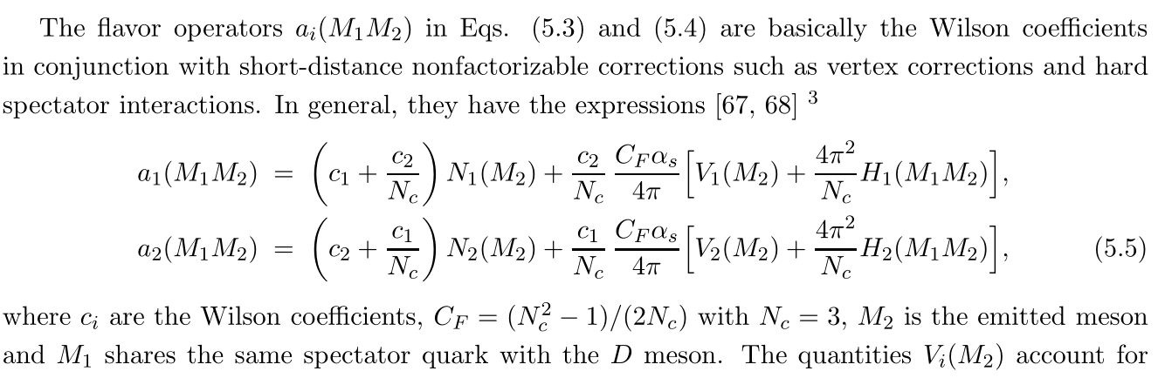

Slide 34
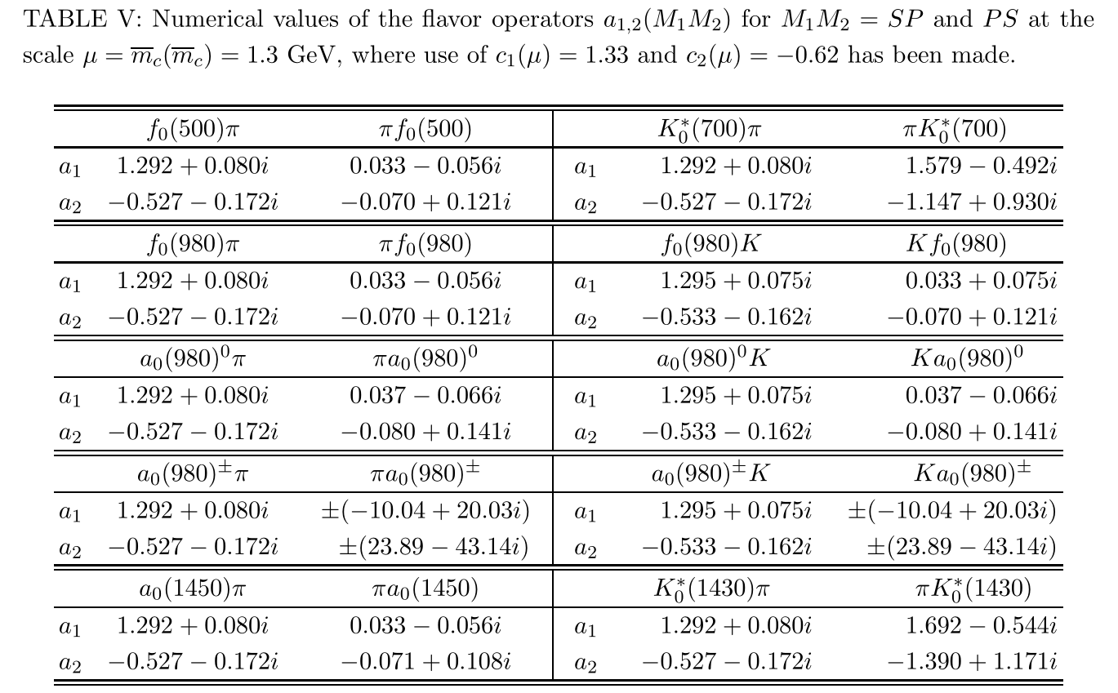

Slide 35
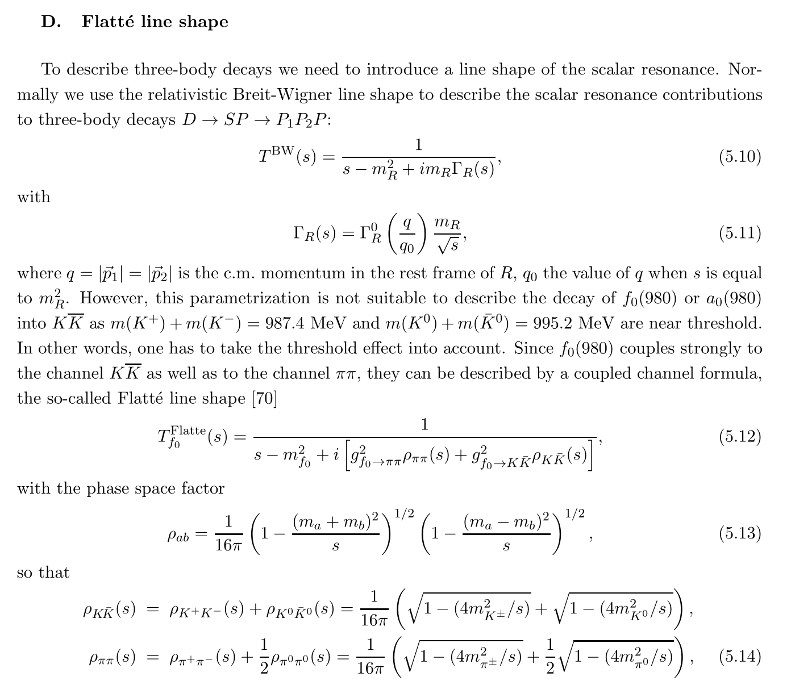

Slide 36
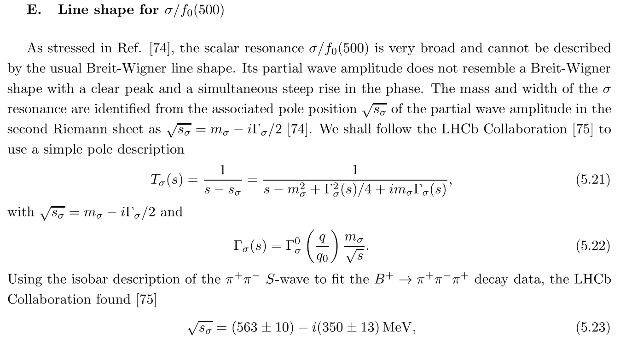

Slide 37
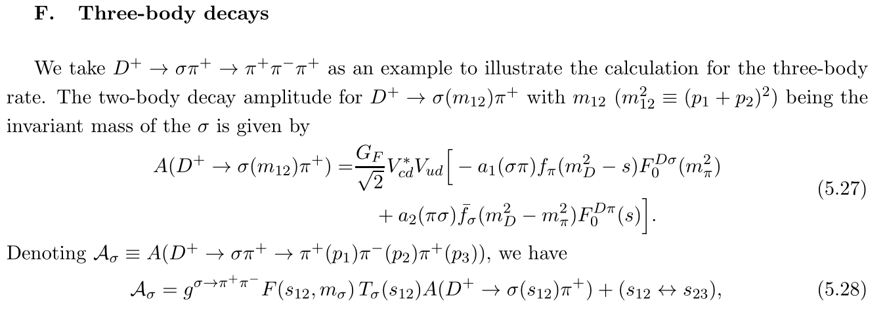


Slide 38


Slide 39


Slide 40


Slide 41


Slide 42

谢谢大家！

