Slide 1



CEPC Accelerator: TDR and Plan
Yuhui Li
On behalf of the CEPC accelerator research team
29-31. Oct. 2023, Beijing, 9th CEPC International Advisory Meeting

Slide 2
Content
Background information
TDR review meetings
  International review to the technical design
  International review to accelerator cost
  Domestic review to the civil construction
Highlights in the TDR research
Future plans
Summary

Slide 3
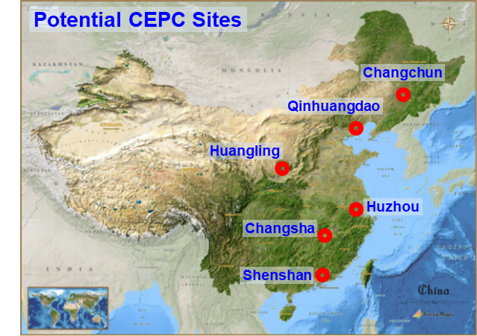
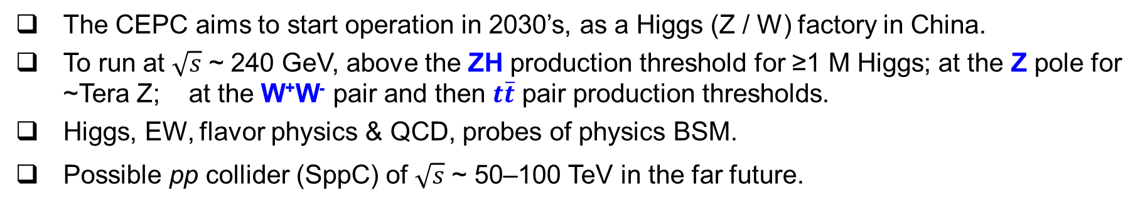

A brief introduction to CEPC
The CEPC aims to start operation in 2030’s, as a Higgs (Z / W) factory in China.
To run at $\sqrt{s}$ ~ 240 GeV, above the ZH production threshold for ≥1 M Higgs; at the Z pole for ~Tera Z; at the W⁺W⁻ pair and then $t\overline{t}$ pair production thresholds.
Higgs, EW, flavor physics & QCD, probes of physics BSM.
Possible pp collider (SppC) of $\sqrt{s}$ ~ 50–100 TeV in the far future.
IP 2
$e^{+}e^{−}$ Higgs (Z) factory
Ring length ~ 100 km
IP 1

Slide 4
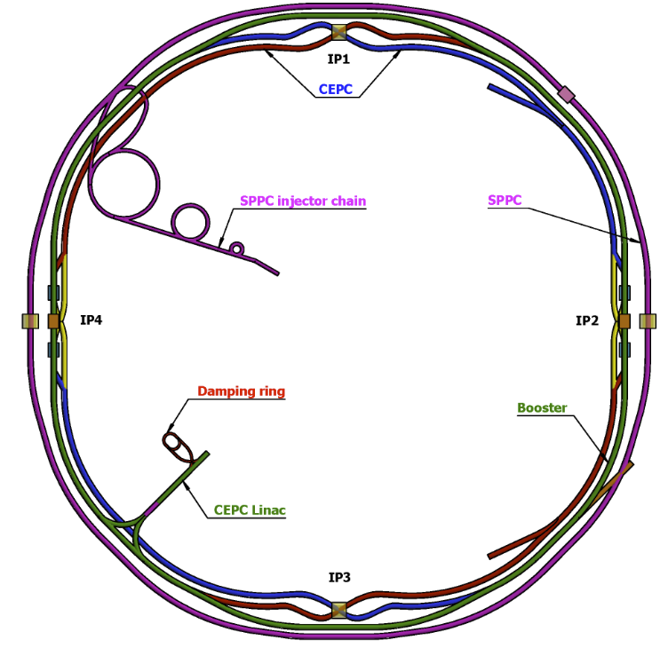
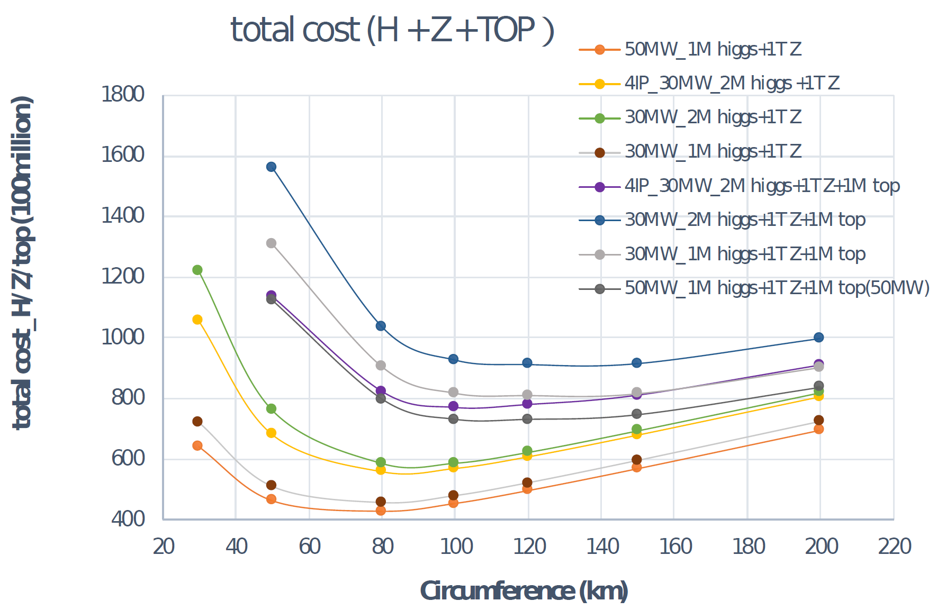
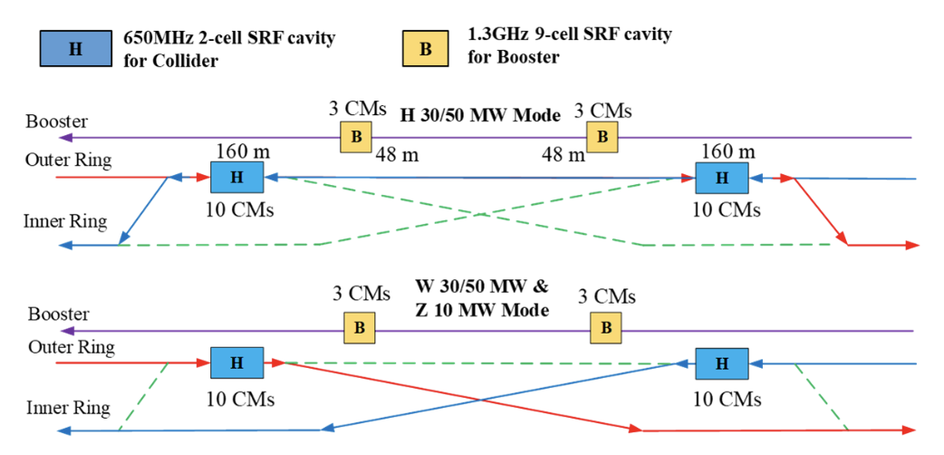
CEPC Layout and Design Essentials
Cost optimization v.s. circumference
Switchable operation for Higgs W and Z
D. Wang et al 2022 JINST 17 P10018
Baseline: 100 km, 30 MW; Upgradable to 50 MW, High Lumi Z, ttbar
Circular collider: Higher luminosity than a linear collider
100km circumference: Optimum total cost
Shared tunnel: Compatible design for CEPC and SppC
Switchable operation: Higgs, W/Z, top
Common tunnel for booster/collider & SppC

Slide 5


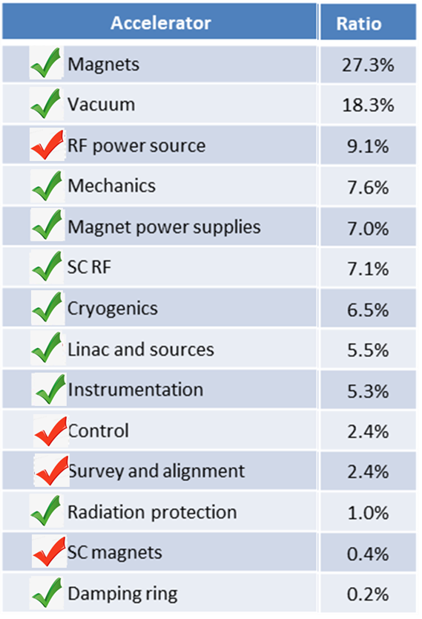
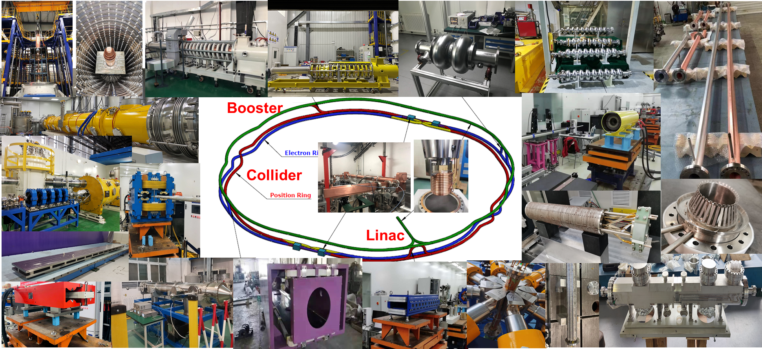
Key components and prototype R&D
Specification Met
Prototype Manufactured
Fraction
Represented Key Technologies for the CEPC
  Key technology R&D spans all component lists in CEPC CDR

Slide 6
Key Technology Readiness
  CEPC received ~ 260 Million CNY from MOST, CAS, NSFC, etc for the key technology R&D
  Large amount of key technology validated in other project by IHEP: BEPCII, HEPS, …
Novel magnets: Weak field dipole, dual aperture magnets
Extremely fast injection/extraction
Electrostatic deflector
MDI
High efficiency klystron
SRF cavities
Positron source
High performance accelerator
CEPC R&D
~ 40% cost of acc. components
High precision magnet
Stable magnet power source
Vacuum chamber with NEG coating
Instrumentation, Feedback system
Survey & Alignment
Ultra stable mechanics
Radiation protection
Cryogenic system
MDI
BEPCII / HEPS
~ 50% cost of acc. components
~10% missing factor indicates the anticipated challenges in the machine integration, commissioning etc. which is anticipated to be completed by 2026, and the international aid/collaboration may be needed.
6

Slide 7
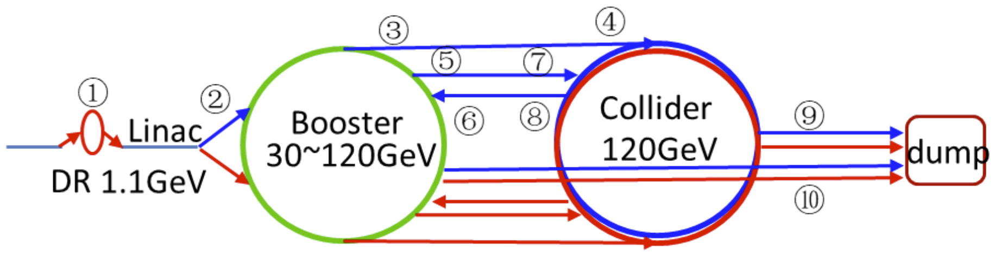

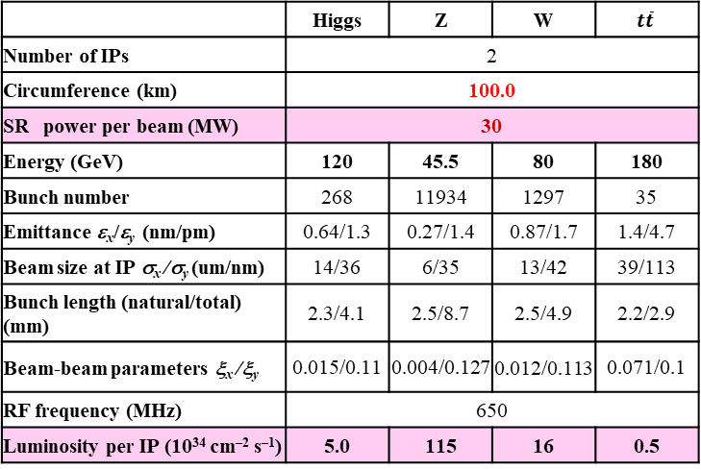
TDR main parameters
The brief TDR design parameters for different accelerator complex are as follows:
Linac
Booster
Collider
Parameter | Symbol | Unit | Baseline
Energy | E_{e-}/E_{e+} | GeV | 30
Repetition rate | f_{rep} | Hz | 100
Bunch number per pulse |  |  | 1 or 2
Bunch charge |  | nC | 1.5 (3)
Energy spread | σ_{E} |  | 1.5×10⁻³
Emittance | ε_{r} | nm | 6.5
 |  | tt | H |  | W | Z
 |  | Off axis injection | Off axis injection | On axis injection | Off axis injection | Off axis injection
Circumfer. | km | 100
Injection energy | GeV | 30
Extraction energy | GeV | 180 | 120 |  | 80 | 45.5
Bunch number |  | 35 | 268 | 261+7 | 1297 | 3978 | 5967
Maximum bunch charge | nC | 0.99 | 0.7 | 20.3 | 0.73 | 0.8 | 0.81
Beam current | mA | 0.11 | 0.94 | 0.98 | 2.85 | 9.5 | 14.4
SR power | MW | 0.93 | 0.94 | 1.66 | 0.94 | 0.323 | 0.49
Emittance | nm | 2.83 | 1.26 |  | 0.56 | 0.19
RF frequency | GHz | 1.3
RF voltage | GV | 9.7 | 2.17 |  | 0.87 | 0.46
Full injection from empty | h | 0.1 | 0.14 | 0.16 | 0.27 | 1.8 | 0.8
 | Higgs | Z | W | $$t\overline{t}$$
Number of IPs | 2
Circumference (km) | 100.0
SR power per beam (MW) | 30
Energy (GeV) | 120 | 45.5 | 80 | 180
Bunch number | 268 | 11934 | 1297 | 35
Emittance ε_{x}/ε_{y} (nm/pm) | 0.64/1.3 | 0.27/1.4 | 0.87/1.7 | 1.4/4.7
Beam size at IP σ_{x} /σ_{y} (um/nm) | 14/36 | 6/35 | 13/42 | 39/113
Bunch length (natural/total) (mm) | 2.3/4.1 | 2.5/8.7 | 2.5/4.9 | 2.2/2.9
Beam-beam parameters ξ_{x} /ξ_{y} | 0.015/0.11 | 0.004/0.127 | 0.012/0.113 | 0.071/0.1
RF frequency (MHz) | 650
Luminosity per IP (10³⁴ cm^{–2} s^{–1}) | 5.0 | 115 | 16 | 0.5
Transport line
1. Injection/Extraction to the Damping ring (e⁺) 2. Injection to the Booster ring from Linac (e⁺/e⁻)
3. Booster ring extraction system (e+/e-) 4.Collider off-axis injection system (e+/e-)
5. collider on-axis swap-out injection (e+/e-) 6. Collider swap-out extraction (e+/e-)
7. beam dump system (e+/e-)
⑦

Slide 8
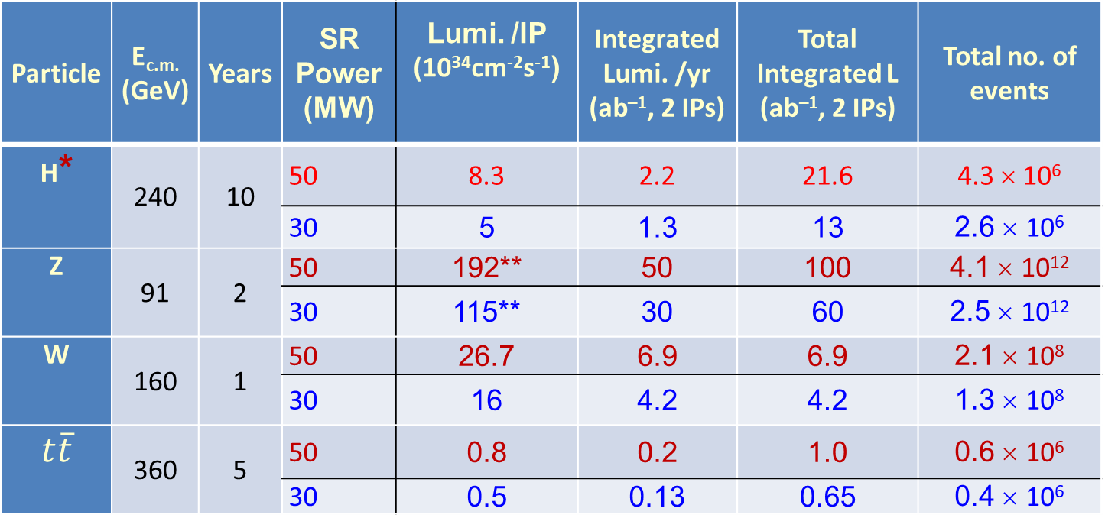
CEPC operation plan
Particle | E_{c.m.} (GeV) | Years | SR Power (MW) | Lumi. /IP (10³⁴cm⁻²s⁻¹) | Integrated Lumi. /yr (ab^{–1}, 2 IPs) | Total Integrated L (ab^{–1}, 2 IPs) | Total no. of events
H* | 240 | 10 | 50 | 8.3 | 2.2 | 21.6 | 4.3 × 10⁶
 |  |  | 30 | 5 | 1.3 | 13 | 2.6 × 10⁶
Z | 91 | 2 | 50 | 192** | 50 | 100 | 4.1 × 10¹²
 |  |  | 30 | 115** | 30 | 60 | 2.5 × 10¹²
W | 160 | 1 | 50 | 26.7 | 6.9 | 6.9 | 2.1 × 10⁸
 |  |  | 30 | 16 | 4.2 | 4.2 | 1.3 × 10⁸
$$t\overline{t}$$ | 360 | 5 | 50 | 0.8 | 0.2 | 1.0 | 0.6 × 10⁶
 |  |  | 30 | 0.5 | 0.13 | 0.65 | 0.4 × 10⁶
* Higgs is the top priority. The CEPC will commence its operation with a focus on Higgs.
** Detector solenoid field is 2 Tesla during Z operation, 3Tesla for all other energies.
*** Calculated using 3,600 hours per year for data collection.

Slide 9
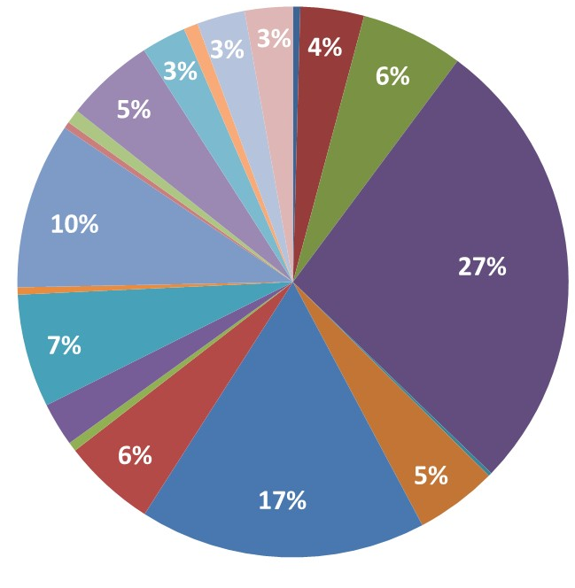
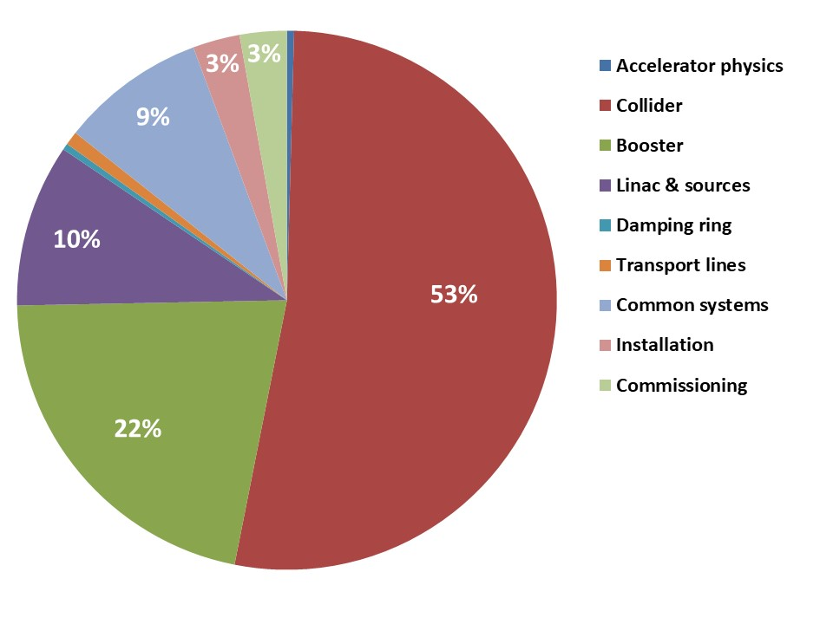
Cost proportion
System
Magnets
Vacuum
Linac and sources
Mechanics
RF power source
Instrumentation
Cryogenics
Magnet power supplies
SRF
Installation (3%)
Commissioning (3%)
Survey and alignment
Control
Radiation protection
Transport lines
Inj. / Extr.
Beam separation system
Accelerator physics
Damping ring
SC magnets

Slide 10
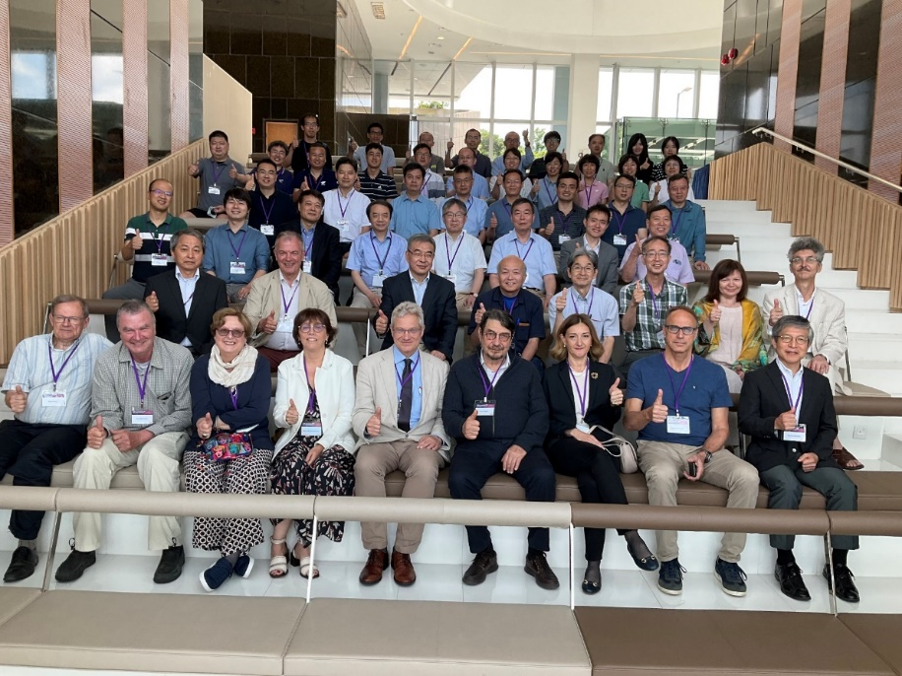
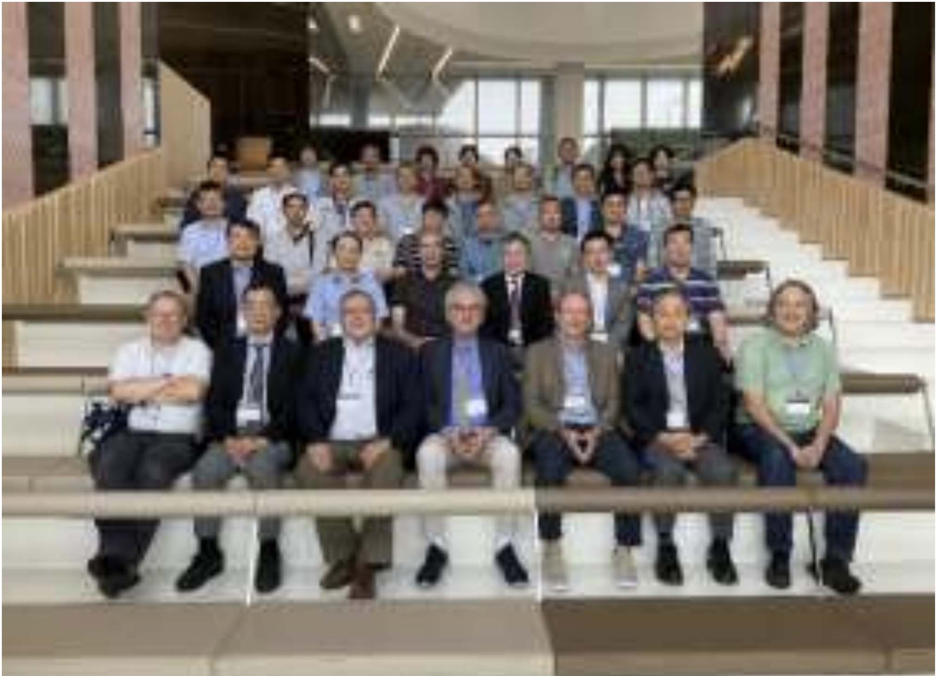
TDR international reviews
The CEPC Accelerator TDR covers
  The design and the knowledge and progress gained by the CEPC
  The advancement of the technologies the CEPC depends upon, delivered through the comprehensive R&D program, HEPS experience and international contributions and cooperation
  New, innovative ideas and future upgrades to make the CEPC start-of-art as times moves forward
  The costs
Two phases of reviews conducted by different committees
Phase-I: This review on the technical aspects of CEPC accelerator June 12-16, HKUST
  Phase-II: Review on the cost aspects
  civil cost review by a domestic committee June 26, 2023
  committee report was presented to an international panel July 17, 2023, online
  cost of accelerator technical system reviewed by an international committee September 11-15, 2023, HKUST
Group photos of the TDR technical & cost review meetings, Hongkong

Slide 11
Technology review presentations
31 specific topic talks + 2 overview talks
Theoretical design and optimization:
Key technology R&D:
The lattice and dynamic aperture optimization for collider
Booster lattice and damping ring design
Beam-beam effects studies in CEPC
MDI design
CEPC SRF system for collider, booster and upgrade plan
Collective instabilities to collider, booster and damping ring
Designs of CEPC electron and positron injection linac
CEPC beam transport lines and timing designs
CEPC application potentials as an advanced photon source
Plasma acceleration as the backup solution for the injector
CEPC polarization studies
SppC design and the compatibility with CEPC
CEPC collider ring magnets development
CEPC booster magnets development
CEPC MDI SC magnet development
CEPC magnets power sources and electrostatic deflector
Injection/extraction kickers, pulse generators and septum
Vacuum system and key technologies
SRF cavity and relevant key technology development
CEPC electron/positron injector linac key technologies
RF power source development and the distribution system
Instrumentation and beam diagnostics system
Mechanical system, MDI collimator and supports
CEPC control system
CEPC radiation protection and beam dumps
Installation plan and alignment issues
SppC high field SC magnet dipole development
Common utilities and civil construction:
Cryogenic system design and key technologies
CEPC auxiliary facility and power consumption
CEPC site and civil engineering design
Industrialization preparation and Deep-C documentation

Slide 12
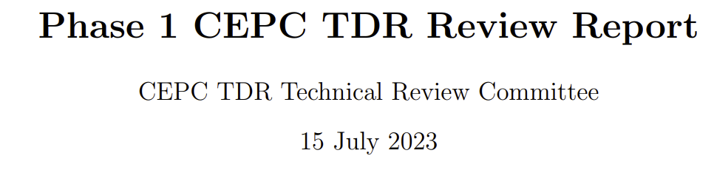
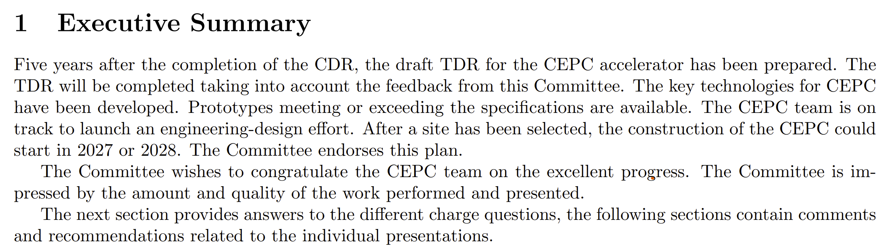
Technical review reports
Committee chaired by Frank Zimmermann

Slide 13
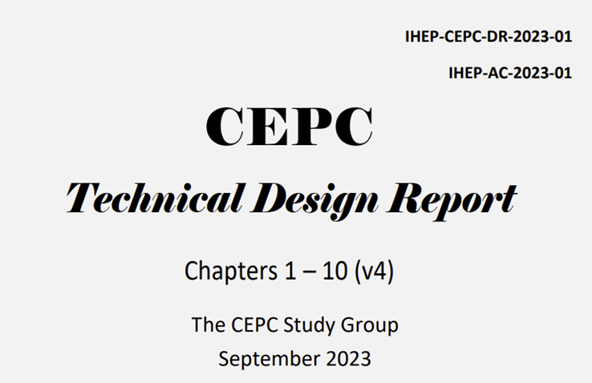
Major activates to finalize the TDR
The draft TDR for the review in June was revised
- adding the latest results to some prototypes (full length magnet measurement, electrostatic septum, …)
- addressing the recommendations from the TDR review
The revised chapters of TDR was completed by the end of September

Slide 14
Technology review presentations
Theoretical design and optimization:
Key technology R&D:
Collider ring design, components and specifications
Booster&damping ring design, components and specification
e-/e+ linac injector design and components
Transport line and components
MDI design and components
SRF system cost estimate
Booster and transport line magnets and their cost
Collider ring magnet and cost evaluation
MDI SC magnets and their cost
CEPC magnet power sources and the cost
Injection/extraction system and the cost
CEPC vacuum system and its cost
The e+/e- linac injector cost evaluations
CEPC RF power source TDR cost
Instrumentation and beam diagnostics cost
Cost review for the mechanical system
Cost of the control system
Cost review to the radiation protection and dumps
SR application and preliminary cost evaluation
CEPC cost review to the alignment
Common utilities and civil construction:
Cryogenic system and the TDR cost
Cost of the CEPC auxiliary facility
22 specific topic talks + 2 overview talks
https://indico.ihep.ac.cn/event/20278/timetable/

Slide 15
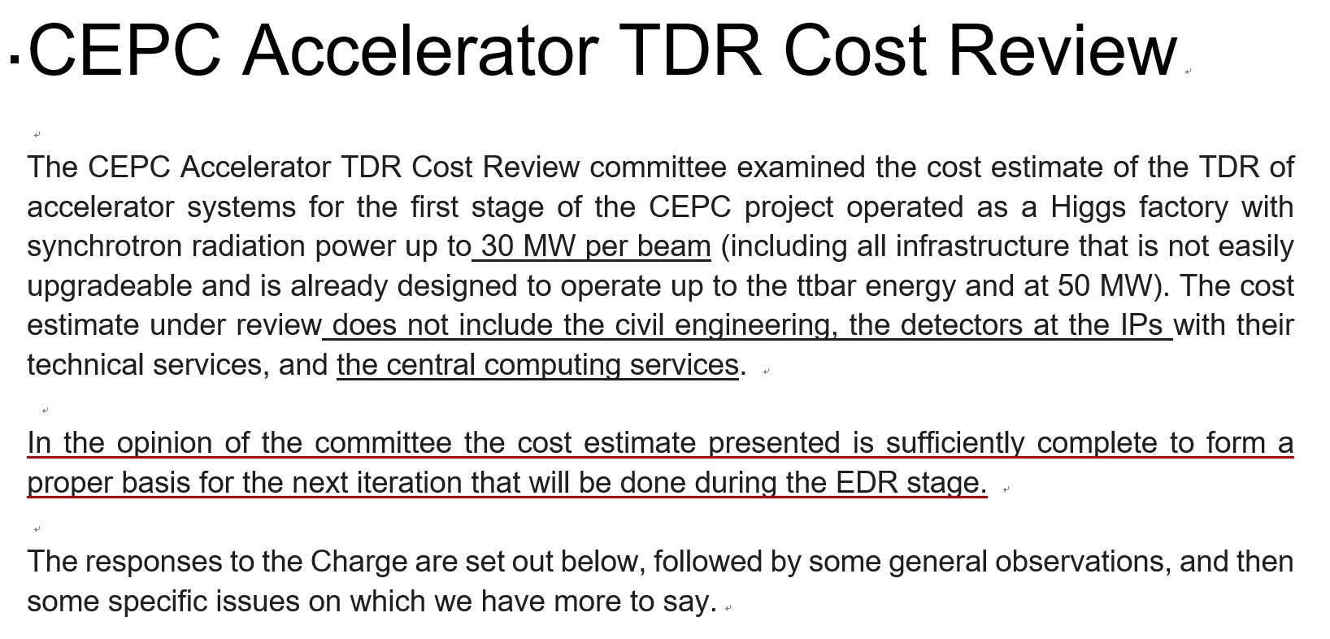
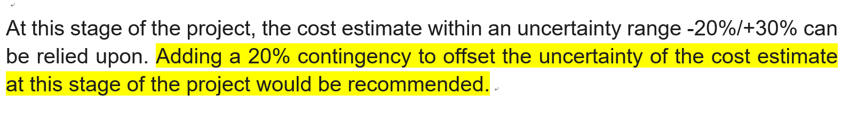
Cost review report
Committee chaired by Loinid Rivkin
……

Slide 16
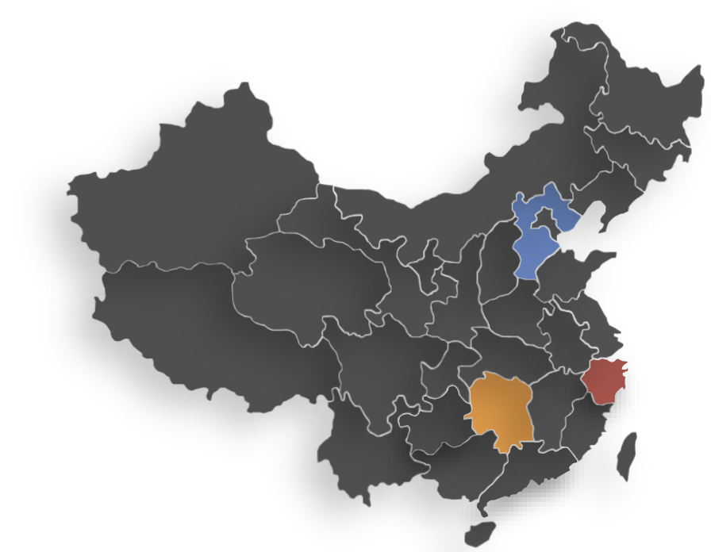
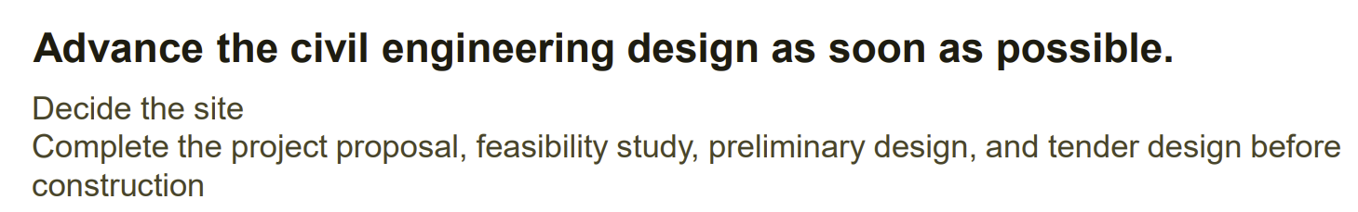
Domestic civil review
A dedicative civil cost review was made on June. 24. Three experienced companies, ①Yellow River Engineering Consulting Co., Ltd, ② HUADONG Engineering Corporation Limited,③ ZHONGNAN Engineering Corporation Limited, were invited to evaluate the civil construction cost respectively for three candidate sites: Changsha, Huzhou and Qinhuangdao
An authoritative organization has reviewed the cost evaluation given by the 3 companies. Report has been delivered.

Slide 17
Civil review report to IAC subpanel
The conclusion of the domestic review was reported to a special, separate CEPC-TDR international review subpanel on 17th. July.
Civil construction incorporates both subterranean structures and above-ground buildings :
  - main tunnel - auxiliary tunnel - shafts - adits -experimental hall -service caverns
  Mechanical structures and equipment encompass cranes, elevators, tracks, and associated machinery. Temporary constructions encompass roads and buildings required during the construction period, intended for subsequent demolition.
  Costs related to land acquisition and population relocation are not incorporated, as they fall under local government coverage. Other expenses entail fees for environmental evaluation, water and soil preservation are also not incorporated.
  The proper method was used to evaluate the cost of civil construction.
  The drill-expo method is used to evaluate the cost of tunnel excavation

Slide 18
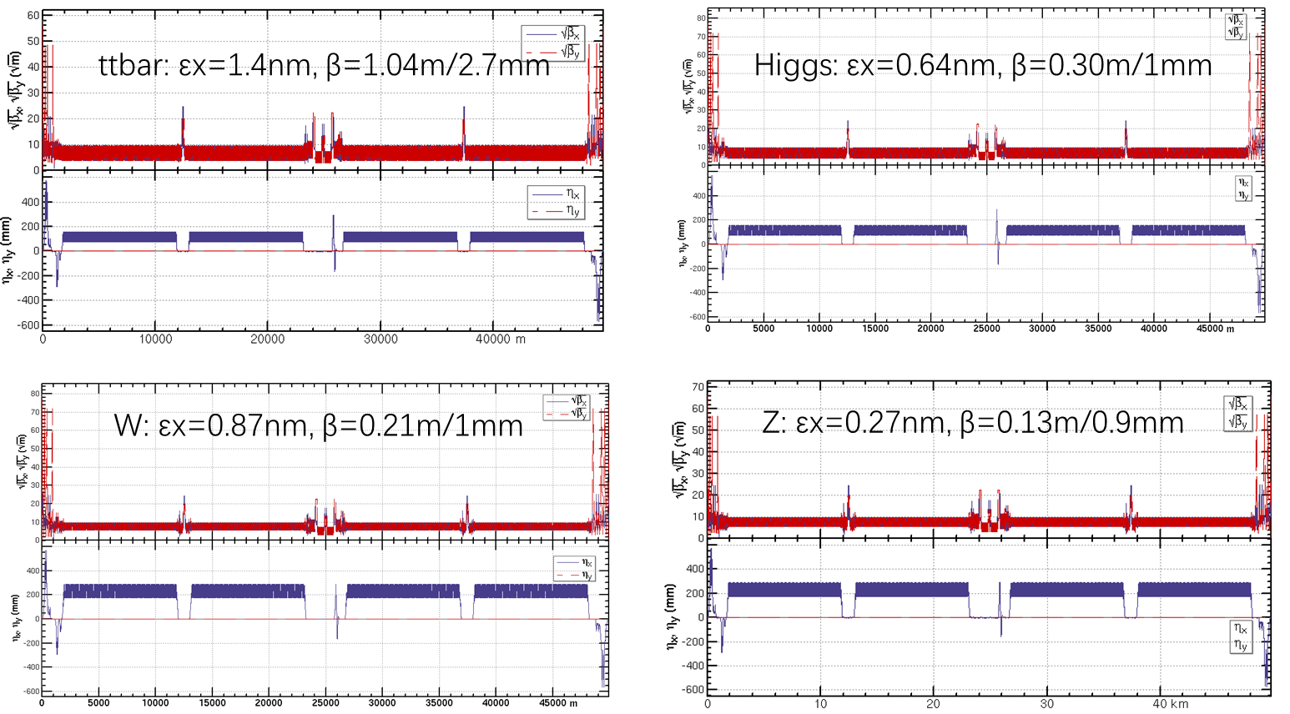
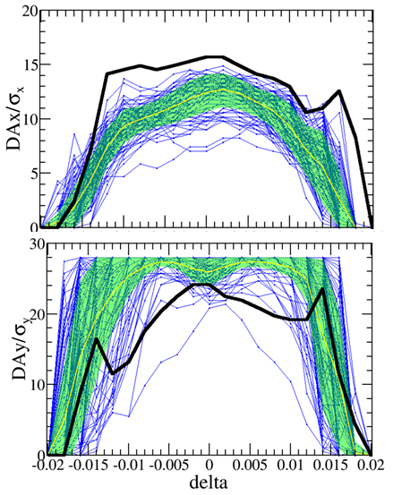
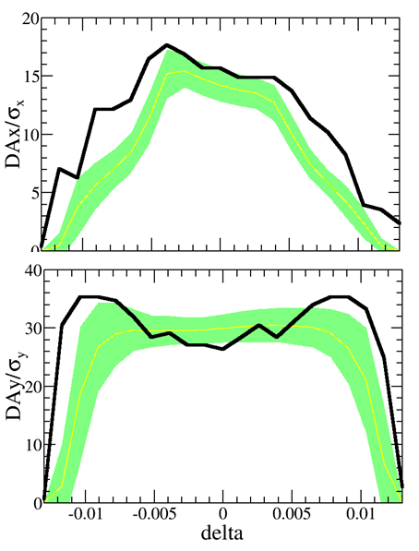
Highlights: collider lattice for all energies
Lattice design for MDI, Arc, straight line for all modes
Emittance & DA with errors
The global lattice design for the regions of MDI, Arc, straight line, was conducted for all energies;
Emittance and DA for all modes were optimized. Errors were included and mitigation measures were carried out;
Based on the physical design, the CEPC main parameters, including luminosities, are calculated

Slide 19
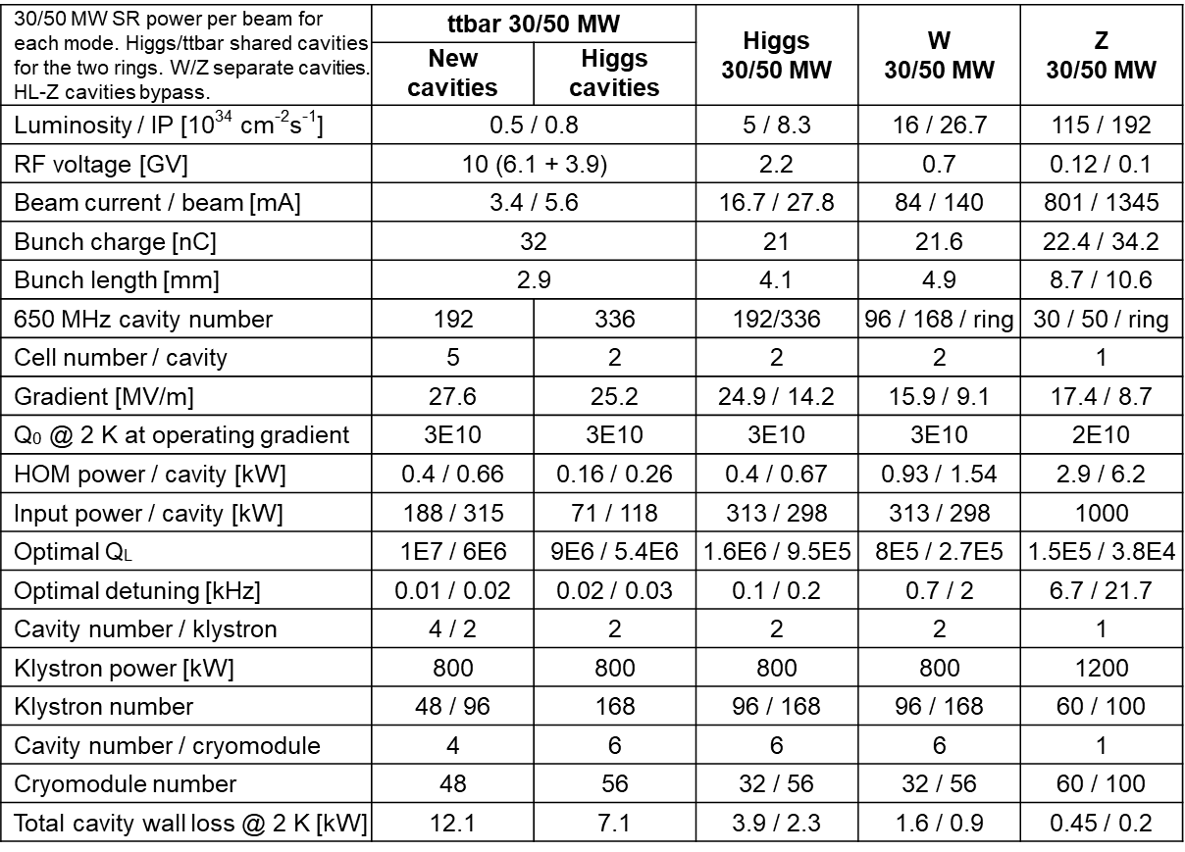
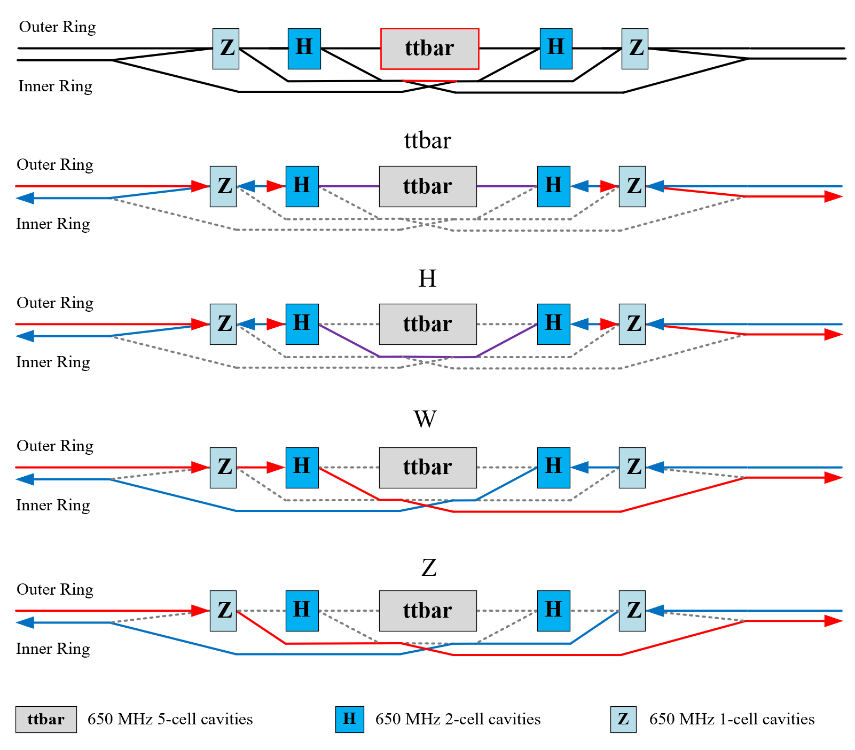
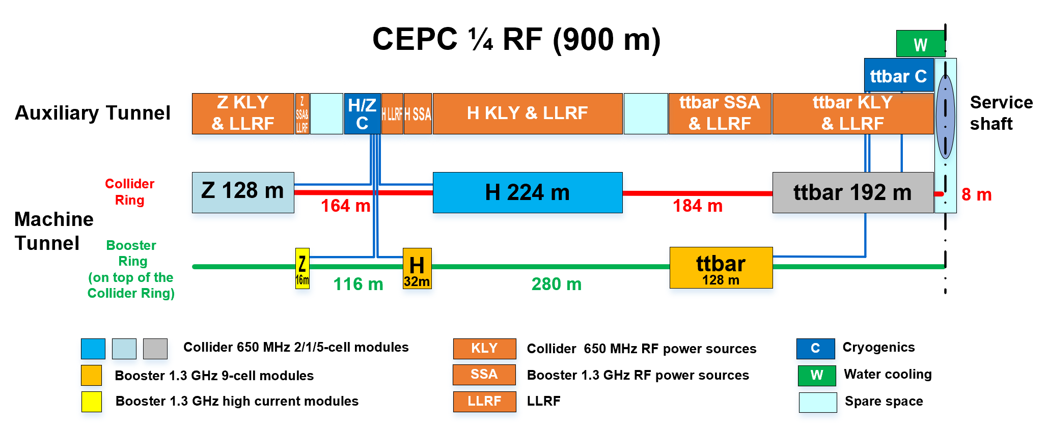
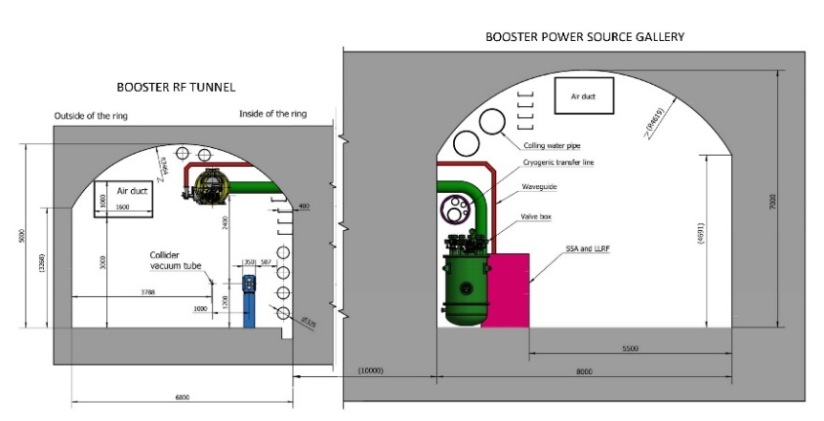
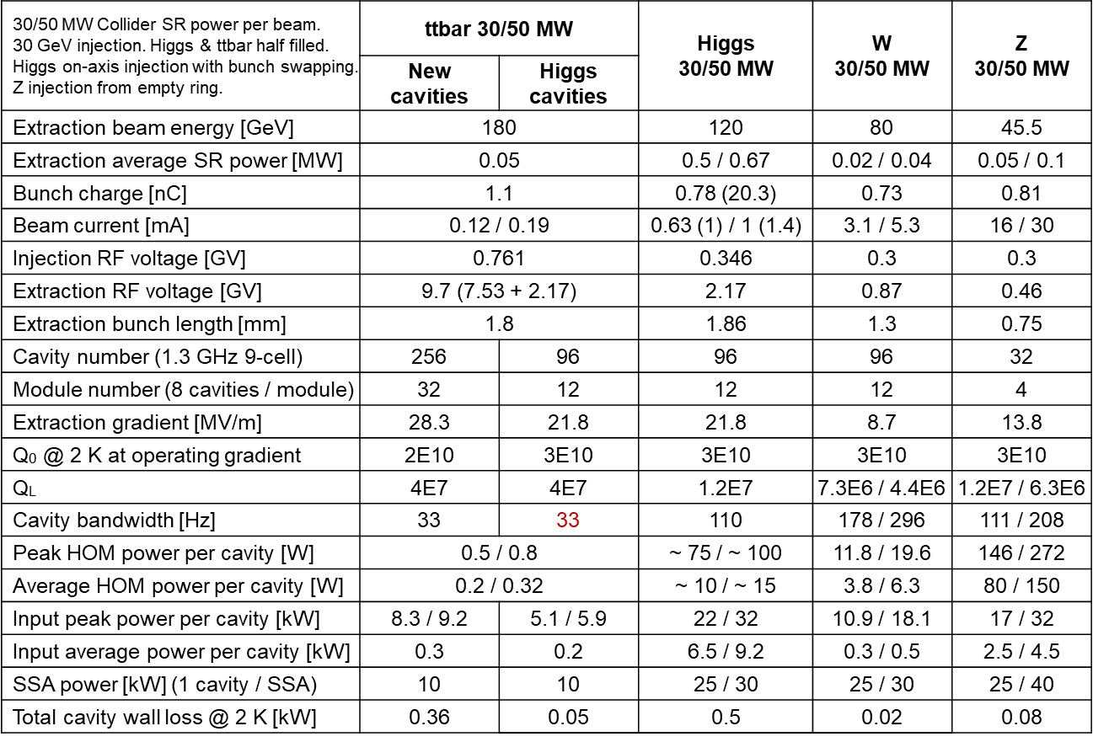
Highlights: SRF System Design and Upgrade Plan
0.65 GHz Parameters
H/W/Z/ttbar bypass scheme
SRF power supply auxiliary tunnel
1.3GHz Parameters
CEPC TDR SRF layout and parameters are designed to meet physics requirements;
RF system design optimized for Higgs 30/50 MW. Power and energy upgrade by adding cavities, RF power sources and cryogenic plants and other systems are compatible;
Use dedicated high current 1-cell cavity for 10-50 MW Z. Solve the FM & HOM CBI problems.

Slide 20
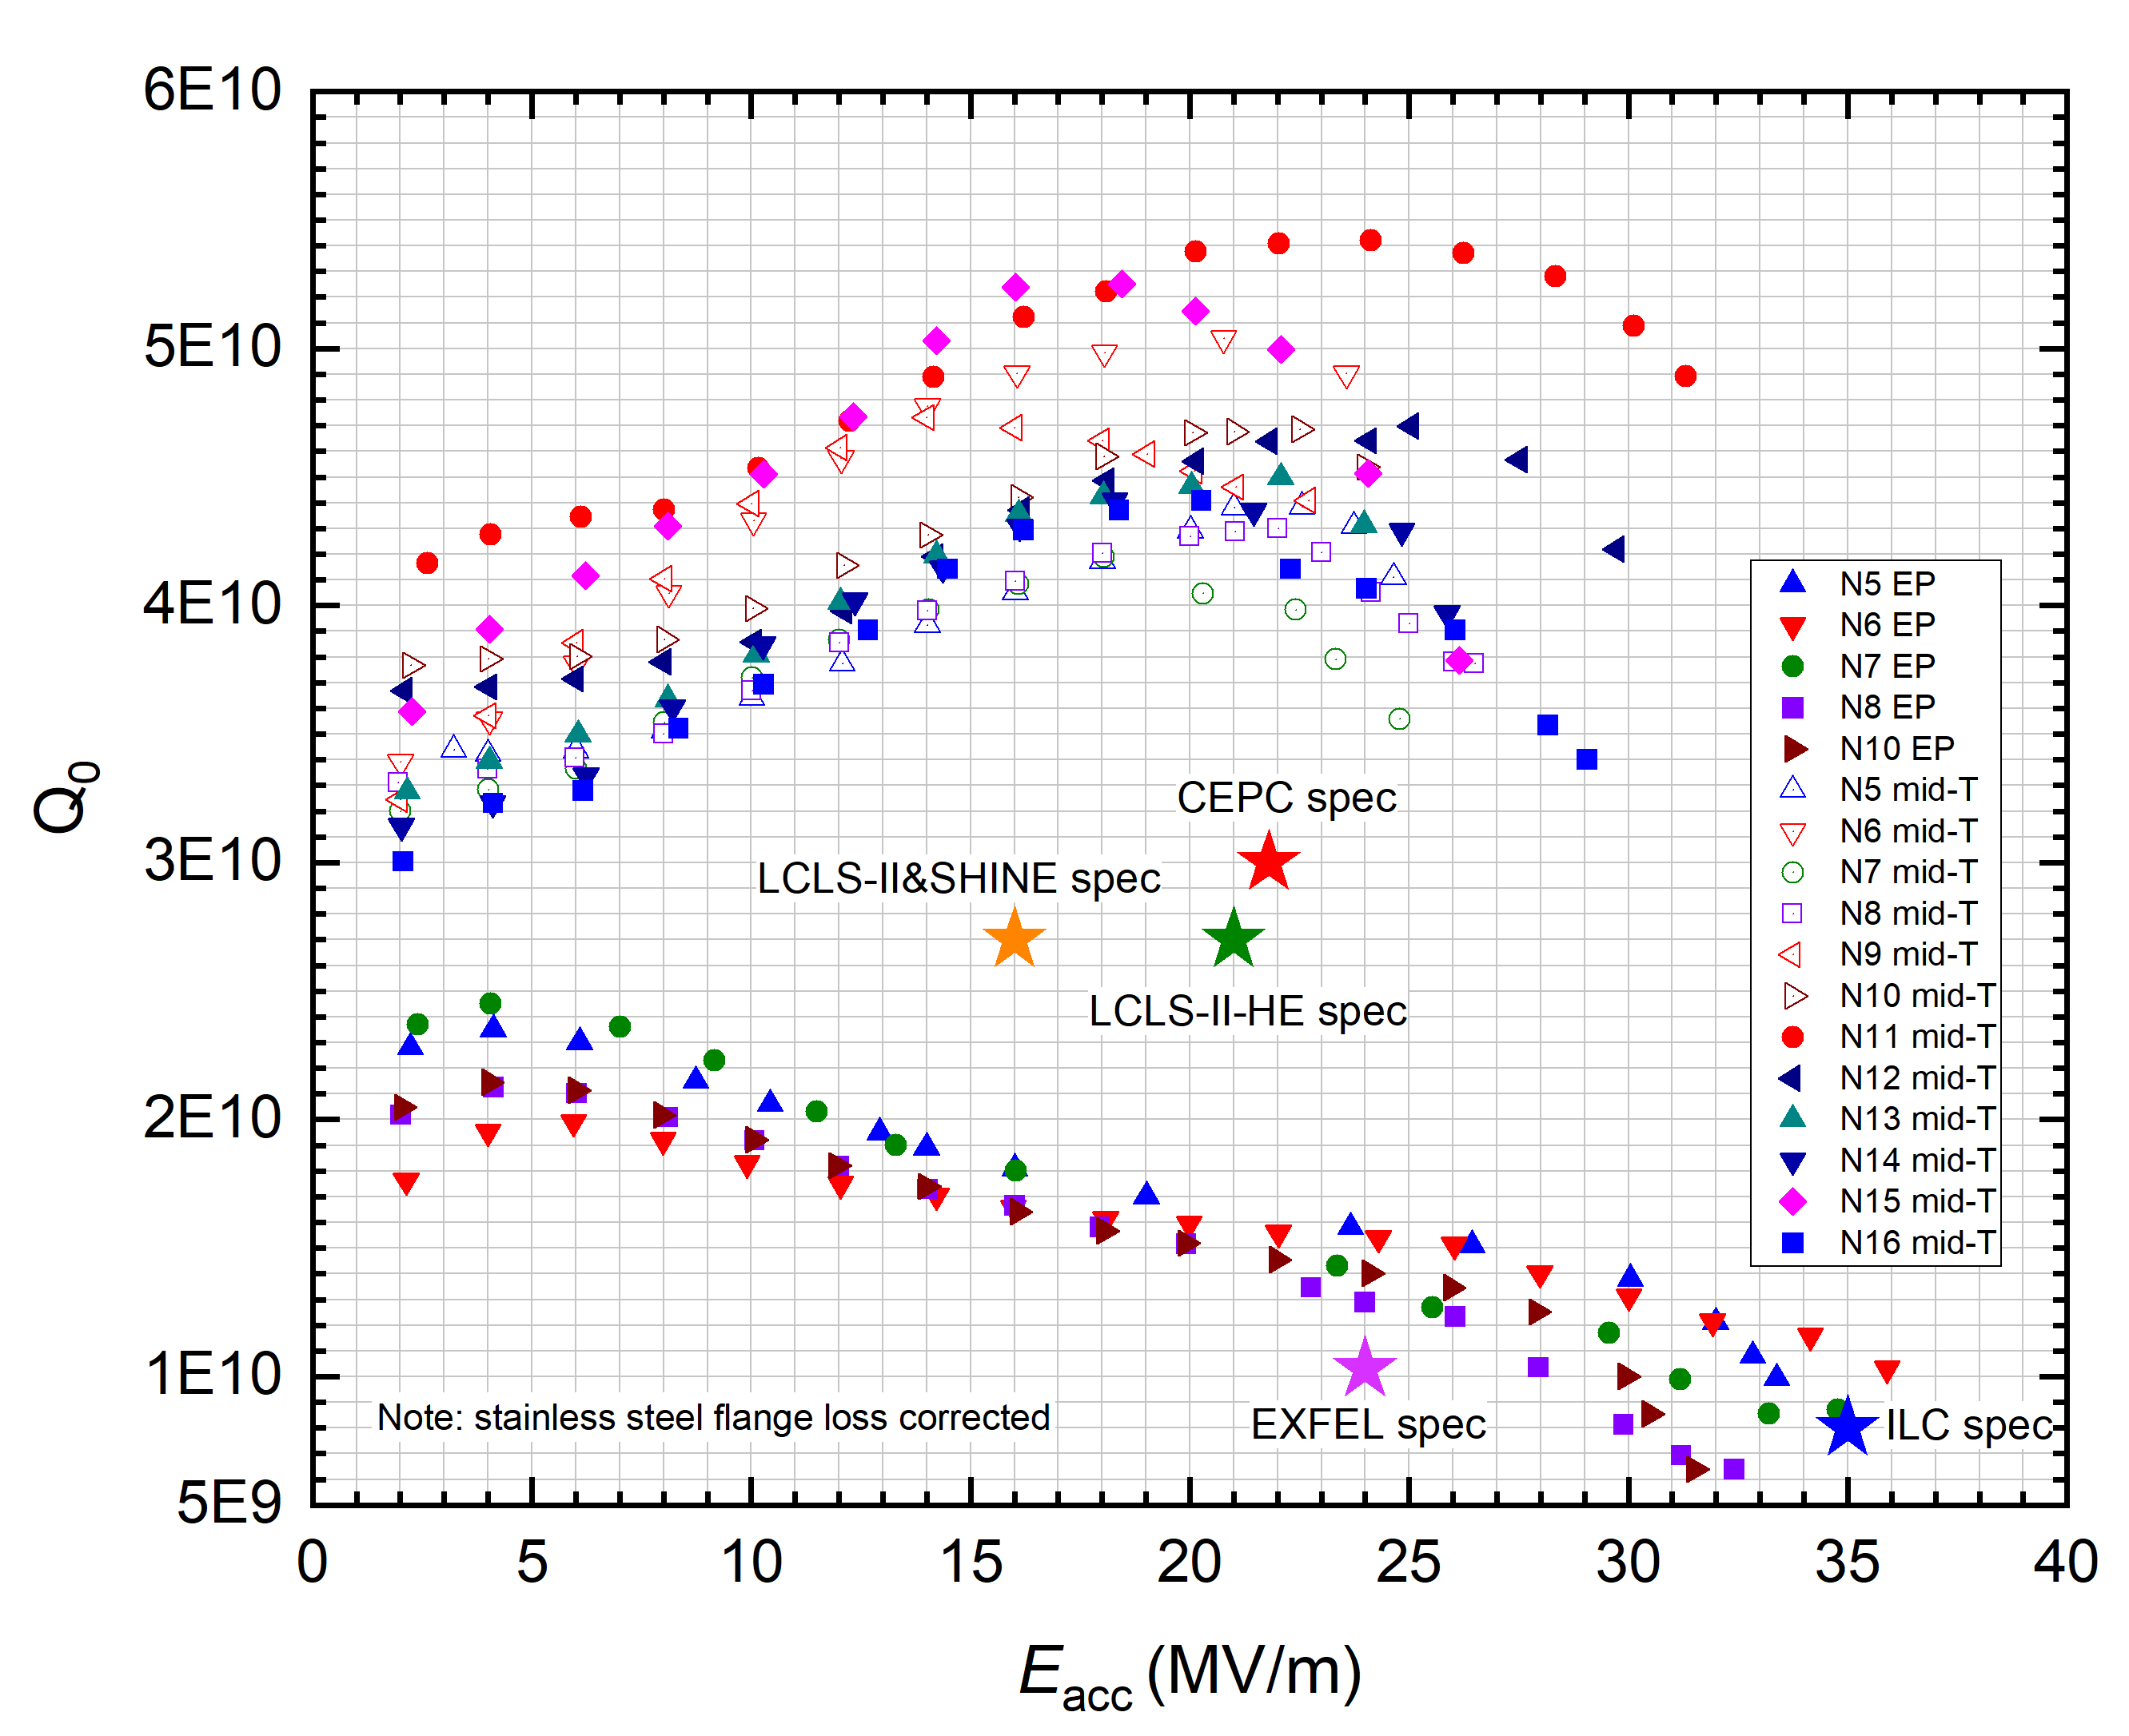
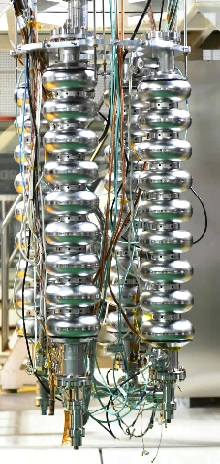
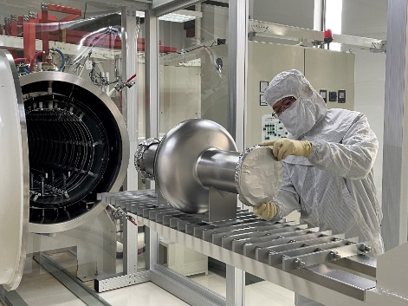
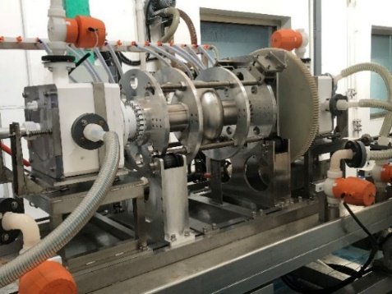
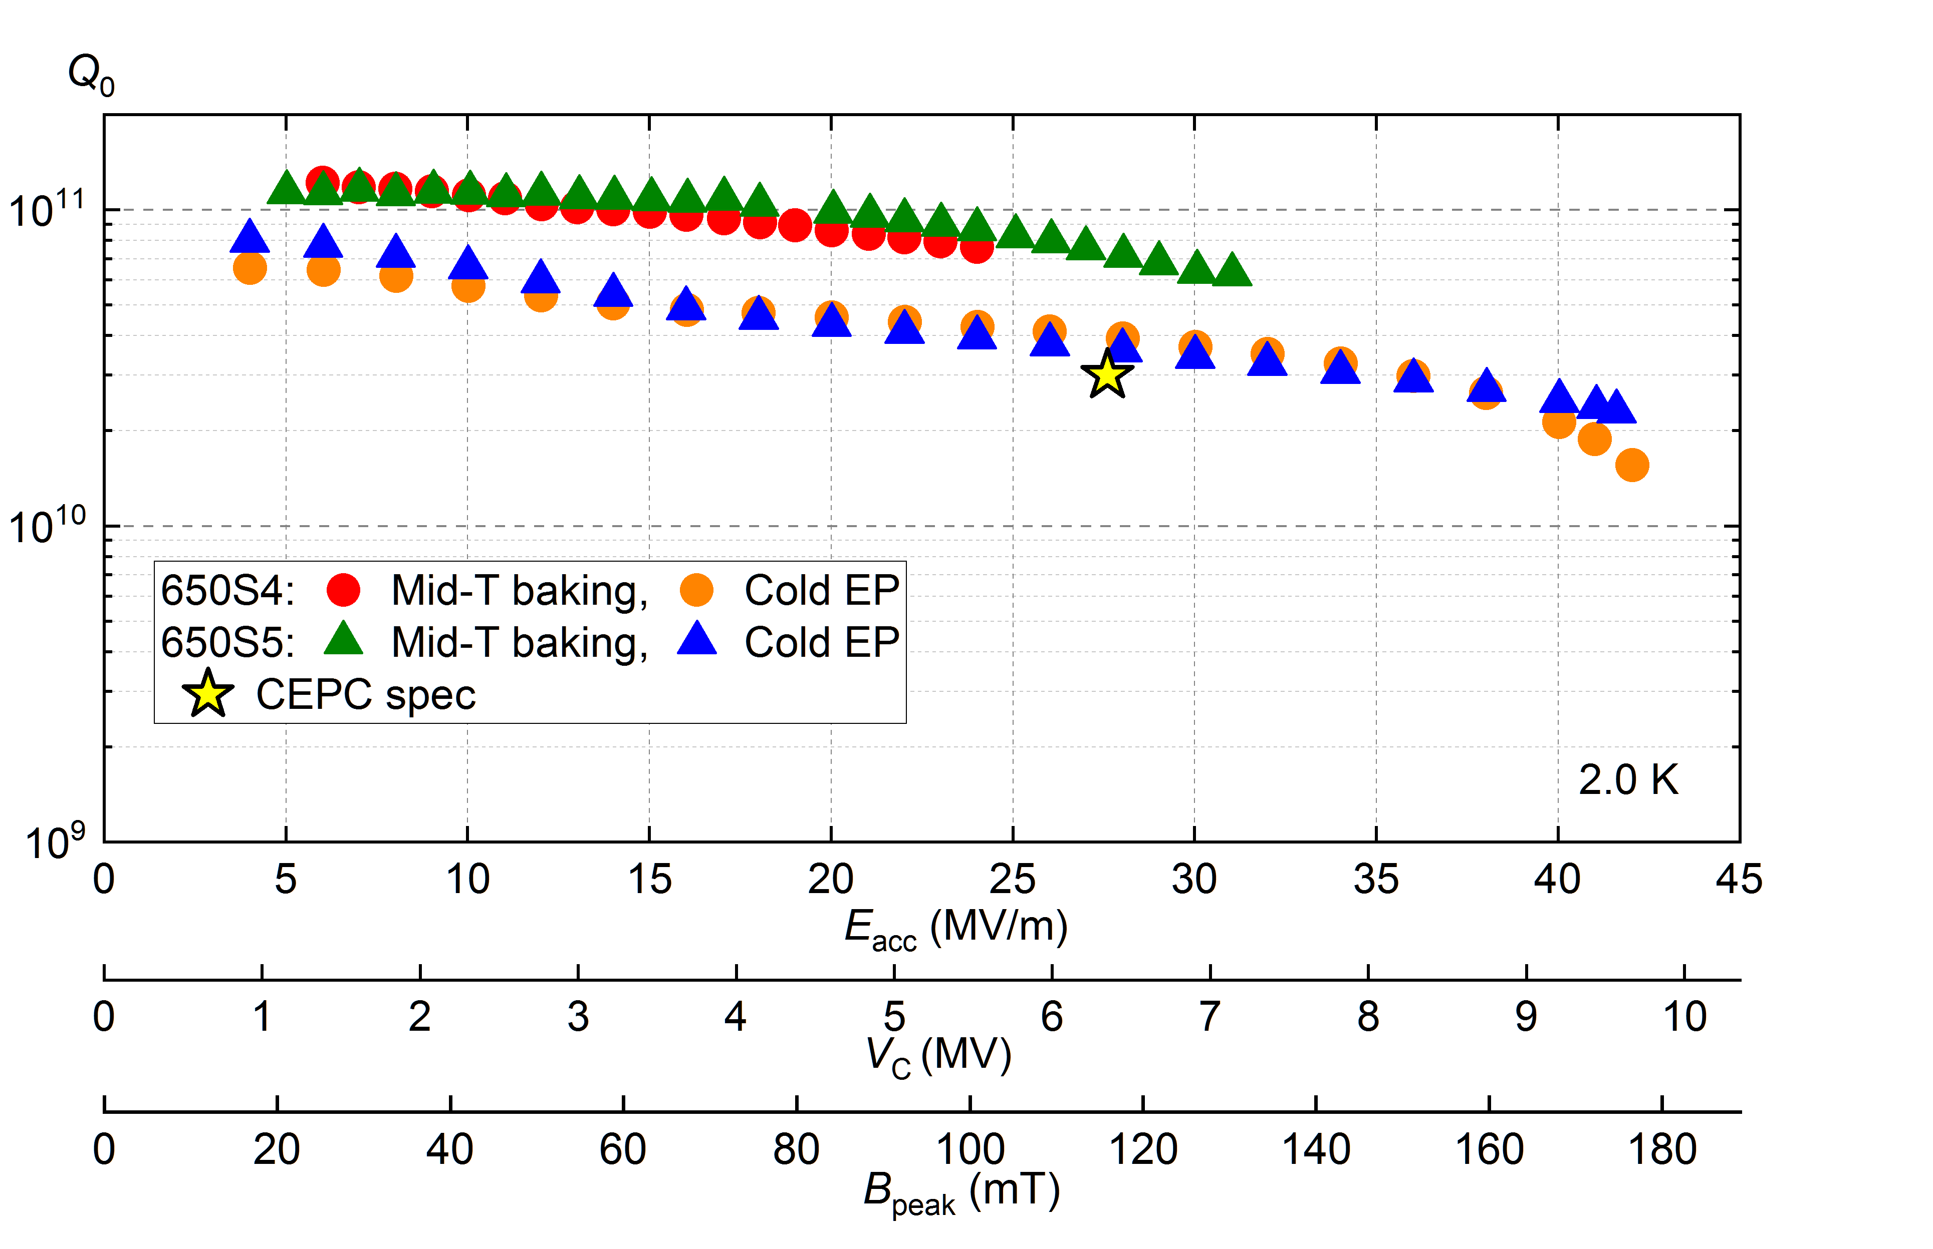
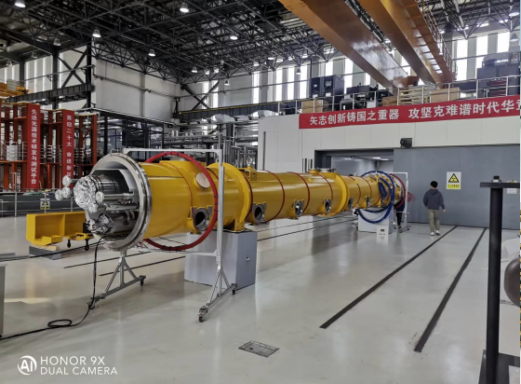
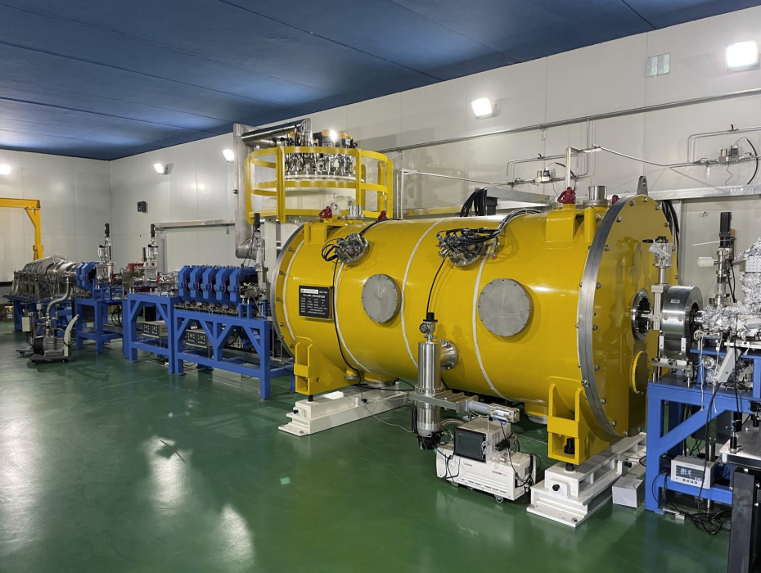
Highlights: SRF cavities and modules
Vertical test of 1.3GHz 9-cell cavity
Mid-T baking applied to 1.3GHz/650MHz cavities, resulting in High Q SRF cavity that meets the CEPC specification;
Completed SRF modules for both 1.3GHz and 650MHz cavities were assembled;
V-test
baking
EP
6.3E10 @ 31 MV/m
1.3GHz Module
650MHz Module
42 MV/m
Vertical test of 650 MHz 1-cell cavity

Slide 21
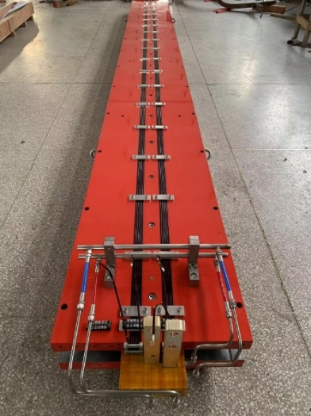
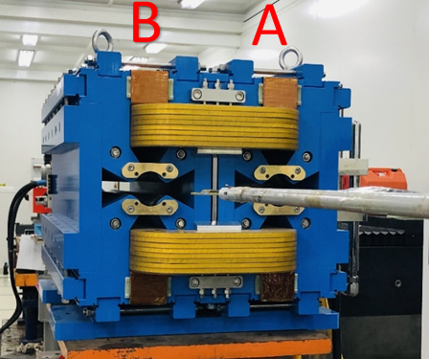
Highlights: dual-aperture magnet for collider
Full-length Dual aperture dipole
Dual aperture QUAD
E(GeV) | Ap1 ByL(T.mm) | Ap2 ByL(T.mm) | Differ
45 | 15.3972 | 15.3765 | -0.13%
80 | 27.3358 | 27.3199 | -0.06%
120 | 41.2001 | 41.1810 | -0.05%
E(GeV） | GL(T)-A | GL(T)-B | difference
45 | -3.36 | 3.35 | 0.40%
80 | -5.91 | 5.88 | 0.59%
120 | -8.89 | 8.85 | 0.49%
148 | -10.93 | 10.89 | 0.40%
175 | -12.77 | 12.73 | 0.30%
182.5 | -13.27 | 13.21 | 0.40%
 | Dipole | Quad. | Sext. | Corr. | Total
Dual aperture | 3008 | 3008 | - | - | 17562
Single aperture | 162 | 1120 | 3176 | 3544*2
Total length [km] | 68.71 | 9.95 | 2.17 | 3.1 | 83.9
Power[MW]@120GeV | 6 | 17.5 | 8.91 | 0.28 | 32.7
Large quantity of dual-aperture dipoles (69km) and quad. (10km) are required;
Full length dual-aperture dipole and dual aperture QUAD (short length) have been fabricated;
Dipole/QUAD prototypes meet the requirements.

Slide 22
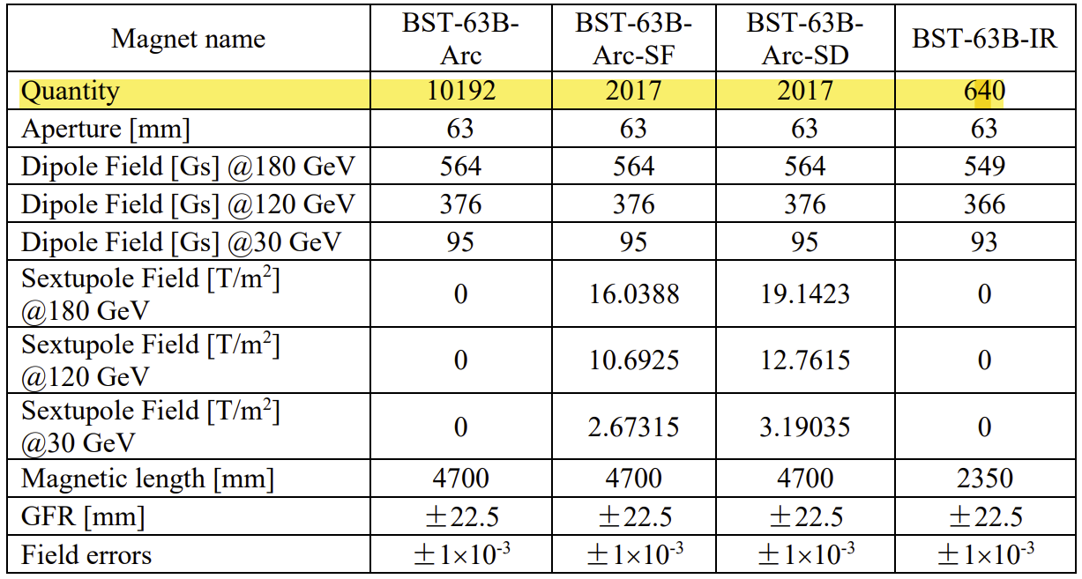
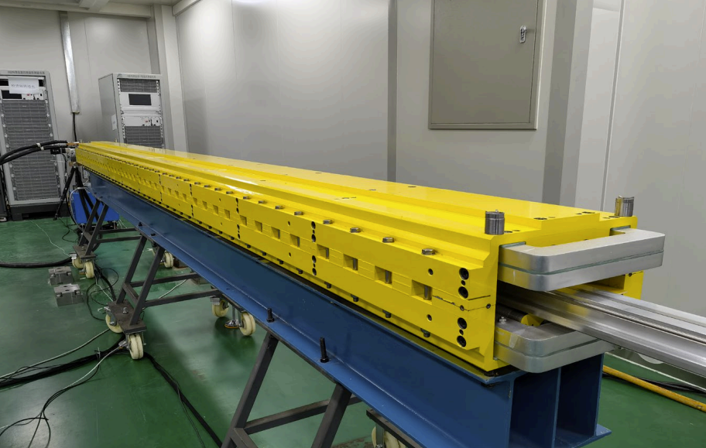
Highlights: weak field dipole for booster
Booster requires ~15k pieces magnets (68km);
Booster dipoles are required to work at the low field of 95 Gs (30GeV) with error smaller than 1×10^{–3} ;
Full length (4.7m) dipole was developed, and it meets the field specification;

Slide 23
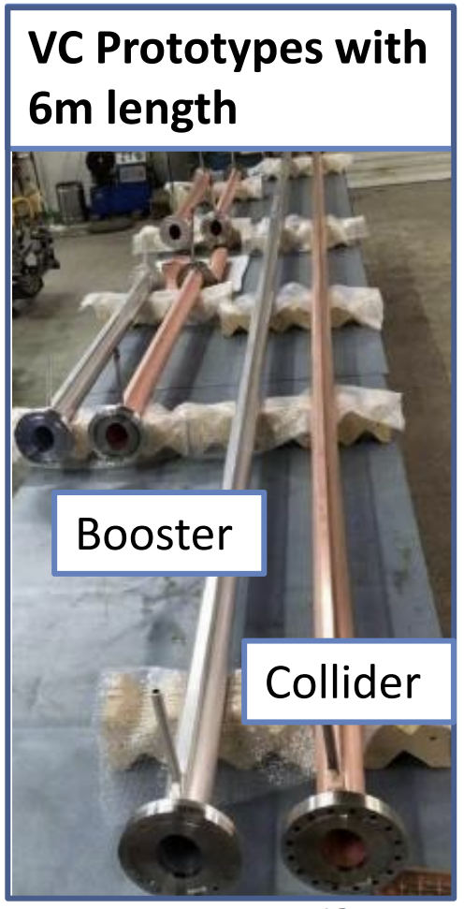
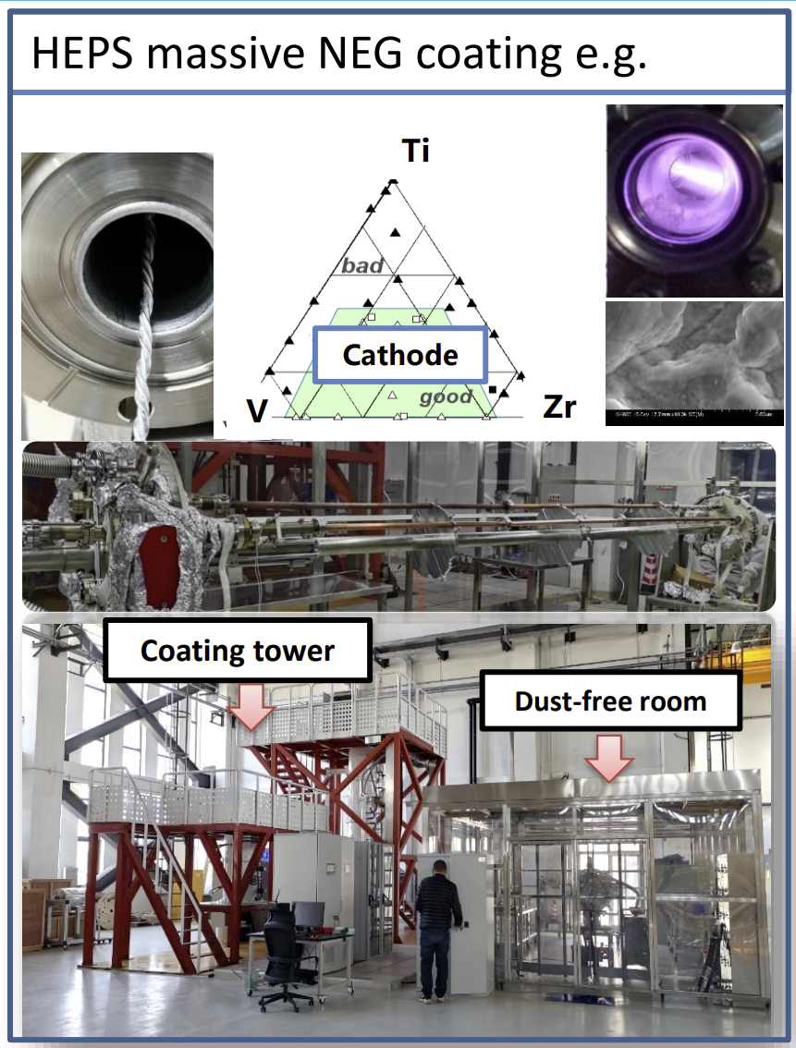
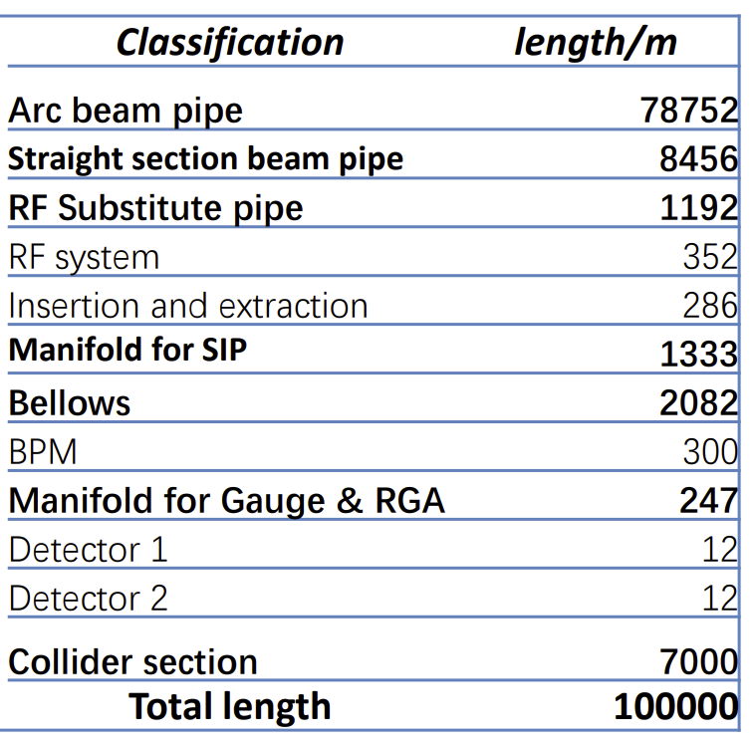
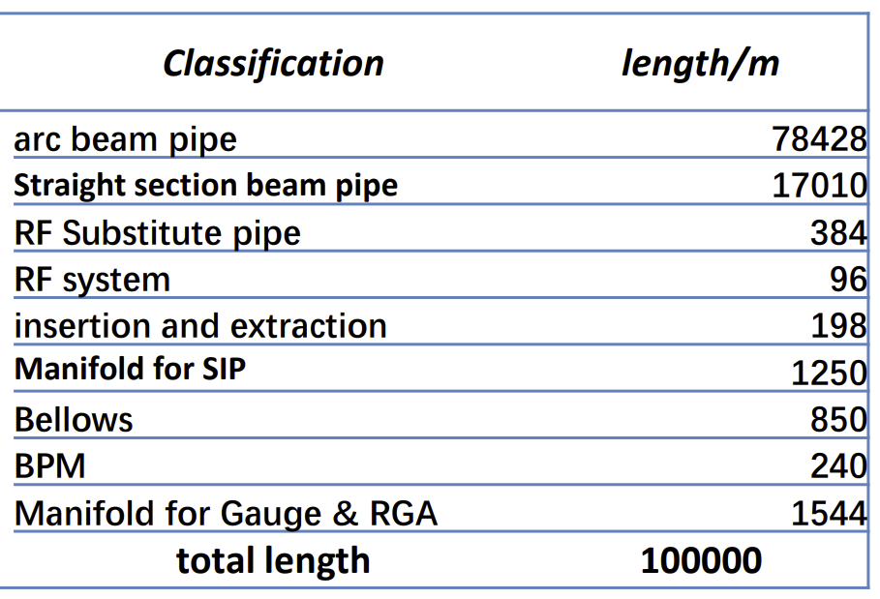
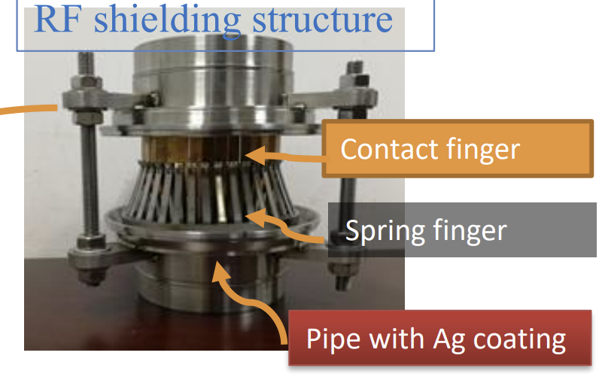
Highlight: Vacuum system
Collider
Booster
Key component

Slide 24
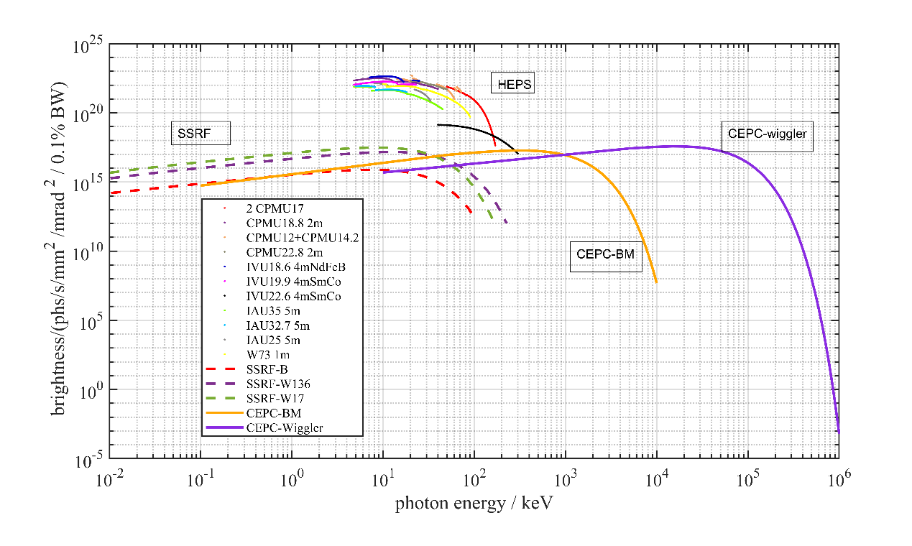
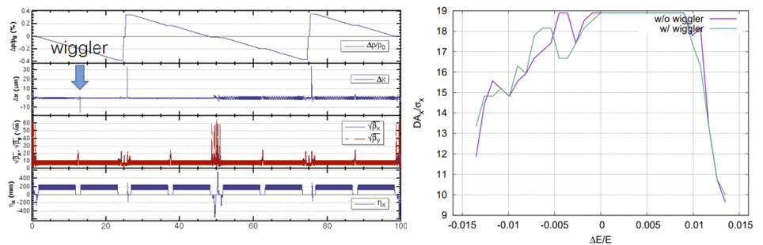
Highlights: CEPC as a gamma SR source
SR sources:
Wiggler parameter
B (T) | 2
Total length (m) | 0.32
Magnetic period Length (m) | 0.32
Period number | 1
K value | 59.7
Critical energy (MeV) | 19.2
Bending magnet
B (T) | 0.04
Length (m) | 20
Critical energy (keV) | 383
Impacts to beam dynamics:
Bending magnets generate intensive x-ray photon with energy around 100 keV
Wiggler with 2T generates gamma-ray in the level of 100 MeV

Slide 25
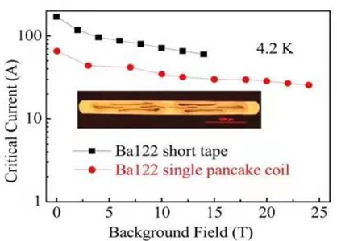
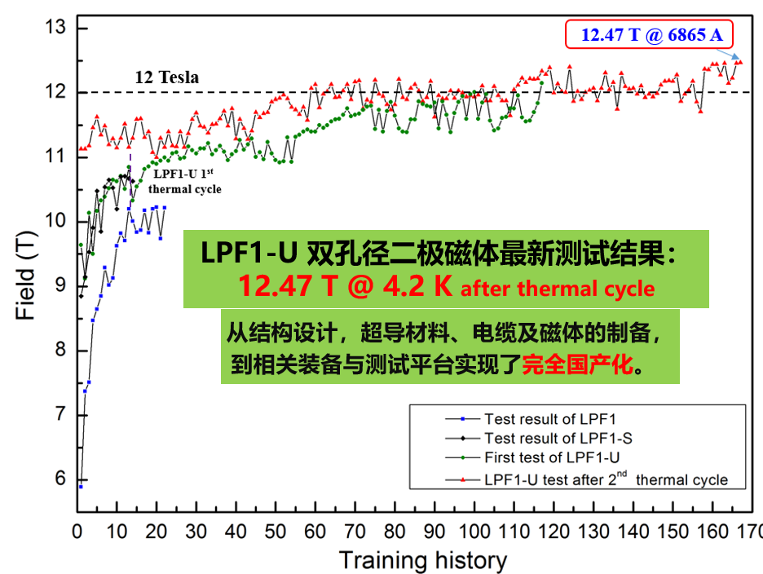
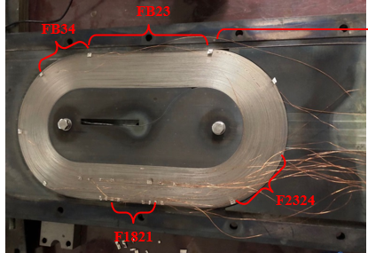
Highlight: R&D for Iron-based HTS magnets
Iron-based superconducting materials are very promising for high-field magnets
  Isotropic
  May go to very high field
  Raw materials are cheap
  Metal, easy for production
Technology spin-off can be enormous
Major R&D goals
  High Jc: > 1000A/mm²@4.2K
  Long cable: > 1000 m
  Low cost: < 5$/kA⋅m
A collaboration formed in 2016 by IHEP, IOP, IOEE, SJTU, etc., and supported by CAS
World first: 1000m IBS cable, IBS coil, ➔ magnet
1st Iron-based Superconducting solenoid Coil at 24T
12.5T dipole with Nb3Sn and NbTi coil

Slide 26







Highlight: conventional technology from HEPS/BEPC
Many of the CEPC needed key technologies were developed and verified in projects such as BEPCII and HEPS, which was conducted by IHEP. These technologies include conventional magnets, vacuum system, magnet power supply, mechanical system, alignment, etc.
The relevant system cost for CEPC can be accordingly evaluated precisely.
Linac Complex
Conventional magnet
Power Supply
Alignment
Various vacuum components
BPM and electronics

Slide 27






Experience on Acc. Construction and good records
BEPC
BEPCII & BESIII
ADS
Construction years: 1984-1988
Budget: 0.24 Billion CNY
On time, on budget
Construction years: 2004-2008
Budget: 0.64 Billion CNY
On time, on budget
Construction years: 2011-2016
Budget: 0.40 Billion CNY
On time, on budget
CSNS
HEPS
IHEP has constructed large-scale accelerator facilities since 1980’s, including circular collider, proton superconducting linac, splashing neutron source, synchrotron radiation source. All these high-budget accelerators have been built on schedule and in budget
Construction years: 1984-1988
Budget: 1.87 Billion CNY
On time, on budget
Construction years: 2019-2025
Budget: 4.8 Billion CNY
In construction, on schedule, on budget
14

Slide 28





Plans: klystron
2nd klystron
Strive to meet design goal of the high efficiency klystron
@630kW
3rd klystron
1st round test for the 2nd klystron was finished, achieving 70.5% @630kW
Cavity has been modified to suppress an unwanted frequency mode
Ceramic window has been replaced to improve thermal distribution
2nd round test is scheduled by the end of 2023
3rd klystron with MBK technology is fabricated
Test is scheduled the first half of 2024

Slide 29
Plans: Alignment
The recommendations from TDR review
- geodetic survey for the tunnel, geoid precise: impact of the gravity direction
- ground motion / deformation
- error propagation, especially in the 100km level tunnel
- fiducialisation accuracy
- temperature gradient and its impacts
- Smoothing measurements and required time
The plan
- A dedicated discussion with alignment groups from other Chinese institutes took place. All the aforementioned issues were addressed, and it is clear that more efforts are needed in the coming years.
- A new alignment group led by the senior scientist Lan Dong is founded in the Accelerator Division at IHEP. This group consists of experts and staff members who have been assigned to the HEPS project.
- With provided budget, more mini workshop will be organized, dedicated phD and post doctor program will be carried out.

Slide 30

Plans: Control system
The plan
- A new group leader, Dr. Dapeng Jin from CSNS, will be assigned to the leader of the current control group, who is required to impose an overall plan for the CEPC control system. He will address important issues such as timing system for CEPC.
- At HEPS, a simulation/commissioning soft will “pyapass” have been developed based on Python, which may be further developed for CEPC

Slide 31

Plan: Automatic production line for magnet
The magnet system is the most costly component of the accelerator complex (26.82%). It plays a significant role in determining the overall cost of the accelerator. Compare to the HEPS price:
Collider + Booster @ HEPS: 2 km
@ CEPC: 200 km
Total magnet length & cost
@ HEPS: 1.6km, 276million → 172.5million/km
@ CEPC: 159km, 5,192million → 32.6million/km
The material cost between HEPS and CEPC basically scales with the quantity
The cost ratio between fabrication and material
@ HEPS is: ~3
@ CEPC is: ~1.1
There is a significant difference in fabrication cost, which is understandable based on the experience with the prototype.
  Simple structure
  Mass production
  Low field strength
  Automatic manufacturing

Slide 32


Plans: Further efforts on green accelerator
Measures at HEPS
  Solar panel on roof: 10 MW ➔ 10% saving
  Permanent-magnet dipole @ storage ring: 5.6M kWh saving/yr
  Energy recovery from cooling water (13 MW@42oC) : Exceeds HEPS heating requirement
R&D for CEPC
  High Q SRF cavity: reduce 10MW operation power in a comprehensive evaluation, saving electricity consumption ~60M kWh per-year
  R&D effort for High efficiency & Energy recovery klystron: improve the efficiency from the conventional value (55%) the high efficiency of 80%, CEPC will save 160M kWh electricity per-year
  Proposal and R&D for “heating-cooling” switchable waste energy recovery system, and increasing the re-use of energy in the cooling water
  R&D and prototypes for dual-aperture magnets with a common coil
Solar panel on the roof of HEPS

Slide 33
Plans: Continue MDI studies
The plan
- Collaborate with the detector group to obtain more details about the MDI region in a coherent way, with clear boundaries as well as potential interactions.
- addressing important issues such as: SC solenoid, SC final quadrupole, space for various sensors/monitors, radiation background and protection system, …

Slide 34



TDR plan: Plasma wake field acceleration
High gradient: ~10-100GV/m, ~1000times higher than conventional Acc.
High energy conversion rate
High repetition rate possibility
Focus on PWFA acceleration
Plasma wake field
Driver beam
Trailer beam
Conventional linac
1GeV accelerator in hand

Slide 35


CEPC drives PWFA study @ IHEP
  Backup solution for CEPC linac, conceptual design based on simulation shows that the scheme is feasible
  Conventional technology as the baseline design:
  PWFA backup design:
  Main linac: 10GeV S-band
  L-band (10+ nC) and S-band (≤5nC) RF guns
  Compression and combination
  Different e+ acc. scheme
  e+ PWFA need to be cascaded
  e- PWFA with TR ~ 3.5

Slide 36
Leading scientist and founding
  Prof. Wei Lu, renowned plasma accelerator scientist originally from Tsinghua University will join IHEP to lead the plasma accelerator team
  A dedicative funding, around 119 millions CNY, is granted for the development of PWFA technologies, addressing the following issues by ultilizing the existing facilities at BEPCII:
  Positron acceleration
  Cascaded acceleration
  High repetition

Slide 37



Test facility to be built at BEPCII
Plasma Acc. Experimental Hall
束流中心
2.5 GeV e-/e+ beamline + PW-level high performance laser system

Slide 38

CEPC timeline
TDR (2023), EDR(2026), start of construction (2027-8)

Slide 39

Plan: Carry out EDR study
Preliminary EDR phase working plan was collected
Details see Prof. Jie Gao’s talk

Slide 40
Summary
CEPC
has made strong and systematic progress since the CDR was published in 2018; design and technologies are reaching maturity;
is completing the TDR for the e⁺e⁻ accelerator and will enter the EDR phase;
International reviews have been conducted to assess technical issues and costs. A domestic review has been carried out specifically for civil construction and cost evaluation
has a strong-experienced team, backed by IHEP support and international cooperation, which are keys to bring CEPC to fruition;
aims schedule following China’s 5-year planning; expects to complete the R&D and the preparation to build the facility and carry out the science program

Slide 41
Acknowledgements
Thanks go to CEPC-SppC accelerator team’s hard works,
international and CIPC collaborations
Special thanks to CEPC, IAC, IARC and TDR review committee’s critical comments,
suggestions and encouragement
Thank you for your attention

Slide 42
Backup slides

Slide 43




History
2012.7Higgs boson was observed at CERN
2018 CEPC-CDR was officially published for both Accelerator and Detector
2023 The CEPC-TDR for accelerator was completed and reviewed by an international committee
2012.9 Chinese scientist propose the idea of CEPC, serving as “Higgs factory”
2013(2016) China domestic “Xiangshan” meeting confirms the significance of CEPC
2015 CEPC pre-CDR was released
1st CEPC IAC meeting

Slide 44

Key scientific issues and technological route

