Slide 1
CEPC TDR-Phase 1 Review
Frank Zimmermann, CEPC IAC meeting, 30 October 2023

Slide 2
Phase 1 CEPC TDR Review Committee meeting in person at HKUST, Hong Kong, from 12 to 16 June 2023; a total of 33 talks on a variety of topics*
Charge to committee:
1. Are the accelerator system design goals well defined? Have the goals been reached in the TDR?
2. Are the accelerator physics issues adequately addressed?
3. Are the accelerator complex design, the key technologies adopted, and the conventional facilities effective for achieving the performance goals?
4. Are the CEPC operation modes and upgrade plans well defined?
5. Is the CEPC design compatible with the future upgrade to the SppC?
6. Regarding the key technology research and development, are critical technologies and components of the CEPC accelerator ready or will they be ready before 2026, through the R&D program being carried out, or achieved with the Light Source project undertaken by IHEP, for the eventual realization of the CEPC?
7. What are the primary technical risks and their potential impacts on the CEPC? What are the mitigation measures that should be taken?
8. Will the CEPC accelerator be ready for construction, after the completion of the outlined R&D program, and industrial and engineering preparation, as well as issues identified in item 7 above be properly addressed in due time?
9. Any other issues you notice or any improvements you may suggest.
A draft of the relevant chapters of the TDR draft was made available to the Committee prior to the meeting. Presentations, Q&A and discussion at the IAS HKUST helped the committee examine the TDR draft material. The Review Committee evaluated the draft report and made comments or suggestions on the TDR.
*see appendix

Slide 3
Executive Summary
Five years after the completion of the CDR, the draft TDR for the CEPC accelerator has been prepared. The TDR will be completed taking into account the feedback from this Committee. The key technologies for CEPC have been developed. Prototypes meeting or exceeding the specifications are available. The CEPC team is on track to launch an engineering-design effort. After a site has been selected, the construction of the CEPC could start in 2027 or 2028. The Committee endorses this plan.
The Committee wishes to congratulate the CEPC team on the excellent progress. The Committee is impressed by the amount and quality of the work performed and presented.
The next section provides answers to the different charge questions, the following sections contain comments and recommendations related to the individual presentations.

Slide 4
Question 1: Are the accelerator system design goals well defined? Have the goals been reached in the TDR?
The overall accelerator design goals are well defined. The design goals have already been met for the key systems, such as the 650 MHz and 1.3 GHz superconducting RF cavities, RF power sources, and collider-arc magnets. For some other subsystems, such as the machine-detector interface, collimation and alignment, more detailed studies and further optimisation need to be carried out.
Question 2: Are the accelerator physics issues adequately addressed?
The accelerator-physics effort focuses on the relevant points. Beam-beam simulations including impedance are being carried out in an outstanding way. Recently a novel beam-beam effect lowering the transverse-mode coupling instability threshold has been discovered and understood. The assessments of impedance and collective effects, the polarisation studies, and the accelerator optics development are also executed at a high level.
The transverse dynamic aperture should be further improved, both for the bare machine and taking into account all machine errors. Optics corrections and tuning schemes for the machine with realistic errors should be further developed and refined to ensure an acceptable dynamic aperture, achieving the design vertical emittance, and a good beam-beam performance. The on-axis injection scheme and associated transient effects in the collider rings, as well as the collimation system, may require further studies.
2.3 Are the accelerator complex design, the key techn

Slide 5
Question 3: Are the accelerator complex design, the key technologies adopted, and the conventional facilities effective for achieving the performance goals?
The accelerator complex design, the key technologies and conventional facilities are effective. The design choices and optimisation are based on the experience of BEPCII, the design and construction of HEPS, the state-of-the-art SRF developments and technology R&D at the Platform of Advanced Photon Source (PAPS), and also on developments from the parallel FCC-ee design effort in Europe.
Question 4: Are the CEPC operation modes and upgrade plans well defined?
Yes, the well defined “10-2-1-5” operation plan foresees an initial 10 years of Higgs running, followed by 2 years on the Z pole, and then 1 year at the WW threshold. A subsequent upgrade will enable the CEPC to operate at the ttbar energy, after installing additional RF cavities in collider and booster. An RF bypass scheme allows for
flexible operation at the different energies. The baseline design assumes 60 MW synchrotron-radiation power. The luminosity can be increased by operating at 100 MW with the installation of additional RF power sources.

Slide 6
Question 5: Is the CEPC design compatible with the future upgrade to the SppC?
The arc-tunnel curvature is appropriate to accommodate the SppC. Also the lengths of the straight sections are sufficiently long to house the required collimation and beam-extraction systems for the hadron collider.
The arc-tunnel cross section appears potentially sufficient to host the CEPC collider, booster, and SppC magnets simultaneously. A detailed integration study should be based on the final SppC magnet design and associated cryogenic distribution line.
Additional tunnels of ∼10 km total length will be needed to bypass the two long CEPC RF straights. The CEPC detector straights could be bypassed by installing the SppC in the CEPC booster bypass tunnel. New experimental caverns are required for the SppC detectors.
To realise ep collisions, the SppC and CEPC machines need to have the same circumference. Concurrent operation of CEPC and SppC will require suitable shielding to prevent radiation damage to equipment.

Slide 7
Question 6: Regarding the key technology research and development, are critical technologies and components of the CEPC accelerator ready or will they be ready before 2026, through the R&D program being carried out, or achieved with the Light Source project undertaken by IHEP, for the eventual realization of the CEPC?
The key R&D technologies will be ready. The most important superconducting RF cavities are available today, with performance (maximum gradient, Q values) exceeding the design specifications. RF power sources have also been developed with good to excellent efficiency, which will be further improved. Prototypes exist for the main collider- and booster-arc magnets. The experience of, and developments for, HEPS cover most of the main technologies.
Collimation systems, machine protection, machine-detector interface and alignment system are not fully addressed by HEPS and should be brought to the desired level of readiness through the ongoing R&D program.

Slide 8
Question 7: What are the primary technical risks and their potential impacts on the CEPC? What are the mitigation measures that should be taken?
Primary technical risks are the machine protection and collimation system (robustness against injection failures, asynchronous beam-dump-kicker firing, “dust” events or sudden beam-loss phenomena as in SuperKEKB, collimator survival in case of reduced beam lifetime, etc.), the swap-out on-axis injection (e.g., transient effects when a bunch is reinjected), and achieving plus maintaining the magnet-alignment tolerances.
Mitigation measures should include appropriate R&D and international collaboration with currently operating facilities such as SuperKEKB, LHC and large light sources.

Slide 9
Question 8: Will the CEPC accelerator be ready for construction, after the completion of the outlined R&D programme, and industrial and engineering preparation, as well as issues identified in item 2.7 above be properly addressed in due time?
The CEPC accelerator will be ready for construction after the successful completion of the outlined R&D program, and industrial and engineering preparation. Some of the issues identified in item 7 could be addressed during the construction phase.

Slide 10
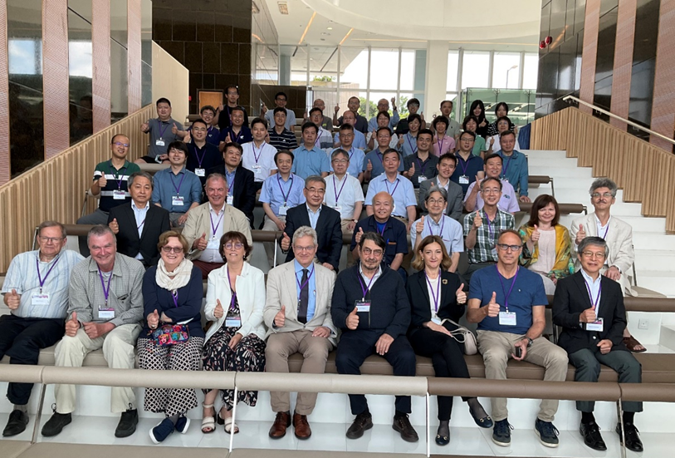
a thumbs-up from the Phase-1 Review Committee !

Slide 11
the Phase-1 Review Committee
Philip Bambade, IJCLab
Maria Enrica Biagini, INFN Frascati
Manuela Boscolo, INFN Frascati
Brian Foster, DESY & U. Oxford
Yoshihiro Funakoshi, KEK
Kazuro Furukawa, KEK
Roberto Kersevan, CERN
Hélène Mainaud Durand, CERN
Norihito Ohuchi, KEK
Carlo Pagani, INFN Milano
Anatoly Sidorin, JINR
Makoto Tobiyama, KEK
Kay Wittenburg, DESY
Akira Yamamoto, KEK
Zhentang Zhao, SINAP
Frank Zimmermann, CERN, chair

Slide 12
Phase-1 Review “Sign-Off” Meeting 12 October 2023: zoom meeting to discuss the revised TDR
Our final version of the Phase 1 CEPC TDR Review report was submitted to the IHEP Director on 15 July 2023
On 30 September 2023 we received a revised TDR
All the committee members consider the new version of the TDR much improved, notably the sections on survey & alignment, and on MDI / Interaction Region.
We do not have any additional comments or corrections.

Slide 13
appendix

Slide 14
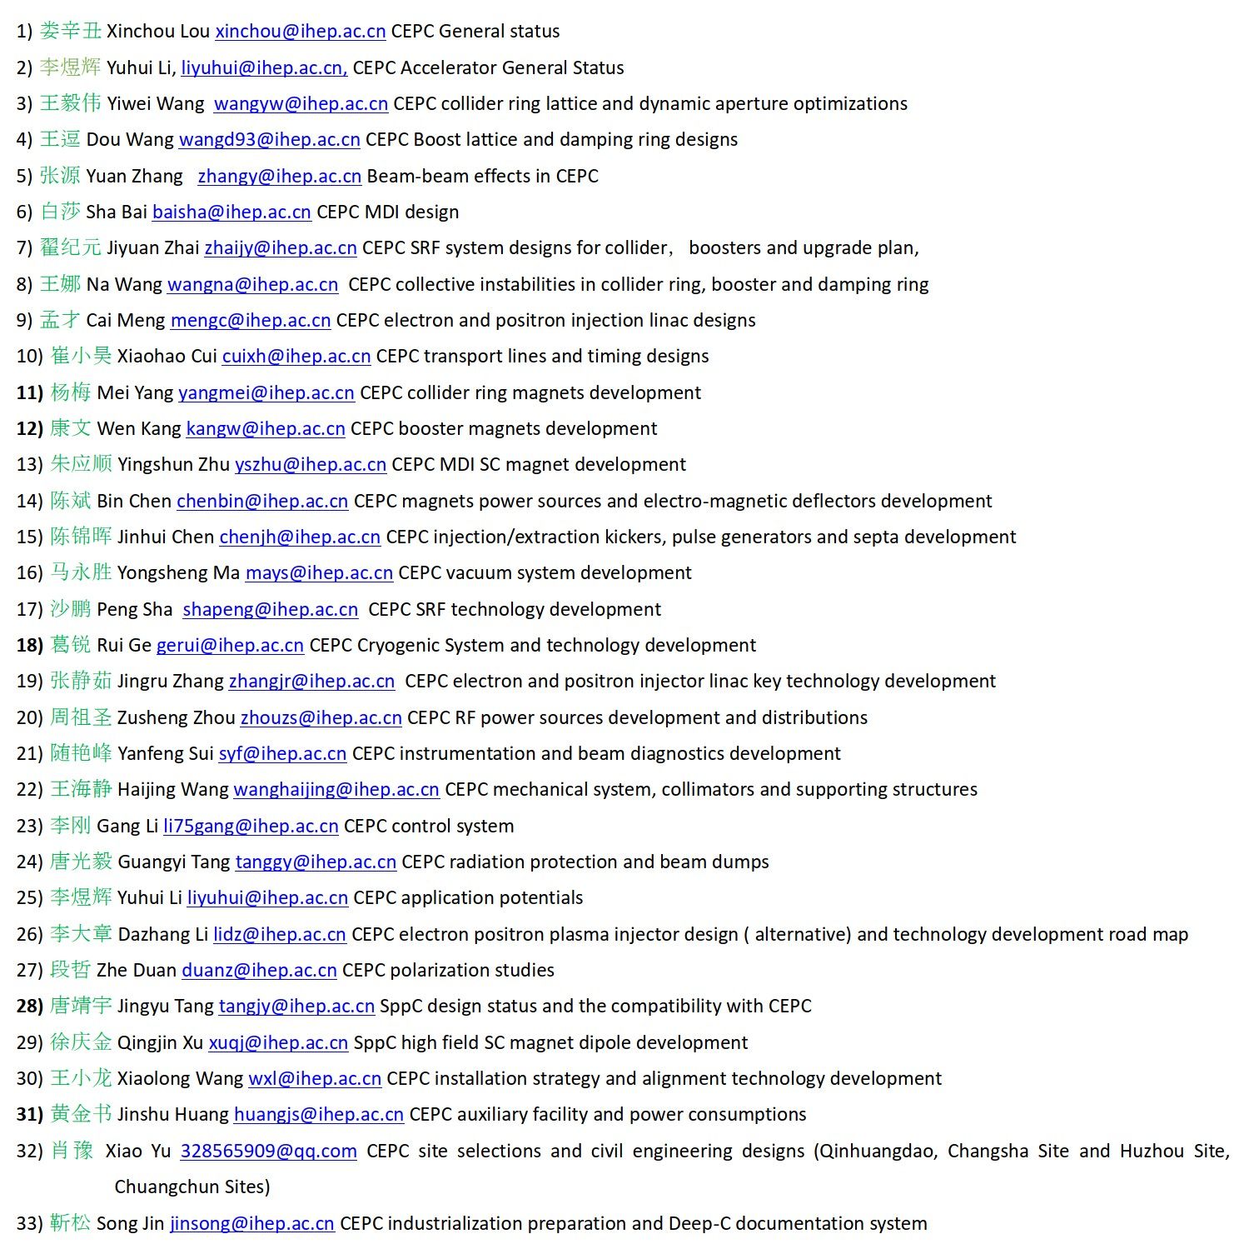
presentations at the review meeting

