Slide 1
CEPC Software and Computing
Weidong Li
representing the CEPC software and computing team
9th CEPC-SppC IAC meeting
IHEP, 31 October 2023

Slide 2
Contents
Introduction to CEPCSW
Progress since the last IAC meeting
Summary

Slide 3
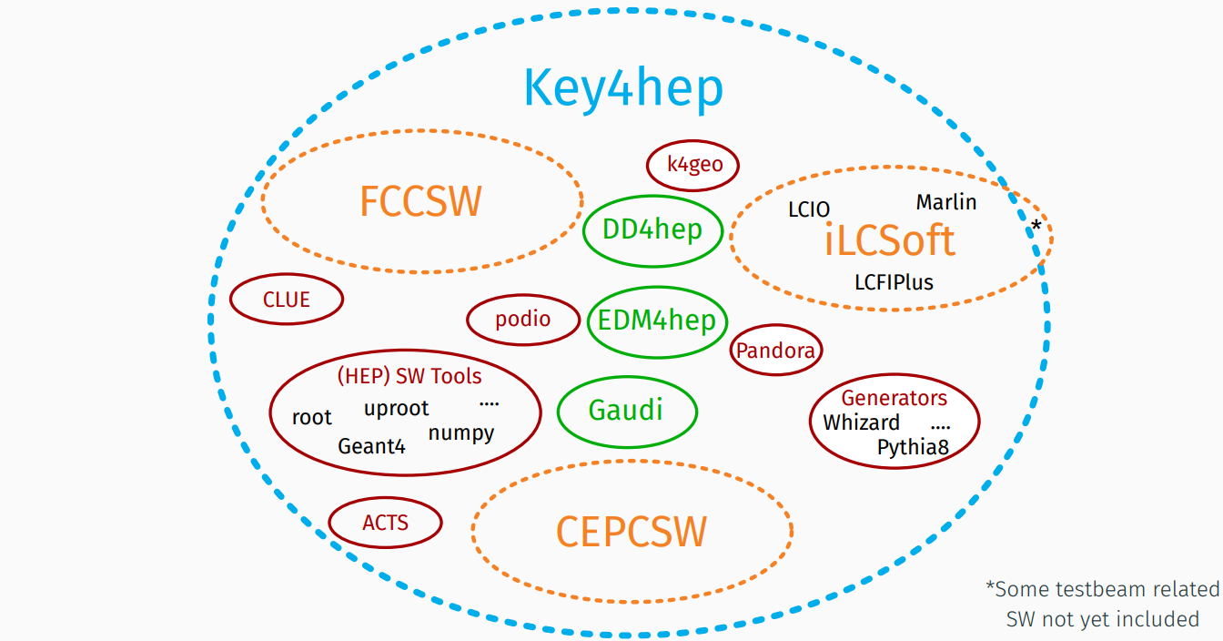
Key4hep
The consensus among CEPC, CLIC, FCC, ILC and other future experiments was reached at the Bologna workshop in 2019
  Develop a Common Turnkey Software Stack, Key4hep, for future collider experiments
  Maximize the sharing of software components among different experiments
The development of CEPCSW is based on Key4hep and most of our efforts are put on CEPC experiment specific software and workflows

Slide 4
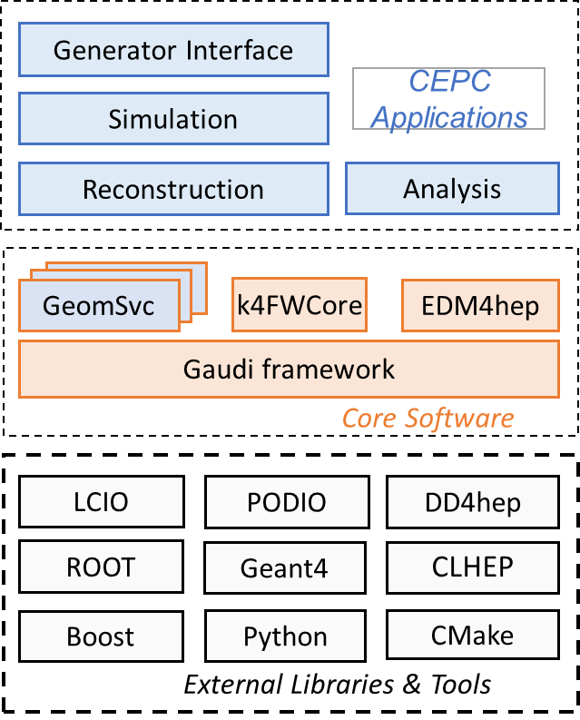
Structure of CEPCSW
CEPCSW is organized as a multi-layer structure
  Applications: simulation, reconstruction and analysis
  Core software
  External libraries
The key components of core software include:
  Gaudi/Gaudi: defines interfaces to all software components
  Edm4hep: generic event data model
  k4FWCore: management of event data objects
  DD4hep: detector geometry description
  CEPC-specific components : GeomSvc, simulation framework, analysis framework, beam background mixing, fast simulation, machine learning interface, etc.

Slide 5
Packages of CEPCSW
Detector Options
  CDR (baseline design)
  The 4th concept
MC Generators
  Multiple formats supported: HepMC, HepEvt, StdHep, LCIO
  GuineaPig++ for MDI
  Particle Gun
Simulation
  G4 simulation framework
  Fast simulation algoritrhms e.g.ML-based dE/dx simulation
  Digitization algorithms for silicon, CALO, drift chamber
Reconstruction
  Marlin based tracking algorithms for silicon detector
  Tracking algorithm for drift chamber
  Pandora-based PFA
  Arbor-based PFA
Analysis tools
  RDataFrame-based analysis framework
Examples and docs
  Menu for EDM4hep, Identifier, etc.
https://github.com/cepc/CEPCSW
~ 50 packages in total

Slide 6
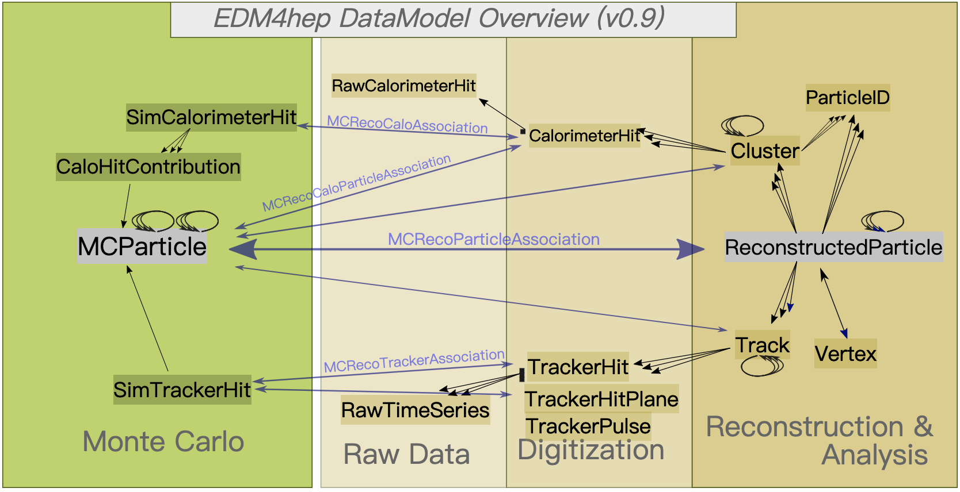
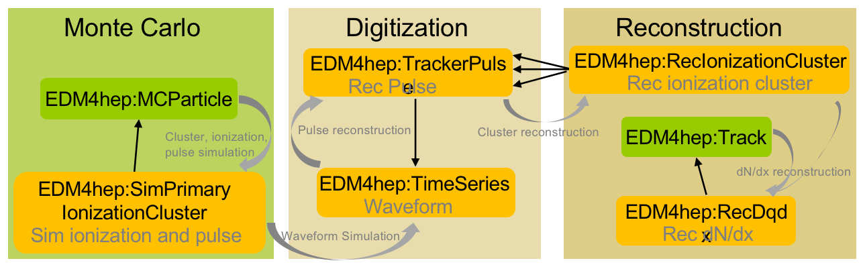
Progress in Event Data Model
EDM4hep is the common event data model (EDM) being developed for the future experiments
  describing event objects created at different data processing stages and also reflecting the relationship between them.
Extension of the Edm4hep was completed and released
  By using the upstream mechanism of PODIO, a common EDM was implemented for both TPC and drift chamber

Slide 7
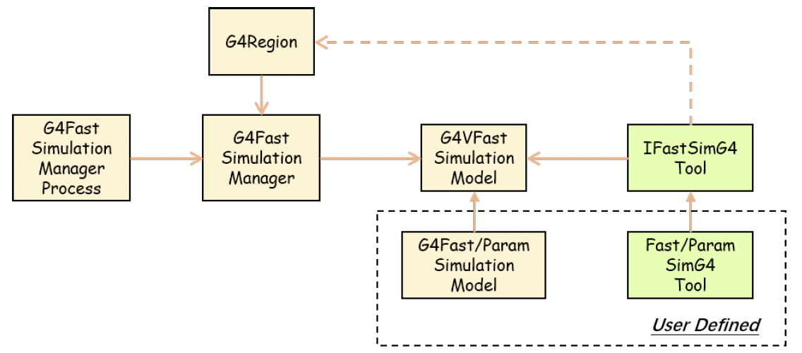
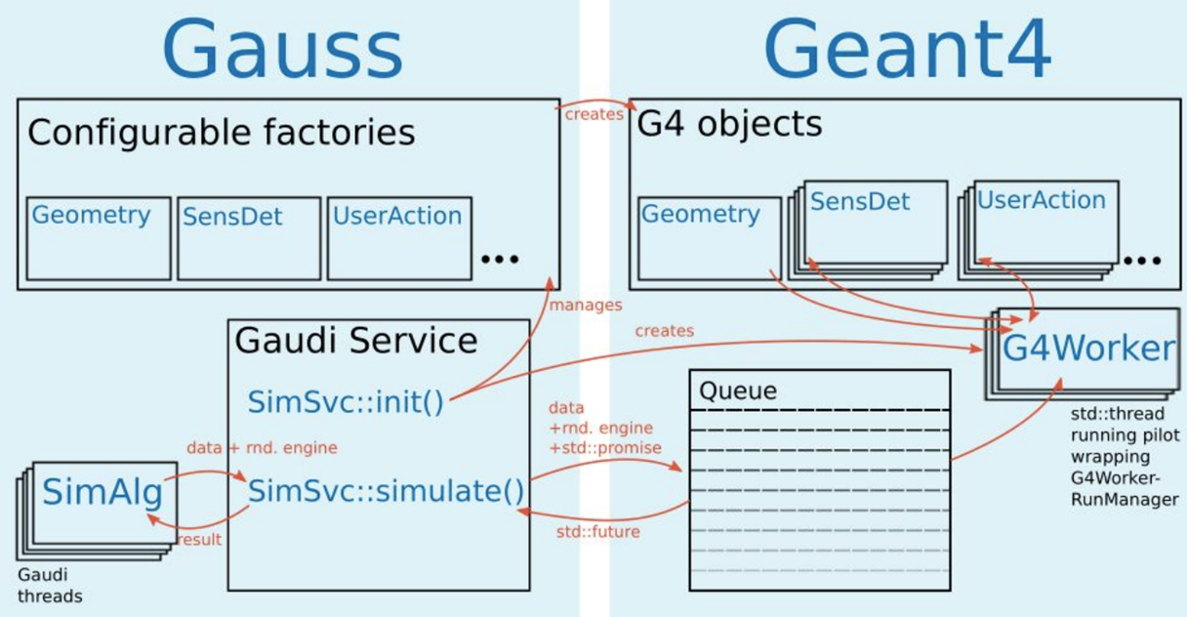
Progress in Simulation Framework
The simulation framework was developed and currently the simulation chain is complete
Gaussino, a general simulation framework originally developed by LHCb, is being added into Key4hep as k4Gaussino
In collaboration with CERN, we are developing simulation prototype for silicon vertex detector using Gaussino as the underlying framework
  Step 1: Using the original version having the dependency on the LHCb software (Done)
  Step 2: Creating the modified version in which the LHCb dependency is removed (Done)
  Step 3: Directly using k4Gaussino (Not started)

Slide 8
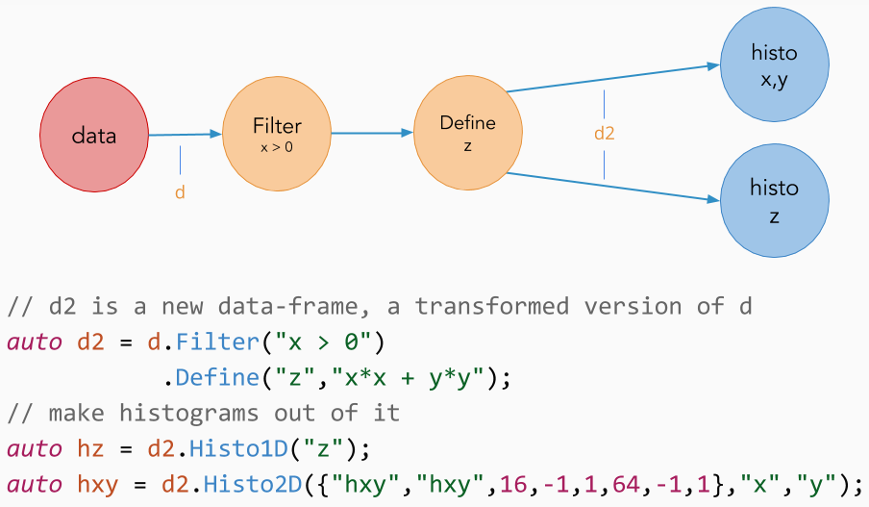
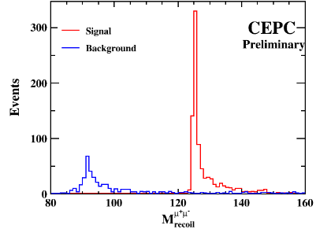
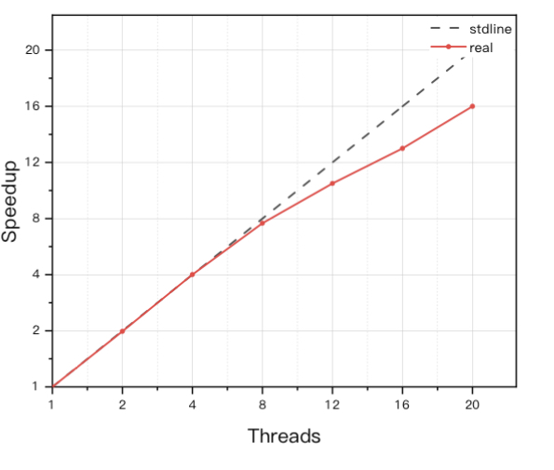
Progress in RDataFrame-based Analysis Framework
RDataFrame is a powerful tool for data analysis
  Program language: Python and C++
  Declarative programming and parallel processing
  Used by many experiments such as FCC-ee
New developments since last meeting
  Several algorithms were ported from Marlin
    JetClustering, KinematicFit,
  More are being implemented
    VertexFit, JetTagging, PID etc.
  Performance test with two analysis channels
    e+e- -> Z(mumu)H
    e+e- ->H(2jet) mumu
Scalability
Identical
with Marlin

Slide 9
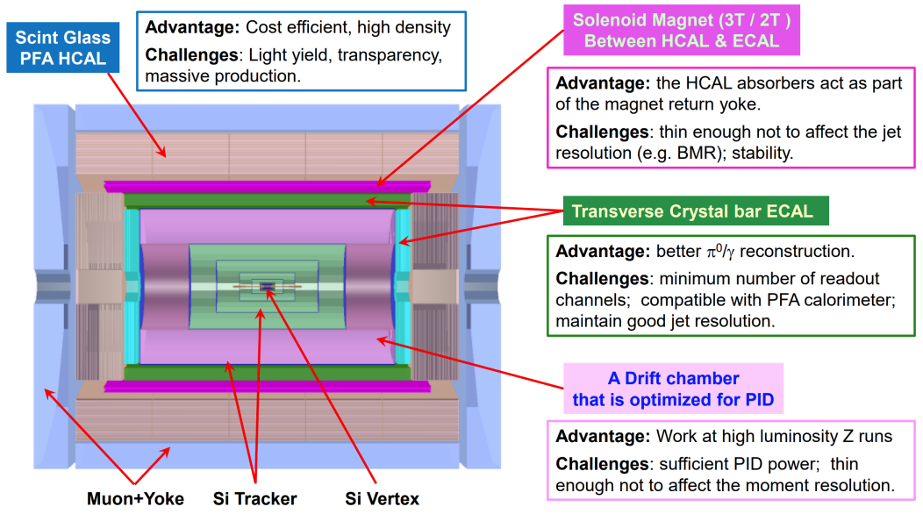
Detector Software Development
The 4th conceptual detector
  Silicon Tracker
  Drift Chamber
  Transverse Crystal-bar ECAL
  Scintillator Glass HCAL
Both detector design and physics potential studies need simulation and reconstruction software
In the past year, software development was mainly focused on the first three sub-detectors

Slide 10
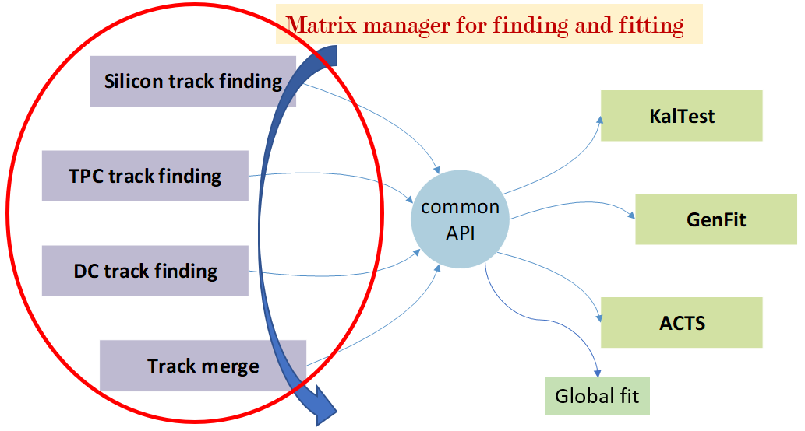
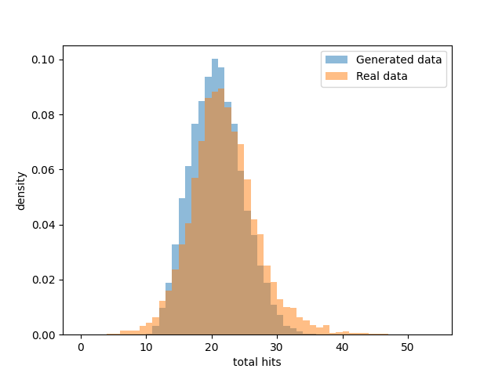
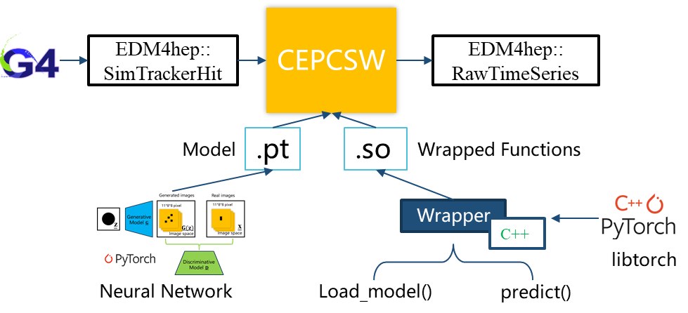
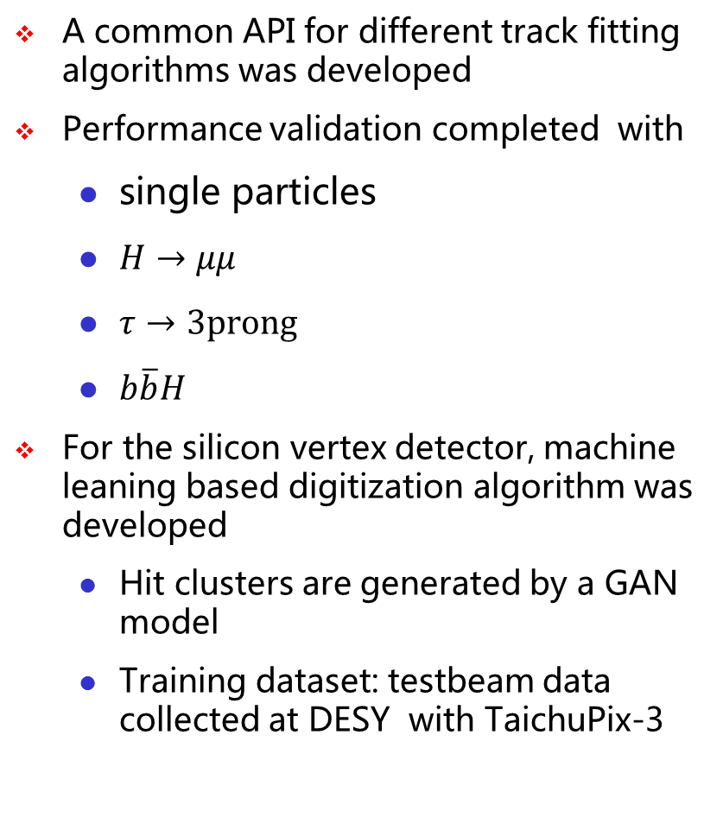
Progress in Silicon Tracker Software (1)
A common API for different track fitting algorithms was developed
Performance validation completed with
  single particles
  $H→μμ$
  $τ→3prong$
  $b\overline{b}H$
For the silicon vertex detector, machine leaning based digitization algorithm was developed
  Hit clusters are generated by a GAN model
  Training dataset: testbeam data collected at DESY with TaichuPix-3
Comparison of cluster between GAN and data

Slide 11
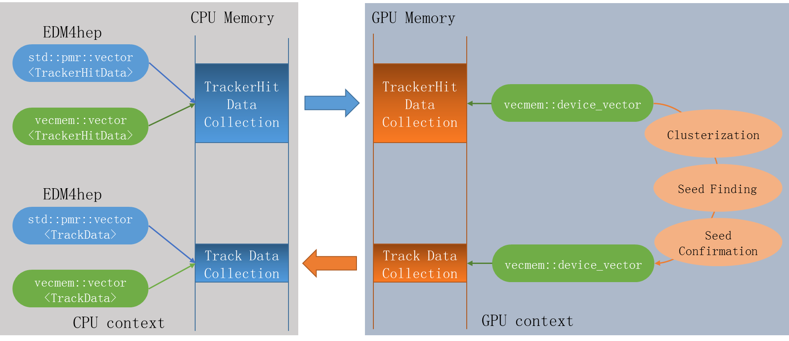
Progress in Silicon Tracker Software (2)
TRACCC: one of ACTS R&D projects
  Full chain demonstrator for track reconstruction on CPU/GPU
Developing CEPC seeding algorithm based on TRACCC
Building a bridge between EDM4hep and TRACCC
  Common memory for both EDM4hep and TRACCC
  No data conversion is needed between them
https://github.com/acts-project/traccc

Slide 12
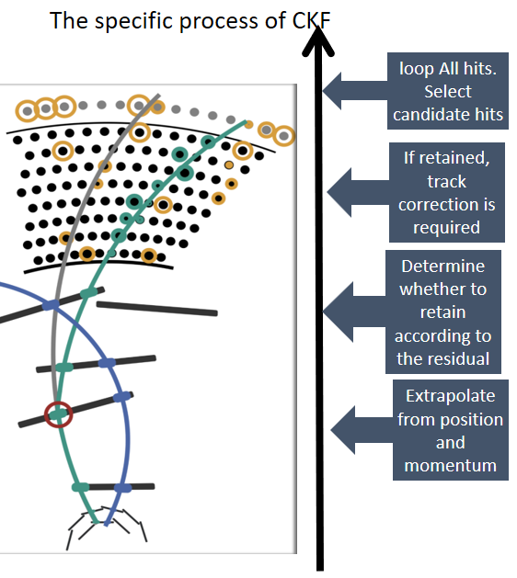
Progress in Drift Chamber Software (1)
Track finding algorithm
  Track segments reconstructed in the silicon detector, called seeds, are extrapolated to the DC (Drift Chamber) and then all the DC hits belonging to the track will be collected
Track fitting algorithm
  Adopt experiment-independent track fitting toolkit Genfit which is also being used by many other experiments like BelleII, PANDA, COMET etc.
Completed work includes
  Porting the BelleII code to the CEPCSW
  Implementation of geometry and magnetic field
  Optimization of hit selection criteria
  Performance validation with simulated data

Slide 13
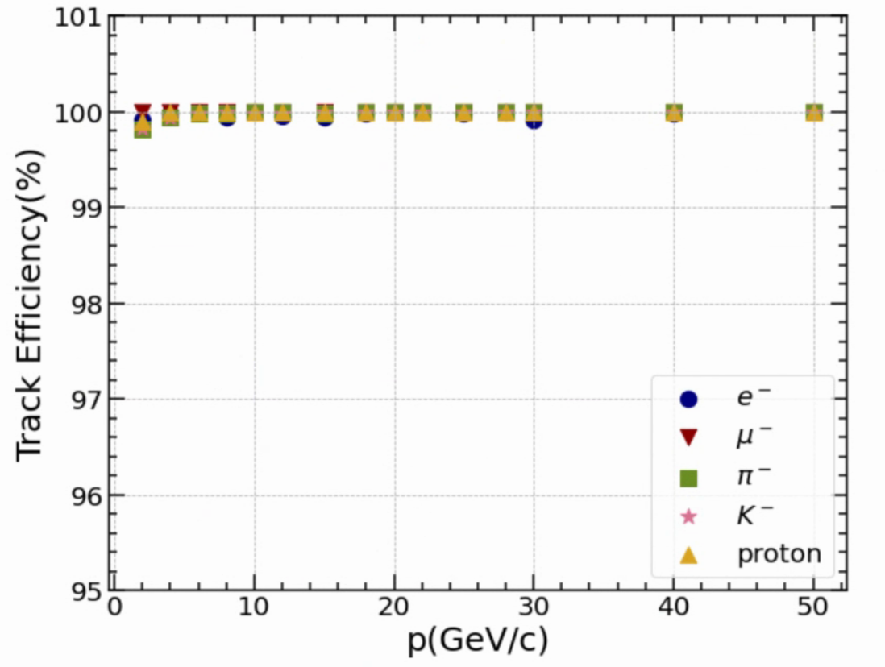
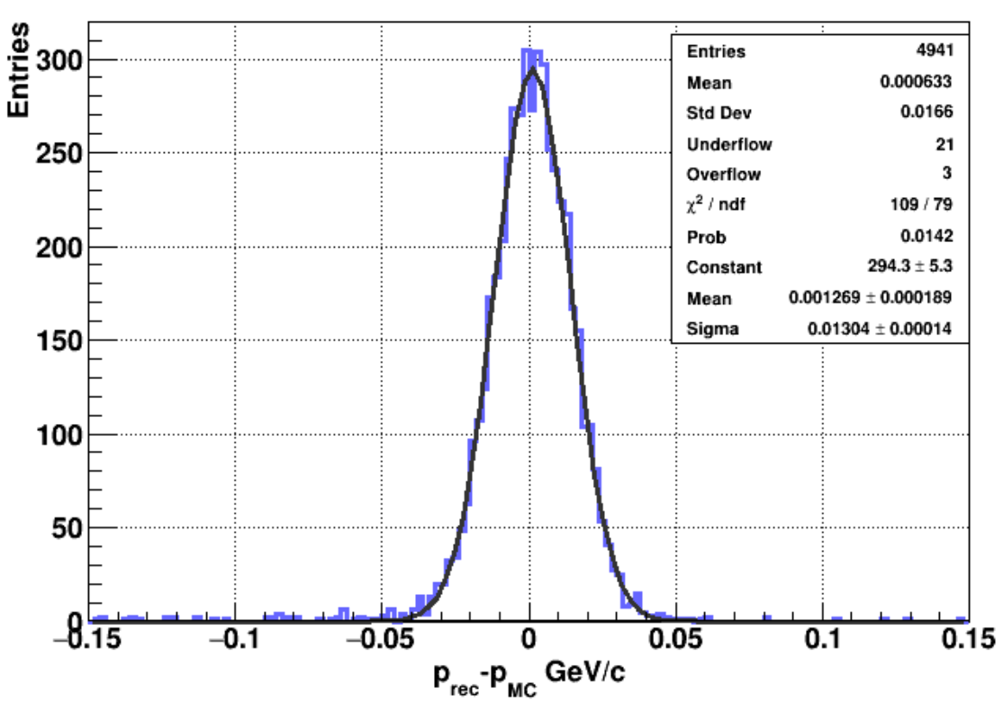
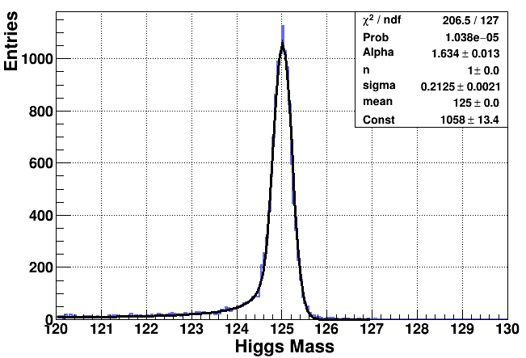

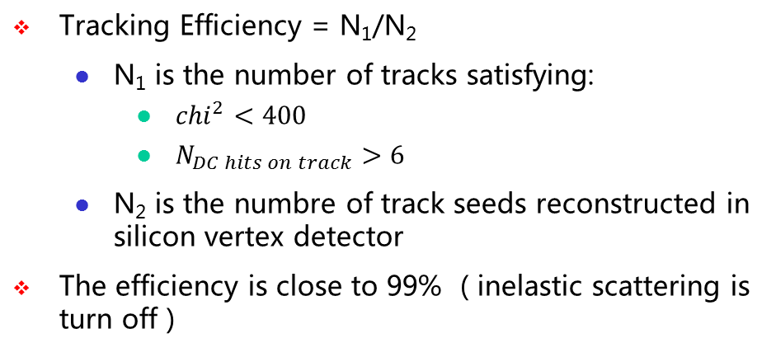

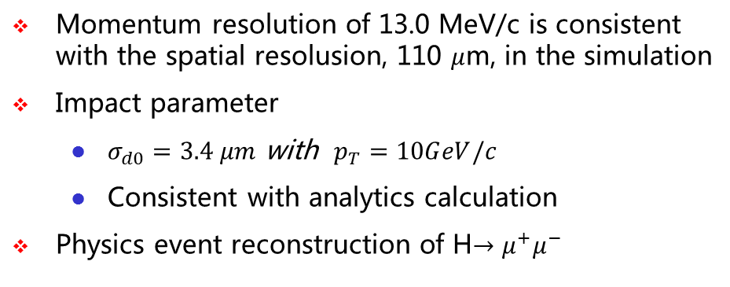
Progress in Drift Chamber Software (2)
Tracking Efficiency = N₁/N₂
  N₁ is the number of tracks satisfying:
    ${chi}^{2}<400$
    $N_{DC hits on track}>6$
  N₂ is the numbre of track seeds reconstructed in silicon vertex detector
The efficiency is close to 99% ( inelastic scattering is turn off )
Momentum resolution of 13.0 MeV/c is consistent with the spatial resolusion, 110 $μ$m, in the simulation
Impact parameter
  $σ_{d0}=3.4 μm$ with $p_{T}=10GeV/c$
  Consistent with analytics calculation
Physics event reconstruction of H$→μ^{+}μ^{−}$
Tracking efficiency v.s. momentum
Momentum of 10 GeV/c μ⁻
$σ$ = 13.0 MeV/c
Μ = 125 GeV/c
$σ$ = 212MeV/c

Slide 14
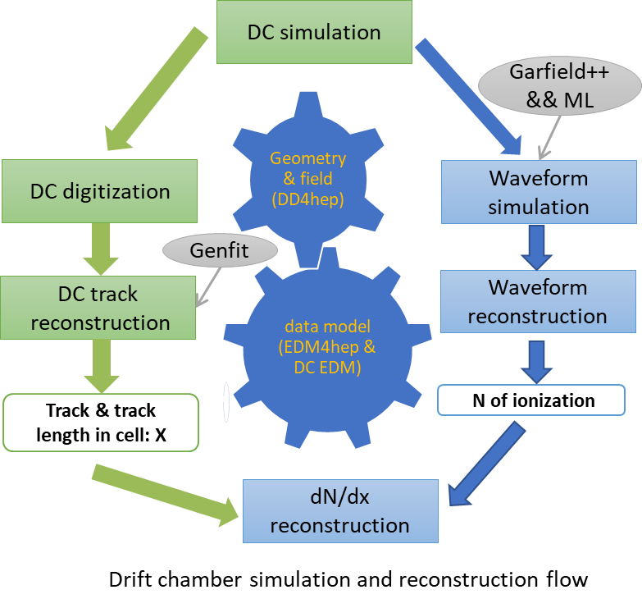
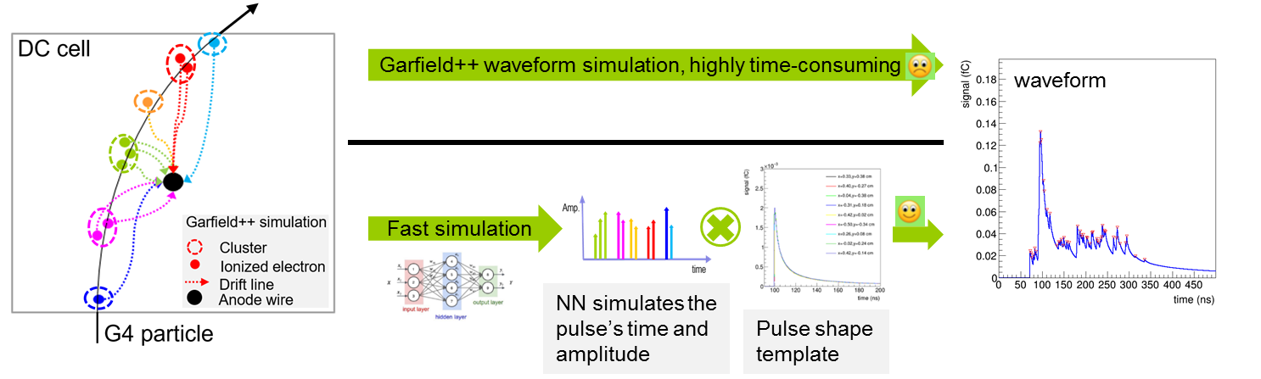
Plan for Drift Chamber Software
Use neural network to simulate the time and amplitude of the pulse of an ionized electron
Add waveform reconstruction algorithm into the CEPCSW
Develop dN/dx reconstruction algorithm
Improve tracking performance by using multiple time information obtained from the waveform

Slide 15
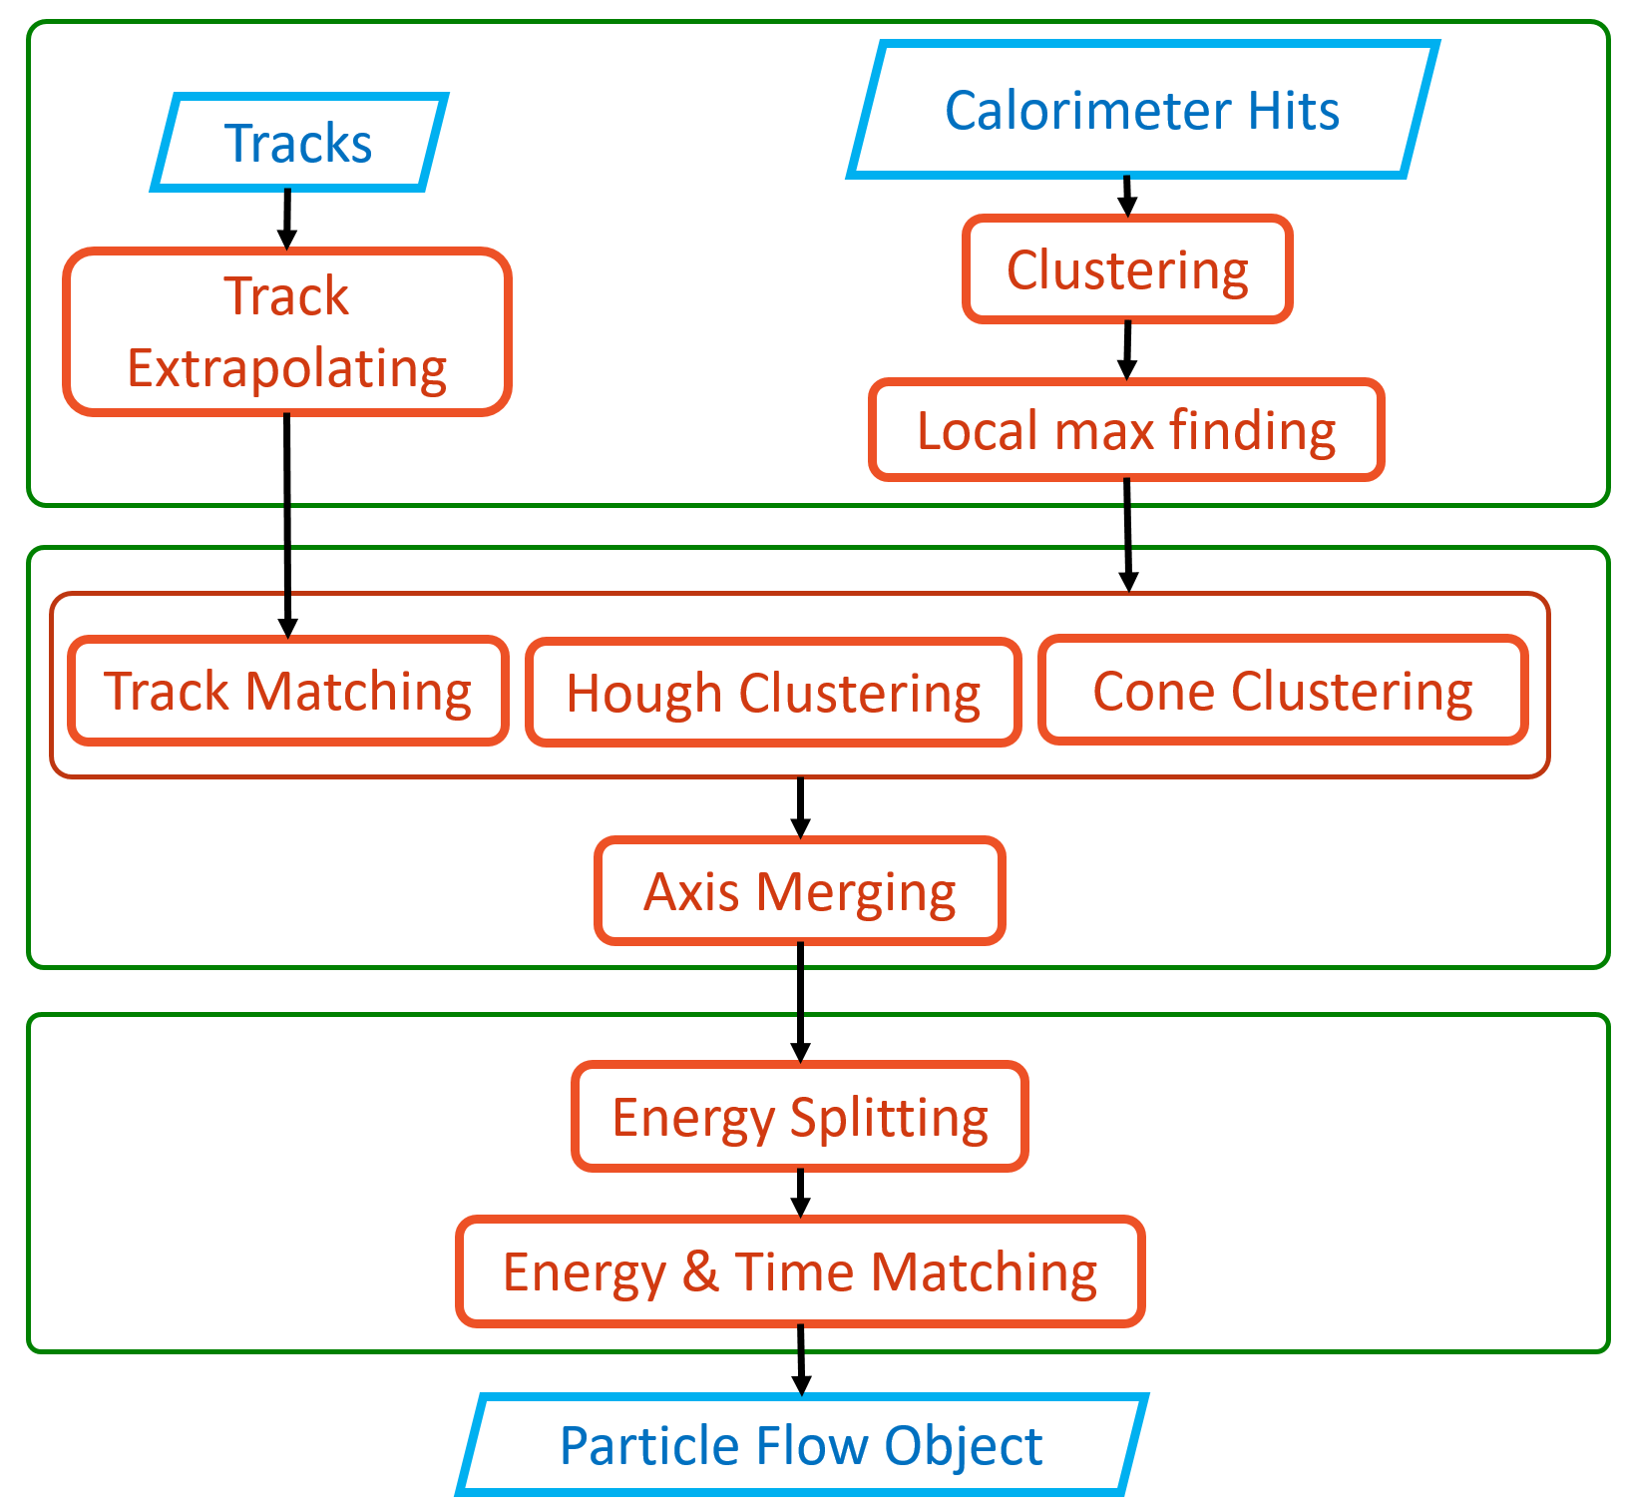
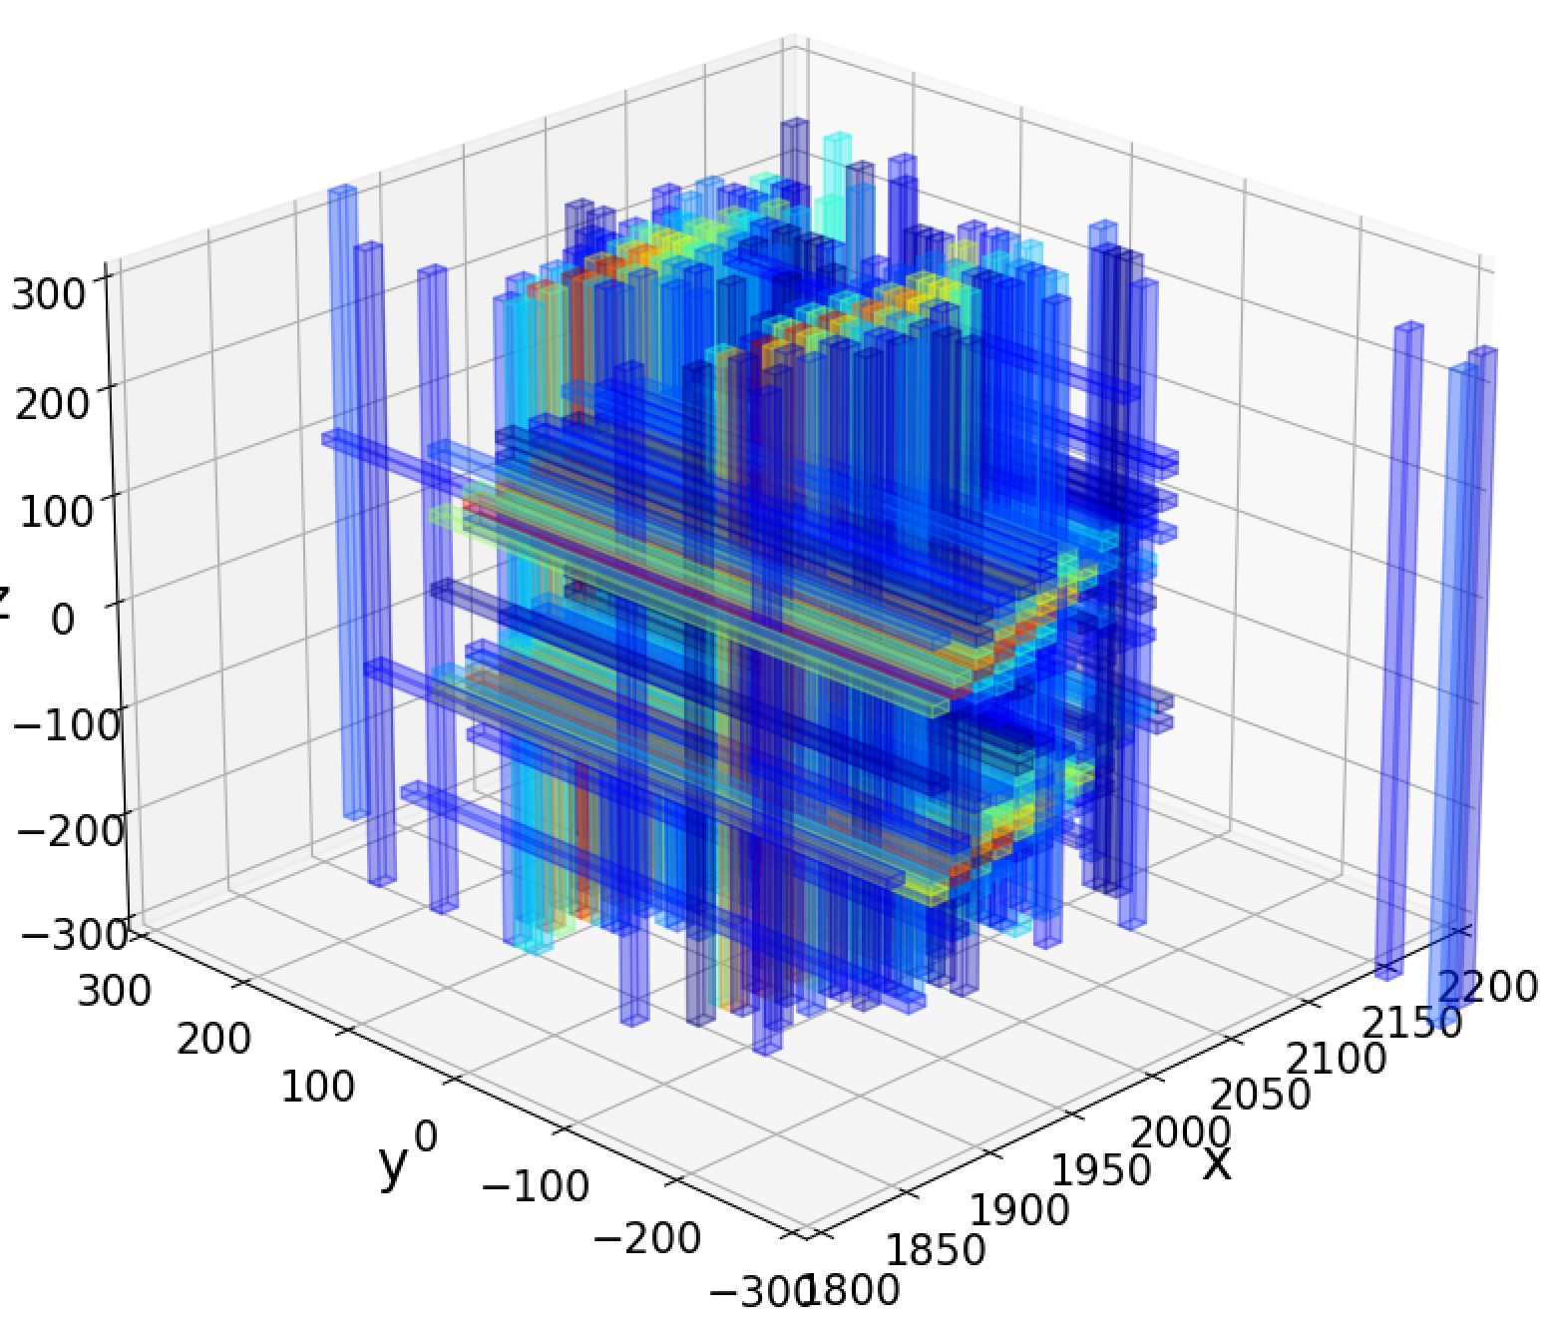
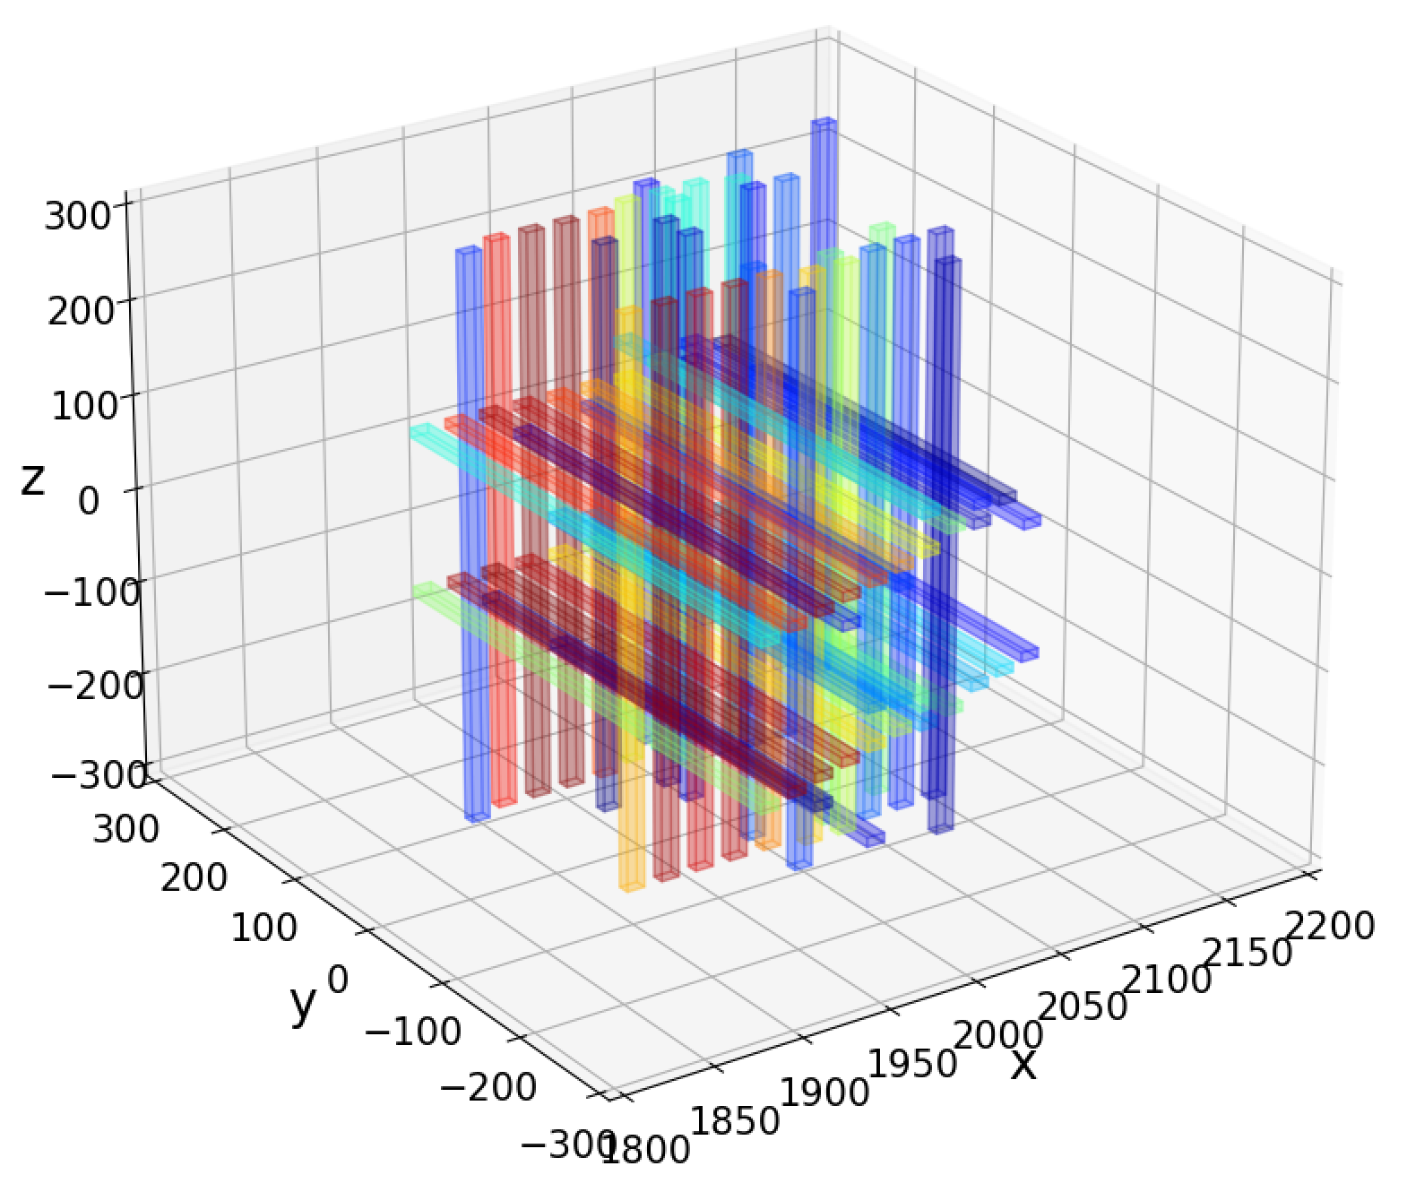
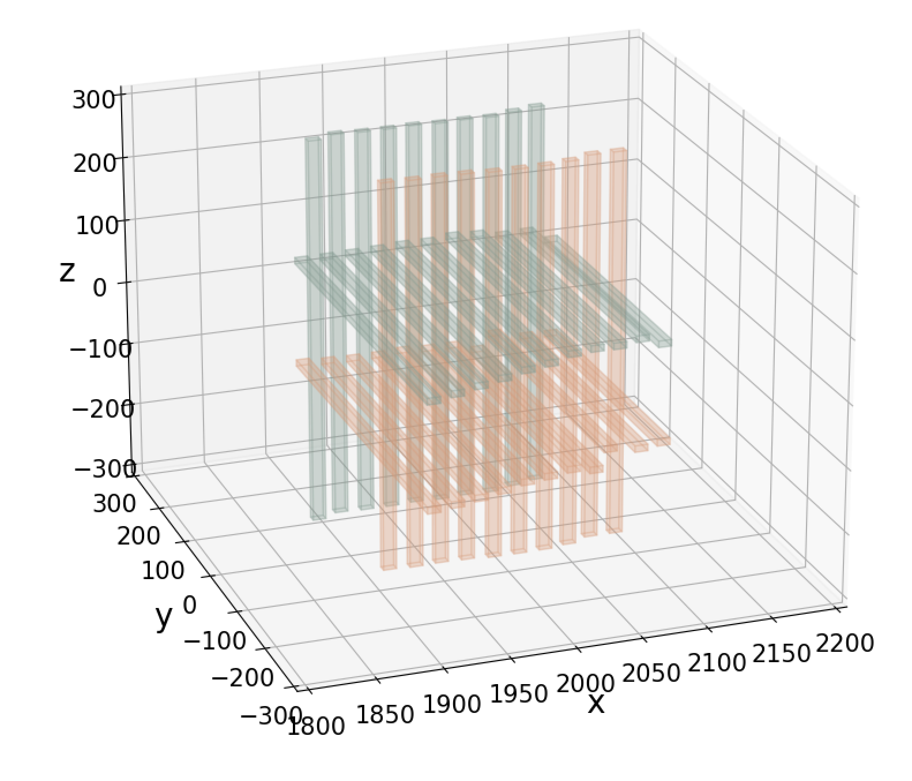

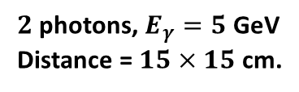

Progress in Crystal-bar ECAL Software (1)
Software developers worked closely with the detector group
A prototype of reconstruction algorithm was developed, which mainly consists of 4 functional modules
  Clustering
  shower recognition
  splitting of overlap showers
  ambiguity removal
$2$photons, $E_{γ}=5$ GeV
Distance = $15×15$ cm.
clustering
recognition
$$γ_{1}$$
recognition
splitting
$$γ_{2}$$

Slide 16
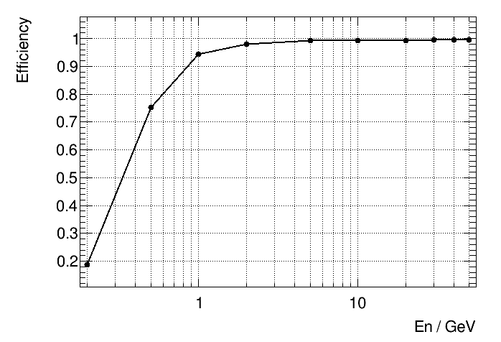
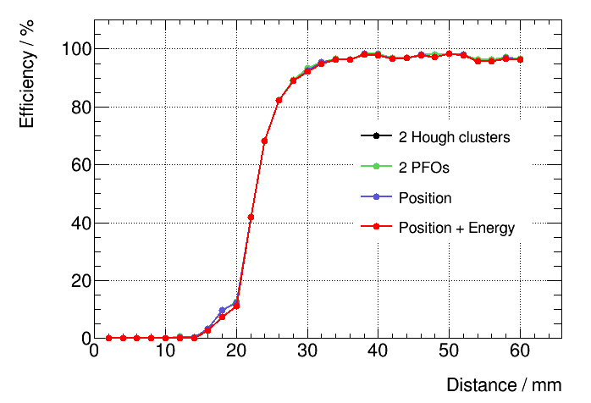
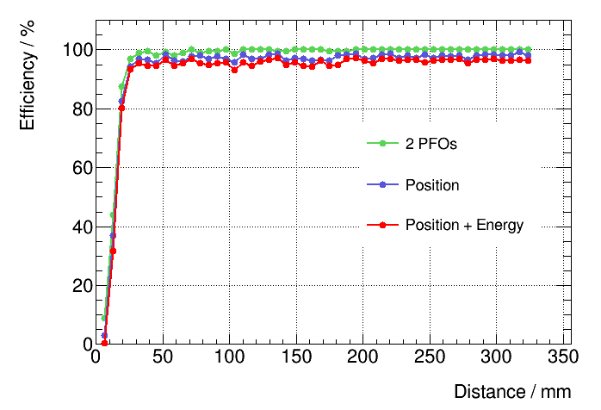

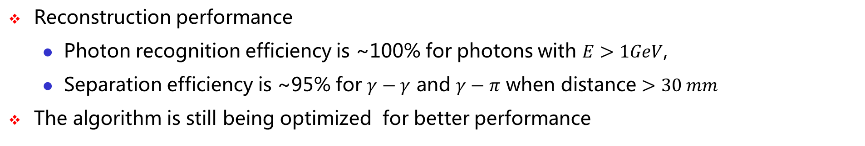


Progress in Crystal-bar ECAL Software (2)
Reconstruction performance
  Photon recognition efficiency is ~100% for photons with $E>1GeV$,
  Separation efficiency is ~95% for $γ−γ$ and $γ−π$ when distance $>30 mm$
The algorithm is still being optimized for better performance
$γ$ recognition efficiency
$γ−γ$ separation efficiency
$γ−π$ separation efficiency

Slide 17
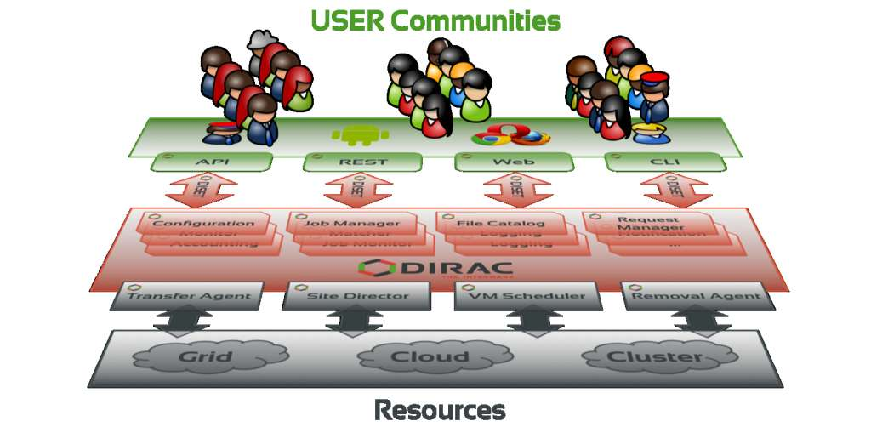
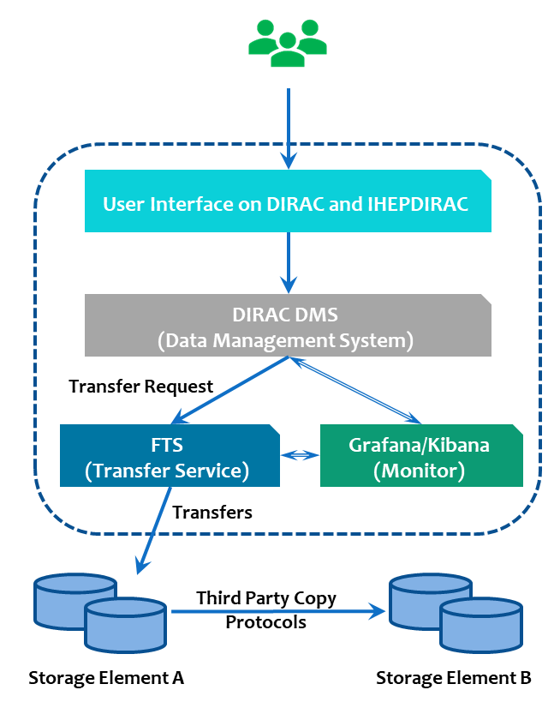
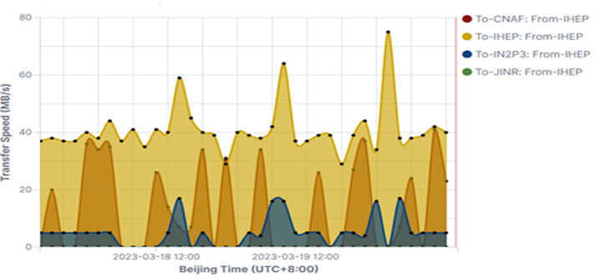
Progress in CEPC Computing Platform
CEPC has established a distributed computing platform for detector R&D
  DIRAC as middleware , also using VOMS, FTS, CVMFS, StoRM, EOS, WLCG middleware
  IHEPDIRAC contains tools developed for CEPC applications
There are about 4,600 CPU cores in this platform
  IHEP holds 2,000 dedicated cores including 640 cores shared with ILC
  Other sites contribute the rest 2600 cores
The prototypes for workload management and data management were developed
  Regular TPC test system was established and monitoring was implemented with ElasticResearch+Kibana/Grafana

Slide 18
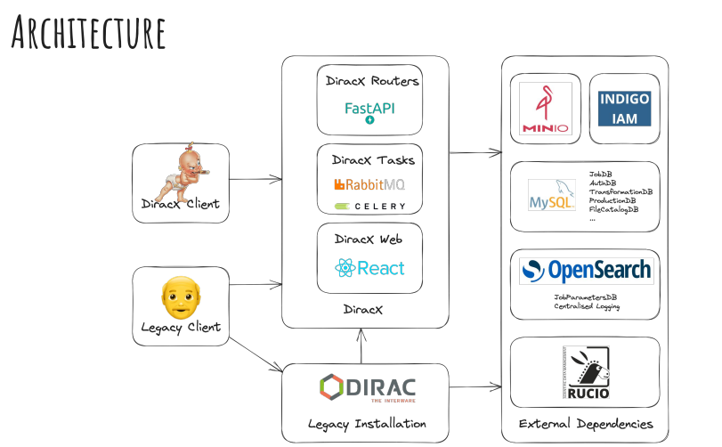
Plan for CEPC Computing Platform
Complete the implementation of token-based authorization and authentication infrastructure
Migration to DiracX, which is the next incarnation of Dirac re-implemented with emerging IT technologies
Evaluate the“Data Lake” model with Rucio and XCache for smart data access and management
Integration with HPC resource and adding support for machine learning activities

Slide 19
International Collaboration
IHEP and SDU are non-EU members of Key4hep project (AIDAinnova WP12)
  Bi-weekly Key4hep/Edm4hep meetings and WP12 monthly meeting
Collaboration with IDEA detector group in R&D of drift chamber
  Weekly discussion on cluster counting method
  Further collaboration on tracking is being discussed
Collaboration with the ACTS group established this year
  Adding precise simulation of drift chamber into the Open Data Detector
  Implementation of tracking in drift chamber with ACTS
IHEP is an official member of the DIRAC consortium
  Weekly DIRAC development meeting and DIRAC workshop

Slide 20
Summary
The CEPCSW is being developed based on Key4hep
Significant progress has been made since the last IAC meeting
  Core software: event data model, simulation framework and RDataFrame-based analysis framework
  Detector software: silicon tracker software, drift chamber software and crystal-bar ECAL software
  CEPC distributed computing platform
International collaboration and cooperation are being promoted with HEP R&D teams
Thank You !
谢谢

