Slide 1
Review Report
Riccardo Bartolini (DESY)
Philippe Lebrun (CERN)
Benno List (DESY)
Vittorio Parma (CERN)
Lenny Rivkin (EPFL, PSI) - Chair
Tetsuo Shidara (KEK)
Akira Yamamoto (KEK, CERN)
Brian Foster (DESY, Oxford) - observer
International Cost Review of the CEPC Accelerator TDR

Slide 2
Acknowledgements
We congratulate the CEPC team on the impressive progress with defining an ambitious project. We thank the CEPC team for their excellent preparation, their presentations and their patience in answering all our questions.
Very well structured presentation of the Phase-II CEPC TDR Cost Estimate
The cost estimate presented is sound and sufficiently complete to form a proper basis for the next iteration during the EDR stage

Slide 3
Charge
Are the CEPC team and the presenters professionally competent and possessing the technical proficiency to perform the cost evaluation?
Are there any missing subsystem or components in the consideration that will affect the accuracy of the cost calculation of the CEPC accelerator?
Are the basic considerations, pricing information on the material, manufacturing cost and other relevant inputs adequate and credible?
Are the cost models adopted in this report credible and reliable?
What are the primary uncertainties, and how should they be addressed?
Can the CEPC accelerator cost evaluation can be relied upon to budget for its construction and commissioning, after the completion of the outlined R&D program, and industrial and engineering preparation, as well as issues identified in item 5 above have been properly addressed?
Any other issues you notice or any improvements you may suggest.

Slide 4
Answers to the Charge
Are the CEPC team and the presenters professionally competent and possessing the technical proficiency to perform the cost evaluation? Yes
The involvement of IHEP staff in many projects built and under construction in China (BEPC/BEPCII, ADS, CSNS, and HEPS) provides a good basis for the current CEPC cost estimate. Scaling up to the CEPC number of components will require a qualitatively higher level of scheduling, procurement strategy and risk management and will allow refinement of the TDR cost estimate in the next, EDR stage of project development..
Are there any missing subsystem or components in the consideration that will affect the accuracy of the cost calculation of the CEPC accelerator?
Interface items and system integration need to be more detailed/accounted
Details on 3% installation and 3% commissioning
Site specific items (not part of this review) bear significant uncertainty
Are the basic considerations, pricing information on the material, manufacturing cost and other relevant inputs adequate and credible? Yes

Slide 5
Answers to the Charge 2
Are the cost models adopted in this report credible and reliable? To a large extent
Scaling to 100 x larger project may bring potential savings due to large series production.
Procurement strategy to be refined
What are the primary uncertainties, and how should they be addressed?
Market uncertainties of material costs are the major risk factor
Risk management plan for early detection of appearing cost and schedule risks
Can the CEPC accelerator cost evaluation can be relied upon to budget for its construction and commissioning, after the completion of the outlined R&D program, and industrial and engineering preparation, as well as issues identified in item 5 above have been properly addressed?
Yes (+20% contingency) Given R&D program is detailed further (cf. TDR Review Report)
Any other issues you notice or any improvements you may suggest.
Resource-loaded schedule integrating procurement strategy and logistics plan
Assessing maturity levels of components (TRL methodology) will reduce cost uncertainty

Slide 6
General Observations and recommendations

Slide 7
Scope
Costed is Higgs factory of 30 MW SR power/beam, upgradable to 50 MW. Excluded are civil engineering, detectors at IP with their technical services, central computing services, operation and maintenance costs (including spare parts), personnel expenses.
The technical design of accelerator components and systems has been “optimized to reduce material and fabrication costs”, i.e. capital expenditure, at the expense of operational expenditure. In a general context of increasing energy costs and limitation of CO₂ emissions, the Committee wonders whether the technical optimization of the project should not be revised to take into account both capital and operational expenditure.

Slide 8
Scope
R1: Consider re-optimizing the technical design of components and systems with large electricity consumption, taking into account both capital and operational expenditure.
Define unambiguously what constitutes the end of the construction project

Slide 9
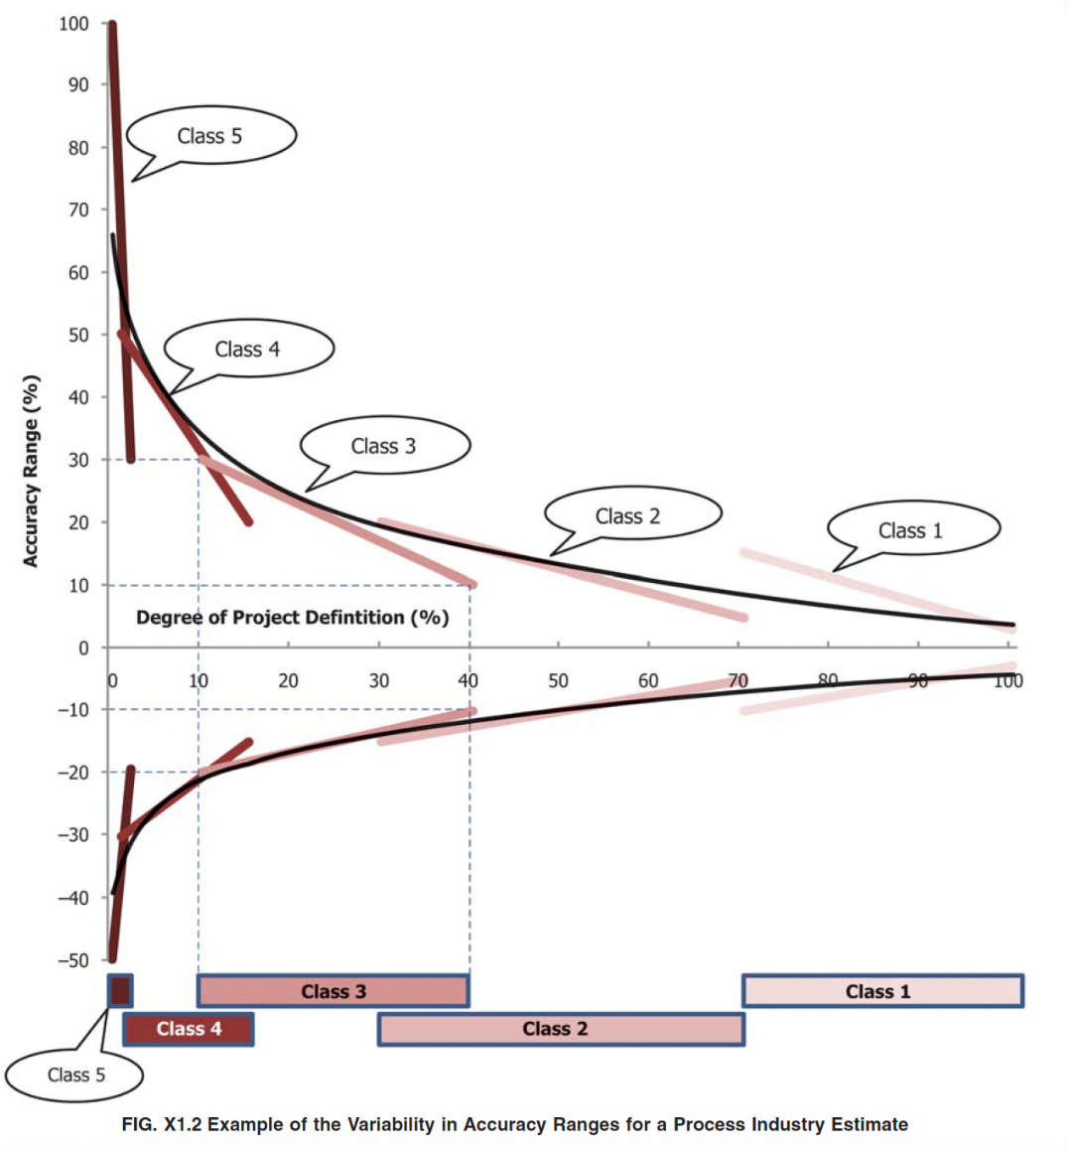
Methodology of the cost estimate
Uncertainty on individual systems is estimated to be -20 % to +30 % (Class 3 maturity level), leading to an uncertainty on the total cost stated to be around 10% at the TDR stage, expected to be reduced to 5 % at the time of project approval. Based on experience the Committee considers that 10% value of uncertainty would be difficult to achieve at this stage of the project.
R2: Adding 20% contingency to offset the uncertainty of the cost estimate at this stage of the project would be recommended.
AACE 18R-97
International Cost Estimate Classification System

Slide 10
Methodology of the cost estimate 2
Costs for acceptance, tests, quality control, handling and processing are generally not quoted in the estimates provided. A project the size of CEPC is likely to surpass the in-house person power capabilities in areas that were completed entirely by institute staff in previous projects such as BEPCII, CSNS, or HEPS.
R3: For labour-intensive, high-volume activities, in particular the components of the collider and booster, refine and review the production model to check the availability of in-house resources.

Slide 11
Completeness and maturity of cost estimate
Reflects that of the PBS/WBS. No major system appears missing given the scope considered. However, some missing costs may be hiding in the insufficiently defined interfaces, e.g. the MDI - detector interface, the civil construction - accelerator systems interface (making the bare tunnel viable and ready for installation of accelerator systems), the connection to site-specific existing networks (e.g. utility power lines, raw-water adduction, roads).
Potential cost increases with refined system engineering (e.g. between SRF and cryogenics) in particular for securing equipment safety and He resource conservation even in major emergency cases including total power failure.
Conversely, there may be potential cost reduction in improving systems integration or sharing of technical services between accelerators and detectors.
R4: Improve cost-estimate maturity of several systems (particularly MDI and cryogenics) and the system integration.

Slide 12
Procurement Strategy
For a number of large-series key components, in particular magnets, vacuum and power sources, contracts will have to be split among multiple vendors for reasons of production capacity, competitive pricing, risk reduction and balancing of possible in-kind contributions from contributing regions.
Although requiring more industrialization and production follow-up work, such multi-sourcing would act as an insurance for the project not to fall into significant delays or cost increase.
A procurement strategy should be developed for the cost, schedule and performance critical components, addressing questions such as:
international vs domestic procurement, number of vendors, specification process (build to print versus build to specification), bidding process, etc.
This strategy would be a prerequisite for efficient production engineering (e.g. number of parallel lines, series order and learning curves, manufacturing test stations, transport and intermediate storage of components), eventually resulting in lower component prices.

Slide 13
Installation plan
CEPC as a large, underground facility with limited access through long, vertical shafts poses unique challenges to the installation process.
One possible issue is the use of ventilation shafts for material transport during construction and installation, with their subsequent conversion to ventilation shafts. Contentions with the detector installation need to be taken into account.
R5: Analyze the installation sequence and evaluate the necessary manpower and associated cost, the ensuing logistics issues, and the requirements on transport means as well as storage and logistics needs.

Slide 14
Commissioning budget
CEPC machine commissioning costs with beam are included in the 3% commissioning cost quoted; the degree of machine performance (luminosity) reached within this cost cap is not clearly defined at this stage.
For CEPC, a construction project of almost ten years duration, the commissioning costs are likely to be a larger fraction of the overall capital costs, as compared to smaller projects of shorter duration.
Spares are in the operation budget and were not part of the cost estimate. Necessary provisions for “teething problems” with hardware in the start-up phase are considered to be covered by the 3% commissioning budget.
Spare parts for sensitive components with long delivery time, such as gun cathodes, SHB RF power supplies, flux concentrator coils, and so on, must be available at the start of commissioning.

Slide 15
Schedule and Logistics
The project schedule is a highly important aspect also for the cost planning, as project delays can cause or necessitate cost overruns.
Priority should be given in the engineering design phase to the development of a resource-loaded project schedule, with particular emphasis on the procurement times and strategy for large quantity items such as magnets, vacuum and RF system components, and the plans for assembly, testing and installation.
This should include a logistics plan, detailing necessary storage capacities and space for assembly and testing.
.

Slide 16
Schedule and Logistics 2
Some detector subsystems, notably the superconducting solenoids, have construction times of ~ 10 years, comparable to the entire project execution time, and thus need to be ready for ordering almost immediately after project start, if not before. This needs to be taken into account in the overall project schedule.
The integrated accelerator/detector master schedule indicates that the detectors’ construction will finish a couple of years later than the accelerator. This would delay the start of physics to the late 2030ies, and therefore reduce the 10-year advantage over the competing project FCC-ee, an advantage that is considered to be one of the major benefits to the HEP community.
Synchronising the construction and commissioning of both accelerators and detectors is highly desirable.
.

Slide 17
Risk management
R6: Implement the risk-mitigation plan in the cost estimates for the procurement plan to eliminate major risk during the mass production, providing multiple vendors and multiple production lines.
In the Engineering Design Phase, it is advisable to create and maintain a database of cost items with information regarding technology maturity (TRL), design completeness and cost basis, to identify and prioritize areas for R&D, prototyping and industrialisation.

Slide 18
Access to underground galleries during machine operation
Defining personnel access conditions to the underground technical galleries during machine operation is key to ensure maintainability of the technical systems and should be thoroughly reviewed. Accessibility requires access control, interlocked systems and adequate level of radiation shielding, i.e. additional associated costs which may however be beneficial to machine availability. As an example, accessibility to the klystron/SSA galleries requires an adequate level of shielding from the machine tunnel.

Slide 19
Raw Materials Costs
A number of high value components have a significant fraction of cost originating from raw material costs that are highly volatile, notably:
magnets (steel, aluminum), vacuum chambers (copper), supports (steel).
R7: Include raw material costs explicitly as line items in the cost estimate, for WBS items with a high dependency on raw material costs (magnets, vacuum system, supports).

Slide 20
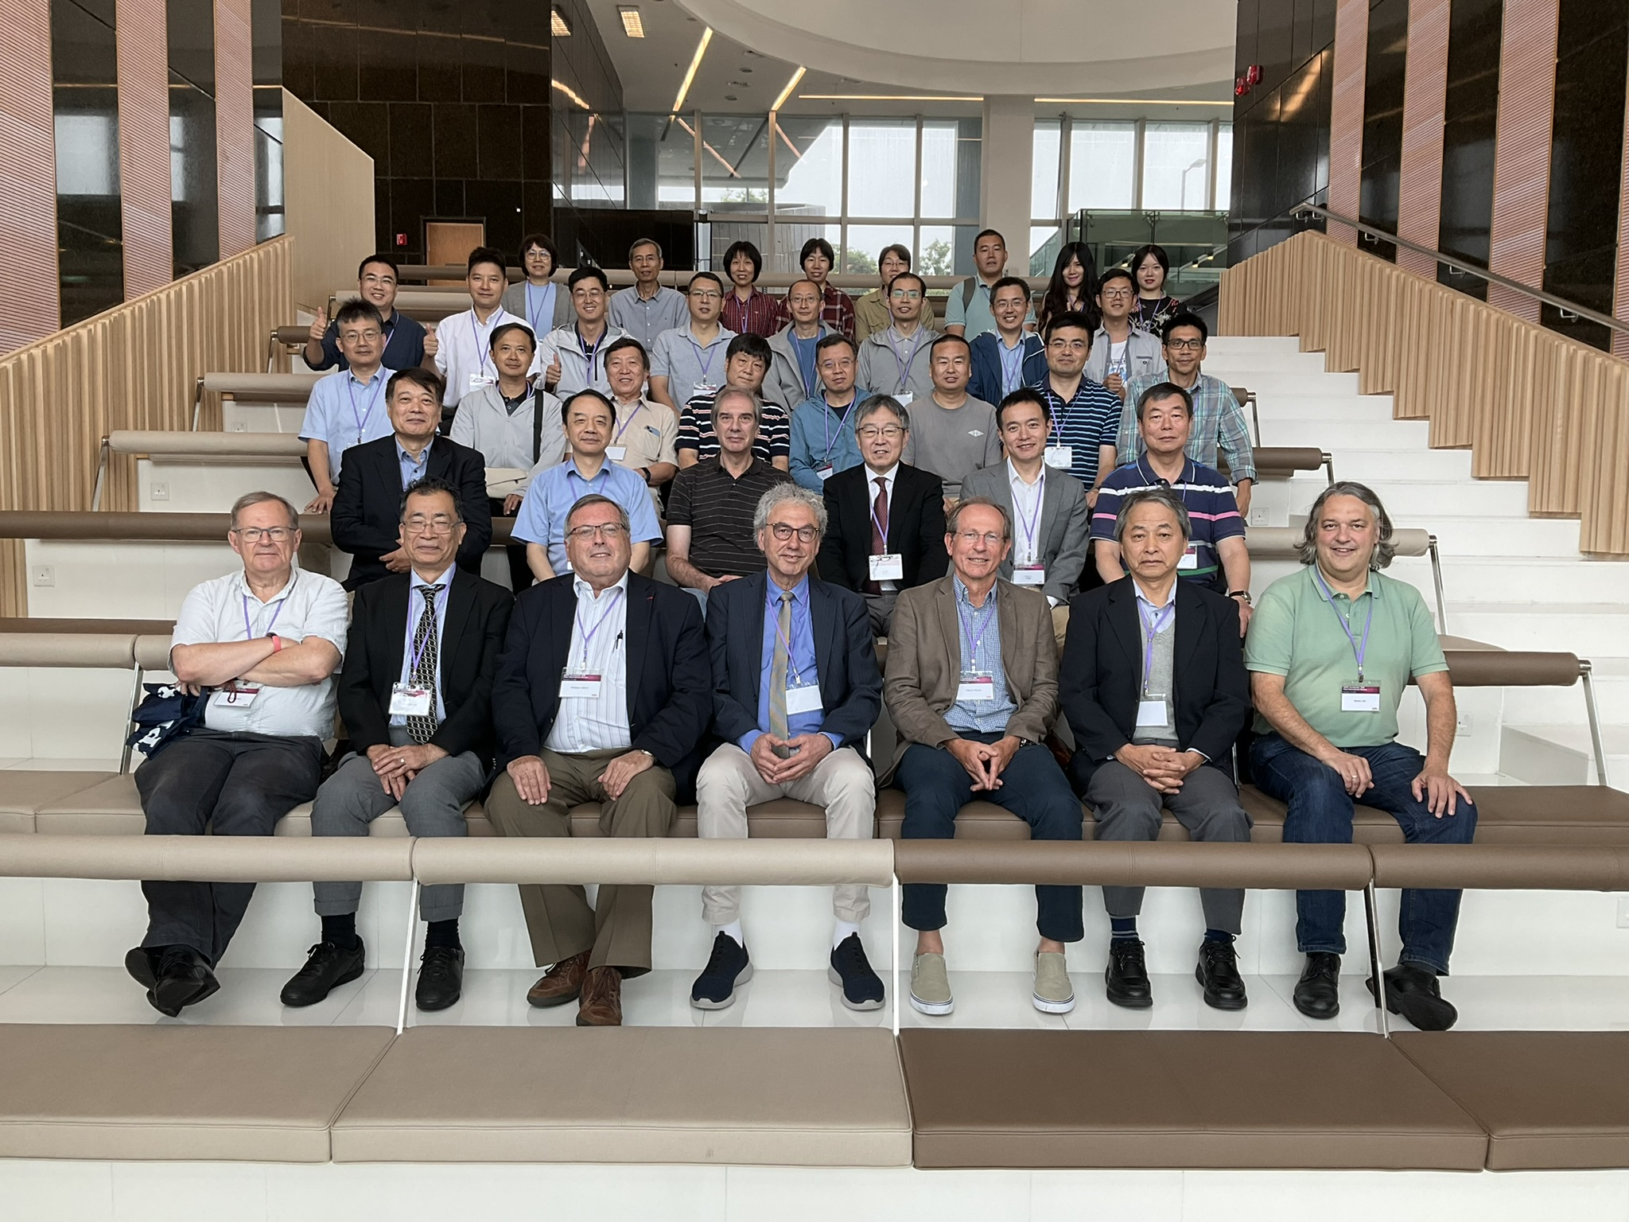
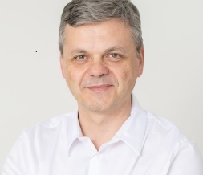
Thank you
祝好！

