Slide 1
Sr90 test for TaichuPix3 FLEX BOARD
Tianya Wu，Xiaomin Wei，Wei Wang
wuty@ihep.ac.cn
2023.07.06

Slide 2
Setup
Only U9 is turned on
ITHR is set to 11111000
Sr90 is put on the top of U9 with 2cm
Power is 12V/0.535A
Take data with matlab

Slide 3
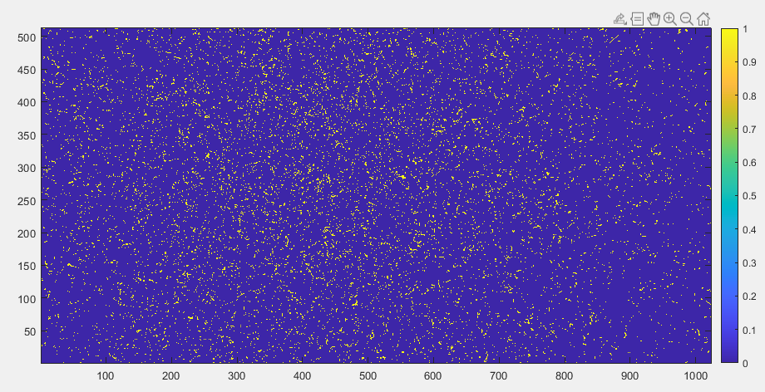
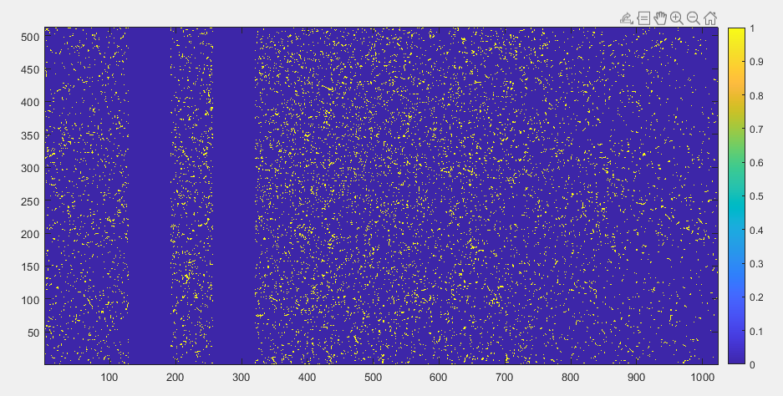
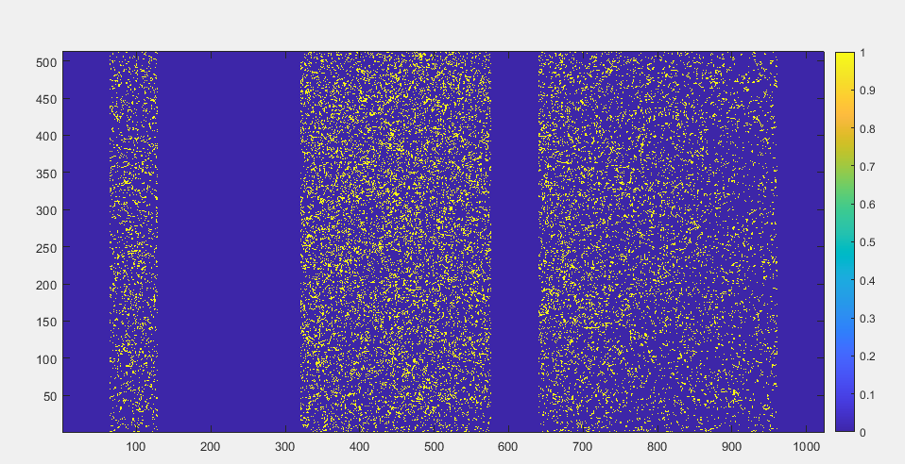
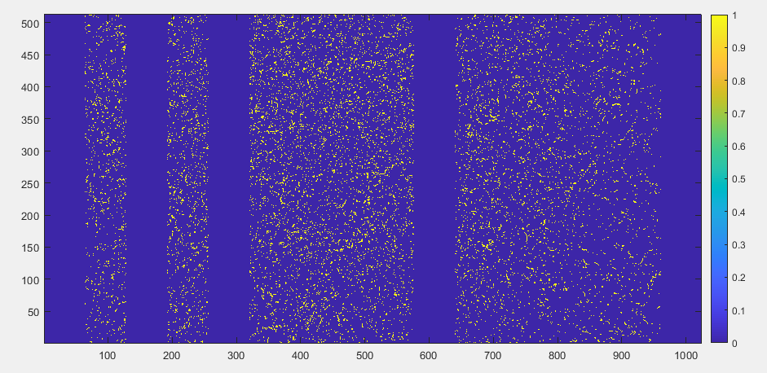
Data lose

Slide 4
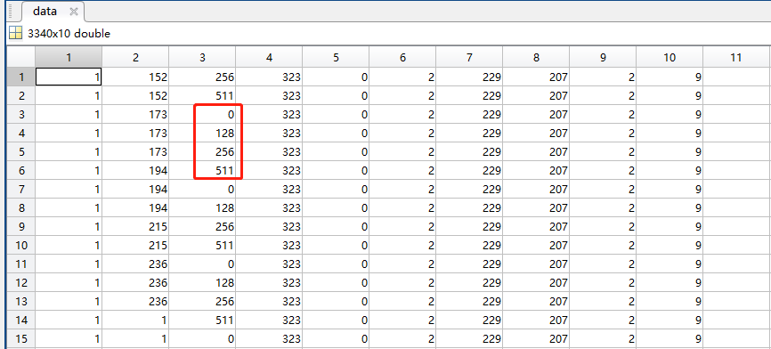
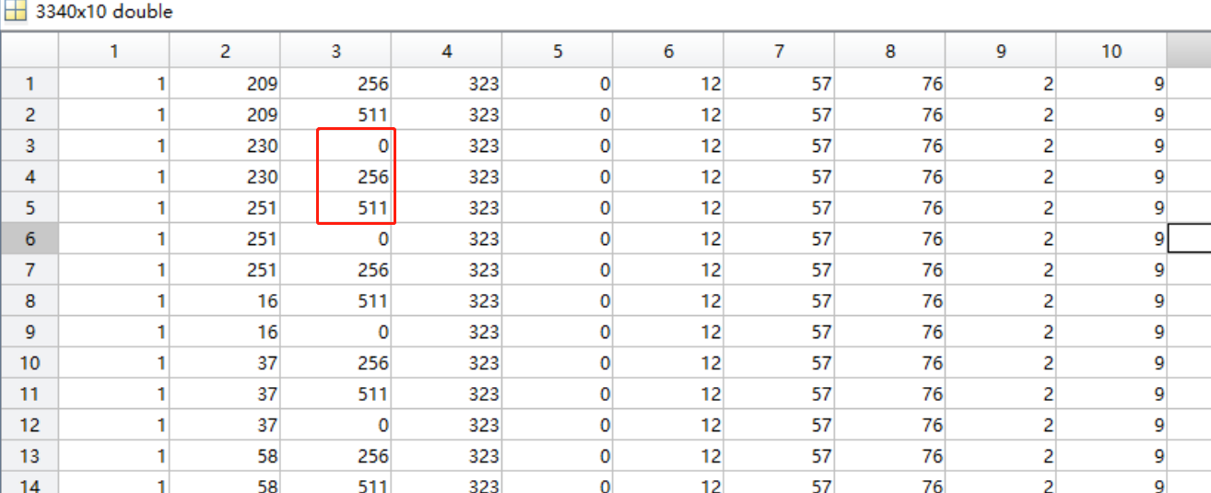
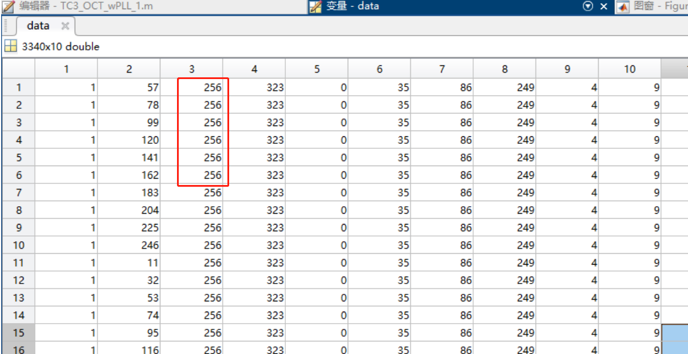
Data lose

Slide 5
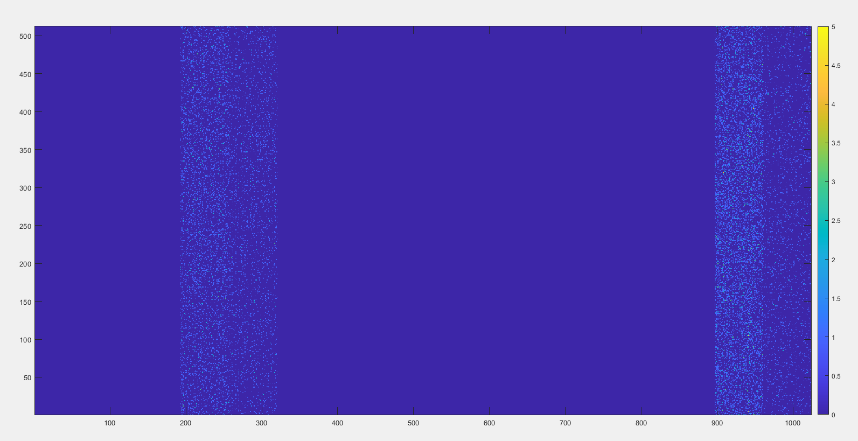
ENTP Recover
Try different interface frequency with DOFREQ register, no valid data received.
Turning on compression, no any data received;
Turn on OCT mode, no data
Turn on ENTP, correct data
Compression mode

Slide 6
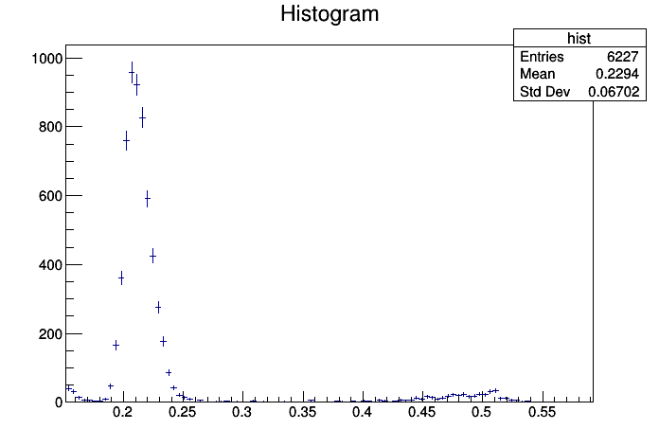
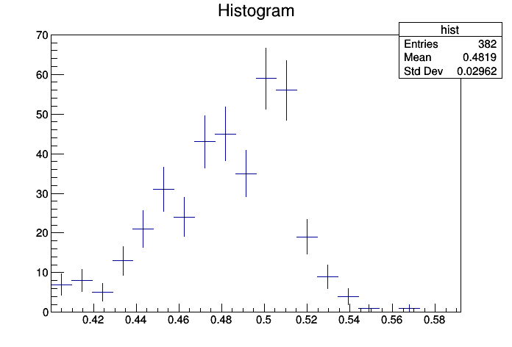
Fe55 data analysis
Two peaks are appeared
Suppose analog front-end is linear, one peak is 1640e-, the other is 1800 e-, the baseline is 0.15V, the Kb/Ka=1800/1640=1.097
Then (0.48-0.15)*1.097+0.15=0.512 V which agree with the measurement.

Slide 7
Thanks for your attention!

