Slide 1
Search for new physics at LHCb
王纪科
武汉大学

Slide 2
Report content
Mainly focus on the results related with Charm and LHCb typical
D CPV Searches
Rare decay (including LFV)
LFU test results

Slide 3
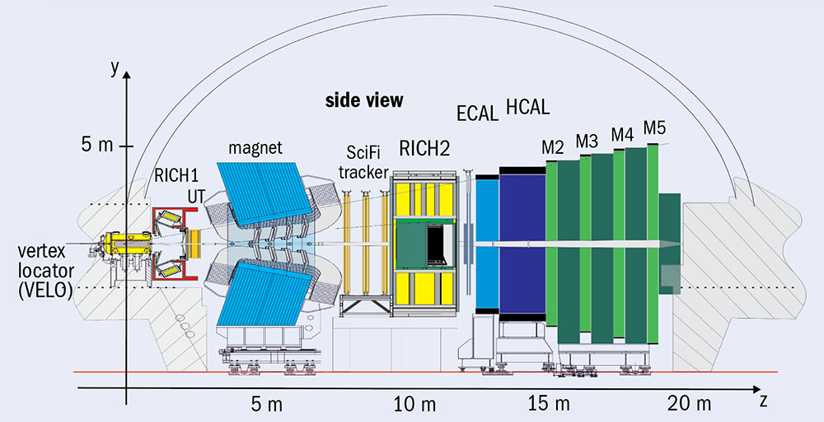
LHCb detector
优秀的顶点、径迹重建和粒子鉴别等性能，灵活高效的在线触发系统
单臂前向的谱仪，对应于前向η范围2<η<5。在LHC上专门用于重味物理。
- LHC pp对撞中，$b\overline{b}$强子对在前向和后向相对于束流方向（Z-方向）的小极角上产生。
包括一个高精度的径迹探测系统、两个环形的切伦科夫探测器、一个量能器系统和一个$μ$子探测器。

Slide 4
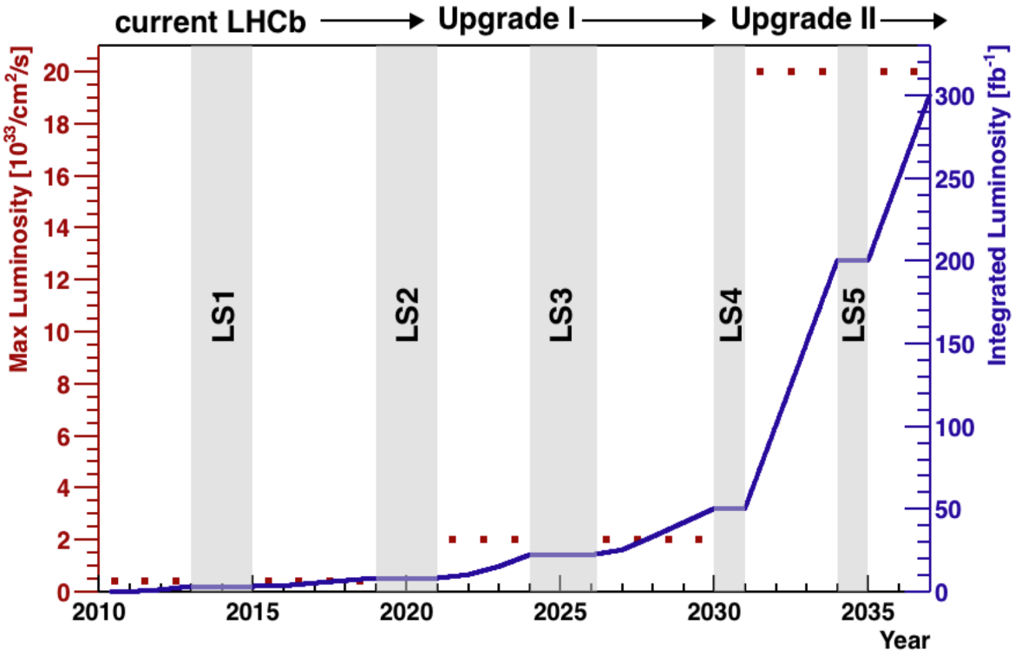
Data taking
LHCb Run-I（2010-12）： 3 ${fb}^{−1}$的 7/8 TeV 的pp对撞数据
Run-II（2015-18）： 6 ${fb}^{−1}$
13TeV的pp对撞数据
预计在RunIII（2022-24）采集约 30 ${fb}^{−1}$的13 TeV 的pp数据

Slide 5
D CPV search results

Slide 6
Search for CPV in $D_{(s)}^{+}$ $→K^{−}K^{+}K^{+}$ decays
For the charm, CPV are very small: direct CPV (i.e. in the decay) can occur only for Cabibbo-suppressed (CS) decays, expected at O(${10}^{−3}$) .
For doubly Cabibbo-suppressed (DCS) decays, CPV is essentially forbidden, thus its observation would indicate a manifestation of BSM physics.
To date there is only one observation of CPV in the charm sector, through the difference of CPV in $D^{0}→K^{+}K^{−}$ and $D^{0}→{\text{π}}^{+}{\text{π}}^{−}$.
thus important to extend to different charm-hadron species decaying into a broad range of final states, including not only CS but also DCS decays
A model-independent search for direct CPV in the Dalitz plots of the CS $D_{s}^{+}$ $→K^{−}K^{+}K^{+}$ and DCS $D^{+}$ $→K^{−}K^{+}K^{+}$ decays
- with 5.6 ${fb}^{−1}$ Run-II data
Divide the Dalitz plot in 2D bins and computing, for each bin, the significance of the difference in the numbers of $D_{(s)}^{+}$ candidates and $D_{(s)}^{−}$candidates,
JHEP 07 (2023) 067

Slide 7
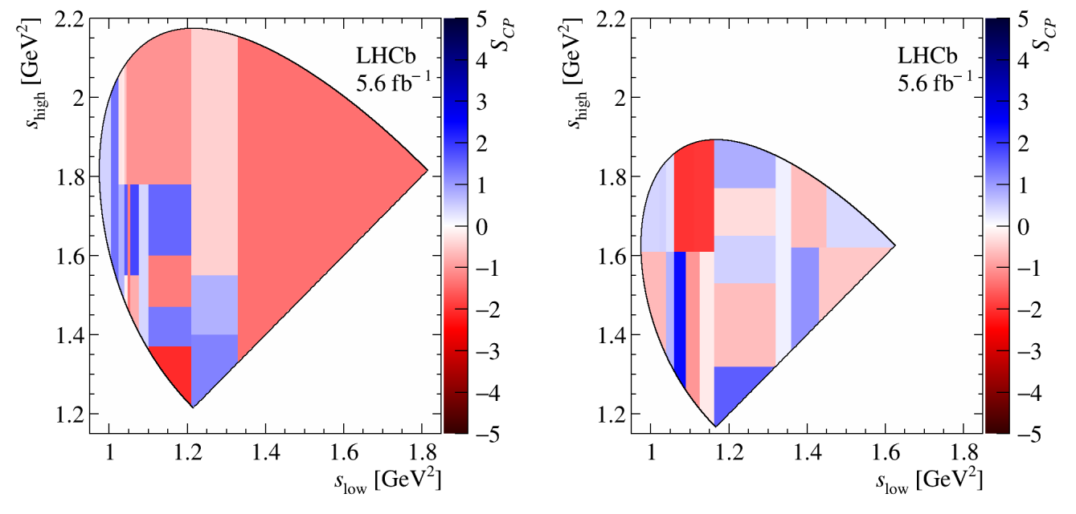
Search for CPV violation in $D_{(s)}^{+}$ $→K^{−}K^{+}K^{+}$ decays
binned model-independent technique used, local CP observable $S_{CP}$
$S_{CP}$across the Dalitz plot for (left) $D_{(s)}^{+}$ $→K^{−}K^{+}K^{+}$ and (right)
$D^{+}$ $→K^{−}K^{+}K^{+}$ signal candidates using 21 bins
Results (p-values): 13.3% for $D_{s}^{+}$ $→K^{−}K^{+}K^{+}$ and 31.6% for $D^{+}$ $→K^{−}K^{+}K^{+}$; No evidence for CP violation is found.
The first search for CP violation in the CS channel $D_{s}^{+}$ $→K^{−}K^{+}K^{+}$ and in the DCS channel $D^{+}$ $→K^{−}K^{+}K^{+}$
JHEP 07 (2023) 067

Slide 8
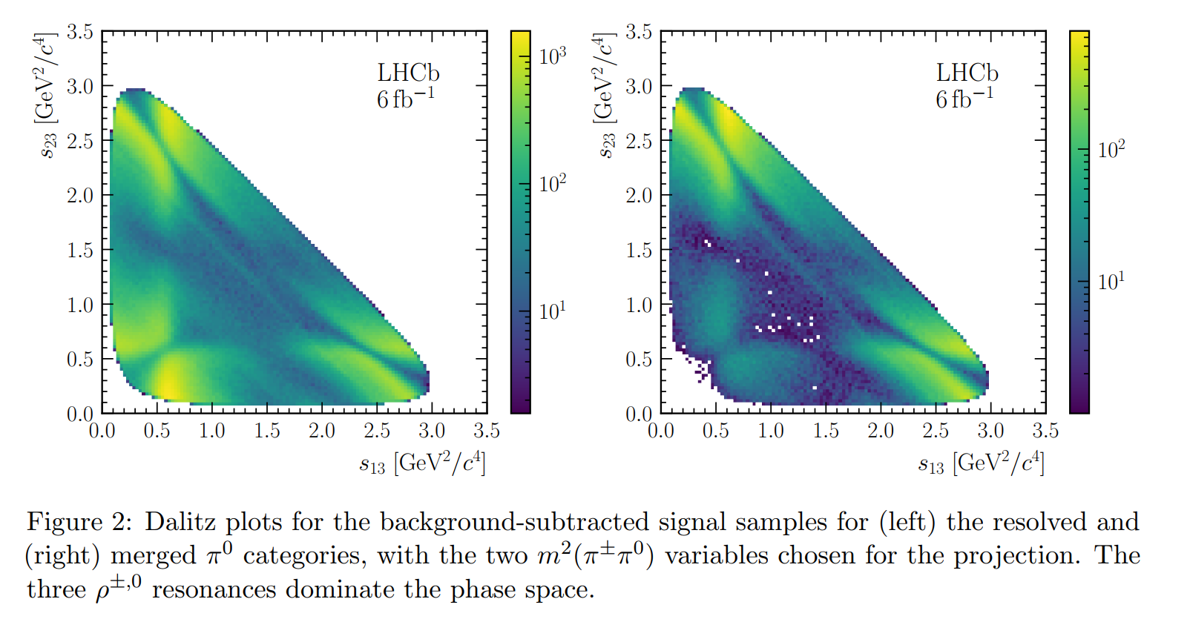
Search for CPV in the phase-space of $D^{0}→π^{+}π^{−}π^{0}$
Multi-body charm decays provide a powerful tool to probe CPV. In these decays, PS-dependent local CP asymmetries can arise from the interference among intermediate resonances
Studies of these local asymmetries provide additional sensitivity to observation of CPV, complementing studies of PS integrated asymmetries and two-body decays.
Use 2015 to 2018 data, 6 ${fb}^{−1}$
flavour-tagged $D^{0}→π^{+}π^{−}π^{0}$is obtained by selecting $D^{∗+}→{D^{0}(π}^{+}π^{−}π^{0})$ $π^{+}$
no evidence is found for CPV in localised regions of the PS
JHEP 09 (2023) 129

Slide 9
Rare decay searches (including LFV)

Slide 10
Search for $D^{0}→μ^{+}μ^{−}$
It is among the most interesting charm-hadrons decays, being fully leptonic and additionally suppressed by helicity reasons.
SM short-distance contribution extremely suppressed：${10}^{−18}$；long-distance contribution：${10}^{−13}$
However the rate can be enhanced in many NP models:
- new particles could mediate the $D^{0}→μ^{+}μ^{−}$decay at tree level.
- SUSY models with R-parity symmetry violation would allow tree level contributions
The rate is correlated to the rate of $D^{0}$- ${\overline{D}}^{0}$ mixing in many NP models. This is of uttermost importance given the recent first observation of the mass difference between neutral charm-meson eigen-states
PRL 131 (2023) 041804

Slide 11
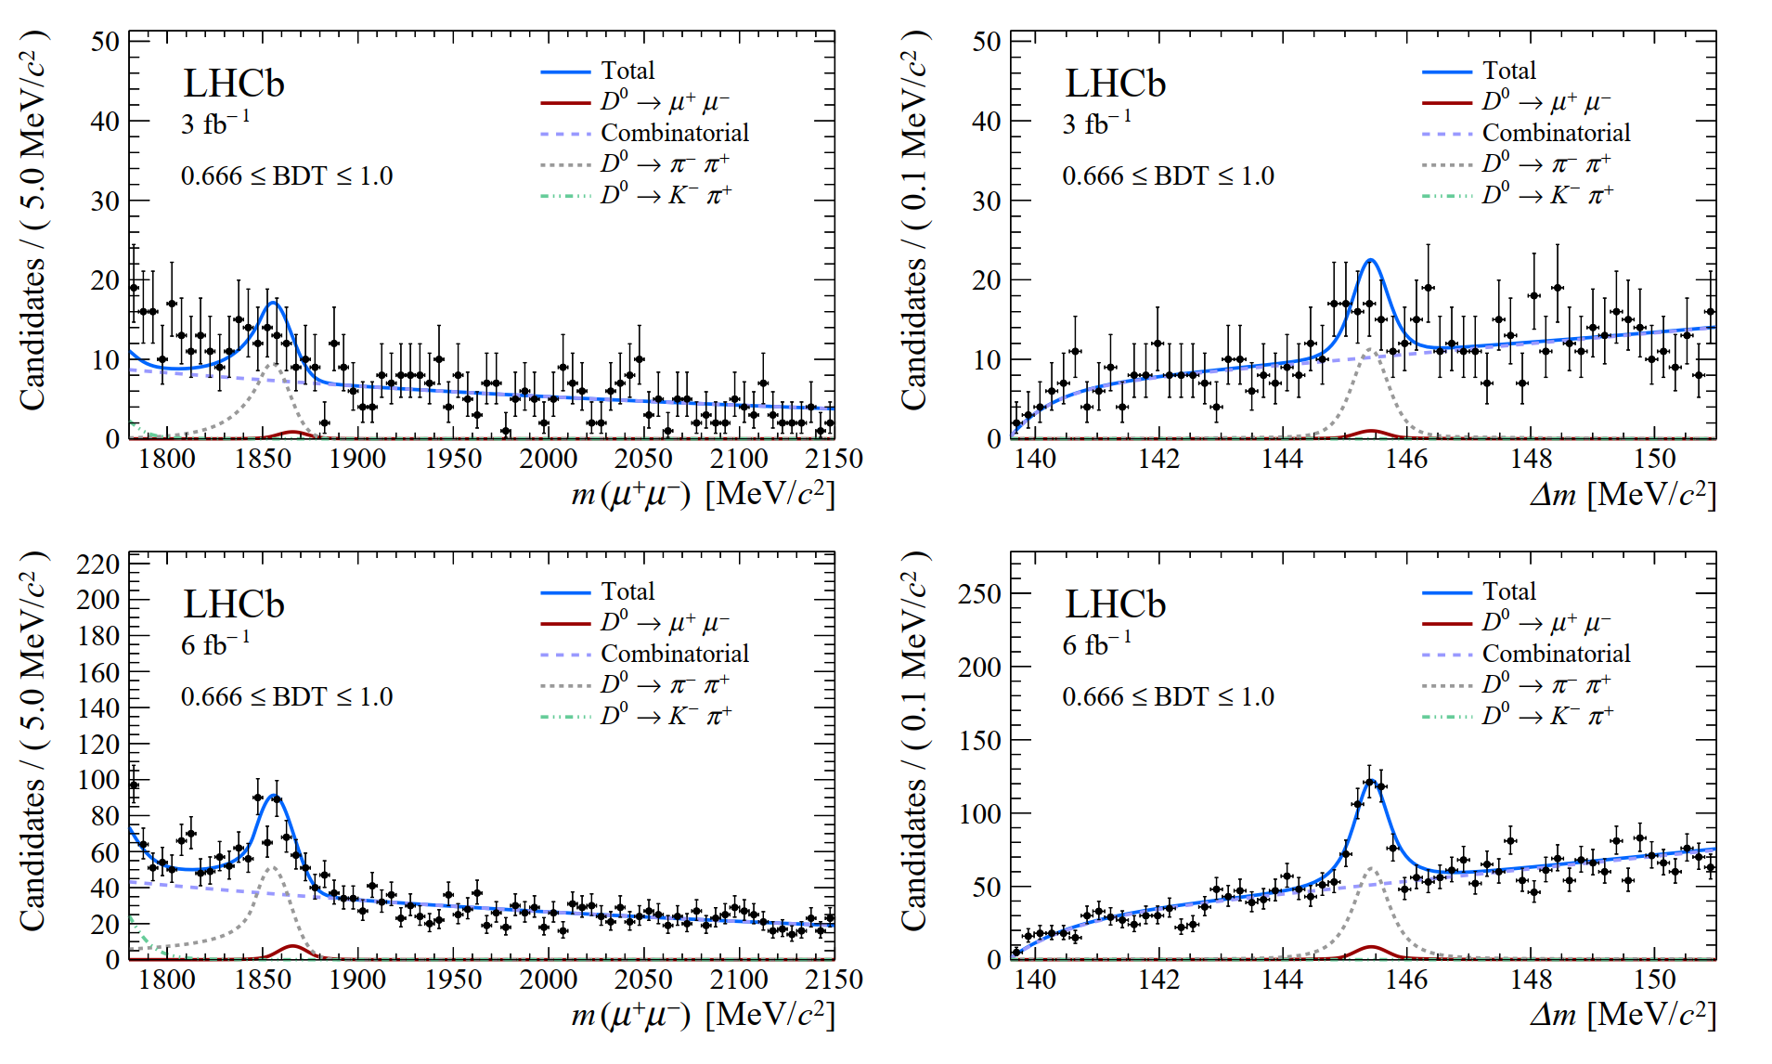
Search for $D^{0}→μ^{+}μ^{−}$
Searched for using $D^{∗+}→D^{0}π^{−}$ decays, as this improves the background rejection and allows the yield of the decay to be obtained Charge conjugate processes are implied throughout.
2-D fit to the m($μ^{+}μ^{−}$), and the mass difference between the $D^{∗+}$ and $D^{0}$: $∆m$
for the most sensitive BDT interval
Most stringent limit on the relevant FCNC couplings in the charm sector, allowing to set additional constraints on NP
PRL 131 (2023) 041804

Slide 12
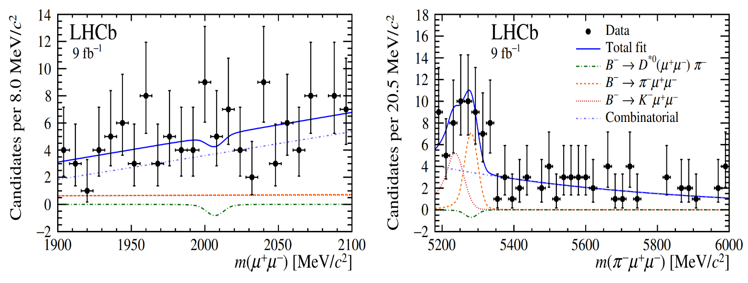
Search for $D^{∗} {(2007)}^{0}$ $→$ $μ^{+}μ^{−}$ in $B^{−}→π^{−}μ^{+}μ^{−}$
First search for a rare charm-meson decay exploiting production via B decay
The most promising approach appears to be with the $B^{−}→π^{−}D^{∗0} {(μ}^{+}μ^{−})$ decay chain since the displaced vertex and exclusive final state provide powerful background rejection capabilities.
Reconstructed (left) $μ^{+}μ^{−}$ and (right) $π^{−}μ^{+}μ^{−}$ mass for the selected candidates,
The first search for a rare charm-meson decay exploiting its production in B-meson decays. the most stringent limit on $D^{∗0}$ decays to leptonic final states.
Eur. Phys. J. C 83, 666 (2023)

Slide 13
Search for $K_{S(L)}^{0}→μ^{+}μ^{−}μ^{+}μ^{−}$
They are FCNC process that has not yet been observed. In SM its decay rate is highly suppressed, with an expected branching fraction:
BSM can lead to large enhancements of B($K_{S(L)}^{0}→μ^{+}μ^{−}μ^{+}μ^{−}$). For instance, proposed dark-sector scenarios can enhance the BR by up to ∼ 2 × ${10}^{−12}$
To date, no direct experimental search of these decays has been performed.
The analysis data(13 TeV, 5.1 ${fb}^{−1}$) sample is split according to the L0 hardware trigger decision: TIS and xTOS; $K_{S}^{0}→π^{+}π^{−}$ as normalization
PRD108 (2023) L031102

Slide 14
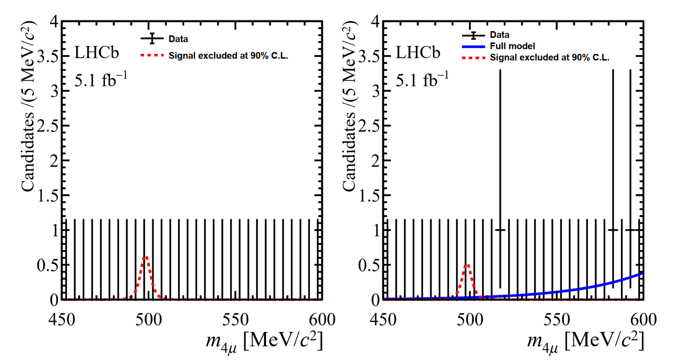
Search for $K_{S(L)}^{0}→μ^{+}μ^{−}μ^{+}μ^{−}$
$μ^{+}μ^{−}μ^{+}μ^{−}$candidates in the (left) xTOS trigger category, and (right) TIS trigger category.
PRD108 (2023) L031102

Slide 15
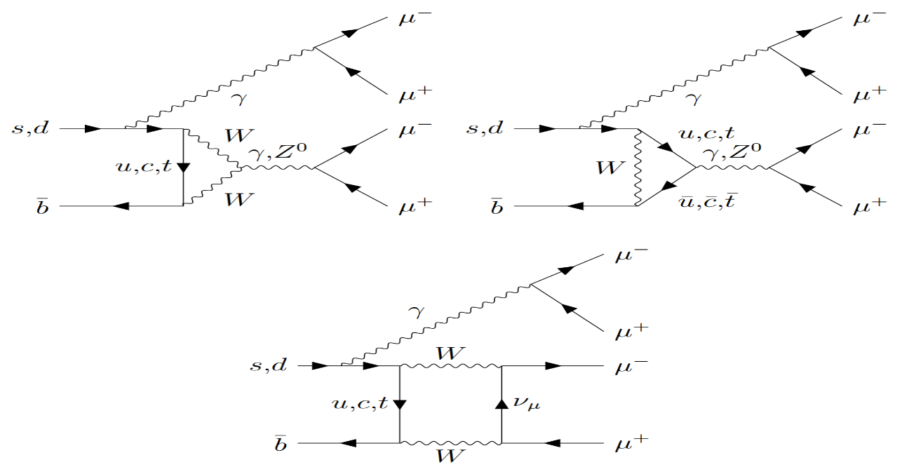
Search for the rare decays $Bs0→μ^{+}μ^{−}μ^{+}μ^{−}$and $B0→μ^{+}μ^{−}μ^{+}μ^{−}$
Highly suppressed in SM: BR (B⁰ $→4μ)\text{\sim }{10}^{−12}$, BR($B_{s}^{0}→4μ)$~ ${10}^{−10}$
For example, decays via scalar and pseudoscalar Sgoldstino particles into a pair of dimuons in the MSSM may lead to significant enhancements of the BRs
Furthermore, the decays into a pair of dimuons mediated by BSM light narrow scalars， $B_{(s)}^{0}→{a(μ}^{+}μ^{−})a(μ^{+}μ^{−})$, naturally occur in the extensions of SM
- In particular, such models can account for the long-standing tension of the anomalous magnetic
dipole moment of the muon, as well as the widely discussed anomalies in transitions

Slide 16
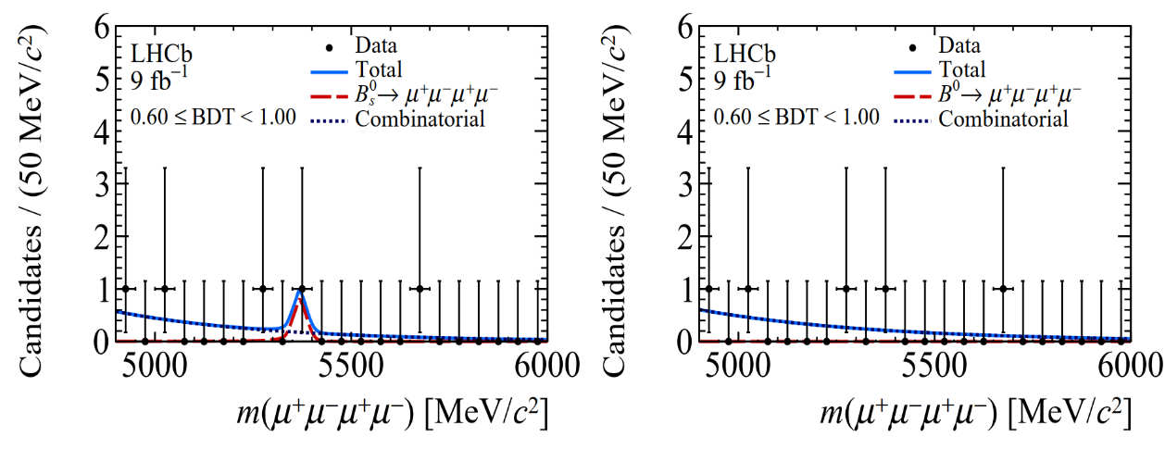
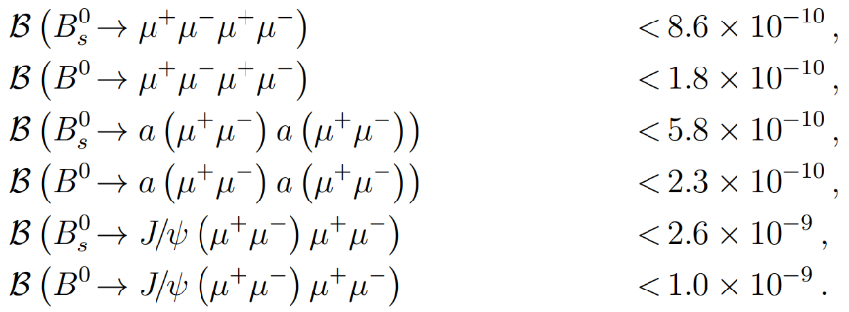
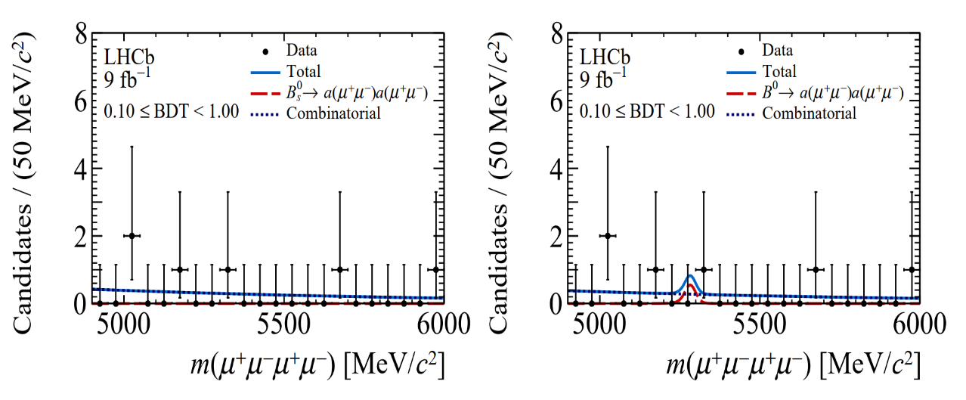
Search for the rare decays $Bs0→μ^{+}μ^{−}μ^{+}μ^{−}$and $B0→μ^{+}μ^{−}μ^{+}μ^{−}$
No evidence for the six signal decay modes, with the most significant excesses found in the $B_{(s)}^{0}→\text{J}\text{/}ψ{(μ}^{+}μ^{−})μ^{+}μ^{−}$searches, amounting to 2$σ$
The most stringent limits on each of the six decays
JHEP 03 (2022) 109

Slide 17
The baryon and lepton number violating decays $Bs0→pμ$⁻ and $B0→pμ$⁻
Matter-antimatter asymmetry is a serious challenge to our understanding of nature. Proposed three necessary conditions to produce such a large matter-antimatter asymmetry, one of which is baryon number violation.
Various violation processes have been searched for in τ , Λ, D, J/ψ, and B decays by the CLEO, CLAS, BESIII and BABAR experiments, but no evidence has been found so far.
? ? ?

Slide 18
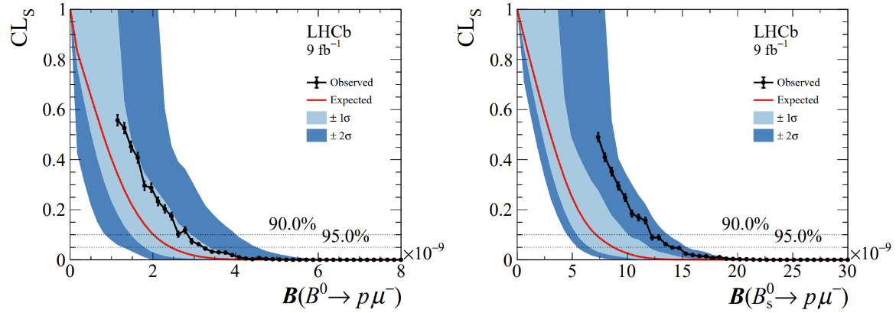
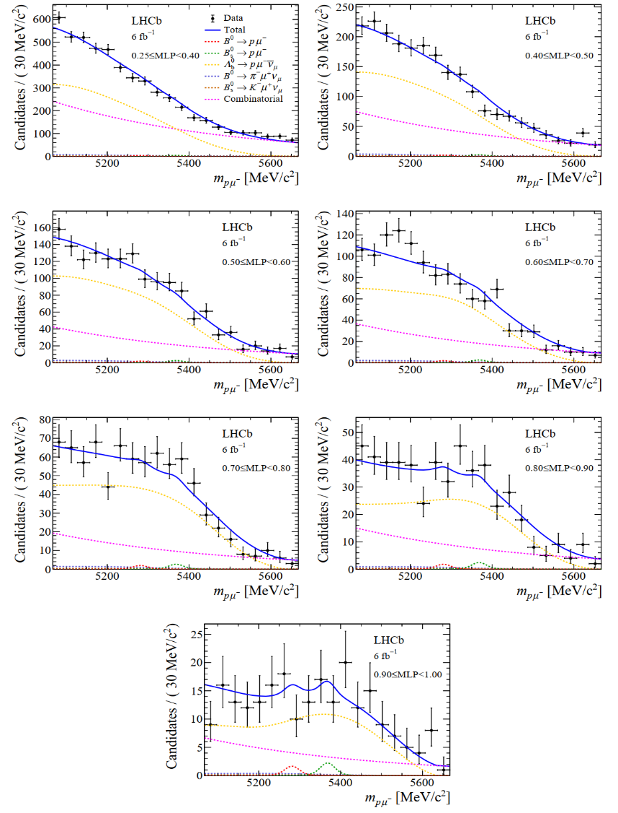
The baryon and lepton number violating decays $Bs0→pμ$⁻ and $B0→pμ$⁻
Mass distribution of signal candidates for Run 2 samples in regions of MLP.
Results from the CLs scan used to obtain the limit on BR($B0→pμ\text{−}$) and BR($Bs0→pμ\text{−}$)
the first upper limits on these decays
arXiv:2210.10412

Slide 19
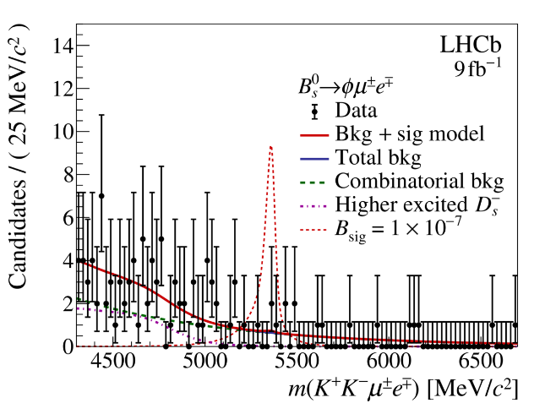
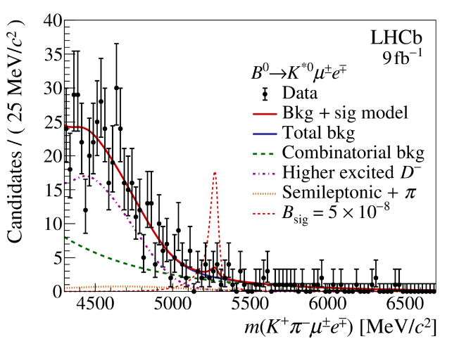
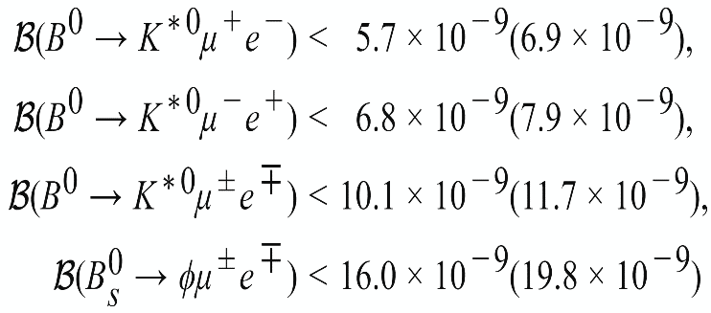
LFV decays $B_{s}^{0} →φμ^{±}e^{∓}$, $B^{0}→K^{∗0}μ^{±}e^{∓}$
An observation of LFV decays involving charged leptons would constitute a clear and unambiguous sign of New Physics
- Specific NP scenarios that can induce LFV b-hadron decays include models with scalar or
vector leptoquarks and models with additional Z’ bosons
the flavour anomalies in rare $b→sl^{+}l^{−}$ also make LFV important, as lepton flavour non-universality is closely connected with LFV
The world's most stringent limits to date
arXiv:2207.04005

Slide 20
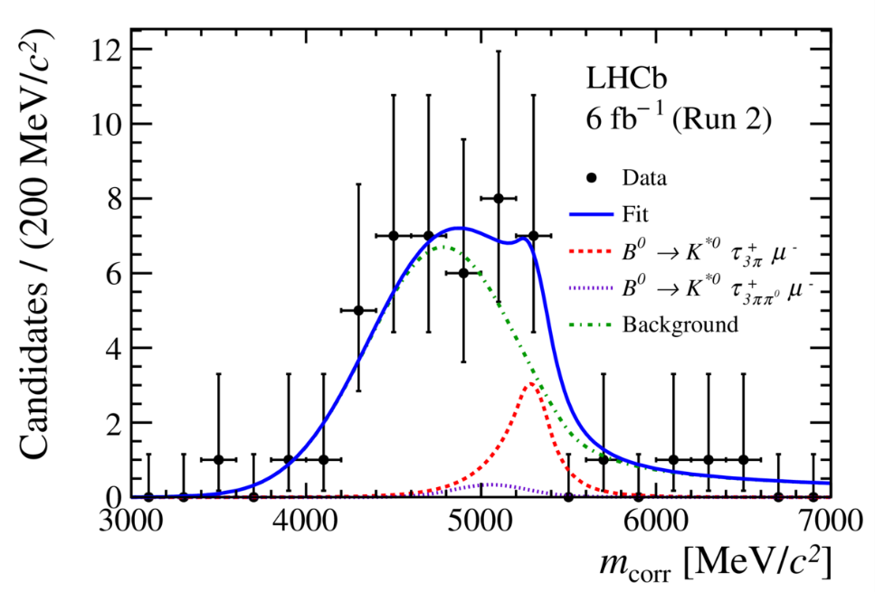
LFV decays $B^{0}→K^{∗0}μ^{±}τ^{∓}$
Not ever investigated by any prior experiment
corrected mass
BR($B^{0}→K^{∗0}μ^{−}τ^{+}$) <1.0(1.2)$×{10}^{−5}$, BR($B^{0}→K^{∗0}μ^{+}τ^{−}$) <8.2(9.8) $×{10}^{−6}$
The world's most stringent limits to date
arXiv:2209.09846

Slide 21
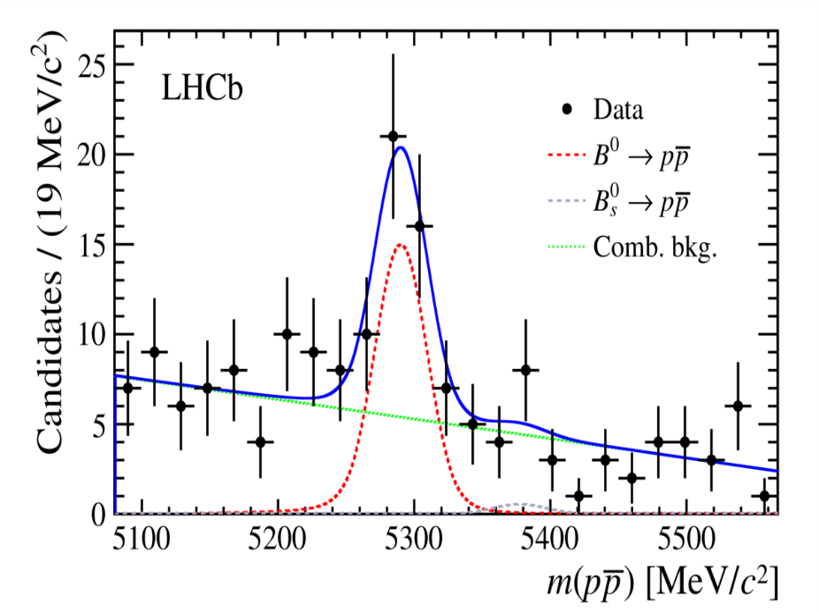
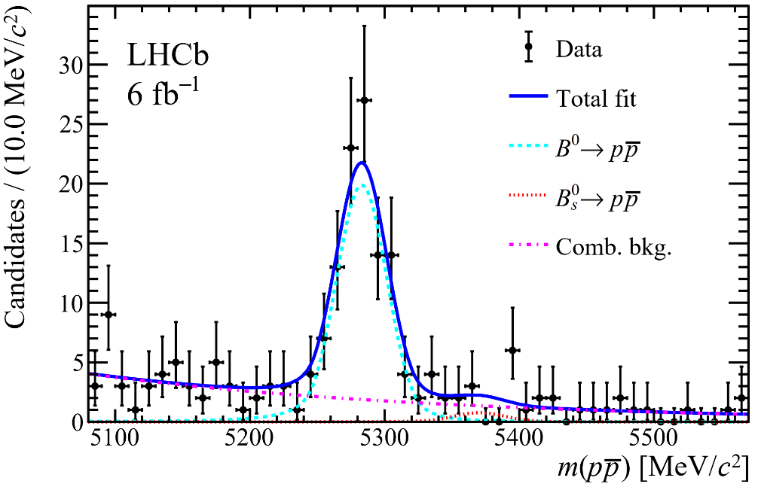
Search for the rare hadronic decay B_{s}⁰ → $p\overline{p}$
To date only three charmless two-body baryonic decays have been observed, namely the B⁺ → p $\overline{\text{Λ}}$(1520) , B⁺ → p $\overline{\text{Λ}}$ and B⁰ → $p\overline{p}$ modes.
Run-I result:
BR(B⁰→$p\overline{p}$)= (1.25±0.27±0.18) ×${10}^{−8}$
arXiv:2206.06673

Slide 22
Search for the rare hadronic decay B_{s}⁰ → $p\overline{p}$
No statistically significant excess of the decay is observed.
The 90% (95%) upper limit on the B_{s}⁰ → $p\overline{p}$decay branching fraction is set at
Using the measured quantities and the equation below, the branching fraction of the (B⁰→$p\overline{p}$) decay is measured more precisely to be:
arXiv:2206.06673

Slide 23
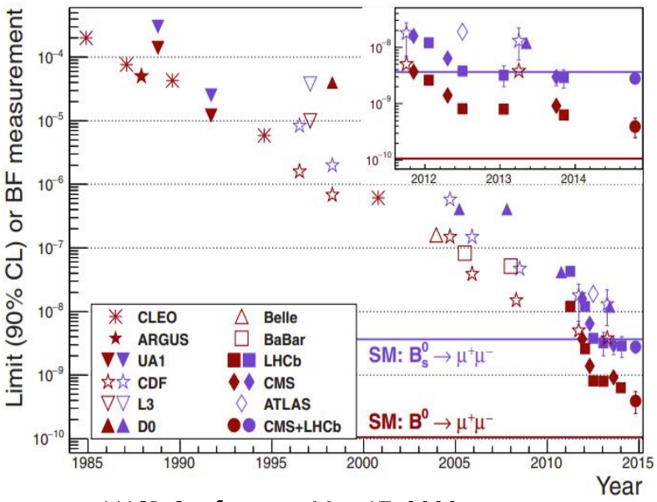
Measurement of $B_{s}^{0}→μ^{+}μ^{−}$and search for B⁰ $→μ^{+}μ^{−}$, $B_{s}^{0}→μ^{+}μ^{−}γ$
Highly suppressed in SM, (i)Cabibbo suppressed, (ii)Helicity suppressed
Extremely rare in SM ($B_{s}^{0}→μ^{+}μ^{−}$ ~(3.66±0.14) ×${10}^{−9}$, B⁰ $→μ^{+}μ^{−}$ ~(1.03±0.05) × ${10}^{−9}$ ).
powerful probes for detecting deviations from the SM due to new physics contributions mediated, for instance, by heavy Z’ gauge bosons, leptoquarks or non-SM Higgs bosons
Phys. Rev. Lett. 128, (2022) 041801
Phys. Rev. D105 (2022) 012010

Slide 24
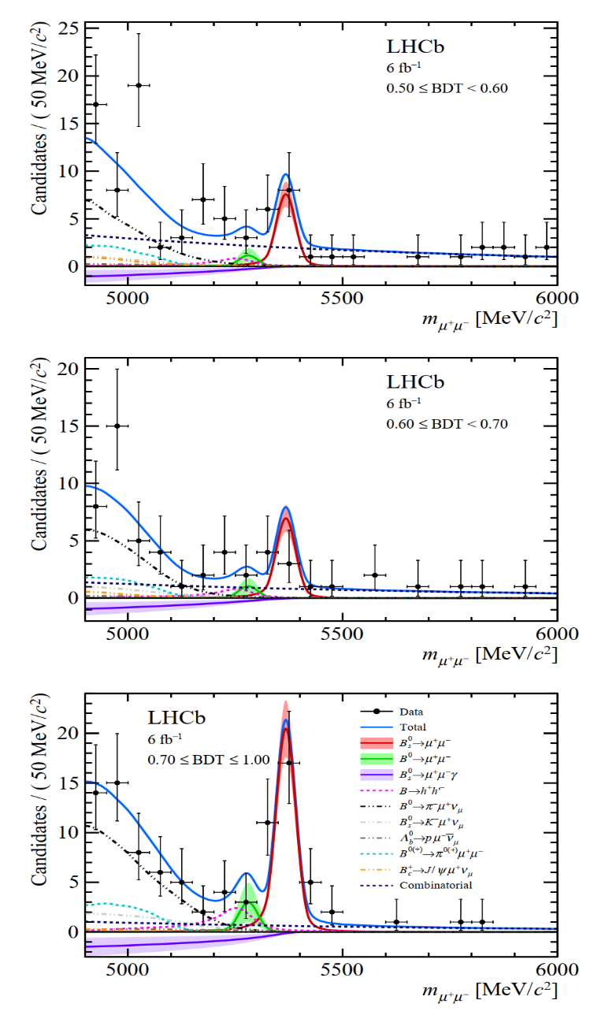
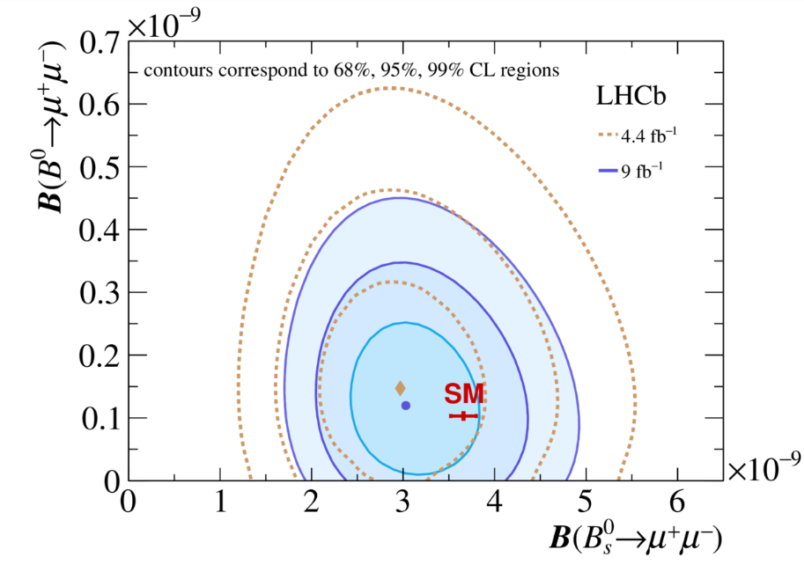
LHCb Run 1 + Run 2, $B_{s}^{0}→μ^{+}μ^{−}$
Branching ratios, consistent with SM:
Systematic uncertainties of $B_{s}^{0}→μ^{+}μ^{−}$ and B⁰ $→μ^{+}μ^{−}$are dominated by the uncertainty on fs/fd (3%) and the knowledge of the background from specific processes (9%), respectively.
Phys. Rev. Lett. 128, (2022) 041801
Phys. Rev. D105 (2022) 012010

Slide 25
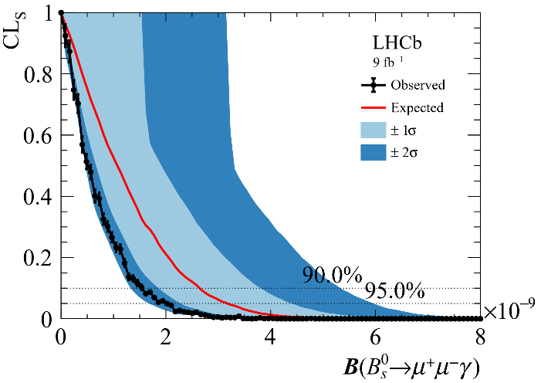
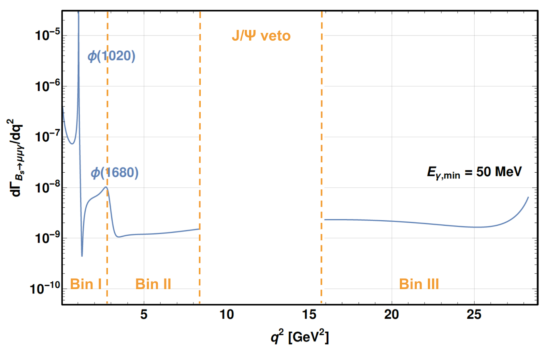
Search for $B_{s}^{0}→μ^{+}μ^{−}γ$
Compared to the $B_{s}^{0}→μ^{+}μ^{−}$amplitude, the additional suppression arising from the photon is compensated by no longer helicity suppressed, increasing the total predicted BR
The $B_{s}^{0}→μ^{+}μ^{−}γ$process is a powerful probe of SM, being sensitive to C7 , C9 and C10, While $B_{s}^{0}→μ^{+}μ^{−}$is only sensitive to C10
Direct search (coming very soon):
Direct photon search first time
Probe low $q^{2}$ regions for the first time
Indirect search:
Phys. Rev. Lett. 128, (2022) 041801
Phys. Rev. D105 (2022) 012010

Slide 26
LFU tests

Slide 27
R(D^{(*)}) measurements
$\text{R}\text{(}\text{D}\text{(∗)}\text{) =}\frac{ℬ(B→D(∗)τντ) }{ℬ(B→D(∗)μνμ)}$
Hadronic $τ→\text{πππ}(\text{π}0)\overline{ν} \text{:}$
Relatively high purity
External BR measurement for normalization
Decay vertex of τ well measured to suppress dominant backgrounds
3π dynamics important for the separation of $B→\text{D}\text{∗}\text{DX}$ backgrounds
Muonic $τ→μ\overline{ν}ν \text{:}$
Large statistics
Study of τ and μ modes in one dataset
measure R(D) and R(D*) simultaneously
arXiv:2302.02886 arXiv:2305.01463

Slide 28
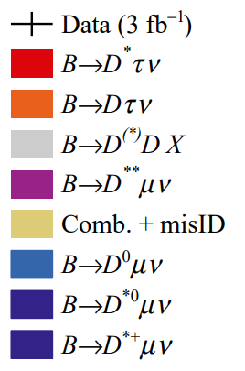
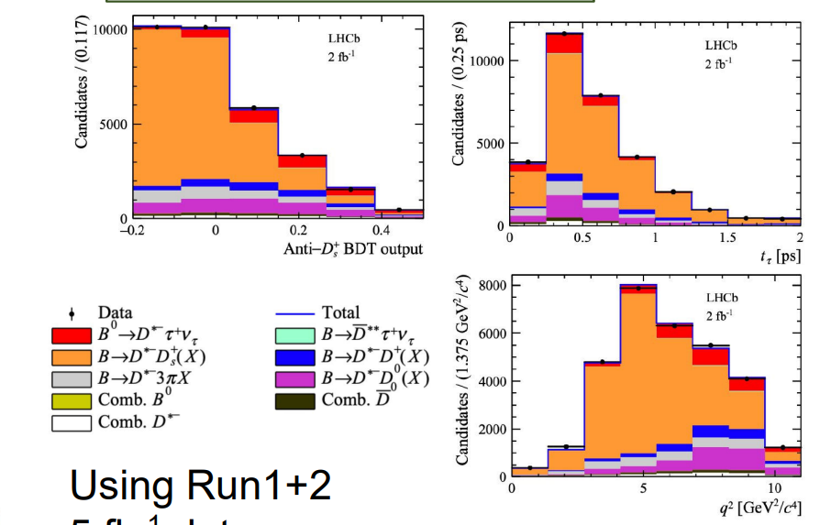
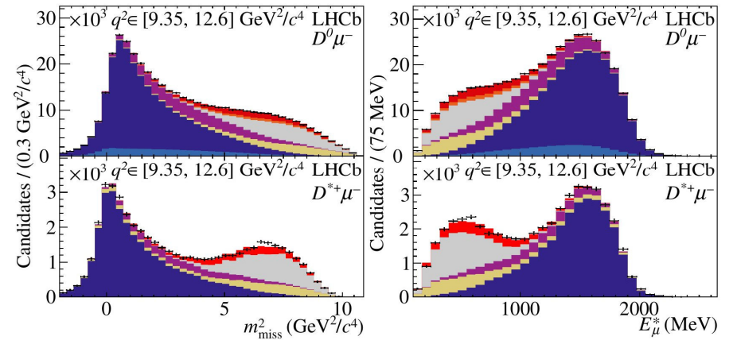
R(D^{(*)}) measurements
Muonic $τ→μ\overline{ν}ν \text{:}$
Hadronic $τ→\text{πππ}(\text{π}0)\overline{ν} \text{:}$
Using Run1+2 5 fb⁻¹ data:
R(D*)=0.257±0.012(stat.)±0.014(syst.)±0.012(ext.)
Using Run-I 3 fb⁻¹ data:
R(D*) = 0.281±0.018 (stat.) ±0.024(syst.)
R(D) = 0.441±0.060 (stat.) ±0.066(syst.)
$$ρ=−0.43$$
Agreement w/ SM <1σ
arXiv:2302.02886 arXiv:2305.01463
1.9σ deviation from SM

Slide 29
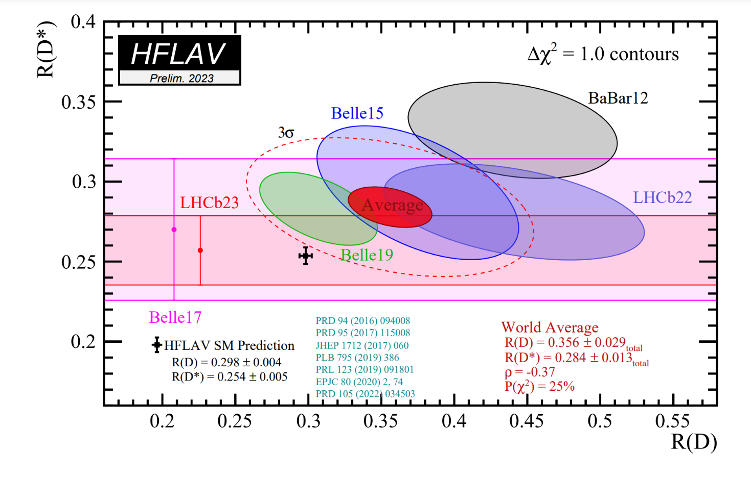
Updated R(D*) world averages
Updates with inclusion of two new results (LHCb22, LHCb23)
R(D*) = 0.284±0.013
R(D) = 0.356±0.029
$\text{Deviation} \text{from} \text{SM} \text{for} \text{combined} \text{R}\text{(}\text{D}\text{) − }\text{R}\text{(}\text{D}\text{∗}\text{) }\text{now} \text{moves} \text{from}\text{ 3.3}\text{σ} \text{to}\text{ 3.2}\text{σ}$
Recent BESIII measurements on $D_{(s)}→\text{3}π\text{X}$ could be helpful in understanding double-charm backgrounds in hadronic R(D*) measurements
arXiv:2212.13072 arXiv:2301.03214

Slide 30
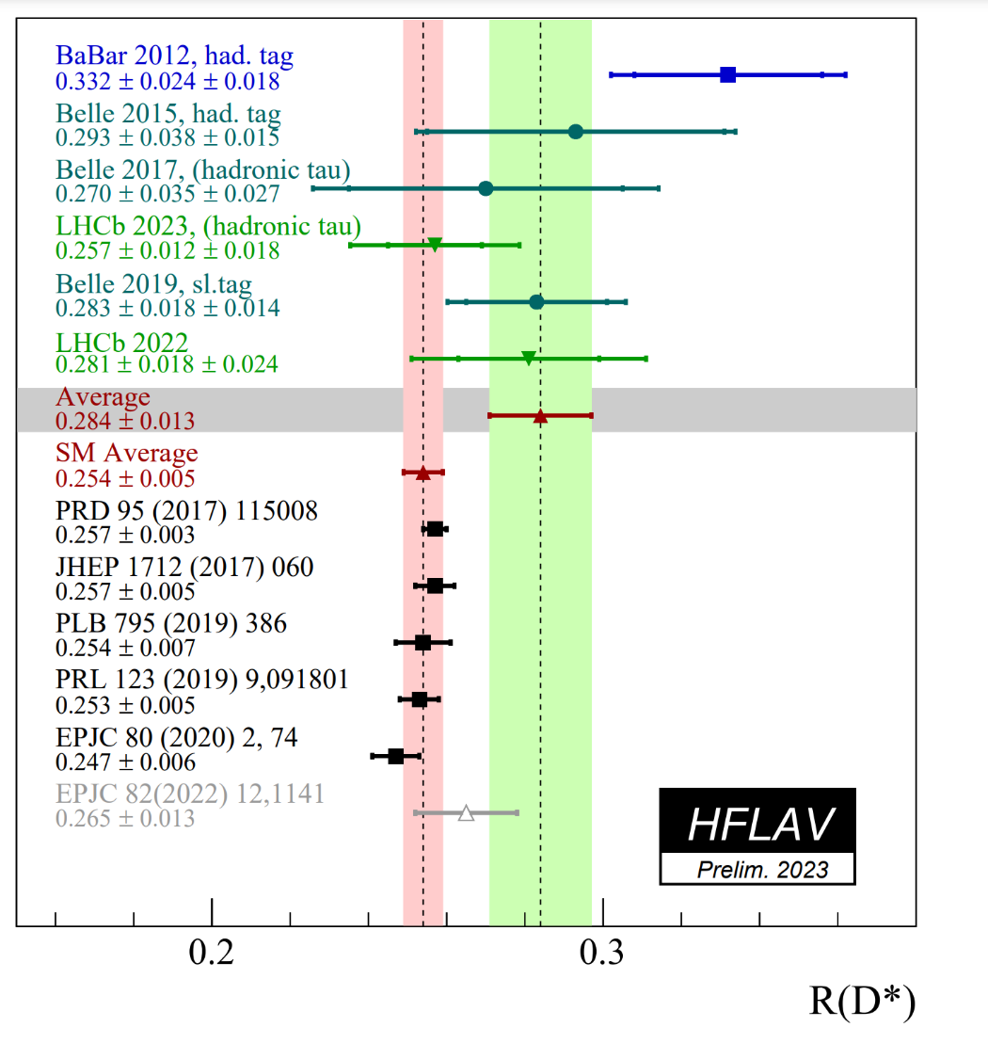
Updated R(D*) world averages
Updates with inclusion of two new results (LHCb22, LHCb23)
R(D*) = 0.284±0.013
R(D) = 0.356±0.029
$\text{Deviation} \text{from} \text{SM} \text{for}$
$$\text{combined} \text{R}\text{(}\text{D}\text{∗) }\text{now} \text{at} \text{1.9}\text{σ}$$
Recent BESIII measurements on $D_{(s)}→\text{3}π\text{X}$ could be helpful in understanding double-charm backgrounds in hadronic R(D*) measurements
arXiv:2212.13072 arXiv:2301.03214

Slide 31
Summary
• LHCb is in fact a charm factory as well • High statistics and excellent detector performance allow for high precision measurements on charm CP, rare decays, etc.
• Still more charm results in the pipeline with full Run1+2 data; and new data (Run3) has started
• Complementary and cross-check with BESIII in many aspects.

Slide 32
谢谢大家！

Slide 33
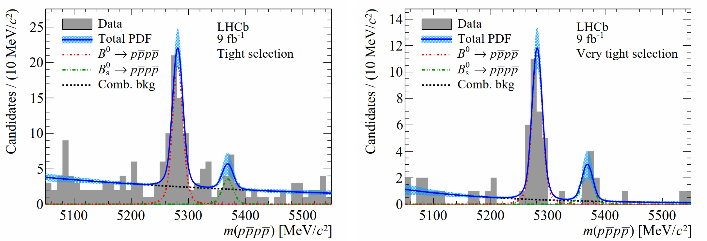
The rare hadronic decay $B_{(s)}^{0}$→ $p\overline{p}p\overline{p}$
No reliable theoretical prediction for $B_{(s)}^{0}$→ $p\overline{p}p\overline{p}$ decays for now, a first measurement of the corresponding BR would allow to better understand the underlying dynamics
The BRs of multi-body baryonic decay modes may be significantly increased due to a threshold enhancement effect in the baryon-antibaryon invariant mass, while two-body baryonic decays (such as $B_{(s)}^{0}$→ $p\overline{p}$) are suppressed
$B^{0}$/ $B_{s}^{0}$: significance of 9.3$σ$ and 4.0$σ$
significance of 9.3$σ$ and 4.0$σ$
arXiv:2211.08847

Slide 34
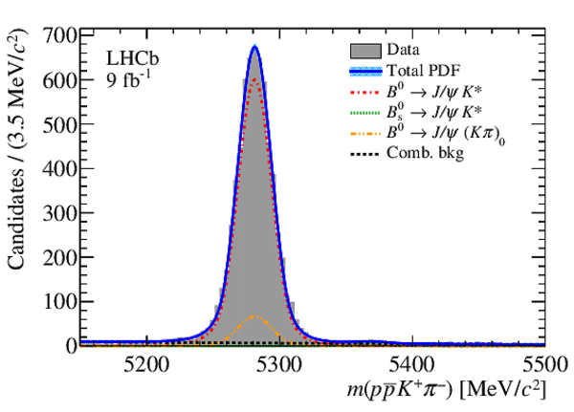
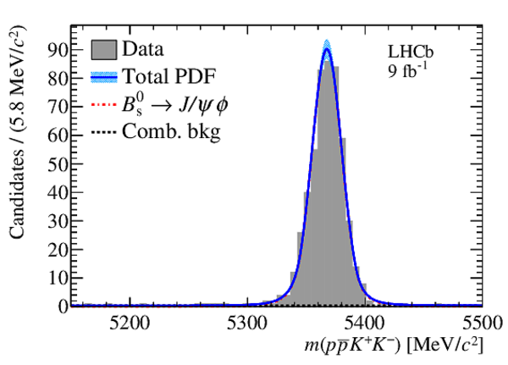
The rare hadronic decay $B_{(s)}^{0}$→ $p\overline{p}p\overline{p}$
The branching fractions are measured relative to the topologically similar normalisation decays：$B^{0}$→ J/$ψ(→p\overline{p})K^{∗0}(→Kπ)$ and $B_{s}^{0}$ → J/$ψ(→p\overline{p})φ(→KK)$
Results: BR(B⁰→$p\overline{p}p\overline{p}$)= (2.2±0.4±0.1) ×${10}^{−8}$ and BR($B_{s}^{0}$ → $p\overline{p}p\overline{p}$)= (2.2±1.0±0.2) ×${10}^{−8}$
arXiv:2211.08847

Slide 35
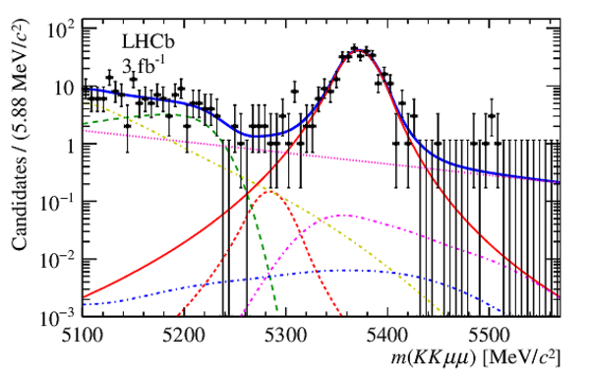
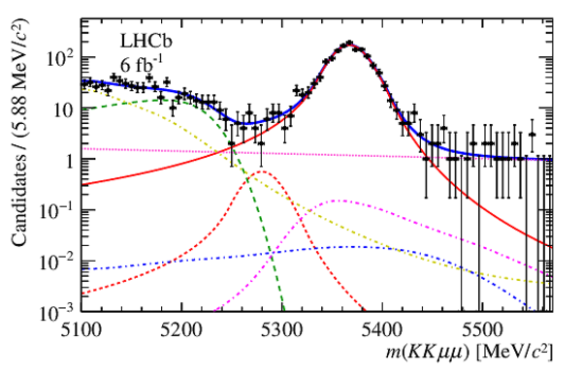
Search for the B⁰ → φµ⁺µ⁻
No statistically significant excess of the decay B⁰ → φµ⁺µ⁻
An upper limit on its BR excluding the φ and charmonium regions in the dimuon spectrum, relative to that of the decay B_{s}⁰ → φµ⁺µ⁻ is determined to be 4.4 × 10⁻³ at a 90% CL.
Using the LHCb measurement of B(B_{s}⁰ → φµ⁺µ⁻), an upper limit on B(B⁰ → φµ⁺µ⁻ ) in the full q² range is set to be 3.2 × 10⁻⁹ at a 90% CL, which is compatible with the SM prediction.
JHEP 05 (2022) 67

Slide 36
Search for $B_{s}^{0}→μ^{+}μ^{−}γ$
Compared to the $B_{s}^{0}→μ^{+}μ^{−}$amplitude, the additional suppression arising from the photon is compensated by no longer helicity suppressed, increasing the total predicted BR
The $B_{s}^{0}→μ^{+}μ^{−}γ$process is a powerful probe of SM, being sensitive to C7 , C9 and C10, While $B_{s}^{0}→μ^{+}μ^{−}$is only sensitive to C10
Direct search (coming very soon):
Direct photon search first time
Probe low $q^{2}$ regions for the first time
Indirect search:
Phys. Rev. Lett. 128, (2022) 041801
Phys. Rev. D105 (2022) 012010

